Slide 1
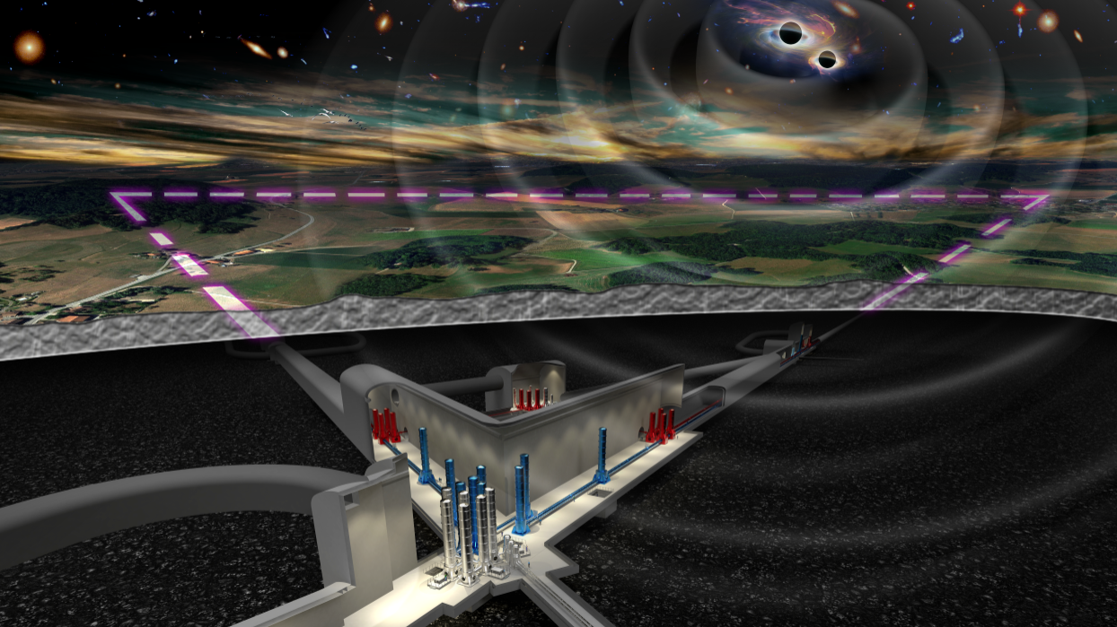


Einstein Telescope
The Einstein Telescope beam pipe vacuum system: challenges and perspective
Aniello Grado
Co-chair ET beam pipe vacuum system
^{INAF/INFN}
Credits: A. Pasqualetti, P. Chiggiato, Harald Lueck, Yoshi Saito, C. Bradaschia, Michael Zucker, M. Punturo
AIV XXV Conference May 10-12 Naples

Slide 2
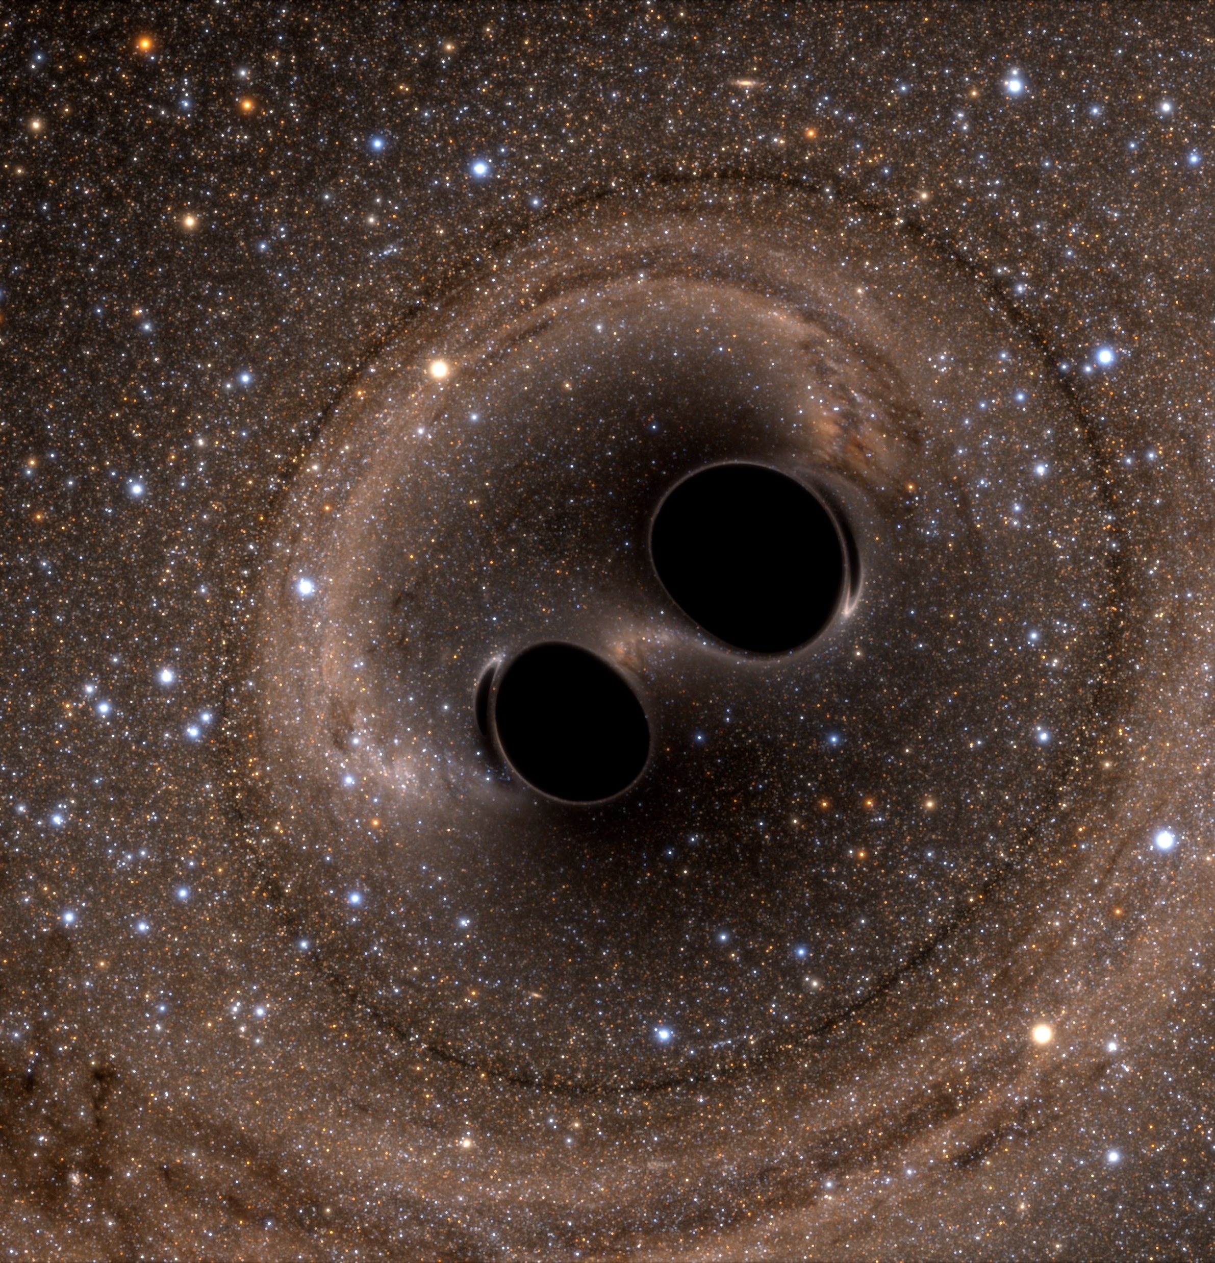
Monumental successes of the Advanced detectors
Gravitational waves are deformations of spacetime produced by rotating non-spherical symmetric bodies that progate at the speed of light
VIRGO
Cascina (Pi)
First detection of GWs from a BBH system (GW150914)
  Physics of BHs
First detection of GWs from a BNS system (GW170817)
  Birth of the multimessenger astronomy with GWs
  Costraining EOS of NS
Localisation capabilities of a GW source
Measurement of the GW propagation speed
Test of GR
Alternative measurement of H₀
GW polarisations
Intermediate mass black hole (GW190521)
LIGO
USA

Slide 3

Einstein Telescope in a nutshell
3G GW DETECTORS
The Einstein Telescope (ET) will be a new 3rd generation (3G) GW observatory
3G means a factor ~10 better than advanced (2G) GW detectors, and ~1000 more universe to explore
A completely new infrastructure is needed
2 candidated sites: Sardinia (Italy) and Dutch-German-Belgium border
~ 200 m underground
30 km ~6.5 m diameter galleries + caverns (30x30x60 m)
  -> total excavation 5.4 Mm³
6 interferometers arranged in triangular shape
120 km 1 m beam tubes UHV (10⁻¹⁰ mbar)
~200 in-vacuum towers to host optics and seismic
isolation systems
Mirrors 200 kg
Some part under criogenics operation (~ 10 - 20 k)
> 500 W ultra stabilized lasers
Lifetime: 50 years

Slide 4

Detection distance of GWD
0.1
3G Target
Z~1.14 (GW190403)
Z=0,09 (GW150914)
Image credit: NAOJ/ALMA http://alma.mtk.nao.ac.jp/

Slide 5


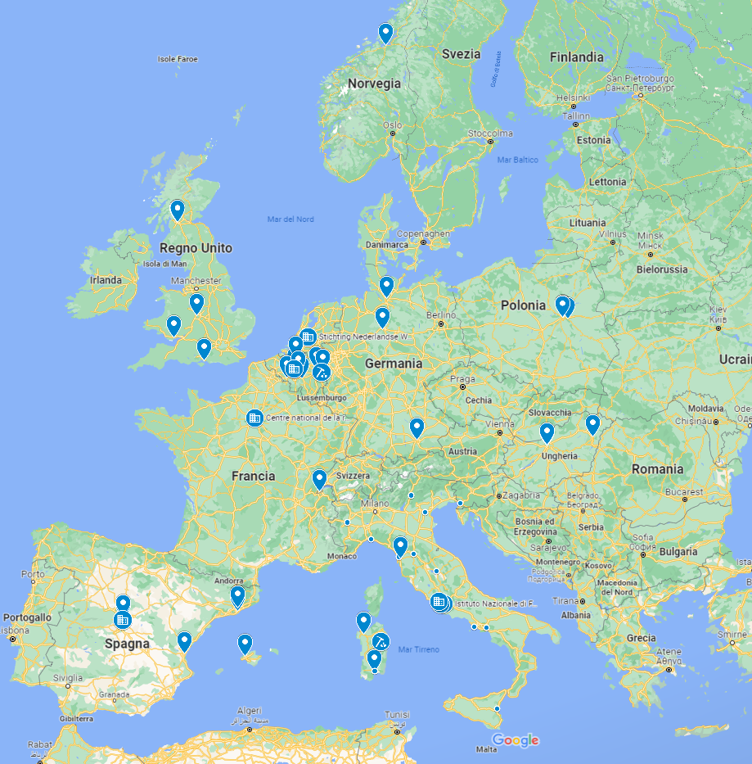
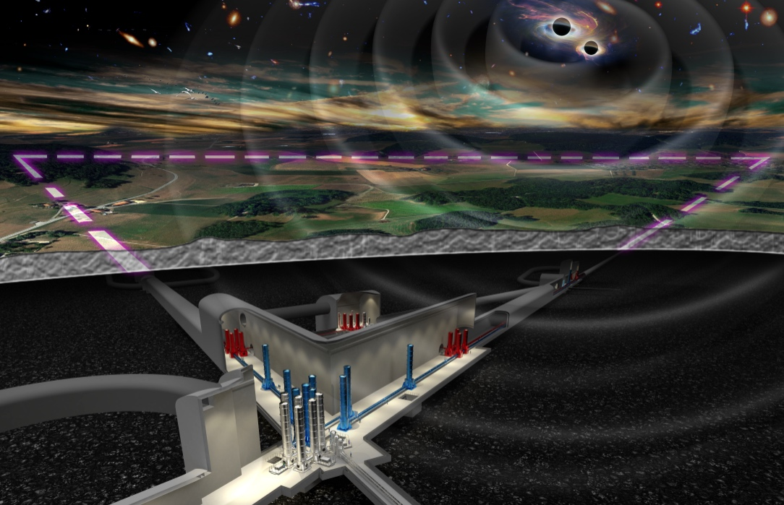


ESFRI Roadmap
Proposal submitted by:
Italy (Lead Country)
Belgium
Netherlands
Poland
Spain
ET CA originally signed by 41 institutions
  Consortium currently coordinated by INFN and Nikhef
The project and the collaboration activities now also include agencies and institutions belonging to:
Austria
France
Germany
Hungary
Switzerland
UK
Large preparatory funds available in some country (IT, NL, …), an EU INFRA-DEV proposal just approved with a grant of 3.45M€ and an EU INFRA-TECH proposal has been just submitted
Several hundreds of scientists and engineers currently collaborating in ET

Slide 6
ET vacuum

Slide 7
ET Enabling Technologies
Challenging engineering
New technology in cryo-cooling
The multi-interferometer approach asks for two parallel technology developments:
New technology in optics
Evolved laser technology
  ET-LF:
    Underground
    Cryogenics
    Silicon (Sapphire) test masses
    Large test masses
    New coatings
    New laser wavelength
    Seismic suspensions
    Frequency dependent squeezing
New laser technology
Evolved technology in optics
High precision mechanics and low noise controls
  ET-HF:
    High power laser
    Large test masses
    New coatings
    Thermal compensation
    Frequency dependent squeezing
Highly innovative adaptive optics
High quality opto-electronics and new controls
High quality opto-electronics and new controls

Slide 8
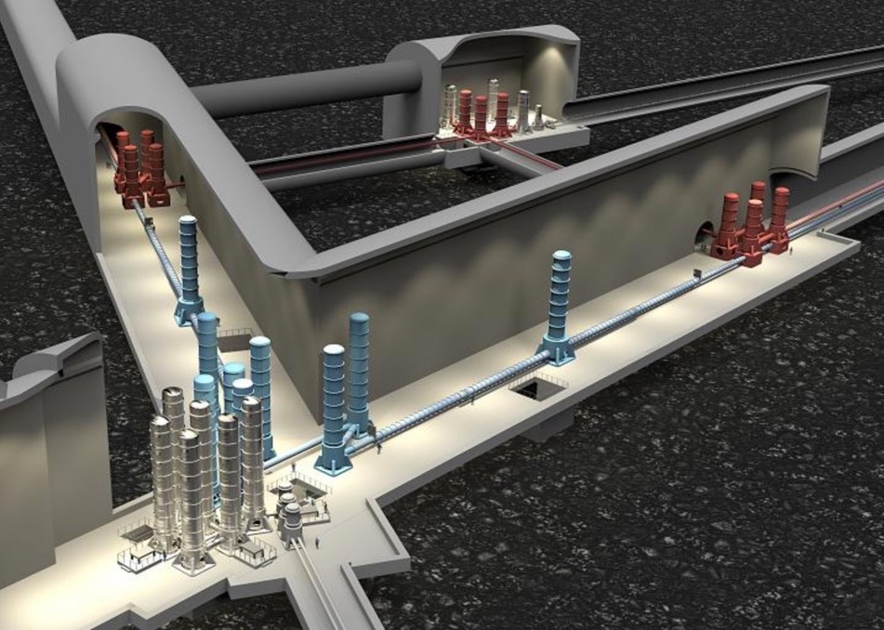
ET vacuum
Why under vacuum?
• reduce the noise due to residual gas fluctuations …..along the beam path to an acceptable level;
• isolate test masses and other optical elements
f from acoustic noise;
• reduce test mass motion excitation due to residual gas fluctuations,
• contribute to thermal isolation of test masses and of their support structures;
• contribute to preserve the cleanliness of optical elements.

Slide 9
ET beam tubes requirements
Tube diameter ~ 1m
Total lenght 120 km
Total residual pressure: H₂ 10⁻¹⁰ mbar, H₂O 5x10⁻¹¹
mbar, N₂ 10⁻¹¹ mbar (more stringent reqs comes from
ET-HF)
Hydrocarbon partial pressure < 10⁻¹⁴ mbar
Material ?(2G detectors: SS 304L or 316L)
Life time: 50 years
Surface: 3.8x10⁵ m²
Volume: 9.4x10⁴ m³
ET technical report 2020

Slide 10
Post manufacturing treatments
(assuming a Virgo detector approach)
Each tube module (15 m long) needs treatments to meet the UHV requiremets
Cleaning
  Careful cleaning to remove dusts and non-volatile hydrocarbon contamination
  (ultrasound, hydrokinetic ….)
Air-firing
  High temperature (400 - 450 ºC) in oven with dry air flux in order to remove the H from bulk material. Factor ~100 depletion of H₂ content. Permanent
Bake-out
  Treatment at ~150 -200 ºC in-situ under vacuum to remove the tightly bonded H₂O from the surfaces. If vented to air needs to be repeated

Slide 11
ET beampipe vacuum system
Assuming a Virgo approach and ~ 3 years for the production
13000 t of raw steel
8000 modules 15 m long (including the bellow for thermal expansion)
8 modules/day production (includes leak and extensive quality control checks)
240 pumping stations (5000 l/s effective, ionic, getter, ausiliary turbo molecular)
480/720 gate valves (250 mm)
spare flanges every 250 m?
48/72 gate valves (1 m diameter)
200 RGA
~ 1000 gauges
10 ovens (each 4 modules at times) operating ~3 years 24/7 for air-firing
4 cleaning systems
Backout system (2G heat dissipation is ≈ 250 W/m @ 150°C )
Just scaling the Virgo vacuum costs to ET it would requires > 560 Meuro !!
Find cost effective solutions to reduce the total cost !!
A. Grado INAF/INFN

Slide 12
R&D
Materials: austenitic, low carbon steel, aluminium, ferritic?
  Low raw material cost
  low H content
  easy H depletion
Optimize tube modules thermal treatments
for dehydrogenation
Cheap surface cleaning scalable to
large area (~400000 m²)
Inner surface passive coating?
  hydrogen permeation barrier scalable to
  large area
Corrosion resistance (50 years lifetime)
A. Grado INAF/INFN

Slide 13
Pumping system design
In Virgo 15% of the budget went in pumping
Reach the target vacuum
Management of the mechanical vibrations and acoustic noise
A careful design and pumps distribution optimization
Minimize maintenance costs

Slide 14
Agreement INFN/Nikhef - CERN on beam pipe
Re-evaluate the baseline solution (Virgo) with minor modifications imposed by the new requirements (5 x better vacuum, 20 x size).
Design and test an alternative solution that fulfil the ET requirements and is less expensive than the baseline.
Manufacture, assembly and test a pilot sector.
Write the technical design report, including cost estimations.
Coordination of the ET collaboration effort

Slide 15
Work-Breakdown Structure
WP1: engineering
WP2:
production
WP3:
treatments
WP4:
transport
WP5:
installation
WP6:
vacuum
Design and engineering of the vacuum chamber
Choice of materials and manufacturing technology
Choice of post-manufacturing treatments
Handling and logistics
Installation procedure and interface with other systems
Choice of vacuum pumps and valves
WP7:
prototyping
WP8:
coordination
Installation and test of a pilot sector
Coordination of the different work packages and contribution of collaborators

Slide 16
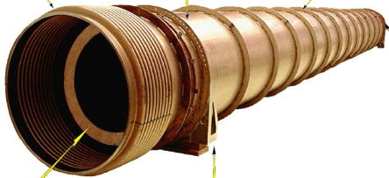
What we need: beampipe design and production
Steel mills
Metallurgists
Experts on hydrogen permeation/diffusion in steel
Welding experts
Tube manufacturing
Metal cleaning systems (project required)
Ovens for dehydrogenation (project required)
Quality control assessment (steel, weldings, contamination)
logistic

Slide 17
What we need: vacuum
Pumping systems
large valves (cheap solution ?)
Vacuum control system
Low voltage high current power
supplies for in-situ backout

Slide 18
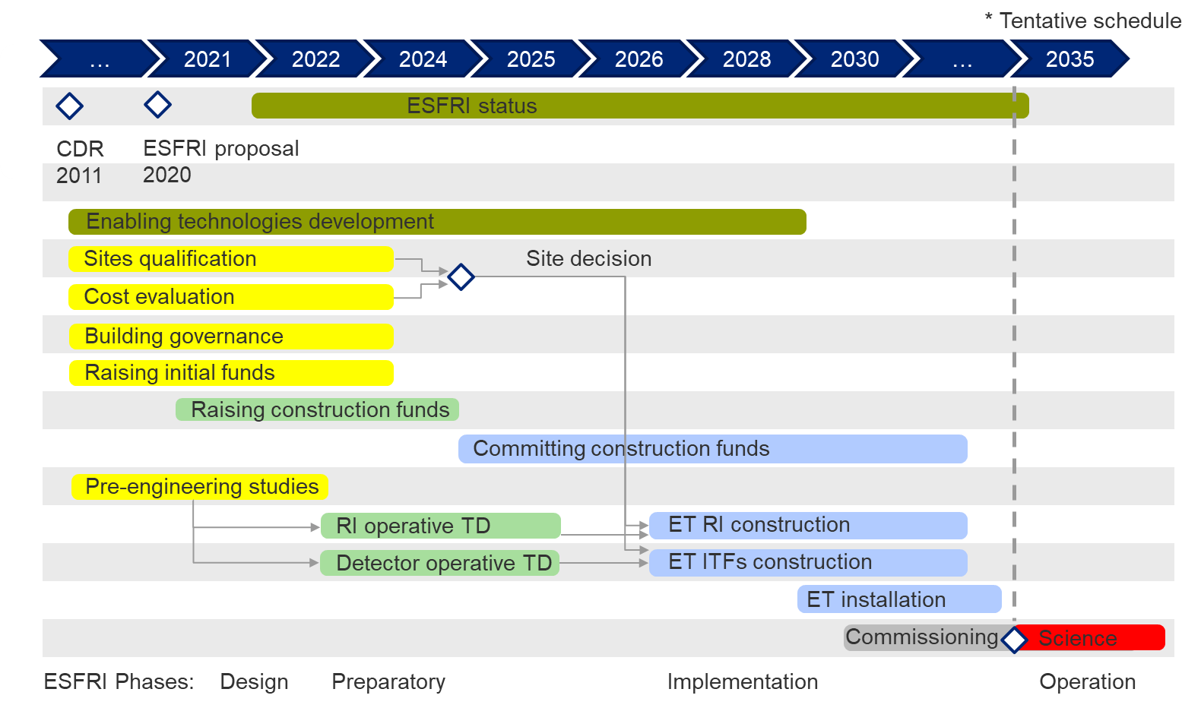
ET timeline
ET timeline presented to ESFRI
  As expected, the ESFRI approval boosted the activities at all the levels:
Scientists
Agencies
Governments
Beam pipe vacuum system
Beam pipe vacuum system
CDR evaluations:
Total budget ~ 2G€
  Observatory budget ~ 1.7G€
    Infrastructure Budget:
      Civil infrastructure: ~930M€
Manufact.
Installation
Verification
3 - 4 years
TDR

Slide 19
Next 3 years
Will be decided the main technological solutions for the ET beam pipe system
A full scale tube module (15 m) prototype will be realized at CERN
Possibly other prototypes will be tested in other labs of the ET collaboration
Of course there is room for new solutions (compared to Virgo) if substantial cost saving is achieved

Slide 20
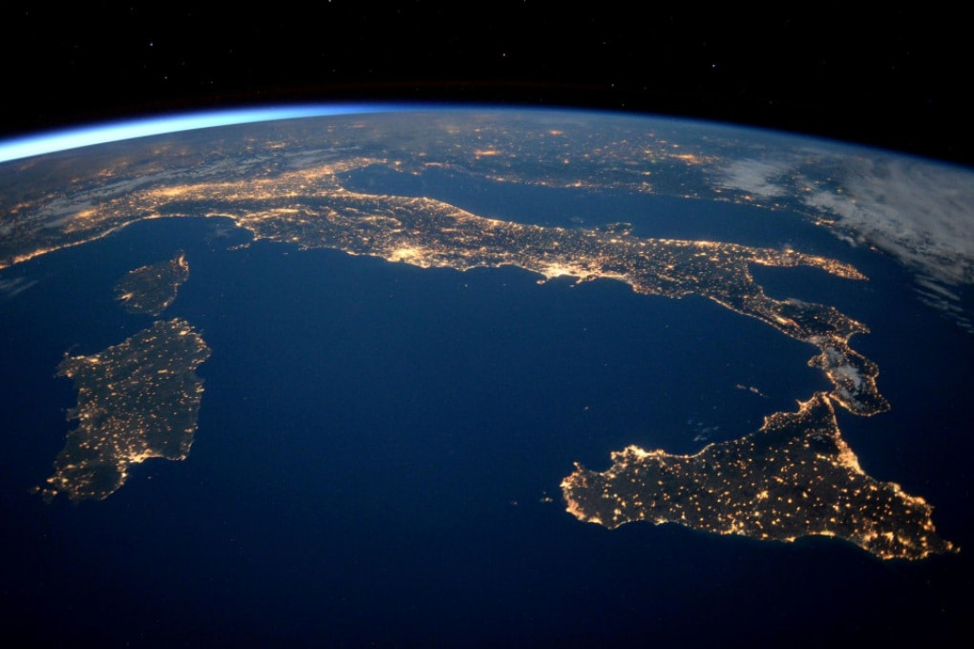


ET& PNRR: ETIC – Einstein Telescope Infrastructure Consortium
Next Generation EU
Investment proposed 100M€ focused on ET enabling technology and Sardinian site candidature support
8% Human Resources
30% Scientific apparatuses
12% Distributed Infrastructures
28% ET design
12% Training
Additional 5M€ funding on the same framework for the site characterization
The project has been selected
Next week will start negotiation with MUR
INFN – GE
Genova University
INFN-BO
Bologna University
INFN-PD
Padova University
INFN-PG
Perugia University
INFN – TO
INFN-LNGS
GSSI
Vanvitelli University
INFN – PI
Pisa University
INAF-Adoni
ASI-Matera
INFN – RM1
La Sapienza University
INFN – RM2
Tor Vergata University
INFN – NA
Federico II University
INFN – LNS
ET
INFN – CA
Cagliari University

Slide 21
CALATIA (Centro ALtA TecnologiA) per il vuoto di Einstein Telescope @ Uni Vanvitelli (Caserta)
realize an international facility for:
qualification, research and development of full scale beampipe sections for the ET project.
samples testing of ET pipe sections during production
Development optimization and testing of ET vacuum system heat treatments to reduce outgassing.
development and testing of surface treatments on large surfaces to eliminate or limit heat treatments

Slide 22
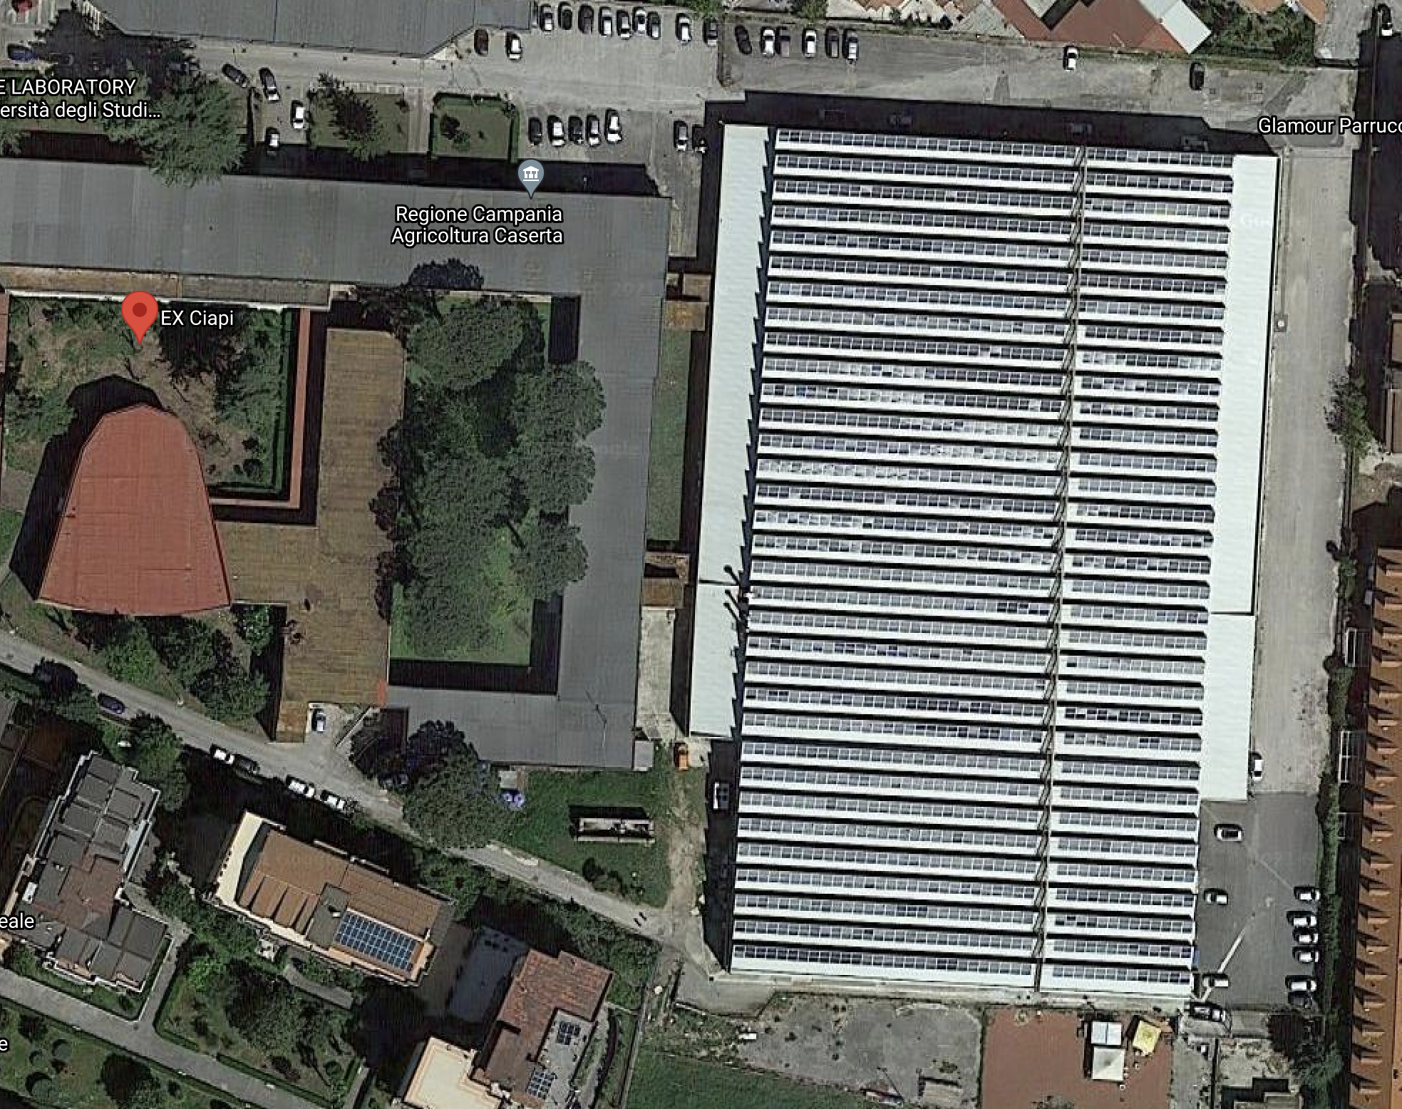
Labs equipped with:
Cleaning system for modules in scale 1:1
Thermal treatments
Degassing station
Pumping stations
HC Contamination assesments (FTIR)
XPS
88 m
Km3NeT
INFN
ET CALATIA
1200 m²
140 m
Particles accelerators
Uni. Vanvitelli
20 m

Slide 23
Conclusion
ET is a 2 Billion project recently entered the ESFRI roadmap that will enter in operation in 2034
Sardinia is one of the two sites candidates to host the detector
The ET beam pipe vacuum system will be the largest UHV system ever realized (10⁵ m³) with a preliminary estimated cost of 560 Meuro
Next 3 years will be dedicated to write a TDR that includes a realistic estimate of the costs
We are at an early stage of the project, there is room for R&D to find a cost effective solution
A project for ET within the PNRR has been approved. Negotiations for the real budget will start next week

Slide 24
THANK YOU FOR YOUR ATTENTION
For further details you can contact: aniello.grado@inaf.it

