Slide 1
Industrial Opportunity Days 2022 Industrial opportunities in civil engineering at CERN
https://agenda.infn.it/event/30896/timetable
Alejandro Martínez (CERN, Site and Civil Engineering Department)
June 9th 2022

Slide 2
SCE
MANDATE
VISION
The Site and Civil Engineering (SCE) Department manages and develops CERN’s real estate assets and infrastructures in agreement with CERN’s scientific strategy, as well as all the services related to the caretaking and operation of the CERN site.
Creating an inspiring and welcoming environment for CERN’s scientific community now and in the future.

Slide 3
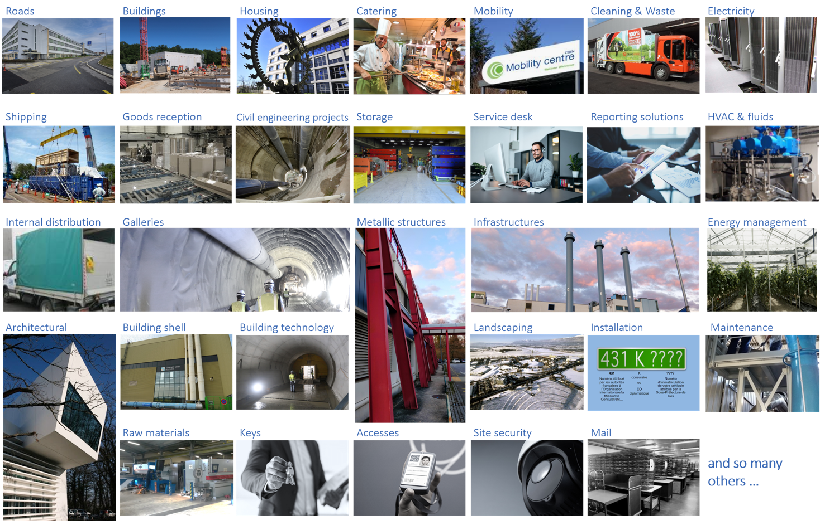
SCE ORGANIZATION & COMPETENCIES
GROUPS
Project Portfolio Management
(PPM)
Site Asset Management
(SAM)
Services and Supply Chain
(SSC)
Service Management and Support
(SMS)
Departmental Operation and Development
(DOD)

Slide 4
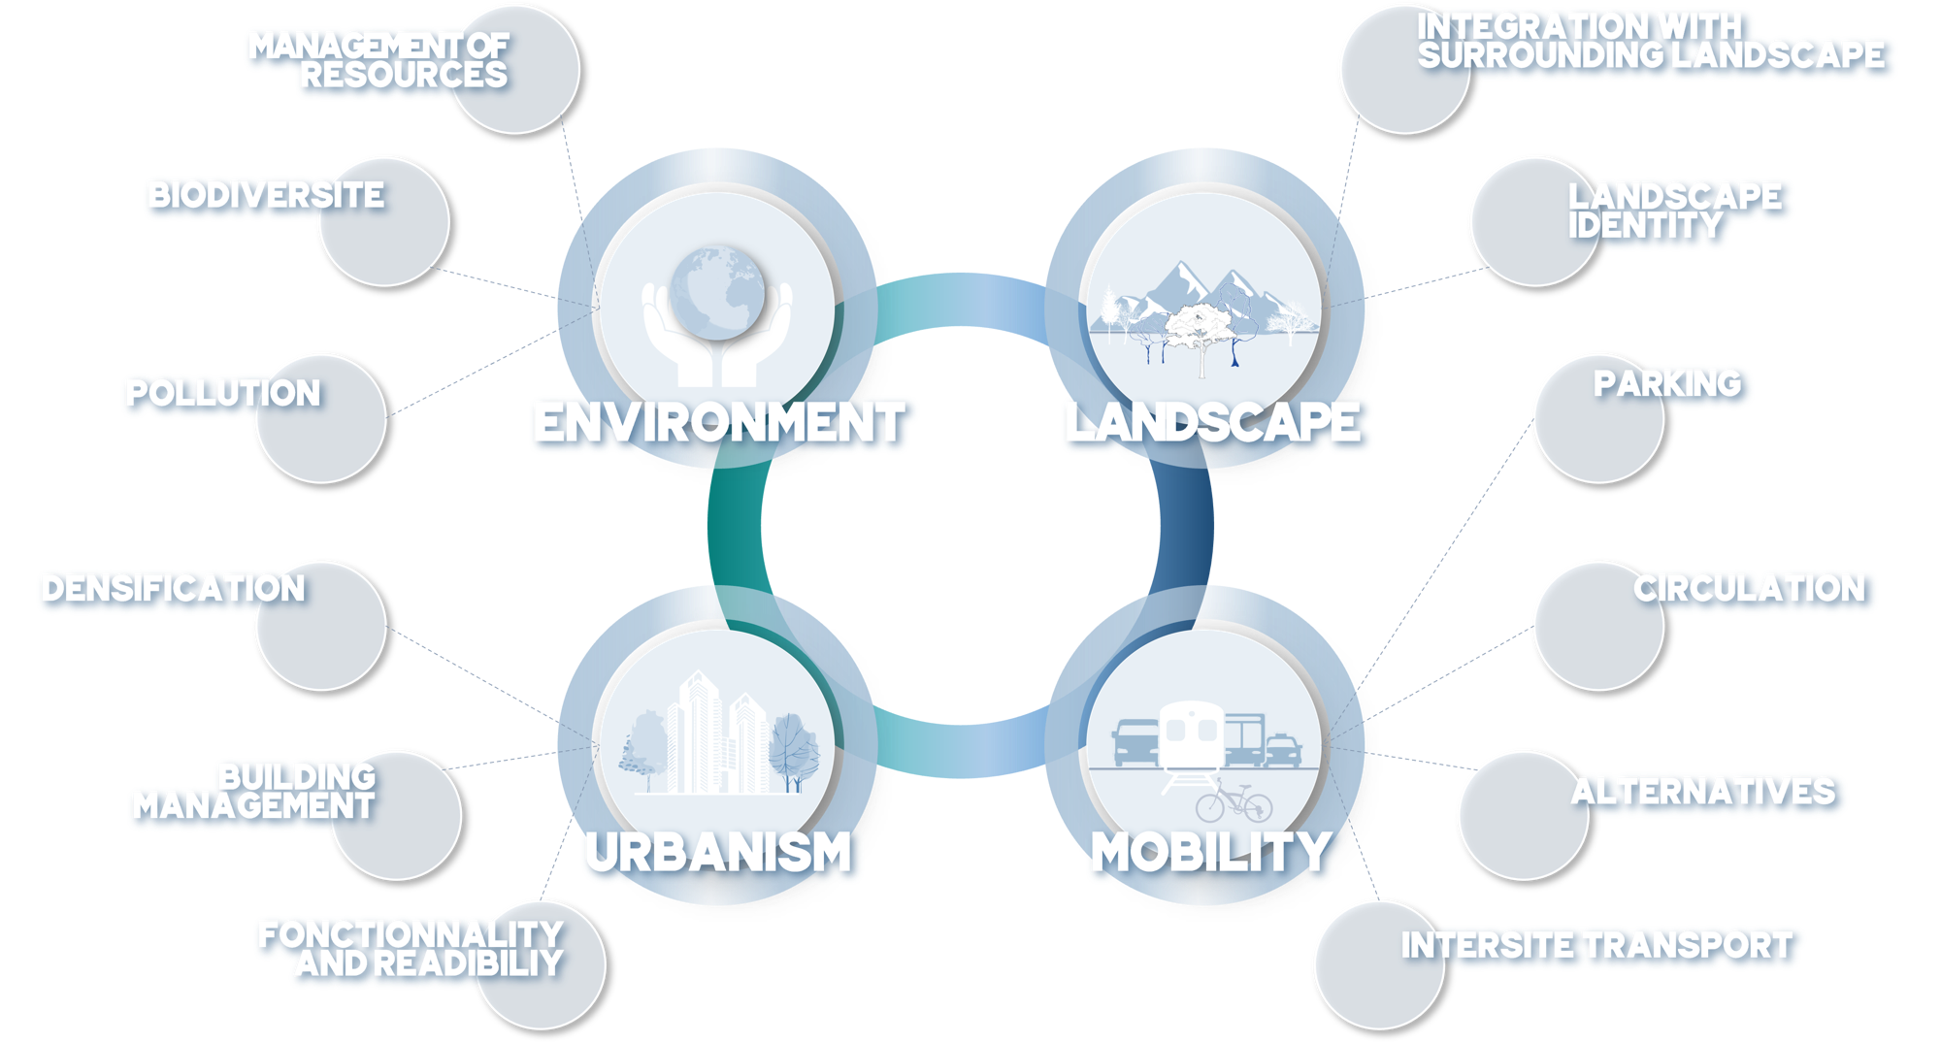
MASTERPLAN2040
Framework objectives and measures

Slide 5
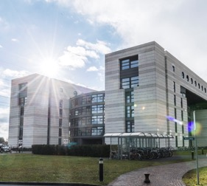
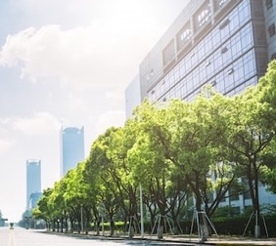
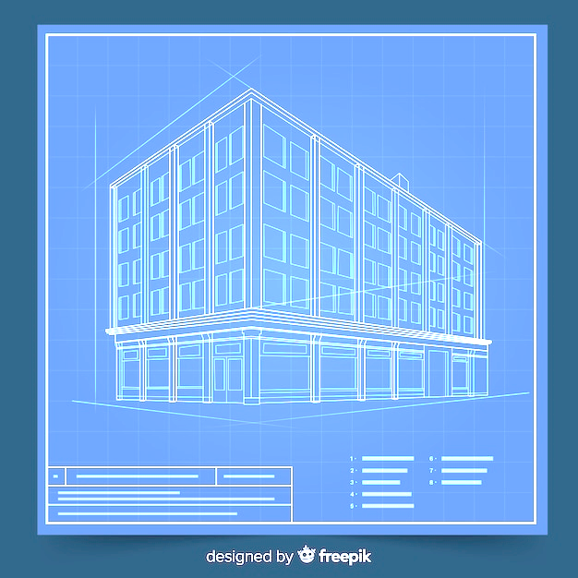
MASTERPLAN2040
DENSIFICATION
Densify land occupation by ensuring flexibility of use
Identify the areas set aside for development and define priorities
Continue to monitor CERN’s development
Draw up a land improvement plan
Favour taller buildings where site conditions and building use so permit
BUILDING MANAGEMENT
Standardise the use of built-up areas:
Develop a policy for the management of built-up areas with a specific strategy for each purpose
Continue monitoring existing buildings
Continue the renovation programme
Propose a specific land-use area on the Swiss side of the CERN site and define regulatory provisions
URBANISM
FUNCTIONALITY & READABILTY
Consolidate the functionality of the Meyrin and Prévessin sites and the experiment sites, and make the Prévessin site autonomous :
Enhance the organisation and coherence of the sites by creating specific zones: visitor, academic, scientific–technological .
Create one or more decentralised service hubs on the existing and future sites, notably bringing together amenities, restaurants, public spaces, lawns, gathering areas, etc

Slide 6
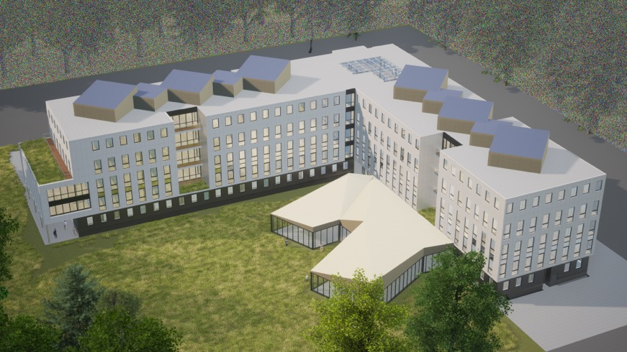
PREVESSIN OFFICE CENTER
Key design information:
Tertiary building (475 p.) + new restaurant (500 s.) + Parking
Compliance Master Plan 2040
Compliance RE 2020 (environmental regulation) ;
Low embodied energy (mass timber structure)
Preservation of near by forest
Integrate soft mobility ;
2026 : end of works
MS and IT consultant: 2022
MS and IT Contractors: 2023
Beginning of Works: 2024
Reference Design

Slide 7
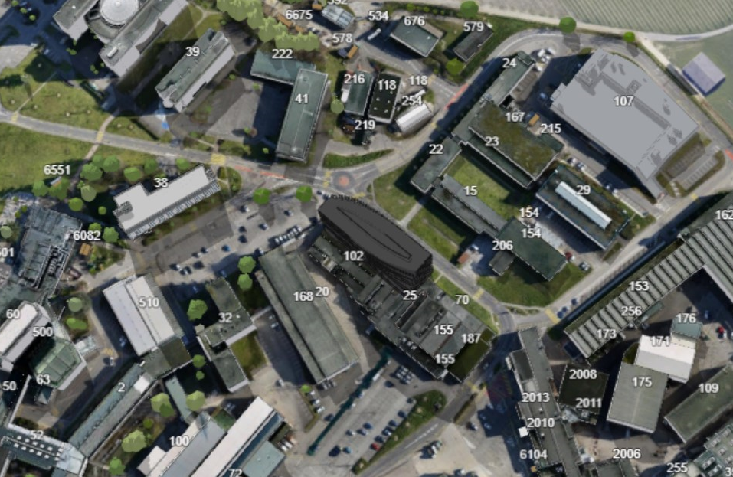
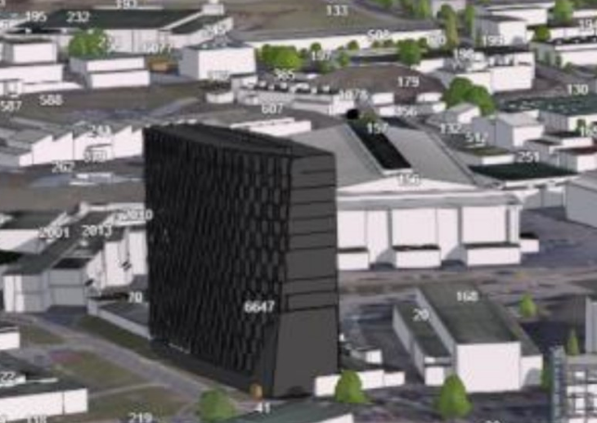
B140 (MEYRIN)
Base assumptions:
18000 m²
Office building, training center, light laboratories, cafeteria & parking
Emphasis on sustainable design & construction
Tendering process to target beginning of works in 2027

Slide 8
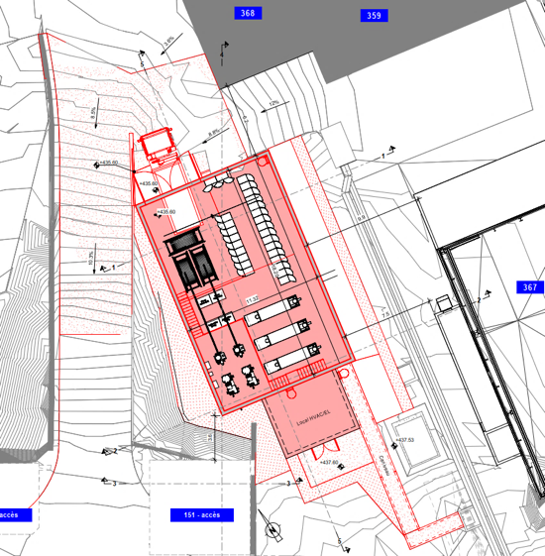
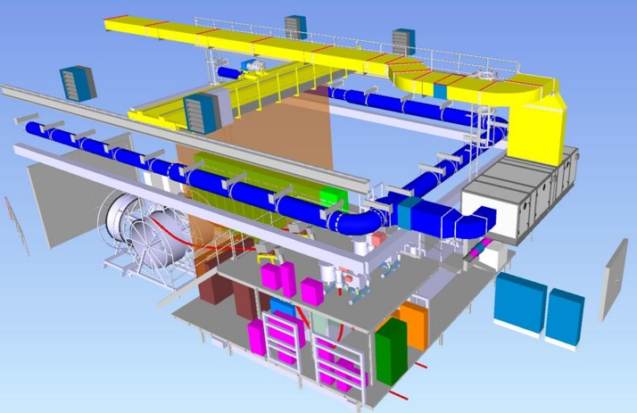
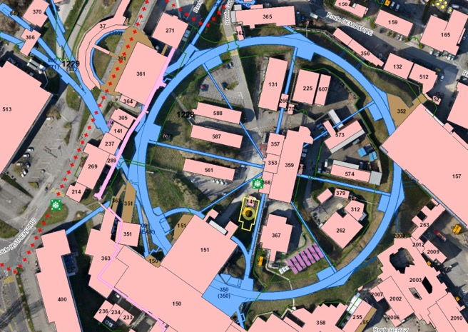
B369 MTE KICKERS (MEYRIN)
Base assumptions:
Standard industrial building composed by a main hall (≈235m², including a mezzanine level), which will house the relocated kicker’s system and its operational equipment
Emphasis on sustainable design & construction
Procurement
IT: Summer 2022 (FC on Dec22)
Beginning of the works: January 2023
Delivery: December 2023

Slide 9
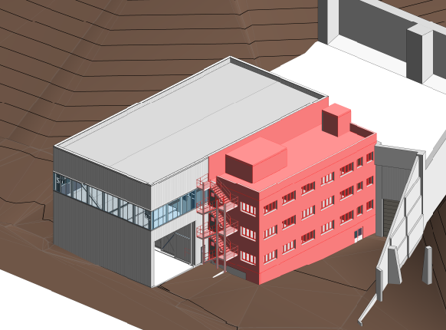
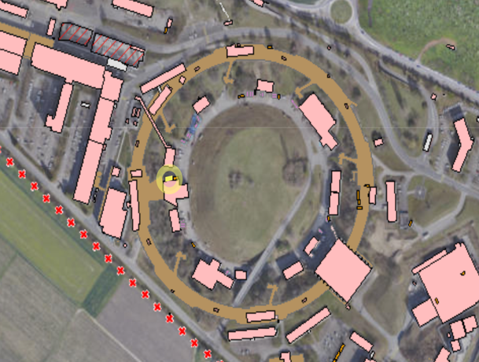
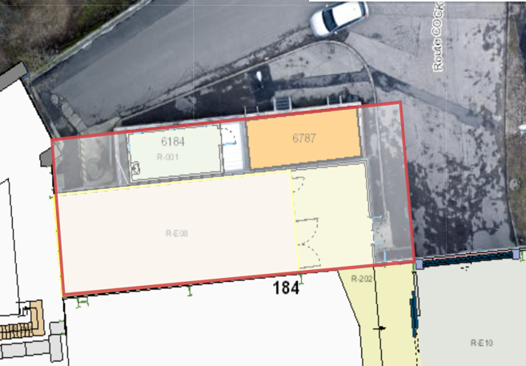
B184 (MEYRIN)
Base assumptions:
315 m² extension and reconditioning of the Radioactive Waste Treatment Centre with offices and renovation of technical infrastructures
Emphasis on sustainable design & construction
Procurement
Contractor IT: Q2 2022
Contract: October 2022
Works: Q4 2022 to Q4 2023

Slide 10
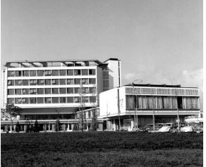
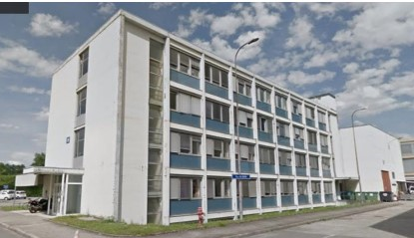
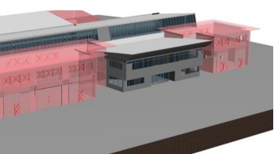
RENOVATION WORKS
Global renovation of up to 2 buildings/y
Densify consolidated space
Emphasis on sustainable design & construction
Demolish depreciated space
B60
B36
B100
Procurement from Summer 2022
B36, design procurement phase from Autumn 2022, followed by construction
B100, procurement phase in 2023

Slide 11
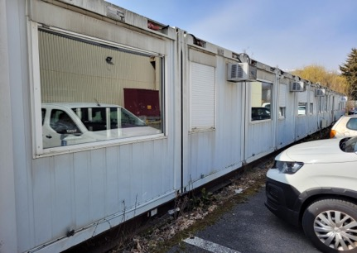
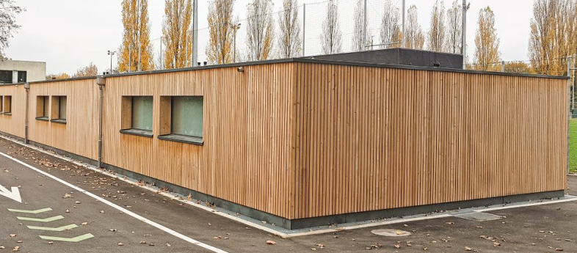
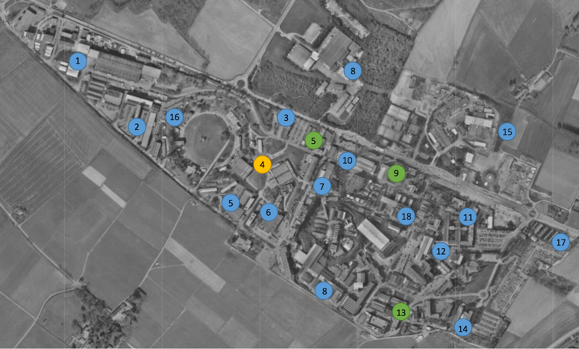
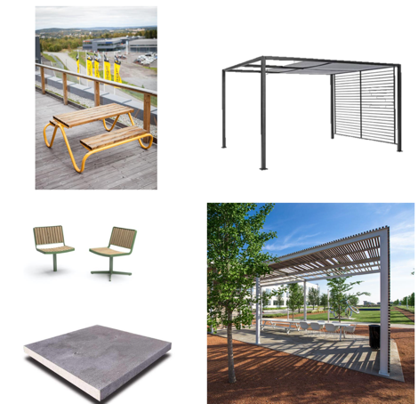
RENOVATION WORKS
Demolish obsolete barracks at P1 (~400 m2) and replace it by a pre-fabricated building doubling the capacity within the same footprint
Procurement ongoing
Delivery expected end 2023
Pilot for future projects
Outdoor Spaces:
Complete CERN working spaces with outdoors social and informal work areas;
Give an urban identity to outside spaces;
Exposition areas to share general knowledge.

Slide 12
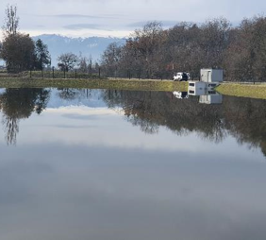
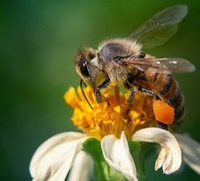
MASTERPLAN2040
MANAGEMENT OF
RESSOURCES
Control the resource requirements for the operation of tertiary infrastructures:
Improve energy consumption and reduce greenhouse gas emissions
Promote new energy-generation technologies
Limit the increase in water consumption.
BIODIVERSITY
Initiate an action plan in favour of biodiversity, green spaces and protected species:
Continue to implement the rainwater management strategy at CERN
Draw up an inventory of the existing biodiversity, protected species and green spaces
Continue the development of the ecological continuity of environments and wildlife corridors.
POLLUTION
ENVIRONMENT
Control and mitigate CERN's environmental pollution:
Limit noise pollution
Increase the recycling rate and reduce waste production
12

Slide 13
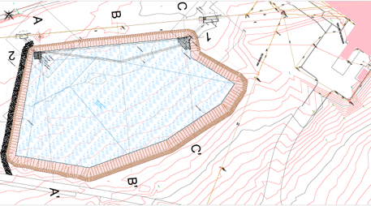
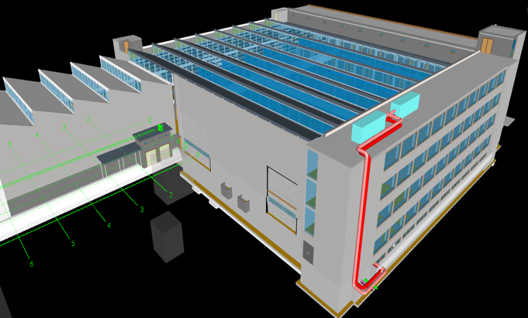
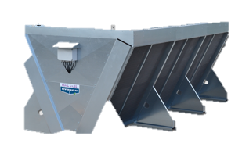
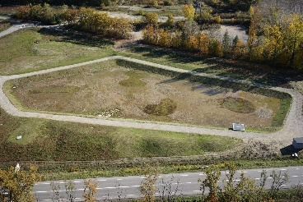
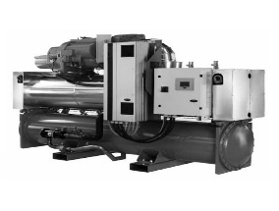
ENVIROMENTAL INITIATIVES
Retention basins
Upgrade of Cooling and Heating networks
3 Projects under discussion
Ad hoc tendering for studies and construction:
France in 22-23
Switzerland 23-24
Tendering 2022

Slide 14
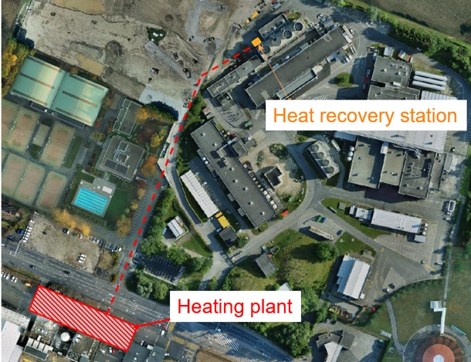
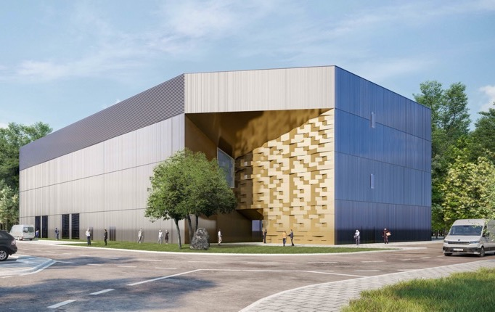
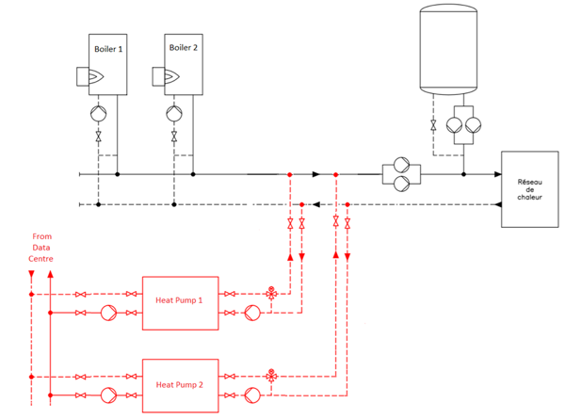
ENVIROMENTAL INITIATIVES
Sustainable Heating Plants
Main power via renewable energy sources to cover the major part of the current heating needs in Meyrin & Prevessin sites
Projects under discussion
Tendering 2023
Meyrin
Prévessin

Slide 15
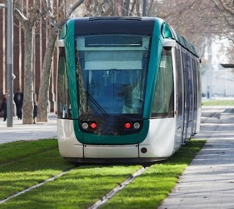
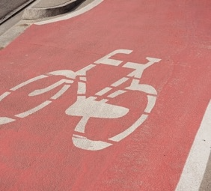
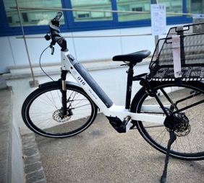
PARKING
MASTERPLAN2040
Optimise the car-parking facilities and their management :
Limit car parking
Privilege car parks close to the main road network in the context of new developments
Continue the development of facilities for soft-mobility
Develop communication promoting a reduction of the impact of people’s mobility at CERN
CIRCULATION
Promote efficient and fluid access to and circulation on the CERN sites :
Optimise the fluidity of access to the CERN sites.
Improve the hierarchy of the road network inside the CERN site.
Continue developing accessible facilities for people with reduced mobility.
ALTERNATIVES
MOBILITY
Encourage alternatives to individual motorised transport for commuting :
Encourage car sharing.
Improve the continuity, safety and comfort of soft-mobility routes and provide parking for bicycles.
INTERSITE TRANSPORT
Promote alternatives for travelling between the CERN sites :
Continue developing facilities associated with collective transport on site.
Optimise the management and supply of CERN vehicles
Expand and diversify CERN’s bicycle fleet.
Continue developing the network of footpaths and cyclepaths on site.

Slide 16
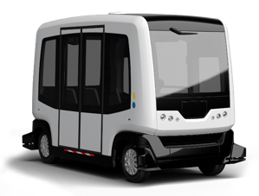
MOBILITY
Electric vehicles
Small cars
Car sharing
Car sharing system satisfying CERN requirements
Virtual key with cell phone
4G network cross border (FR/CH)
Free floating scheme
Autonomous shuttle
Exploration of new way of moving from A to B on demand
Bike sharing
E-bikes
Standard bikes
E-scooters
Station to station scheme
Charging stations
Exploration phase: 2022-2023

Slide 17
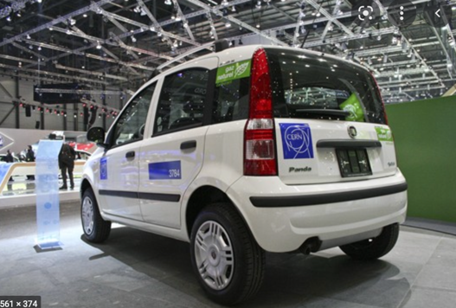
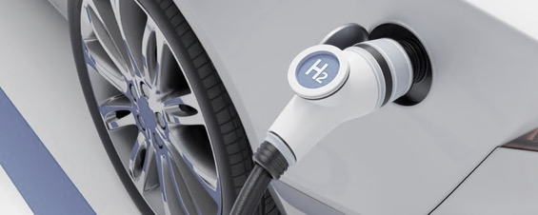
MOBILITY
Charging stations for electric/hydrogen vehicles
Installation of terminals (Quick plug)
Professional cars fleet contract (hundreds of cars)
Exploration phase: 2022-2023
Procurement phase in 2023

Slide 18
CERN SITE KEY FIGURES
590 ha (220 fenced)
2 main sites and 15 satellite sites
670 building from 10 m² to 20.000 m²
65% built before the 70s
70 km tunnels and 80 caverns
30 km roads
1000 km technical galleries and trenches
9000 persons/daily
490 hostel rooms
8500 working places
>5000 parking places
25000 daily movements to- and inter-sites
Public transport links in CH, not in FR
Green.Village@cern.ch

Slide 19
GREEN VILLAGE
FROM SOCIETY TO CERN TO SOCIETY
Enabling rapid access to CERN campus as a test site for technologies linked to environment and sustainability
Accelerating the commercialization of ideas, technologies and prototypes
Involving Young Innovators (new ideas for unforeseen applications) Ideasquare: The Innovation Space @ CERN
CHALLENGES
Waste management
Mobility
Energy efficiency for tertiary activities on campus
Space management, IoT, urban analytics…
Zero-waste
Green.Village@cern.ch

Slide 20
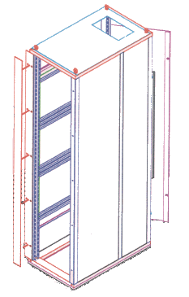
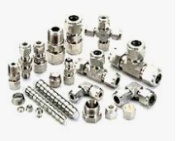
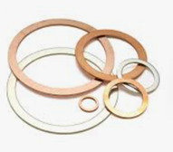
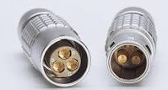
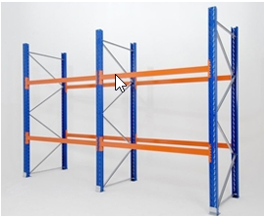
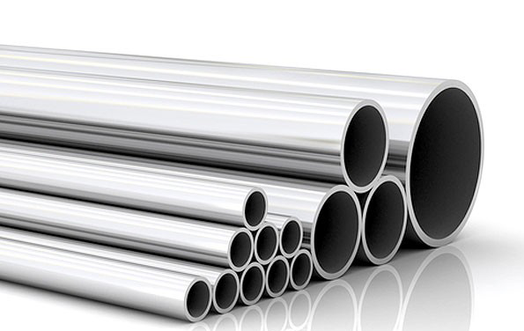
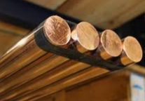
SUPPLIES
19 inch instrument rack & accessories (3 y ~ 600 kCHF )
Safety signs and labels (3y ~ 170 kCHF)
Fluid handling process and control valves: pressure control valves, safety valves, pressure transmitter (3y~ 190 kCHF)
Instrumentation fittings (3y~500k CHF)
Punchout Industrial supply and tools (~1,4 MCHF/y)
Metallic gaskets for UHV applications (3y ~ 3 MCHF)
Coaxial connectors (3y ~500 kCHF) – from 2023
Flexible single core copper cables (2y ~1,2 MCHF) – CPR
Industrial wood products: engineered wood panels, plywood, MDF, etc. (3y contract ~500 kCHF)
Stainless steel tubes, grades 1.4307/1.4404/1.4435 (280 kCHF/3y)
Oxygen-free copper “Cu-OFE” forged round bars (200 kCHF/3y)
Raw Materials store
New cutting machines:
Circular and band saw machine
Hydraulic shears
Flame cutting machine
New storage system:
Pallet racks (W:50m, H:4m)
Sheet metal/plastic storage (up to 200 references)

Slide 21
CONTRACTS
Frame contracts
Gas supply (2022)
Cleaning CH (2022)
Green spaces (2023)
Light vehicles (2023)
Drilling and boring (2023)
Waste collection (2023)
Service Desk (2023)
Bus rentals (2024)
1-shot contracts, Invitations to Tender
CE, Vertical Cores HL-LHC (8/22)
Car washing station (7/22)
Landscaping CERN Perimetry (7/22)
Installation of fences CERN Perimetry (7/22)
Contact: SCE-DH-Office@cern.ch
Non exhaustive list
Subject to change

