Slide 1
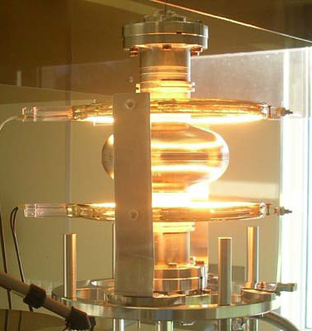
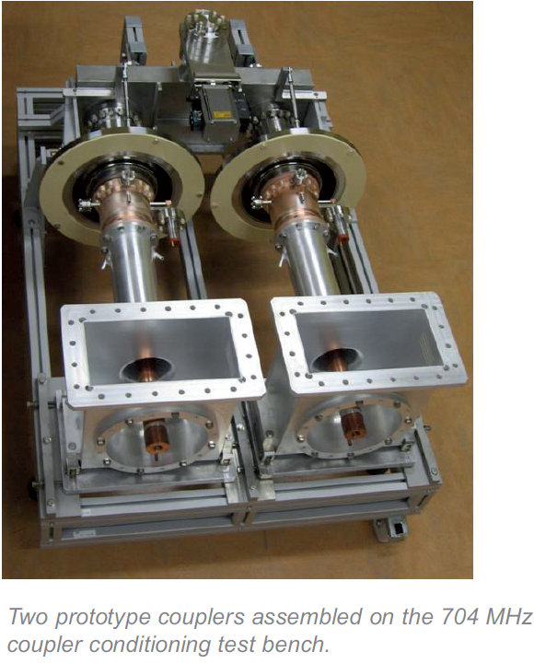
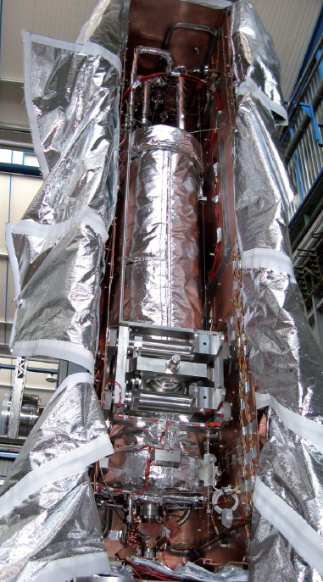
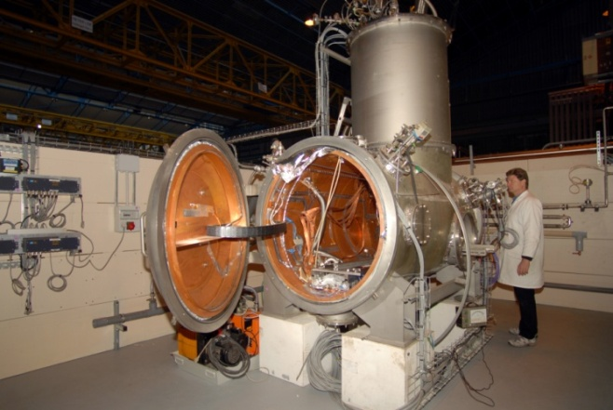
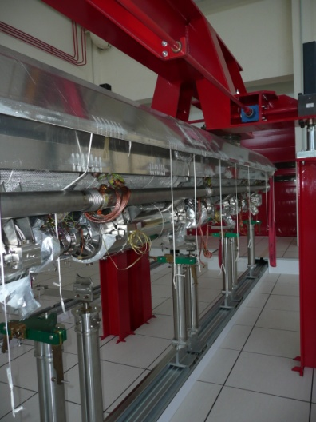
CEA – Saclay, Irfu
Status of SCRF Accelerator Activities
at CEA-Saclay
Olivier NAPOLY

Slide 2
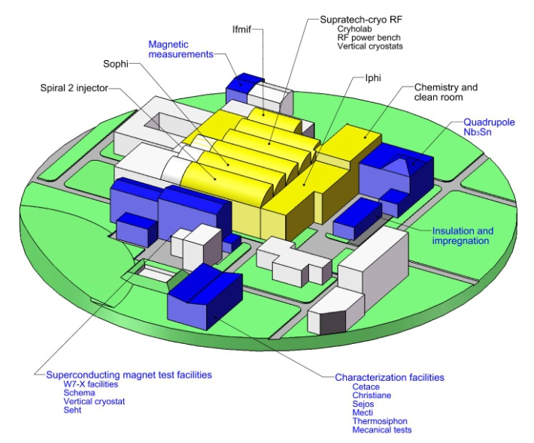
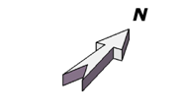
Irfu – Accelerator Installations
XFel

Slide 3
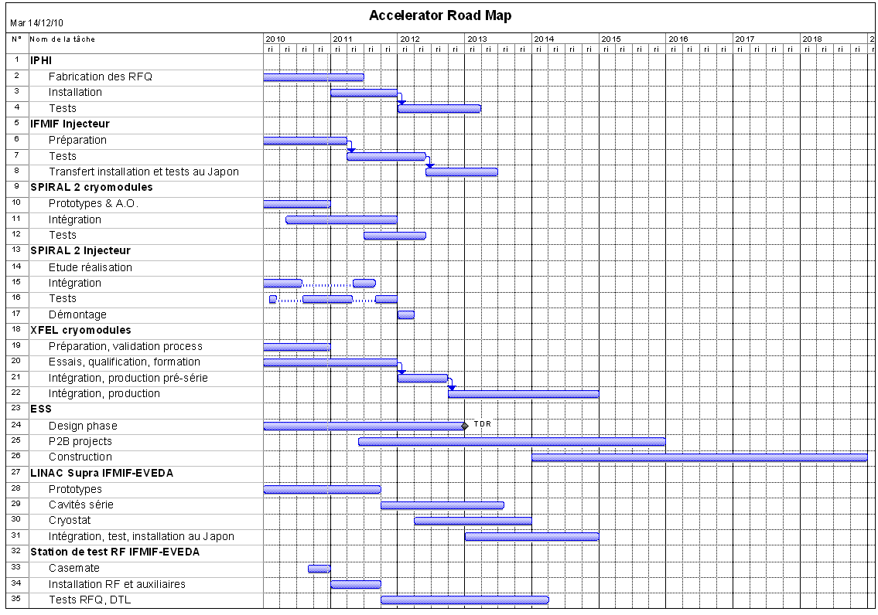
Irfu’s SCRF Roadmap
H+
D+
H+,D+
H+,D+
e⁻
cf. C.Madec
H+
cf. G. Devanz
D+
cf. F.Orsini
+ SPL Cavities (EuCARD)

Slide 4
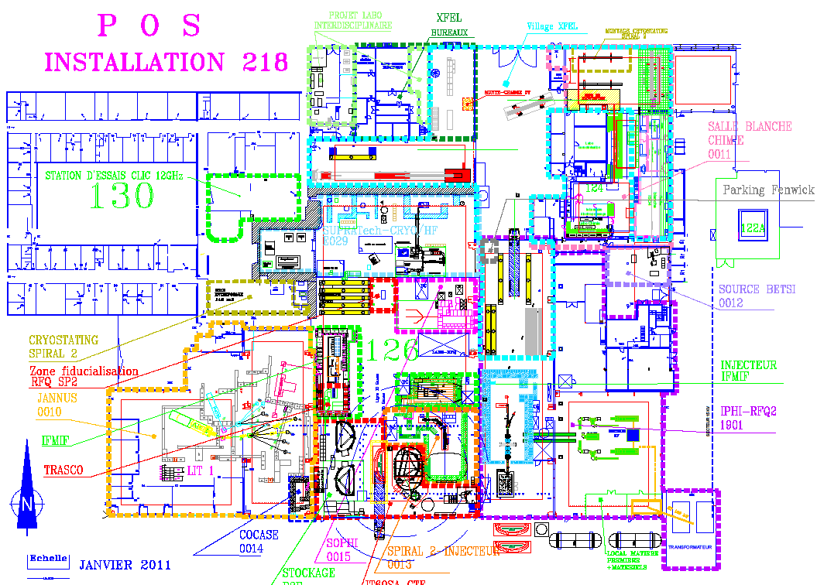
14 000 m²
100 m

Slide 5
Assembly Buildings
Village XFel
Clean Romm
4
Bât. 124 Nord
25x15 m²
7
6
Cour MA
2
1
Assembly Halls
Bât. 126 Nord
40x11 m²
5
3
8
Bât.126 Sud 30x17 m²
Offices Warehouse
6b
©GoogleMap

Slide 6
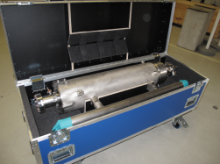
Clean Room Workstations
Unpacking / packing and cleaning pieces
Cavity string assembly
(1 string / week)
Second week string assembly
Control and acceptance test
1 day
Cavity storage
Cavity washer
Coupler cold part assembly
(8 cavities / week)

Slide 7
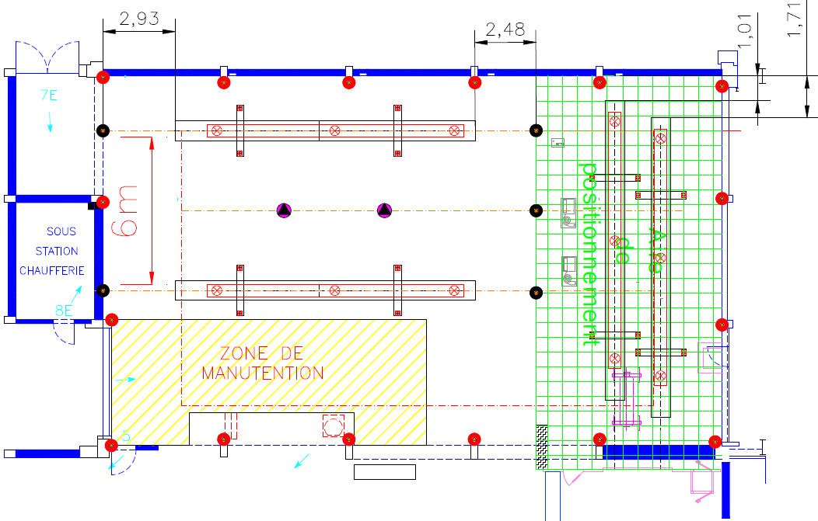
Roll-Out and Alignment Workstations
AL-WS2
AL-WS1
RO-WS2
RO-WS1

Slide 8
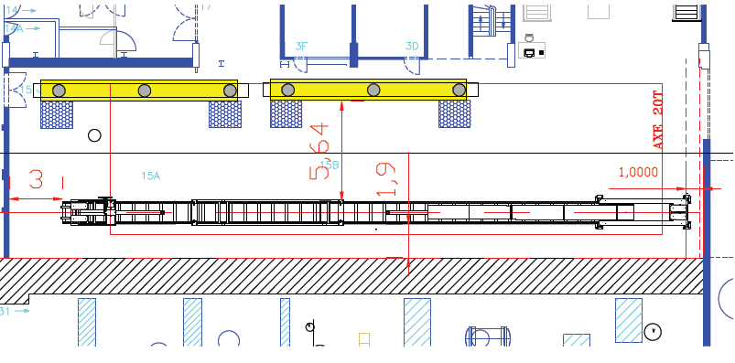
Cantilever and Coupler Workstations
CO-WS1
CO-WS2
CA-WS1

Slide 9
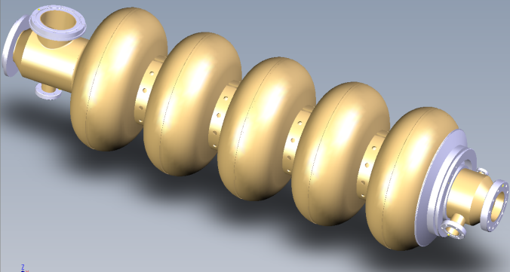
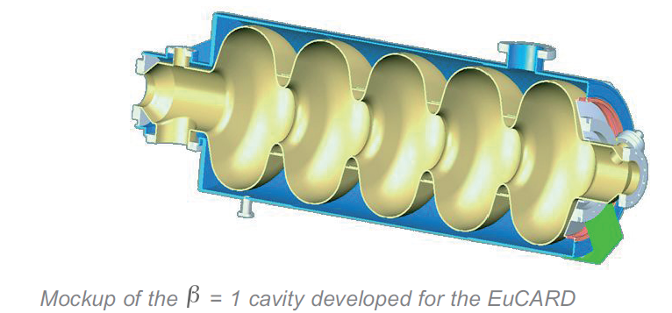
SPL Cavity in the EuCARD Program
IPN/Orsay and CEA/Saclay decided to standardize the beam end-pipes in order to perform qualification tests in the horizontal cryostat CryHoLab of their common platform SUPRATech.
Both helium tanks are made of titanium and, on one side, are equipped with the same titanium thick disk welded on cavity end-tube on which fits the lateral tuner already developed (Saclay IV type with one piezo actuator).
Technical specifications are almost ready, and documents for the calls for tender are in preparation.

Slide 10
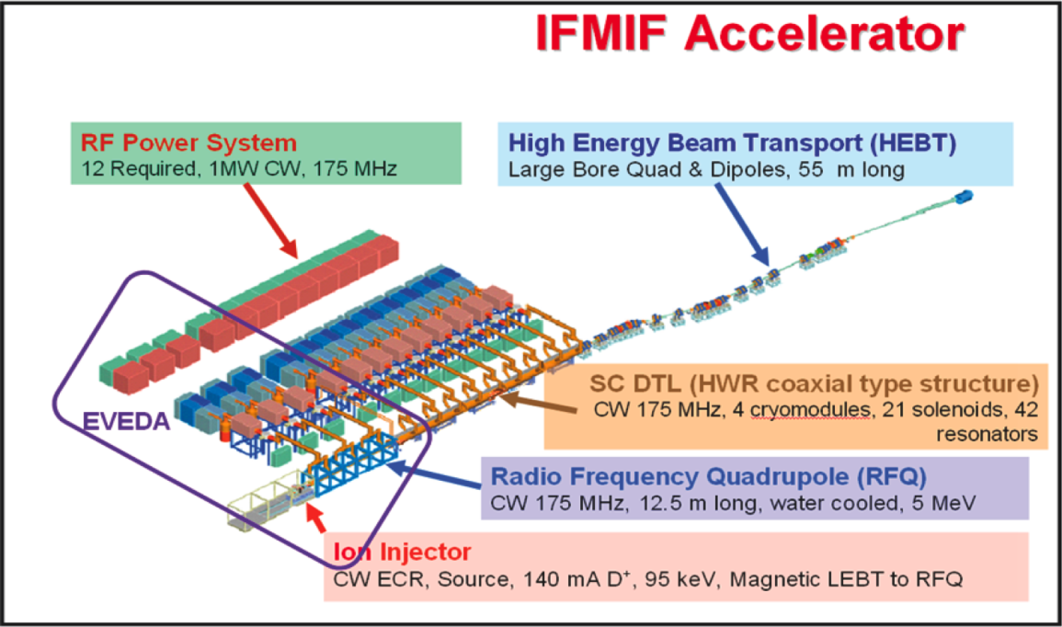
IFMIF-EVEDA Project
Irfu is in charge of the construction of :
a) overall accelerator coordination, including beam dynamics
b) the ion injector (125 mA D+) c) the high power RF tests
d) the superconducting linac module, e) the linac control-command

Slide 11
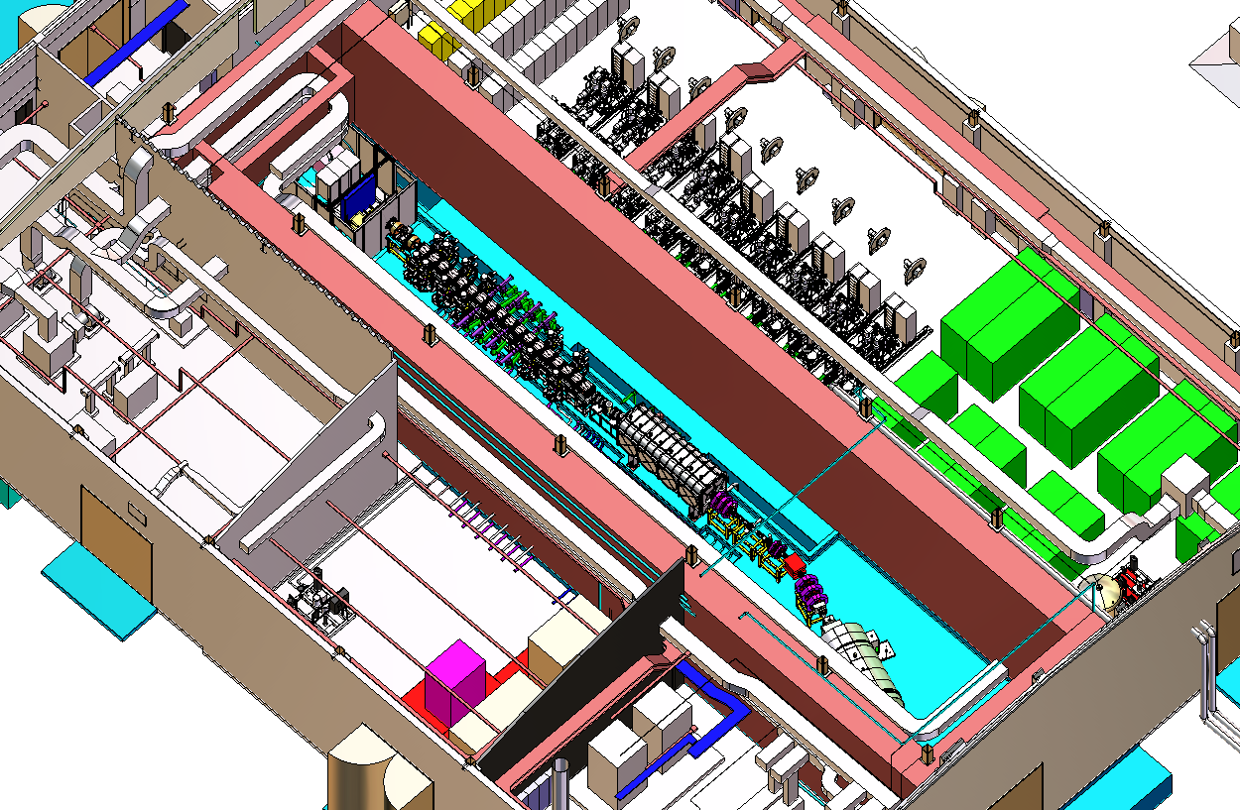
IFMIF EVEDA : 125mA Deuterons 9MeV

Slide 12

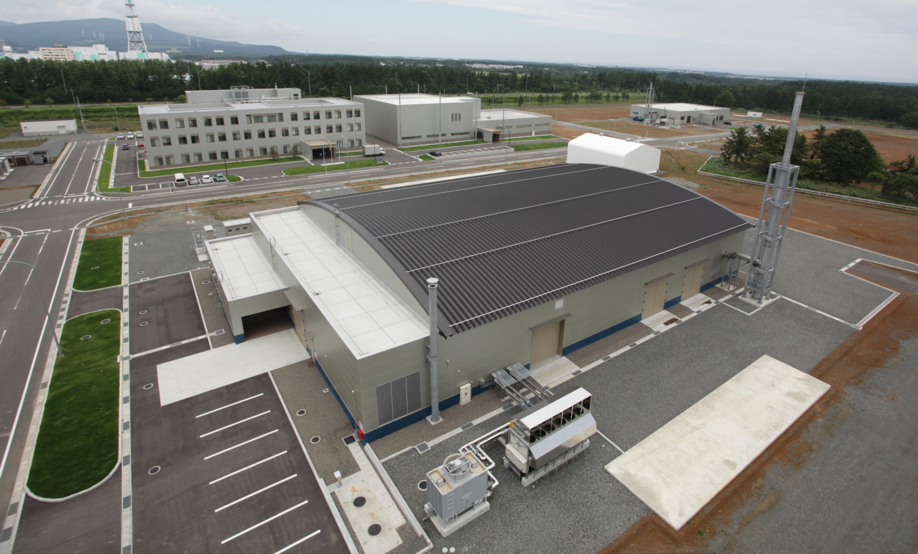
International Fusion Energy Research Centre
Administration &
Research Building
Computer Simulation &
Remote Experimentation Building
DEMO R&D Building
IFMIF/EVEDA
Accelerator Building
All buildings completed in March 2010

Slide 13
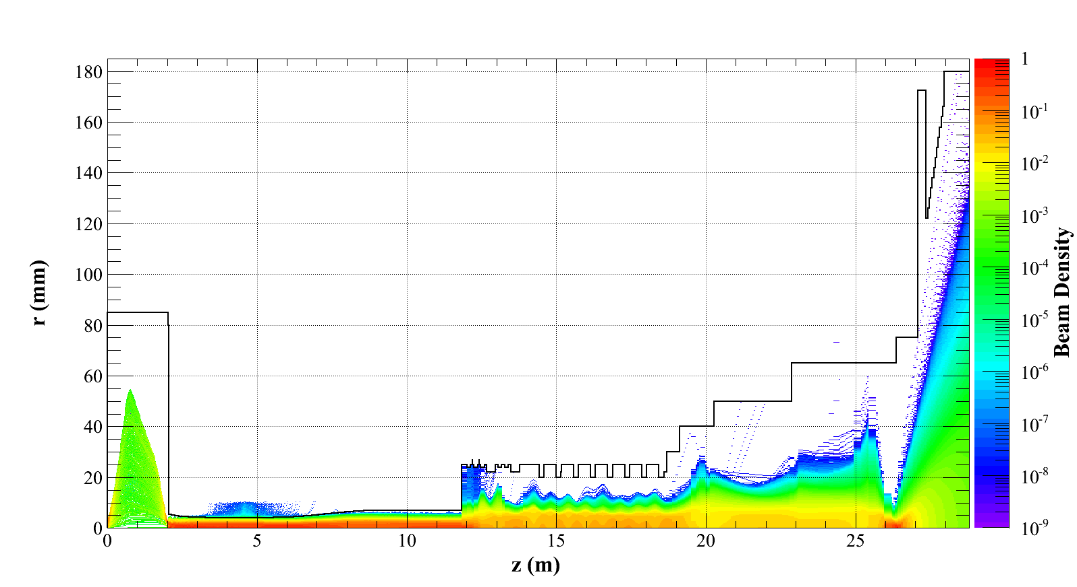
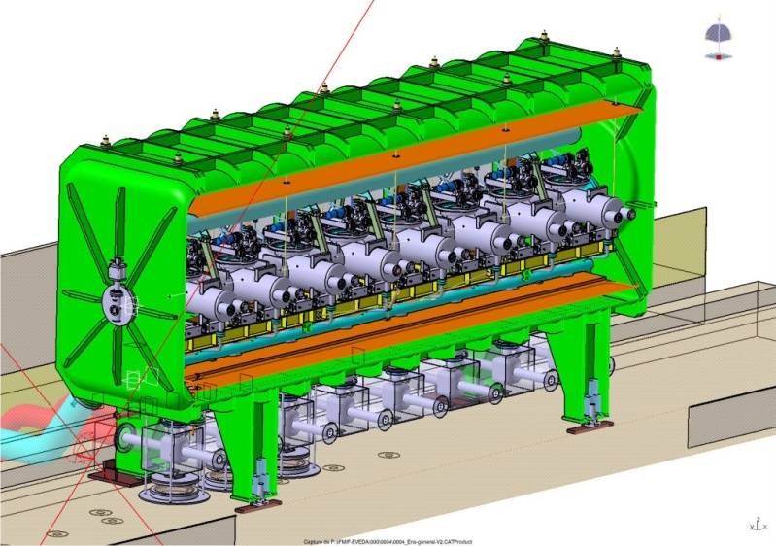
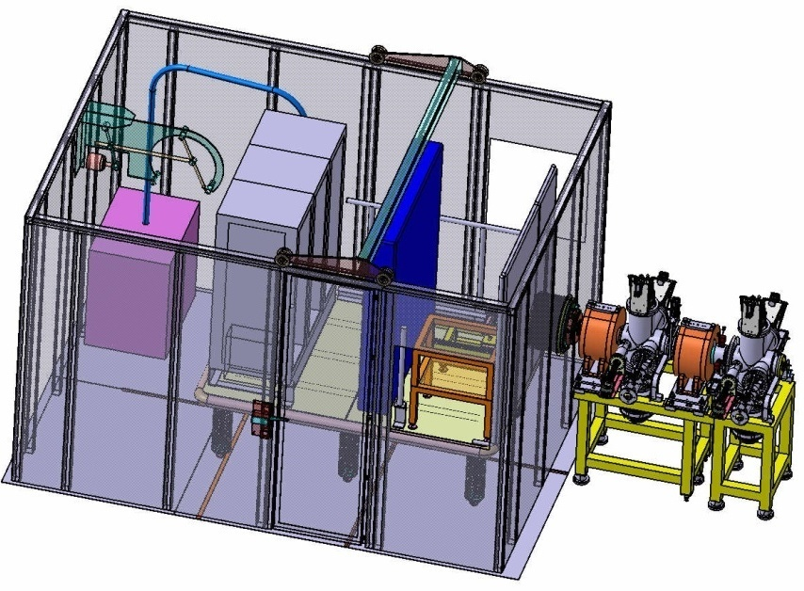
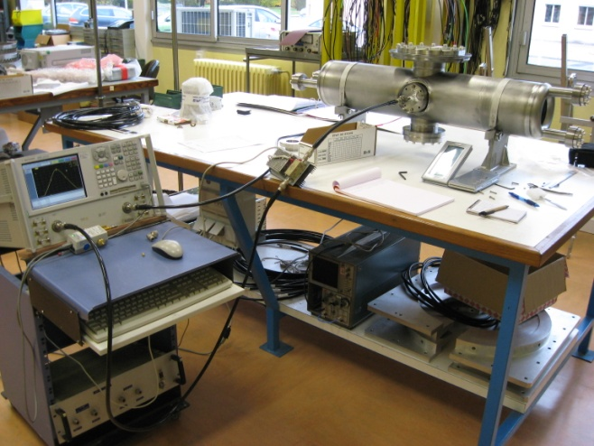
IFMIF-EVEDA Project : 1 MW D+ beam (125 mA, 9 MeV)
Beam Dynamics: start-to-end simulations with space charge
Cryomodule
First prototype cavity under RF measurements
D+ injector

Slide 14
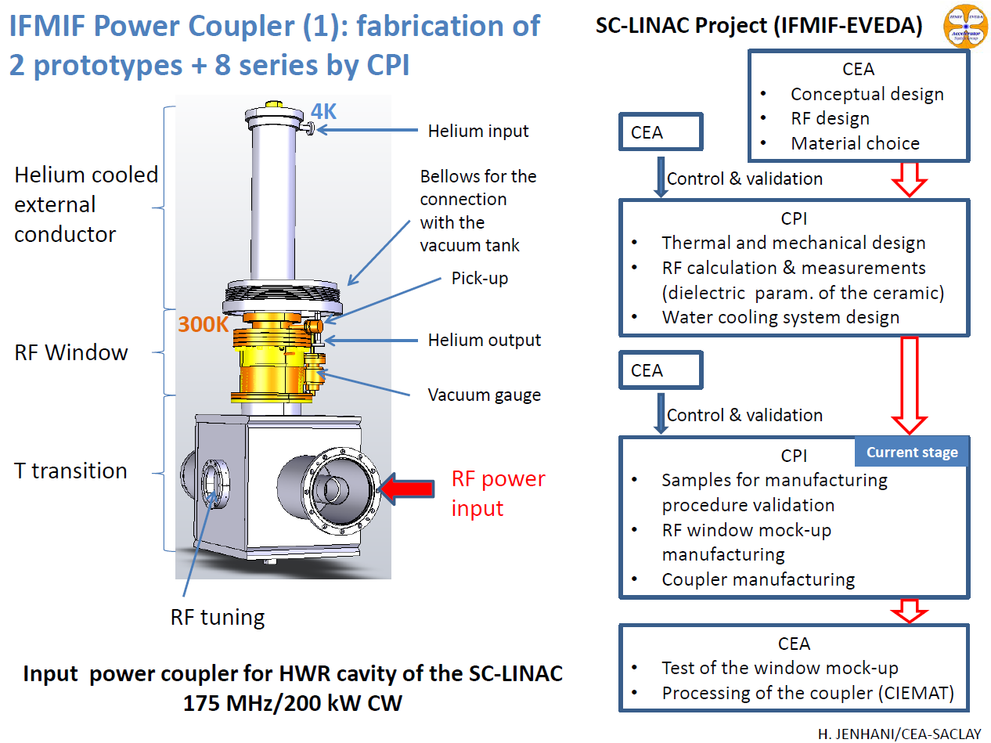
IFMIF-EVEDA Project : Coupler development

Slide 15
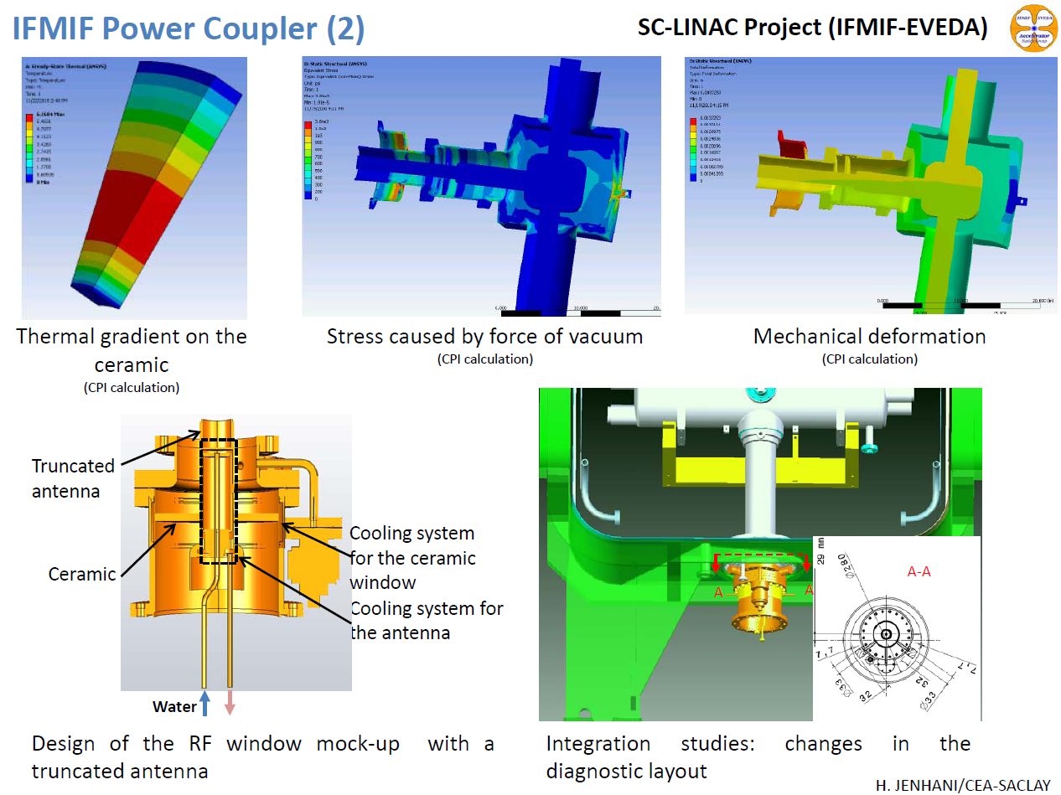
IFMIF-EVEDA Project : Coupler development

Slide 16
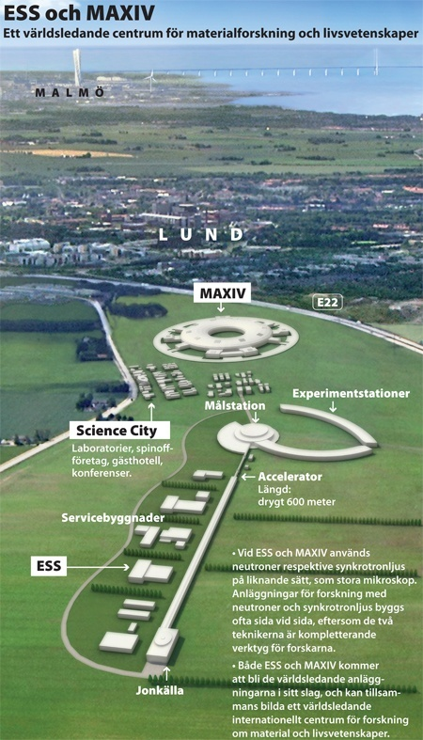

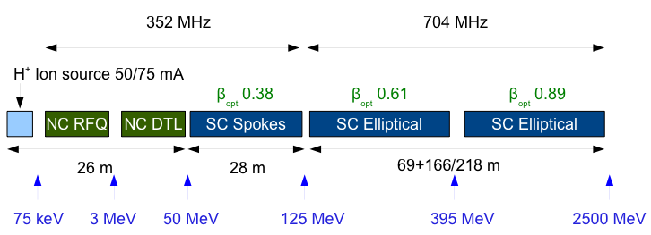
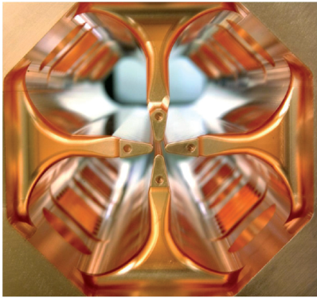
European Spallation Source
Proton Beam of 2.5 GeV and 5MW
Design Phase: 2010-2015.
Construction Phase: 2015-2025.

Slide 17
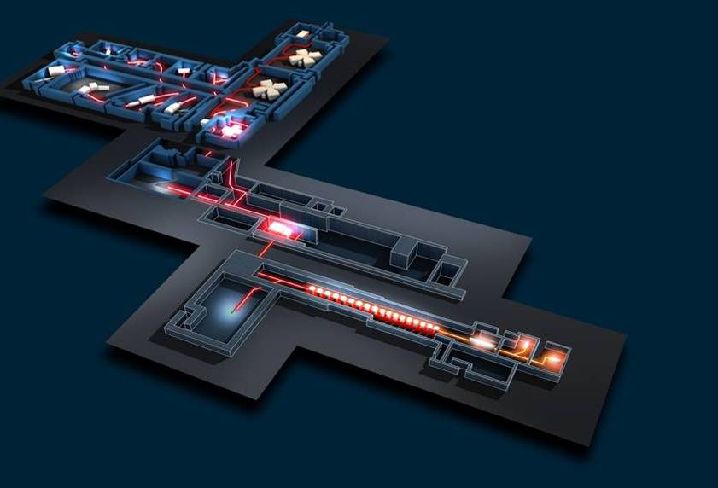
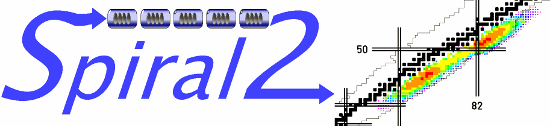
The Chain of Accelerators for SPIRAL2 at GANIL
GANIL
GANIL existant
Cyclotron CIME
~ 10 MeV/u
Cyclotron CIME
~ 10 MeV/u
LIRAT
LIRAT
RIB production building
≤ 1014 fissions/s
converter C + targer UCx
bâtiment de production
≤ 1014 fissions/s
convertisseur C + cible UCx
RFQ
RFQ
Sources d’ions
Ion sources
Aire Expérimentale
Ions Stables
Experimental area
for stable ions
Superconducting LINAC
deuterons : 40 MeV, 5 mA
Q/A = 1/3 : 14 MeV/n, 1 mA
LINAC supraconducteur
deutons : 40 MeV 5mA
ions lourds : 14 MeV/n 1 mA

Slide 18
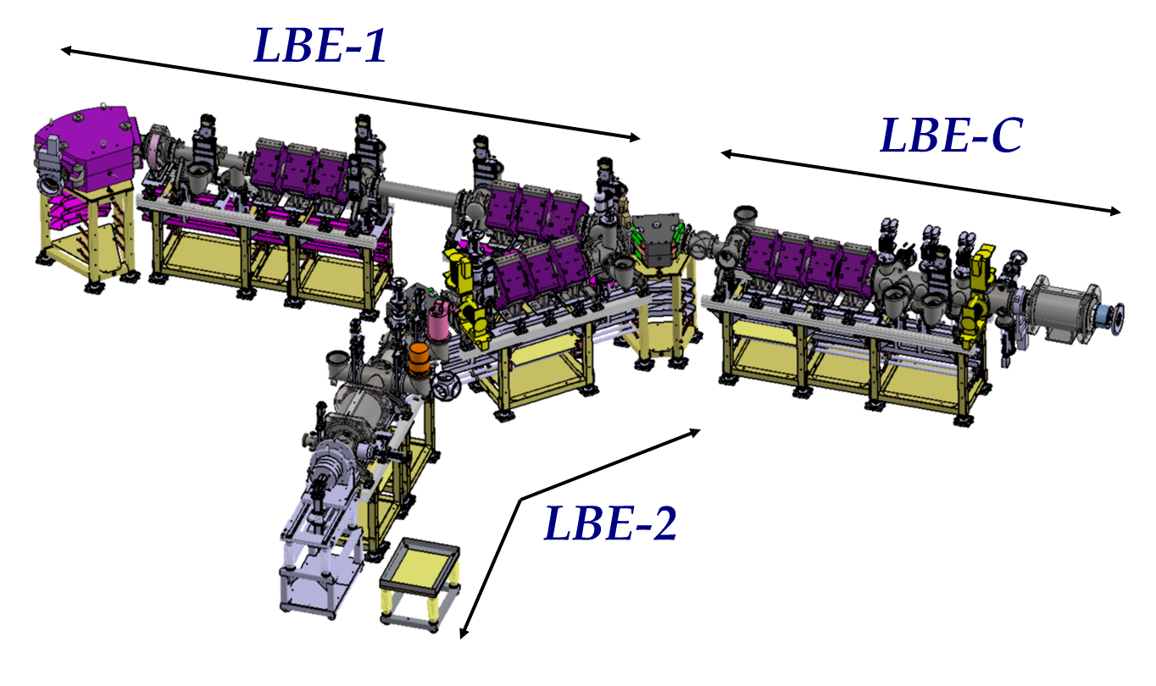
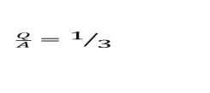
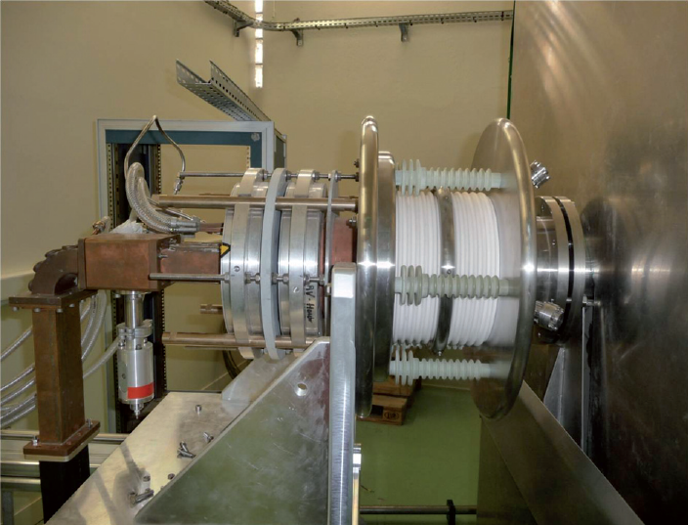
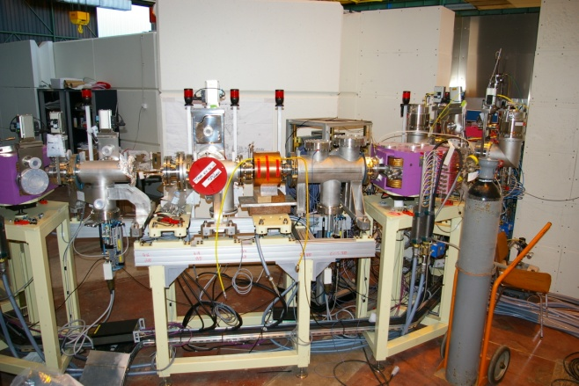
SPIRAL2 Project
Irfu is in charge of the construction of : a) the D+ ion source
b) the ion injectors (D+ and Q/A=1/3) c) the RFQ
d) the low energy superconducting linac, e) the linac LLRF
Spiral2 Injector
D+ source

Slide 19
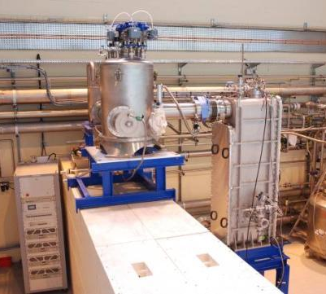
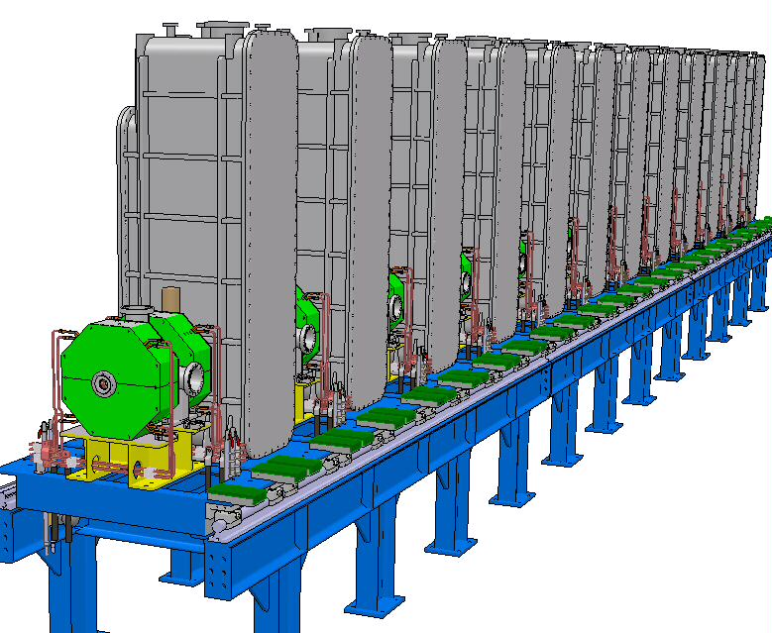
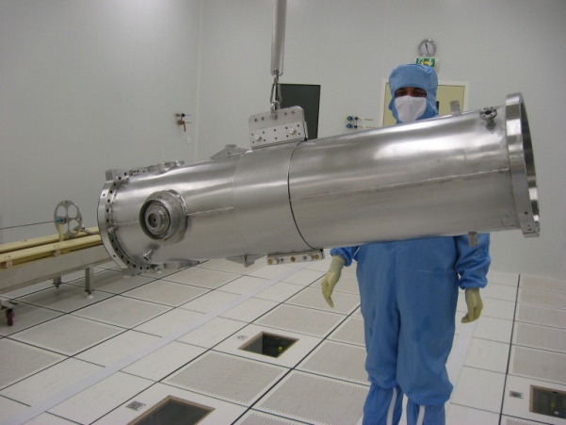
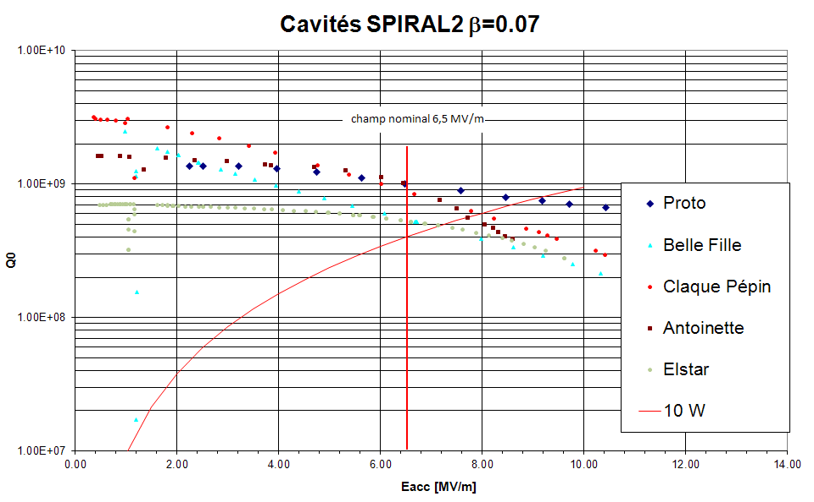
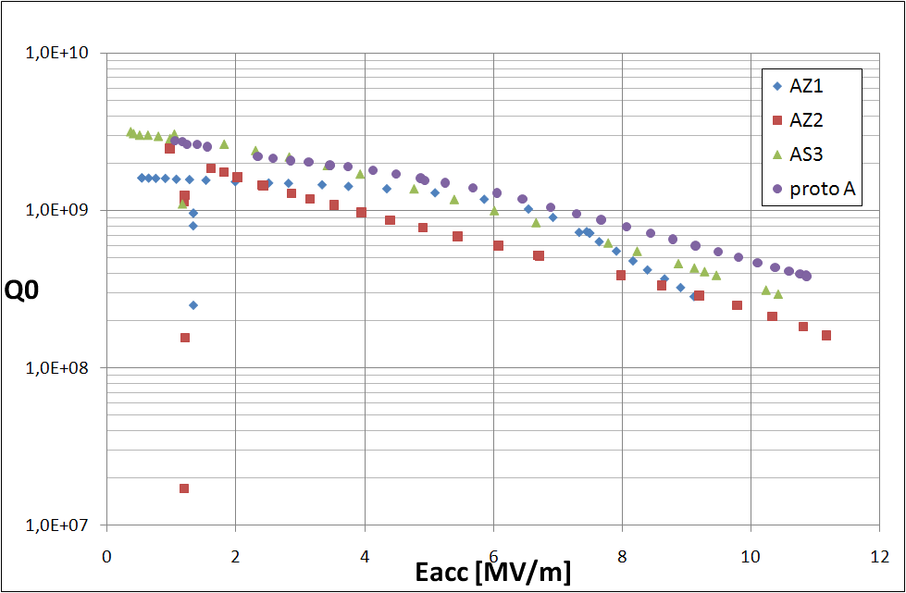
SPIRAL2 Project: 12 Cryomodules, λ/4, β=0.07
Low energy SC Linac
Cryomodule RF Tests

Slide 20
Vertical Electro-Polishing set-up at CEA-Saclay
Vertical treatment with circulating acid
Horizontal preparation of the cavity
Commissioning expected at the end of June 2011
Automated process
Piping: mostly PFA

Slide 21
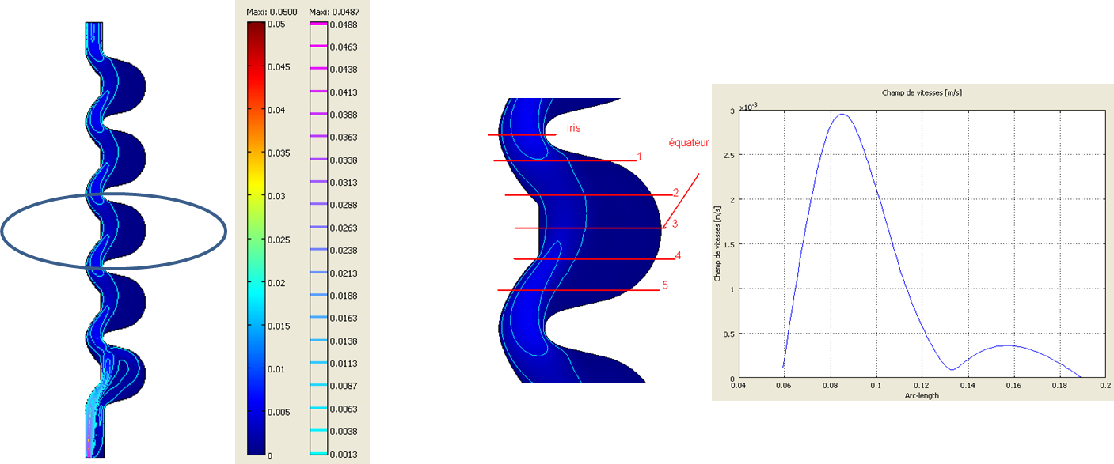
Goal of the VEP set-up
Treatment of ILC 9-Cell cavities (HiGrade program)
EP (or BCP as a backup) of larger cavities: 5-cell proton cavities (EuCARD)
Process modeled for both cavities with COMSOL software
(Fluid dynamics, Electric Field with 2D axis-symmetry).
    EP more challenging for large cavities
    Shaped cathode anticipated
Example of fluid modelling with alternative shape

Slide 22
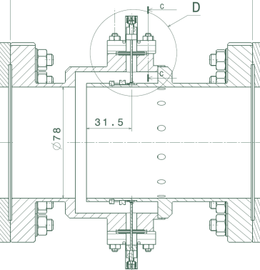
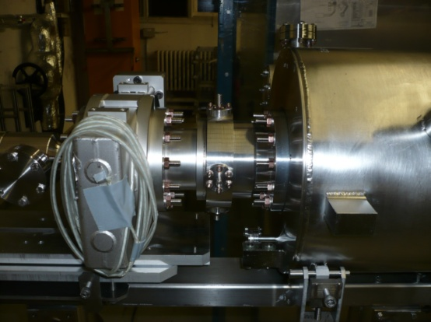
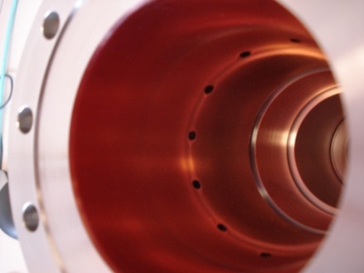
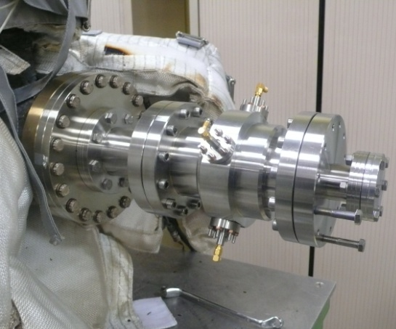
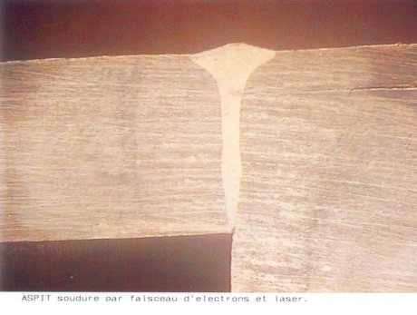
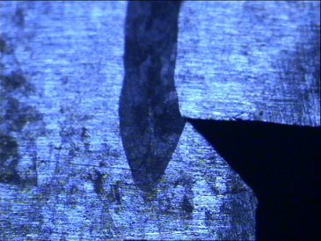
XFEL Cryomodule Reentrant BPM
Two prototypes built
  First prototype integrated in an XFEL
  Prototype cryomodule
  Pickups passed cryogenic tests
    Process: cooled down to 4 K and
    warmed up to 330K 3 times
  Coaxiality of 2 parts: 19 µm
  For the second prototype, copper coating process was changed to
  avoid cleaning problem.
  special tools used to protect the re-entrant part and
  outside parts which are not copper coated
  Investigation to improve EB welding for the production
Reentrant BPM mounted on PXFEL2
Copper coating of the BPM
4.5 mm
Samples of EB welding with geometry
used for prototype1 & 2
Samples of EB welding with a new geometry
BPM under RGA

Slide 23
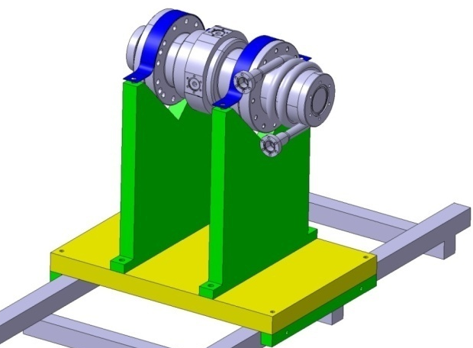
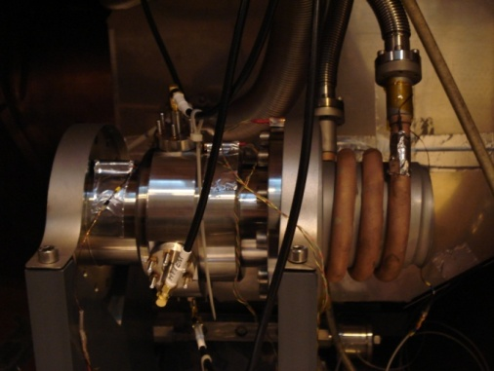
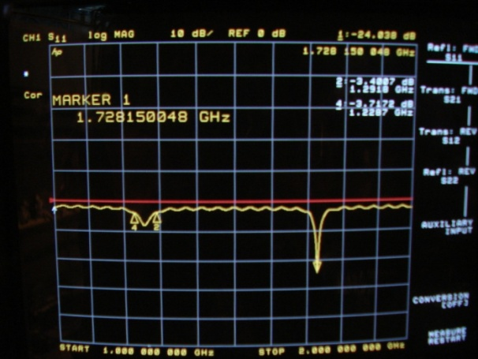
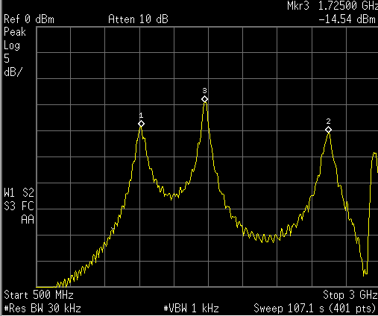
Reentrant BPM tested in CryHoLab
Test in a horizontal cryostat at Saclay (CryHOoLab)
 | Frequency (MHz)
 | Measured in Cryholab at 300 K | Estimated at 6 K | Measured in Cryholab at 6 K
Monopole mode | 1254 | 1257.7 | 1257.2
Dipole mode | 1720.6 | 1725.8 | 1727.7
BPM
He tube
to cool down
BPM integrated in CRYHOLAB.
CryHoLab
Reflection and transmission measurements

Slide 24
Conclusion
Irfu SCRF Accelerator activities have a clear and busy roadmap up to 2018 with heavyweight Spiral 2, XFEL, IFMIF and soon ESS.
Accelerator R&D (SPL, VEP, HiGrade) is supported by European programs.
Thin film and multilayer research for SC cavities is applying for national funding (ANR).

