Slide 1



Design and Construction Experiences for the Cornell ERL Injector and Main Linac Cryomodules
Matthias Liepe
Assistant Professor of Physics
Cornell University
The Cornell ERL Cryomodules

Slide 2
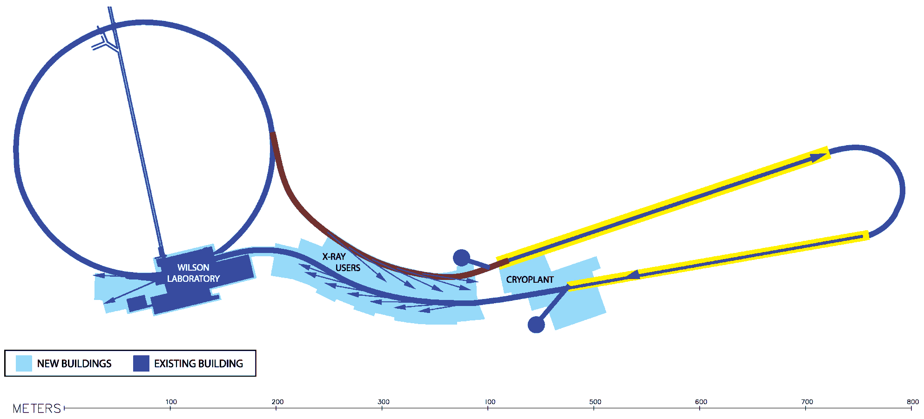
The Cornell Energy Recovery Linac Project
5 GeV, 100 mA, hard X-ray light source
CESR
North ERL Linac, 35 modules
Injector
The Cornell ERL
South ERL Linac, 29 modules
Beam Stop
Cornell is pursuing funding for a Energy Recover Linac (ERL) based x-ray light source.
A project design and description report is completed.
An ERL injector prototype has been developed, fabricated, and is currently under commissioning.
Design work on the main linac cryomodule has started.

Slide 3
Outline
What is needed from an ERL cryomodule?
Cornell ERL cryomodules: An overview
  Design philosophy
  The injector cryomodule
  The main linac cryomodule
Cavity support and alignment
Magnetic shielding for high Q₀
Cryogenics and thermal shield
Mechanical design and microphonics
Other design changes compared to FLASH/XFEL modules
Summary and outlook
Not discussed: Beamline design and performance
Outline

Slide 4
What is needed from and ERL Cryomodule?
Provide good cavity alignment (<0.5 mm)
Provide excellent magnetic shielding for high Q₀
Minimize cavity vibration and coupling of external sources to cavities to support efficient cavity operation with high loaded Q_{L} (no effective beam loading in main linac)
Intercept significant heat loads from cw operation with high (100 mA) beam current (dynamic cavity load; HOM power; high RF input power in injector)
High reliability
Minimize cost (construction and operational)
What is needed from and ERL Cryomodule?

Slide 5
Cornell ERL cryomodules: An overview
The injector cryomodule
The main linac cryomodule
Cornell ERL cryomodules: An overview

Slide 6
Design Philosophy
Use the same cryomodule concept in the injector and the main linac.
  Reduces risk
Rely on well established and tested performance of the TTF III technology to reduce risk, cost and minimize development time.
  Many improvements
  Cavities supported by large diameter Helium-gas return pipe (HGRP)
  All cryogenic piping inside of cryomodule
  Some changes needed for ERL specific needs
Further simplify and reduce cost.
Cornell ERL cryomodules: An overview

Slide 7
The Cornell ERL Injector
photocathode
DC gun
deflector
cryomodule
beam dump
experimental beam lines
buncher
design parameters
Nominal bunch charge 77 pC
Bunch repetition rate 1.3 GHz
Beam power up to 550 kW
Nominal gun voltage 500 kV
SC linac beam energy gain 5 to 15 MeV
Beam current 100 mA at 5 MeV
33 mA at 15 MeV
Bunch length 0.6 mm (rms)
Transverse emittance < 1 mm-mrad
Cornell ERL cryomodules: An overview
Achieved so far
77 pC
50 MHz and 1.3 GHz
125 kW
350 kV
5 to 15 MeV
25 mA
World record for CW injector current!

Slide 8
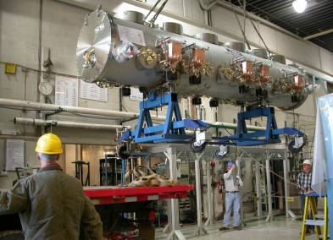
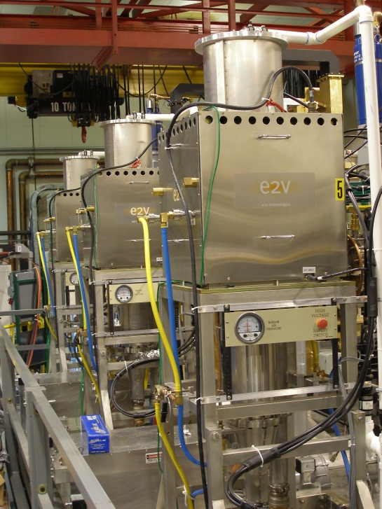
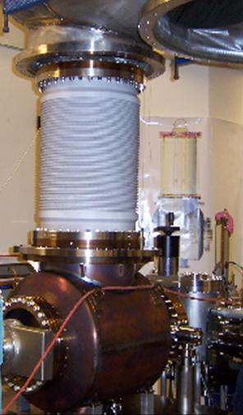
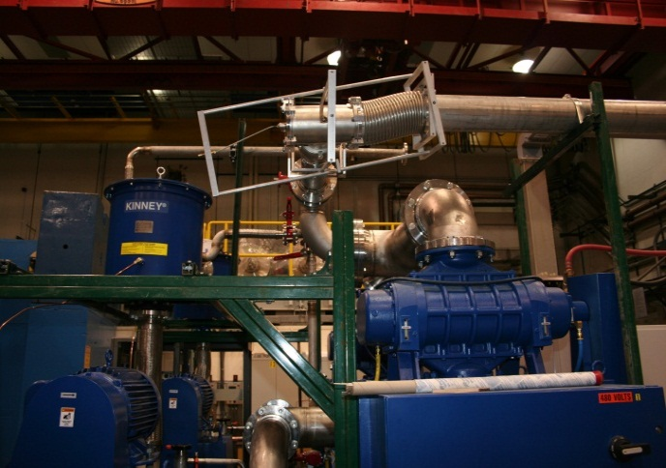
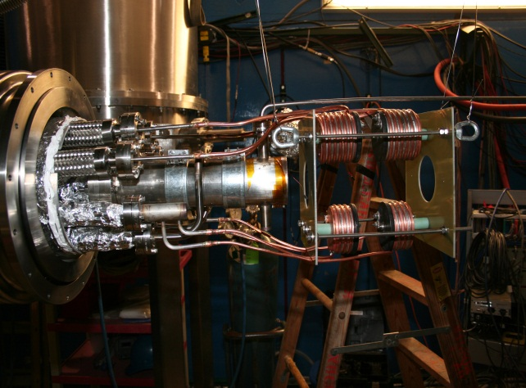
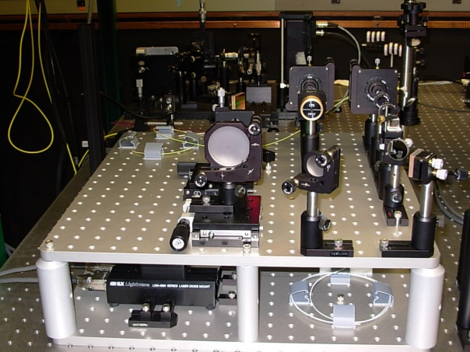
ERL Injector: Technical Components (I)
SRF Injector Cryomodule
135 kW cw Klystrons (e2v)
Cornell ERL cryomodules: An overview
DC Gun
120 W @2k Pumping Skid
Cold Box
Gun Laser

Slide 9
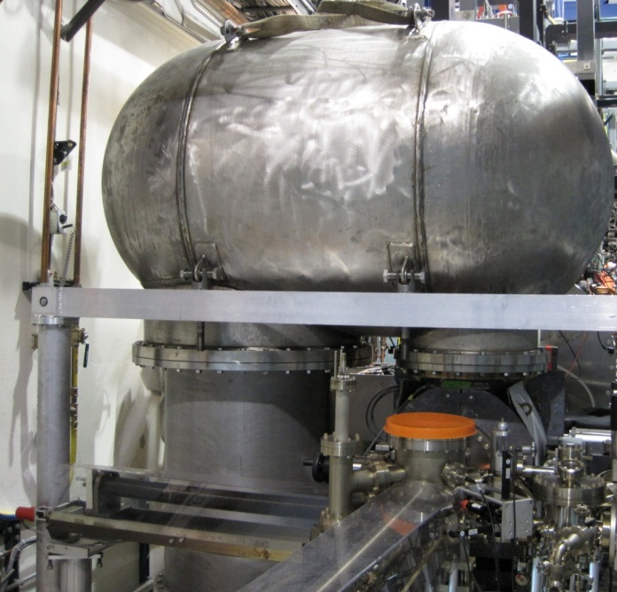
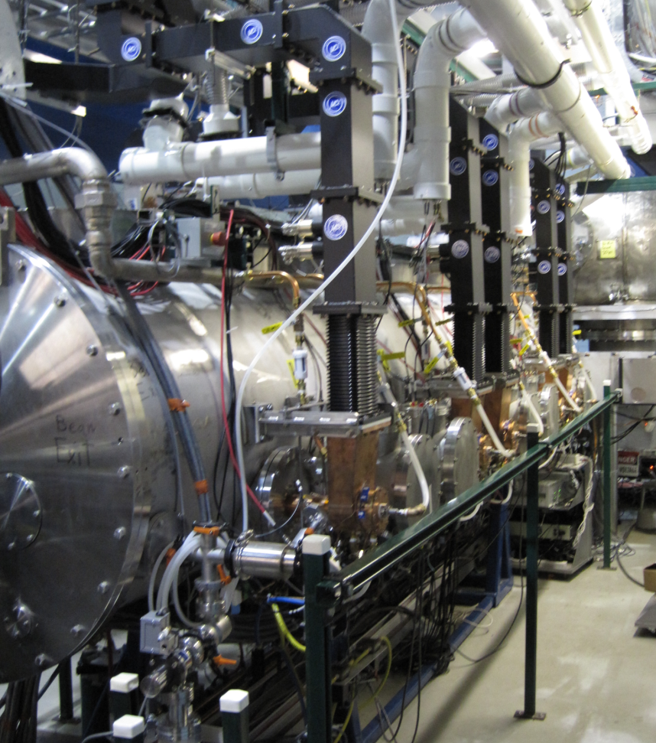
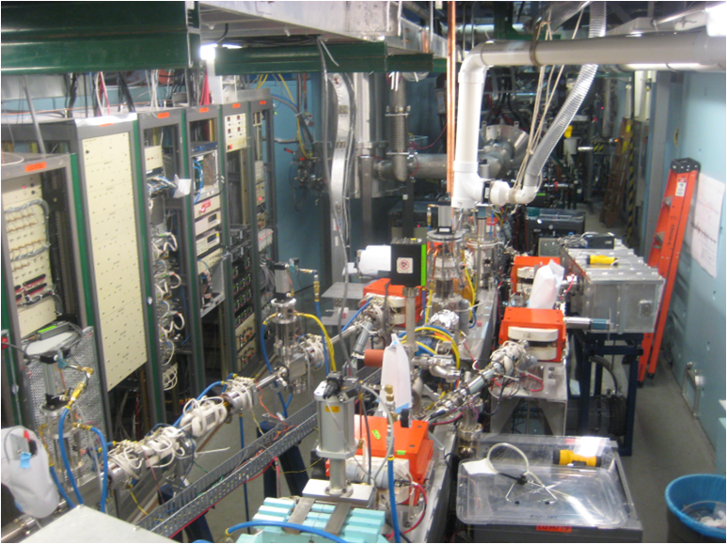
ERL Injector: Technical Components (II)
SF6 tank
DC gun
Cornell ERL cryomodules: An overview
100 mA, 5 MeV SRF module
5 x 2-cell 1.3 GHz cavities
Diagnostics section
emittance measurement systems
deflecting cavity
view-screens
BPMs, BLMs, Faraday-cups, …

Slide 10
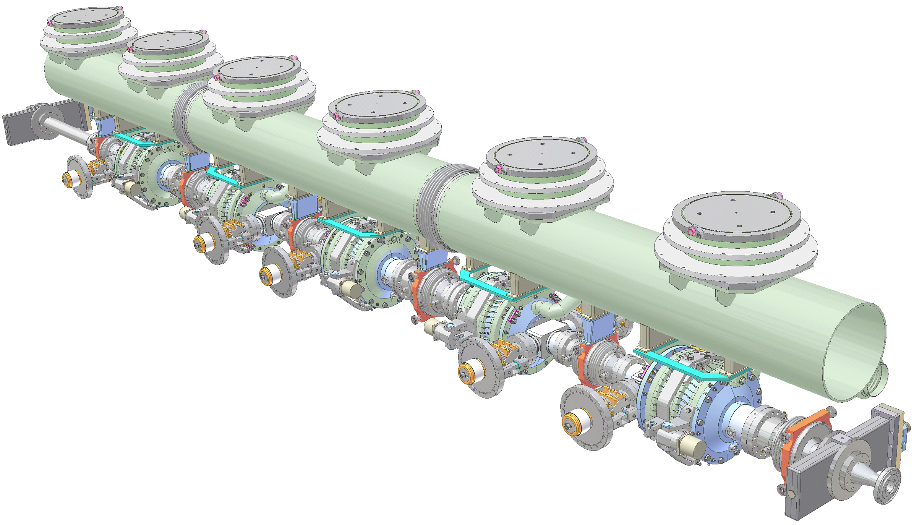
The Cornell ERL Cryomodule
HGRP system with 3 sections
15 feet
Frequency tuner
HOM absorber at 80K
between cavities
Cornell ERL cryomodules: An overview
Twin Input Coupler
1.3 GHz RF cavity
Number of 2-cell cavities 5
Acceleration per cavity 1 – 3 MeV
Accelerating gradient 4.3 – 13.0 MV/m
R/Q (linac definition) 222 Ohm
Qext 4.6×10⁴ – 4.1×10⁵
Total 2K / 5K / 80K loads: 30W / 60W / 700W
Number of HOM loads 6
HOM power per cavity 40 W
Couplers per cavity 2
RF power per cavity 120 kW
Amplitude/phase stability 10⁻³ / 0.1° (rms)
ICM length 5 m

Slide 11
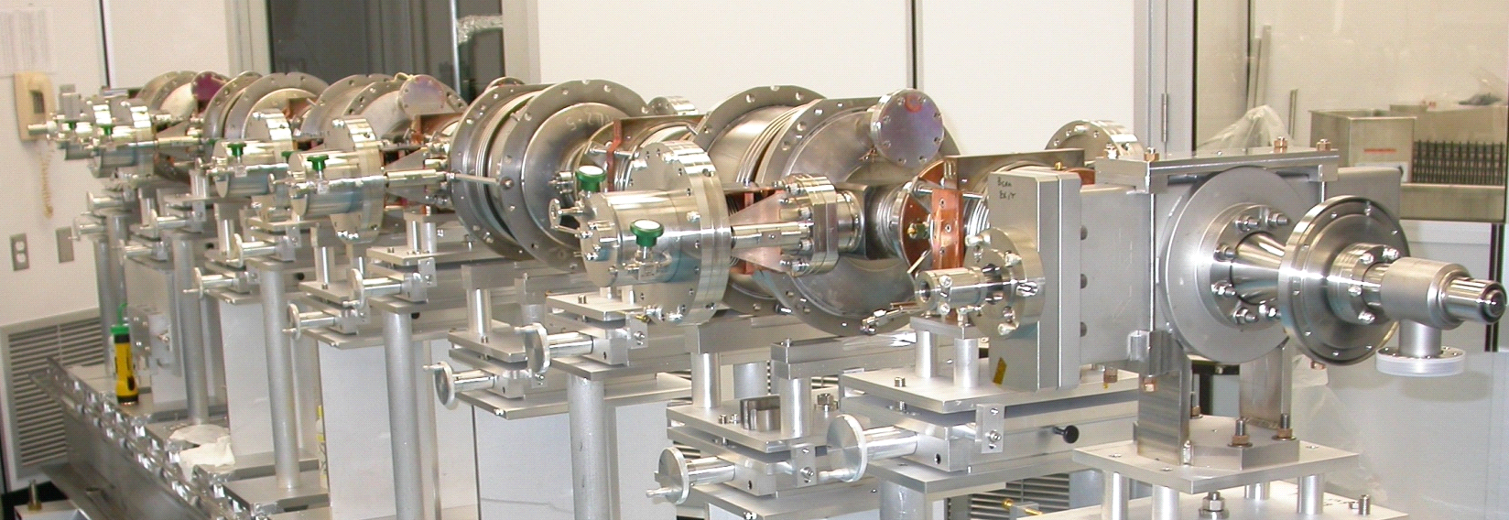
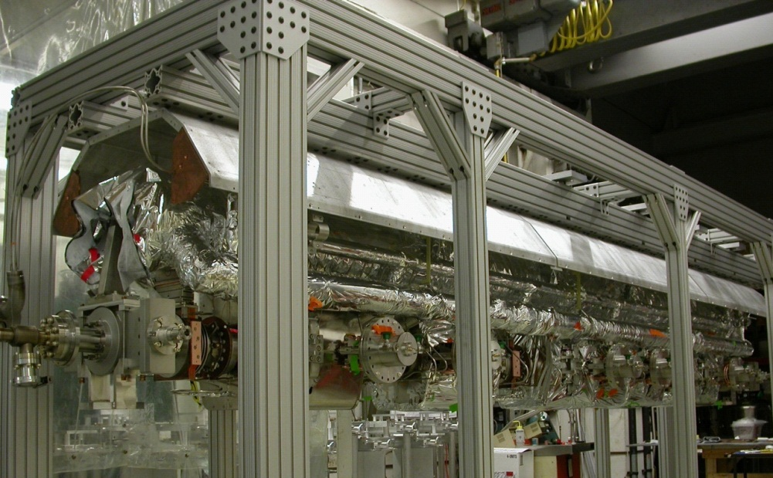
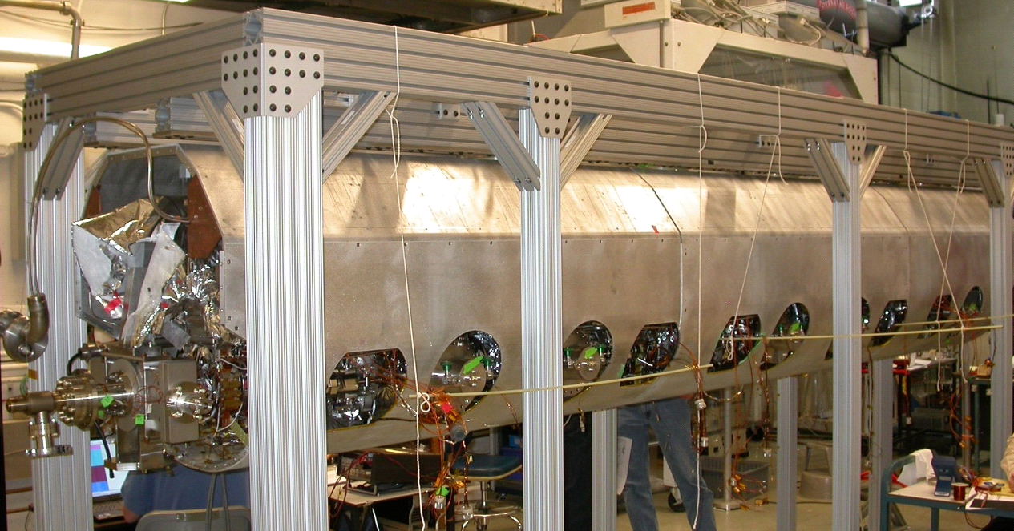

ERL Injector Module Assembly at Cornell
Beamline in clean room
Gate valve internal
Gate valve internal
to cryomodule
to cryomodule
Cornell ERL cryomodules: An overview
Superconducting RF Workshop 2009, September 21–25, 2009
Berlin, Germany
Slide 11
Vacuum vessel interface flange
Cleanroom assembly fixturing
Vacuum vessel interface flange
Cleanroom assembly fixturing
80K shield
Cold mass assembly
80K shield
1100 aluminum
Cold mass assembly
1100 aluminum
1100 aluminum
1100 aluminum
80K shield
80K shield
Instrumentation
80K shield
Instrumentation
5K manifold
80K shield
5K manifold
ports
Beam entrance
ports
Beam entrance
gate valve
2K 2
gate valve
2K 2
-
-
phase pipe
phase pipe
Superconducting RF Workshop 2009, September 21–25, 2009
Berlin, Germany
Slide 11
RF coupler ports
RF coupler ports
Magnetic shield II
Magnetic shield II

Slide 12
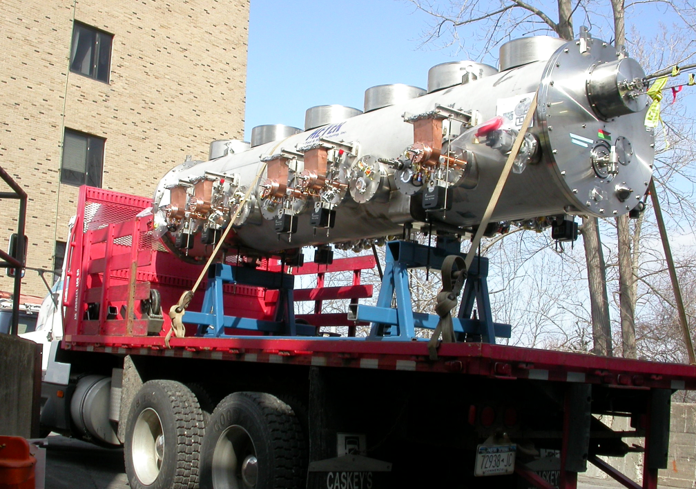
ERL Injector Module Assembly at Cornell
Warm coupler attachment
Transport from Newman Lab to Wilson Lab
Cornell ERL cryomodules: An overview
Insight from the Assembly:
Assembly revealed no significant problems
Fast, easy assembly (once we had all parts)
Fixed cavity alignment concept works well
Full 3D modeling (including assembly drawings) extremely helpful

Slide 13
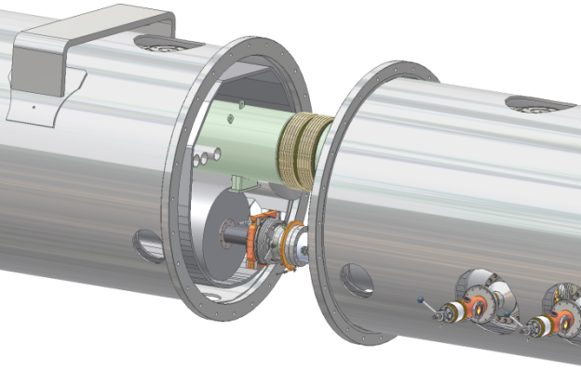
Cornell ERL Main Linac
5 GeV total, 384 cavities
  13 MV per cavity (~16 MV/m)
  64 identical cryomodules, each with 6 cavities and a single quadrupole magnet
Two continuous linac sections:
Cavities per cryomodule | 6
Cryomodules per linac | 35 / 29
# linacs | 2
# cavities | 384
# cryomodules | 64
Cryomodule length [m] | 9.82
Linac length [m] | 344 / 285
Total active length [m] | ~310
Module Filling factor | 0.49
Final energy [GeV] | 5.0
Gradient [MV/m] | 16
Cornell ERL cryomodules: An overview
Linac A = 35 Modules
Linac B = 29 Modules
= 0.25m Cold-warm transition

Slide 14
Cornell ERL Main Linac Cryomodule
HGRP support post
HGRP
~40K thermal shield
Cornell ERL cryomodules: An overview
Superconducting magnet & BPM
Beamline HOM absorber
7-cell cavity
Gate valve
Number of 7-cell cavities 6
Acceleration gradient 16.2 MV/m
R/Q (linac definition) 774 Ohm
Qext 6.5×10⁷
Total 2K / 5K / 80K loads: 76W / 70W / 1500W
Number of HOM loads 7
HOM power per cavity 200 W
Couplers per cavity 1
RF power per cavity 5 kW
Amplitude/phase stability 10⁻⁴ / 0.05° (rms)
Module length 9.8 m

Slide 15
Cavity support and alignment
Cavity support and alignment

Slide 16
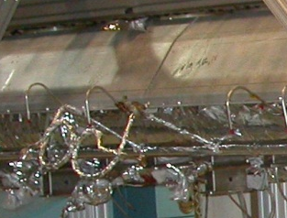
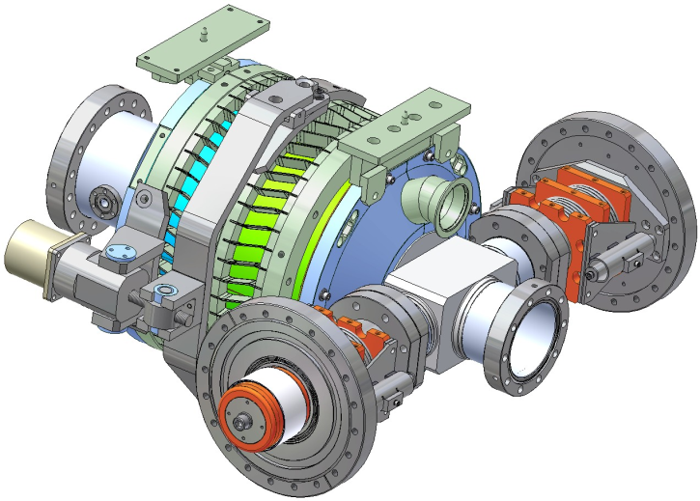
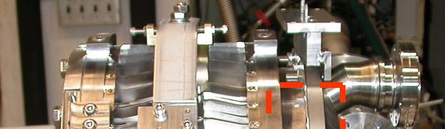
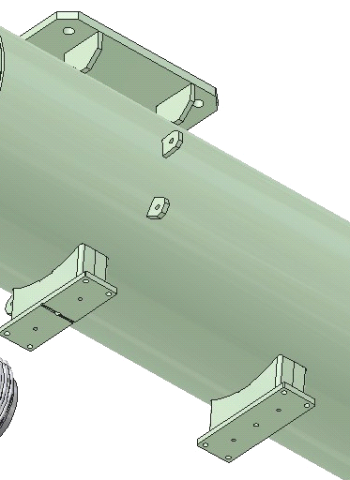
ERL Injector Cavity Support (I)
High precision supports (with keys, pins) on cavities, HOM loads, and HGRP for “self” alignment of beam line components
Only very rough initial alignment is needed when beamline is assembled in clean room
No final alignment needed (excellent warm alignment was verified at injector beamline)
Cavity support and alignment

Slide 17
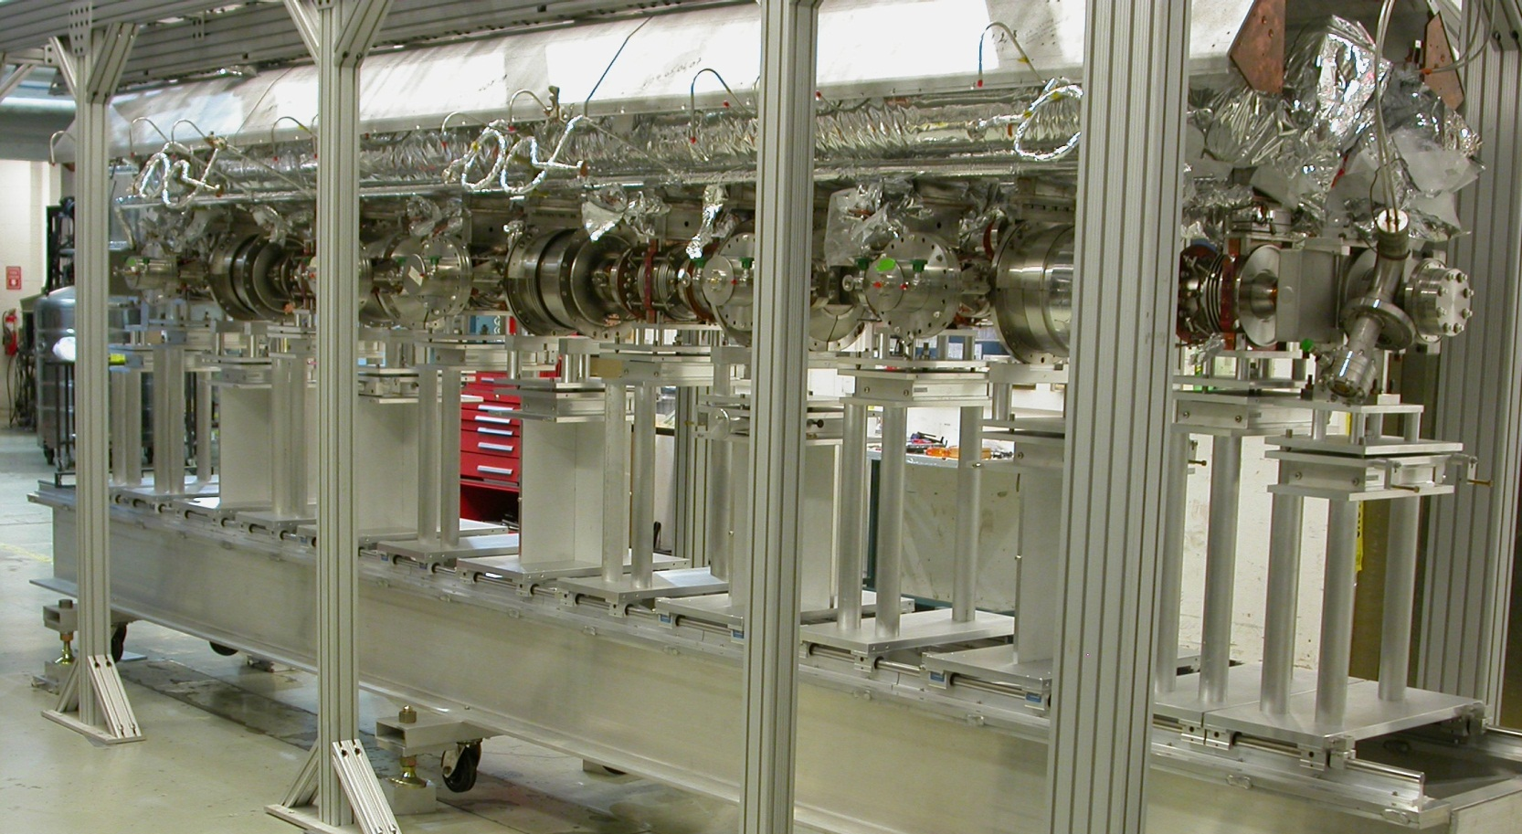
ERL Injector Cavity Support (II)
Cavity support and alignment
String is raised and the precision mounting surfaces on the string and the HGRP are brought together with alignment keys and pins being engaged.
“Self” alignment proved to be quick and easy for the injector beam line (<1 hour)

Slide 18
ERL Injector: Excellent Cavity Alignment
Shift of cold mass (from Wire Position Monitor):
Expected: Δx= 0.38 mm Δy= 0.94 mm
Observed: Δx = 0.58 mm
  Δy = 0.81 mm
Cavity string is aligned to ±0.2 mm after cool-down!
-> Cavity support and alignment concept works very well!
Cavity support and alignment
1.00
0.50
0.00
X1 [mm]
X position [mm]
ERL Injector Cooldown WPM Horizontal
X3 [mm]
-0.50
X4 [mm]
-1.00
X5 [mm]
4/29/08 0:00
4/30/08 0:00
5/1/08 0:00
5/2/08 0:00
Date-Time

Slide 19
ERL Main Linac Cavity Support
Titanium HGRP in two sections (connected by bellow) with 4 support posts per module acts as main support of beam line components
  Simplifies design (fewer bellows, transitions to stainless steel)
  Fewer bellows -> rigid design (good for low microphonics)
  Smaller thermal contraction -> simplifies design
  Sections (and cavities) can be re-aligned at 2K if needed
Beamline is aligned via high precision mounting surfaces on HGRP as in injector module
Cavity support and alignment

Slide 20
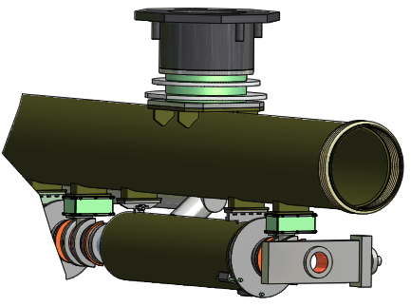
ERL Main Linac Cavity Alignment
HGRP Support post
Simple, fixed high precision supports for the cavities and the HOM loads (bolted to HGRP) as in ERL injector module
ERL main linac uses simple, low power, fixed input couplers
  Easy to include flexibility for transverse deflection
  Cavities can shift longitudinal relative to vacuum vessel by up to 1 to 2 cm
HGRP
Cavity support and alignment
SRF cavity
Fixed, high precision support

Slide 21
Magnetic shielding for high Q₀
Magnetic shielding for high Q0

Slide 22
Magnetic Shields
Excellent magnetic shielding essential for high Q₀ in cw operation (B < few mG at cavities)
Use three layers of magnetic shielding
ERL injector module:
  Magnetic shield on outside of 80 K shield (Stainless steel vacuum vessel)
  Two, spaced layers of magnetic shields on outside of cavity LHe tank
ERL main linac module:
  Carbon steel vacuum vessel
  Inside of vacuum vessel lined with magnetic shield
  Magnetic shields on outside of cavity LHe tank
Magnetic shielding for high Q0

Slide 23
Residual Magnetic Field Measurement at the Injector Test Module (at Room Temperature)
Magnetic shielding for high Q0
B < 3 mG

Slide 24
Cryogenics and thermal shield
Cryogenics and thermal shield

Slide 25
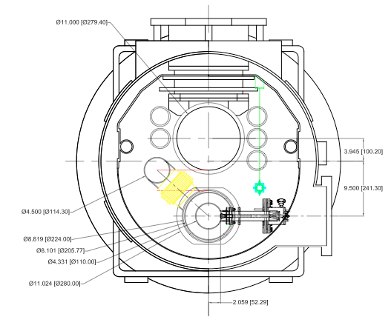
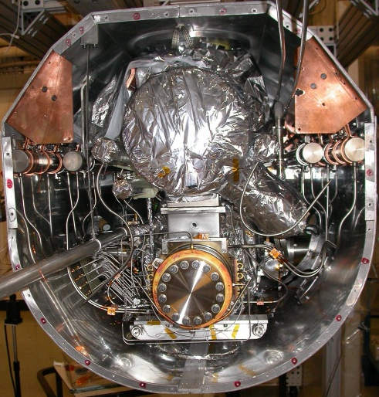
1.8K, 5K, 40 – 80 K Systems
ERL Injector
ERL Main Linac
Support post alignment
40K shield
Vacuum vessel
Support post
Rails
He Gas Return Pipe
Vacuum vessel
5K supply
HGRP
Support post
80K supply
80K return
80K return
80K supply
Cryogenics and thermal shield
5K return
Warm-up/Cool-down tube
2K – 2 phase line
Wire position monitor
HOM support
HOM load
Mumetal
Shields
Cryoperm
Beam axis
= 1.8 K (HGRP, 2-phase, warm-up/cool down, 2K forward)
= 5 K (forward and return)
= 40 – 80 K (3 pipes)

Slide 26
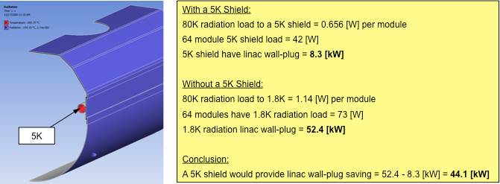
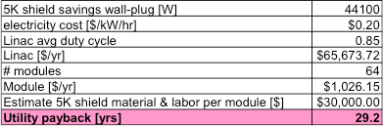
Thermal Shields
One thermal shield at ~40K (grade 1100 aluminum) with extruded supply pipe
No 5K shield (not economical with high 1.8 K loads in cw cavity operation)
Cryogenics and thermal shield

Slide 27
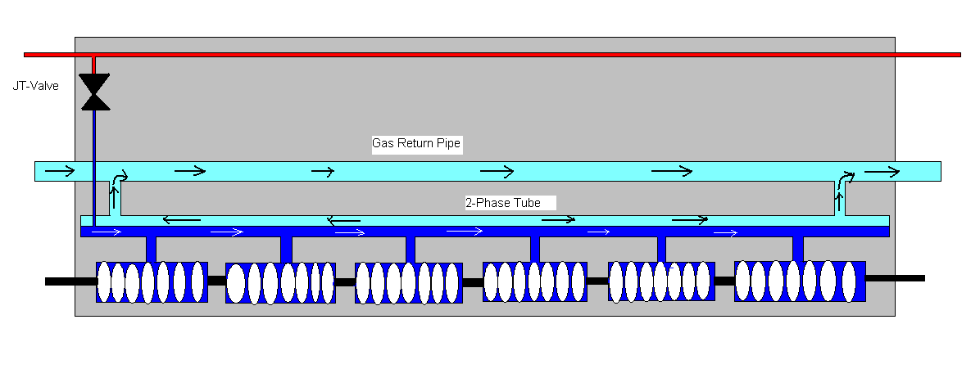
1.8 K System in the Main Linac
  High 1.8K load (~80W) for cw cavity operation
    Individual 2-phase line in each module with JT valve
    Connection from 2-phase line to HGRP in middle of module to symmetrize gas flow and minimize gas velocity (stratified flow!)
    Diameter of 2-phase line and connection to LHe vessel increased to >10 cm to keep gas velocity below 1 m/s and heat flux < 1 W/cm²
Cryogenics and thermal shield

Slide 28
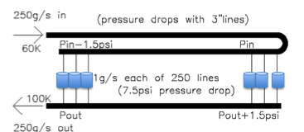
5 K and 40 – 80 K System
Large diameter (~3”) supply lines along entire linac
      3 line layout gives ~uniform pressure drop (and thus flow) though large number (~100) of local heat exchangers, connected to supply lines in parallel)
  Small diameter distribution pipe supply gas to local heat exchangers where needed (copper stripes used to intercepts smaller head loads)
Cryogenics and thermal shield

Slide 29
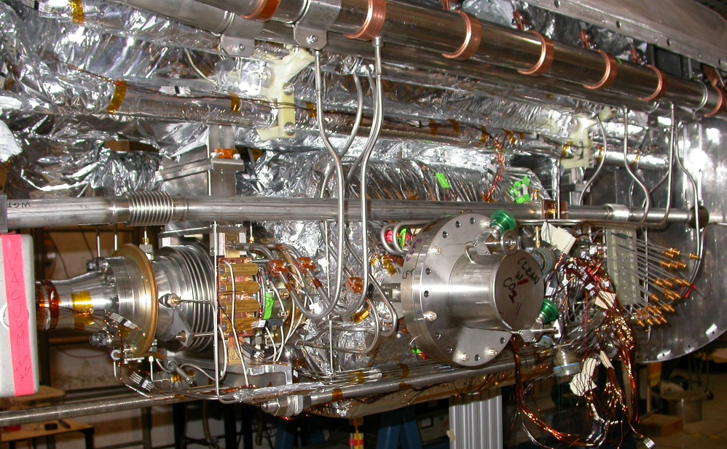
5 K and 40 – 80 K System in the Injector Module
5K supply
80K supply
5K distribution to heat exchanger
80K distribution to heat exchanger
Cryogenics and thermal shield

Slide 30
Mechanical design and microphonics
Mechanical design and microphonics

Slide 31
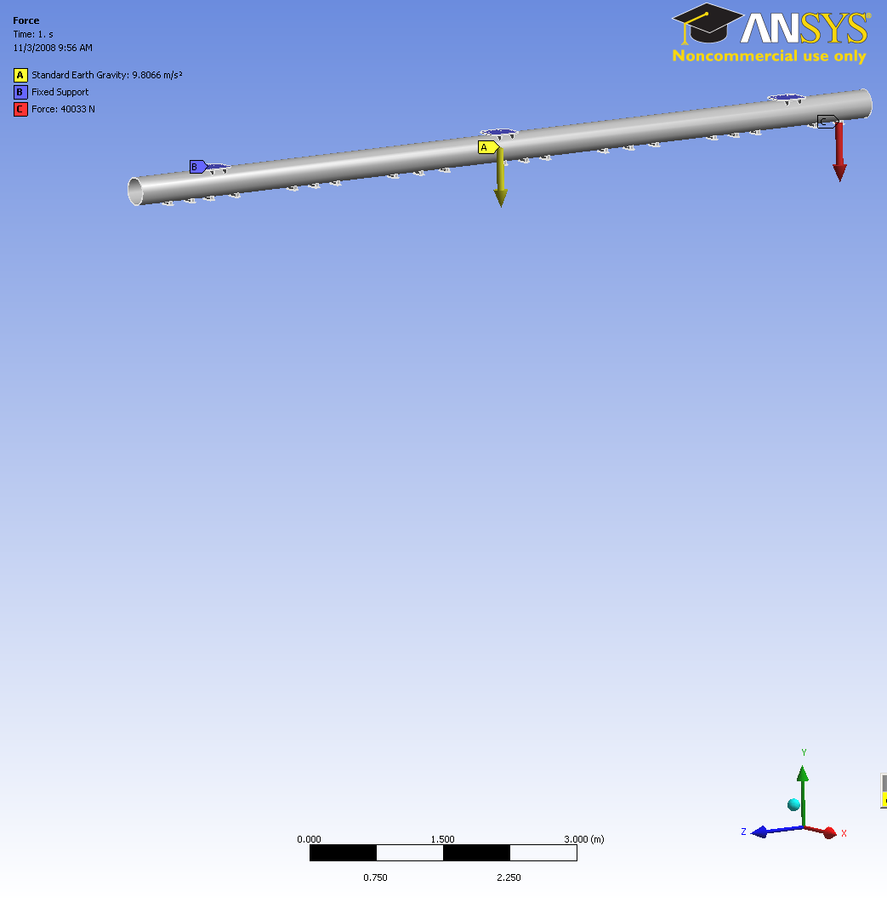
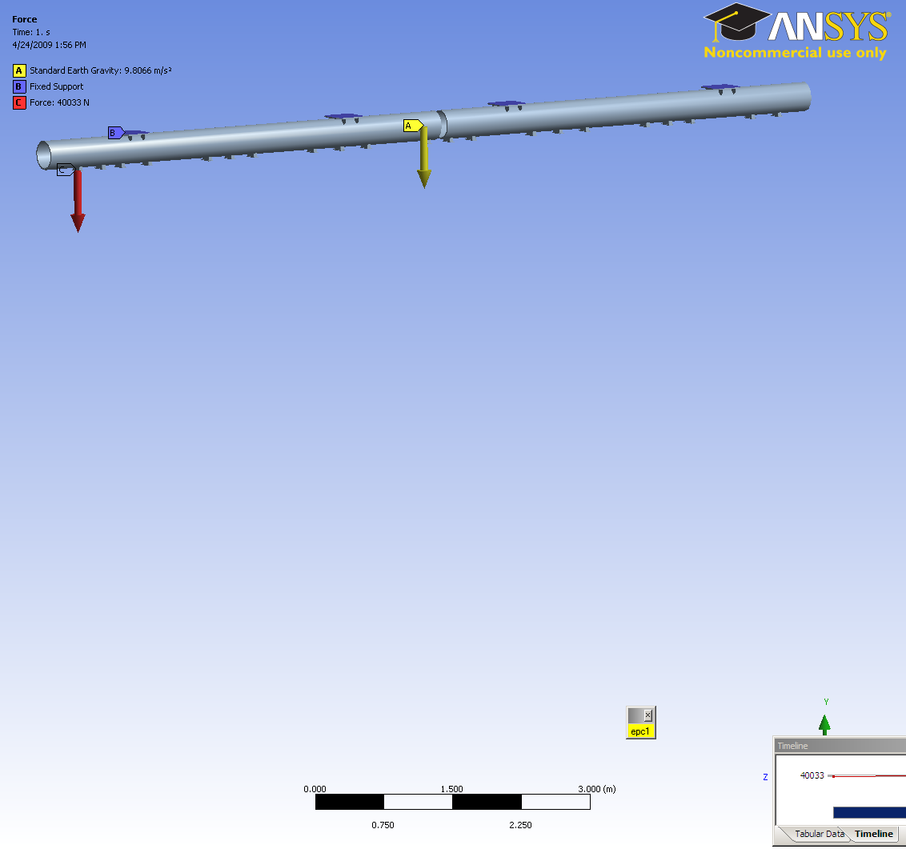
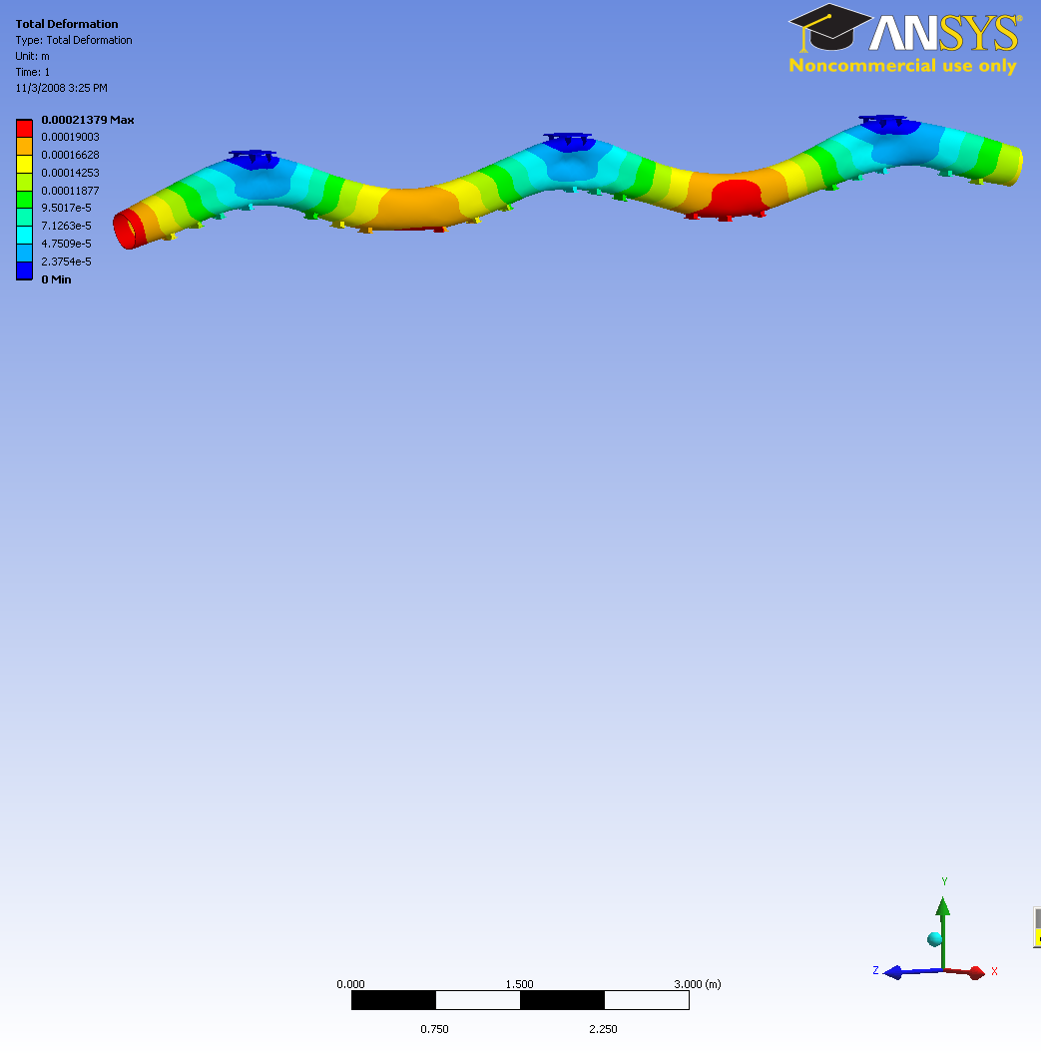
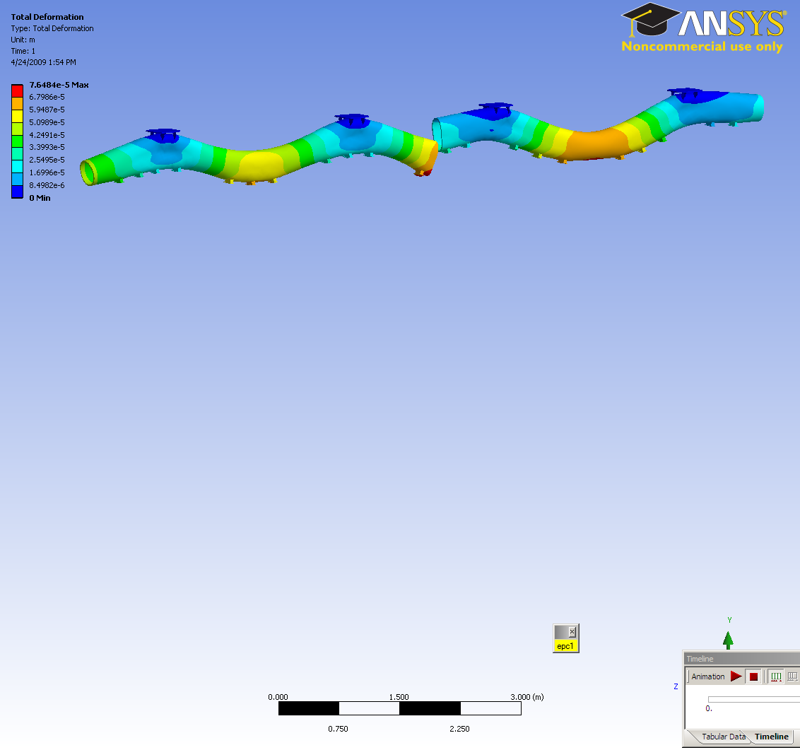
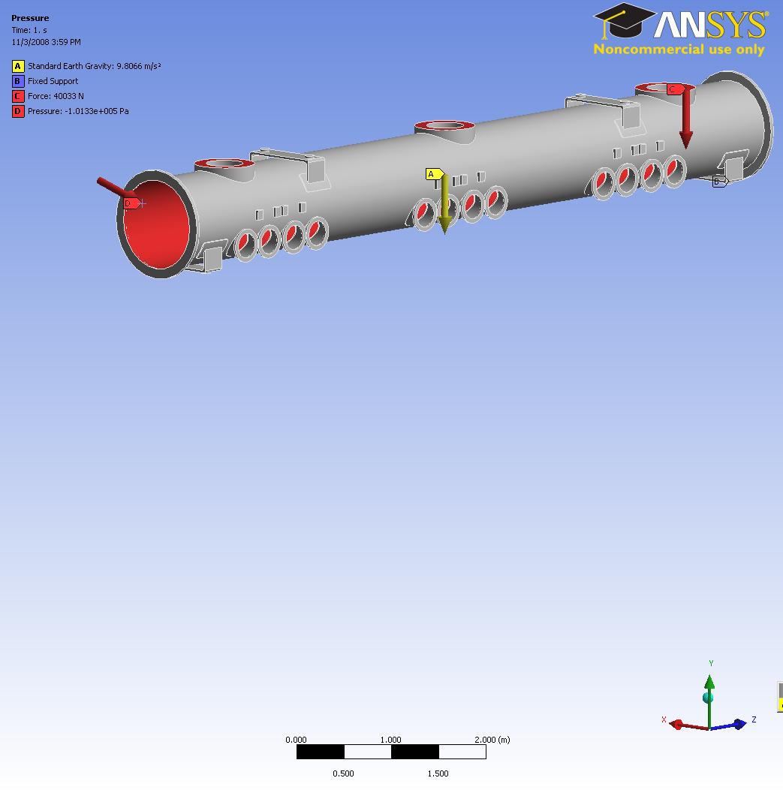
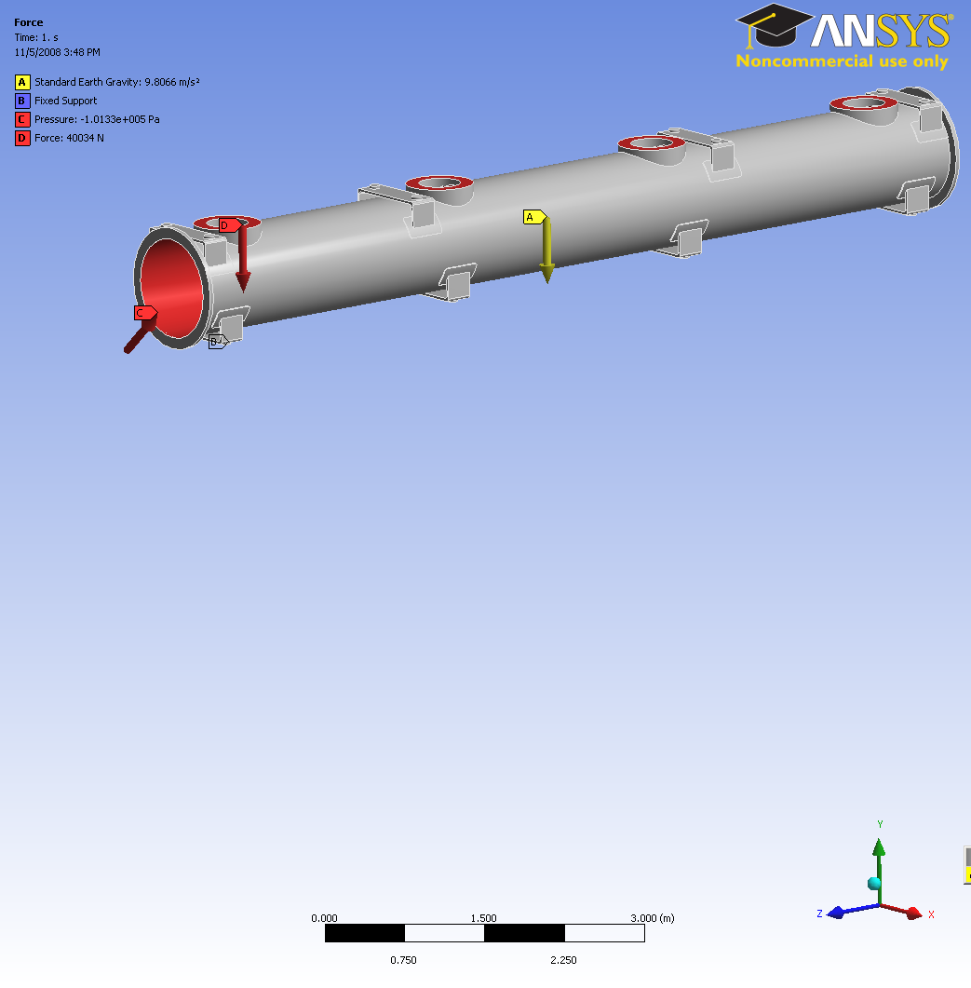
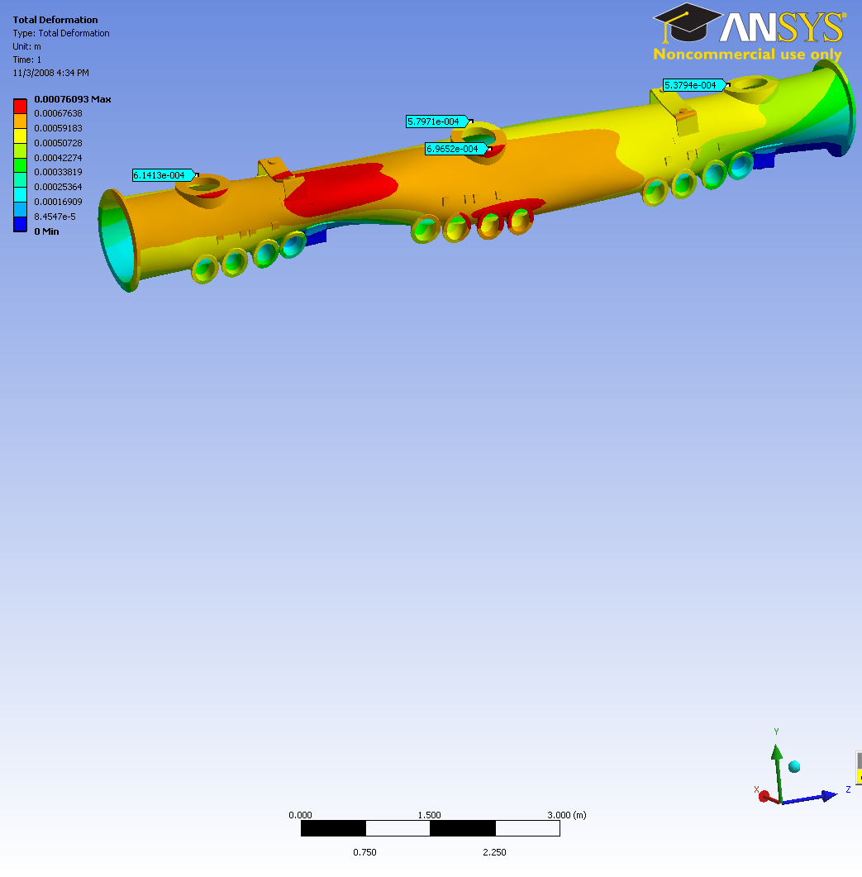
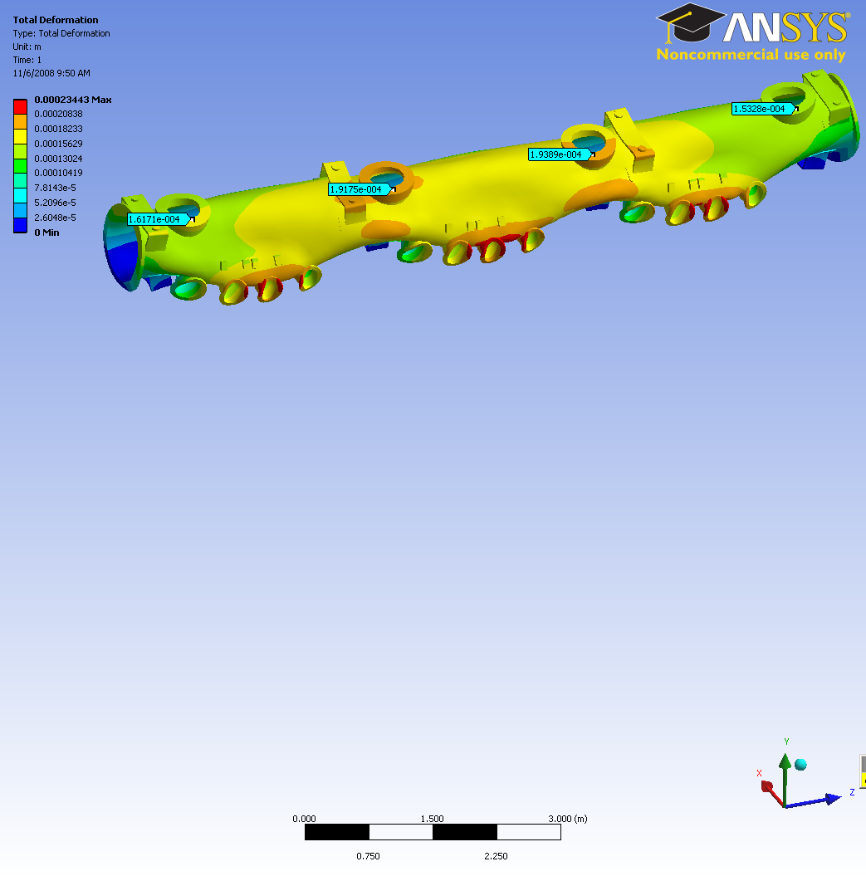
Number of Support Posts
TTF-Type with 3 Supports
4 Supports & Mid-Bellows
Mechanical design and microphonics
HGRP needs to be straight to give good alignment of beamline
4 support posts gives factor of 2-3 smaller deformations of HGRP and stiffer structure with higher mechanical resonances
Two ~ 5 m long HGRP sections per module give minimal deflection of HGRP from weight of beamline (<0.07 mm)
Maximum relative shift at support post flanges on vacuum vessel: 0.05 mm

Slide 32
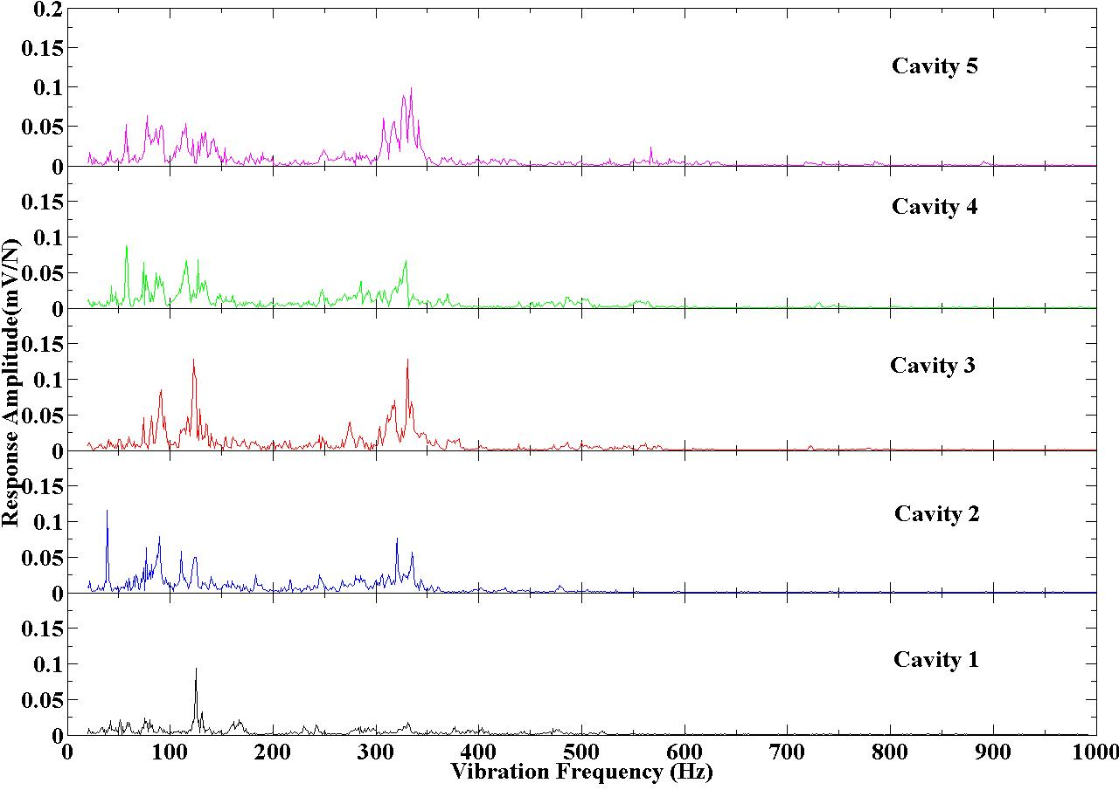
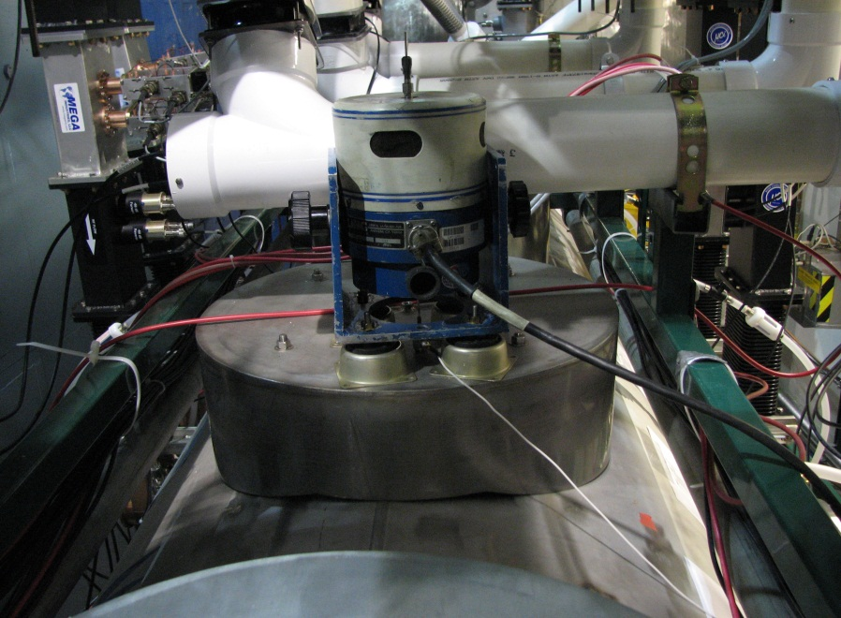
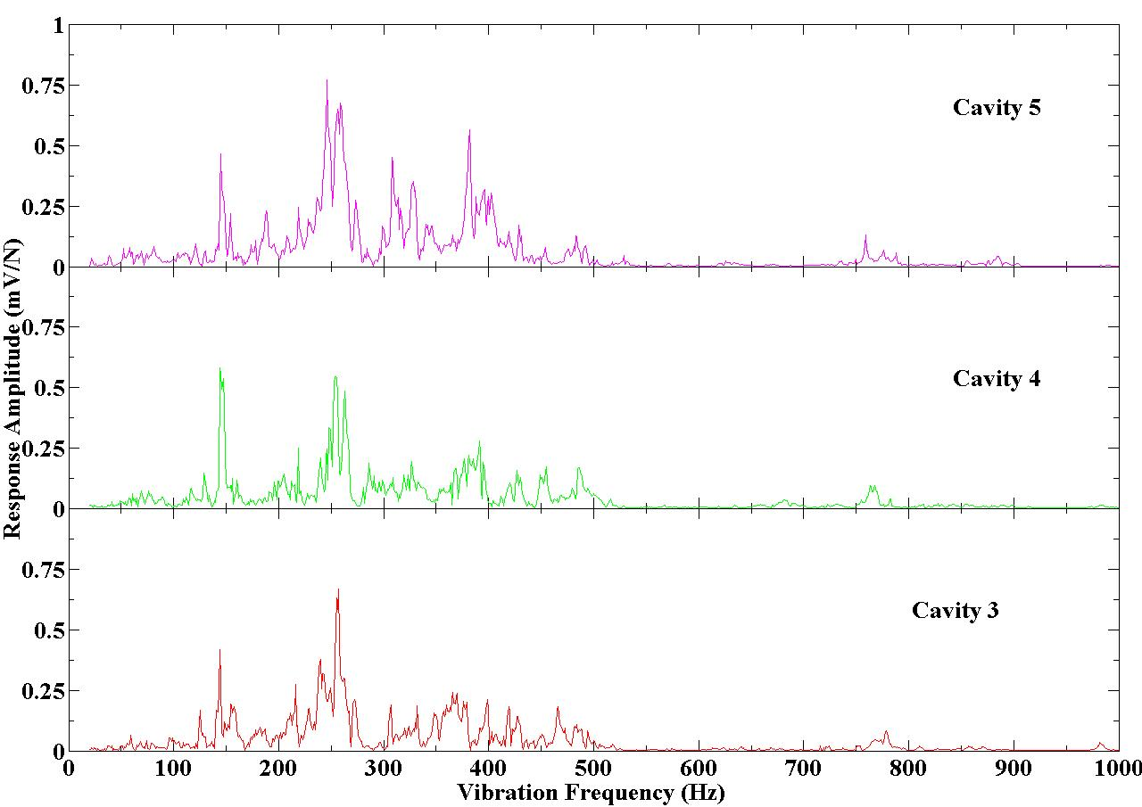
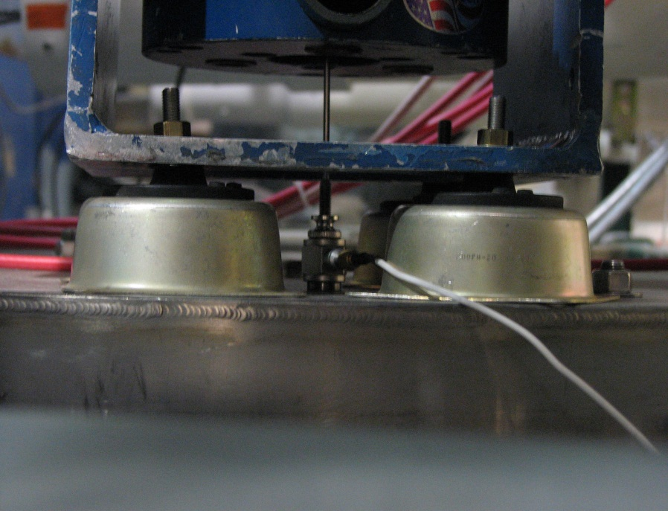
Mechanical Coupling Characterization Measurements with a Modal Shaker
Shaker on module support
Response ampl. [arb. units]
Mechanical design and microphonics
Vibration frequ. [Hz]
Shaker on module top (HGRP support)
Response ampl. [arb. units]
Vibration frequ. [Hz]

Slide 33
Mechanical Coupling Characterization Measurements with a Modal Shaker
Excitation Point | Excitation Force | Detectable With Cavity Accelerometer | Detectable On Cavity RF Frequency (>0.1Hz modul.)
Coupler Waveguide | 110 N (25 lbs) | No | No
Coupler | 110 N (25 lbs) | No | No
Cryomodule Saw-Horse Support | 110 N (25 lbs) | Yes | No
Helium Gas Return Pipe Support | 110 N (25 lbs) | Yes | Yes
Beam Line | 10 N (2 lbs) | No | No
Helium Supply/Return | 110 N (25 lbs) | No | No
Ground vibrations and other mechanical vibrations do not strongly couple to the SRF cavities
Main contribution to cavity microphonics comes from fast fluctuations in the He-pressure and the cryogenic system
Mechanical design and microphonics

Slide 34
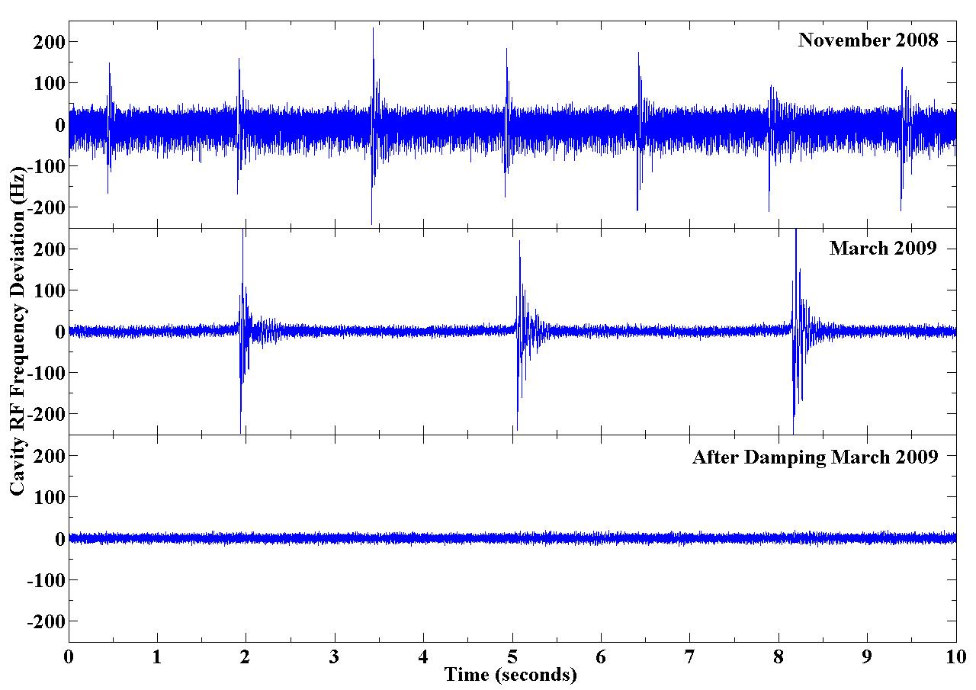
Microphonics driven by the Cryogenic System in the ERL Injector Module: How things can go wrong…
Significant changes over time
Step impulses at second scale rep-rate!?
Mechanical design and microphonics
After setting up flow though warm up – cool down pipe

Slide 35
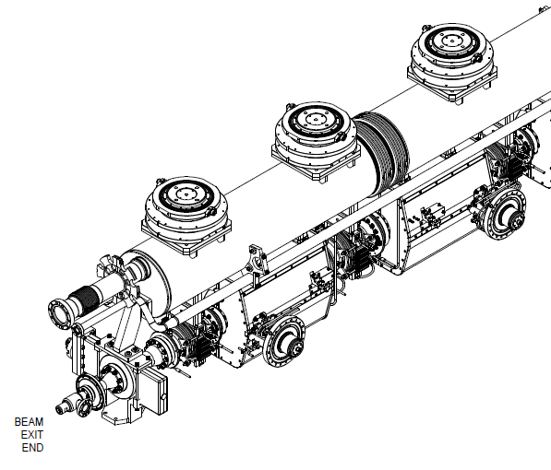
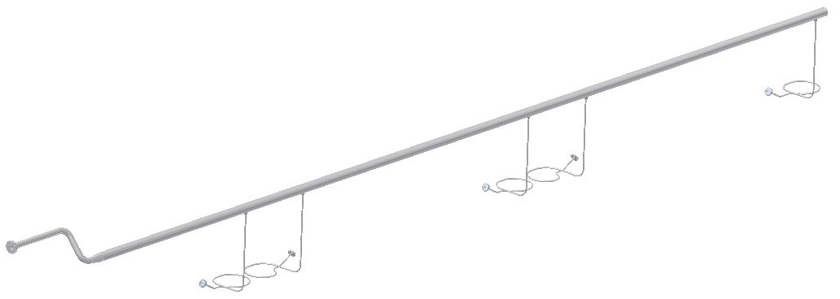
Microphonics driven by the Cryogenic System in the ERL Injector Module: How things can go wrong…
Source of “bursts”:
Thermo-acoustic oscillations in
Warm Up – Cool Down plumbing
Mechanical design and microphonics
Closed end (valve) creates dead end with trapped gas

Slide 36
Other design changes compared to FLASH/XFEL modules
Other design changes

Slide 37
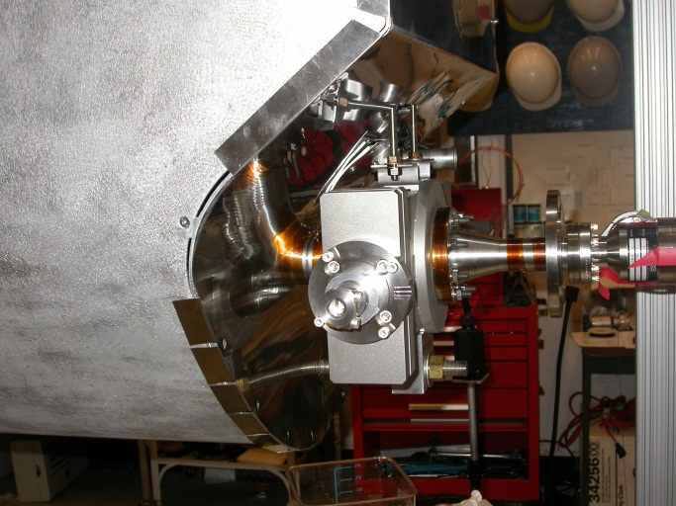
Other changes compared to a TTF cryomodule: Gate Valves
Gatevalves at module ends are inside of module with actuator outside of module
Other design changes

Slide 38
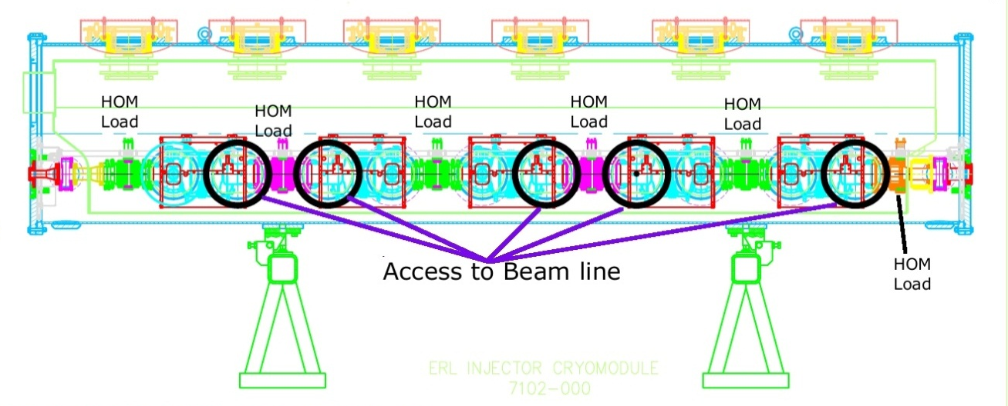
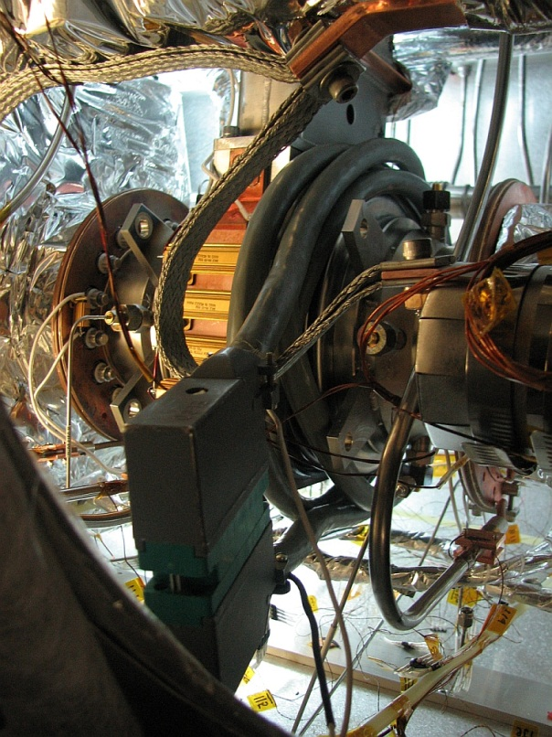
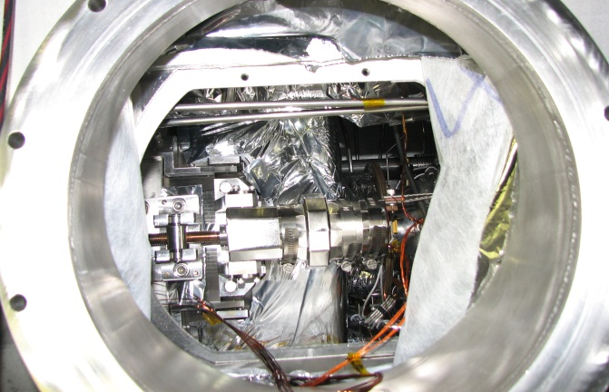
Access Ports in Vacuum Vessel
  Access ports in the vacuum vessel allow the tuner stepper motor, piezos, cables… to be accessible for repair without removing the cold mass
Other design changes

Slide 39
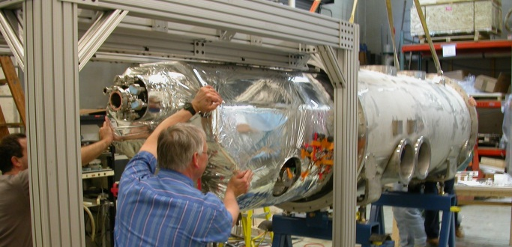
Cold-Mass Rail System
Rails mounted on the inside of the vacuum vessel and rollers on the composite support posts are used to insert the cold mass into the vacuum vessel
Other design changes

Slide 40
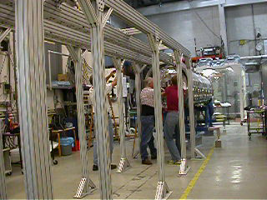
Cold mass rolled into vacuum vessel (ERL Injector)
Other design changes

Slide 41
Summary and outlook
Summary and outlook

Slide 42
Summary and Outlook
ERL injector cryomodule:
  Designed, constructed, and tested
  cryogenics, cavity alignment, cavity voltage, input couplers, LLRF field control, and HOM damping all meet or exceed specs
  25 mA cw beam accelerated to 5 MeV
ERL main linac cryomodule:
  Design underway: fixed, high precision cavity support; 3 layers of magnetic shielding; optimized for low cavity microphonics; cryogenic manifolds for high loads
  Cavity fabrication has started
  Goal: Full module ready for test in ~3 to 4 years
Summary and outlook

Slide 43
End
Thanks for you attention!

