Slide 1



Summary of HOM Workshop at CORNELL
Matthias Liepe
Assistant Professor of Physics
Alfred P. Sloan Research Fellow
Cornell University
Summary of HOM Workshop at CORNELL

Slide 2
Outline
HOM10: Introduction
  Why this workshop and what was covered?
Antenna / loop HOM couplers
Waveguide couplers
Beamline dampers
RF absorbing materials
HOM measurement and simulation tools
Summary of the Summary
Outline

Slide 3
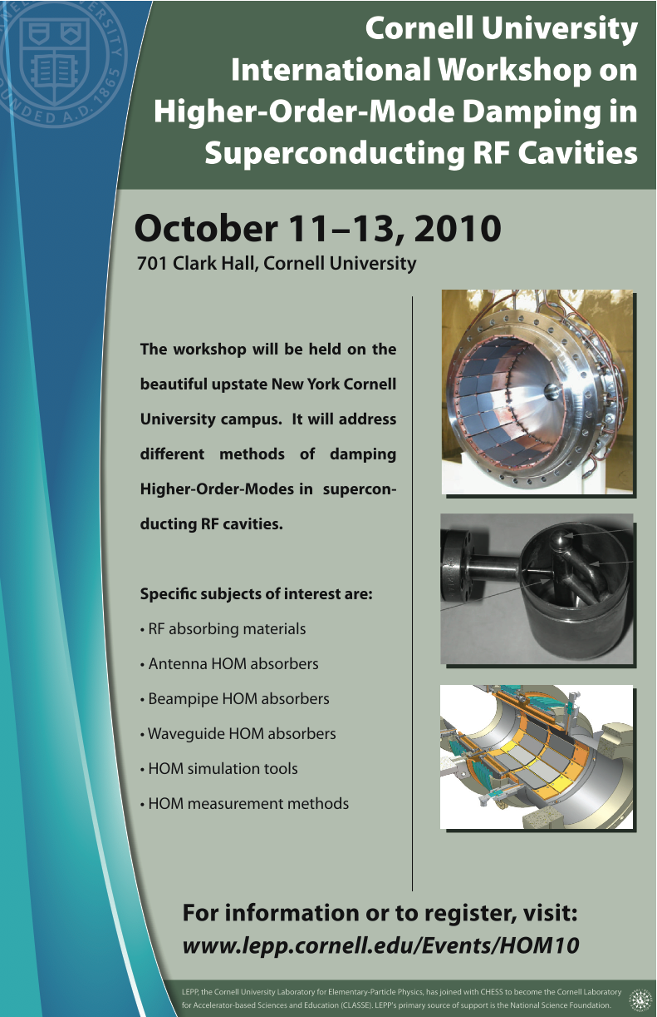
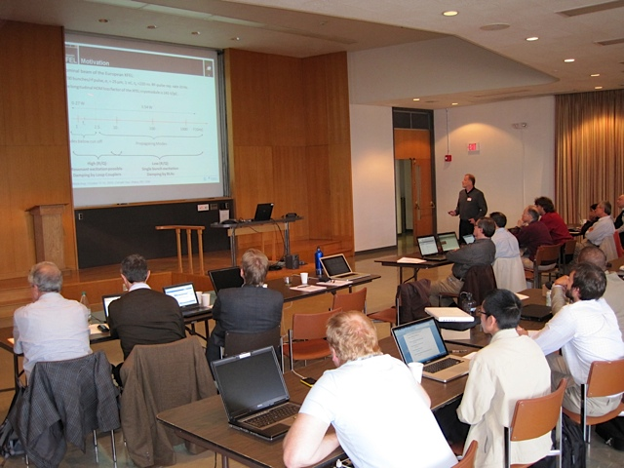
HOM Damping Workshop
October 11 – 13 (2.5 days)
At Cornell University
Topic: Methods of damping Higher-Order-Modes in superconducting RF cavities
Introduction

Slide 4
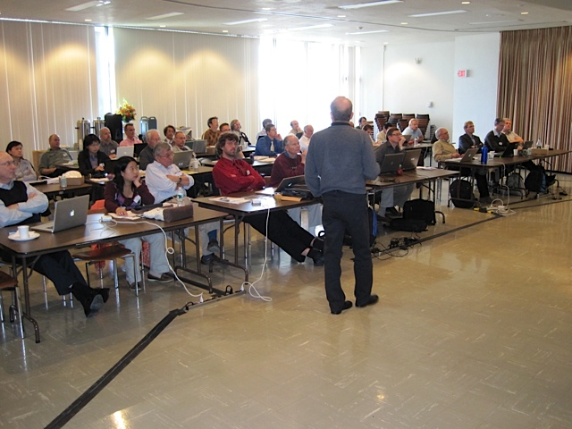
HOM 2010
~40 participants
From 15 different labs/ universities from Asia, Europe and U.S.
Nearly all experts on HOM damping
35 presentations
http://www.lepp.cornell.edu/Events/HOM10/Agenda.html
Introduction

Slide 5
Why this Workshop, why now?
The success of SRF is pushing the beam parameter envelope constantly
  Higher currents
    >1 A in rings
    > 100 mA in linacs
  Higher bunch charges
    Up to 10’s of nC
  Shorter bunches
    Down to 25 μm
Introduction

Slide 6
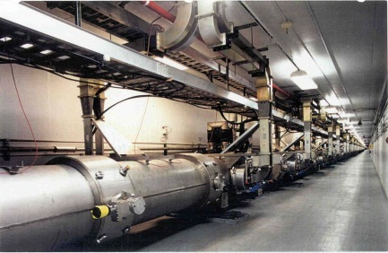
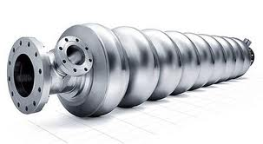
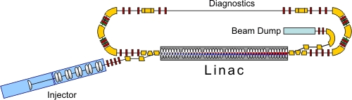
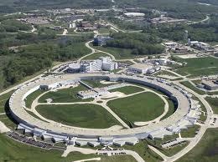
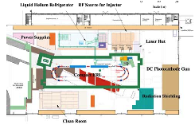
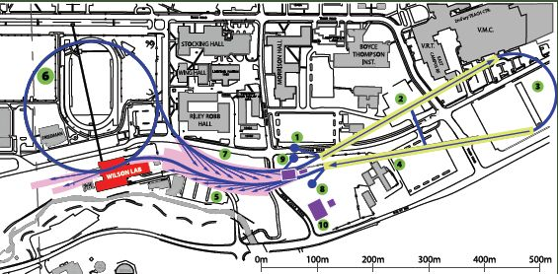
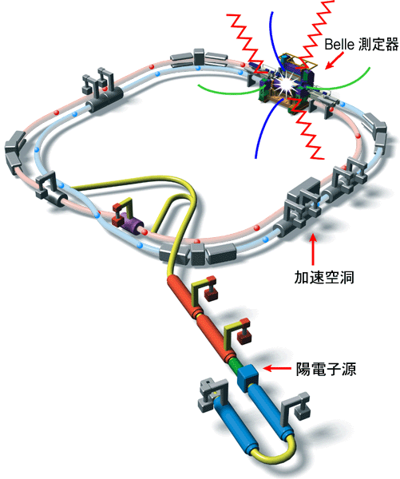
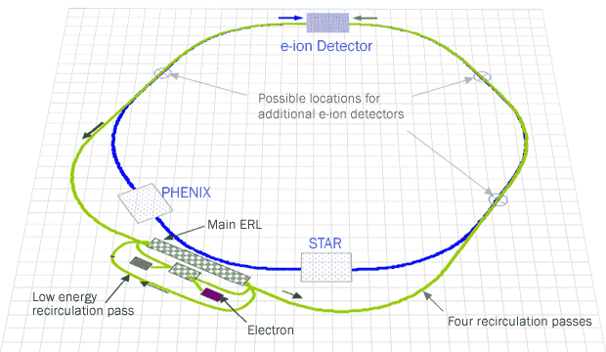
HOM Damping for (Future) SRF Projects
CEBAF Upgrade @TJNAF
Project X @ FNAL
XFEL @ DESY
SPL @ CERN
APS Upgrade SPX @ ANL
BERLinPro @ HZB
KEK-cERL @ KEK
Cornell ERL @ Cornell
eRHIC @ BNL
KEKB @ KEK
Different projects -> different beam parameter -> different HOM damping schemes
Introduction

Slide 7

Beam Current and HOM Damping Requirements
High beam current requires high power handling capabilities of HOM damping scheme
Risk of resonant mode excitation and beam stability require strong HOM damping by HOM damping scheme
Project | Beam current [mA] | Average HOM power per cavity [W] | Required monopole Q < | Required dipole Q <
CEBAF 12GeV | 0.10 | 0.05 | 1.40E+09 | 1.50E+09
Project X | 1 | 0.06 | 2.00E+07 | 1.00E+09
XFEL | 5 | 1 | 1.00E+05 | 1.00E+05
SPL | 40 | 22 | 1.00E+04 | 1.00E+07
APS SPX | 100 | 2,000 | 5.00E+02 | 2.00E+02
BERLinPro | 100 | 150 | 1.00E+04 | 1.00E+04
KEK-CERL | 100 | 185 | 1.00E+06 | 1.00E+04
Cornell ERL | 100 | 200 | 5.00E+03 | 1.00E+04
eRHIC | 300 | 7,500 | 1.00E+04 | 4.00E+04
KEKB | 1,400 | 15,000 | 1.00E+02 | 1.00E+02
Introduction
$P_{avg}=k_{||}QI$

Slide 8
Bunch Length and HOM Damping Requirements
Project | Bunch length [ps] | 90% HOM power below [GHz]
APS SPX | 40 | 4
KEKB | 25 | 9
eRHIC | 7 | 25
SPL | 4 | 17
Project X | 3
BERLinPro | 2 | 45
KEK-CERL | 2 | 52
Cornell ERL | 2 | 50
CEBAF 12 GeV | 0.30
XFEL | 0.08 | 100
Short bunch length requires broadband HOM damping scheme: few GHz to tens of GHz
Introduction

Slide 9
HOM Damping Challenges
Depending on project, the HOM damping scheme must
  Efficiently handle high power up to several kW per cavity
  Provide very strong HOM suppression of monopole, dipole, quadrupole modes with Q=100 - 10,000
  Be broadband (up to ~100 GHz)
  Be inexpensive / require little beam line length
Luckily, usually not all of these are required at the same time
Different requirements - > different solutions
Introduction

Slide 10
HOM10: Damping Schemes Covered
Antenna / loop HOM couplers
Waveguide HOM dampers
Introduction
RF absorbing materials
Beamline HOM loads

Slide 11
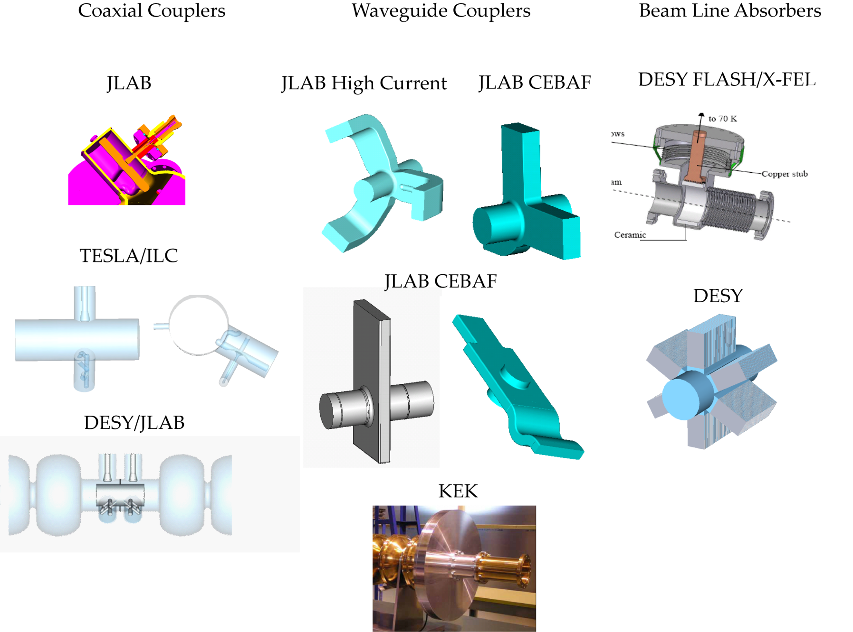
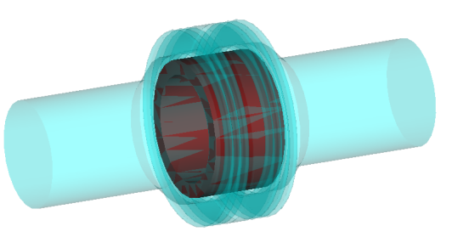
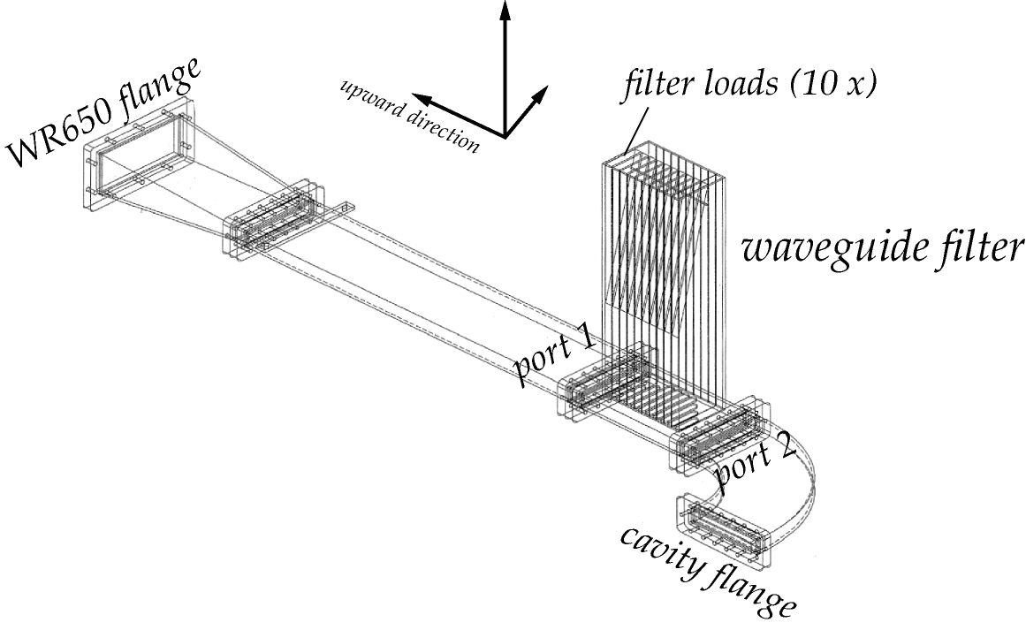
HOM Damping Efficiency: A Comparison by F. Marhauser
Cornell ERL
F. Marhauser
CEBAF filter

Slide 12
Antenna / Loop HOM Couplers
10 Talks presented:
  HOM Damper and Filter Design for 56MHz SRF Cavity for RHIC (Qiong Wu)
  HOM Damping Properties of Fundamental Power Couplers in the SC Electron Gun of the Energy Recovery LINAC at BNL (L. Hammons)
  Capacitive-Antennae HOM Damper (H. Hahn)
  New HOM coupler design for High Current Superconducting cavity (W. Xu)
  Experience with 3.9 GHz loop couplers (T. Khabiboulline)
  Heating in DESY style HOM couplers in cw operation (J. Sekutowicz)
  Heating of HOM loop couplers in CW mode (W.Anders/A.Neumann)
  HOM damping variations in SRF cavities (F. Marhauser)
  Optimization of HOM Couplers using Different Time Domain Schemes (C. Potratz)
  Computation of Coupler Damping Properties in Concatenated Arrangements (H.-W. Glock)
Projects: BNL ERL, FLASH, XFEL, CEBAF upgrade
Antenna / Loop HOM Couplers

Slide 13
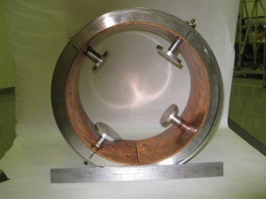
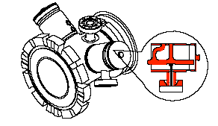
Why consider Antenna HOM Couplers?
Require no extra beamline length
  But filter is needed to suppress coupling to fundamental mode
Easy to clean
HOM power can be absorbed at room temperature
Antenna / Loop HOM Couplers

Slide 14
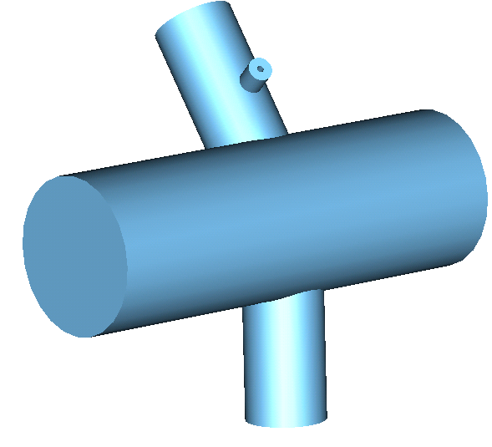
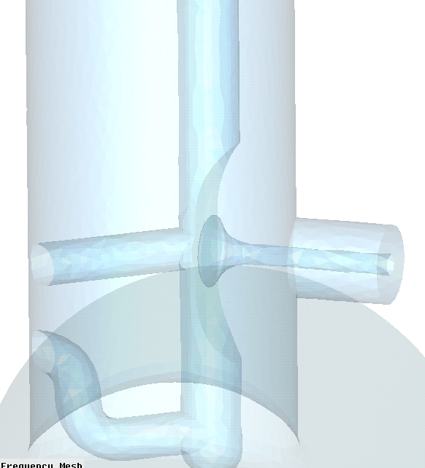
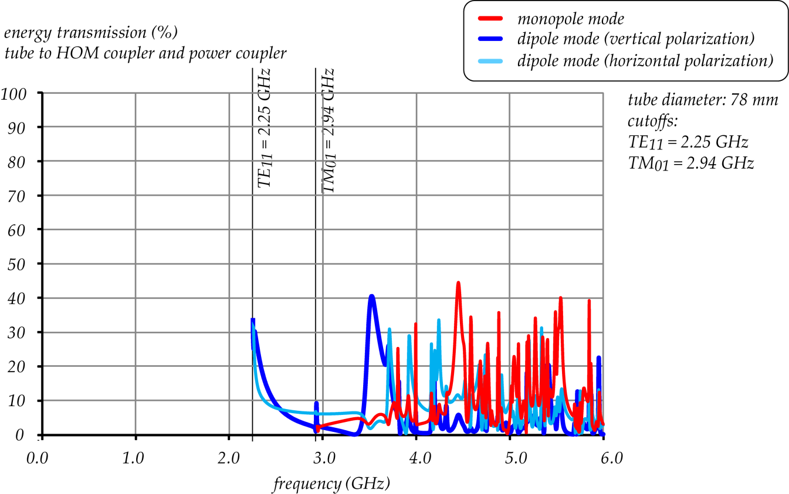
HOM Damping Efficiency: A Comparison by F. Marhauser
HOM loop coupler:
Imbalance between horizontal and vertical dipole mode damping (not good)
Performance depends strongly on HOM frequency
RF feedthrough also impacts broadband performance
Poor coupling at high frequencies
power coupler
actually horizontal
F. Marhauser

Slide 15
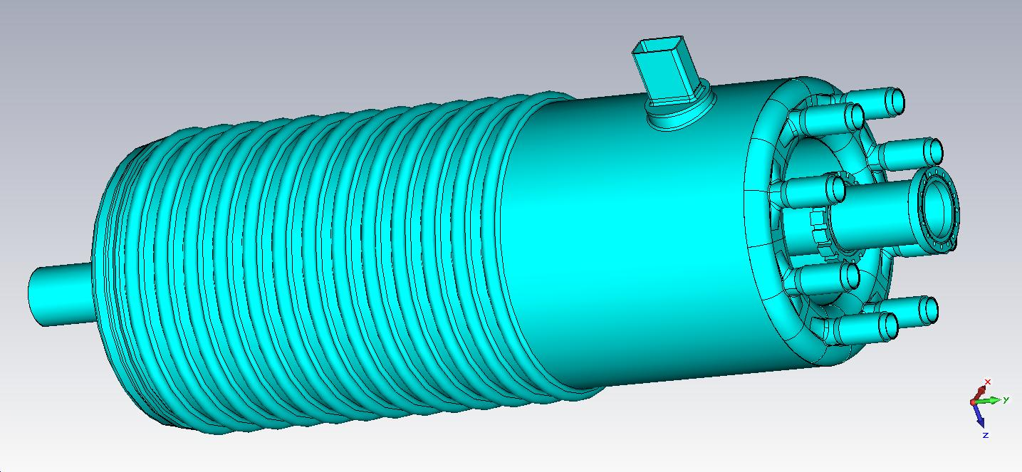
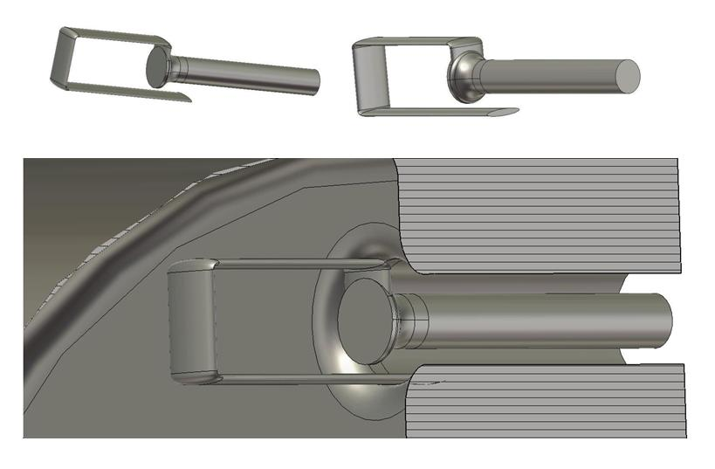
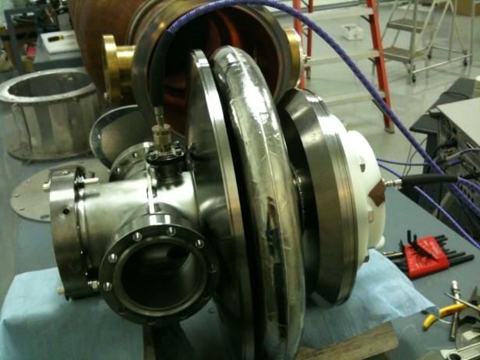
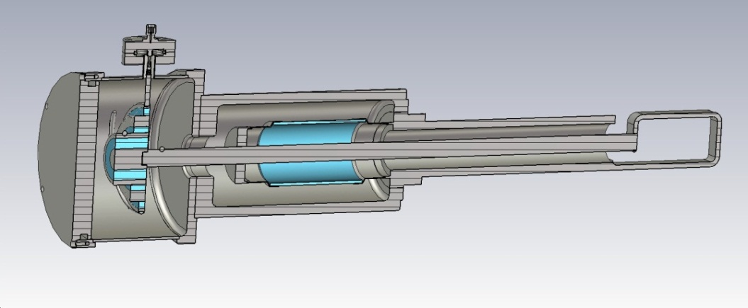
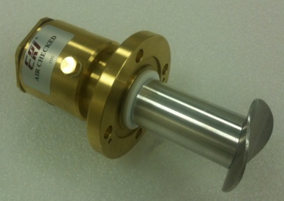
BNL QWR HOM and FPC Coupler
BNL Gun HOM Coupler
HOM damping by BNL fundamental power coupler
Qiong Wu, L. Hammons
HOM coupler for 56 MHz QWR
Chebyshev high-pass filter reduces coupling to fundamental mode
HOMs couple significantly to fundamental power coupler
HOM power must be intercepted in FPC waveguide with little reflection

Slide 16
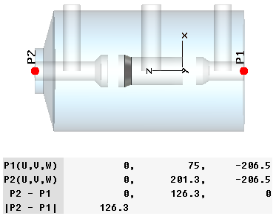
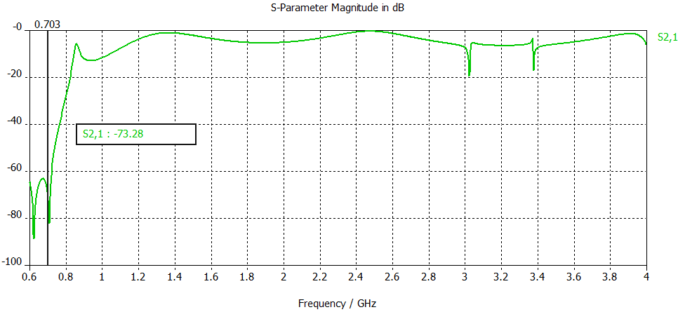
Capacitive and 2-Stage HOM Couplers
BNL Capacitive HOM Couplers
BNL 2-stage HOM Coupler Filter
50 Ω transmission line to room temperature
D=72mm
H. Hahn, W. XU
HOM couplers provide good damping of lower frequencies HOMs (Q of 1e2 to 1e5)
Filter needs to be added to suppress coupling to fundamental mode
HOM couplers provide good damping of lower frequencies HOMs (Q of 1e2 to 1e5)
Filter to suppress coupling to fundamental mode

Slide 17
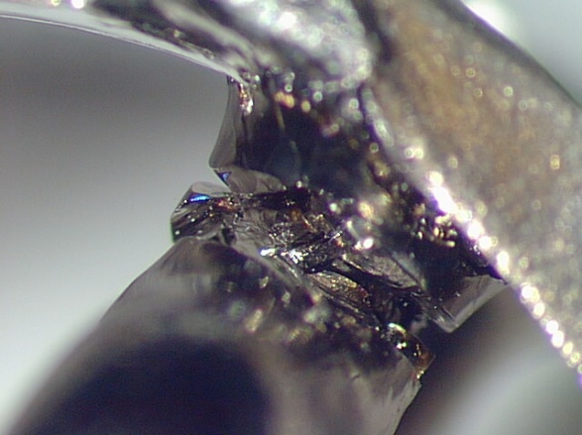
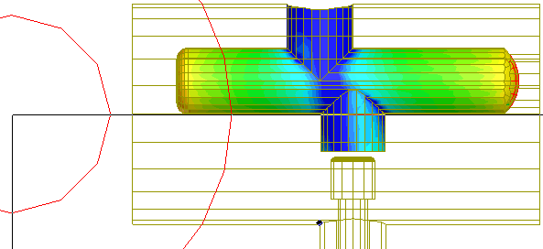
Risk of Multipacting and Fracture
3.9 GHz FNAL cavities for FLASH:
Initial problems with the HOM coupler in 3.9 GHz cavity (MP→overheating→ fracture)
Solution: New designs (one or two legs) reduce MP, field level in coupler and improved thermal properties
Also observed MP in SNS couplers
T. Khabiboulline
1-post design
F₂=4400 MHz

Slide 18
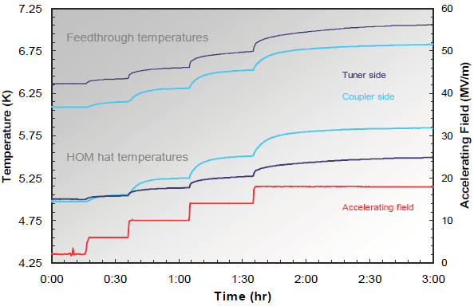
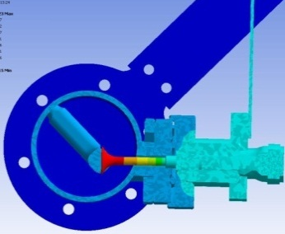
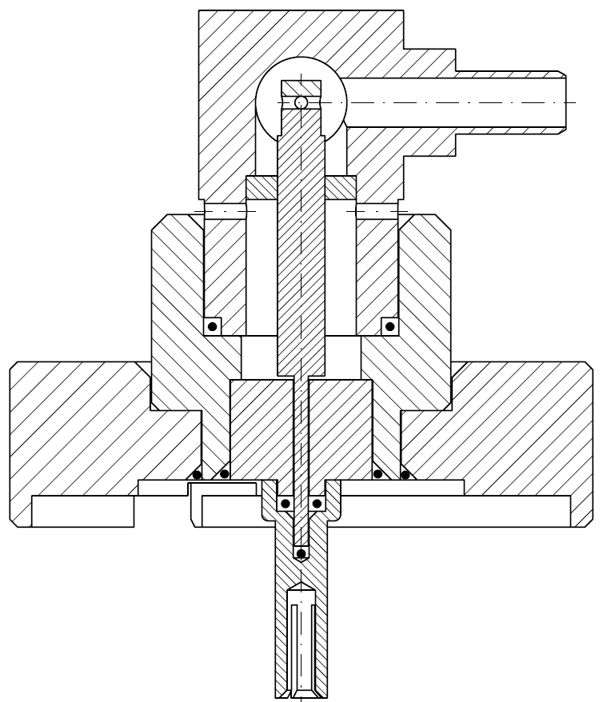
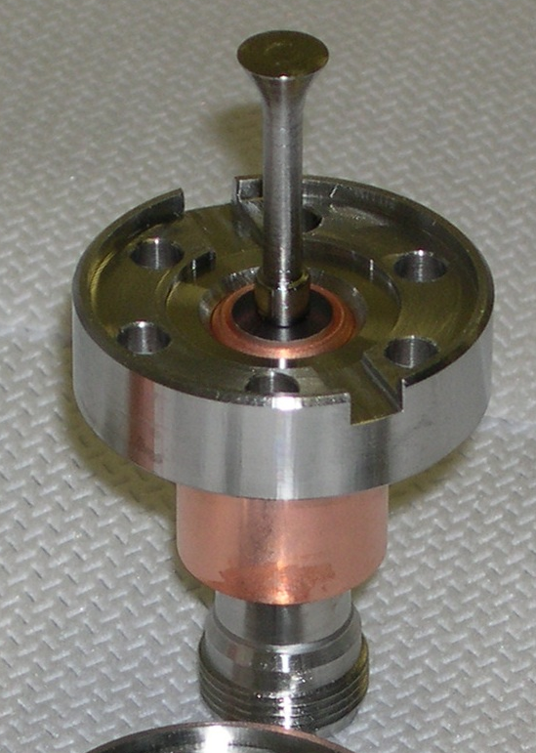
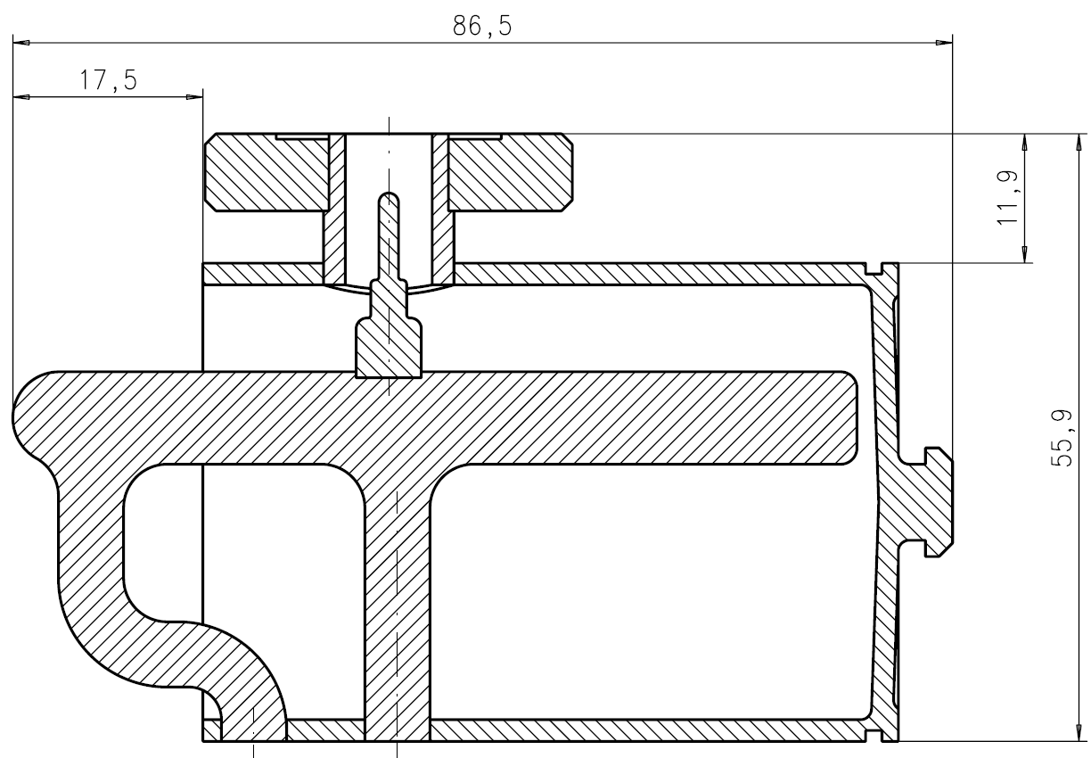
Thermal Issues in CW operation
Pick-up „sees“ a small part of the accelerating field
  Heating (<< 1 W)
  HOM feedthroughs with Saphire window are essential for sufficient cooling of inner conductor in CW mode
Pick-up cables are a significant source of heat! These need a thermal anchor and/or low conductivity cables must be employed
Modified coupler geometries (JLAB, DESY) reduce temperature increase further
J. Sekutowicz, W. Anders

Slide 19
From Closeout Discussion:
Antenna / Loop Couplers
Parameter | Current status | Improvement needed | Goal
Frequency range | 3 x fundamental | Feedthrough, Geometry | 6 x fundamental
Power | 100 W | Transmission line needs improvement | 1 kW
Q-factors | Monopole: 1e3 (100 for single-cell); Dipole: 1e5 (100 for single-cell); Quadrupole: 1e9 (quads – limited by field in end-cells) | For Quads: improve cell to cell coupling, cell geometry, reduce number of cells, fluted tube (KEK) | Quads: 1e8 – 1e5
Eacc (CW) | 15 MV/m (KEK); 20 MV/m (mod. TTF); > 38 MV/m (CEBAF) | Coupler design, Feedthrough thermal conductivity
Filling Factor | good
Cleaning | No problem (demonstrated by TTF)
Mechanical issue | Sensitive to tuning; Sensitive to MP & FE bombardment; Feedthrough issues | Use high-pass filter for tuning
Thermal | Low cryogenic load
Long term reliability | good (TTF, HERA); poor (SNS)
Cost | 25 kEUR (5 loop couplers including LHe cooling)
Coupler kicks | Must symmetrize
Other issues | losses in transmission cable at higher HOM powers -> heating of antenna and feed through?
Antenna / Loop HOM Damper

Slide 20
Waveguide HOM Dampers
Talk presented:
  Waveguide HOM damping studies at JLAB (R. Rimmer)
Project: TJNAF ERL studies
Waveguide HOM Dampers

Slide 21
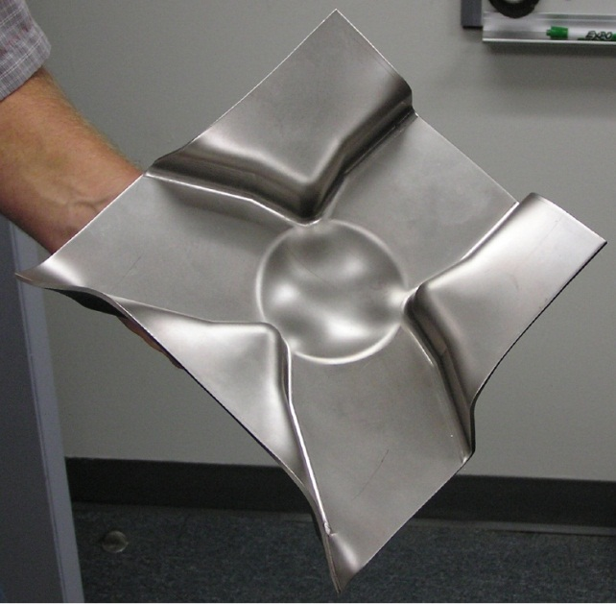
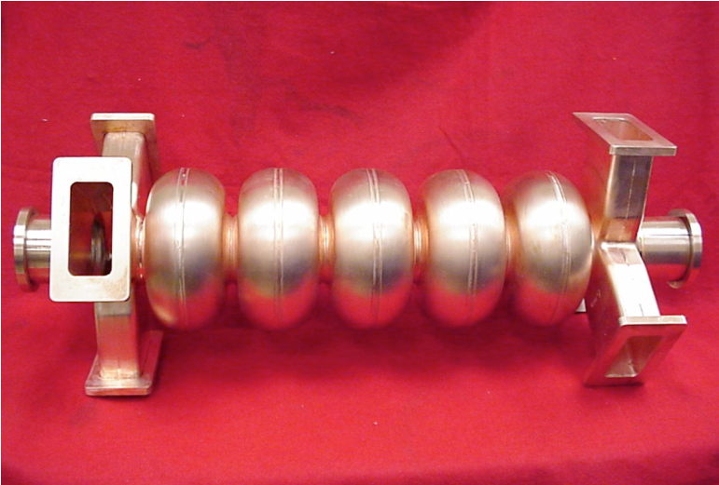
Why consider waveguides?
Waveguide is a natural high-pass filter
High power-handling capability
Small beamline length required
Loads can be at higher temperature
Good experience at PEP-II and CEBAF
Easy to fabricate
R. Rimmer et. al. HOM10

Slide 22
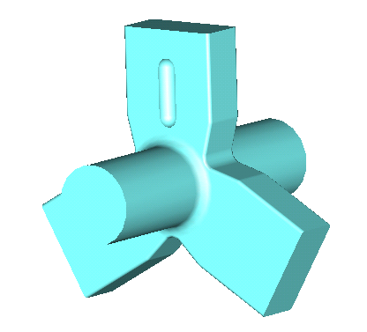
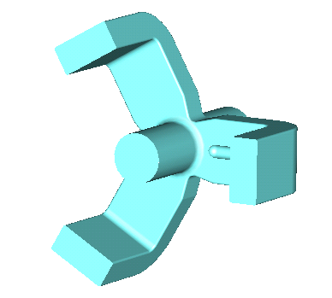
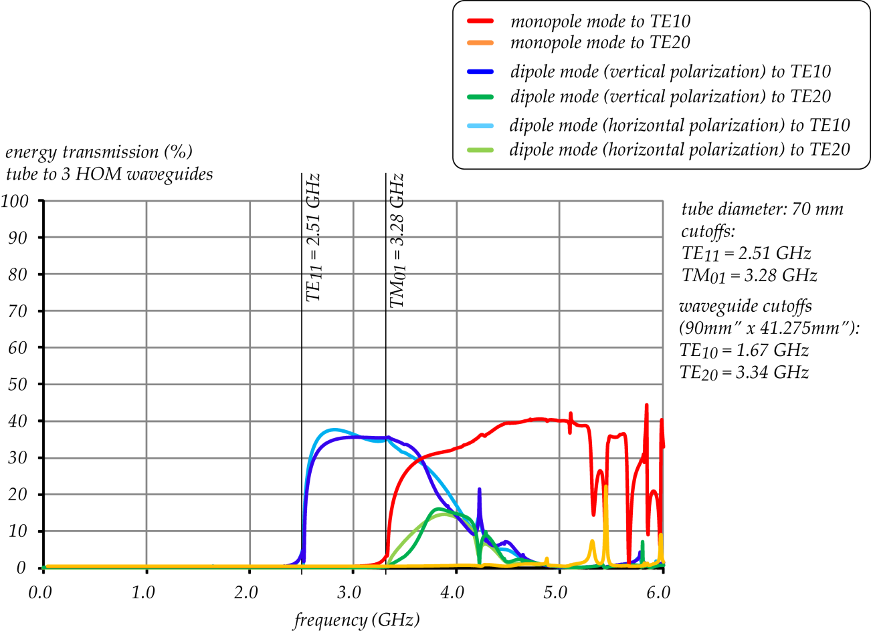
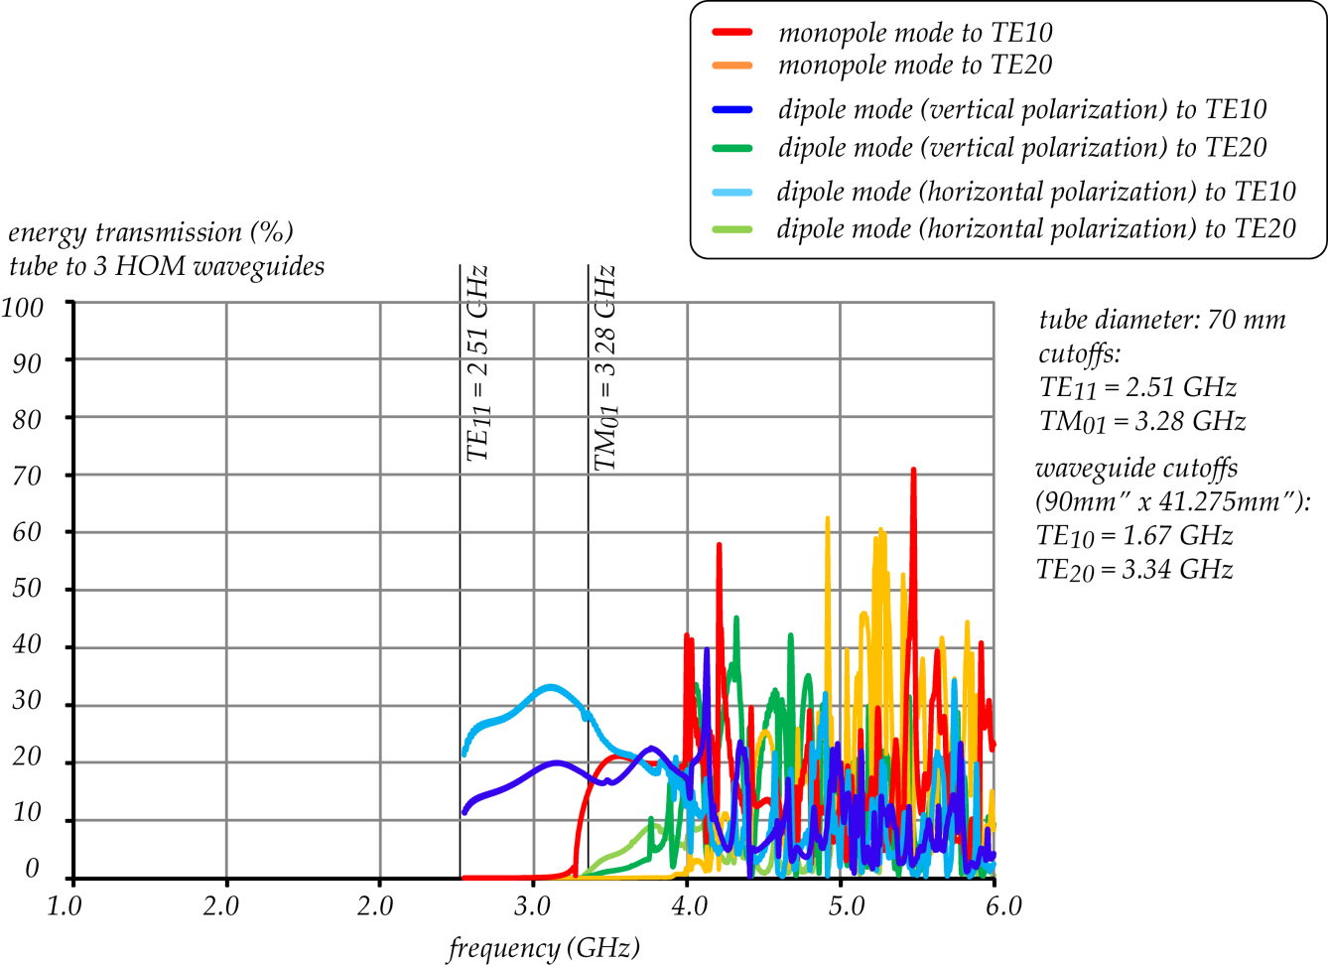
HOM Damping Efficiency: A Comparison by F. Marhauser
F. Marhauser
Waveguides give effective, smooth and broadband performance
But: performance depends on waveguide length

Slide 23
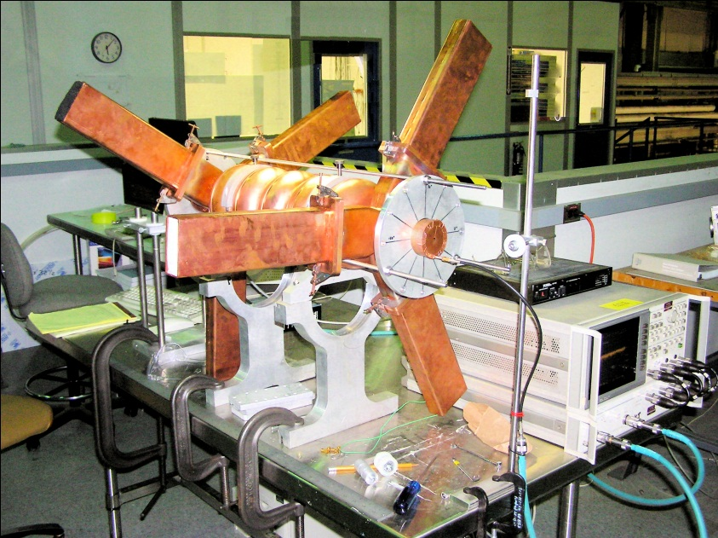
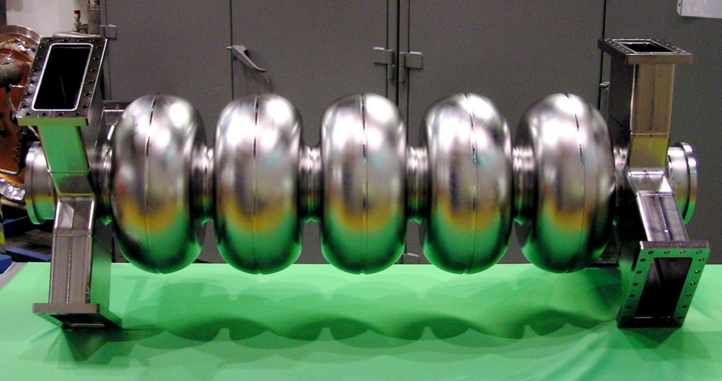
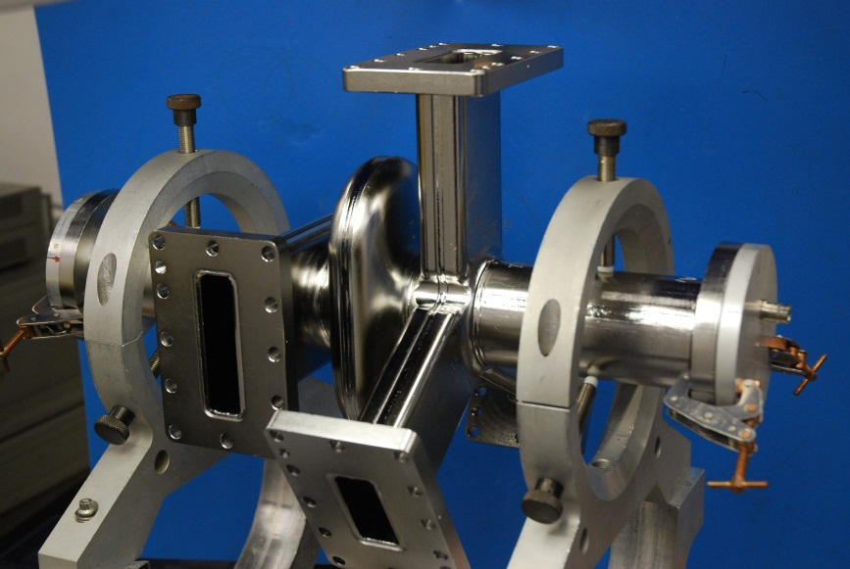
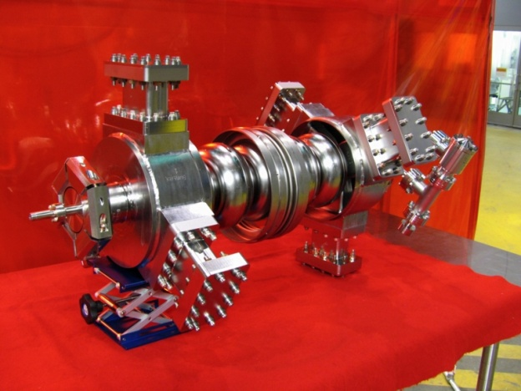
JLab Waveguide HOM Damping Studies
Copper 5-cell model
748.5 MHz High Current Cavity
R. Rimmer et. al. HOM10
ANL SPX baseline cavity
1497 MHz High Current

Slide 24
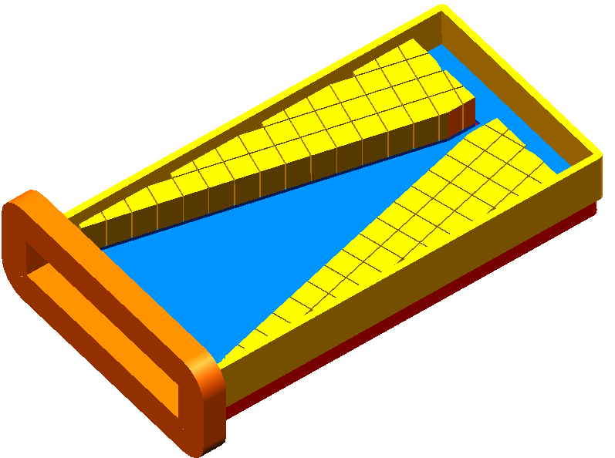
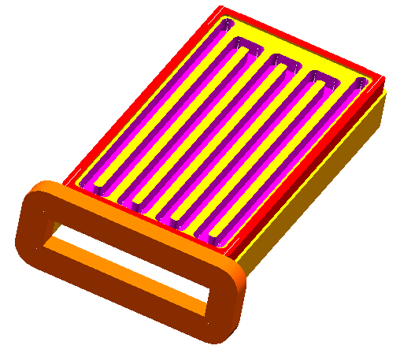
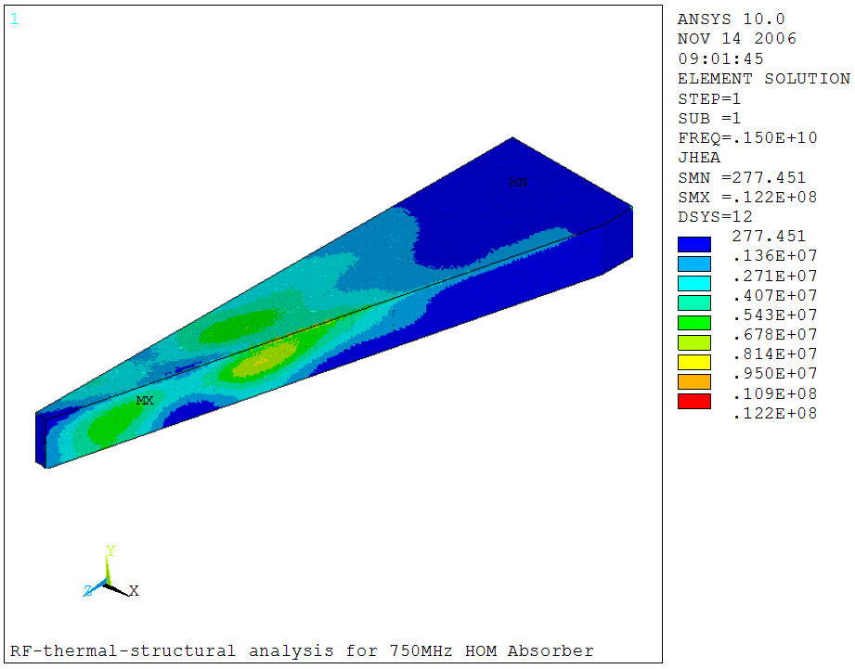
HOM Waveguide Load
Joule heat densities
Joule heat densities at the interested four frequencies are calculated and superimposed for thermal analysis.
High-power HOM load concept
RF heat summary
R. Rimmer et. al. HOM10
Freq. GHz | Input Power, W | Dielectric Loss, W | Surface loss, W | Total power loss, W
1.497 | 1775.200 | 1764.876 | 7.7799 | 1772.6557
2.994 | 1923.921 | 1909.972 | 8.6038 | 1918.5754
4.5 | 150.700 | 149.195 | 0.8314 | 150.0267
6 | 150.179 | 148.113 | 1.0018 | 149.1147
Sum | 4000 | 3972.156 | 18.217 | 3990.372
99.5% of the RF heat is absorbed in tiles. Only ~0.5% surface heat loss.

Slide 25
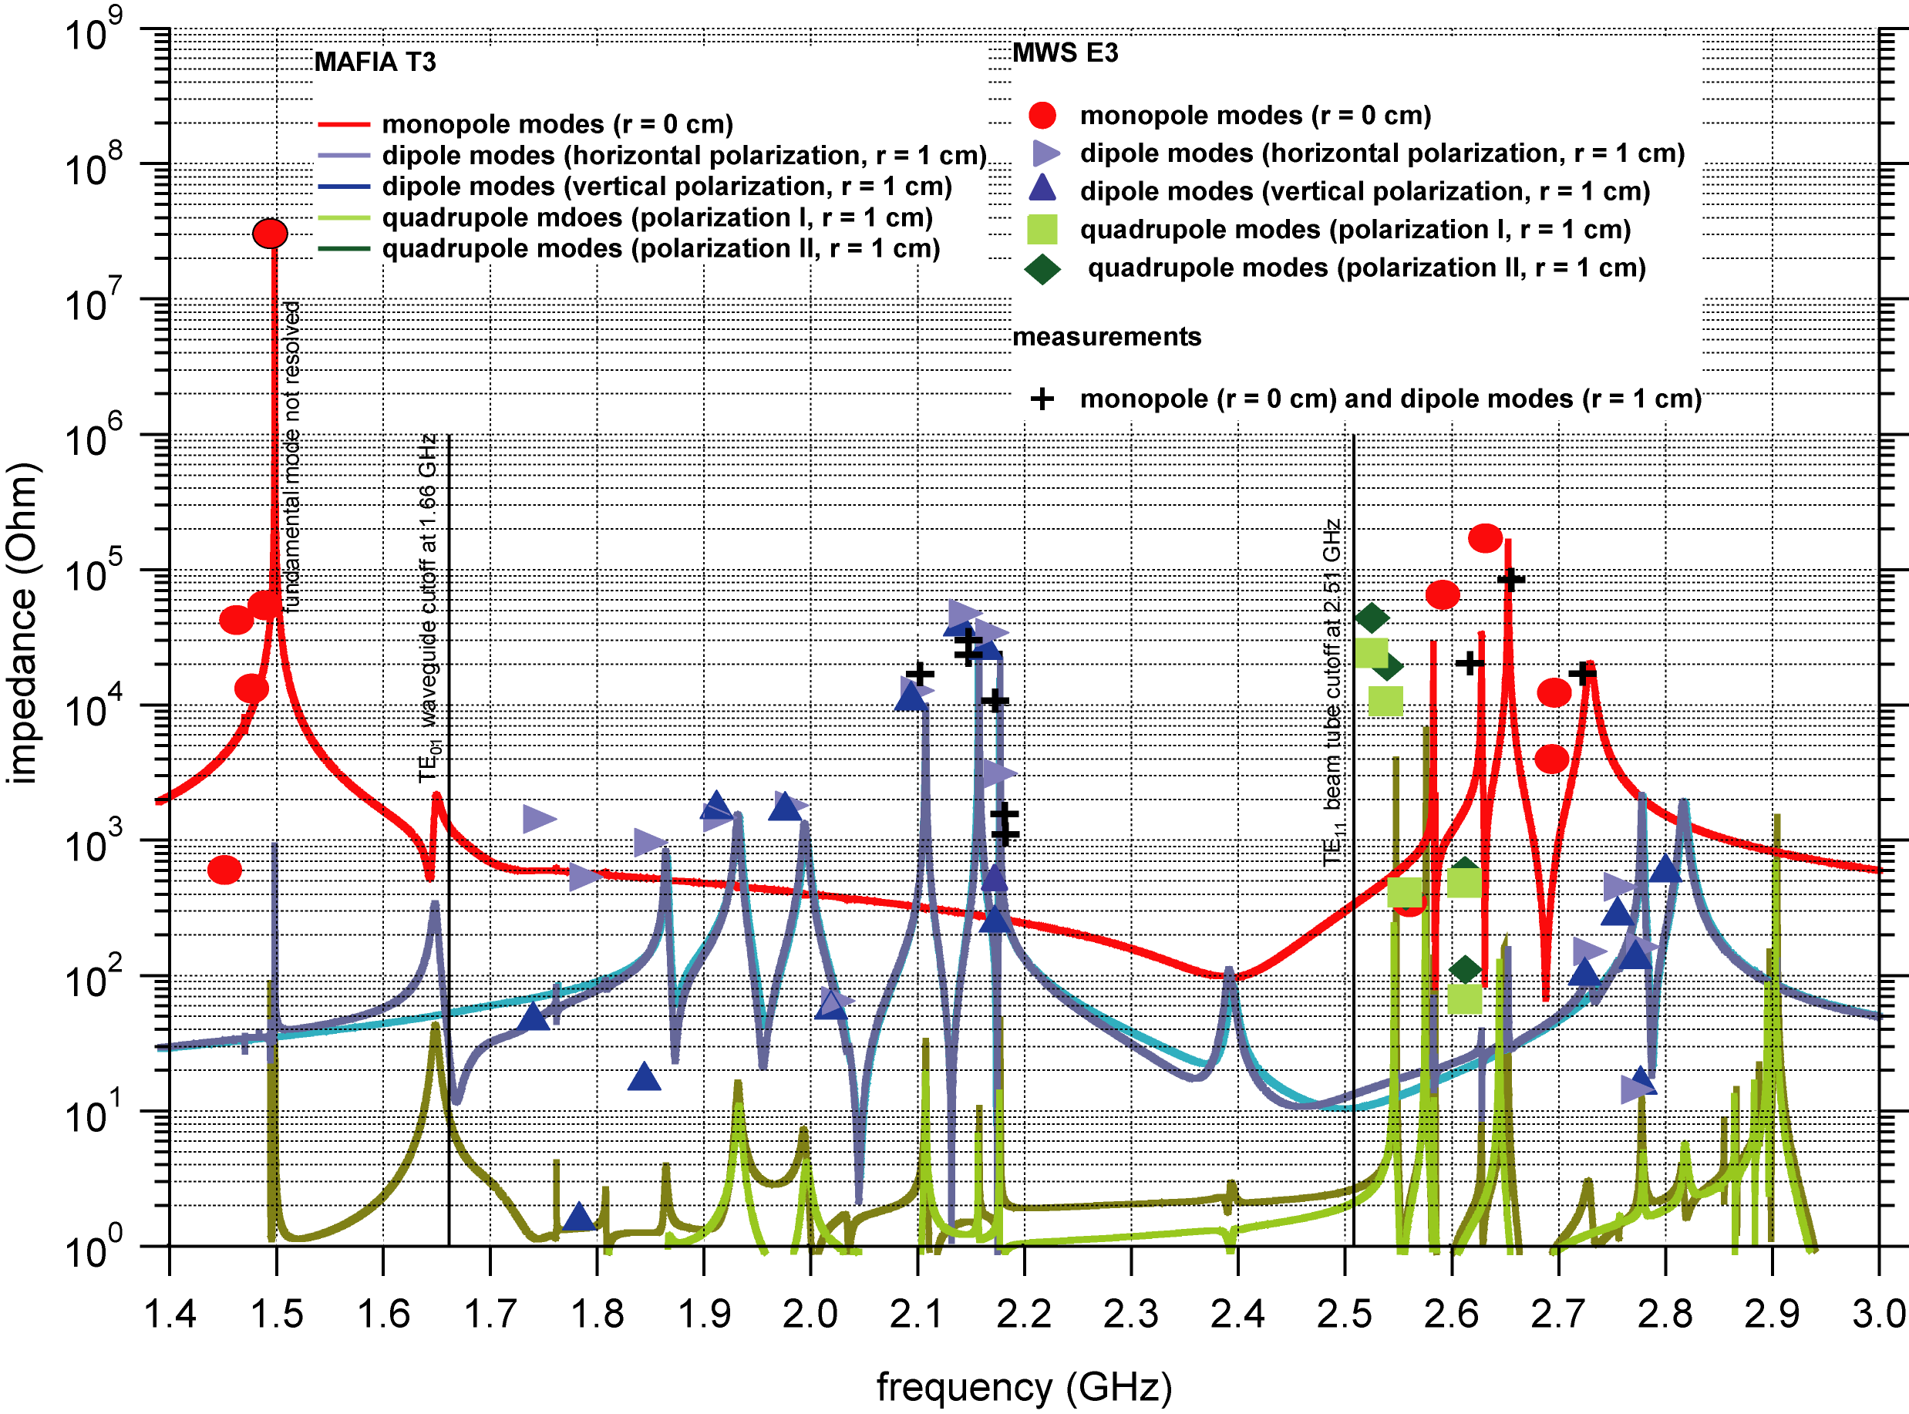
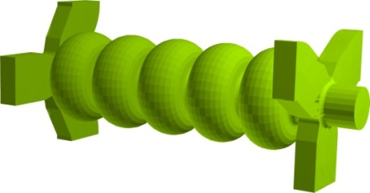
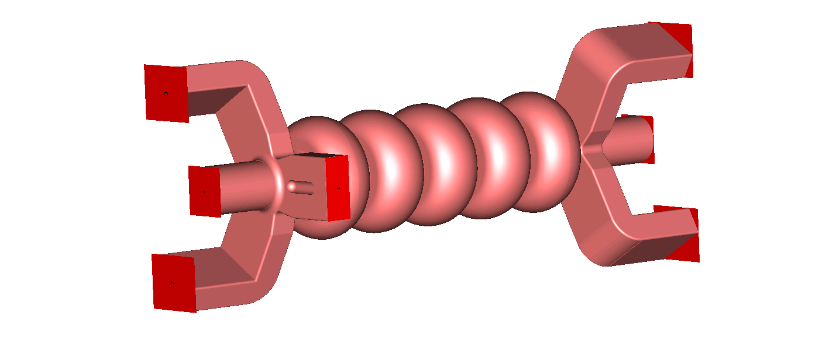
JLAB HC Cryomodule Development:
Broadband HOM Damping Efficiency
Most parasitic HOMs measured on warm model (“2 bead-pull measurement method”)
Simulation also performed with Eigenmode solver of CST Microwave Studio (MWS)
Conclusion: HOM damping requirements can be met to support Ampere-level of current
Simulation and measurement in good agreement
ideal absorbing boundaries
at waveguide ports
R. Rimmer et. al. HOM10
CST MAFIA model
CST MWS model
Q_{ext} with beam tube
and waveguide ports

Slide 26
From Closeout Discussion:
Waveguide HOM Dampers
Parameter | Current status | Improvement needed | Goal
Frequency range | Potentially > 40 GHz | Gentle curves of WG, no (thin) window
Power | kW
Q-factors | 1e3 (mono); 1e5 (dipole); 1e9 (quads) | For Quads: improve cell to cell coupling, cell geometry
Eacc (CW) | No limit?
Filling Factor | Good
Cleaning | Easy but more connections
Mechanical issue | Low frequency resonances due to long WG (microphonics) | Study in test facilities
Thermal issues | High static heat leak (Order 1 W per WG) High cryogenic load | Reduce this, e.g., thin wall, improved thermal intercepts
Long term reliability | Good
Cost | 18 kEUR (to WG flange) for 2 BT with 6 WG stubs; need to add cost for waveguides, thermal intercepts and loads to this | Reduce number of WG (can couple to both polarizations of dipoles!) -> still sufficient damping
Coupler kicks | Must symmetrize | Stubs opposite to symmetrize if only one WG
Other issues | need to verify efficient coupling at higher frequencies
Waveguide HOM Dampers

Slide 27
Beamline HOM Dampers
9 Talks presented:
  Ferrite HOM Load Surrounding a Ceramic Break (L. Hammons)
  Absorbing materials for beamline absorbers: How good is good enough? (N. Valles)
  Experience with the Cornell ERL beamline absorber prototype and future plans (E. Chojnacki)
  Resonant HOM load made of a resistive material (V. Shemelin)
  Test of the Beam Line Absorber at FLASH (J. Sekutowicz)
  Cooling test of HOM absorber model for cERL in Japan (M. Sawamura)
  Operation Experience of HOM absorbers at KEKB (T. Furuya)
  Beamline absorber work at Muon, Inc (R. Johnson)
  Design and Application of the High-Efficiency HOM Absorbers at PEP-II (A. Novokhatski)
Projects: BNL ERL, Cornell ERL, KEK ERL, KEKB
Beamline HOM Dampers

Slide 28
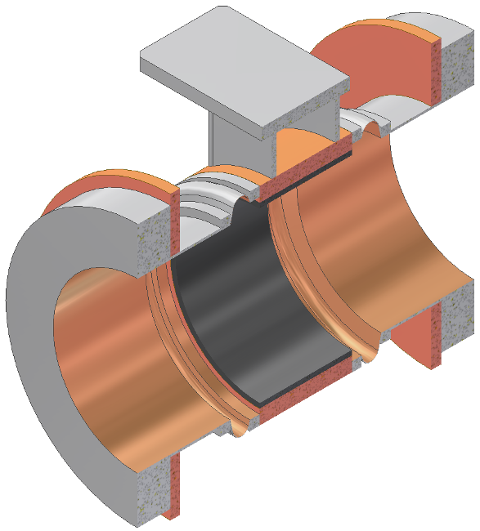

Why consider Beamline HOM Dampers?
Beampipe is a natural high-pass filter
High power-handling capability
Very broadband
Radial symmetry helps avoid beam kicks
Radial symmetry ensures all HOM polarizations are damped
Can incorporate bellow sections between cavities
Good experience with CESR, KEKB
Relative simple design
Beamline HOM Dampers

Slide 29



HOM Damping Efficiency: A Comparison by F. Marhauser
Beampipe absorber give very effective, smooth and broadband performance
Ceralloy CA137 absorber
ideal absorber
F. Marhauser

Slide 30


BNL and Cornell Beamline Loads
BNL Gun HOM Load
Cornell HOM Load
Mount to He Gas Return Pipe
5K intercepts
80K cooling
L. Hammons, E. Chojnacki
RF absorber at 80K
Bellows for flex
Based on simplified and improved version of ERL injector HOM load
Full-circumference heat sink to allow >500W dissipation @ 80K
Includes bellow sections
New beamline flanges, variations of the KEK “Zero Impedance Flange”
Ferrite tiles surrounding a ceramic break
Ceramic break ferrite from beam vacuum
Good HOM damping verified

Slide 31



KEK ERL and Resonant Beamline Loads
KEK ERL HOM Load
Resonant HOM Load (V. Shemelin)
M. Sawamura, V. Shemelin
Conceptual design
Resonant grooves in absorbing material can be tuned to provided strongest damping of most dangerous modes
Bellows
80K Anchor
4K Anchor
HIP ferrite of new-type IB004 (cryogenic testing still to be done)
Comb-type RF bridge

Slide 32



FLASH/XFEL and Muon Inc. Beamline Loads
FLASH/XFEL HOM Load
Muon Inc. HOM Load
J. Sekutowicz, R. Johnson
Absorbing ceramic ring (ceramic CA 137) brazed to Cu stub
At “80” K
Low cost
Capacity ~ 100 W
Tested with beam at FLASH
Modified version of Cornell ERL injector HOM load
Solid rings inside, tiles outside
Studied hot compression ring assembly of inner absorber ring (no braze)

Slide 33


KEKB and PEP II Beamline Loads
KEKB HOM Load
PEP II HOM Load
Absorbing Tile
2.75” long by .24” wide HOM Trapping Slots
T. Furuya, A. Novokhatski
25 absorbers installed in ring
Absorb several kW each
Use Ceralloy 137 type ceramic
Coupling slots give strong damping of transverse fields, but not longitudinal
HIP ferrite ring absorber
Water cooled
14 kW HOM power intercepted per cavity

Slide 34
From Closeout Discussion:
Beamline HOM Dampers
Parameter | Beam-tube absorber | Improvement needed | Goal
Frequency range | > 40 GHz | Don’t worry about it (EPC)
Power | 200 W at 80 K , >5 kW at room temp
Q-factors | 1e2 (mono) 1e4 (dipole), 100 for single cell 1e9 (quads)
Eacc (CW) | No limit provided the absorber is far enough from the cavity
Filling Factor | Poor
Cleaning | Difficult | Simplified design (e.g. DESY design) | Easy
Mechanical issue | Good thermal contact, Stresses
Thermal issues | High dynamic cryogenic load | Consider DESY design to extract HOMs to higher temp, check IR radiation load | Moderate cryogenic load.
Long term reliability | Good for RT, Bad for Cryotemps | New materials, Brazing, compression rings, Quality control … connect process parameters with performance
Cost | 10 to 45 kEUR |  | 10 kEUR
Coupler kicks | None
Other issues | Direct interaction with beam | check this for short bunches | < 20%
Beamline HOM Dampers

Slide 35
RF Absorbing Materials
4 Talks presented:
  RF absorber studies at Cornell, part 1 (V. Shemelin)
  RF absorber studies at Cornell, including DC conductivity, part 2 (E. Chojnacki)
  RF absorber studies at KEK (M. Sawamura)
  Measurements of absorber materials from room temperature to 2K (F. Marhauser)
RF Absorbing Materials

Slide 36

RF Absorbing Materials: Ferrites
Very lossy at certain frequency bands
Temperature dependent
Not broadband
Relative brittle
Low CD conductivity (risk of charging up)
V. Shemelin, M. Sawamura

Slide 37



RF Absorbing Materials: Graphite loaded SiC
Broadband
Temperature independent
Sufficient DC conductivity @ 300K and 80K
Not as lossy as ferrite
E. Chojnacki, M. Sawamura, F. Marhauser

Slide 38



RF Absorbing Materials: Ceralloy CA137
Broadband
Temperature independent
Sufficient DC conductivity @ 300K and 80K
Not as lossy as ferrite
Poor reproducibility of properties
F. Marhauser, J. Sekutowicz, V. Shemelin

Slide 39

RF Absorbing Materials: Carbon-Nanotube loaded Alumina Ceramics
Quite lossy and broadband
Temperature independent
Sufficient DC conductivity at 300K and 80K
Currently only available in small samples
E. Chojnacki, Cornell

Slide 40
HOM Measurement Methods and Simulation Tools
6 Talks presented:
  ACE3P and HOM power flow in the Cornell ERL (Liling Xiao)
  HOM simulations with ANSYS (S. Posen)
  Higher Order Mode Heating Analysis for the ILC Superconducting Linacs (C.r Nantista)
  RF absorber studies using waveguides in transmission (E. Chojnacki; V. Shemelin)
  HOM-BPMs at the 3.9 GHz Superconducting Cavities for FLASH and the European XFEL (R.M. Jones)
  Experiments on HOM Spectrum Manipulation in a ILC 1.3 GHz Cavity (T. Khabiboulline)
HOM Measurement and Simulation Tools

Slide 41
Accelerator Modeling with EM Code Suite ACE3P
Meshing - CUBIT for building CAD models and generating finite-element meshes. http://cubit.sandia.gov.
Modeling and Simulation – SLAC’s suite of conformal, higher-order, C++/MPI based parallel finite-element electromagnetic codes
https://slacportal.slac.stanford.edu/sites/ard_public/bpd/acd/Pages/Default.aspx
Postprocessing - ParaView to visualize unstructured meshes & particle/field data. http://www.paraview.org/.
ACE3P (Advanced Computational Electromagnetics 3P)
Frequency Domain: Omega3P – Eigensolver (damping)
S3P – S-Parameter
Time Domain: T3P – Wakefields and Transients
Particle Tracking: Track3P – Multipacting and Dark Current
EM Particle-in-cell: Pic3P – RF gun (self-consistent)
Multiphysics: TEM3P – Thermal, RF and Structural
Liling Xiao
Goal is the Virtual Prototyping of accelerator structures
Notes:
41

Slide 42

T3P – Beam Transit in ILC Cryomodule
Liling Xiao
Visualization by Greg Schussman

Slide 43
Capability Comparison
Capability | ANSYS | MWS | ACE3P
Eigenmode Solver
Time Domain (wakefields)
S-Parameters
Multipacting
Coupled EM-Thermal-Structural |  |  | Not Yet
Complex µ and ε
Parallel Computing
Sam Posen
ANSYS: Excellent for thermal, structural analyses!
Not capable of introducing particles.
Not intended for accelerator applications!

Slide 44


ANSYS Example: Mechanical Design of ERL 7-Cell Cavity
Optimize position of stiffening rings to minimize frequency sensitivity to LHe pressure changes
Sam Posen
Calculate Lorentz-force detuning
Thermal design of end-groups
Mechanical resonances

Slide 45




HOM Experiments
V. Shemelin: RF absorber
studies with waveguides
Roger Jones: 3rd harmonic cavity HOM studies
HOM Measurement and Simulation Tools
T. Khabiboulline: HOM spectra manipulation by tuning

Slide 46
Summary of the Summary
New SRF accelerators put high demands on the HOM damping schemes (high power, broadband…)
Lots of activity worldwide
  Antenna HOM couplers
  Waveguide HOM couplers
  Beamline loads
Several good RF absorbers are available for operation at room temperature as well as at cryogenic temperatures
This summary is by no means complete (my apologies if I did not include your favorite slide from your talk…)
Summary

Slide 47
End
Thanks for you attention!
The end

