Slide 1

“In-situ” measurement of material removal during BCP
Mircea Stirbet and Peter Kneisel
TTC Meeting Milan, Italy 28th Feb – 3rd Mar 2011

Slide 2
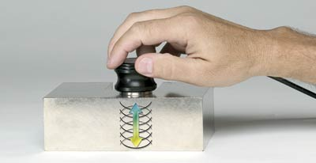
Principle of ultrasonic thickness measurement
The transducer contains a piezoelectric element which is excited by a short electrical impulse to generate a burst of ultrasonic waves. The sound waves are coupled into the test material and travels through it until they encounter a back wall or other boundary. The reflections then travel back to the transducer, which converts the sound energy back into electrical energy. In essence, the gage listens for the echo from the opposite side. Typically this time interval is only a few millionths of a second. The gage is programmed with the speed of sound in the test material, from which it can then calculate thickness using the simple mathematical relationship
T = (V) x (t/2)
where
T = the thickness of the part
V = the velocity of sound in the test material
t = the measured round-trip transit time
TTC Meeting Milan, Italy 28th Feb – 3rd Mar 2011

Slide 3
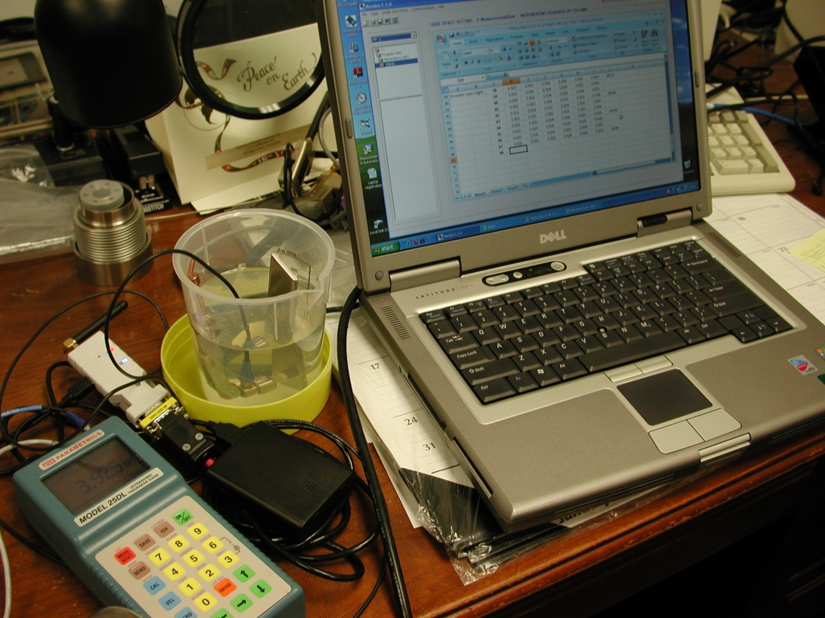
Hardware at JLAB for US measurements
Panametrics 25DL (old instrument: ~2000)
Panametrics 25DL Plus (quite new but no more in production)
Temperature measurement instrumentation
Laptop and software for data acquisition (via serial port)
Wireless replacement for the serial cable (data can be transmitted over 200 ft.)
- Dealing with measurement errors in ultrasonic thickness measurements…
Errors related with:
- US gauge dimensions
- Surface shape
Surface finish
Nb fine or large grains
Instrumental errors
Operator training
TTC Meeting Milan, Italy 28th Feb – 3rd Mar 2011

Slide 4
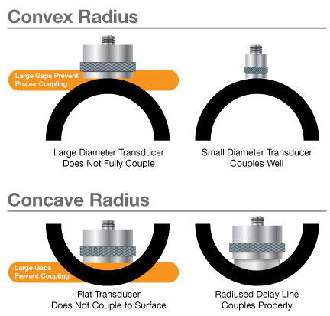
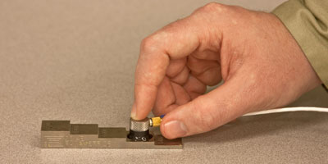
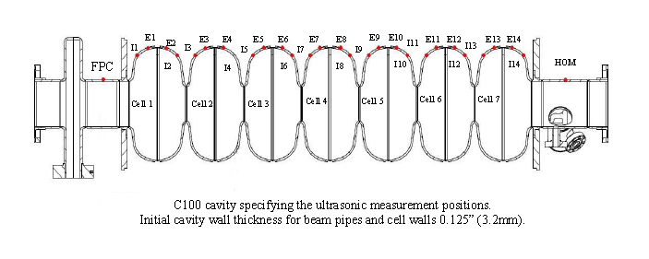
Typical NB thickness measurements done at JLAB
TTC Meeting Milan, Italy 28th Feb – 3rd Mar 2011

Slide 5
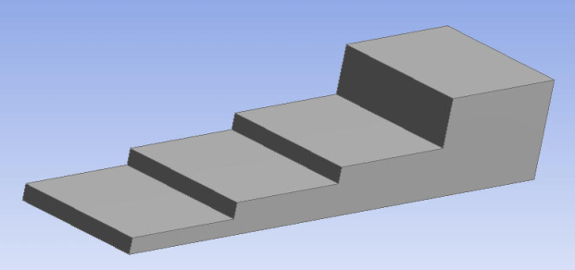
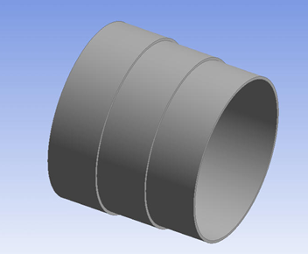
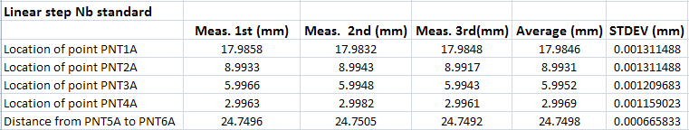
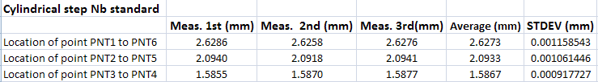
Nb step standard for Ultrasonic gauge calibration
Linear step Nb standard
Cylindrical step Nb standard
TTC Meeting Milan, Italy 28th Feb – 3rd Mar 2011

Slide 6
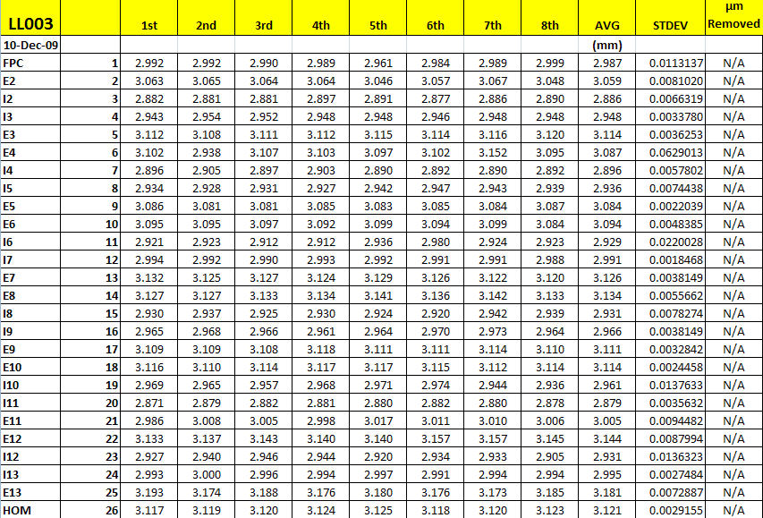
Typical Nb thickness measurements done at JLAB cont
TTC Meeting Milan, Italy 28th Feb – 3rd Mar 2011

Slide 7
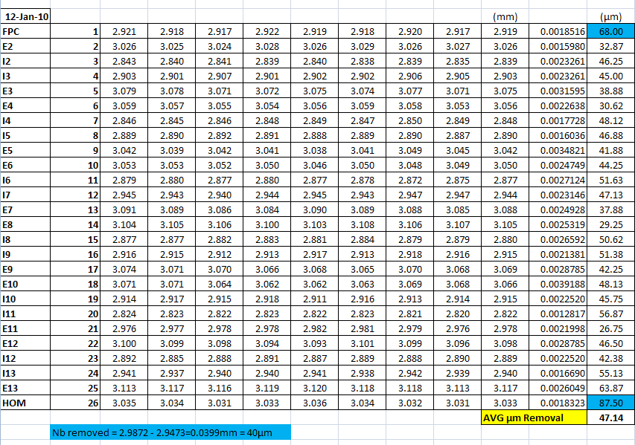
Typical Nb thickness measurements done at JLAB cont
TTC Meeting Milan, Italy 28th Feb – 3rd Mar 2011

Slide 8

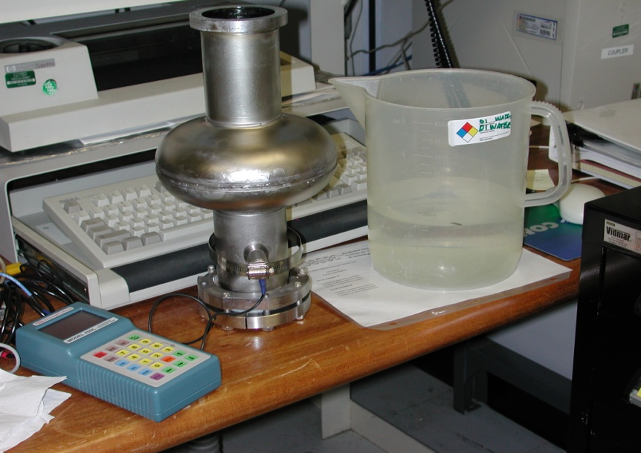
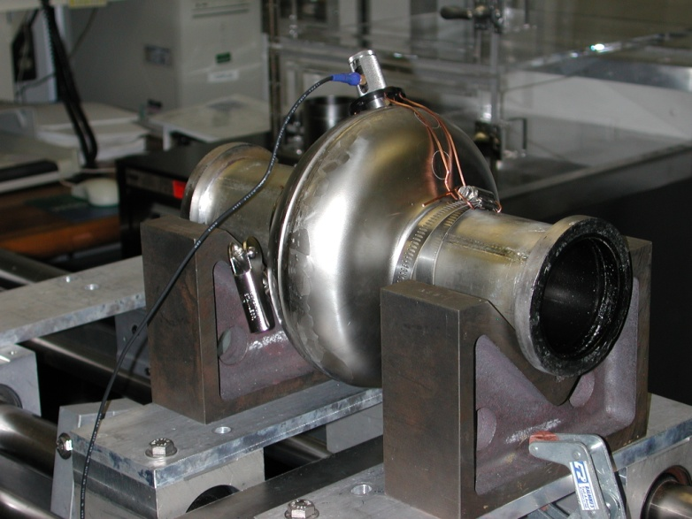
Setup and data acquisition for in situ US measurements
Panametrics Model 25DL
Gauge calibrated against Nb standard
Couplant : glycerin Initial measurements done on large grains single cell cavity (measurements affected by crystal boundaries) then test done on fine grain 1500 MHz singe cell cavity.
TTC Meeting Milan, Italy 28th Feb – 3rd Mar 2011

Slide 9
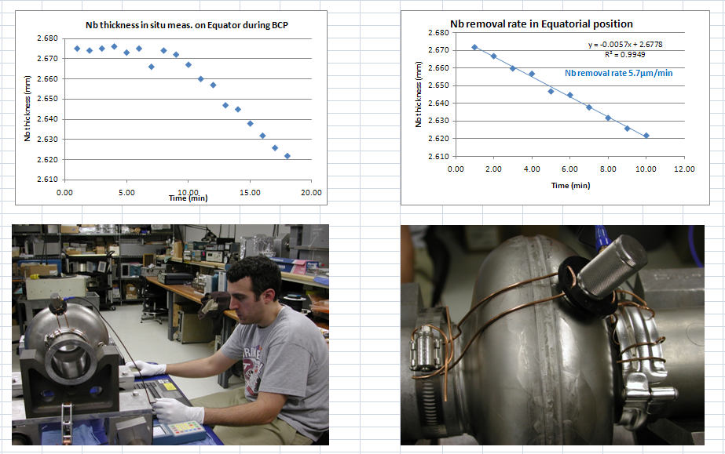
Results large grains cavity (Feb 2010)
TTC Meeting Milan, Italy 28th Feb – 3rd Mar 2011

Slide 10
Results fine grains cavity (June 2010) cont
Nb removal rate = 5.3 μm/min
Total Nb removed during 10 min of BCP = 53 μm
Total Nb removed during 9 min of BCP = 47 μm
TTC Meeting Milan, Italy 28th Feb – 3rd Mar 2011

Slide 11
Results fine grains cavity (June 2010) cont
After BCP freq= 1482.4 MHz
∆ freq = 1482.85 - 1482.4 = 0.45 MHz
Nb removed =450 kHz/(11 kHz/μm) = 40.9 µm
TTC Meeting Milan, Italy 28th Feb – 3rd Mar 2011

Slide 12
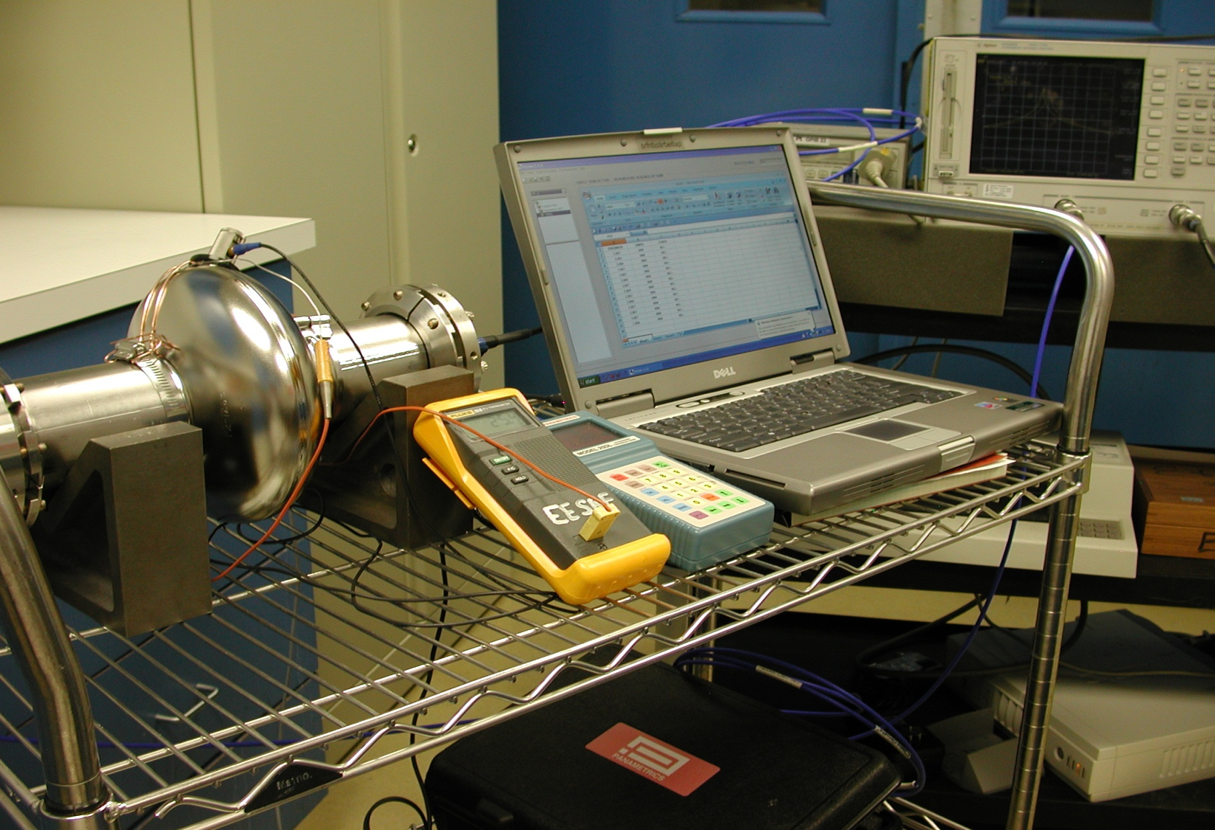
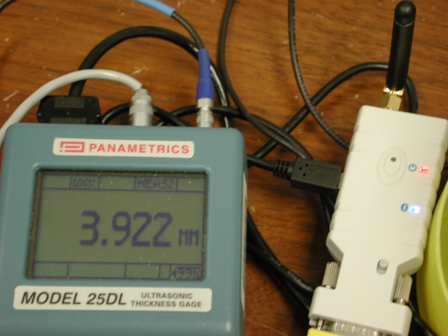
Wireless transmission of US measurements
1500 MHz single cell with probes attached for frequency measurements after BCP.
TTC Meeting Milan, Italy 28th Feb – 3rd Mar 2011

Slide 13
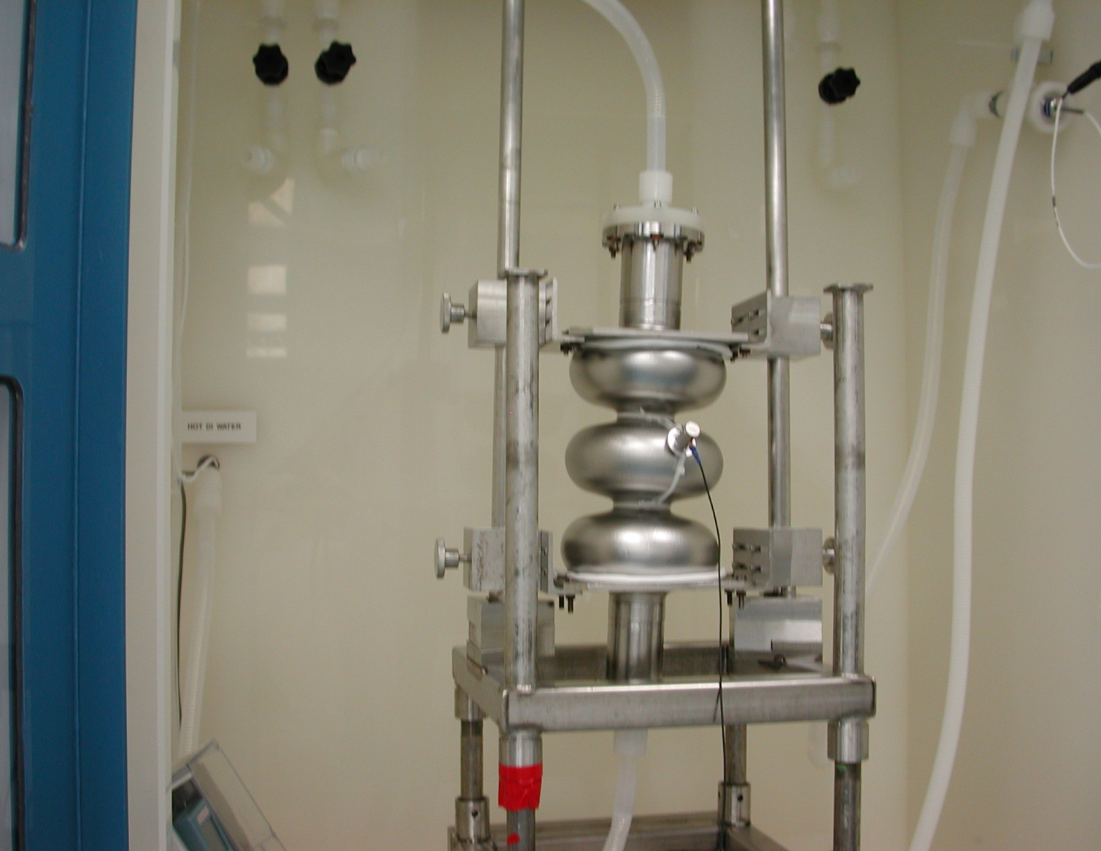
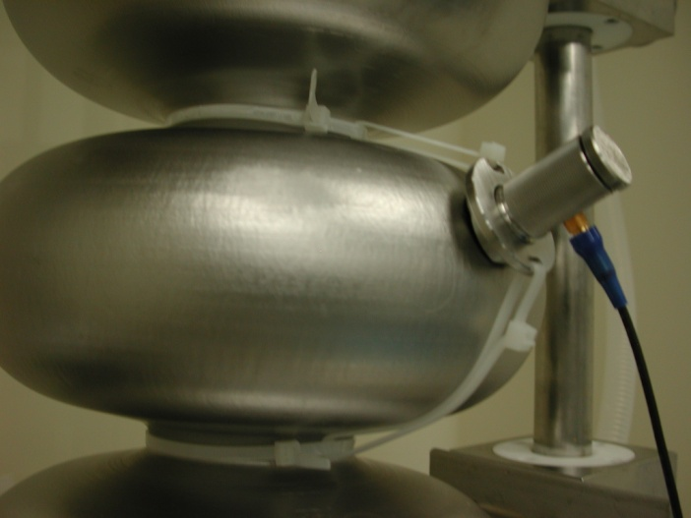
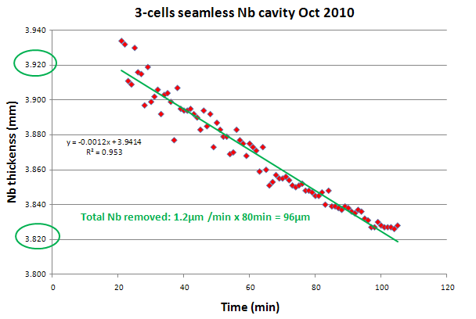
Seamless fine grain Nb 3-cells cavity Oct 2010
In situ Nb thickness measurements with wireless data transmission during BCP.
TTC Meeting Milan, Italy 28th Feb – 3rd Mar 2011

Slide 14
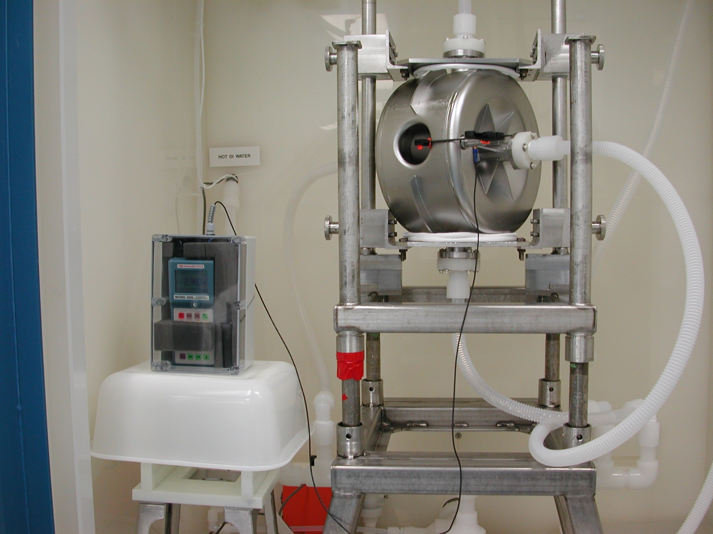
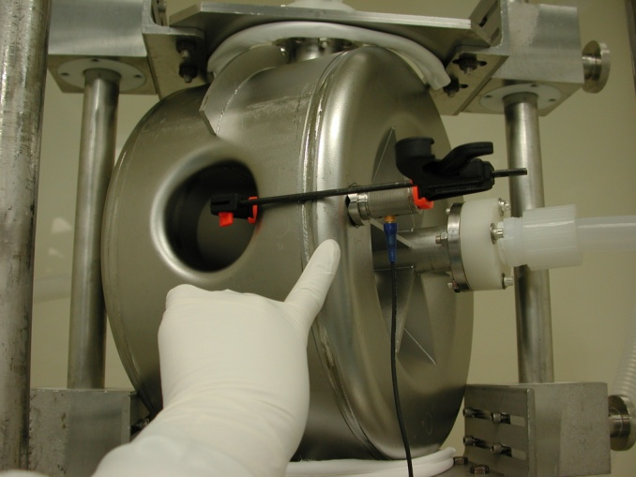
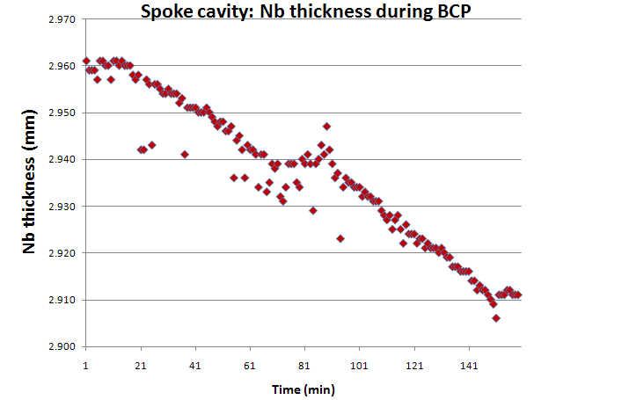
Spoke cavity July 2010
In situ Nb thickness measurements on a spoke cavity during BCP.
TTC Meeting Milan, Italy 28th Feb – 3rd Mar 2011

Slide 15
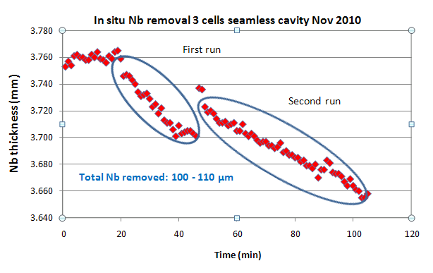
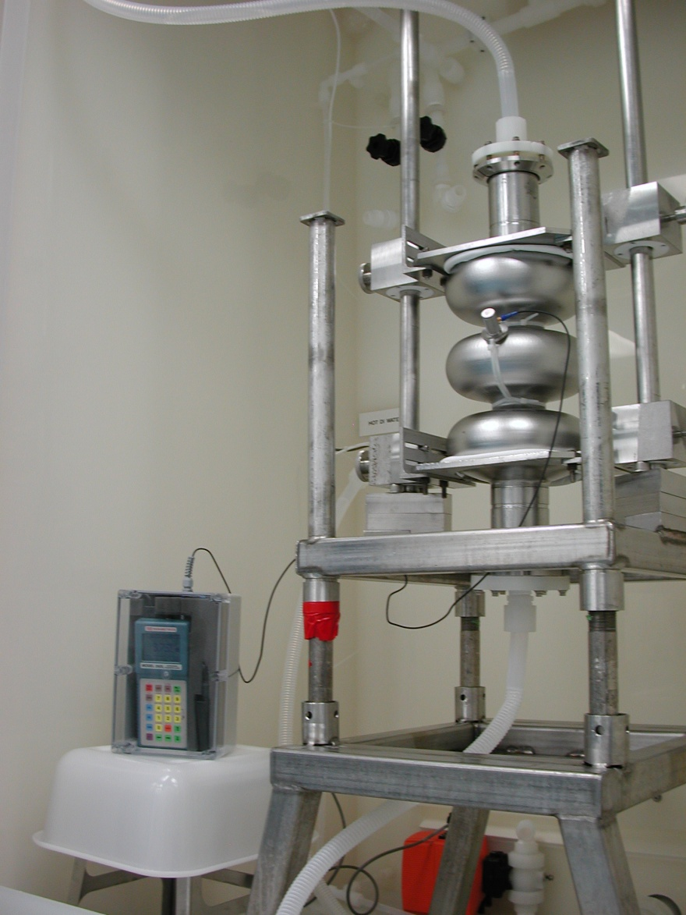
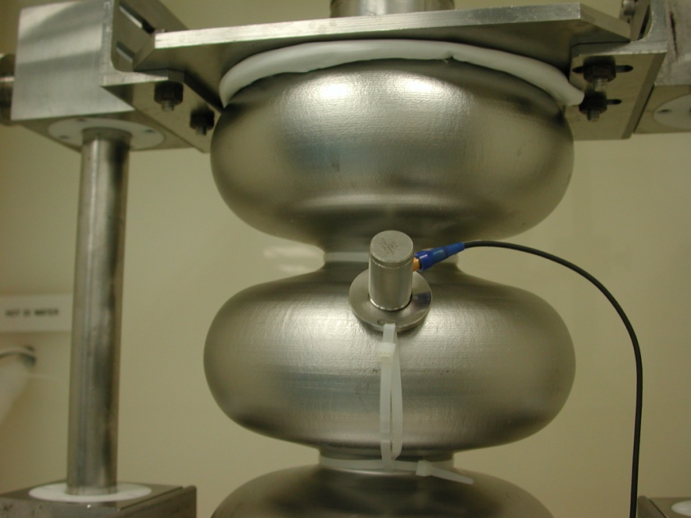
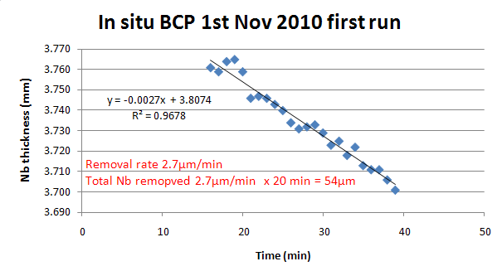
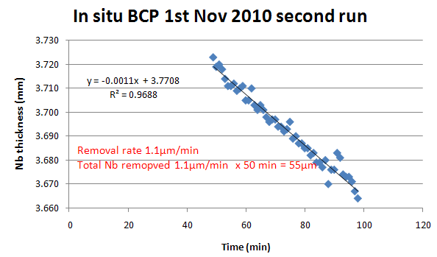
Seamless 3-cells cavity Nov 2010
Seamless 3 cell cavity with ultrasonic probe for thickness measurements during BCP.
TTC Meeting Milan, Italy 28th Feb – 3rd Mar 2011

Slide 16
Still to be done
Data acquisition program (LabView).
Multichannel ultrasonic measurement instrumentation (8 channels?).
Fixture for the US gauge on the multicell cavity.
Water proof box for instrument and wireless transmitter and fixture of the box on the cavity stand.
Ultrasonic Nb thickness measurements during PCB on a multicell cavity.
Study of Nb removal rate as function of acid strength and temperature.
TTC Meeting Milan, Italy 28th Feb – 3rd Mar 2011

Slide 17
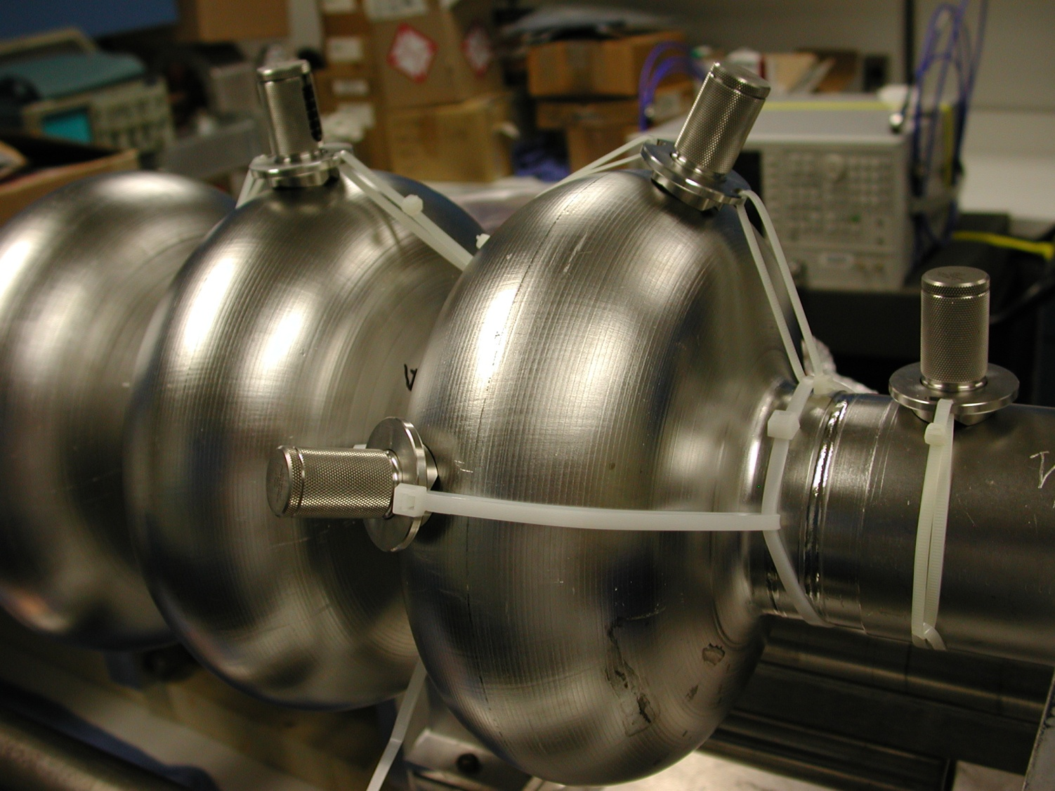
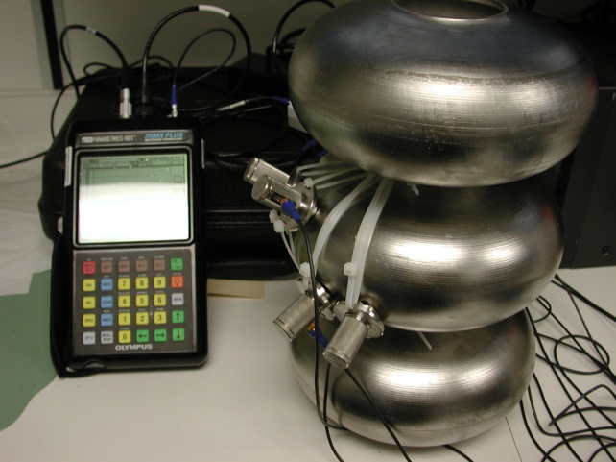
Multi gauge setup
3-cell seamless cavity with probes attached for simultaneously thickness measurements.
TTC Meeting Milan, Italy 28th Feb – 3rd Mar 2011

Slide 18
Conclusions
In situ ultrasonic Niobium thickness measurements during BCP - can be DONE – consistent results were obtained for Nb removal as measured with the ultrasonic device or estimated from frequency shift measurements.
It is an efficient direct method for in situ Nb thickness measurements. Saving in measurement time.
Wireless transmission of facilitates data acquisition in controlled environment.
Acknowledgements: Tony Reilly, James Davenport and Teena Harris
TTC Meeting Milan, Italy 28th Feb – 3rd Mar 2011

