Slide 1

An Inexpensive Inspection System for Niobium Cavities
Mircea Stirbet and Peter Kneisel
TTC Meeting Milan, Italy 28th Feb – 3rd Mar 2011

Slide 2
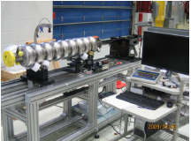
Optical Inspection Systems for SRF cavities
Kyoto camera system
FNAL system
DESY system
K. Watanabe, Review of Optical Inspection Methods and Results, TUOBAU01, SRF 2009, Berlin 2009.
TTC Meeting Milan, Italy 28th Feb – 3rd Mar 2011

Slide 3
Defect localization
W-D. Muller: Review of Results from Temperature Mapping and Subsequent Cavity Inspection, TUOAAU04,SRF 2009 Berlin 2009.
TTC Meeting Milan, Italy 28th Feb – 3rd Mar 2011

Slide 4
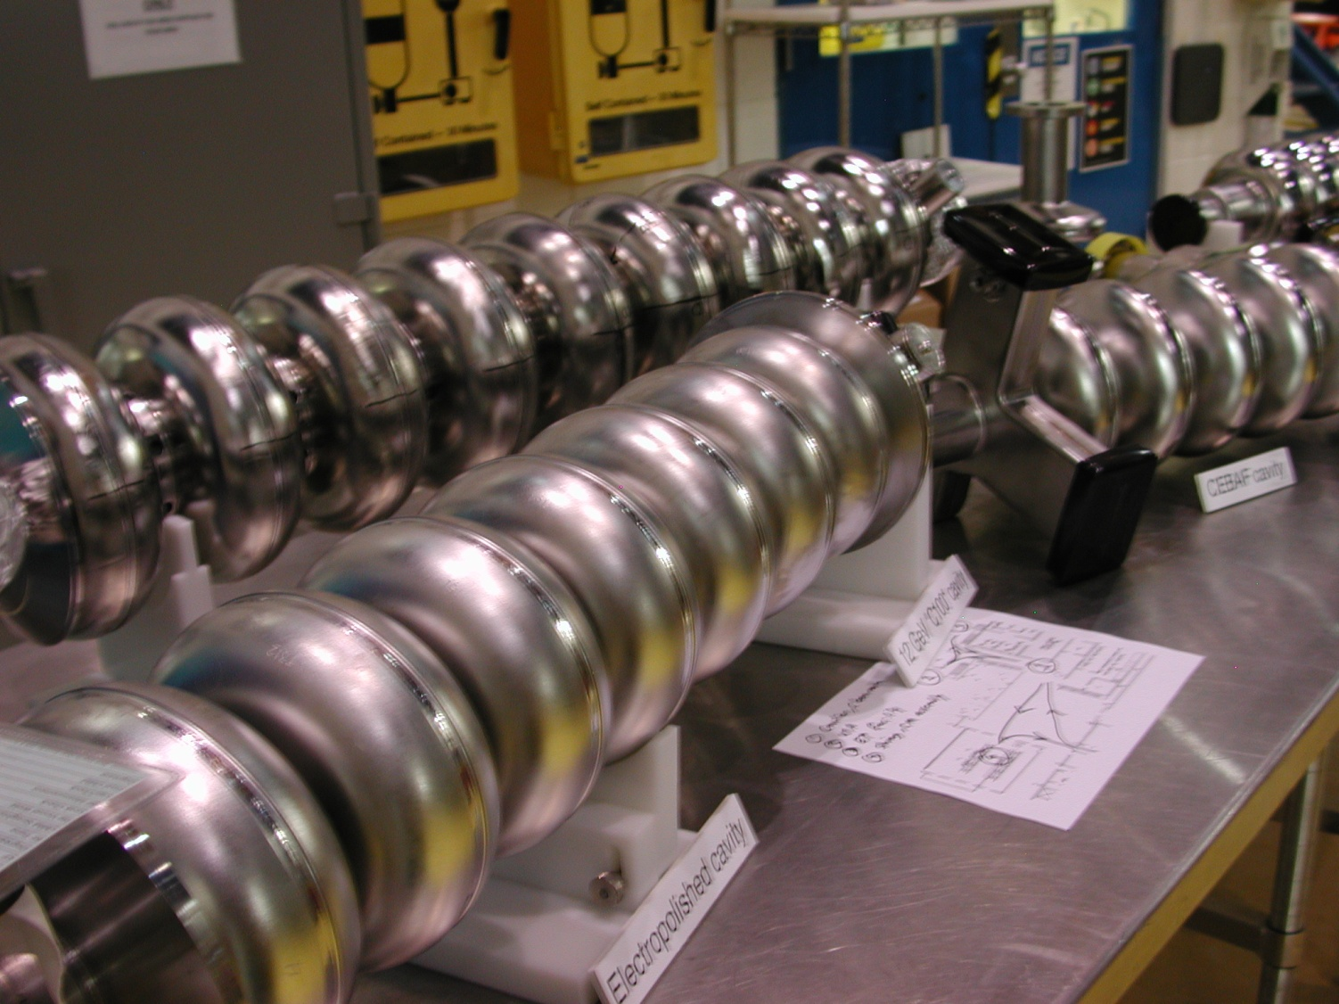
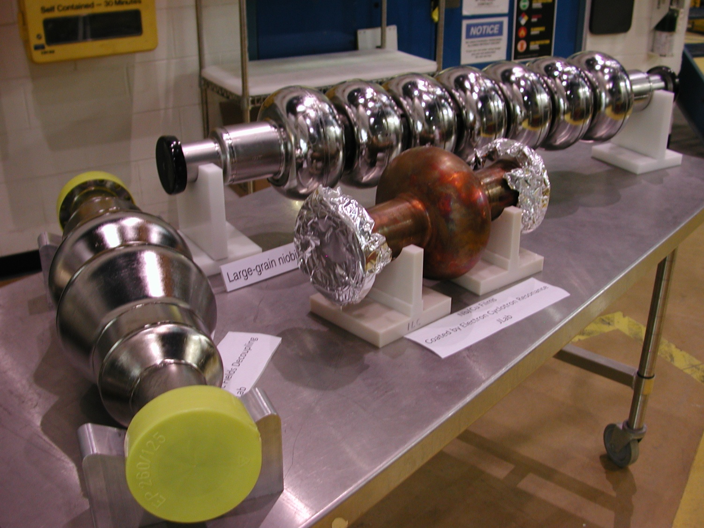
SRF cavities at JLAB
TTC Meeting Milan, Italy 28th Feb – 3rd Mar 2011

Slide 5
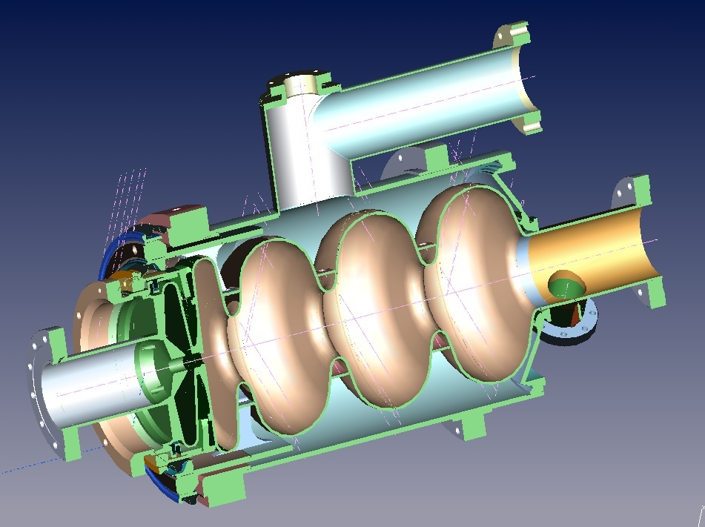
3 1/2-cell photo injector cavities
50 mm
Mechanical marks
TTC Meeting Milan, Italy 28th Feb – 3rd Mar 2011

Slide 6
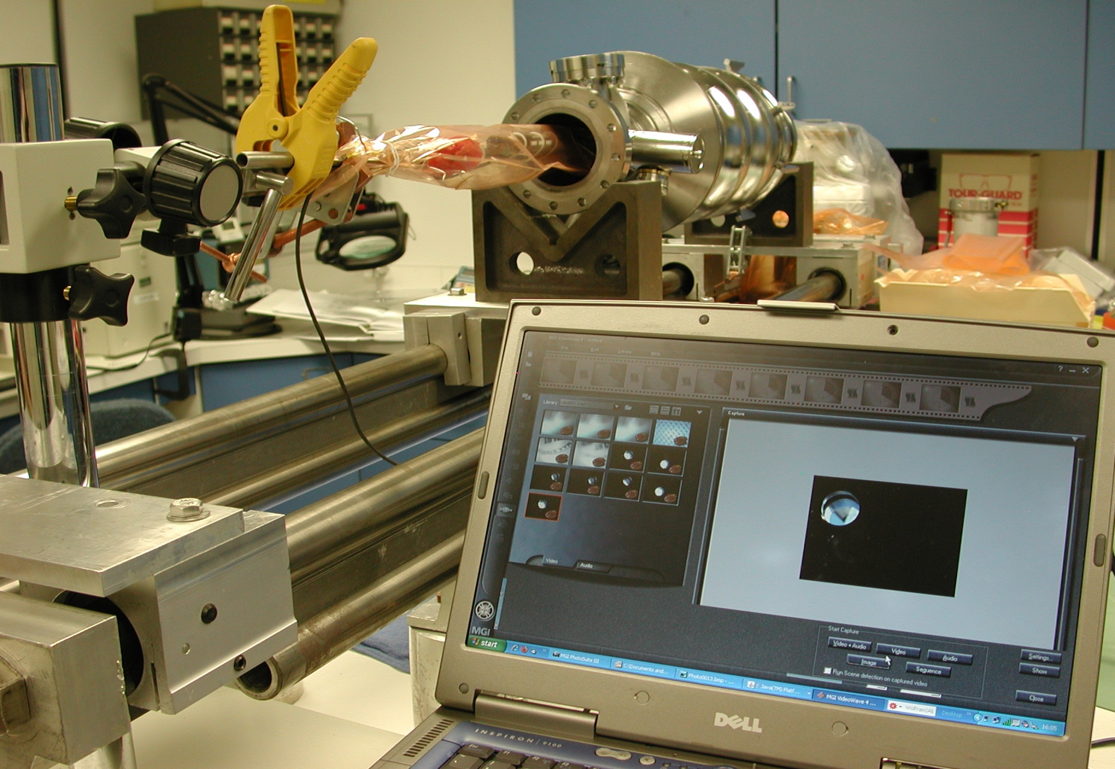
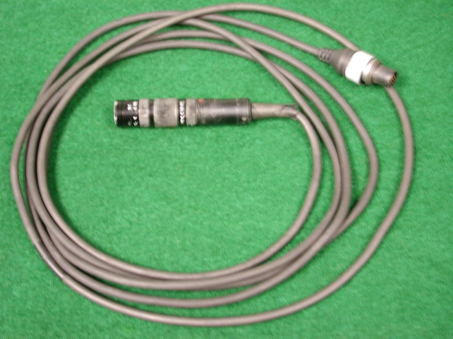
Initial setup for visual inspection on 3 1/2-cell cavities
TTC Meeting Milan, Italy 28th Feb – 3rd Mar 2011

Slide 7
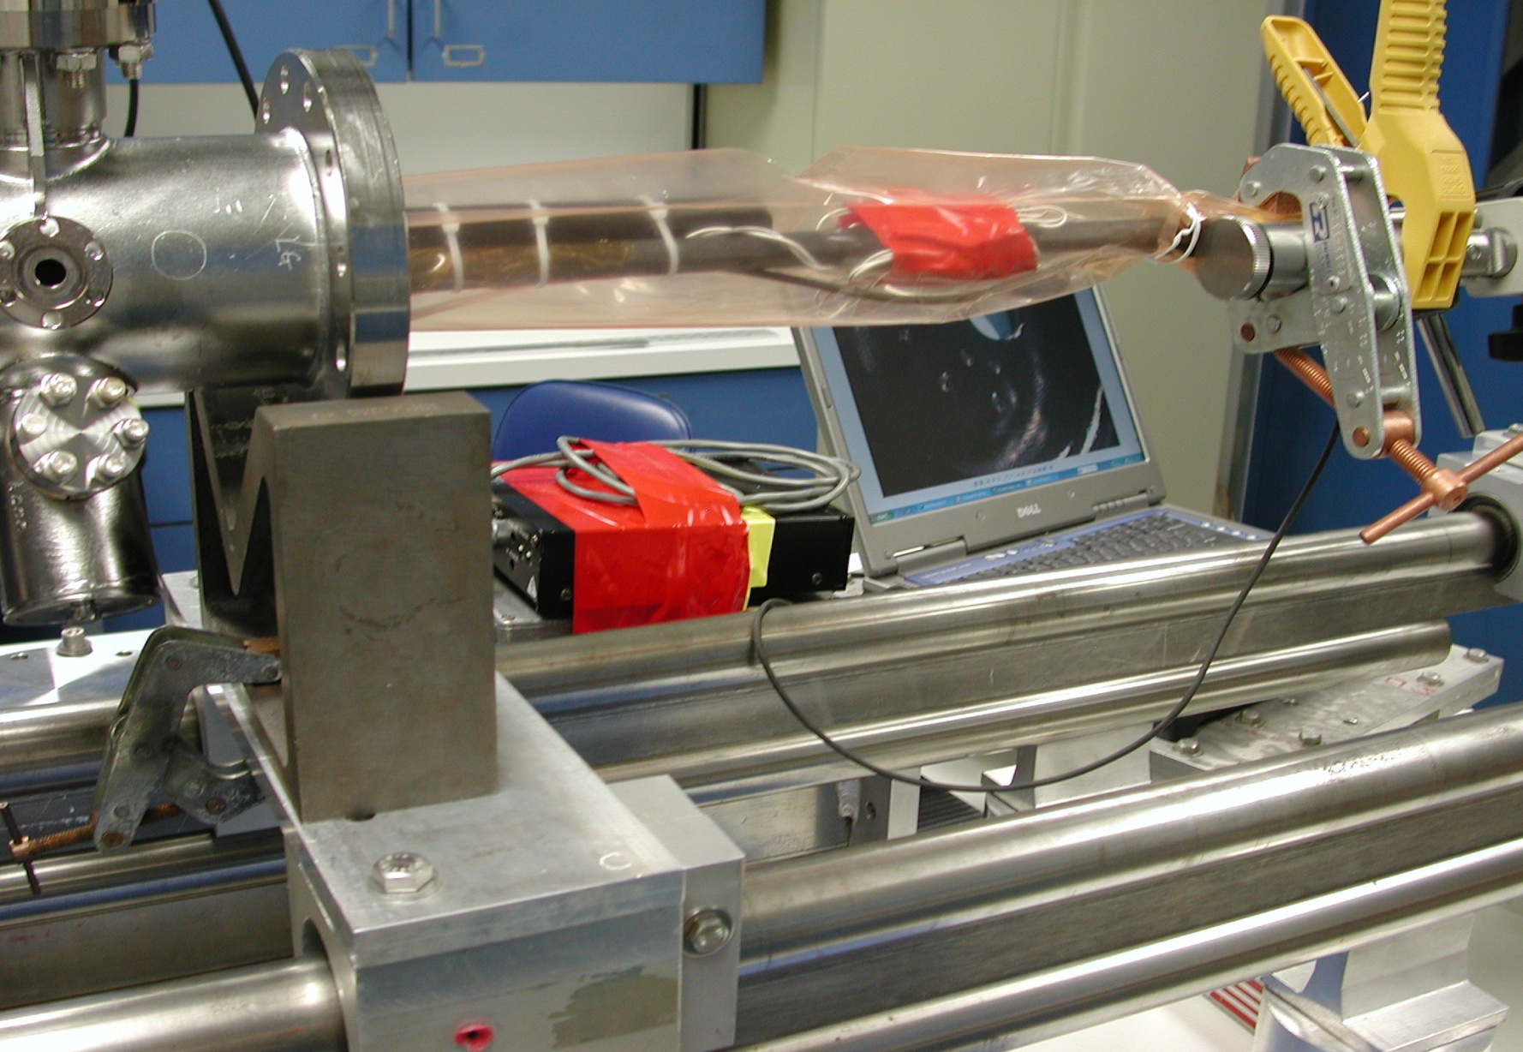
Mechanical marks on the endplate of the 3 1/2-cell cavities
TTC Meeting Milan, Italy 28th Feb – 3rd Mar 2011

Slide 8
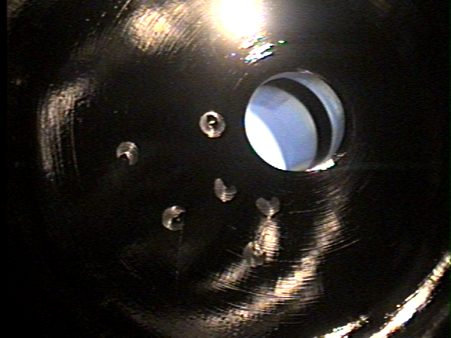
Mechanical marks on the endplate of the 3-cell cavity cont
10 mm
TTC Meeting Milan, Italy 28th Feb – 3rd Mar 2011

Slide 9
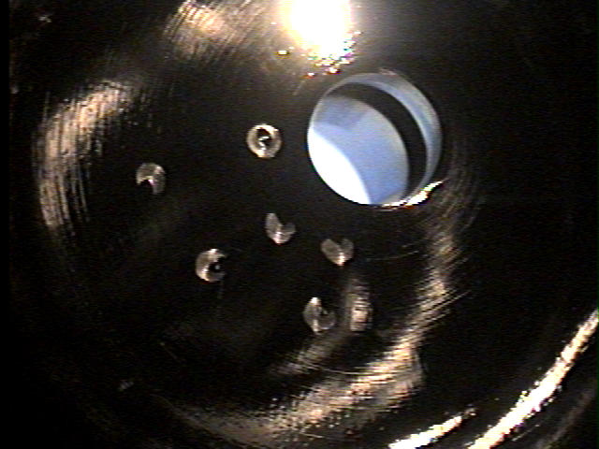
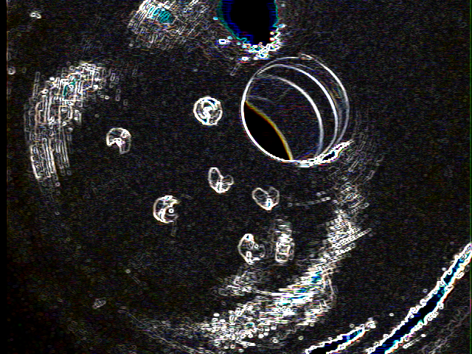
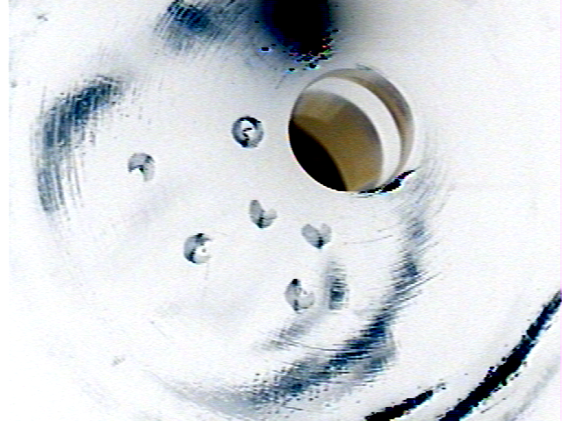
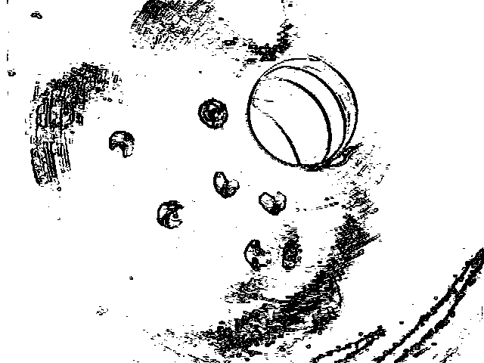
Image processing using ImageJ software
10 mm
TTC Meeting Milan, Italy 28th Feb – 3rd Mar 2011

Slide 10
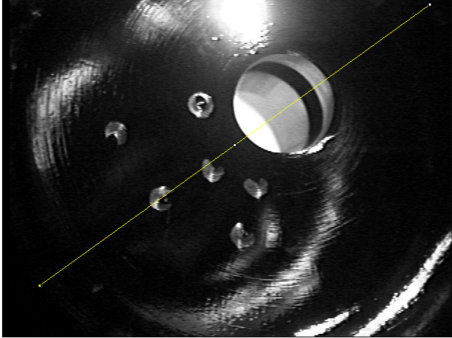
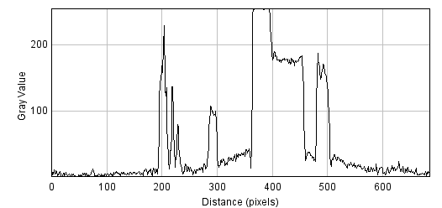
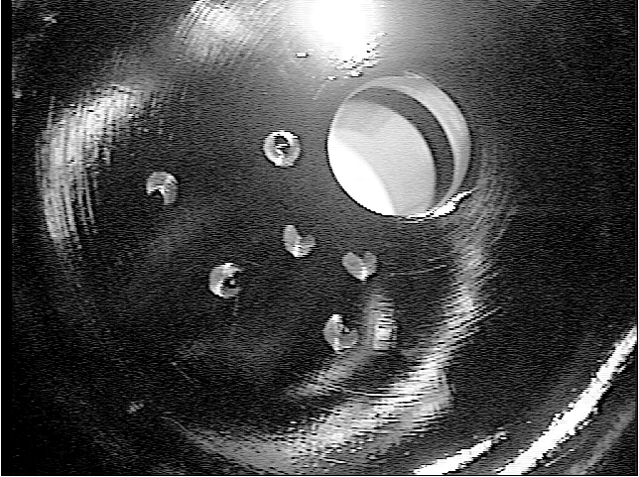
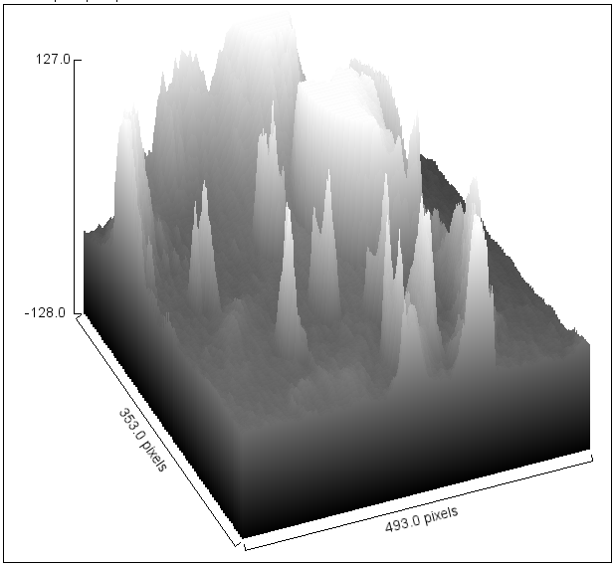
Image processing using ImageJ software cont.
Density profile along line
Surface plot
TTC Meeting Milan, Italy 28th Feb – 3rd Mar 2011

Slide 11
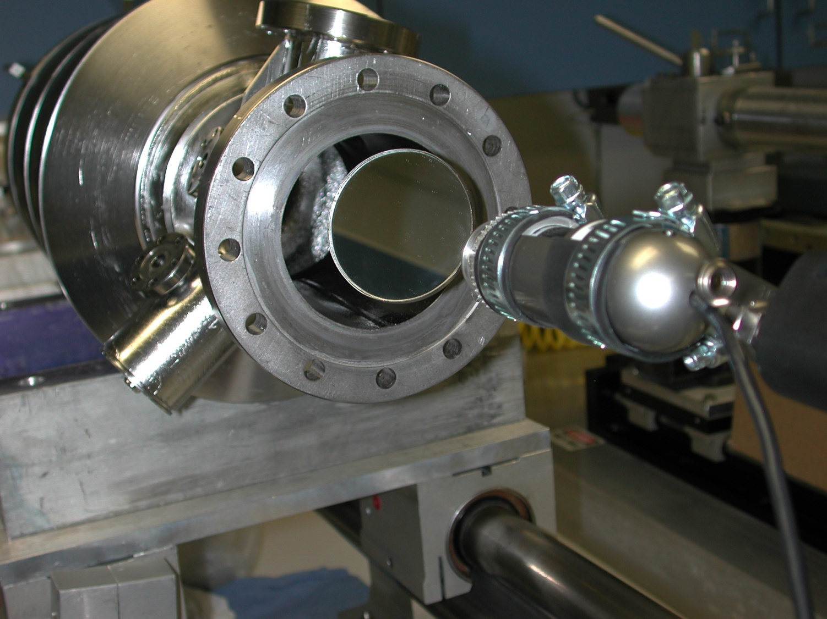
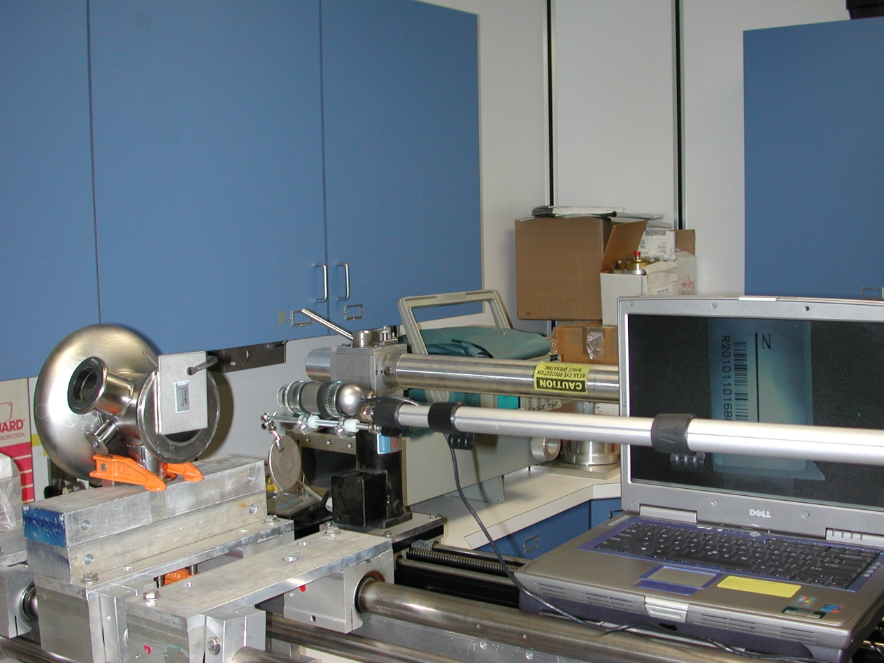
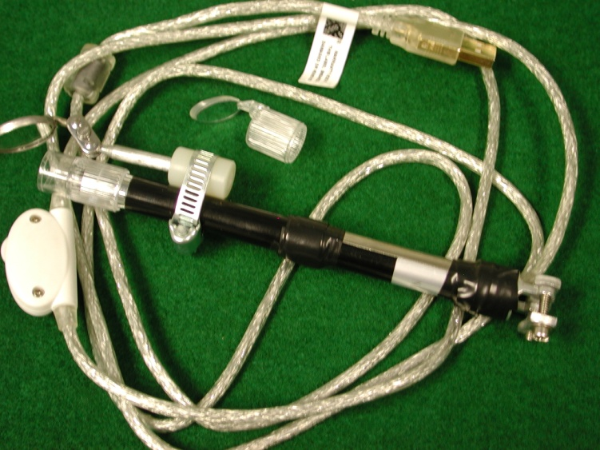
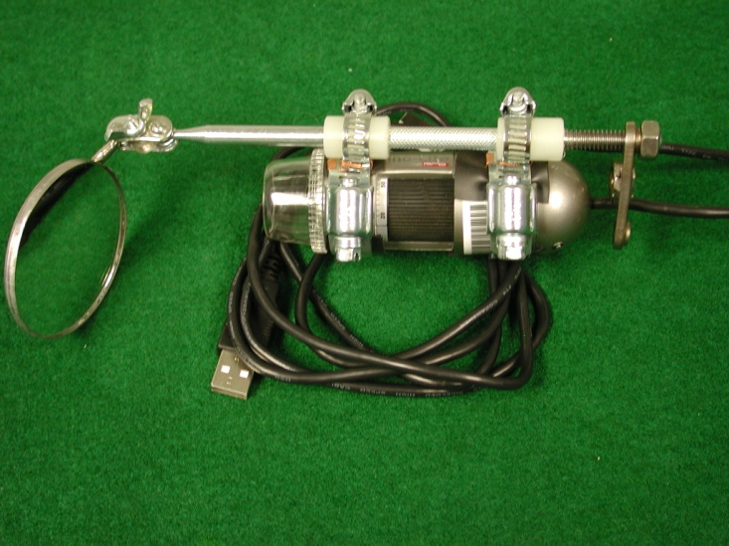
Setup with half-cell for mirror and focus adjustments
TTC Meeting Milan, Italy 28th Feb – 3rd Mar 2011

Slide 12
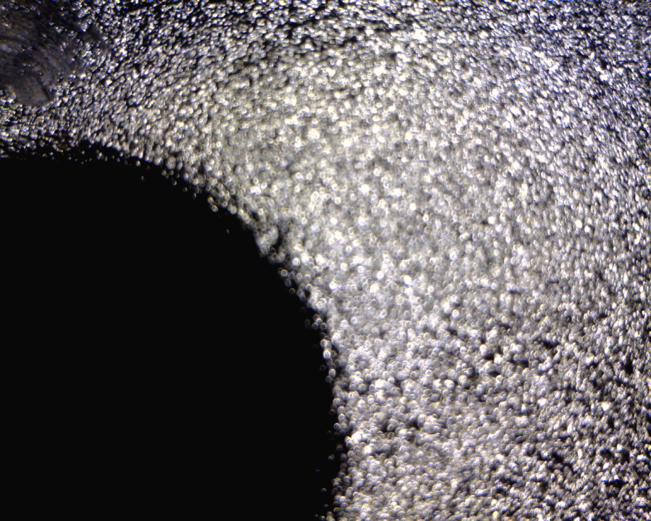
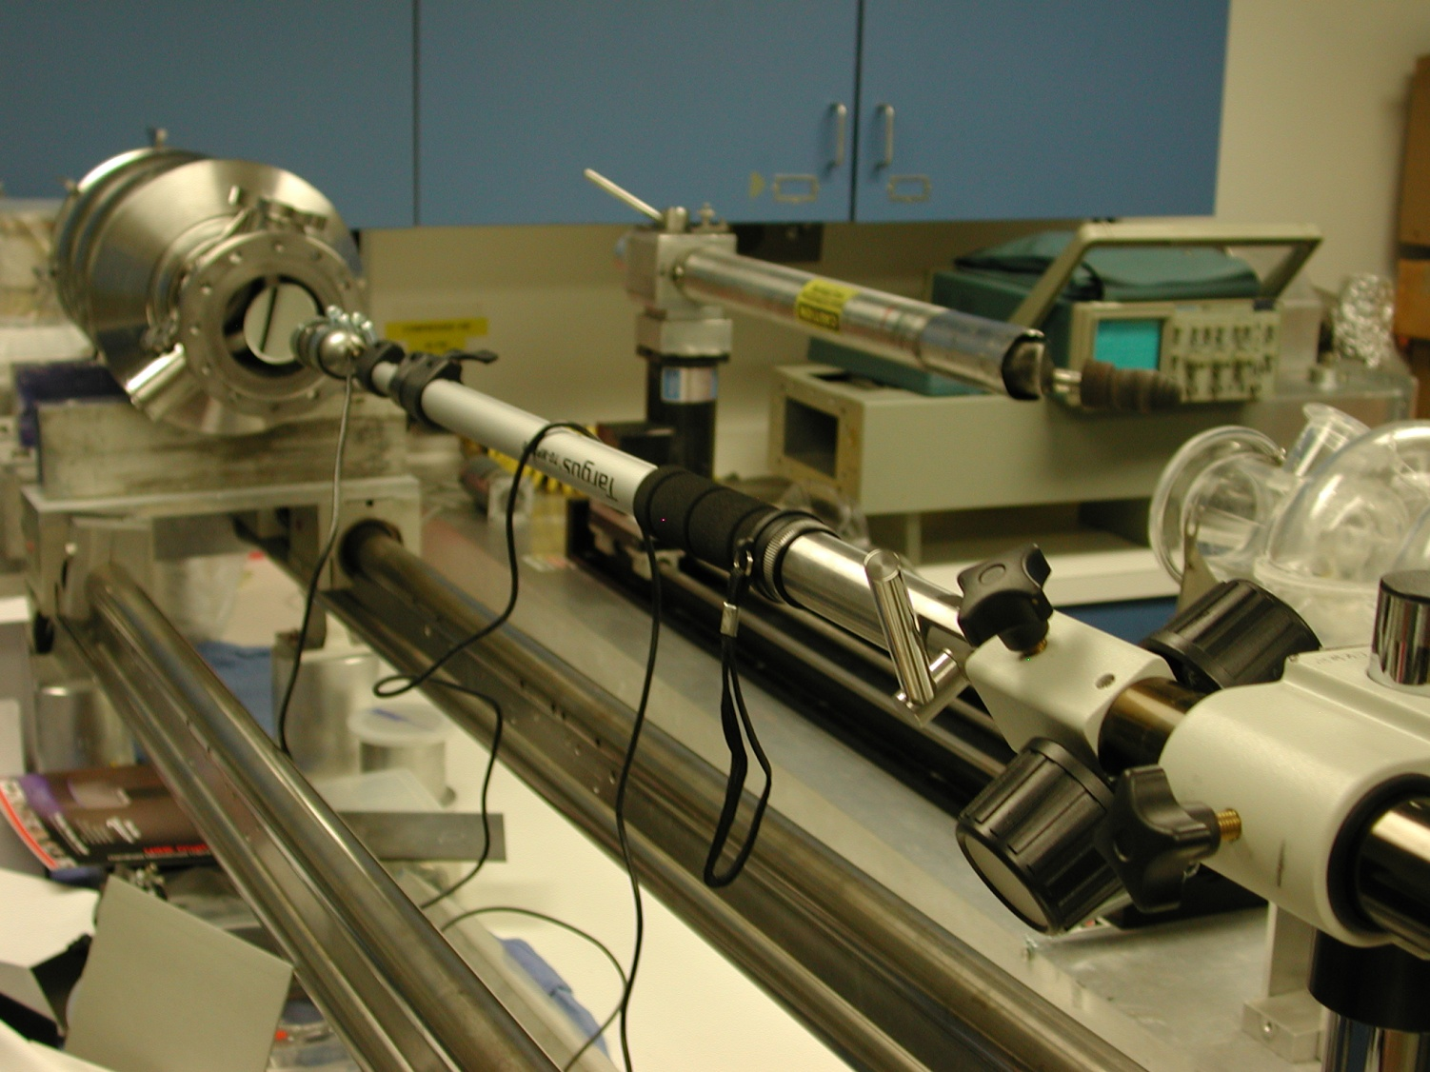
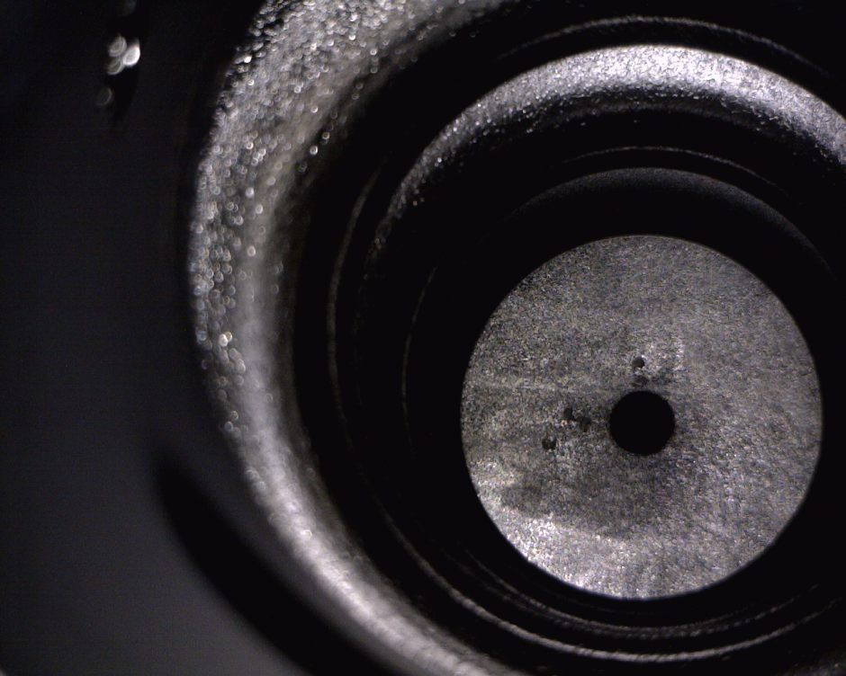
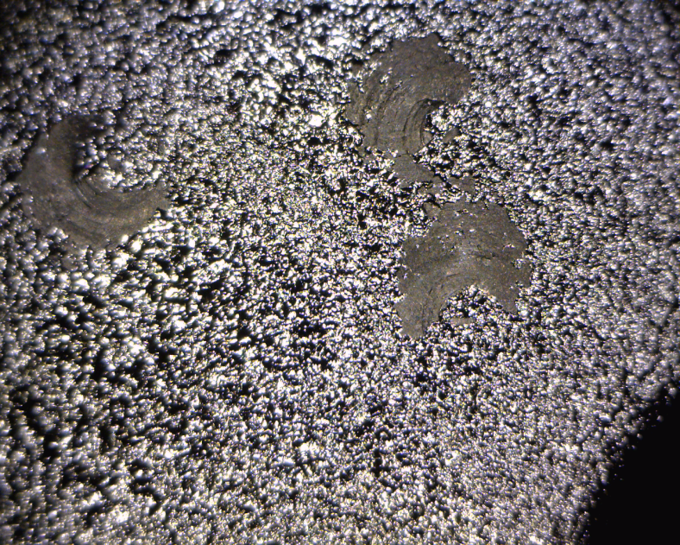
Visual inspection of the endplate after BCP
TTC Meeting Milan, Italy 28th Feb – 3rd Mar 2011

Slide 13
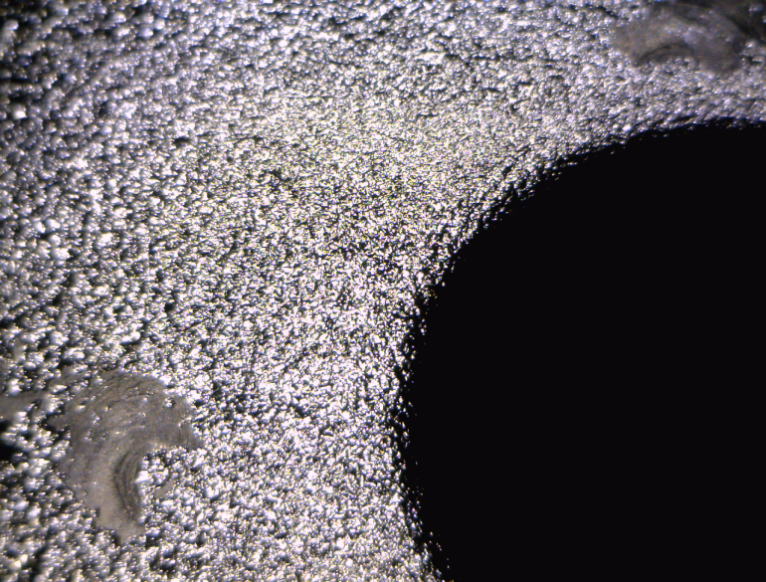
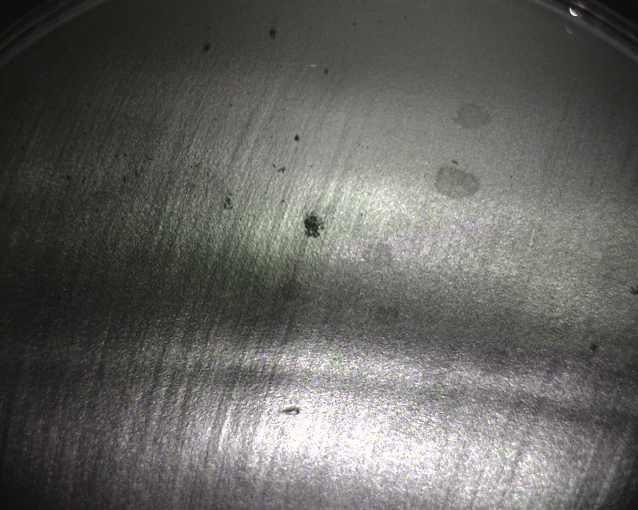
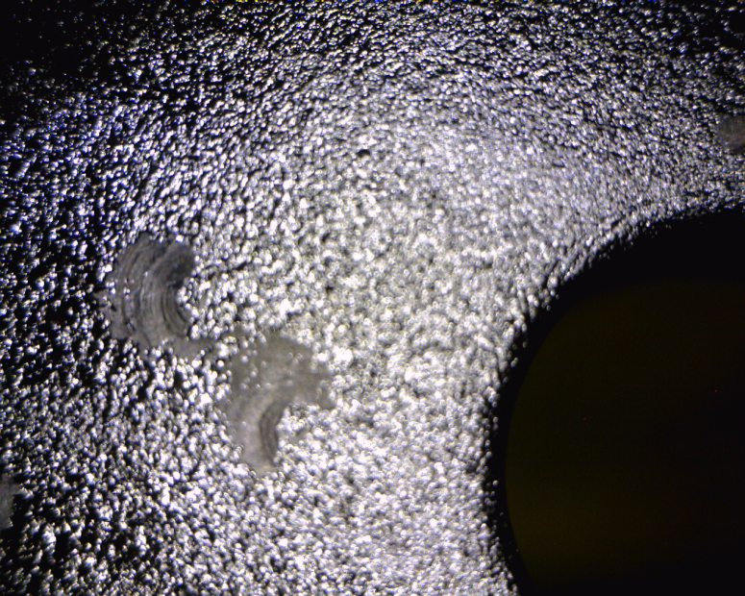
Surface details after BCP
TTC Meeting Milan, Italy 28th Feb – 3rd Mar 2011

Slide 14
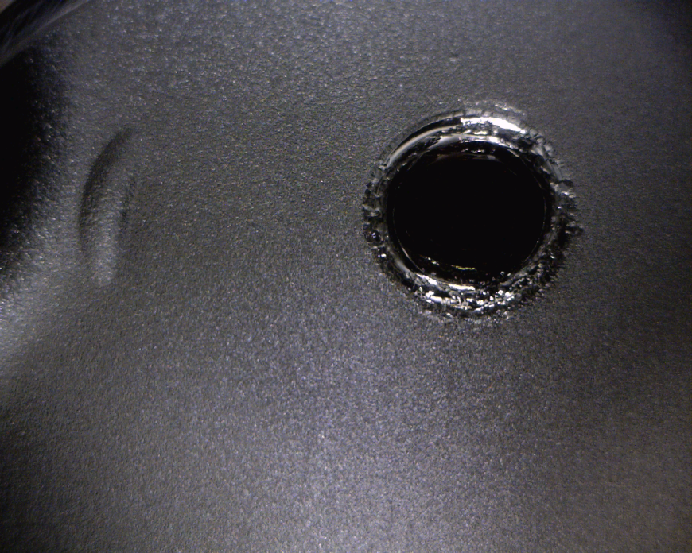
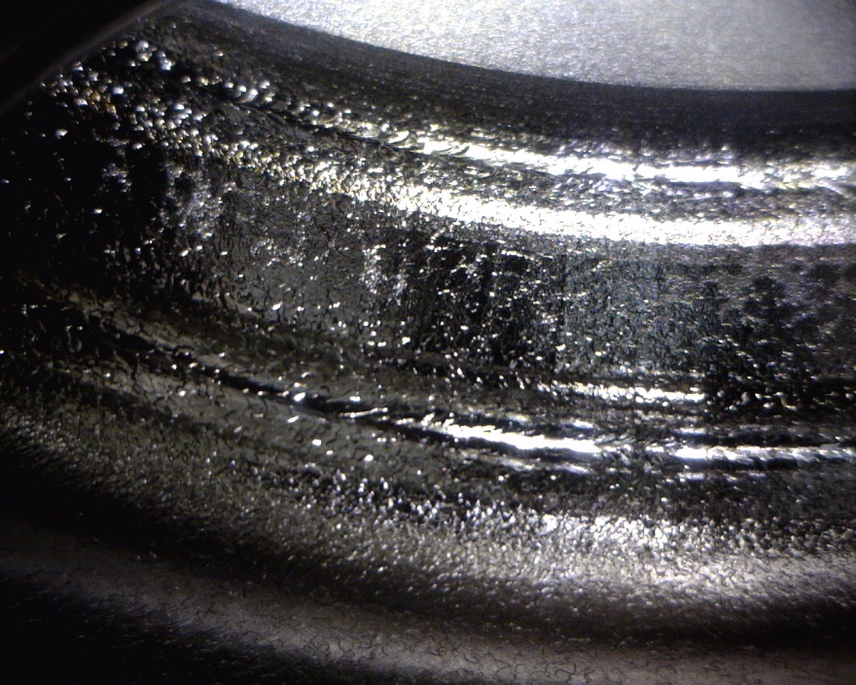
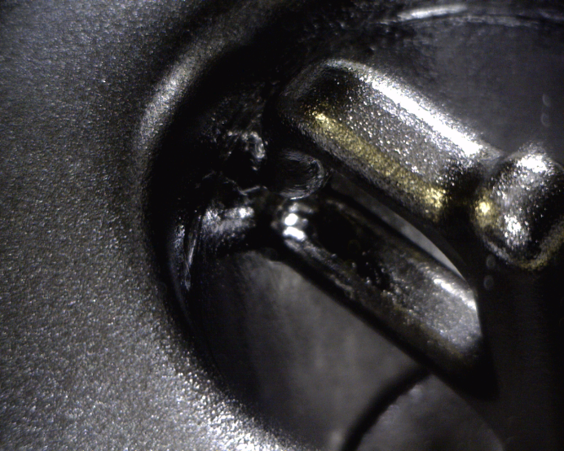
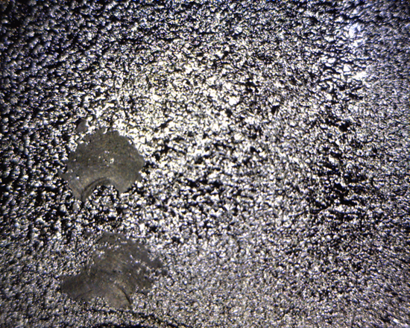
Images in different locations of the 3 1/2-cell cavities
Field probe port
Equator weld
Endplate
HOM probe
TTC Meeting Milan, Italy 28th Feb – 3rd Mar 2011

Slide 15
Wish list for an optical inspection system
Illumination: variable intensity, different colors (filters), polarized
Manual focus ←→ auto focus
Optical stand with dampers (System vibrations free)
Optical stand with linear arm movement
Optical system clean room compatible?
Image acquisition via interface to a laptop
Optical wedges for software calibration
Image processing using dedicated software
If in situ cavity repair is intended, the optical system CAN help to
control the operation done in real time, but they should be cheap,
easy to be replaced.
Expensive optical system can be irreversible affected by dust (if grinding is used) or plumes (if local laser healing procedure is intended).
TTC Meeting Milan, Italy 28th Feb – 3rd Mar 2011

Slide 16
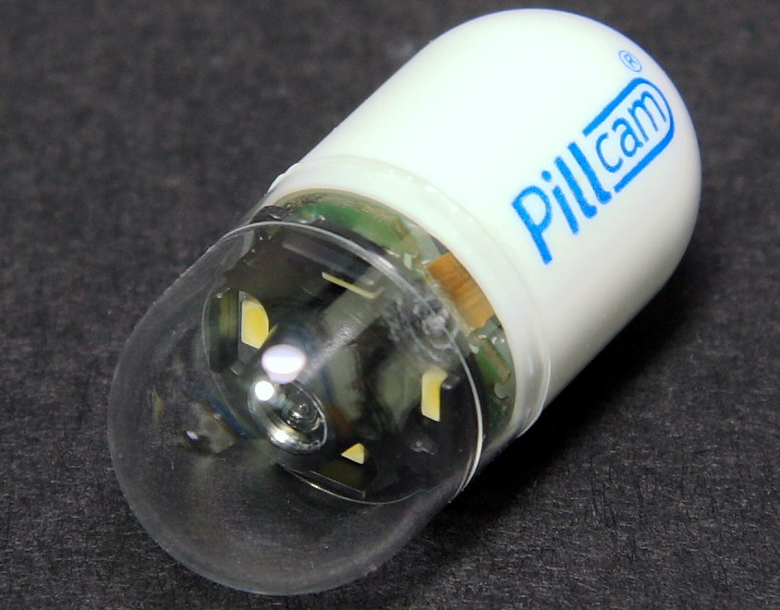
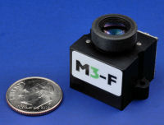
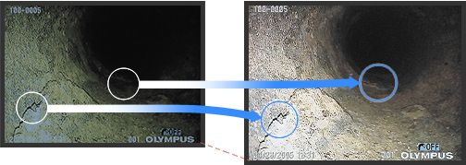
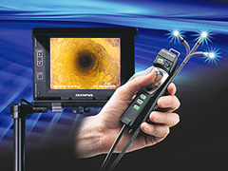
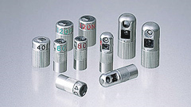
Miniaturized camera with autofocus features
Olympus IPLEX SA IIR Replaceable optical adapters sharply focus light at the micro-pixel level to realize supremely sharp, vivid detail that contributes precise measurement and inspection.
TTC Meeting Milan, Italy 28th Feb – 3rd Mar 2011

Slide 17
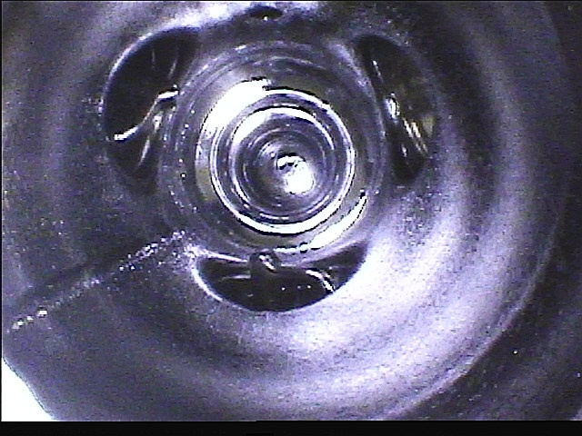
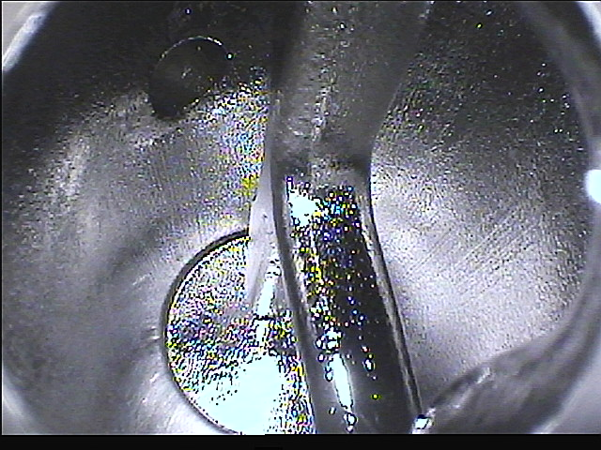
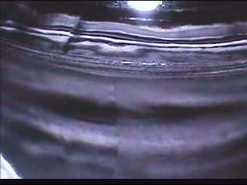
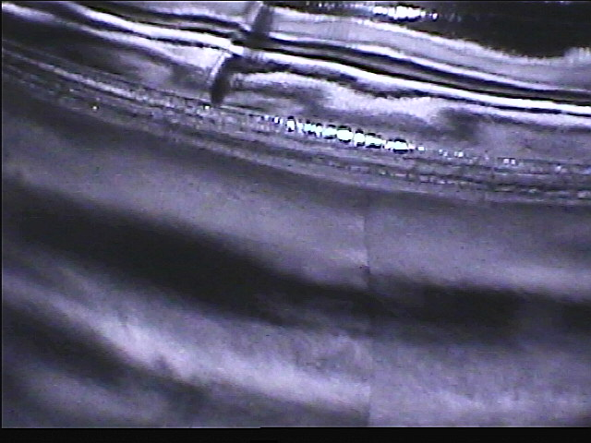
Olympus demo

Slide 18
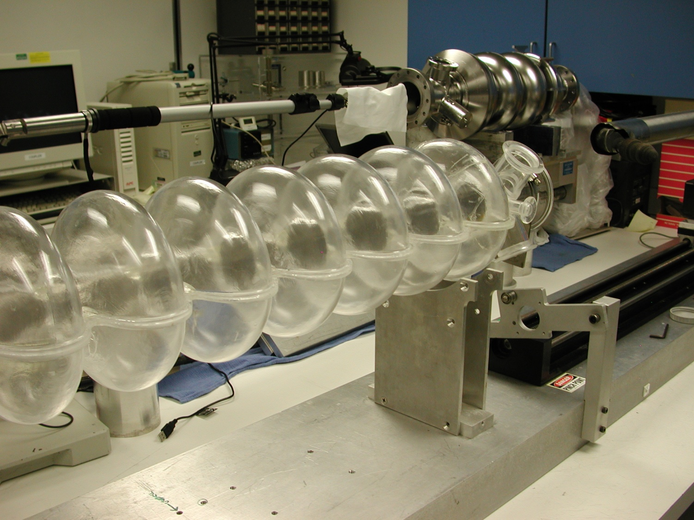
Conclusions
Efficient, inexpensive optical systems for visual inspection
metallic surfaces can be successfully implemented.
These systems can provide valuable information and
defect localization on initial material as well as on the internal cavity surface.
Once data acquisition is done (large cavity production will need TB of storage space), computer assisted analysis can facilitate interpretation and data base mining.
TTC Meeting Milan, Italy 28th Feb – 3rd Mar 2011

