Slide 1
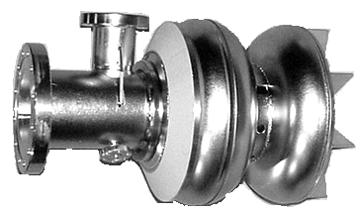
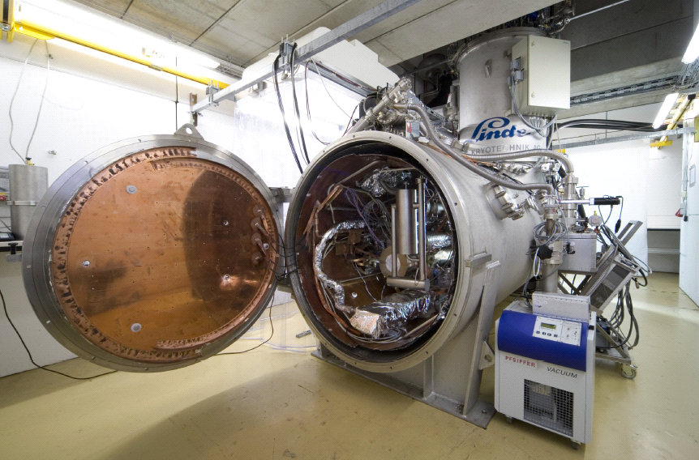
SRF Photoelectron Source
Development for BERLinPro
TTC-meeting Februar 28 – March 3 2011 – Milano, Italy
O. Kugeler (based on talk given by A. Neumann)

Slide 2
Path towards a Photoinjector for BERLinPro
ERL: Combine high beam quality of linac with high average current of storage rings
Booster
Gun
Main linac
Merger
Return arcs
Beam dump
RF Photoinjector
Undulator
Goals for ERL demonstrator
ERL challenges:
  Optics design
  HOM excitation, beam break up
  Bunch length manipulation
  Beam loss
  Timing jitter
  Field control
But: The beam quality is determined by
the source
max. beam energy | 100 MeV
max. current | 100 mA
nominal bunch charge | 77 pC
max. rep. rate | 1.3 GHz
normalized emittance | < 1mm mrad
cryo load @ 1.8K | 240 W
No source has ever reached these parameters
→ Workshop at HZB with leading experts in 2009: Decision for SC RF Photoinjector

Slide 3
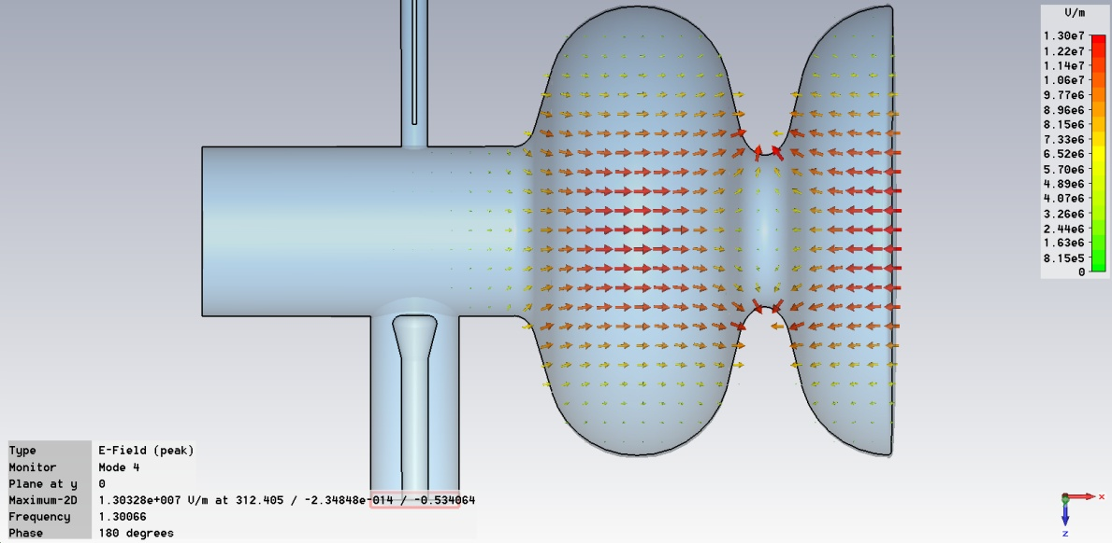
SC RF photoinjector principle
Pick-up probe
Excited π-TM₀₁₀ mode
Pb-Cathode
TTF-III Input coupler
- 1.6 cell TESLA structure with backplane
at the equator; EM design by
Jacek Sekutovicz:
Highest fields at Cathode region
Reaching ERL parameters is a complex
task and challenge
follow a three stage approach

Slide 4
The three stage approach
Stage A (Beam dynamics):
Study beam dynamics
of SC RF photoinjector:
  Emittance
  Field levels
  Stability
Starting point for SC design
and operation of SRF gun
no tuner. Sync with feeback
loop on laser rep-rate
Stage B (Peak Brightness):
Study + develop cathode
insert into SC injector
(choke filter):
Lifetime + quantum efficiency
of cathode materials
Reliable cathode
replacement scheme
Stage C (High avg. Current):
SC design for ERL design
current
High power operation
HOM damping
Cathode lifetime
Started here

Slide 5
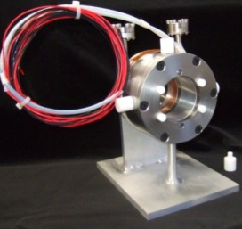
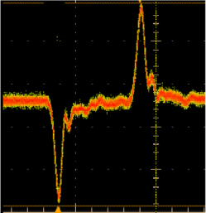
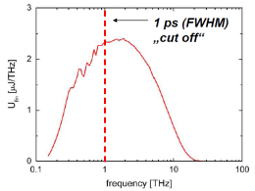
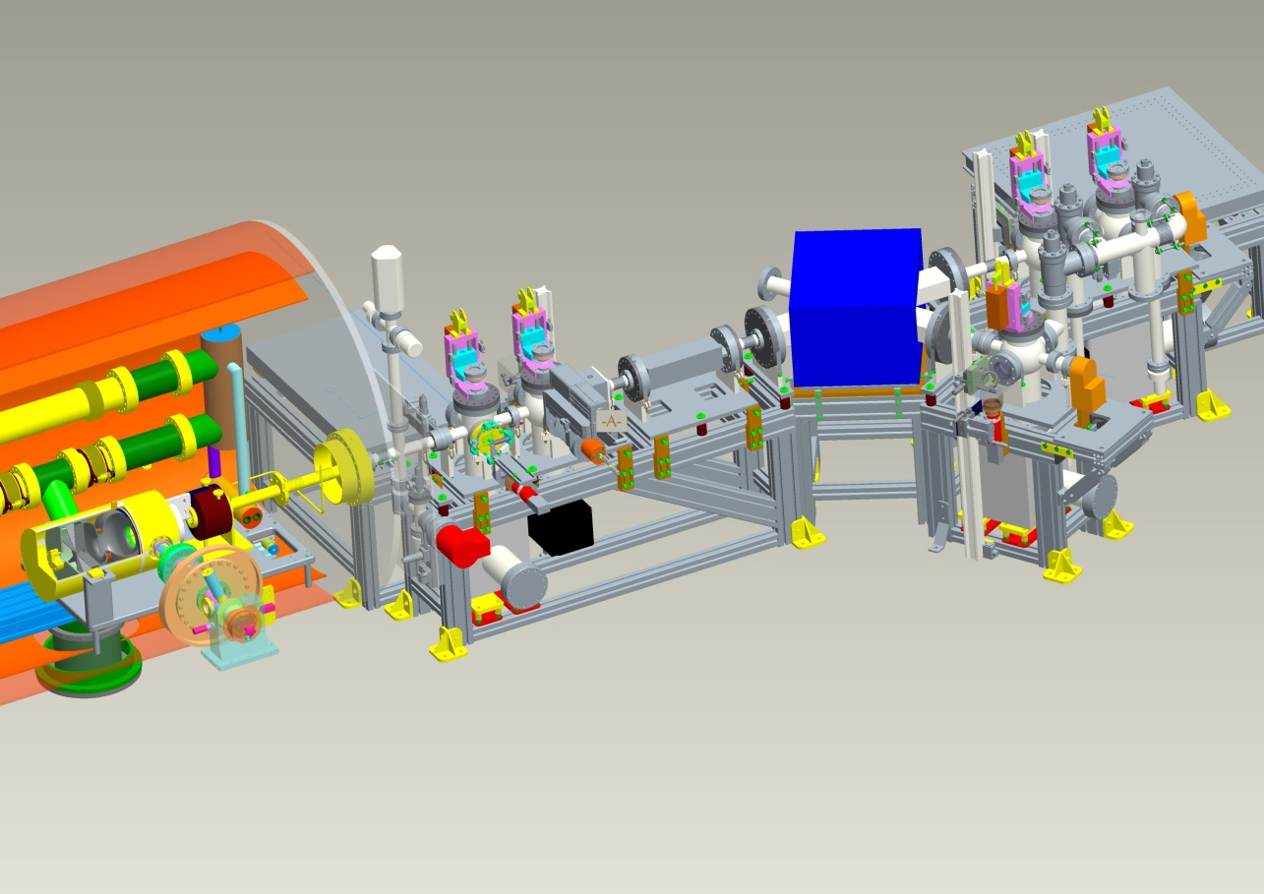

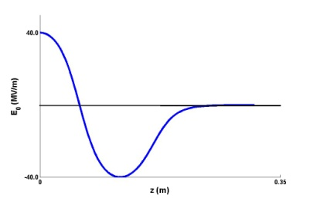
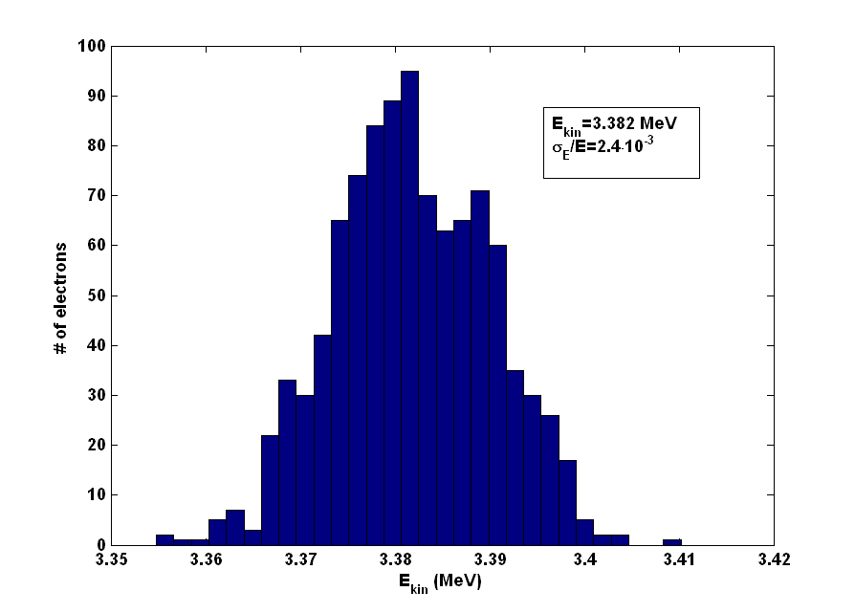
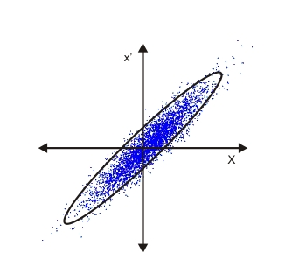
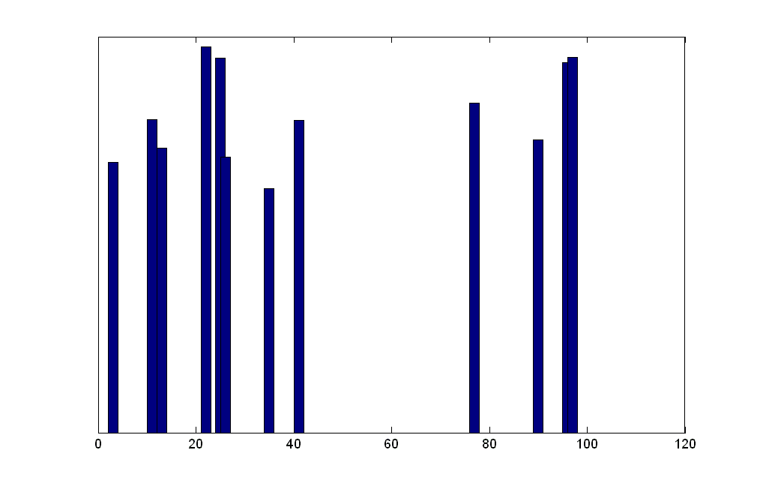
Stage A Gun with Diagnostic beamline at HZB
SC Solenoid
(Niowave)
Stripline BPM,
ICT
THz diagnostics
ΣQ
Faraday Cups
SC Cavity
HoBiCaT
cryostat
Dipole magnet
Mass Spectrometer
Viewscreens
First time operated fully SC photoinjector ensemble (SC Cathode, Cavity & Solenoid)

Slide 6
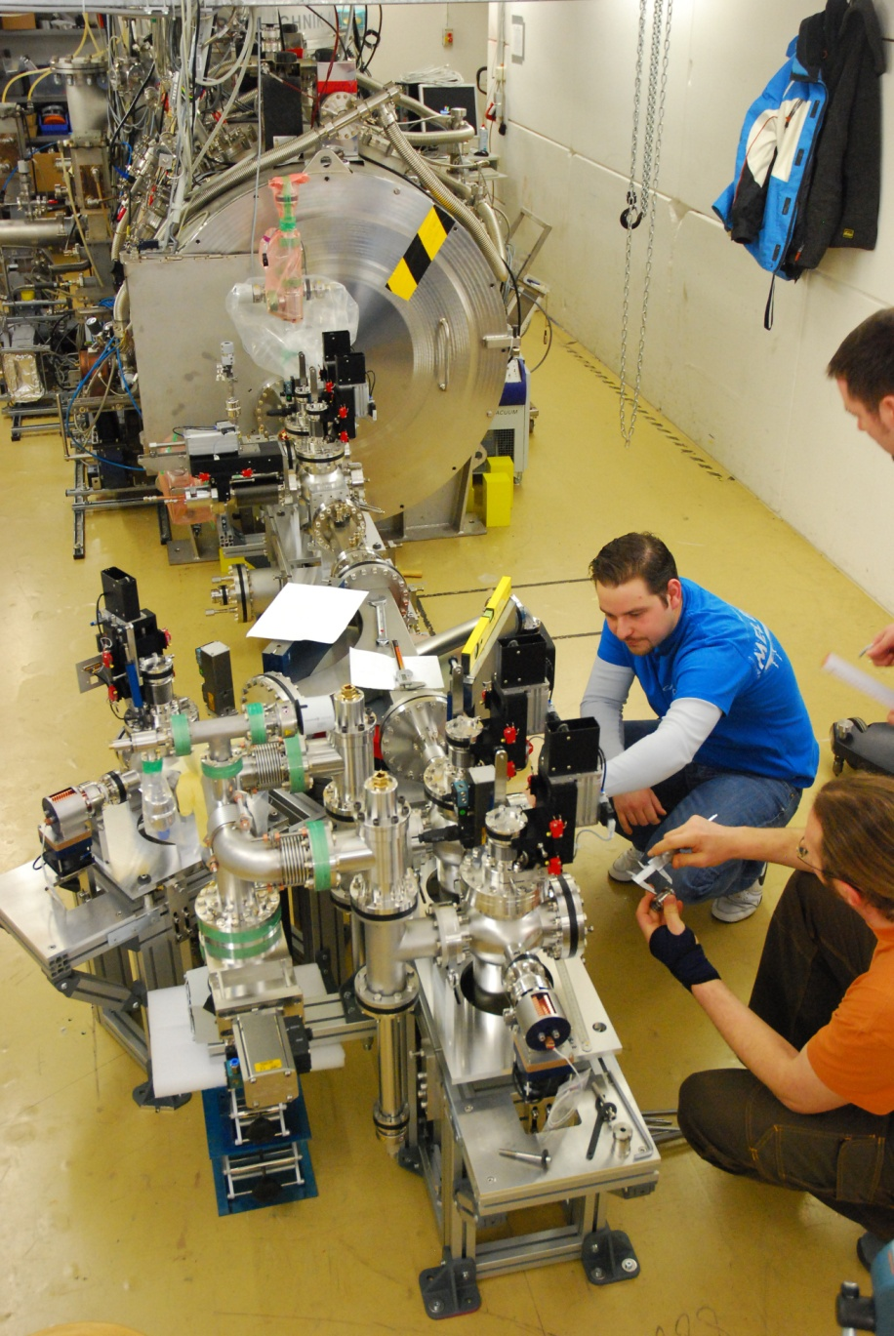
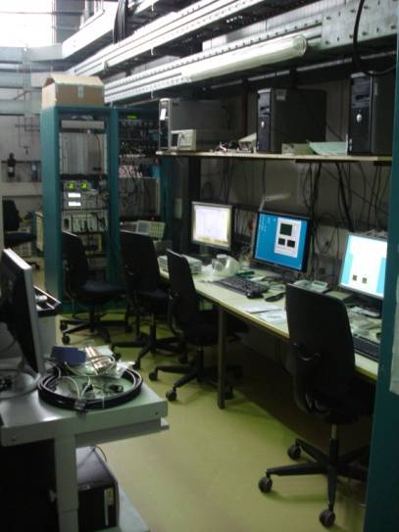
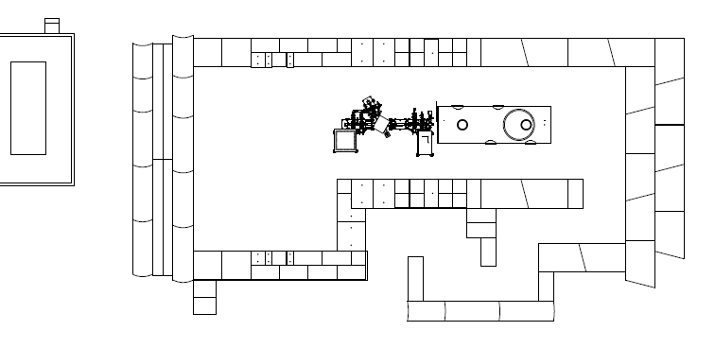
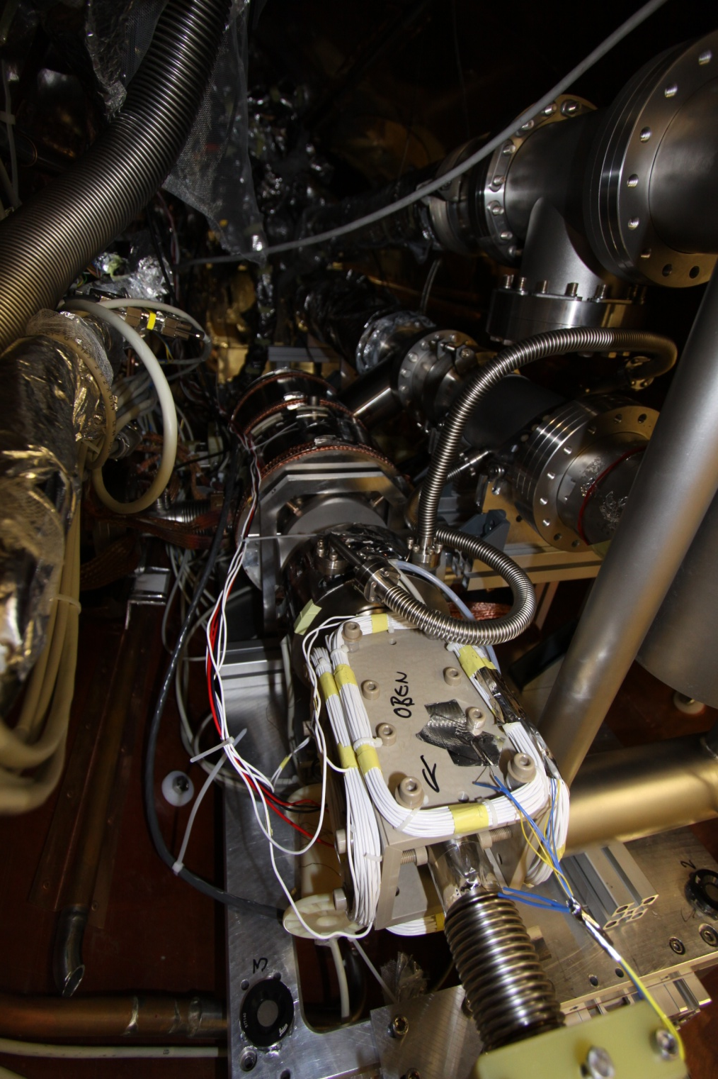

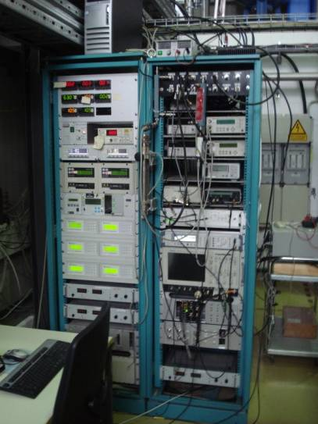
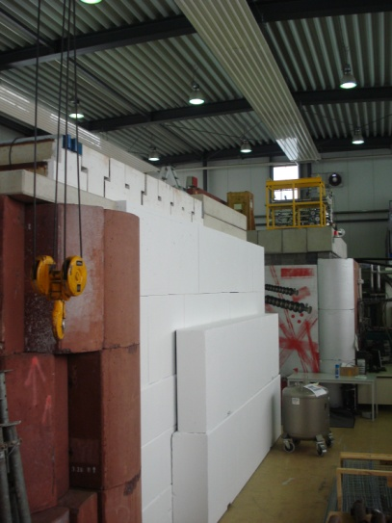
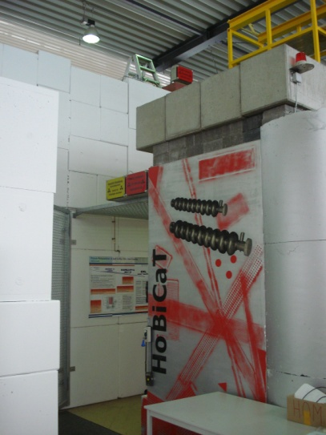
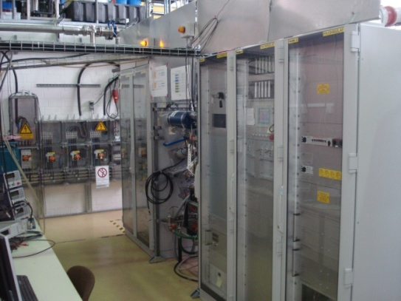
Extension of the HoBiCaT Cavity Test Facility
Laser
hut
Laser beamline
C
o
n
t
r
o
l
ro
o
m
HoBiCaT cryostat
Diagnostic
e- beamline
IOT (CPI, cw, 17kW)

Slide 7



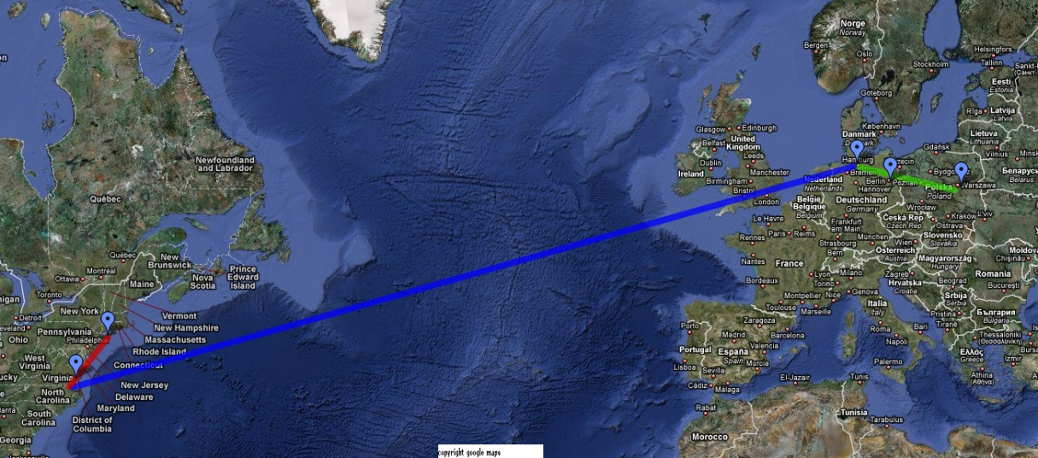







The Collaboration for the Stage A injector
Cathode Laser cleaning
QE measurements
Cavity
electro-magnetic design
Pb Cathode
deposition
Cavity fabrication,
treatment and testing
Project planning
Cavity mechanical design,
Setup of test facility,
Beam physics program
Laser design
and fabrication

Slide 8
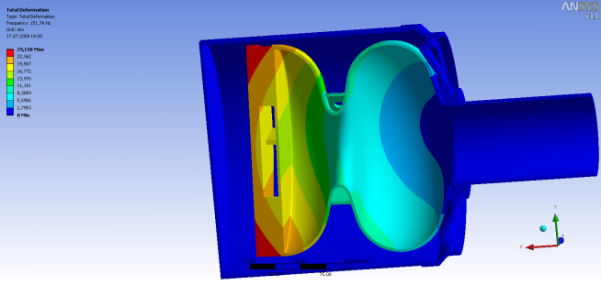
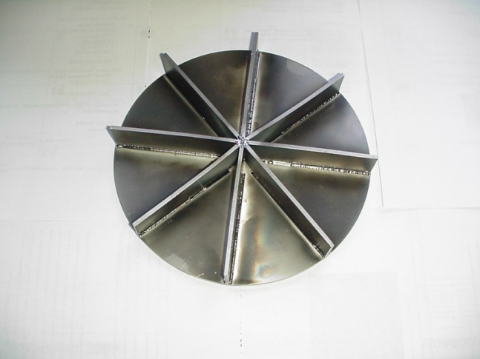
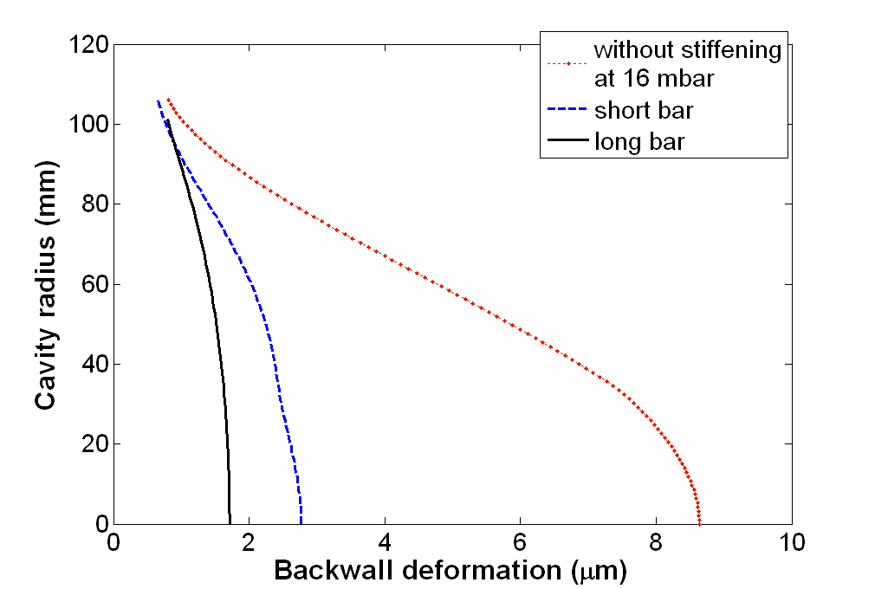
Mechanical design: Countermeasures to increase field stability
Beam quality dominated by field stability
Field stability in SC cavity: Avoid detuning (deformation) of the cavity
Combined FEM mechanical and
Electro-magnetic field simulations
→ low deformation (detuning) design
ANSYS simulation
Backwall stiffening
Detuning in Hz/mbar
F

Slide 9
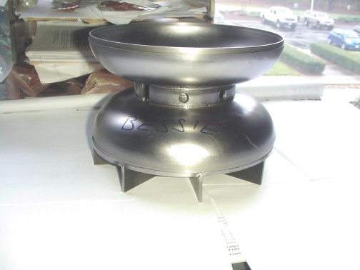
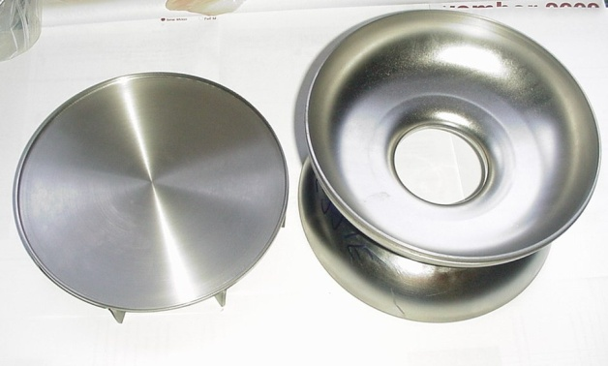
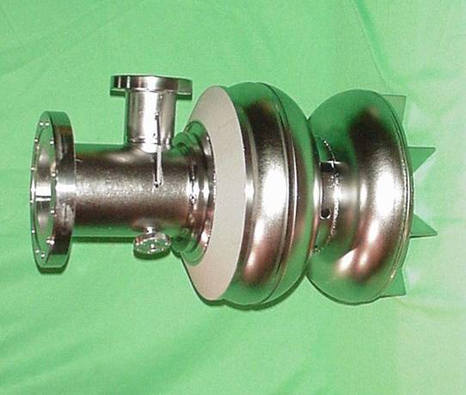
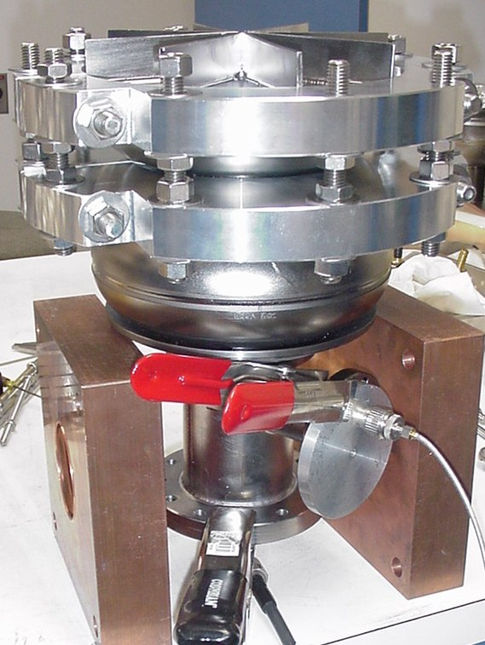
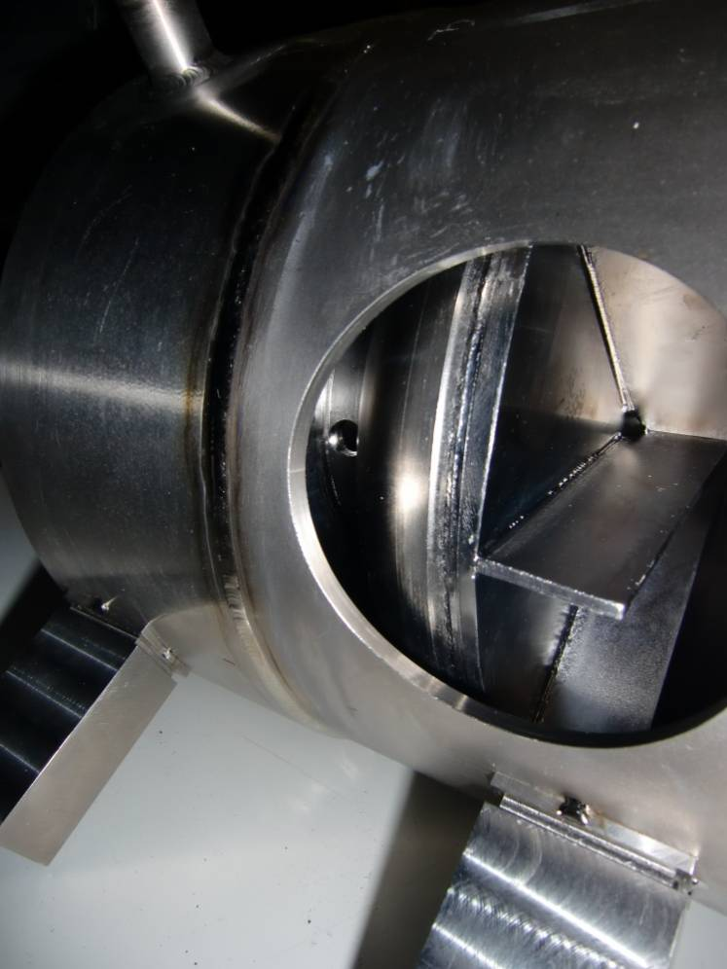
Cavity fabrication at Thomas Jefferson Lab
Fundamental power
coupler port
Stiffening ring
Status Anfang des Jahres:
Cavity backwall for
cathode
Cavity half-
cells
Passive stiffening
System: “Spider“
Pick-up Port
„Helium vessel endplate“
All pictures courtesy
of Peter Kneisel
Cavity in helium vessel
Cavity tuning setup at JLab

Slide 10
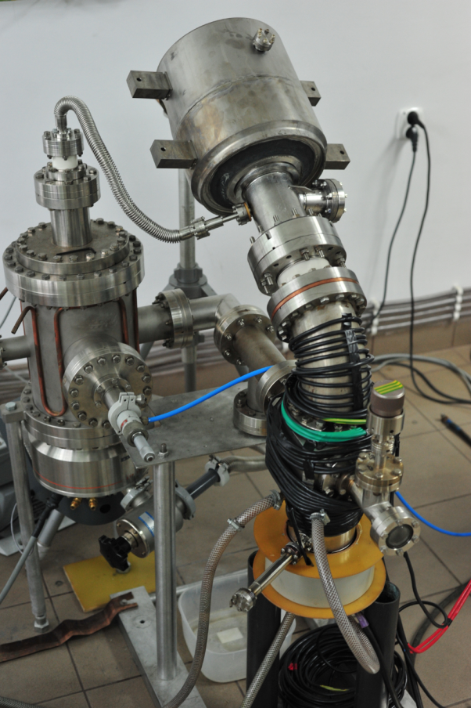
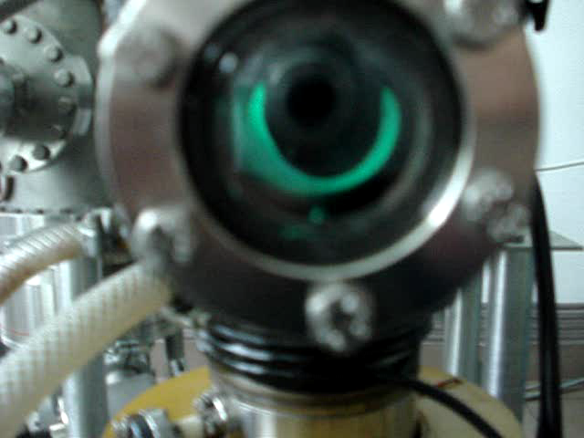
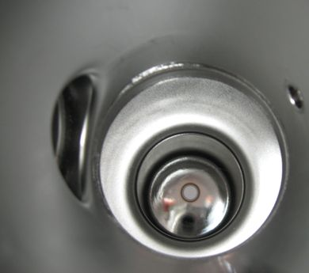
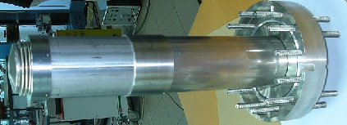
Cathode deposition at IPJ Andre Soltan Swierk
Plasma arc
depositon setup
in 30° configuration
16 x 5min depositions result
in a few hundred nm thick
Pb cathode film
Cavity with helium vessel
Pb cathode film
Mask to protect cavity

Slide 11
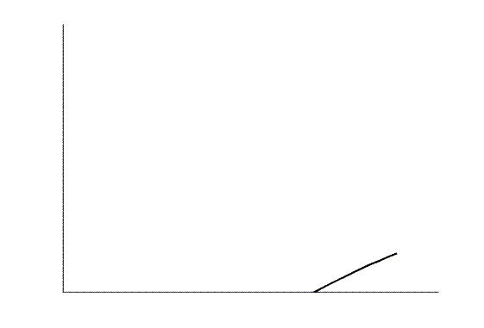
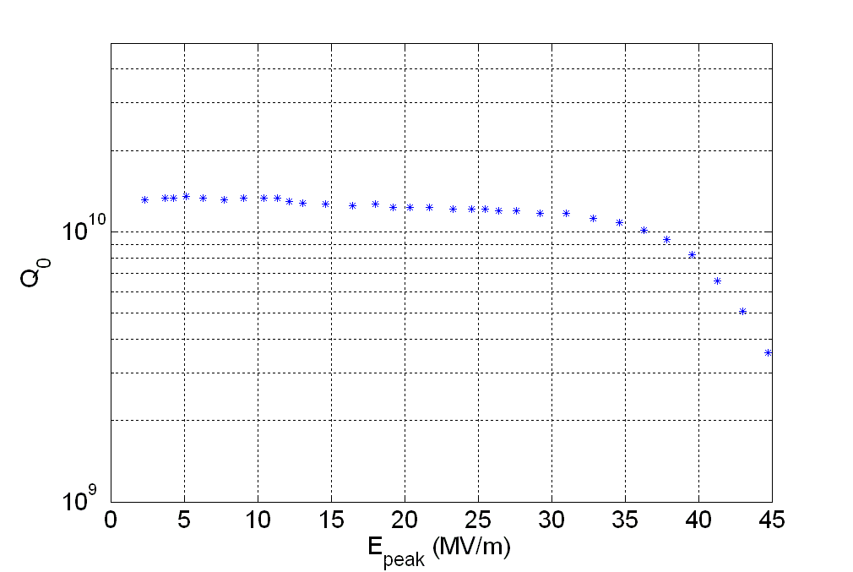
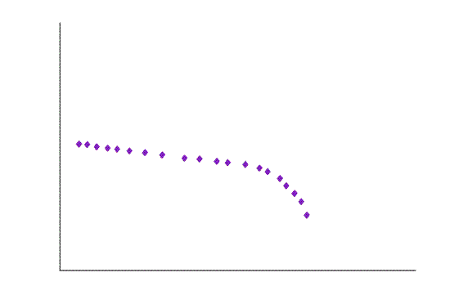
Cavity vertical tests at Jlab: Current status
                Acceptance tests for SC cavity:
                R_{surf} or Q₀ as function of peak field
                Test after fabrication, tuning and
                several treatments:
                Peak fields > 40 MV/m, light field
                emission at highest fields
                Cathode deposition
                First cathode was lost
                Second cathode depositon
ERL operation
Final vertical test with cathode:
Fields above ERL operating range
Surface resistance below cryogenics limits
→ Cavity ready for beam production!

Slide 12
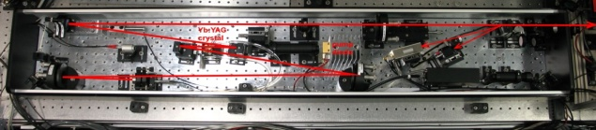
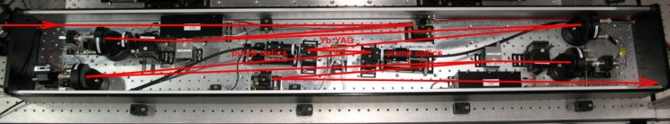
Outlook: Near future
almost done
Installation of cavity, solenoid and beamline in HoBiCaT
Cold test of solenoid
Installation and commissioning of laser
First horizontal RF tests:
  Q₀(E_{acc}), cryogenic tests
  LLRF field control: Field stability
  Test with laser and RF, synchronization
First beam on viewscreen by spring 2011
Start design of Stage B in collaboration with FZD (HZDR), DESY
and TU Dortmund
almost done
People involved:
W. Anders, M. Dirsat, A. Frahm, A. Jankowiak, T. Kamps, J. Knobloch, O. Kugeler, A. Neumann, T. Quast, J. Rudolph,
M. Schenk, M. Schuster, Helmholtz-Zentrum Berlin für Materialien und Energie GmbH, Berlin, Germany
T. Rao, J. Smedley, BNL, Upton, Long Island, New York, USA
J. Sekutowicz, DESY, Hamburg, Germany
P. Kneisel, JLAB, Newport News, Virginia, USA
R. Nietubyc ,The Andrzej Soltan Institute for Nuclear Studies, Swierk/Otwock, Poland
I. Will, MBI, Berlin, Germany + the support of many more…….

