Slide 1
1.3 GHz SC Cavities for the European XFEL
Presented by
Waldemar Singer
on behalf of the XFEL WP4 cavity team
Notes:
1
How to edit the title slide
Upper area: Title of your talk, max. 2 rows of the defined size (55 pt)
Lower area (subtitle): Conference/meeting/workshop, location, date,
your name and affiliation,
max. 4 rows of the defined size (32 pt)
Change the partner logos or add others in the last row.

Slide 2
Main issues: preparation phase are finished, production started
Preparation Phase 2005-2010
Specification
Mechanical fabrication
Treatment
RF measurement
Documentation
Prototype cavities
Production Phase 2010-2014
Current status of the cavity fabrication contract
Contract related issues (PED, Transport, Spec. changes)

Slide 3
Specification
Specification is released. Contact person: waldemar.singer@desy.de.
Specification documents:
Series mechanical fabrication: (XFEL/001- XFEL/018)
Series Surface and acceptance test preparation (XFEL/A - D)
Hardware and Processes used at DESY (XFEL/Appendix I - IV)
ILC-Hi Grade Cavities as a Tool of Quality Control (XFEL/HiGrade)
Sets of drawings
Two main aims have been pursued:
Spec. has to contain all detailed requirements for the cavity mechanical fabrication, treatment and assembly for RF test
DESY experienced has to be included.
The work was done by the assistance of the experienced external advisers from the industry. Many thanks to the contributing DESY and INFN experts, whose enthusiastic effort allowed us to bring forward the work on cavity specifications for the XFEL project.

Slide 4
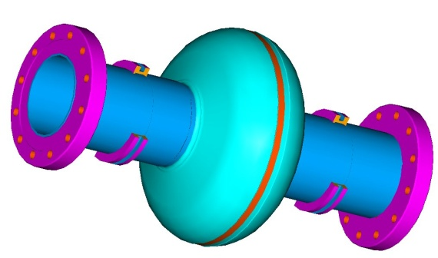
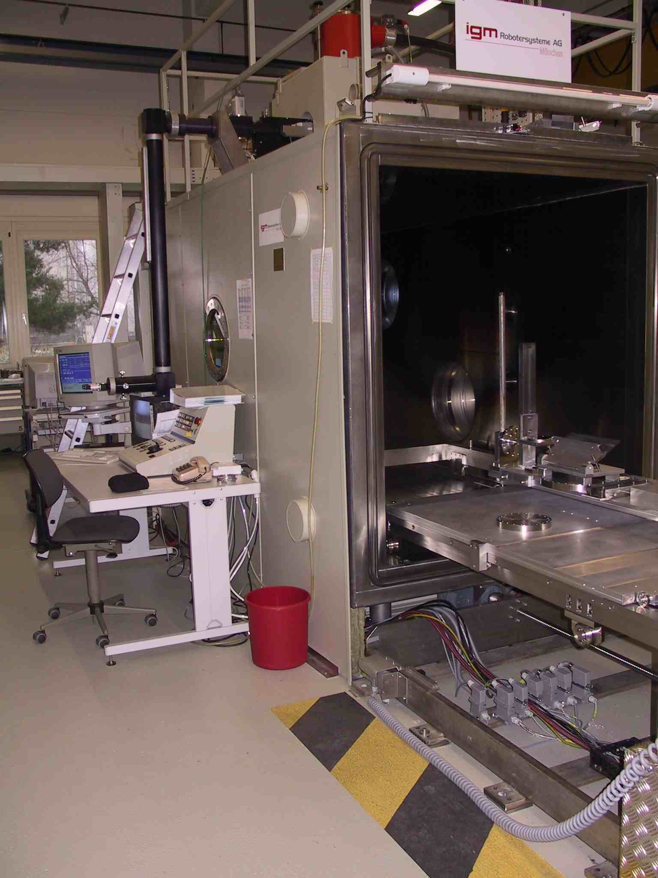
Single cell cavity R&D program (D. Reschke) was a good tool for specification
Iris seam
Rework the specification for cavity mechanical fabrication
Qualifying of new material suppliers
Rework of the material specification:
DESY EBW machine

Slide 5
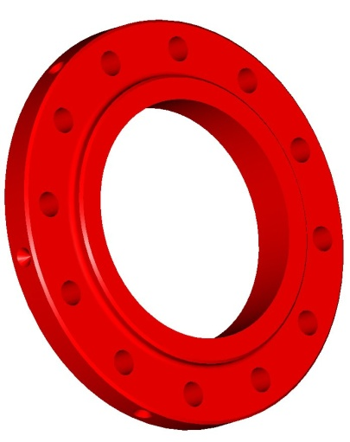
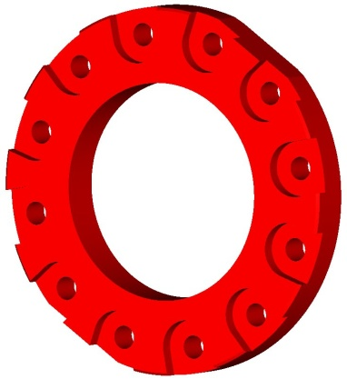
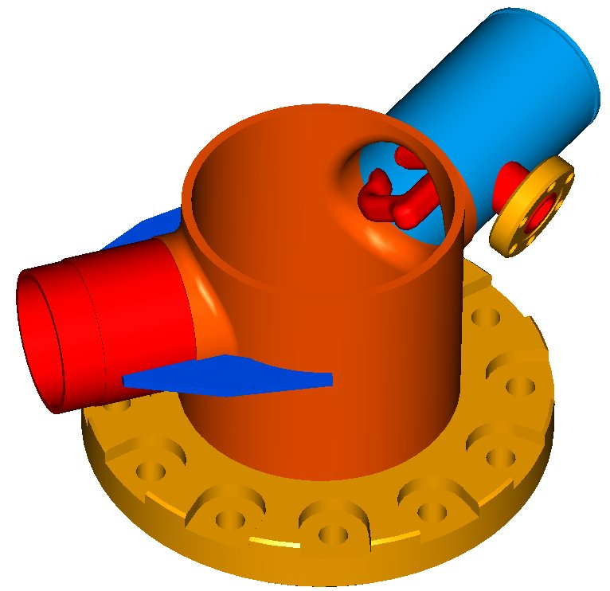
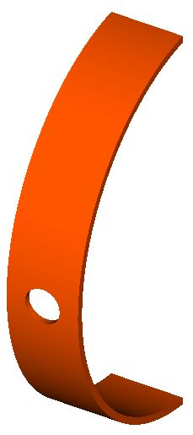
Mechanical fabrication: TESLA Design – minor design changes. Four cavities of XFEL design produced
Reducing of flange machining
reference boreholes
Removal of coupler port stiffener (rib)
Reducing of flange machining
Removal of outside recess (equator area)
Less holes and thinner the stiffening ring
New reference boreholes for cavity-string-alignment
Review tolerances
Stiffening ring
Rib is removed

Slide 6
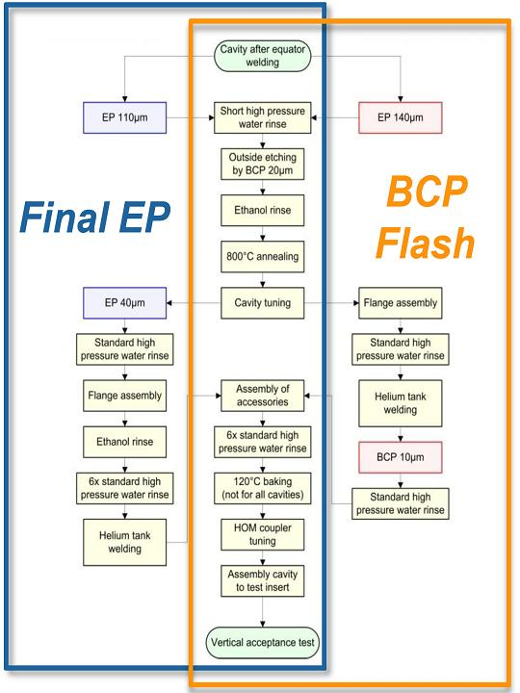
Treatment: XFEL treatment recipe was worked out on prototype cavities
Prior surface treatment.
EP 110-140 μm (main EP), ethanol rinse, outside BCP, 800°C annealing, tuning
Final surface treatment - two alternative options
1. Final EP of 40 μm, ethanol rinse, high pressure water rinsing (HPR) and 120°C bake
2. Final BCP of 10 μm (BCP Flash), HPR and 120°C bake.
Integration of the helium tank, assembly of HOM, pick up and high Q antennas before vertical RF test

Slide 7
RF Measurement. Q-switch. Observed on several cavities
Cavity in tank with HOM couplers and feedthroughs
Cavity is limited by the Q-switch at 10..15 MV/m without FE.
Q-switch is a thermal effect connected with HOM couplers.
Without HOM couplers and feedthroughs no Q-switch.
EP 110μm, alc. rinse, 800°C 2h, EP 48μm, HPR, alc. rinse, 6xHPR, tank welding, HOM feeds, 6xHPR, 120C bake out.

Slide 8
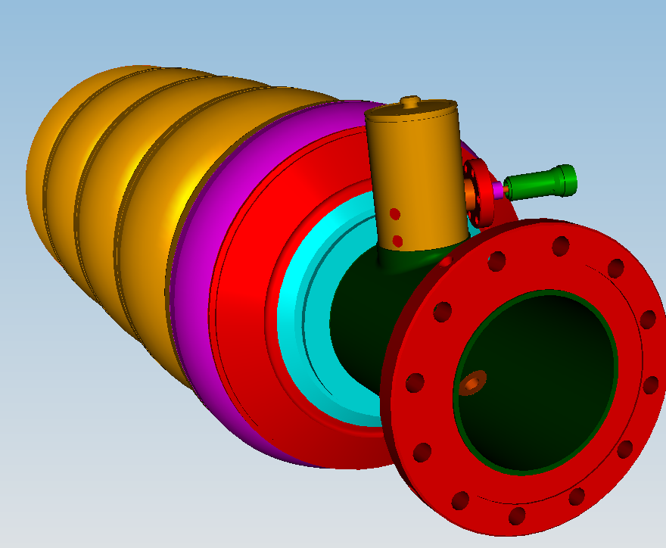
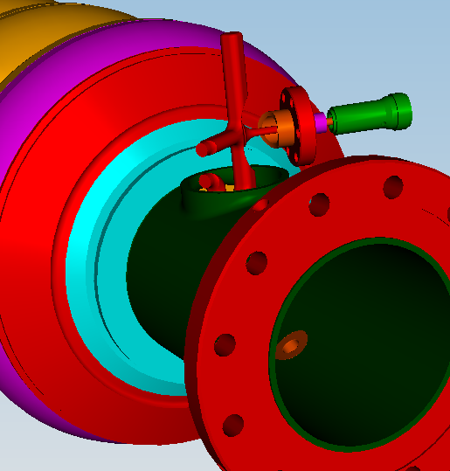
RF Measurement
 | Nominal operation (FLASH) | Acceptance cw RF test
Maximum E_{acc} | 24 MV/m | 24 MV/m
Maximum Cryogenic Load | If nominal=1 (~TESLA design) | x 100
F-part
Coupler housing
April, 19-22, 2010 , TTC, FNAL
J. Sekutowicz,
  In past we tested in the CW mode many cavities with welded HOM couplers (the coupler housing and F-part); reached Eacc is up to 40 MV/m. The difficulties come from the limited heat conduction of the HOM feedthroughs, when antenna is installed
Notes:
Before you start editing the slides of your talk change to the Master Slide view:
Menu button “View”, Master, Slide Master:
Edit the following 2 items in the 1st slide:
1) 1st row in the violet header:
Delete the existent text and write the title of your talk into this text field
2) The 2 rows in the footer area: Delete the text and write the information
regarding your talk (same as on the Title Slide) into this text field.
If you want to use more partner logos position them left
beside the DESY logo in the footer area
Close Master View

Slide 9
RF Measurement: Pulse Acceptance Test for XFEL Cavities
Proposed by J. Sekutowicz and successfully implemented
t_{pulse} = 7 x τ
E_{acc}
[MV/m]
t [s]
This reduces the mean cryogenic load by factor of 10.
Cavities in the pulse test demonstrate similar Eacc compared to the CW RF test without HOM antennas
t_{pulse}
~10 x t_{pulse}

Slide 10
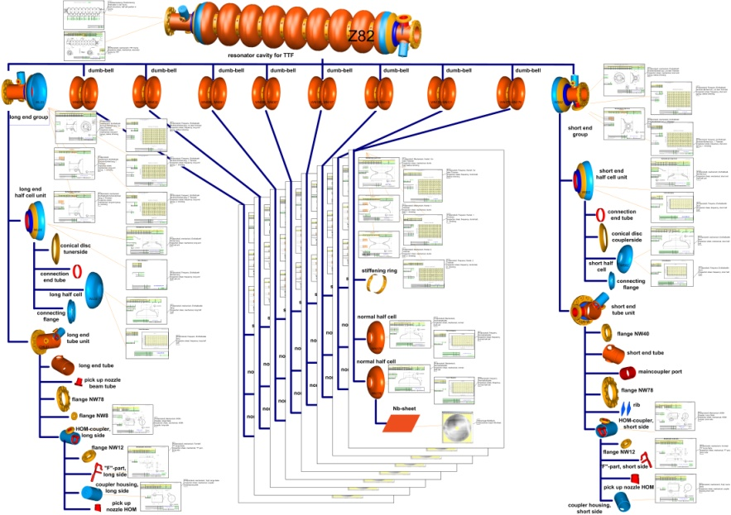
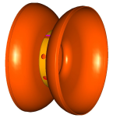
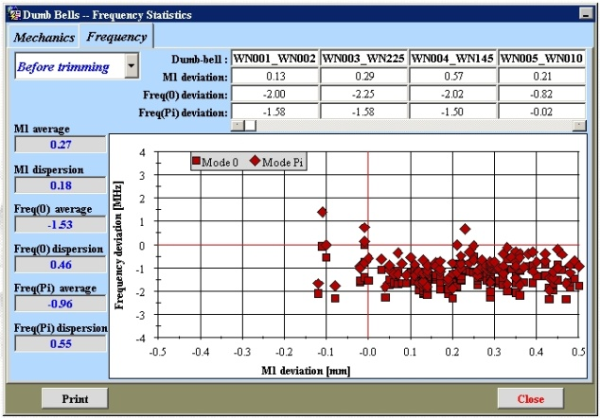
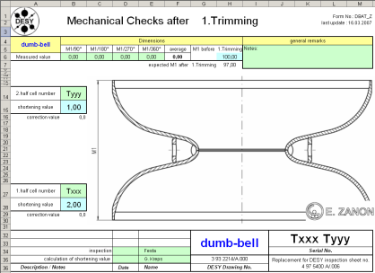


Electronically Documentation in EDMS.
Data Bank for statistic
EDMS
Fabrication
Cavity-DB
Phys. Part
Files
Inspection sheet
Inspection sheets for quality management
Fabrication structure. Subassembly parts related. Procedure related
Statistical analysis
All XFEL SC cavity documents (specifications, protocols, PED data etc.) recorded in EDMS. RI and E. Zanon have an access (to relevant data only)

Slide 11
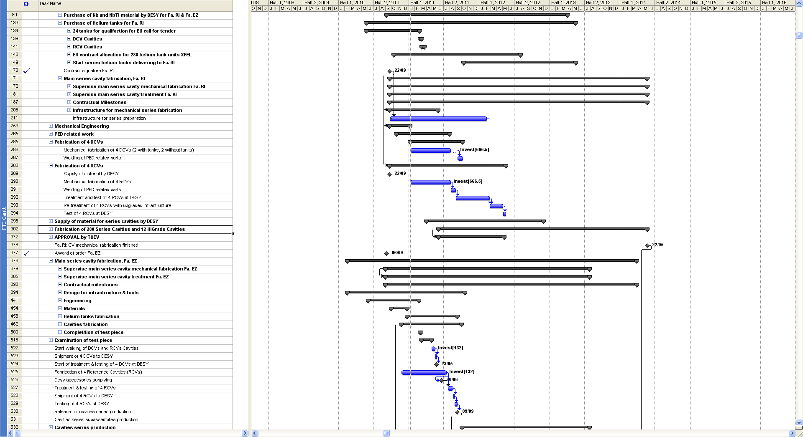
MP Plan with incoming and outgoing milestones and tracking possibility (example, not actual)

Slide 12
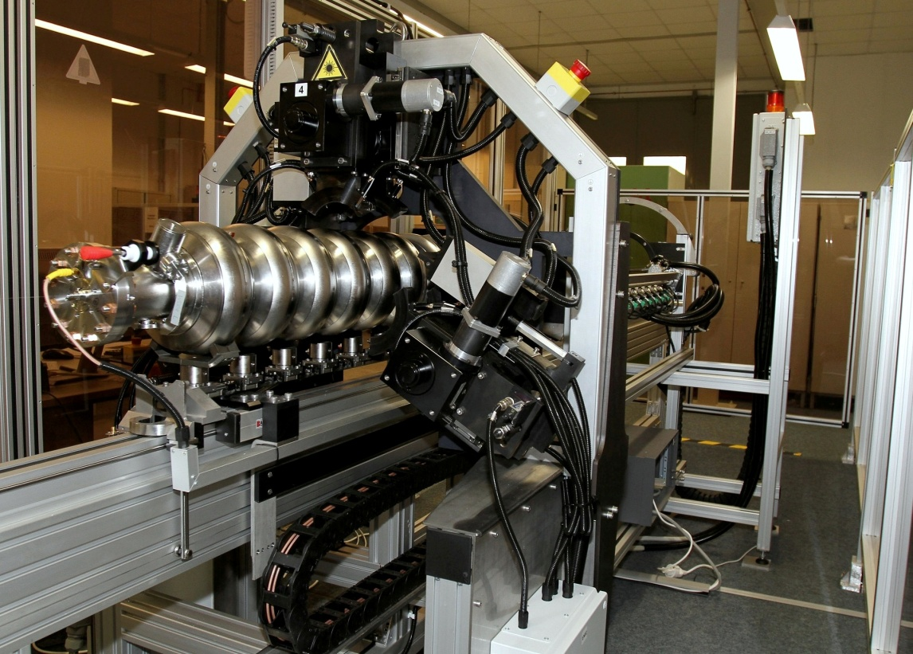
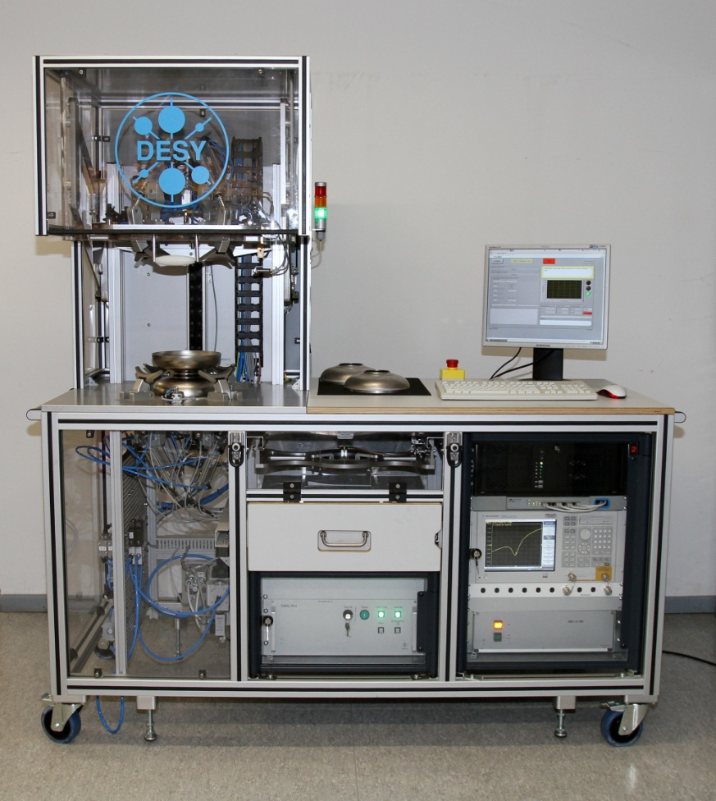
DESY support production with special equipment build at DESY (W.-D. Moeller ) and installed at RI and EZ
Machine for warm cavity tuning TM (tuning machine)
Equipment for RF measurement of half cells, dumb bells and end groups HAZEMEMA (Delivered to E. Zanon, will be delivered to RI in 2011)
Provided with CE certification according EU regulations

Slide 13
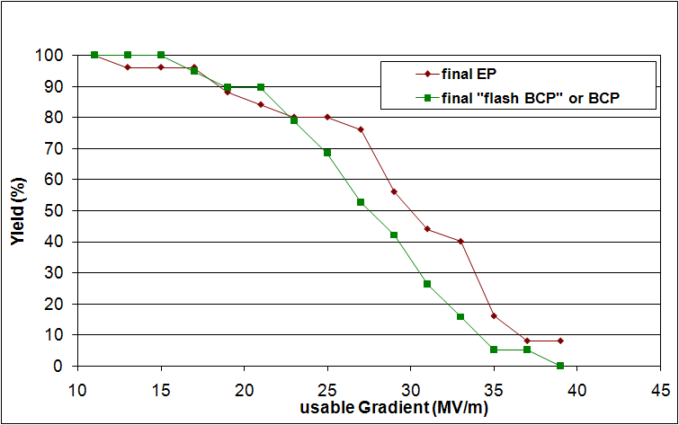
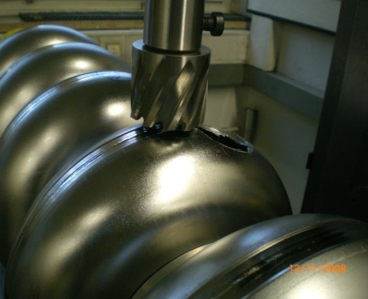
Performance statistic on prototype XFEL cavities.
Ca. 50 prototype cavities produced
13
Required for XFEL Eacc=24,3 MV/m. Qo=1E+10.
Performance statistic:
  - Difference between first and last test dominated by FE reduction
  - Final surface treatment
  influences yield at higher gradients
Decision: destroy few worst cavities and investigate the inside surface

Slide 14
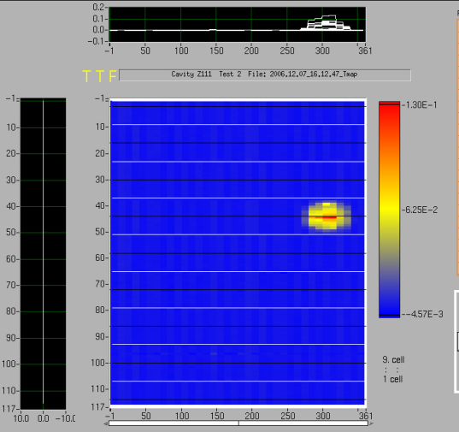
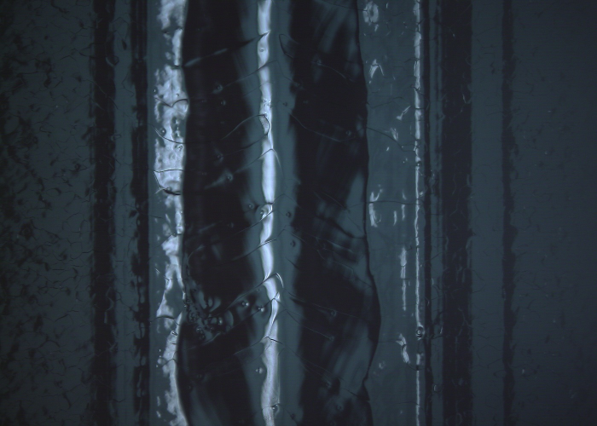
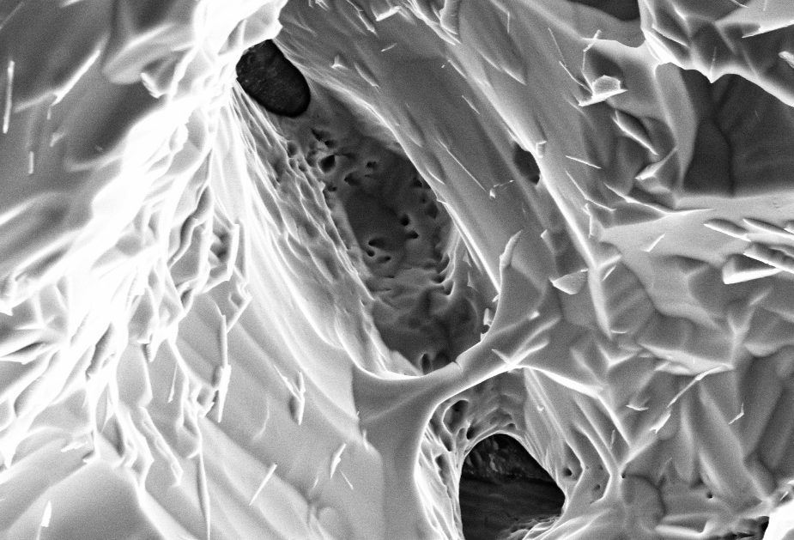

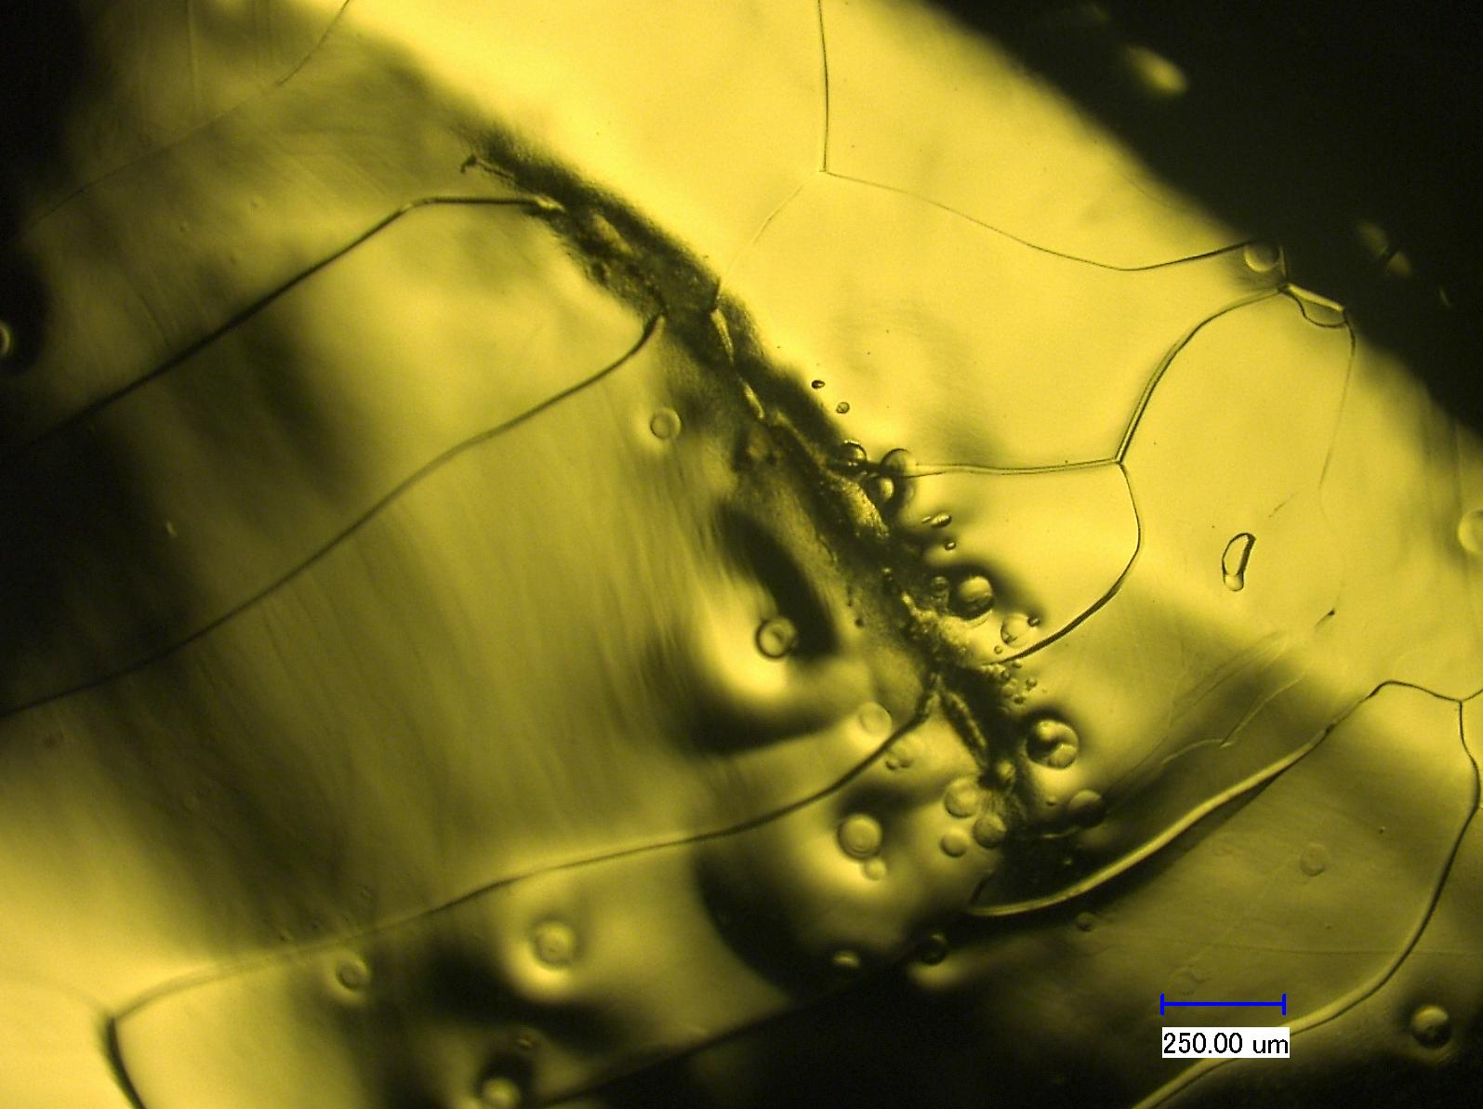
Type 1: Topographical defects at the welding seam.
3D image
Quench at 16,2 MV/m on equator
SEM. Quench location
Optical inspection by high resolution camera (S. Aderhold)

Slide 15
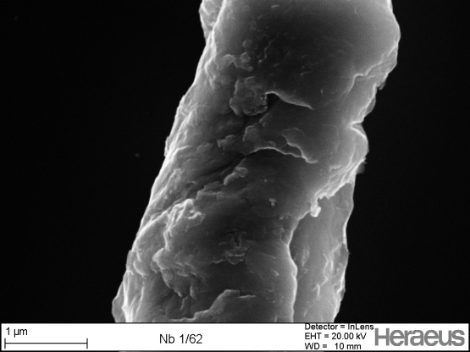
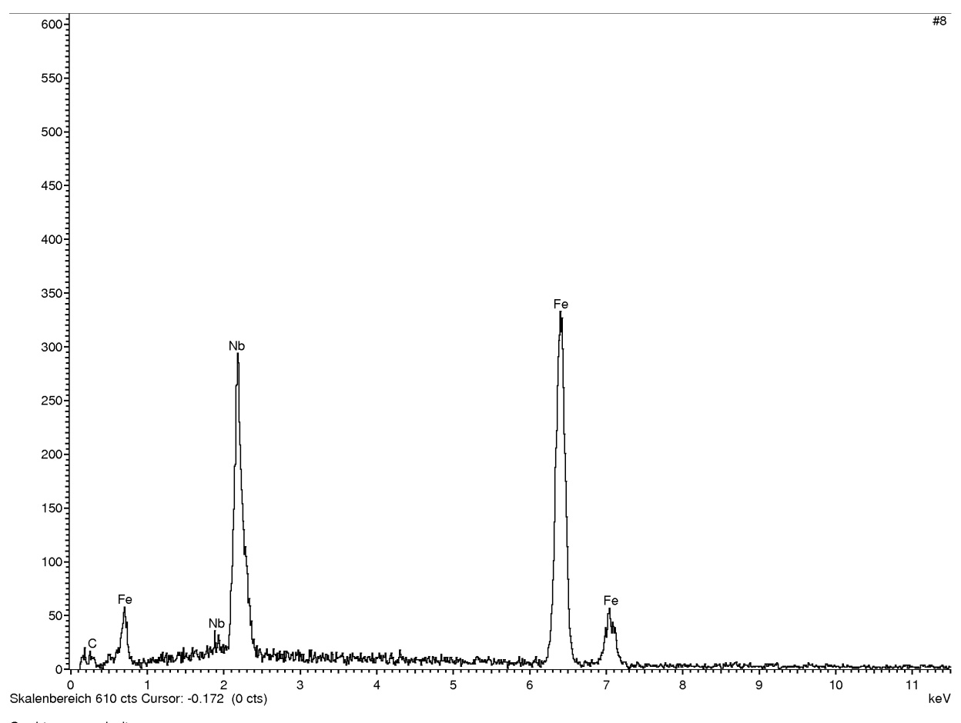
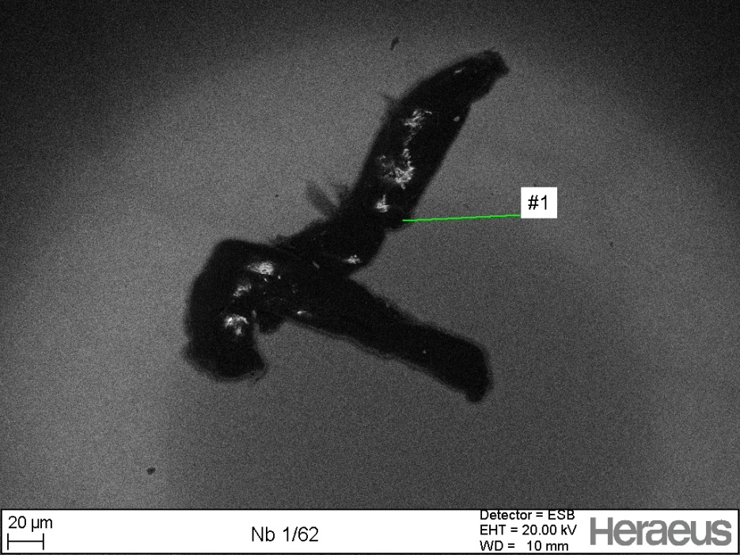
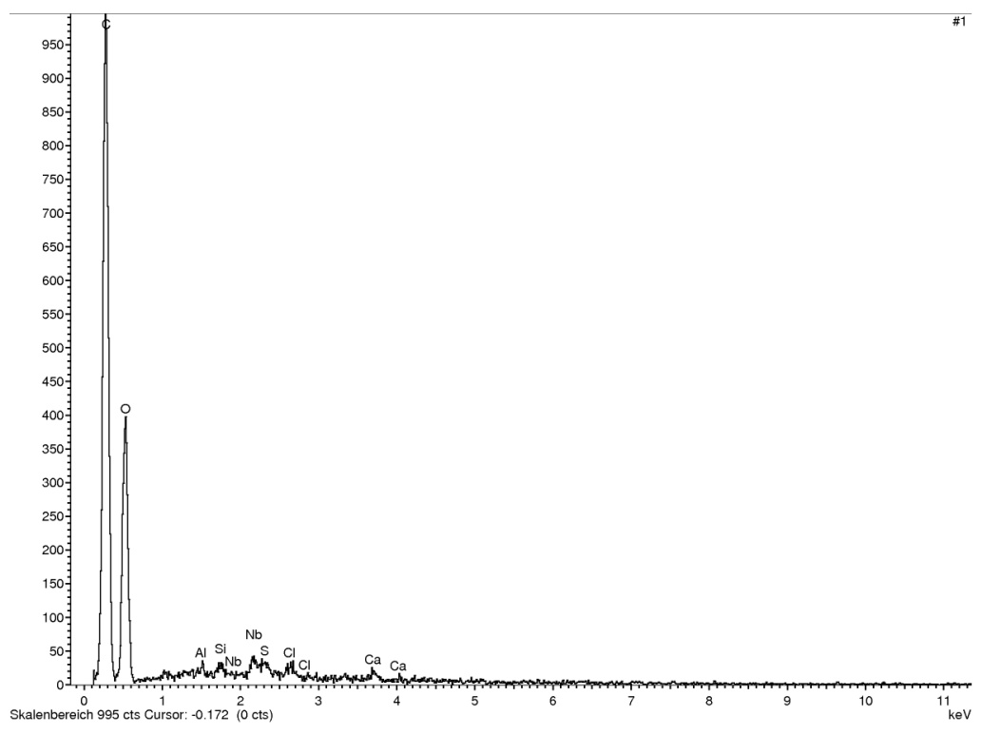
Type 2: Defects with foreign materials
C
Fe
Iron particle found
Many spots are detected. EDX of the biggest spot: C and O found

Slide 16
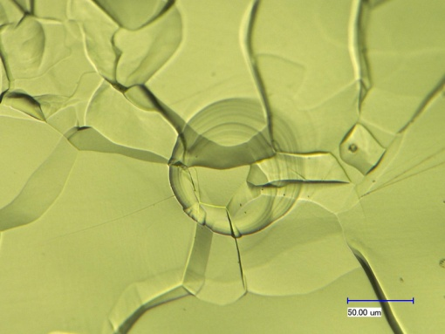
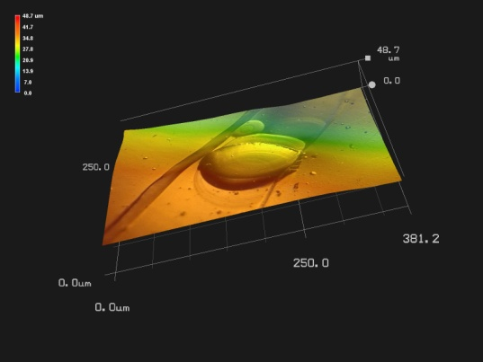
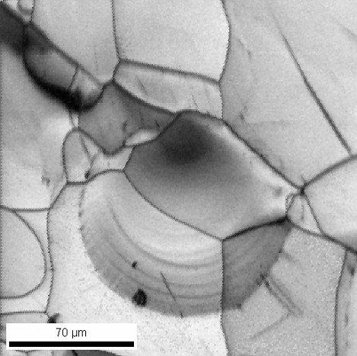
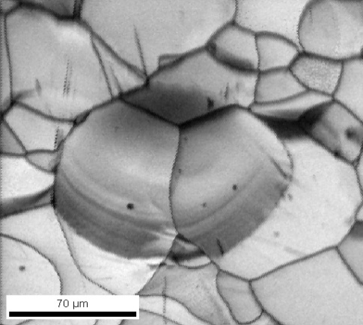
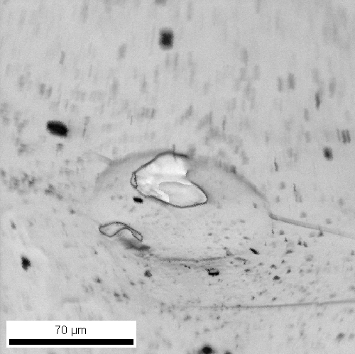
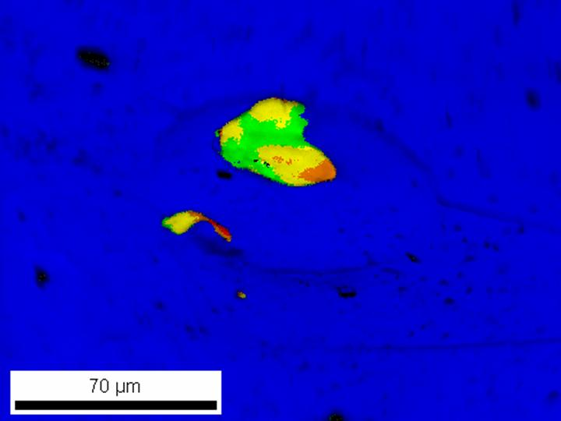
Type 3: Etching pits. EBSD with strain maps via grain reference orientation deviation (GROD)
Pits away from the weld, with grain boundary triple junctions
Cavity Z111: 3D Images of etching pits
GROD. Max lattice
Curvature 2.5°/mm
- Pits don’t seem to be related to grain orientation
Pits in weld HAZ are near areas of remaining cold work (high dislocation density)
Pits away from the weld, in fine grain area tend to be centered on grain boundary triple junctions
Z111: Pit in heat affected zone HAZ of weld, enclosing region of strain, all within one grain (R. Croocs)()

Slide 17
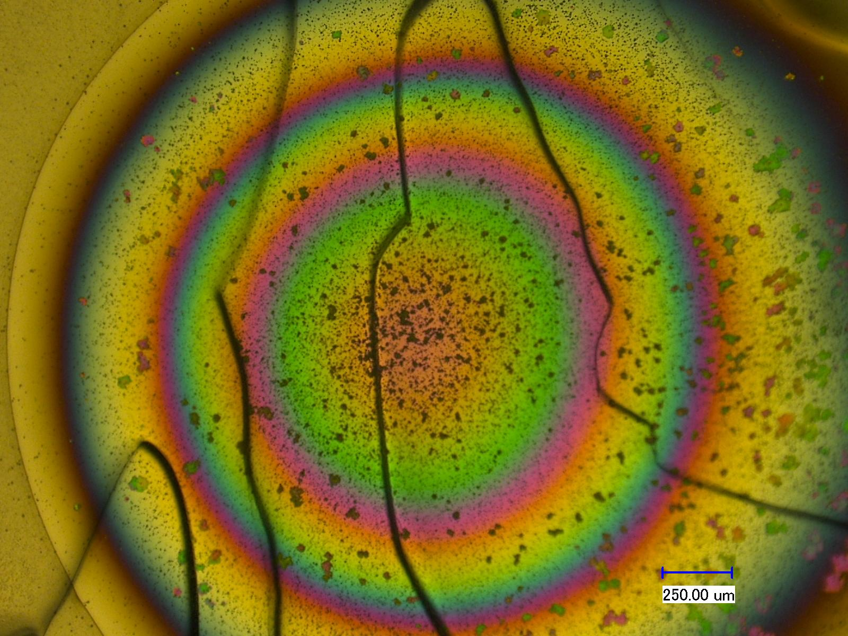
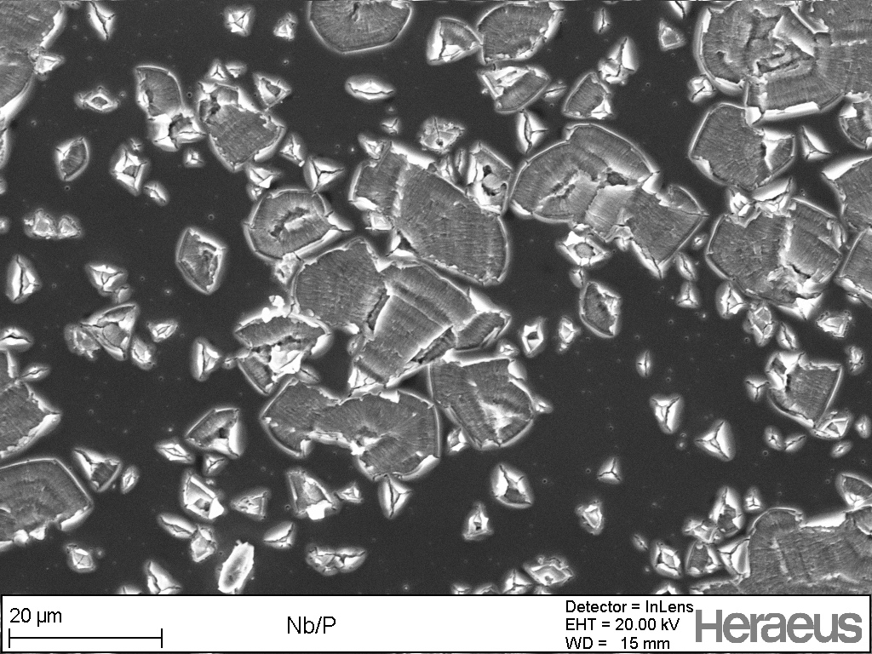
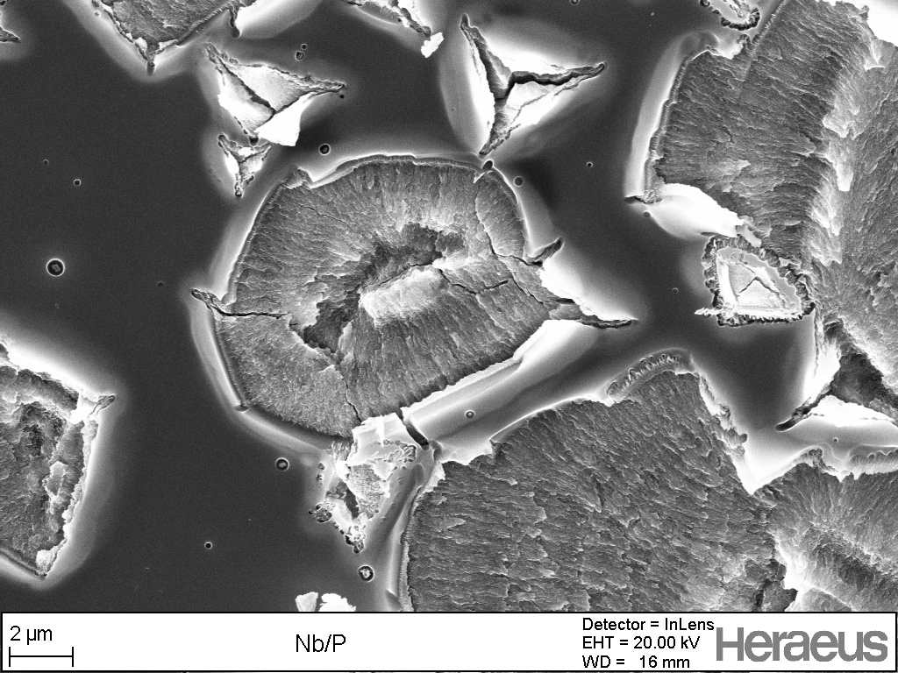
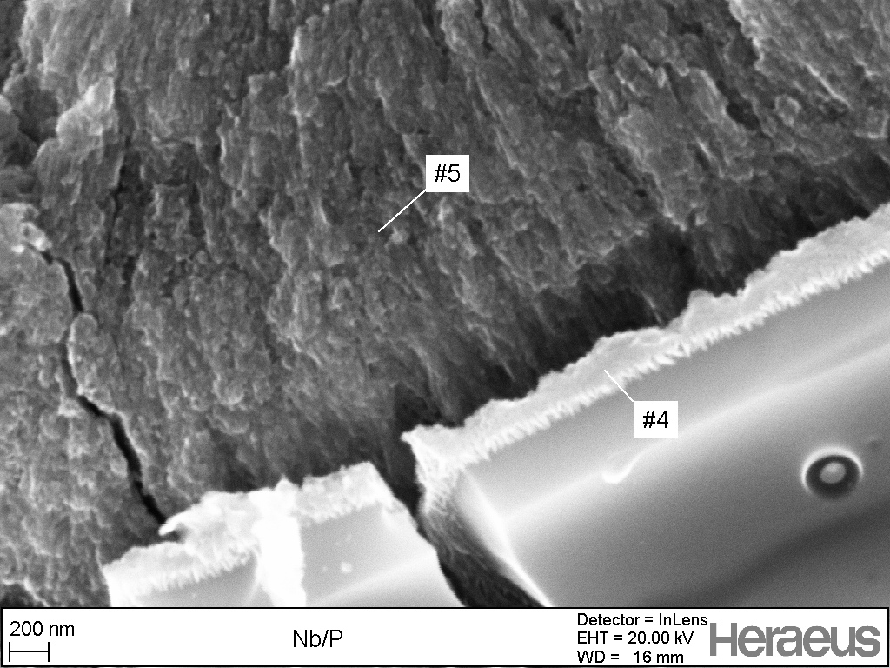
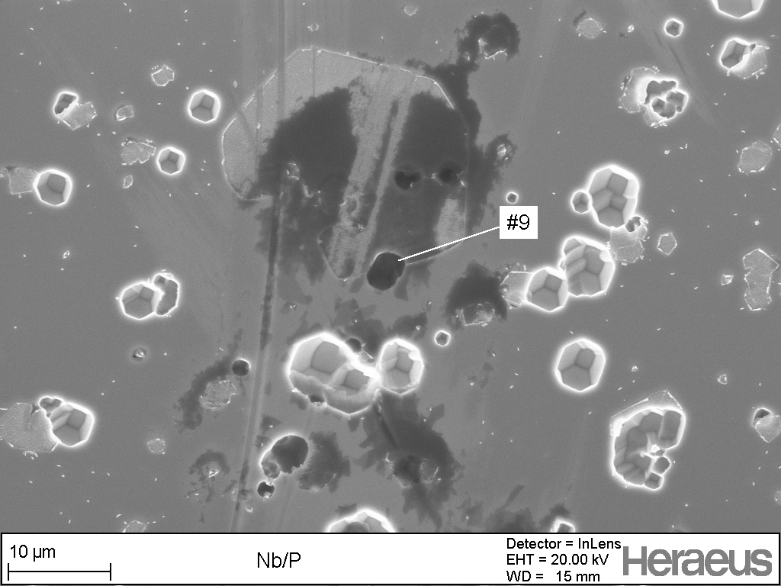
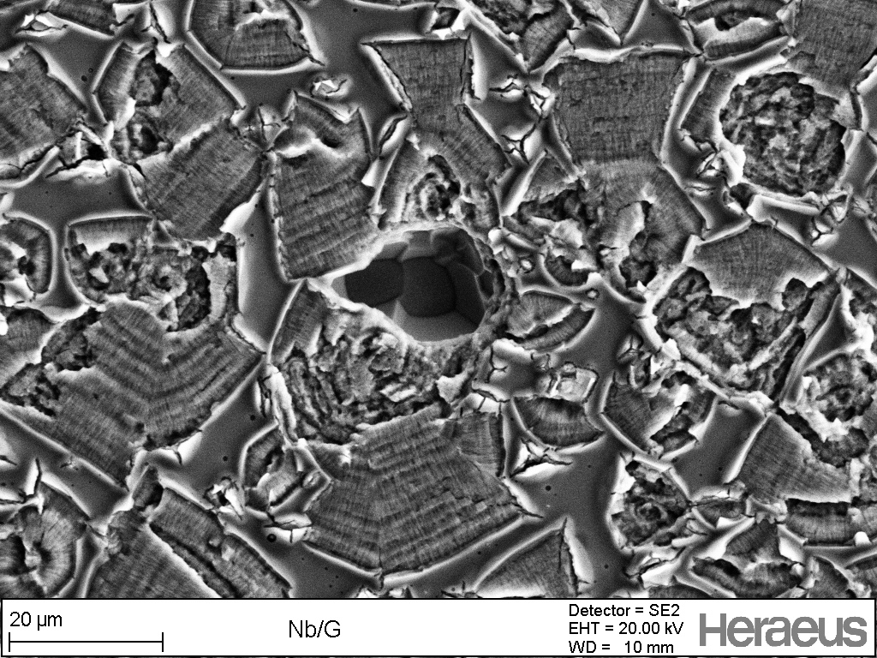
Type 4: Damaged surface; evidently by high pressure water rinsing, can cause quench (AC126)
Auger spectrums indicates very high presence of oxygen.
Light microscope image
Oxide layer with thickness:
>114 nm (spot)
32.5 nm (blue)
SEM
Images
195 nm (red)
13 nm (outside rings)
SEM image of the black spots
EDAX indicates carbon

Slide 18
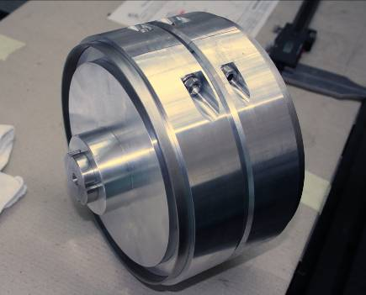
Triggered activities of Zanon and INFN/DESY towards improvement of XFEL cavity production
18
Review & optimization of the cavity mechanical fabrication cycle at E.Zanon:
  new joint geometry for EBW optimized with several tests on single cell and 9-cell cavities
  tools for the production successfully tested: new tool for DB cutting, tool for EG cutting, tool for coupling of cavity components
  Three CVs produced. The up to now tested cavity achieved > 25 MV/m
  100 μm BCP and 800 °C
  (w/o EP and w/o 120 °C). All three CVs EP treated and in preparation for RF test at DESY
Courtesy E. Zanon
Q(Eacc) of cavity Z160
Notes:
18
Copy & paste an element from the Clip Board to the particular slide:
1) Click on a box to mark it.
2) Position the mouse pointer on the box frame: Copy!
3) Click on the particular slide: Paste!
How you intend to use the elements is your choice.
You can combine the text block style with the background colour
in different manner.
How to change the height or the width (or both) of a box
(including its background):
Mark the box, and grip and draw the specific edge of the box frame.
You can position a text block inside a frame: 1) Mark the text block.
2) Click on the menu point “Format”: “Text box”, “Text Box”,
“Text Anchor Point”.
Insert a new slide: Menu button “New Slide”
For more bullet levels (max. 5) use the tab stop button →| on your keyboard,
back with |←
The default colour scheme for font, line and fill is (1st row, from left to right):
White  Violet  Grey  Black  Violet  Orange  Violet  Orange

Slide 19
Status: Contracts XFEL cavity production
Research Instruments (RI) and E. Zanon (EZ) were contracted beginning of September 2010 to produce each
Cavities for qualification of the infrastructure (4 DCVs, 4 RCVs)
280 XFEL type series cavities
12 ILC HiGrade cavities
- Material for cavities Nb / NbTi to be supplied by DESY.
- He-vessels for RI cavities to be supplied by DESY
- Production precisely following the in detail worked out specifications which also include the exact definition of infrastructure to be used (build to print)
- Final treatment after main electropolishing: Final EP for RI / flash BCP for EZ

Slide 20
Status: Contracts XFEL cavity production
- No performance guaranty by the vendors, i.e. the risk of unexpected low gradient or field emission is taken over by DESY (responsibility for re-treatment); goal: average usable XFEL gradient 24.3 MV/m at Qo=1x10¹⁰
- Additional 80 cavities as an option will be placed after the evaluation of the start of the series production
- First series cavities to be delivered mid of 2012; all cavities to be delivered till mid of 2014
Kick off meetings:
RI: 6th of September 2010
E.ZANON: 7th of September 2010
Both companies started: Infrastructure, Fabrication drawings, PED activities etc. (e.g. Talk of G. Corniani, E. Zanon)

Slide 21
Status: PED (Pressure Equipment Directive) Issues
The cavity with helium tank has to be build as a component according PED/97/23/EC Pressure Equipment Directive
The notified body (TUEV NORD) supervises the production
PED Activities (started)
Module B (constr. example check)- contracted
examination of design, FEM calculation
qualification of material
qualification of welding processes
qualification of another PED relevant processes (annealing, deep drawing)
destructive tests on specially build test pieces (2 cell cavity with helium tank)
supervising the fabrication of Dummy CV and Reference CV
find PED relevant testing methods for the series production of the cavities
Module F (check of the products) - not contracted yet
Supervision the serial cavity fabrication
More details in talk of Axel Matheisen tomorrow

Slide 22
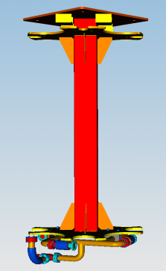
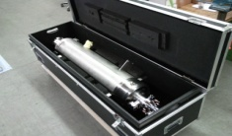

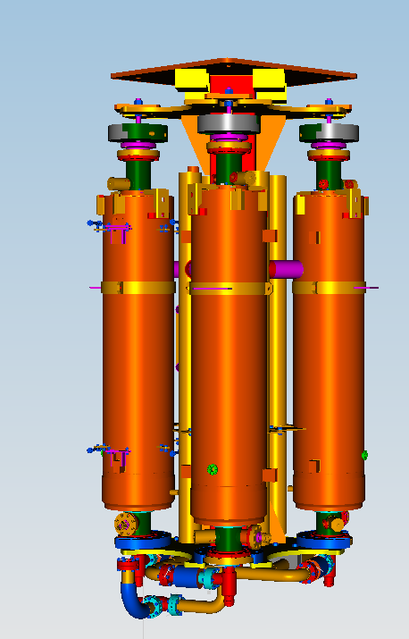
Waving the performance guarantee simplify the transport (proposed by A. Matheisen)
Version with Performance guaranty at Company
Version with best efforts request at Company
Contractors
facility
Contractors
facility
CEA Saclay
DESY
AMTF
DESY
AMTF
Transport boxes now
Transport frame

Slide 23
Specification
Some changes occurred as a result of negotiations with companies - cavity producers. In particular DESY has taken over:
Material procurement
Performance guaranty
Organization and costs for PED issues
He-vessels fabrication for one of the companies
Cavity transport containers and transport conditions are changed
These changes forced us to adopt the specification documents to the order circumstances. Change reports linked to companies have been created. In addition companies asked for approval of some changes in the specifications (change requests)

Slide 24
Acknowledgement
Many thanks to all participating colleagues enthusiastically pushing forward the work on cavities for XFEL
especially to J. Iversen, A. Matheisen, P. Michelato

