Slide 1
Infrastructure status and plans at CERN¹⁾
W. Weingarten/CERN
Most of the slides are based on a talk given by O. Brunner at the 4th ESS-SPL collaboration meeting
http://indico.cern.ch/conferenceTimeTable.py?confId=82809#20100630.detailed

Slide 2
Outline
RF premises at CERN
RF available infrastructure
High power and SC RF activities
SCRF premises at SM18
Conclusion

Slide 3
RF – premises 1
“SM18”
252
118
152

Slide 4
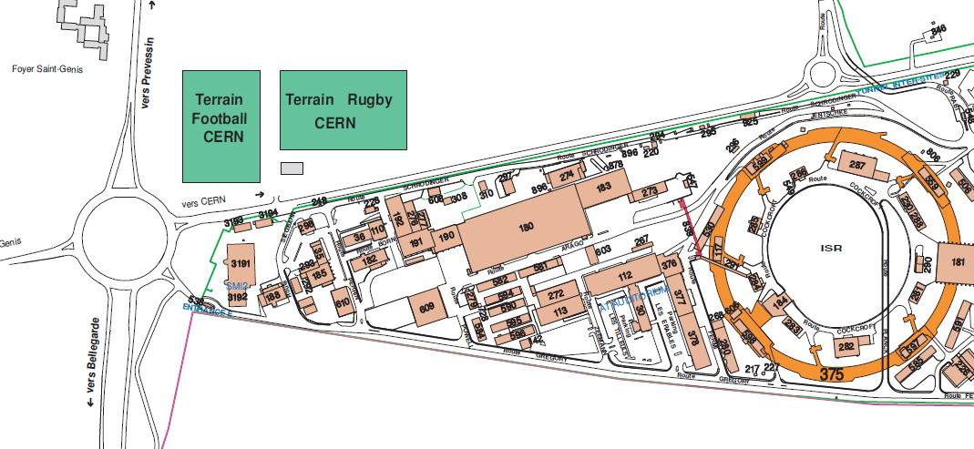
RF – premises 2
112
A5

Slide 5
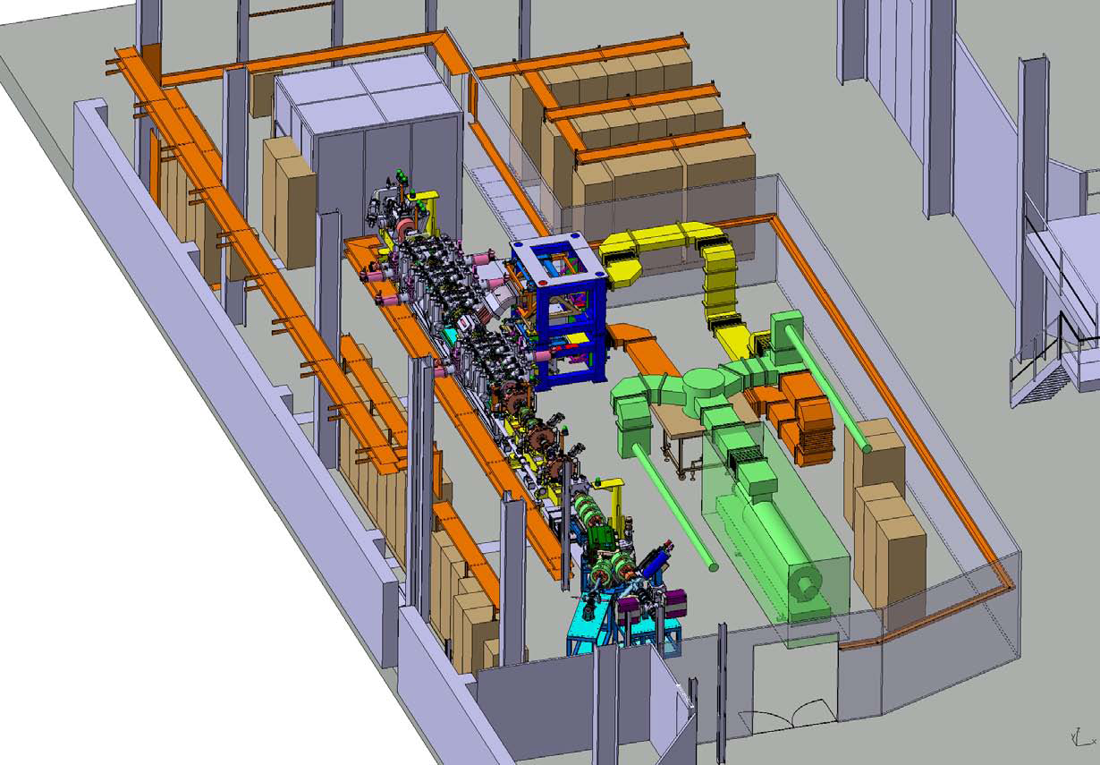
RF - available infrastructure 1
  Building A5:
    LHC & Linac4 High Voltage
      Klystron modulators, fast protection systems, klystron HV tanks
      100kV, 15mA power supply
  Building 112:
    LHC & Linac4 High Power RF
      Tests of klystrons, circulators, WG, HV equipment, controls
      LHC power coupler tests
      100kV, 20A power supply, Linac 2Hz modulator
  Building 152:
    Linac4 3MeV test station
      Tests of Linac4 3MeV section (in 2011) + some L4 RF structures (2010 ->?)
      Complete Linac4 2Hz power station (modulator, klystron,..)
  Building 252:
    SC cavities coating & clean rooms
      LHC, HIE Isolde, SPL
      Nb deposition system for HIE Isolde cavities (system for LHC cavities to be re-installed)
      Low pressure ultra pure water rinsing (max 10 bars)
      Two clean room (class 10000, 100)
  Building 118 (vacuum group):
    Chemical treatments
      LHC, HIE ISOLDE, SPL + many other activities
      EP station
      High pressure ultra pure water rinsing (100 bars)

Slide 6
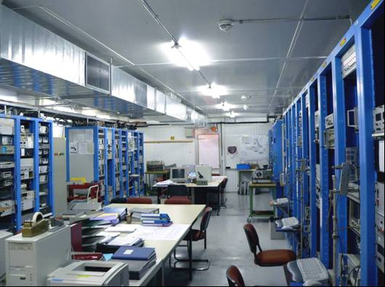
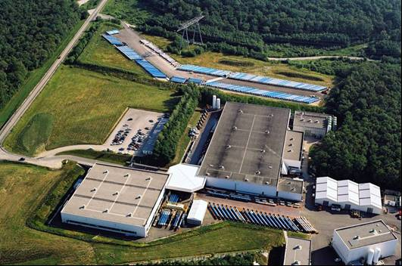
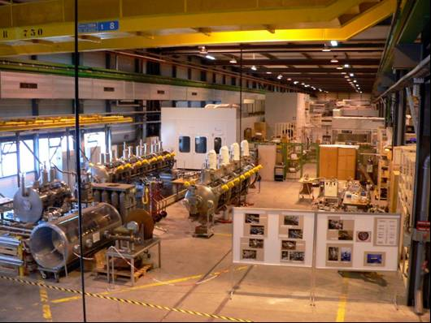
RF - available infrastructure 2
  Building SM18:
    Cavity/cryomodule assembly
    Two 15m clean rooms (class1000/10) + access zone
    One 4 meter high clean room (class100)
    Four vertical cryostats
    Two bunkers
    High RF power zone
    Main control room
    Cryogenic system
      Limited availability (LHe to be shared with other SM18 activities -> LHC magnets)
      LHe distribution line will be replaced in 2011

Slide 7
High power and SC RF activities 1
  High power RF
    LHC
      400MHz, 330kW CW, 16 power stations in LHC + 2 test stations
    Linac4
      352MHz, 1.3/2.8 MW, 19 future power stations + 3 test stations
    CLIC&CTF3
      3GHz, 45 MW, 1.5GHz, 25 MW, 13 power stations + 1 place
      12GHz, 50MW, 1 test station
    LEP RF equipment tests for external requests
      352MHz
    SPL test stand
      704 MHz, ≈1MW, 50 Hz, 1 future test stand
    Crab cavities
      Under study..

Slide 8
High power and SC RF activities 2
  SC cavities & Cryomodules
    LHC
      4 cryomodules in LHC, 1 spare + 1 spare cavity
      3+2 spare cavities to be built & tested (2011-2012)
    HIE ISOLDE
      32 cavities to be built & tested
      5 cryomodules to be assembled & tested
    SPL
      4 cavities to be built & tested
      1 cryomodules to be assembled & tested
    CLIC & CTF3 structures
      RF structure assembly in clean rooms

Slide 9
SCRF premises at SM18
General parameters for vertical cryostats/bunkers/cryoplant for SCRF cavity/cryo-module tests
General parameter | V3 | V4 | V5 | V6 | Bunker A | Bunker B
Size (depth/diam) [m] | 4/1.1 | 2.5/1.1 | 4/1.1 | 4/1.1 | 13 m useful length | 13 m useful length
RF frequency [MHz] | 704 | 400 - 1200 | 100 | 400 | 352 – 704 | 101 - 400
Typical temperature range [K] | 2.0 – 4.5 | 2.0 – 4.5 | 4.5 | 4.5 | 2.0 - 4.5 | 4.5
Nominal installed RF power | 300 W | 200 – 400 W | 600 W | 300 W | 300 W CW – 1 MW pulsed | 300 W – 300 kW
Max. lHe production @ 4.5 K [g/s] with shared utility | ≤ 30 g/s (600 W cooling capacity as liquefier)
Capacity of pumping unit at 30 mbar [g/s] | 18 (36 with 2 pumping units)
Cooling capacity at cryostat @ 2.1 K, 42 mbar | 15 g/s (330 W) liquefier operation
In red: to be refurbished

Slide 10
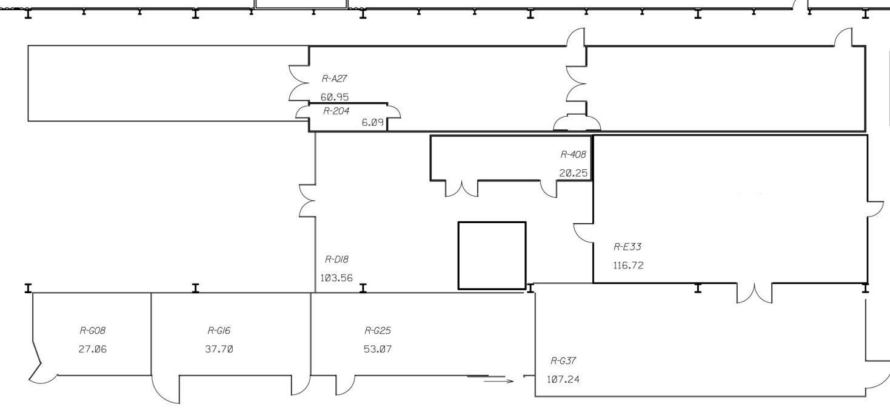
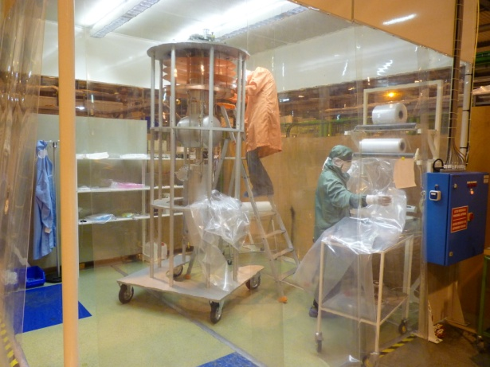
SCRF premises at SM18: Existing clean room facility
Outer working place
Class 10 000
Class 10
Air shower
Personnel access
Air supplier
Control room
Useful space = 13m×2.10m
Magnet equipment storage
Baldaquin Class 100
What is missing for high gradient resonators?
High Pressure Rinsing (HPR)
Ultra Pure Water (UPW)
Clean space dedicated to the cleaning operations
Better cleanliness
More space
Slide courtesy J. Chambrillon

Slide 11
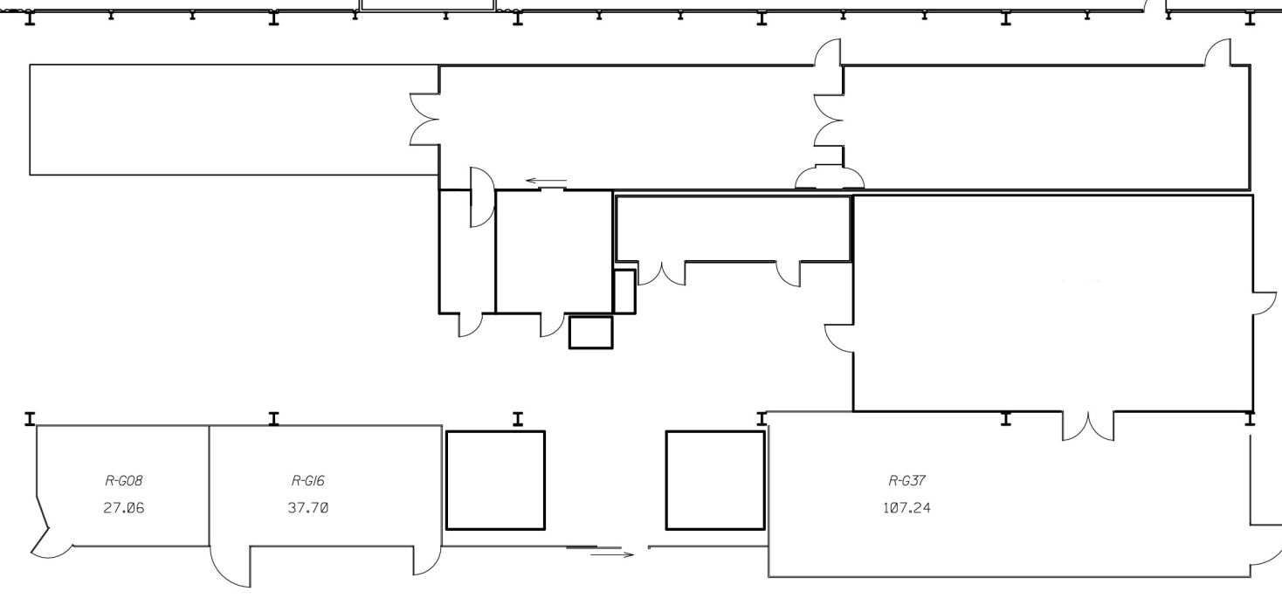
SCRF premises at SM18: Upgrade proposal clean room facility
Outer working place
Class 100
Class 10
Ionized air shower
Personnel access, with air shower Class 1000
Air supplier
Control room
HPR system
Cleaning & rinsing room Class 100
UPW production
Baldaquin 2
Storage area Class 100
Baldaquin 1
Class 100
Class | Price per m² (€)
100 | 6 000 to 10 000
1000 | 4 000 to 8 000
In red: to be refurbished
Slide courtesy J. Chambrillon

Slide 12
SCRF premises at SM18: SPL cryomodule – cavities - assembly
  Will profit from all existing infrastructure
    Clean rooms
    UP water rinsing stations
    EP station
    SM18 clean rooms not fully compliant with SPL cryomodule assembly requirements
      Must be equipped with:
        Dressing zone (class100)
        UP water rinsing zone(class 100) – main couplers, HOM couplers,..
        Existing 15 m class 10 room shall be equipped with vacuum leak detection and other equipment
        → J. Chambrillon, Cleanroom refurbishment in SM18 within the SPL project frame, feasibility study, sLHC Project Note 0026, 2011-01-24

Slide 13
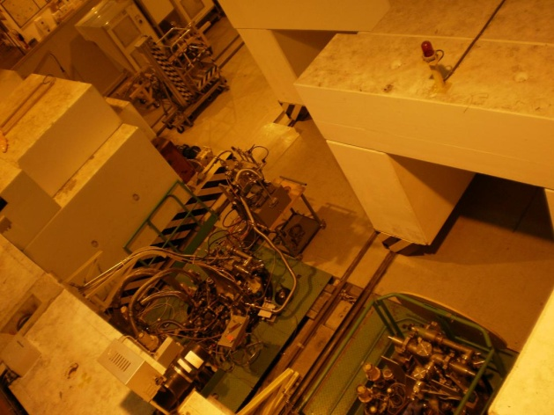
SCRF premises at SM18: SPL cryomodule – Cavity tests
  SM 18 is equipped with four vertical cryostats
    LHC cavities (4.2K) – operational
    HIE Isolde cavities (4.2K) – operational
    Quadrupole resonator for sample tests (2K) – operational
    SPL cavities (2K) – availability: summer 2011
  One fellow works on SC cavities diagnostic tools
    Temperature & X-ray mapping (not yet started)
    He II second sound development (test station in CERN Cryolab)

Slide 14
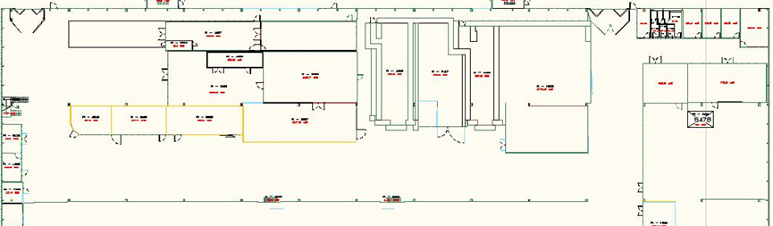
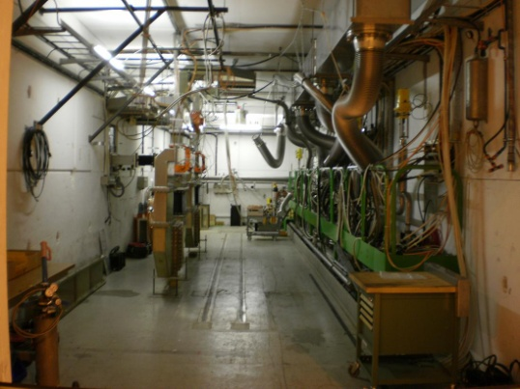
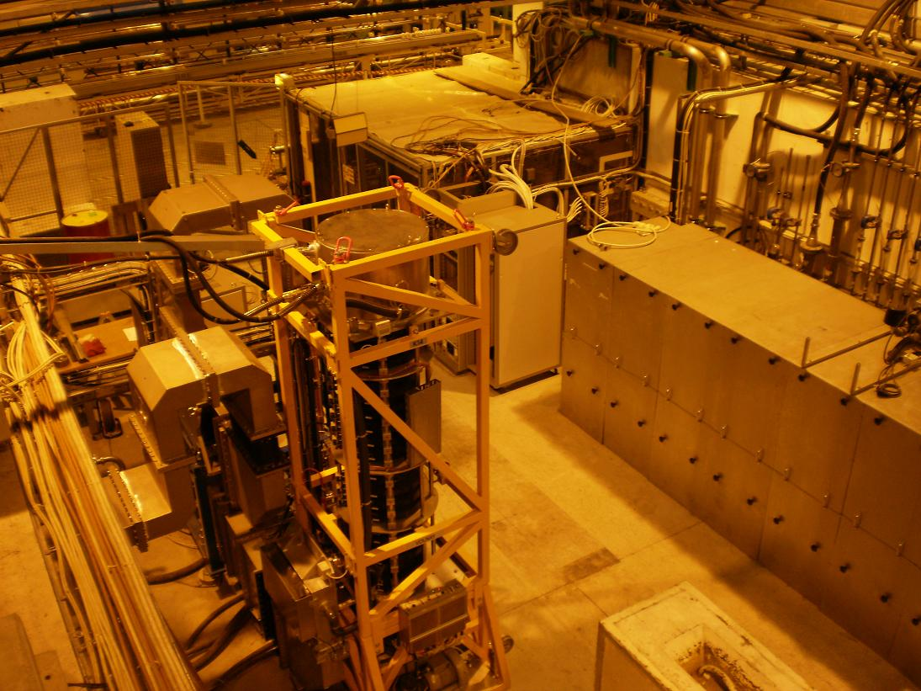
SCRF premises at SM18: SPL – high power tests 1
    Two bunkers in SM18:
        Bunker A :
            will be modified for 2K operation (2011) /control system to be completely renewed
            will be modified for the Linac4 RF structure tests (2011 -> end 2012)
            ready for SPL cryomodule tests in 2013
        Bunker B:
            operational
            priority: LHC cryomodules
            HIE Isolde cryomodule tests (2012/14)

Slide 15
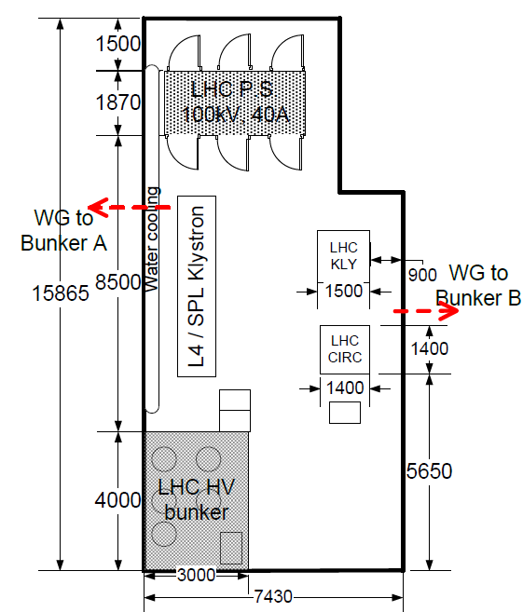
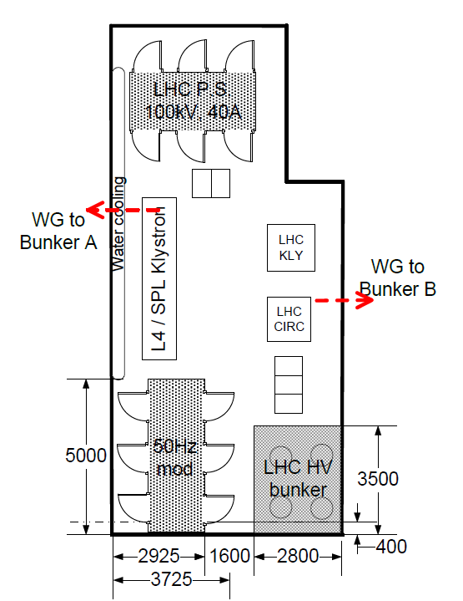
SCRF premises at SM18: SPL – high power tests 2
    Bottleneck is the High RF power zone:
        Very crowded area:
          100kV, 40A Power Converter
          LHC high RF power
          LHC HV bunker
          352MHz 1.3MW klystron (Linac4 tests)
      No real extension possible
    Upgrade towards Linac4 / SPL tests:
        Move LHC HV bunker to free space for pulsed modulator
          2011: installation of a 2Hz Linac 4 type modulator
          Asap: integration of 50Hz modulator – footprint??
        Specify & order high power components
          704MHz, 1MW klystron (specs 90% completed)
            Interface with modulator not defined!
          Circulator & RF load (specs to be done)
          WG components (specs to be done)
        Specify & built control system
          ready early 2011 for L4 tests

Slide 16
Conclusions
Several projects going on in parallel
  Existing infrastructure: good starting point
  Objective is to get the best share of the existing infrastructures between activities/projects
Upgrade of infrastructures is ongoing, in particular for the SPL cryo-module
  High pressure UP water rinsing
  Electro-polishing station (new)
  Cavity vertical test stations, diagnostic tools
  SM18 lHe distribution line to be changed (2 K operation, reduction of static losses)
  SM18 clean room upgrade necessary
SPL cryo-module high power tests
  Bunker A in SM18 requires hardware modification to host SPL high power tests
    50Hz modulator size under study
  Will profit from preparation work done for Linac 4
  Specification documents for 704 MHz high power equipment in preparation

