Slide 1

test results of Spiral-2
Cavities & Cryomodules B
Guillaume Olry
on behalf the IPN Orsay SPIRAL2 team

Slide 2
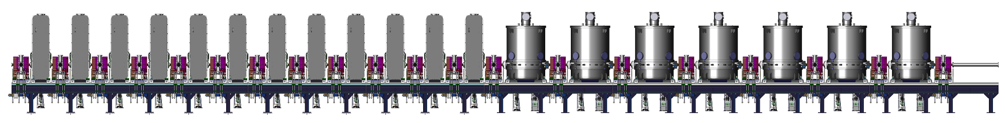
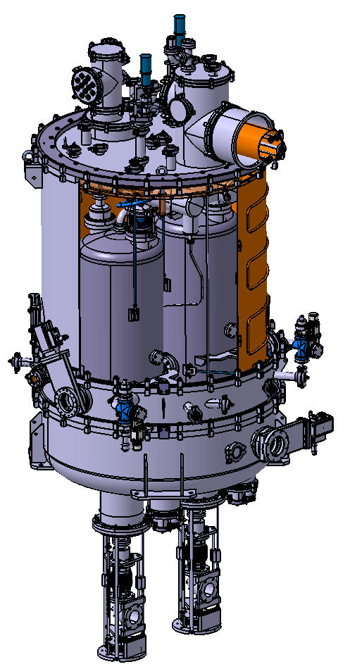
SPIRAL2 SC linac
Quarter-Wave Resonator, 88.05 MHz, beta 0.12
Cryomodules A section
Cryomodules B section
Cryomodule type | A | B
Valve-to-valve length [mm] | 610 | 1360
Nb cavities | 12 | 14
f [MHz] | 88.05 | 88.05
β_{opt} | 0.07 | 0.12
Epk/Eacc | 5.36 | 4.76
Bpk/Eacc [mT/MV/m] | 8.70 | 9.35
r/Q [Ω] | 599 | 515
Vacc @ 6.5 MV/m & β_{opt} | 1.55 | 2.66
Lacc (=Leff) [m] | 0.24 | 0.41
Beam tube ∅ [mm] | 38 | 44
Cryomodule B housing two beta 0.12 QWR

Slide 3
ouline
Beta 0.12 QWRs: vertical tests
  Design
  Preparation: BCP & HPR
  Baking @ 120°C
  Qo=f(Eacc)
  Field emission
Cryomodules : tests @ 4K & 10kW
  Cooldown
  RF couplers conditioning
  Cavities performances

Slide 4
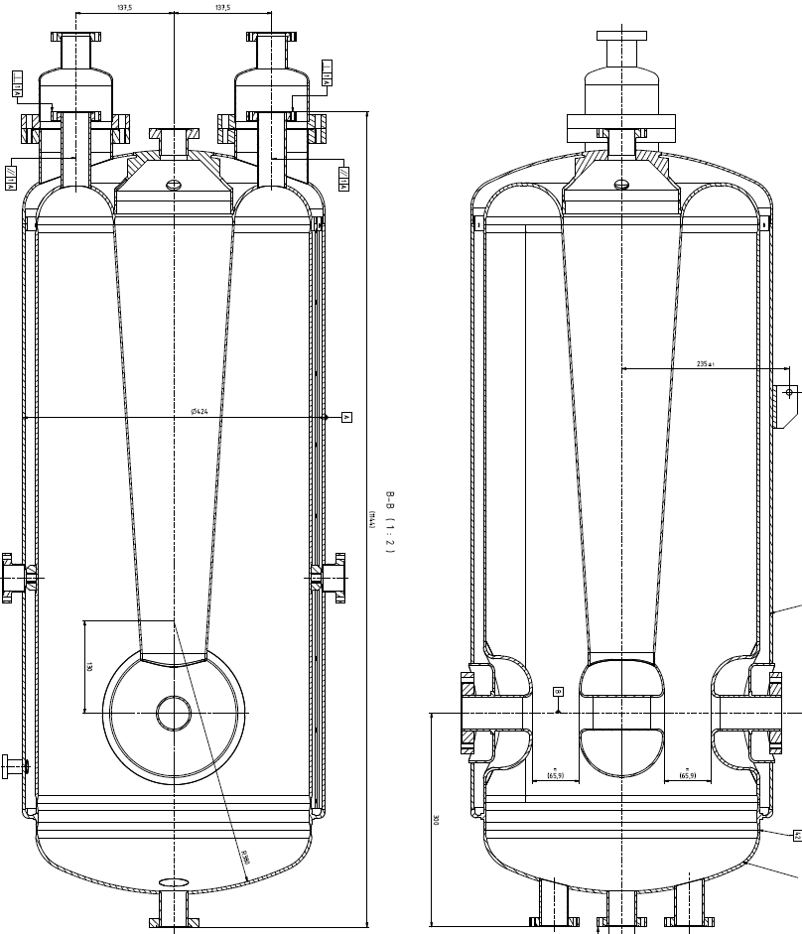
Cavity B
16 Quarter-Wave Resonatosr, 88.05 MHz, beta 0.12 (made by RI)
Bulk Niobium RRR>250 (Tokyodenkai)
  Body: 4.2 mm
  Stem: 2.7 mm
  Ports and beam tubes: 3.2 mm
Cavity flanges: CF 316LN Stainless Steel
Helium vessel made of Titanium (4 mm)
  Flanges CF16→ Ti
  Flanges CF40→ Ti
  Flanges CF100→ SS
No bellows
No dismountable bottom flange
SPIRAL2 specs: Eacc = 6.5 MV/m and Pcav < 10W

Slide 5
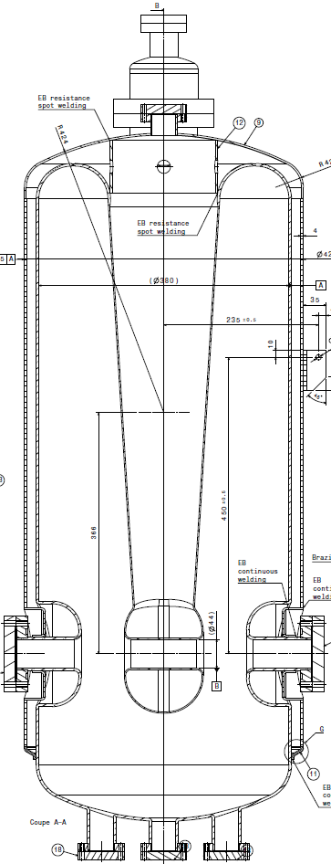
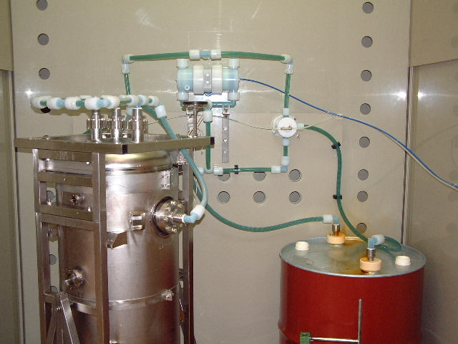
Preparation [1]
“CLASSICAL” BCP CHEMISTRY
  Goals: “coarse” frequency tuning + etching>100µm min.
  Standard process: 2 x 2h in 2 phases (cavity turned upside down after phase 1)
  Active cooling (water) inside the helium vessel
out
out
180°
Data for13 BCP processes
Etching rate | [µm/min] | 0.35 … 0.45
Sensitivities | [kHz/min] | 0.13 … 0.15
 | [kHz/µm] | 0.35 … 0.45
in
in
PHASE1
PHASE2

Slide 6
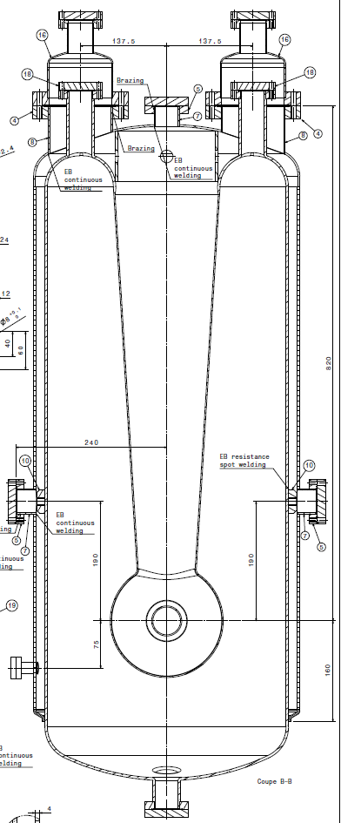
Preparation [2]
High Pressure Rinsing
  80 bars
  3 phases:
    20min/beam ports for phase 1
    45 min/port for phases 2 and 3
  Drying: 72h (in phase 3 position)
90°
180°
PHASE1
Through beam ports
PHASE2
PHASE3

Slide 7
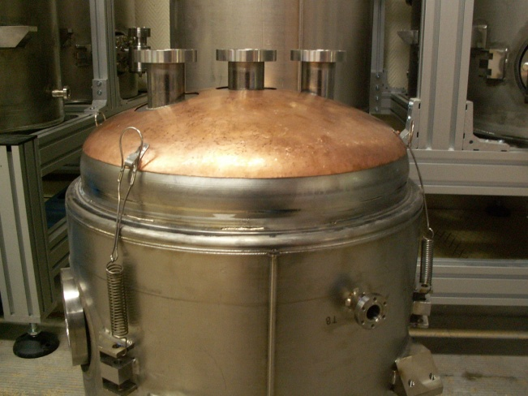
Cavity baking set-up
After 72h drying → 48 h baking @ 120°C
“Forced” air flow inside the helium vessel + heater on the cavity bottom
Cavity wrapped in a foil blanket
Input
~120°C
Output
~110°C
Heater (not shown) glued onto the copper cap
Heater
~110°C

Slide 8
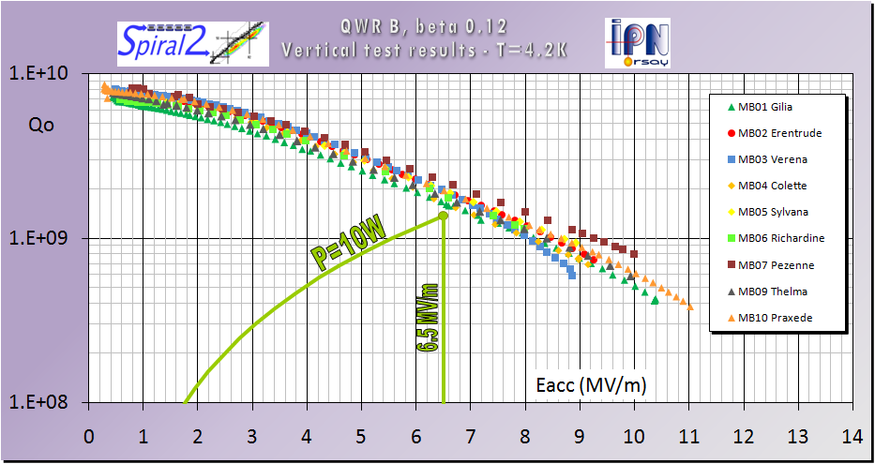
Vt results: no baking
Cavities: MB01, 02, 03, 04, 05, 06, 07, 09 and 10 (08/2008-09/2009)
Cavity | Losses @ 6.5 MV/m [W]
MB01 | 8.5
MB02 | 6.9
MB03 | 7.0
MB04 | 8.4
MB05 | 7.2
MB06 | 7.5
MB07 | 6.9
MB09 | 8.9
MB10 | 7.1
Mean value | 7.6

Slide 9
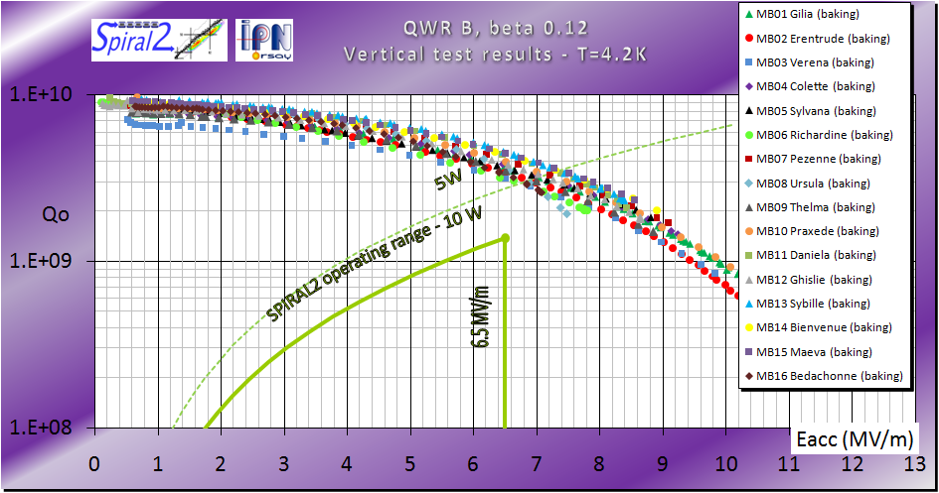
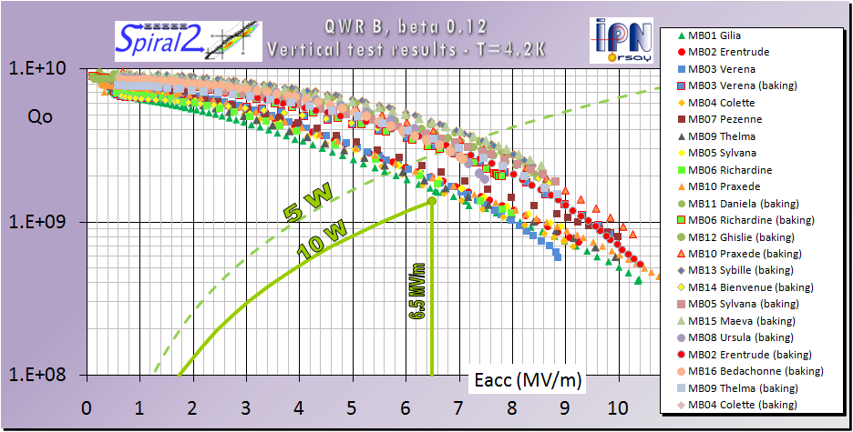
Vt results: with baking
Cavity | Losses @ 6.5 MV/m [W] No baking | Losses @ 6.5 MV/m [W] With baking
MB01 | 8.5 | 3.7 (-56%)
MB02 | 6.9 | 4.1 (-41%)
MB03 | 7.0 | 4.4 (-47%)
MB04 | 8.4 | 3.6 (-58%)
MB05 | 7.2 | 3.5 (-51%)
MB06 | 7.5 | 4.8 (-36%)
MB07 | 6.9 | 3.4 (-51%)
MB08 | X | 4.0
MB09 | 8.9 | 3.9 (-56%)
MB10 | 7.1 | 3.5 (-51%)
MB11 | X | 3.1
MB12 | X | 3.8
MB13 | X | 3.0
MB14 | X | 4.0
MB15 | X | 3.1
MB16 | X | 3.9
Mean value | 7.6 | 3.7
Losses divided by ~2 @ Eacc=6.5 MV/m
Total: 32 tests from July ‘08 to May ’10
Last 5 months: 3 tests/month

Slide 10
Vt results: field emission
Cavity | X-ray dose @ 6.5 MV/m [mSv/h] | X-ray dose @ Eacc max [mSv/h] | Onset [MV/m]
MB01 | 0 | 13 | 7.5
MB02 | 0.20 | 100 | 5.0
MB03 | 0.05 | 100 | 5.5
MB04 | 0 | 5 | 7
MB05 | 0 | 0.003 | 8.5
MB06 | 0.003 | 0.04 | 6
MB07 | 0.003 | 0.005 | 6.5
MB08 | 9 | 29 | 4
MB09 | 0 | 0.1 | 7
MB10 | 0 | 5 | 7
MB11 | 0 | 0 | -
MB12 | 0 | 0.3 | 7.5
MB13 | 0.3 | 2 | 5.5
MB14 | 0.01 | 1 | 6
MB15 | 0 | 0 | -
MB16 | 0.9 | 3 | 4.5
Eacc max < 7.5 MV/m
Eacc max < 7.5 MV/m
8 cavities without FE @ 6.5 MV/m
2 cavities (MB02 & MB03) with very strong FE (>100 mSv/h) at Eacc max
Onset FE @ 6.6 MV/m (mean value)

Slide 11
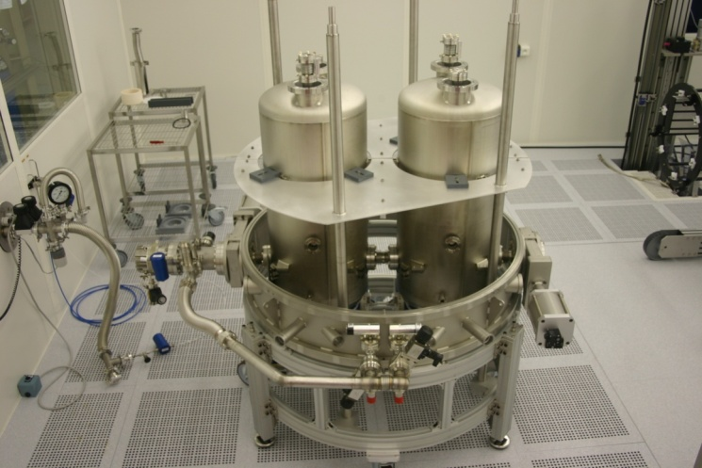
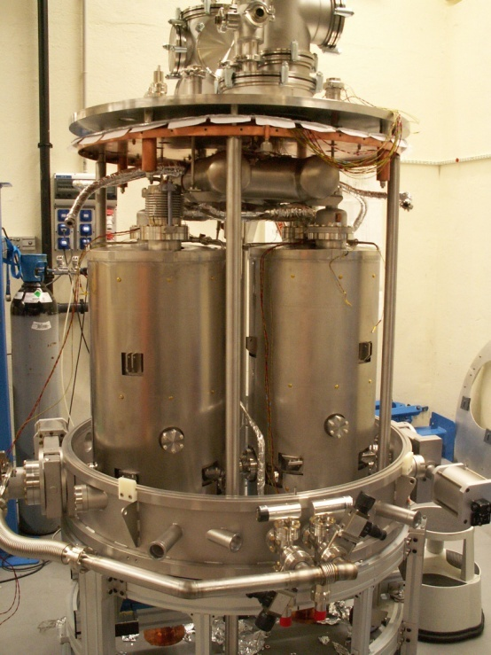
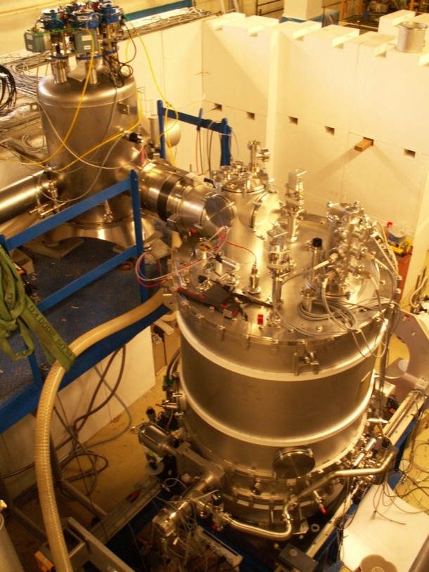
Cryomodules B
2 cryomodules assembled and tested in October 2010 and January 2011
Goal: one test every 2 months
Clean room
Assembly outside de clean room
Cryomodule test bench

Slide 12
Cryomodules B: what is good?
Both have the same “behavior”
Cooling rates: OK
  Thermal shield from 300K→80K in 10h
  Cavities from 250K→4K: < 5h (<1h between 120K an 80K)
RF conditioning of the 4 couplers at 300K and 4K up to 10 kW in CW: OK
  Done in 1 hour for each Temp in 2 cycles
Vacuum > 5 10⁻⁷ mbar
= 10kW

Slide 13
Cryomodules B: what is not good?
Cavity performances limited by strong field emission (> 100 mSv/h for all cavities) → quench
  Cryomodule n°1: Eacc max 4.4 MV/m (8.9 in VT) & 5.1 MV/m (8.7 in VT)
  Cryomodule n°2: Eacc max 5.2 MV/m (10.4 in VT) & 8.4 MV/m (10.4 in VT)
Hypothesis: pollution during the final leak check in clean room → we had leaks on both cryomodules (CF copper gasket on beam tube, bellows and CF flange on one coupler pumping tube…).
→ Venting to atmospheric pressure were probably not enough controlled !
Cryomodule n°1 entirely disassembled last month
Disassembly scheduled this month for Cryomodule n°2
Cavities of cryomodule n°1: visual inspection with a videoscope
  Areas of high peak surface electrical fields → clear!
  Whereas…

Slide 14
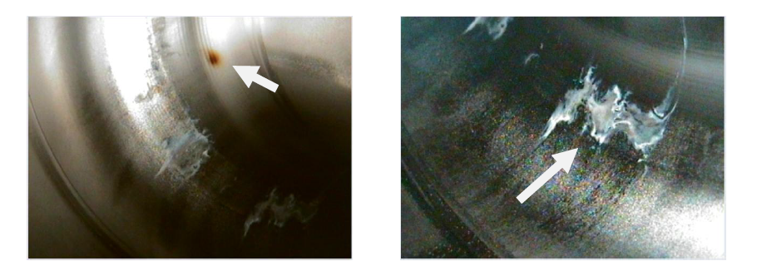
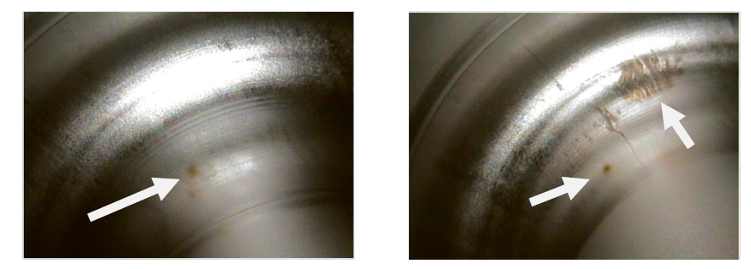
Cryomodules B: what is not good?
Impact from HPR process
“???”
Top part of cavity MB14 = high magnetic field area
“???”
Impact from HPR process
Impact from HPR process
Top part of cavity MB12 = high magnetic field area

Slide 15
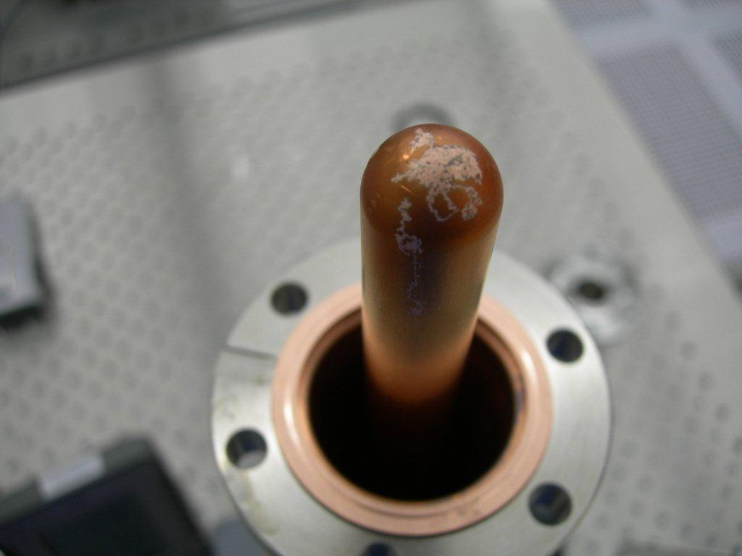
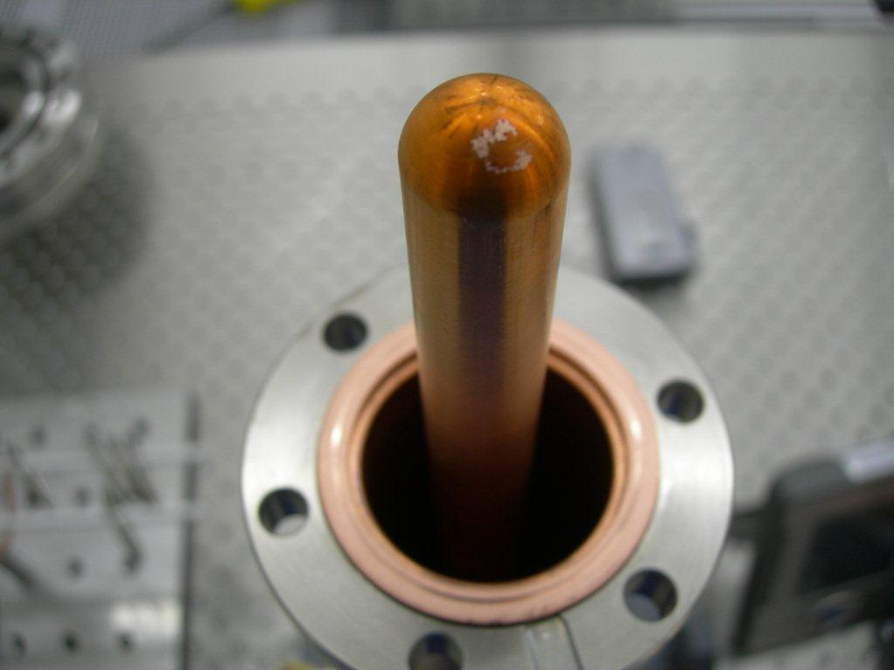
Cryomodules B: what is not good?
Couplers
  Marks of discharges on both antenna tips → strong FE origin (?)

Slide 16
Short conclusion
Visual inspection with videoscope of each cavitiy after HPR (?)
We will try to assemble a cryomodule from A to Z without any leaks and will see…
  Thank you for your attention

Slide 17
Backup slides

Slide 18
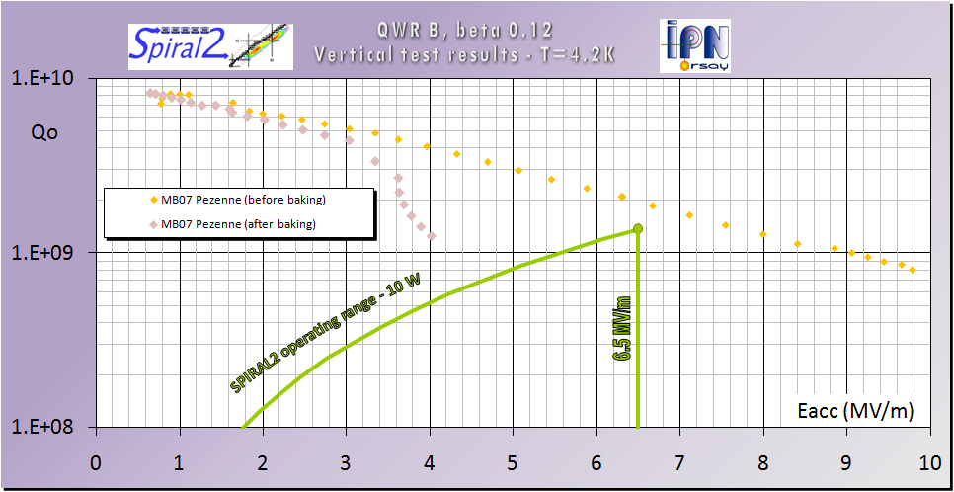
Vt results: “BAD” baking
Heater “OFF” for the first 24 hours of baking, then turn on for the last 24 hours → same Qo at low field and more field emission
Test stopped…
110°C
30°C

Slide 19
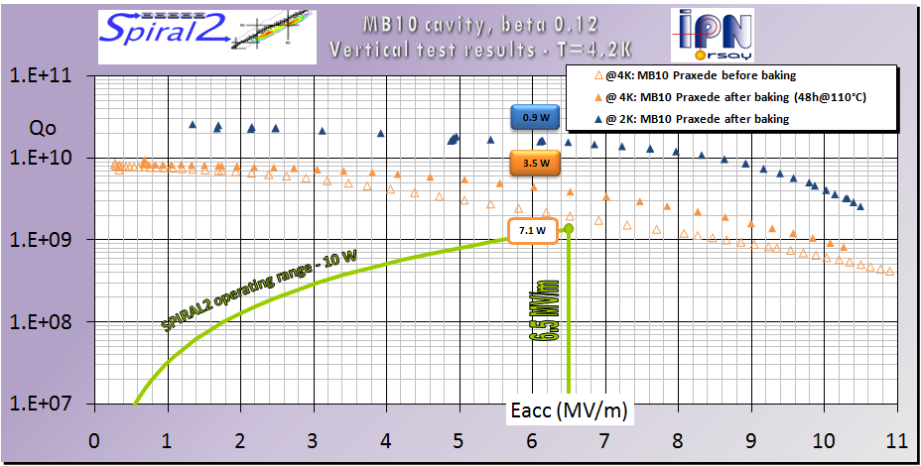
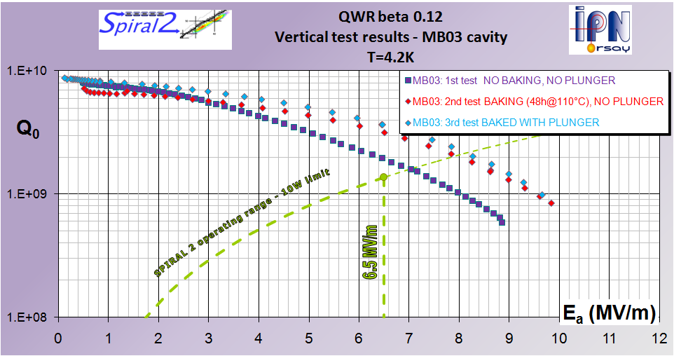
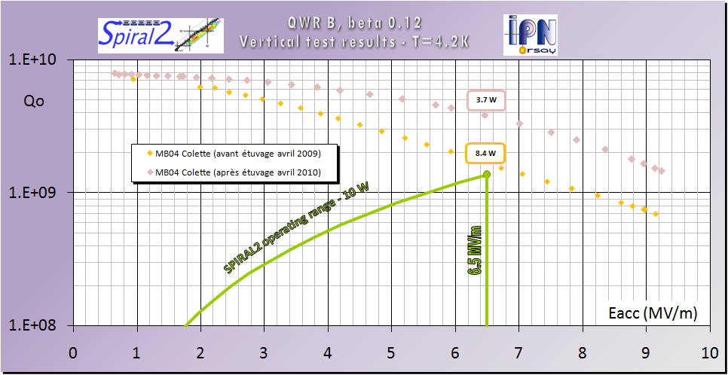
Other Vertical tests results with baking

Slide 20
Cryomodules B: what was not good?
Tuning system
  Good linearity and sensitivity for large displacements (~1mm): 1.1 kHz/mm
  But … backlash of 0.5 mm
New tests performed last 2 weeks @ 300K after cryomodule disassembly showed that some parts of the mechanism have to be changed (too much backlash). New results are good.

