Slide 1


COLD Lab activity report
Claudio Gatti
63nd LNF Scientific Committee – May 2022

Slide 2

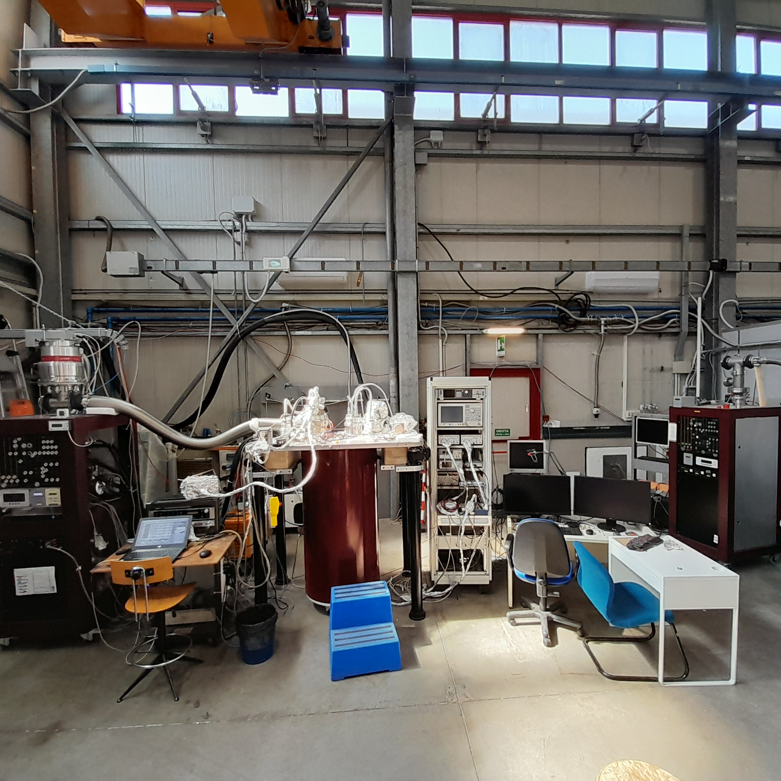

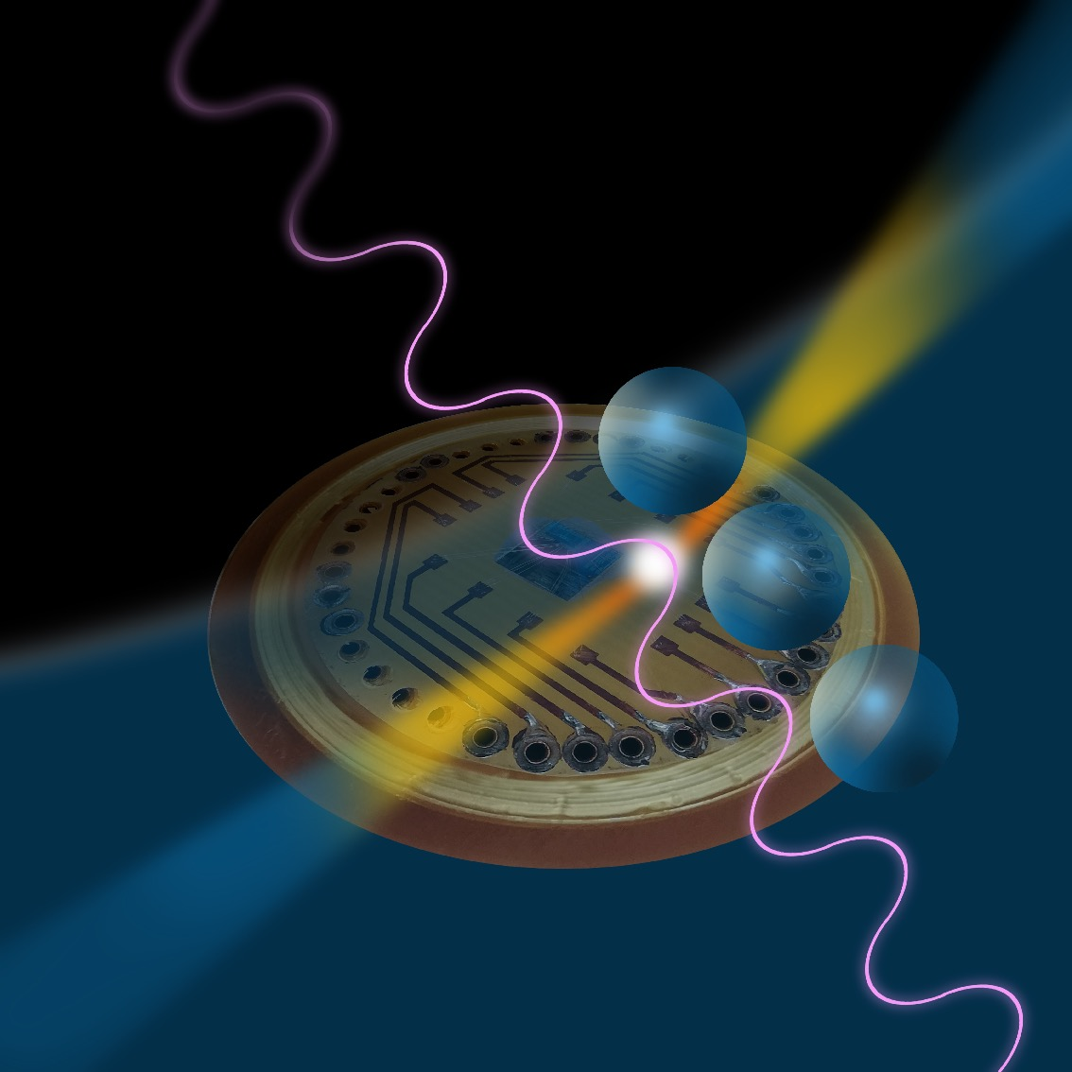




EXPERIMENTS
COLD - Cryogenic Laboratory for Detectors
Axion Experiments
Superconducting Quantum Devices
Superconducting Cavities
Magnetic Measurements
QUAX – QUest for AXions
Search for galactic axions with Sikivie’s Haloscopes at 10 GHz (Ongoing experiments at LNL and LNF).
(K)FLASH
Search for galactic axions with a Sikivie’s Haloscope at 100 MHz (Design Study).
Superconducting Devices
DART WARS (Detector Array Readout with Travelling Wave AmplifieRS)
Development of wide band quantum amplifiers for multi-channel detector readout (Ongoing).
SIMP (Single Microwave Photon detectors)
Development of single-microwave photon detector (Ends 2021)
Qub-IT Quantum Sensing with superconducting qubits (Started 2022).
Supergalax FET H2020 Project
SC-qubits array photon-detector for axion experiments
SQMS USA DOE Project
Superconducting Quantum Materials and Systems
SC materials for cavities

Slide 3
outline
QUAX - Galactic Axion Search at 10 GHz (35-50 μeV)
FLASH - Galactic Axion Search at 100 MHz (0.5-1.5 μeV)

Slide 4
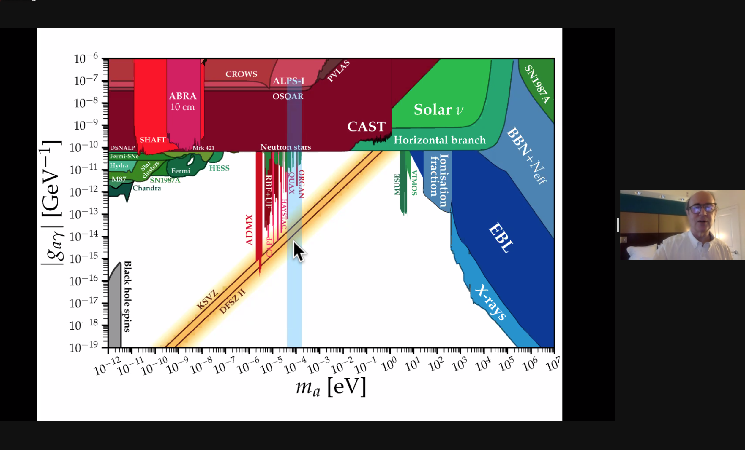
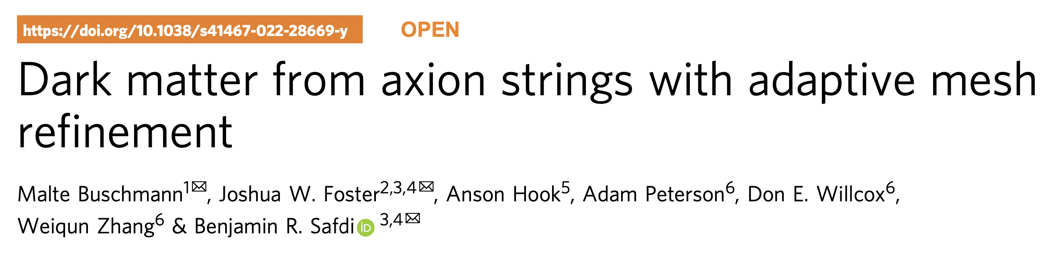
Wilczek’s seminar on February 2022

Slide 5
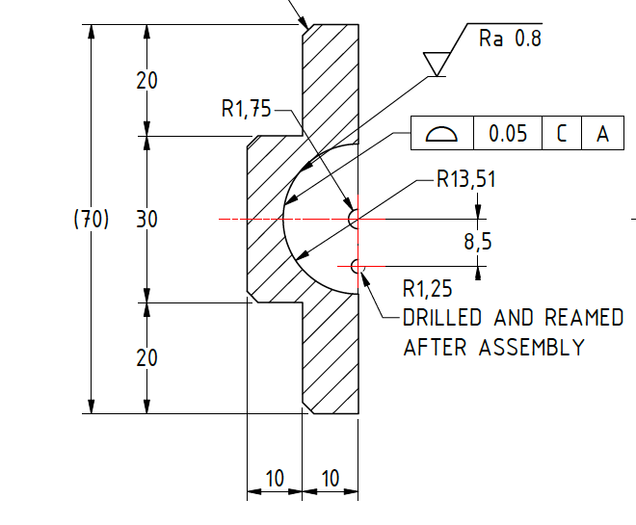
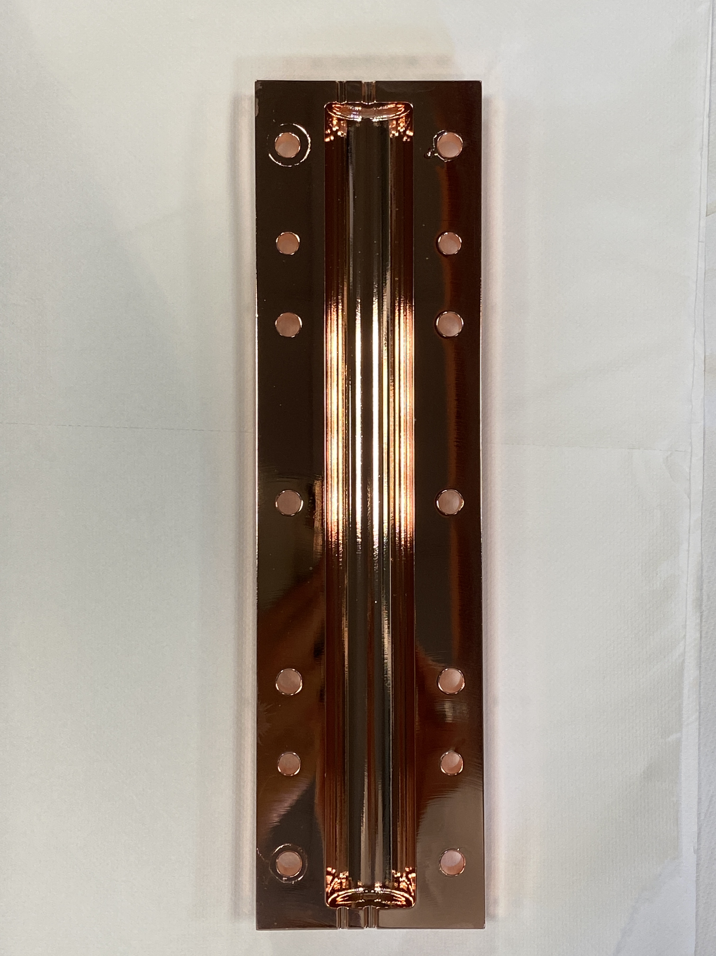
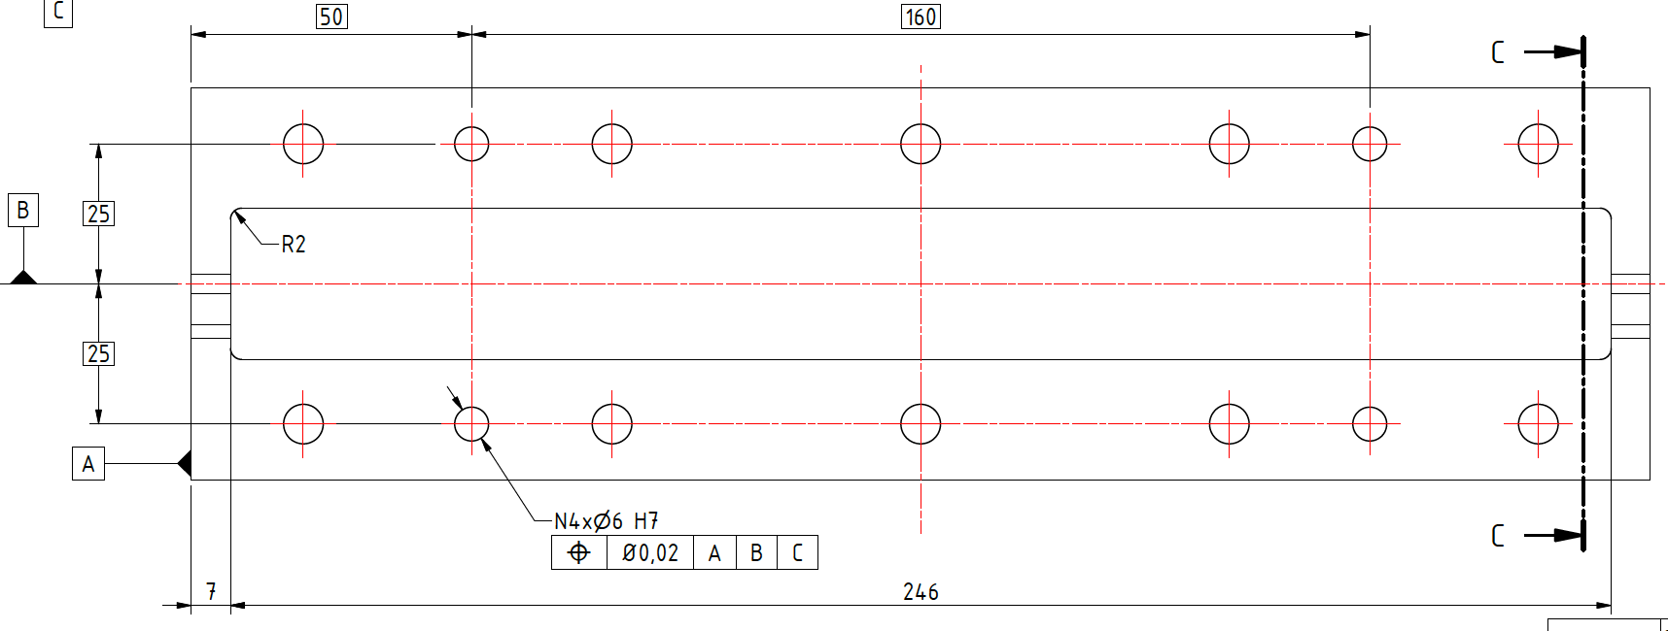
Resonant Cavity - Cu 8.5 GHz
Simulations S. Tocci
Technical design S. Lauciani
Fabrication LNF workshop
Chemical polishing LNL

Slide 6
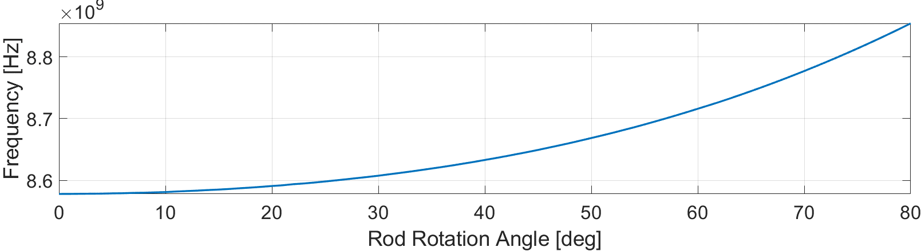
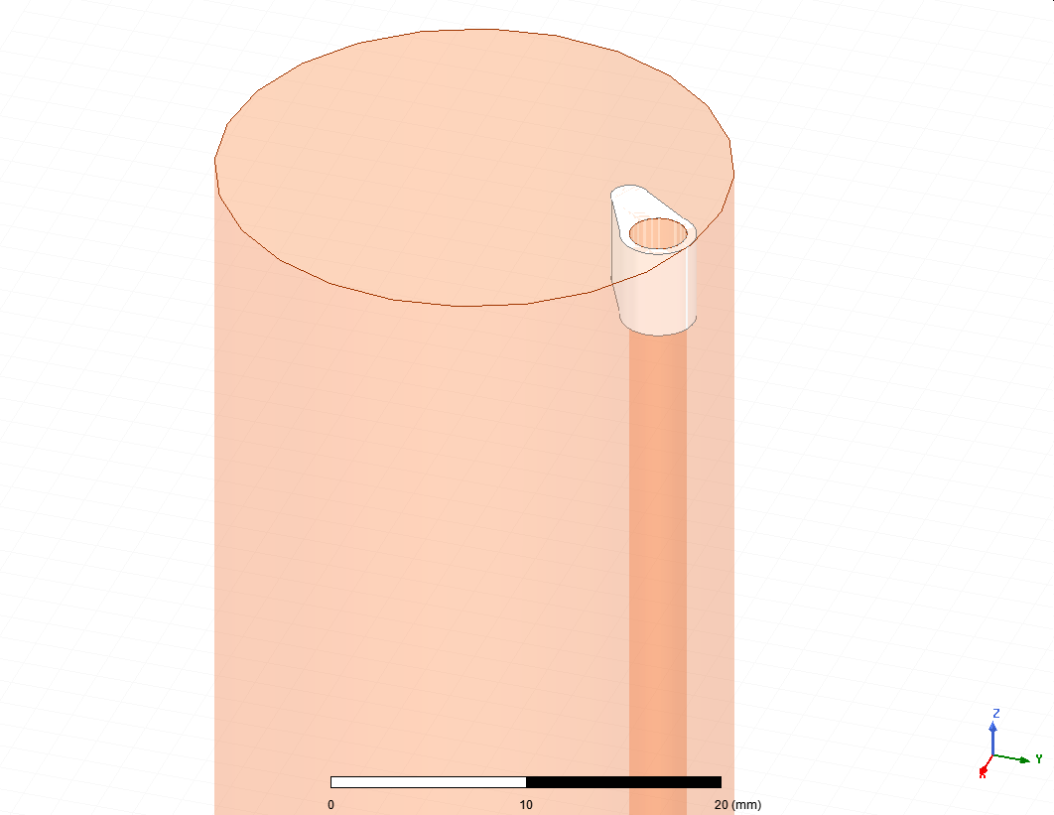
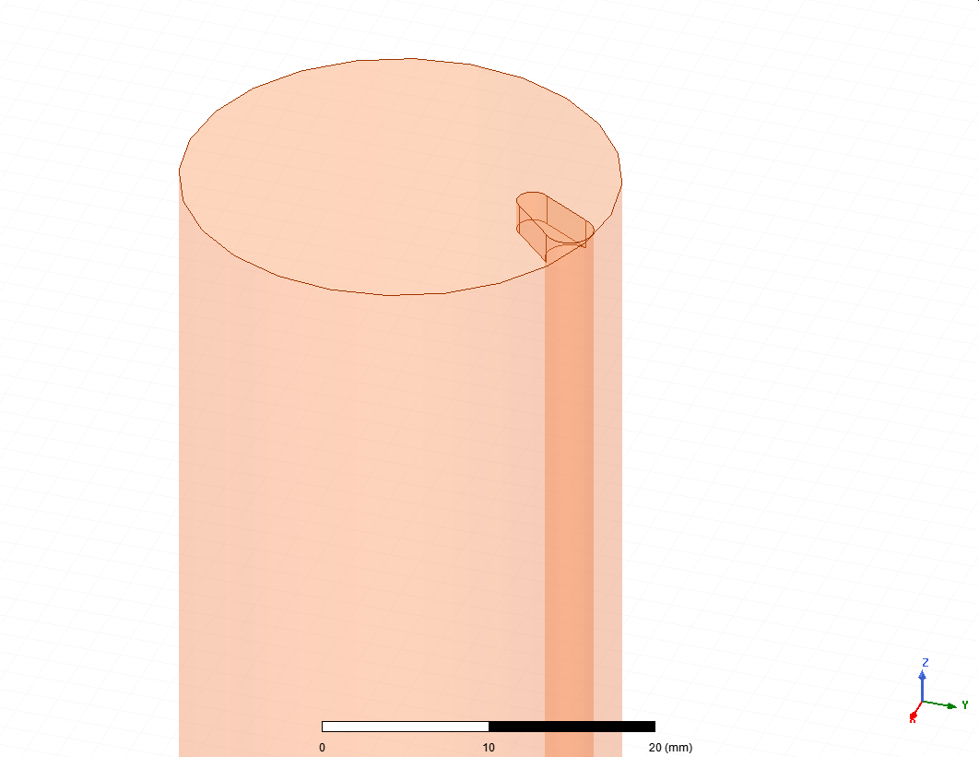
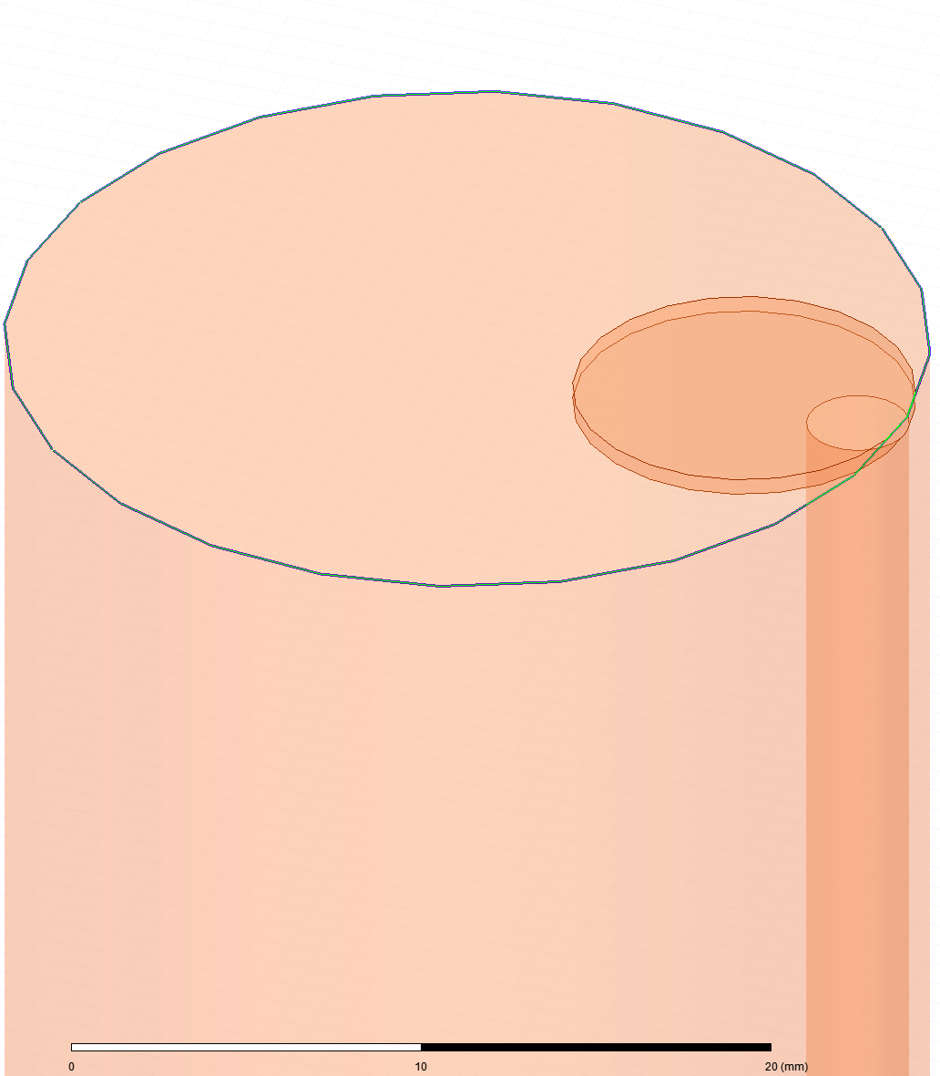
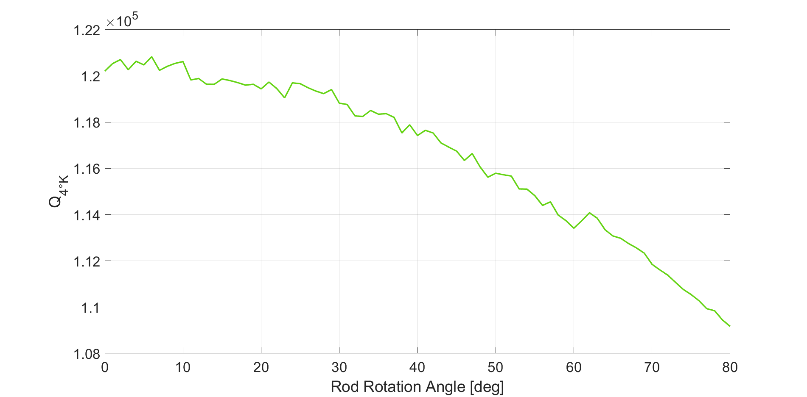
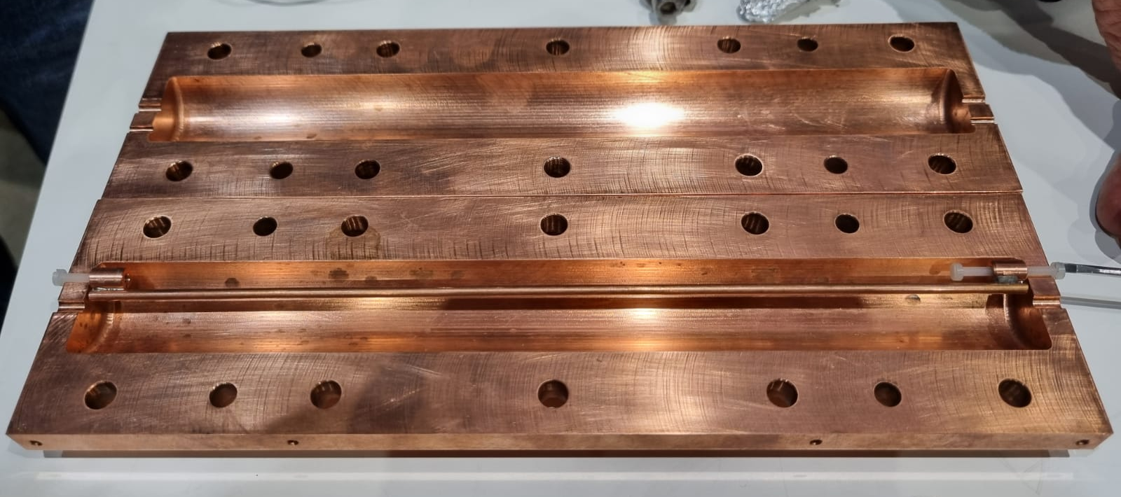
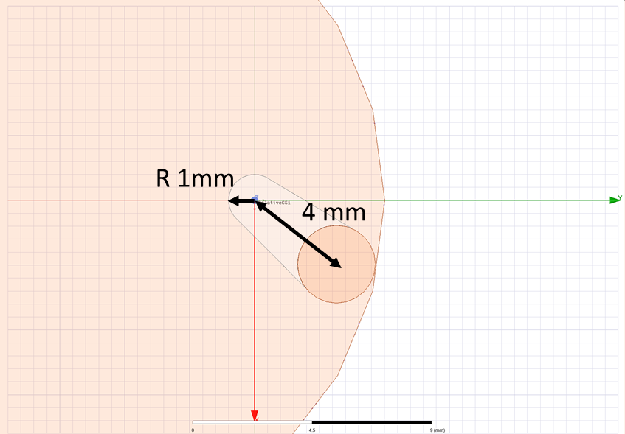
Tuning
Allumina
Copper
Cu Disk
~200 MHz scan
Type | Q | C₀₁₀
Ideal | 117,000 | 0.669
Allumina | 114,000 | 0.665
Copper | 114,000 | 0.666
Cu Disk | 115,000 | 0.663

Slide 7
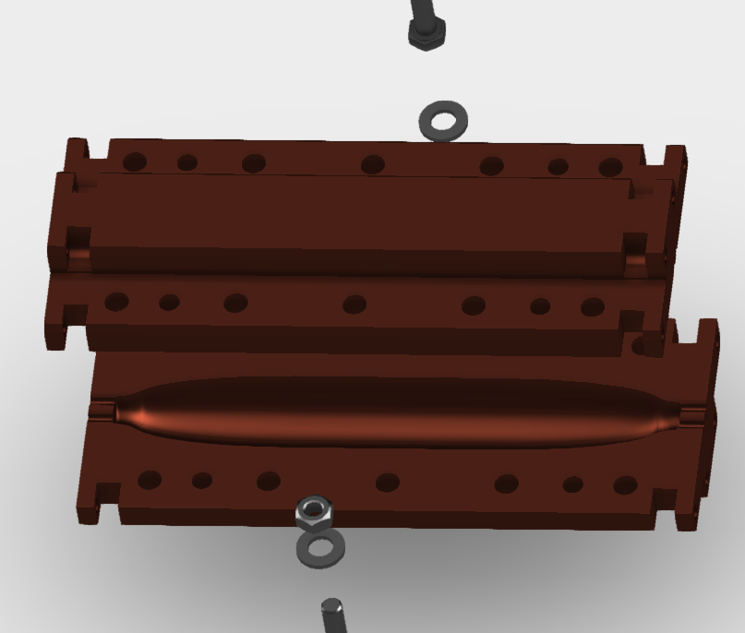
Superconductive Cavity: Nb₃Sn (SQMS)
Design di M. Checchin (FNAL)
Tuning S.Tocci
Technical design S. Lauciani
Fabrication in progress at FNAL

Slide 8
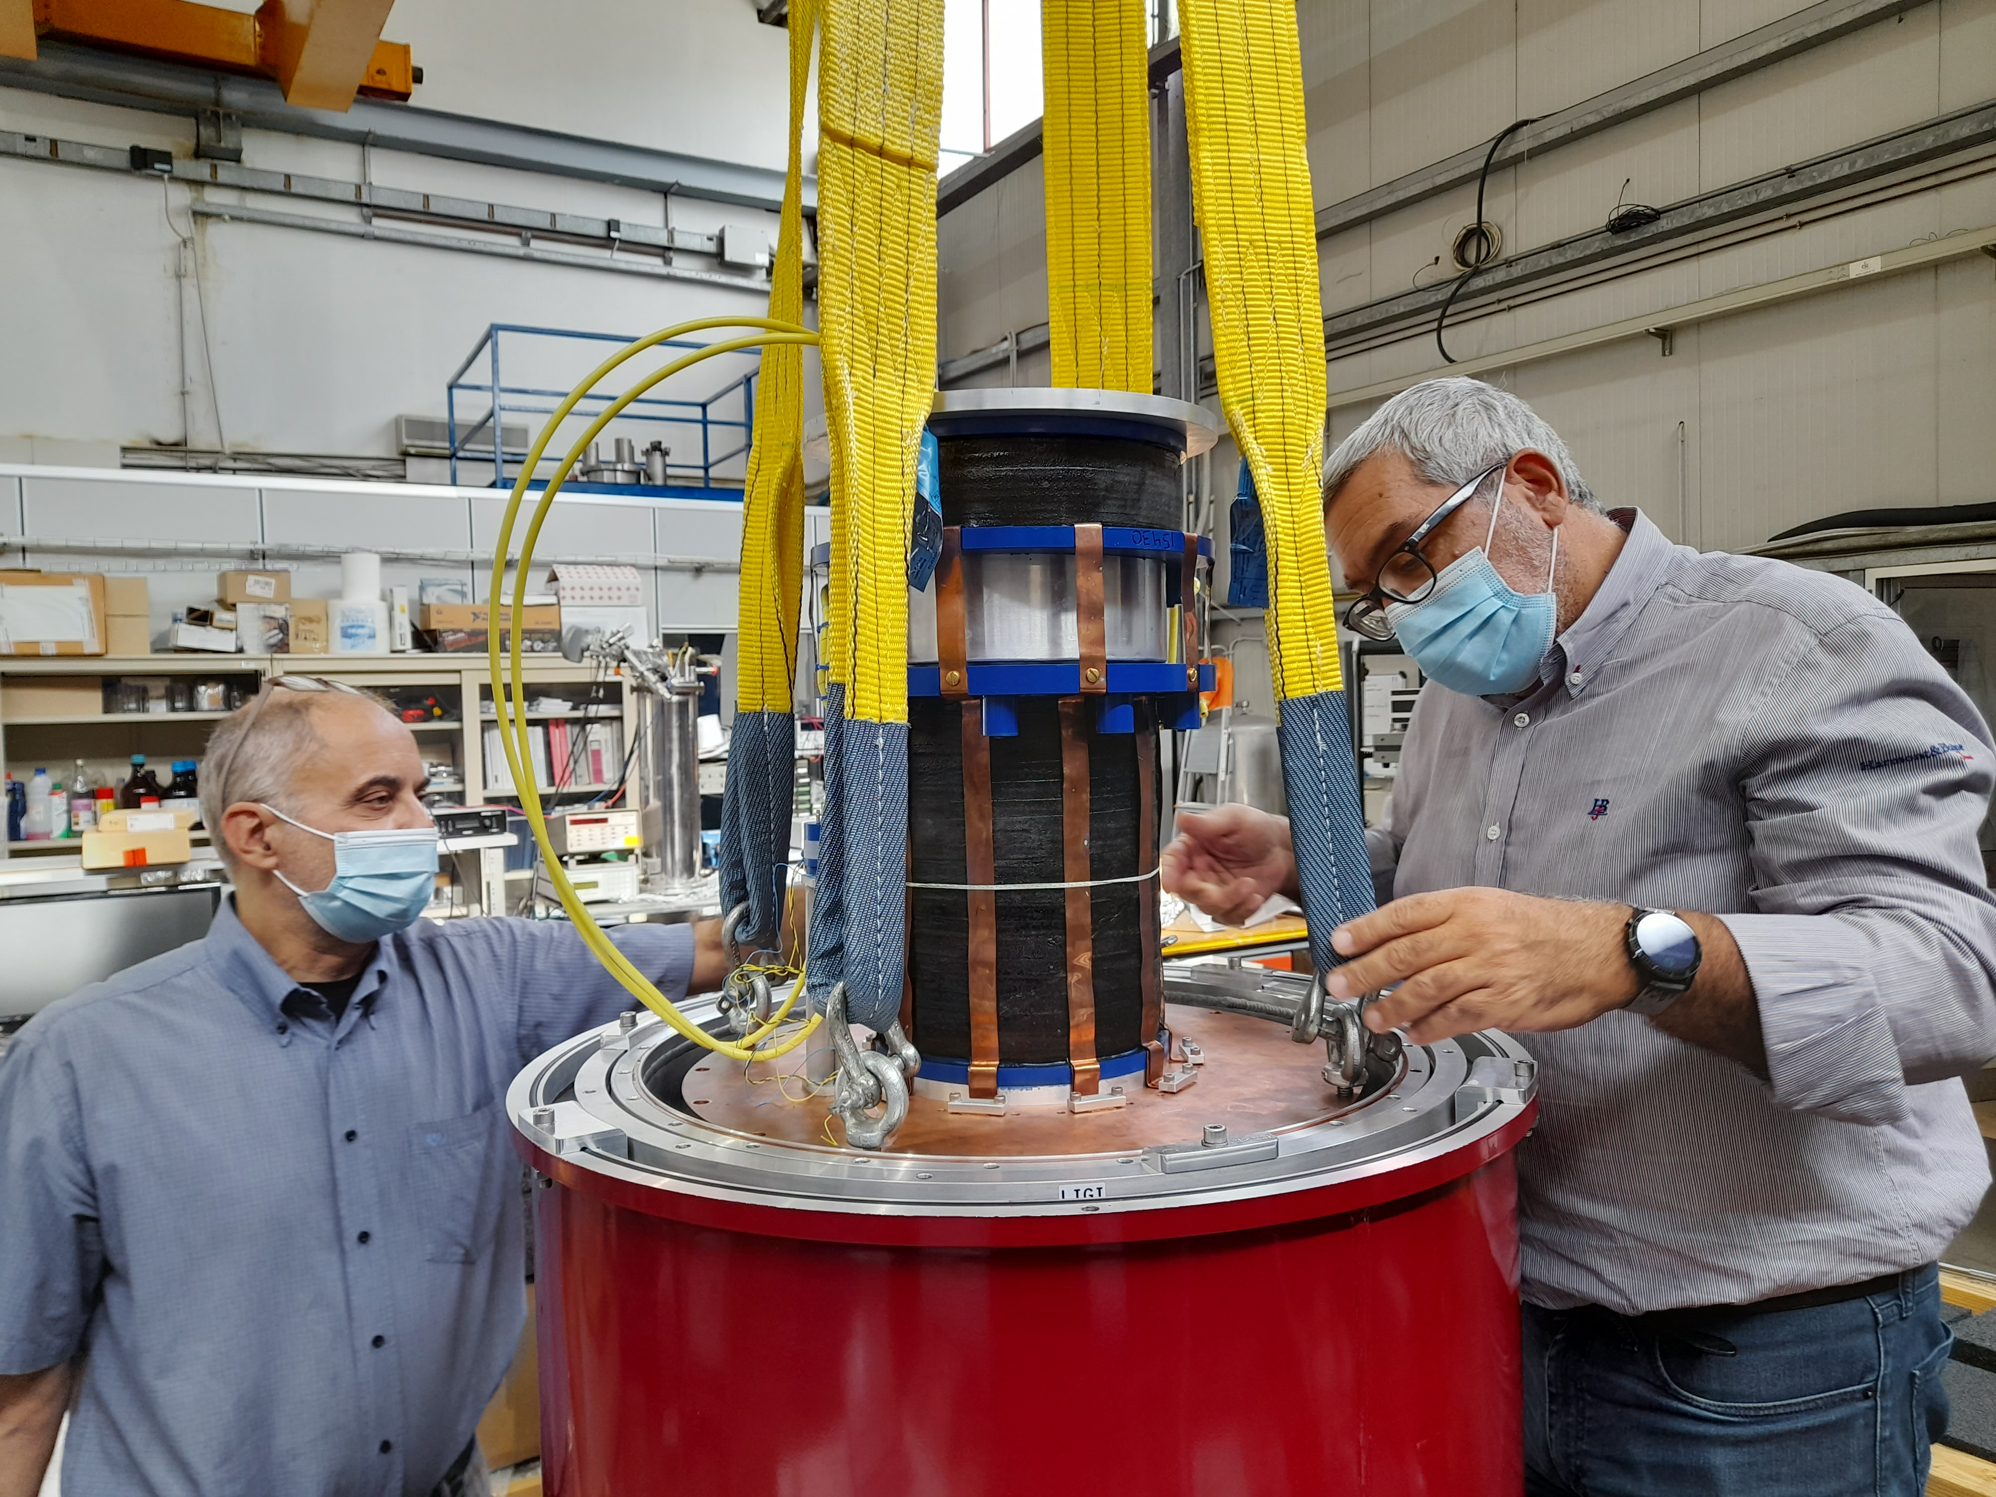
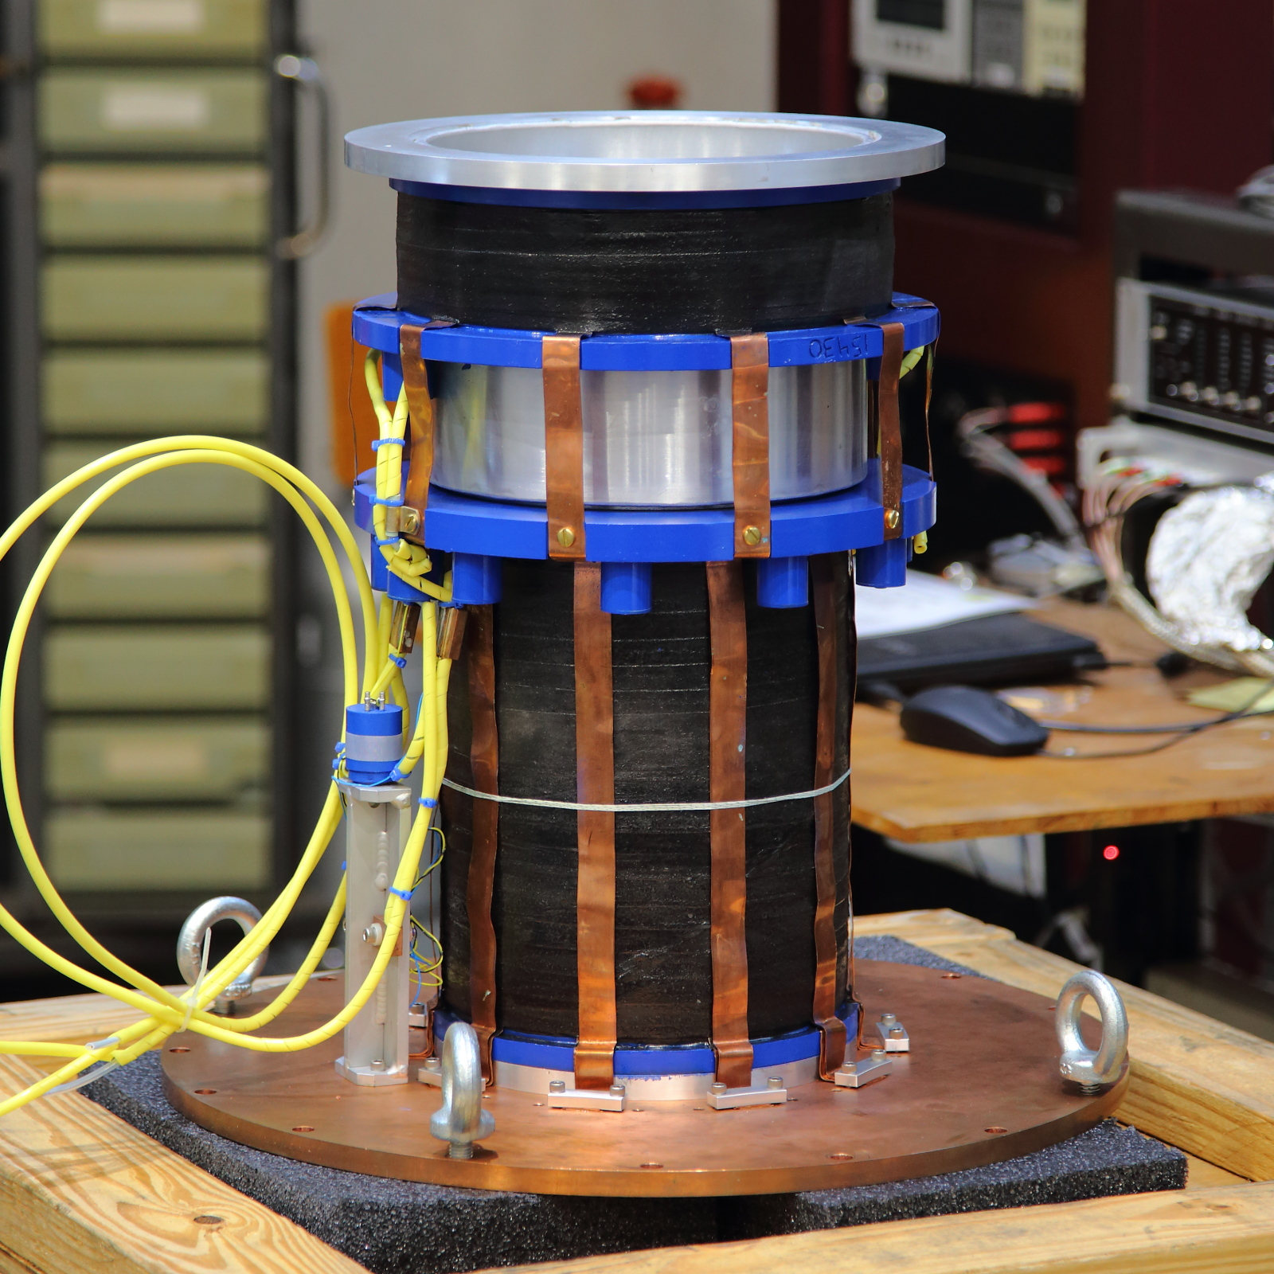
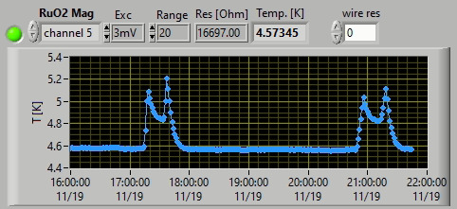
Test of 9T Magnet
New 9T NbTi magnet from AMI succesfully installed in the cryostat
I=10 Ampere/Tesla
Succesfully ramped to 5 T (50 Amps) and set in persistent mode
Above 50 amps, the temperature of the 4K plate increases by more than 1K
New Pulse Tube (~1.5 W@ 4K) purchased. Delivery expected this summer

Slide 9
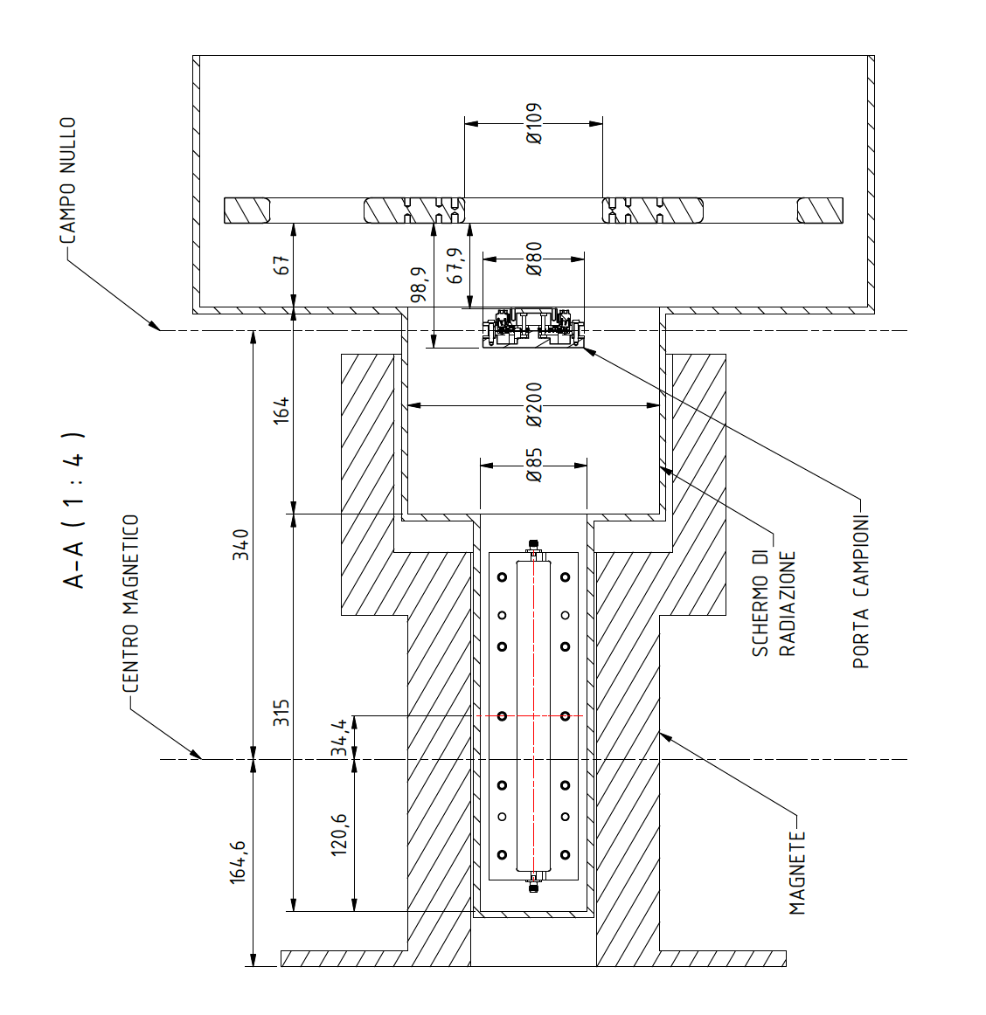
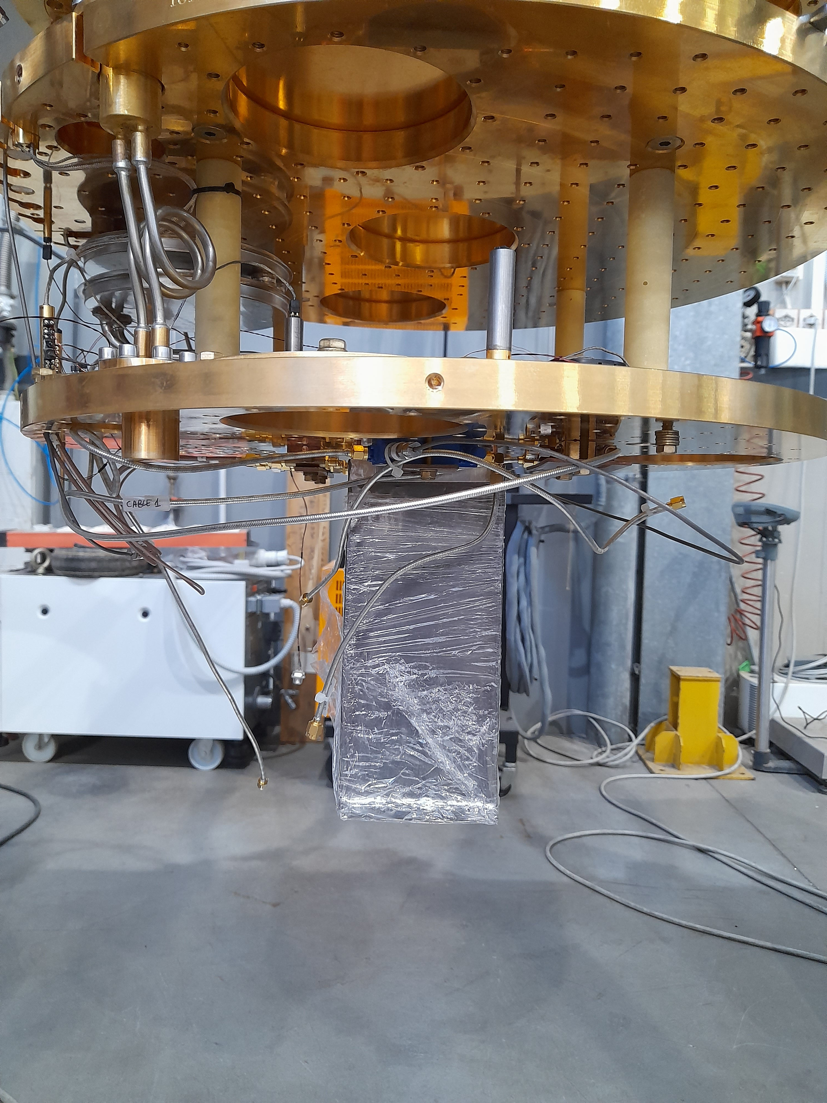
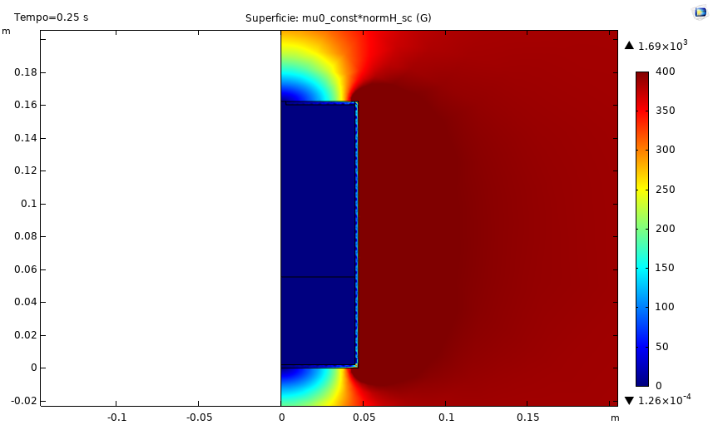
B Field Shield For SC Electronics
B-field shield
Shield simulation G. Iannone (Salerno)
Lead B-field shield

Slide 10
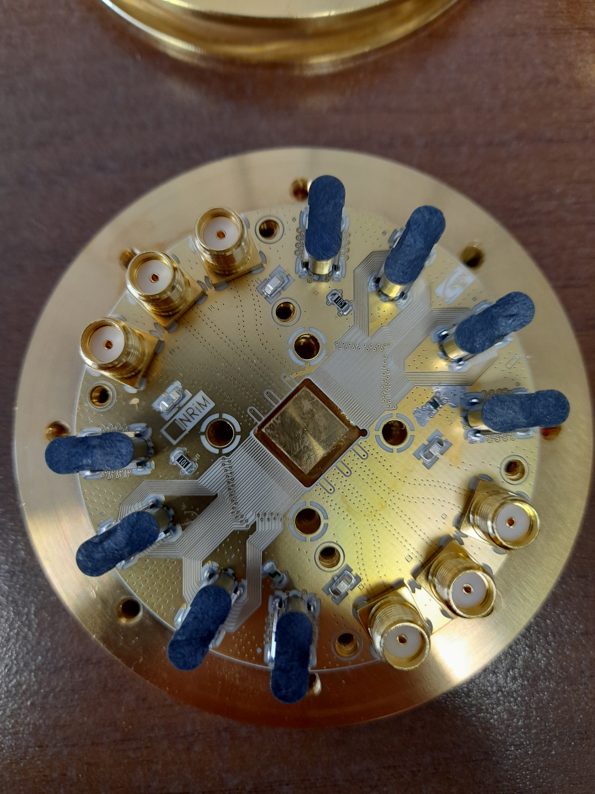
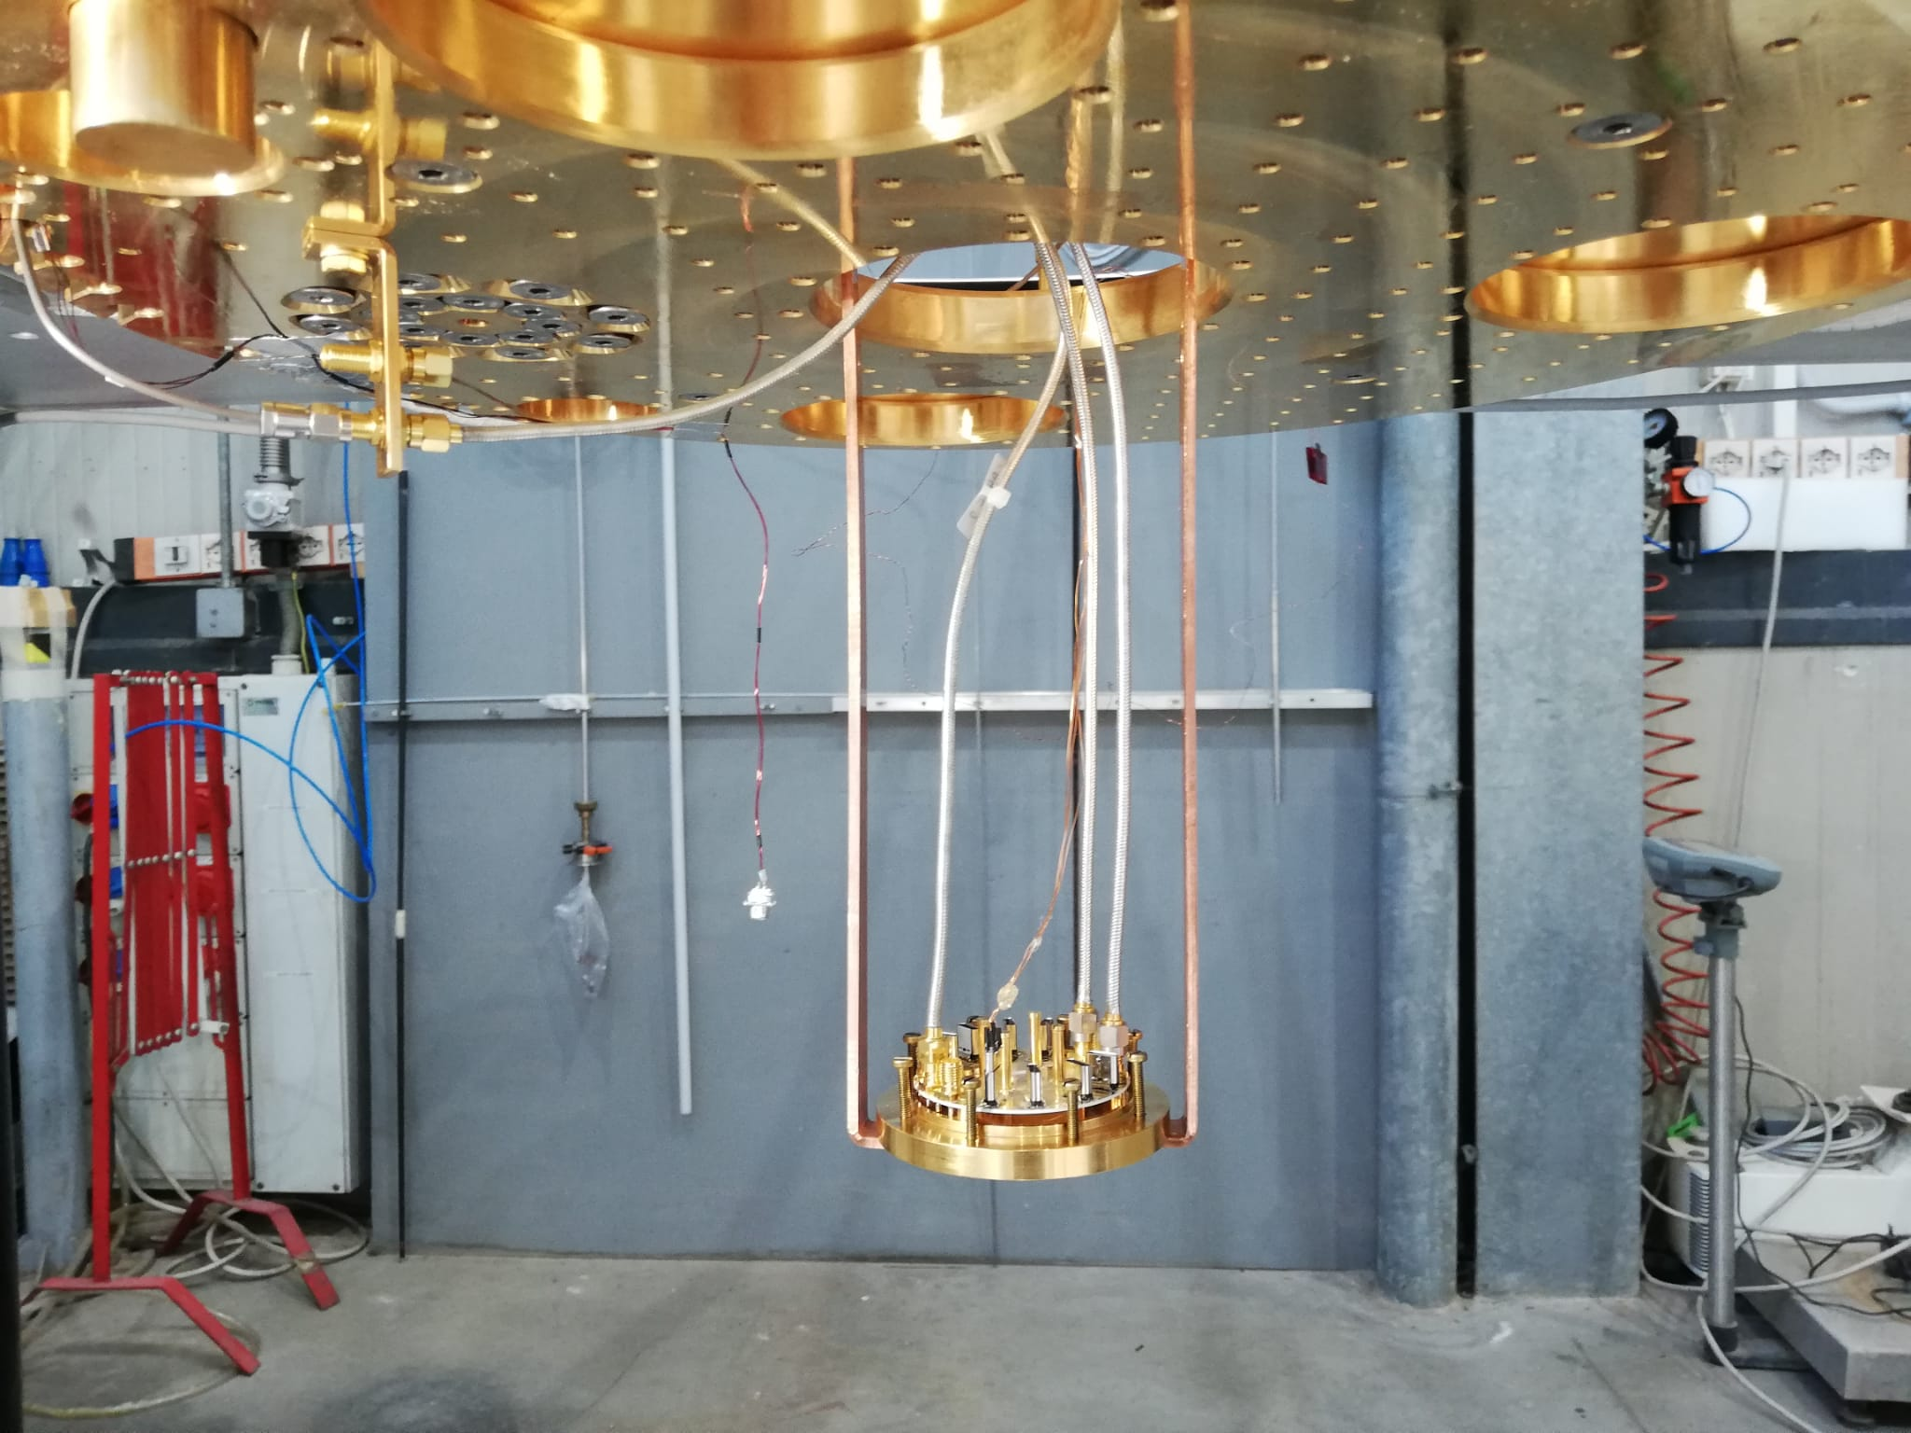
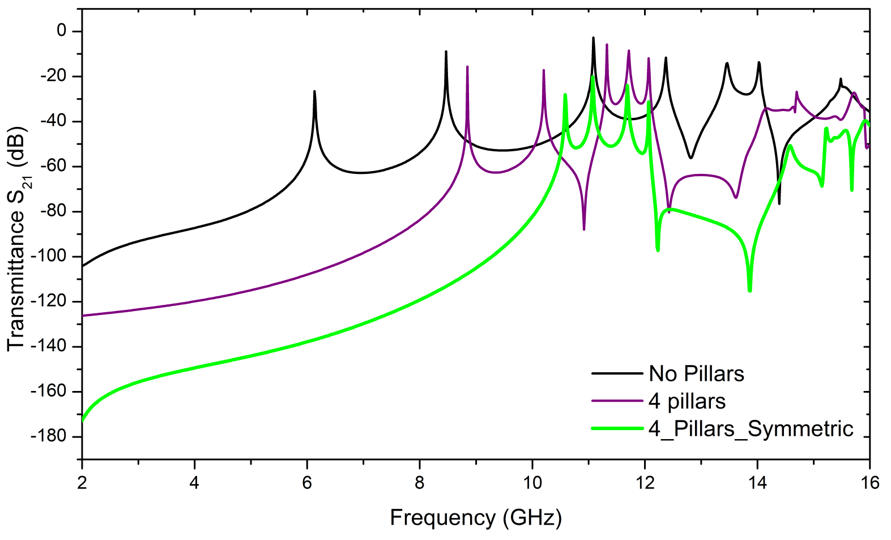
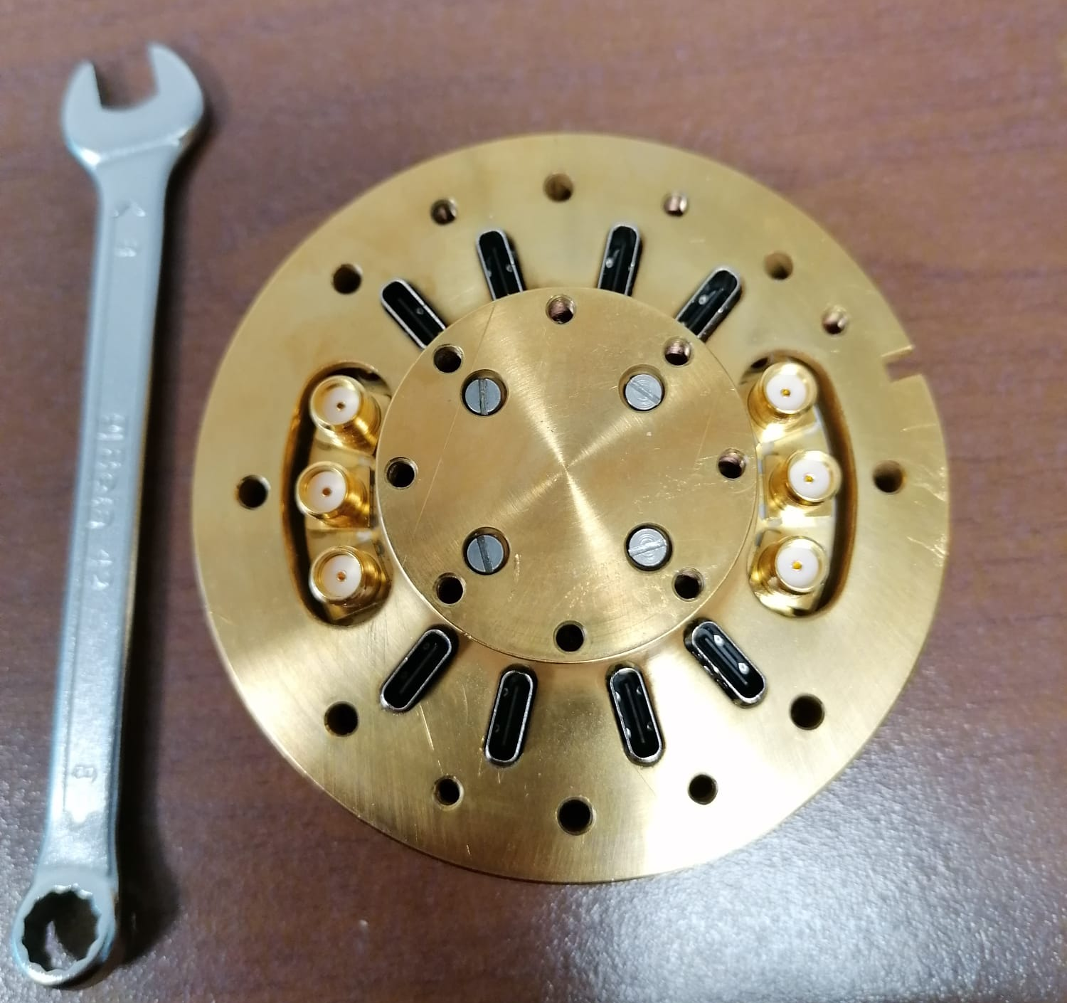
New Sample Holder
Simulation of “cavity” mode removal by pillars
Simulations by Nassim Chikhi, CNR (Supergalax)

Slide 11
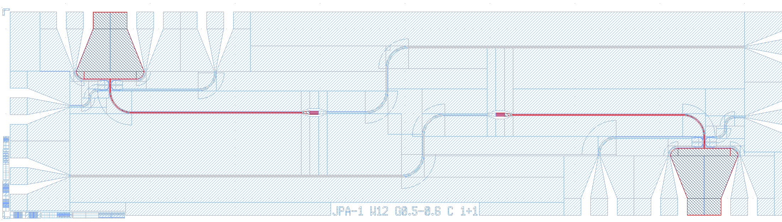
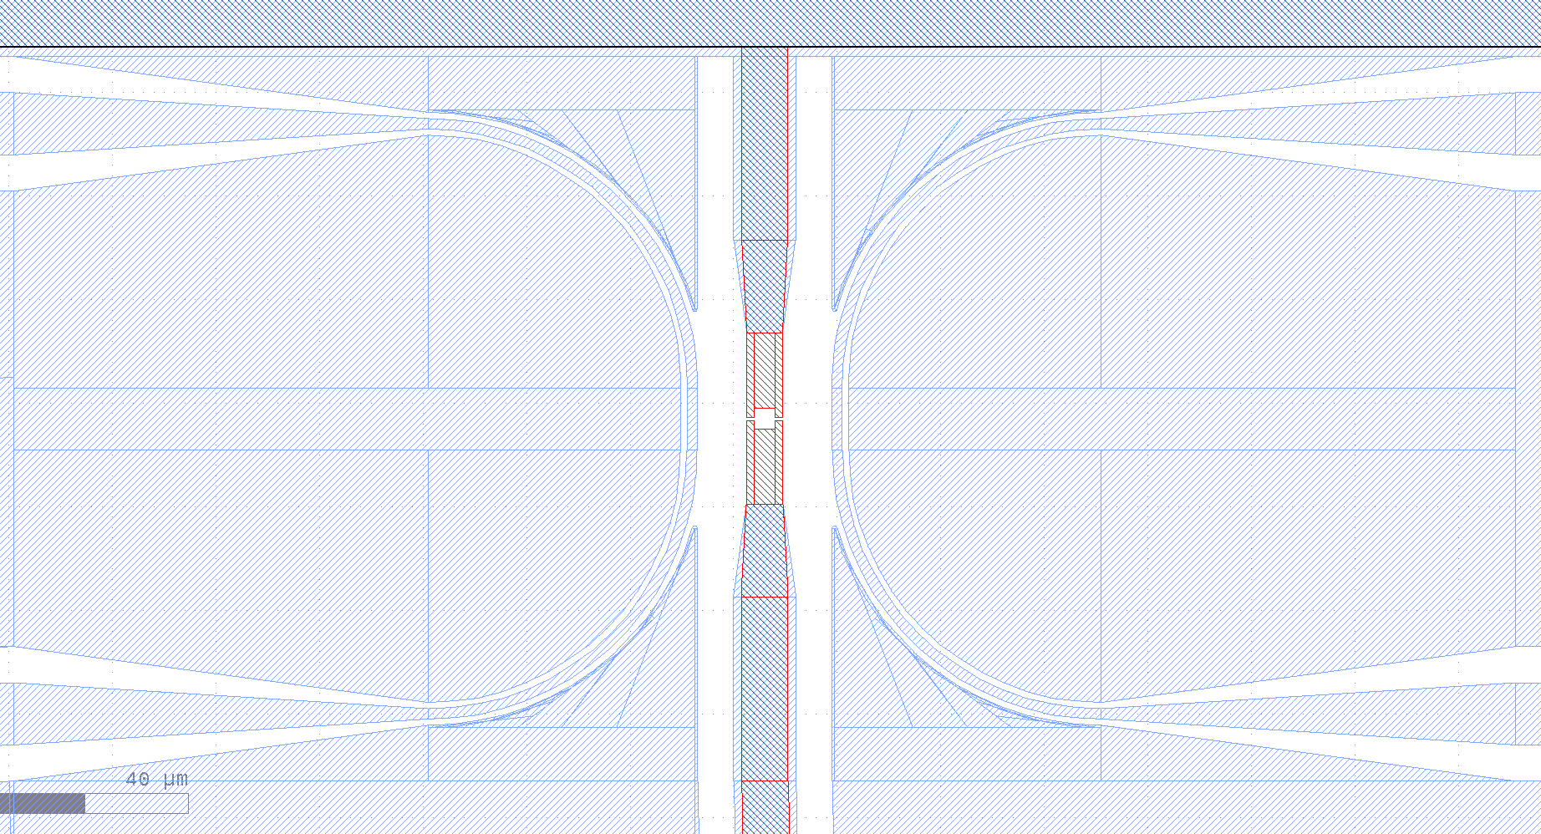
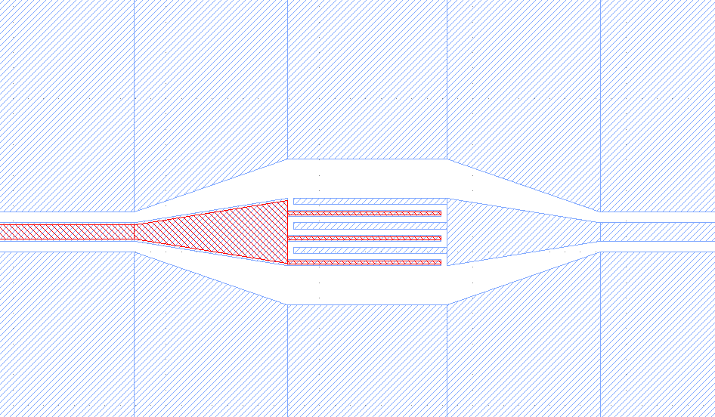
Quantum Limited Amplification: Flux JPA (QubIT)
Signal line
Pump line
Resonator λ/4
Circuit design LNF
Chip design FBK
E.M. simulation Uni Fi
Device simulation Salerno
Fabrication FBK/CNR-IFN
Coupling capacitor (20 fF)
DC Squid
First device at 8.5 GHz in fabrication now at FBK!

Slide 12
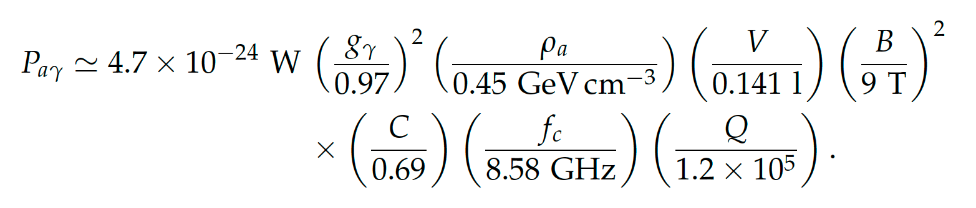
Sensitivity of LNF Haloscope
Gagg 90% cl | T_{noise} | Q | B(T)
1.6×10⁻¹³ | 8 K (HEMT) | 120,000 Cu Cavity | 5
9×10⁻¹⁴ | 8 K (HEMT) | 120,000 Cu Cavity | 9
2×10⁻¹⁴ | SQL (JPA) | 120,000 Cu Cavity | 9
1.3×10⁻¹⁴ | SQL (JPA) | 300,000 SC Cavity | 9
Gagg(KSVZ)=1.3×10⁻¹⁴ GeV⁻¹
m_{a}=35 μeV
→ Ready for the first experimental run (Summer 2022)!
→ After new Pulse Tube commissioning
→ With JPA
→ With SC cavity
1h data taking
Multi-cavity: with 4 cavities at differet frequencies, 4 times the scan speed with same sensitivity.

Slide 13
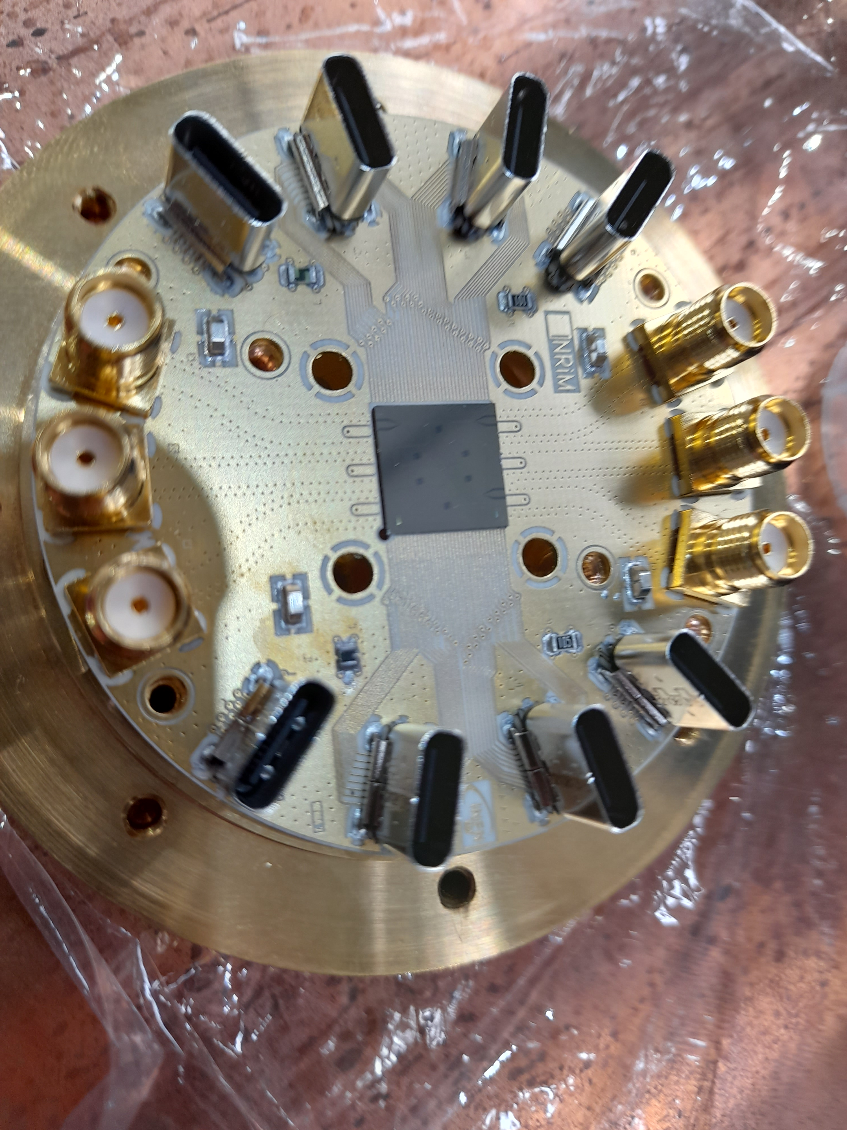
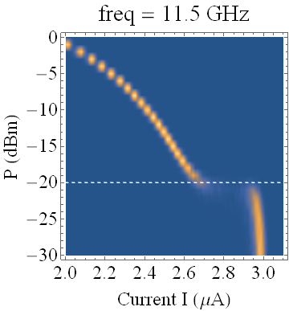
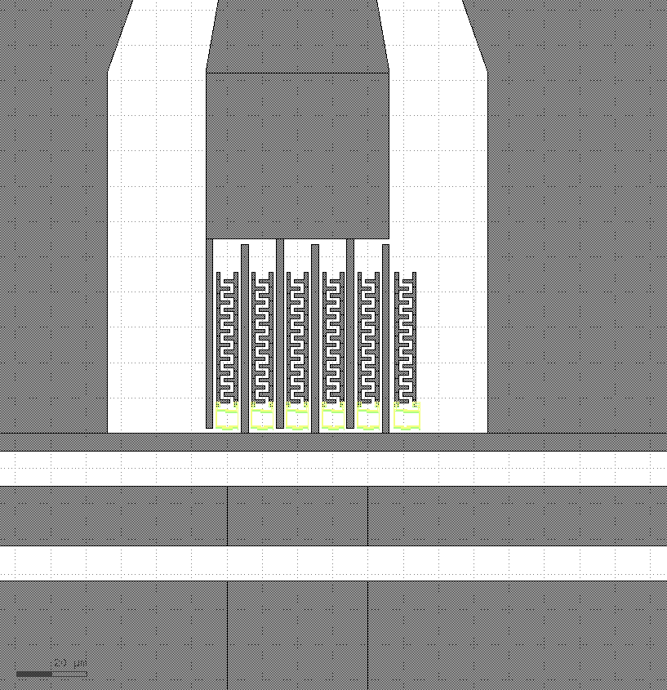
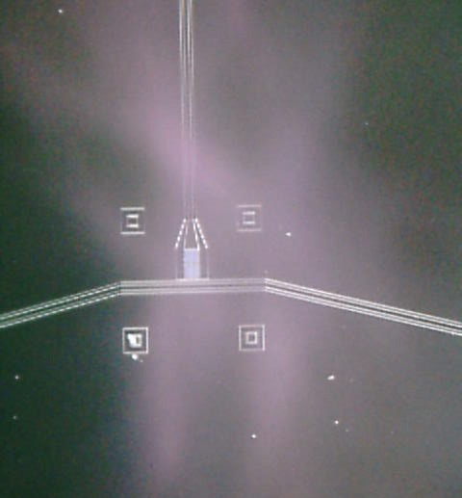
Single Photon Detection
Observed Resonant Activation of a CBJJ
Two resonators coupled by 5 qubits
Test at LNF in preparation (end of May)
SIMP
IEEE TRANSACTIONS ON APPLIED SUPERCONDUCTIVITY, VOL. 32, NO. 4, JUNE 2022
A. Rettaroli Ph.D. Thesis “Study of devices based on Josephson junctions for galactic axion search” Uni Roma Tre (2022)

Slide 14
FLASH
Finuda magnet for Light Axion SearcH
Galactic axion search at 100 MHz (0.4-1.1 mev)

Slide 15
The Flash
FLASH - Finuda magnet for Light Axions SearcH
Proposal of a large Haloscope
Search of galactic axions in the mass range 0.5-1.5 μeV
Large volume RF Cavity (4 m³)
Moderate magnetic field (1.1 T)
Copper rf cavity Q~500,000
T 4.5 K
Experiment | ω B² V Q (rad T²m³/s) (×10¹⁵)
The FLASH | 1.5
ADMX | 5
HAYSTAC | 0.2

Slide 16
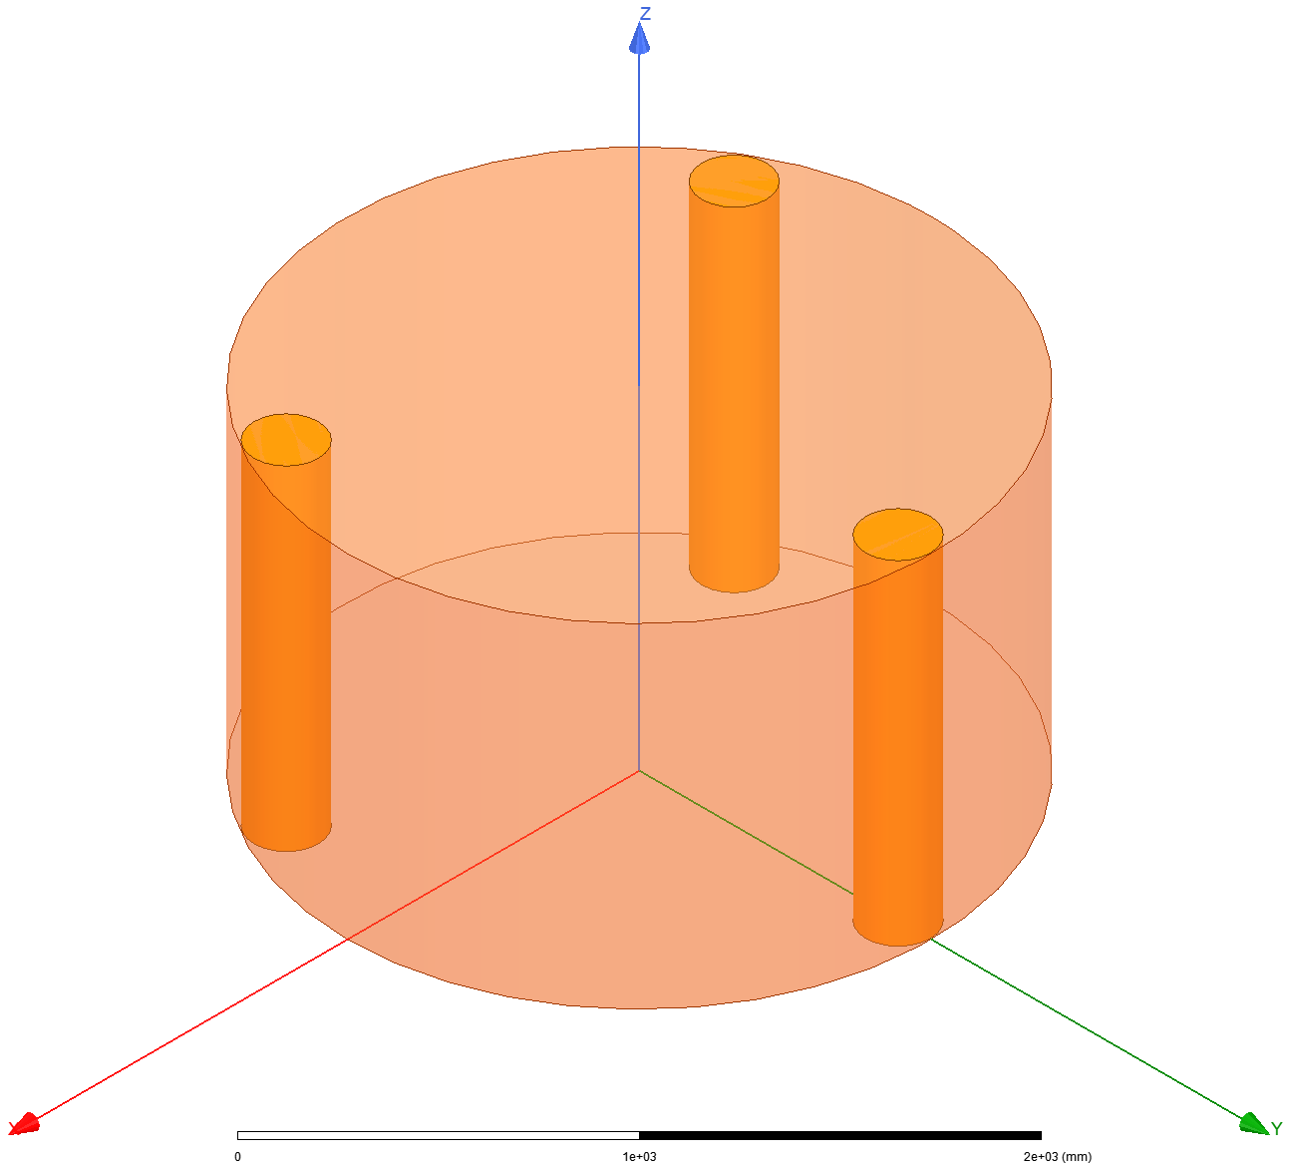
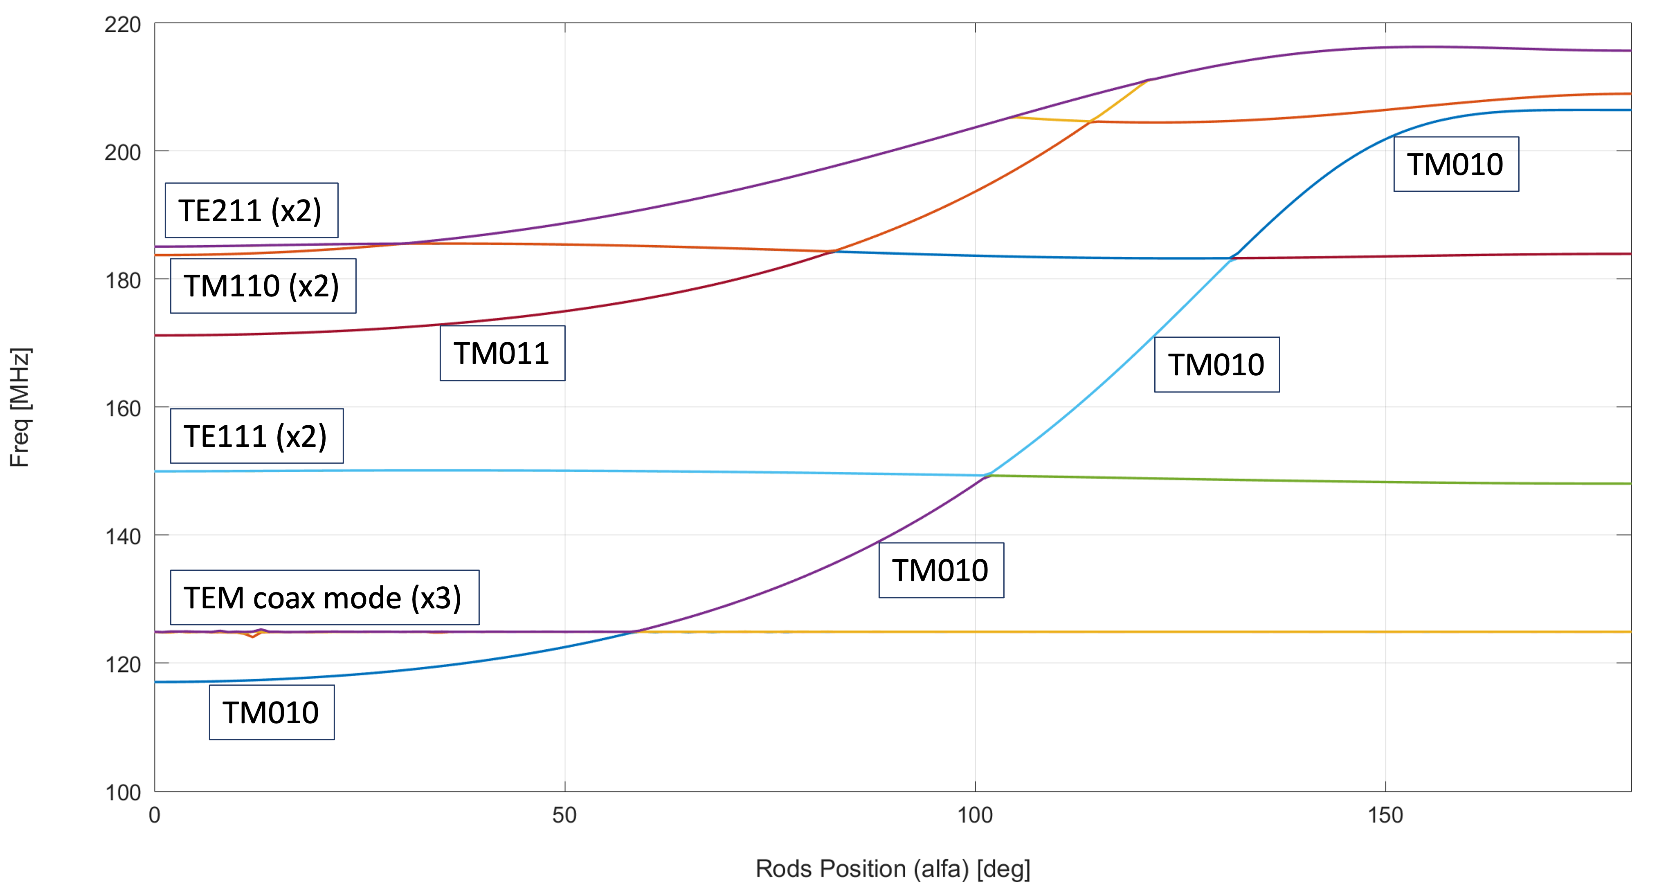
THE FLASH Frequency Tuning - LF
From 117 to 206 MHz
L=1200 mm
Φ_{rod}=230mm
R_{cav}=1050 mm
$$f_{{TM}_{{010}_{\left|α\right.=0°}}}≅117 MHz$$
Simulations S.Tocci

Slide 17
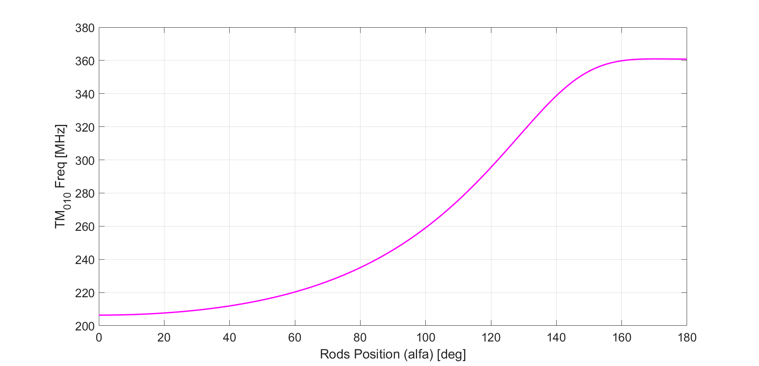
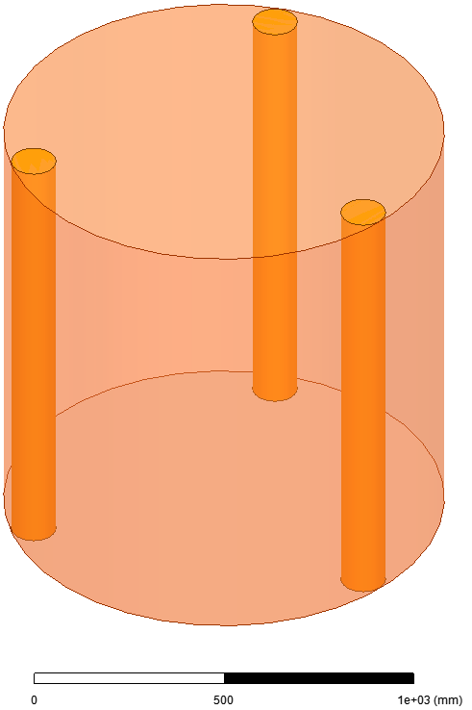
THE FLASH Frequency Tuning - HF
From 206 to 360 MHz (preliminary)
Φ_{rod}=120 mm
L=1200 mm
R_{cav}=590 mm
$$f_{{TM}_{{010}_{\left|α\right.=0°}}}≅206 MHz$$

Slide 18
FLASH sensitivity 0.5 – 1.5 μeV
Generated with https://github.com/cajohare/AxionLimits by Ciaran O’Hare

Slide 19
With projections from other experiments
Generated with https://github.com/cajohare/AxionLimits by Ciaran O’Hare

Slide 20
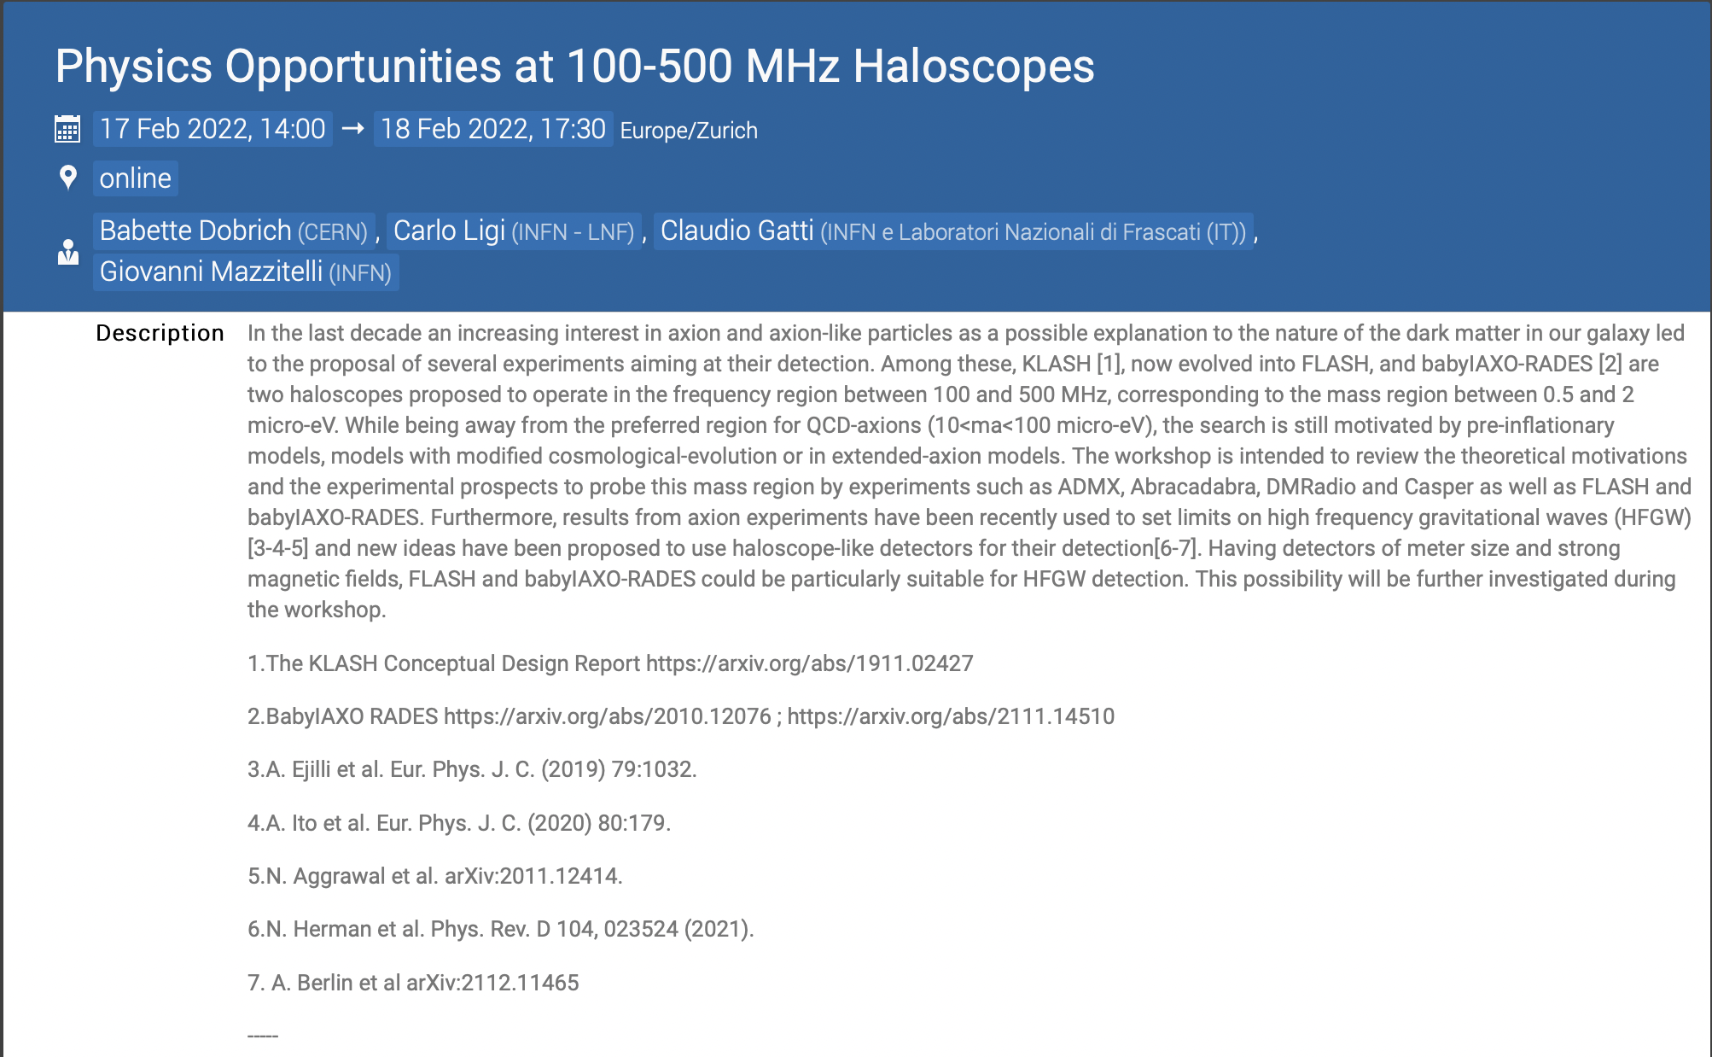
Two days workshop to discuss physics opportunities at 100-500 MHz Haloscopes
115 registered people
FLASH (Design study;120-1360 MHz; 4K;1.1T)
Baby Iaxo-RADES (Design study; 200-500 MHz; 6K; 2.5 T)
ADMX Low Frequency (Design study, 9T MRI magnet, 100 mK, 160-500 MHz)
DMRadio-ABRACADABRA (TDR in preparation; 4 T; mK; 5-200 MHz)
https://indico.cern.ch/e/MHzHaloscope

Slide 21
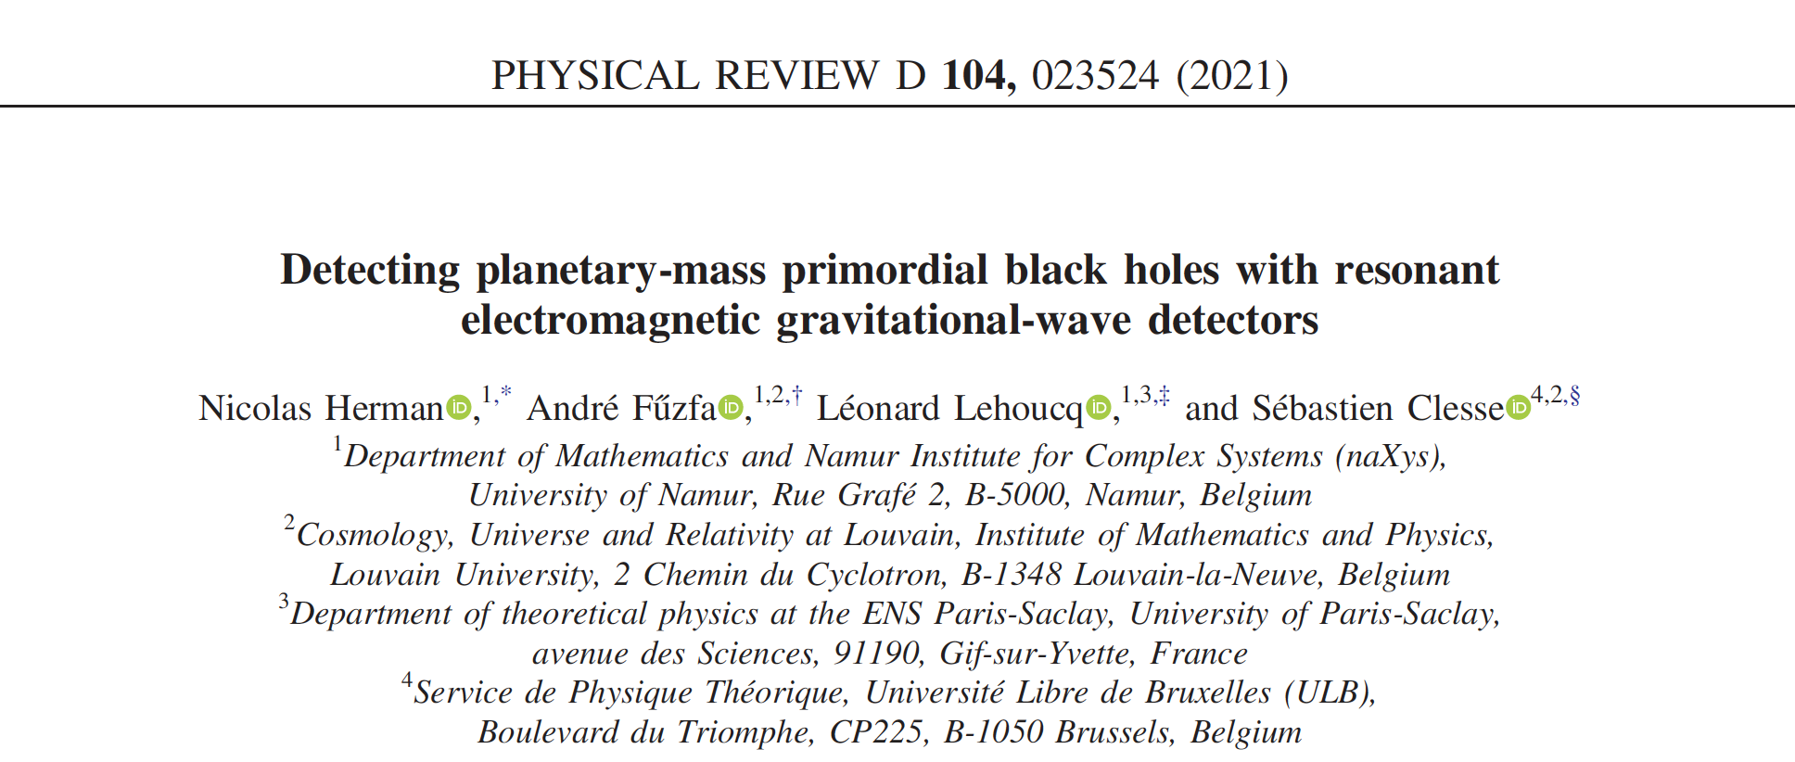
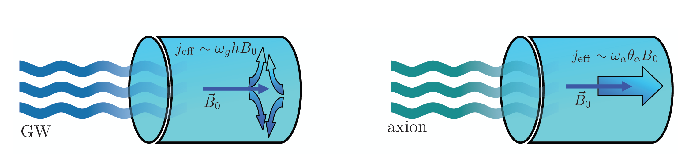
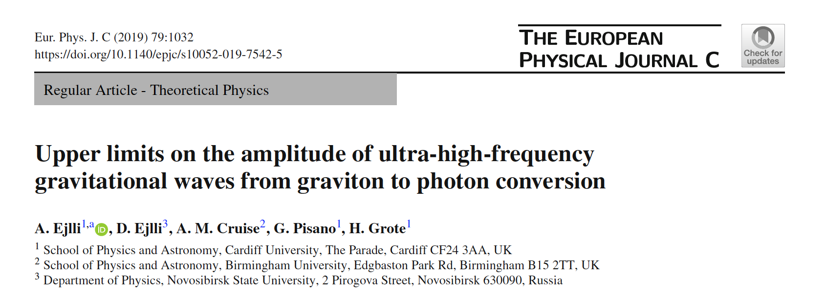
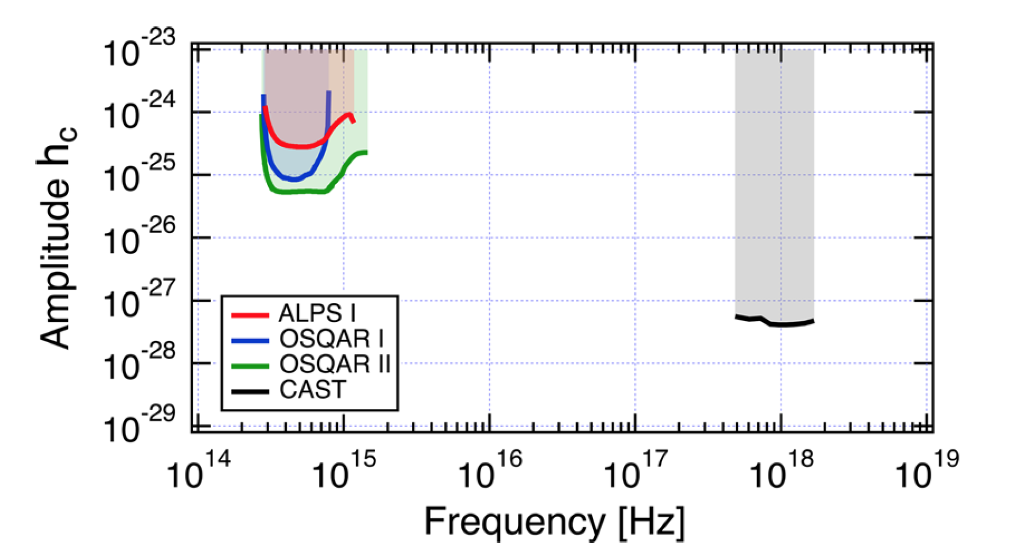
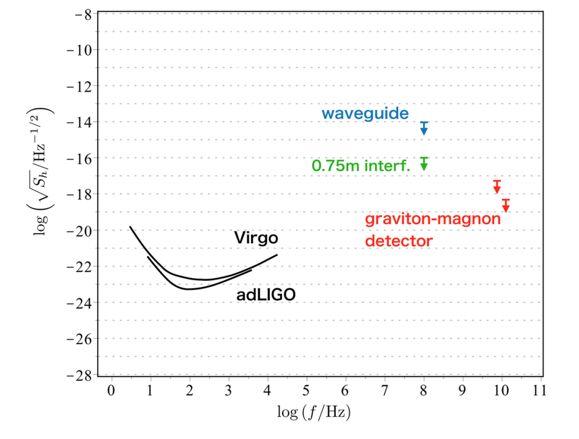
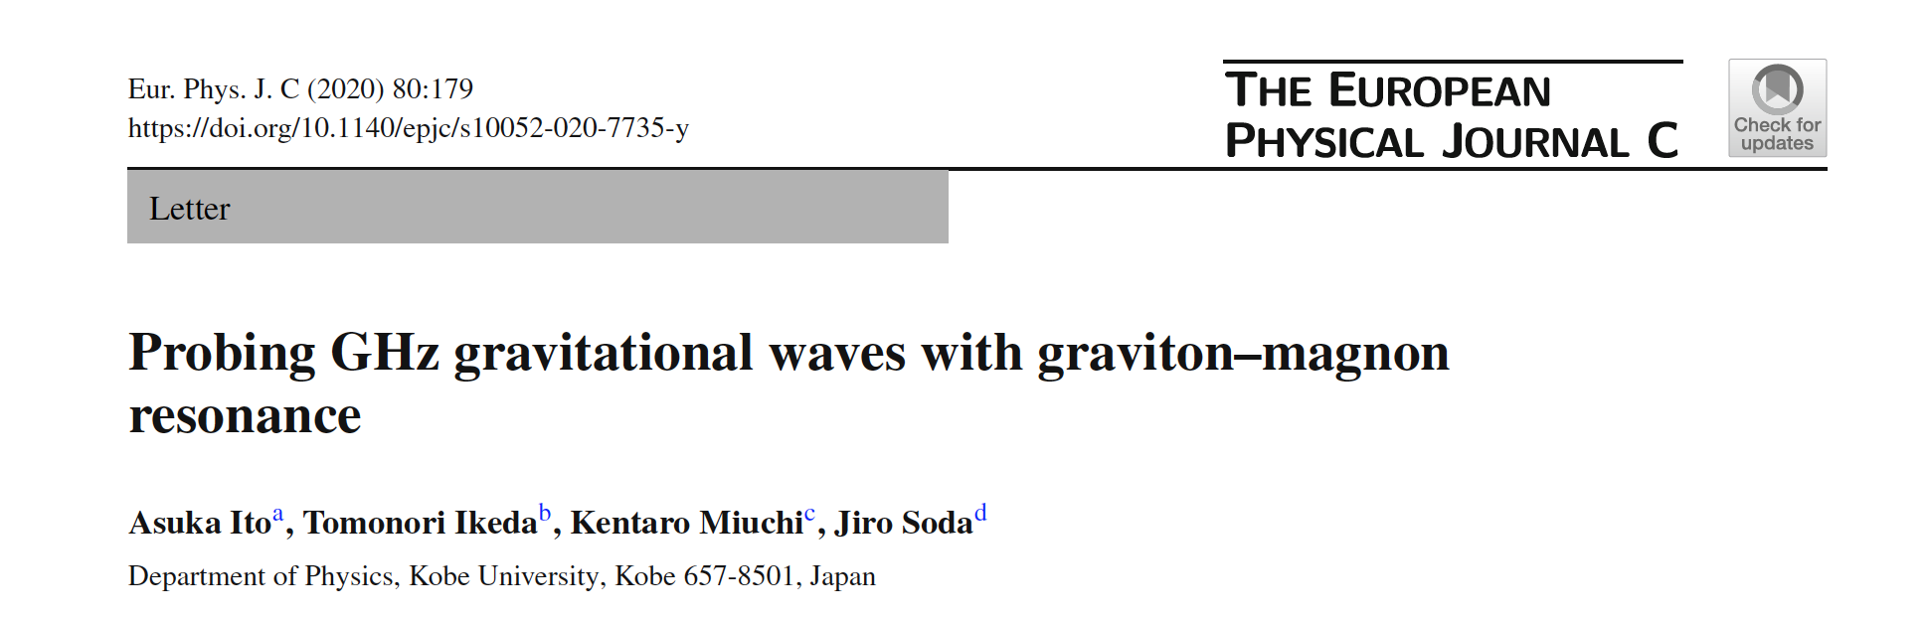
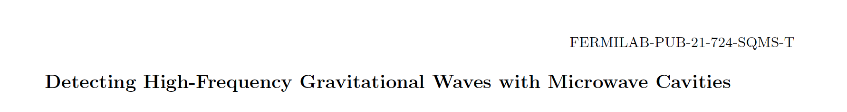
High Frequency Gravitational Waves
arXiv:2112.11465

Slide 22
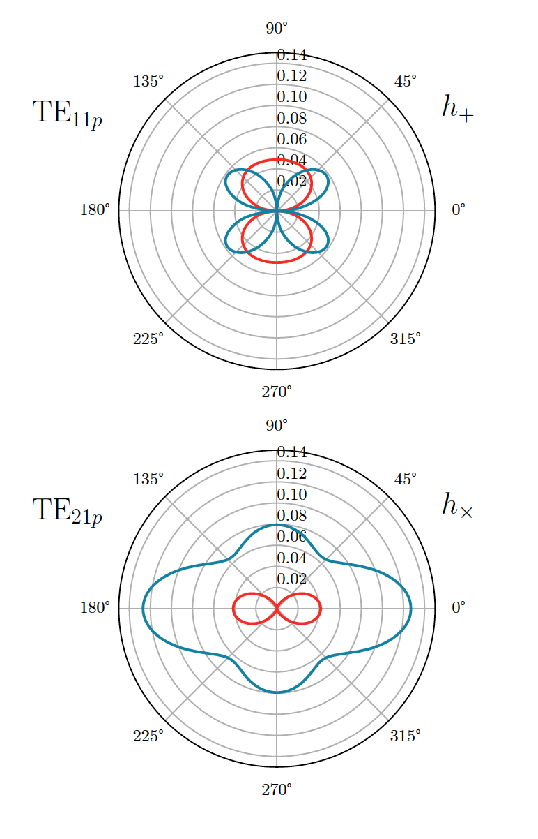
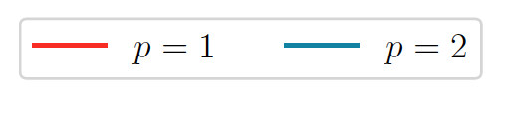
Sensitivity to HFGW
Mode | Resonant Frequency [MHz] | Q factor (@4°K)
TE111 | 150.4 | 711e3
TE112 | 263.5 | 871e3
TE211 | 186.9 | 735e3
TE212 | 285.9 | 817e3
arXiv:2112.11465

Slide 23
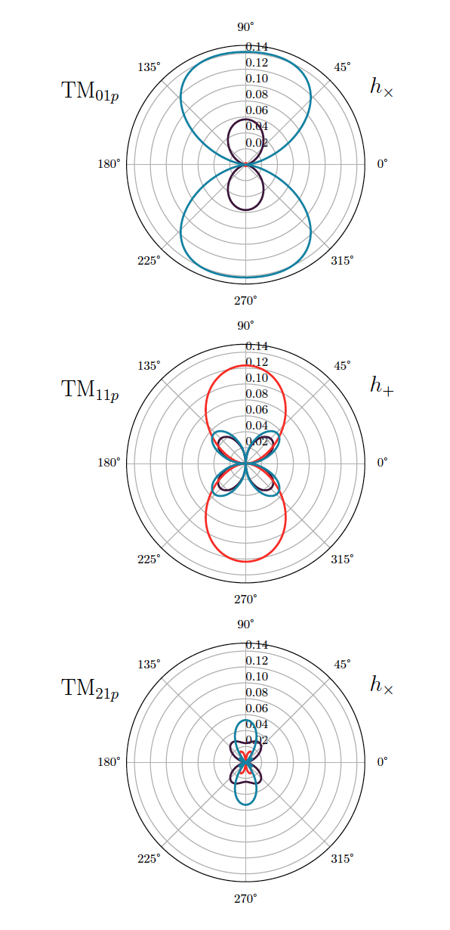

Sensitivity to HFGW
Mode | Resonant Frequency [MHz] | Q factor (@4°K)
TM010 | 109.5 | 626e3
TM011 | 166.1 | 526e3
TM012 | 272.3 | 752e3
TM110 | 174.4 | 790e3
TM111 | 214.5 | 598e3
TM112 | 304.7 | 712e3
TM210 | 233.7 | 915e3
TM211 | 264.9 | 664e3
TM212 | 342.1 | 755e3

Slide 24
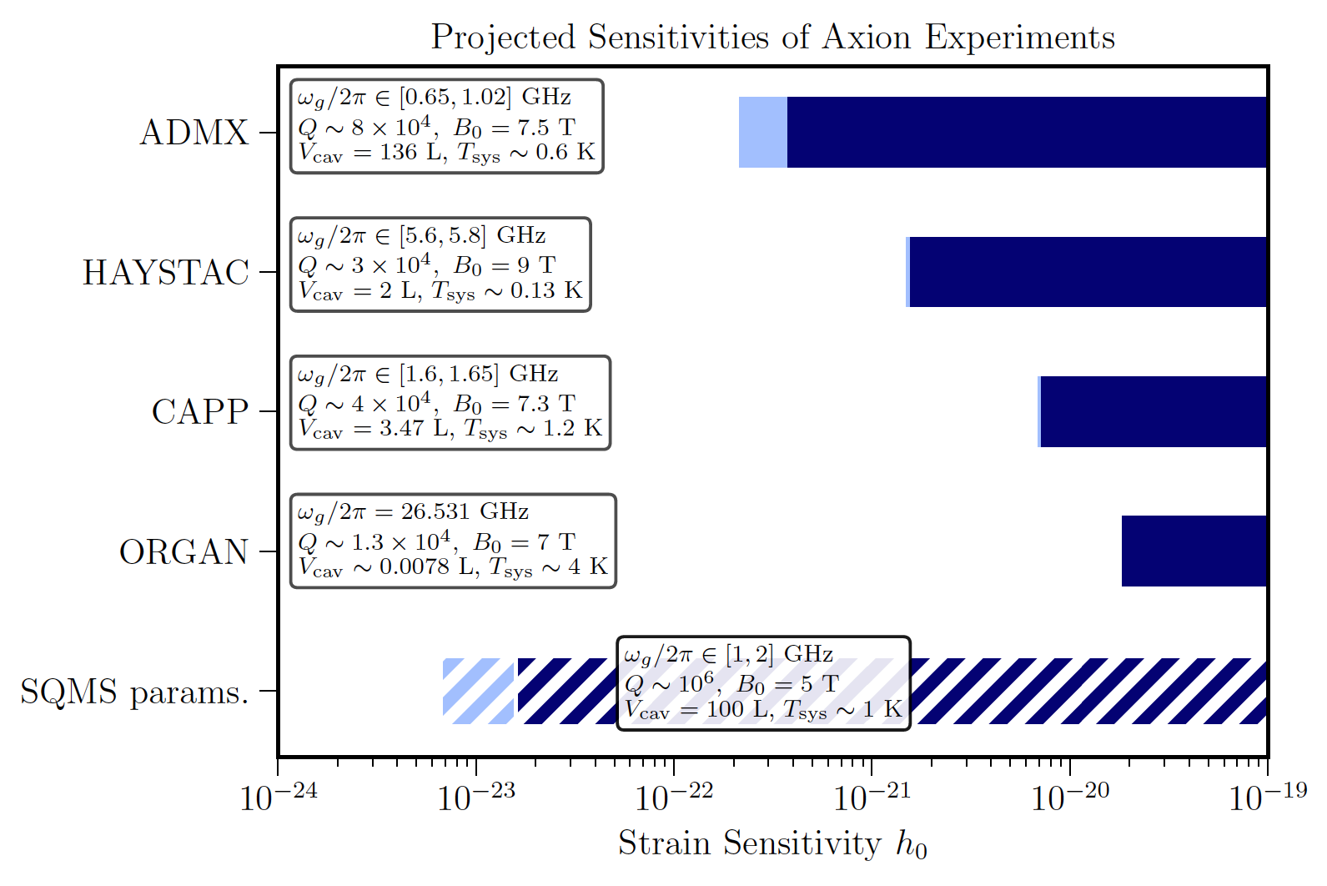
Sensitivity to HFGW
Mode | TM012
frequency | 270 MHz
η_{n} | 0.14
B₀ | 1.1 T
V_{cav} | 4.15 m³
Q₀ | 7×10⁵
T_{sys} | 4.9 K
Δν | 10 kHz
t_{int} | 1 min
FLASH
FLASH strain sensitivity h₀ ~ 4×10⁻²²
arXiv:2112.11465

Slide 25
Plan for the Test of the Finuda Magnet
Revision of He Buffer
Revision of safety valves
September
Test of pumping system
June
Elongation of He transfer line
Repair of control panel
New cooling system of magnet power supply and test
Endcaps closing
September
July
September 2022- January 2023
January 2023
September - October

Slide 26
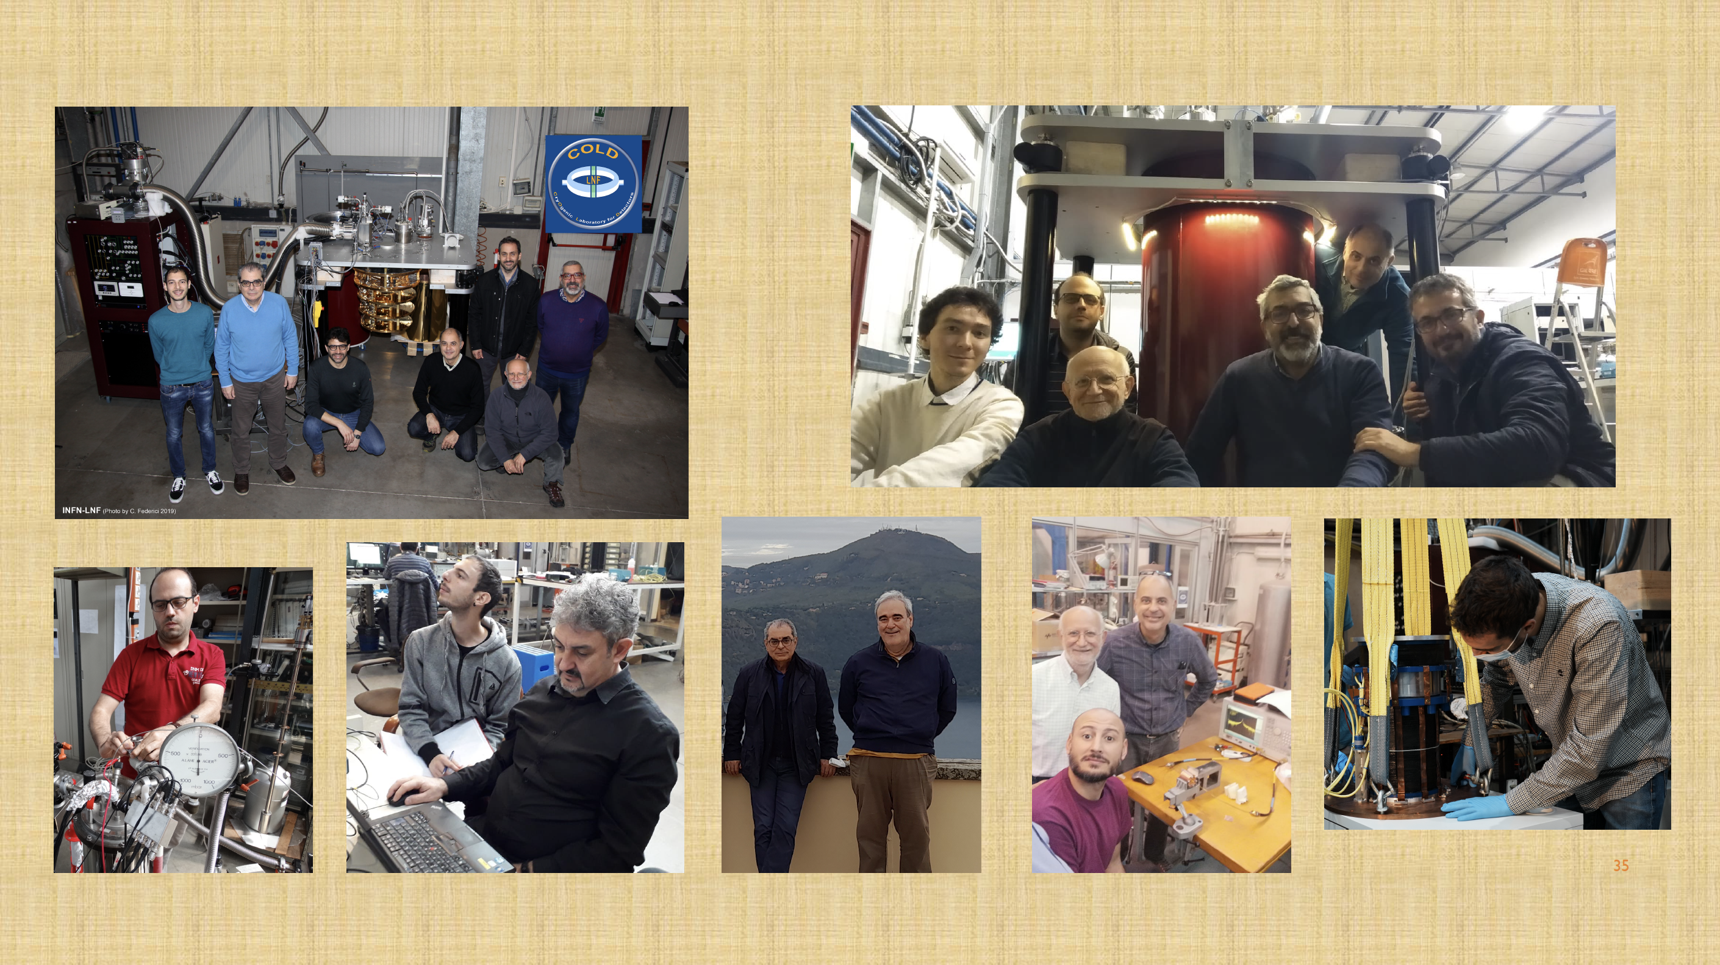
Conclusion
Ready for the first QUAX@LNF run with sensitivity 10×KSVZ (June-July)
Roadmap to KSVZ:
  Tuning system
  Quantum limited amplification (JPA/TWPA)
  Superconducting cavity (Nb₃Sn, NbTi, YBCO)
  Multicavity
  Single microwave photon counters (CBJJ, SC qubits)
Estimate of FLASH sensitivity to axions and HFGW with e.m. simulations
Large attendace at 100 MHz Haloscopes Workshop!
Ongoing work to prepare the test of the FINUDA magnet at beginning of 2023

