Slide 1
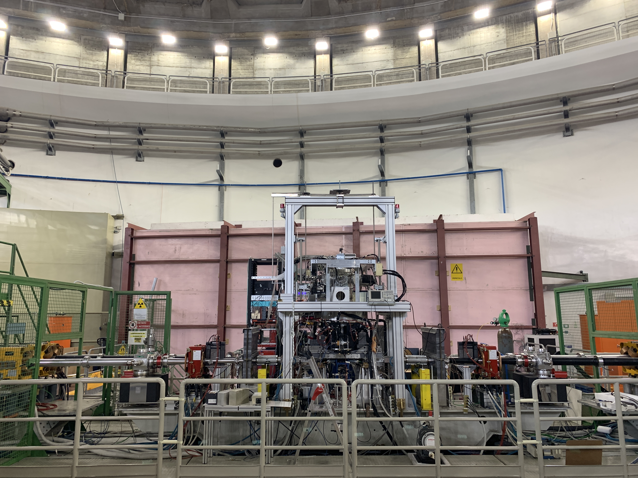
SIDDHARTA-2 status report
Catalina Curceanu, INFN – LNF
on behalf of the SIDDHARTA-2 Collaboration
63rd LNF Scientific Committee Meeting
May 16th, 2022

Slide 2
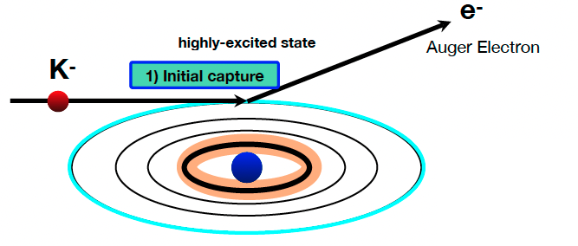
Kaonic atom Formation
Kaonic Atoms with SIDDHARTA-2 at the DAFNE Collider

Slide 3
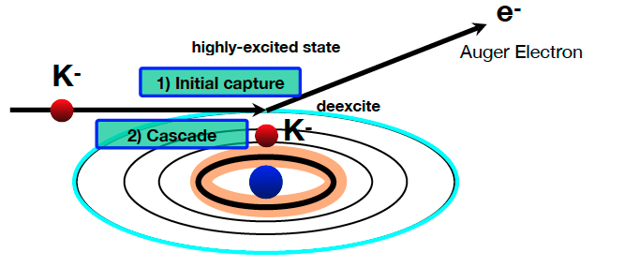
Kaonic atom Formation
Kaonic Atoms with SIDDHARTA-2 at the DAFNE Collider

Slide 4
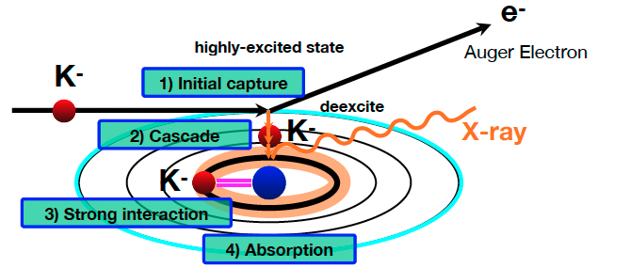
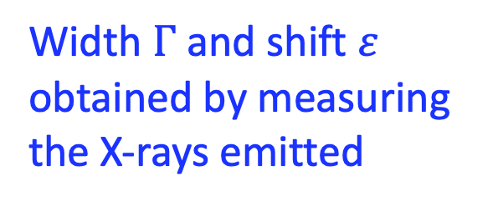
Kaonic atoms and the QCD effects
Width $Γ$ and shift $ε$ obtained by measuring the X-rays emitted
Kaonic Atoms with SIDDHARTA-2 at the DAFNE Collider

Slide 5






SIDDHARTA-2 Collaboration
Silicon Drift Detectors for Hadronic Atom Research by Timing Application
LNF-INFN, Frascati, Italy
SMI-ÖAW, Vienna, Austria
Politecnico di Milano, Italy
IFIN –HH, Bucharest, Romania
TUM, Munich, Germany
RIKEN, Japan
Univ. Tokyo, Japan
Victoria Univ., Canada
Univ. Zagreb, Croatia
Univ. Jagiellonian Krakow, Poland
ELPH, Tohoku University
5

Slide 6
SIDDHARTA-2 Scientific Goal
To perform the first measurement ever of kaonic deuterium X-ray transition to the ground state (1s-level) such as to determine its shift and width induced by the presence of the strong interaction.
Kaonic Atoms with SIDDHARTA-2 at the DAFNE Collider

Slide 7
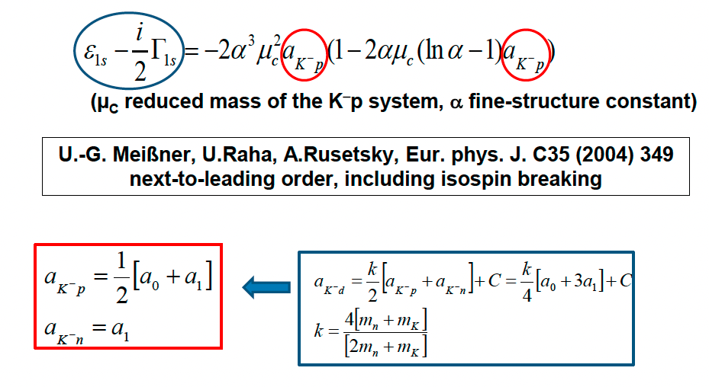
SIDDHARTA-2 Scientific Goal
To perform the first measurement ever of kaonic deuterium X-ray transition to the ground state (1s-level) such as to determine its shift and width induced by the presence of the strong interaction.
Analysis of the combined measurements of kaonic deuterium and kaonic hydrogen
completely solve Isospin-dependent K-N scattering length
Kaonic Atoms with SIDDHARTA-2 at the DAFNE Collider

Slide 8
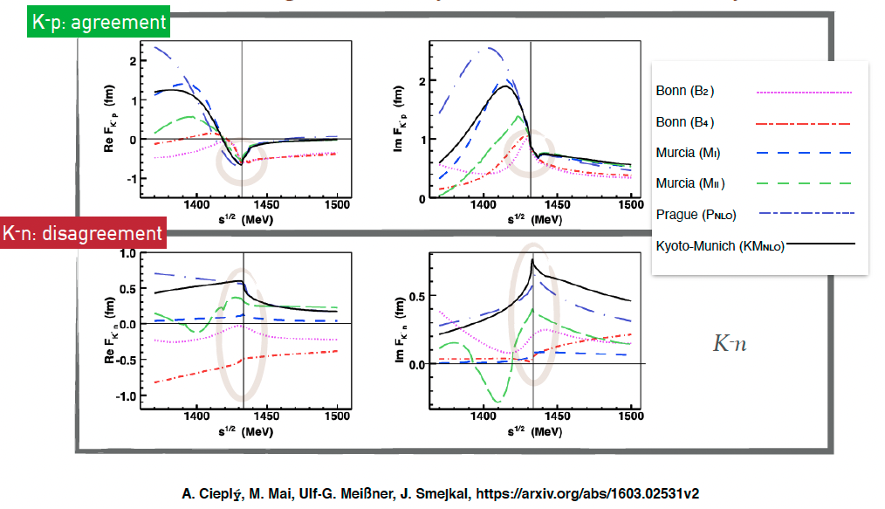
Kaonic atoms – scattering amplitudes
Francesco Sgaramella
Kaonic Atoms with SIDDHARTA-2 at the DAFNE Collider

Slide 9
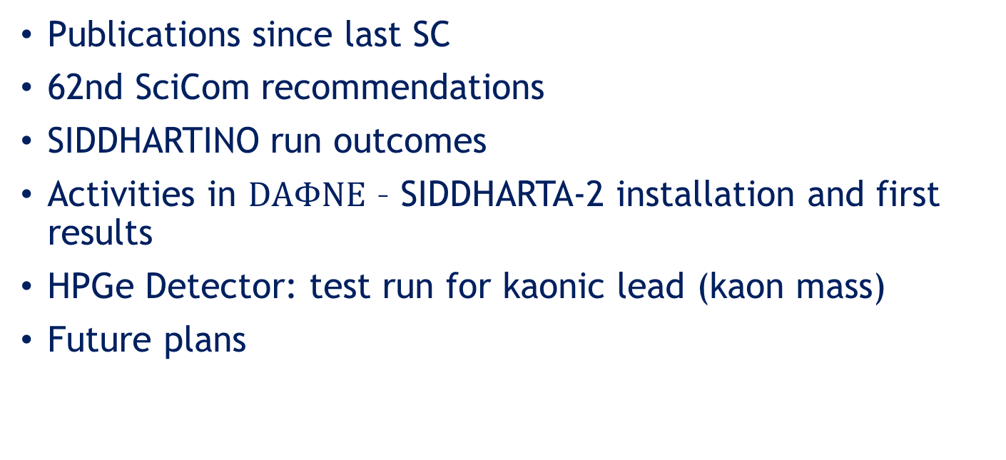
Contents
Publications since last SC
62nd SciCom recommendations
SIDDHARTINO run outcomes
Activities in $DAΦNE$ – SIDDHARTA-2 installation and first results
HPGe Detector: test run for kaonic lead (kaon mass)
Future plans
9

Slide 10
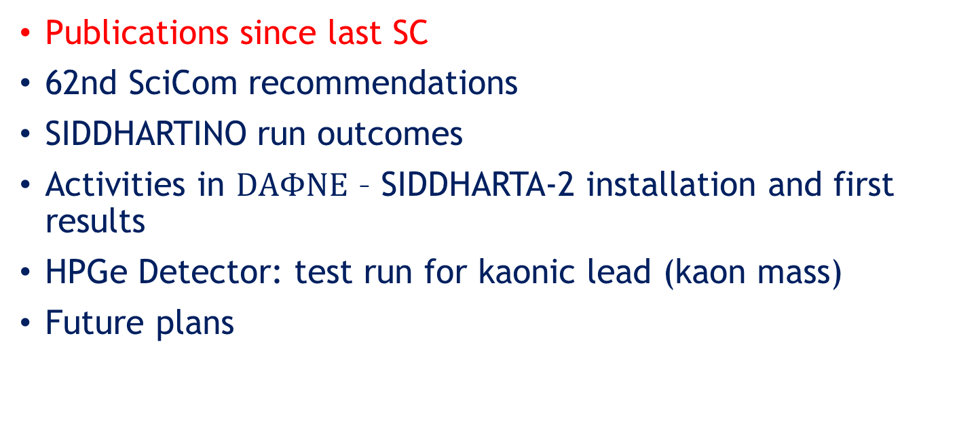
Contents
Publications since last SC
62nd SciCom recommendations
SIDDHARTINO run outcomes
Activities in $DAΦNE$ – SIDDHARTA-2 installation and first results
HPGe Detector: test run for kaonic lead (kaon mass)
Future plans
10

Slide 11
Publications since last SC
D. Sirghi et al., A new kaonic helium measurement in gas by SIDDHARTINO at the DAΦNE collider, J.Phys.G 49 (2022) 5, 055106
F. Sirghi et al., Status and perspectives for low energy kaon-nucleon interaction studies at DAΦNE: from SIDDHARTA to SIDDHARTA-2, PoS PANIC2021 (2022) 200
M. Miliucci et al., Low energy kaon-nuclei interaction at DAΦNE:The SIDDHARTA-2 experiment, Il Nuovo Cimento 44 C (2021).
Selected communication at 106° SIF Congress (best presentation: Marco Miliucci) for with publication on Rivista de il Nuovo Cimento, accepted.
A. Scordo et al, HAPG mosaic crystal Von Hamos spectrometer for high precision exotic atoms spectroscopy, PoS PANIC2021 (2022) 195.
F. Sgaramella et al., The SIDDHARTA-2 calibration method for high precision kaonic atoms X-ray spectroscopy measurements, e-Print: 2201.12101, submitted to Physica Scripta.
F. Napolitano et al., Kaonic Atoms at the DAΦNE Collider with the SIDDHARTA-2 Experiment, e-Print:2201.11525, submitted to Physica Scripta
Hexh Shi et al., Kaonic helium-4 L series X-rays yields in gas measured by SIDDHARTINO, under submission to Nuclear Physics A
11

Slide 12
Publications since last SC
C. Curceanu et al, Kaonic atoms measurements at the DAΦNE collider: the SIDDHARTA-2 experiment, EPJ Web Conf. 258 (2022) 07006
M. Tuechler et al, Main Features of the SIDDHARTA-2 Apparatus for Kaonic Deuterium X-Ray Measurements, EPJ Web Conf. 262 (2022) 01016.
K. Piscicchia et al., Low energy kaon-nuclei interaction studies at DAΦNE, EPJ Web Conf. 262 (2022) 01006.
M. Miliucci, Silicon drift detectors technology for high precision light Kaonic atoms spectroscopic measurements at the DAΦNE collider, AIP Conf.Proc. 2416 (2021) 1, 020009.
V. De Leo et al, Reflection efficiency and spectra resolutions ray-tracing simulations for the VOXES HAPG crystal based Von Hamos spectrometer, Condens.Mat. 7 (2021) 1, 1.
M. Miliucci, Silicon Drift Detectors’ Spectroscopic Response during the SIDDHARTA-2 Kaonic Helium Run at the DAΦNE Collider, Condens.Mat. 6 (2021) 4, 47. .
+ other 4 articles submitted awaiting reviews
12

Slide 13
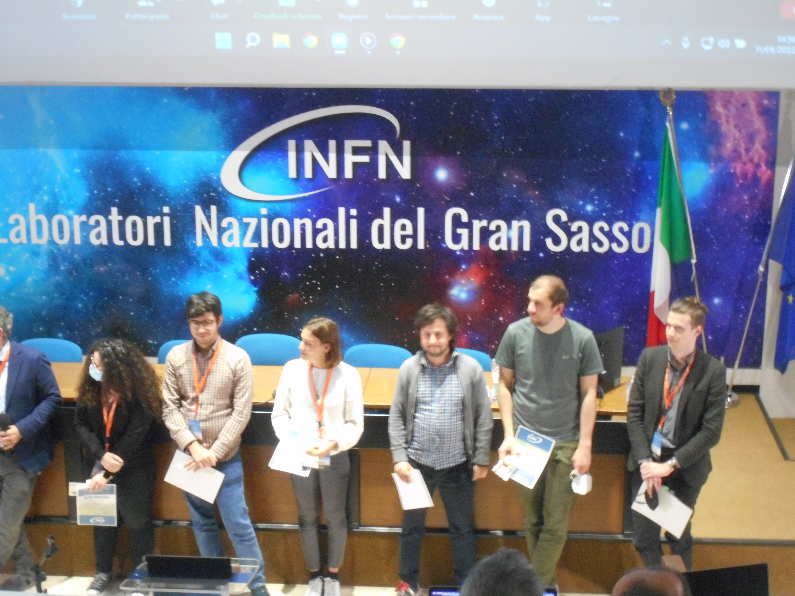

Luca De Paolis: Best Poster award

Slide 14
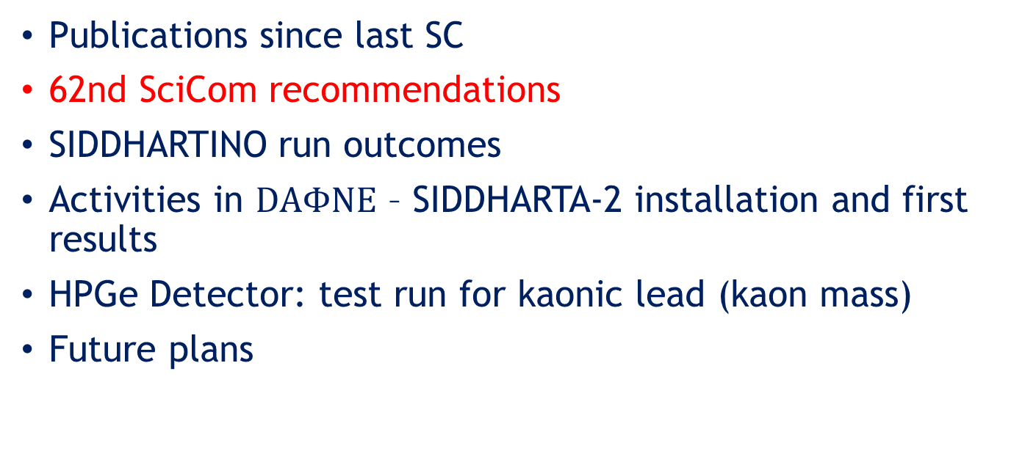
Contents
Publications since last SC
62nd SciCom recommendations
SIDDHARTINO run outcomes
Activities in $DAΦNE$ – SIDDHARTA-2 installation and first results
HPGe Detector: test run for kaonic lead (kaon mass)
Future plans
14

Slide 15
62nd LNF Scientific Committee Meeting
Recommendations SIDDHARTA
“The SIDDHARTA-2 team should start taking data with the present luminosity, while working carefully on optimizing their S/B ratio as much as possible, like they have been doing in the past. Given the present background and machine conditions, it is important to know what is the minimum integrated luminosity required to get sensible results for the kaonic deuterium measurement.”
We address this question – data taking planned to be started end of May/early June 2022; need (probably) to go end of 2022 and/or through 2023 to get sensible results
15

Slide 16
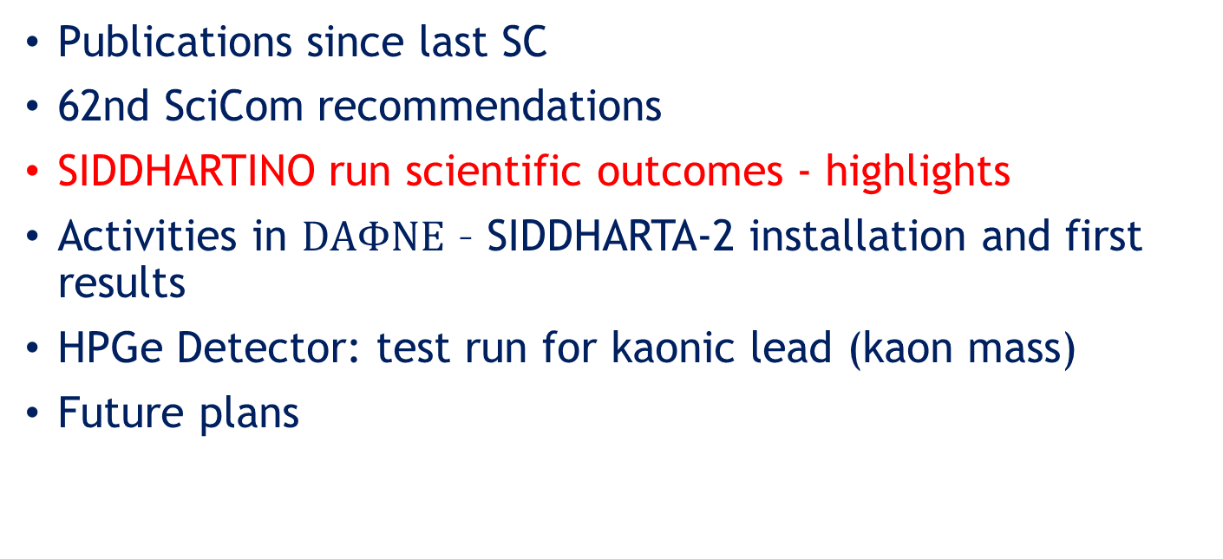
Contents
Publications since last SC
62nd SciCom recommendations
SIDDHARTINO run scientific outcomes - highlights
Activities in $DAΦNE$ – SIDDHARTA-2 installation and first results
HPGe Detector: test run for kaonic lead (kaon mass)
Future plans
16

Slide 17
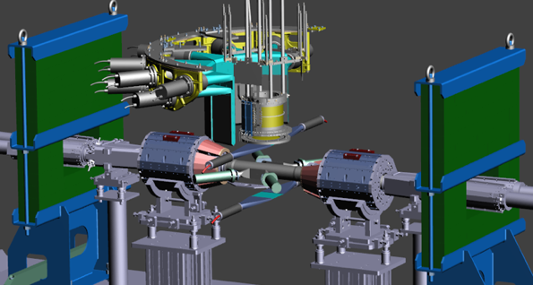
SIDDHARTINO run
Schematic representation of SIDDHARTINO setup
He cooling line
VETO-1
TARGET CELL
Pb LATERAL
SHIELD
VETO-2
8 SDDs arrays
K-TRIGGER
LUMINOMETER
1 Bus
17

Slide 18
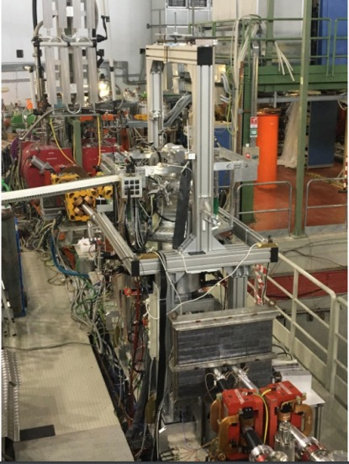
SIDDHARTINO setup (1/6 SDDs)
Phase 1 with SIDDHARTINO:
during the commissioning of DAΦNE:
optimization with the SIDDHARTINO setup
for the K-⁴He measurement
(with 8 SDD arrays)

Slide 19
Project timeline –shown at the last SciCom
Analysis of the SIDDHARTINO data.
Start SIDDHARTA-2 Installation
Installation of SDD, veto and electronics. Update of the DAQ….
SIDDHARTINO optimization run
2021, June
SIDDHARTINO K-⁴He run
2021, 24 June – 18 July
Start SIDDHARTA-2 installation: mechanics
2021, August
62nd LNF
SciCom
2021, November
SIDDHARTA-2
Installation
and tests
2021, September -October
61st LNF
SciCom
2021, May
Different combinations of the degrader
thickness
and different gas density
Ready for run
Software and hardware optimization
back. reduction

Slide 20
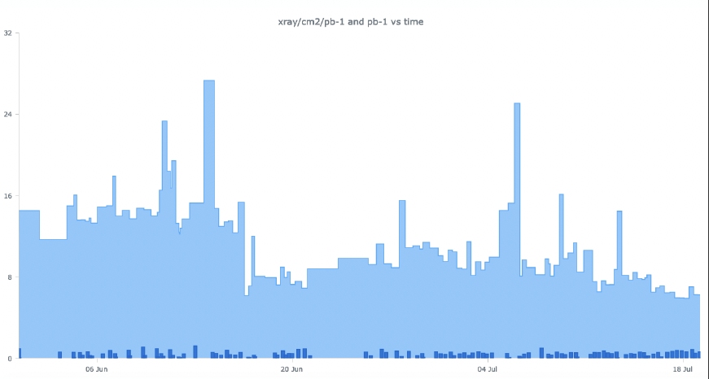
SIDDHARTINO - xray/cm2/pb⁻¹
Optimization of xray/cm2/pb⁻¹ very visible!
6.2 xray/cm2/pb⁻¹
Factor nearly 3
OK for SIDDHARTA-2
15 xray/cm2/pb⁻¹

Slide 21
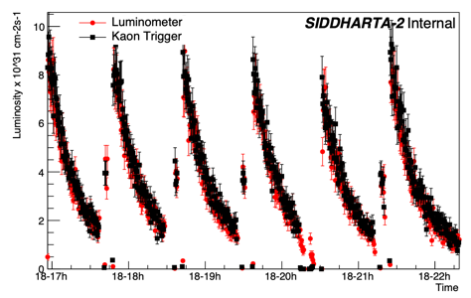
SIDDHARTINO data - Integrated Luminosity
Total integrated luminosity:
54 pb⁻¹
Optimization run:
24 pb⁻¹
Trigger, DAQ, SDD optimization
Kaonic ⁴He
run:
30 pb⁻¹
Degrader optimization, low and high ⁴He density measure
Kaon monitor and Luminometer measure at the end of SIDDHARTINO run

Slide 22








Experimental Principle
Degrader
Veto system
DA$Φ$NE Collider
$$K^{−}$$
Target
$$γ$$
$$K^{−}$$
e⁻
e⁺
$$Φ$$
Monochromatic
Low energy kaons
Solid angle
Kaonic
atom
$$K^{+}$$
Trigger
X-ray detectors
Kaonic Atoms with SIDDHARTA-2 at the DAFNE Collider

Slide 23
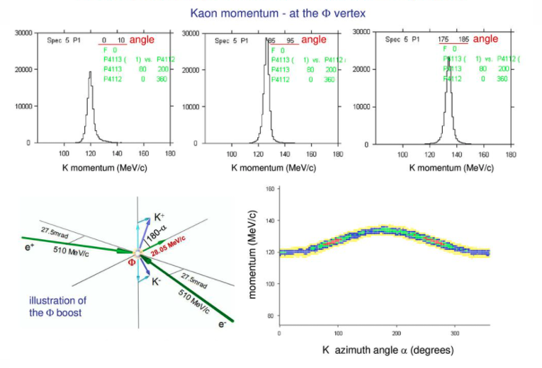
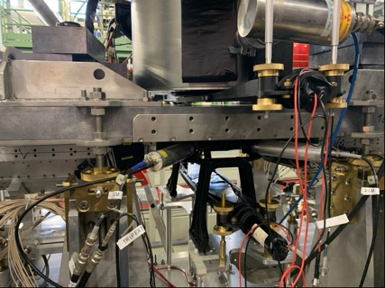
Degrader Optimization
the degrader is composed of mylar foil (micron) and is placed below the trigger up
Trigger up
Degrader thickness optimization is fundamental to maximize the number of stopped kaons in the target
Trigger down
23

Slide 24
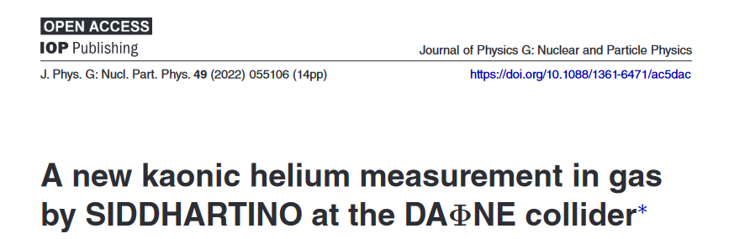
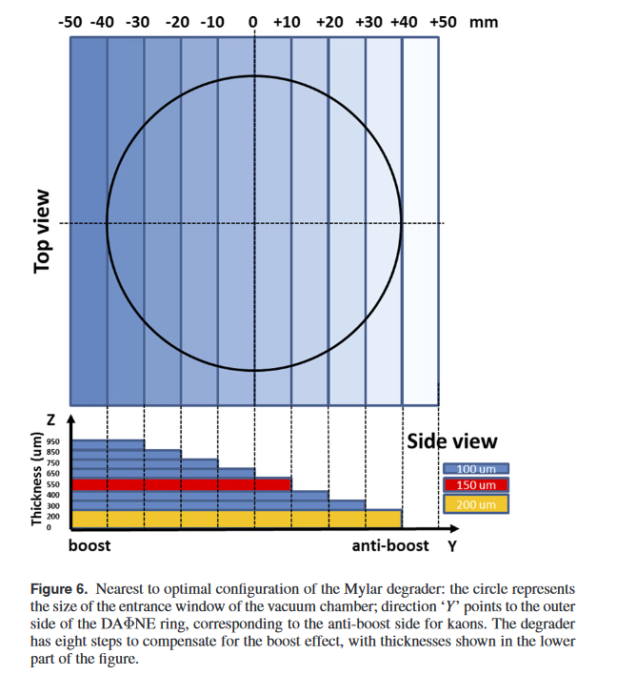
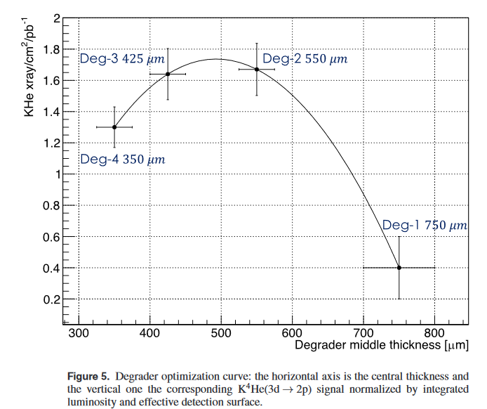

Slide 25
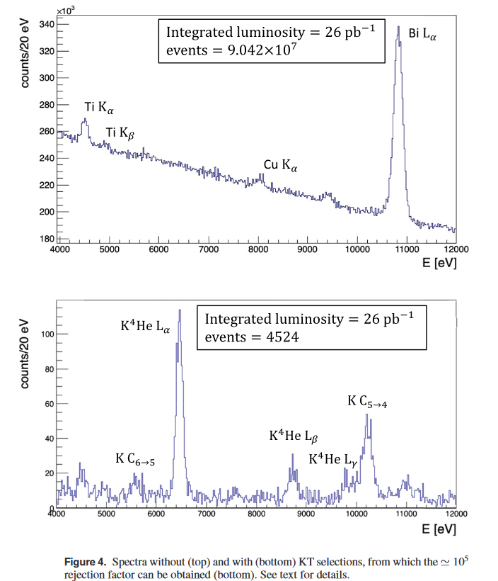
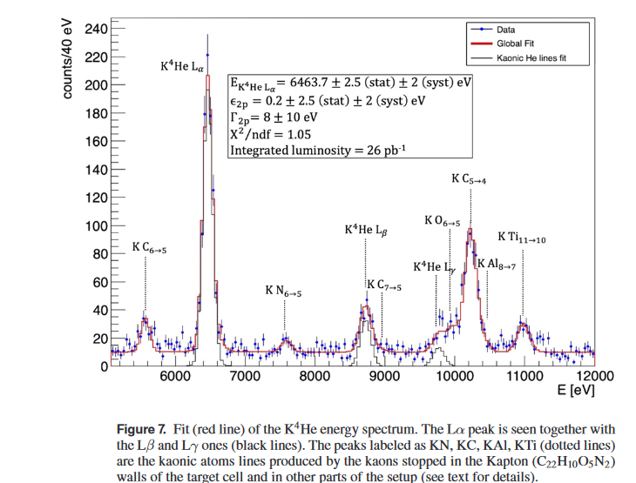

The most precise KHe measurement in gas

Slide 26
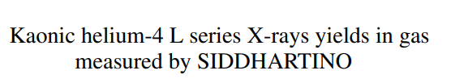
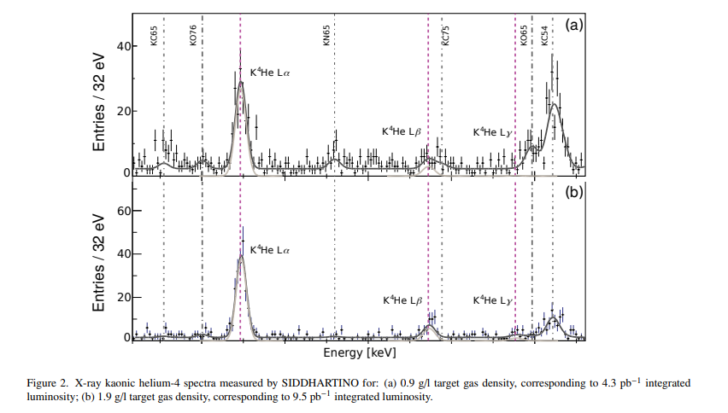
Kaonic atoms cascade processes (yields)

Slide 27
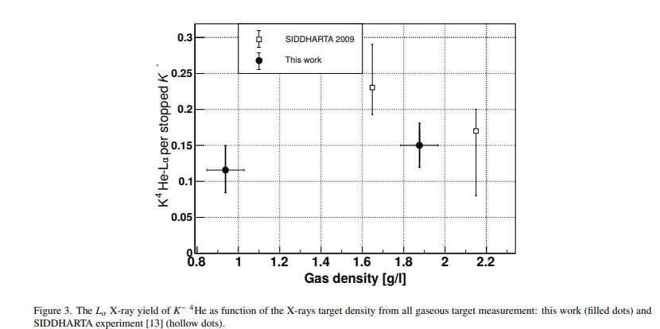
Kaonic atoms cascade processes (yields) for Nucl Phys A

Slide 28
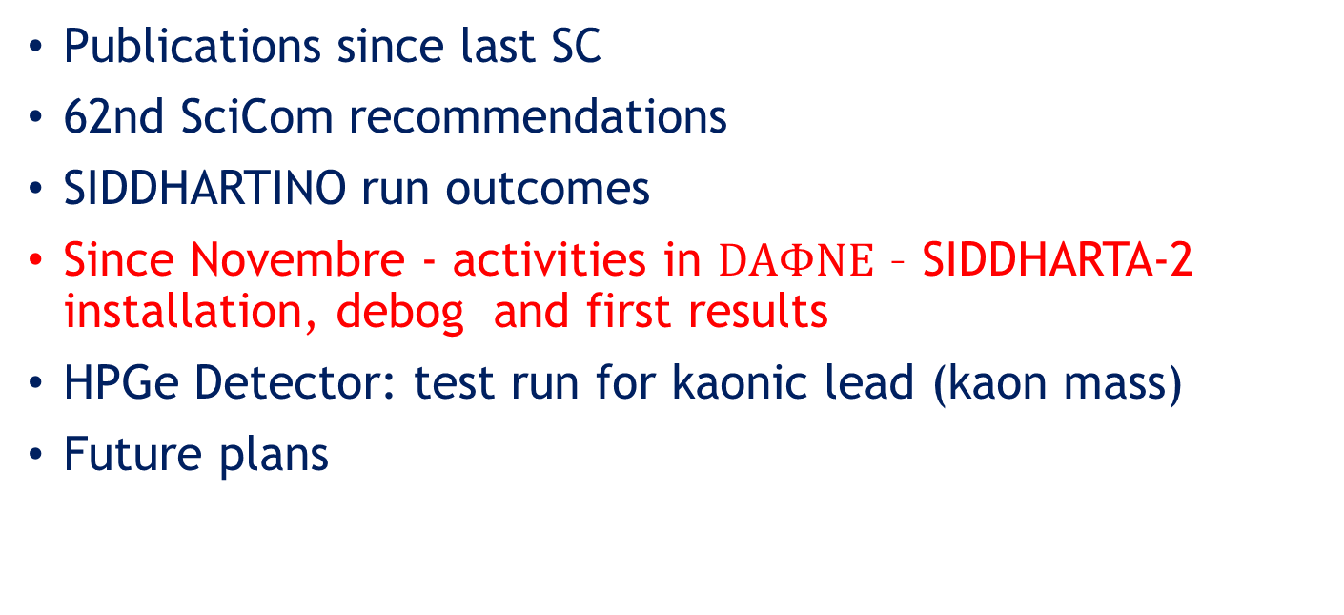
Contents
Publications since last SC
62nd SciCom recommendations
SIDDHARTINO run outcomes
Since Novembre - activities in $DAΦNE$ – SIDDHARTA-2 installation, debog and first results
HPGe Detector: test run for kaonic lead (kaon mass)
Future plans
28

Slide 29
Installation of SIDDHARTA-2
SDD detectors installation
Veto-2 installation
Front-end electronic installation
Veto-1 installation
29

Slide 30
SDD installation
calibration target
SDD installed around the target

Slide 31
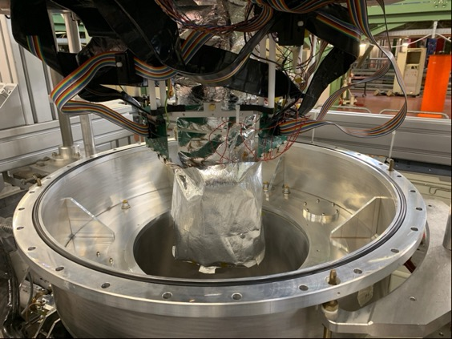
SDD installation
Wrap for thermal isolation
31

Slide 32
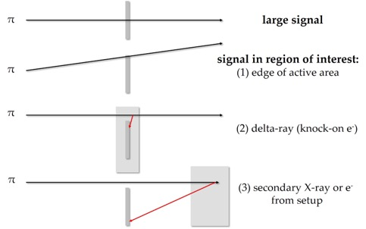
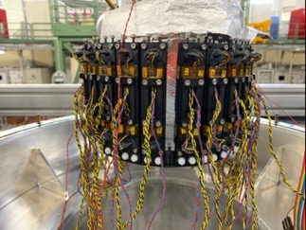
Veto-2 installation
Working principle of veto-2 system
32

Slide 33
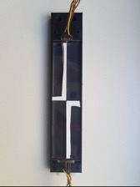
Veto-2 installation
The installation of veto 2 has been completed and the correct operation of each unit has been verified
Each veto-2 unit is equipped with an LED that will allow to calibrate and verify the correct functioning of the system with and without beams
Veto-2 Calibration spectrum
Veto-2 single unit
33

Slide 34
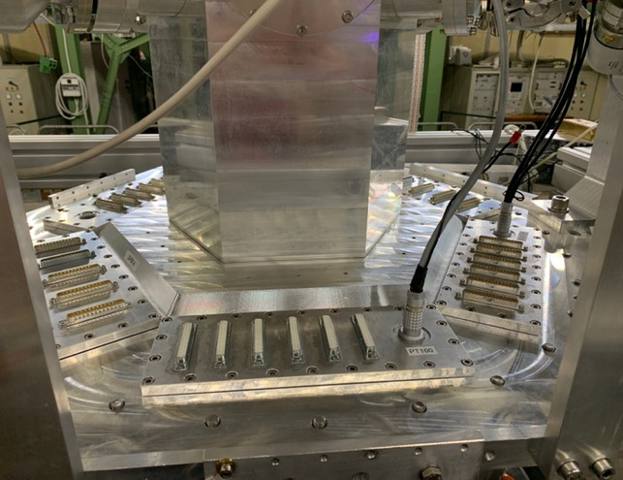
Front-end electronics installation
Veto2
connectors
SDD power supply connector
SIDDHARTA-2 setup before the installation of electronic components
SDD Front-end connector
34

Slide 35
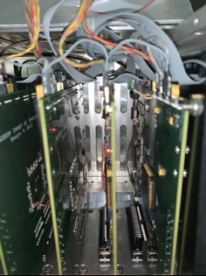
Front-end electronics installation
Electronic Box
SDD Front-end electronics
Veto-2
Front-end electronics
35

Slide 36
Front-end electronics installation
SDD Front-end electronics
SDD power supply
Veto2
electronics
36

Slide 37
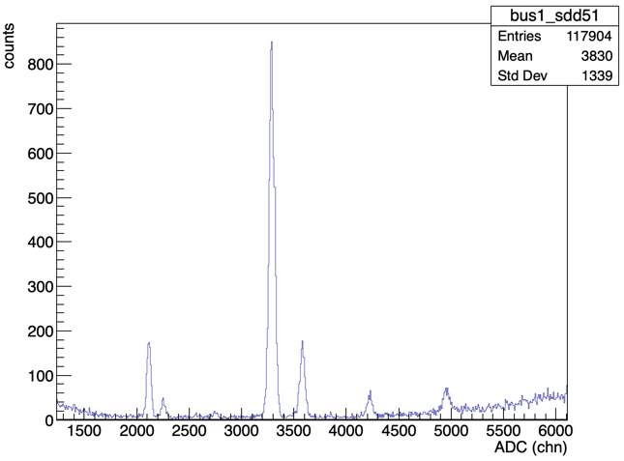






SDD calibration spectrum acquired with SIDDHARTA-2
CuK$α$
Preliminary calibration
29/10/2021
TiK$α$
CuK$β$
TiK$β$
BiL$α$
BiL$β$
37

Slide 38
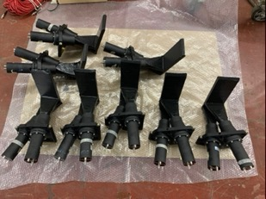
Veto-1 system installation
Veto-1 single unit
Drawing of the veto-1 elements placed around the vacuum
chamber
Working principle of veto-1 system
M. Bazzi et al, 2013 JINST 8 T11003
38

Slide 39
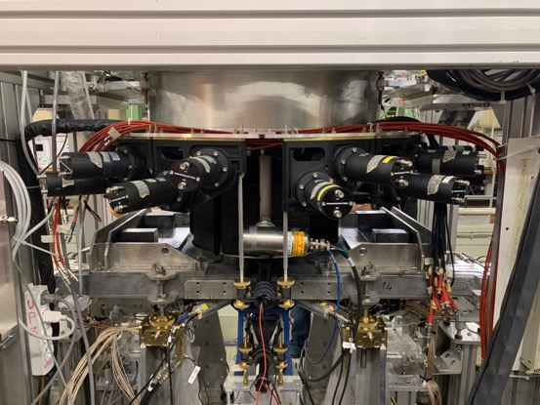
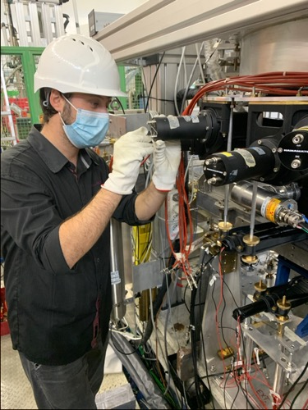
Veto-1 system installation
Veto-1 system installed
39

Slide 40
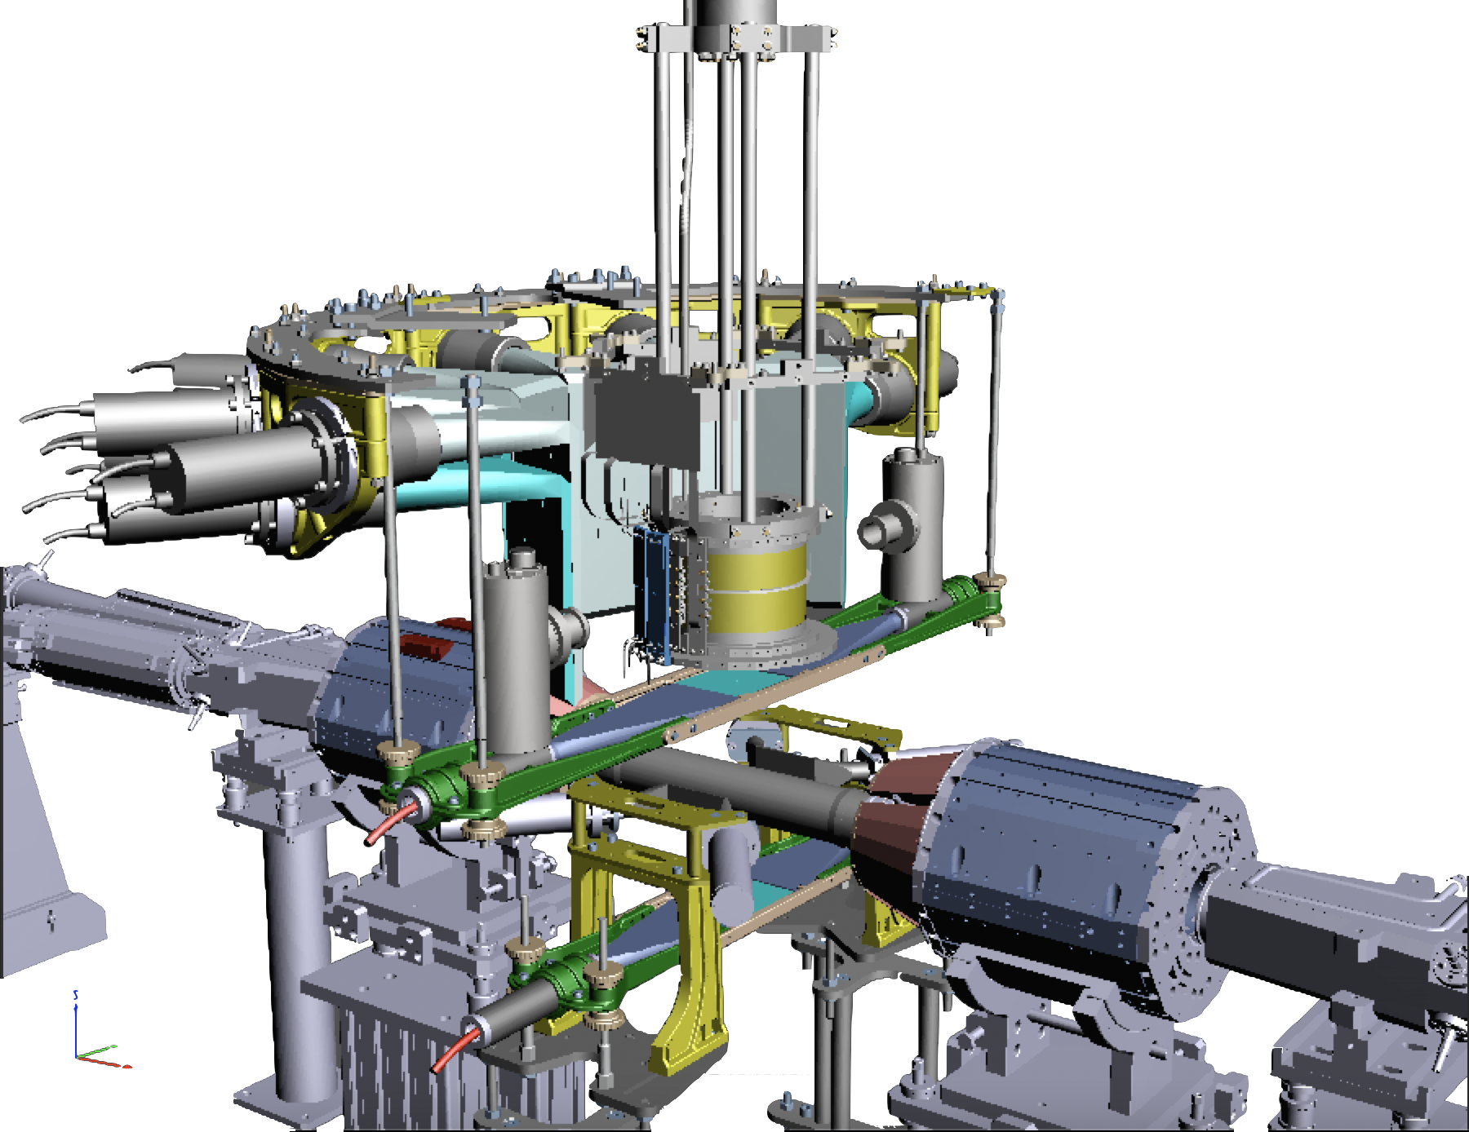


SIDDHARTA-2 setup
Cooling line
Luminosity Monitor
Kaon Trigger
Cryogenic gaseous target
SDD detectors
Veto-2 system
Veto-1 system
Veto-1
384 SDDs
Target
$$π$$
Veto-2
DAFNE luminosity monitor
$$Φ$$
Kaon Trigger
SIDDHARTA-2 luminosity monitor
Francesco Sgaramella

Slide 41
SIDDHARTA-2 setup
Installed on DAFNE within early November 2022
Ready for Run
41

Slide 42
Project timeline
Debog of system with beam (trigger and luminometer)
Ready for Kd run (DAFNE optimization continued)
Kaonic helium runs
Degrader, SDD calib, trigger, veto…
SIDDHARTA-2
debug
2021, Nov. – December.
SIDDHARTA-2
Optimization
(while awaiting for DAFNE)
HPGE activitty
January – 7th April 2022
Start SIDDHARTA-2 debug with beam
7 – 13 April
2022
Kd run
end May/early June till July (as long as possible)
HPGe run
SIDDHARTA-2
KHe run
and HPGe debug
while commissioning
7 April – 63rd SciCom
62nd LNF
SciCom
2022, Nov.
Change of cryo lines
Installation and calib of HPGe
SDD calibration
DAQ optimization

Slide 43
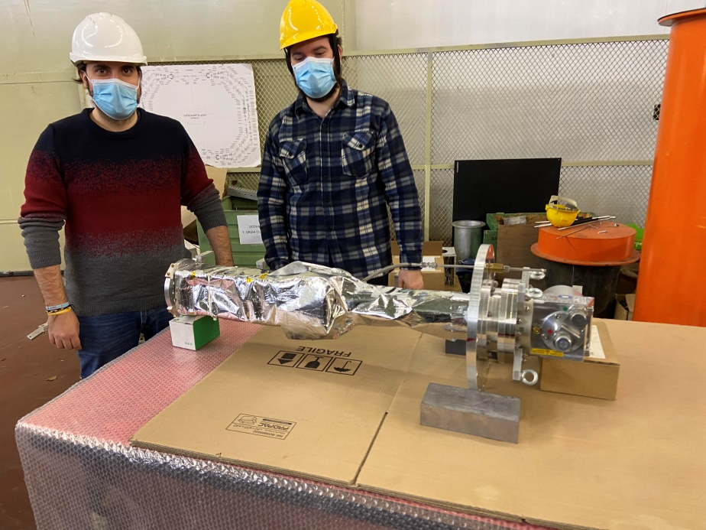
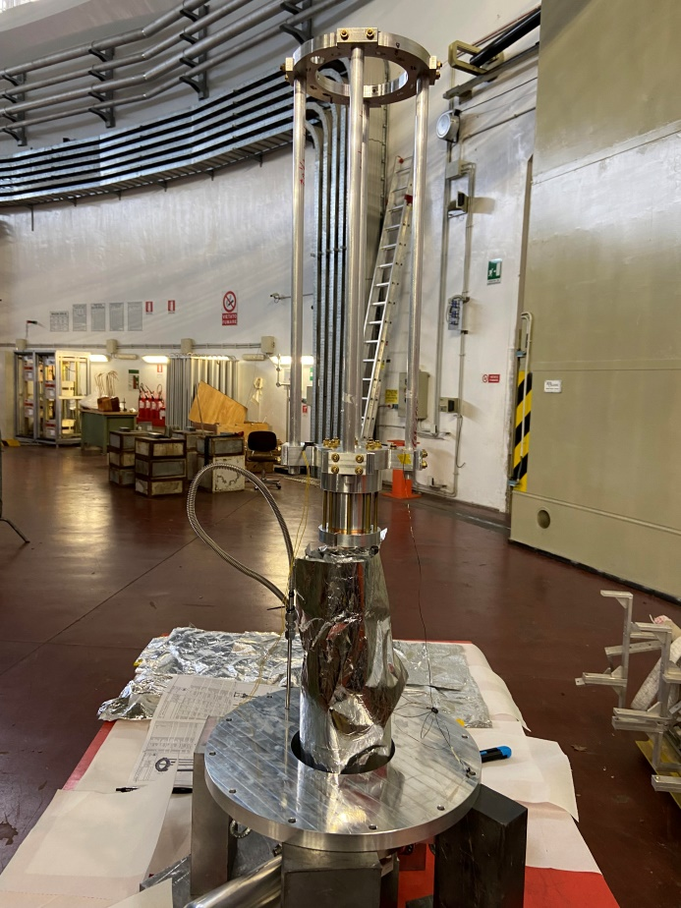
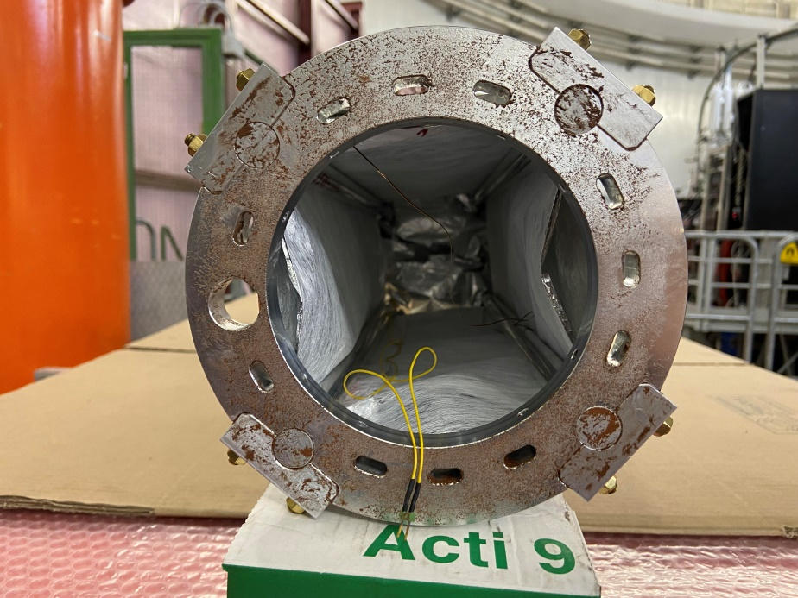
Early 2022
Cooling improvement
Replace the Al bars from
the cooling head and the target

Slide 44
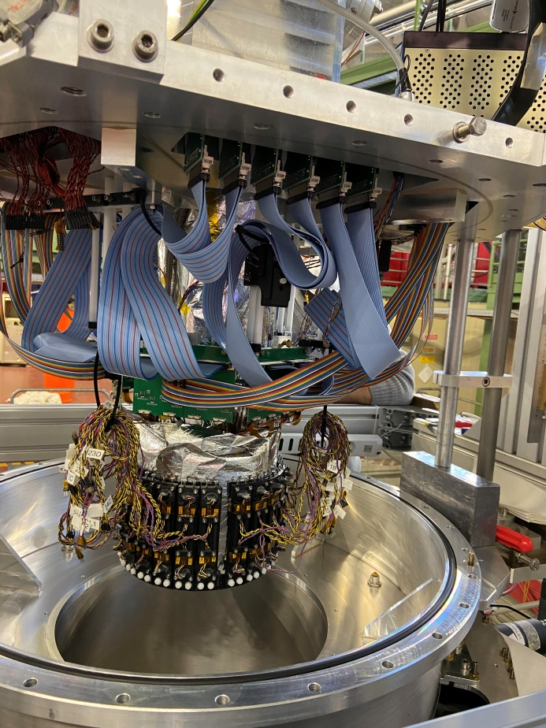
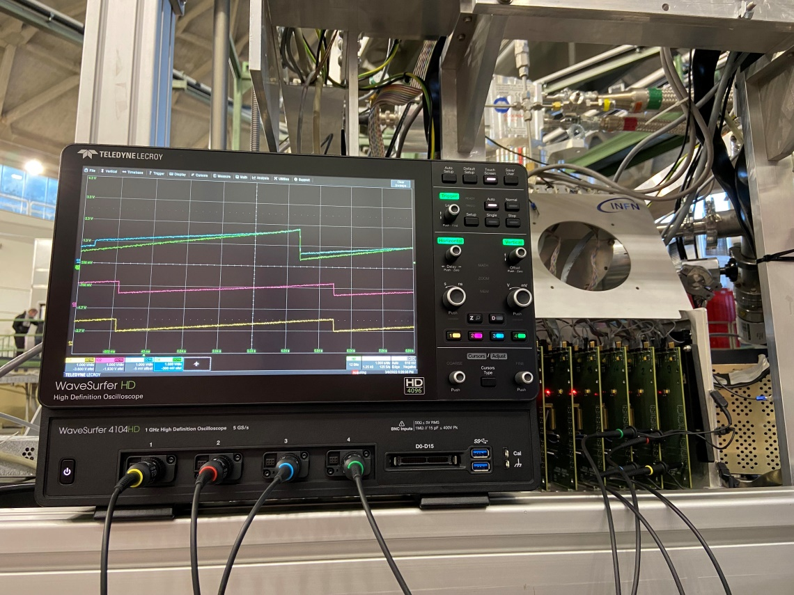
Early 2022
Internal cabling to SFERA ASIC
(high density SCSI type connectors)
Output signals from CUBE preamplifier

Slide 45
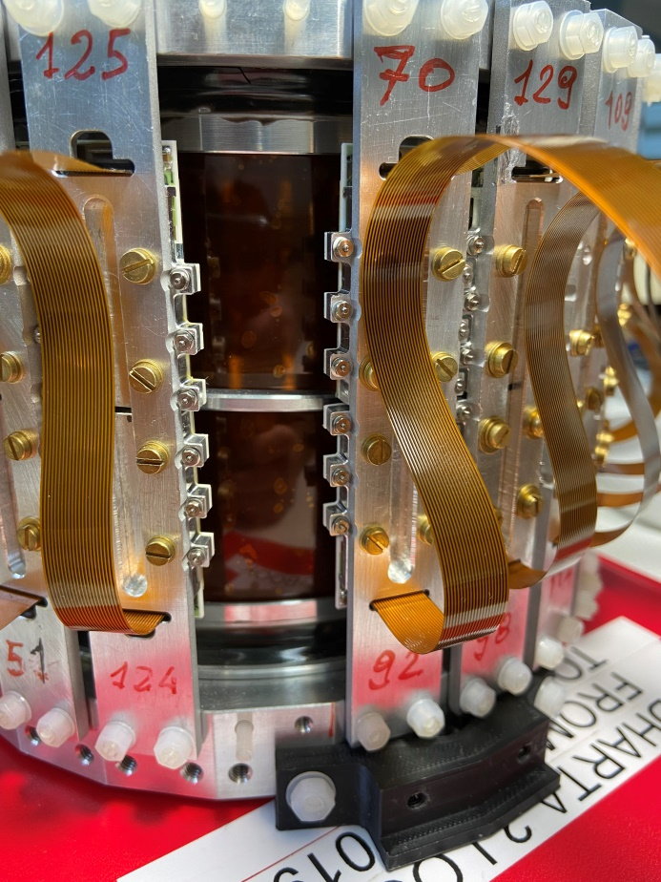
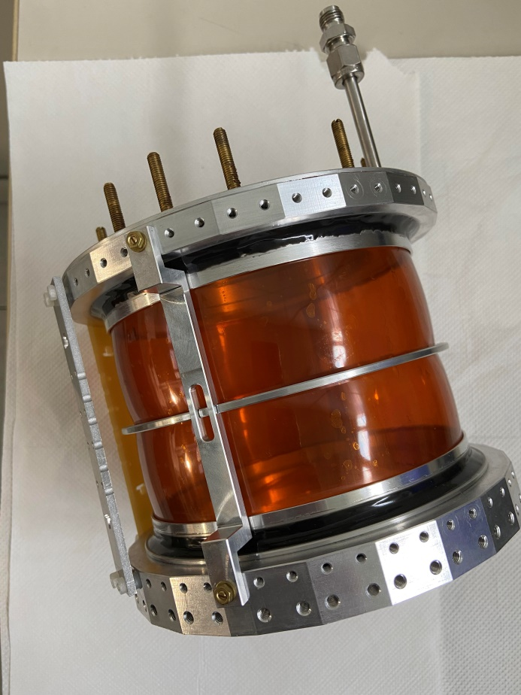
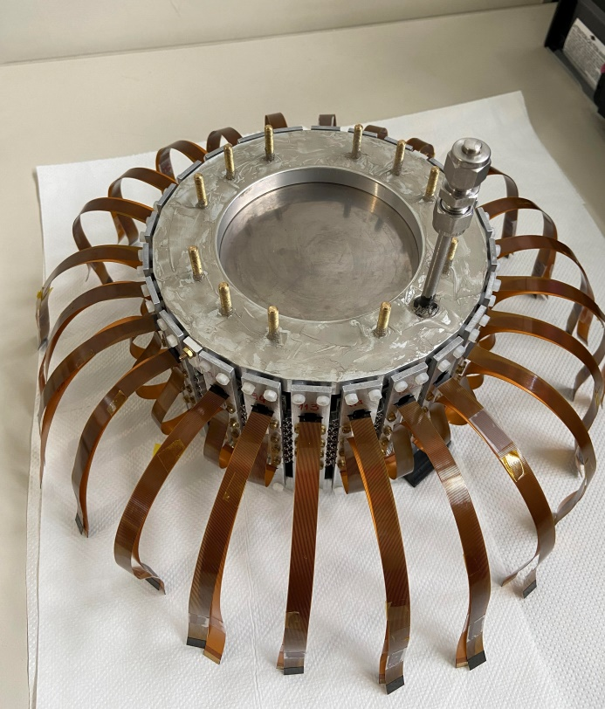
Early 2022
Replace:
non working SDD arrays
AL finger support for better cooling

Slide 46
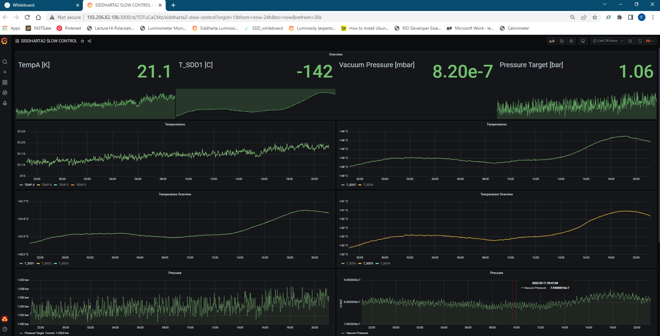
Online monitoring for setup parameters

Slide 47
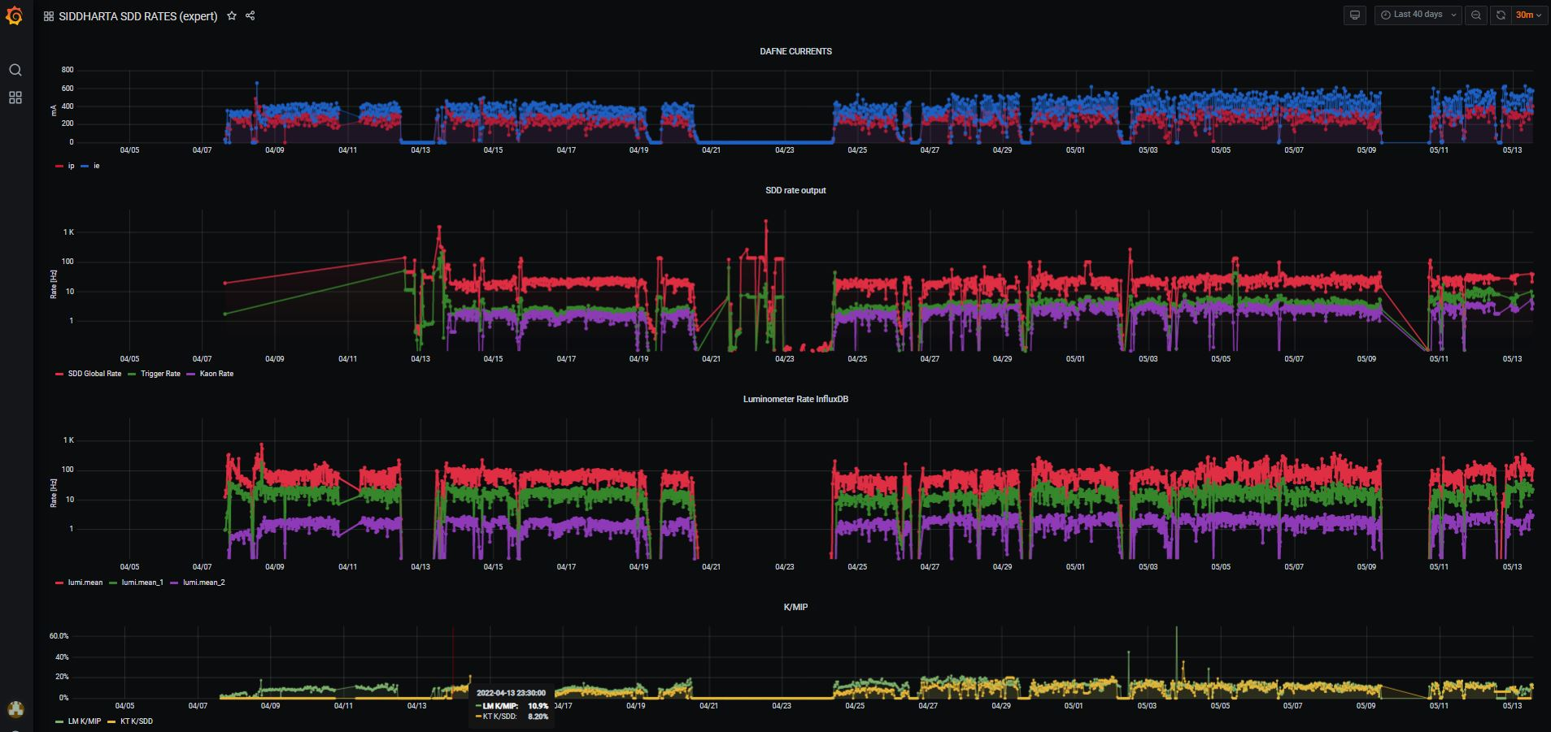
SIDDHARTA-2: Run History April – May 2022

Slide 48
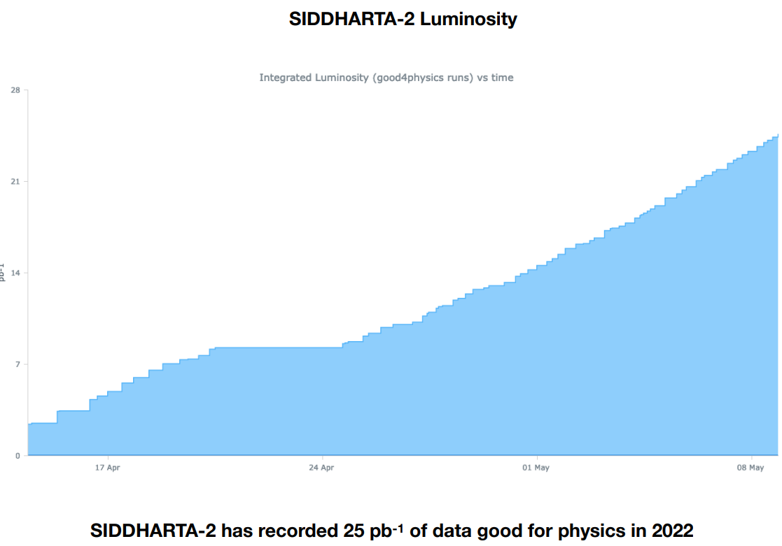
SIDDHARTA-2: Run History April – May 2022

Slide 49
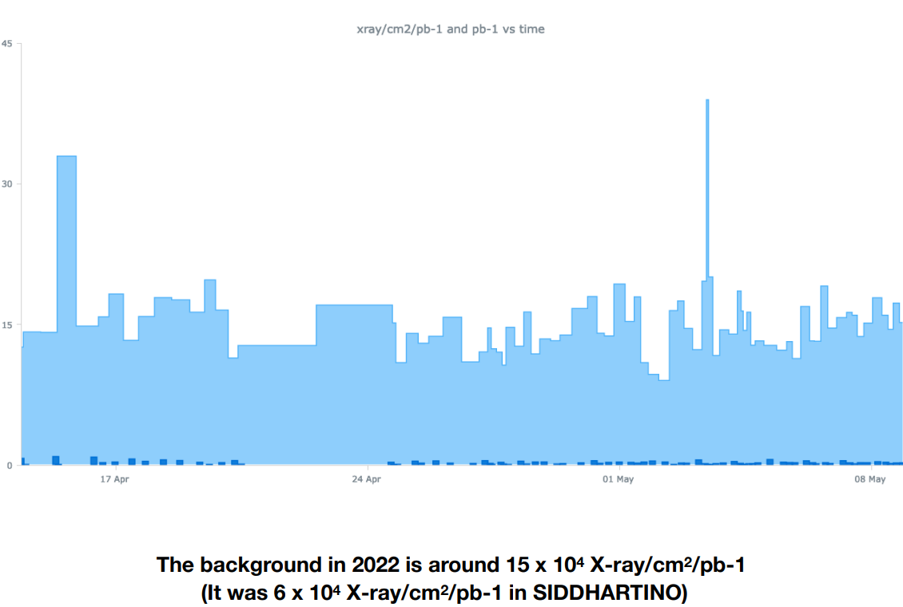
SIDDHARTA-2: Run History April – May 2022

Slide 50

SIDDHARTA-2: Run History April – May 2022 (ex 1 May)

Slide 51

Optimization of working regime

Slide 52

Optimization of working regime

Slide 53

Optimization of working regime

Slide 54



SIDDHARTA-2 KHe 1.4%
Degraders: 475um (new) + 600 um
N° SDDs: 319
bkg function: pol1
L= 12.06 pb⁻¹
 | E_{e.m.} [eV] | E_{exp} [eV] | Amp | events
KHe 3->2 | 6463.5 | 6462.5 $±$ 2.0 | 416 $±$ 9 | 1705 $±$ 83
KAl 8->7 | 10435.1 | 10460 $±$ 40 | 12$±$ 4 | 55 $±$ 20
KAl 7->6 | 16088.3 | 16082.5 $±$ 14 | 33 $±$ 3 | 183 $±$ 23
KHeLa
KC5->4
KHeLb
KAl8->7
(10435 eV)
KHeL$γ$
KO6->5
KN5->4
KAl7->6
(16088 eV)
KN6->5
KHe L-high
KC6->4
KO5->4
KN6->5

Slide 55


SIDDHARTA-2 KHe 1.4%
Degraders: 475um (new) + 600 um
N° SDDs: 319
bkg function: pol1
L= 12.06 pb⁻¹
 | E_{e.m.} [eV] | E_{exp} [eV] | Amp | events
KHe 3->2 | 6463.5 | 6462.5 $±$ 2.0 | 416 $±$ 9 | 1705 $±$ 83
KAl 8->7 | 10435.1 | 10460 $±$ 40 | 12$±$ 4 | 55 $±$ 20
KAl 7->6 | 16088.3 | 16082.5 $±$ 14 | 33 $±$ 3 | 183 $±$ 23
KAl7->6
KC6->4
KO7->5

Slide 56
SIDDHARTA-2: first scientific outcomes:
An improved Khe measurement with higher precision
The most precise kaonic aluminium measurement
Plan to prepare 1-2 new articles!

Slide 57

Contents
Publications since last SC
62nd SciCom recommendations
SIDDHARTINO run outcomes
Activities in $DAΦNE$ – SIDDHARTA-2 installation and first results
HPGe Detector: test run for kaonic lead (kaon mass)
Future plans
57

Slide 58

Charged kaon mass puzzle:

Slide 59



Installation of HpGe structures and preliminary shielding
Pb target support behind luminomiter

Slide 60


Ge refilling
establish procedure to be done each 7-10 days

Slide 61

Present status

Slide 62

First HPGe spectrum (we plan a technical paper)

Slide 63


Slide 64

Contents
Publications since last SC
62nd SciCom recommendations
SIDDHARTINO run outcomes
Activities in $DAΦNE$ – SIDDHARTA-2 installation and first results
HPGe Detector: test run for kaonic lead (kaon mass)
Future plans, requests
64

Slide 65
Project timeline – future
SIDDHARTA-2 Kd run: run 1 (requested 300 pb⁻¹ – 100 pb⁻¹ ?) run 2/3 (700 pb⁻¹) with optimized components
SIDDHARTA-2
setup ready
End May 2022
Start Run
SIDDHARTA-2
and
HPGe parasitic test
From end May – early June 2022
Continue the run
SIDDHARTA-2
Kd
HPGe
as soon as possible!
$DAΦNE$ summer
shutdown
middle July 2022
𝐃𝐀𝚽𝐍𝐄 summer
shutdown
middle July 2022
Start of the data taking kaonic deuterium SIDDHARTA-2 run
65

Slide 66


SIDDHARTA-2 K-d measurement
achievable precision
Kaonic deuterium run in 2022/3
Monte Carlo for an integrated luminosity
of 800 pb⁻¹
to perform the first measurement of the strong interaction induced energy shift and width of the kaonic deuterium ground state
(similar precision as K-p) !
When significative?
Depends on yield (unknown)
Not less than 500 pb ⁻¹

Slide 67

SIDDHARTA-2 kaonic deuterium at $DAΦNE$
width [eV]
shift [eV]

Slide 68
SIDDHARTA-2 K-d measurement
    SIDDHARTA-2 setup ready for Kaonic deuterium first ever measurement:
    Plans and requests
Optimization of veto systems integration: end May 2022
First run with SIDDHARTA-2 setup originally planned for
about 300 pb⁻¹ integrated luminosity; we now realistically can envisage ia first run to start June 2022 (till July tbd) – 100 pb⁻¹?
Second and Third (?) runs with optimized shielding, readout electronics and other necessary optimizations; (for remaining integrated luminosity, i.e. about 700 pb⁻¹) – as soon as possible
SIDDHARTA-2
Kaonic Atoms with SIDDHARTA-2 at the DAFNE Collider

Slide 69


Slide 70


Slide 71


Slide 72
Conclusions
Despite the difficult period, we have been able to follow our plan and Sci Com recom. and perform our activities along the schedule @SC62
In particular we: performed the most precise KHe measurement in gas and the measurement of yields at lowest density
17 articles were published/submitted since the last Sci Com – important scientific outcome, 2 are in preparation
We are ready and very motivated to start the SIDDHARTA-2 planned first Kd measurement as soon as possible
We put forward proposal for solid targets measurements with SIDDHARTA-2 setup for 100-150 pb⁻¹ after Kd run - @SC62 as well as future measurements proposal
Notes:
found the instruments In this contest we achived also aour phisics goal performi the most ..
We published about 10 articles and otjer 2 are in preparation.

Slide 73
Kaonic Atoms to Investigate Global Symmetry Breaking Symmetry 12 (2020) 4, 547
The modern era of light kaonic atom experiments Rev.Mod.Phys. 91 (2019) 2, 025006
Part. and Nuclear physics QCD @ low-energy limit Chiral symmetry, Lattice
Fundamental physics New Physics
Kaonic atoms
Kaon-nuclei interactions
(scattering and nuclear interactions)
On self-gravitating strange dark matter halos around galaxies Phys.Rev.D 102 (2020) 8, 083015
The equation of state of dense matter: Stiff, soft, or both? Astron.Nachr. 340 (2019) 1-3, 189
Astrophysics
EOS Neutron Stars
Dark Matter studies
Kaonic Atoms with SIDDHARTA-2 at the DAFNE Collider
Notes:
The kaonic atoms spectroscopy is really a unique opportunity to obtain information about QCD at threshold energy because compared to scattering experiments the kaon interacts with the nucleus with relative energy of a few keV, instead of the tens MeV.

Slide 74

Part of the SIDDHARTA-2 collaboration
Thank you!

Slide 75


Special thanks to the accelerator, research and technical divisions,
and in particular to
the DA$Φ$NE staff and
to the LNF Director

Slide 76
spares

Slide 77


SIDDHARTA-2 KHe 1.4%
Degraders: 475um (new) + 600 um
N° SDDs: 319
bkg function: pol1
L= 12.06 pb⁻¹
 | E_{e.m.} [eV] | E_{exp} [eV] | Amp | events
KHe 3->2 | 6463.5 | 6462.5 $±$ 2.0 | 416 $±$ 9 | 1705 $±$ 83
KAl 8->7 | 10435.1 | 10460 $±$ 40 | 12$±$ 4 | 55 $±$ 20
KAl 7->6 | 16088.3 | 16082.5 $±$ 14 | 33 $±$ 3 | 183 $±$ 23
KC5->4
KO6->5
KHe L-high
KAl8->7

Slide 78


Back. reduction: reinforced shielding around the setup
Lead bricks around the vacuum chamber
Lead foil near the beam pipe
78

Slide 79
SIDDHARTINO - xray/cm2/pb⁻¹
reinforced shielding around the setup
Background lowered by a factor 2
15 xray/cm2/pb⁻¹
7 xray/cm2/pb⁻¹

Slide 80

Luminosity measurement to monitor also background
Luminosity detector:
- SIDDHARTA-2 luminometer used for back: kaons/MIPS
- luminosity delivery
Back to plastic scintillators in coincidence with RF/4 signal

Slide 81


Background levels monitor
Background levels were monitored online by a counter based on Kaon/Mip rate and a second based on Kaon/SDD rate.
Shared with the $DAΦNE$ staff to optimize the background
81

