Slide 1
UNIVERSITA’ DEGLI STUDI DI PAVIA
Laboratorio di Strumentazione Elettronica
Characterization of Superpix0 chips
Noise scan results
A. Manazza, G. Traversi, L. Ratti

Slide 2
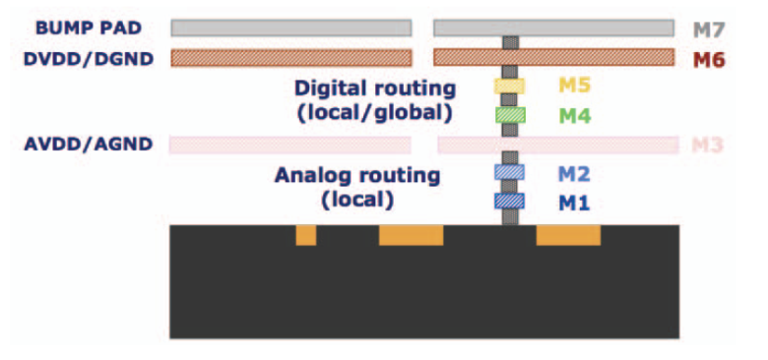
SuperPix0 - Fine Pitch Hybrid Pixel Sensor
SuperPix0 layout
The prototype chip contains 4096 readout cells of 50 μm × 50 μm arranged in a 32 × 128 matrix and organized in MacroPixels (MP)
We have tested 3 chips with no sensor connected:
CHIP4
CHIP6
CHIP7
Photograph of the prototype
Cross sectional view of the metal layers used in the layout of the SuperPix0 chip
ALUCAP
CHIP1 could not be tested because some bonding wires were damaged

Slide 3
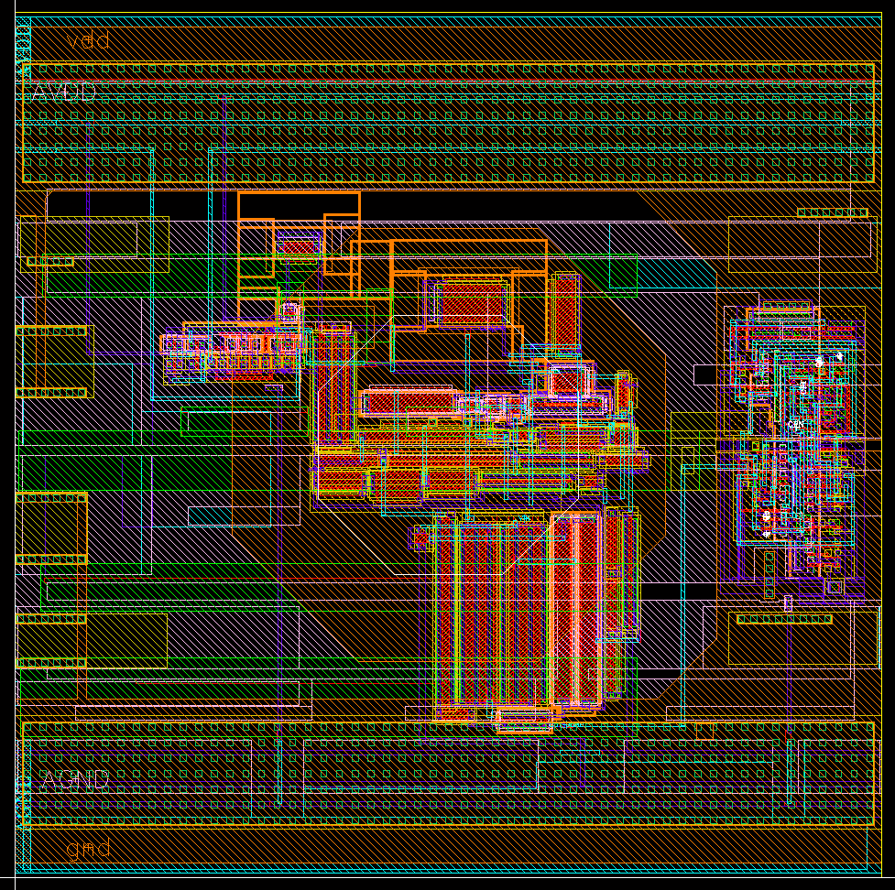
SuperPix0 - Analog Cell
Pixel layout integrated in the SuperPix0 chip
I_{FB}
InjectMaskOut
C_{inject}
PA
+
DISC
In-pixel
digital
logic
C_{detector}
-
HIT
InjectMaskIn
D
Q
V_{TH}
FFD
C_{FB}
InjectMaskClock
Q_{inject}
ENC = 120 e- + 0.51 e-/fC * Cd
ENC = 90 e- + 0.55 e-/fC * Cd
ENC = 120 e- @Cd=0
Q = 66000 e-
ENC = 90 e- @Cd=0

Slide 4
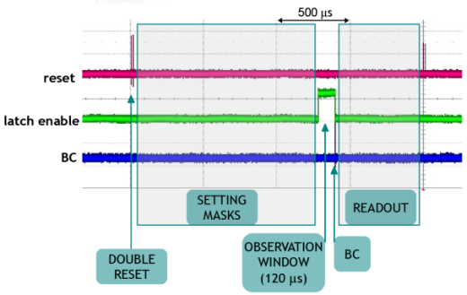
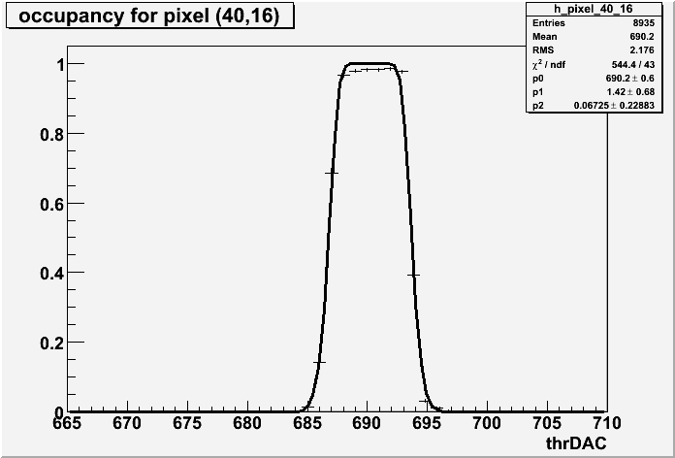
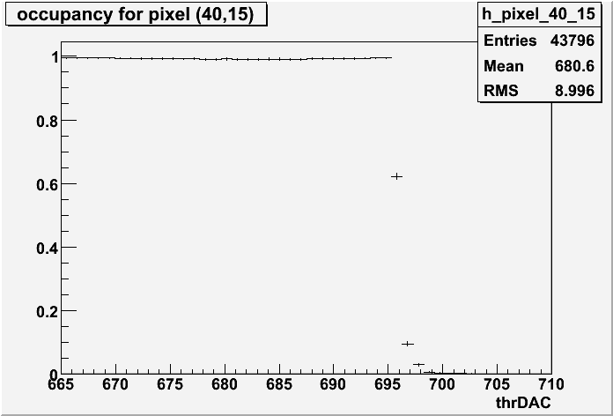
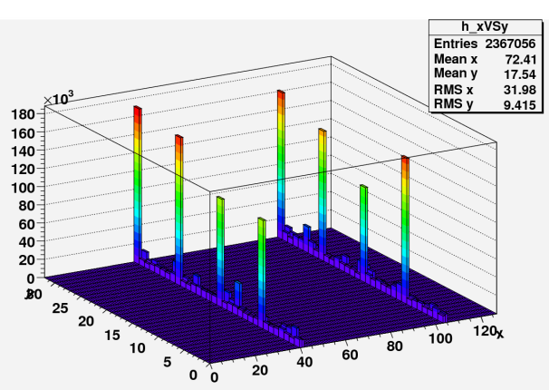
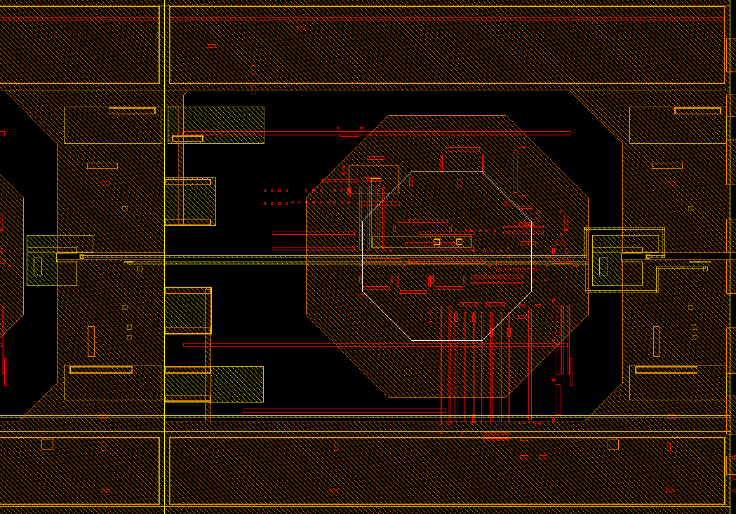
Noise Scan Measurements
We measured the occupancy as a function of the comparator threshold and we fitted the histogram and extracted noise and dispersion parameters with the function:
O(V_{th} - V_{bl}) = 1 – exp [- T_{oss} ν_{o} exp (- (V_{th} - V_{bl})/2 σ²)]
There are 8 pixels that have larger occupancy than the others. This happens only for pixels in a particular position in the MP
The fastOR and the latch enable lines run below the bump bonding pad and when they change state it is like the pixel is injected
Observation
window (120 μs)
Frequency
at zero threshold
Noise
Baseline
voltage

Slide 5
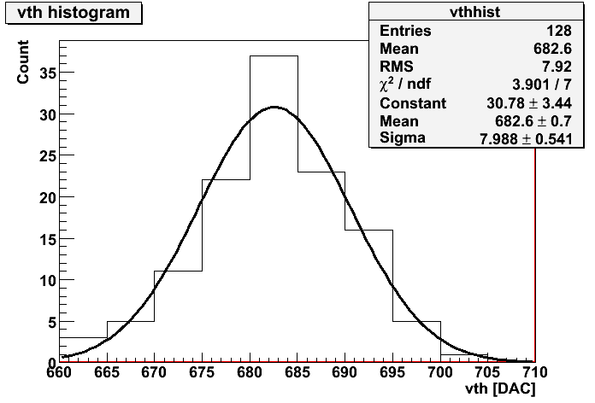
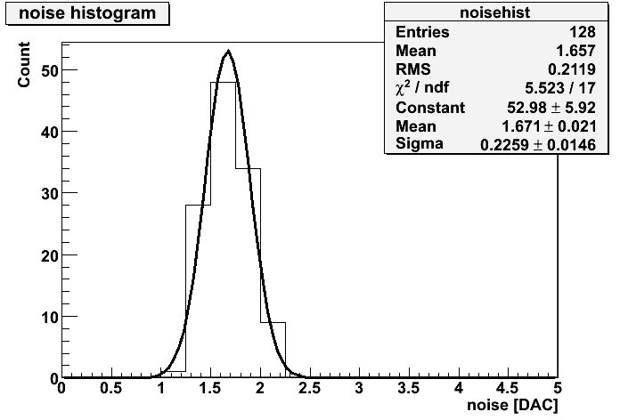
Noise scan results
 | Simulations | CHIP 4 | CHIP 6 | CHIP 7
THRESHOLD [mV] | 180 | 208.3 ± 0.2 | 207.3 ± 0.2 | 207.8 ± 0.2
THRESHOLD DISPERSION [mV] | 2.52 (350 e-) | 2.43 ± 0.17 | 2.19 ± 0.15 | 1.98 ± 0.13
NOISE [mV] | 0.63 (90 e-) | 0.51 ± 0.01 | 0.503 ± 0.01 | 0.504 ± 0.01
The threshold dispersion and the ENC parameters are calculated with post-layout charge sensitivity (Gq = 44 mV/fC)
The threshold and noise histograms are referred to chip 4

