Slide 1
HASPIDE
WP3 Simulation
24/03/2022

Slide 2
WP3 Simulations – Status and short term plans
  Technology CAD (TCAD) approach (Sentaurus Synopsys TCAD),
  aiming at accurate description of:
  - the charge transport within a-Si:H material;
  - the device electrical response (DC, transient simulations).

Slide 3
Study of LIFETIMES and MOBILITY models
  Interplay between carriers lifetimes and mobility models on current densities computation (e.g. simulation findings to be compared with measurements).
  New mobility model for a-Si:H

Slide 4
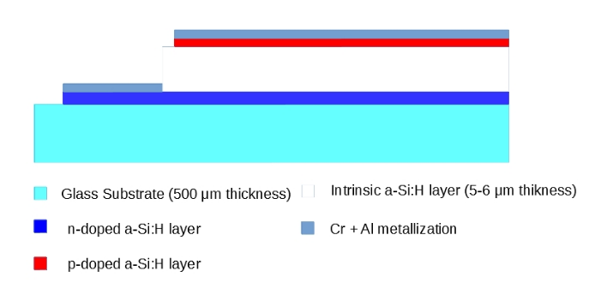
Simulated structure reference

Slide 5
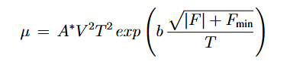
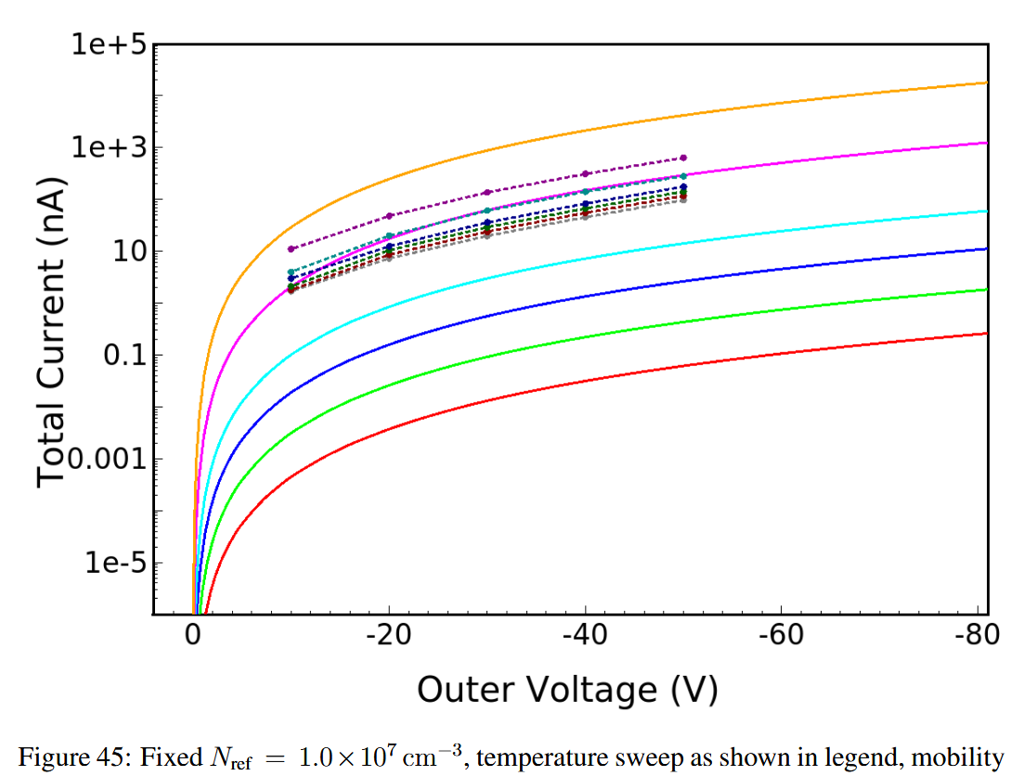
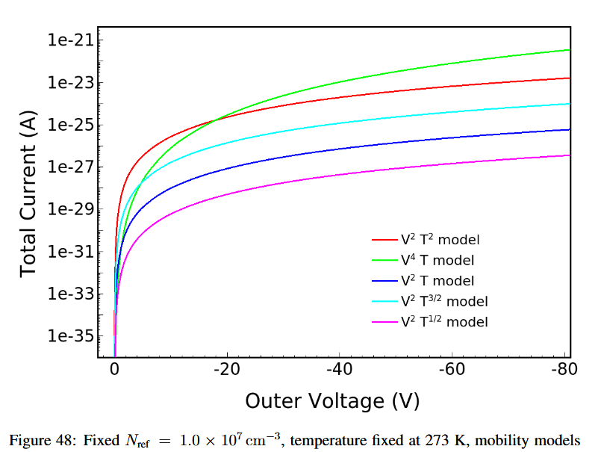
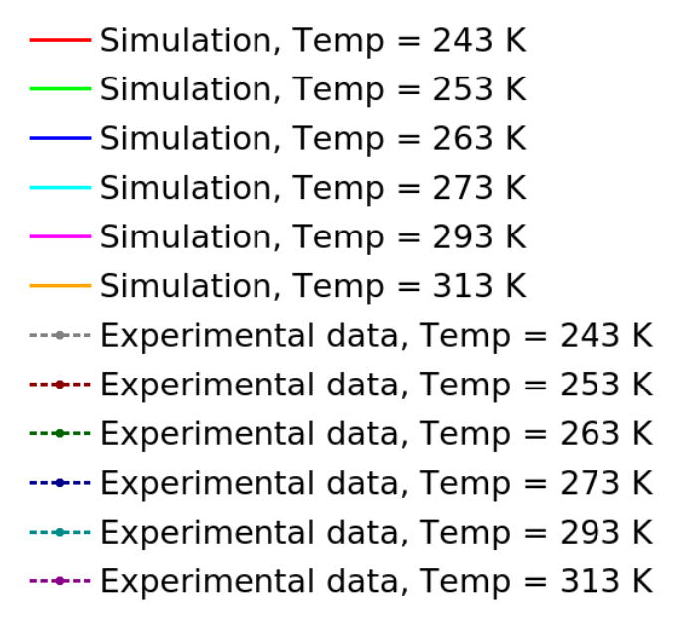
Analyses of carriers LIFETIMES + MOBILITIES (PMI ad hoc) models
  Reference mobility model
After Riccardo Vinti’s Thesis
T

Slide 6
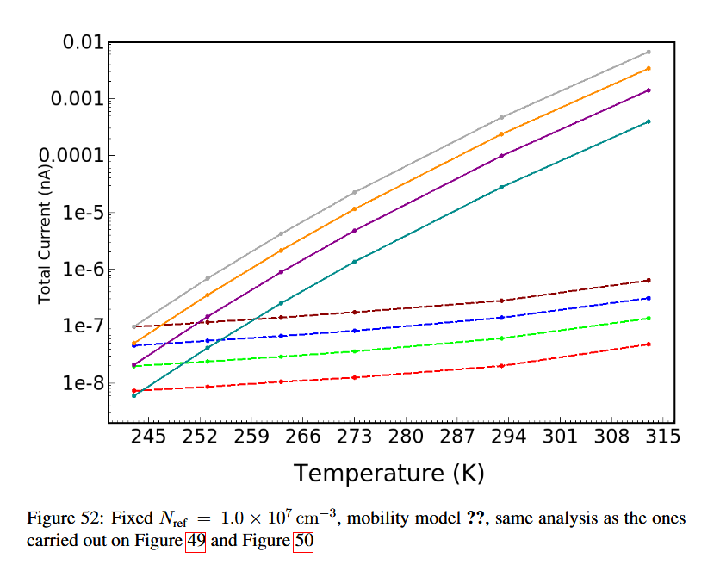
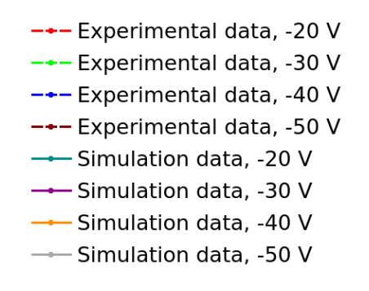
After Riccardo Vinti’s Thesis
Temperature Analyses: measurements vs. simulations

Slide 7
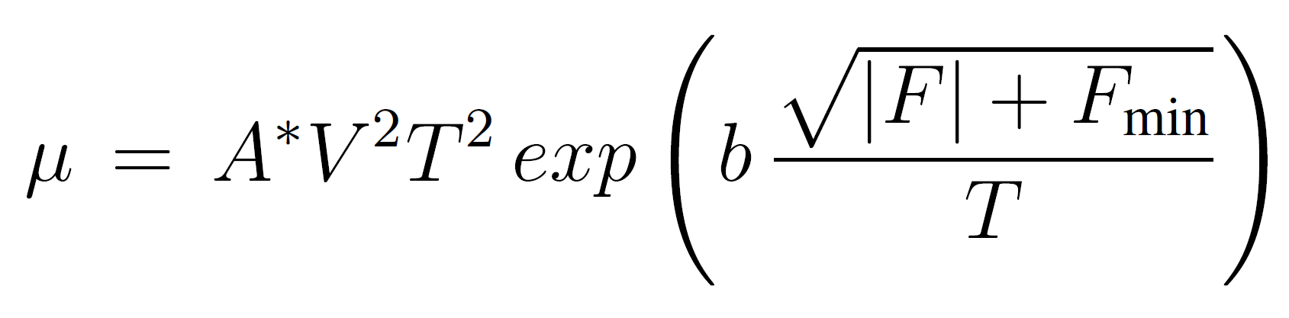

Variations on the fitting parameters: influence analysis on b
  Reference mobility model
TCAD Simulations ~ 3D-SiAm ~ 24/03/2022
7

Slide 8
Variations on the fitting parameters: influence analysis on b
  Reference mobility model
A* and temperature are fixed
b seems to affect solely the curve’s slope
TCAD Simulations ~ 3D-SiAm ~ 24/03/2022
8

Slide 9
Variations on the fitting parameters: influence analysis on A*
  Reference mobility model
TCAD Simulations ~ 3D-SiAm ~ 24/03/2022
9

Slide 10
Variations on the fitting parameters: influence analysis on A*
  Reference mobility model
b and temperature are fixed
A* effect …
TCAD Simulations ~ 3D-SiAm ~ 24/03/2022
10

Slide 11
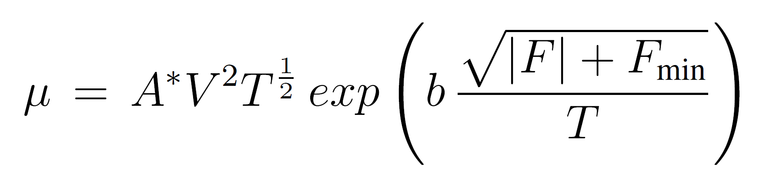
Variations on the fitting parameters: influence analysis on A*
  Reference mobility model
TCAD Simulations ~ 3D-SiAm ~ 24/03/2022
11

Slide 12
Variations on the fitting parameters: influence analysis on A*
  Reference mobility model
Note: each group of curves is represented in the same graph to understand the extent of the change between different A* values.
Lowering the dependence on T while varying the value of A* doesn’t reduce the spacing between the curves
TCAD Simulations ~ 3D-SiAm ~ 24/03/2022
12

Slide 13
Variations on the fitting parameters: influence analysis on A*
  Reference mobility model
A* = 2.89 and b = 3.86, temperature variations according to the values ​​of the “legacy” experimental measurements
The results are perfectly superimposable with what as already been observed
Experimental data is represented by the dashed curves
TCAD Simulations ~ 3D-SiAm ~ 24/03/2022
13

Slide 14
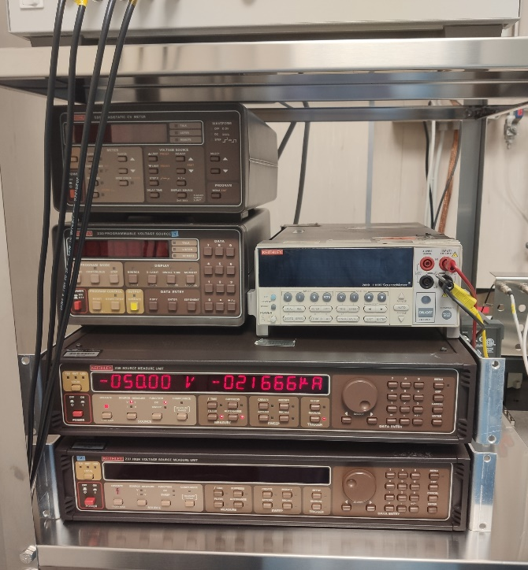
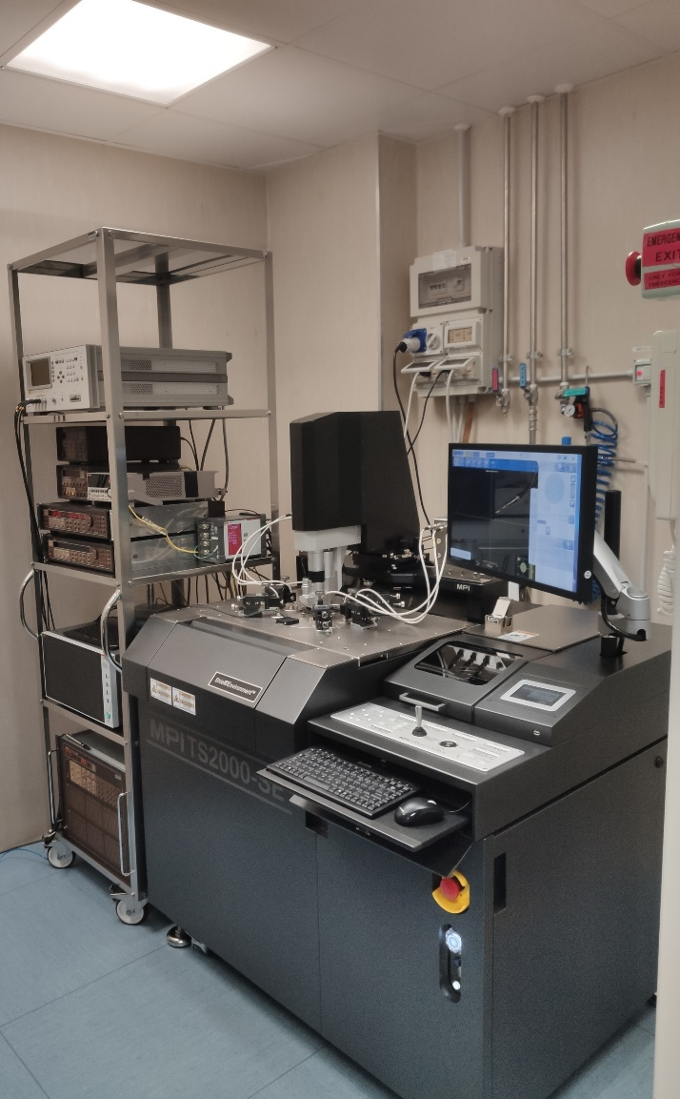
Diode C new measurements
New set of measurements on “Diode C” structure
Measurements performed on 8/03/2022 at INFN’s Clean Room in Perugia
Structure stabilization at each temperature of 30 minutes, 5 minutes stabilization between voltage variations
TCAD Simulations ~ 3D-SiAm ~ 24/03/2022
14

Slide 15
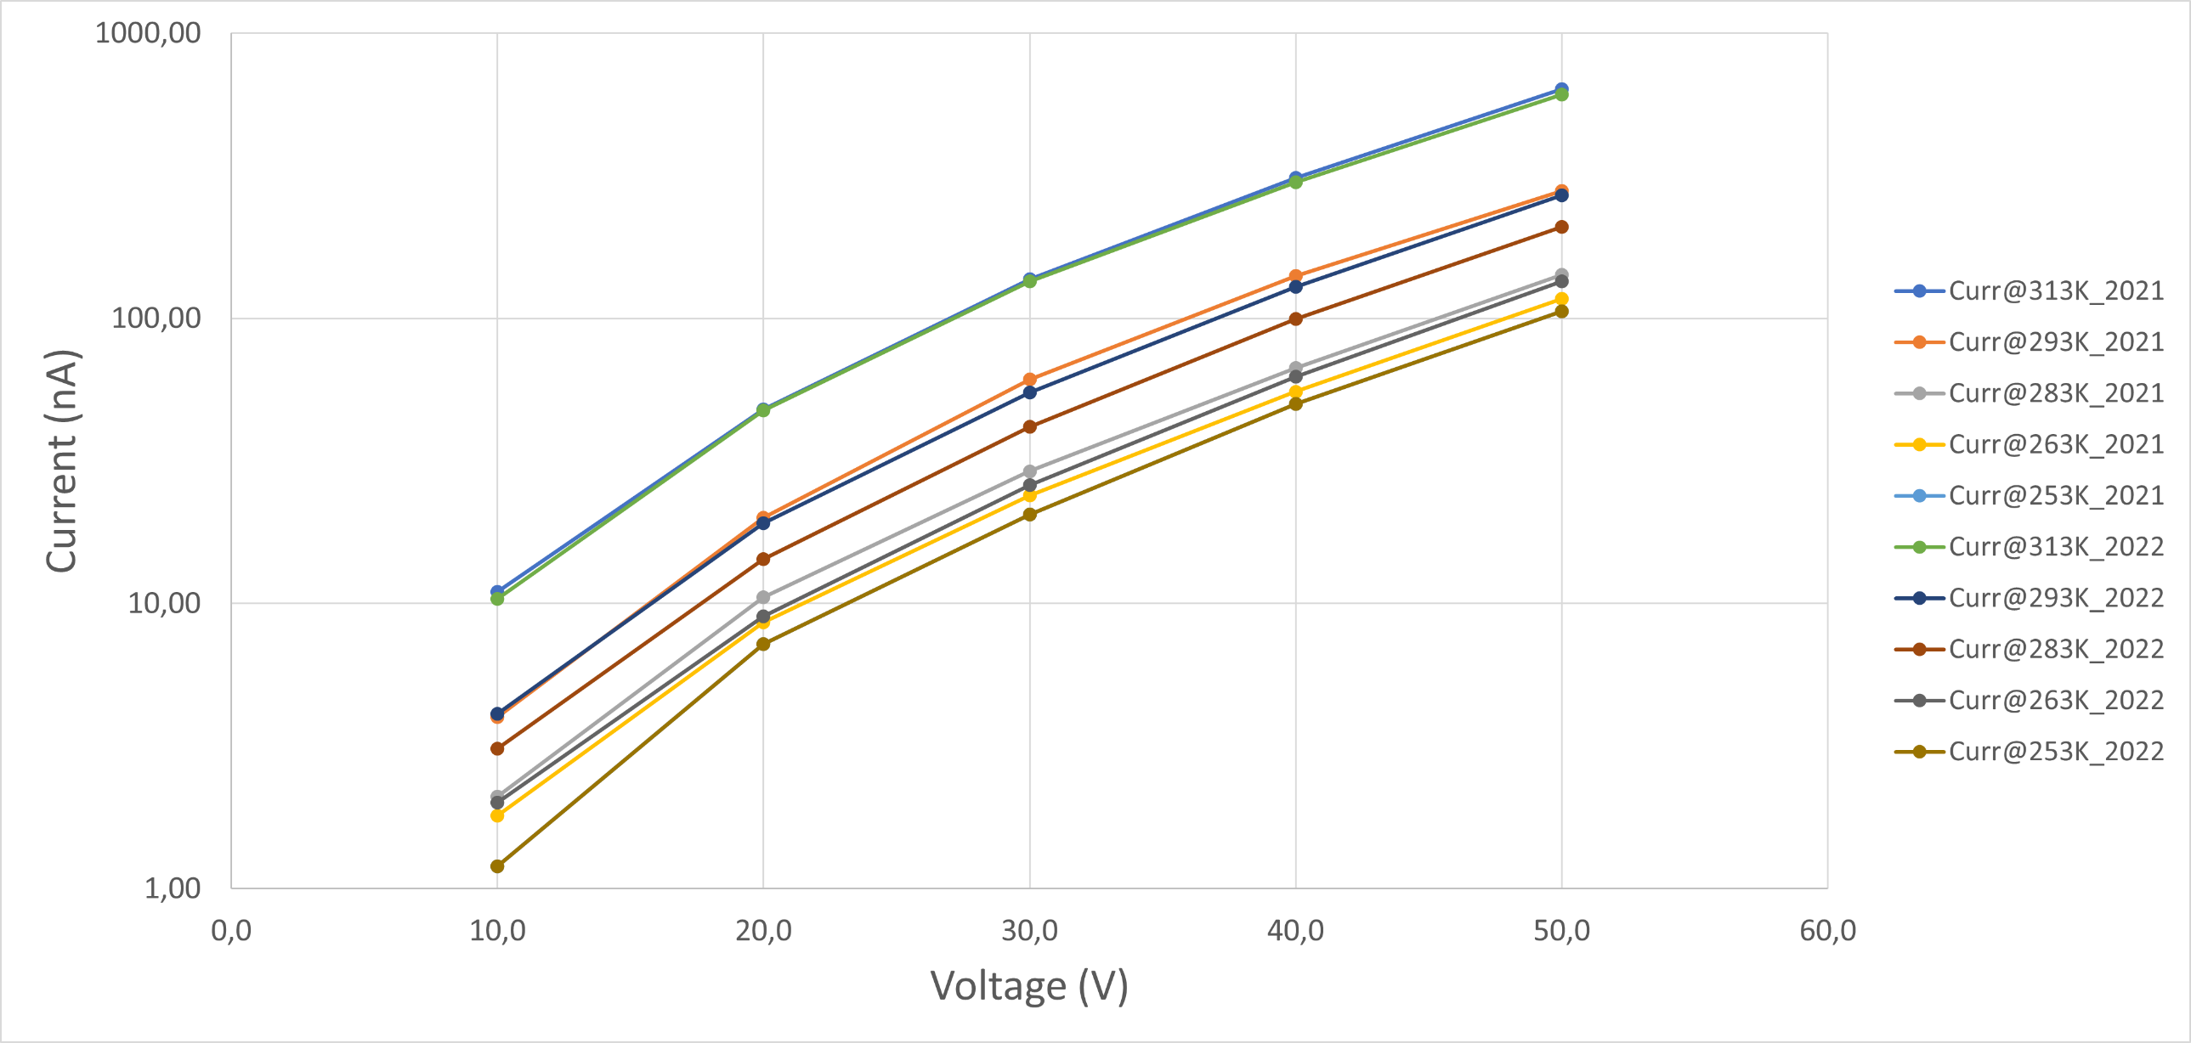
Diode C new measurements
TCAD Simulations ~ 3D-SiAm ~ 24/03/2022
15

Slide 16
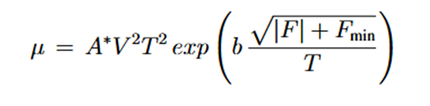
Conclusions and future work
  Reference mobility model
    good predictive capabilities / measurement agreement.
    Physically grounded (V, E, doping, T)
  Effects of @T under study…
  New fitting parameters A and b
    Dimensional Consistency / Units [A]! -> range…
  New measurements (cross-check with old data)
  Future work: Transient Analysis

Slide 17
BACKUP
24/03/2022

