Slide 1
New NbTiN thin films (∼20 nm) + test structures (resonators)
Goal: determine all material parameters relevant to the design of KI-TWPA
Transition Temperature T_{c}
Kinetic inductance (per square) L_{k}
Dissipation/quality factor Q
Nonlinearity
Critical current
Film thickness reduced from ∼100 nm to ∼20 nm in order to enhance L_{k}

Slide 2

Film parameters
$$L_{K}=\frac{ℏ}{1.76πk_{B}T_{c}}R_{n}$$
W6
W5
W1

Slide 3
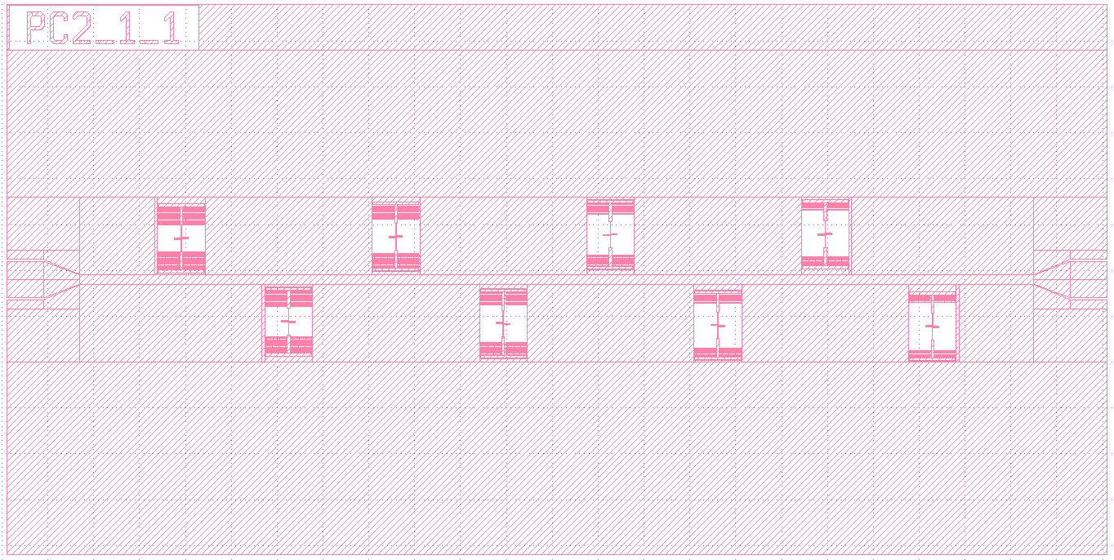

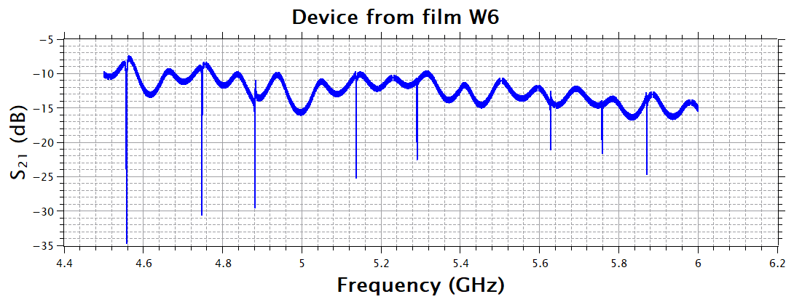
KID test devices layout

Slide 4
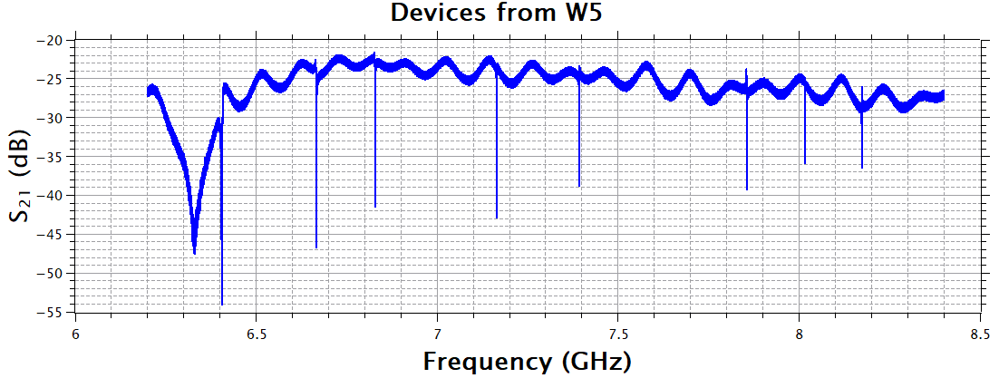
VNA Characterization

Slide 5
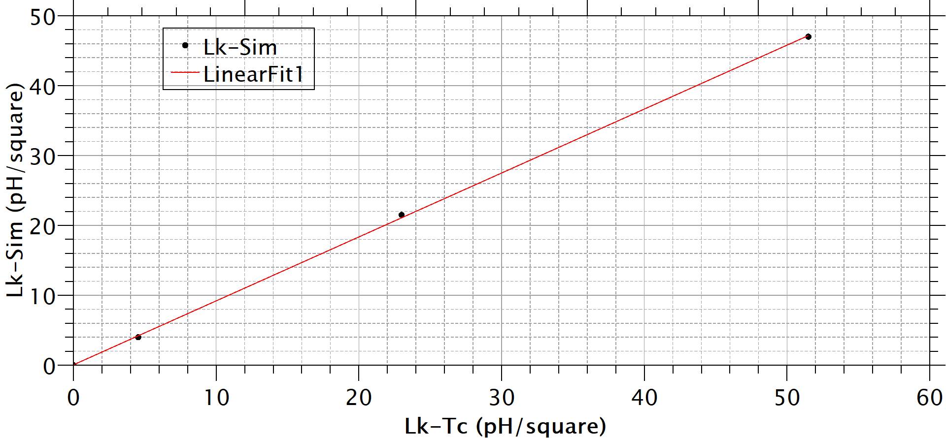
Kinetic Inductance from f₀ and T_{c}
W6
W5
W1

Slide 6
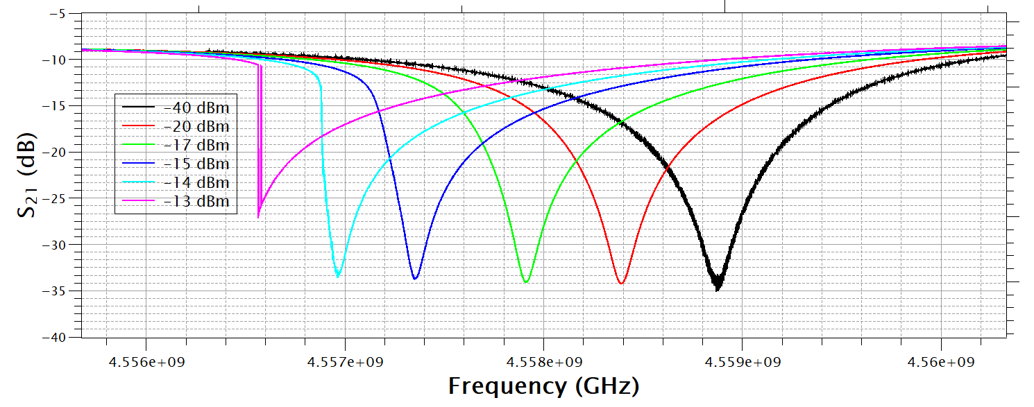

Frequency shift vs Power
Film W6 - Resonator 8
$$L_{k}=L_{k0}\left[1+{\left(\frac{I}{I_{∗}}\right)}^{2}\right]$$

Slide 7
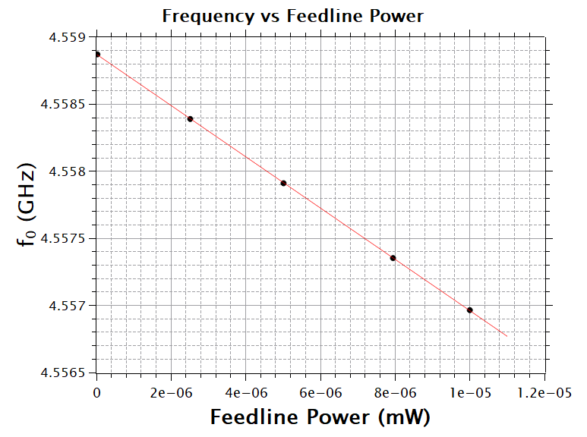
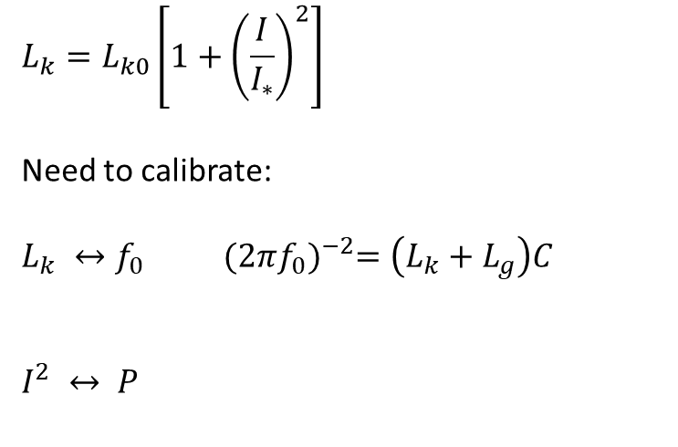
Kinetic Inductance Nonlinearity: first estimation
$$L_{k}=L_{k0}\left[1+{\left(\frac{I}{I_{∗}}\right)}^{2}\right]$$
Need to calibrate:
$L_{k} ↔f_{0}$ ${(2πf_{0})}^{−2}=\left(L_{k}+L_{g}\right)C$
$I^{2} ↔ P$
SONNET
Need to relate Power in the feedline to I² in the resonator!
QUCS
+ Uncertainty ∼ 20% on Feedline power
(Attenuators, Cable loss … )

Slide 8
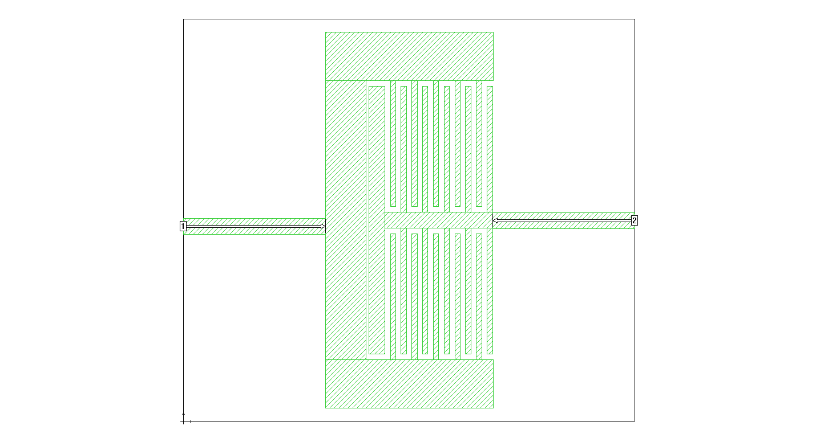
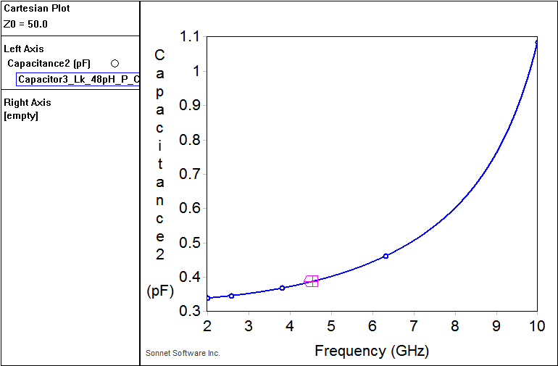
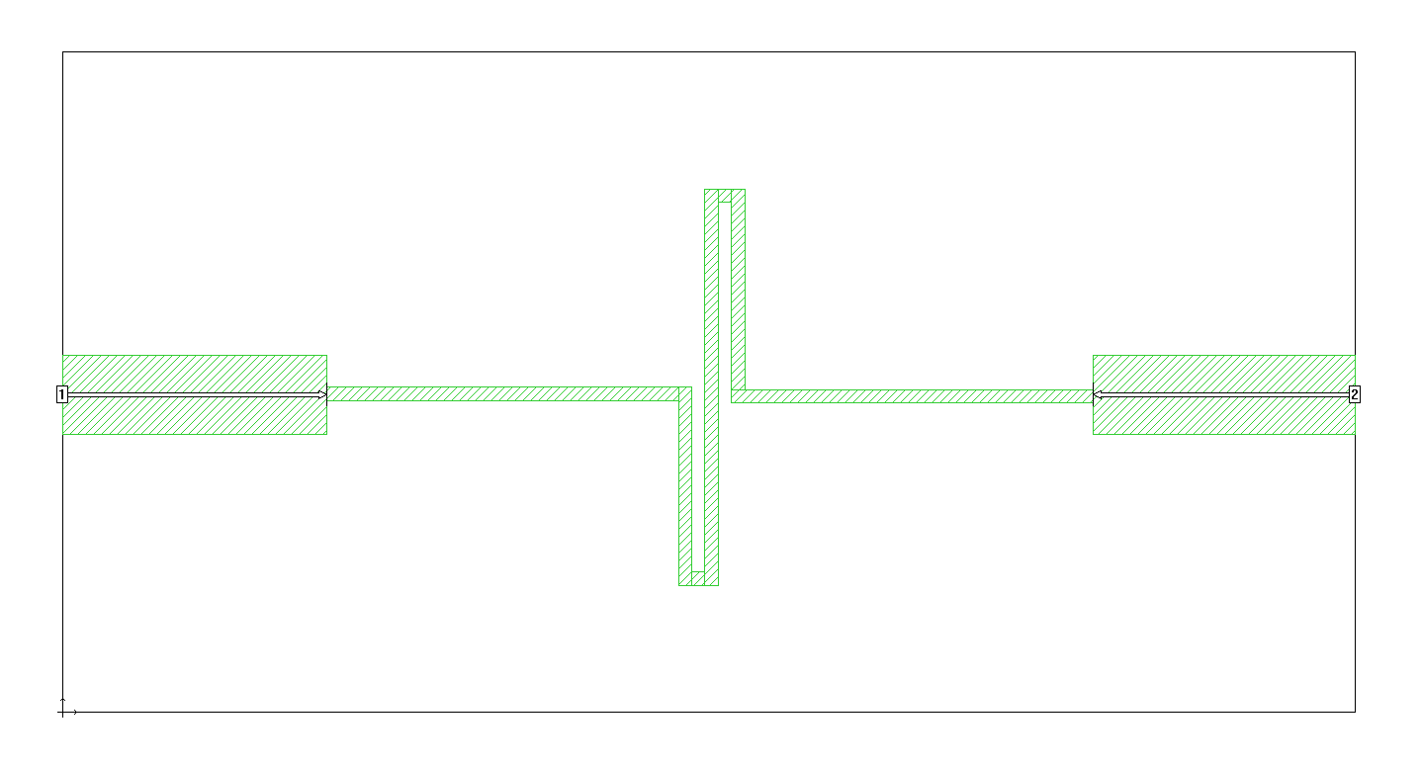
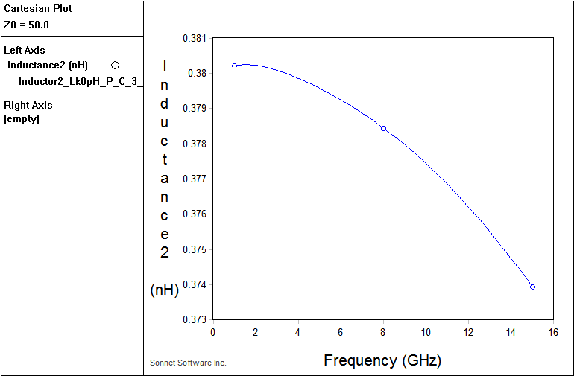
SONNET Separate simulation of the L&C elements
C (In the resonator there are 2 C in series!)
Quite Consistent
With full LC !
L

Slide 9
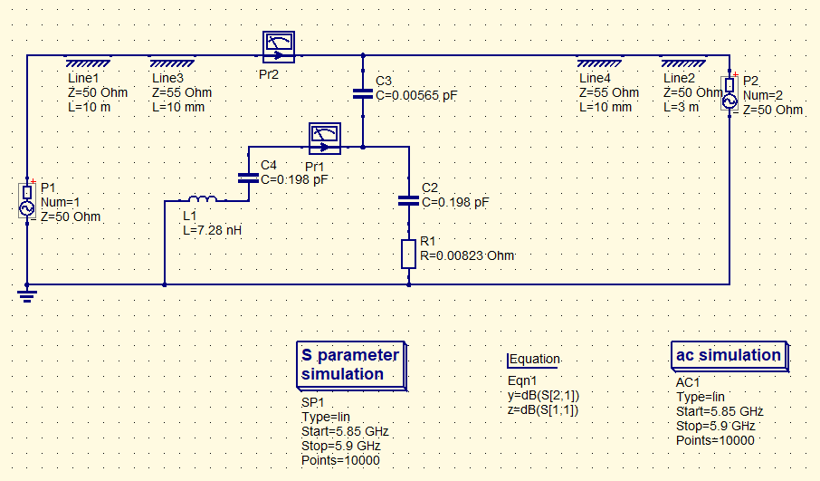
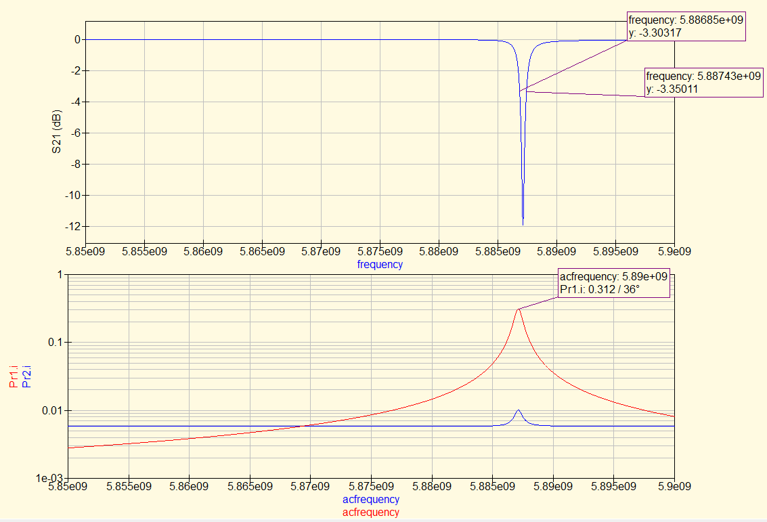

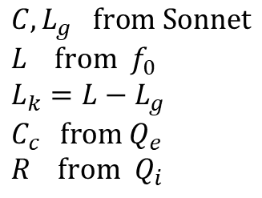
Lumped model of the system (Qucs)
Adapt parameters to experimental fit
$$C, L_{g} \text{from} \text{Sonnet}$$
$$L \text{from} f_{0}$$
$$L_{k}=L−L_{g}$$
$C_{c}$ from $Q_{e}$
$$R \text{from} Q_{i}$$
Conversion factor $\frac{\text{Current} \text{in} \text{resonator} }{\text{Current}\text{−}\text{power} \text{in} \text{the} \text{feedline}}$

Slide 10
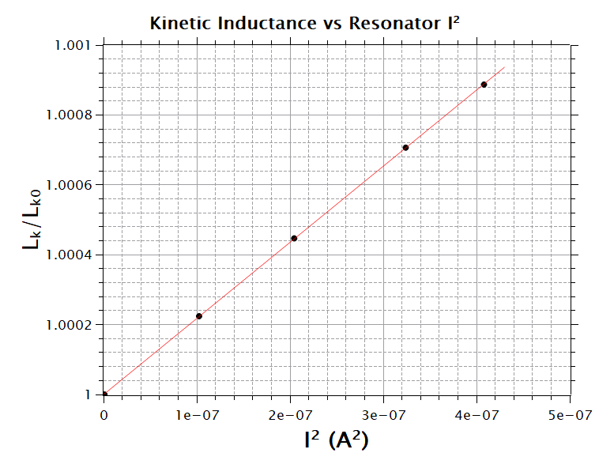
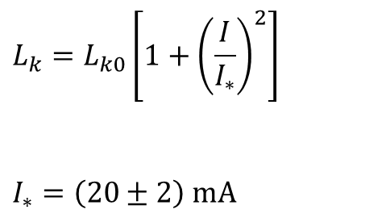

Finally, L_{k} vs resonator I²
RESONATOR 1 - f₀=4.55 GHz
NbTiN FILM W6 (highest kinetic inductance)
$$L_{k}=L_{k0}\left[1+{\left(\frac{I}{I_{∗}}\right)}^{2}\right]$$
$$I_{∗}=\left(20±2\right) \text{mA}$$
( @NIST: $I_{∗}=7 \text{mA}$ for a 1 um width )

Slide 11

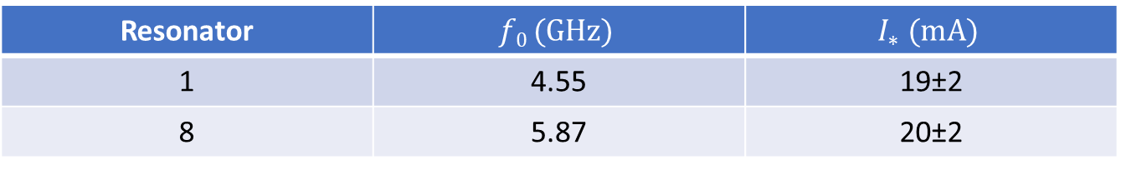
Results film W6 (resonator width 5 μm)
Resonator | $$f0 (GHz)$$ | $$I_{∗} (\text{mA}\text{)}$$
1 | 4.55 | 19±2
8 | 5.87 | 20±2
Results film W5 (resonator width 5 μm)
Resonator | $$f0 (GHz)$$ | $$I_{∗} (\text{mA}\text{)}$$
8 | 8.17 | 18±3

Slide 12
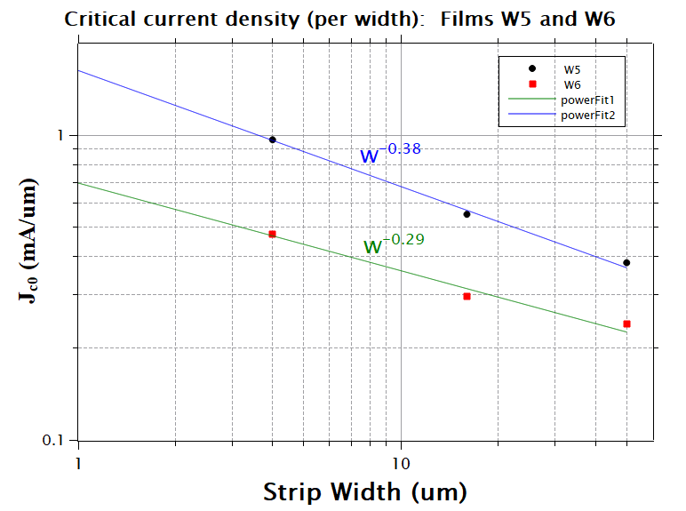



Critical current of NbTiN (SC to normal)
Increase current slowly until voltage jumps (normal state)
Measured with film immersed in liquid helium to minimize self-heating effects
Correct to zero temperature with Ginzburg-Landau prediction, modified for thin films:
$$I_{c}=I_{c0}\left(1−t^{2}\right){\left(1−t^{4}\right)}^{1/2}$$
$$t=\frac{T}{T_{c0}}$$
Roughly expected $J_{c} ∝ w^{−\frac{1}{2}}$
(because current density increases at the strip edges … )

Slide 13
Ratio I_{c}/I*
Why is it important?
$L_{k}=L_{k0}\left[1+{\left(\frac{I}{I_{∗}}\right)}^{2}\right]$MAXIMUM ACHIEVABLE NONLINEARITY = ${\left(\frac{I_{c}}{I_{∗}}\right)}^{2}$
NbTiN film (width) | I_{c} (mA) | I* (mA) | I_{c}/I*
W5 (5 um) | 4.4 | 18 | 0.25
W6 (5 um) | 2.2 | 20 | 0.09
NIST (1 um) | 2.4 | 7 | 0.34
COULD BE A PROBLEM !
I_{c}/I* should increase slightly for smaller width
NEED TO EVALUATE I_{c} & I* FOR THE FINAL WIDTH ∼ 1 μm !!

