Slide 1
Status of the NA62 experiment
F. Ambrosino
Università degli Studi di Napoli «Federico II»
INFN- Sezione di Napoli

Slide 2
Outline
Motivations for PNN (and more)
The CERN Kaon factory
Recent results (a personal selection)
Prospects

Slide 3
NP: hunting high and low
Some well known open questions in SM :
  Hierarchy
  Neutrino masses and mixings
  Origin of Dark Matter
  Matter/antimatter asymmetry
  Strong CP problem
New physics at TeV scale not found (so far)
Explore higher mass scale via virtual production (ultrarare processes)….
…or search for light ( but feebly coupled) particles in production and/or decay

Slide 4
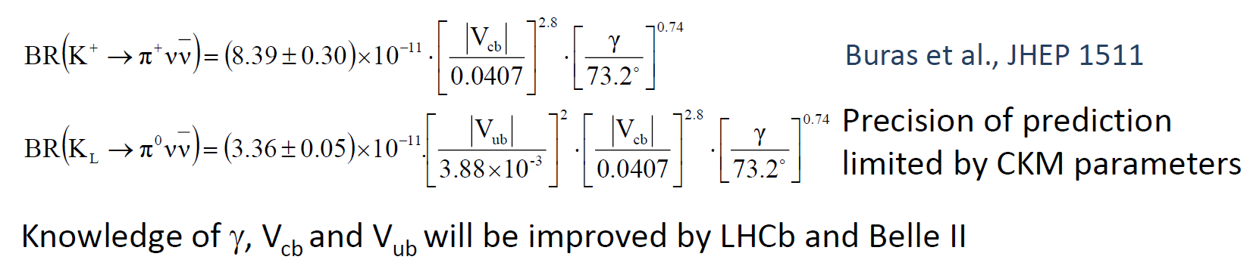

K→πνν and SM
FCNC processes : no tree-level SM contribution
$\sin^{5}{θ_{C}}$ suppression (top loop dominance)
Hadronic part from K_{e3} : accurate prediction in SM
Theoretical uncertainty dominated by CKM elements.
See also most recent results: J. Buras, E. Venturini Eur. Phys. J. C 82 (2022) 7, 615
G. D’Ambrosio, A.M. Iyer, F. Mahmoudi, S. Neshatpour arxiv:2206.14748v1

Slide 5
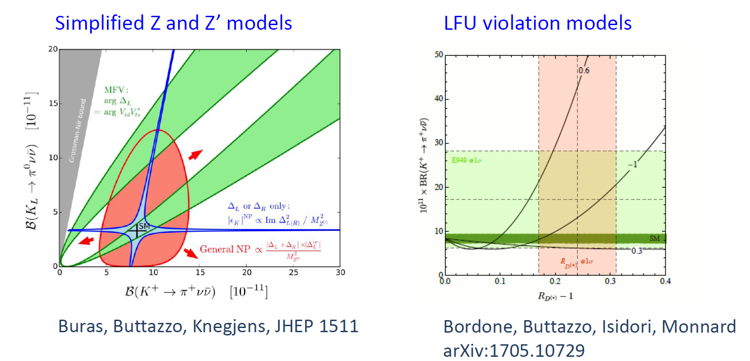
K→πνν and NP at high mass
Eur.Phys.J. C77 (2017) no.9, 618
May test scales up to 2000 TeV (!) in generic
NP scenarios.
Or «just» 50-100 TeV for pure L/R NP
ν_{τ} contributes to the decay

Slide 6
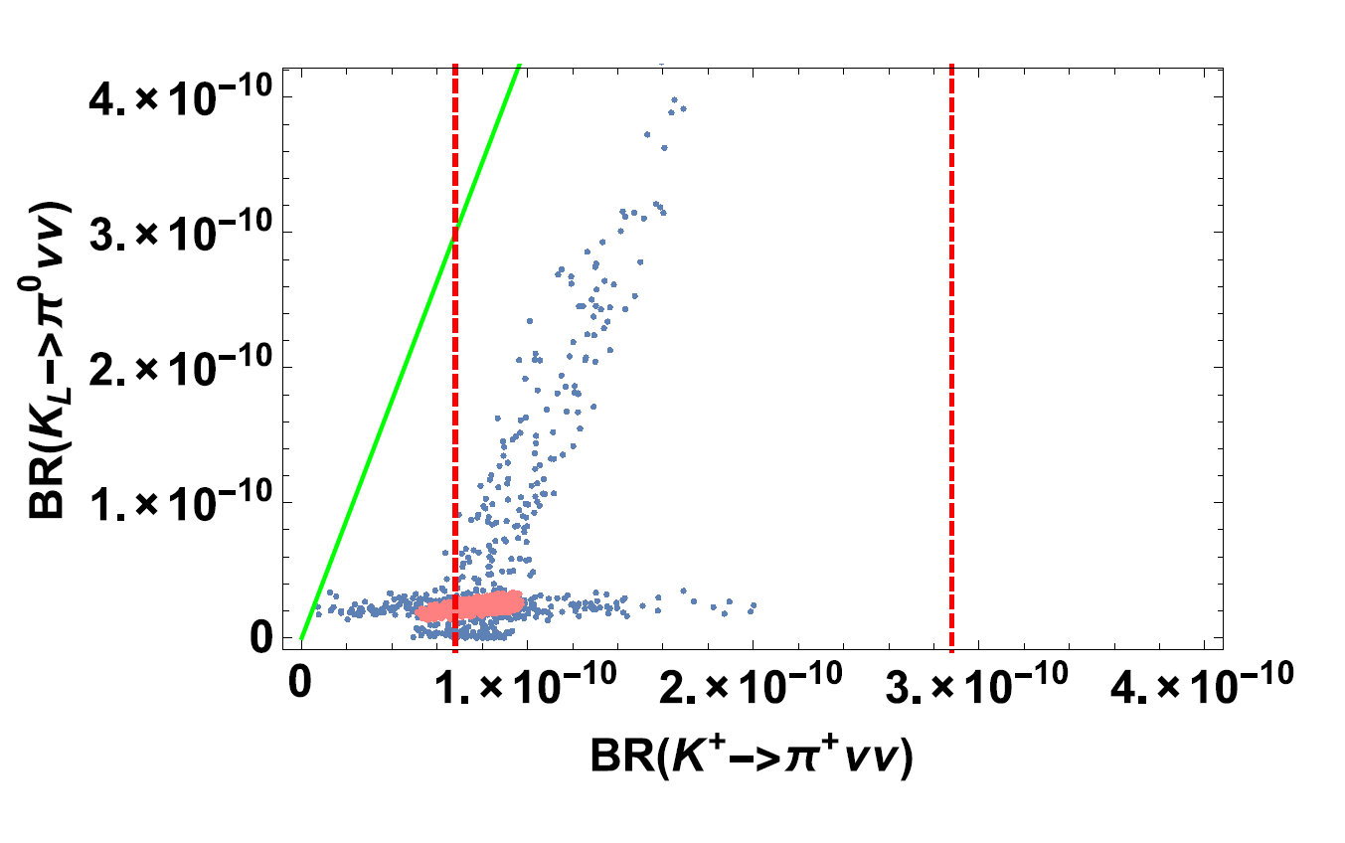
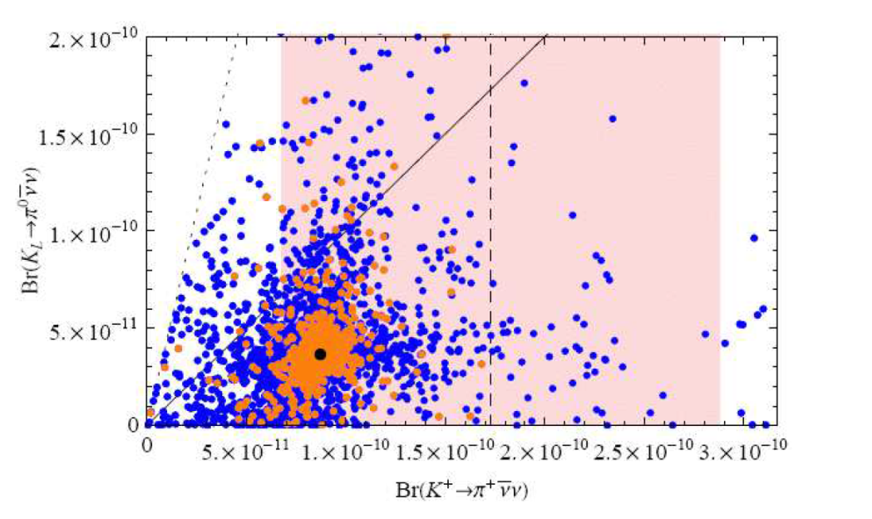
K→πνν and NP at high mass
Non-MFV MSSM @10 TeV
Randal-Sundrum models with custodial symmetry
Blanke, Buras, Duling, Gemmler, Gori
JHEP 0903 (2009) 108
M.Tanimoto and K. Yamamoto
PTEP 2016 (2016) no.12, 123B02
See also: Blazek, Matak Int.J.Mod.Phys. A29 (2014)
Isidori et al., JHEP 0608 (2006) 064

Slide 7

K→πX and NP at low mass
Limits on $K→πX$ translate in strong limits on ALPs or scalars in the usual mass/coupling plane
ALP coupled to gluons
Search for light dark scalars
PBC workshop report, Eur.Phys.J.C 81 (2021) 11, 1015
M. Bauer, M. Neubert, S. Renner, M.Schnubel and A. Thamm JHEP 09 (2022) 056

Slide 8

The needle in the haystack
Unconstrained kinematics, backgrounds 10¹⁰ times higher than signal….
Need for a dedicated kaon factory !

Slide 9

The CERN kaon factory
400 GeV protons extracted from SPS
Up to 3.3 x10¹² protons on target /spill
T10 target : 1 λ_{int} Be target→ 75 GeV/c secondary hadron beam
Possibility to dump the beam onto 22 λ_{int} Cu «target»
Up to $≈$5∙10¹² kaon decays/year in 60 m decay volume
Up to 10¹⁸ pot/year to search for exotic particles
with very low background

Slide 10
The CERN kaon factory
40%
55%
65%
Intensity/Nominal
RUN 1
RUN 2 : 2021-2025. Nominal intensity + upgraded detector.
We are taking data of excellent quality right now !

Slide 11
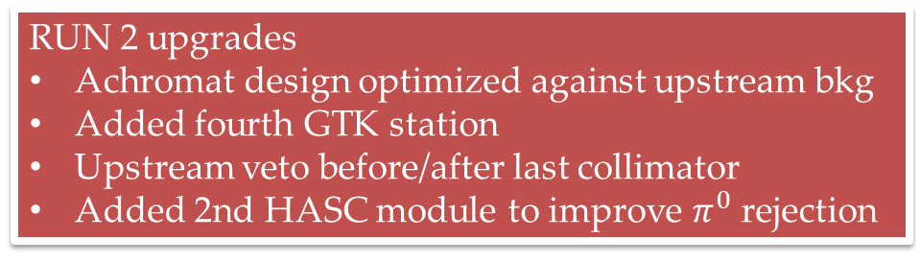
NA62 @ CERN SPS
RUN 2 upgrades
Achromat design optimized against upstream bkg
Added fourth GTK station
Upstream veto before/after last collimator
Added 2nd HASC module to improve $π^{0}$ rejection

Slide 12
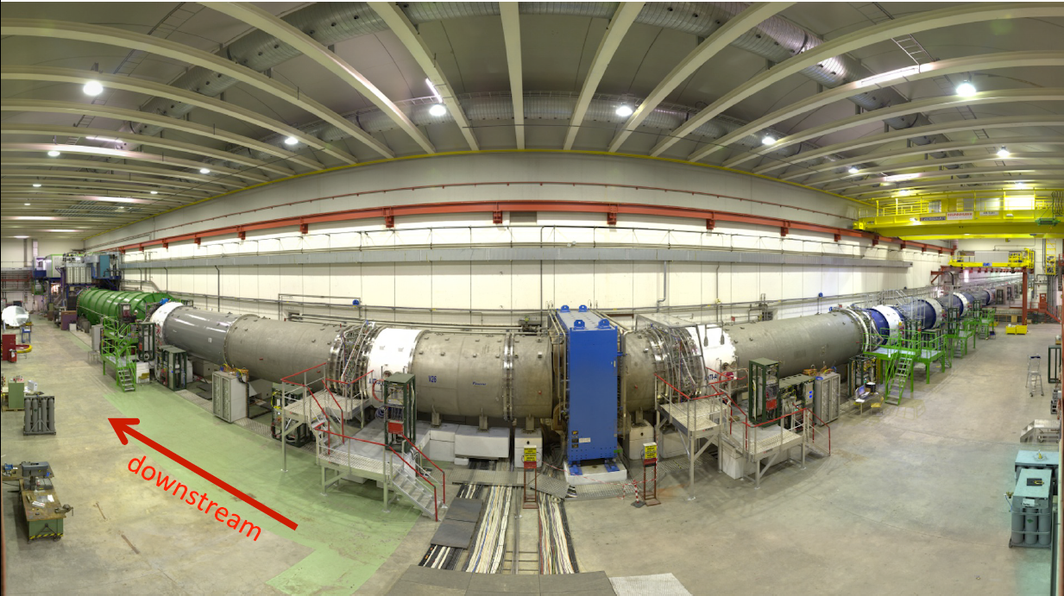
NA62 @ CERN SPS
Time resolution: O(100) ps
Beam and decay tracking: sq. missing mass resolution 10⁻³ GeV²
Particle id: O(10⁷) μ vs π rejection for 15 GeV< p < 35 GeV
Photon detection: O(10⁷) π⁰ rejection
Primary goal: precision measurement of BR(K⁺→π⁺νν)
JINST 12 P05025 (2017)

Slide 13
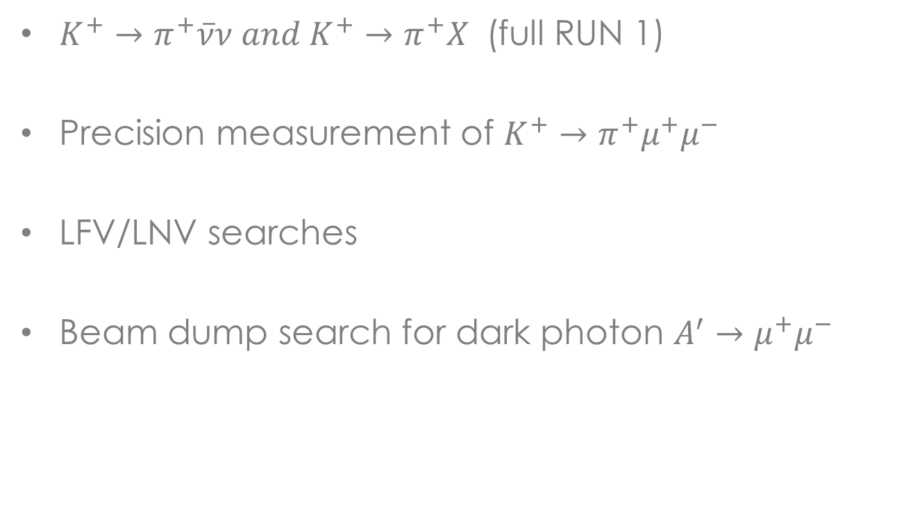
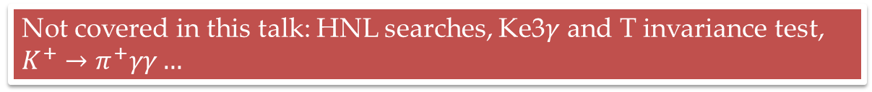
Some recent results
$K^{+}→π^{+}\overline{ν}ν and K^{+}→π^{+}X$ (full RUN 1)
Precision measurement of $K^{+}→π^{+}μ^{+}μ^{−}$
LFV/LNV searches
Beam dump search for dark photon $A^{′}→μ^{+}μ^{−}$
Not covered in this talk: HNL searches, Ke3$γ$ and T invariance test, $K^{+}→π^{+}γγ…$

Slide 14
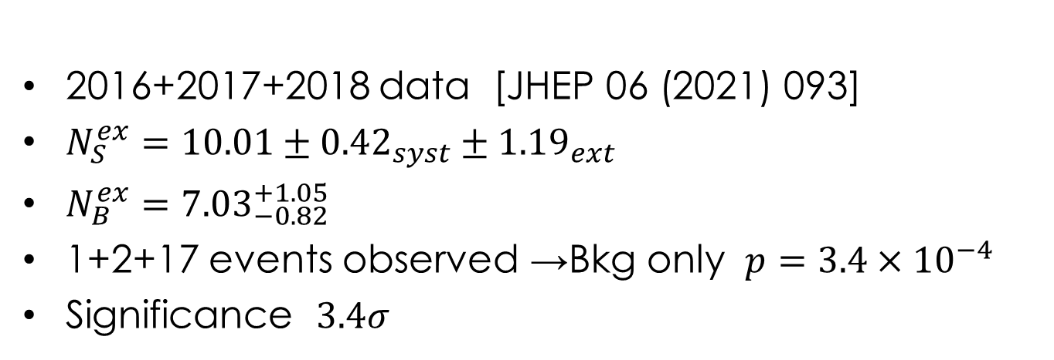
RUN 1 result on πνν
2016+2017+2018 data [JHEP 06 (2021) 093]
$N_{S}^{ex}=10.01±{0.42}_{syst}±{1.19}_{ext}$
$N_{B}^{ex}={7.03}_{−0.82}^{+1.05}$
1+2+17 events observed →Bkg only $p=3.4×{10}^{−4}$
Significance $3.4σ$

Slide 15
RUN 1 result on πνν

Slide 16
RUN 1 result on πνν
68% CL interval

Slide 17
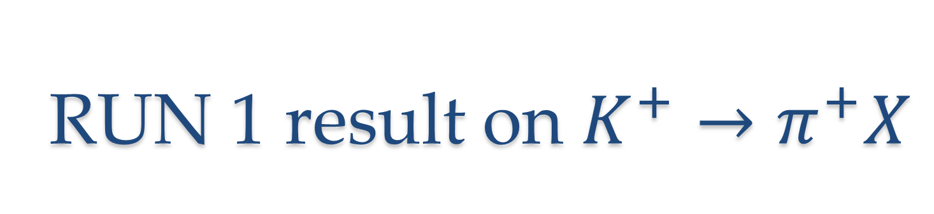
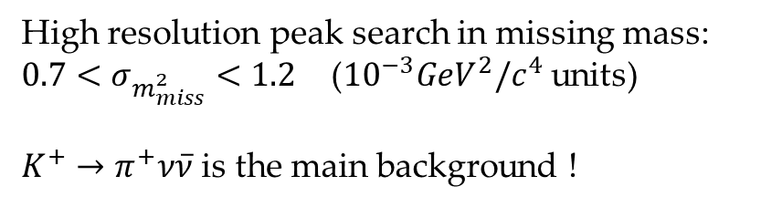
RUN 1 result on $K^{+}→π^{+}X$
[JHEP 06 (2021) 093]
High resolution peak search in missing mass: $0.7<σ_{m_{miss}^{2}}<1.2$ (${10}^{−3}GeV^{2}/c^{4}$ units)
$K^{+}→π^{+}ν\overline{ν}$ is the main background !

Slide 18
RUN 1 result on $K^{+}→π^{+}X$
Limits on $K→πX$ translate in strong limits on ALPs or scalars in the usual mass/coupling plane
ALP coupled to gluons
Search for light dark scalars
PBC workshop report, Eur.Phys.J.C 81 (2021) 11, 1015
M. Bauer, M. Neubert, S. Renner, M.Schnubel and A. Thamm JHEP 09 (2022) 056

Slide 19

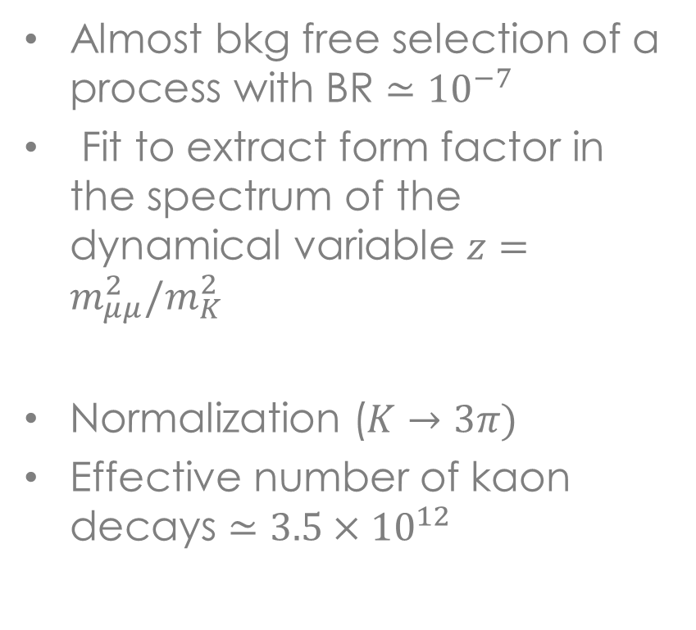
Precision measurement of $K^{+}→π^{+}μ^{+}μ^{−}$
Almost bkg free selection of a process with BR $≃{10}^{−7}$
Fit to extract form factor in the spectrum of the dynamical variable $z=m_{μμ}^{2}/m_{K}^{2}$
Normalization ($K→3π)$
Effective number of kaon decays $≃3.5×{10}^{12}$

Slide 20
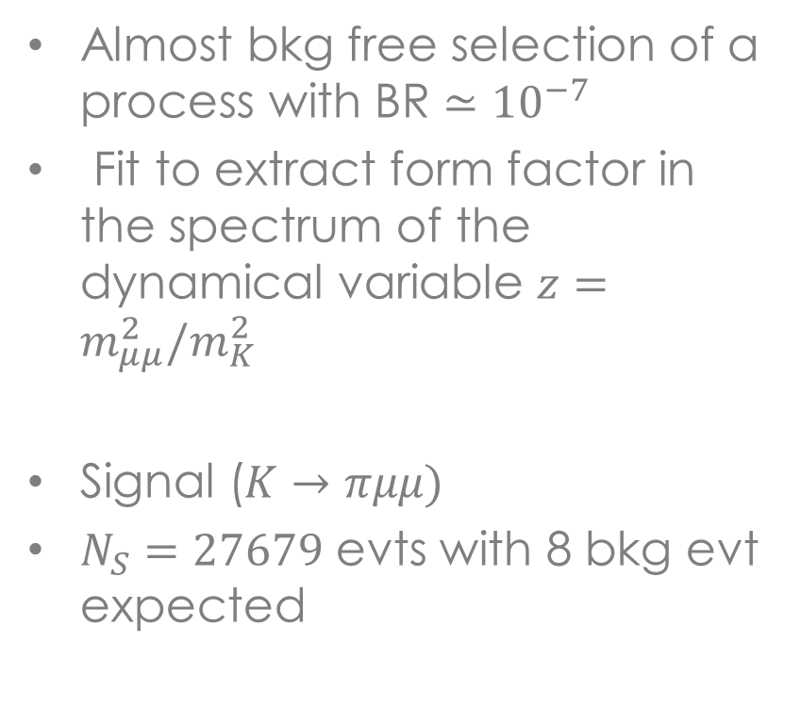
Precision measurement of $K^{+}→π^{+}μ^{+}μ^{−}$
Almost bkg free selection of a process with BR $≃{10}^{−7}$
Fit to extract form factor in the spectrum of the dynamical variable $z=m_{μμ}^{2}/m_{K}^{2}$
Signal ($K→πμμ)$
$N_{S}=27679$ evts with 8 bkg evt expected

Slide 21
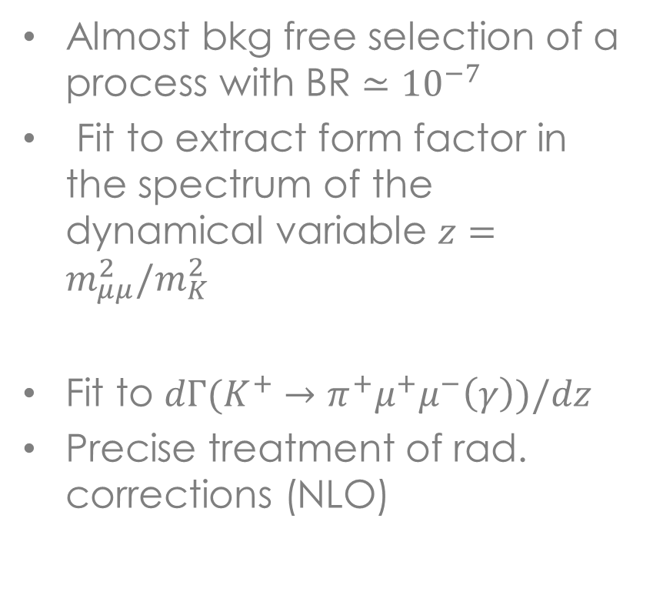
Precision measurement of $K^{+}→π^{+}μ^{+}μ^{−}$
Almost bkg free selection of a process with BR $≃{10}^{−7}$
Fit to extract form factor in the spectrum of the dynamical variable $z=m_{μμ}^{2}/m_{K}^{2}$
Fit to $dΓ(K^{+}→π^{+}μ^{+}μ^{−}\left(γ\right))/dz$
Precise treatment of rad. corrections (NLO)

Slide 22
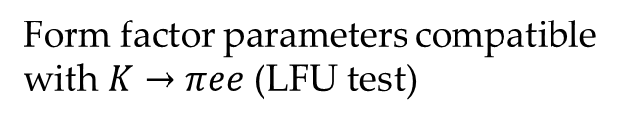
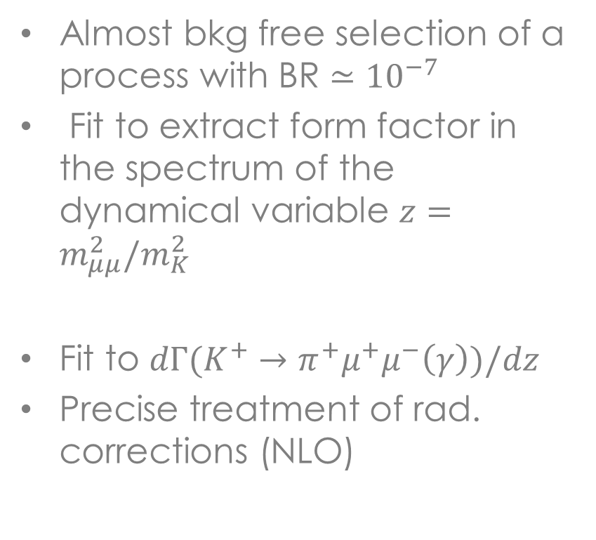
Precision measurement of $K^{+}→π^{+}μ^{+}μ^{−}$
Almost bkg free selection of a process with BR $≃{10}^{−7}$
Fit to extract form factor in the spectrum of the dynamical variable $z=m_{μμ}^{2}/m_{K}^{2}$
Fit to $dΓ(K^{+}→π^{+}μ^{+}μ^{−}\left(γ\right))/dz$
Precise treatment of rad. corrections (NLO)
Form factor parameters compatible with $K→πee$ (LFU test)
G. D’Ambrosio, A.M. Iyer, F. Mahmoudi, S. Neshatpour arxiv:2206.14748v1
G. D’Ambrosio, M. Knecht, S. Neshatpour arXiv:2209.02143

Slide 23



LFV/LNV searches
LNV (same sign leptons) mediated by Majorana neutrinos. Similar to $0νββ$.
Signatures: $K^{+}→π^{−}ℓ^{+}ℓ^{+}$ with $ℓ=e, μ$ or $K^{+}→μ^{−}{\overline{ν}}_{μ} ℓ^{+}ℓ^{+}$ with $ℓ=e, μ$
($μ)$
($ν ̅)$

Slide 24

LFV/LNV searches
LFV (opposite sign different family ) mediated by Leptoquarks
Signature: $K^{+}→π^{+}ℓ_{1}^{+}ℓ_{2}^{−}$ with $ℓ_{1}=e, μ$ and $ℓ_{2}=μ,e$

Slide 25
LFV/LNV searches

Slide 26
LFV/LNV searches

Slide 27
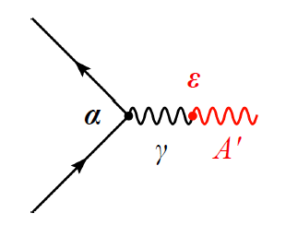
Dark photon @ NA62
Extra U(1) massive gauge singlet
Mixing with SM hypercharge
ε and m_{A’} are free parameters
Searches at NA62 :
  Invisible modes (K⁺ →π⁺A’ or K⁺ →π⁺π⁰ and π⁰→γA’ )
  Production at target/dump and decays:
  A’→ee or A’→μμ

Slide 28
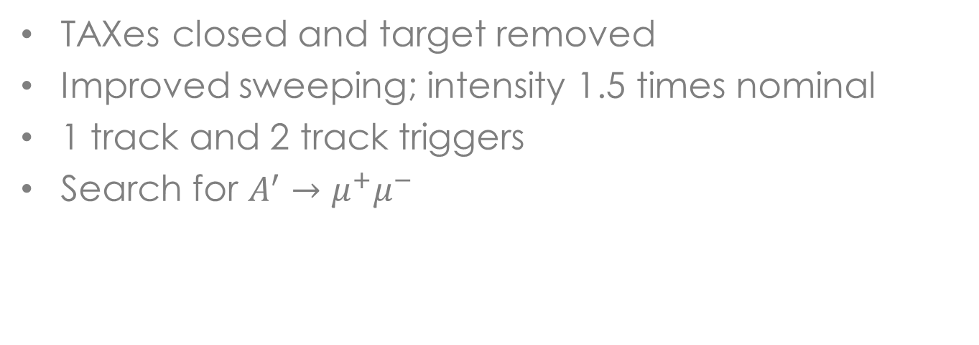
NA62 in beam dump mode
TAXes closed and target removed
Improved sweeping; intensity 1.5 times nominal
1 track and 2 track triggers
Search for $A^{′}→μ^{+}μ^{−}$

Slide 29
NA62 in beam dump mode
2021 RUN

Slide 30

$$A^{′}→μ^{+}μ^{−}$$
Control samples: same sign leptons (combinatorial background)

Slide 31
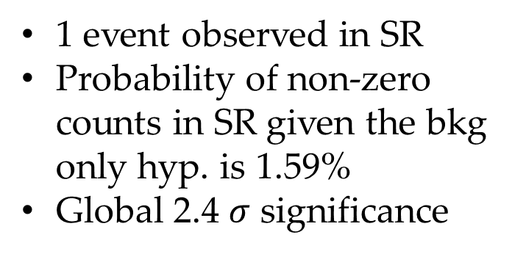
$$A^{′}→μ^{+}μ^{−}$$
1 event observed in SR
Probability of non-zero counts in SR given the bkg only hyp. is 1.59%
Global 2.4 $σ$ significance

Slide 32
$$A^{′}→μ^{+}μ^{−}$$

Slide 33
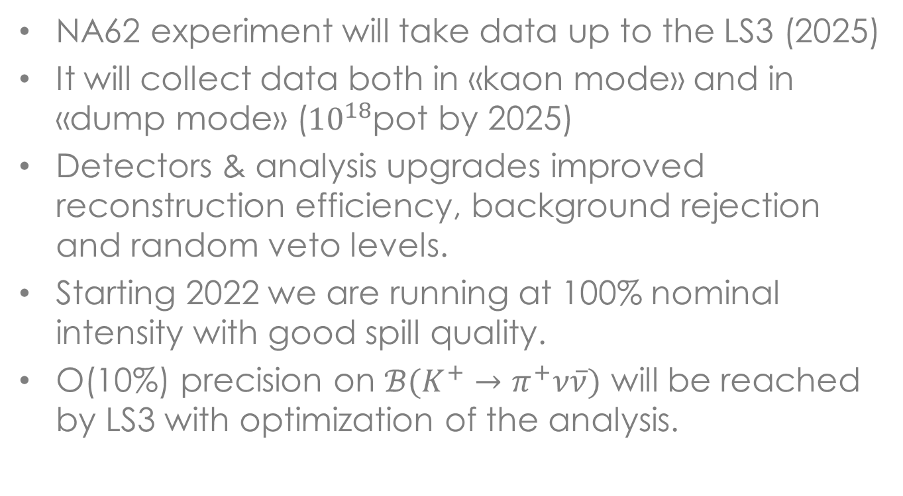
Prospects
NA62 experiment will take data up to the LS3 (2025)
It will collect data both in «kaon mode» and in «dump mode» (${10}^{18}$pot by 2025)
Detectors & analysis upgrades improved reconstruction efficiency, background rejection and random veto levels.
Starting 2022 we are running at 100% nominal intensity with good spill quality.
O(10%) precision on ${ℬ(K}^{+}→π^{+}ν\overline{ν})$ will be reached by LS3 with optimization of the analysis.

Slide 34

Prospects
${ℬ(K}^{+}→π^{+}ν\overline{ν})$ @ 10%

Slide 35
The (near) future: HIKE
A comprehensive, multi-staged project for kaon physics at CERN after LS3 : the High Intensity Kaon Experiment (HIKE) project.
Measurement of all of rare kaon decays, charged and neutral
Need to increase intensity at level 4x (charged beam) or 6x (neutral beam). Beamline design studies already started.

Slide 36
HIKE program

Slide 37
HIKE physics program

Slide 38
Conclusions
The CERN Kaon factory has a vast and unique physics program for the search of NP , complementary to what can be done at LHC and B-factories
High quality physics results are being published by the collaboration.
The current run (2021-2025) will allow to fully exploit the physics reach with the current NA62 setup
In a longer time-scale the HIKE project will measure all rare decay modes of charged and neutral kaons: stay tuned !

Slide 39
Additional material

Slide 40
RUN 2 upgrades

Slide 41
RUN 2 upgrades
GTK reco inefficiency

Slide 42
HIKE phase 1
The in-flight technique is firmly established and a 5% measurement of the charged PNN mode is attainable with appropriate modifications to the current design of NA62 to cope with high intensity.
Improve time resolution to reduce random veto
Keep detector/daq performances with higher rates
Tests of possible configuration have started.
See also M. Moulson talk @ KAON 2022 for details

Slide 43
High intensity beams

Slide 47
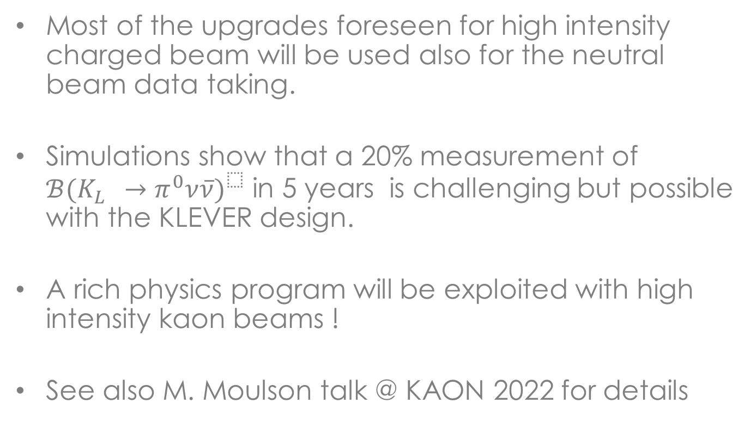
KLEVER
Most of the upgrades foreseen for high intensity charged beam will be used also for the neutral beam data taking.
Simulations show that a 20% measurement of ${ℬ(K_{L}^{}→π^{0}ν\overline{ν})}^{}$ in 5 years is challenging but possible with the KLEVER design.
A rich physics program will be exploited with high intensity kaon beams !
See also M. Moulson talk @ KAON 2022 for details

