Slide 1
B-anomalies at LHCb
T. Bowcock
On behalf of
the LHCb Collaboration
FCCP 2022

Slide 2
Anomaly
/əˈnɒm(ə)li/ something that deviates from what is standard, normal, or expected.
e.g. "there are a number of anomalies in the present system“
Is there a common thread?
I rely on a number of excellent recent (21-22) presentations e.g.
  2021: M. Patel, Planck Conference (30/6/21)
  Talks by: V. Gligorov; F. Blanc; L. Bian; P. Resmi; S. Schmitt; all in (ICHEP 2022, 6/7/22);
  F. Dordei (NuFACT, 2022, 1/8/22)
  A. Mauri (XVth Quark Confinement and Hadron Spectrum Conference, 1/8/22)
  L. Scantlebury (Rencontres de Vietnam, 16/8/22)
  C. Marin (14th Conference on Intersections and Nuclear Physics, 29/8/22)

Slide 3
Context Here
Introduction
Golden Mode
Semileptonic Decays
Lepton Universality
Lepton
Flavour Violation
Summary
Huge world wide activity on flavour in lepton sector
  Neutrinos ( flavour violation)
  CERN – LHC can study b decays
    Future experiments such as MuonE
  Belle
  FNAL (g-2, ,mu2e)
  PSI (mu3e…)
Theory/Phenomenology…
Probing for BSM at LHCb
  Golden Mode
  B-Decays (EWP)
  Lepton Universality
    Angular Tests b→s𝝁𝝁
    Ratios of Branching Fractions
      b→ sll (FCNC)
      b → clν (CC)
    Ratios sensitive to 3rd Generation
  Lepton Flavour Violation
The Future
  LHCb Sensitivities

Slide 4
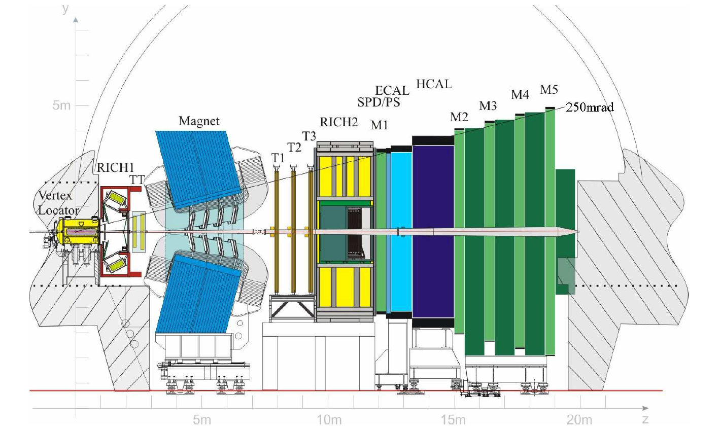
Detector
JINST 3 (2008) S08005
Introduction
Golden Mode
Semileptonic Decays
Lepton Universality
Lepton
Flavour Violation
Summary
IP resolution ~ 20 μm @high P_{T}
Excellent vertex reconstruction
INT. MOD. PHYS A30 (2015) 1530022
Highly efficient Particle ID

Slide 5

Detector
Electrons
2012: E_{T} 3 GeV trigger threshold
Bremsstrahlung influences momentum resolution, requiring “recovery”
ID
$$e→e : 90\%$$
  $h→e : 5\%$
Muons
2012: p_{T} 1.5 GeV trigger threshold (lower)
ID
$μ→μ : 97\%$
  $π→μ: 1−3\%$
Introduction
Golden Mode
Semileptonic Decays
Lepton Universality
Lepton
Flavour Violation
Summary
>
~
>
~

Slide 6
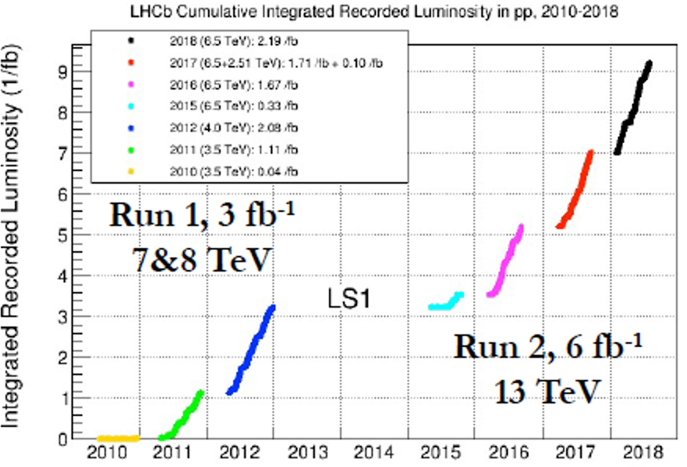
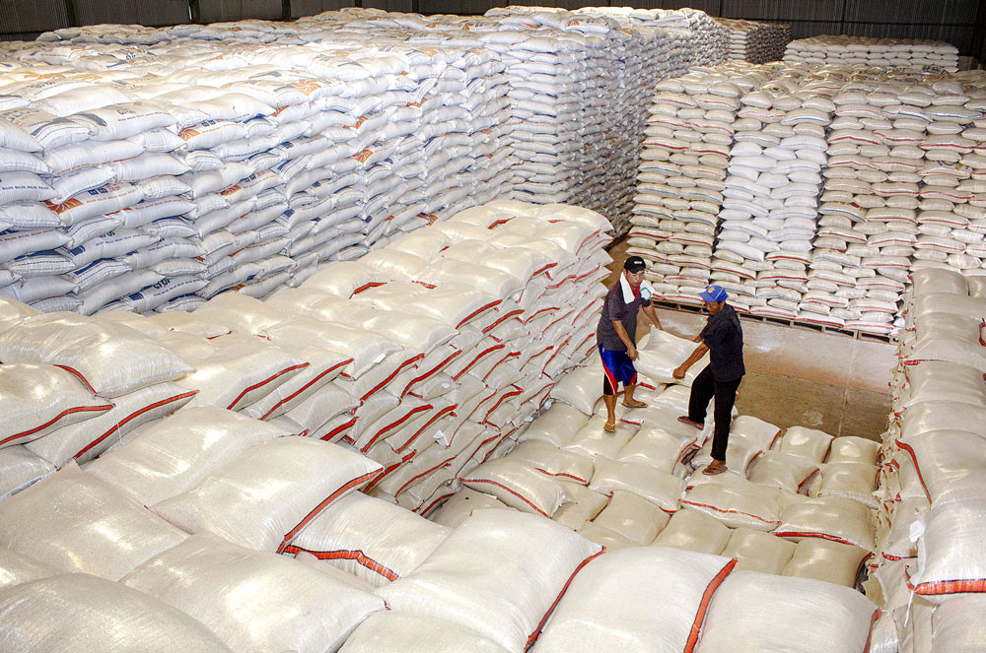
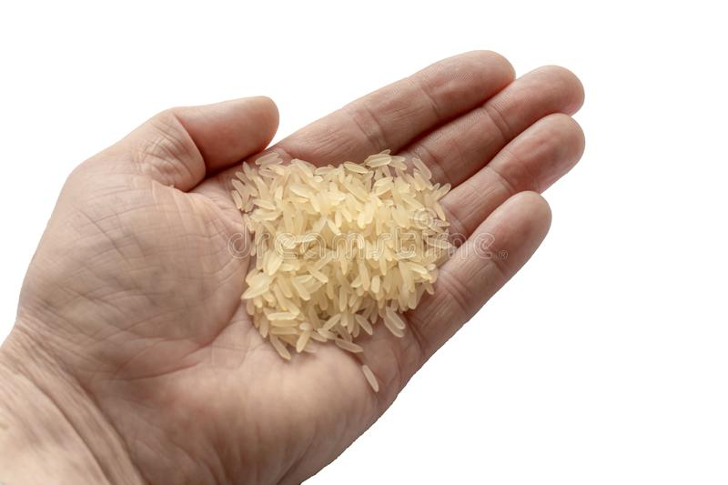
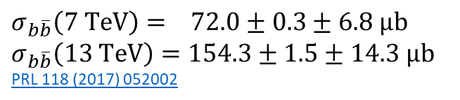
LHCb sample of B’s
Introduction
Golden Mode
Semileptonic Decays
Lepton Universality
Lepton
Flavour Violation
Summary
$$σ_{b\overline{b}}\left(7 TeV\right)= 72.0±0.3±6.8 μb$$
$$σ_{b\overline{b}}\left(13 TeV\right)=154.3±1.5±14.3 μb$$
PRL 118 (2017) 052002
3fb⁻¹ @ 70μb O (10¹¹) B’s
6fb⁻¹ @ 150μb O (10¹²) B’s

Slide 7
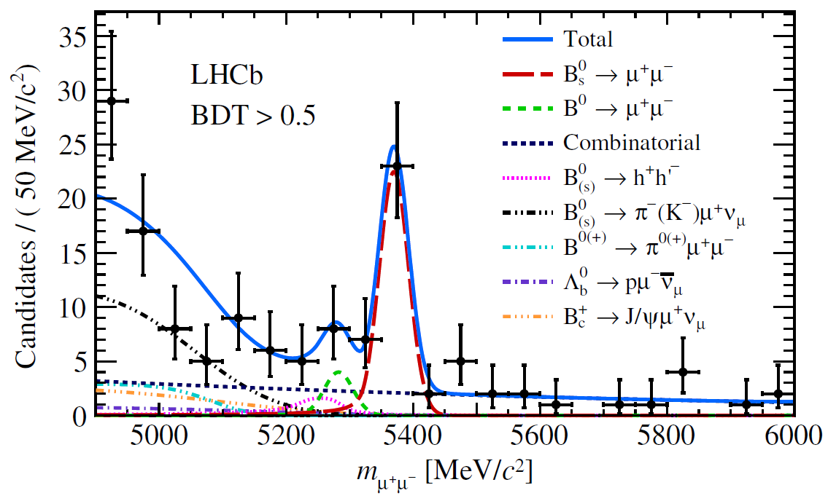
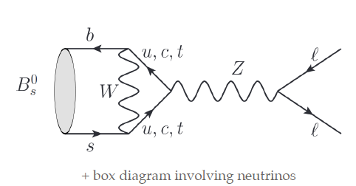
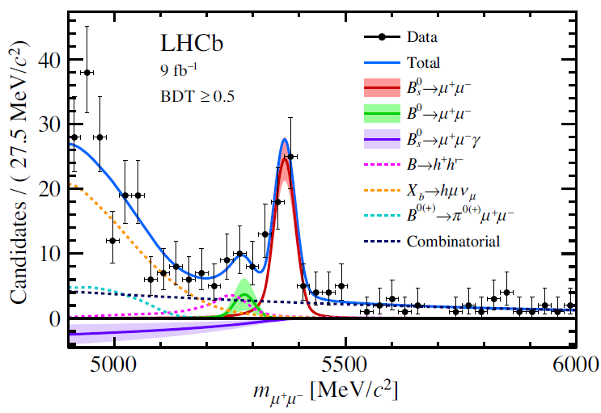
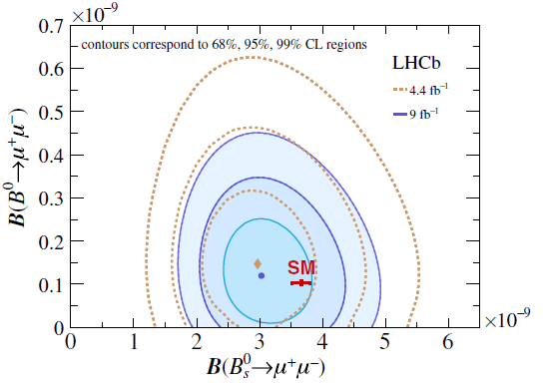
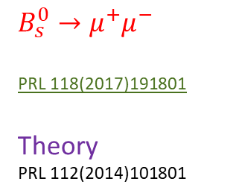

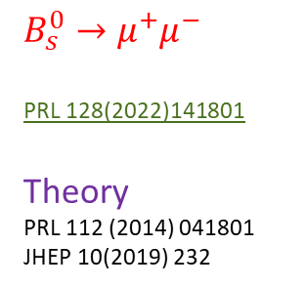
Golden Mode: Fully leptonic $B_{s}→μ^{+}μ^{−}$
Introduction
Golden Mode
Semileptonic Decays
Lepton Universality
Lepton
Flavour Violation
Summary
$$B_{s}^{0}→μ^{+}μ^{−}$$
PRL 118(2017)191801
Theory
PRL 112(2014)101801
2017
$$B_{s}^{0}→μ^{+}μ^{−}$$
PRL 128(2022)141801
Theory
PRL 112 (2014) 041801
JHEP 10(2019) 232
2022
2022

Slide 8
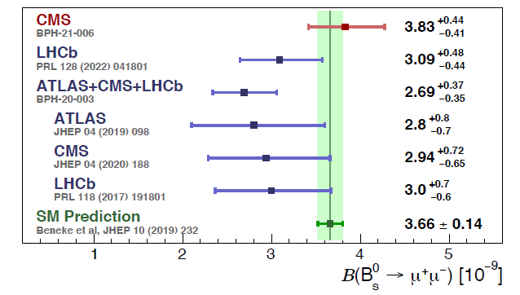
Golden Mode: Fully leptonic $B_{s}→μ^{+}μ^{−}$
See CERN Seminar 26 Jul 2022
Introduction
Golden Mode
Semileptonic Decays
Lepton Universality
Lepton
Flavour Violation
Summary
$$B_{s}^{0}→μ^{+}μ^{−}$$
PRL 118(2017)191801
Theory
PRL 112(2014)101801
2017
$$B_{s}^{0}→μ^{+}μ^{−}$$
PRL 128(2022)141801
Theory
PRL 112 (2014) 041801
JHEP 10(2019) 232
2022
One of our most important rare decay modes shows no sign of anomaly
2022

Slide 9
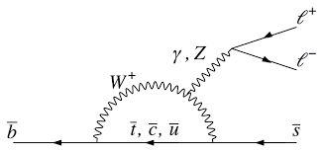

Electro-Weak Penguins
Introduction
Golden Mode
Semileptonic Decays
Lepton Universality
Lepton
Flavour Violation
Summary
FCNC
Sensitive to NP in Loops & high mass range
Fundamental test of couplings to b-quarks
Semi-leptonic decays
  Elegant (and reasonably) and “easy” to reconstruct (p, ID, low multiplicity)
  Hadrons in final and initial state (unlike )
leptons
e, μ, …
$$B_{s}→μ^{+}μ^{−}$$
Branching Fractions
“count how many you get” – consistency with SM (i.e. theory?)
Check as function of kinematics (e.g. q²= inv. mass of leptons, …)
Understand (require) hadronic corrections to interpret
“Early” and important tests

Slide 10
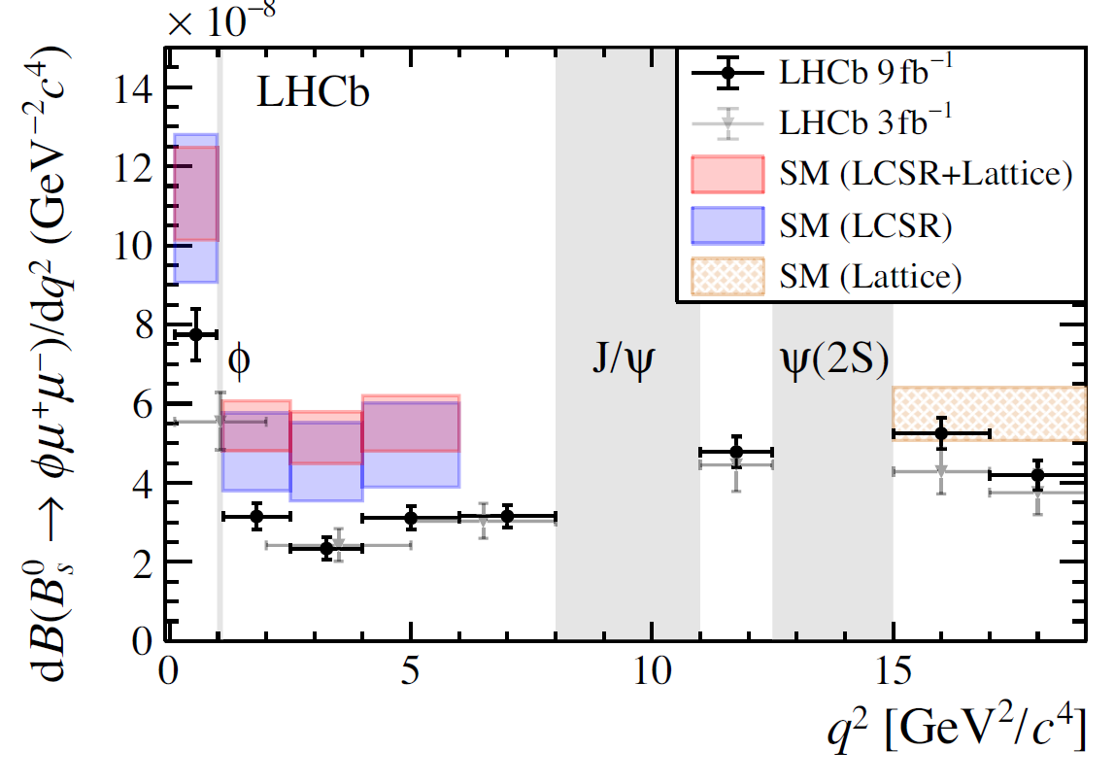
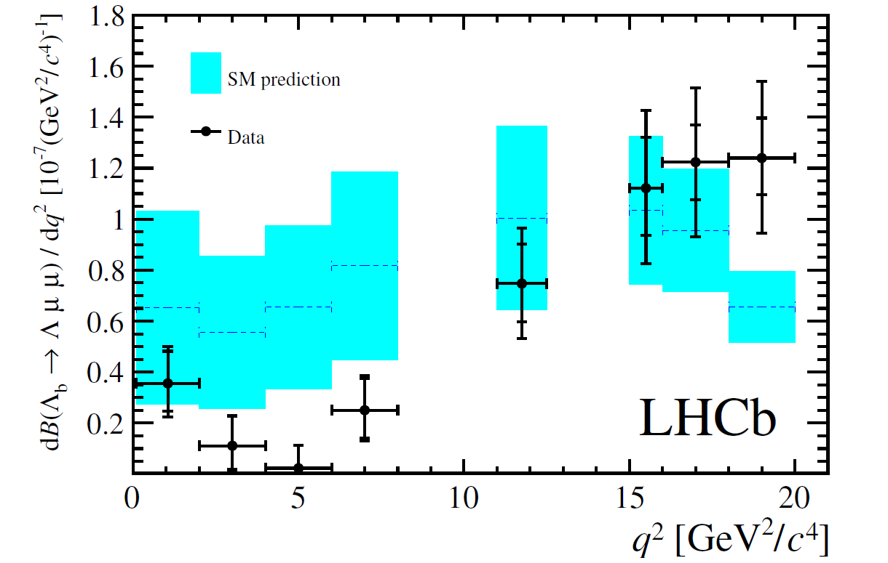
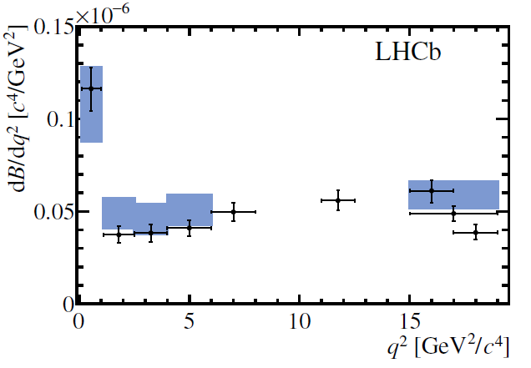
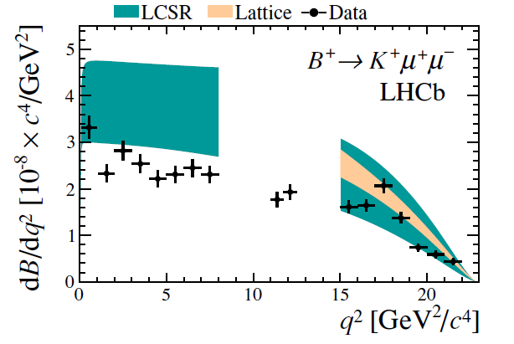
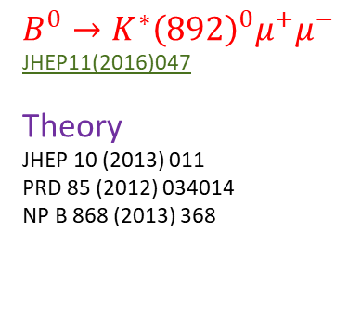
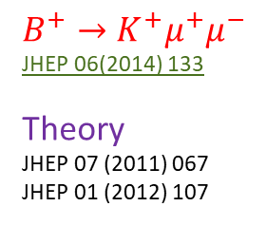
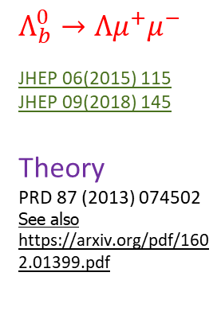
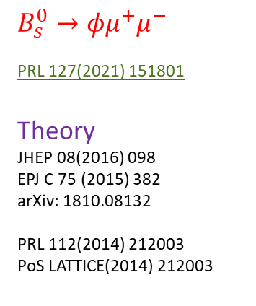
Some branching fractions (2014-2021)
Introduction
Golden Mode
Semileptonic Decays
Lepton Universality
Lepton
Flavour Violation
Summary
$$B_{s}^{0}→{φμ}^{+}μ^{−}$$
PRL 127(2021) 151801
Theory
JHEP 08(2016) 098
EPJ C 75 (2015) 382
arXiv: 1810.08132
PRL 112(2014) 212003
PoS LATTICE(2014) 212003
$$Λ_{b}^{0}→{Λμ}^{+}μ^{−}$$
JHEP 06(2015) 115
JHEP 09(2018) 145
Theory
PRD 87 (2013) 074502
See also https://arxiv.org/pdf/1602.01399.pdf
“lie below”
“3.6 σ low”
$$B^{0}→{K^{∗}{\left(892\right)}^{0}μ}^{+}μ^{−}$$
JHEP11(2016)047
Theory
JHEP 10 (2013) 011
PRD 85 (2012) 034014
NP B 868 (2013) 368
$$B^{+}→{K^{+}μ}^{+}μ^{−}$$
JHEP 06(2014) 133
Theory
JHEP 07 (2011) 067
JHEP 01 (2012) 107
“compatible with theory”
“Low but consistent”

Slide 11
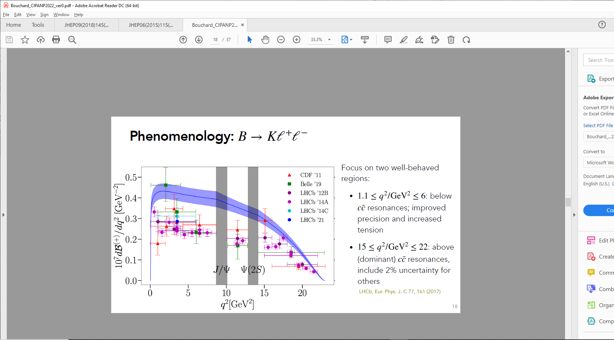
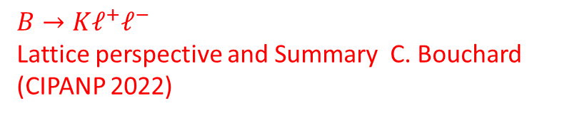

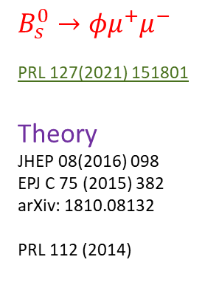

Some branching fractions (2014-2021)
LHCb, JHEP 06 (2014
Introduction
Golden Mode
Semileptonic Decays
Lepton Universality
Lepton
Flavour Violation
Summary
$$B_{s}^{0}→{φμ}^{+}μ^{−}$$
PRL 127(2021) 151801
Theory
JHEP 08(2016) 098
EPJ C 75 (2015) 382
arXiv: 1810.08132
PRL 112 (2014)
$$Λ_{b}^{0}→{Λμ}^{+}μ^{−}$$
JHEP 06(2015) 115
JHEP 09(2018) 145
Theory
PRD 87 (2013) 074502
$B→{Kℓ}^{+}ℓ^{−}$
Lattice perspective and Summary C. Bouchard (CIPANP 2022)
$$B^{0}→{K^{∗}{\left(892\right)}^{0}μ}^{+}μ^{−}$$
JHEP11(2016)047
Theory
JHEP 10 (2013) 011
PRD 85 (2012) 034014
NP B 868 (2013) 368
$$B^{+}→{K^{+}μ}^{+}μ^{−}$$
JHEP 06(2014) 133
Theory
JHEP 07 (2011) 067
JHEP 01 (2012) 107
“single experiment (LHCb ‘14A) approaching … 5σ”
See: https://arxiv.org/pdf/2207.13371.pdf

Slide 12
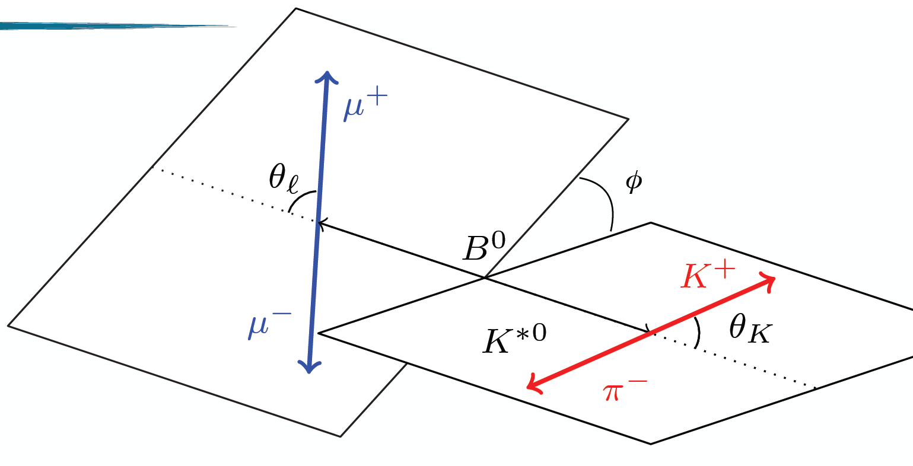


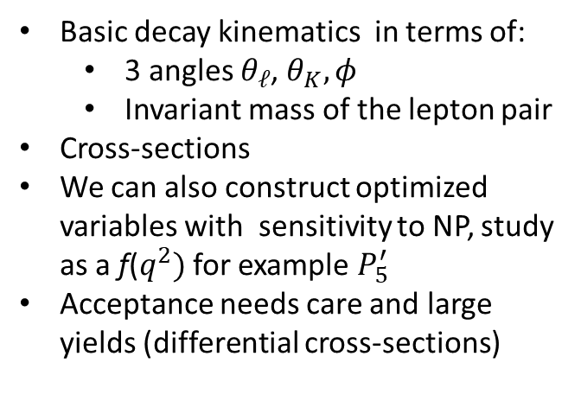
Angular Analyses - $b→sℓℓ$
Introduction
Golden Mode
Semileptonic Decays
Lepton Universality
Lepton
Flavour Violation
Summary
Basic decay kinematics in terms of:
  3 angles $θ_{ℓ}$, $θ_{K},φ$
  Invariant mass of the lepton pair
Cross-sections
We can also construct optimized variables with sensitivity to NP, study as a f($q^{2})$ for example $P_{5}^{′}$
Acceptance needs care and large yields (differential cross-sections)
e.g. $B^{0}→K^{∗0}μ^{+}μ^{−}$

Slide 13
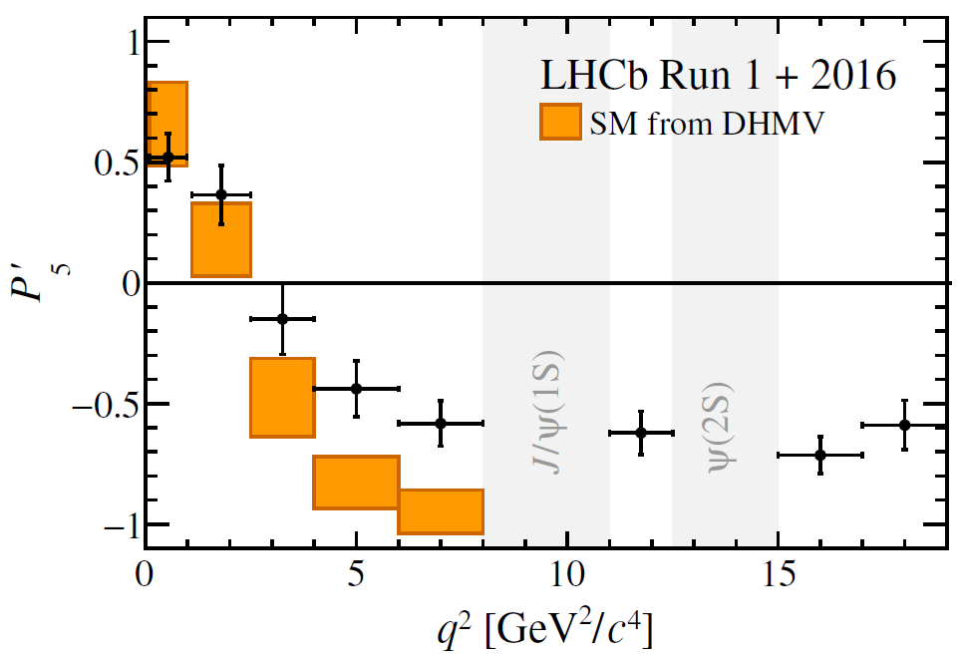
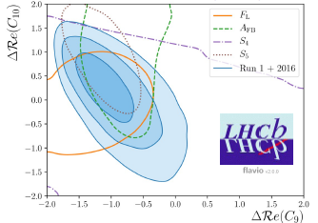
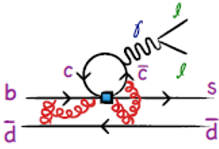

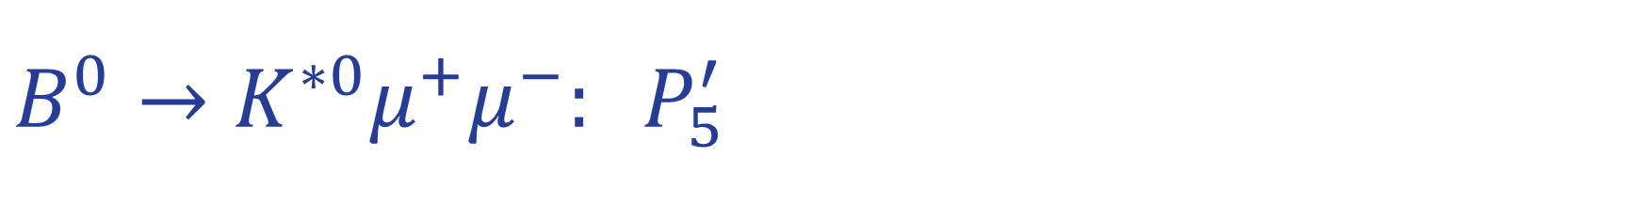
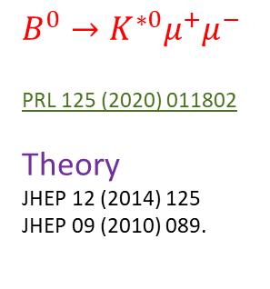
$${B^{0}→K^{∗0}μ^{+}μ^{−}: P}_{5}^{′}$$
Introduction
Golden Mode
Semileptonic Decays
Lepton Universality
Lepton
Flavour Violation
Summary
$$B^{0}→{K^{∗0}μ}^{+}μ^{−}$$
PRL 125 (2020) 011802
Theory
JHEP 12 (2014) 125
JHEP 09 (2010) 089.
“individual measurements … largely in agreement with the SM predictions”
4600 events
Charm loops?
4.7 fb⁻¹
2.7 - 3.3 σ preference for NP with negative $ℛe(\text{C}\text{9})$

Slide 14
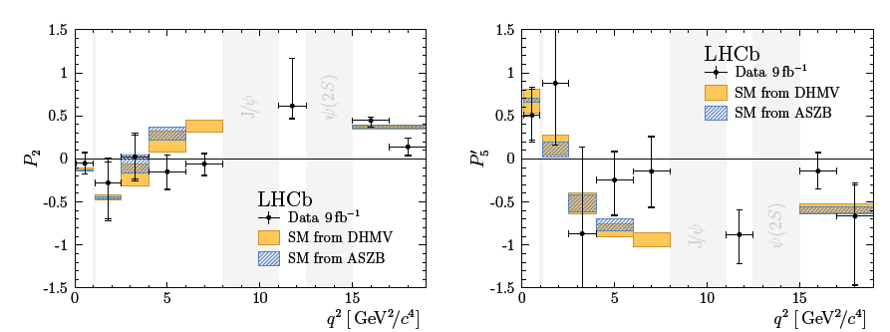
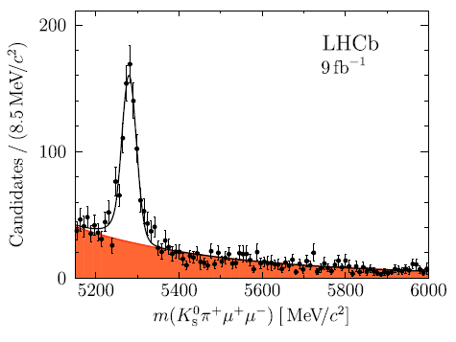
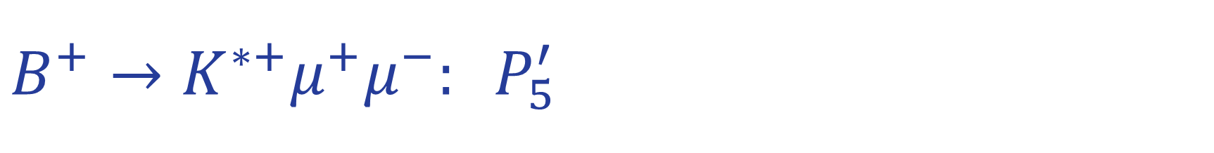
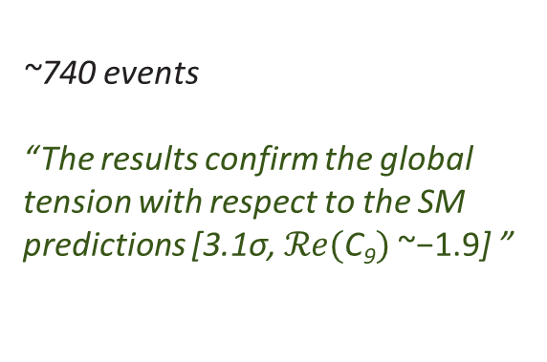
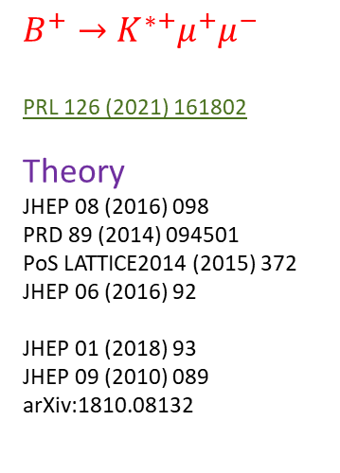
$${B^{+}→K^{∗+}μ^{+}μ^{−}: P}_{5}^{′}$$
Introduction
Golden Mode
Semileptonic Decays
Lepton Universality
Lepton
Flavour Violation
Summary
$$B^{+}→{K^{∗+}μ}^{+}μ^{−}$$
PRL 126 (2021) 161802
Theory
JHEP 08 (2016) 098
PRD 89 (2014) 094501
PoS LATTICE2014 (2015) 372
JHEP 06 (2016) 92
JHEP 01 (2018) 93
JHEP 09 (2010) 089
arXiv:1810.08132
~740 events
“The results confirm the global
tension with respect to the SM predictions [3.1σ, $ℛe(\text{C}\text{9})$ ~−1.9] ”

Slide 15
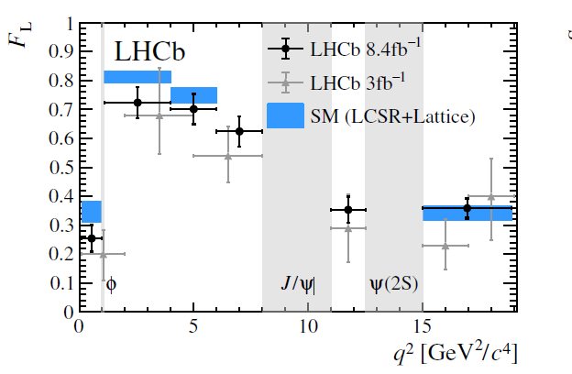
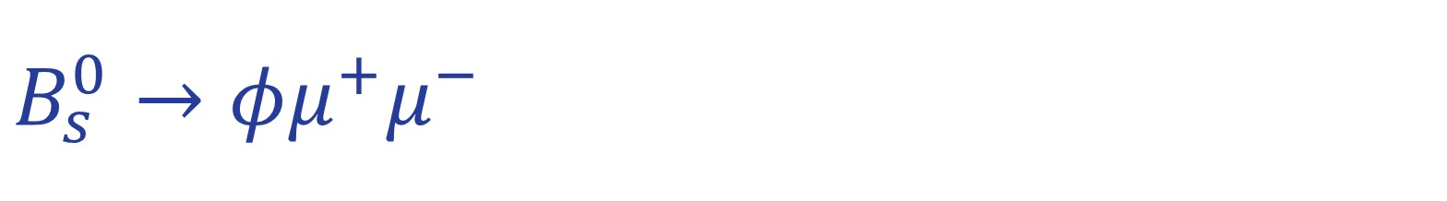
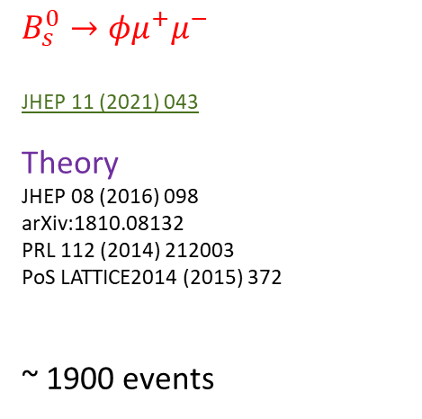
$$B_{s}^{0}→φμ^{+}μ^{−}$$
Introduction
Golden Mode
Semileptonic Decays
Lepton Universality
Lepton
Flavour Violation
Summary
$$B_{s}^{0}→φμ^{+}μ^{−}$$
JHEP 11 (2021) 043
Theory
JHEP 08 (2016) 098
arXiv:1810.08132
PRL 112 (2014) 212003
PoS LATTICE2014 (2015) 372
~ 1900 events
Angular distributions are a key tool in our search for NP
“The results are found to be compatible with SM predictions”

Slide 16


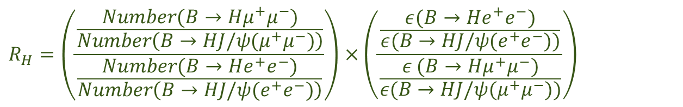
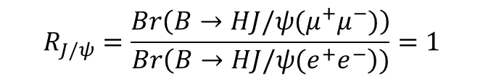
Lepton Flavour Universality: $R_{H }(b→sℓℓ)$
Introduction
Golden Mode
Semileptonic Decays
Lepton Universality
Lepton
Flavour Violation
Summary
Do electrons, muons (and taus) couple according to the SM? For electrons and muons one way has been:
Experimentally:
Minimize systematics using:
$$R_{H}=\frac{Br(B→Hμ^{+}μ^{−})}{Br(B→He^{+}e^{−})}$$
$$R_{H}=\frac{Number(B→Hμ^{+}μ^{−})}{Number(B→He^{+}e^{−})}×\frac{ε(B→He^{+}e^{−})}{ε (B→Hμ^{+}μ^{−})}$$
$$R_{J/ψ}=\frac{Br\left(B→HJ/ψ(μ^{+}μ^{−})\right)}{Br\left(B→HJ/ψ{(e}^{+}e^{−}\right))}=1$$
ratio of numbers × ratio of efficiencies
arXiv:2103.11769
$$R_{H}=\left(\frac{\frac{Number(B→Hμ^{+}μ^{−})}{Number\left(B→HJ/ψ(μ^{+}μ^{−})\right)}}{\frac{Number(B→He^{+}e^{−})}{Number\left(B→HJ/ψ(e^{+}e^{−})\right)}}\right)×\left(\frac{\frac{ε(B→He^{+}e^{−})}{ε(B→HJ/{ψ(e}^{+}e^{−}))}}{\frac{ε (B→Hμ^{+}μ^{−})}{ε(B→HJ/ψ{(μ}^{+}μ^{−}))}}\right)$$

Slide 17
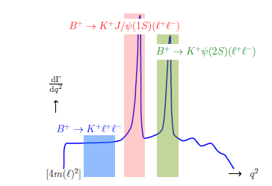
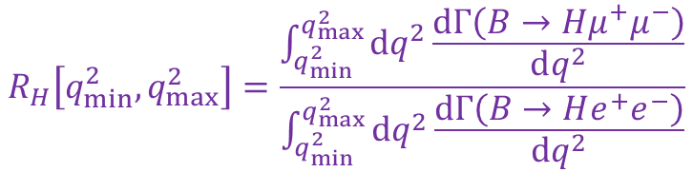
Theory Expectation
Introduction
Golden Mode
Semileptonic Decays
Lepton Universality
Lepton
Flavour Violation
Summary
$$R_{H}\left[q_{min}^{2},q_{max}^{2}\right]=\frac{\int_{q_{min}^{2}}^{q_{max}^{2}}{dq^{2}\frac{dΓ\left(B→Hμ^{+}μ^{−}\right)}{dq^{2}}}}{\int_{q_{min}^{2}}^{q_{max}^{2}}{dq^{2}}\frac{dΓ\left(B→He^{+}e^{−}\right)}{dq^{2}}}$$
R_{K, K*}
EPJ C 76 (2016) 440
“a deviation of R_{K} or R_{K∗} from 1 exceeding the 1 % level, performed along the lines of … in the region 1 GeV²<q²<6 GeV², would be a clear signal of physics beyond the Standard Model”
One has a series of complex measurements (and checks) to do…
Can use the 2S region for validation

Slide 18
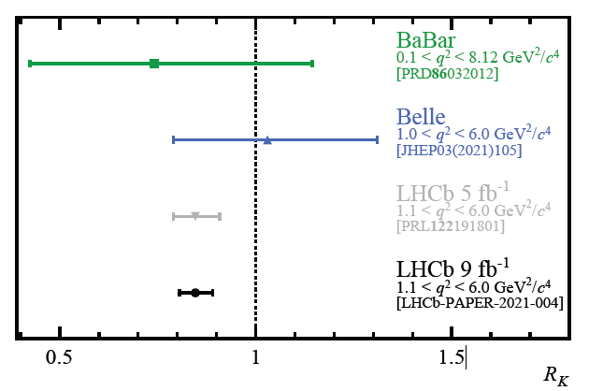
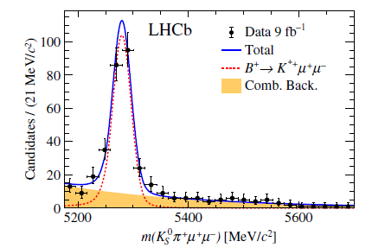
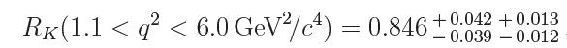
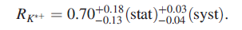








R_{H}
Introduction
Golden Mode
Semileptonic Decays
Lepton Universality
Lepton
Flavour Violation
Summary
$$R_{K^{+}}$$
Nature Phys 18 (2022) 277-282
Theory
JHEP 06 (2016) 092
JHEP 12 (2007) 040
EPJ C76 (2016) 440
arXiv:1810.08132.
arXiv:1810.08132
$$R_{K^{∗+}}$$
PRL 128 (2022) 191802
$$R_{K_{S}^{0}}$$
PRL 128 (2022) 191802
$$R_{pK^{−}}$$
JHEP 08 (2020) 040
“ measurements are individually consistent with the SM … ”

Slide 19


Status
Introduction
Golden Mode
Semileptonic Decays
Lepton Universality
Lepton
Flavour Violation
Summary
LHCb working on a unified analysis of $R_{K}$and $R_{K^{∗0}}$(isospin partners)
Final Run 1 and Run 2 results
Deeper understanding of the measurements
HIGH PRIORITY for collaboration
“We appreciate your patience”
Schmitt@ICHEP

Slide 20



Lepton Flavour Universality: $R_{H_{c} }(b→cℓν)$
Introduction
Golden Mode
Semileptonic Decays
Lepton Universality
Lepton
Flavour Violation
Summary
Look at 3rd Generation
Plentiful (CC) Decays
LFU probe
$$R_{H_{c}}=\frac{Br\left(H_{b}→H_{c}τ\overline{ν_{τ}}\right)}{Br\left(H_{b}→H_{c}ℓ\overline{ν_{ℓ}}\right)}$$
Tau decays can be either muonic or hadronic (e.g. 3 pions)
Neutrinos not detected (MC fits, special fitting)
Semileptonic decays predicted at O(%) level

Slide 21



Lepton Flavour Universality: $R_{H_{c} }$
Some results (Muonic)
  $R_{D^{∗}}=0.336±0.027 ±$ 0.030 PRL 115 (2015) 111803 (2σ from SM)
  $R_{J/ψ}=0.71±0.17 ±$ 0.18 PRL 120 (2018) 121801 (2σ from SM)
Some results (Hadronic)
  ${ R}_{D^{∗}}=0.280±0.018 ±$ 0.026 + 0.013(ext Br) PRL 120 (2018) 171802 (1σ from SM)
  $R_{Λ_{c}}=0.242±0.026 ±$ 0.040 + 0.059 (ext Br) PRL 128 (2022) 191803 (1σ from SM)
Introduction
Golden Mode
Semileptonic Decays
Lepton Universality
Lepton
Flavour Violation
Summary
new

Slide 22



Recent fits to $R_{D^{∗}}−R_{D}$
Introduction
Golden Mode
Semileptonic Decays
Lepton Universality
Lepton
Flavour Violation
Summary
arXiv:2206.07501
arXiv:2105.14019

Slide 23
Lepton Flavour (Number) Violation
Introduction
Golden Mode
Semileptonic Decays
Lepton Universality
Lepton
Flavour Violation
Summary
LFV decays super-suppressed in SM with Br O(10⁻⁵⁴)
  Loops
  Neutrino oscillations
Evidence of LFV clearly would indicate NP
LHCb has undertaken a programme of searching for flavour violating effects with electrons and muons as well as muons and taus.

Slide 24

Lepton Flavour (Number) Violation
Introduction
Golden Mode
Semileptonic Decays
Lepton Universality
Lepton
Flavour Violation
Summary
$B^{+}→K^{+}{e^{±}μ}^{∓}$ < 7.0×10⁻⁹ * Phys. Rev. Lett. 123 (2019) no.24, 241802
$B^{+}→K^{+}{μ^{±}τ}^{∓}$ < 3.9×10⁻⁵ * JHEP 06 (2020), 129
$B_{(s)}^{0}→{e^{±}μ}^{∓}$ < 1.0×10⁻⁹ * JHEP 03 (2018), 078
$B_{(s)}^{0}→{μ^{±}τ}^{∓}$ < 3.4×10⁻⁵ * Phys. Rev. Lett. 123 (2019) no.21, 211801 )
$B_{(s)}^{0}→pμ^{−}$ < O(10⁻⁸) LHCb-paper-2022-022 (in preparation - from Dordei @NUFACT)
$B^{0}→K^{∗0}$ ${μ^{±}τ}^{∓}$ < O(10⁻⁵) LHCb-paper-2022-021
$B^{0}→K^{∗0}$ ${e^{±}μ}^{∓}$ < O(10⁻⁸) LHCb-paper-2022-008 (in preparation - from Dordei @NUFACT)
$B_{s}^{0}→{{φe}^{±}μ}^{∓}$ < O(10⁻⁸) LHCb-paper-2022-008 (in preparation - from Dordei @NUFACT)
Note the tau decay modes limits https://arxiv.org/abs/2207.04005
* I have only given the higher of two numbers !

Slide 25
Evidence for NP from Anomalies
Introduction
Golden Mode
Semileptonic Decays
Lepton Universality
Lepton
Flavour Violation
Summary
LHCb opens a unique window on SM and potential BSM physics at the LHC thanks to its detector configuration
Almost all measurements are well understood within the standard model
The excitement in the muon sector (not least from g-2!) makes the tests we can perform especially important
No “obvious” signature of NP in exclusive and semileptonic decays nor in tests of lepton universality and lepton flavour violation
Global fits (not discussed here) and indications (e.g. in FCNC angular distributions) exhibit chronic tensions with SM
  (where not done already) measurements should be done with full Run 1 & 2 data
  Extended R_{K} studies a priority
More data in Run 3 (and of course other experiments add to landscape)

Slide 26


Future
Introduction
Golden Mode
Semileptonic Decays
Lepton Universality
Lepton
Flavour Violation
Summary
Extensive and exciting Physics Programme for Run 3
  Expand anomaly search to baryons?
New detector capabilities (e.g. VELO) for improved performance with new 40 MHz trigger
Example: (from Schmitt @ ICHEP22) a huge step forwards

Slide 27
Thanks
To FCCP for invitation
To my colleagues for the amazing achievement of designing, building, commissioning, operating and analysing the data from LHCb.

Slide 28
Backup

