Slide 1
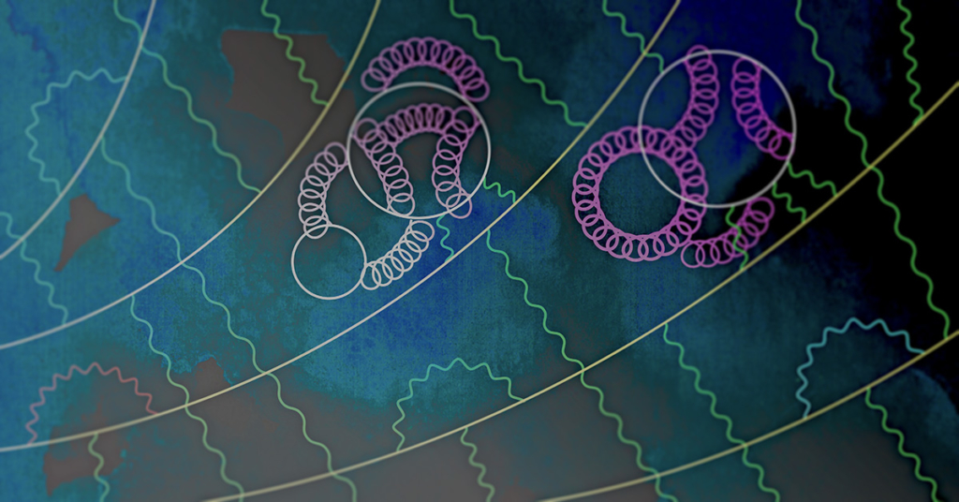
Light quark vacuum polarization contribution to the muon g-2
Tom Blum (UConn/RBRC)
FCCP 2022
Capri
September 22, 2022
Anomalous moment for the muon, Cern Courier May/June 2021
Credit: Mark Rayner/CERN

Slide 2
Outline
Hadronic Vacuum Polarization Contribution
  intermediate window
  short distance window
  long distance window
  total contribution
  isospin symmetry breaking corrections
Summary/Outlook

Slide 3
Hadronic vacuum polarization contribution from Lattice QCD
Calculate C(t) on 4d
Euclidean space-time lattice
RBC/UKQCD 2018
Notes:
Euclidean space time lattice for HVP, quarks props: large sparse matrix, gluons: MC integration of gauge fields

Slide 4
Outline
Hadronic Vacuum Polarization Contribution
  intermediate window
  short distance window
  long distance window
  total contribution
  isospin symmetry breaking corrections
Summary/Outlook

Slide 5
Intermediate window
Light quark connected only
Isospin symmetric world

Slide 6
(slide: C. Lehner, muon g-2 TI 5th Plenary Workshop, Edinburgh 2022)

Slide 7
RBC/UKQCD 2018
Window Method
Fig.: G. Colangelo, PWA12/ATHOS7 2021
Fig.: RBC/UKQCD 2018

Slide 8
From Aubin et al. talk at the 2019 Muon g-2 TI workshop in Seattle

Slide 9
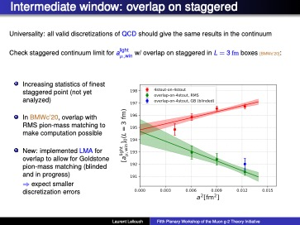
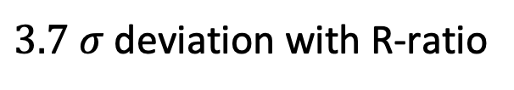
BMWc (talk by L. Lellouch)
$3.7 σ$ deviation with R-ratio
blinded

Slide 10
ABGP (talk by T. Blum)
(HISQ fermions (staggered))
SRHO model
NLO SChPT
NNLO SChPT
R-ratio
R-ratio
Compatible with BMW; NNLO SChPT no good
SRHO model and NLO SChPT about the same
but different values in continuum limit
Need smaller lattice spacing
Issue: no reliable calc. of corrections!
𝑎_{𝜇}^{𝑊1,lqc} = 206.8(2.2) × 10⁻¹⁰

Slide 11
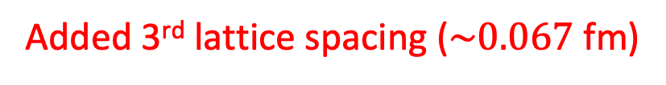
RBC/UKQCD (talk by C. Lehner)
(Domain wall fermions)
Added 3rd lattice spacing ($\sim 0.067$ fm)

Slide 12
RBC/UKQCD (talk by C. Lehner)
(Domain wall fermions)
8 different combinations of currents, Z factors,
weighting functions fit simultaneously to
common continuum limit

Slide 13
RBC/UKQCD (talk by C. Lehner)
(Domain wall fermions)

Slide 14
Mainz (talk by S. Kuberski)
(Wilson-clover fermions)
(includes s,c,b,disconnected,IB)

Slide 15
ETMc (talk by G. Gagliardi)
(Twisted mass fermions)

Slide 16
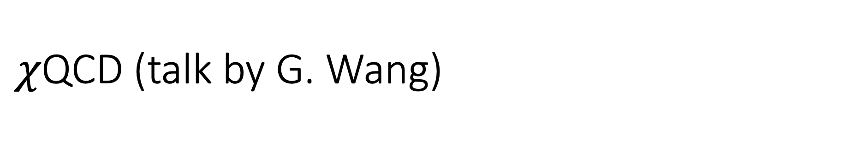
$χ$QCD (talk by G. Wang)
(Overlap fermions)

Slide 17
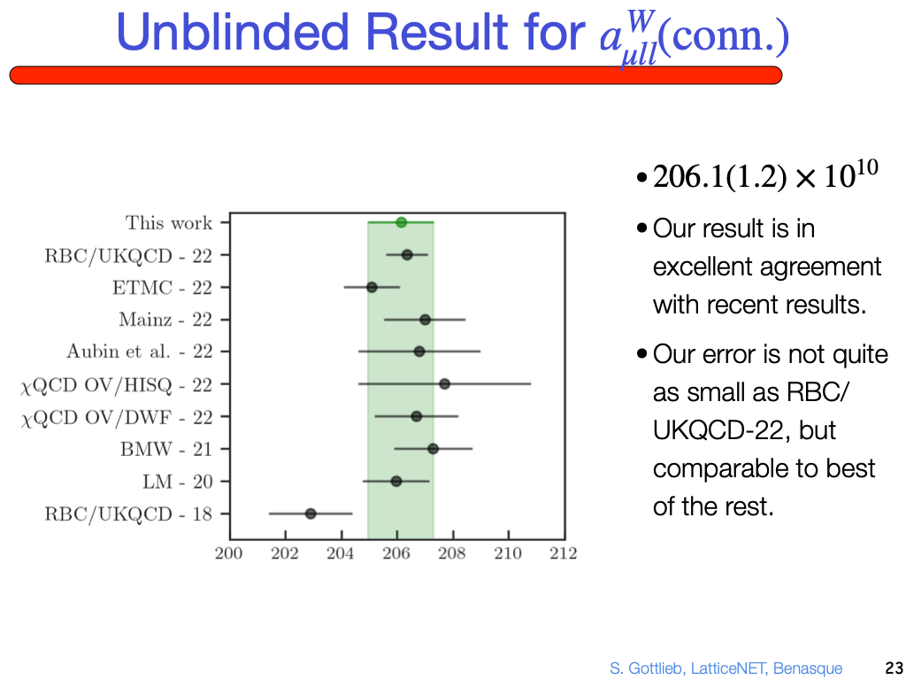
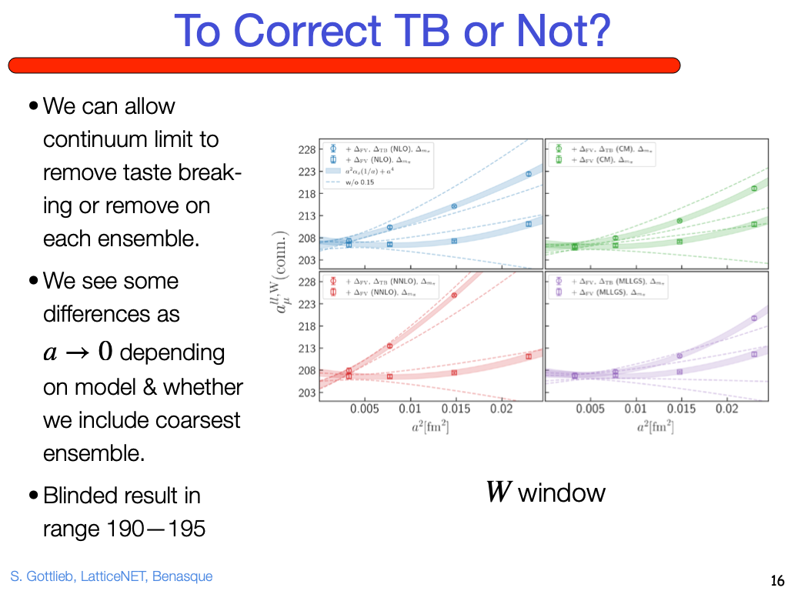
Fermilab-HPQCD-MILC (talk by S. Gottlieb)
(HISQ fermions (staggered))

Slide 18
Summary of Intermediate Window Results
Colangelo et al. 2022 shifted by -29.10 for strange, etc. from RBC/UKQCD 2018
Discrepancy between lattice and R-ratio of size 6-7 x 10⁻¹⁰
(about ½ of total between BMW and R-ratio)

Slide 19
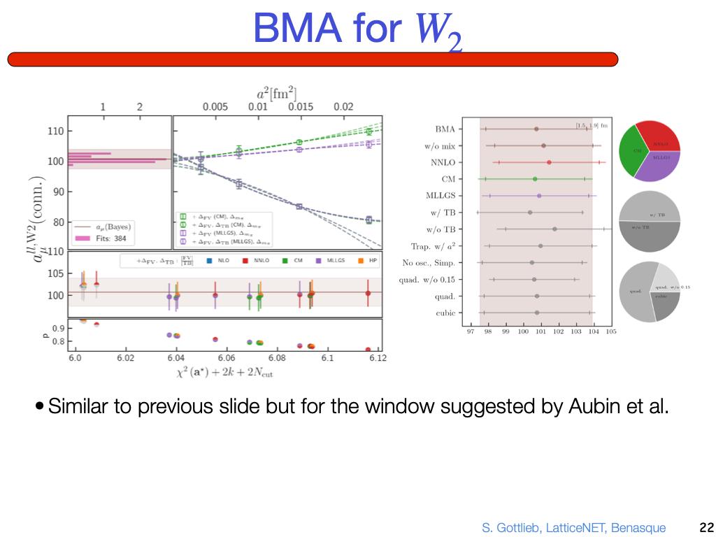
A second window
𝑎_{𝜇}^{𝑊2,lqc} = 102.1(2.4) × 10⁻¹⁰
𝑎_{𝜇}^{𝑊2,lqc} ~ 100.8(3.2) × 10⁻¹⁰
(my guess from plot)

Slide 20
Outline
Hadronic Vacuum Polarization Contribution
  intermediate window
  short distance window
  long distance window
  total contribution
  isospin symmetry breaking corrections
Summary/Outlook

Slide 22
RBC/UKQCD (talk by C. Lehner)

Slide 23
ETMc (talk by G. Gagliardi)
+ s, c, b, IB, disconnected
Light quark, connected

Slide 24
Outline
Hadronic Vacuum Polarization Contribution
  intermediate window
  short distance window
  long distance window
  total contribution
  isospin symmetry breaking corrections
Summary/Outlook

Slide 25
Long distance contribution: Low Mode Average
(LMA: Neff et al., Giusti et al., Degrand and Schaefer)
Degenerate light quark contribution (u+d)
ABGP 19
m_{π} =133 MeV
m_{π} =129 MeV
(figure: S. Kuberski, g-2 TI 2022, Edinburgh)
RBC/UKQCD 18, ABGP 19, 22, BMWc 20, FHM, Mainz, …
(C(t) averaged over all EM current source-sink pairs)

Slide 26
Long Distance Contribution: spectral reconstruction
Mainz, RBC/UKQCD 2019 (see S. Kuberski, Muon g-2 TI talk, Edinburgh)
m_{π}=129 MeV
(figure: S. Paul, Lattice 2022)

Slide 27
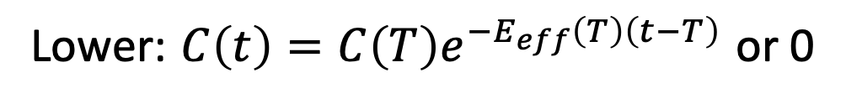
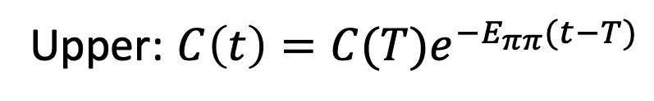
Long Distance Contribution: bounding method
Impose strict upper and lower bounds on C(t) for t > T:
Upper: $C\left(t\right)=C(T)e^{−E_{ππ}(t−T)}$
Lower: $C\left(t\right)=C\left(T\right)e^{−E_{eff}\left(T\right)\left(t−T\right)}$ or 0
Original method: RBC/UKQCD, BMWc
Mainz-19, RBC/UKQCD: Improved method
using long distance correlator reconstruction
T
T
(figure: A. Meyer, RBC/UKCD)
t/a
t/a
LMA + spectral reconstruction + bounding method = sub-percent statistical errors on total

Slide 28
Outline
Hadronic Vacuum Polarization Contribution
  intermediate window
  short distance window
  long distance window
  total contribution
  isospin symmetry breaking corrections
Summary/Outlook

Slide 29
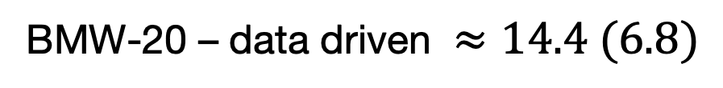
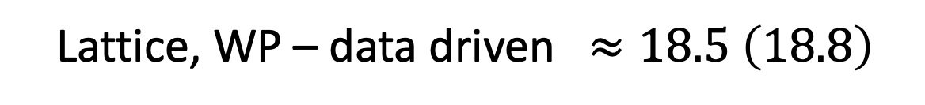
a_{μ}-HVP Summary (TI WP 2020+)
(0.75%)
HVP (BMW-20): a_{μ} = 707.5 (5.5) x 10⁻¹⁰
(2.6%)
HVP (Lattice, WP): a_{μ} = 711.6 (18.4) x 10⁻¹⁰
(0.58%)
HVP (data driven): a_{μ} = 693.1 (4.0) x 10⁻¹⁰
Lattice, WP – data driven $≈18.5 \left(18.8\right)$
BMW-20 – data driven $≈14.4 (6.8)$
29

Slide 30
Disconnected contributions
Improving, but can be further cleaned up

Slide 31
ABGP (talk by T. Blum)

Slide 32
ABGP (talk by T. Blum)

Slide 33
Total HVP Contribution Summary

Slide 34
Outline
Hadronic Vacuum Polarization Contribution
  intermediate window
  short distance window
  long distance window
  total contribution
  isospin symmetry breaking corrections
Summary/Outlook

Slide 35
RBC/UKQCD (talk by M. Bruno)
$\sim +7$x10⁻¹⁰ discrepancy with e⁺e⁻ R-ratio determination

Slide 36
Outline
Hadronic Vacuum Polarization Contribution
  intermediate window
  short distance window
  long distance window
  total contribution
  isospin symmetry breaking corrections
Summary/Outlook

Slide 37
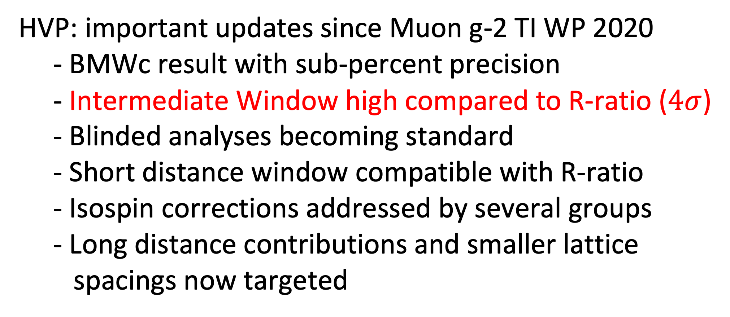
Summary/Outlook
HVP: important updates since Muon g-2 TI WP 2020
- BMWc result with sub-percent precision
- Intermediate Window high compared to R-ratio ($4σ$)
- Blinded analyses becoming standard
                - Short distance window compatible with R-ratio
                - Isospin corrections addressed by several groups
                - Long distance contributions and smaller lattice
                spacings now targeted

Slide 38
Acknowledgements
Work partially supported by US Department of Energy (DOE)
Computations done on
  ALCF at Argonne (MIRA) and OLCF at Oakridge under ALCC (US DOE)
  Bridges2 at PSC, Expanse at SDSC, and Stampede2 at TACC under XSEDE (US NSF)
  USQCD KNL cluster at JLAB (US DOE)

