Slide 1
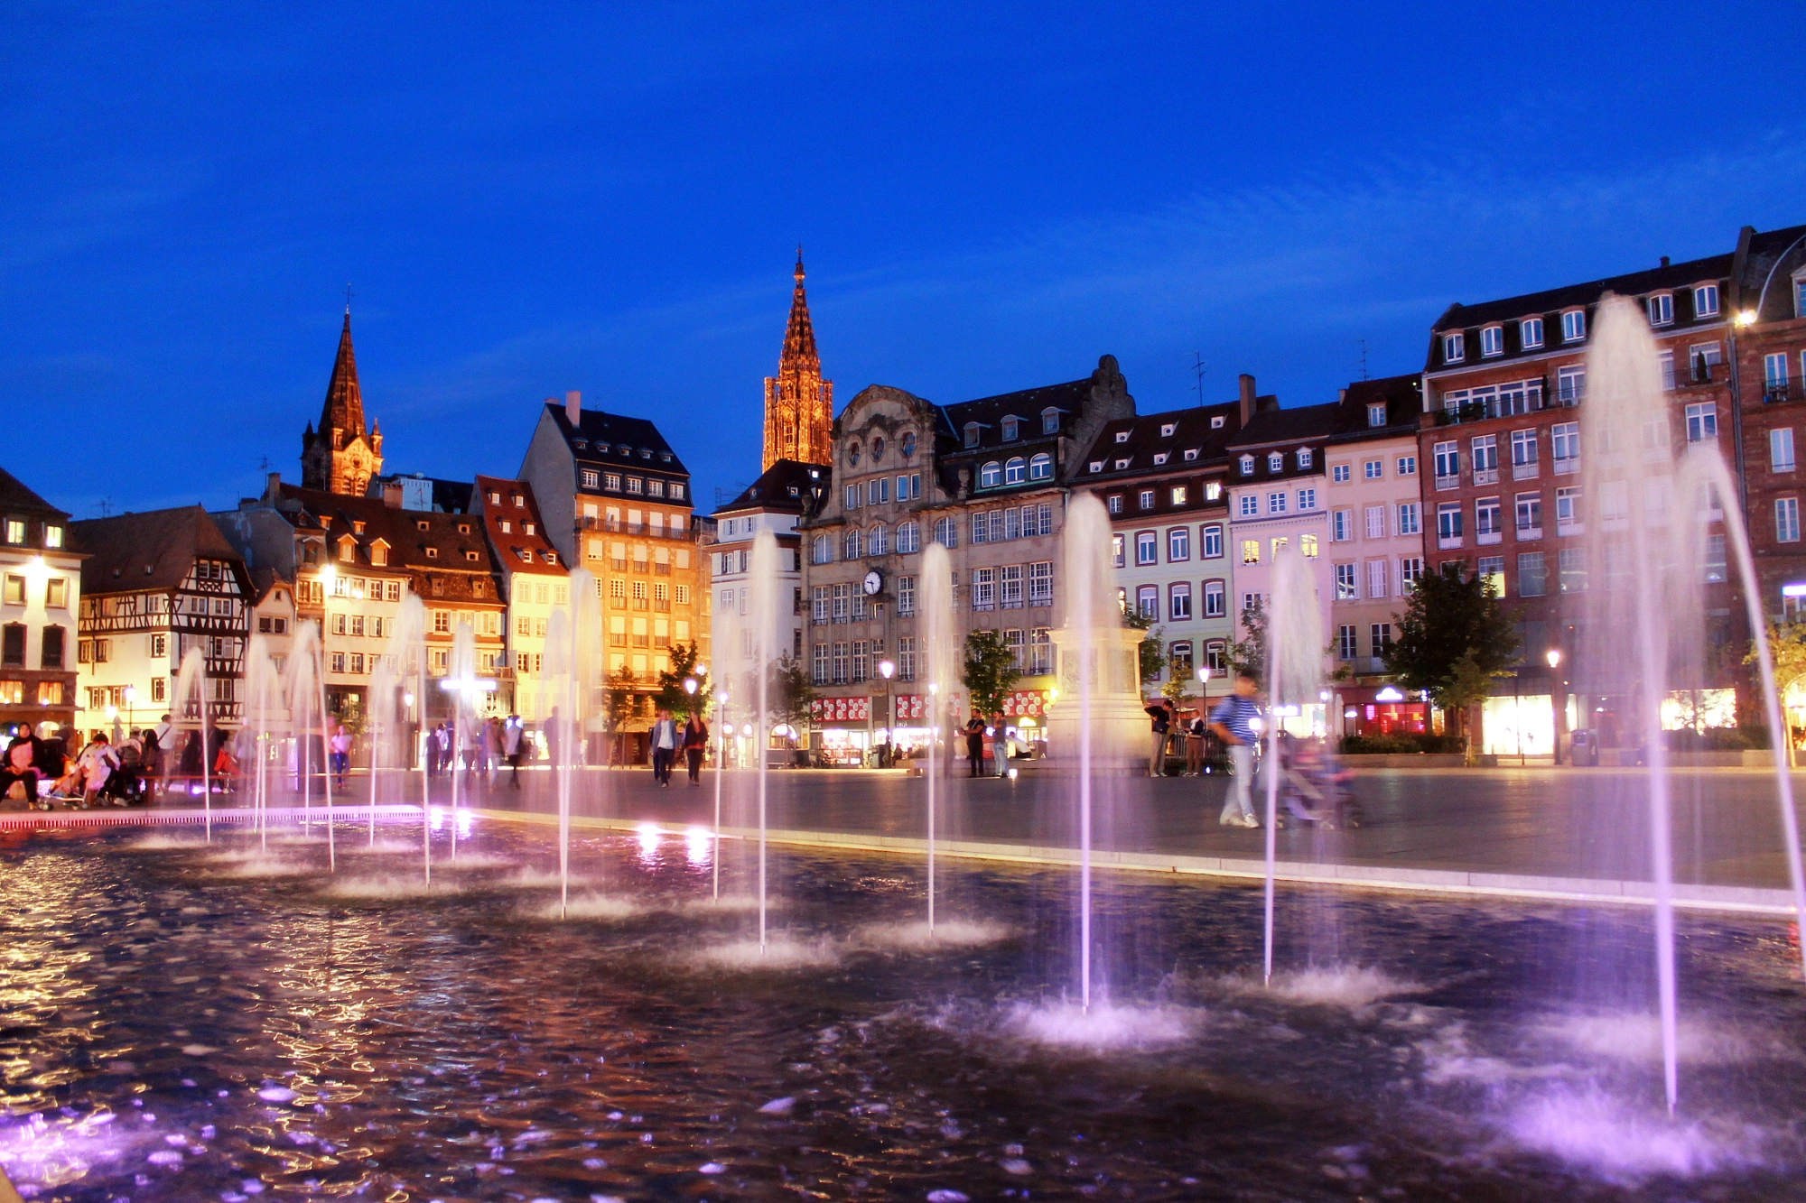
Welcome Address
XII Foot General meeting
Strasbourg, 30th may-1st june 2022
M. Villa

Slide 2
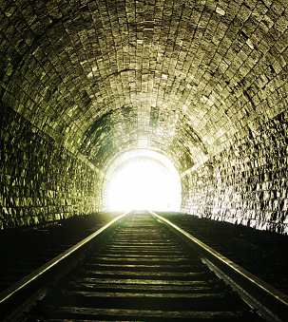
Recent meeting’s history
VIII FOOT Collaboration Meeting, Strasbourg, Virtual
  10 Jun - 12 Jun 2020
IX FOOT Collaboration Meeting, Strasbourg, Virtual
  09 Dec - 11 Dec 2020
X FOOT Collaboration Meeting, Strasbourg, Virtual
  24 May - 26 May 2021
XI FOOT Collaboration Meeting, Pavia, in presence
  29 Nov - 30 Nov 2021
Thanks to Marie and Chris for organizing all our recent general meetings !!

Slide 3
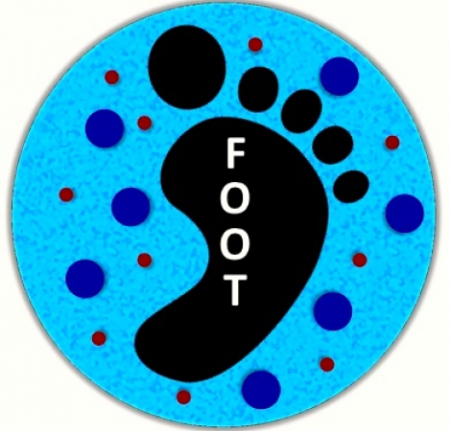
Where we are with our electronic set-up ?
Magnet ordered, but not yet produced (problems!)
→ Holding mechanics delayed
IT modules being assembled
CALO to be completed in 2022
We look forward to perform
in 2022 2023 the first data
taking with the full e set-up

Slide 4
Data, tools and analyses
Data takings
  We have performed many calibration studies for single detectors
  We have complete data sets that await the completion of the analysis
  More data sets are coming in the future (HIT, CNAO, LNS?, … to be defined …)
Software tools
  Continuously progressing, both for the electronic and emulsion set-ups, but the progress does not keep up with the data takings
Analyses
  Several analyses are ongoing, but the man-power in this field is scarse.
  We now have to move towards full tracking and cross section measurements: almost everything is now in place

Slide 5
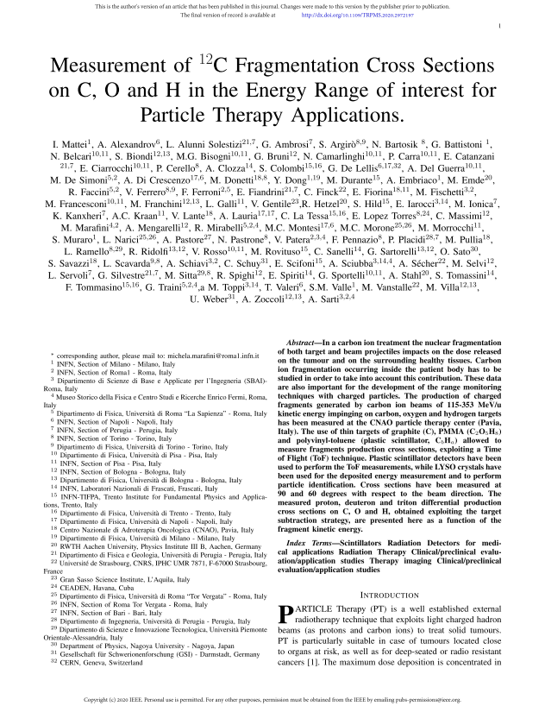
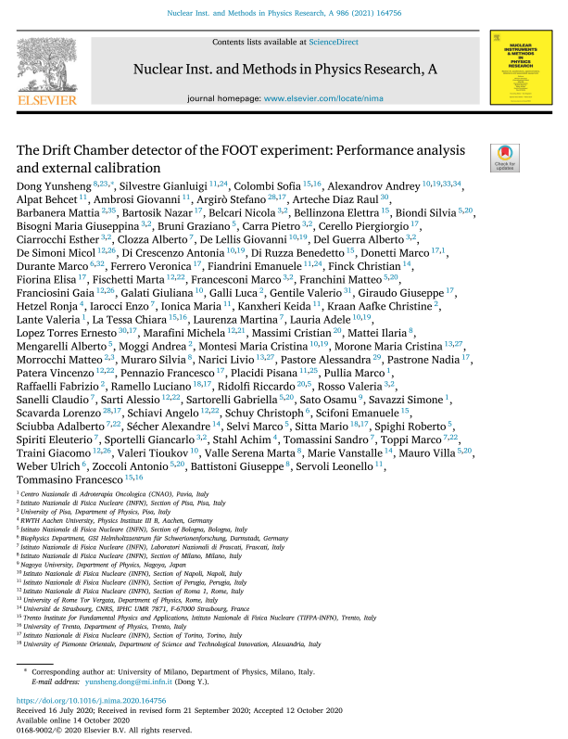
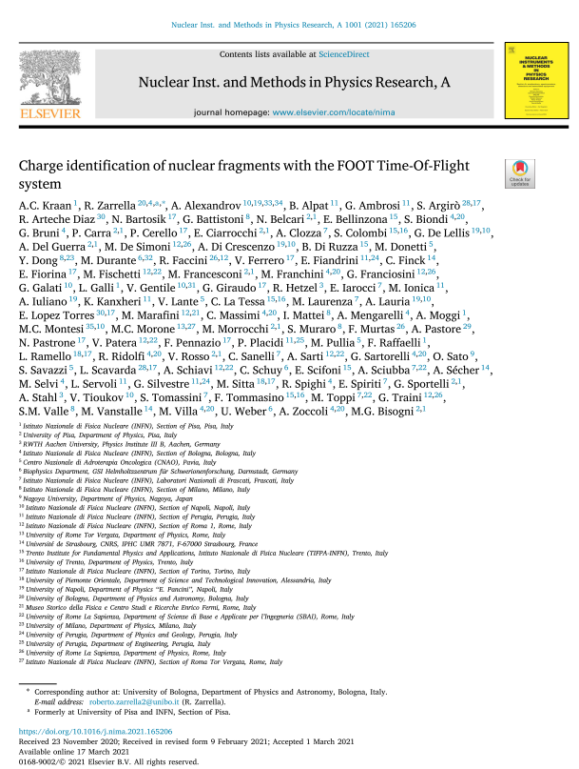
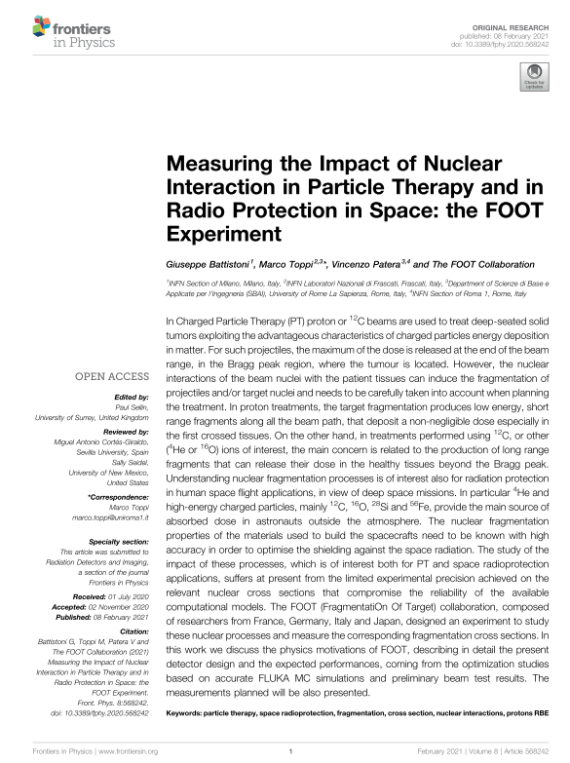
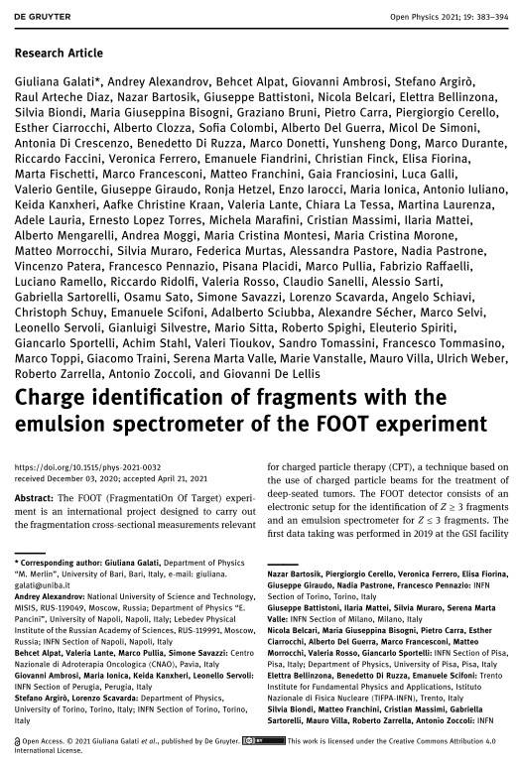
Future and organization
Next data takings
  Heidelberg, ⁴He, July 2022
  CNAO exp Hall: measurement in autumn without magnet
  CNAO exp Hall: measurement with full set-up in 2023
  IBPER proposal: p, ⁴He, C, O @ 50 – 800 MeV/u (2023-24)
Responsabilities
  Some adjustments on responsabilities needed: more info during the meeting
Publications
  It is time to be even more focused on publication.
  We are now in the condition to increase
  the article writings.

Slide 6
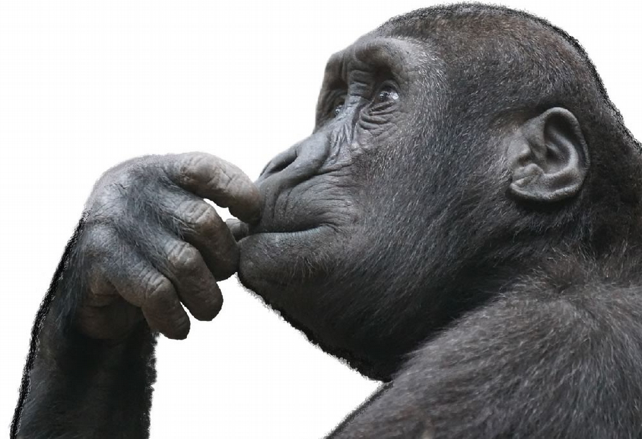
Future developments
Wednesday
  (short term plans) 1 h discussion on preparation of the measures at Heidelberg.
  (long term plans) 1h discussion on the outlook of FOOT
    Approach (PT, SRP), physics (neutrons, heavier beams/target, others?), cross section measurements, their use, their interpretation!
  Man power issue!
PRINs, ERC, FIS, Early researcher grants ….
  We always have to be ready for the next bunch of funding programs (including: «Dipartimenti eccellenti», PNRR…). The number of PhD bourses is increasing: let’s not miss this opportunity!

Slide 7
And now let the meeting begin!
Speakers: please upload your contribution to indico in advance!

