Slide 1
FOOT (FragmentatiOn Of Target ) pixel tracker status
FOOT electronic setup
The magnet system
The FOOT Vertex detector
New VTX daq interface board
Inner Tracker ( IT ) status (end of may, 2022)
Conclusions

Slide 2
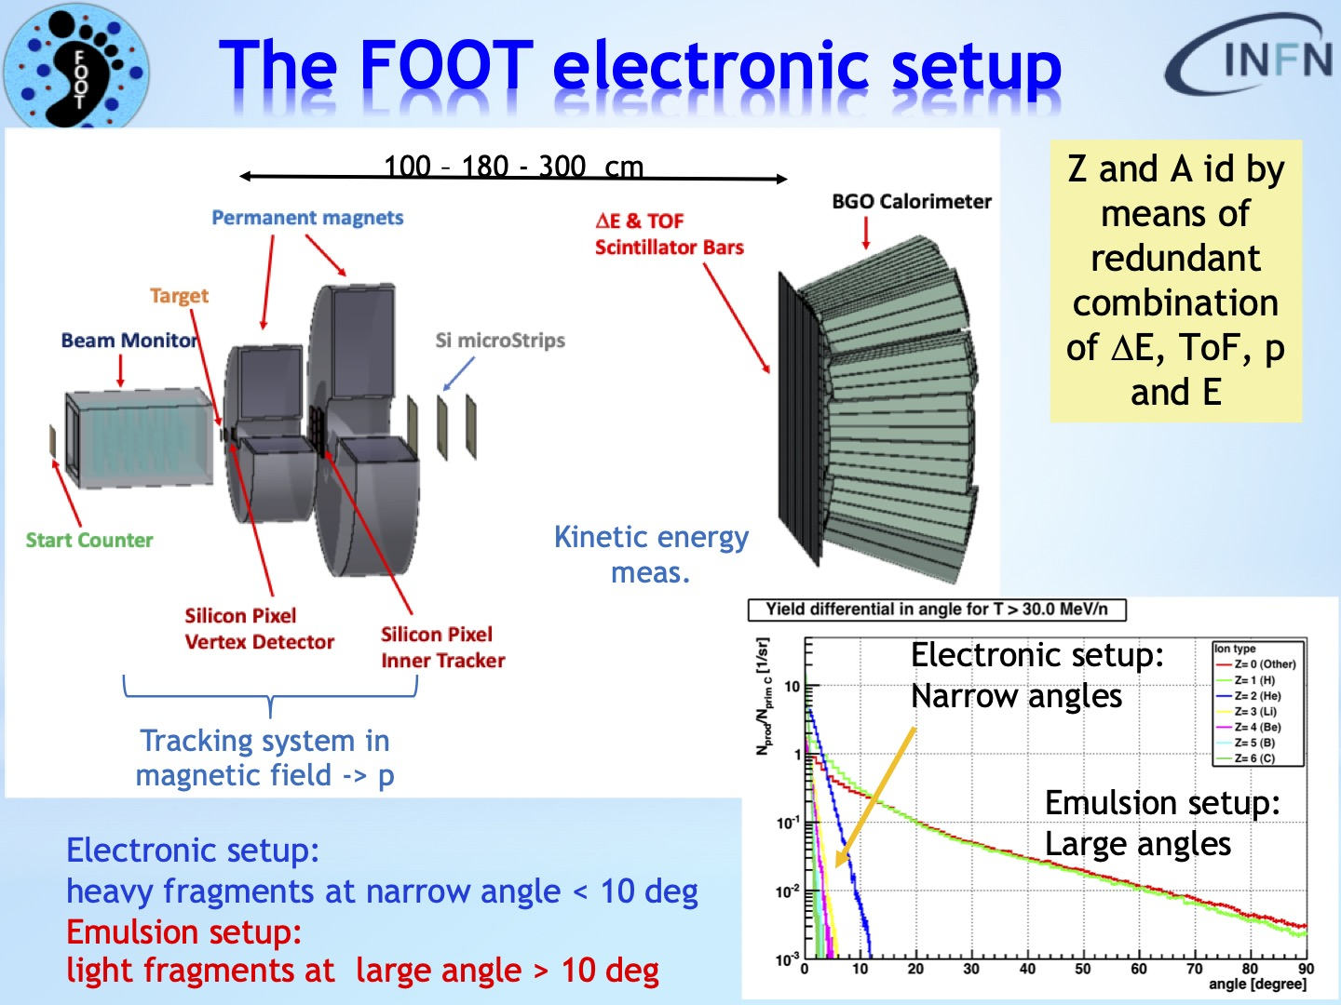

Slide 3
Magnetic system
 |  |  |  |  | Radianti | Gradi
Lvtx | 3,00 |  | 0,179 | Accettanza M1 (gradi) | 0,177 | 10,12
L1 | 11,00 |  | 0,177 | Accettanza M2 (gradi) | 0,175 | 10,02
Lit | 5,00 |  | 0,171 | Accettanza MSD (gradi) | 0,169 | 9,70
L2 | 11,00 |  | 0,171 | Accettanza IT1 (gradi)
Lmsd | 1,00 |  |  | Accettanza IT2 (gradi)
Rin1 | 2,50
Rin2 | 5,30
Dmsd | 9,00
ITdist | 1,00
05/12/2019
3

Slide 4
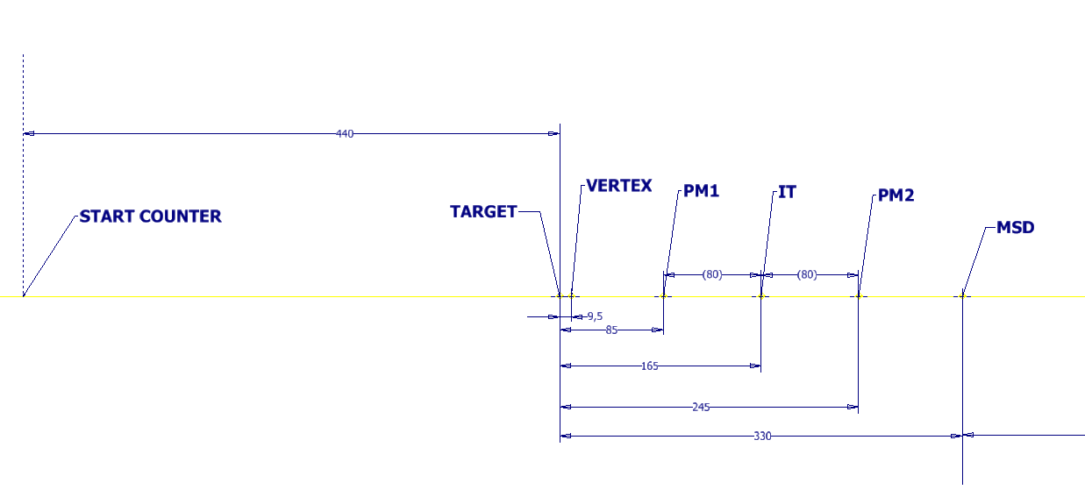
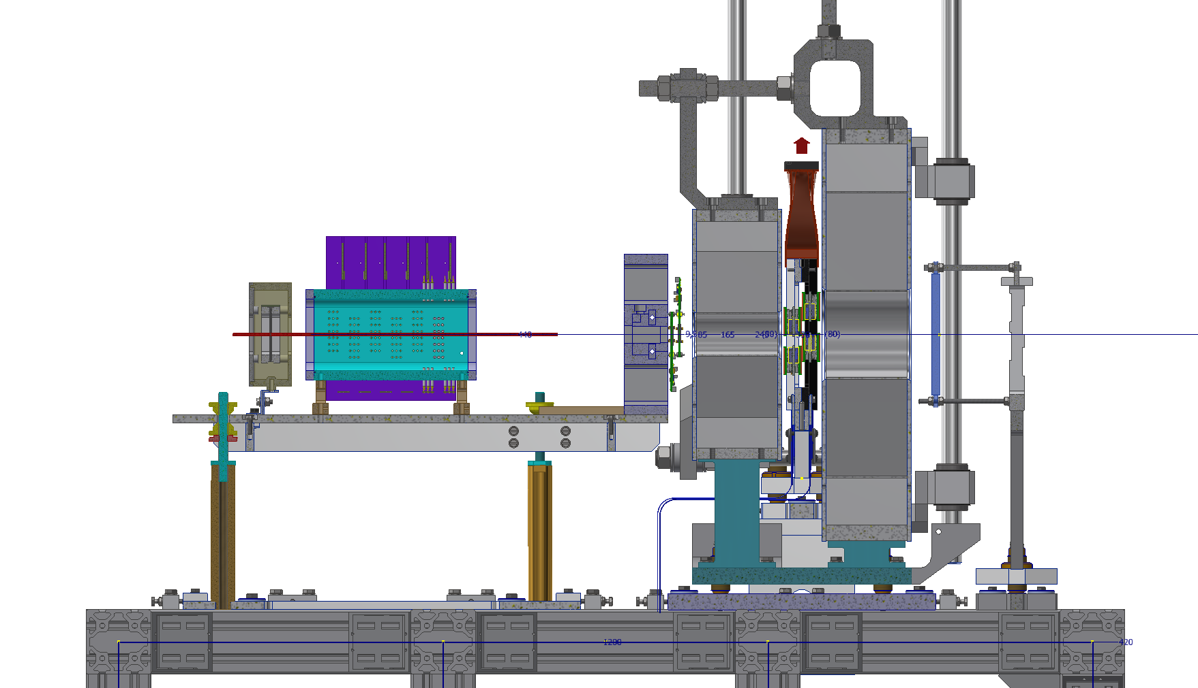
FOOT Tracking region
Mechanical Layout:
designer
Sandro Tomassini
 | Z [mm]
TARGET | 0
VERTEX | 9.5
PM1 | 85
IT | 165
PM2 | 245
MSD | 330
S. COUNTER | - 440

Slide 5
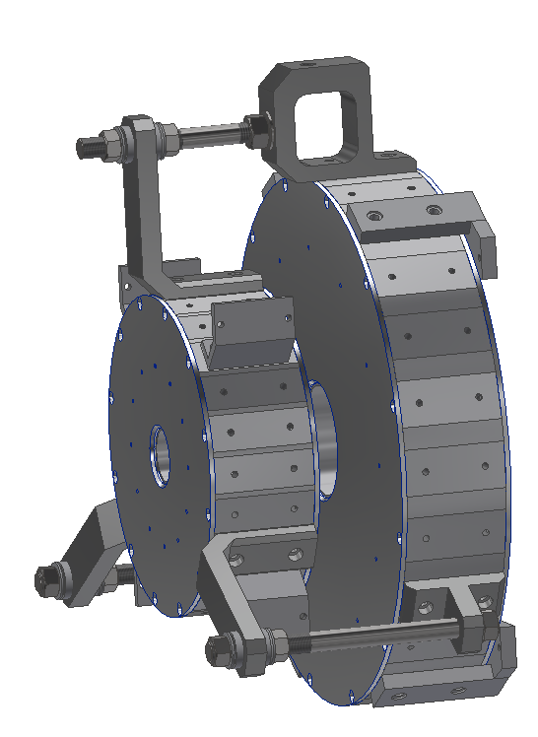
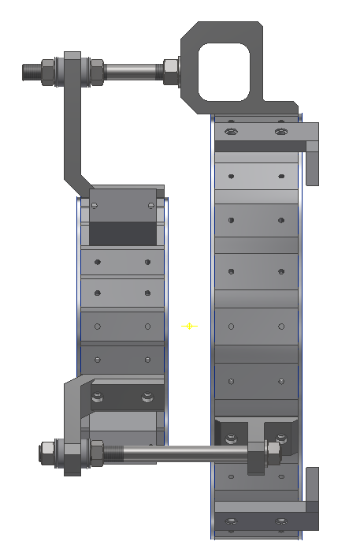
Two Permanent Magnet Dipoles in one assembly to avoid handling issues (special toolings required for safe handling)
Repulsion force: 2000 N @ 50 mm gap
Weight: 250 kg
Magnetic field aligned at the vendor
Magnetic map to be checked
at LNF after delivery
S. Tomassini, INFN-LNF- Research Division

Slide 6
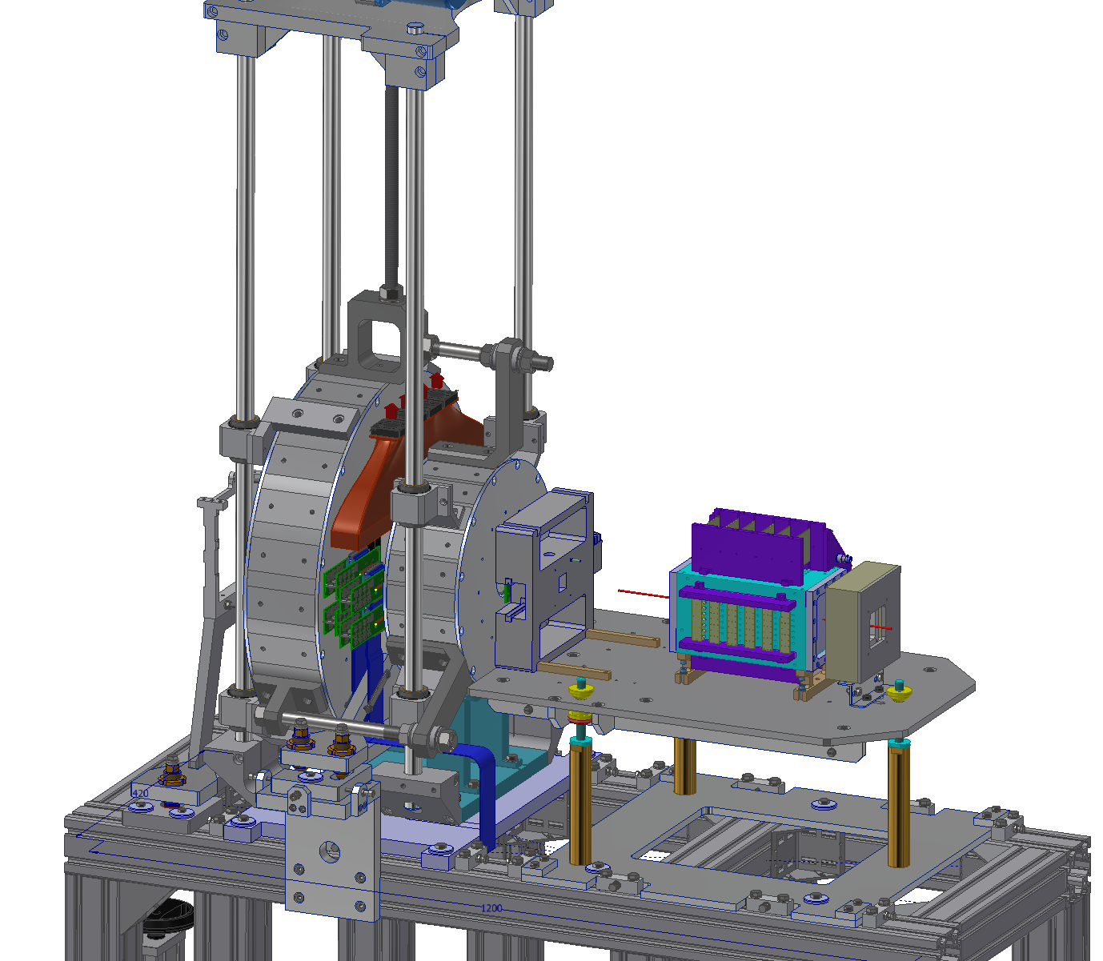
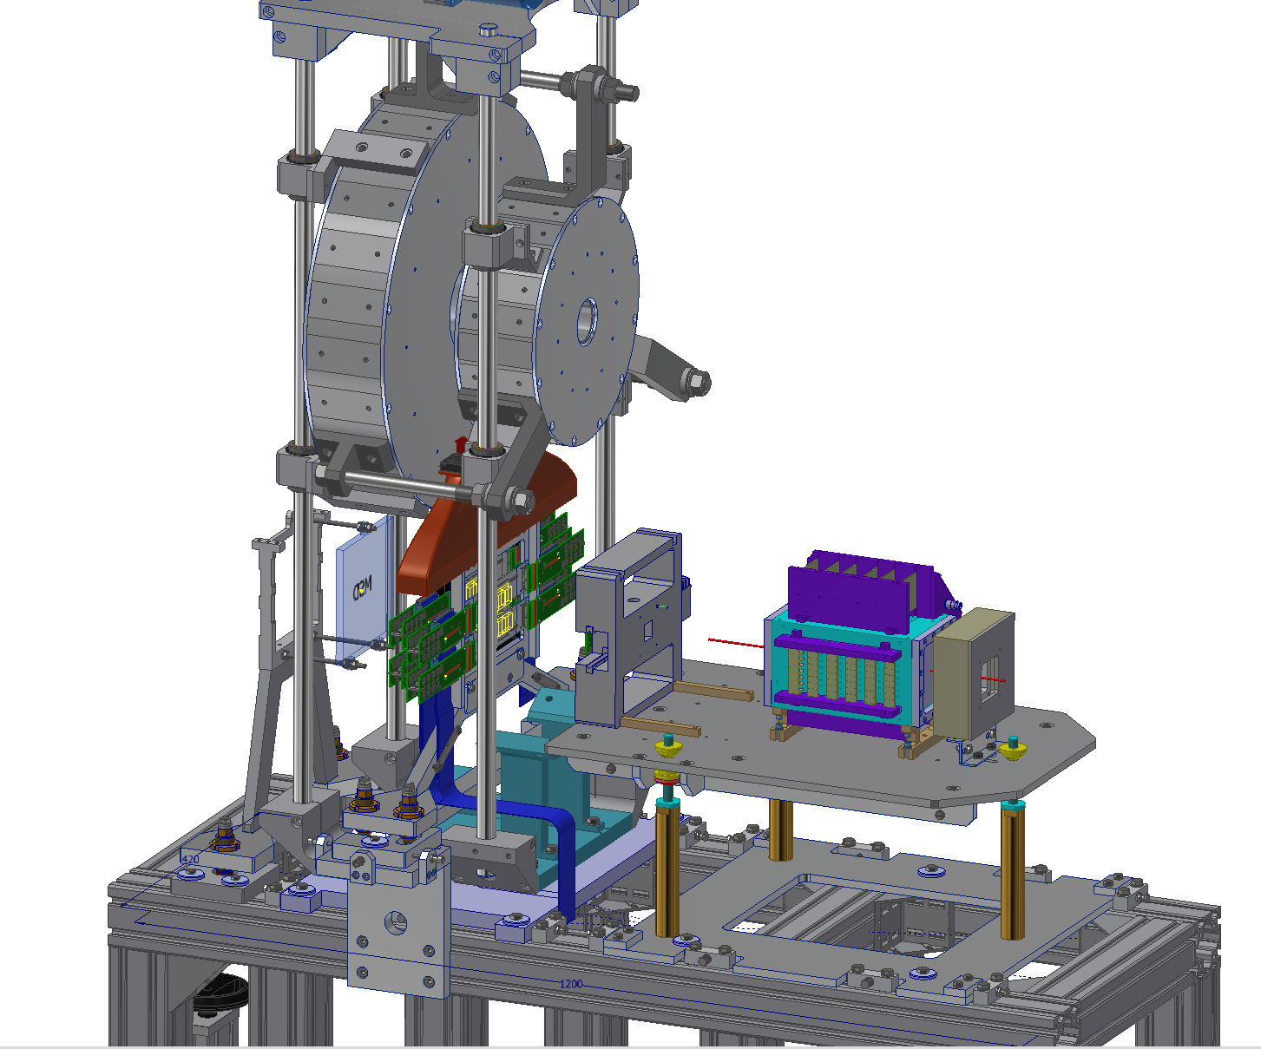
Calibration with straight tracks
Magnet offset compatible with detector cabling

Slide 7
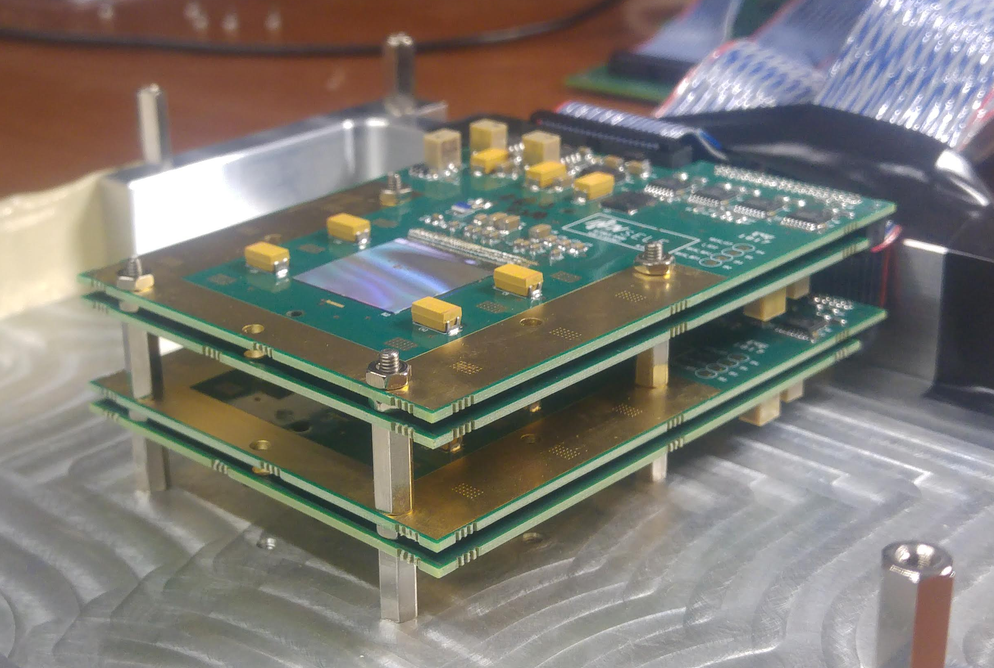
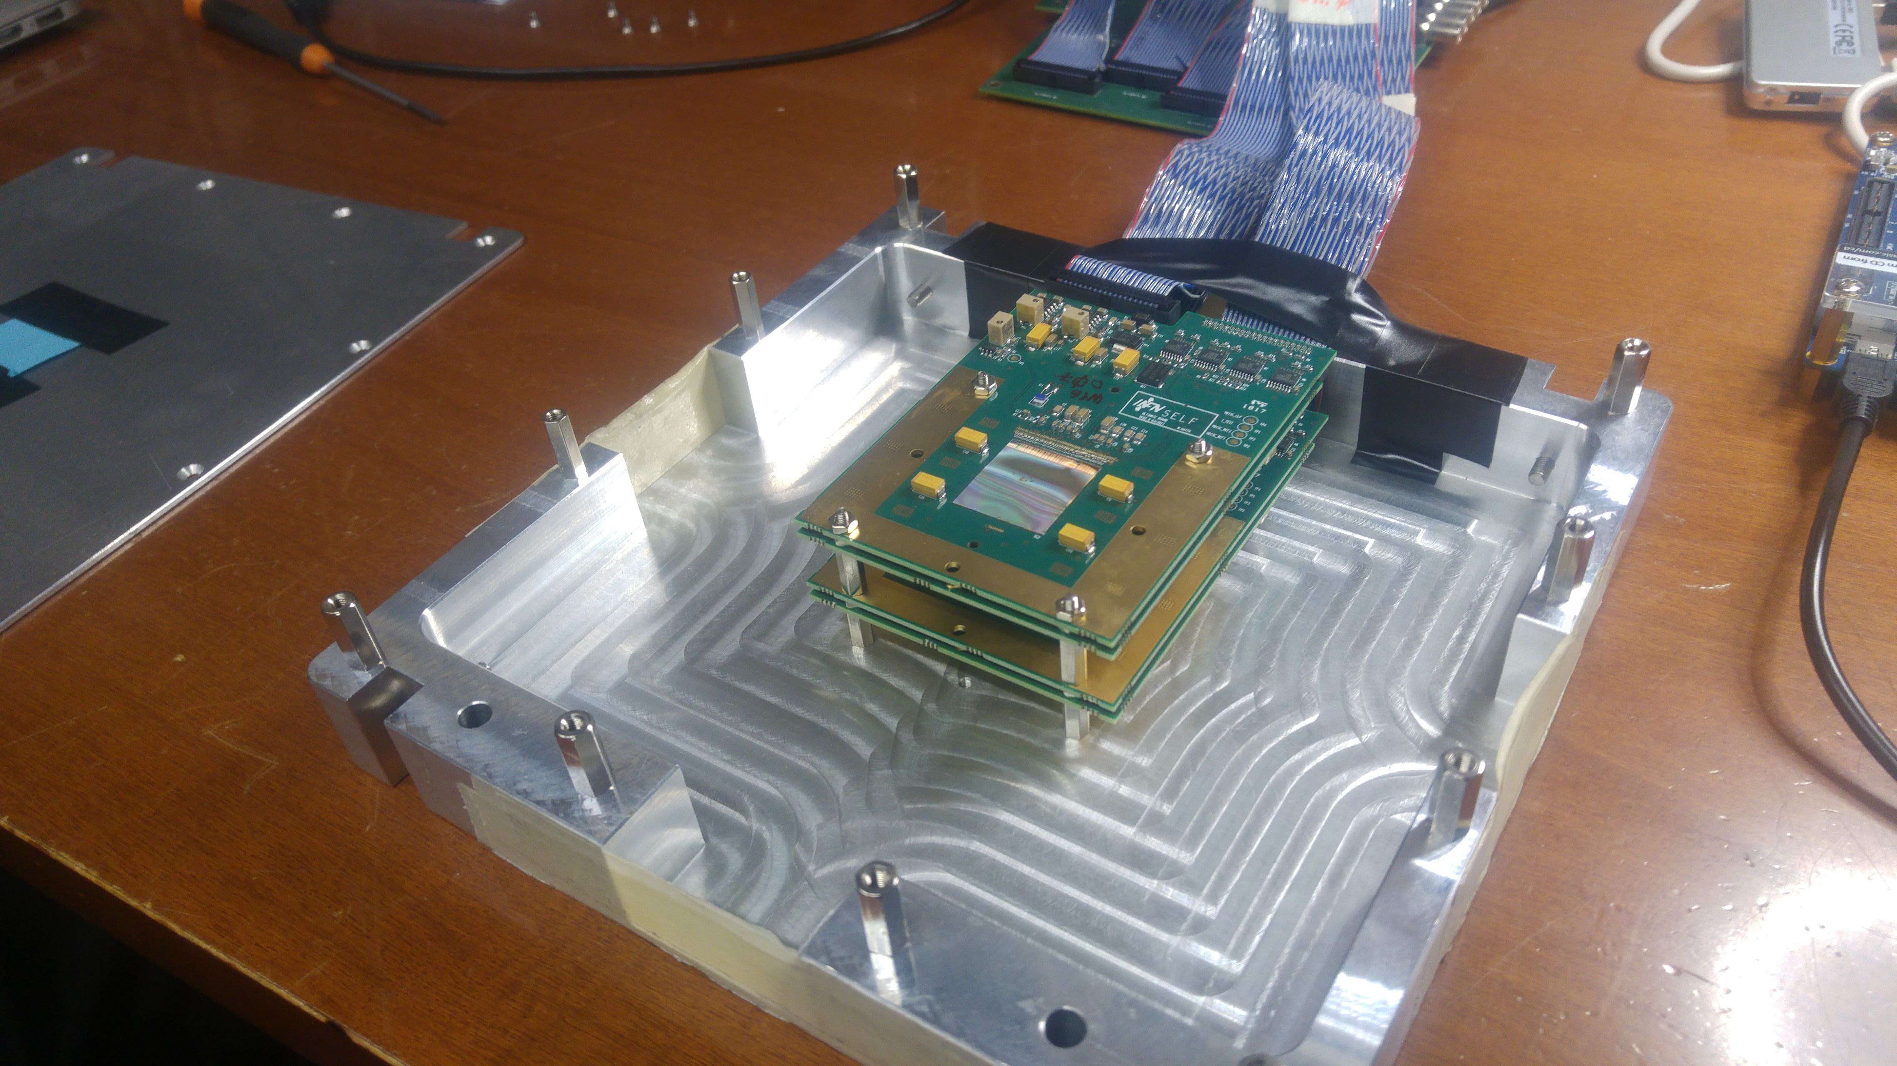
FOOT Vertex Tracker
Four Ultimate boards, designed in Frascati (SEA), sensors glued and bonded in Strasbourg (IPHC - In2p3)
Already used for data taking at GSI (Darmstadt)
Already used for data taking at PADME (see next slide) IN VACUUM

Slide 8
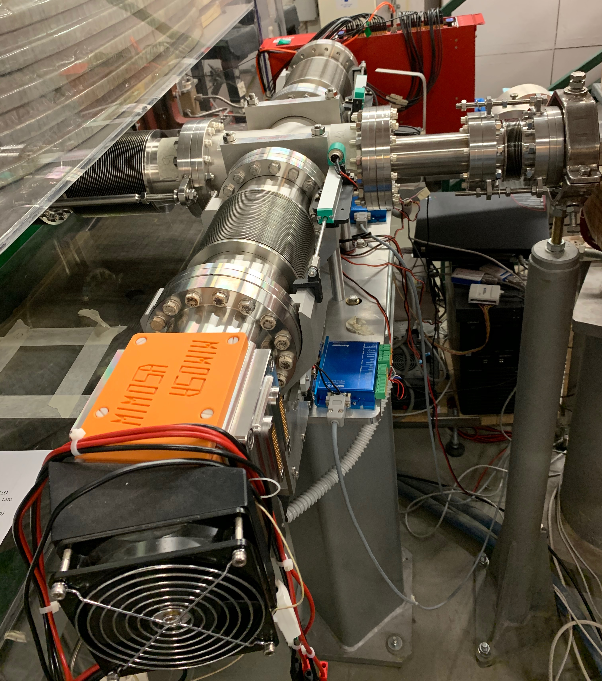
Vertex: results from PADME
PADME beam line
M28 signal connector
Cooling fan

Slide 9
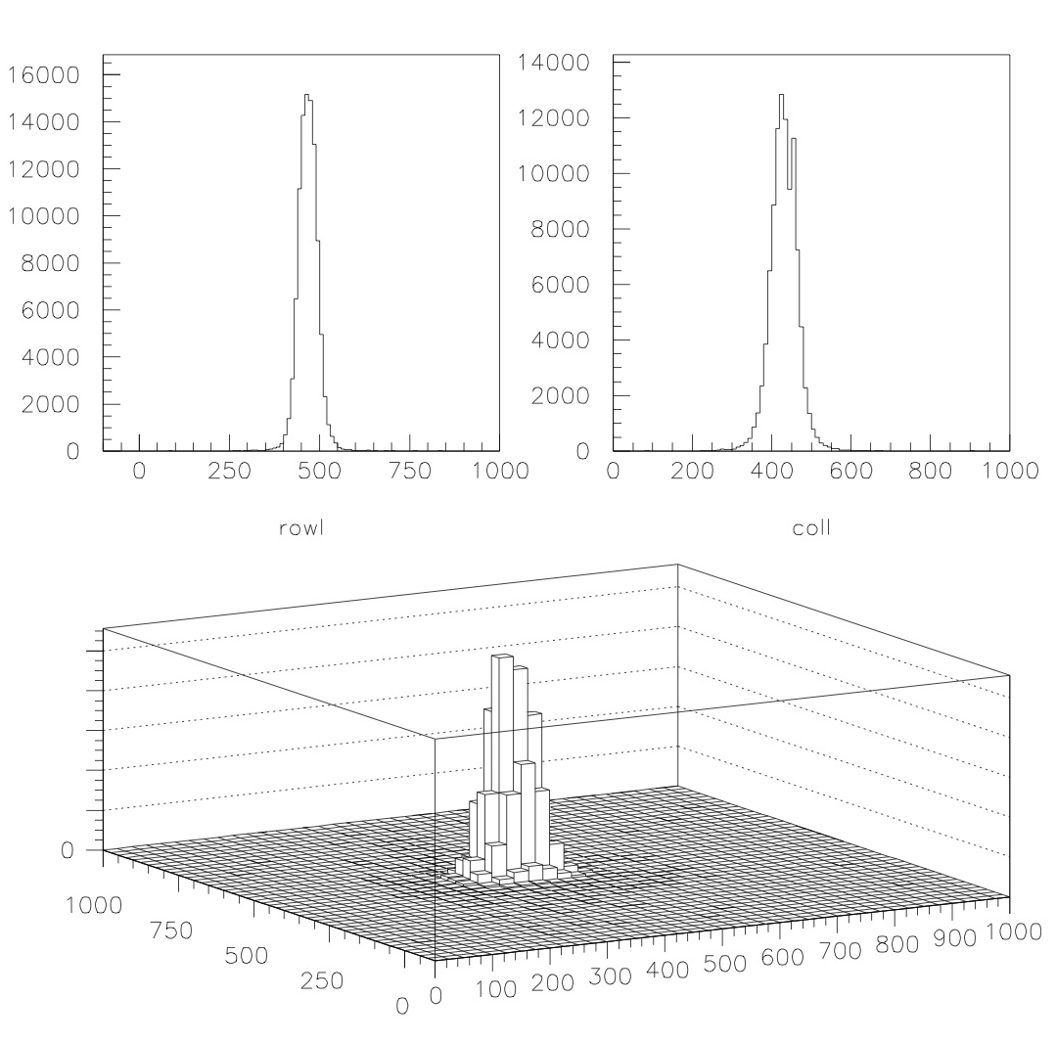
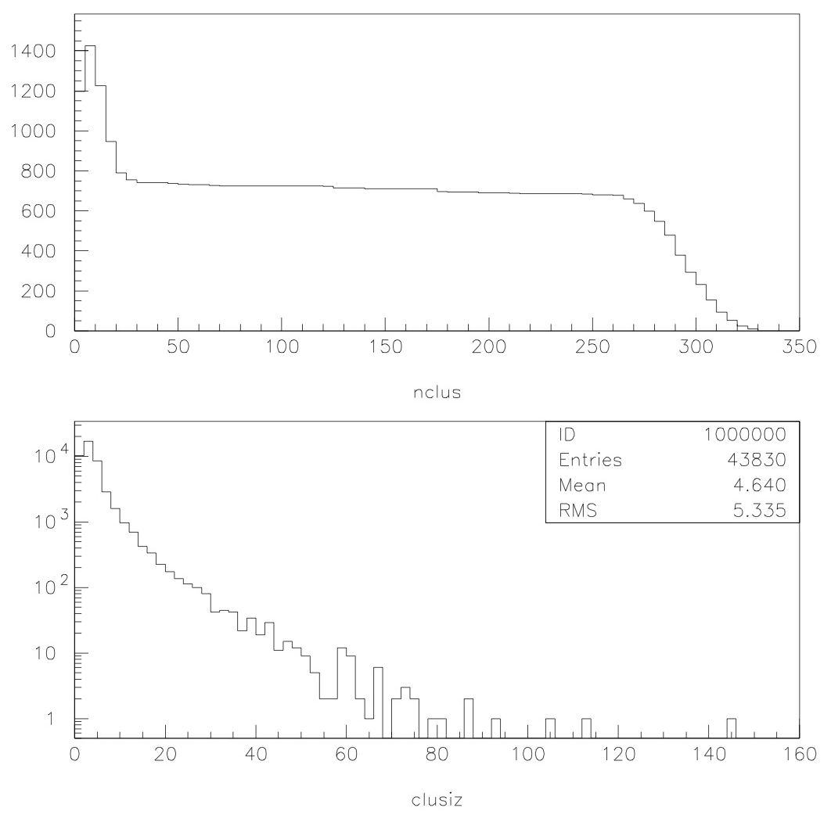
Vertex: results from PADME
Main goal of the measure: check maximum multiplicity allowed by Ultimate/M28
Collected about 1.5 Milion event without DAQ problems
Beam profile ( positrons @ about 500 MeV )
Cluster multiplicity and size

Slide 10
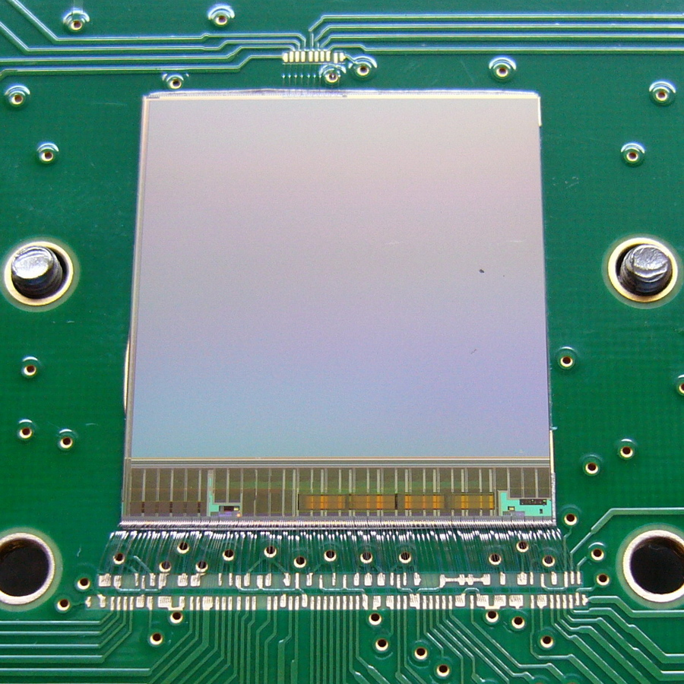
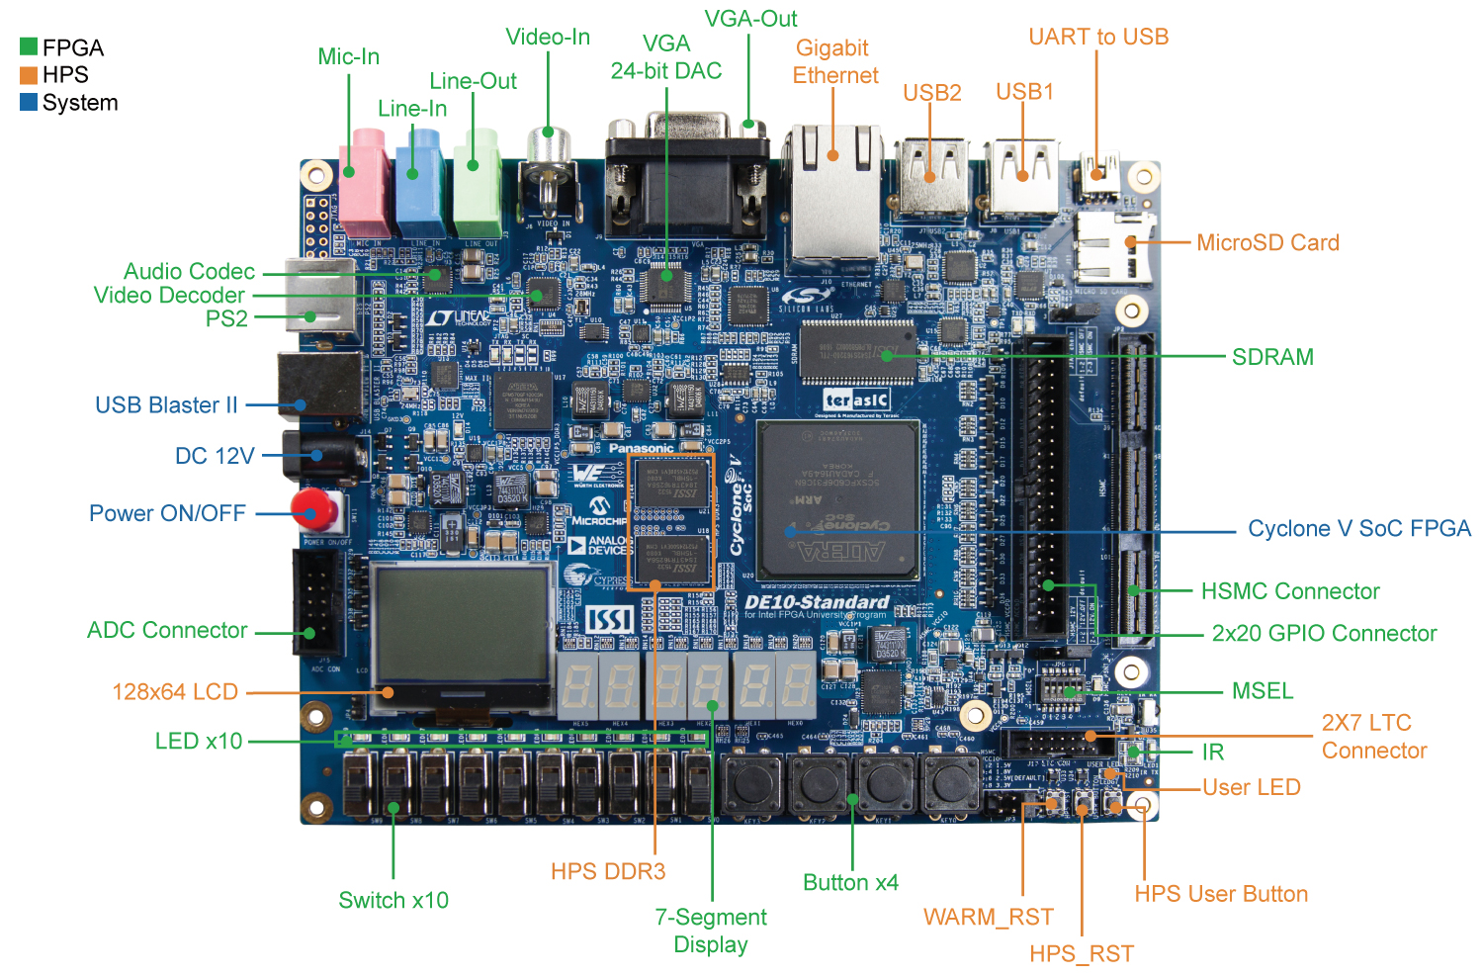
FOOT Vertex Readout Architecture
11*4=44 signals
22 LVDS pairs
11 single ended
Terasic DE10 SoC
Local pixel DAQ:
FPGA firmware +
Read Out program
Global FOOT DAQ
40 wires cable
Vertex adapter board
Trigger
Gigabit ethernet connection
( UDP protocol )

Slide 11
Readout Architecture logic (for both Vertex and IT)
Two
serial out
DO0, DO1
(160MHz)
Intermediate PC
Send UDP
packets
on Gigabit
ethernet
DP RAM
DO0
SoC
Arm A9
CPU
Local pixel
DAQ
program
SoC
FPGA
firmware
JTAG
DP RAM
DO1
Trigger
Architecture running also on PADME.
PADME trigger rate requirement at 50 Hz!!!!!!!!
Data logger listening on sockets,
one for each readout board and
writing data on files.

Slide 12
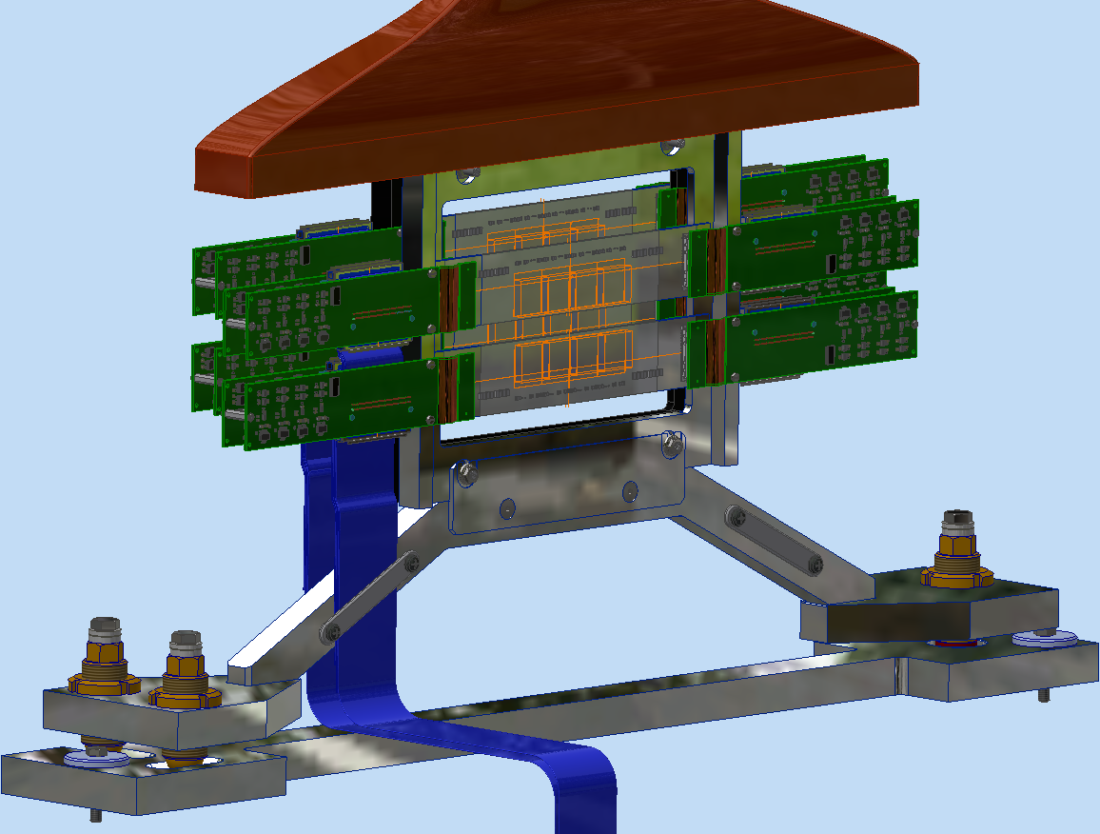
Inner Tracker ( IT )
Two back ladders:
one PlumeM28
+
four Adapter_PlumeM28
each
Two front ladders:
one PlumeM28
+
four Adapter_PlumeM28
each

Slide 13
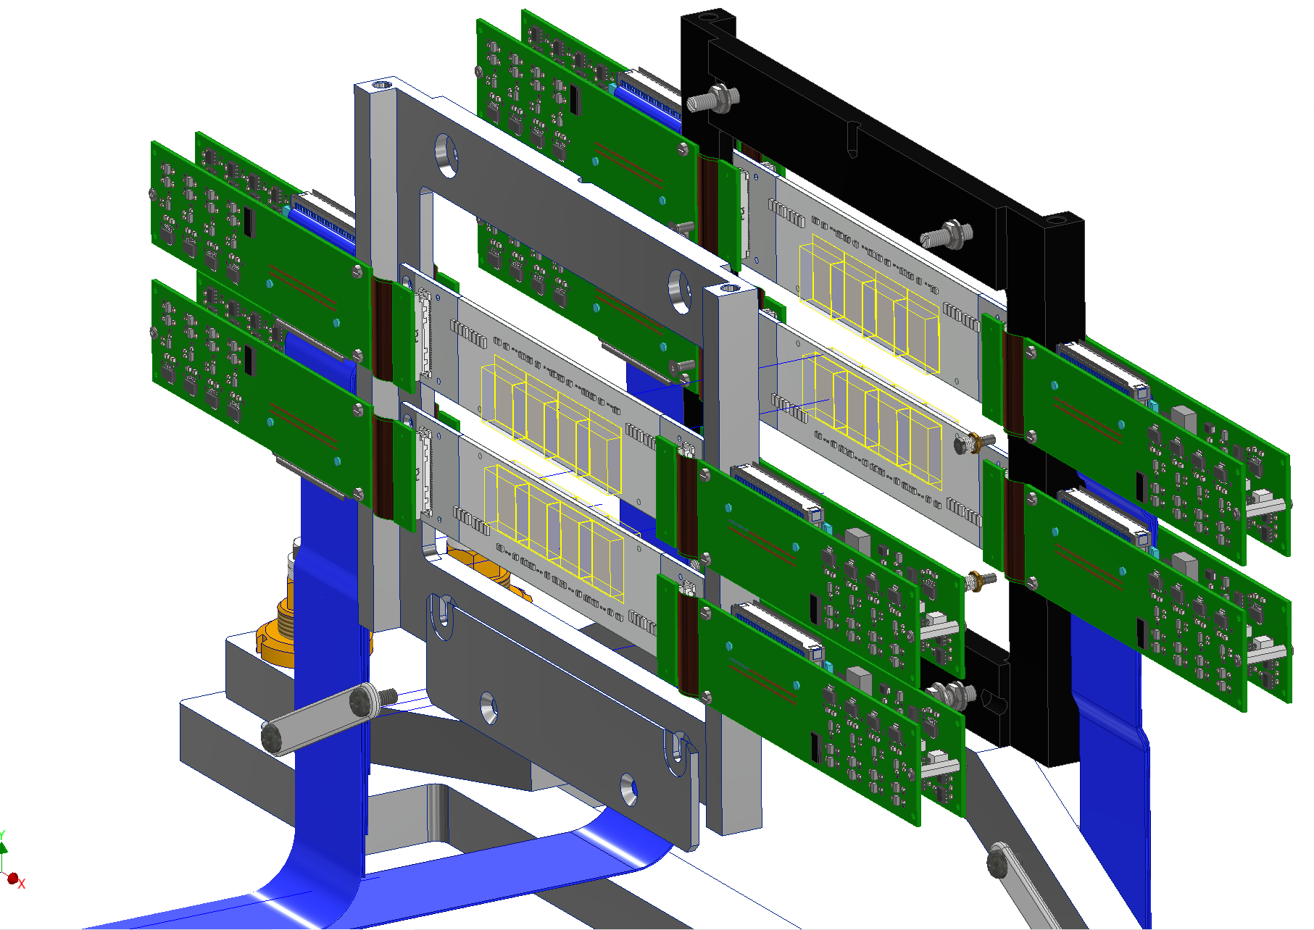
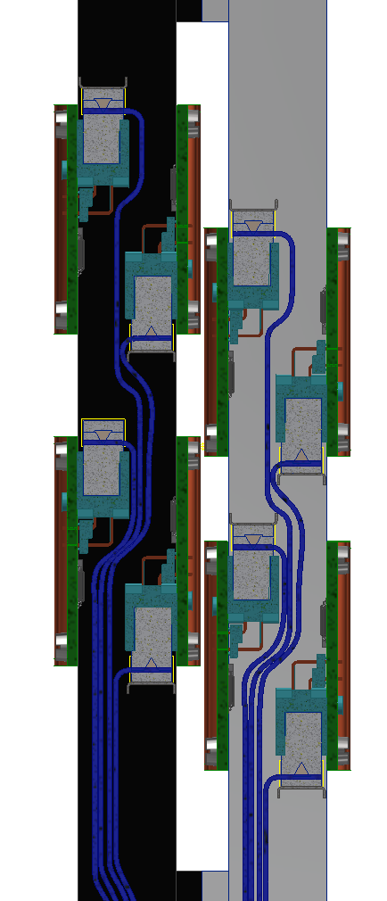
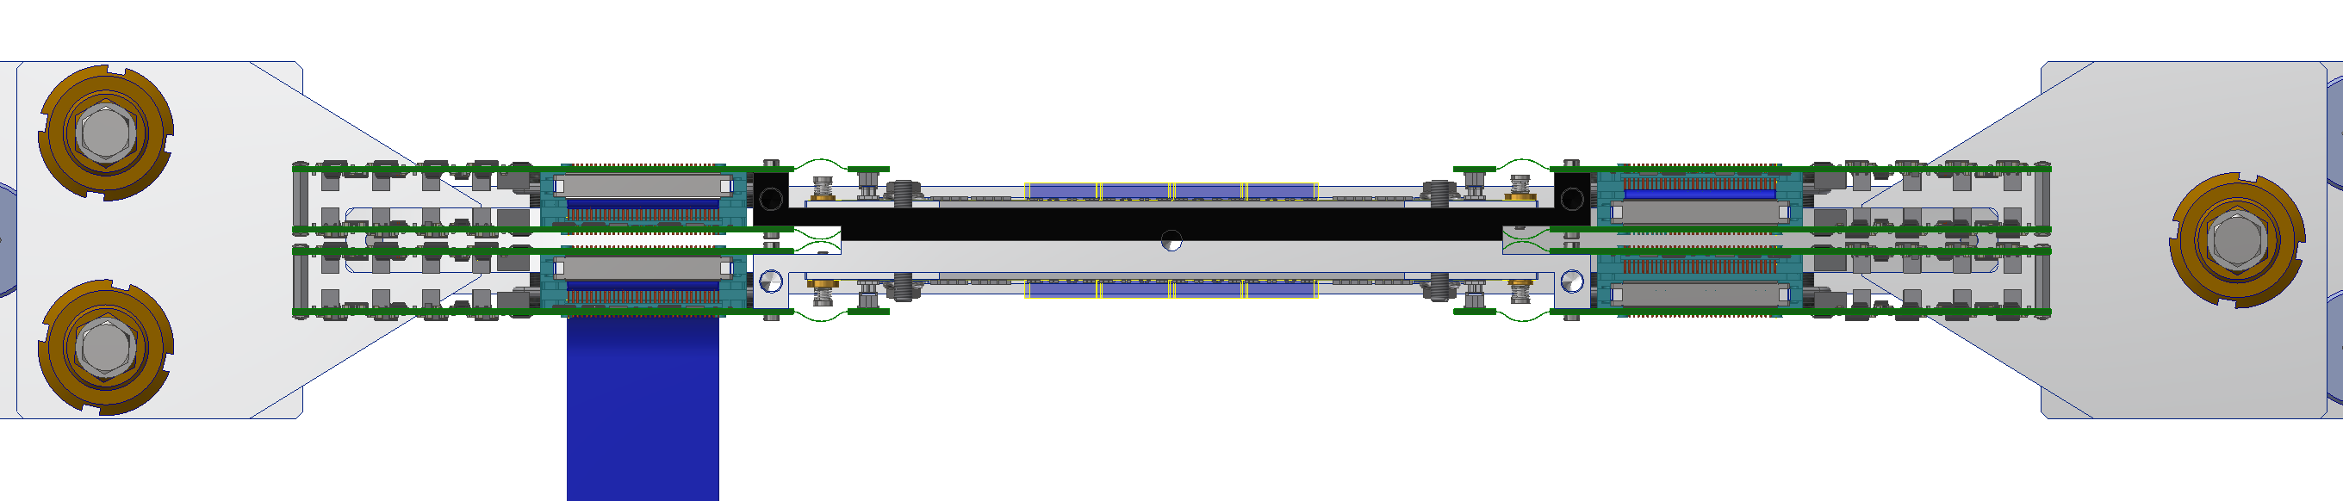
Inner Tracker INTEGRATION SEQUENCE

Slide 14
Inner Tracker ( IT ) status
october 30, 2020
Final signature of MoU
december 4, 2020
Inner Tracker assembly order issued

Slide 15
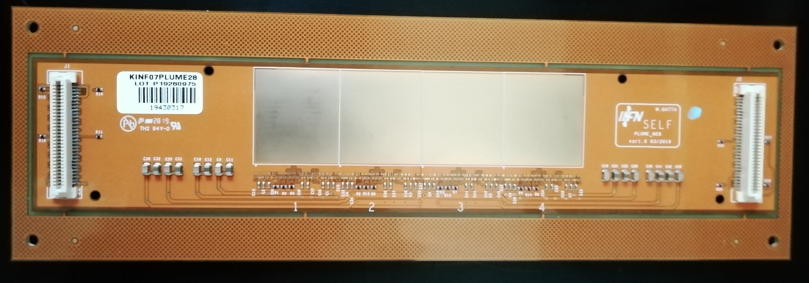
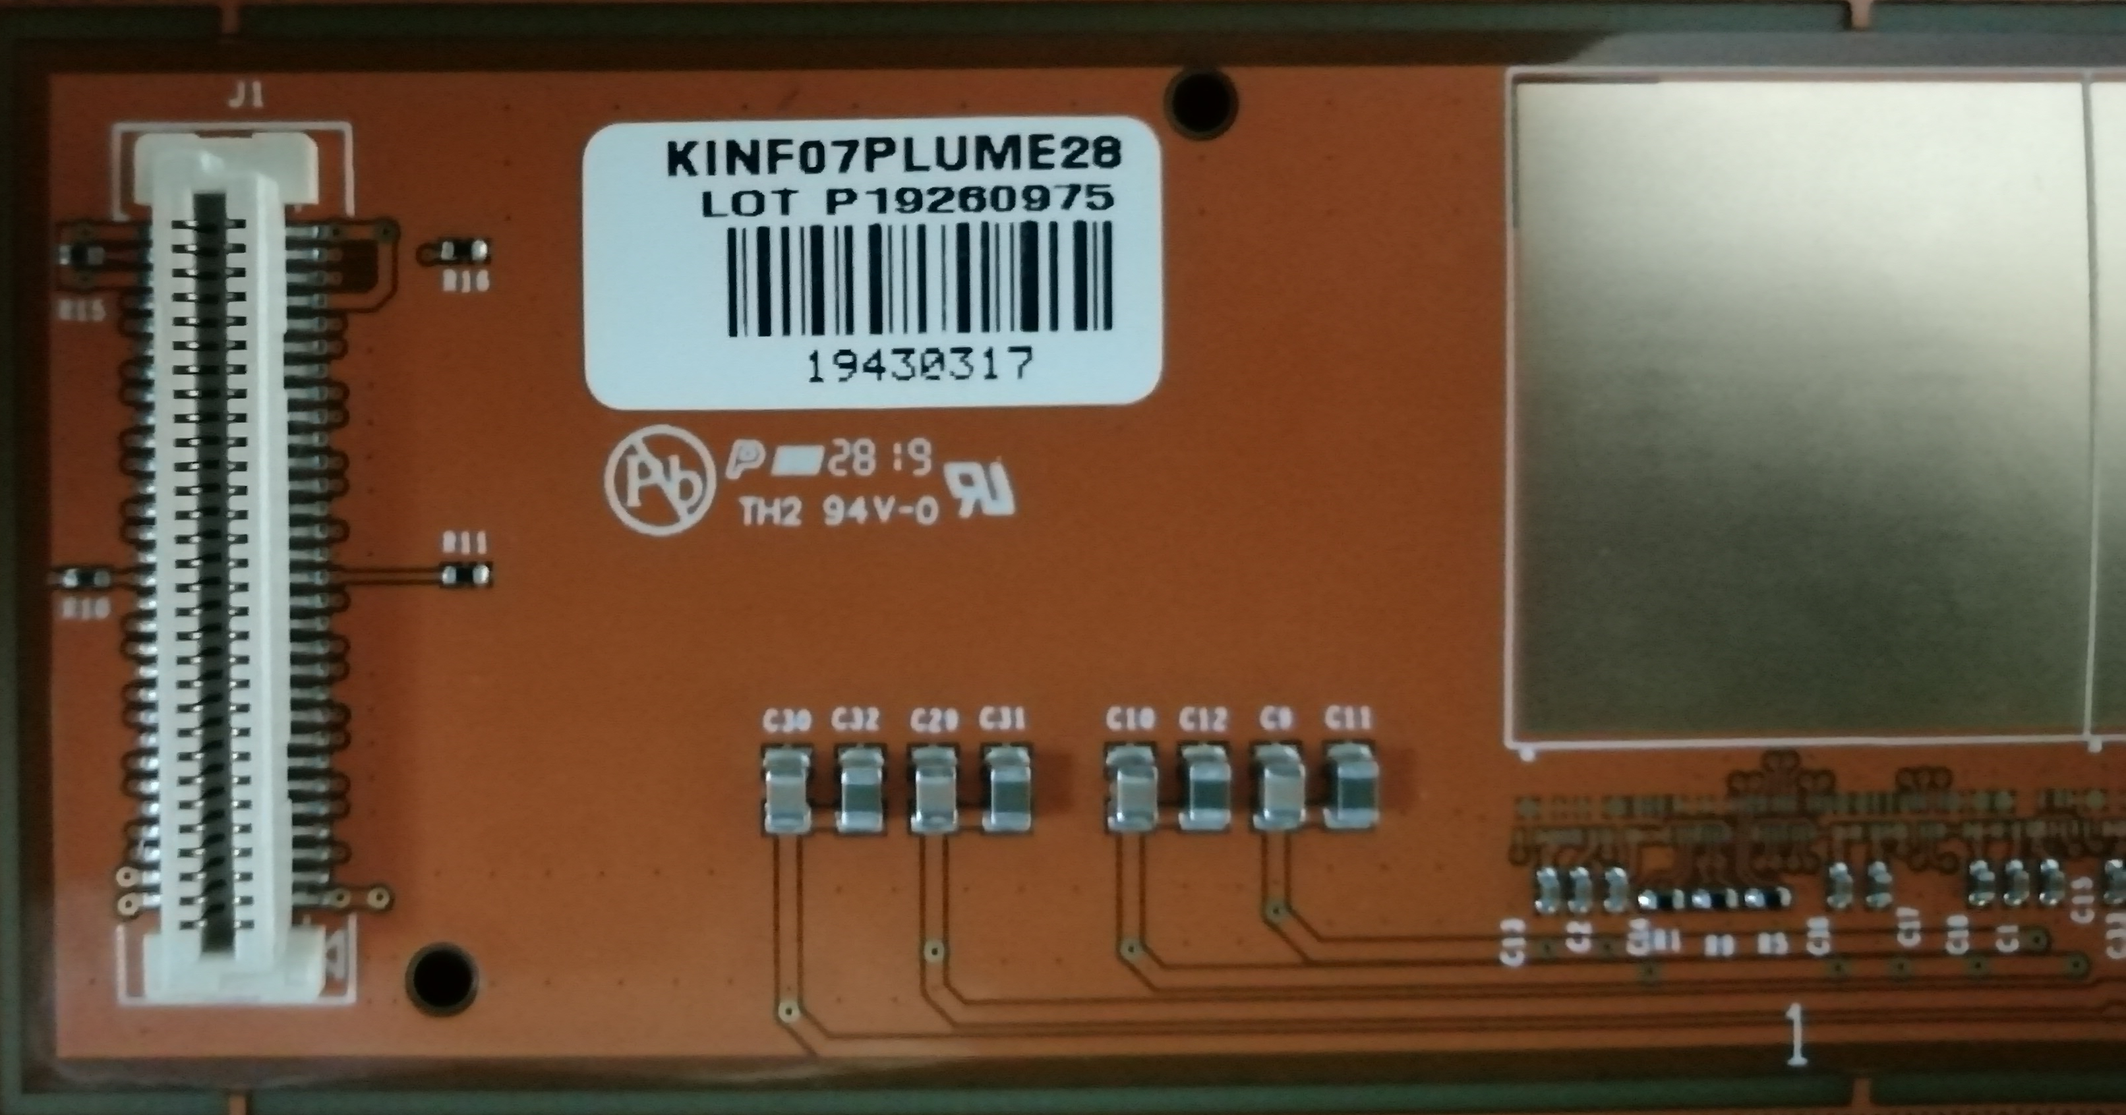
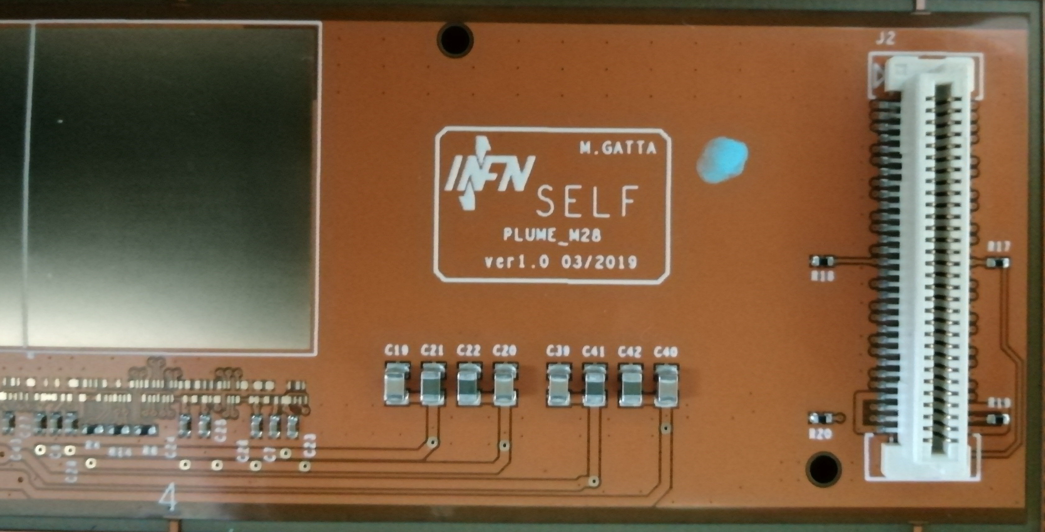
Inner Tracker ( IT ) status
The PlumeM28 first PCB prototypes

Slide 16
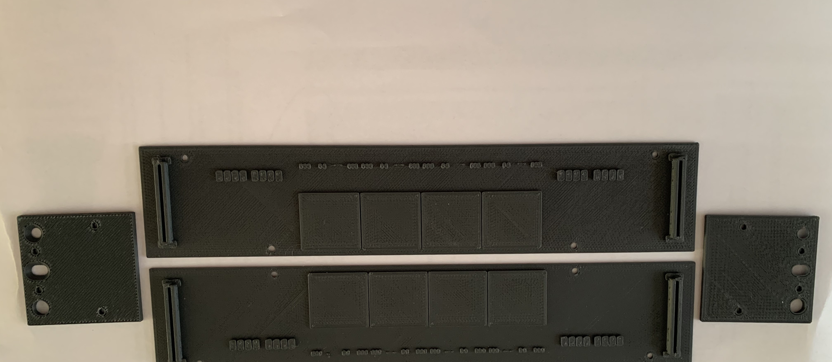
Inner Tracker ( IT ) status
3D pieces prototype for lab tests of assembly procedure

Slide 17
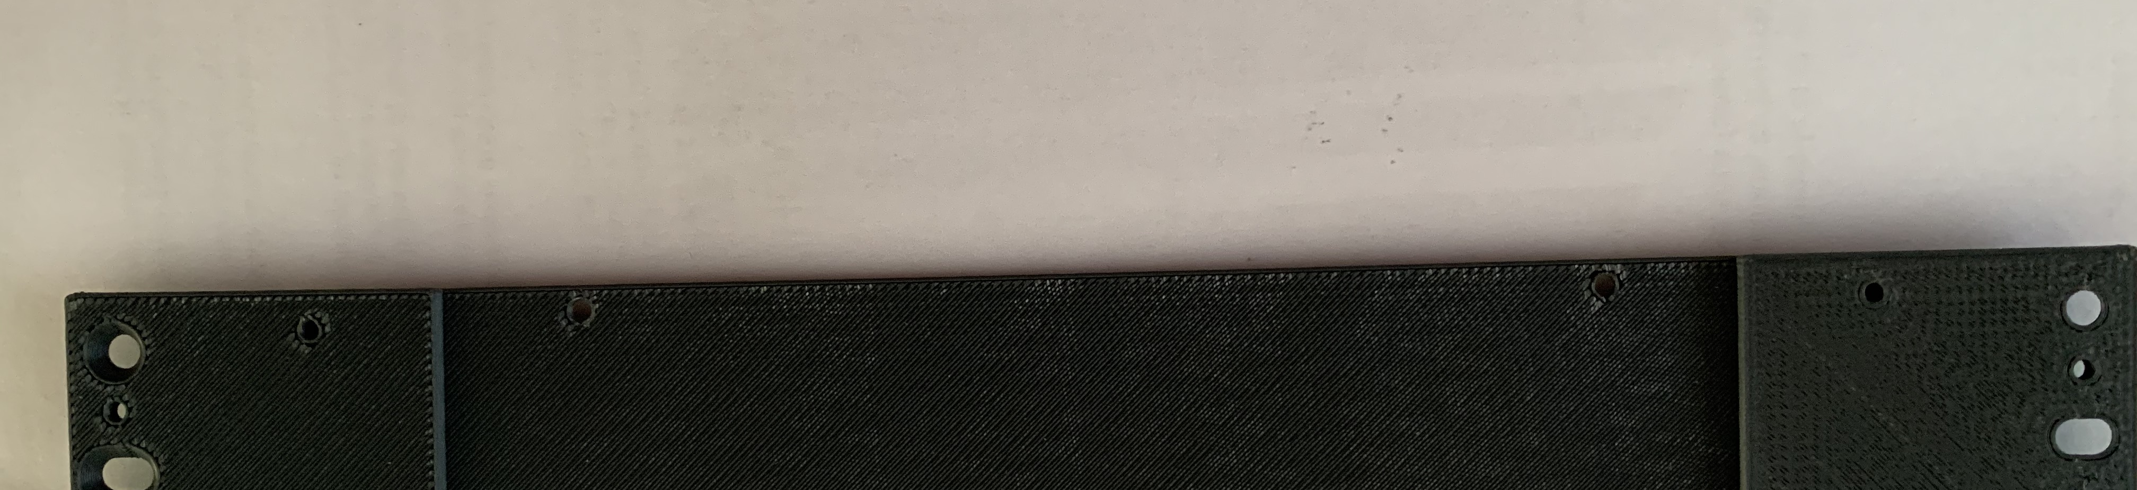
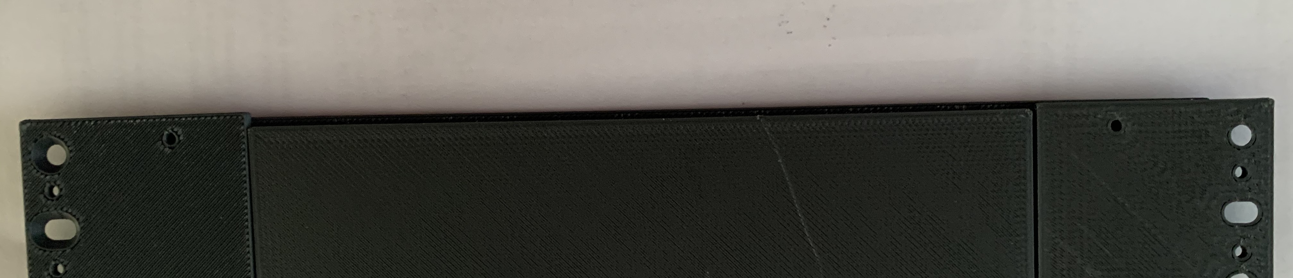
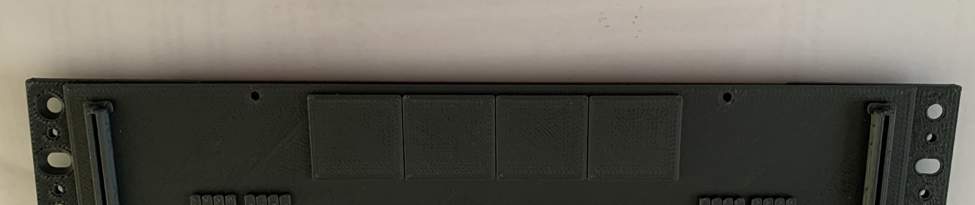
Inner Tracker ( IT ) status: Strasbourg activity
3D printed pieces
One module + 2 holders
One module + 2 holders + foam
One module + 2 holders + foam + second module = one ladder

Slide 18
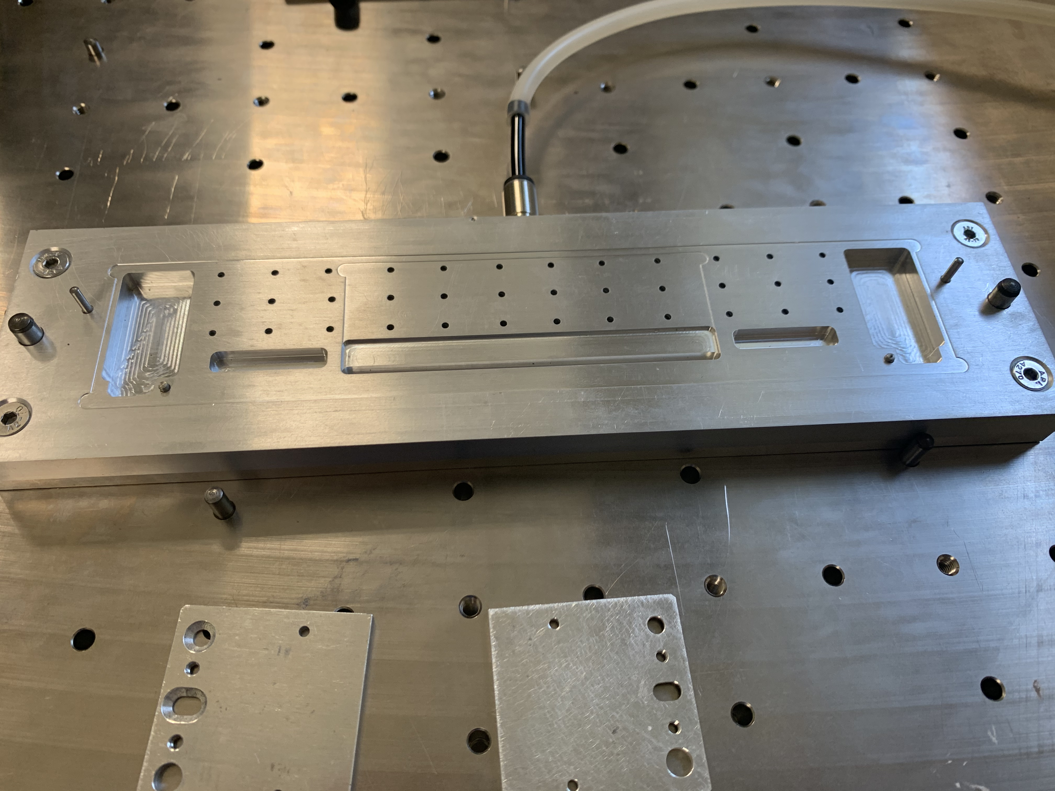
Inner Tracker ( IT ) final assembly jigs in Strasbourg

Slide 19
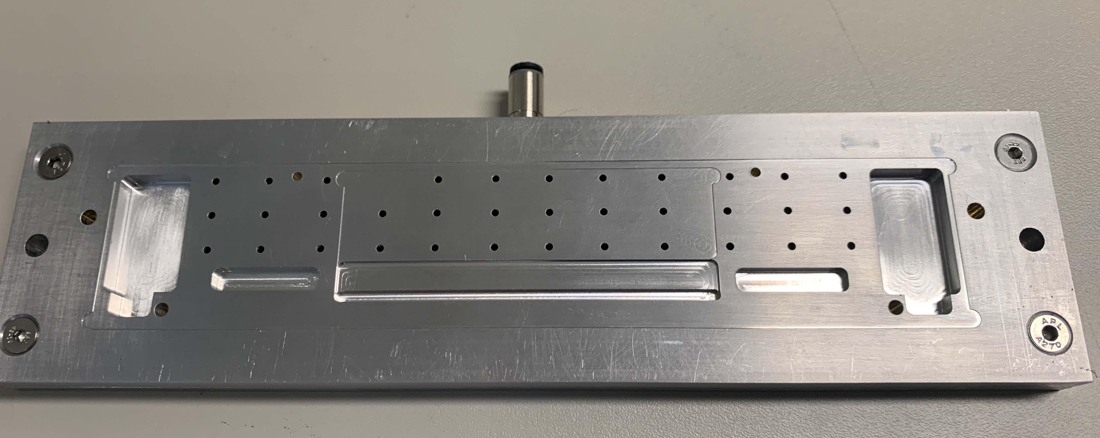
Inner Tracker ( IT ) final assembly jigs in Strasbourg

Slide 20
Inner Tracker ( IT ) list of needed components
Overall for the IT we need 3 different PCBs:
PlumeM28 ( kapton PCB ) to hold the sensors
1 PlumeM28 holds 4 sensors and is definde a module. Two glued modules assembled with
a RVC ( Resistive Vitreous Carbon foam ) spacer thick 2mm forms a Ladder.
The Inner Tracker is composed by 4 Ladders covering (acceptance ) about 8x8 cm.
Adapter_PlumeM28 ( Flex-Rigid PCB ) to collect signals from 2 sensors ( half of PlumeM28 ) on
each side of a module and houses transcievers, monitors currents and voltages and
includes “interlock” circuitry. Each adpapter_PlumeM28 is connected by a 68 wires flat
cable to the subsequent CableAdapter_PlumeM28 board.
CableAdapter_PlumeM28 that translates all differential signals to single ended, provide the
  power supplies and master the Tigger, Busy, clocsk, etc… control signal.
  Two of this boards ( we need 16 of this boards ) are connectet to a DE10_nano_SoC
DE10-Nano-SoC from Terasic each of the 8 needed reads 4 M28 sensors from 2 different
    PlumeM28 ladders. Sends data via one Gigabit link to the intermediate PC.

Slide 21
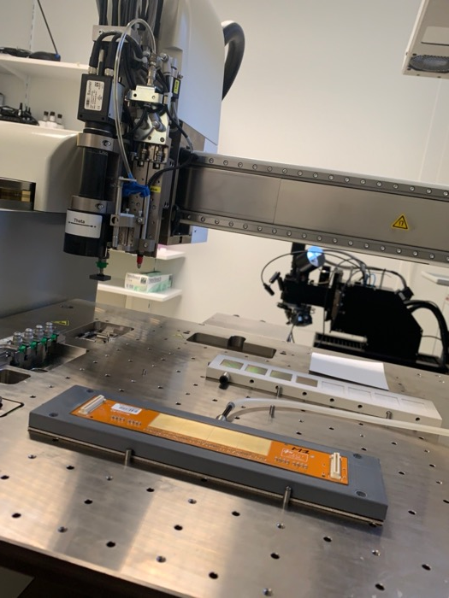
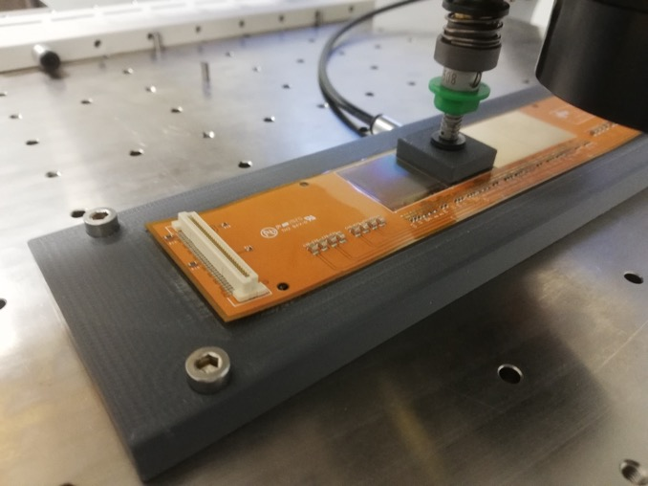
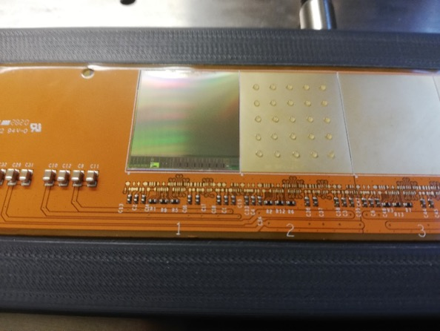
Inner Tracker ladder assembly in Strasbourg
sensors (M28) placement

Slide 22
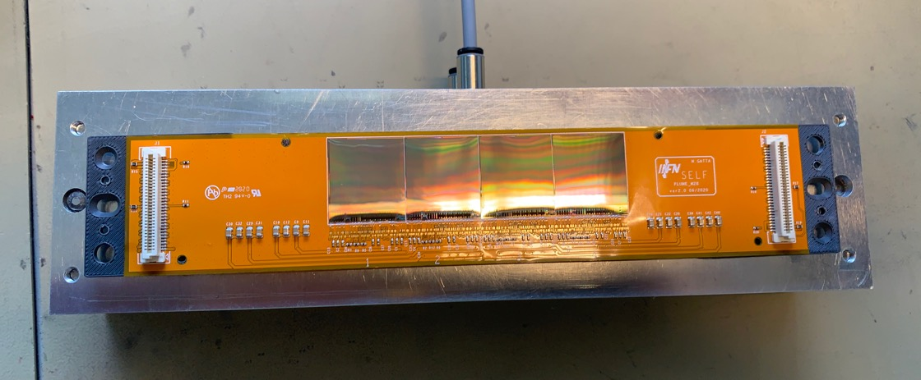
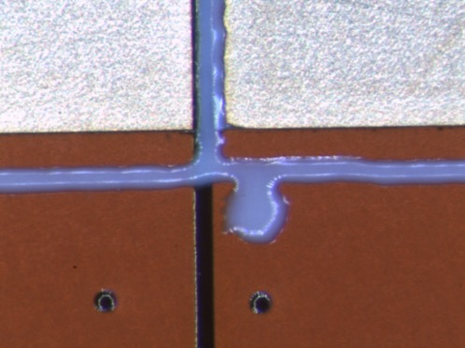
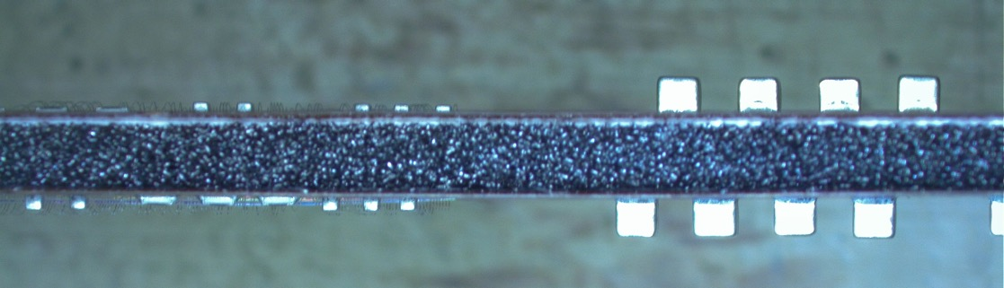
Inner Tracker ladder assembly in Strasbourg
sensors (M28) placement and gluing
Dummy modules Dummy stave
March 2021

Slide 23
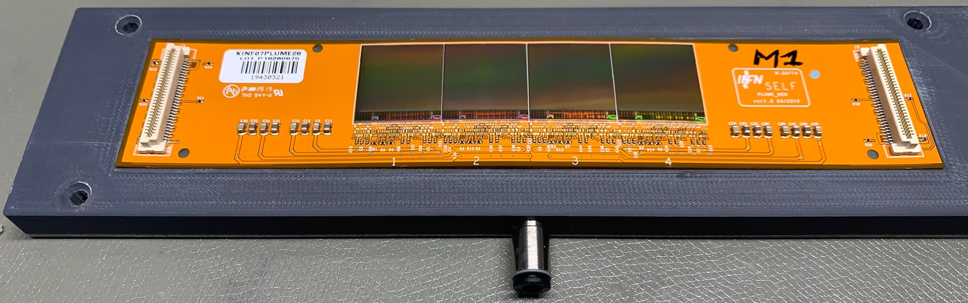
Inner Tracker ladder assembly in Strasbourg
First real module produced

Slide 24
Inner Tracker ( IT ) status
The Adapter_PlumeM28 ( produced only 4 prototypes )
Output 68 pins for flat cable
to CableAdapter_PlumeM28
Connector to PlumeM28
side A/B
Kapton cable to mechanical
Decouple the PlumeM28 to the Adapter

Slide 25
Inner Tracker ( IT ) status
The CableAdapter_PlumeM28 ( all produced )
Connector to
Trigger system
Connector to
Adapter_PlumeM28
Connector to
DE0nano_SoC

Slide 26
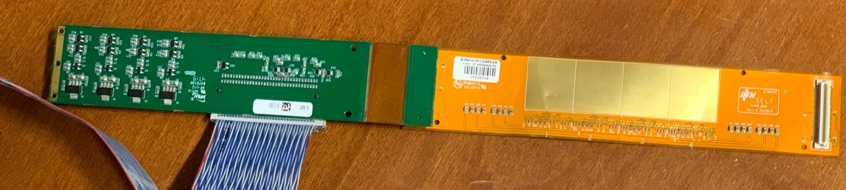
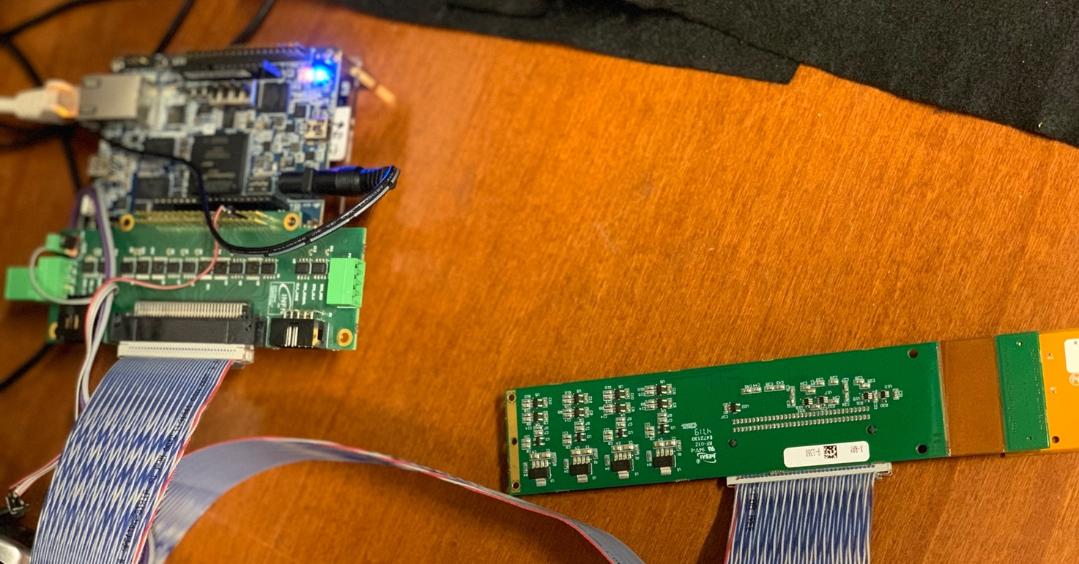
Inner Tracker ( IT ) ladder test system
( provided to Strabourg group for ladder production testing )
The testing system we used is composed by three different pieces:
The Terasic DE0 nano board.
The CableAdapter_plume M28 connected to one of the GPIO connector of the Terasic board.
The Adapter_PlumeM28 board connected to one of the two 60 pin connectors housing each the signals of 2 M28 sensors.
Test of module 0 in Frascati
Long and deep testing discovered
a wrong bonding that prevented
the module full functionality.

Slide 27
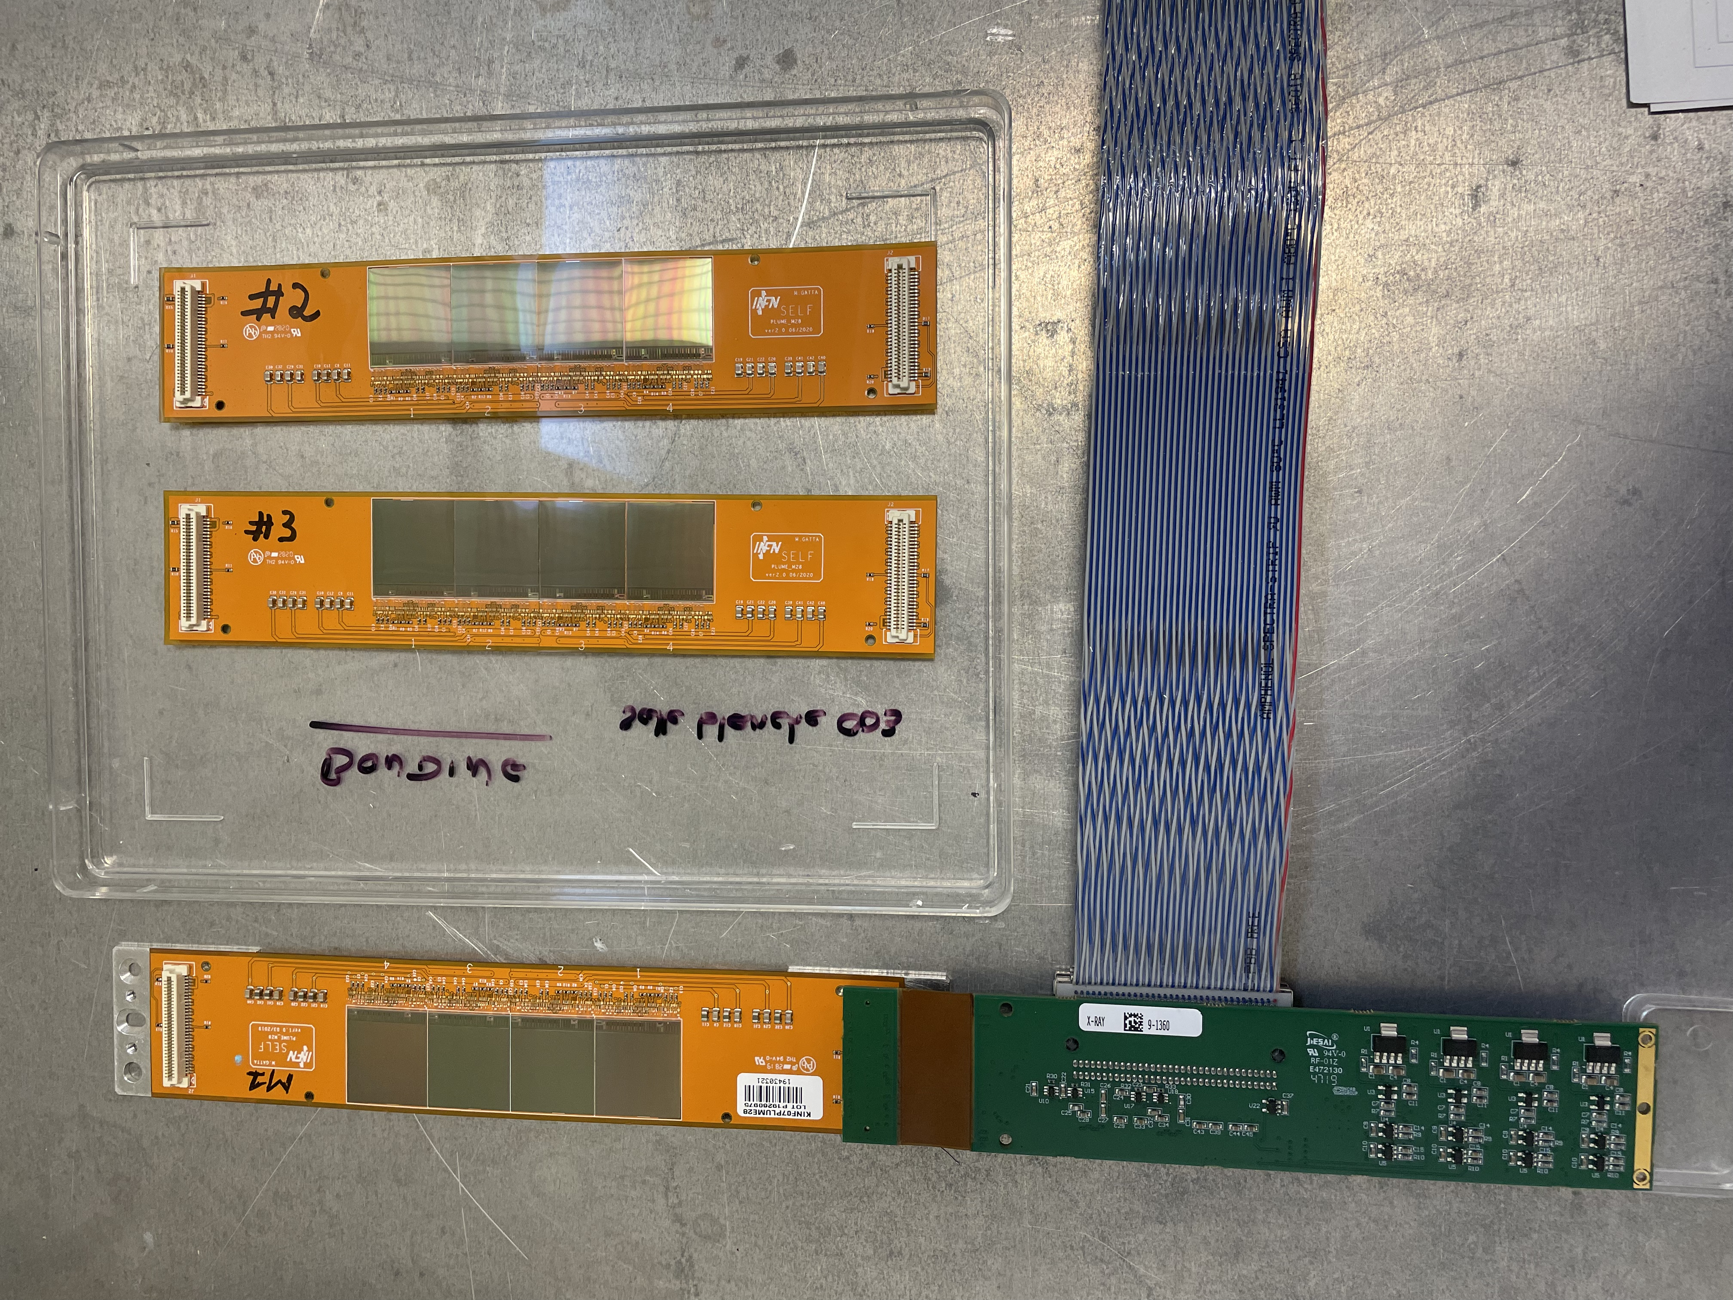
Inner Tracker ( IT ) status ( pictures from Strasbourg )
First module assembled
( used for test system qualification in Frascati.
Now back in Strasbourg )
Adapter_PlumeM28 board
Flat PCB
Two new modules ready to be qualified (tested) before first ladder assembly.

Slide 28
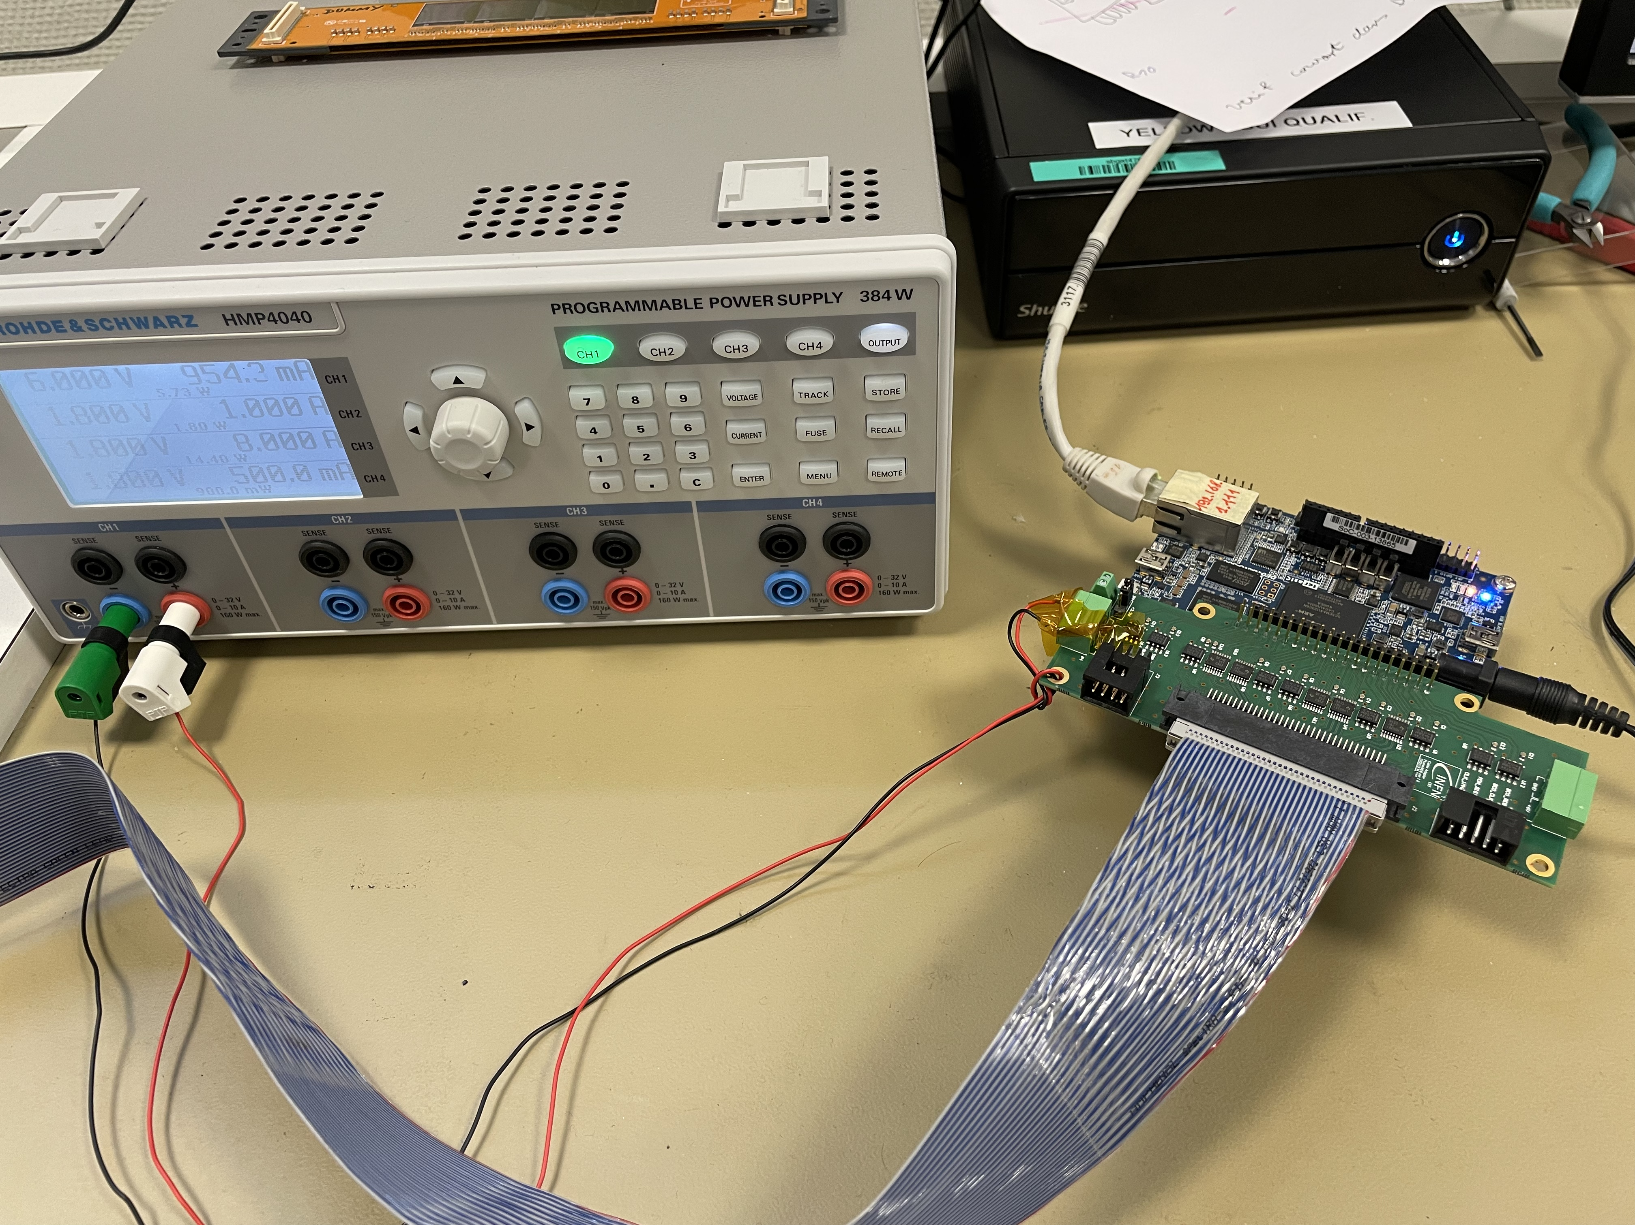
Inner Tracker ( IT ) status ( pictures from Strasbourg )
Ethernet connection
Terasic DE0nano-SoC
CableAdapter_PlumeM28

Slide 29
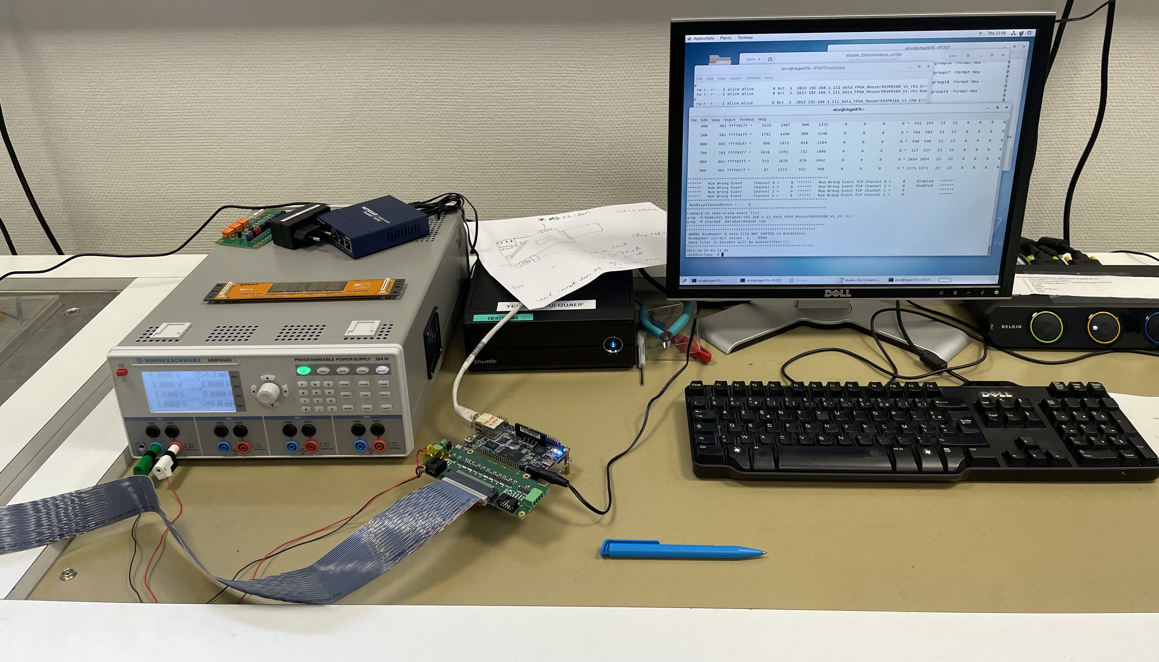
Inner Tracker ( IT ) status ( pictures from Strasbourg )

Slide 30
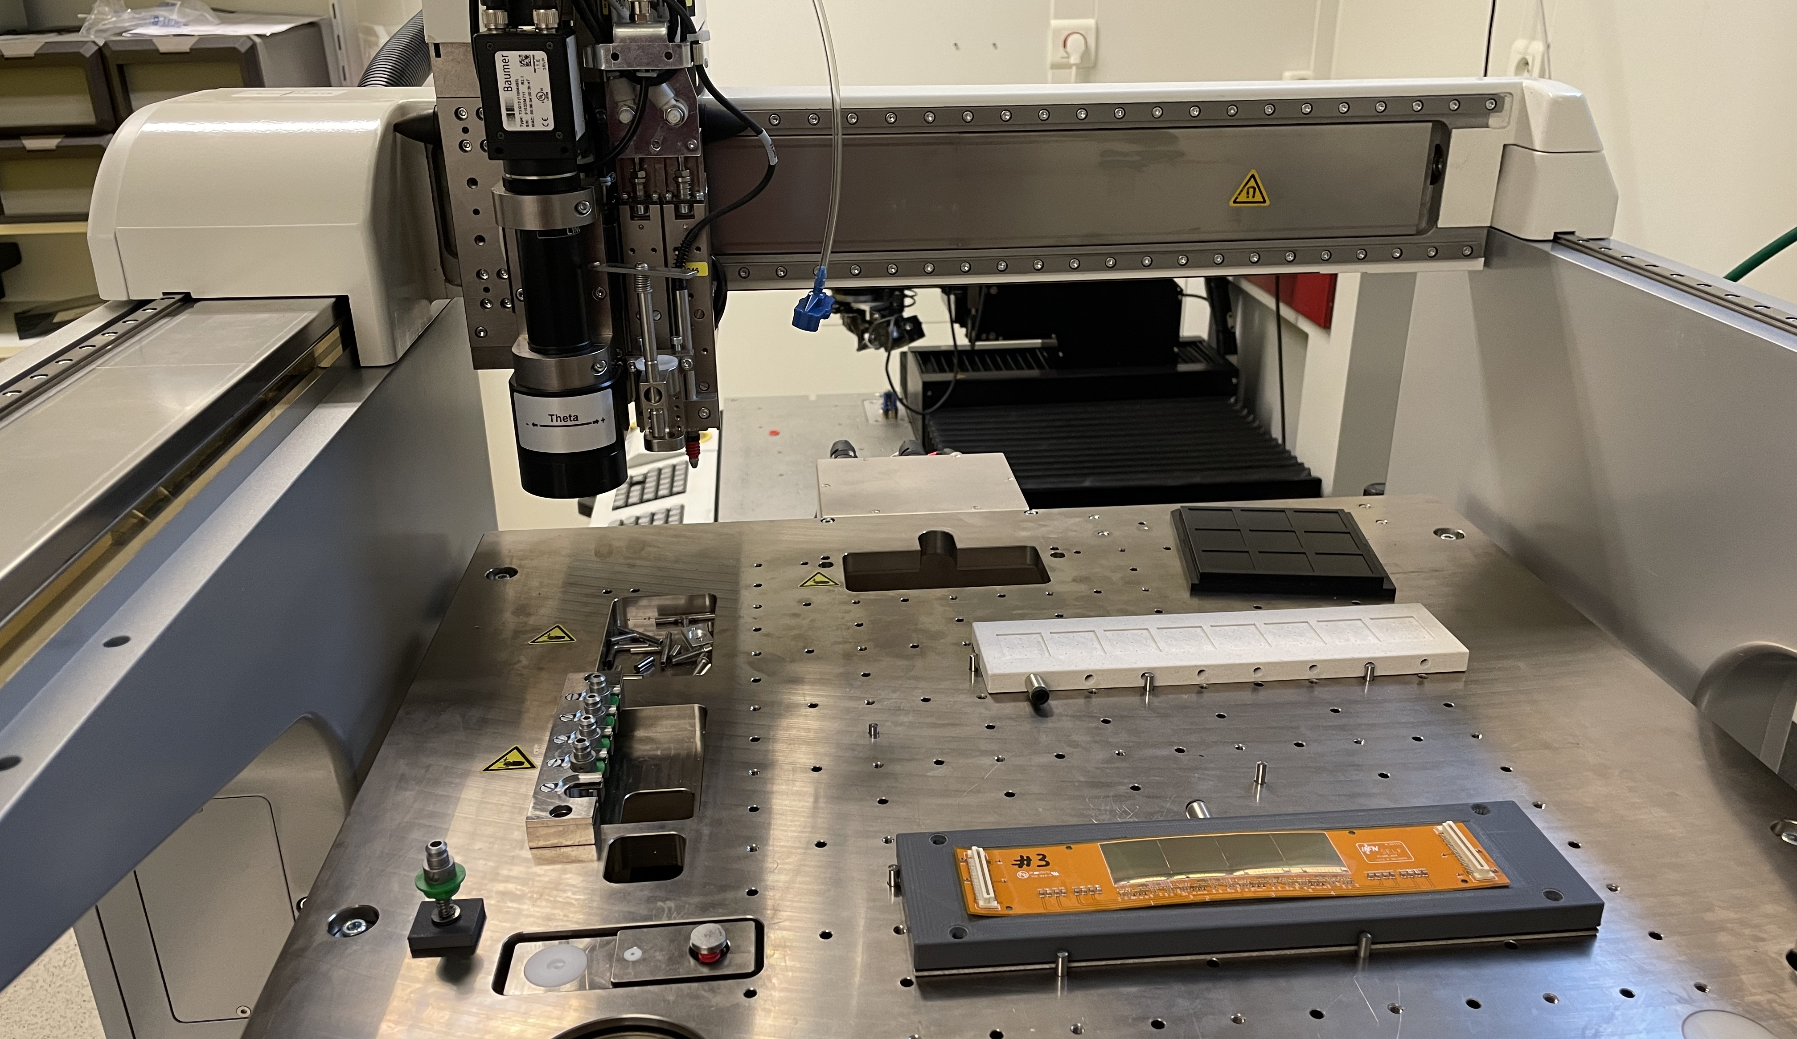
Inner Tracker ( IT ) status ( pictures from Strasbourg )

Slide 31
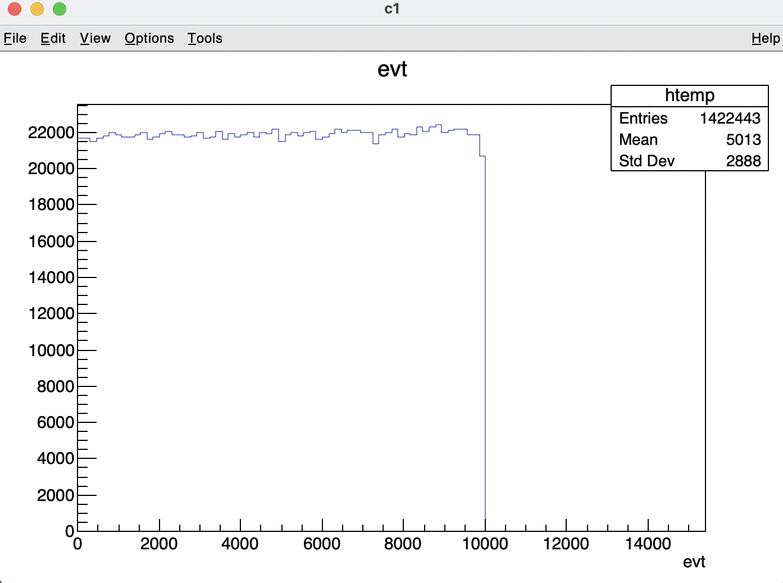
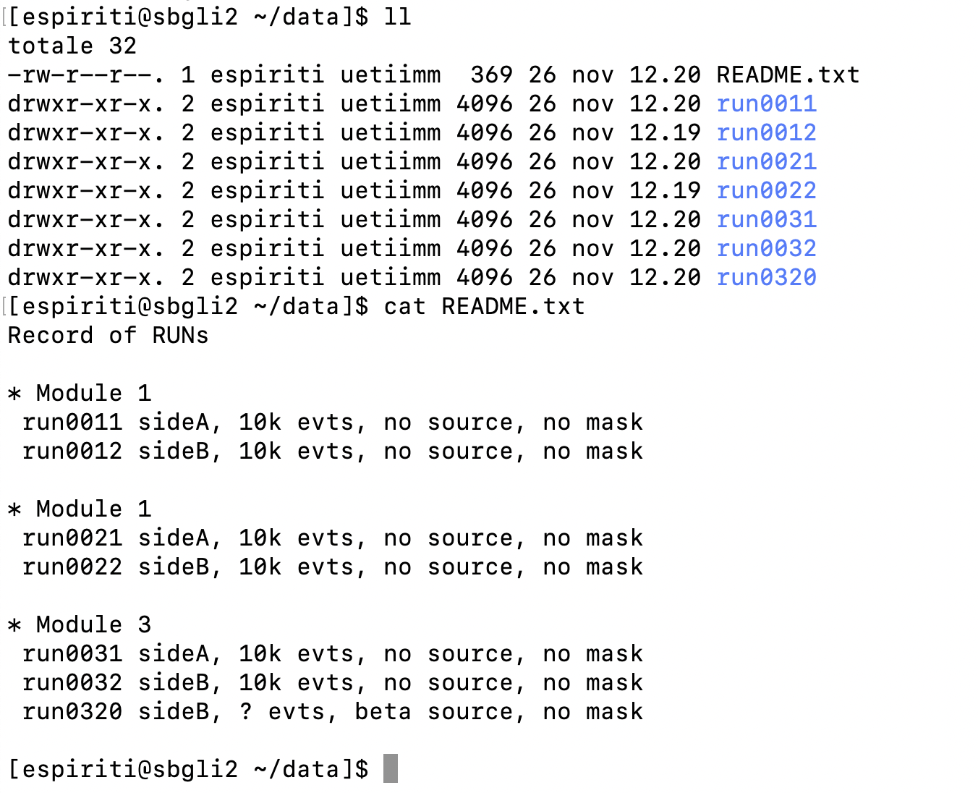
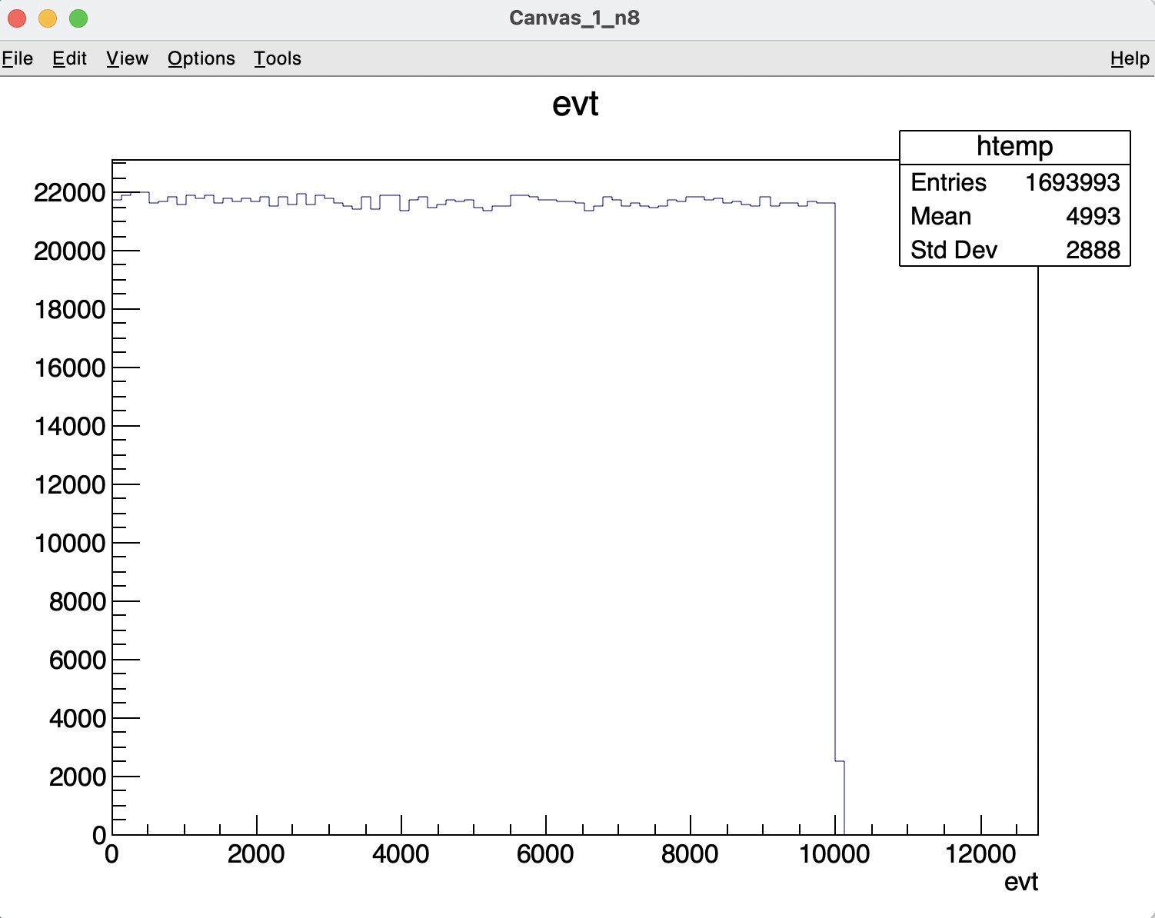
Inner Tracker ( IT ) status (test preliminary results)
Run0320_ch0 event number
First sensor
10 kevents
∽1.4Mhits
Iron 55 radioactive source
Run0320_ch1 event number
Second sensor
10 kevents
∽1.7Mhits
Data shown in the following

Slide 32
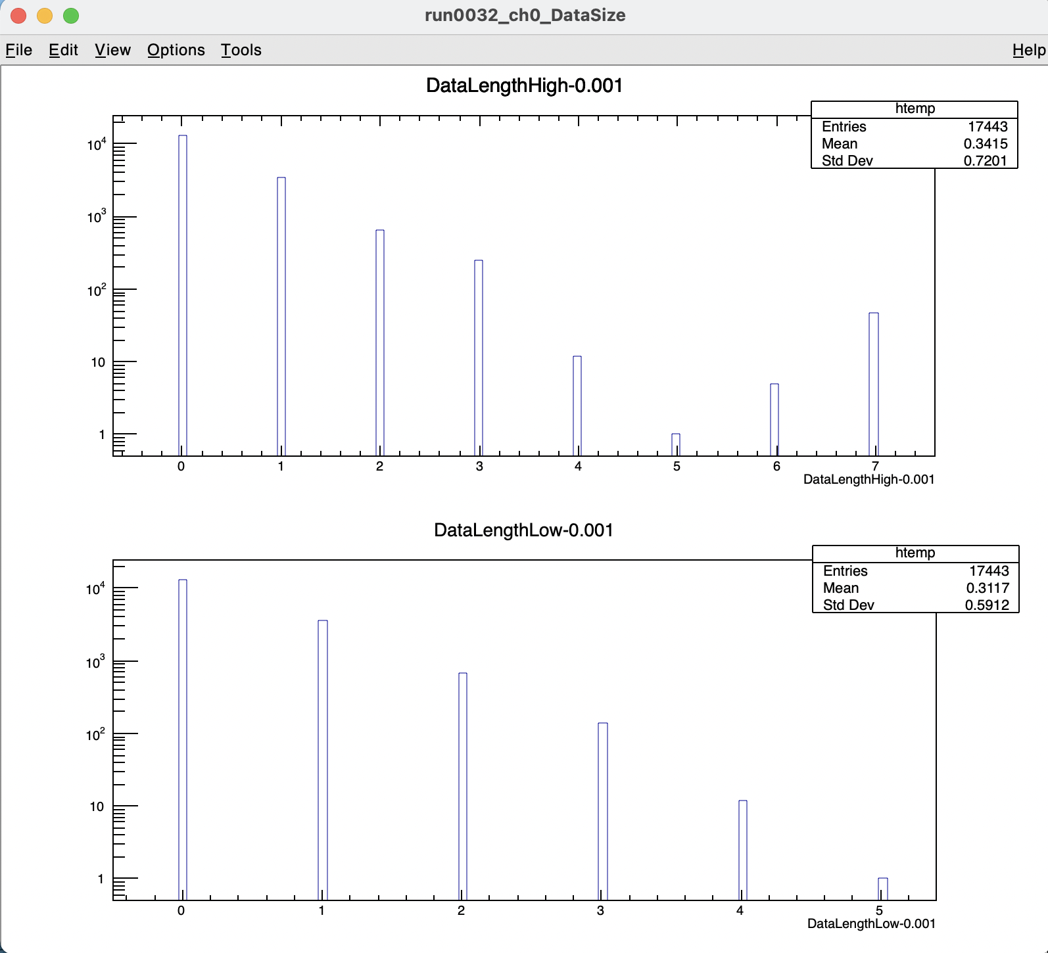
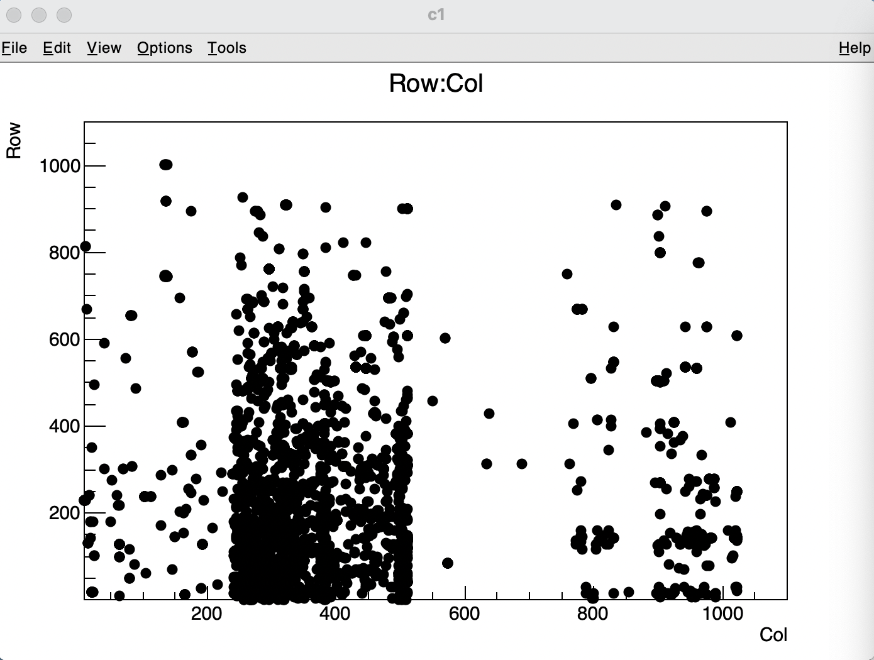
Inner Tracker ( IT ) status (test preliminary results)
«Pedestal» run ( run0032 ) first sensor
Data size (num. of long words)
Hit map. Clear thresholds (4 regions) non-uniformity

Slide 33
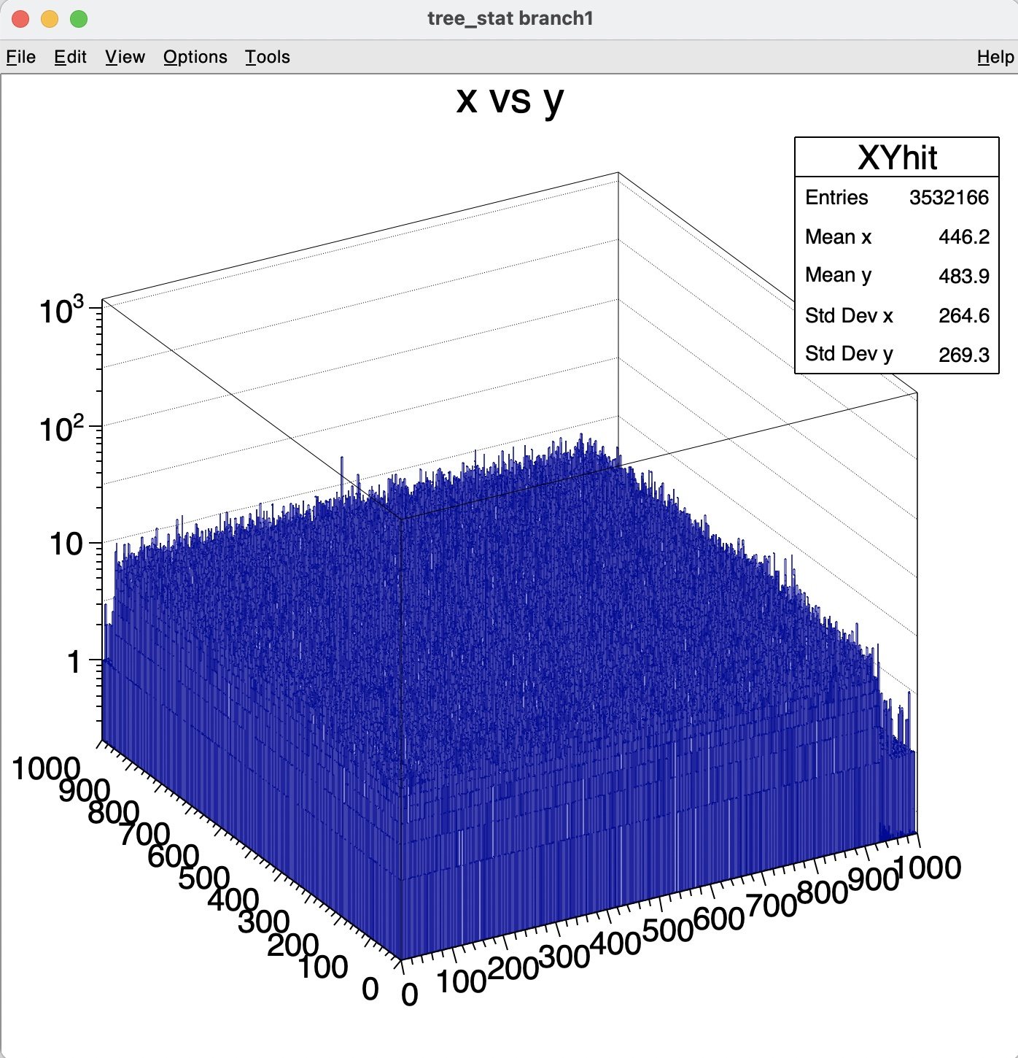
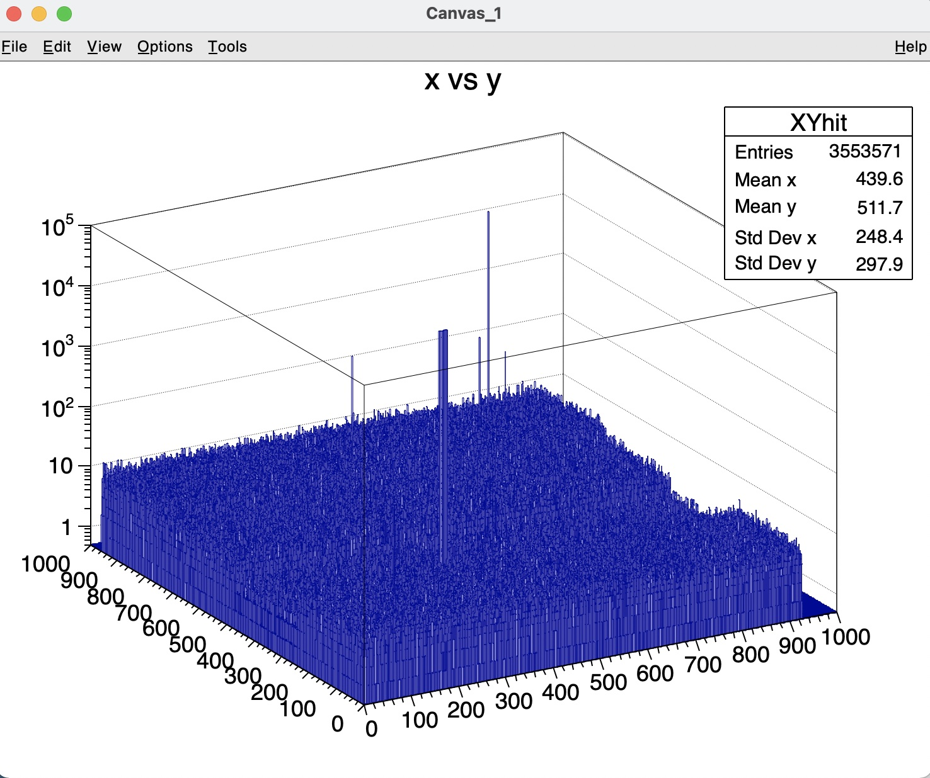
Inner Tracker ( IT ) status (test preliminary results)
Iron 55 radioactive source run hit maps ( run0320 )
First sensor - 10 kevents - ∽3.5 Mhits
Second sensor - 10 kevents - ∽3.5 Mhits

Slide 34
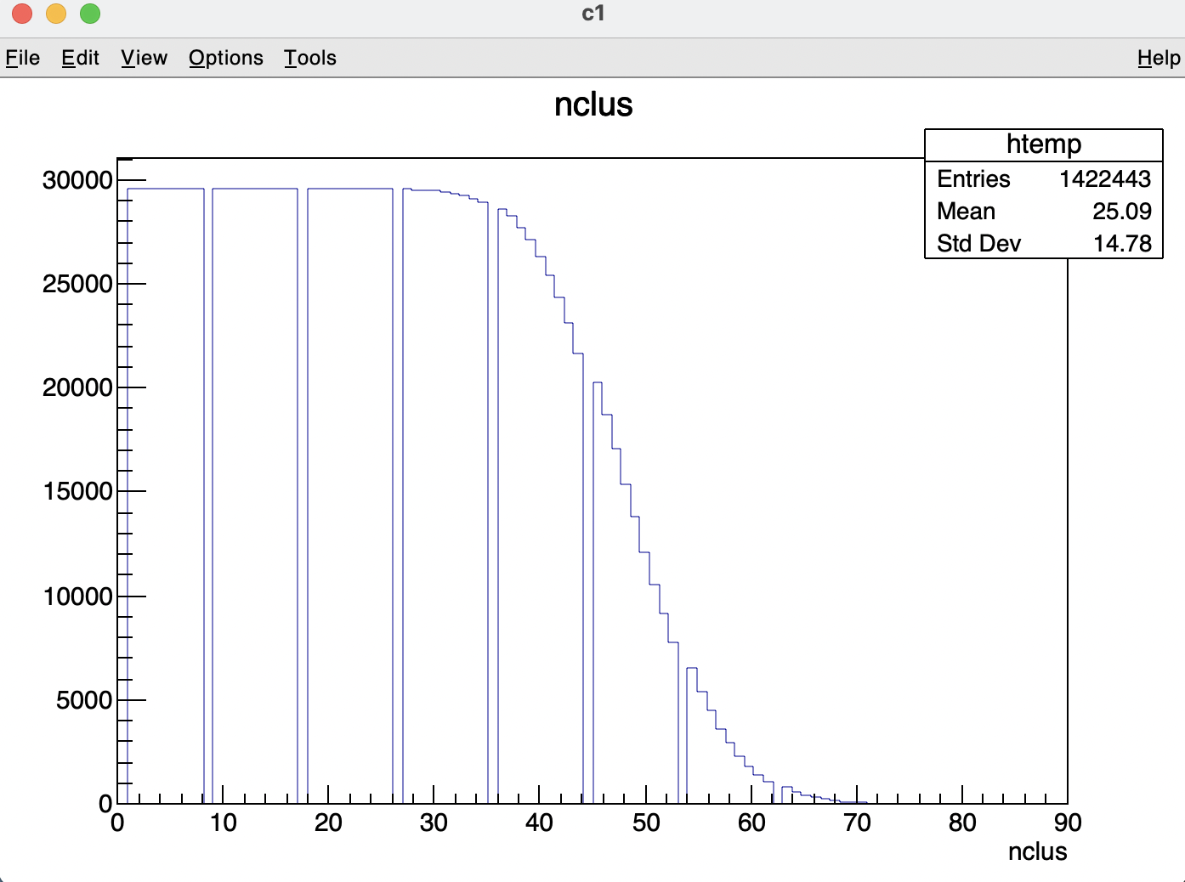
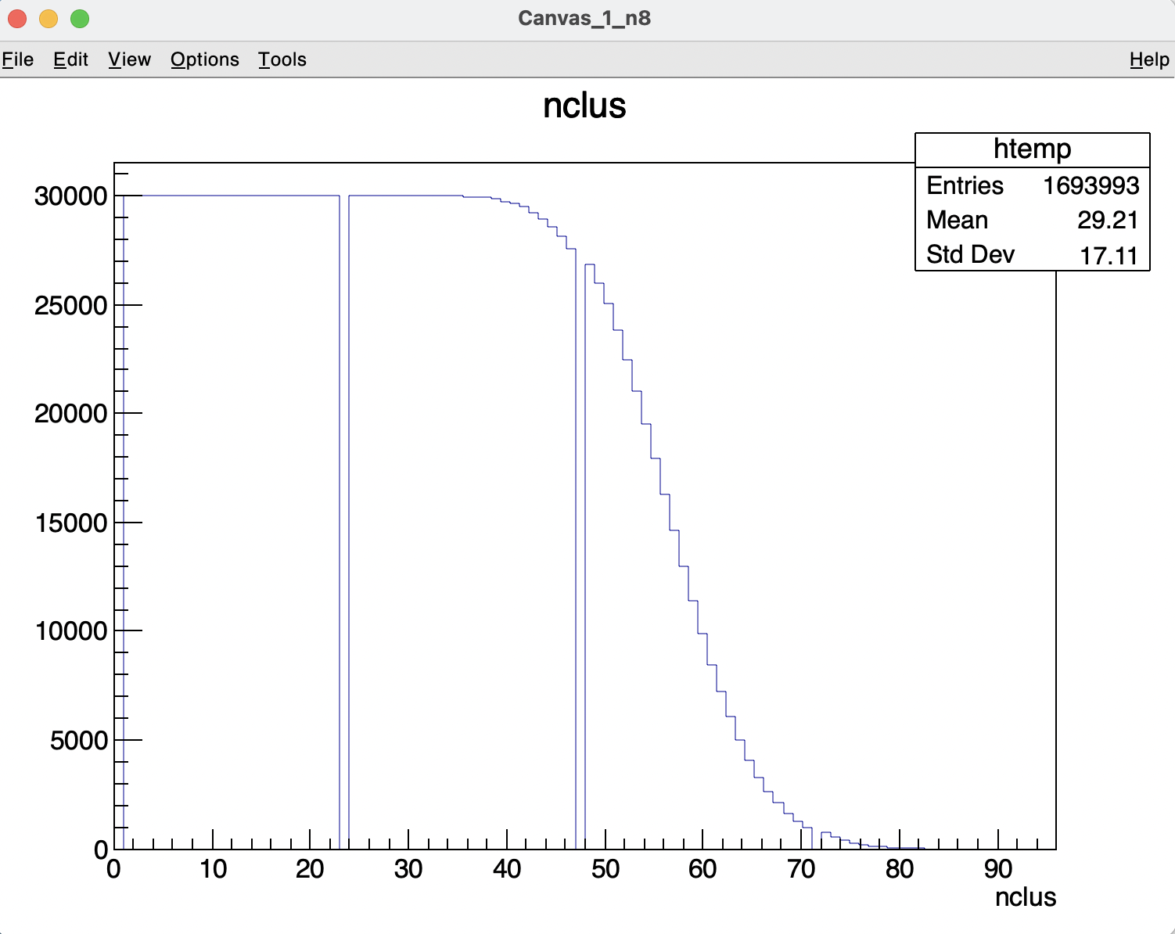
Inner Tracker ( IT ) status (test preliminary results)
Iron 55 radioactive source run ( run0320 ) – cluster number per event
First sensor - 10 kevents - ∽1.4 Mcluster
Second sensor - 10 kevents - ∽1.7 Mcluster

Slide 35
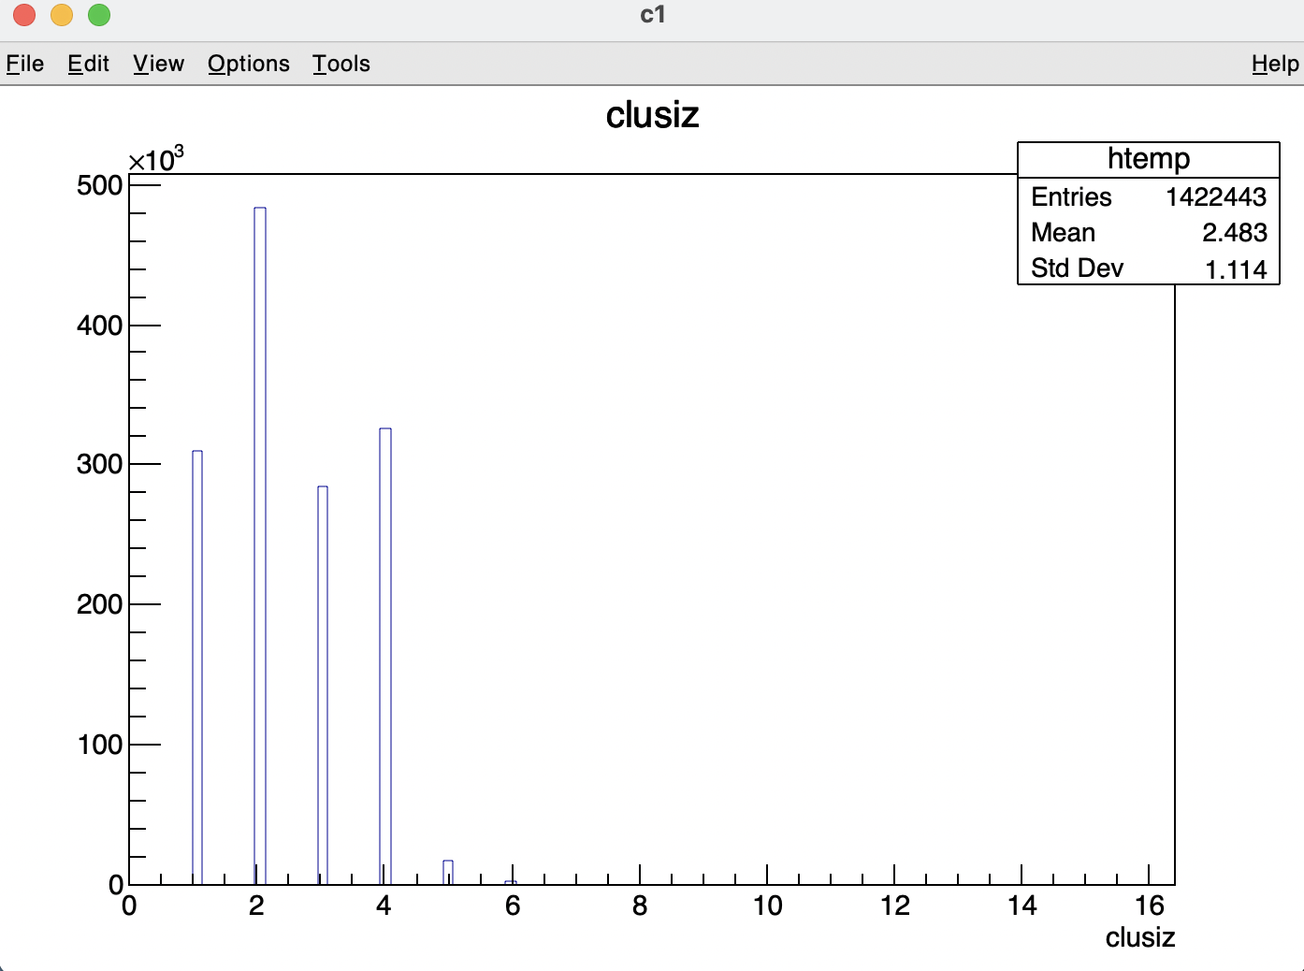

Inner Tracker ( IT ) status (test preliminary results)
Iron 55 radioactive source run ( run0320 ) – cluster size per event
First sensor - 10 kevents - ∽2.48 hits/cluster
Second sensor - 10 kevents - ∽2.10 hits/cluster

Slide 36


Inner Tracker ( IT ) status (test preliminary results)
«Ped» run, NO source ( run0032 )
First sensor – data size- ∽0.3 long word/event
Iron 55 radioactive source ( run0320 )
First sensor – data size- ∽90 long word/event

Slide 37


Inner Tracker ( IT ) status (test preliminary results)
«Ped» run, NO source ( run0032 )
Second sensor – data size- ∽17 long word/event
Iron 55 radioactive source ( run0320 )
Second sensor – data size- ∽90 long word/event

Slide 38
Vertex ( VTX ) status - hardware upgrade
IT Cable_adapter_board
+
DE0nano Terasic board
Terasic DE10 SoC - Vertex DAQ:
FPGA firmware + Read Out program
Vertex adapter board
Replacing the 68 pin connector on the Cable_adapter_PlumeM28 (left picture)
With two of the 40 pin connector to the Ultimate_boards (bottom right piture)
NEW Cable_adapter_Ultimate board (2 needed to read the Vertex)
Two Cable_adapter_Ultimate are read out by one Terasic DE0nano-SoC
Same hardware and software (VTX and IT) interface to the general daq system!

Slide 39
Vertex ( VTX ) status - firmware upgrade
Vertex daq
program
Vertex daq
program
Vertex daq
program
trigger
busy
We introduce 2 trigger counters in the VTX/IT firmware:
Input trigger counter (including the time stamp each time)
COUNTING EXTERNAL ARRIVING TRIGGER PULSES (RISE EDGES)
Internal trigger (event) counter (including the time stamp each time)
COUNTING EVENTS STORED BY THE FIRMWARE IN BUFFER DP-RAM
Save in the data the (last three):
«Input trigger counter» and «Internal trigger counter
including the time stamp of both

Slide 40

Inner Tracker ( IT ) status (mechanical structure)

Slide 41


Inner Tracker ( IT ) status
Modules and ladder inventory
Assembled 9 modules (10 needed)
module 1,3 and 9 not fully functional
module 1 – 1 broken sensor
module 3 – 2 broken sensor (even if one replaced!)
Assembled ladder 1 using module 1 and 3
check of the ladder assembly procedure
( now in Frascati )

Slide 42
Conclusions
FOOT tracker mechanical setup:
Final mechanical design
Funds available 2022
Order will be issued january 2022
Magnet system:
Delivery foreseen beginning february 2022 (last november forecast…………..)
Pixel vertex detector:
Used at GSI (collected 40 Mevents)
Slow control firmware under development
Two upgrades: HARDWARE AND FIRMWARE
Inner Tracker:
Plume ladder assembly process definition concluded in Strasbourg
All production tools available
First module tested at LNF, wrong bonding discovered (bonding plan modified)
9 modules assembled
1 ladder (out of 5) assembled
All needed pieces available
Mechanical compatibilities under final check (50 mm space for IT in the magnets?)!

