Slide 1
Impact of the beam rate at CNAO
Marco Bon - 31/05/2022
Marco Bon

Slide 2
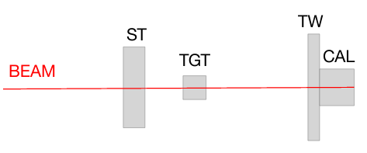
Introduction
The aim of this presentation is to show the impact of the beam rate on the Z-ID and on the trigger efficiency using data taken from CNAO in November 2021
Beam: Carbon ions with
1) E=200 Mev/N, Target: C, C2H4, Events (for cross section measurement)
2) E=(150, 300, 400)MeV/N, Target: C, Events (for calibration purposes)
Marco Bon

Slide 3
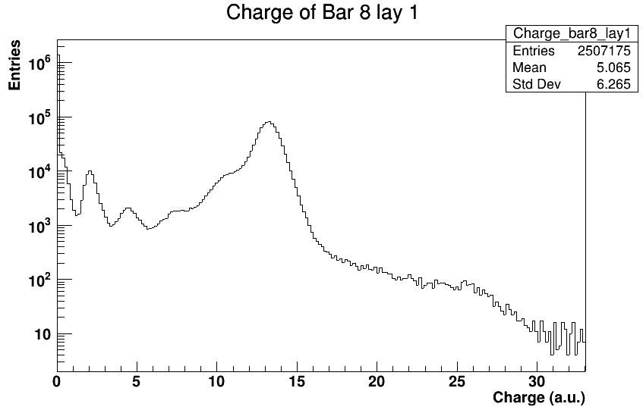
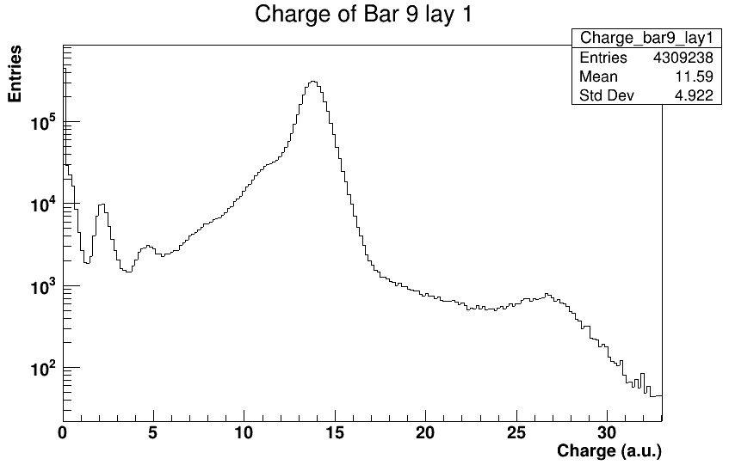
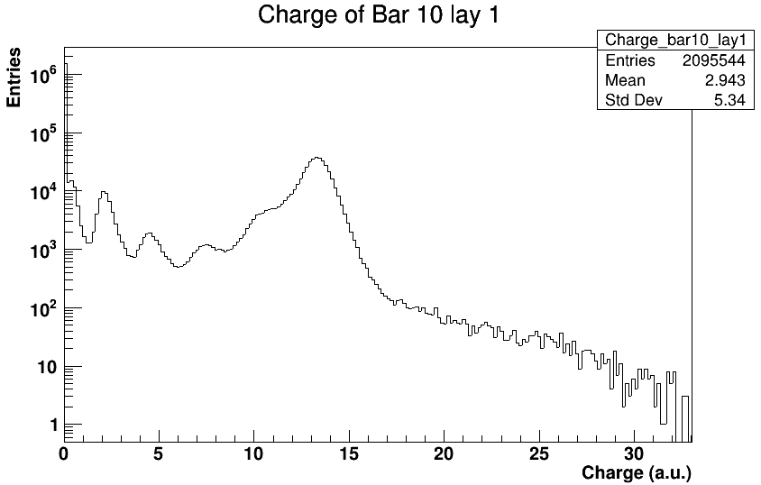
Charge in the central bars
In the central bars (8-9-10) we don’t see clearly the expected peaks
200 MeV/u — All run
DATA
DATA
DATA
Marco Bon

Slide 4
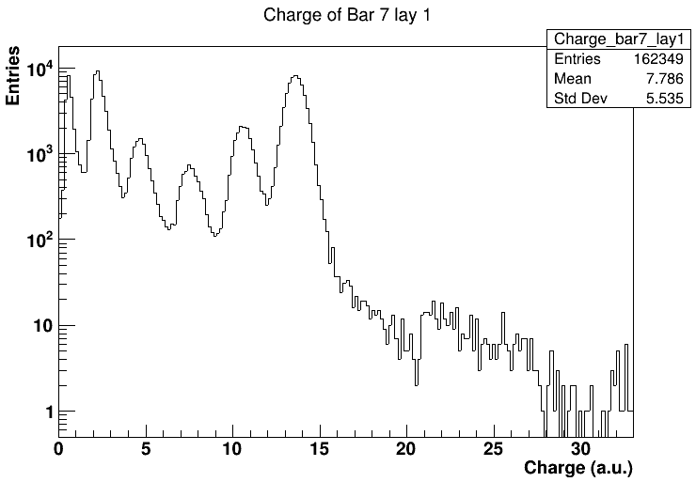
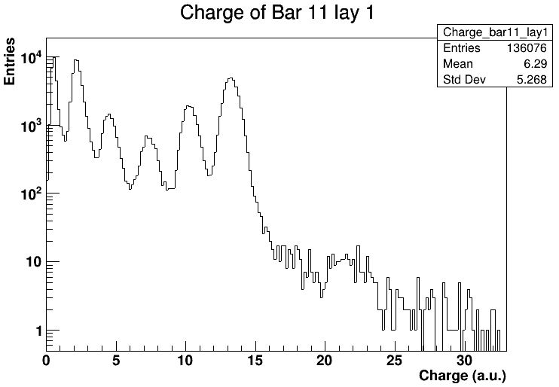
Charge in bars 7-11
For the “lateral” bars we don’t have the same effect
200MeV/N — All runs
DATA
DATA
Marco Bon

Slide 5
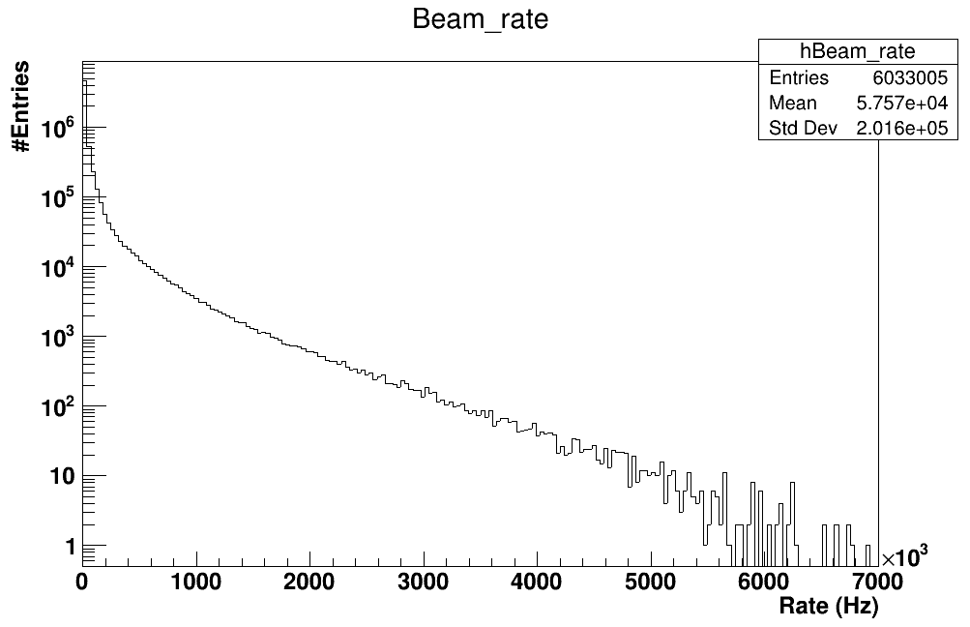
Beam rate
In order to understand the problem we studied the rate.
200 MeV/u — All run
1st NIGHT
E (MeV/u) | Runs | Trigger | Mean beam rate (kHz)
200 | 751-865 | MB | 20.1
200 | 1000-1093 | MB | 23.8
200 | 1100-1446 | MB+frag | 67.9
2nd NIGHT
200 | 2000-2091 | MB | 18.6
200 | 2100-2470 | MB | 18.4
200 | 2500-2959 | MB | 13.7
200 | 3300-3969 | MB+frag | 95.8
200 | 4000-4226 | MB+frag | 65.3
Values of the order of MHz
3rd NIGHT
200 | 10000-10035 | MB+frag | 54.9
200 | 10900-11069 | MB | 15.9
150 | 10650-10893 | MB | 93.2
150 | 10200-10624 | MB+frag | 175
300 | 11100-11231 | MB | 57.6
300 | 9660-9859 | MB+frag | 165
400 | 11300-11475 | MB | 21.5
400 | 9200-9957 | MB+frag | 52.1
Marco Bon

Slide 6
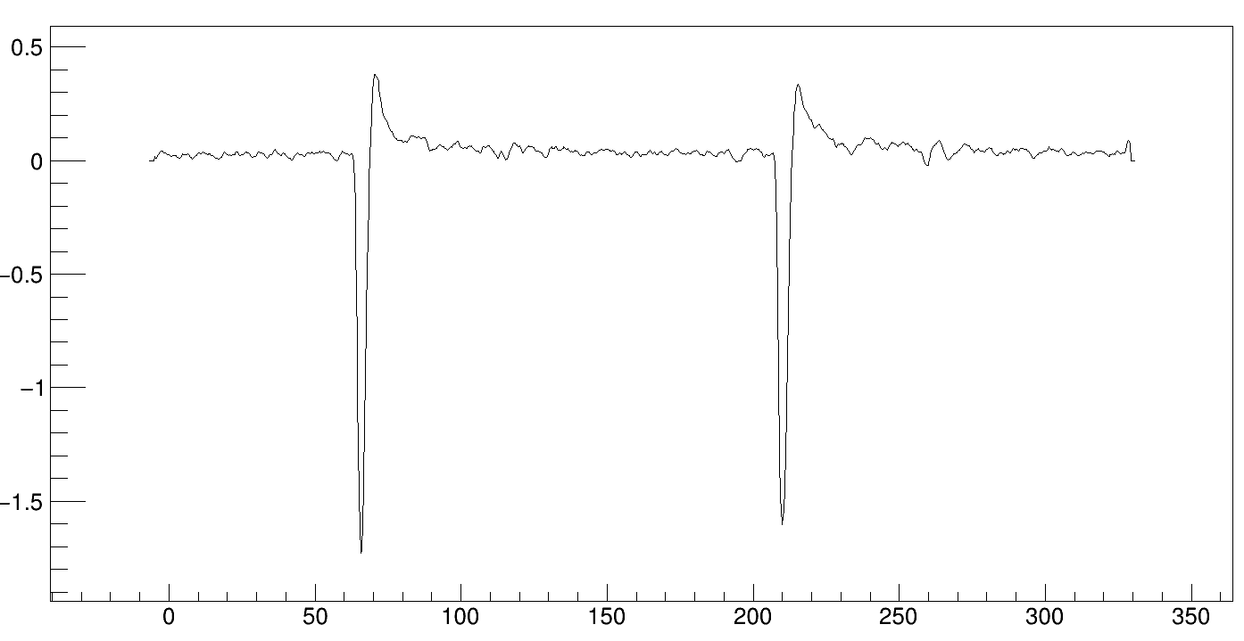
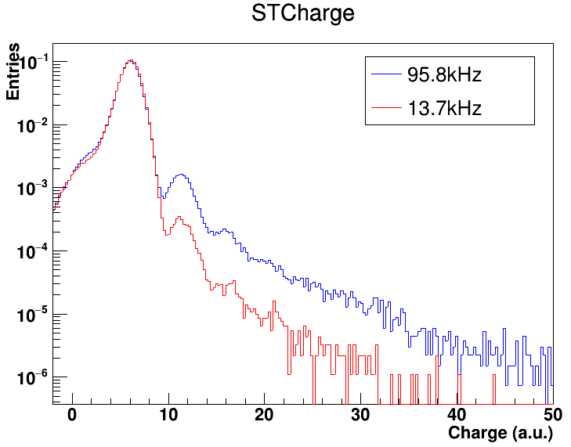
Pile-up estimation
ST waveform
Amplitude (mV)
Because of this high rate we tried to quantify the pile up with the start counter
t (ns)
1st NIGHT
E (MeV/u) | Runs | Trigger | Mean beam rate (kHz)
200 | 751-865 | MB | 20.1
200 | 1000-1093 | MB | 23.8
200 | 1100-1446 | MB+frag | 67.9
Pile-up (%)
0.49
0.50
1.62
STCharge
1C
2C
2nd NIGHT
200 | 2000-2091 | MB | 18.6
200 | 2100-2470 | MB | 18.4
200 | 2500-2959 | MB | 13.7
200 | 3300-3969 | MB+frag | 95.8
200 | 4000-4226 | MB+frag | 65.3
0.48
0.50
0.42
2.27
1.71
3C
…
3rd NIGHT
200 | 10000-10035 | MB+frag | 54.9
200 | 10900-11069 | MB | 15.9
1.71
0.46
Marco Bon

Slide 7
Pile-up estimation
The fraction of pile up events depends on the beam rate and it varies between 0.4% and 2.5% within all the acquired runs
The estimated pile-up is not enough to justify the absence of peaks in the central bars
Marco Bon

Slide 8
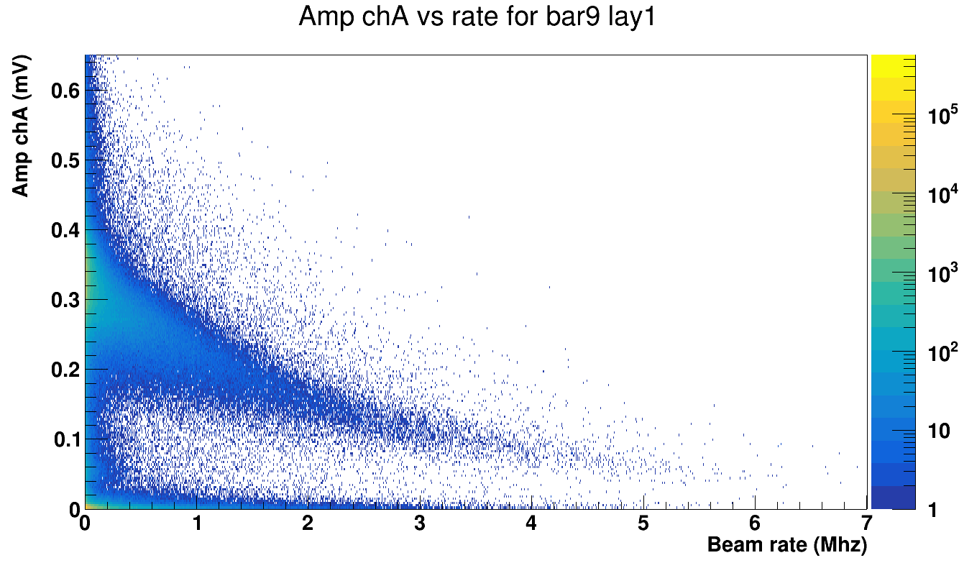
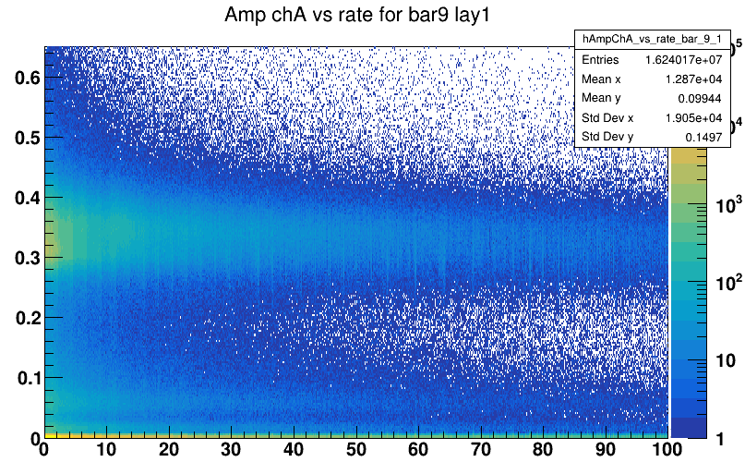
TW Amplitude vs rate for the central bars
At high rates the TW is not able to correctly compute the charge
200 MeV/u — All runs
Amp chA (mV)
ZOOM
Beam rate(kHz)
Marco Bon

Slide 9
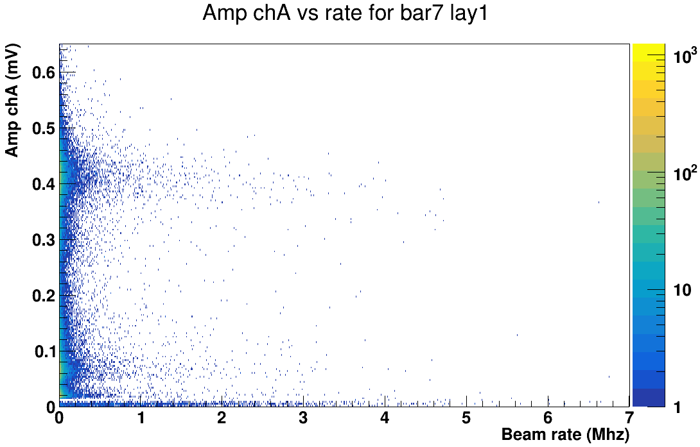
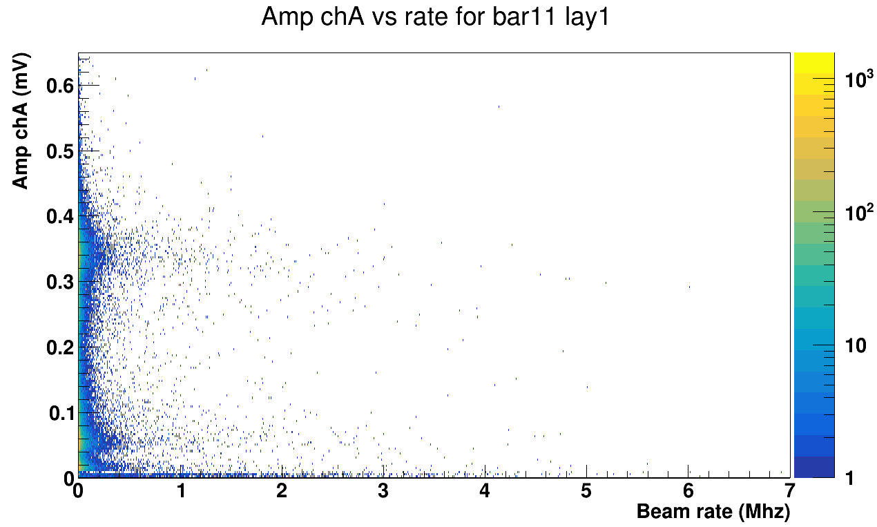
TW Amplitude vs rate for the lateral bars
For the “lateral” bars we don’t have the same effect
200 MeV/u — All runs
Marco Bon

Slide 10
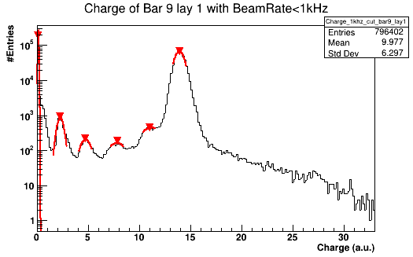
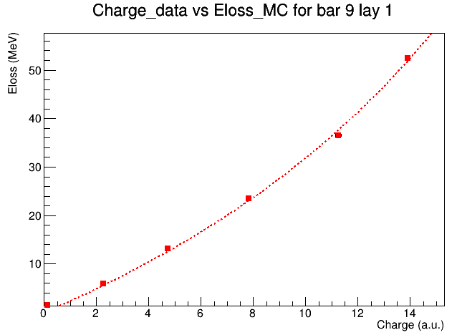
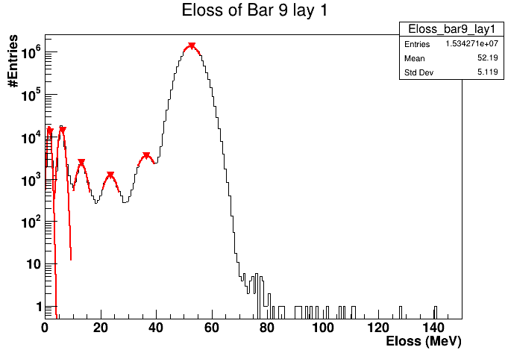
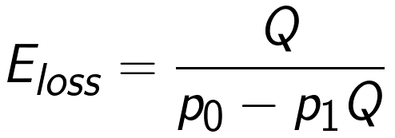
Energy loss calibration
Calibration used for GSI data does not fit well on CNAO data. In order to calibrate the charge with the Eloss_MC for all bars separately Birks law was used.
For the central bars, most affected by the high beam rate, to make the peaks more visible, a cut was placed on the charge distributions, imposing that Beam_Rate<1kHz
DATA
MC
Marco Bon

Slide 11
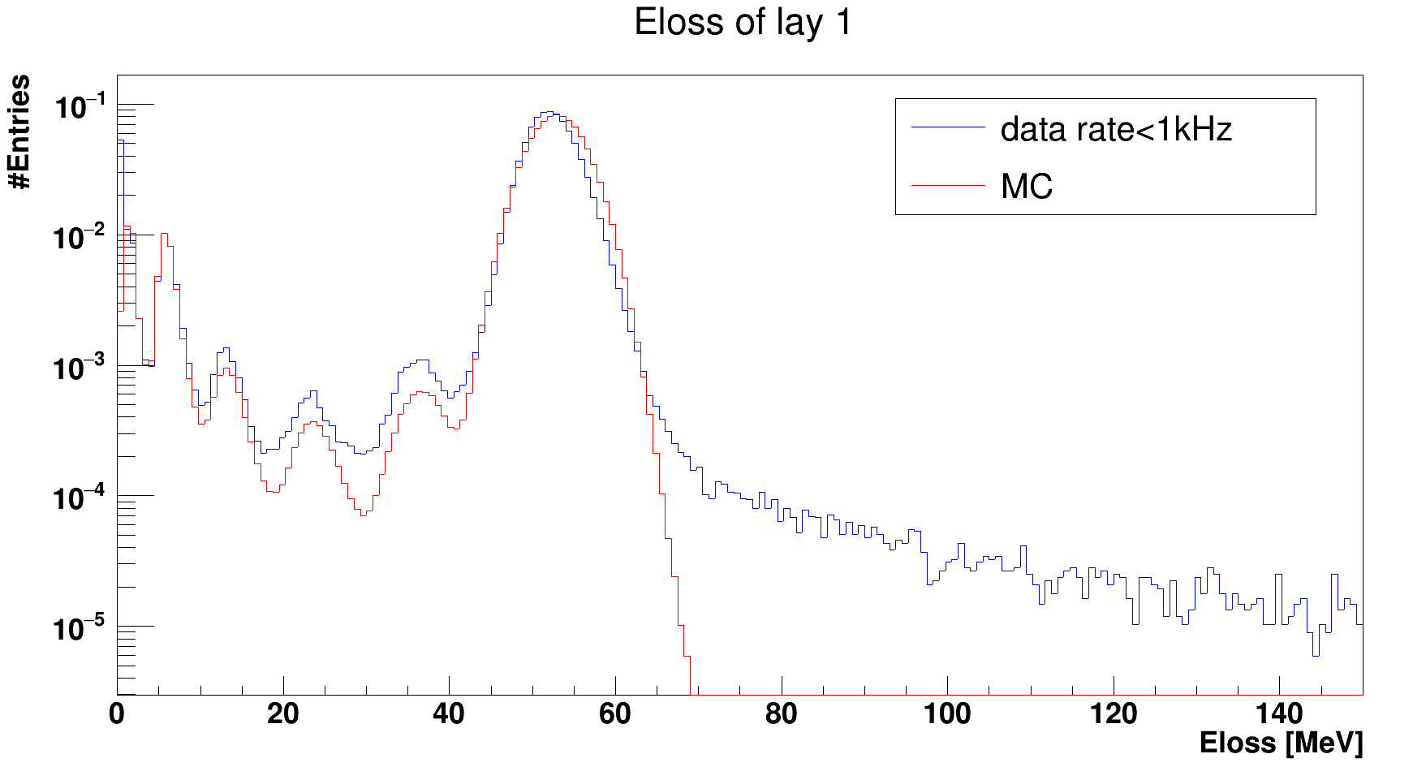
Energy loss calibration
The calibration works quite well. Here is reported the Eloss of the whole layer 1 after calibration compared with the MC
200 MeV/u - All runs
Marco Bon

Slide 12
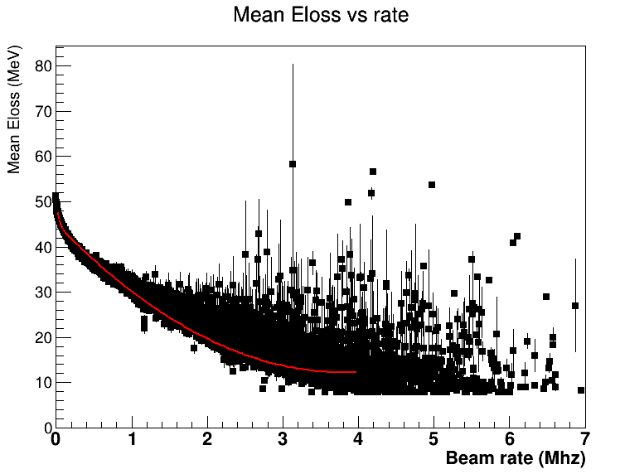
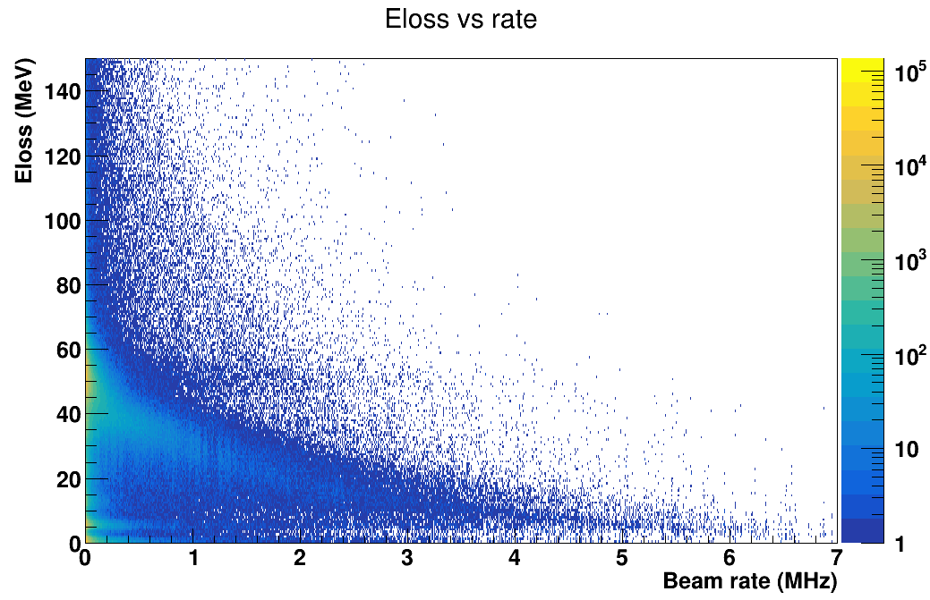
Introducing the rate into MC simulation
In order to parameterize the Eloss response to the beam rate, we did a smearing of the MC based on experimental data.
To do this, we studied the average Carbon peak value of the central bars as a function of the beam rate.
DATA
ProfileX( )
Marco Bon

Slide 13
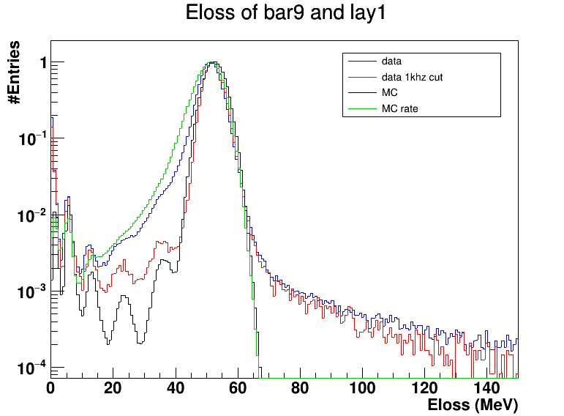
Introducing the rate into MC simulation
200 MeV/u — Only MB
Marco Bon

Slide 14
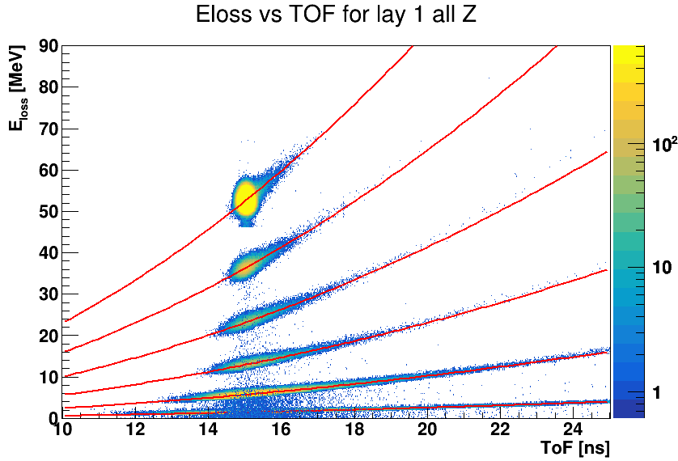
Z identification
In order to apply the Z reconstruction algorithm we have to find the Bethe-Bloch parameters
Only the primary fragments produced in the interaction of the beam with the TG are considered.
MC
Marco Bon

Slide 15
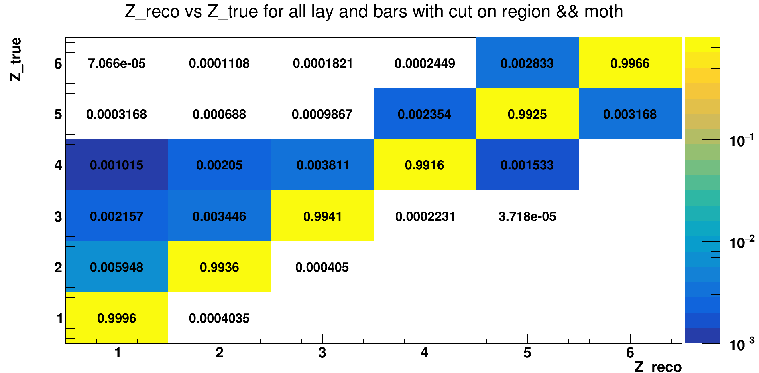
Z identification - no rate
We studied the performance of Z-ID on the reconstructed hit with only the experimental resolution (NO RATE)
Marco Bon

Slide 16
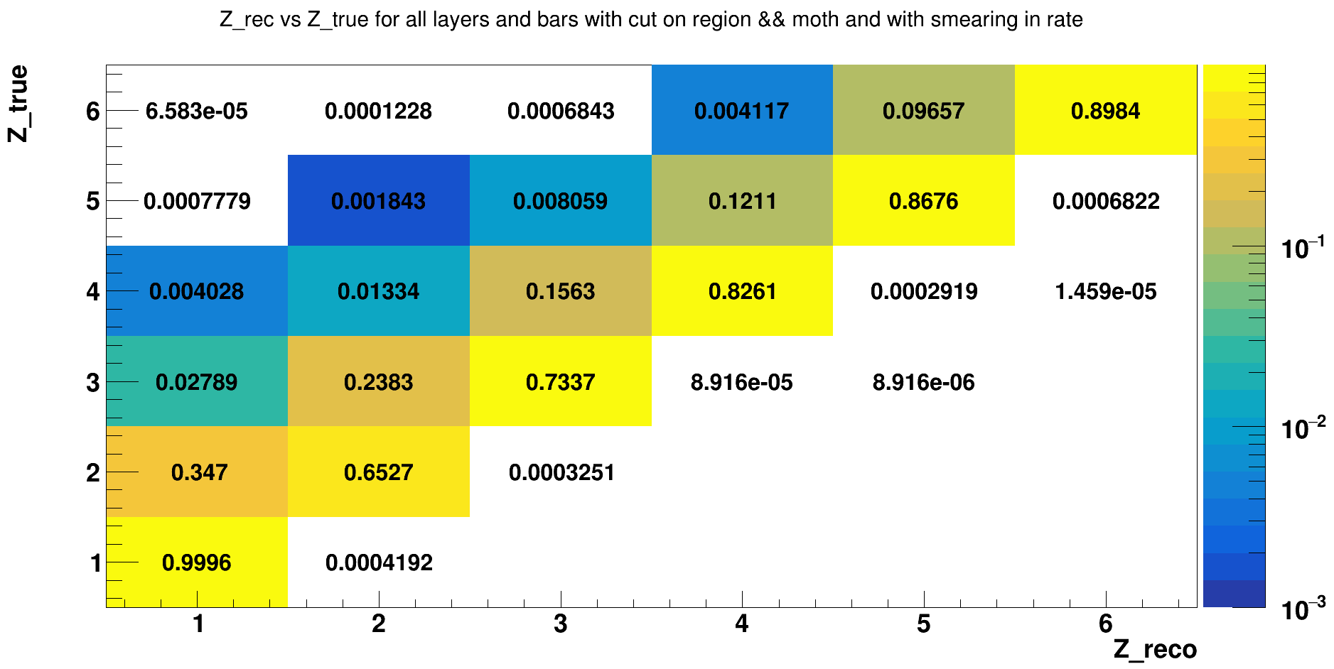
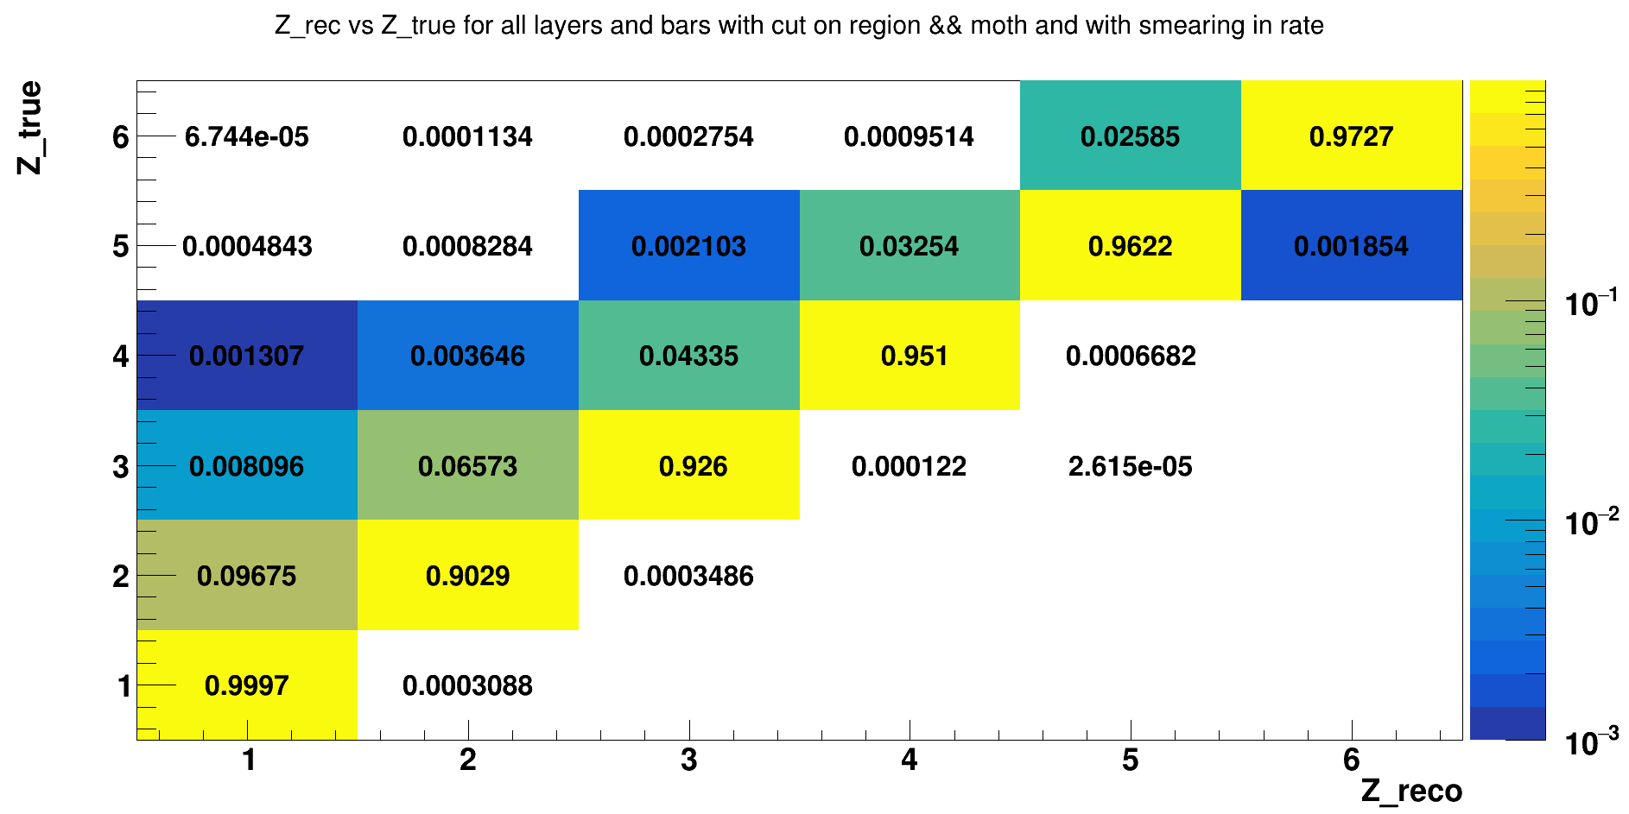
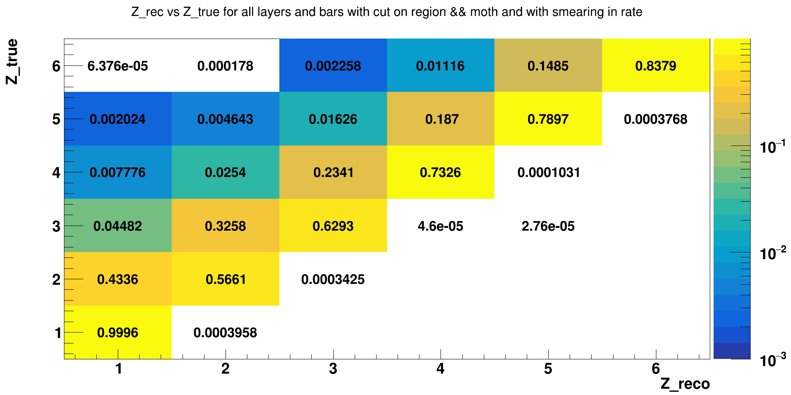
Z identification - rate
At 13kHz the rate effect on the reconstructed hit is not too evident
55kHz
13kHz
96kHz
Marco Bon

Slide 17
Trigger efficiencies
We also studied the impact of the beam rate on trigger efficiency using the calibrated and reconstructed data
number of points acquired with the MB trigger that would have fired the fragmentation trigger.
number of points acquired with the MB trigger
Marco Bon

Slide 18
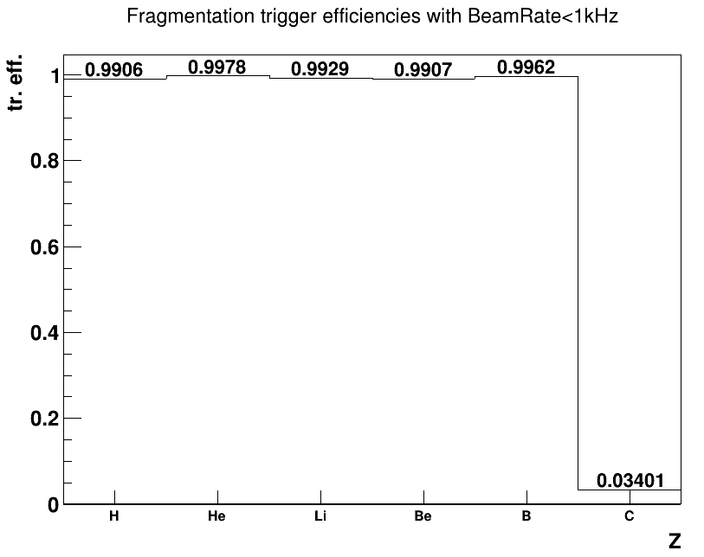
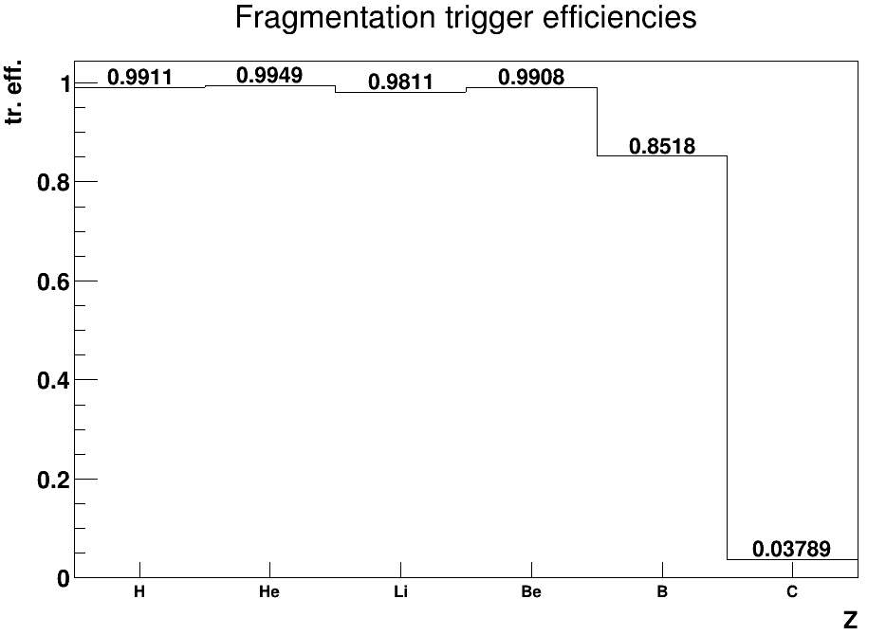
Trigger efficiencies -13 kHz
We focused our attention on the run in which the mean beam rate was 13kHz
For boron, the results are different from those of Lorenzo Marini's work, but taking the events below 1kHz, even with reconstruction (point), we get the same values.
200 MeV/u — run (2500-2959)
DATA
DATA
1kHz cut
Marco Bon

Slide 19
Conclusions
The fraction of pile up events is small (0.4%-2.5%)
We introduced in the MC simulation the effect of the beam rate to study
1. the performance of the Z-ID on the reconstructed hit
2. the trigger efficiency
We are trying to apply the efficincies to fragmentation data to recover the MB ones. At the moment there are some discrepances that we are checking…
At 13kHz the rate effect is not too evident
At 13kHz for boron fragments the trigger efficiency varies from 0.85 to 0.99 with a cut on the beam rate of 1kHz
Marco Bon

Slide 21
Conclusions
The fraction of pile up events is small (0.4%-2.5%)
We introduced in the MC simulation the effect of the beam rate to study
We studied the performance of Z-ID on the reconstructed hit. With a mean beam rate of 13kHz the (VUOI CHE QUANTIFICO QUANTO PERDIAMO IN EFFICIENZA DI RICOSTRUZIONE PER I SINGOLI FRAMMENTI a 13khZ? ACCENNO QUALCOSA SUI 55 E 96 KHZ?) rate effect is not too evident
We studied the impact of the beam rate on trigger efficiency. For a run in which the mean beam rate is 13 kHz, for boron fragments the trigger efficiency varies from 0.85 to 0.99 with a cut on the beam rate of 1kHz. It is important to understand this behavior since the value of the trigger efficiency actively participates in the computation of the cross section.
Marco Bon

Slide 22
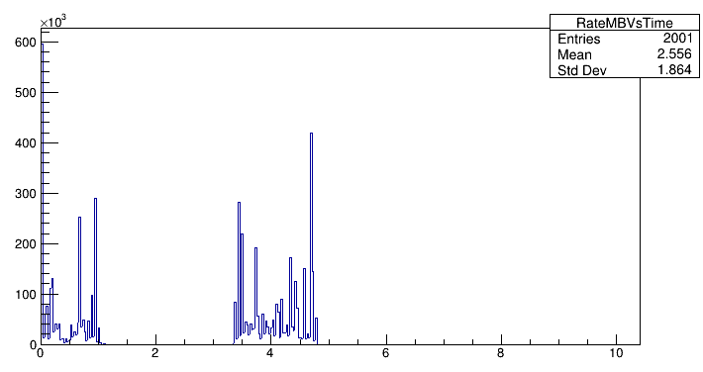
Spill structure
Even within the same run, the beam rate has many fluctuations
Spill structure
Rate MB (Hz)
t (s)
Marco Bon

Slide 23
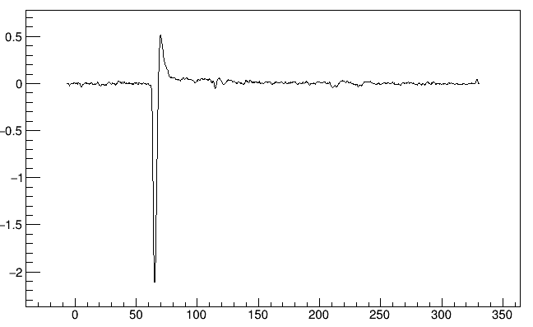
ST summed signal
In order to tag the pile up events, we used the ST
The ST has 8 channels. To compute the charge, the summed signal is integrated
The mean and standard deviation of the amplitudes of the first part of the signal were taken in order to remove the positive overshoot induced by a high pass filter.
The signal integral is computed excluding the samples with
Amplitude (mV)
t (ns)
Marco Bon

Slide 24
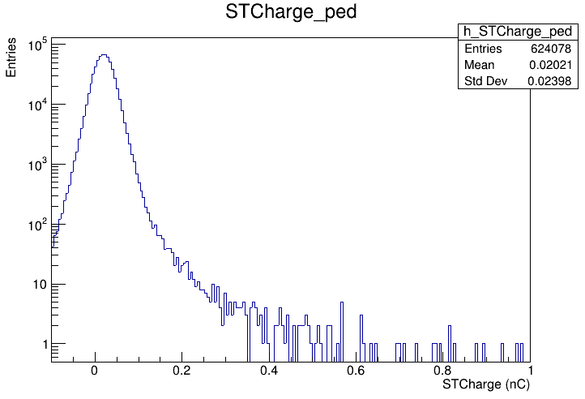
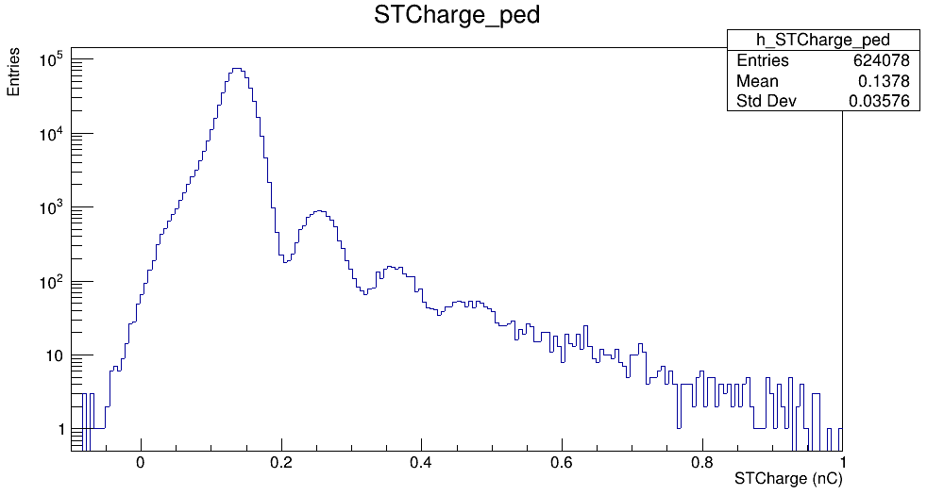
Pile-up estimation -1
E= 150MeV/N (MB)
With the ST we are able to tag the pile-up events.
The fraction of pile up events depends on the beam rate and it varies between 0.5% and 3% within all the acquired runs
1C
After removing the positive overshoot
2C
3C
…
Marco Bon

Slide 25
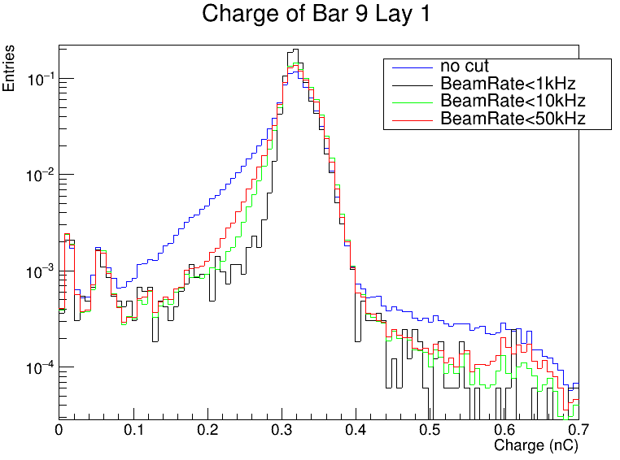
Selection on beam rate
Since we knew of the presence of high rate, we tried to put a cut directly on the beam rate
150MeV/N (MB)
Mean beam rate= 93kHz
We have normalized the distributions to see how the shape changes
By applying the cuts we’ve lost:
1) 1kHz->96% of the events
2) 10kHz->46% of the events
3) 50kHz-> 24% of the events
Marco Bon

Slide 26
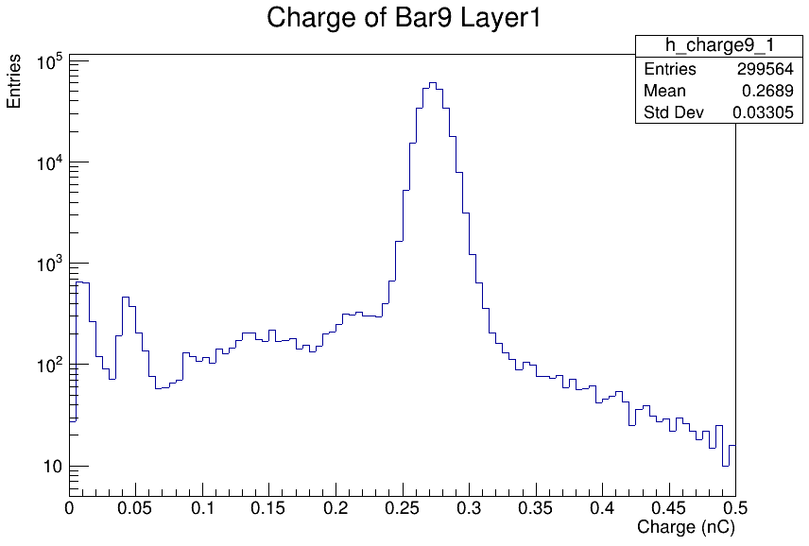
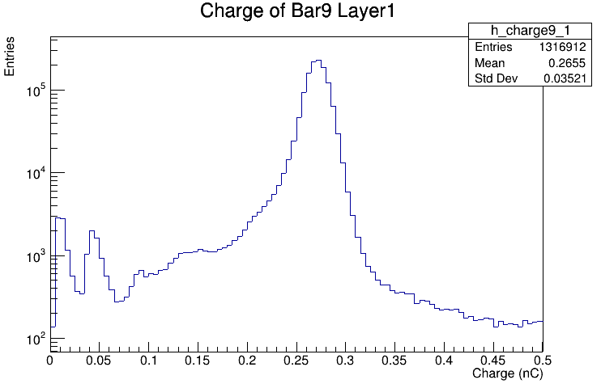
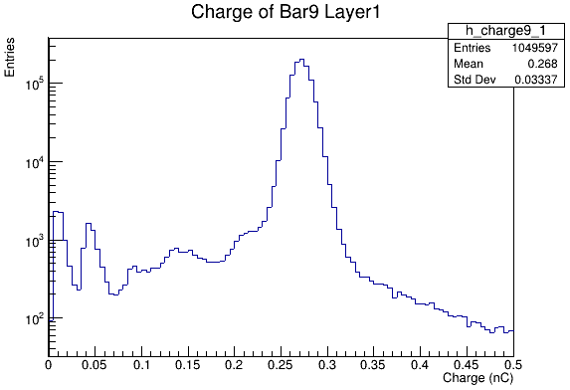
Beam rate -3
Beam_rate<1 kHz
Since we knew of the presence of high rate, we tried to put a cut directly on the beam rate
E=200 MeV/N (MB)
Without cut
Beam_rate<10 kHz
Marco Bon

Slide 27
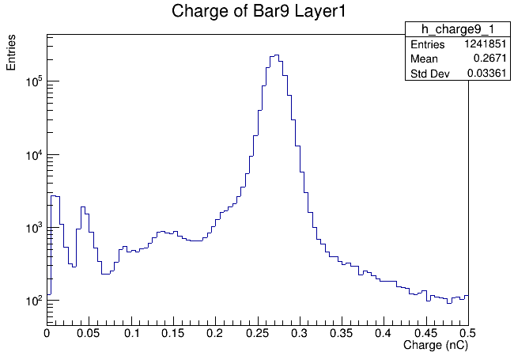
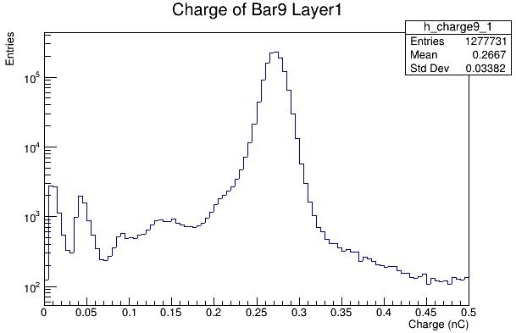
Beam rate -3
Beam_rate<50 kHz
If we impose cuts on the Beam_rate, the charge distributions improve slightly
E=200 MeV/N (MB)
Without cut
Beam_rate<100 kHz
Marco Bon

Slide 28
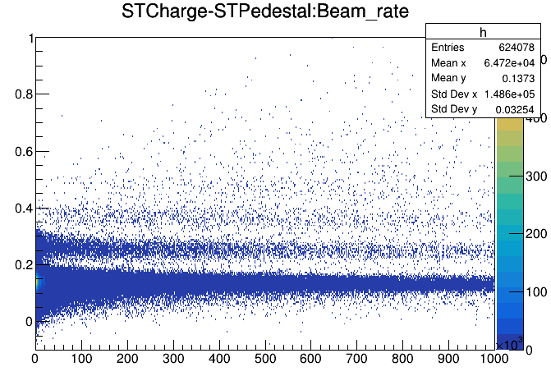
Marco Bon

Slide 29
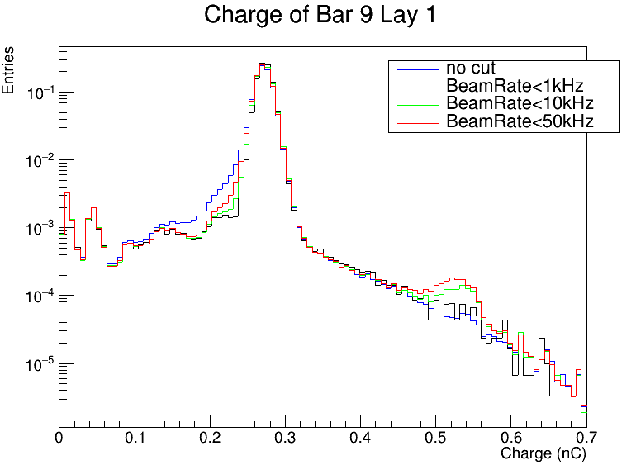
200MeV/N
Marco Bon

Slide 30
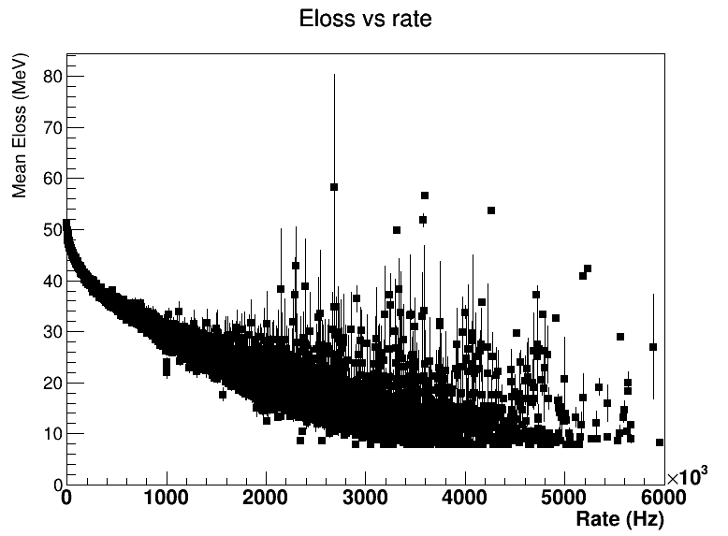
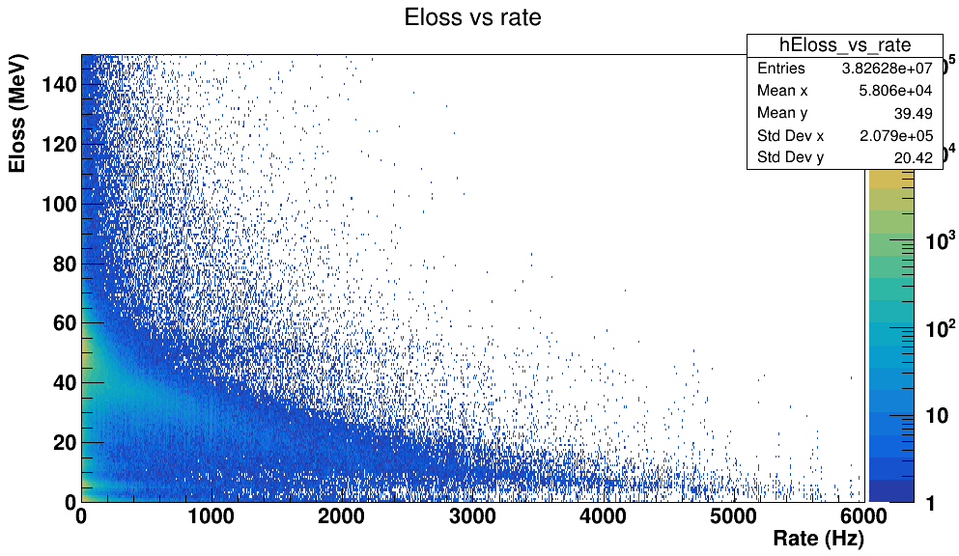
Introducing the rate into MC simulation
Without the rate, in order to introduce the sperimental resolution, a random value, taken from a Gaussian with G(mean=0, ), is summed to the MC_true
In order to parameterize the Eloss response to the beam rate, the mean value of the Eloss at fixed rate was taken:
ProfileX( )
Marco Bon

Slide 31
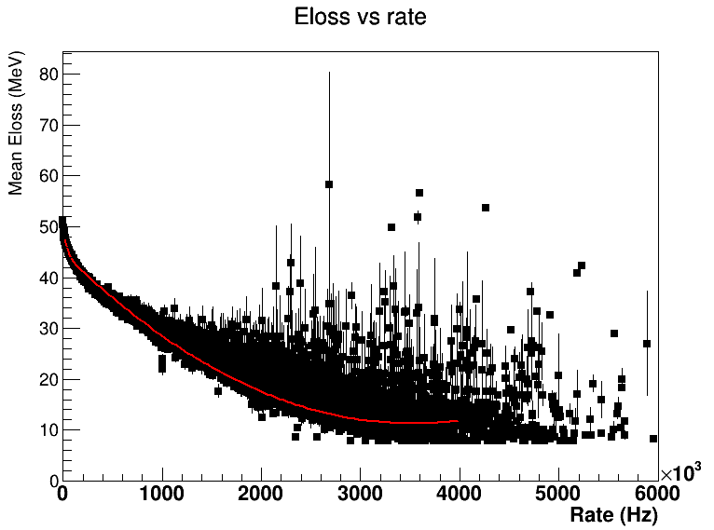
Introducing the rate into MC simulation
To implement our dependent-rate model, we performed a fit with the function:
Marco Bon

Slide 32
Introducing the rate into MC simulation
From this distribution, a random value “r” is extracted from the rate distribution. To this random value is associated a smeared E(r).
Let E(1) be the value of energy when the rate is 1kHz, it is possible to define the shift in energy caused by the beam rate
shift = E(r) - E(1)
E(1)
.
E(r)
r
With this value it is possible to introduce the smearing caused by the rate in the MC simulation by summing a random value from a Gaussian with
G(mean= shift, )
to the MC_true
Marco Bon

Slide 33
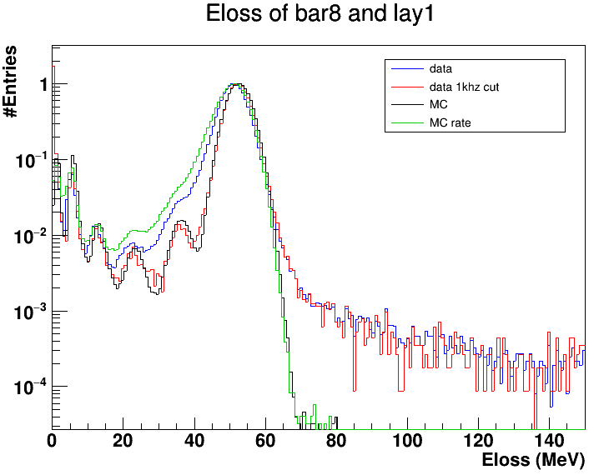
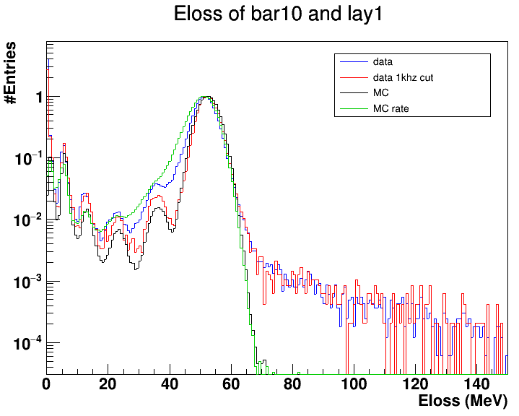
Introducing the rate into MC simulation
200 MeV/u — Only MB
Marco Bon

Slide 34
Introducing the rate into MC simulation
To implement our dependent-rate model, we performed a fit with the function:
p0 | 44.8
p1 | 5.9
p2 | 2.7 E4
p3 | -1.9 E-5
p4 | 2.7 E-12
Marco Bon

Slide 35
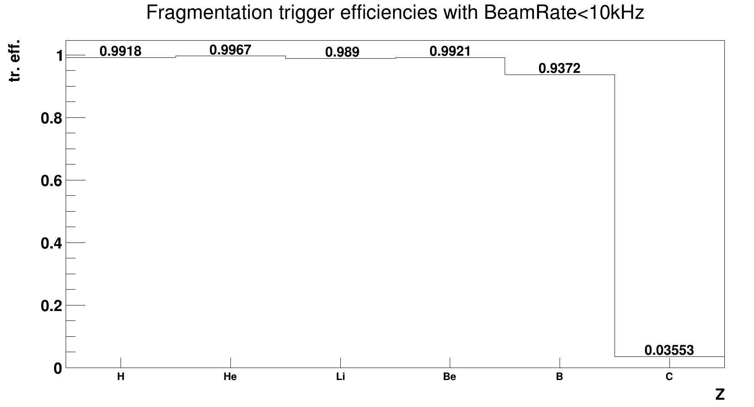
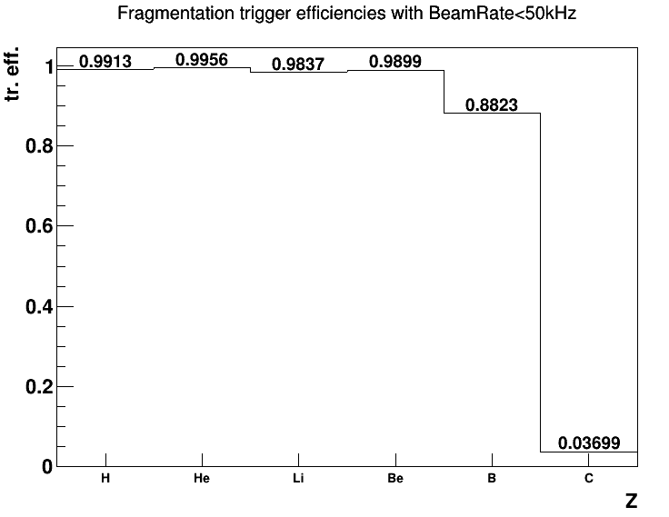
Trigger efficiencies
Marco Bon

Slide 36
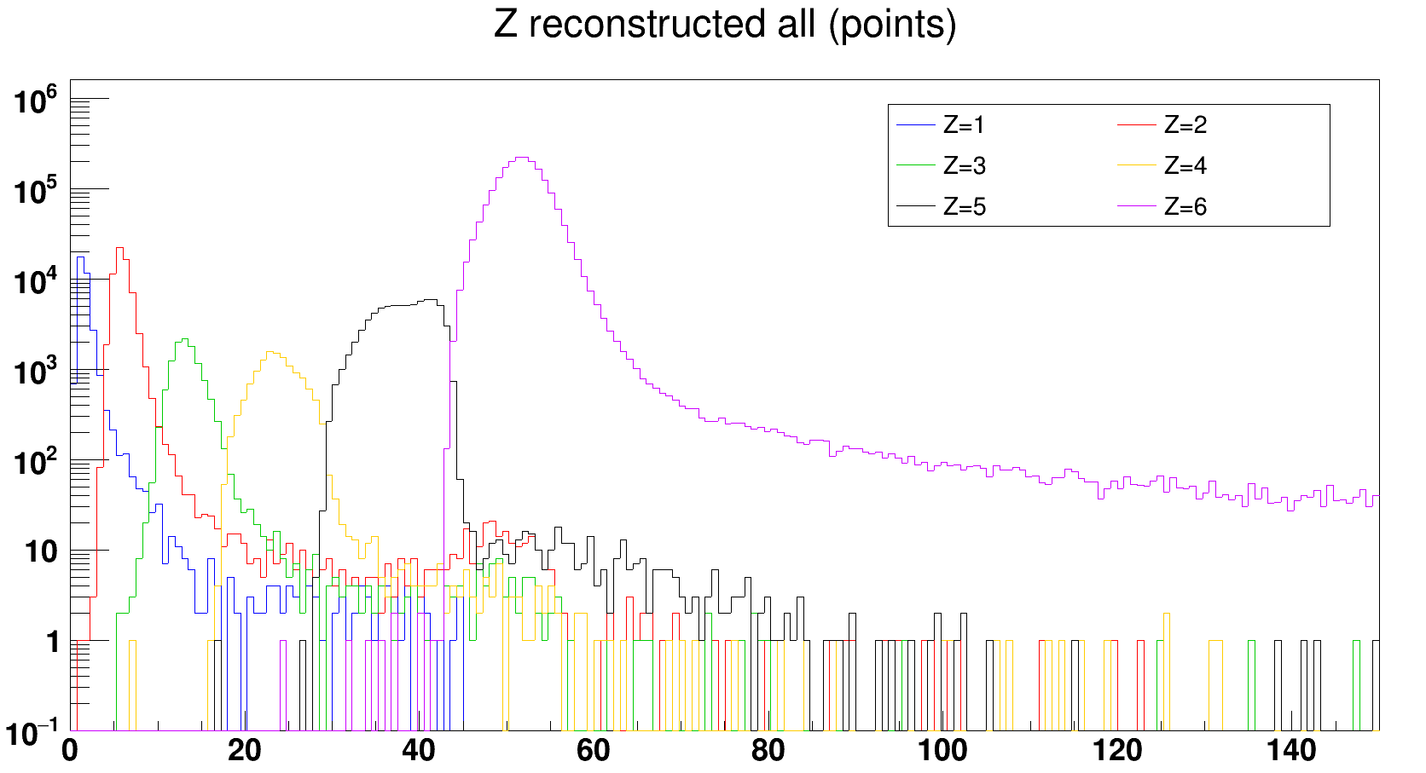
Z reconstruction
MB
Marco Bon

Slide 37
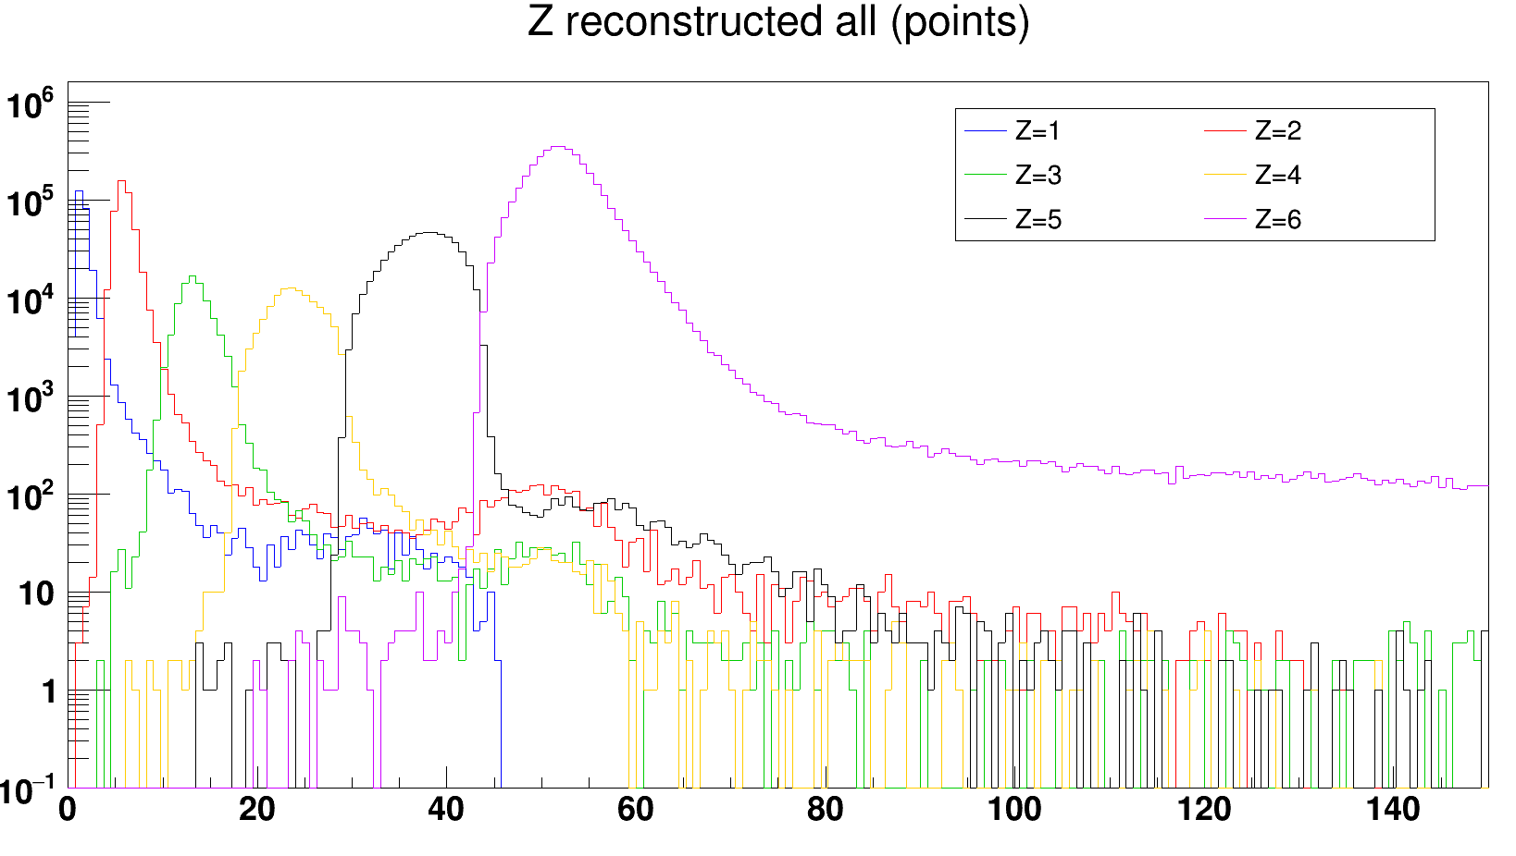
Z reconstruction
MB+frag
Marco Bon

Slide 38
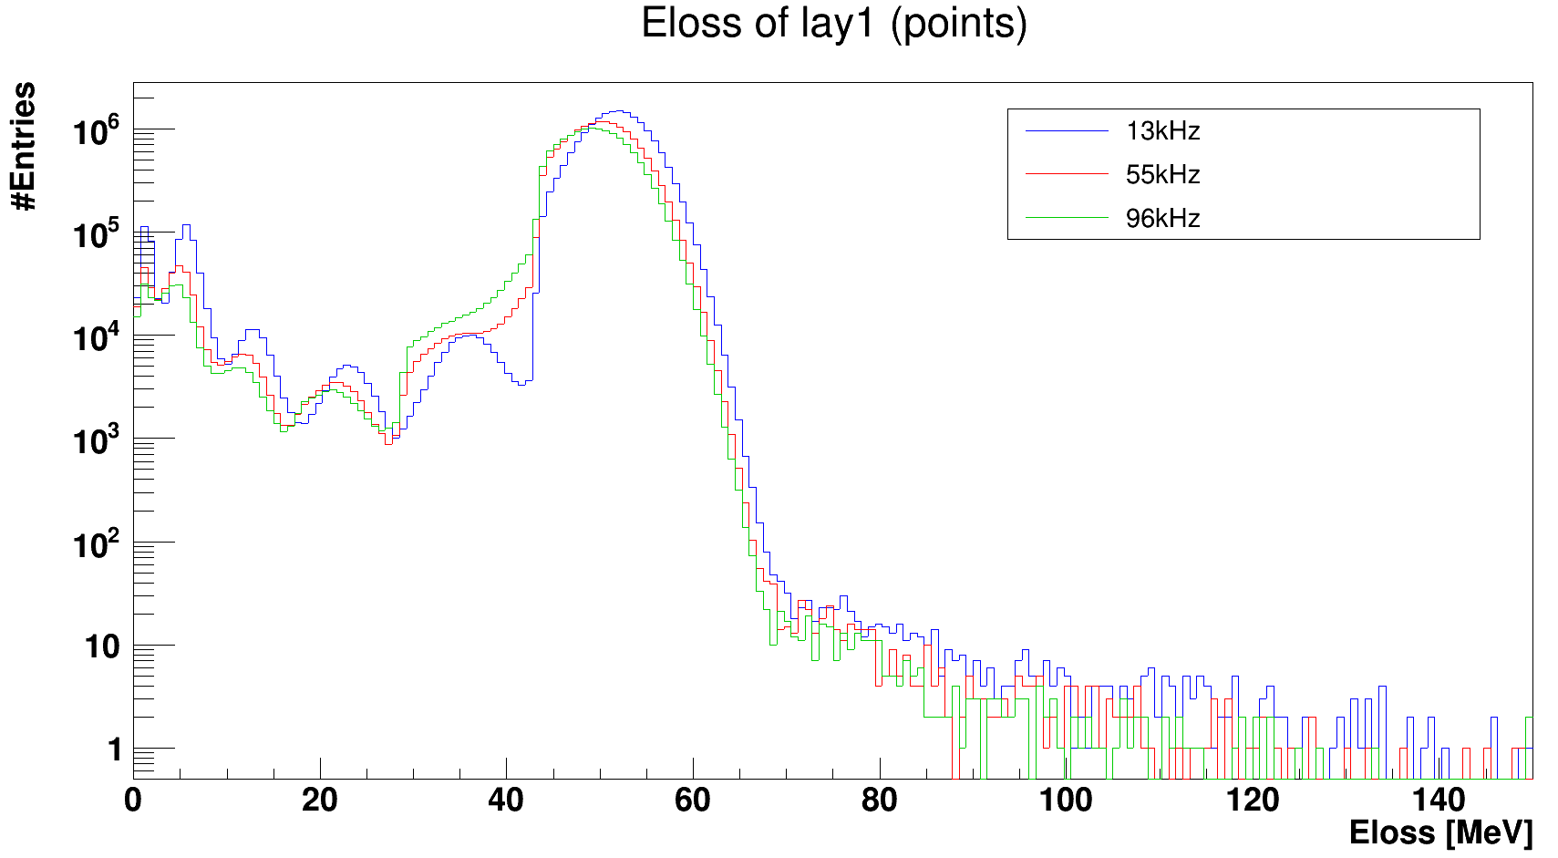
Z identification
By losing efficiency in reconstructing the Z on the single hit, when reconstructing the point (requiring that the Z of the two layers match), you lose statistics
MC
Rate (kHz) | Entries | Normalization
13 | 1.85 E7 | 1
55 | 1.56 E7 | 0.84
96 | 1.38 E7 | 0.74
Marco Bon

Slide 39
Z reconstruction
Marco Bon

Slide 40
Z identification
By losing efficiency in reconstructing the Z on the single hit, when reconstructing the point (requiring that the Z of the two layers match), you lose statistics
MC
Rate (kHz) | Entries | Normalization
13 | 1.85 E7 | 1
55 | 1.56 E7 | 0.84
96 | 1.38 E7 | 0.74
Marco Bon

