Slide 1

NEPTUNE
Nuclear process-driven Enhancement of Proton
Therapy UNrav Eled
WG-3: Microdosimetry
PoliMi, LNL, LNS, TIFPA
4th Annual NEPTUNE Collaboration Meeting
9th September 2022

Slide 2
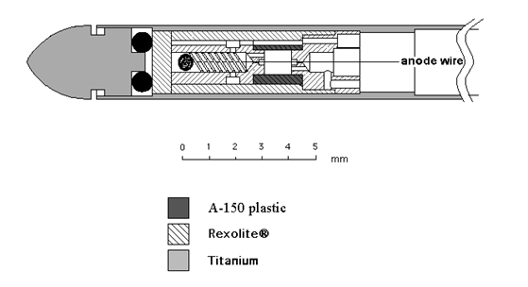
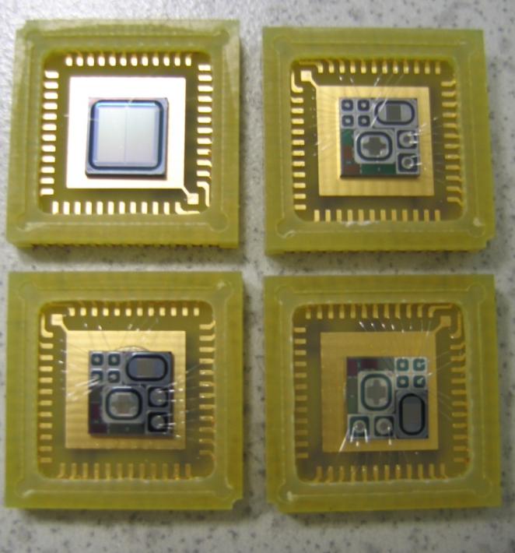
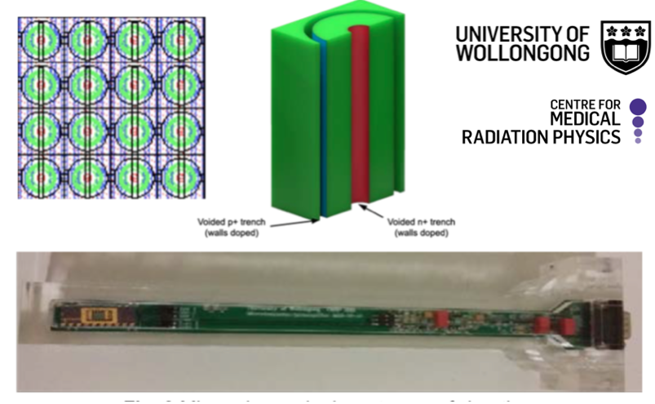
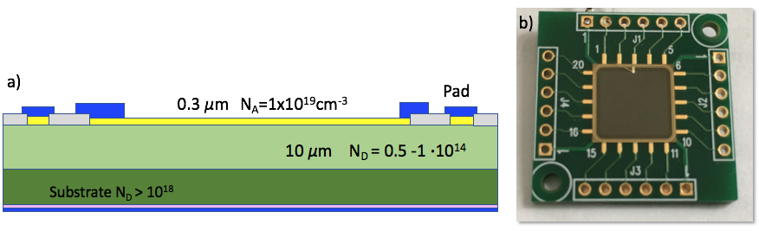
Detectors
Measurements of microdosimetric spectra across the proton Bragg peak with detectors with tissue-equivalent (TE) walls/converters unloaded and loaded with boron.
Proton irradiations performed at LNS (CATANA) and TIFPA.
Mini-TEPC (LNL)
Silicon Telescope (PoliMi)
MicroPlus probe (LNS)
Silicon Carbide Detector (LNS)

Slide 3
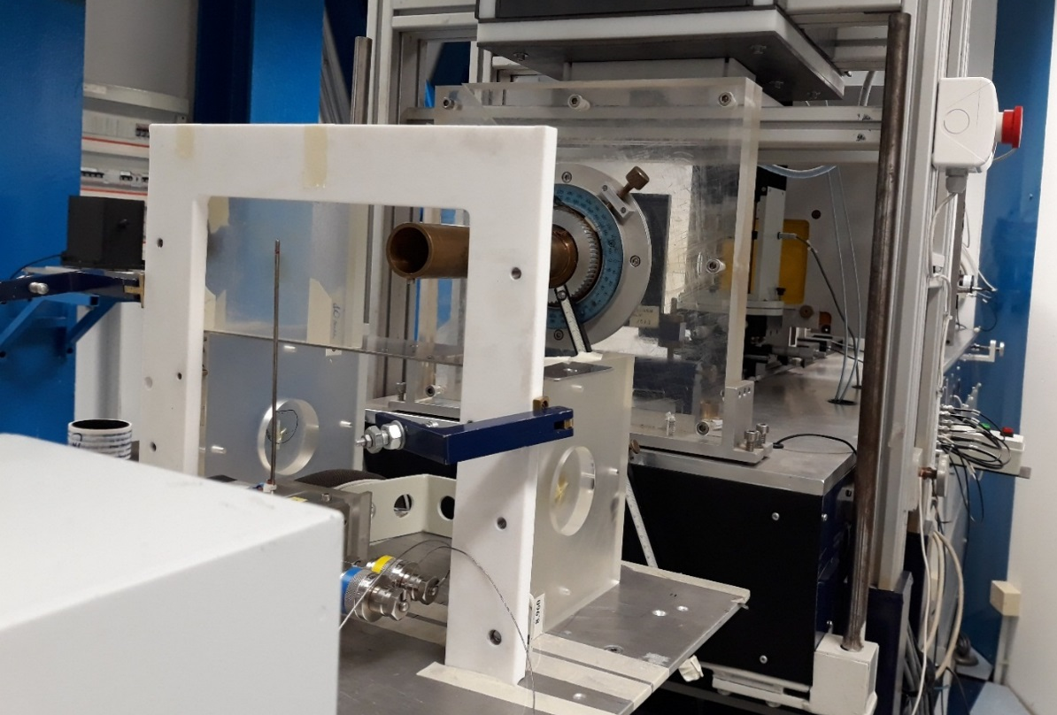
Experimental set-up at CATANA
62 MeV modulated proton therapy beam: range of 2.9 cm and modulation width of 1.1 cm
Measurements performed at different positions along the Spread‒Out Bragg Peak, corresponding to positions of clinical relevance (entrance, proximal, central, and distal end of the SOBP)

Slide 4
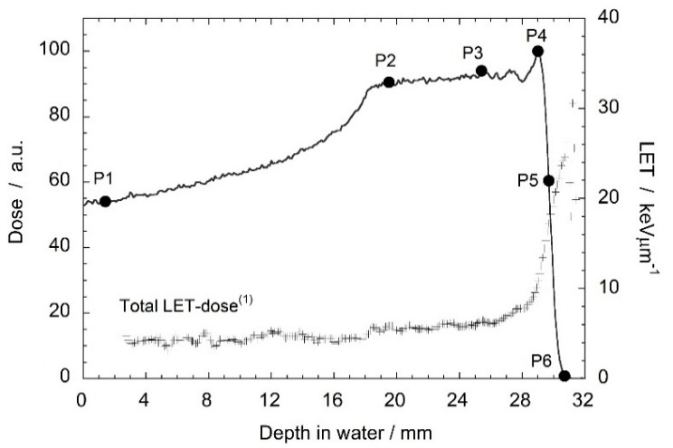
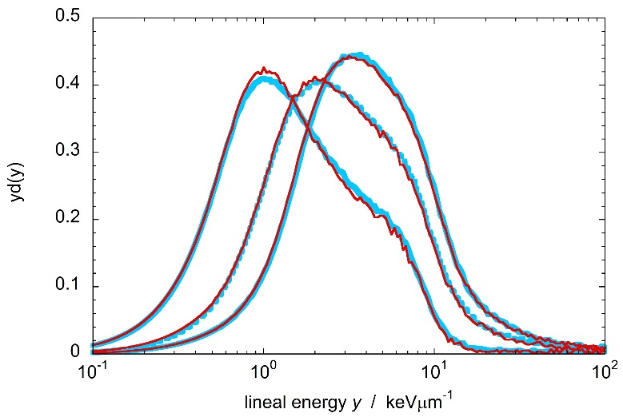
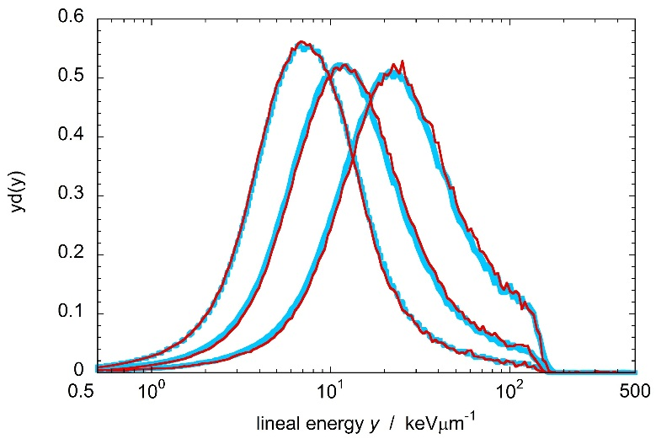
Reproducibility tests with mini-TEPC
Stability of the sealed mini-TEPC checked at 6 positions
Light blue: first shift of measurements
Red: second shift four months later
No significant difference detected

Slide 5
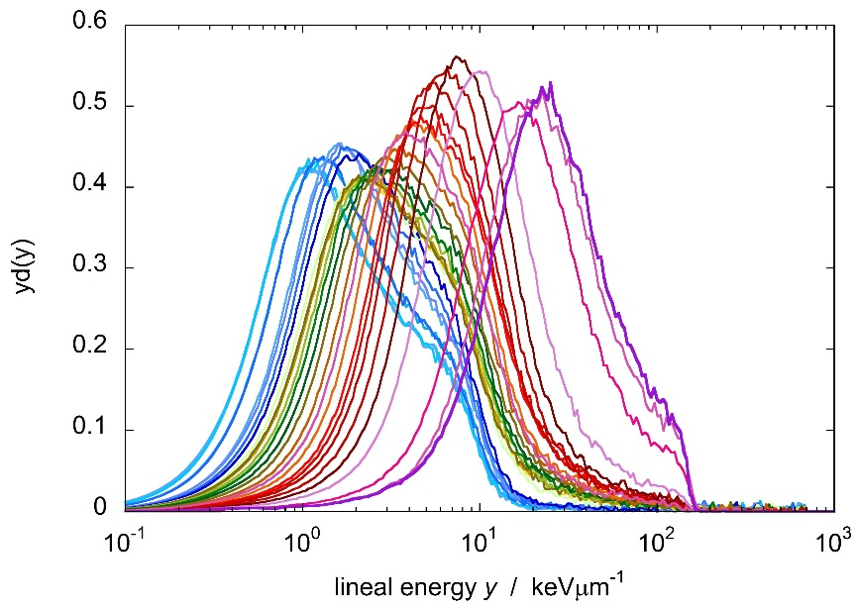
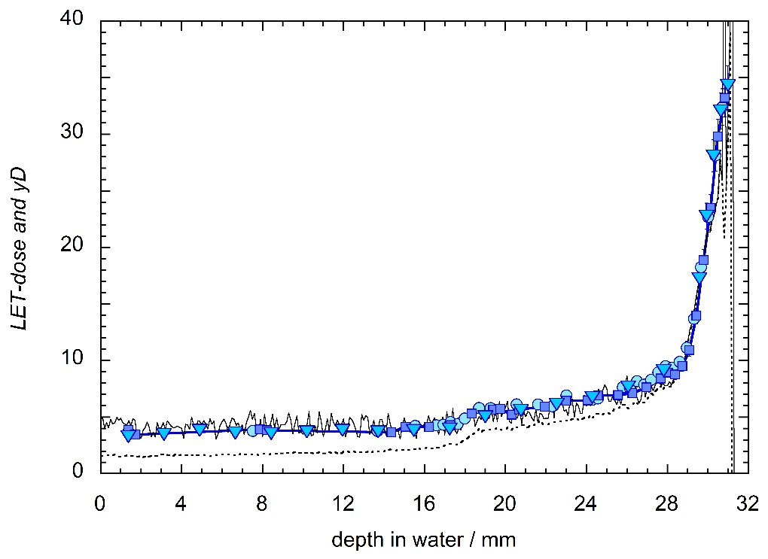
Reproducibility tests with mini-TEPC
Full SOPBP characterization
Three measurements campaigns
y_{D} models total LET-dose

Slide 6
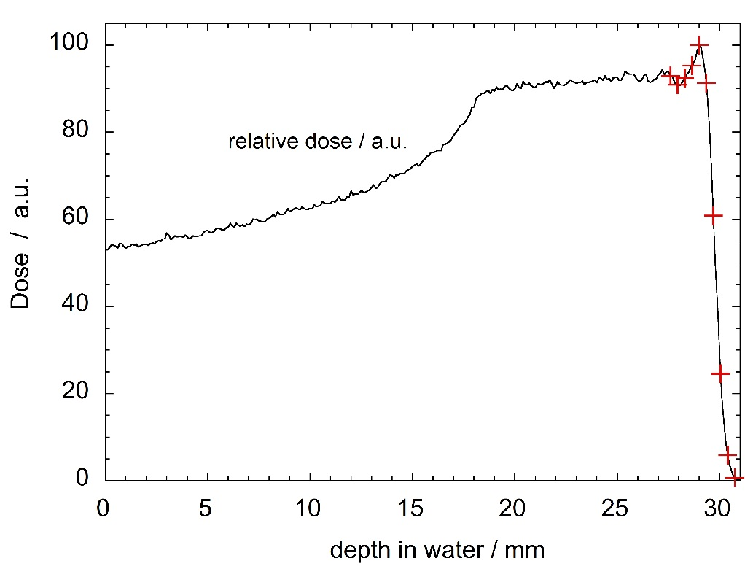
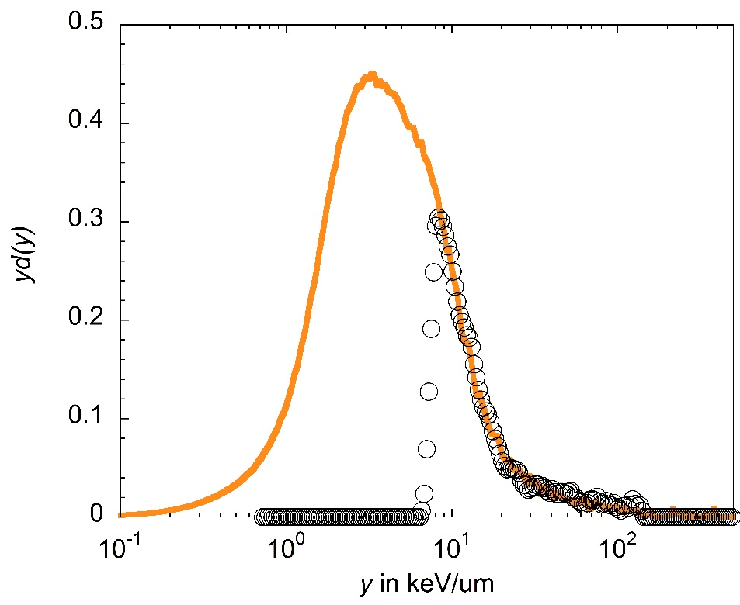
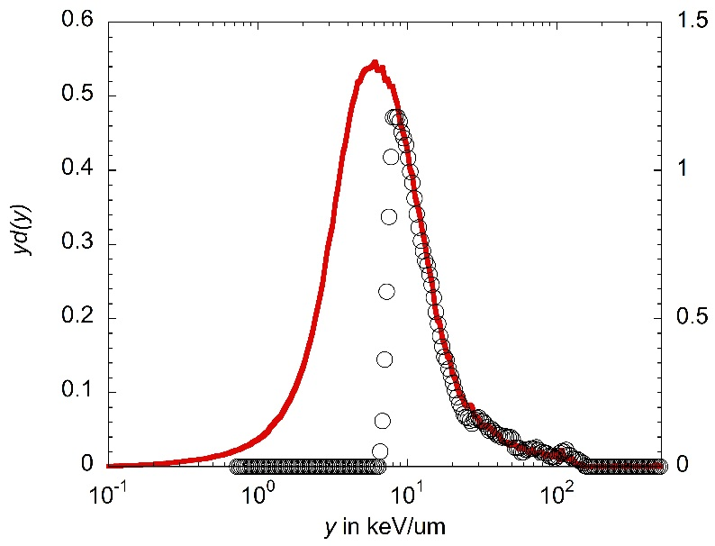
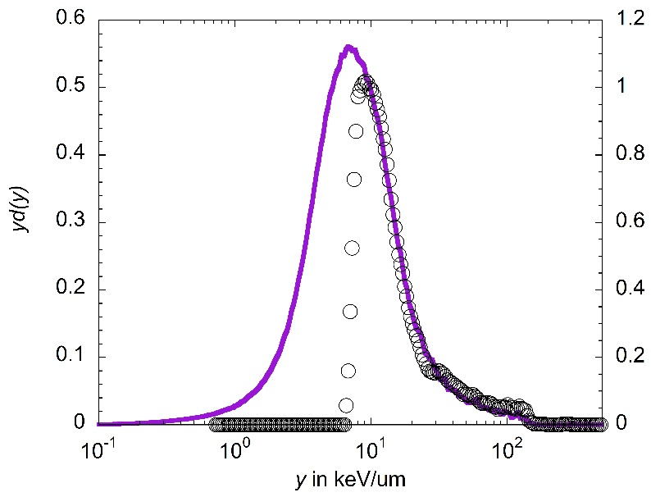
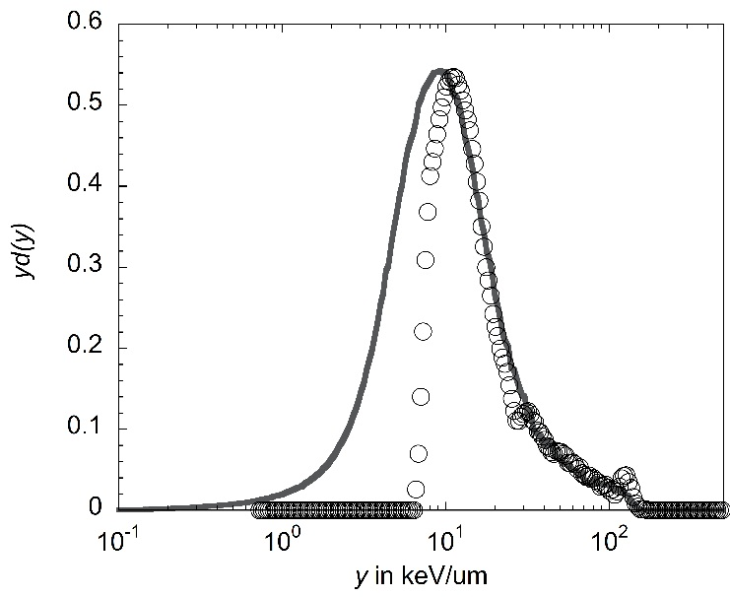
Results: comparison between mini-TEPC and silicon telescope
Mini-TEPC
Silicon telescope

Slide 7
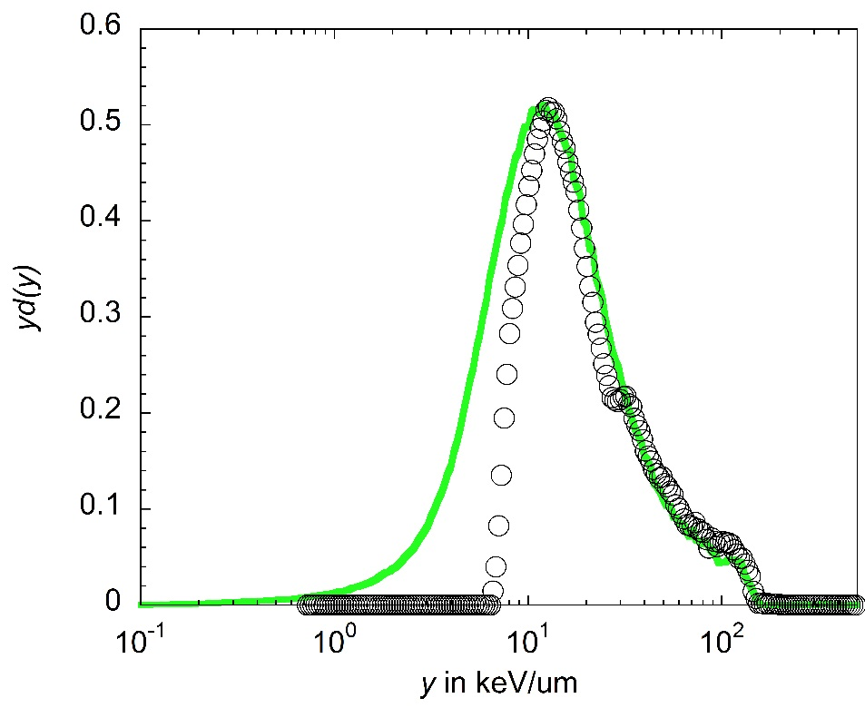
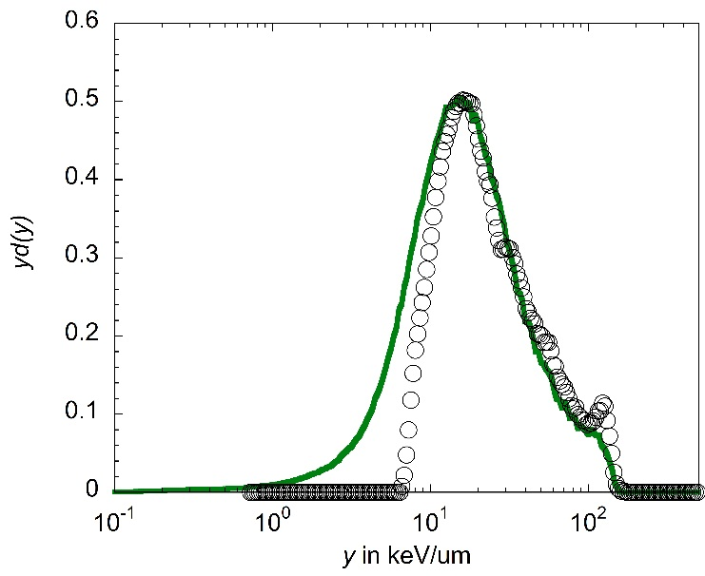
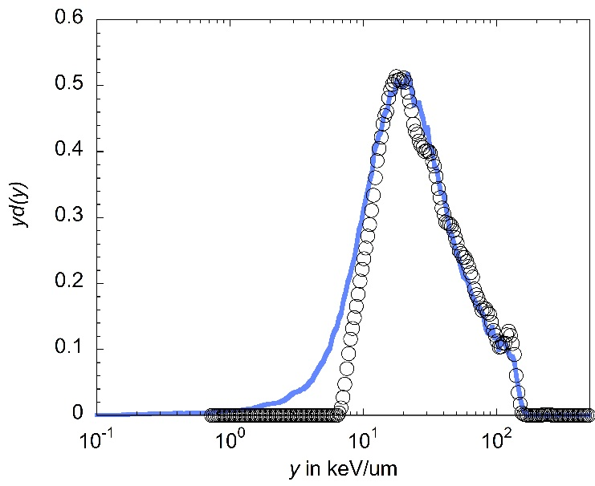
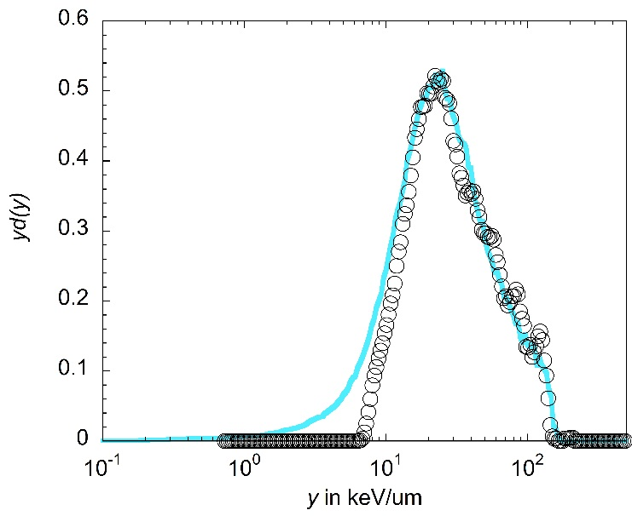
Results: comparison between mini-TEPC and silicon telescope

Slide 8
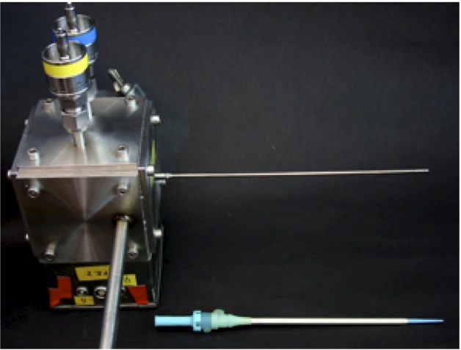
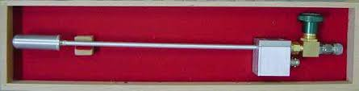
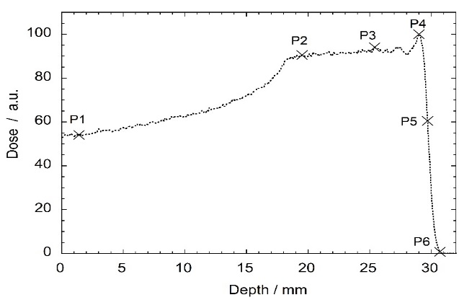
Results: comparison between mini-TEPC and FWT LET1/2
Mini-TEPC
(LNL)
FWT LET1/2
(TIFPA)

Slide 9
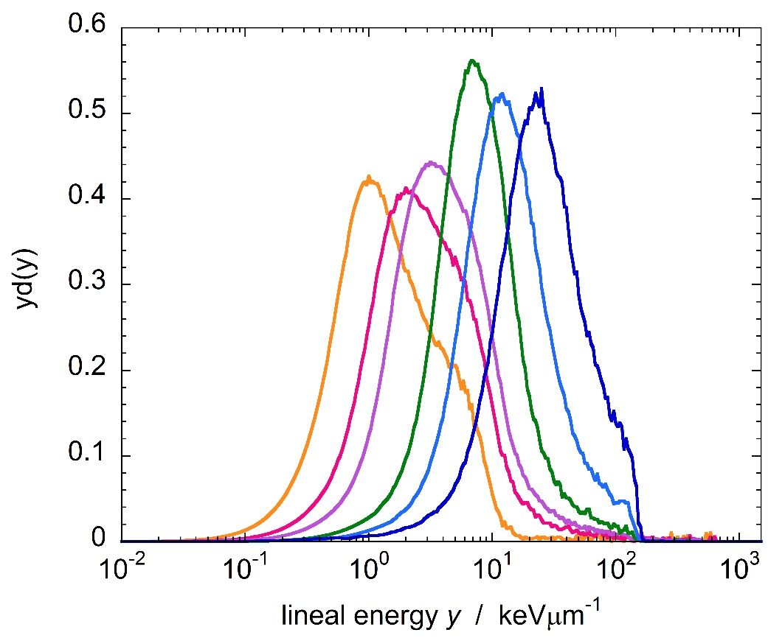
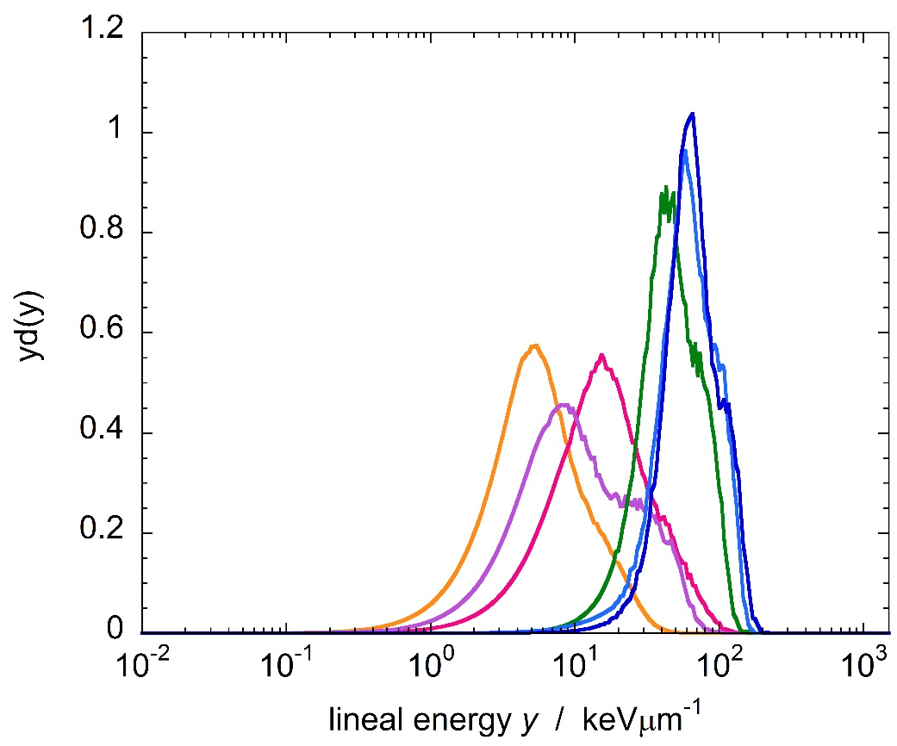
Results: comparison between mini-TEPC and FWT LET1/2
Mini-TEPC
FWT LET1/2
PILE UP !

Slide 10
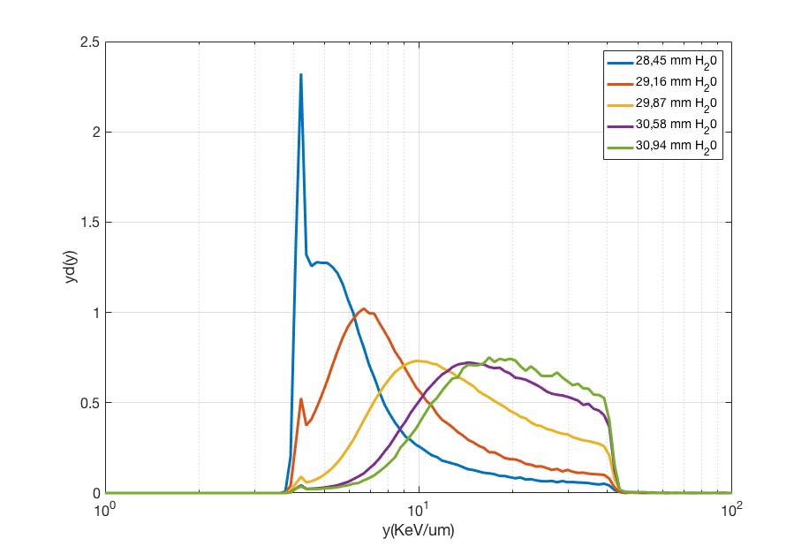
Results: MicroPlus probe

Slide 11
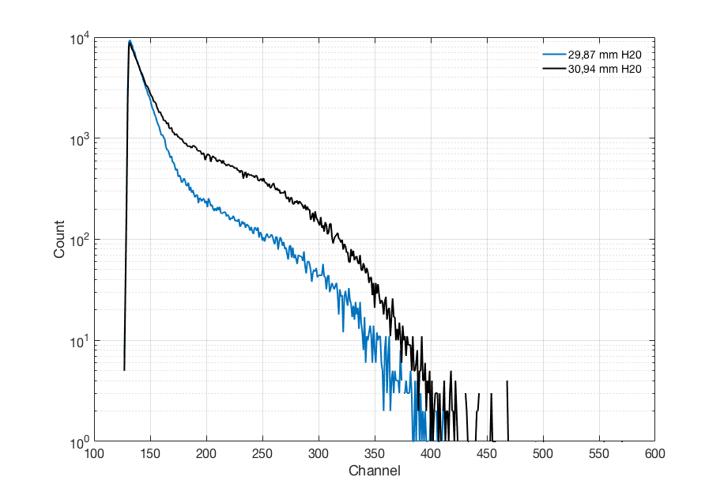
Results: Silicon Carbide Detector
Preliminary results

Slide 12
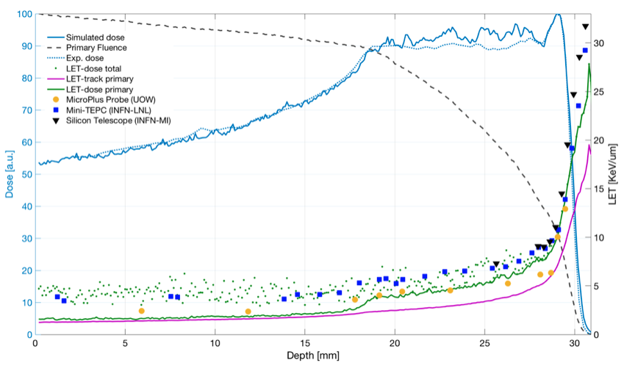
Results: comparison between sim and exp
Experimental dose (blue dotted line) and simulated (blue line) is reported. The simulated fluence of primary protons corresponds to the black dotted lines. Circles refer to the yD obtained with the MicroPlus probe, squares to the measurements performed with the mini-TEPC and triangles with the Silicon telescope. Simulated LET is reported as well: green points corresponds to the LET-dose total, pink line to the LET-track primary and green line to the LET-dose primary.

Slide 13
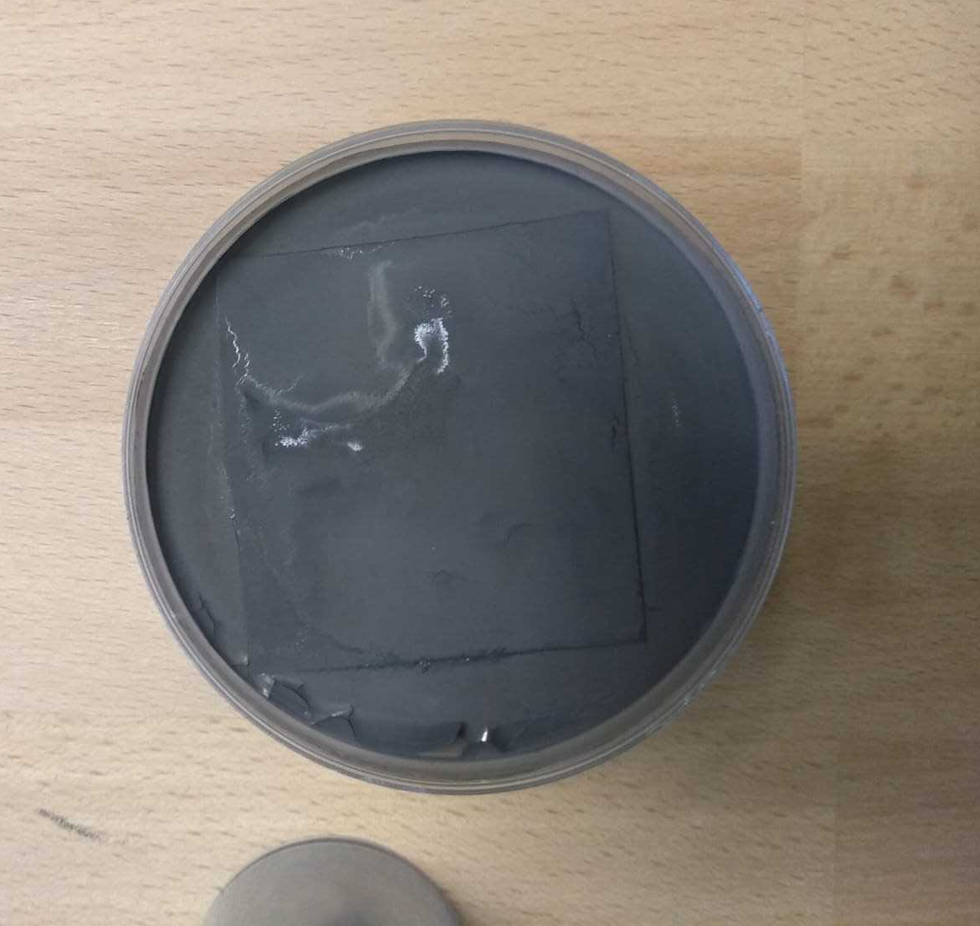
Boron targets for solid state microdosimeters
Preliminary PMMA foils containing boron have been designed and produced. The converter is produced by depositing a thin layer (tens of 𝜇m) of boron carbide (B₄C) on a 50 𝜇m PMMA foil through a chemical procedure.
The thickness of the deposited boron has been optimized for minimizing the yield of alpha particles undergoing self-absorption inside the converter (in order to maximize the yield of detectable alpha particles).
Other converters employing natural and enriched (in B-11) boric acid are being studied and will be fabricated in the next months.

Slide 14
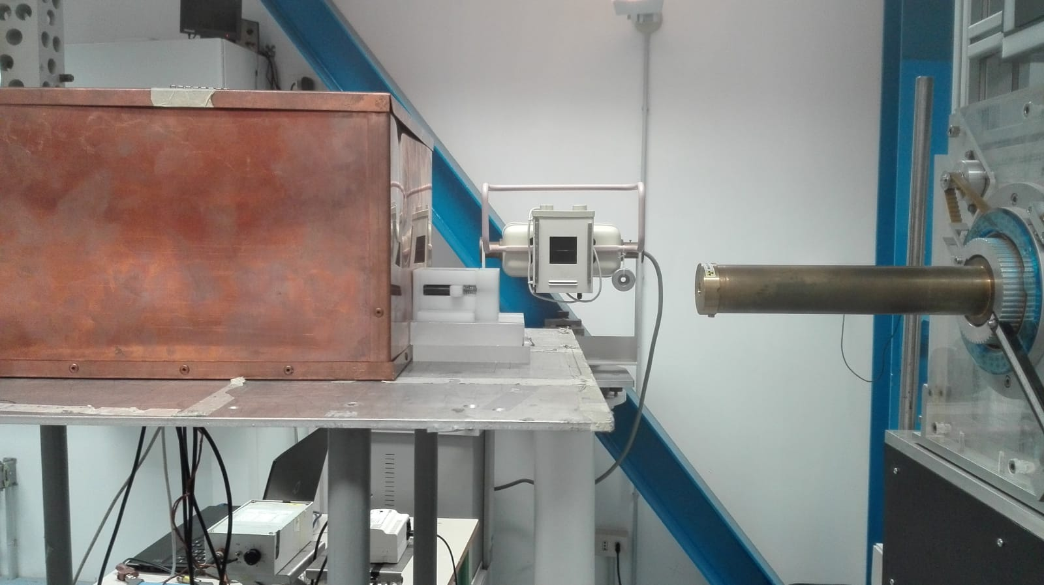
Preliminary measurements at CATANA with natural Boron

Slide 15
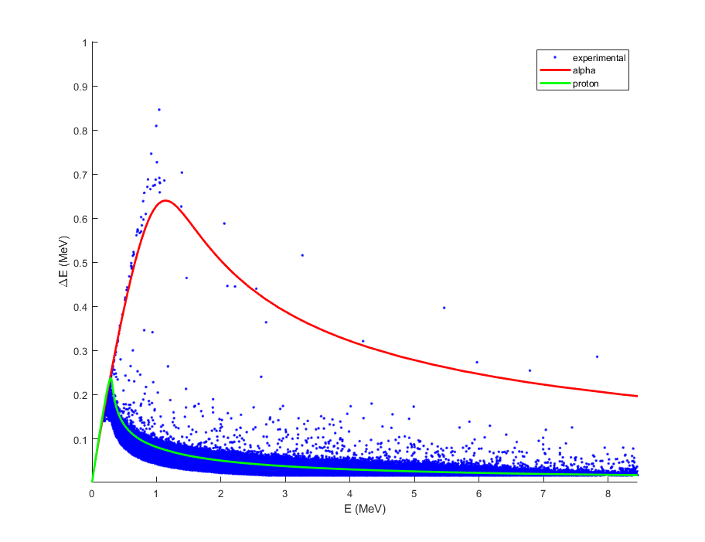
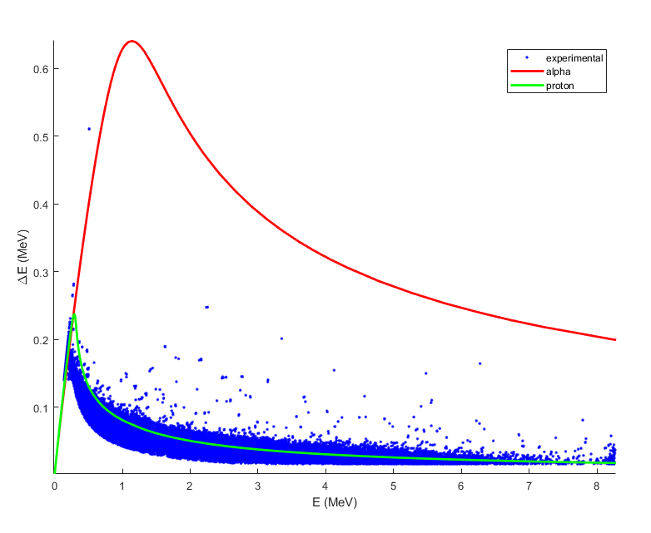
Preliminary measurements at CATANA with natural Boron
Silicon telescope
Without boron
With boron

Slide 16
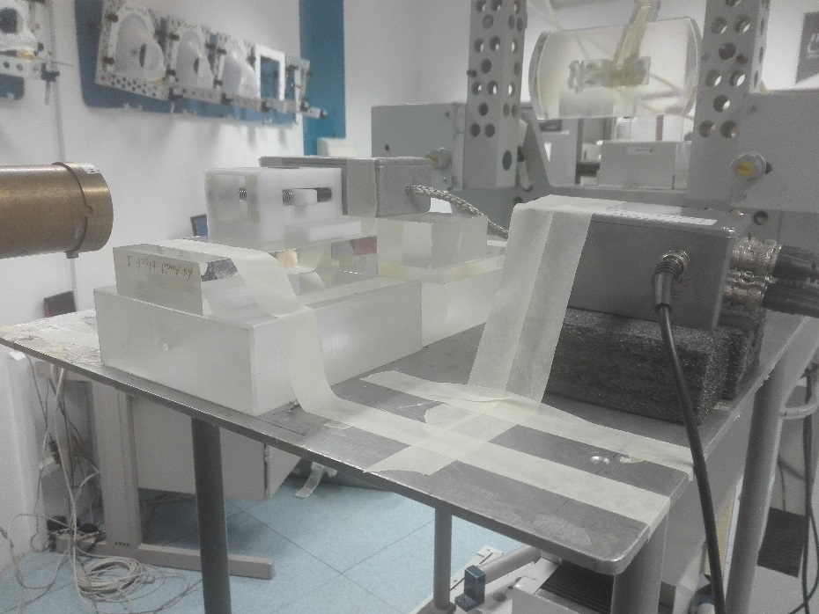
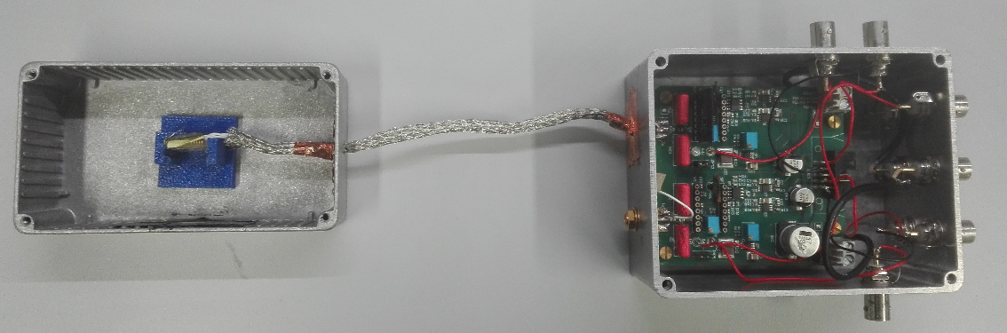
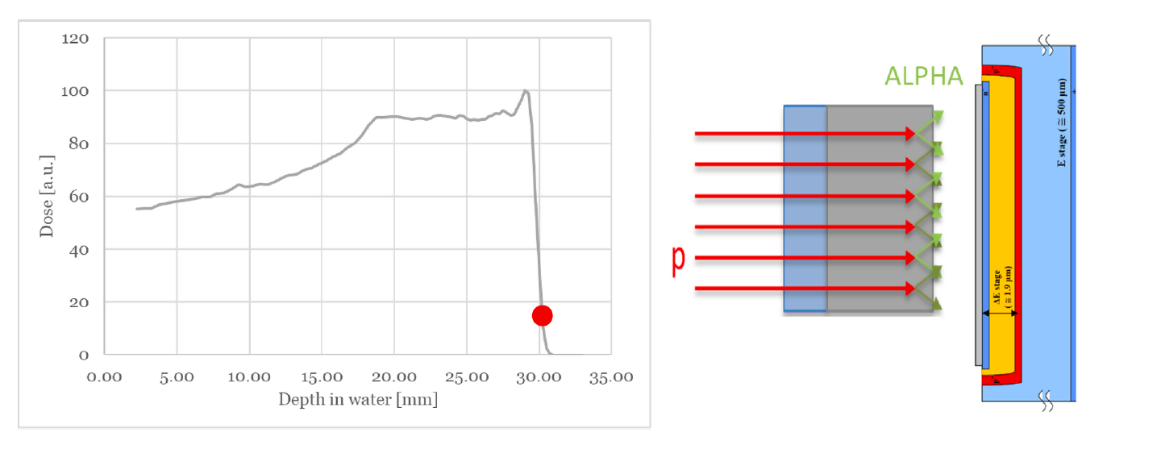
New boric acid targets enriched in B-10 or B-11 @CATANA
#85 gafchromic films for reproducing 28.05 mm in water
Boric (99 % B-11 or B-10) acid (H₃BO₃) target

Slide 17
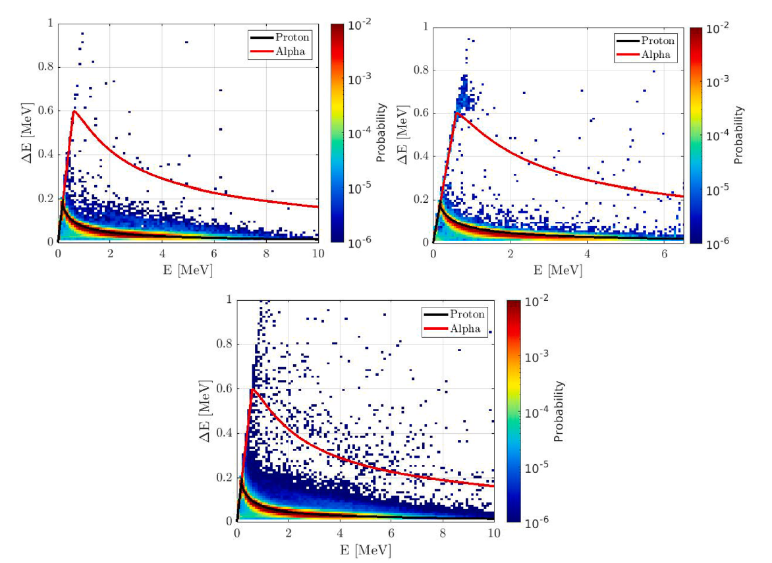
Scatter plots
B-10
No B
B-11

Slide 18
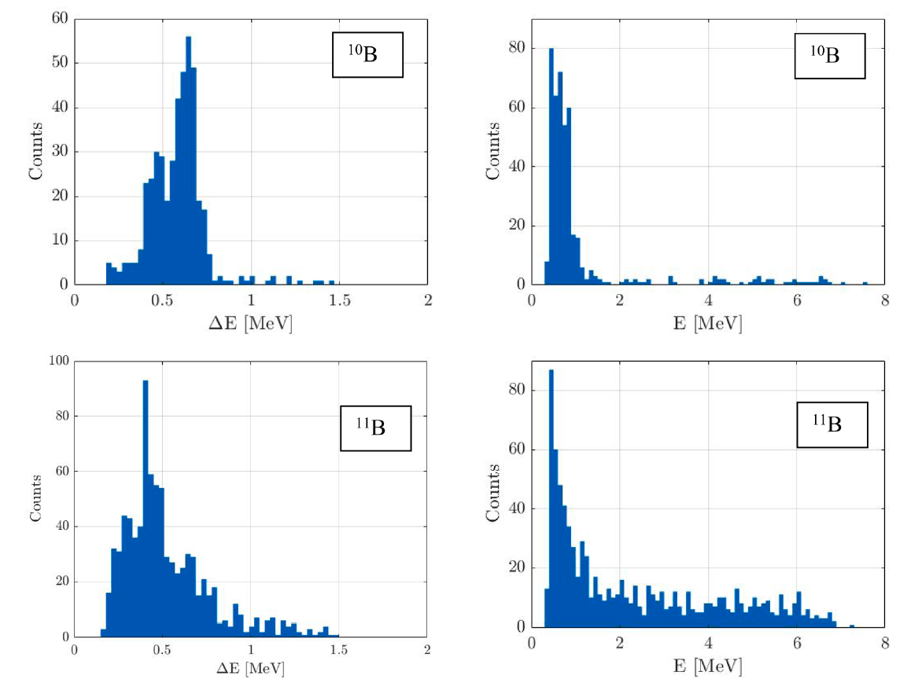
Energy spectra

Slide 19
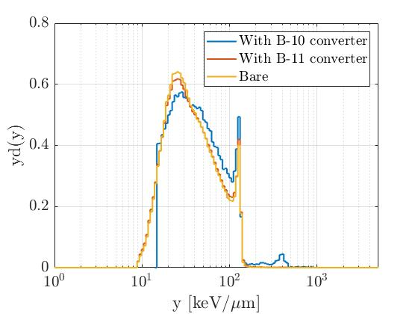
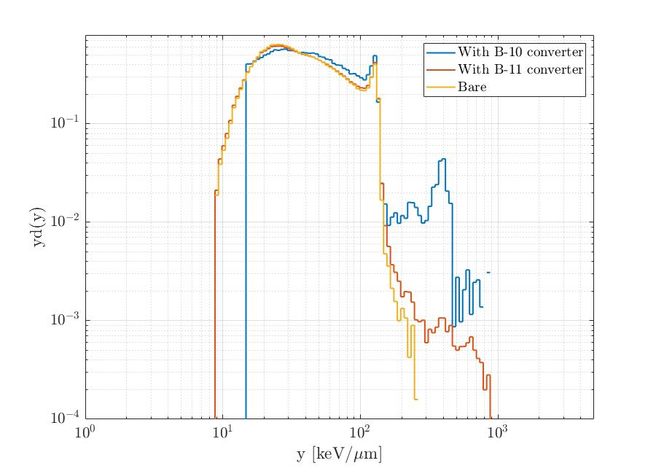
Microdosimetric spectra
Detected alpha per primary proton: 1.0e-3 (B-10) and 1.2e-4 (B-11)
Contribution to the dose: 1.3 % (B-10) and 0.12 % (B-11)

Slide 20
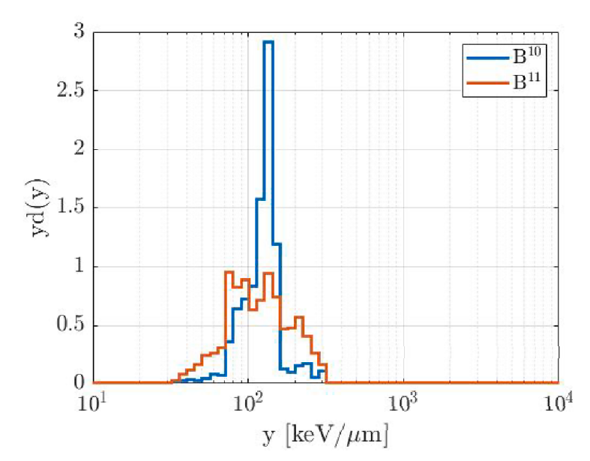
Microdosimetric spectra of alpha particles
Detected alpha per primary proton:
7.6⋅10-5 ± 23.6% without any converter
1.0⋅10-3 ± 9.8% for ¹⁰B
1.2⋅10-4 ± 7.0% for ¹¹B
Dose-mean lineal energies:
120.4 keV/μm ± 23.0% for ¹⁰B
122.2 keV/μm ± 13.0% for ¹¹B

Slide 21
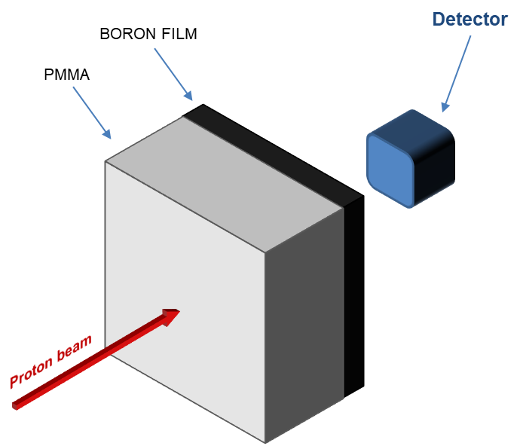
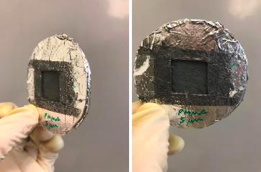


Development of new boron targets
Micro- and Nanostructured Materials Lab (NanoLab) @ PoliMi
Pulsed Laser Deposition Technique (PLD)
Optimization via FLUKA simulations

Slide 22
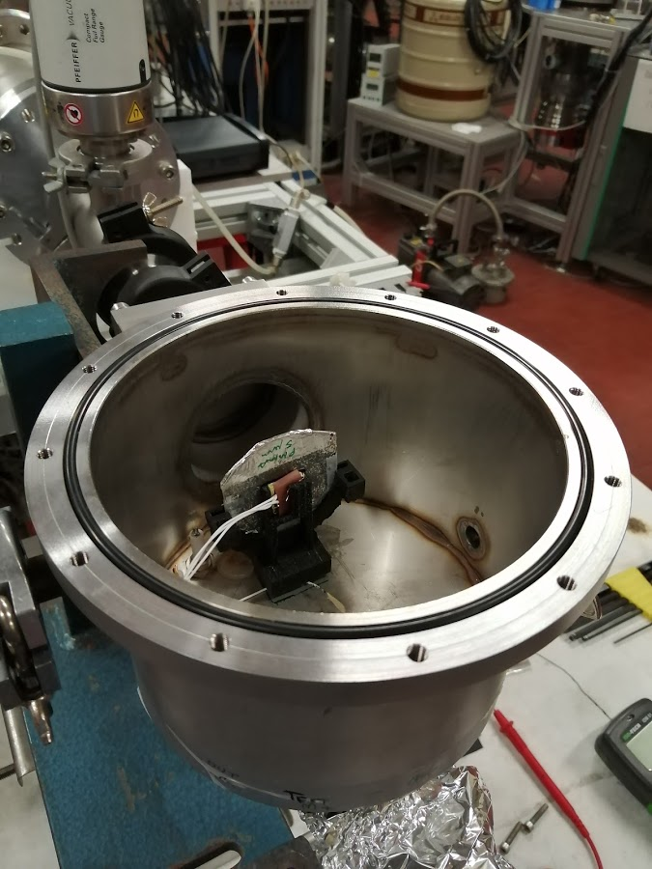
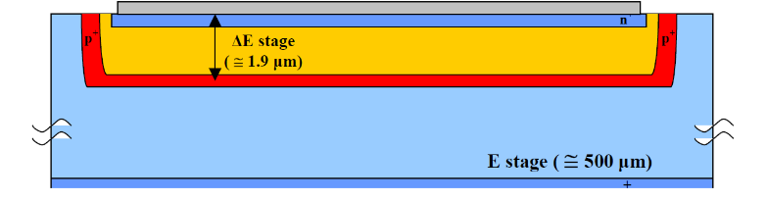
Measurements @INFN-LNL – CN accelerator
Monoenergetic proton beams: 2 and 2.5 MeV
5 μm Boron layer on a 55 μm PMMA substrate
High Vacuum conditions
Monolithic silicon telescope
Scatter plots for particle discrimination

Slide 23
Preliminary results @INFN-LNL – CN accelerator
2 MeV protons
2.5 MeVprotons

Slide 24
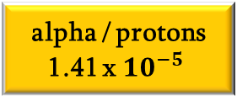
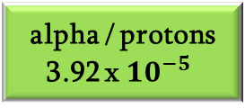
Measurements @INFN-LNL – CN accelerator
2 MeV
protons
Experimental
Simulated (FLUKA)
Threshold
alpha / protons
3.92 x ${10}^{−5}$
alpha / protons
1.41 x ${10}^{−5}$

Slide 25
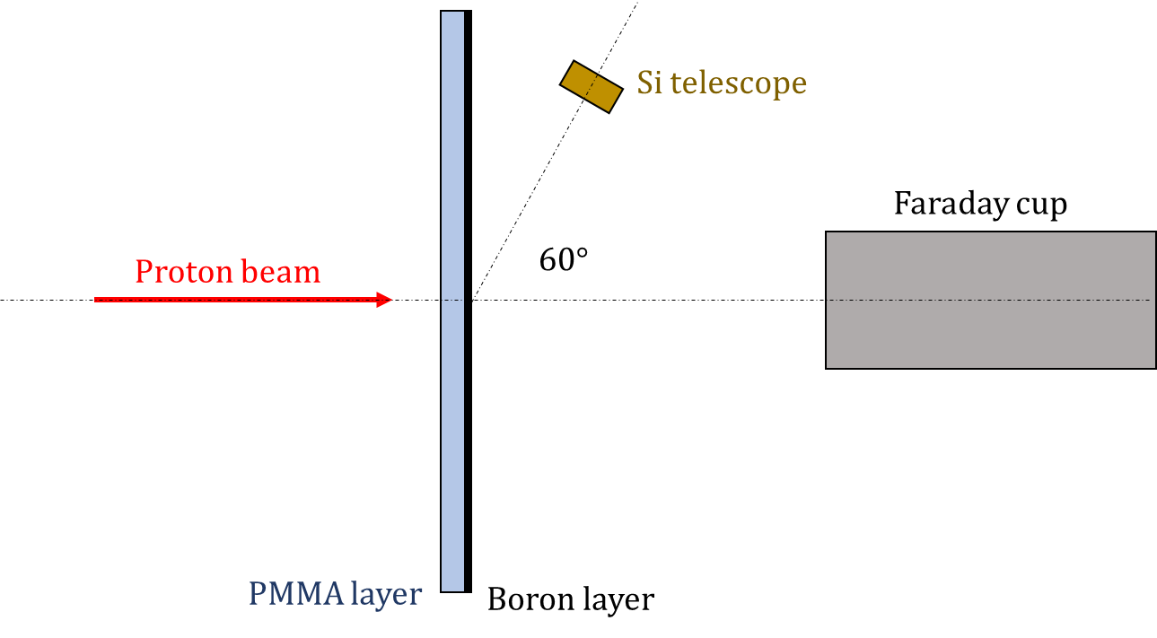
Measurements @INFN-LNL – CN accelerator
Second set-up: detector out-of-field (60°)
Collimated proton beam
5 μm Boron layer on a 55 μm PMMA substrate
High Vacuum conditions
Faraday cup

Slide 26
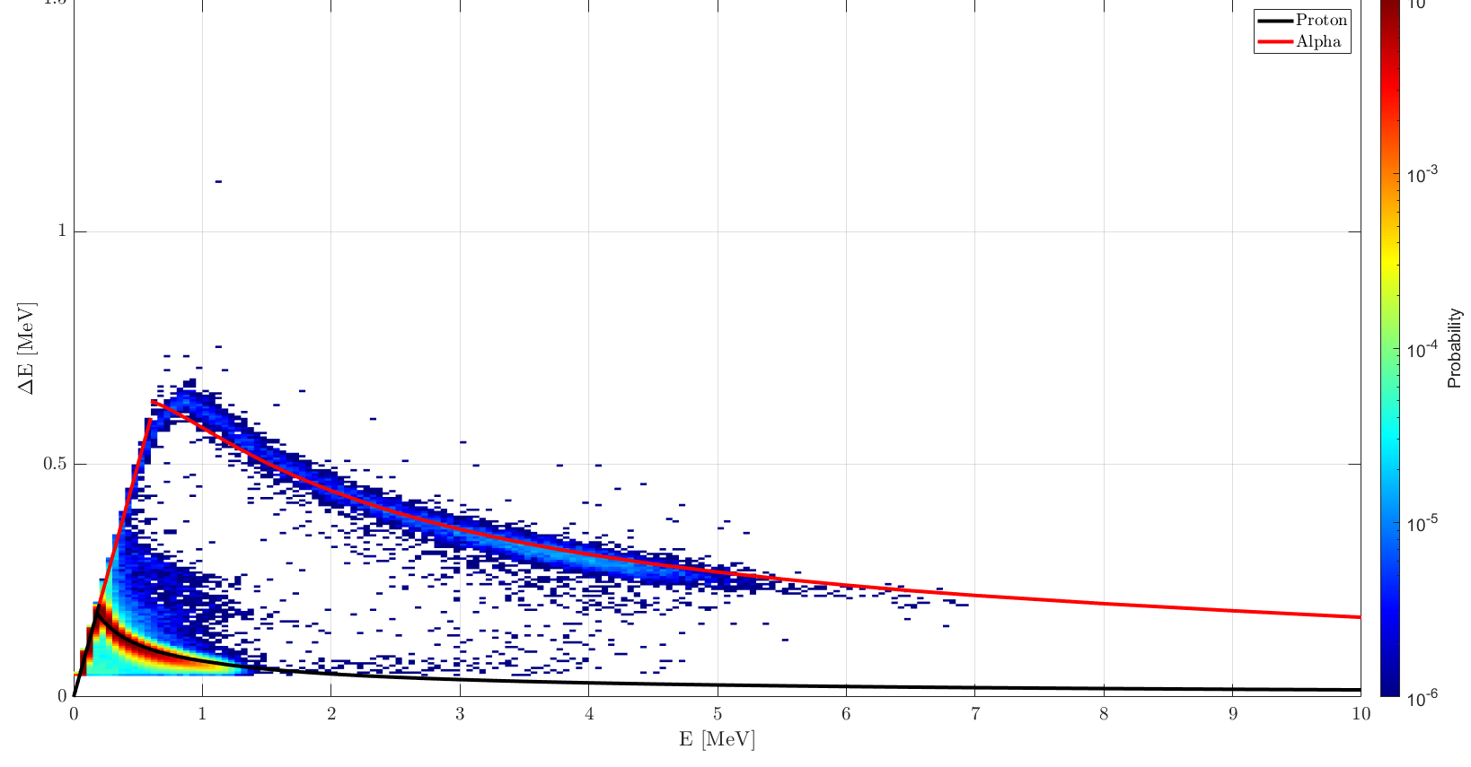
Measurements @INFN-LNL – CN accelerator
2 MeV protons

Slide 27
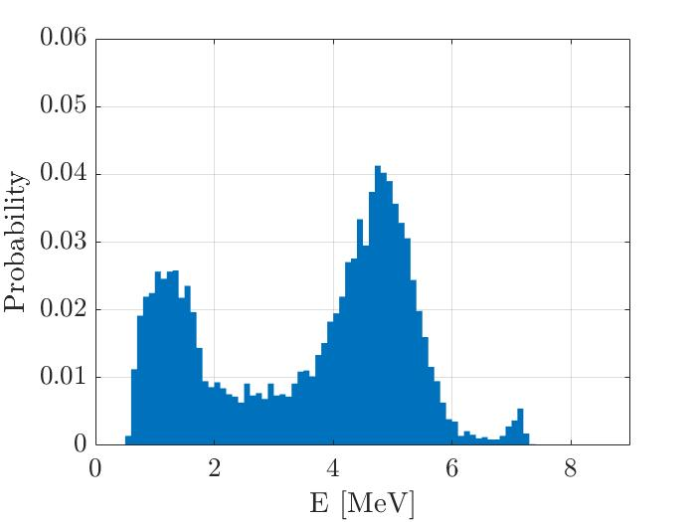
Measurements @INFN-LNL – CN accelerator
Preliminary result: new boron target

Slide 28
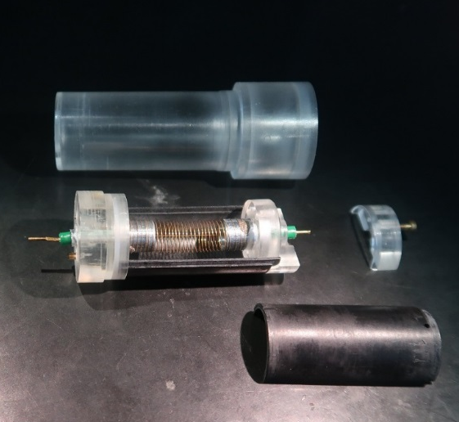
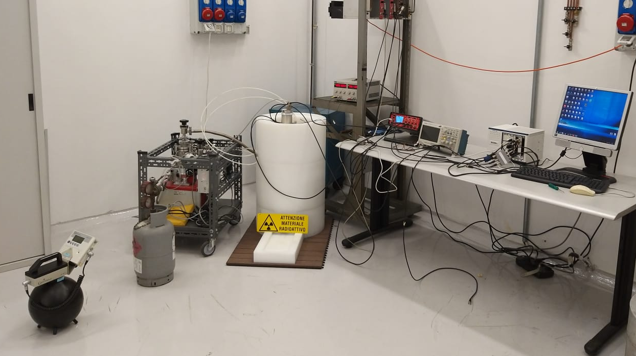
Test of Boron loaded TEPC @PoliMi
Avalanche-confinement TEPC:
Simulated site sizes in the range 1 μm - 25 nm
Different TE walls loaded/unloaded with Boron
Microdosimetry at nanometric level
Test inside the thermal neutron facility @PoliMi

Slide 29


Test of Boron loaded TEPC @PoliMi
300 nm
50 nm
Peak from the Boron Neutron Capture reaction

Slide 30



Test of Boron loaded TEPC @LNL
bismuth window
MUNES neutron field at CN-LNL
Simulated site sizes 1 μm
TE walls loaded/unloaded with Boron
Caratterizzato il rivelatore e la metodologia per discriminare le diverse componenti.
no ¹⁰B
100 ppm ¹⁰B

Slide 31


Test of Boron loaded TEPC @LNL
Peak from the Boron Neutron Capture reaction

Slide 32

Test of Boron loaded TEPC @LNL
Dose fractions
Le alpha sono ben visibili oltre la proton-edge a ~ 150 keV/μm

Slide 33
LNS Activity: Current state
Silicon (MicroPlus probe)
Experimental runs w/o boron:
  60 MeV proton beam (CATANA)
  30 MeV proton beam (REZ)
Experimental runs with alpha:
  60 AMeV 4He beam (LNS)
To do:
  Experimental shifts in Trento to evaluate the response of the silicon detector with and without targets of 19F and 11B
  Experimental shift @LNL to check the detector calibration
Silicon Carbide:
A prototype was realized and electrically tested;
The detector was tested with 60 MeV (CATANA) and 30 MeV (REZ) of proton beam
The detector was entirely simulated with Geant4.
The detector response was compared with the Silicon (MicroPlus probe)

Slide 34

Experimental run @Ústav Jaderné Hyziky av ČR (CZ)
30 MeV proton beam w/o boron

Slide 35

Attività di microdosimetria con TEPCs – Laboratori Nazionali di Legnaro
Nell’ambito del progetto R4I 4MiCA abbiamo potuto costruire nuovi rivelatori. Uno di questi ha le pareti di plastica A150 miscelata a 500 ppm di Boro naturale (400 ppm di Boro11).
Sono state fatte due campagne di misura a Trento (Febbraio e Maggio 2022), sul fascio da 70 MeV, utilizzando due rivelatori uguali, uno con pareti borate e l’altro con pareti non borate.

Slide 36

Risultati: misure sul fascio da 70 MeV senza e con Boro
Con ciascun rivelatore sono state effettuate diverse misure, una con il rivelatore nudo e una dopo spessori variabili di acqua solida (precisamente 1 cm, 2 cm, 2.5 cm, 3.15 cm). Non si nota differenza significativa negli spettri.

Slide 37


Risultati: misure sul fascio da 70 MeV senza e con Boro
Con ciascun rivelatore sono state effettuate diverse misure, una con il rivelatore nudo e una dopo spessori variabili di acqua solida (precisamente 1 cm, 2 cm, 2.5 cm, 3.15 cm). Non si nota differenza significativa negli spettri.
Senza Boro
Con Boro

Slide 38


Risultati: fascio da 70 MeV, senza e con Boro
La visualizzazione doppio log evidenzia i rari eventi ad alti valori di y.
Nessuno spessore
+ 1 cm

Slide 39


Risultati: fascio da 70 MeV, senza e con Boro
La visualizzazione doppio log evidenzia i rari eventi ad alti valori di y.
+ 2 cm
+ 2.5 cm

Slide 40

Risultati: fascio da 70 MeV, senza e con Boro
La visualizzazione doppio log evidenzia i rari eventi ad alti valori di y.
+ 3.15 cm
p-edge
La probabilità di eventi alto y è di
(1.0±0.3)×10⁻⁵ in assenza di Boro
(0.8±0.1)×10⁻⁵ nel rivelatore con Boro.
Differenze non statisticamente significative

Slide 41
Additional slides

Slide 42
Detectors
New mini‒TEPC developed at LNL (same design as the previous TEPC published earlier), but with modified gas and vacuum ducts to improve the counter cleaning from plastic degassing as well as washing and gas filling procedures. It operates in gas‒steady modality
Cylindrical sensitive volume 0.9 mm (diameter and height)
0.35 mm‒thick A‒150‒cathode wall
0.35 mm Rexolite® insulator
0.2 mm‒thick titanium sleeve
(total external diameter of 2.7 mm)
Mini-TEPC (LNL)
∆E stage (about 2 μm in thickness) acts as a solid state microdosimeter and E residual-energy stage (500 μm in thickness) gives information on the energy and the type of the impinging particle
The type of the impinging particle is discriminated through a scatter-plot
An optimized event-by-event correction is performed by measuring the residual energy deposited in the E-stage
Silicon Telescope (PoliMi)

Slide 43
Detectors
It contains several microdosimeter detectors with different-sized sensitive volumes (SVs) that can be selected independently
It is fabricated using silicon-on-insulator wafers with 10 µm thick silicon active volume.
Each microdosimeter detector is fabricated using 3D-mesa technology and has a silicon substrate of area 0.6 mm x 0.8 mm with a single, silicon 3D SV of rectangular-parallelepiped shape on top of silicon oxide.
MicroPlus probe (LNS)
The Silicon detectors used was designed by IMM-INFN and manufactured by ST-Microelectronics (STM) in Catania
The detector has a 0.3 μm thick p-layer and a 10 μm thick n-layer. The detector has an active area of about 10 x 10 mm², and was mounted on PCB board designed to be housed in an aluminum box.
Silicon Carbide Detector (LNS)

Slide 44

Monte Carlo simulation
The CATANA transport beamline is simulated with Hadrontherapy, a free and open source application currently available inside the public release of the Geant4 Monte Carlo code.
A completely new module was used to calculate the track‒averaged LET_{T} and the dose‒averaged LET_{D} of the specific modulated Bragg peak used. To calculate LET_{T} and LET_{D} at a given water depth, the track-mean and the dose-mean LET values of each particle were weighted with their relative frequency and dose contribution, respectively. The following equations were used:
where Ld(z) is the LET_{D} at the depth z in the water phantom, S_{el}^{j} is the electronic stopping power of the particle j of energy E and 𝛗_{E}^{j}(z) is the number of particles of type j that have energy E at depth z.

Slide 45
Depth-dose profile at CATANA

Slide 46


Slide 47


Measurements @INFN-LNL – CN accelerator
Alpha spectrum
alpha / protons
exiting the target
≈ 6.0 x ${10}^{−6}$

