Slide 1
CCE & Charge Sharing vs External Capacitor in HERD SCD
Rui Qiao; Wenxi Peng; Ke Gong

Slide 2
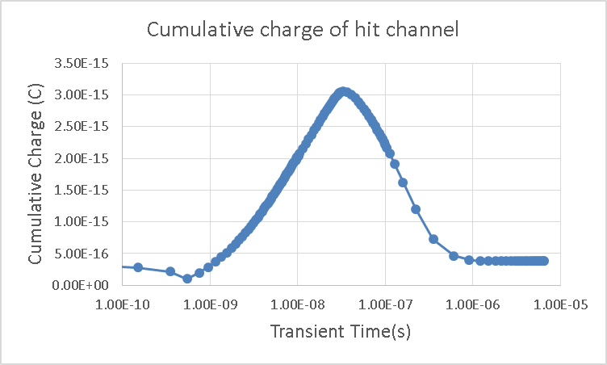
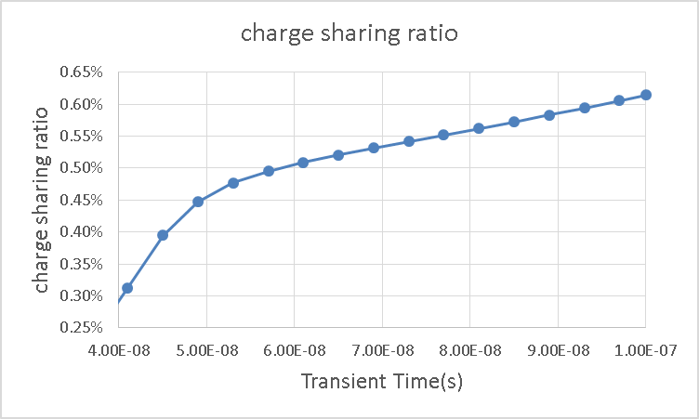
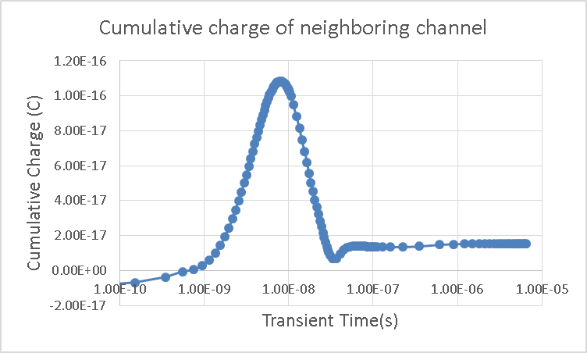
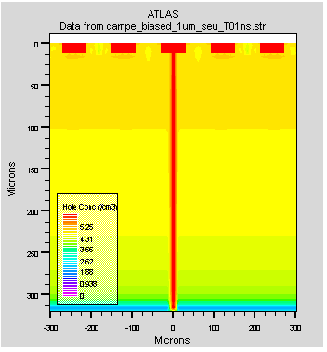
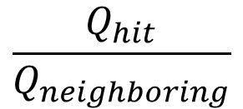
Background: The cumulative charge
Charge
accumulation
Charge
release
$$\frac{Q_{hit}}{Q_{neighboring}}$$
Inorbit
Alberto
SPICE

Slide 3
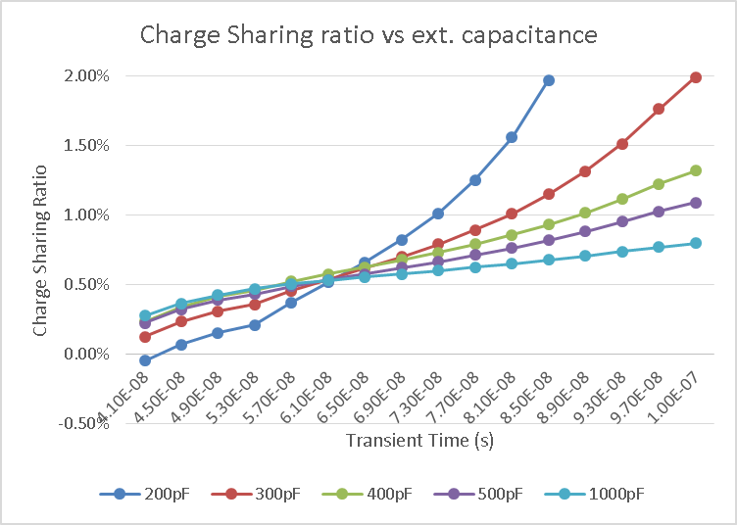
Background: Charge sharing ratio vs ext. capacitor
For long time period (>60ns), a smaller external capacitor increase the charge sharing ratio.
For short time period(<60ns), a smaller external capacitor decrease the charge sharing ratio.
200pF
1000pF

Slide 4
Motivation
Charge Collection Efficiency (CCE)
Adjust the external capacitor
Charge Sharing Ratio
Sensors
IHEP SCD (25/60um width)
Two Methods
SPICE;
FOOT SCD(150/320 um thick;)
AMS-02-Upgrade SCD
TCAD

Slide 5
IHEP Sensors
Parameter | IHEP a) | IHEP b)
Thickness [μm] | 320
Strip length [cm] | 6
Strip width [μm] | 25 | 60
Implant pitch [μm] | 80
Readout pitch [μm] | 160
DC interstrip cap. [pF] | 2.64 | 6.02
Strip bulk cap. [pF] | 1.56 | 1.61
Coupling cap. [pF] | 163 | 377
Notes:
来源：G:\keyan\科研任务\211212_硅微条模拟\MyTCAD\220210——HERD电容和SEU与接触电容的关系\220210_外接电容对CCE和电荷分配系数的影响.docx

Slide 6
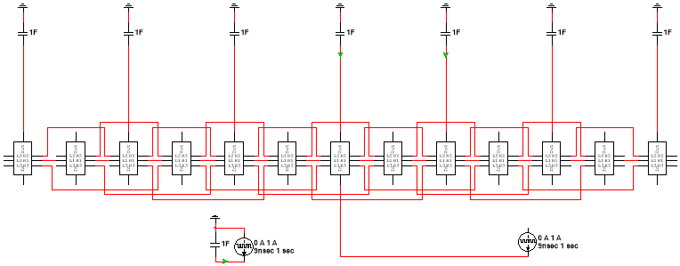
Method(1): SPICE main circuit
13 strips: 7 readout ch., 6 floating ch.
Charge inject in the center (readout ch.)
1F cap. as pre-amplifier
1st Interstrip capacitor (C_Inter1) and 2nd capacitor(C_Inter2)
Notes:
来源: G:\keyan\科研任务\211212_硅微条模拟\MyMultisim\220216_模拟IHEP SCD外接电容的影响\25um条宽\总电路.png

Slide 7
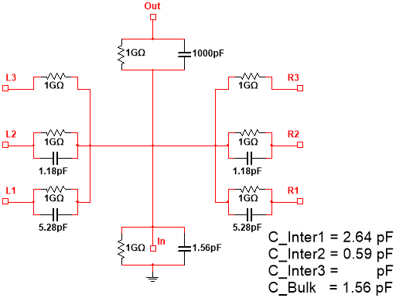
Method(1): SPICE sub circuit
Coupling cap.
Adjustable
Capacitor | Capacitance of IHEP-60 (pF) | Capacitance of IHEP-25 (pF)
Inter1 | 6.02 | 2.64
Inter2 | 0.62 | 0.59
Bulk | 1.61 | 1.56
Interstrip cap.
Fix
Bulk cap.
Fix
Specification of capacitance
Sub circuit of IHEP 25um width
Notes:
来源：G:\keyan\科研任务\211212_硅微条模拟\MyMultisim\220216_模拟IHEP SCD外接电容的影响\25um条宽\一个模块_25um.png
G:\keyan\科研任务\211212_硅微条模拟\MyMultisim\220216_模拟IHEP SCD外接电容的影响\60um条宽\一个模块_60um.png
G:\keyan\科研任务\211212_硅微条模拟\MyMultisim\220209_数值计算IHEP SCD外接电容的影响\220210_HERD SCD电容仿真.docx

Slide 8
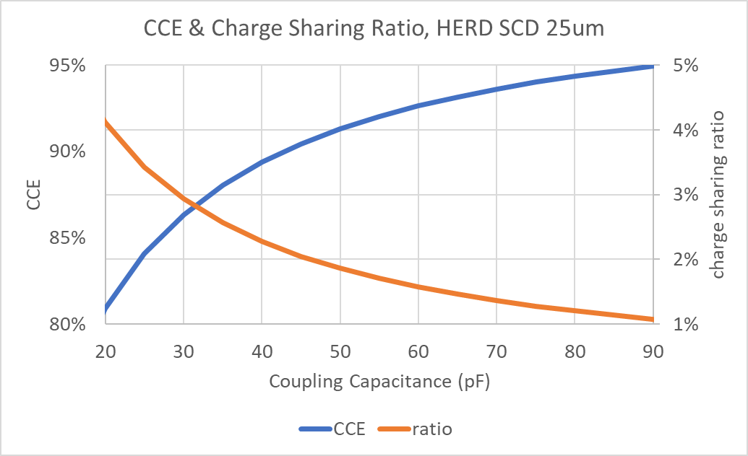
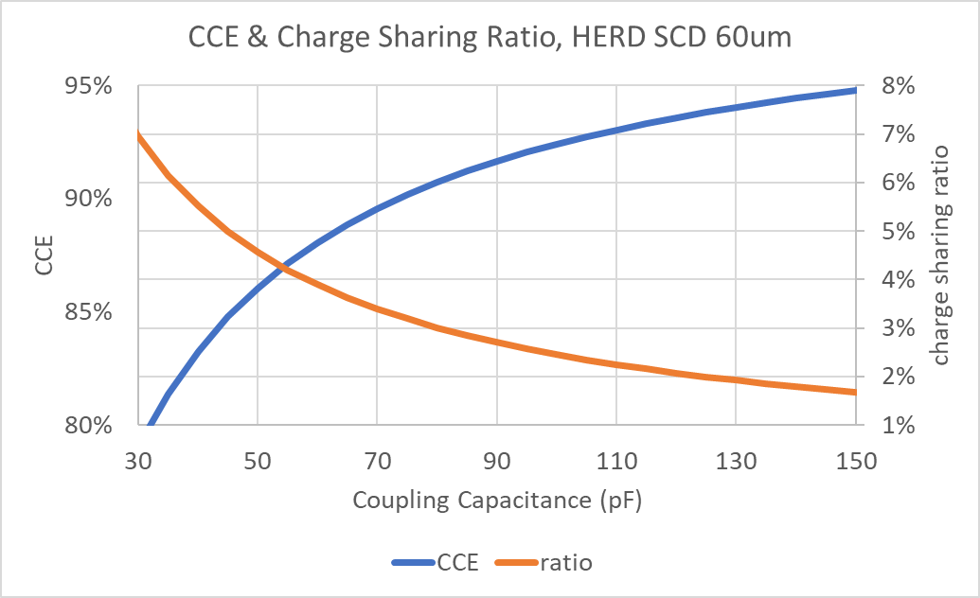
Method(1): SPICE & Analytic
CCE
CCE
Ratio
Ratio
A smaller coupling capacitance, a smaller CCE and larger charge sharing ratio.
Notes:
来源：G:\keyan\科研任务\211212_硅微条模拟\MyTCAD\220210——HERD电容和SEU与接触电容的关系\220210_外接电容对CCE和电荷分配系数的影响.docx

Slide 9
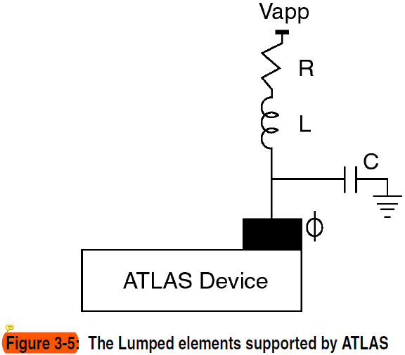

Method(2): TCAD
TCAD can specified additional contact resistor/capacitor/insulator, as shown left.
For our simulation, we use contact capacitor for the AC readout pad.
TCAD can evaluate the voltage of the electrode.
$$Q=V×C$$
Notes:
来源：来源：G:\keyan\科研任务\211212_硅微条模拟\MyTCAD\220210——HERD电容和SEU与接触电容的关系\220210_HERD SEU与接触电容的关系.docx

Slide 10
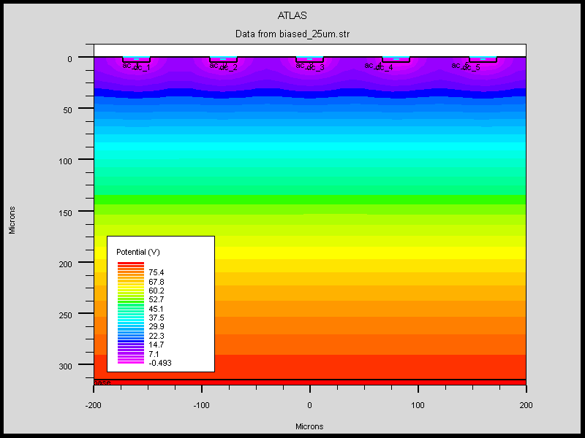
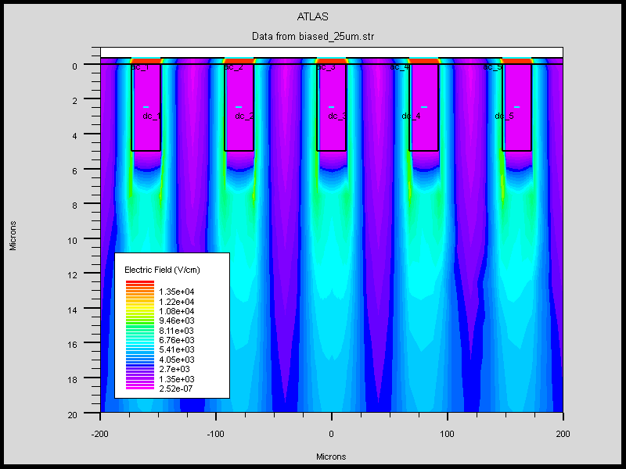
Method(2): TCAD
3 AC readout channel
with contact capacitor
2 floating channel
5 implant Strip
Potential Distribution of 5 strips of IHEP SCD (25um)
Electric Field Distribution of 5 strips of IHEP SCD (25um)
Simulate IHEP SCD with 5 strips: 3 readout; 2 floating
AC readout channel has contact capacitor
Notes:
来源：G:\keyan\科研任务\211212_硅微条模拟\MyTCAD\220210——HERD电容和SEU与接触电容的关系\*.png

Slide 11
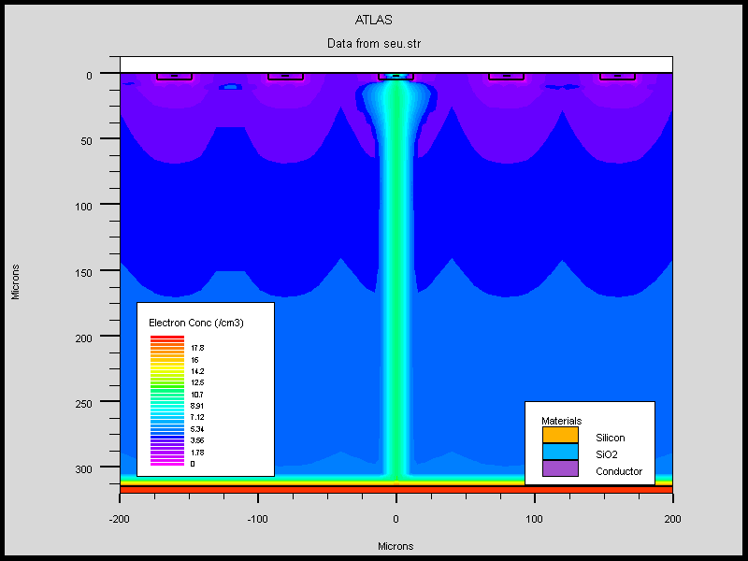
Method(2): TCAD
Hit Channel with contact cap.
2 floating channel
Next Channel with contact cap.
Charge inject into the center.
The Q collected by the hit channel and next channel is evaluated.
Charge
Injection
Notes:
来源：G:\keyan\科研任务\211212_硅微条模拟\MyTCAD\220210——HERD电容和SEU与接触电容的关系\SEU_25um\电荷注入_25um.png

Slide 12
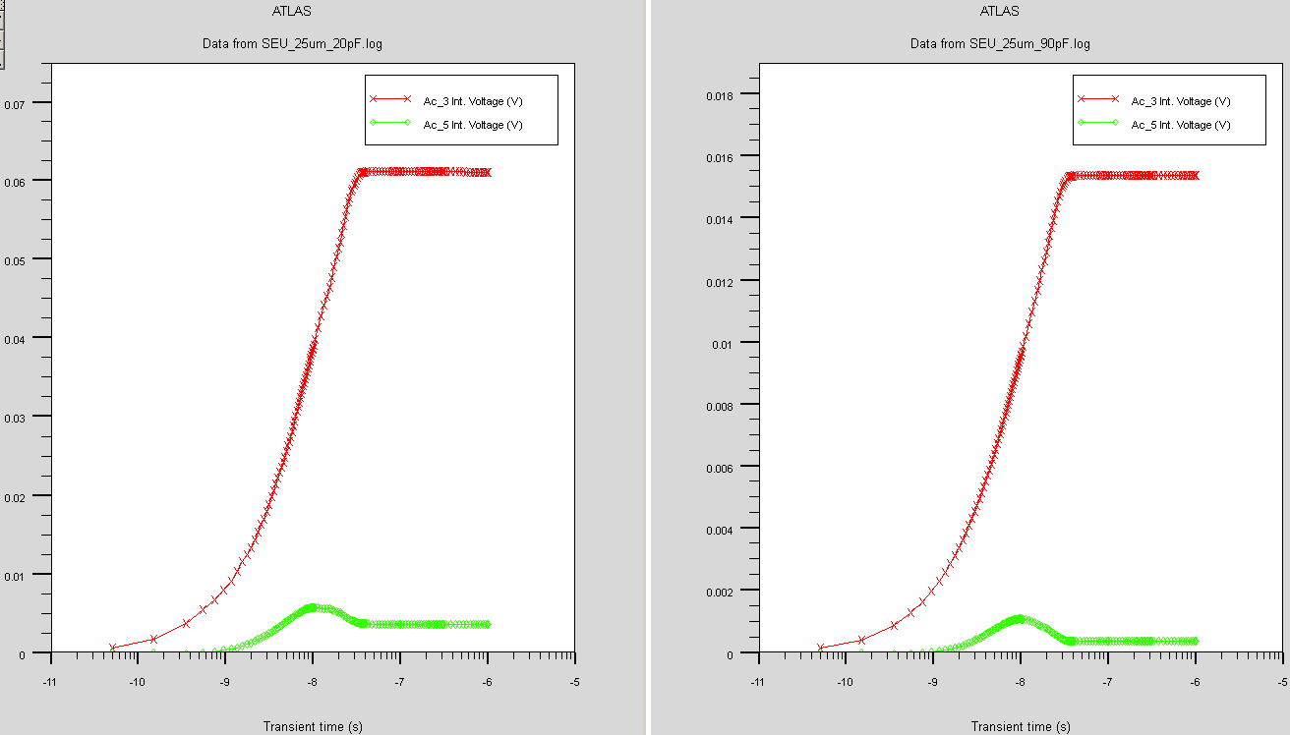
Method(2): TCAD
20 pF
contact
capacitor
90 pF
contact
capacitor
Volt vs Time
Hit Channel
Volt vs Time
Hit Channel
Volt vs Time
Next Channel
Volt vs Time
Next Channel
With smaller contact capacitor, the charge sharing ratio increase.
Notes:
来源：G:\keyan\科研任务\211212_硅微条模拟\MyTCAD\220210——HERD电容和SEU与接触电容的关系\SEU_25um\IntV曲线对比_25um_20pF_vs_90pF.png

Slide 13
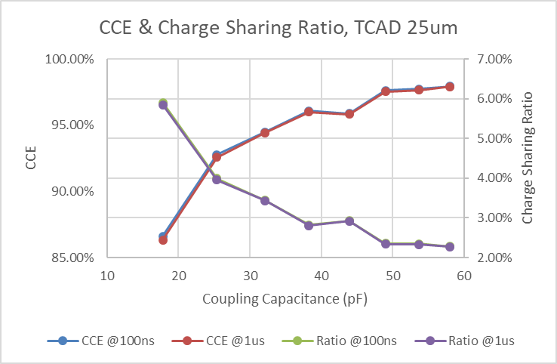
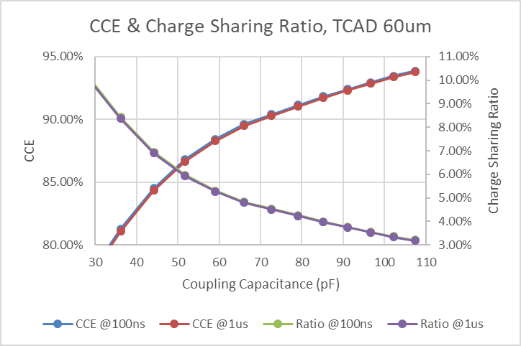
Method(2): TCAD
CCE
CCE
Ratio
Ratio
Similar result to SPICE: A smaller coupling capacitance, a smaller CCE and larger charge sharing ratio.
Notes:
来源：G:\keyan\科研任务\211212_硅微条模拟\MyTCAD\220210——HERD电容和SEU与接触电容的关系\SEU_25um\220210_统计HERD SEU_25um.xlsx
G:\keyan\科研任务\211212_硅微条模拟\MyTCAD\220210——HERD电容和SEU与接触电容的关系\SEU_60um\220210_统计HERD SEU_60um.xlsx

Slide 14
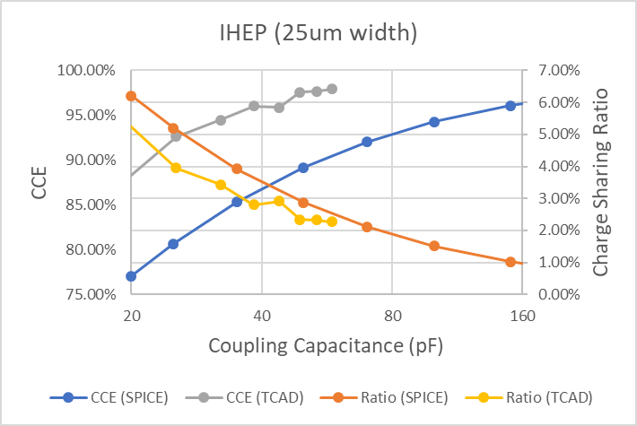
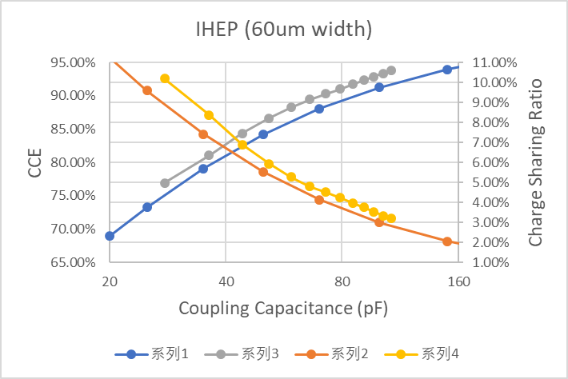
Comparison of two methods
CCE (TCAD)
CCE (TCAD)
CCE (SPICE)
CCE (SPICE)
Ratio (SPICE)
Ratio (TCAD)
Ratio (TCAD)
Ratio (SPICE)
TCAD predict similar charge sharing ratio to SPICE
Currently the CCE of TCAD maybe not accurate.
Notes:
来源：G:\keyan\HERD项目文档\SCD_meeting\220214_CCE & Charge Sharing vs External Capacitor in HERD SCD.xlsx

Slide 15
Apply to all HERD SCD
Detector | IHEP-25 | IHEP-60 | FOOT-150 | FOOT-320 | AMS-Upgrade
Thickness [μm] | 320 |  | 150 | 320 | 320
Strip length [cm] | 6 |  | 9.6 |  | 7.89
Strip width [μm] | 25 | 60 | 12 |  | 12
Implant pitch [μm] | 80 |  | 50 |  | 27.25
Readout pitch [μm] | 160 |  | 150 |  | 109
Readout Num | 1/2 |  | 1/3 |  | 1/4
DC interstrip1 cap. [pF] | 2.64 | 6.02 | 4.08 | 4.36 | 6.34
DC interstrip2 cap. [pF] | 0.59 | 0.62 | 0.62 | 0.86 | 0.73
DC interstrip3 cap. [pF] |  |  | 0.21 | 0.43 | 0.30
DC interstrip4 cap. [pF] |  |  |  |  | 0.16
Strip bulk cap. [pF] | 1.56 | 1.61 | 3.38 | 1.57 | 0.72
Notes:
来源：G:\keyan\科研任务\211212_硅微条模拟\MyTCAD\220210——HERD电容和SEU与接触电容的关系\220210_HERD SCD电容仿真.docx
G:\keyan\科研任务\211212_硅微条模拟\MyTCAD\220214——FOOT电容和SEU与接触电容的关系\CV曲线\220215_FOOT电容.xlsx
G:\keyan\科研任务\211212_硅微条模拟\MyTCAD\220226——AMS升级电容和SEU与接触电容的关系\220226_AMS升级电容.xlsx

Slide 16
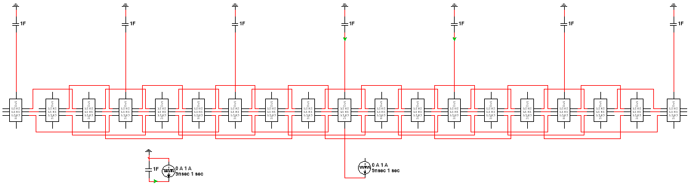
FOOT SPICE Circult
19 strips: 7 readout ch., 12 floating ch.
Charge inject in the center (readout ch.)
1F cap. as pre-amplifier
Interstrip capacitor (C_Inter1), 2nd interstrip capacitor(C_Inter2), 3rd interstrip capacitor(C_Inter3)
Notes:
来源:G:\keyan\科研任务\211212_硅微条模拟\MyMultisim\220215_模拟FOOT SCD外接电容的影响\***

Slide 17
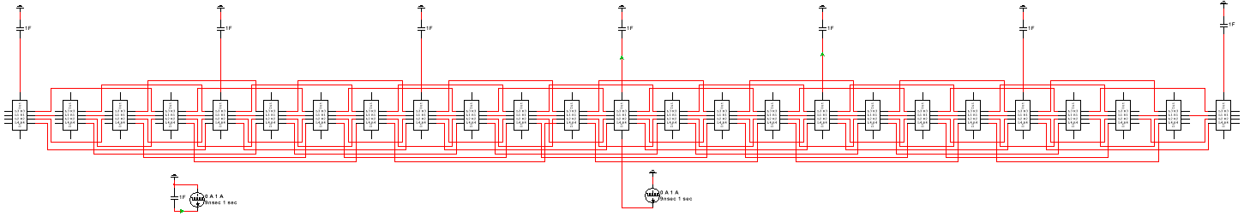
AMS-Upgrade SPICE Circuit
25 strips: 7 readout ch., 18 floating ch.
Charge inject in the center (readout ch.)
1F cap. as pre-amplifier
Interstrip capacitor (C_Inter1), 2nd interstrip capacitor(C_Inter2), 3rd interstrip capacitor(C_Inter3), 4th interstrip capacitor(C_Inter4)
Notes:
来源：G:\keyan\科研任务\211212_硅微条模拟\MyMultisim\220228_模拟AMS SCD外接电容的影响\主模块.png

Slide 18
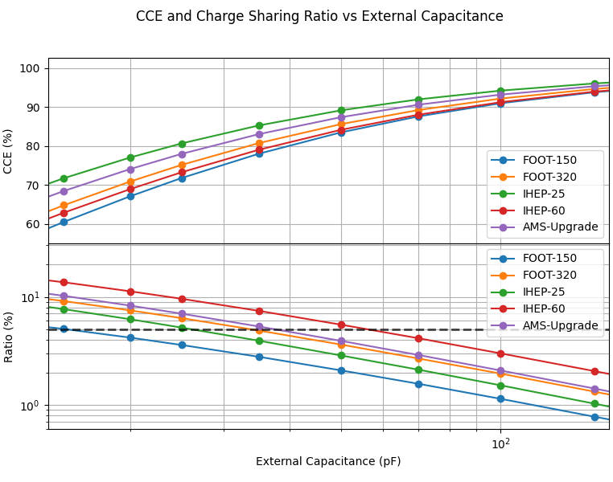
CCE and Charge sharing Ratio on Coupling Cap.
All detectors have similar trends on CCE and charge sharing ratio.
FOOT-150 is worst on both CCE and charge sharing ratio
Notes:
来源:G:\keyan\HERD项目文档\SCD_meeting\220214_CCE & Charge Sharing vs External Capacitor in HERD SCD\CCE_Ratio_on_Couple.png

Slide 19
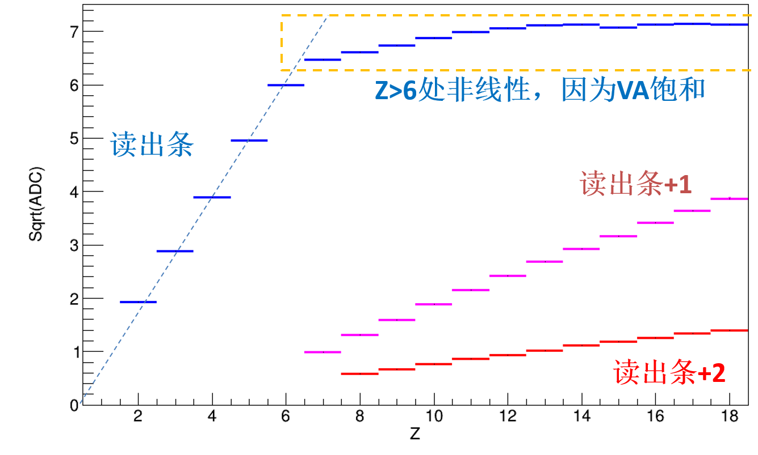
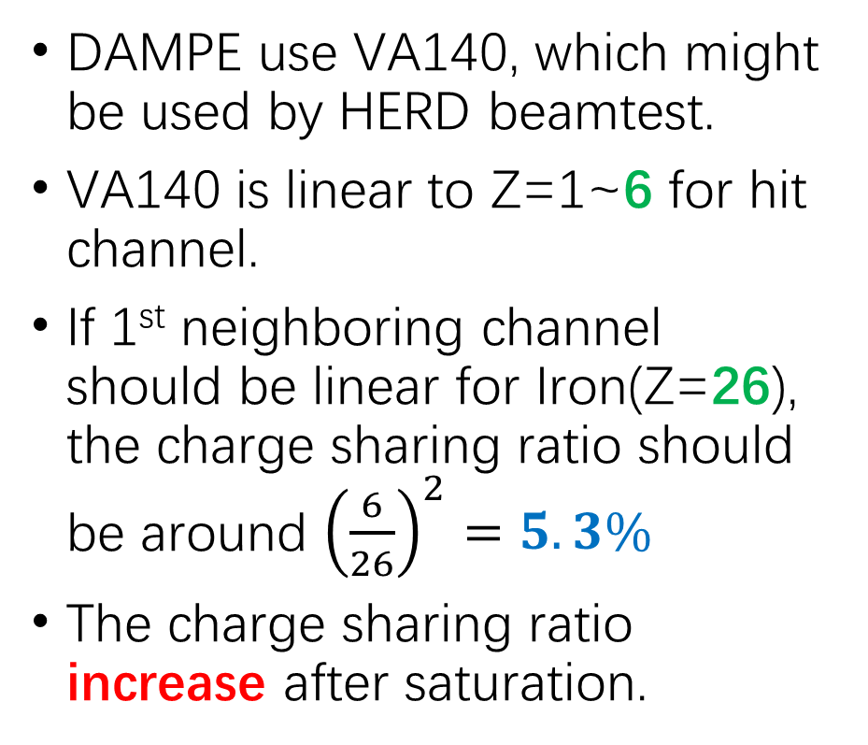
The charge sharing ratio of DAMPE
DAMPE use VA140, which might be used by HERD beamtest.
VA140 is linear to Z=1~6 for hit channel.
If 1st neighboring channel should be linear for Iron(Z=26), the charge sharing ratio should be around ${\left(\frac{6}{26}\right)}^{2}=5.3\%$
The charge sharing ratio increase after saturation.
Hit Ch.
1st Neighbor Ch.
2nd Neighbor Ch.
Notes:
来源：G:\keyan\HERD项目文档\SCD_meeting\220110_IHEP SCD simulation.pptx

Slide 20
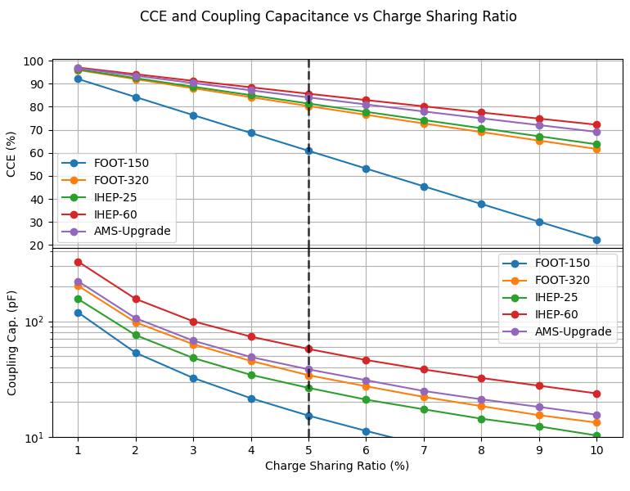
CCE and coupling cap. on charge sharing ratio
For 5% charge sharing ratio, FOOT-150 has lowest CCE, IHEP-25/IHEP-60/FOOT-320/AMS has similar CCE around 80~85%.
The coupling cap was around 30~50 pF correspondingly.
Notes:
来源：G:\keyan\HERD项目文档\SCD_meeting\220214_CCE & Charge Sharing vs External Capacitor in HERD SCD\CCE_Couple_on_Ratio.png

Slide 21
Conclusion
Study the dependency of CCE & charge sharing ratio on coupling capacitance using SPICE.
Use TCAD to verify for IHEP SCD:
  charge sharing ratio match for IHEP-25 & IHEP-60
  CCE of IHEP-60 match; CCE of IHEP-25 disagree
The charge sharing ratio is expected as 5%:
  The corresponding CCE of IHEP SCD and FOOT-320 is 80~85%.
  The corresponding coupling capacitance is 30~50 pF.
  The CCE of FOOT-150 is 60%.

Slide 22
Future plan
The CCE and charge sharing ratio when floating strip is hit.
Design of the pattern of AC readout Aluminum electrode to decrease the coupling capacitance.

Slide 23
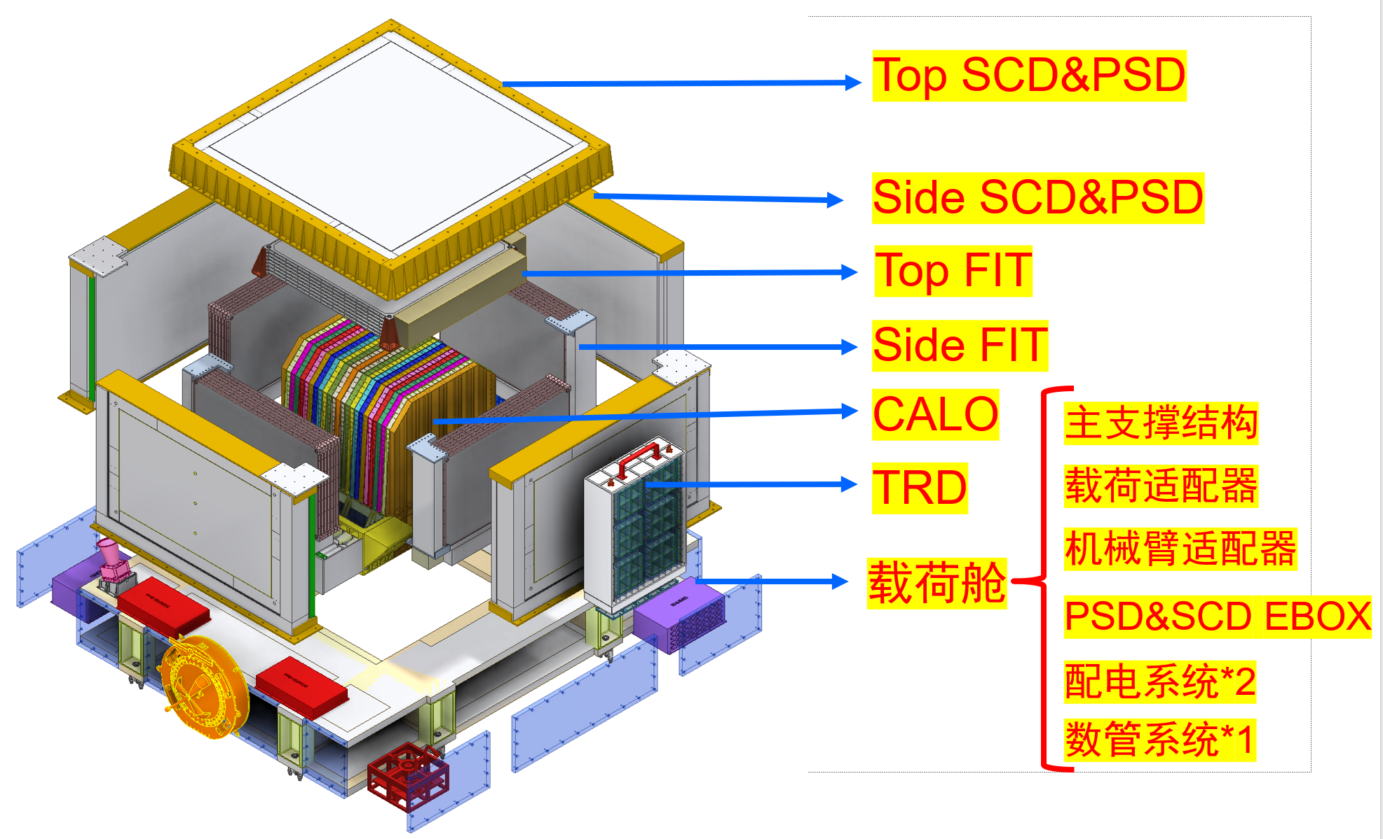
News from IHEP (1): Structure
CABLE between FEE and DAQ
Each Top/Side SCD&PSD is considered as a integrated component:
  Share the same installation interface
  Share the same thermal interface
Design individual thermal conductive circuit, cable between FEE and DAQ.
SCD team need to negotiate with the PSD team about integration.
DAQ
Notes:
来源：weekly meeting (16 February 2022) (ihep.ac.cn)

Slide 24
News from IHEP (2): Thermal control
Component | Need active heater or TEC to for a fine temperature control? | Position of the cooling surface in component | Temperature of thermal interface | Stability of thermal interface | Temperature of thermal interface during storage | Stability of thermal interface during storage
Sensor |  |  |  |  | -30~+50 | 5℃/hr
FEE | Heater | Side of component | -20 ~ -10 | 2~3℃/hr
DAQ | Heater | Side of component | -10 ~ +30
Notes:
来源：G:\keyan\HERD项目文档\热控\220208_SCD Thermal Requirement_by_Qiao.xlsx

Slide 25
News from IHEP (3): Operation mode
Operation mode | Action
Normal | Take data according to scientific trigger
Pedestal | Calibrate the pedestal
DAC calibration | DAC generate different pulsed charge to calibrate ASIC non-linearity

