Slide 1
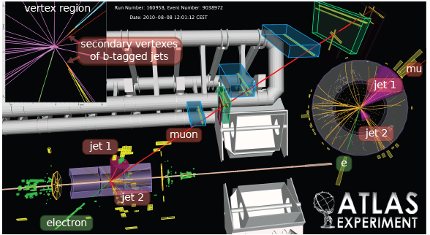
First observation of
top-antitop pairs, and cross section measurement at 7 TeV
Lorenzo Bellagamba, Graziano Bruni, Riccardo Di Sipio (Bologna);
Ilaria Besana, Tommaso Lari, Clara Troncon (Milano);
Bobby Acharya, Marina Cobal, Umberto De Sanctis, Michele Pinamonti, Rachik Souhalak, Kerim Suruliz (Udine);

Slide 2
Outline
  Analysis strategy;
  Data & MC samples;
  Objects definition
  Focus on semileptonic channel:
  - Event selection;
  - QCD & W+jets “Data driven” Background estimation;
  - Cross-section evaluation;
  Combination e/μ + jets and dilepton channel;
  Conclusions and outlooks
2

Slide 3
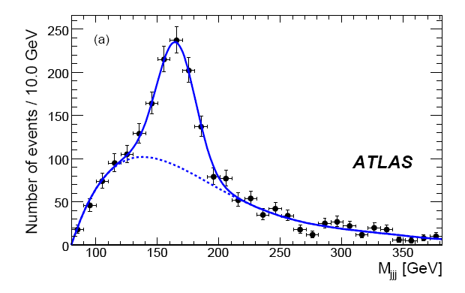
Analysis strategy
10 TeV
200 pb⁻¹
Lepton+jets → look for events with
  At least 4 jets, of which 2 are b-jets
  Hard lepton, missing E_{T}
  Can reconstruct also the invariant mass of jets from hadronic side t→W(qq)b ;
Strategy: Evidence for top based on
excess of events w.r.t known backgrounds
Understanding of backgrounds is key
  - Use data driven approach whenever possible
3

Slide 4
Data & MC samples
DATA taken in DQ periods A-F passing ‘top’ GRL → all detectors & relevant triggers fully operational
  Total luminosity = 2.9 pb⁻¹
TRIGGERS used (evolved with instantaneous luminosity):
Single lepton trigger with threshold fully efficient for leptons with P_{T}>20 GeV
  L1_ MU10 or EF_mu10_MSonly
  L1_EM10,EF_g17_etcut or EF_e10_medium
MC SAMPLES: ATLAS full simulation (GEANT4)
  ttbar → MC@NLO with m(top)=172.5 GeV, x-sec(NNLO)=165 pb.
  QCD multijets→ ALPGEN + HERWIG/Jimmy; filter at generation level on muons (P_{T}>20 GeV) and jets (at least 3 with P_{T}>25 GeV, cut on 4-th jet: P_{T}> 17 GeV);
  W/Z+jets → ALPGEN with K-factor=1.22. Overlap removal procedure on Heavy Flavors (Wbb/Wcc+jets) to avoid double counting with W+light jets sample.

Slide 5
Objects definition: leptons
Electron = ‘Robust medium electron’ with P_{T}>20GeV
- E/p (as in “tight” electron), track with b-layer hit (except 2% dead mod.) to suppress γ conversion;
- |η_{cluster}|<2.47 (excluding 1.37<η<1.52)
- Isolation: E_{T}(R=0.2)< 4 + 0.023*E_{T}(el) GeV
Muon = ‘MUID tight’, P_{T}>20 GeV, |η|<2.5
- Isolation: E_{T}(R=0.3)<4 GeV, P_{T}(R=0.3)<4 GeV
- ΔR>0.4 w.r.t nearest jet with P_{T}>20 GeV
to suppress bckg from hadron and b,c, decays
Details in https://twiki.cern.ch/twiki/bin/view/AtlasProtected/TopCommonObjects
5

Slide 6
Objects definition: jets & MET
Jet = AntiKt4 TopoCluster jets EM+JES (MC hadron scale p_{T},η dependent);
- ΔR(jet-el)>0.2 (to avoid double counting electron as jet).
B-jet (http://indico.cern.ch/getFile.py/access?contribId=3&resId=1&materialId=slides&confId=105461)
Jet + SV0 cut at 50% MC efficiency point
Early tagger - efficiency for ttbar OK; ~220 rejection of light jets
Missing E_{T} = Simplified METRefFinal with contribution from selected muons included
Require a primary vertex with #tracks>4.
Discard events with “bad” jets P_{T}>15 GeV
Contribution from Genova group for the efficiencies
6
Details in https://twiki.cern.ch/twiki/bin/view/AtlasProtected/TopCommonObjects

Slide 7
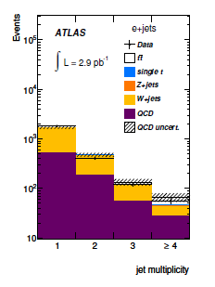
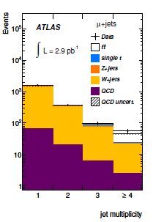
Analysis in the semileptonic channel
The appropriate single electron or muon trigger has fired
Exactly one lepton (e or μ) with P_{T}>20 GeV, matching the corresponding trigger object (e)
E_{T}^{MISS}>20 GeV and E_{T}^{MISS}+M_{T}(W)>60 GeV
Exactly N jets with P_{T}>25 GeV (N=1,2,3) or >=4 jets (N=4)
against QCD
against QCD, W
e+jets
μ+jets
56 events
expected:
20.3±7.1 ttbar
2.9±1.4 t, Z+j
11.2±4.1 W+jets
27.8±11.3 QCD
56 events
expected:
20.5±7.0 ttbar
2.3±0.9 t, Z+j
18.9±4.6 W+jets
2.5±1.2 QCD
signal region
signal region
7

Slide 8
Analysis with b-tagging…
Added requirement = ≥1 b-tagged jet with P_{T}>25
17 events
expected:
14.8±6.7 ttbar
0.8±0.2 Sing. t, Z
1.9±1.1 W+jets
4.8±3.1 QCD
20 events
expected:
14.9±6.6 ttbar
0.8 ±0.2 Single t, Z
3.2±1.7 W+jets
0.8±0.5 QCD
signal region
signal region
W+jets and QCD backgrounds are from Data-driven estimation methods

Slide 9
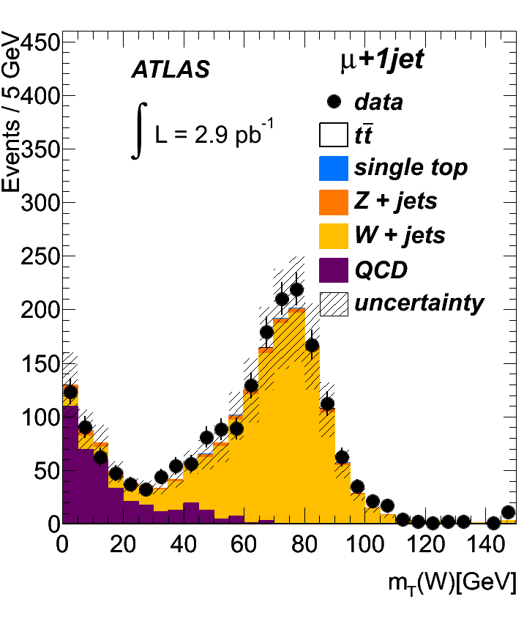
QCD backgrounds: muon channel
HF semilept. decays, fake leptons,γ conversion (in e+jets channel);
Matrix Method: Ok for μ-channel,not for e-channel (contamination in Control Reg.)
- Define 2 samples: ‘tight’ μ (μ ID cut) vs.
‘loose’ μ (μ ID cut except for isolation);
- Then:
where ε is the probability for a real (fake) μ
to pass both ID criteria.
- Inverting the formula we have
with the 2 efficiencies that need to be measured
to do the estimation.
- ε_{REAL} from Z(μμ) events = 0.990±0.003; ε_{FAKE} from QCD dominated control region (2 regions defined: MET < 10 GeV or d₀-sig(μ)>5+ MET>20 GeV) → 0.339±0.013
- Final rescaling to “tagged” events: multiply for the probability for a QCD multi-jet event to have at least 1 b-tagged jet.

Slide 10
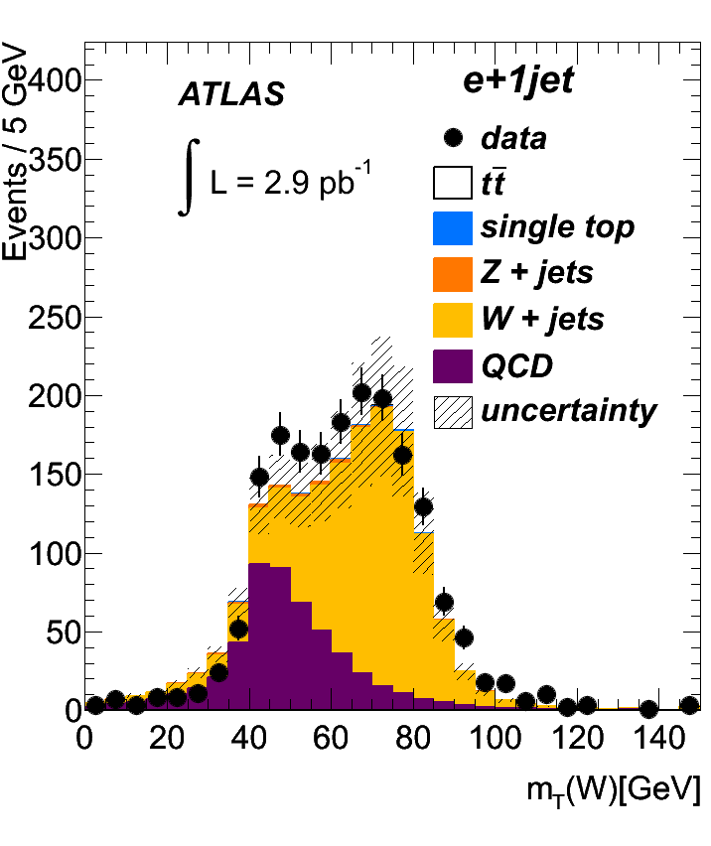
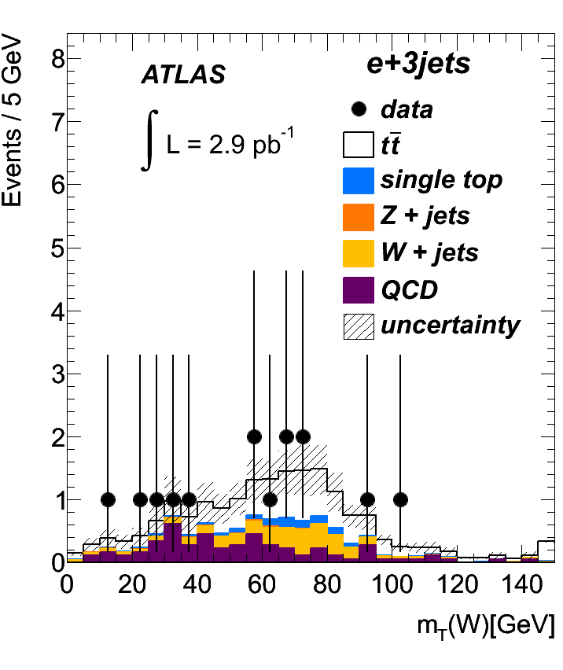
QCD backgrounds: electron channel
Contribution from Milano group in e-channel MM
Multiple sources (Heavy Flavour, γ→e⁺e⁻,hadrons): challenging for Matrix-Method. Not used here but probably more competitive with more data and more time to develop it.
MET fitting method: 2 Control Regions “Jet-electron” (substitute the electron with a jet similar to it ),”anti-electron”(invert e-ID selection criteria)
Fit MET<20 GeV distribution in data + MC templates for tt, W/Z+j. contrib. and then extrapolate in signal regions MET>20 GeV.
10

Slide 11
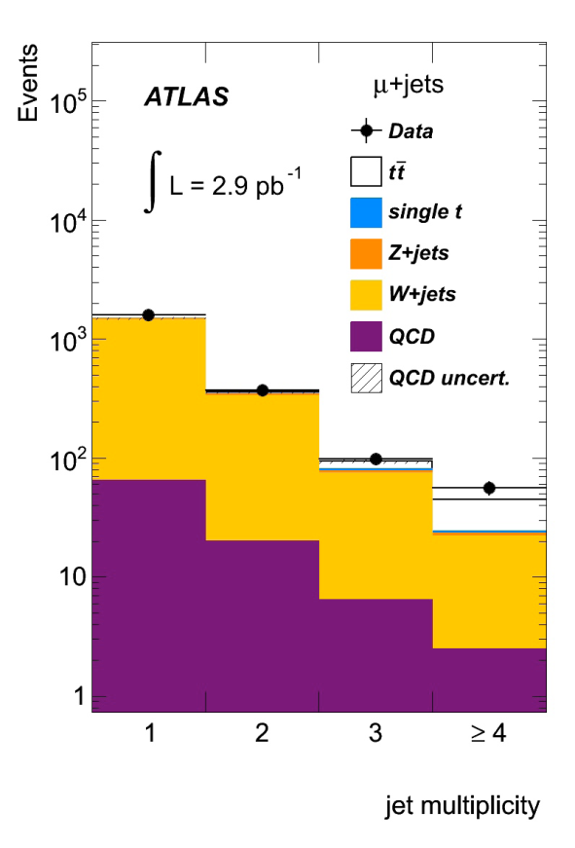
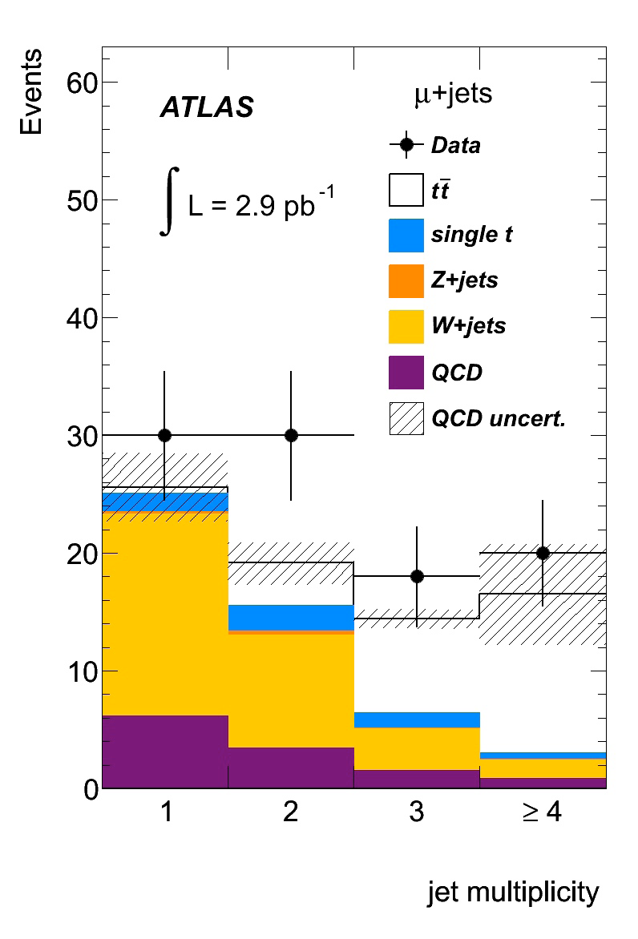

W+jets background estimation
Contribution from Milano group
μ+jets
Estimation in 4-jet pre-tag region ‘Berends-Giele’ scaling: W+N+1 jets/W+N jets approx. constant for each N
Measure W+1,2 jets by subtracting data driven QCD estimate from 1,2-jet pre-tag bins (+ MC estimates for other processes) and extrapolate to signal region.
Estimation in 4-jet tagged region
From data with muon
where
From MC
W(eν)tagged≥4jet = 1.9 ± 0.7(stat) ± 0.9(syst)
W(μν)tagged≥4jet = 3.2 ± 1.2(stat) ± 1.2(syst)
11
11

Slide 12
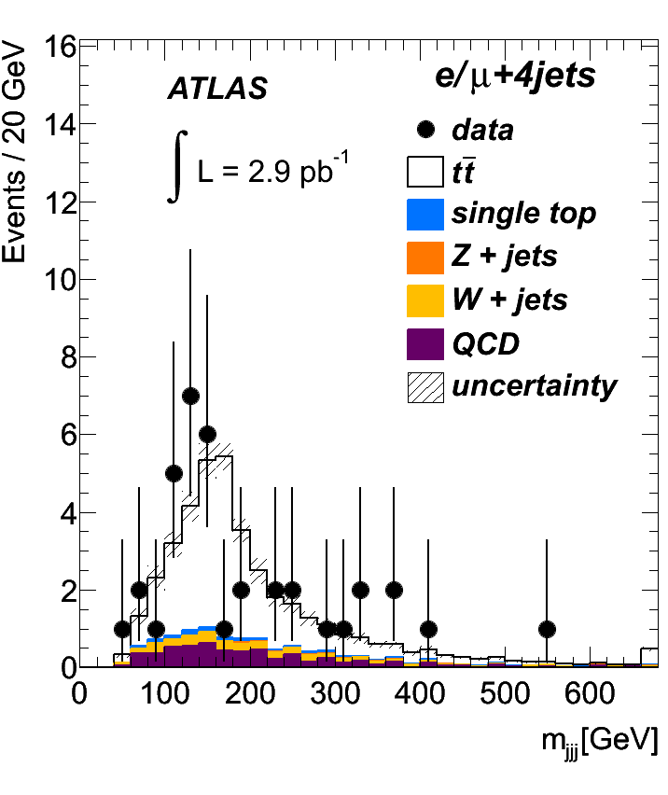
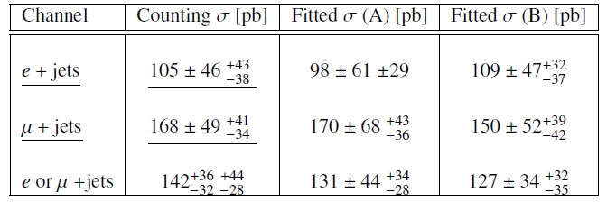
Cross-section evaluation
Cut & Count method: Calculate ttbar event yield – subtract all backgrounds
Source | e+jets | μ+jets
W+jets | 1.9 ± 1.1 | 3.2 ± 1.7
QCD | 4.8 ± 3.1 | 0.77 ± 0.51
single top | 0.66 ± 0.19 | 0.67 ± 0.17
Z+jets | 0.16 ± 0.11 | 0.08 ± 0.06
di-bosons | 0.024 ± 0.020 | 0.025 ± 0.020
Udine group contribution
e+j. N_{obs}= 17 → N_{ttbar}= 9.5 ± 4.1 ± 1.5
μ+j. N_{obs}= 20 → N_{ttbar}=15.3 ± 4.4 ± 1.3
Acceptance/efficiencies from MC@NLO
[ σ(theory - NNLO)=165 pb ]
2 alternative methods: Keep the invariant mass distribution of the 3 jets combination with highest P_{T} from data, use templates shape for other backgrounds and fit simultaneously ttbar and W+jets contribution. First method uses 3-jet and 4-jet “untagged events”, the second one 4 jet events with 0 and ≥ 1 b-tag jet.
12

Slide 13
Combination results
Bologna group contribution
The use of Markov Chain MC allows the solution of the Bayes formula:
in presence of systematic errors related to background estimation, acceptance and luminosity. The aim is to evaluate a posterior x-sec distribution.
13

Slide 14
Significance of the observation
Bologna group contribution
14

Slide 15
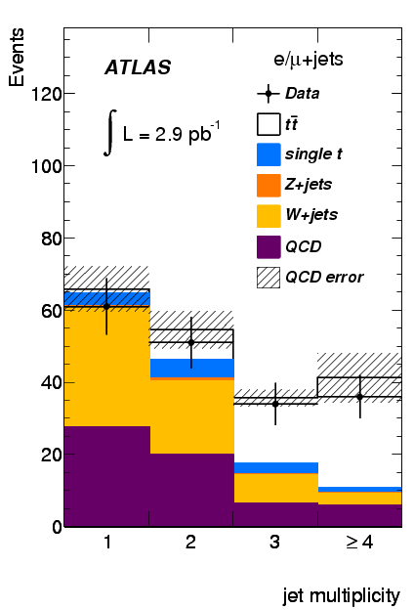
Conclusions & outlooks
We observe a clear excess of events in 3,4-jet tagged samples consistent with ttbar;
Have fully data driven estimate of QCD background and almost fully data driven estimate of W+jets background;
Extract ttbar yield/ cross section using counting method and cross check with other methods with different assumptions on bckg modeling are consistent.
Signal significance in l+jets likely just short of 4σ, becoming 4.8σ after combination with dilepton.
Italian contribution is clearly visible; it could be probably strengthened but we are already competitive and we can maintain our “positions”.
In the next future (i.e. Moriond Conference), the idea is to use the Cut&Count method (and possibly improve some data-driven background estimation) until it is competitive w.r.t. the fit methods.
Then we should try to find such a collaboration looking to other channels.
15

Slide 16
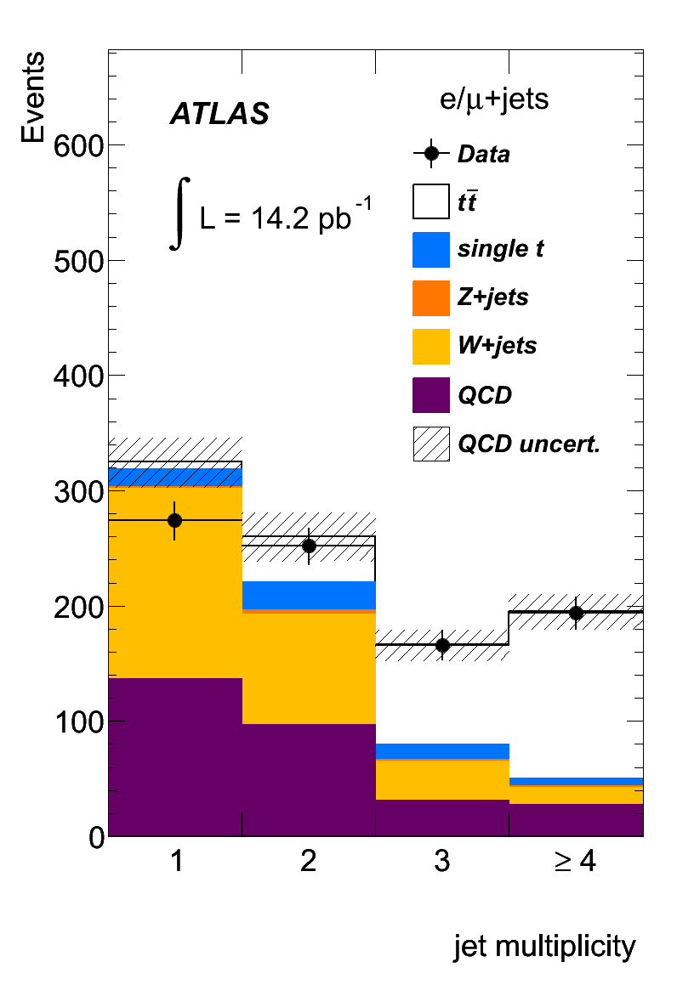
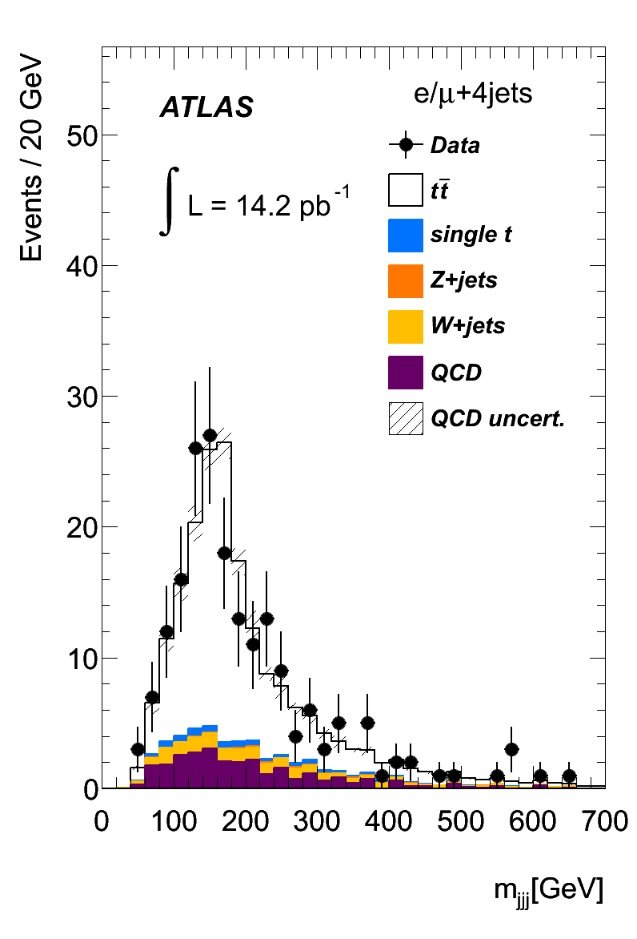
The “latest and greatest”….
16

