Slide 1
Trigger Efficiencies - Tag and Probe with J/Ψ →μμ
M. Biglietti (Univ. La Sapienza Roma1 & INFN)
F. Conventi, E. Rossi (Univ. Napoli & INFN)
&& JpsiIt group (Bologna, Genova, Napoli, Roma1)

Slide 2
Introduction/1
In J/psi→μμ events is possible to identify a self-triggering reconstructed muon (the tag) and search for a second reconstructed muon without using trigger system (the probe)
The efficiency is defined as
# probes that match the trigger
# total number of selected probes
Work mainly driven by “J/Psi cross section and Ratio” paper
Data sample
Trigger selection
Selection cuts

Slide 3
Data Samples & Analysis
Data Samples:
due to different configuration (complicated by the trigger commissioning) not all the data available have been used
period B+C+D1
tested trigger L1_MU0
L= ~50nb⁻¹
period E6 – E7
tested trigger EF_mu4
L= ~350nb⁻¹
Period F
tested trigger EF_mu6
L= ~2pb⁻¹
Analysis developed in the JpsiIt package
information of L1 ROI (on/off time), HLT trigger objects
extrapolation of reconstructed track to the pivot plane
trigger matching between offline reconstructed objects and HLT reconstructed objects (from B physics analysis tools)

Slide 4
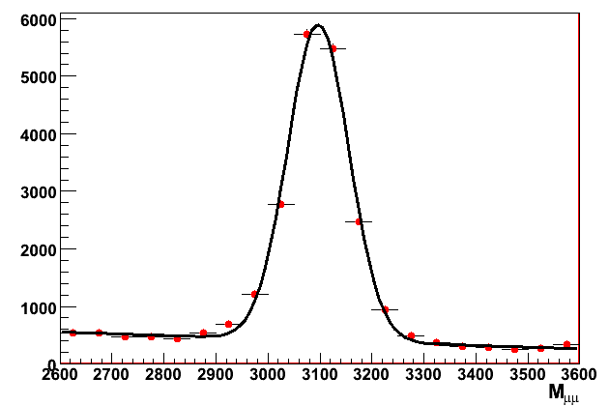
Selection
Selection of dimuon candidates from the J/psi mass (selection baseline as the one for reconstruction efficiencied → Stefania’talk )
2 opposite sign muons
at least 1 combined muon
the other one can be a combined or segment-tagged (low pt)
p>3GeV
nPixels>0, nSCT>5, nTRT>10
0.3<DeltaR<2.5
“Tag” muon matched with the trigger object that gives the event trigger
period B+C+D1: L1_MU0
period E : EF_mu4
period F: EF_mu6
“Probe” muon used to test
different trigger selection (both L1 and HLT)
trigger match:
DR(L1)<0.4, accepted RoIs in -2, -1, 0 BCs
DR(EF)<0.05
bkg ~15%
data

Slide 5
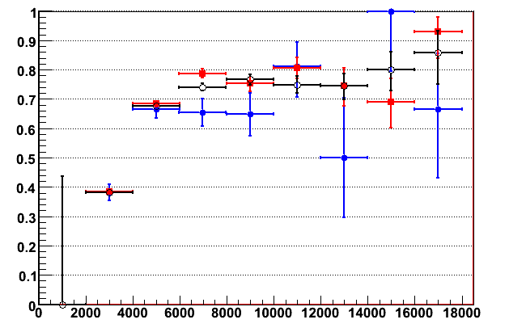
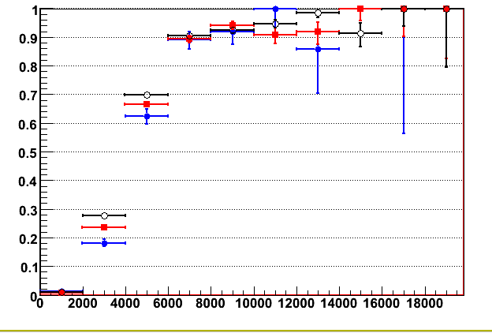
LVL1 TurnOn curves
period B+C+D1
period E
period F
L1 turnon curves for the MU0 threshold for different data periods
L1MU0
barrel
endcaps
pT
pT

Slide 6
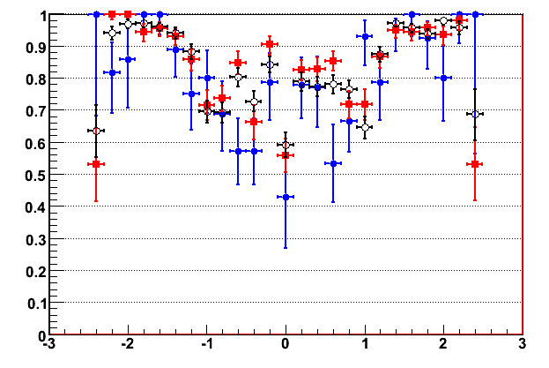
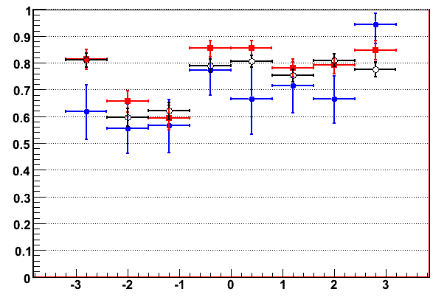
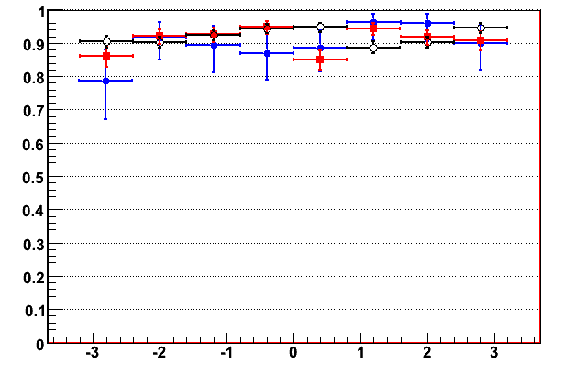
Eta/Phi Efficiencies
L1MU0
period B+C+D1
period E
period F
barrel
L1 efficiencies for p_{T}>6GeV wrt eta/phi for the MU0 threshold for different data periods
eta
pt>6GeV
pt>6GeV
barrel
endcaps
phi
phi

Slide 7
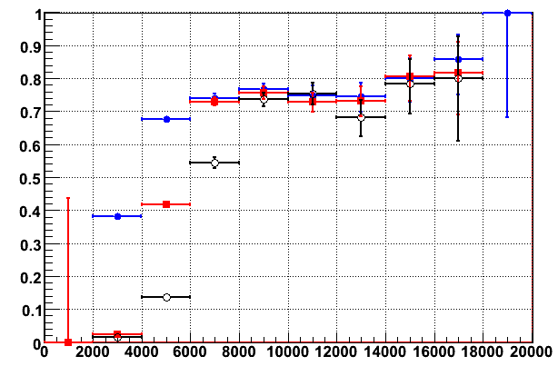
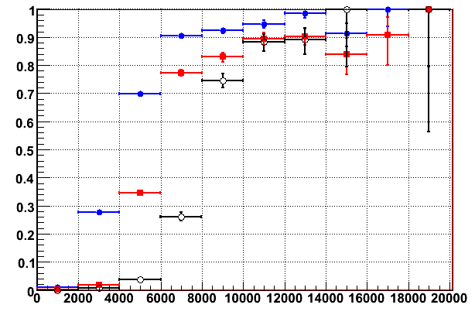
L1 Low p_{T} thresholds
Period F
L1MU0
L1MU6
L1MU10
L1 turnon curves for the low-pt thresholds for data period F
Lower plateau for MU6/MU10 in barrel can be due to bkg
– under study
barrel
endcaps
p_{T}
p_{T}

Slide 8
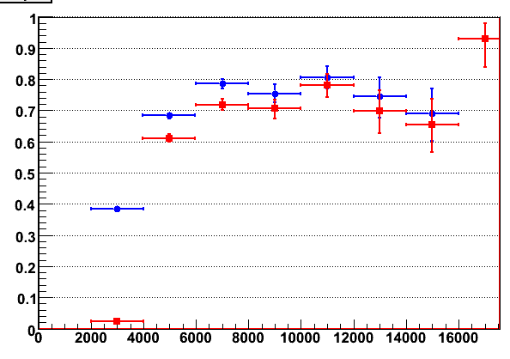
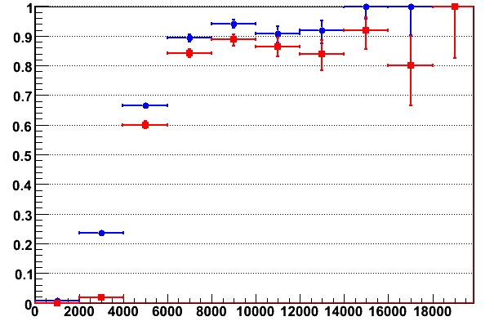
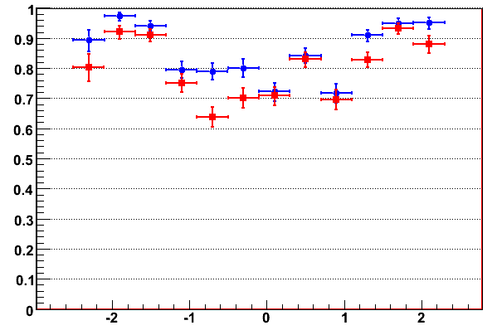
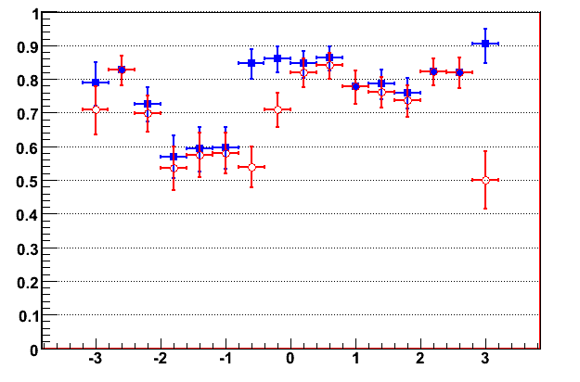
EF_mu4 – period E
L1MU0 and EF_mu4
efficiency in period E
eta/phi region in
which HLT efficiency
is low
barrel
L1MU0
EF mu4
endcaps
p_{T}
p_{T}
pt>6GeV
barrel
barrel
pt>6GeV
eta
phi

Slide 9
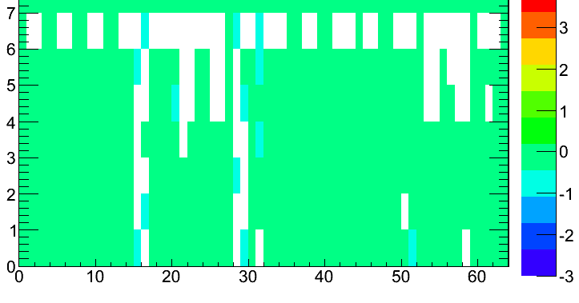
period E6+E7
tag and probe method used to monitor the trigger timing :
-tag muon “in time”
-probes test the arrival of the RPC trigger (wrt the L1A) instead of the efficiency
trigger tower (eta)
barrel sector logic
BC(RPC) – BC(L1)

Slide 10
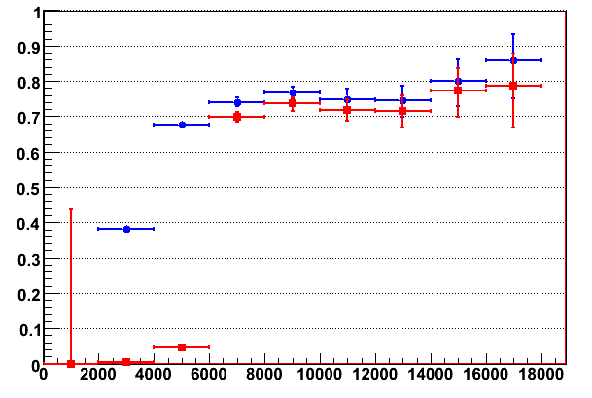
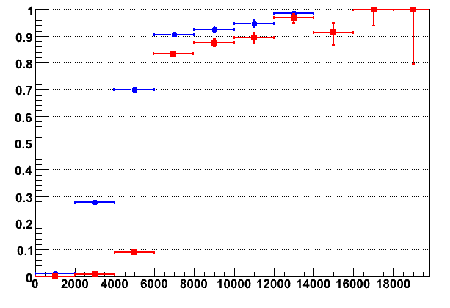
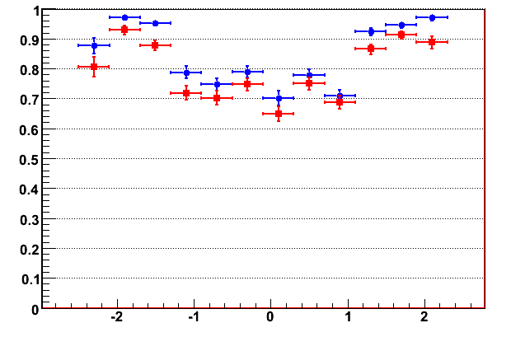
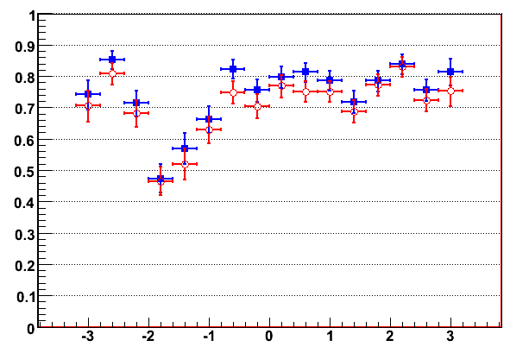
EF_mu6 – period F
L1MU0 and EF_mu6
efficiency in period F
barrel
L1MU0
EF mu6
endcaps
p_{T}
p_{T}
barrel
pt>6GeV
pt>6GeV
eta
phi

Slide 11
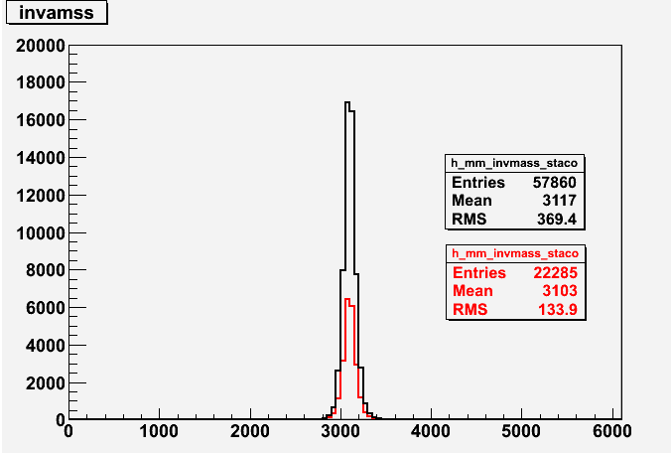
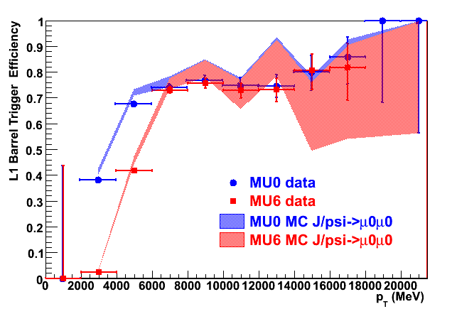
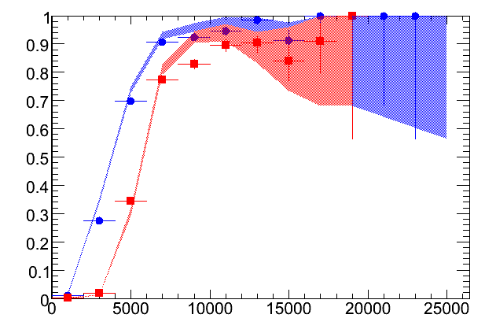
MC Comparison: L1_MU0/ L1_MU6
Period F
L1MU0
L1MU6
MC : J/psi→mu0mu0
comb+any
comb+comb
turnon curves
for MU0 and MU6
threshold for data
(periodF) and MC
barrel
endcaps
endcaps
p_{T}

Slide 12
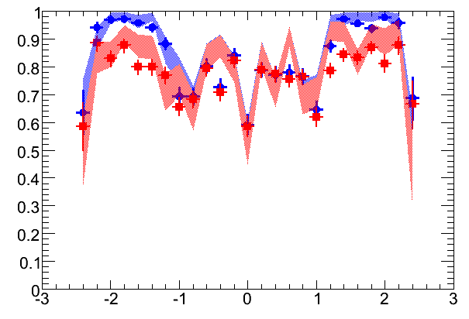
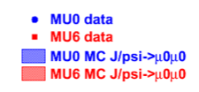
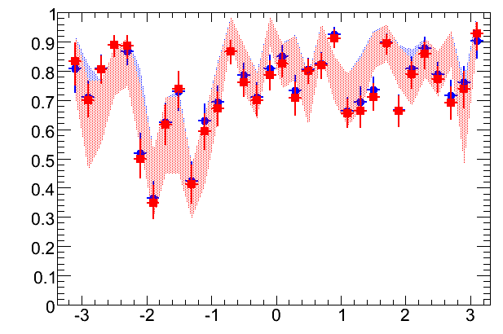
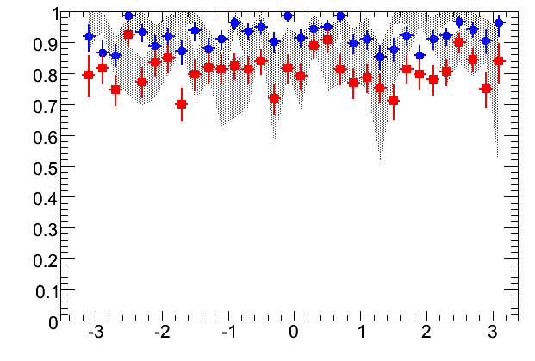
MC Comparison L1_MU0/ L1_MU6
Period F
L1MU0
L1MU6
L1 efficiencies for p_{T}>6GeV wrt eta/phi for the MU0 and MU6 thresholds for data period F
eta
barrel
phi
endcaps
phi

Slide 13
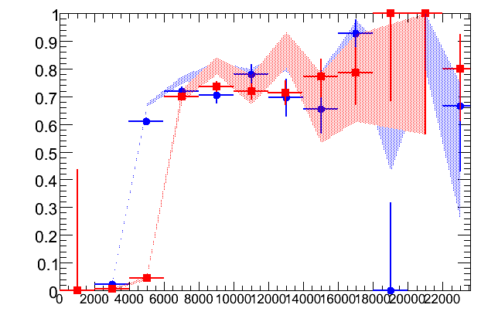
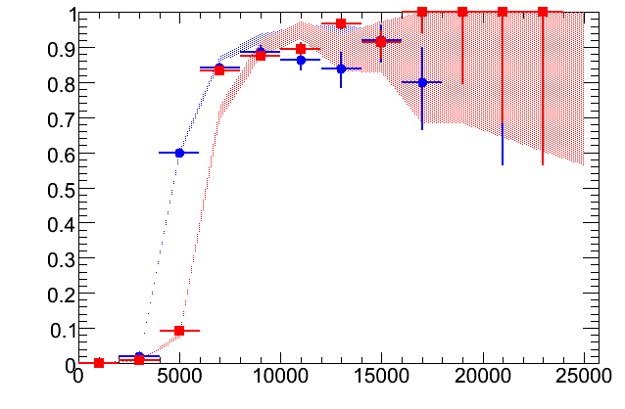
MC Comparison EF_mu4/ EF_mu6
Period E+F
turnon curves for mu4 and mu6 threshold for data (periodF) and MC
barrel
endcaps
p_{T}
p_{T}
note : EF_mu6 in MC
is seeded by L1_MU6

Slide 14
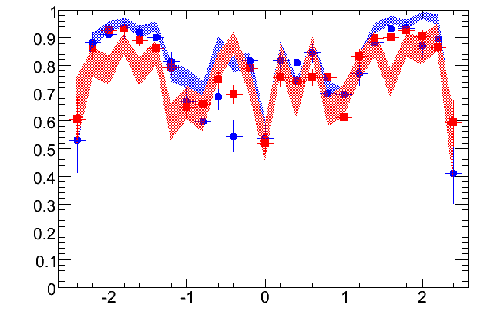
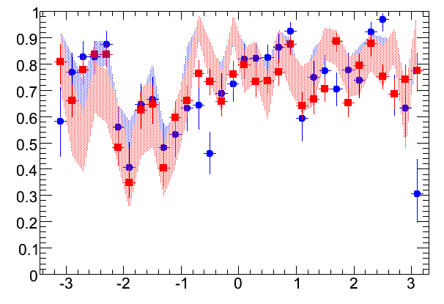
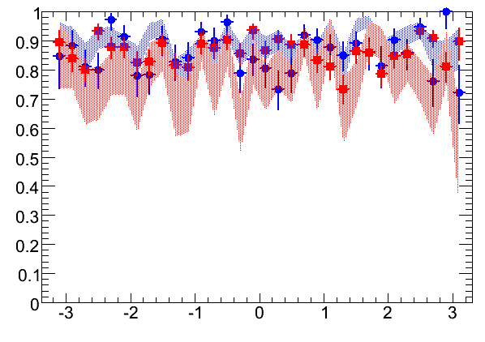
MC Comparison EF_mu4/ EF_mu6
Period E+F
EF efficiencies for p_{T}>6GeV wrt eta/phi for the mu4 and mu6 thresholds for data period F
eta
barrel
endcaps
phi
phi
note : EF_mu6 in MC
is seeded by L1_MU6

Slide 15
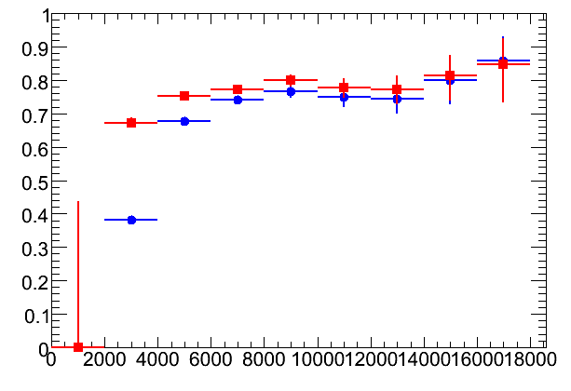
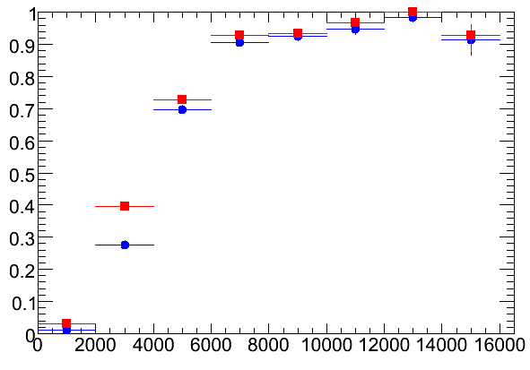
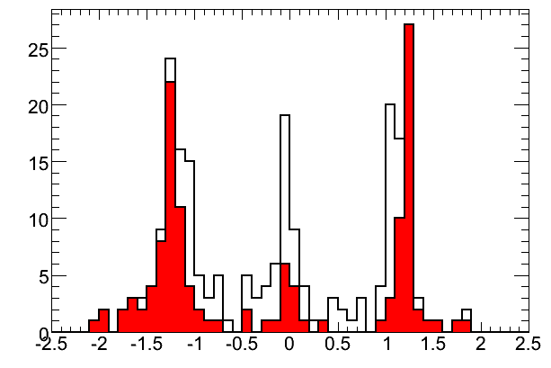
Comb+Comb vs Comb+any Selection
comb+comb
comb+any
barrel
endcaps
any=comb or tagged muons
different sets of efficiency
maps provided
pt>6GeV
all tagged muons
tagged matched
with trigger

Slide 16
Conclusions
Trigger efficiency from Jpsi->μμ using Tag&Probe method:
Both L1 and EF studies are already in place
work ongoing to include also L2
- Efficiency wrt to pT, eta and phi
- Comparison between periods or/and thresholds
MC comparison
On going:
- Study of Systematics
- Look at the bkg level impact on trigger efficiencies
- Trigger matching
- Selection cuts

