Slide 2
WE are also ATLAS members and we participated to AFP LOI

Slide 4
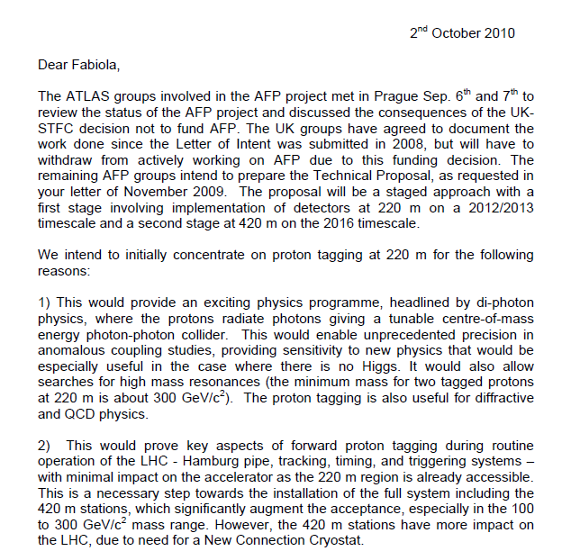
(...)

Slide 5
From the last S. Watts talk, Prague

Slide 14
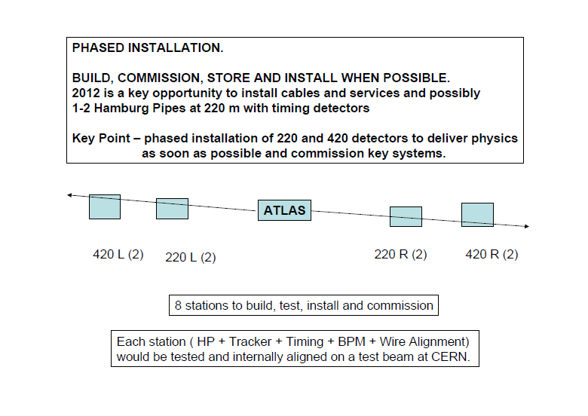

Slide 16
Reserve

