Slide 1
Neutrino oscillations
unlocked
A. Yu. Smirnov
Max-Planck-Institut fur Kernphysik,
Heidelberg, Germany
105 papers with neutrino oscillation in titles since September 2021
NOW 2022, Ostuni
September 5, 2022

Slide 2
Oscillations in vacuum
Wave packets of
the eigenstates of propagation ν_{i}
production
ν₁
detection
ν₂
h
x
x
x
x
V
Entanglement with accompanying
particles
Vacuum : VEV V(x,t),
interactions of ν with VEV h V → m, θ, h = h(< τ >)
Interference:
coherence at production
propagation, detection
NO:
effect of propagation in space - time
Modification of geometry of x-t, metrics, GR, NO in the GW background
Quantum mechanical effect (superposition, interference)
Tests of QM, modification of QM, evolution equation..

Slide 3
Oscillations in media
production
ν₁
detection
ν₂
h
φ
Classical fields (e.g. magnetic fields)
Matter Particle densities
From microscopic picture: scattering on individual electrons,
to macroscopic one in terms of effective potentials.
Interactions with scalar bosons (DM) < φ > → φ
Effective mass squared m² ~ n_{φ} ~ z³ increases with decrease of t_{U}
Oscillating neutrino medium - treatment as open system

Slide 4
Content
Space-time localization diagrams
Coherence, entanglement and wave packets
Matter , vacuum and propagation
Talks on other aspects
of oscillations
B. Dasgupta,
L. Johns
M. Blasone

Slide 5
Δm₄₁² = 1 - 2 eV²
Space-time
LSND
Localization diagrams

Slide 6
Space-time localization diagram
E.Kh. Akhmedov, D. Hernandez, A.Y.S. 1201.4128 [hep-ph]
Reflects computations of oscillation amplitude in QFT, visualizes various subtle issues
Produced and propagated neutrino state
|ν^{P}> = ψ₁^{P}|ν₁ > + ψ₂^{P}|ν₂ >
where the wave packets
ψ_{i}^{P} = ψ_{i}^{P}(x – v_{i}t)
v_{i} - group velocities
Detected state
|ν^{D}> = ψ₁^{D}|ν₁ > + ψ₂^{D}|ν₂ >
ψ_{i}^{D} = ψ_{i}^{D}(x – x_{D}, t – t_{D})
- the detection WP
Amplitude: projection of propagated state onto detection state:
For simplicity ψ_{i}^{D}(x – x_{D}, t – t_{D}) = δ (x – L) ψ_{i}^{D}(t –t_{D})
L- baseline
A (L, t_{D}) = <ν^{D}|ν^{P}> = Σ_{i} dt ψ_{i}^{D*} (t –t_{D}) ψ_{i}^{P}(L – v_{i}t)

Slide 7
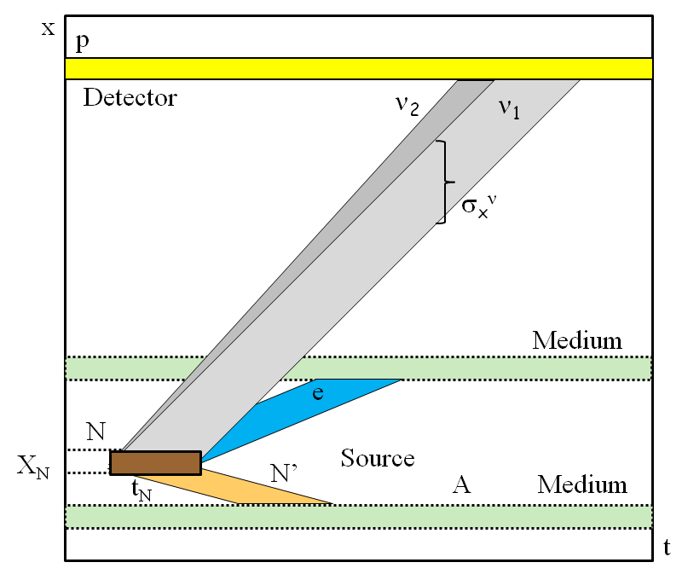
Space-time localization diagram
Oscillation probability
P (L) = dt_{D}|A(L, t_{D})|² =
dt_{D} [|A₁(L, t_{D})|² + |A₂(L, t_{D})|²]
+ 2Re dt_{D} A₁(L, t_{D})*A₂(L, t_{D})
interference
A_{i}(L, t_{D}) = dt ψ_{i}^{D*} (t –t_{D}) ψ_{i}^{P}(L – v_{i}t)
- generalized WP
Further integration over interval of baseline L due to finite sizes of the source and detector
The slopes of bands are determined by group velocities

Slide 8
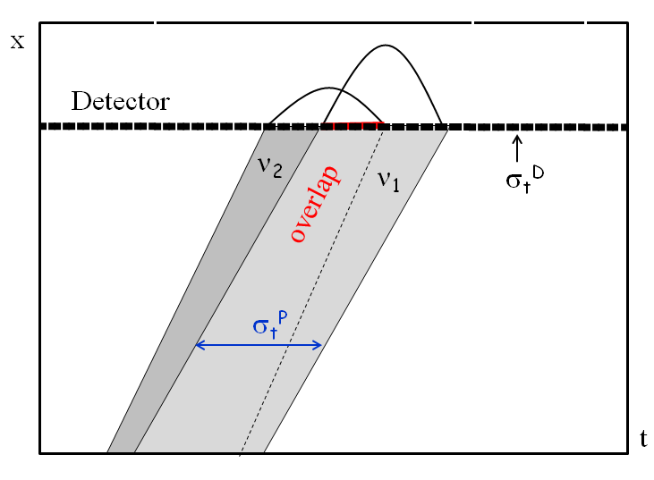
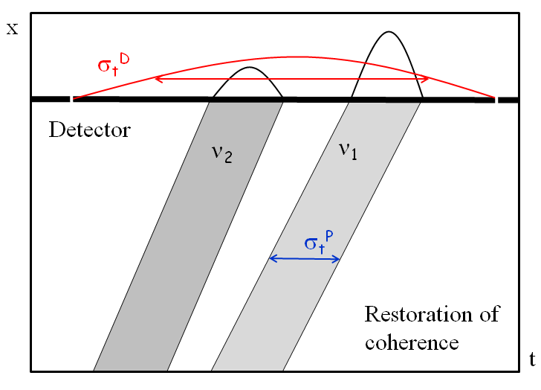
Detection
two extreme cases
σ_{t}^{D} << σ_{t}^{P}
σ_{t}^{D} >> σ_{t}^{P}
short detection coherence time
long detection coherence time
ψ_{i}^{D} (t – t_{D}) ~ δ (t –t_{D})
A_{i}(L, t_{D}) ~ ψ_{i}^{D}(L/v - t_{D})
A_{i}(L, t_{D}) ~ ψ_{i}^{P}(L – v_{i}t_{D})
restoration of coherence if
Interference is determined by overlap of produced WP
σ_{t}^{D} >> t_{sep}

Slide 9
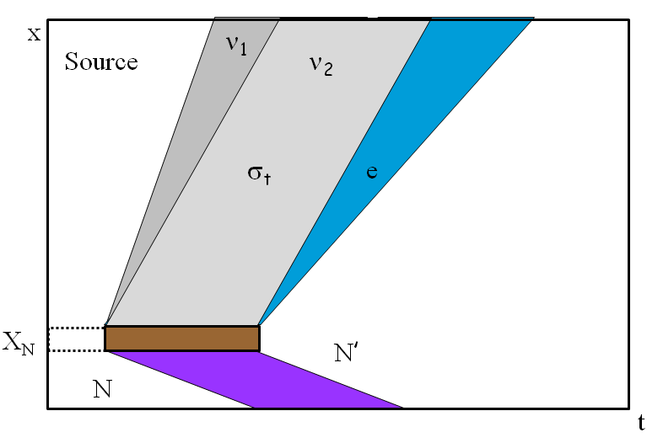
Production
E.Kh. Akhmedov and A.Y.S.
[hep-ph]
WP’s are determined by localization region of the production process: overlap of localization regions of all particles involved but neutrinos.
E.g. in the β decay,
N → N’ + e⁻ + ν
If N’ and e⁻ are not detected or
their interactions can be neglected
localization of process is given by localization of atom N
distance
The latter is determined by time
between two collisions of N, t_{N}
σ_{x} ~ v_{ν}t_{N} ~ X_{N} c/v_{N}
time
enhancement factor

Slide 10
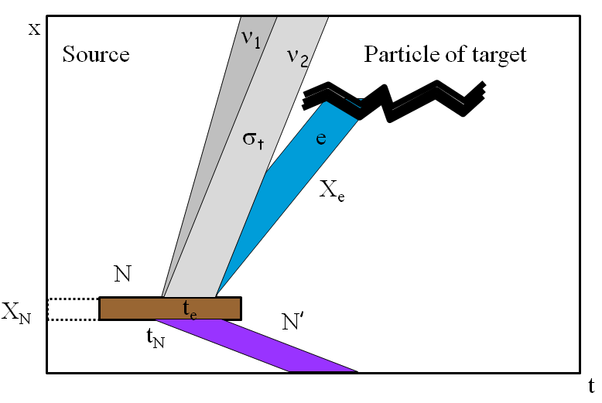
Entanglement and correlations
If N’ or/and e⁻ are detected or interact, this may narrow their WP’s
and therefore the neutrino WP.
If e⁻ is detected during time interval t_{e} < t_{N}, the size of ν WP
will be determined by t_{e}
t_{coll}
If e⁻ interacts with particles of medium which have very short time between collisions t_{coll}, then σ_{x} ~ ct_{coll}
distance
Similar to the EPR paradox
time
consider ν emission and interactions of e⁻ as unique process;
contributions to its amplitude from different interactions regions
appear with random phases ξ_{k} - incoherent
A_{tot} = A_{k} e^{i}
ξ_{k}

Slide 11
Δm₄₁² = 1 - 2 eV²
Propagation coherence
LSND

Slide 12
Observing propagation decoherence
x –t space: separation of wave packets of mass states due to difference of group velocities
equivalent to integration over the energy uncertainty
Ψ
f(E)
σ_{x}
σ_{E} ~ 1/ σ_{x}
x
E
Suppression of interference → damping of oscillations
Survival probability :
P_{ee} = P_{ee} + ½ D(E, L) sin² 2θ cos φ
Damping factor for Gaussian WP
D(E, L) = exp [- ½(L/L_{coh})²]
Coherence length
L_{coh} = σ_{x}
E²
Δm²
Information is not lost
and can be restored at detection

Slide 13
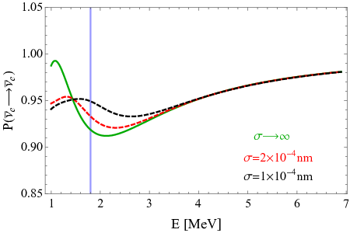
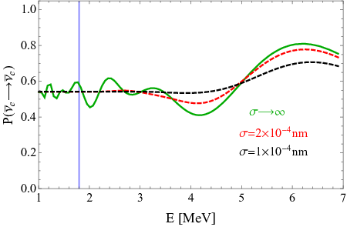
Decoherence of reactor neutrinos
A de Gouvea, V De Romeri,
C.A. Termes, 2104.05806
[hep-ph]
Bound on size of the WP
Daya Bay, RENO
KamLAND
Expected
damping effect
Absence of decoherence (damping) effect means
Δm²
2E²
L << L_{coh}
σ_{x} > L
Analysis of data:
σ_{x} > 2.1 x 10⁻¹¹ cm (90% C.L.)
The bound corresponds to the energy resolution of detectors δ_{E}
σ_{x} ~ 1/δ_{E}

Slide 14
Other studies
Daya Bay: decoherence due to finite momentum spread σ_{p}
σ_{p} /p < 0.23 (95% C.L.)
F.P. An, et al,
1608.01661 [hep-ex]
for p = 3 MeV: σ_{x} ~ 1/σ_{E} = 2.8 x 10⁻¹¹ cm
JUNO in future may set the limit
J. Wang et al.
2112.14450 [hep-ex]
σ_{p} /p < 10⁻² (95% C.L.)
→ σ_{x} > 2.3 x 10⁻¹⁰ cm
Decoherence in oscillations active – eV scale sterile
C.A.Arguelles et al,
2201.05108 [hep-ph]
Damping effects in various experiments computed
for σ_{x} = 2.1 x 10⁻¹¹ cm (as found in A de Gouvea et al).
Claims:
- decoherence allows to reconcile BEST result with reactor bounds;
- results of analysis should be presented in two forms: with and without decoherence

Slide 15
Propagation decoherence and energy resolution
integration over the energy resolution of setup – another sources of damping
E.Kh. Akhmedov and A.Y.S.
2208.03736[hep-ph]
R(E_{r} , E) energy resolution in experimental set-up (width δ_{E} ):
- spectrum of produced neutrinos (line), or
- energy resolution of a detector
f(E, E) – WP of produced neutrino in energy representation
acts on oscillations, as R does, and can be attached to R(E_{r}, E)
Effective resolution function
R_{eff} (E_{r} , E) = dE R(E_{r} , E) |f(E, E)|²
For Gaussian f and R, R_{eff} is also Gaussian with width
δ_{E}² + σ_{E}²
The problem: to disentangle the two contributions

Slide 16
WP’s of reactor neutrinos
Source: β-decays of fragments N of nuclear fission
N → N’ + e⁻ + ν
N quickly thermalise → in equilibrium with medium in the moment of decay → the average velocity:
v_{N} ~ [3T/ m_{N}]^{-1/2}
If N’ and e⁻ are not detected or their interactions can be neglected,
localization of ν production process is given by localization of N.
σ_{x} ~ v_{ν}t_{N} ~ X_{N} c/v_{N}
t_{N} - time between two collisions of N with other atoms
t_{N} ~ [σ_{AA} n_{U} v_{N}]⁻¹
σ_{AA} geometric cross-section σ_{AA} ~ π(2r_{vdW}) ²
Van der Waals radius
n_{U} - number density of Uranium
σ_{x} = 2.8 x 10⁻³ cm

Slide 17
Effect of accompanying particles
Duration of ν production process
is given by the shortest mean free time among particles involved
Consideration of x-t localization
of interactions of accompanying particles.
Electrons have the shortest
Chain of k processes of secondary interactions till equilibration (thermalization)
σ_{t} = t_{e} = X_{e}/v_{e}
X_{e} is determined by ionization
of uranium, σ_{eU}
...
E + A → e’ + A’
A
ν_{i}
X_{e} = (n_{U} σ_{eU})⁻¹
t_{e}
N
σ_{x} = 2 x 10⁻⁵ cm
σ_{t} ~ t_{N} /2^{k}
“short cut” estimation: can be considered as the upper bound
σ_{x} = (5 – 10)x 10⁻⁵ cm

Slide 18
Implications
1.
σ_{x} / σ_{x}^{exp} = 10⁵ - 10⁶
σ_{x} >> σ_{x}^{exp}
2.
Corresponding energy uncertainty
σ_{E} ~ 1 eV
while energy resolution δ_{E} ~ 10⁵ eV
To be sensitive to WP separation energy resolution function should be known with better that 10⁻⁵ accuracy
3.
For Cr source:
σ_{x} = 1.4 x 10⁻⁴ cm
4.
Large Δm² does not help since oscillatory pattern shows up at L ~ l_{ν}
but L_{coh} ~ l_{ν} ~ 1/Δm²
→ Δm² cancels in damping factor
5.
If some additional damping is found, it is due to some new physics and not due to WP separation
6.
Experiments with L ~ L_{coh} ? Lower energies? Widening lines?

Slide 19
Comments and replies
B.J.P. Jones,
2209.00561 [hep-ph]
Three points appear to undermine that WP separation is unobservable:
Causality violation
The statement is based on figures which do not correspond to our computations
Integration in non-orthogonal
basis of entangled recoil
We are not making integration over characteristics of recoil
Nuclear interactions inside nucleus measure position of initial particle (nucleon)
WP are determined by absolute localization of parent particle in the source i.e. wrt other atoms

Slide 20
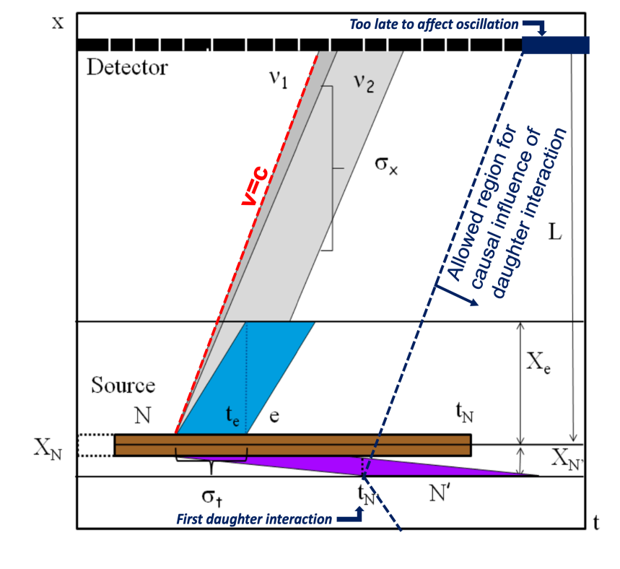
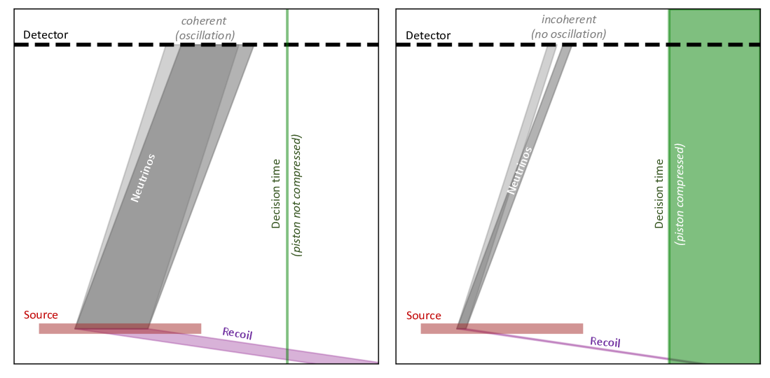
Comments
B.J.P. Jones,
2209.00561 [hep-ph]
Figs do not correspond to our estimations
No problem with casuality
Electron interaction decides
→ light cone should be constructed differently
In this setup t_{N’} >> t_{N} recoil does not affect WP of neutrinos which is determined by t_{N}

Slide 21
Δm₄₁² = 1 - 2 eV²
Matter vacuum
and propagation
LSND

Slide 22
From micro to macro picture
From interactions with individual scatteres to effective potential (mean field approximation)
E.Kh. Akhmedov
2010.07847 [hep-ph]
Point-like scatterers, a coarse graining – coordinate space averaging over macroscopic volumes with large number of particles
A. Y.S. , Xun-jie Xu
Summation of potentials produced by individual scatteres.
e.g., G Fantini,
A.G. Rosso, F. Vissani 1802.05781
For short range interactions r_{WI}, localization of scatterers should be taken into account
X_{e} >> r_{WI} , e.g. localization of e in atom
since λ_{ν}~ 1/p_{ν} << X_{e}
→ make sense to consider propagation of neutrino inside atom

Slide 23
Modeling with castle wall profile
n
b
a
x
V_{a} V_{b}
Half – phases:
φ_{a} φ_{b}
L_{a} L_{b}
Mixing angles:
θ_{a} θ_{b}
Oscillation probability
E. Kh. Akhmedov
P = [1 - I²/(1 – R² )] sin² (n ζ)
ζ = arcos R
n – number of periods
x
I = I(φ_{a} , φ_{b}, θ_{a}, θ_{b} ) , R = R(φ_{a}, φ_{b}, θ_{a}, θ_{b} )
For φ_{a} φ_{b} << 1 the probability can be reduced to
P = sin ²2θ_{m}(V) sin² ½φ(V)
V_{a} L_{a} + V_{b} L_{b}
L_{a} + L_{b}
- averaged potential
V =

Slide 24
WP’s and non-adiabatic evolution
Partially ionized atoms as the electron density perturbations
Number density profile of electrons in atom (O, C, He) is non adiabatic
M. Kusakabe
2109.11942 [hep- ph]
Interplay of non-adiabatic evolution and separation (relative shift) of the WP’s leads to new effects: additional averaging of oscillations
Applications to Supernova neutrinos
No new effects without WP separation and adiabatic evolution
No new effects for very sharp (step-like) density profile

Slide 25
Evolution of WP’s
WP’s are formed at the production (at boundaries)
ψ(t x) = dp f(p) φ_{p}(t x)
φ_{p}(t x) - plane waves
If there is no absorption or p-dependent interactions, f(p) does not change in the process of evolution
Evolution equation
idψ/dt - H ψ = 0,
insert ψ(t x):
dp f(p) [idφ_{p}/dt - Hφ_{p} ] = 0
Superposition principle and linearity of evolution equation → solve
eq for φ_{p}, then integrate over p (which takes care about WP nature) No effects predicted in 2109.11942 [hep- ph]
In t-x space WP can change form in the course of evolution,
but integrated over time result coincides with result in E-p rep.
Y. P. Porto-Silva , A Y S 2103.10149 [hep-ph]
νν - scattering → H = H (φ_{p}) – non-linear equation ?

Slide 26
Non-linear generalization of QM
T. Gherghetta A. Sherin
2208.10567 [hep-ph]
Evolution matrix
U(t, t_{p}, ν^{(p)} (t)) = U₀(t, t_{p}) + εU₁(t, t_{p}, ν^{(p)} (t))
Standard linear evolution matrix
expansion parameter
non-linear correction
Produced state
ν^{(p)} (t) = U(t, t_{p}, ν^{(p)}) ν^{(p)}(t_{p})
ν^{(p)} (t) = ν^{(p,0)} (t) + ε ν^{(p,1)} (t)
Equation for correction ν^{(p,1)} (t) in coordinate representation:
idν⁽¹⁾ (t) /dt = H₀ ν⁽¹⁾ (t) + G(t, x, ν⁽⁰⁾ )
inhomogeneous term
Weinberg 5D operator → interaction with scalar → state dependent term → G
ε‘
4
m₁ - m₂
m₁ + m₂
P = sin ²2θ sin ² ½φ - sin φ
ε‘ = A ε (m₁ + m₂) ²/v²
A = 81.5
Correction is very small

Slide 27
Casual framework for non-linear QM
D E Kaplan S Rajendran 2106.10576 [hep-th]
Schrodinger equation for single particle
q²
4π
idν(t, x) /dt = H₀ + ε d⁴x₁ |ν(t₁, x₁ )|² G_{r}(t x, t₁ x₁ ) ν(t, x)
G_{r} - retarded Green function for scalar φ
q – charge, Yukawa coupling constant of ν and φ
q = m_{ν} /v

Slide 28
Vacuum and properties of oscillations
G.Dvali , L Funcke,
1602.03191 [hep-ph]
Neutrino vacuum condensate due to gravity. Order parameter
<Φ_{αβ} > = <ν_{α}^{T}Cν_{β} > ~ Λ_{G} = meV - 0.1 eV
Cosmological phase transition at T ~ Λ_{G}
Neutrinos get masses m_{αβ} ~ < Φ_{αβ} >
Flavor is fixed by weak (CC) interactions and charged leptons
with definite mass generated by usual Higgs field
m ~ U(θ)^{T} <Φ> U(θ)
<Φ> = diag (Φ₁₁, Φ₂₂, Φ₃₃),
mixing matrix
T < Λ_{G}
Relic neutrinos form bound states φ = (ν_{α}^{T}ν_{β} )
decay and annihilate into φ (neutrinoless Universe)
Symmetry of system SU(3)xU(1) spontaneously broken by neutrino condensate - φ are goldstone bosons
φ get small masses due explicit symmetry breaking by WI via loops

Slide 29
Mixing and topological defects
G.Dvali , L Funcke,
T Vachaspati
2112.02107 [hep-ph]
Symmetry breaking:
string-wall network
SU(3) → Z₂ x Z₂ → I
global strings
domain walls
Length scale of strings ~ inter-string separation
ξ = 10¹⁴ m ( λ/a_{G})
Λ_{G}
1 meV
7/2
(self-coupling of string field Φ/scale factor of phase transition)
Travelling around string winds VEV <Φ> by the SU(3) transformation:
< Φ (θ_{S}) > = ω(θ_{W})^{T} <Φ > ω(θ_{W})
ω(θ_{W}) path - O(3) transformation with angles θ_{W} = (θ_{W}¹², θ_{W}¹³, θ_{W}²³).
After the path ω lepton mixing changes as
U = U(θ) ω(θ_{W})
over length ξ, θ_{W} = O(1)
Solar system moves through the frozen string-DW background with v = 230 km/sec. For 6 years (operation of Daya Bay)
d = vt = 4 x 10¹³ m - comparable with expected ξ

Slide 30
VEV or refraction on scalar DM?
S. F Ge and H Murayama, 1904.02518 [hep-ph]
Ki-Yong Choi, Eung Jin Chun, Jongkuk Kim,
1909.10478 [hep-ph]
Elastic forward scattering of ν on background scalars φ with fermionic χ mediator
2012.09474 [hep-ph]
ν_{L}
Effective potential
ν_{L}
φ
V^{B}
ν_{L}
χ
χ
φ
φ
Wolfenstein
limit
φ
ν_{L}
Resonance: s = m_{χ}²
1/E tail
0
for φ at rest the resonance ν energy:
E_{R} =
m_{χ}²
2m_{φ}
For small m_{φ} resonance at low,
observable energies
resonance
A.Y.S. , V. Valera, 2106.13829 [hep-ph]
0
E
E_{R}

Slide 31
Effective Δm²
Δm_{eff}² ~ 2EV^{B}
1 , E >> E_{R}
ε = 0
y²n_{φ}
4 m_{χ}
Δm_{eff}² ~
E
E_{R}
ε , E << E_{R}
|Δm_{eff} ²|
existing
observations
Δm_{eff}² = constant - checked
down to 0.1 MeV
relic ν
→ take E_{R} << 0.1 MeV
E_{R}
E
For E_{R} = 0.01 MeV:
KATRIN, E ~ 1 eV:
m_{eff} < 2 10⁻⁴ eV - undetectable
COSMOLOGY
m_{eff}² ~ n_{φ} ~ (1 + z)³
→ increased in the past
while VEV = const
Relic ν, E = 10⁻⁴ eV:
m_{eff} (0) < 5 10⁻⁶ eV: m_{eff} (z = 1000) ~ 0.15 eV,
no problem

Slide 32
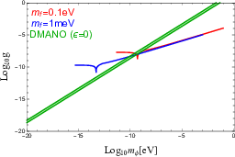
Bounds on parameters
Ki-Young Choi, Eung Jin Chun,
Jongkuk Kim, 2012.09474 [hep-ph]
Green band:
Δm_{eff}² = Δm_{atm}²
Upper bounds on y from scattering of neutrinos from SN1987A on DM φ with zero C- asymmetry and two different masses of mediator f
y
allowed
Similar bound from Lyα
(relic neutrinos) .
m_{φ} , eV
the corresponding resonance energy E_{R} = 0.01 MeV
Allowed
values:
m_{f} < 10⁻³ eV
m_{φ} < 10⁻¹⁰ eV
Cosmological bound is satisfied
y < 10⁻⁹

Slide 33
Summary
Space-time localization diagrams visualize (uncover) the key aspects of neutrino oscillations
Neutrino oscillations – the tool for explorations of properties of space and time, subtle aspects of QM fundamental symmetries (beyond measurements of neutrino parameters)
Effect of propagation decoherence (damping) is unobservable in the present reactor and source experiments. If some additional damping is found → due to new physics
Evolution of ν state and construction of WP in the momentum space commute → propagation decoherence is boundary (for linear case) phenomenon (as well as production and detection decoherence)
Effects of complex structure of vacuum, neutrino condensates,
Non-linear generalization of QM can affect NO
Important study: search for time, space and energy
Dependences of oscillation parameters.

Slide 34
Landscape of studies 2021- 2022
About 100 papers with “Neutrino oscillations “ in titles
Coherence,
Entanglement in neutrino oscillations
Collective neutrino oscillations
Micro vs. macro description
Quantumness, Tests of quantum mechanics
Oscillations in modified metric, gravity
Oscillations in gravitational waves background
Mater, medium effects in presence of new interactions (long range forces, DM ),
Modification of QM, evolution equation
Effects of Lorentz invariance violation,
Equivalence principle violation
Parameter symmetries
…
Topics:
All aspects, components, characteristics of oscillations are under investigation. They can be classified as…

