Slide 1
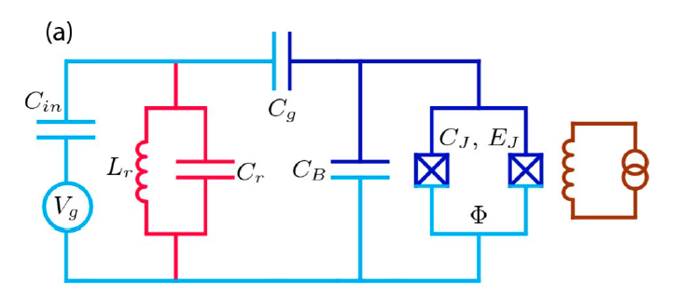
Charge dispersion:
$$E_{J}=\frac{φ_{0}I_{C}}{2π}$$
Make Ec small by choosing a “large” CB
Keep it small (1 kHz) to reduce charge noise and increate T2 →(EJ~20-50 Ec)

Slide 2
Anharmonicity:
absolute
relative
In the limit EJ>>EC
E12
E01
Asymptotic expressions:
Typical value E_{C}=300 MHz needed for fast manipulation of transmon state.
Readout pulse length dT → frequency width df=1/2pi dT then E12-E01=300 MHz>>hdf=hbar/dT → dT>3 ns
Further constraint is the qubit frequency sqrt(8EjEc)-Ec between 3-6 GHz.

Slide 3
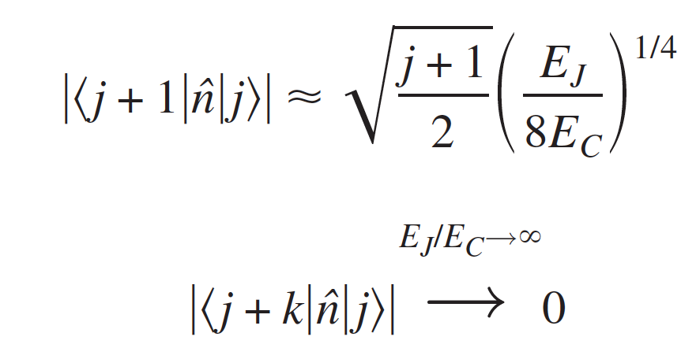
Circuit QED
|i> uncoupled transmon states
for k>1

Slide 4
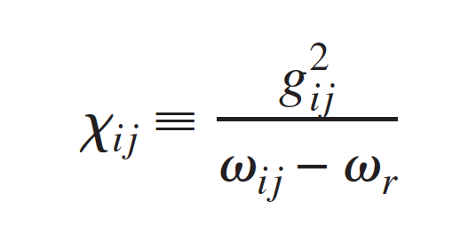
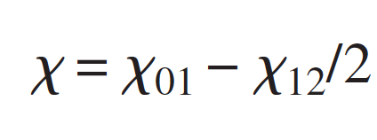
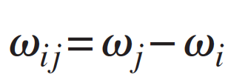
Control and readout
Dispersive limit:
Per Ej/Ec>>1

Slide 5
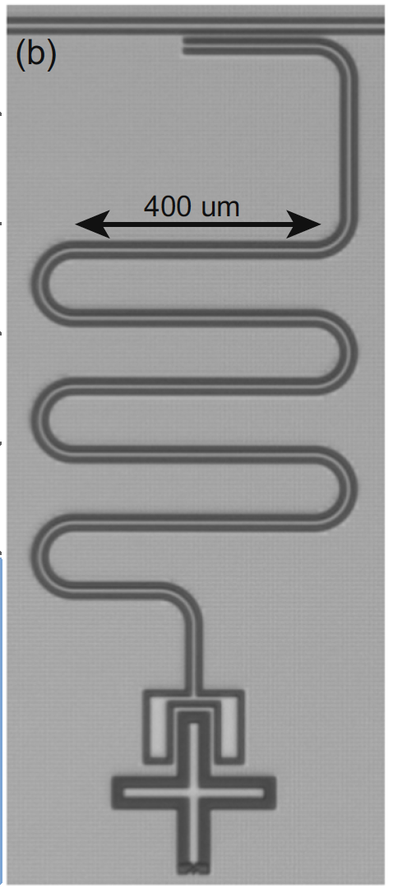
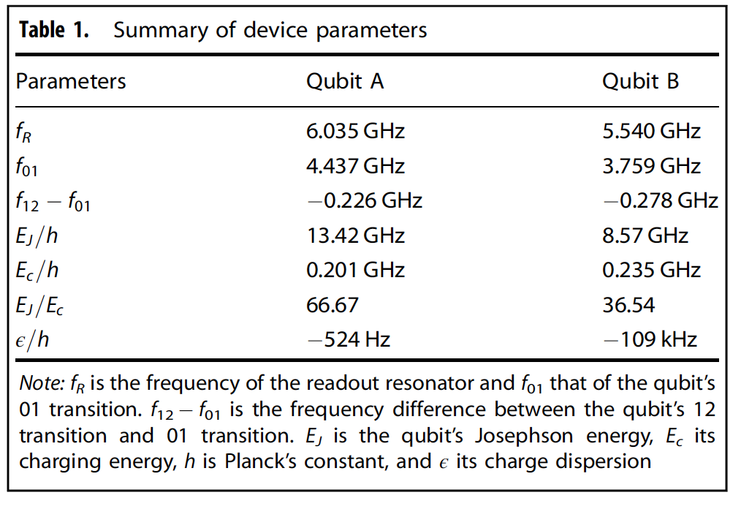
TL inductivelly coupled to lambda/4 resonator
Coupling Resonator to TL
Risonatore lambda/4
https://doi.org/10.1038/s41534-019-0168-5

Slide 6
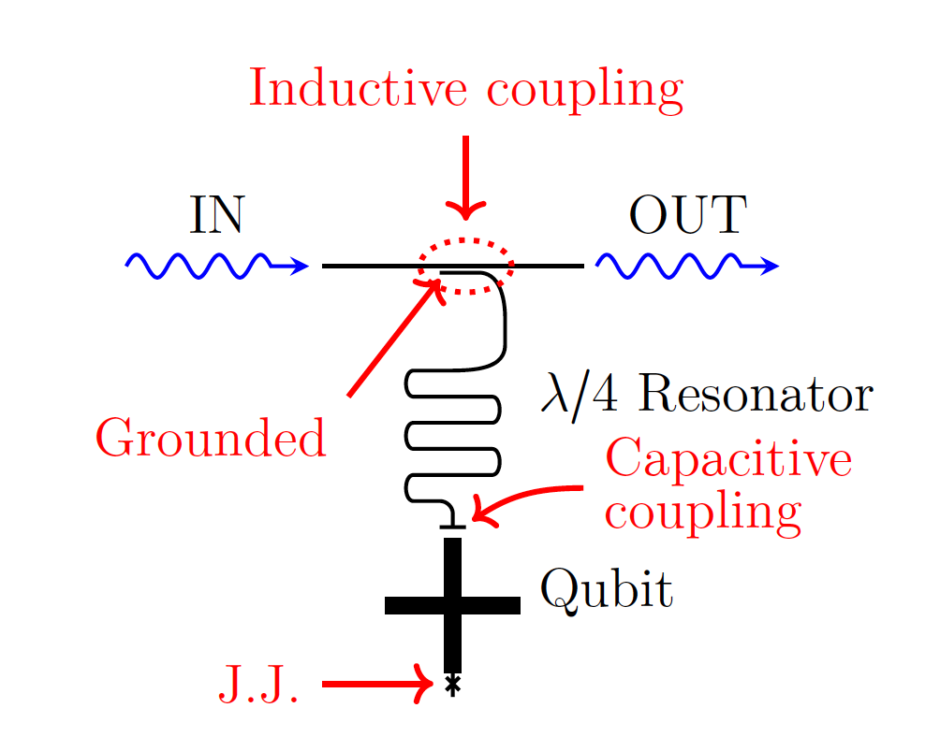
Chalmers Thesis Nilsson
f_q=3.6 GHz
f_r= 6 GHz
Chi=1 MHz

Slide 7
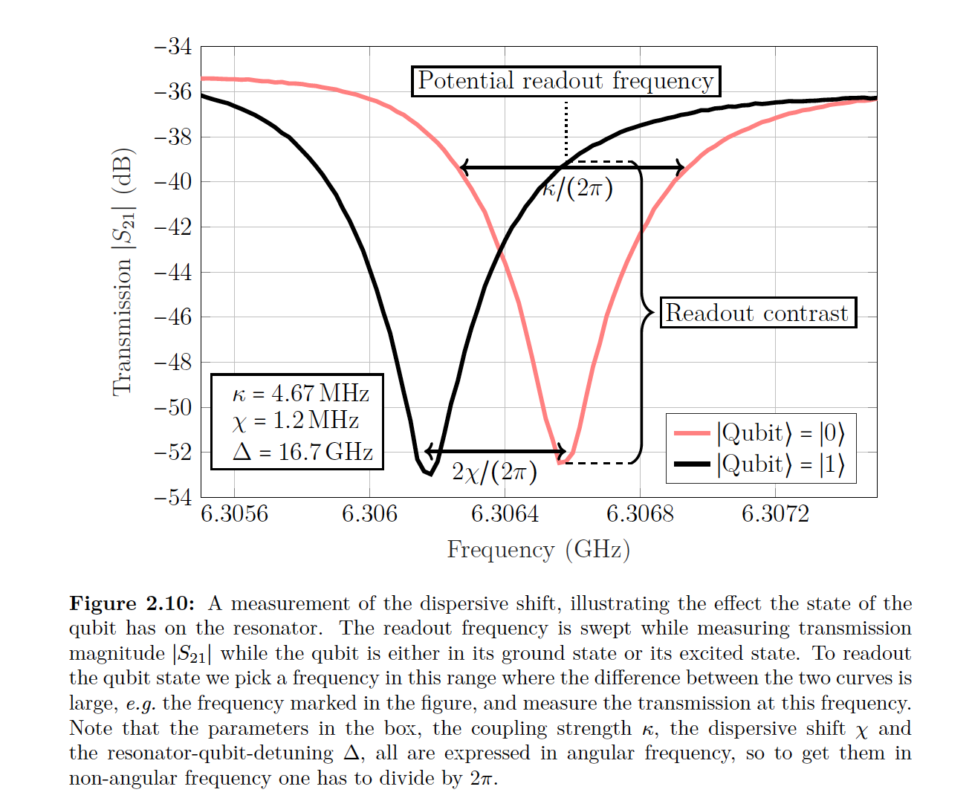
Chalmers Thesis Nilsson

Slide 8
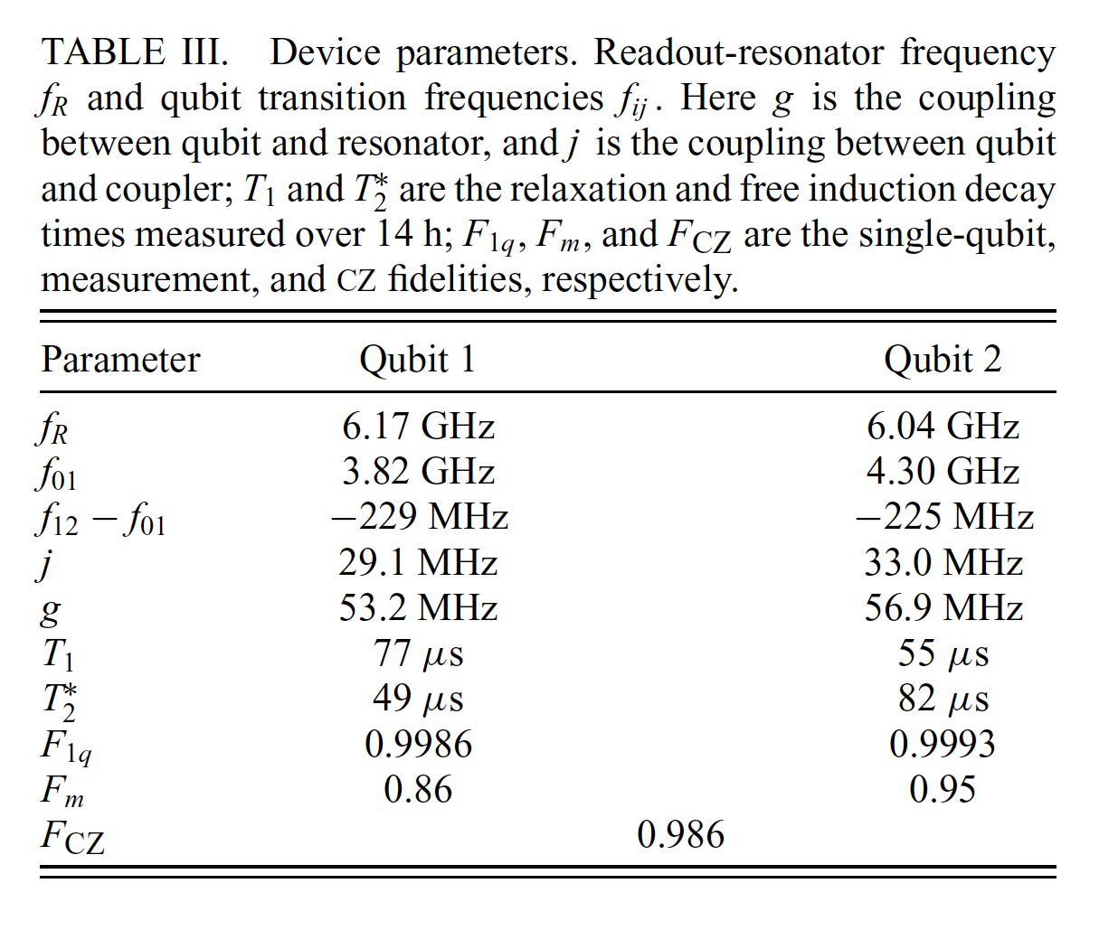
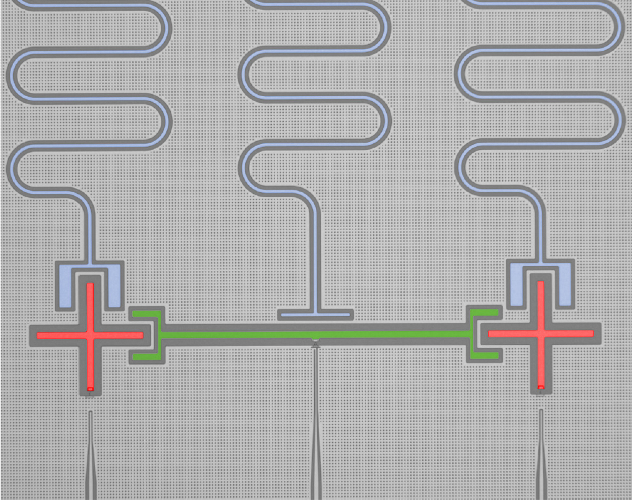
PR App 14 034010 (2020)

Slide 9
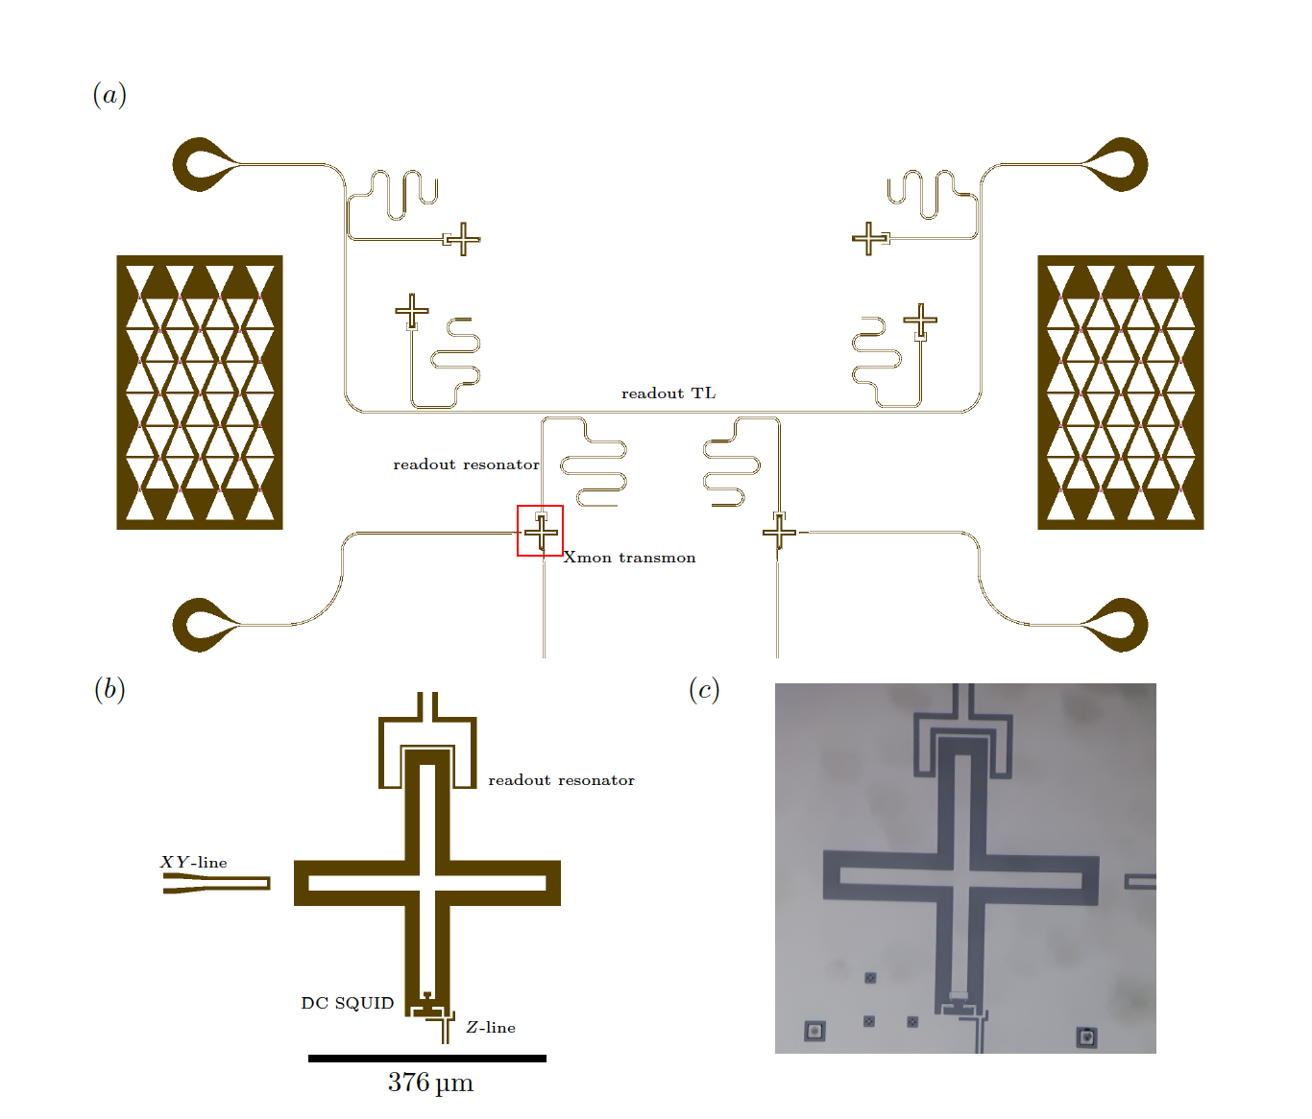
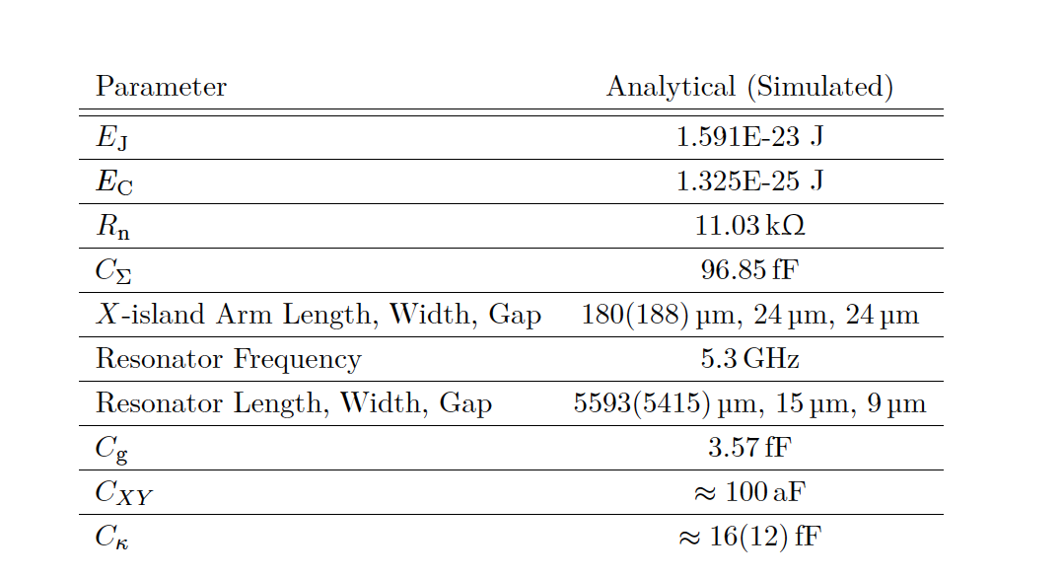
TL capacitivelly coupled to lambda/4 resonator
Thomas G. McConkey Thesis

Slide 10
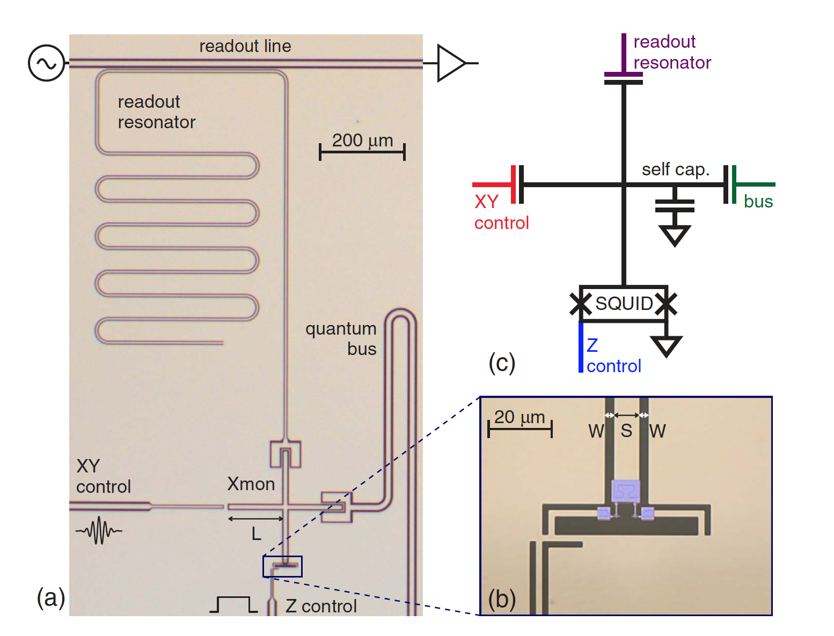
PRL 111, 080502 (2013)
Capacitive coupling
Junction size 0.2x0.3 micron²

Slide 11
Coupling readout resonator transmission line
The resonator-environment coupling, characterized by a leakage rate κr, must be large enough to get photons into and out of the resonators quickly, but weak enough to prevent environmental damping from lowering T1.
PRL 112, 190504 (2014)

