Slide 1
Goal
POSSIBLE CROSS SECTION MEASUREMENTS WITH ACQUIRED DATA
  Charge changing: ¹⁶O + Target → something ≠ ¹⁶O , ΔZ ≥ 1
  Elemental (charge): Integral σ(Z)
  Elemental (charge): Differential (double) dσ(Z)/dθ, dσ(Z)/dE, d²σ(Z)/dθdE
  Isotopic: (Z.A): Integral σ(Z,A)
  Isotopic: (Z.A): Differential (double) dσ(Z,A)/dθ, dσ(Z,A)/dE, d²σ(Z,A)/dθdE
  Neutron: Integral σ(n)
  Neutron: Differential dσ(n)/dE

Slide 2
Till now
GSI (2019): Angelica &Marco
GSI (2021): Riccardo
CNAO (2017): Ilaria &Alessio

Slide 3
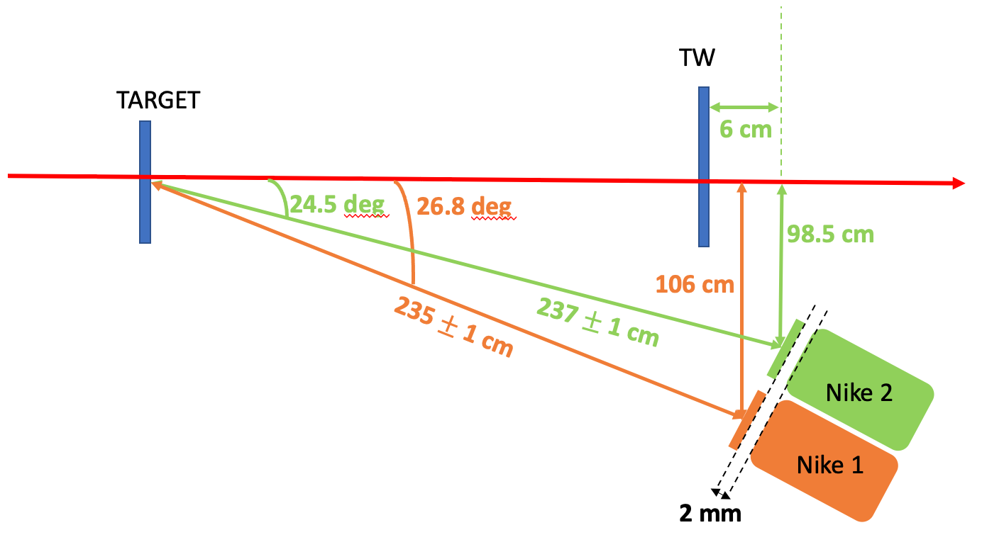
Acquired Data (for physics)
FOOT, v2
.......
….
. . .
. .
GSI 2021
  Electronic Setup: ¹⁶0(200 & 400 MeV/u) on C, C₂H₄ ~ 41·10⁶ mb&trig evts
  Neutron Setup : ¹⁶0(200 & 400 MeV/u) on C, C₂H₄ ~20·10³ mb&trig evts
CNAO 2021
  STC, TW, CALO: ¹²C(200 MeV/u) on C, C₂H₄ ~10·10⁶ mb & trig evts
CNAO 2022
….
. . .
.
FOOT, vS
.
.

Slide 4


Cross section Measurements, 2
  Good Run List: to be done
  detector performances: ONGOING for each detector
  MC agreement: many samples ready, simulation of the final geometry
  Y_{f} Fragment Identification: Charge in good shape, Mass to be done
  ε_{f} to be done
  Bkg_{f} bad reconstructed charge (and mass), air or detector interaction, … to be done
  N_{prim} to be done
  all target characteristic are well known
  Unfolding Procedure to be done (when the MC is ready it take few time)
  Ω_{Ekin} time zero
  Systematic: to be done
CALO
$$A_{2}=\frac{m}{U}=\frac{E_{kin}}{U\left(γ−1\right)}$$
TOF
$$N_{t}= \frac{ρ∙ N_{A} ∙depth}{A}$$

Slide 5
Open Problems: example
GSI 2021
O(200)
CNAO 2021

