Slide 1
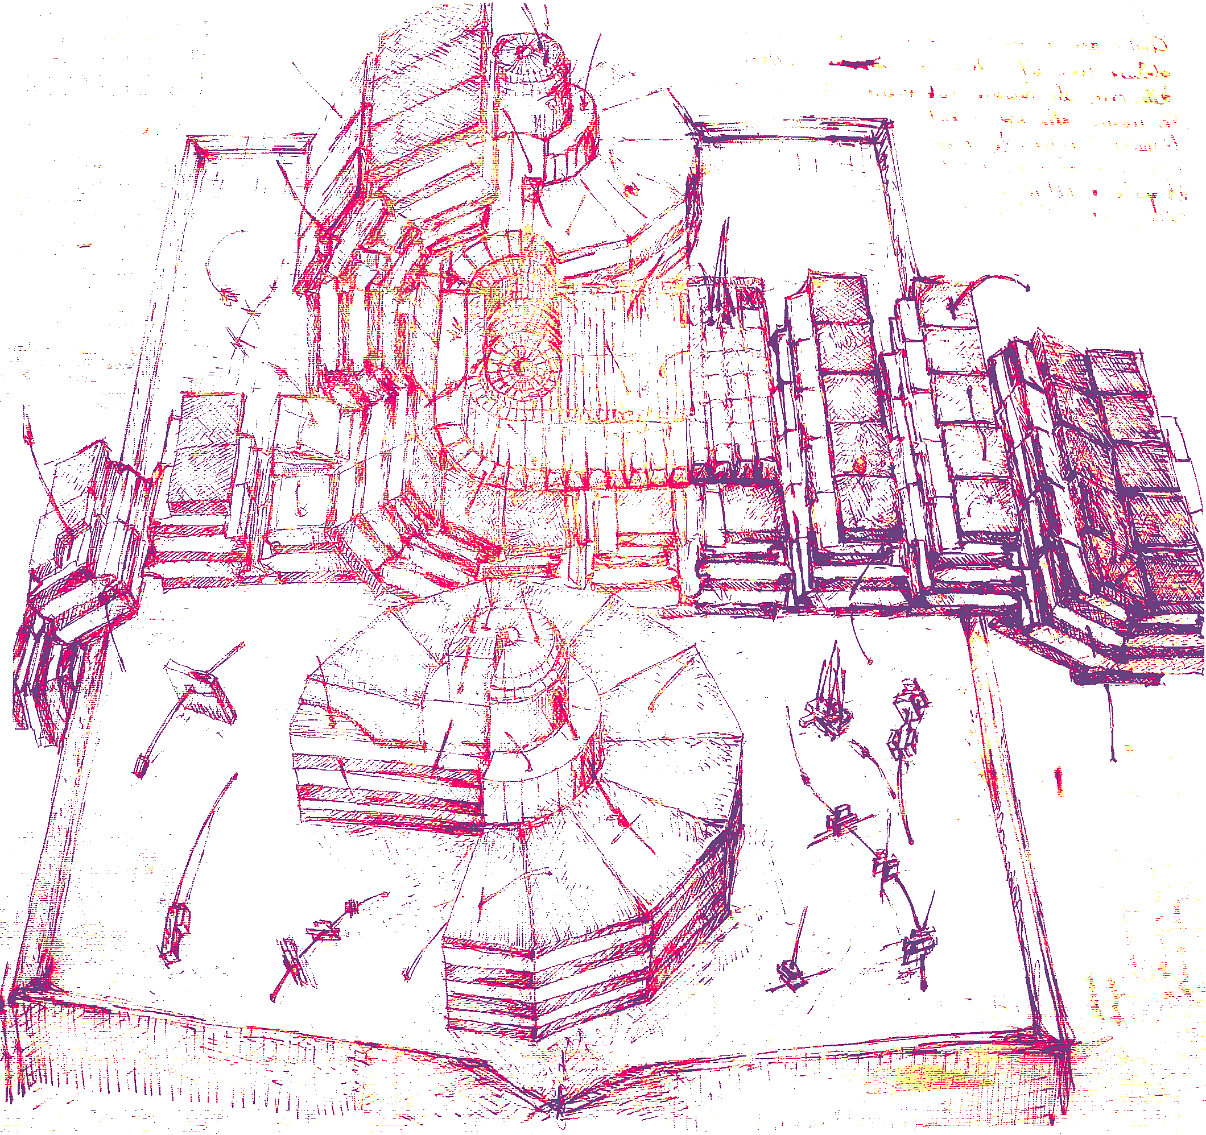



Preliminary results on Supersymmetric Higgs searches @LHC
Mia Tosi
Universita’ degli Studi di Padova & INFN
on behalf of the CMS collaboration
IFAE 2011
– Perugia April 27th÷29th-

Slide 2
outline
introduction
MSSM Higgs
neutral Higgs
φ→τ⁺τ⁻
and
exclusion limits (m_{A},tanβ)
experimental environment
light charged Higgs
and
upper limit on
BR(t→H⁺b)
conclusions

Slide 3
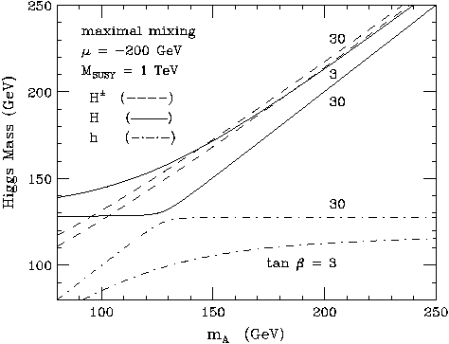
introduction: MSSM Higgs
2 | EM neutral CP even | h⁰,H⁰ | scalar
1 | EM neutral CP odd | A⁰ | pseudo-scalar
2 | EM charged | H⁺, H⁻
Minimal Supersymmetric Standard Model
2 Higgs doublets
  5 physical Higgs Bosons
@tree level
  MSSM Higgs sector
  can be described by 2 parameters:
    tan β:=v₂/v₁
    m_{A}
  but huge radiative corrections
  → m_{h} < 135 GeV/c²
dependency on SUSY parameters
via radiative corrections
already excluded by LEP
m_{H±} > 80 GeV/c² [LEP]
φ = h,H,A mass degenerate
  depending on tanβ regime (h+A,H+A)
A,H,H± mass degenerate
for large m_{A}

Slide 4
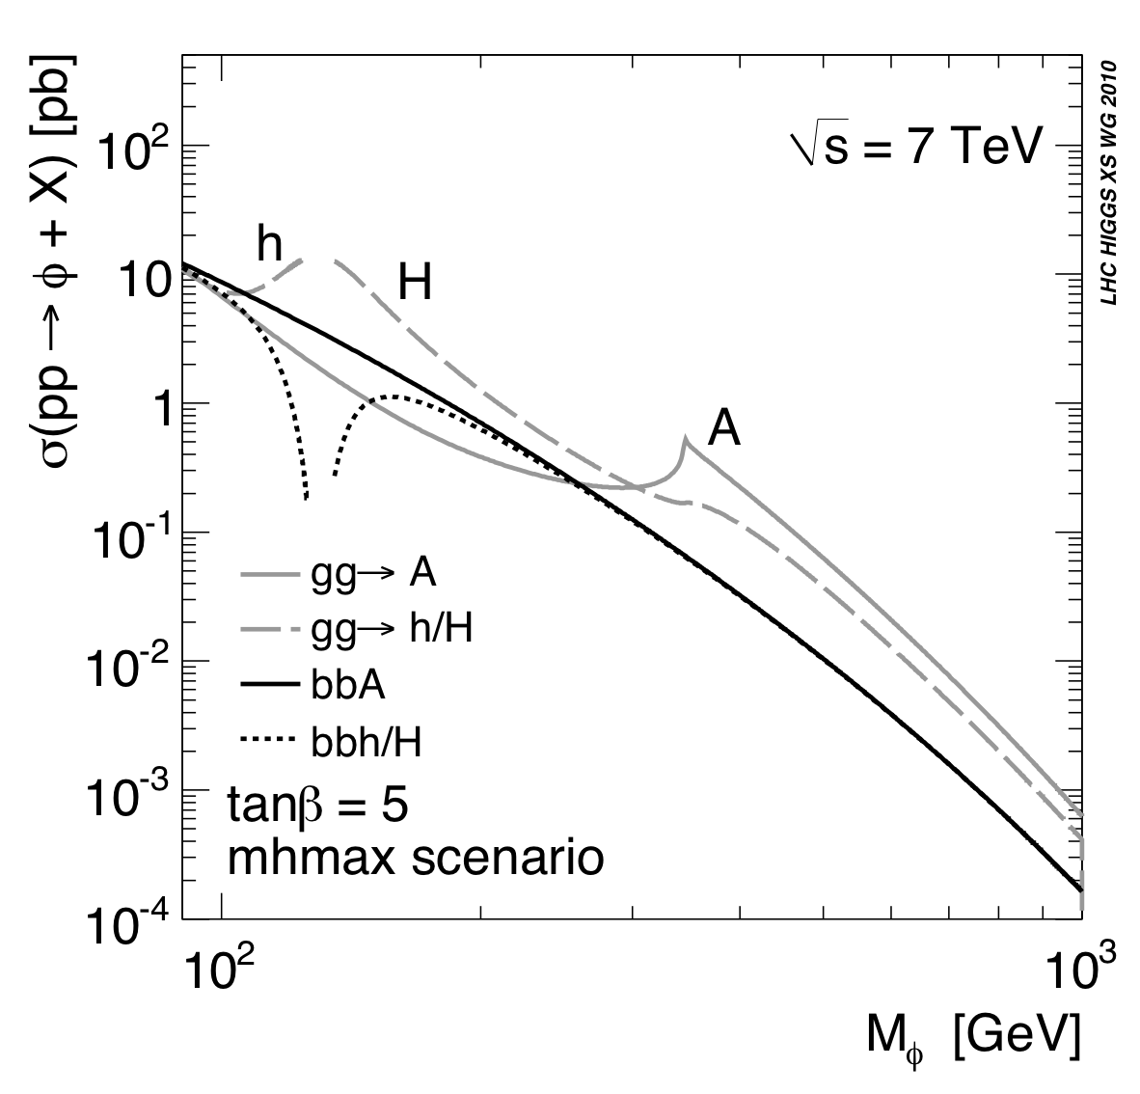
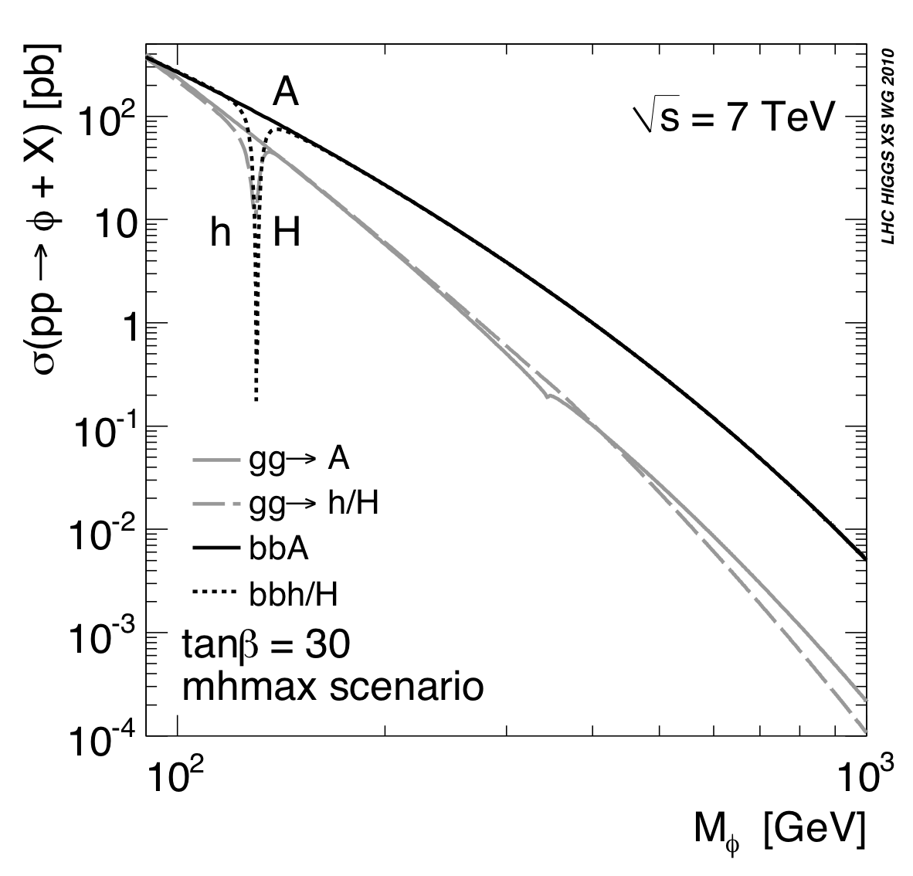
neutral Higgs
search for pp → φ + X
2 main production processes @LHC
Higgs decays to tau-pairs w/ BR(φ→τ⁺τ⁻) ~10÷15%
  (b-quark pairs higher BR, but huge background from QCD)
low tan β
high tan β
φ
arXiv:1101.0593v2 [hep-ph]
arXiv:1101.0593v2
b-quark couplings to
CP-odd like bosons
are enhanced
@large tan β cross section enhanced ;)

Slide 5

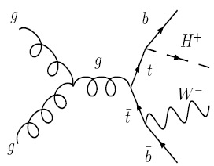
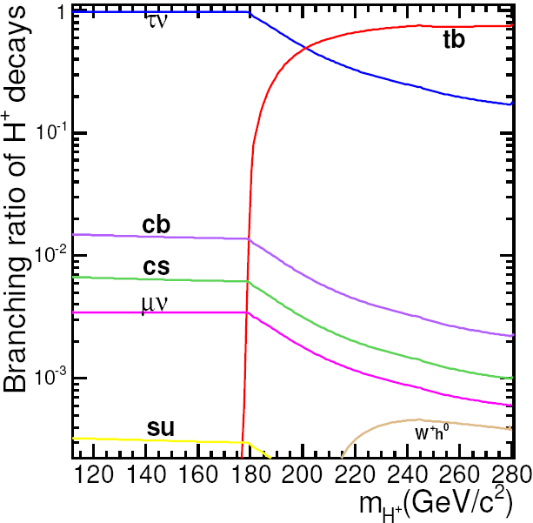
charged Higgs
the discovery of
a charged Higgs boson
would provide
unambiguous evidence
for an extended Higgs sector
beyond the Standard Model
light charged Higgs [m_{H±} < m_{top}]
  dominant production mode:
    top decay t→bH±
  dominant decay:
    H±→τν
BR(t→bH±) depends on both tanβ and m_{H+}
current upper limit
on BR(t→bH±)≈0.15÷0.20
for m_{H±}=80÷155 GeV/c²,
assuming BR(H±→τν)=1
by CDF and D0
http://www-cdf.fnal.gov/physics/new/top/2005/ljets/
charged_higgs/higgs/V2/HiggsAnalysis_publicV2.html
heavy charged Higgs [m_{H±} > m_{top}]
  dominant production modes:
    gg→tbH± and gb→tH±
  dominant decays:
    H±→tb and H→τν
tan β = 20

Slide 6

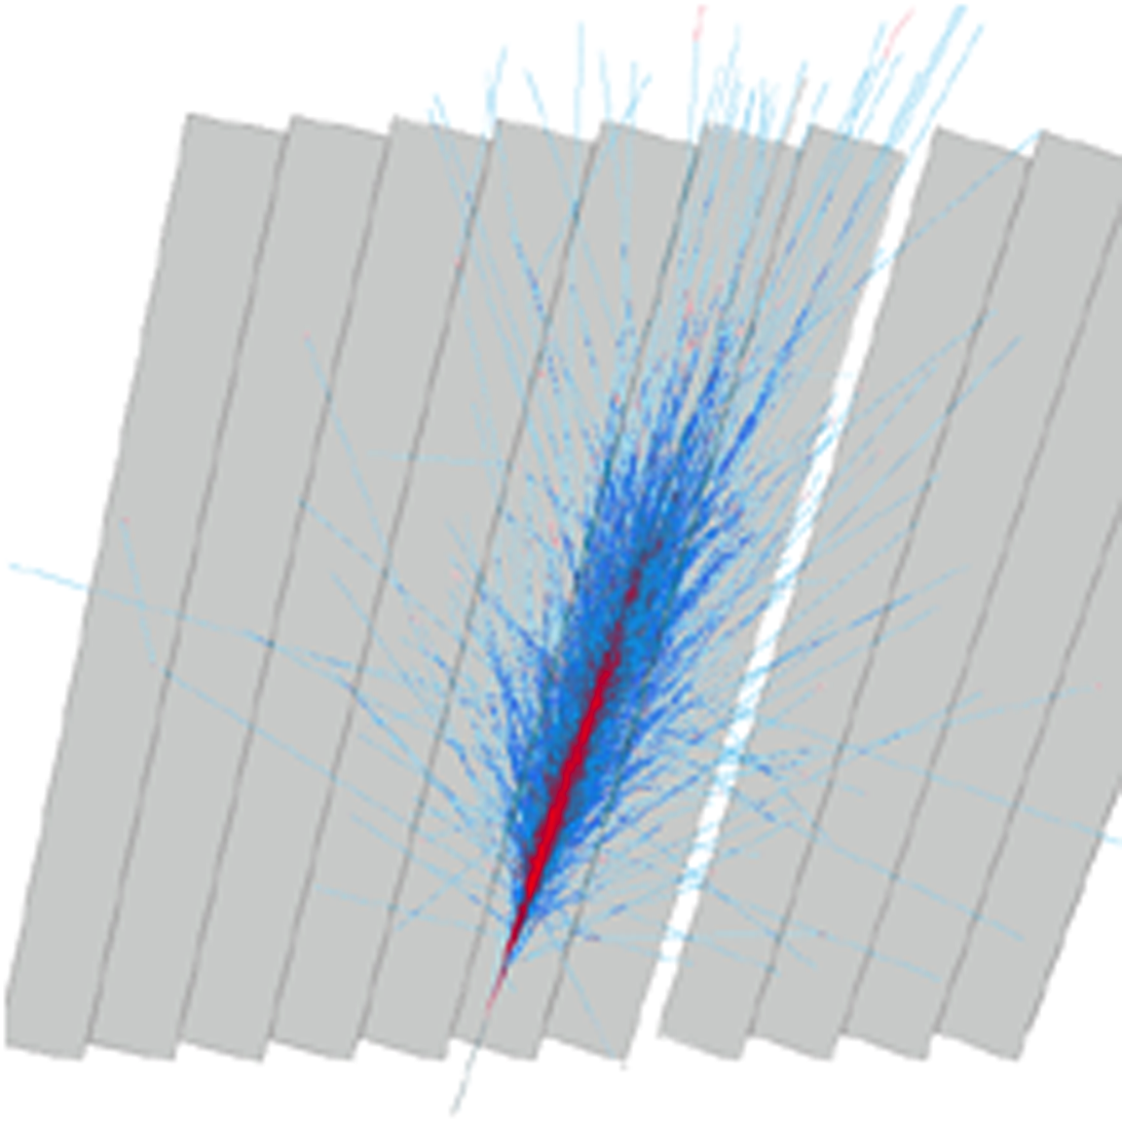
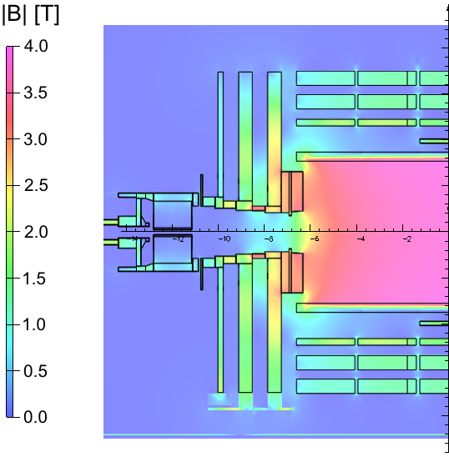
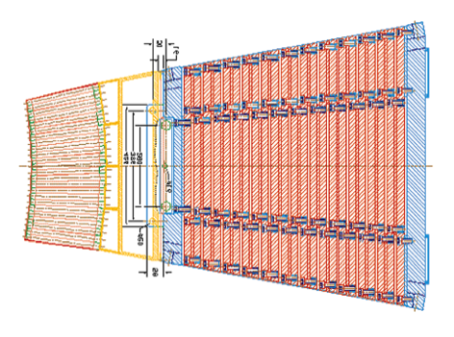
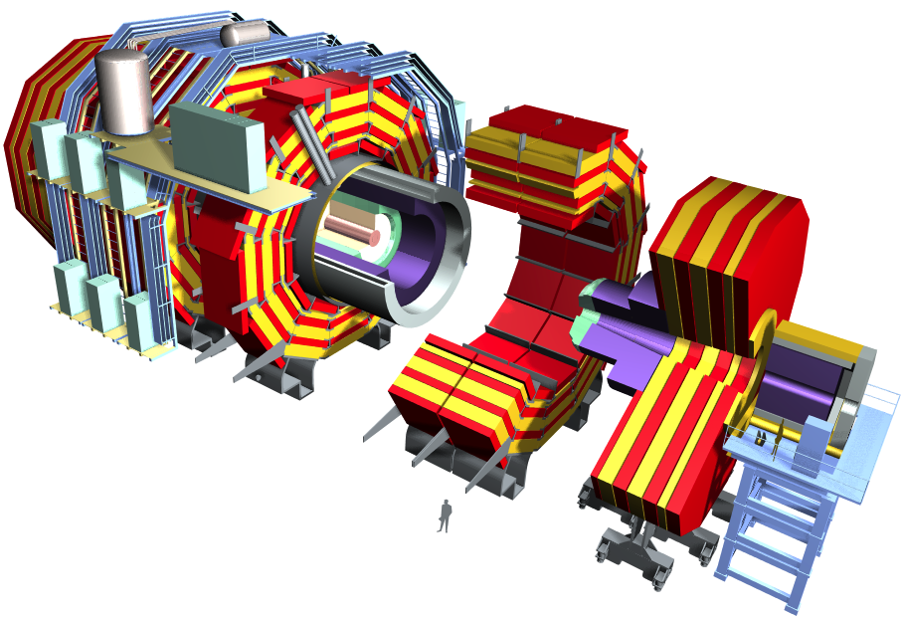
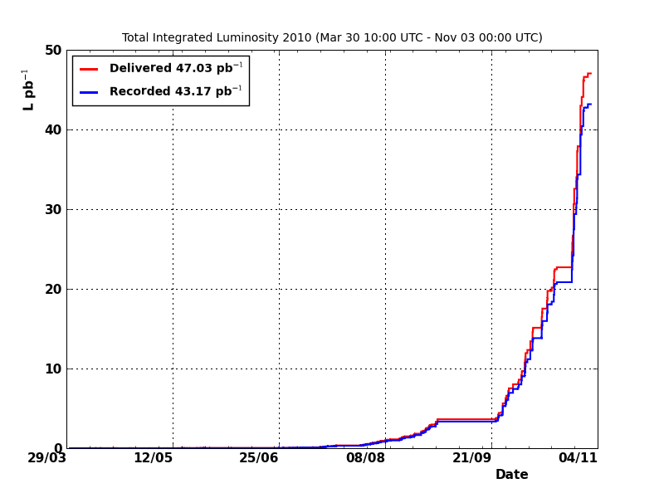
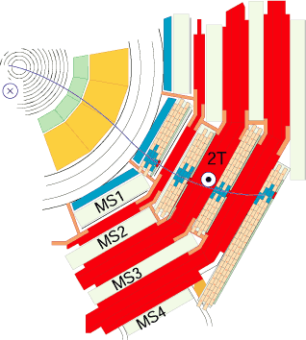
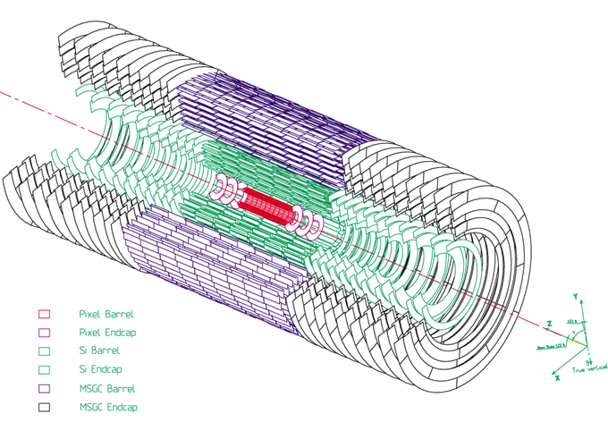
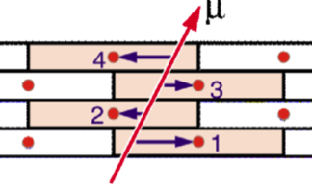
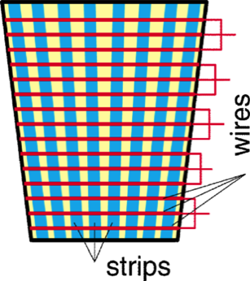
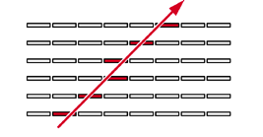
CMS detector
η=-ln tanθ/2
Compact Muon Solenoid [compact 4 experiment]
→ design based on:
• high intensity B field (3.8T superconducting solenoid)
redundant muon spectrometer
hermetic calorimeter
high precision silicon tracker
(_{x} = 15-200μm)
high precision homogeneous
EM calorimeter
|| < 1.48
1.48 < || < 3.0
12,500 T
15 m diameter
21.5 m overall length
ECAL scintillating PBWO₄
crystals
magnet field
B = 3.8 T
|| < 1.3
1 < || < 3
3 < || < 5
SUPERCONDUCTING
COIL
HCAL plastic scintillator
copper sandwich
LHC delivered ~47 pb⁻¹
CMS collected ~43 pb⁻¹ (~92%)
results based on ~36 pb⁻¹ (~85%)
IRON YOKE
2010 operation
L _{PEAK} ~2x10³²Hz cm⁻²
relativistic
cylindrical
coordinates (z,,)
0.9 < || < 2.4
Cathode Strip
Chambers (CSC)
L _{PEAK} ~10²⁷Hz cm⁻²
silicon tracker
Strips and Pixels
Drift Tube (DT)
https://twiki.cern.ch/twiki/bin/view/
CMSPublic/LumiPublicResults2010
|| < 1.2
|| < 2.5
5
Resistive Plate Chambers (RPC)
|| < 1.6

Slide 7
τ Identification [HPS]
tauID:
reconstruction of individual decay modes
combining ParticleFlow candidates
[accounts for conversions]
energy measured only by the tau constituents
hadron
hadron+strip
3hadrons
well commissioned in data
fake rates in
  di-jets
  W + jets
  inclusive muon sample
efficiency on Ζ → ττ → μ+τ_{had} w/ tag and probe
[~23%]
fail HPS
“loose”
CMS TAU-11-001
pass HPS “loose”
CMS TAU-11-001
CMS TAU-11-001

Slide 8

φ→τ⁺τ⁻ search @CMS
τ decay modes:
leptonical: BR~35%
  eν_{e}ν_{τ} and μν_{μ}ν_{τ}
hadronical: BR~65%
  dominantly via
  π/Κ, ρ→ππ⁰
  and α₁→πππ(ππ⁰π⁰)
search for pp → φ + X [inclusive]
2 main production processes @LHC
Higgs decays to tau pairs w/ BR(φ→τ⁺τ⁻) ~10÷15%
  (b-quark pairs higher BR, but huge background from QCD)
final states w/ at least 1 lepton
easier to trigger
lower QCD background
51.8%
mu+had
e+had
e+mu
mu+mu
e+e
had+had
3 decay channels considered:
  mu+had
  e+had
  e+mu
high signal yield
(muonic final state
has smaller background)
very clean,
but low BR
measurement of τ identification efficiencies
commissioning of τ triggers
important background in searches for beyond the SM
Z→τ⁺τ⁻ standard candle
see Cesare Calabria’s poster
CMS-HIG-10-002
arXiv:1104.1619

Slide 9
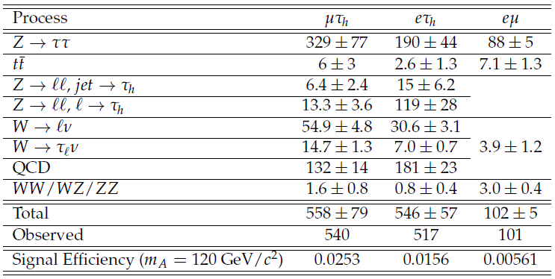
event selection
trigger
μ+τ_{had} and μ+e: single muon
e+τ_{had}: single isolated electron
during last period of data taking
  tau leg of 15GeV
  and loose isolation required @HLT
offline
opposite charge lepton pair
transverse mass
veto events w/ additional isolated leptons
              [for e/μ+τ_{had}]
 | electron | muon | τ_{had}
p_{T} | 15GeV/c |  | 20 GeV/c
|η| | 2.1 (2.4 for e+μ) | 2.1 | 2.3
 | isolated |  | tauID veto against e/μ
 | L1 | HLT
muon | p_{T} >7GeV/c | p_{T}>9-15GeV/c
electron | E_{T} >8GeV | E_{T}>12GeV+isolation
reduce QCD
contamination
reject W→lν
and ttbar
 | M_{T} (l+MET)
e+τ_{had} and μ+τ_{had} | <40 GeV/c²
e+μ (both) | <50 GeV/c²
reject Z→ll

Slide 10
full τ⁺τ⁻ mass reconstruction
Z → ττ is irreducible background
di-tau invariant mass is the best discriminator
… but, 3 neutrinos in the final state
probabilistic approach
to estimate the full mass
CMS-HIG-10-002
σ_{m}~21%
likelihood fit technique [SVfit]
visible τ momenta (decay products)
neutrinos produced in τ decays
  (missing transverse energy)
physical solution for every event
e+τ_{had}+
μ+τ_{had}+
e+μ
background expected number of events
[data driven background estimation]
Z → ττ is constrained by
published CMS Z → μμ/ee result
QCD from ratio of OS/SS (~1) in di-lepton events
and τ-fake rate in multi-jet events
W+jets from W transverse mass shape
[separately in OS,SS]
ttbar and VV by MC
Z → ee/μμ from lepton fake rates
clear Z mass peak
seen in CMS data
more than 600 events
observed in data
arXiv:1104.1619

Slide 11
φ→τ⁺τ⁻ cross section upper limit
likelihood fit to the m_{ττ} spectrum
  [sys. uncertainties are represented
  by nuisance parameters]
is performed using shape information
signal constraints
ggΦ and bbΦ shape relative normalization
[ratio constrained to the expected value
@tanβ=30]
Higgs width assumed for tanβ=30
[negligible w.r.t.
experimental mass resolution (~21%)]
background constraints
QCD and Z → ll shapes taken from data
all other shapes from simulation
data/MC agreement in sidebands
arXiv:1104.1619
CMS HIG-10-002
expecting ~100 Φ events
in m_{A}=120 for tan β = 30!
observed and expected limit on σ✕BR
computed for different mass hypotheses m_{A}
using Bayesian integration
and assuming an uniform prior on σ✕BR
in μ+τ_{had}, e+τ_{had}, e+μ channels
…but, no excess is observed
in the di-tau mass spectrum
95% CL upper limit on σ✕BR
see backup for systematic uncertainties

Slide 12
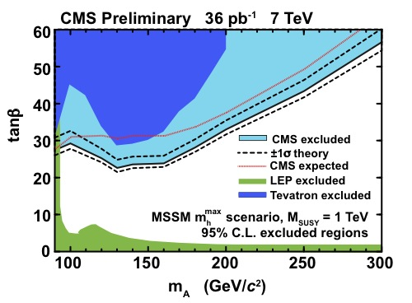
exclusion limit on tanβ vs m_{A}
upper limit on σ✕BR
converted into
MSSM parameter space (m_{A},tanβ)
arXiv:1104.1619
m_{h}^{max} scenario
CMS HIG-10-002
CMS limit
more stringent than
TeVatron one
over whole mass range
relation between σxBR and tanβ
taken from LHC Higgs Cross Sections Working Group
[hep-ph 1101.0593v2]

Slide 13
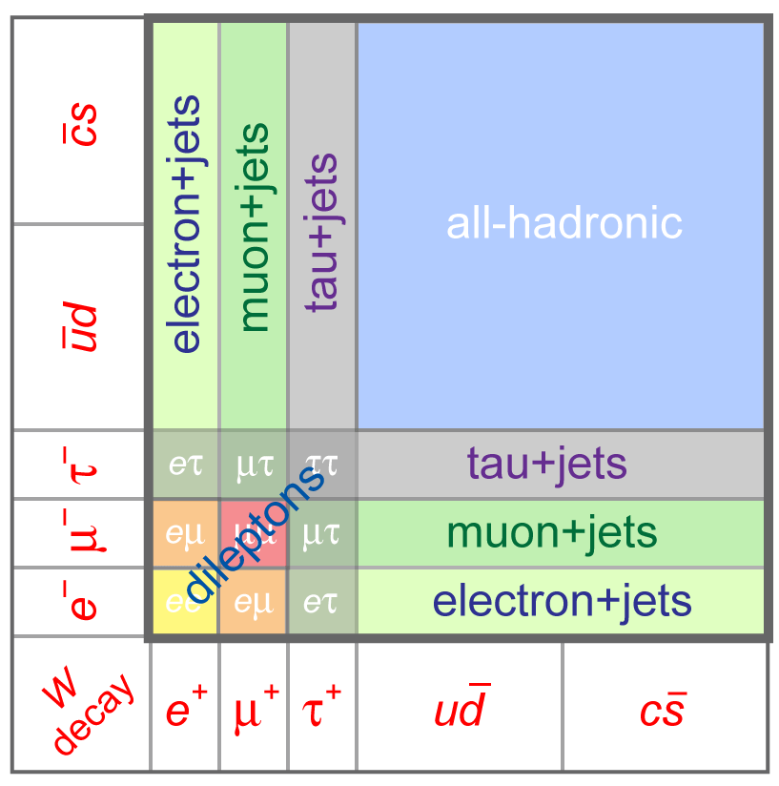
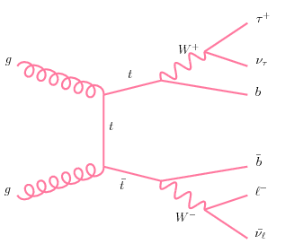
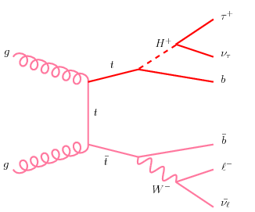
light charged Higgs search
studied H±
in ttbar events
  HH: both top decay into H±b
  WH: 1! top decays into H±b
  80 ≤ m(H±) ≤ 160 GeV/c²
BR(H±→τν) ~ 1
> 4/81
if the H± exists
we may observe an excess of events
in the ttbar’s τ-dilepton channel
incompatible w/ the SM prediction
signature:
E_{T}^{miss}
2 jets
one τ-jet (hadronically decaying τ)
W and top
reconstructed masses
consistent w/ measured values
backgrounds:
● tau–fake:
W+3jets and lepton+jets (in ttbar)
● non tau–fake:
other ttbar, Z→ee,μμ,ττ,
single-top, di-bosons
CMS-HIG-11-002

Slide 14
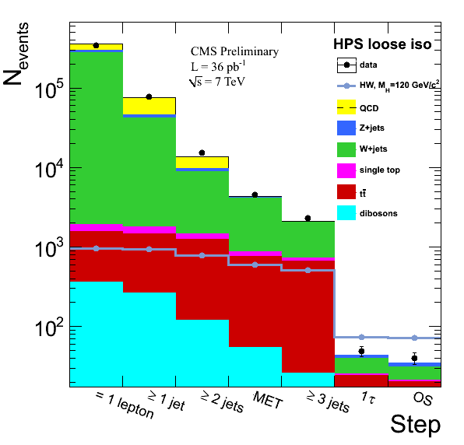
event selection
single lepton triggers
[combination of various triggers,
depending on run number]
1 hard and isolated lepton (e or μ)
● E_{T} >30GeV and |η|<2.5
or p_{T} >20GeV/c and |η|<2.1
● |d₀| < 0.02 cm
● ∆R(l,jet) > 0.3
● ISO_{rel} < 0.1 or 0.005
● loose lepton veto
2 hard jets (AK5 PF)
● p_{T} >30GeV and |η|<2.4
● L2L3 Corrections
(+ residual corrections applied to data)
● ∆R(l,jet) > 0.3
CMS-HIG-11-002
opposite sign
between lepton and τ_{had}:
q_{l} x q_{τ} < 0
MET > 40GeV
1 τ_{had}
p_{T} > 20 GeV/c
HPS loose isolation
similar to CMS top pair cross section measurement
in lepton+jets channel (CMS-PAS-TOP-10-002)

Slide 15
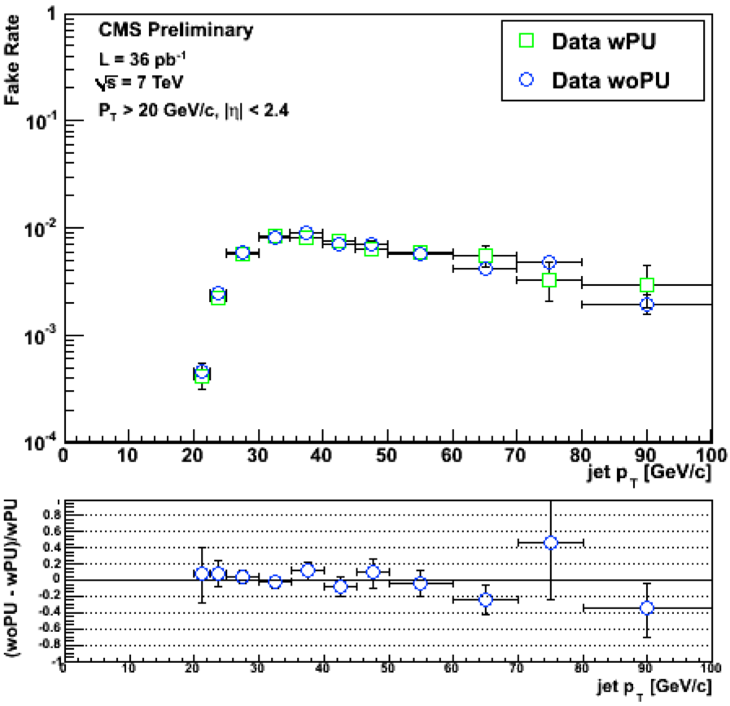
data-driven τ-fake background
dominated by W+jets and ttbar→l+jets
data driven background estimation:
select jets in events w/:
  1 lepton + MET + 3 jets
apply to every jet the
  “jet →  probability”
~25÷30%
systematic uncertainty
jet →  probability evaluated from
  QCD multi-jets (gluon dominated)
  W+jet type events (quark dominated)
jets in lepton+MET+ ≥ 3jets events
have a gluon/quark composition
between the two samples
take average between W+jet and QCD values
assign half the difference between the two as the systematic uncertainty
CMS-HIG-11-002
probability that a jet fakes a tau-jet
obtained from the QCD multi-jet events
taken during runs w/ and w/o pileup.

Slide 16
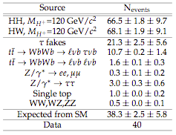
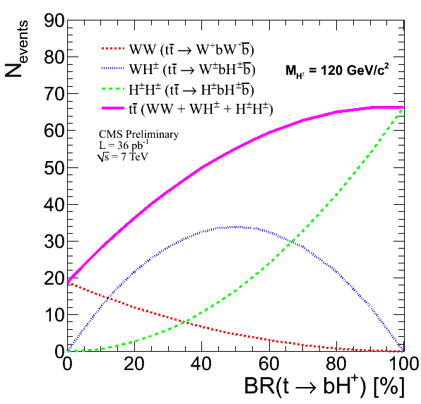
BR exclusion limits: input
statistical uncertainties
due to MC statistics
but, for τ-fakes
due to the fake rate
in the data
expected ttbar events
16 in eτ_{had}
24 in μτ_{had}
[electron efficiency
is lower than
muon efficiency]
CMS-HIG-11-002

Slide 17
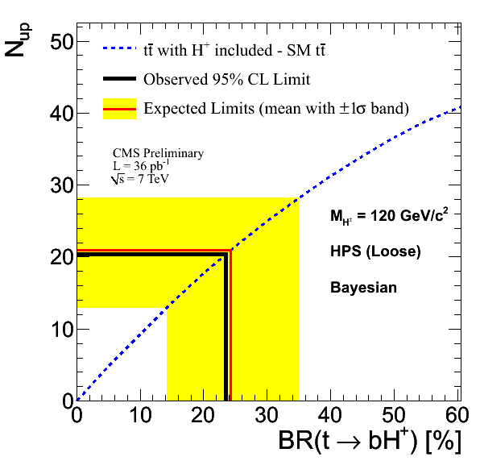
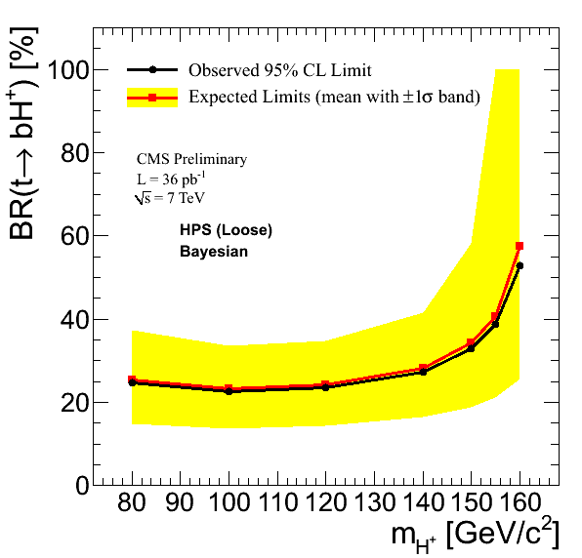
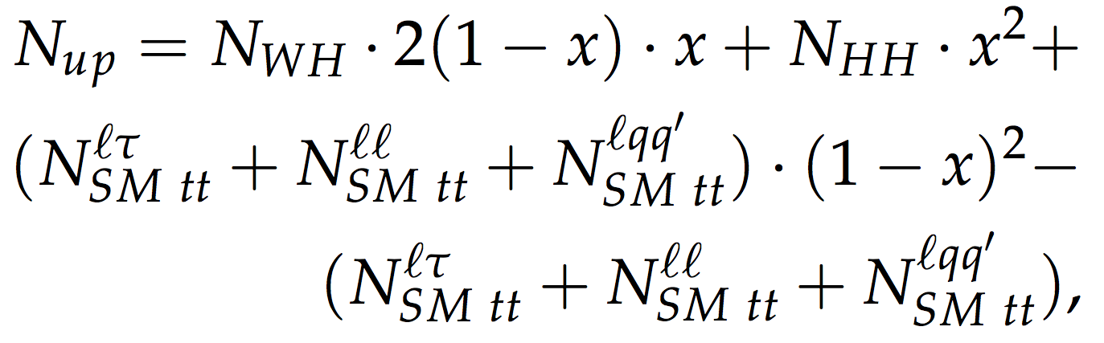
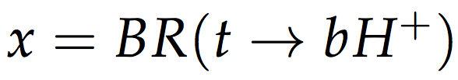
BR exclusion limits: output
upper limit on excess of events
on top of the SM processes
a Bayesian method w/ flat signal strength prior
is used to obtain the upper limits @95% CL
on the excess of events (N_{up}) w.r.t. SM expectation
the background and signal uncertainties modeled
w/ lognormal pdf's, correlations taken into account
CMS-HIG-11-002
for Higgs mass [80;140] GeV/c²
BR(t→bH±)=25%÷28%
[w/ BR(H±→τν)=1]
CMS-HIG-11-002

Slide 18
conclusion…
direct searches for MSSM Higgs
have been performed in CMS w/ 36 pb⁻¹ of data [2010 operation]
MSSM neutral Higgs boson: φ→τ⁺τ⁻
experimental methods
have been validated
in Z → ττ cross section measurement
no evidence of signal observed
  95% CL upper limit
  on σ(pp→φ)✕BR(φ→τ⁺τ⁻) is set
  [Bayesan]
  and translated to m_{A}–tan β plane
  observed limit agrees
  w/ expected sensitivity
CMS results exclude
previously unexplored region
in MSSM parameter space
MSSM light charged Higgs boson
in top-quark events
agreement between MC/data is good
for most of the distributions
the largest background contributions come from
  irreducible ttbar
  tau dilepton channel
  τ-fakes,
  where one jet fakes the tau
no significant excess of events in data
w.r.t. expectations from SM
  95% CL limits
  on the BR (t→bH±) [LandS tool]
our limits are 25%÷28%
for Higgs mass [80;140] GeV/c²
[comparable w/ TeVatron]

Slide 19
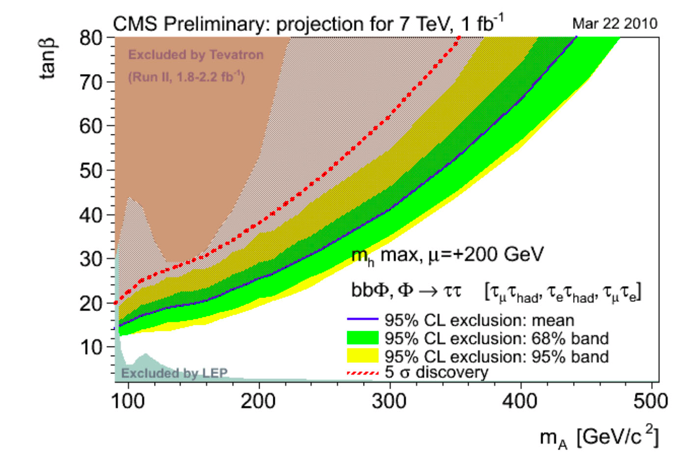
..and prospects w/ 1fb⁻¹
discovery expected
for tanβ>20 for low m_{A}
exclusion expected
for tanβ>15 for low m_{A}

Slide 20
Z→ τ⁺τ⁻ candidate
p_{T}^{μ}=39.3GeV/c
p_{T}^{had}=28.2GeV/c [lead. track p_{T}=3.3GeV/c]
m_{vis}=67.0GeV/c²
MET=19.9GeV
m_{ττ}=90.3GeV/c²
Z→ τ⁺τ⁻ → μ⁺ρ⁻
π⁻π⁰

Slide 21
Z→ τ⁺τ⁻ candidate
p_{T}^{μ}=22.8 GeV/c
E_{T}^{τ}=32.9 GeV
m_{vis}=60.8 GeV/c²
m_{T}(μ,MET)=10.1 GeV

Slide 22
BACKUP

Slide 23
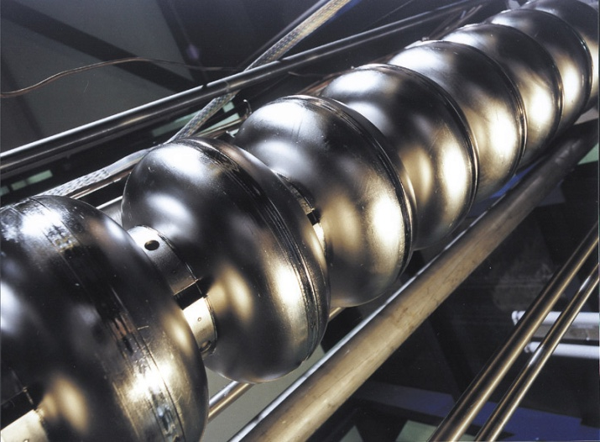
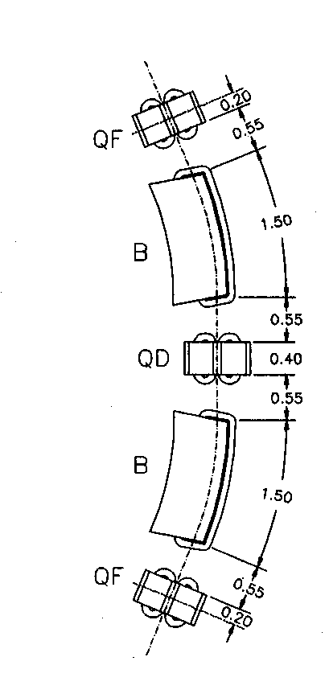
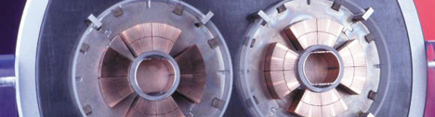
Large Hadron Collider (LHC)
proton-proton collider @CERN
  re-uses the LEP tunnel
  ~100m underground
accelerates protons
  from 450 GeV up to 7000 GeV^{(*)}
  PS/SPS used to accelerate protons upto 450 GeV
8 points,
  4 where the beams interact [experiments]
  2 for beam cleaning
  1 dedicated to beam dumper
  1 containing superconducting RF cavities
  [400MHz]
8 arcs with a regular lattice structure,
  containing 23 arc cells
    each arc cell has a FODO structure
focusing
lens
dipole
magnet
defocusing
lens
superconducting
magnet
[B=8.3T @1.9K]
^{(*)} goal is √s=14TeV
first collisions @7TeV last year (30/3/2010)
max peak luminosity L_{PEAK} ~2x10³² s⁻¹cm⁻²
integrated luminosity: 48 pb⁻¹
[Duoplasmatron Proton Source]

Slide 24
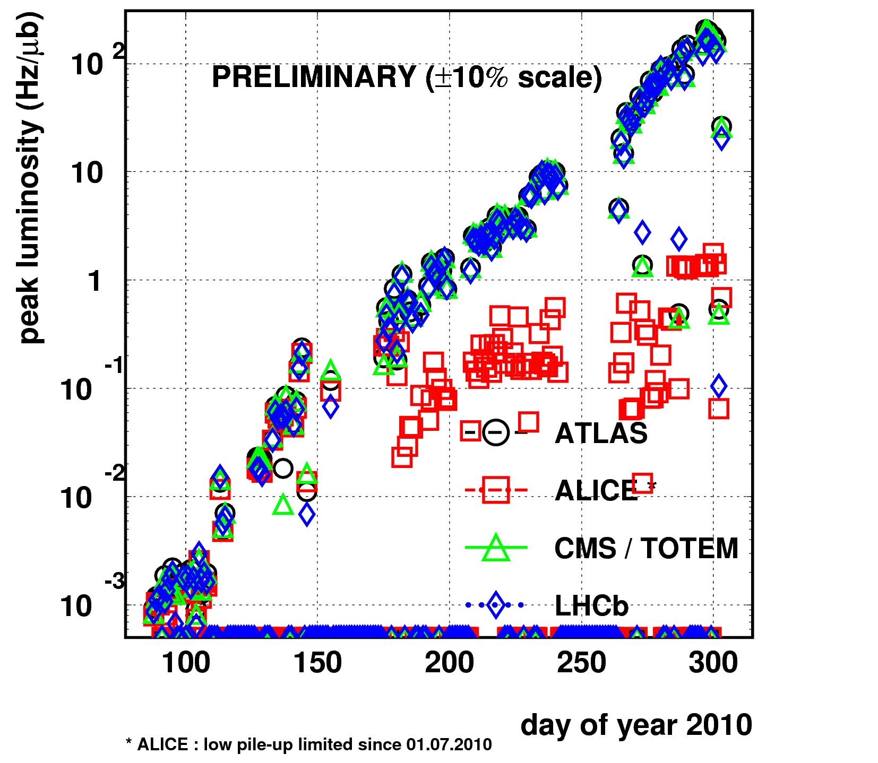


overview of 2010 run
10³² s⁻¹ cm⁻²
2010 in numbers:
  1074 h of stable beams - out of ~6600 h
  147 fills with stable beams
  max peak luminosity ~2x10³² s⁻¹cm⁻²
  integrated luminosity: 48 pb⁻¹
machine parameters achieved at the end of the p-p period
parameter | 2010 | nominal
beam energy (➝γ) | 3.5 TeV | 7 TeV
squeeze (β*) | 3.5 m | 0.55 m
transverse emittance (ε_{N}) | 2-3 µ m rad | 3.75 µ m rad
protons per bunch (N) | up to 1.2 10¹¹ | 1.15 10¹¹
bunch separation | 150 ns | 25 ns
number of bunches (n_{b}) | 368 | 2808
LHC can work
above design parameters
for beam-beam effects
fills at 75 ns and 50 ns
have also been successfully achieved
but mostly not for physics

Slide 25
CMS in the 2010 operation
https://twiki.cern.ch/twiki/bin/view/CMSPublic/LumiPublicResults2010
L _{PEAK} ~2x10³²Hz cm⁻²
LHC delivered ~47 pb⁻¹
CMS collected ~43 pb⁻¹ (~92%)
results based on ~36 pb⁻¹ (~85%)
L _{PEAK} ~10²⁷Hz cm⁻²
average fraction of functional detector channels > 99%
lowest still > 98%
24

Slide 26
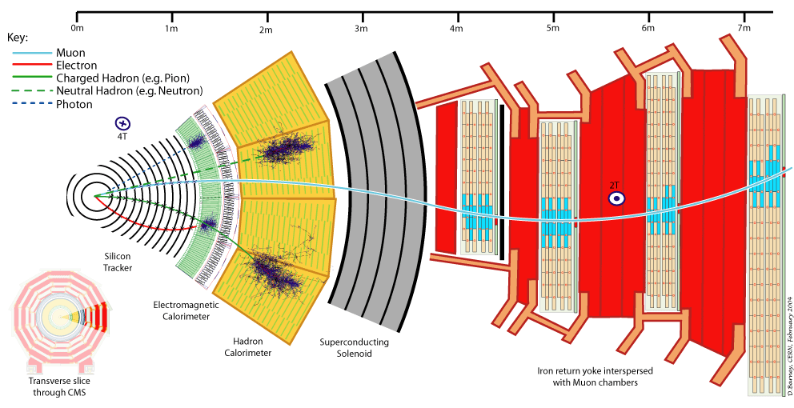
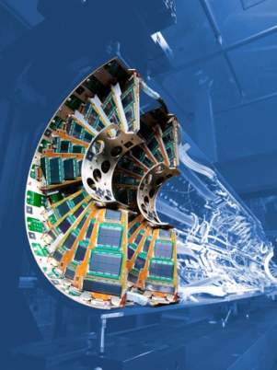
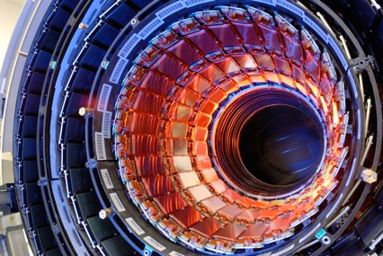
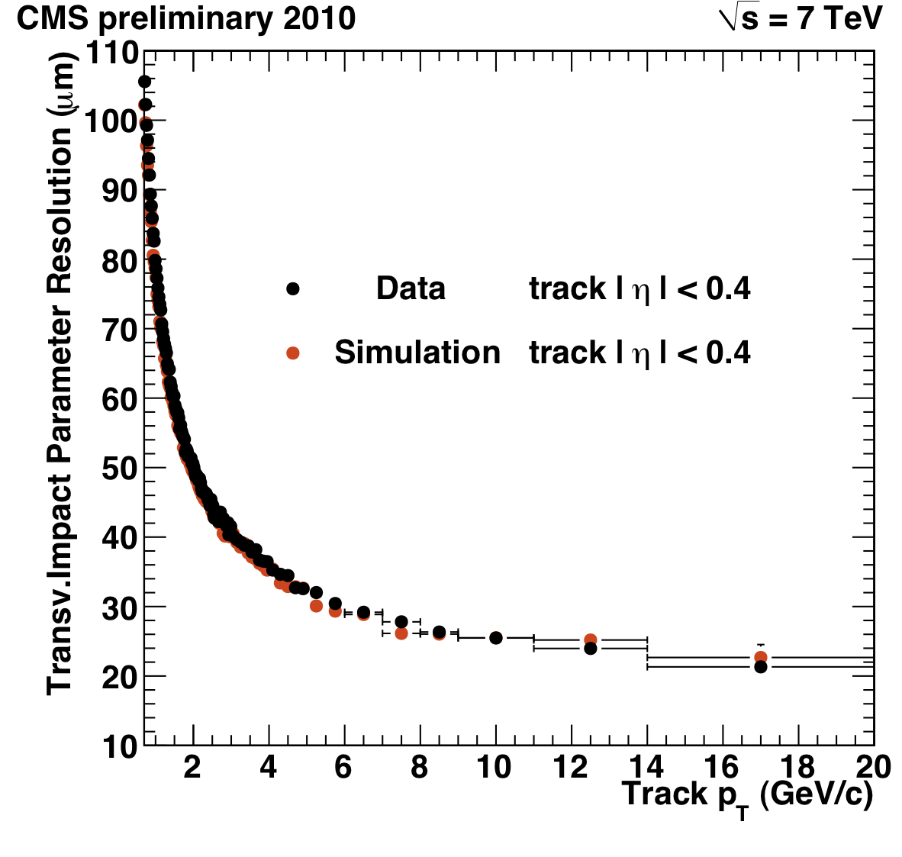
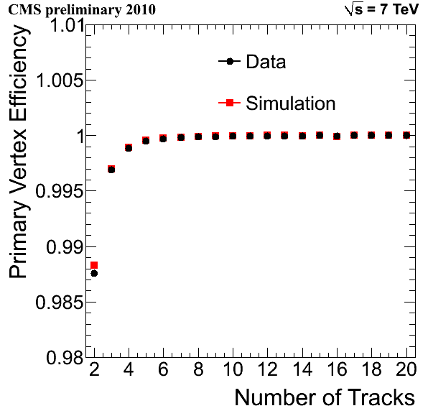
CMS Tracker
|| < 2.5
physics environment | design requirements
high particle fluence | radiation hardness
high track density | high granularity
25 ns bunch crossing | fast detector & electronics
Pixels
~1.1m² of Si sensors, 100x150 m²,
1440 modules, 66M channels,
r = 4, 7, 11cm
3 barrel layers,
2 end-cap disks per side
Strips
~ 200m² of Si sensors,
15,148 modules, 9.3 M channels
10 barrel layers (TIB,TOB) ,
12 end-cap wheels per side (TID,TEC)
Strips
Pixel
25

Slide 27
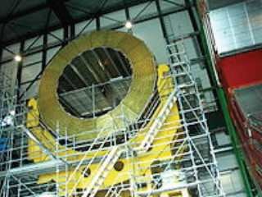
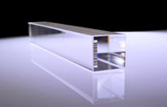
CMS Calorimeters
|| < 1.48
|| < 1.3
1.48 < || < 3.0
1.3 < || < 3.0
3.0 < || < 5
ECAL
homogeneous PbWO₄ crystal calorimeter
  barrel (EB): 26X₀ ΔηxΔφ = 0.0174x0.0174
  61200 crystals (2 x 2 x 23 cm³)
  end-cap (EE):25X₀ ΔηxΔφ = 0.021x0.021
  14648 crystals(3 x 3 x 22 cm³)
pre-shower in end-cap (ES): 3X₀
[lead w/ 2 planes of 61mm x 1.9mm Si strips]
HCAL
sampling calorimeter
barrel (HB): Brass + Scintillators ΔηxΔφ = 0.087x0.087
barrel tail catcher (HO): Scintillators [|η| < 1.2]
end-cap (HE): Brass + Scintillators ΔηxΔφ = 0.087x0.087
forward (HF): Steel + quartz fibre (Čerenkov)
ΔηxΔφ = 0.349x(0.175 or 0.35)
goal: energy resolution
~ 100%/√E⊕5%
HCAL: Scintillator+Brass,
Quartz + Steel
small radiation length (X₀ = 0.89 cm)
allows an active thickness of 26X₀
in 23 cm of radial dimension.
small Moliere radius (R_{M} = 2.10 cm)
provides a small lateral shower dimension
ECAL: PbWO₄
26

Slide 28
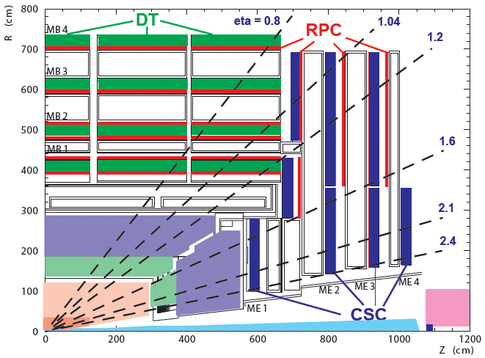
CMS Muon system
|| < 2.4
Muon Detector Constraints
Barrel:
  particle rate ~ 1-10 Hz/cm²
  low magnetic field
End-Caps:
  particle Rate ~ 100-1000 Hz/cm²
  high and non-uniform magnetic field
250 Drift Tubes (DT)
  barrel (|η| < 1.2)
  V_{drift} ~ 55 mm/ns
  -> max drift time ~380 ns
  single wire resolution ~ 250 μm
  local reconstruction (r-φ) ~ 100 μm
540 Cathode Strip Chambers (CSC)
  end-cap (0.9 < |η| < 2.4)
  4 disks of 6 planes/chamber
  [trapezoidal shape multiwire proportional chambers]
  independent cathode and anode read-out
  measured from fit to the induced charge
  r and BX id from the signal on the wire
  φ resolution ~ 100 μm
610 Resistive Plate Chambers (RPC)
  barrel & end-cap (|η| < 1.6)
  fast detectors σ_{t} ~ 2ns
  space resolution ~ 1cm
provide independent muon tracking
to improve muon reconstruction
[especially at high momenta]
provide a robust, redundant, independent Level-1 trigger for muons
27

Slide 29
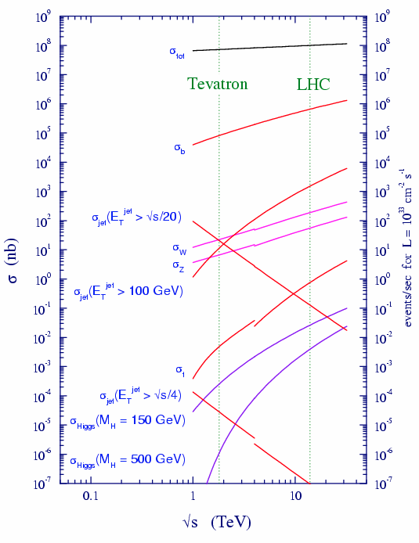
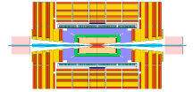
CMS trigger: why
LHC will be colliding p’s at 40,000,000 per second
cross sections for different processes
vary by many orders of magnitude
inelastic | ~10⁸Hz
W | ~100Hz
Z | ~30Hz
tt | ~0.1Hz
Higgs (m_{H}=150GeV/c²) | ~10⁻²Hz
Higgs (m_{H}=500GeV/c²) | ~10⁻³Hz
@L=10³³cm⁻²s⁻¹
collision rate at the LHC is heavily dominated
by large cross section QCD processes
not interesting for the physics program of CMS
not possible to write all the events
and select later on
need to select them beforehand and very quickly
physics driven choices:
select process with
large transverse energy,
and one or more interesting objects
(high momentum leptons or γ or jets)
T( )
event accepted?
YES
NO
28

Slide 30
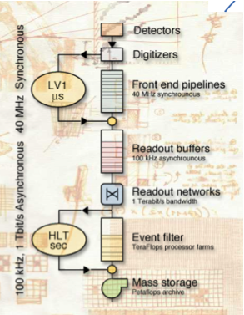
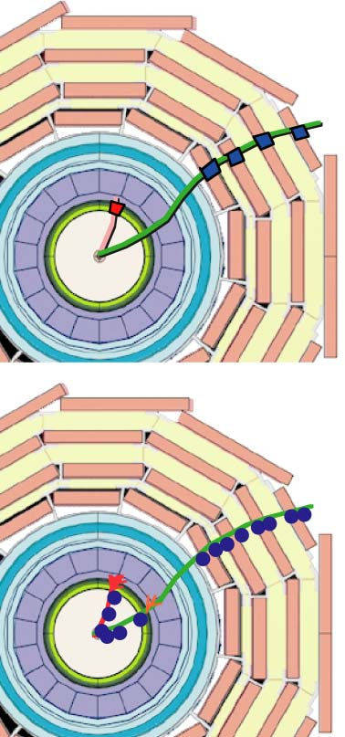
CMS trigger: the answer
the full CMS event rate reduced in two triggering steps:
Level1 (L1):
  macro-granular information from
  calorimeters and muon system:
  local μ tracks and calo clusters
  global measurement of p_{T}/E_{T}
  (e/γ, m, hadron jets, τ-jets)
  threshold and topology conditions possible
  implemented in custom-designed,
  programmable electronics system
1GHz
100KHz
High Level Trigger (HLT):
  more precise information from calorimeters,
  muon system and tracker
  algorithms as sophisticated
  as in the off-line analysis
  (threshold, topology, mass, matching)
  implemented as a dedicated configuration
  of the CMS reconstruction software
  combined the traditional Level-2 and Level-3 steps
  into a single one and uses full granularity data
1 Tb/s
150Hz
a fraction of the bandwidth (close to 30%)
is reserved for calibration triggers
to ensure complete understanding
of the detector performance
 | latency | input rate | output rate
L1 | 3.2μs | 40MHz | 100(50)kHz
HLT | 10⁻³÷1s | 100(50)kHz | 100Hz
29

Slide 31
physics objects: muon
standalone muon
the global muon reconstruction
is divided into three steps
reconstruction of the track
inside the muon system
and search for compatible tracks
in the tracker system
reconstruction of the track
combining the information
from the tracker
and the muon system
reconstruction of the hits
and the track segments
inside a chamber
tracker muon
reconstruction of
the track from
the tracker hits
starting from
all the tracks
in the tracker system
and identify the muons
associating
the tracker tracks
with the segments
in the muon system
30

Slide 32
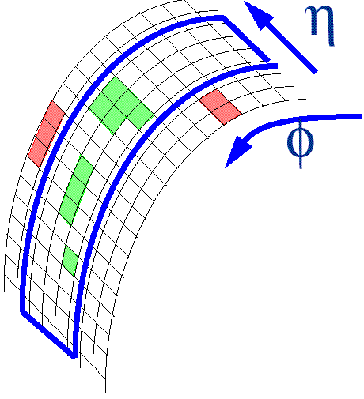
physics objects: electron
electrons
calorimeter reconstruction
    create “super-clusters” of clusters
      to include radiated photons
    apply E_{T} thresholds
tracker reconstruction
    ECAL clusters compatible w/ electron
      are matched to a track
cuts are applied on e/p and HCAL energy deposits
tracker
is used as
a ”preshower“ to identify particles,
which radiate
E_{T}/p_{T} cut
E_{T}
γ
e⁻
tracker
strips
p_{T}
•
pixels
energy losses are taken into account w/ Gaussian sum filter
and the possible individual bremsstrahlung photons are tagged as photons
final identication takes into account several variables
(distance between ECAL and track, track fit quality,
momentum difference @ the beginning and end of track,
ECAL/track compatibility, cluster shape, number of bremsstrahlung photons, etc.)

Slide 33
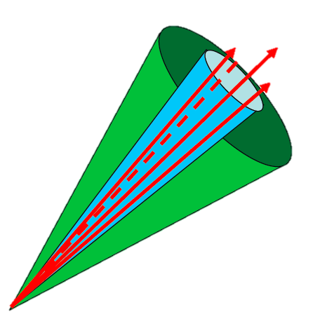
ParticleFlow reconstruction
why is tau reconstruction so tricky?
90% of the energy is contained in a “cone” w/ R=0.2
  around the jet direction for E_{T}>50 GeV
low charged track multiplicity: 1- or 3-prongs
tau decays may contain
  electrons, muons, charged and neutral hadrons, photons
unstable particles, nuclear interactions, photon conversions
need measurements from each sub-detector of the experiment!
π⁺
π⁰
π⁺
π⁻
Particle Flow
provides a complete and unique
event description
@the level of individually
reconstructed particles
the resulting complete list of particles
is the input of
jet clustering
tau and b-jet ID
MET reconstruction
only 10% of jet energy [neutral hadrons]
is measured in “poor resolution” HCAL
improvement of τ reconstruction performance

Slide 34
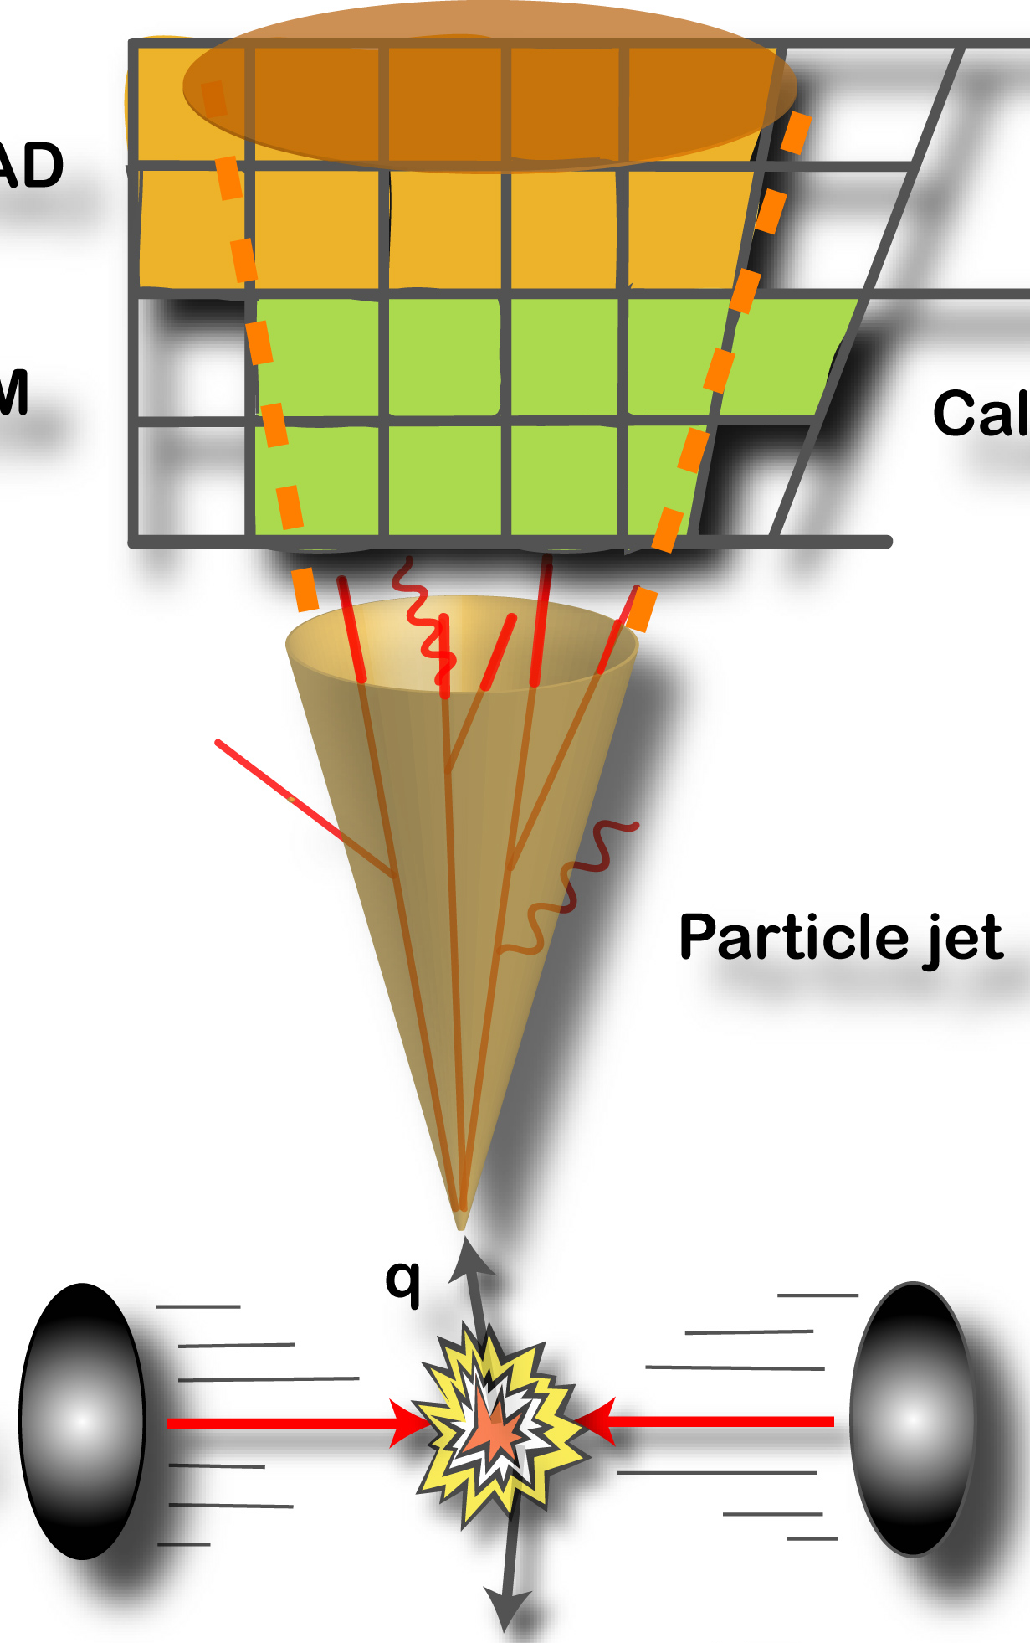
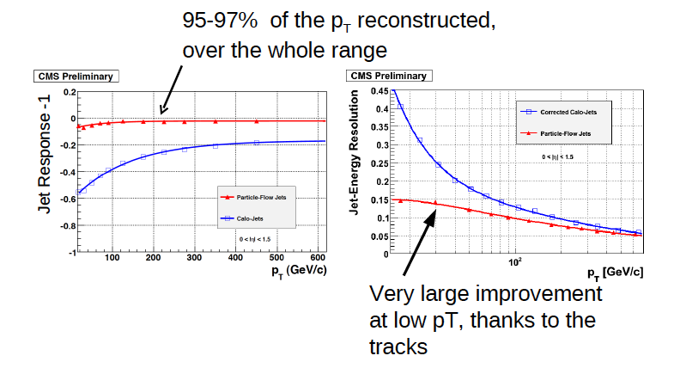

physics objects: jet
JET:= experimental signature of quarks and gluons,
    observed as highly collimated sprays of particles
a jet algorithm is a set of mathematical rules
that reconstructs the properties of jets
by combining the P_{μ} of their constituents
fixed cone algorithms [IC, SisCone]
successive recombination algorithms
        [kT, anti-kT]
Particle Flow
Calorimeter
0≤|η|≤1.5
different inputs to the jet algorithm
lead to different types of jets:
very large
improvement
@low p_{T} [tracks]
Calorimeter Jets
clustered from
ECAL and HCAL
calorimeter towers
Track Jets
clustered from tracks
of charged particles
Particle Flow Jets
clustered from
identified particles
reconstructed using
all detector components
Jet plus Tracks
correct Calorimeter Jets
using momentum of tracks
33

Slide 35

jet energy correction
causes of bias in jet reconstruction
jet reconstruction algorithm
  jet energy only partly reconstructed
non-compensating calorimeter
  non-linear response of calorimeter
detectors segmentation
presence of material in front of calorimeters
  and magnetic field
electronic noise
noise due to physics
  pile-up and Underlying Events
flavor of original quark or gluon
correct reconstructed jets back
either to particle or to parton jets
ca
l
ibrat
i
on
HADRONIZATION
relative:
correct to make calorimeter response
uniform in η
in-situ method: di-jet p_{T} balance
absolute:
correct absolute energy scale
in-situ method:
γ+jet p_{T} balance
correction decomposed into (semi)independent factors
applied in a fixed sequence
34

Slide 36



b-tagging
several b-tag algorithms have been developed
which exploit some b hadron characteristics
[w.r.t. light flavours and gluons]:
  hard fragmentation
  mass → high tracks multiplicity
  long lifetime → secondary vertex, track w/ large impact parameter (IP)
  semi-leptonic decay (BR~20%) → leptons w/ high p_{T} w.r.t. jet axis
for each jet, all algorithms produce a discriminator
[simple or complex variable]
on which one cuts more or less tightly,
in order to distinguish b-jets
[correspondently w/ different efficiency and purity]
signed decay length
of secondary vertexes
μ
SV
PV
SV
signed impact parameter
of tracks in the jet
double b-jet candidate
35

Slide 37
systematic uncertainties
source | uncertainty | reason
lepton ID/trigger | 0.2÷2% | from efficiency estimation in Z→ee/μμ tag and probe
lepton p_{T} scale | 1÷2% | for shape uncertainties
tauID efficiency | 23% | from Z→ττ tag and probe
tau energy scale | 3% | upper bound assuming PFjet scale (for shape uncertainties)
jet energy scale (JES) | 3% | for MET uncertainty on shapes
unclustered E_{T} scale | 10% | for MET uncertainty on shapes
Z→ττ yield | 4% | from CMS Z→ee/μμ measurement
luminosity | 11%
tauID efficiency dominates the systematics
[low statistics of tag and probe measurement]
not present in the leptonic channel

Slide 38


systematic uncertainties
theoretical uncertainty on the cross section
electron/muon trigger & ID & isolation
luminosity uncertainty
uncertainty on jet energy scale and resolution
as well as missing transverse momentum
uncertainty of a lepton faking t
uncertainty on t ID efficiency
Systematic uncertainties (used for limit calculation)

Slide 39

inclusive jet p_{T} distribution in lepton+MET+≥3jets events
jets that can fake taus in events w/ :
1 isolated lepton
E_{T}>30GeV for electrons
p_{T}>20 GeV/c for muons
≥2 jets w/ p_{T}>30 GeV/c
+ at least 1 jet w/ p_{T}>20GeV/c
MET > 40 GeV
fake background is estimated using data

