Slide 1



The proton-boron fusion reaction as a new strategy to enhance protontherapy effectiveness
Lorenzo Manti
University of Naples Federico II &
Istituto Nazionale di Fisica Nucleare (INFN), Sezione di Napoli, Naples, Italy
2nd International Workshop on Proton-Boron Fusion
Catania, September 8th 2022

Slide 2
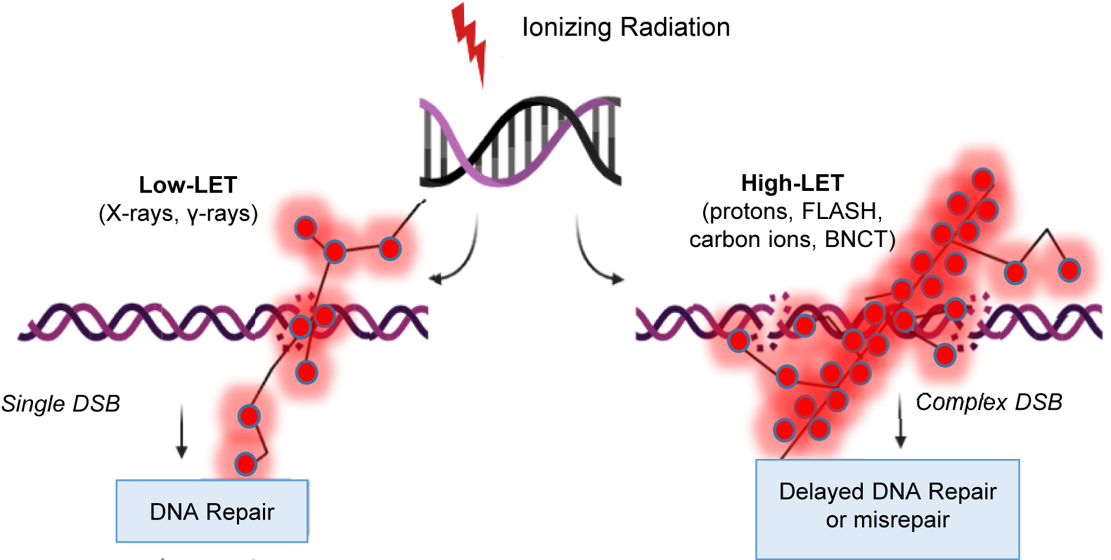
Premise
The biological effects of ionising radiation are critically driven by the initial spatio-temporal energy deposition patterns at the nanometer scale influencing how the ensuing biochemical processes are dealt with at the cellular level and leading to a diversity of tissue/systemic responses

Slide 3
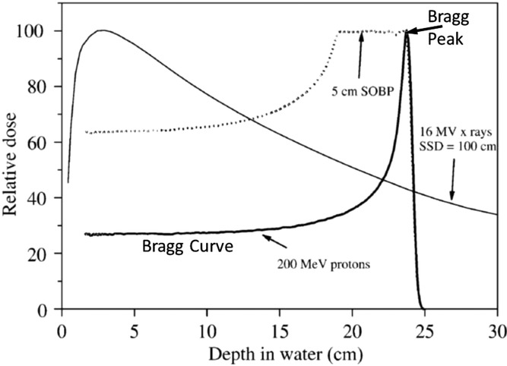
Protontherapy
Mohan et al. Precis. Radiat. Oncol., 2022

Slide 4
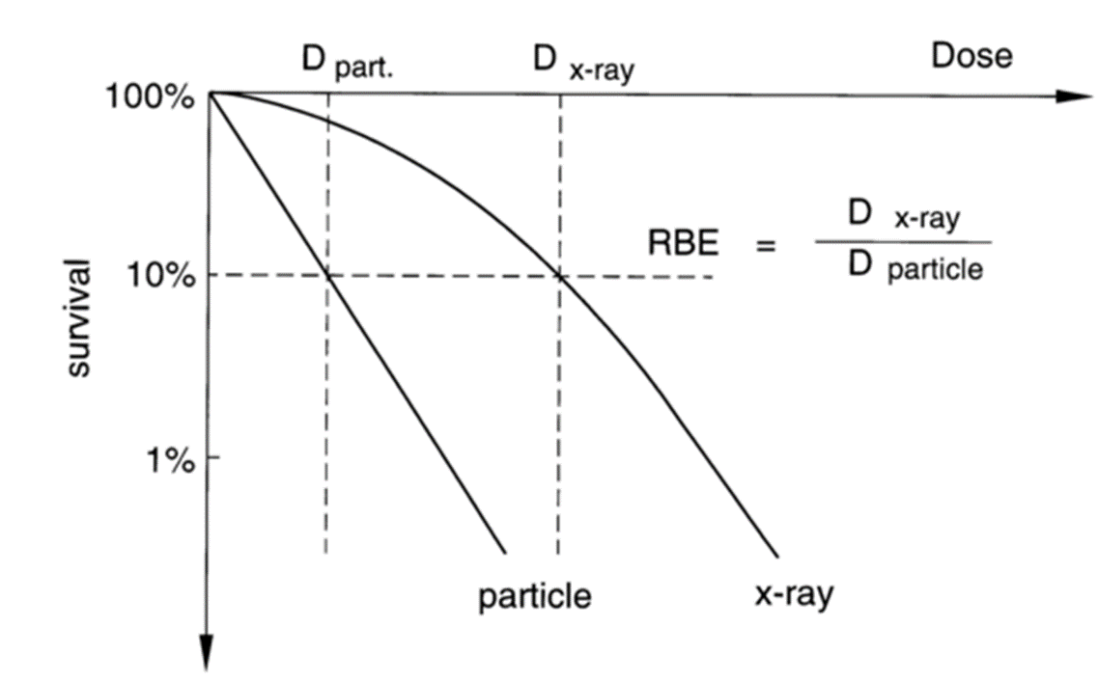
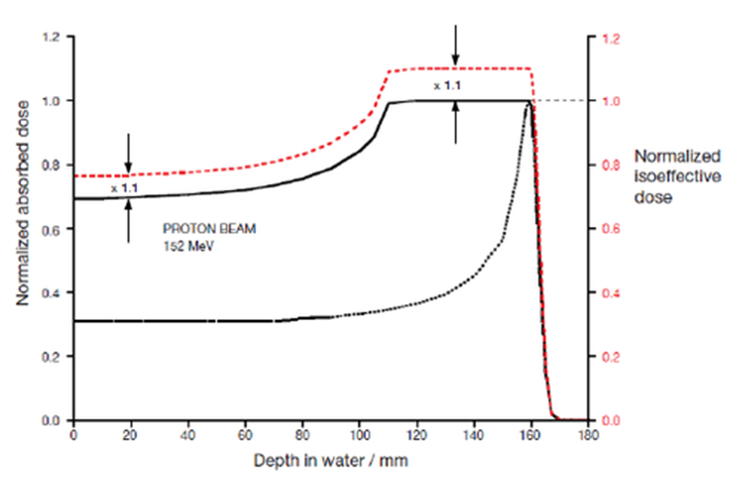
Clinical proton RBE

Slide 5
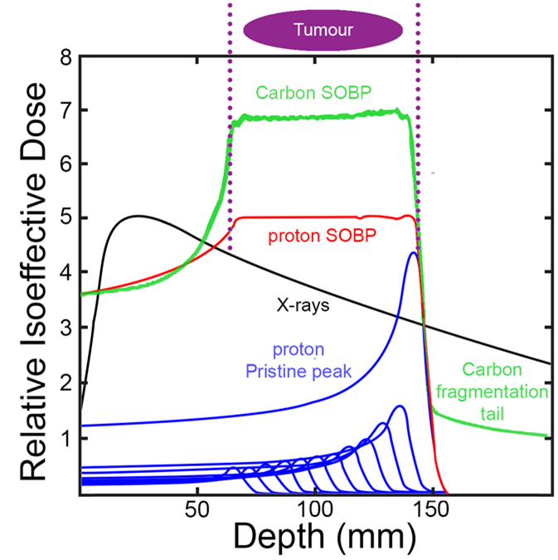
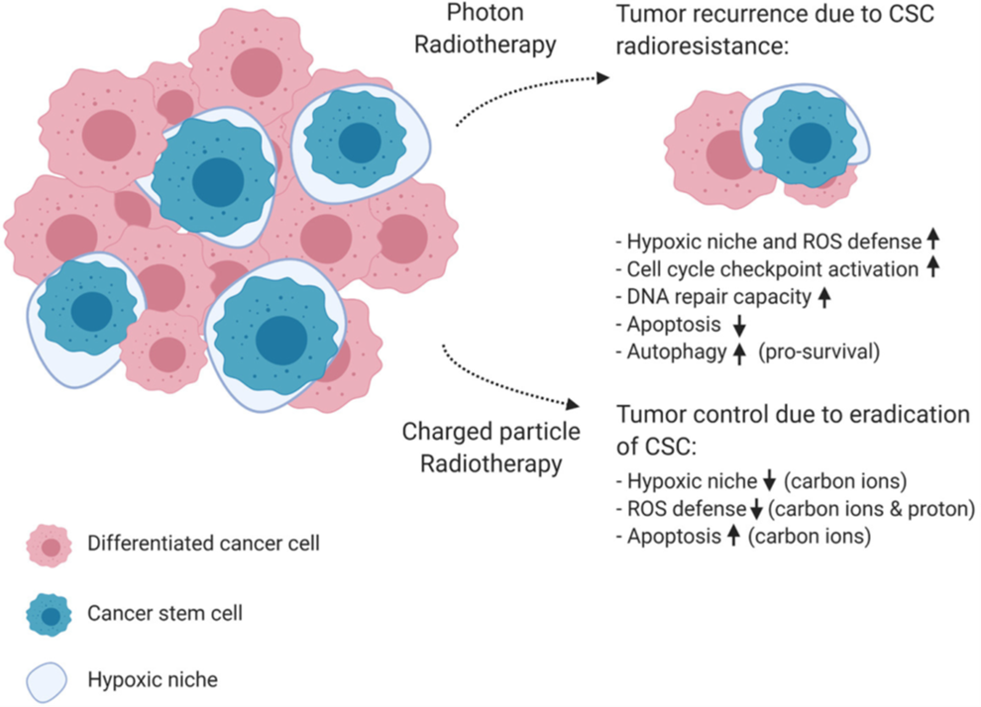
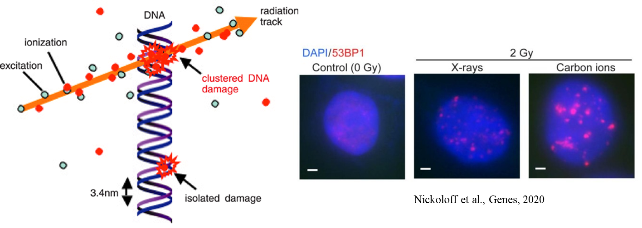
Overcoming tumour radioresistance

Slide 6
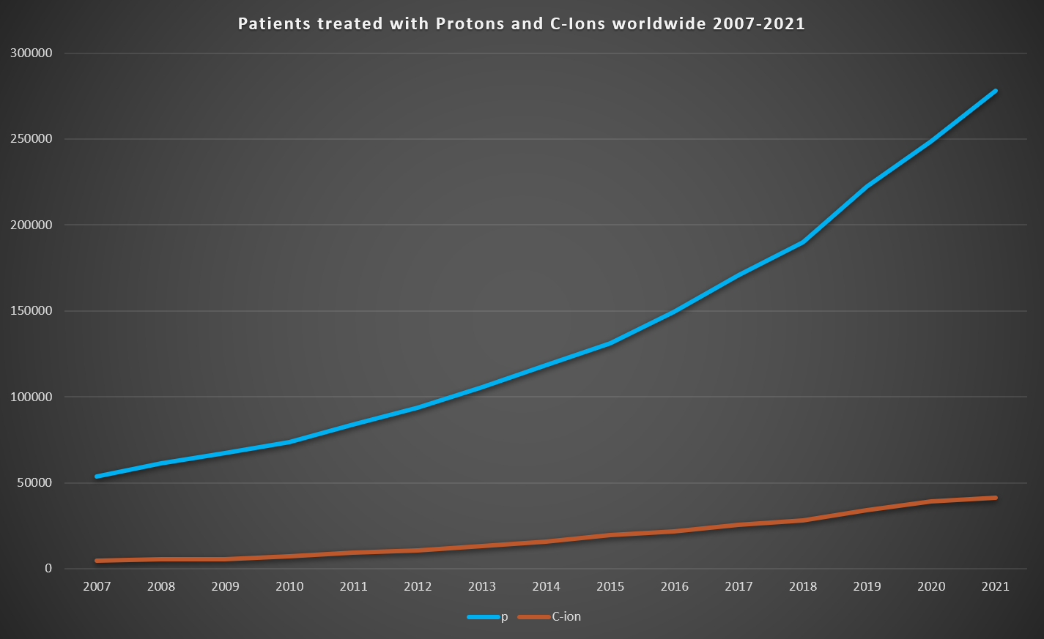
Hadrontherapy: protons vs. ¹²C ions
https://www.ptcog.ch/index.php/patient-statistics. Accessed on line 06/09/22

Slide 7
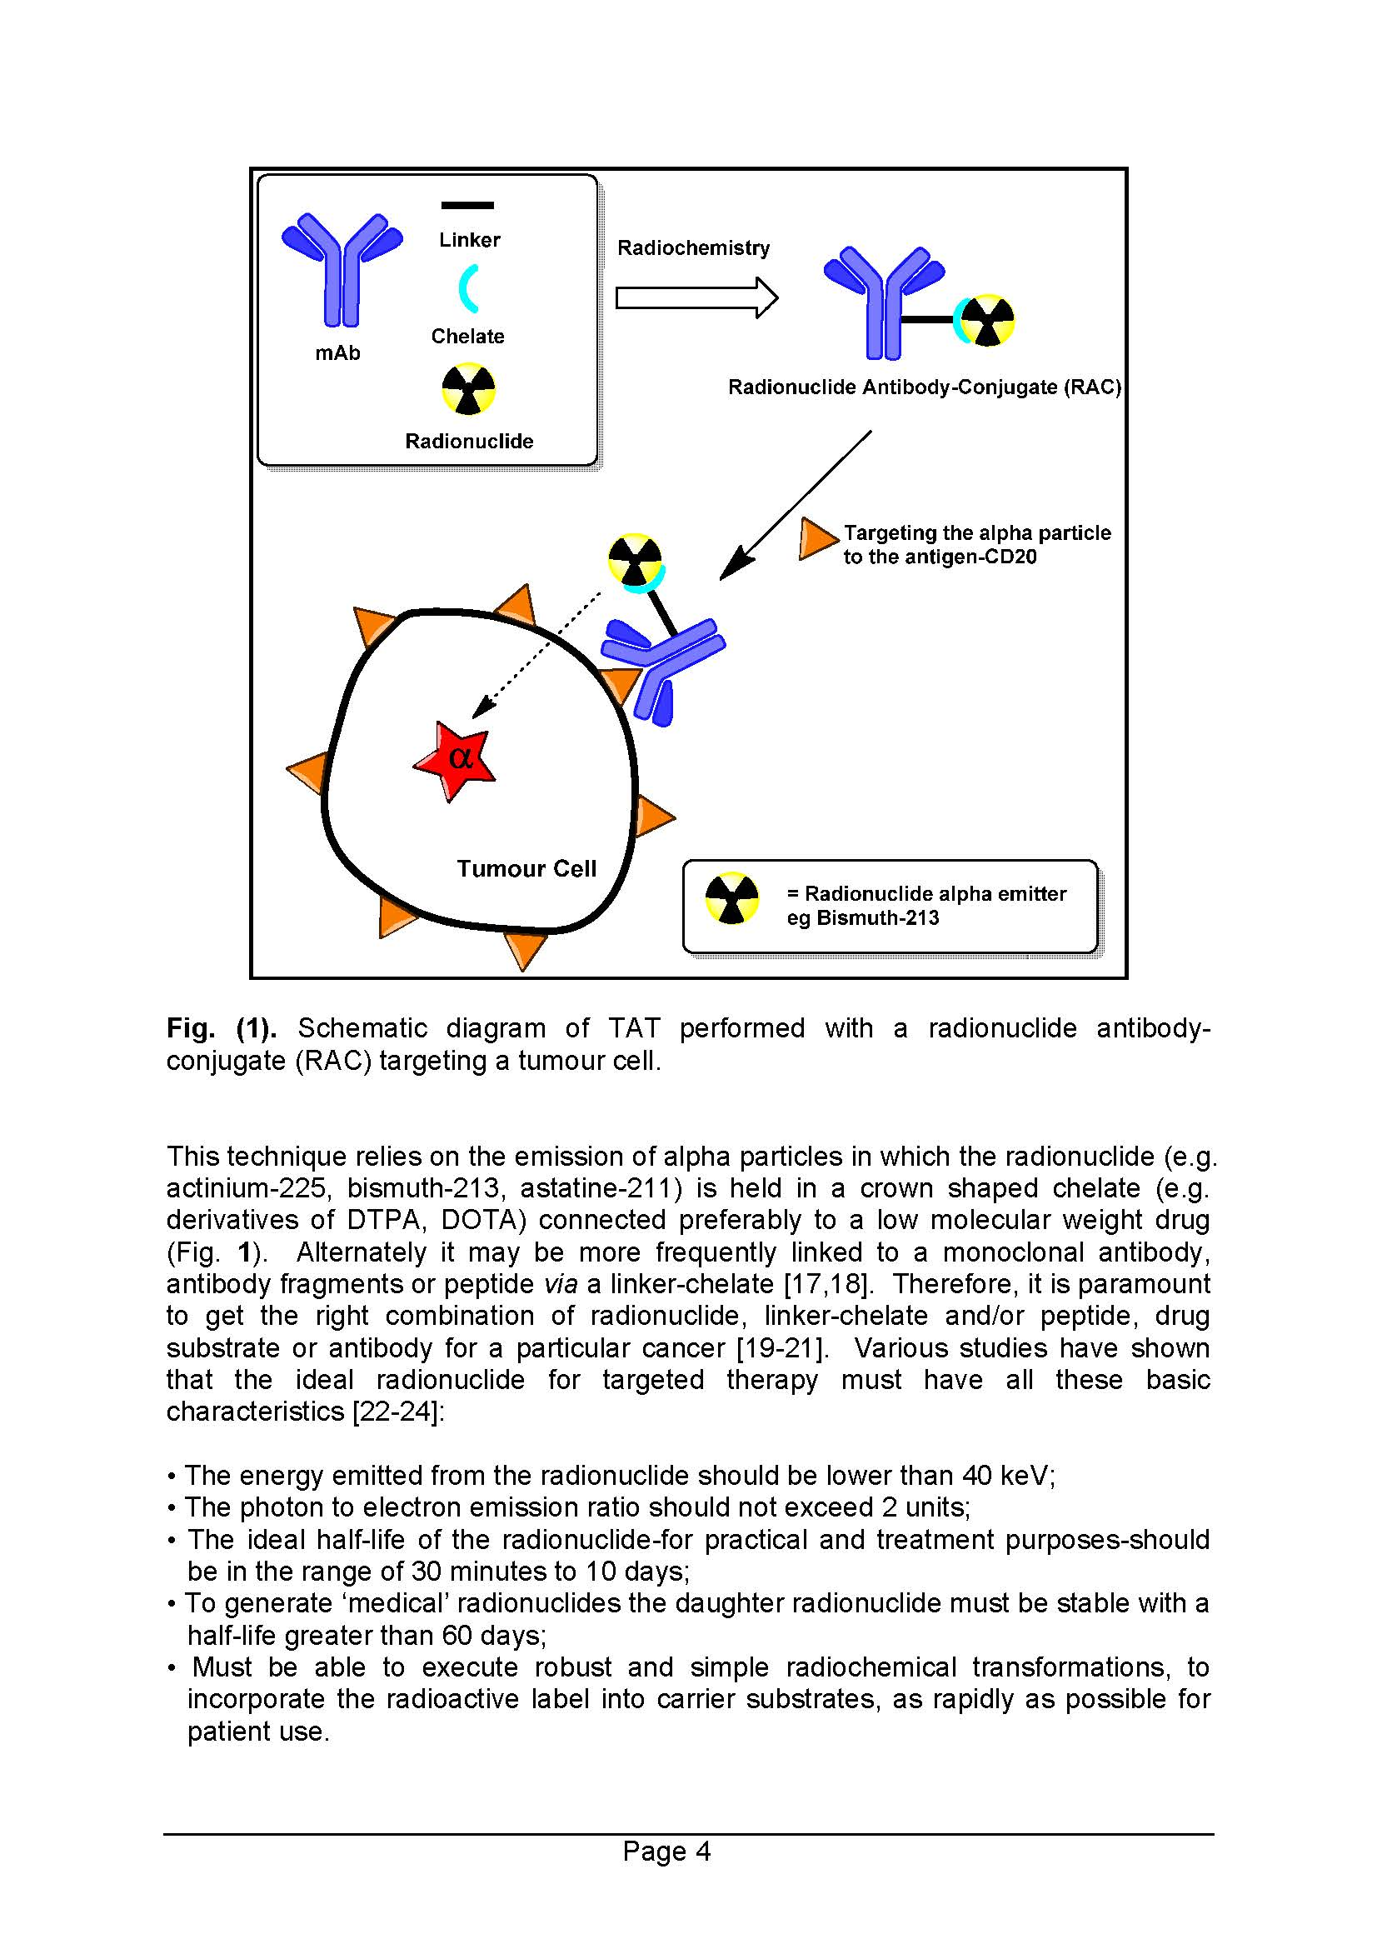
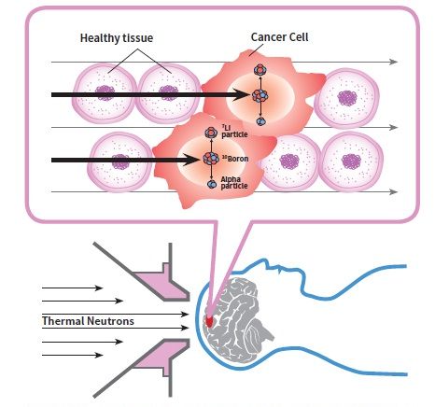
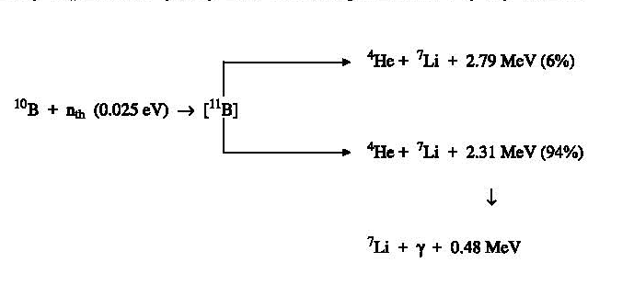
Deploying locally complex DNA damage

Slide 8
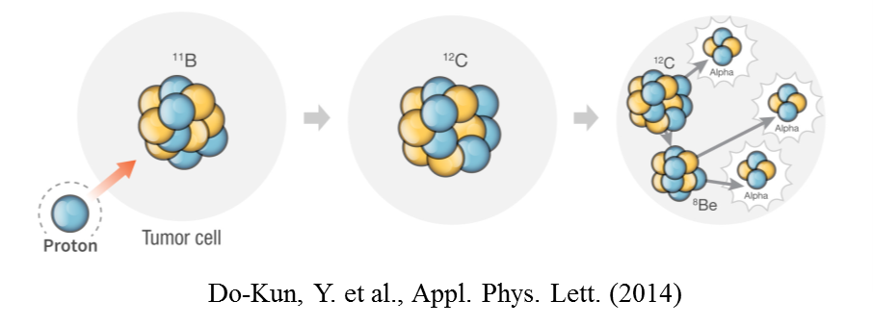
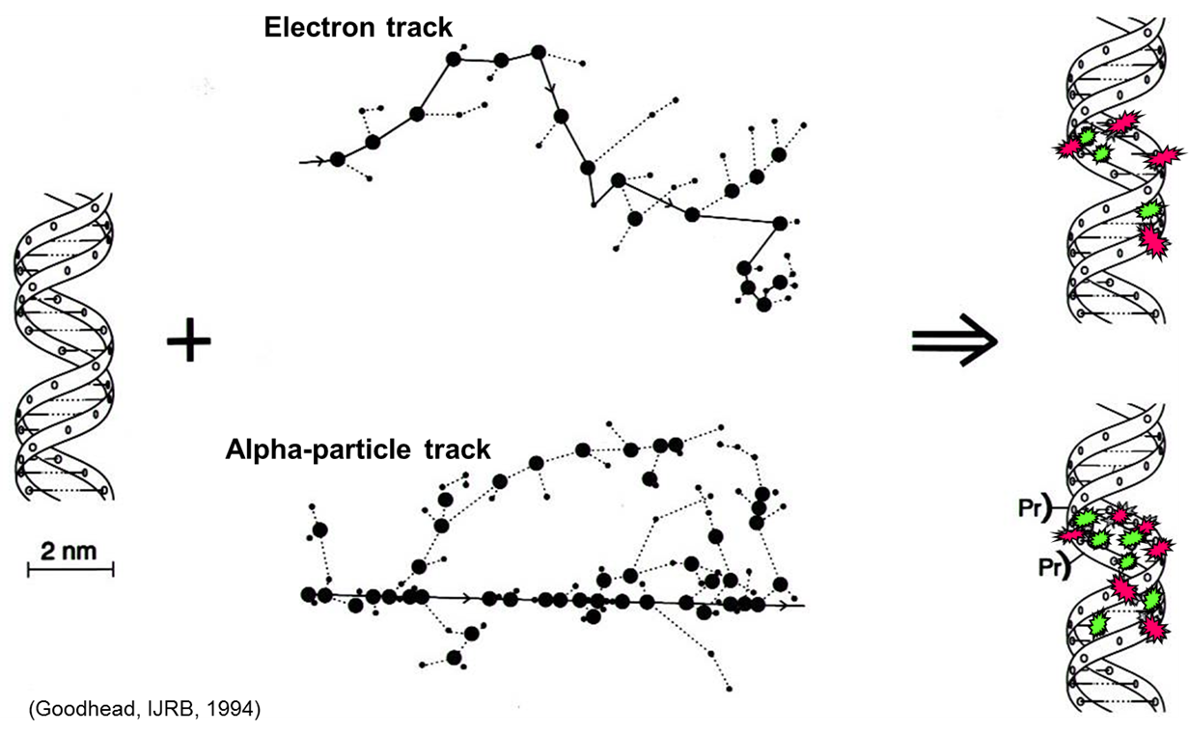
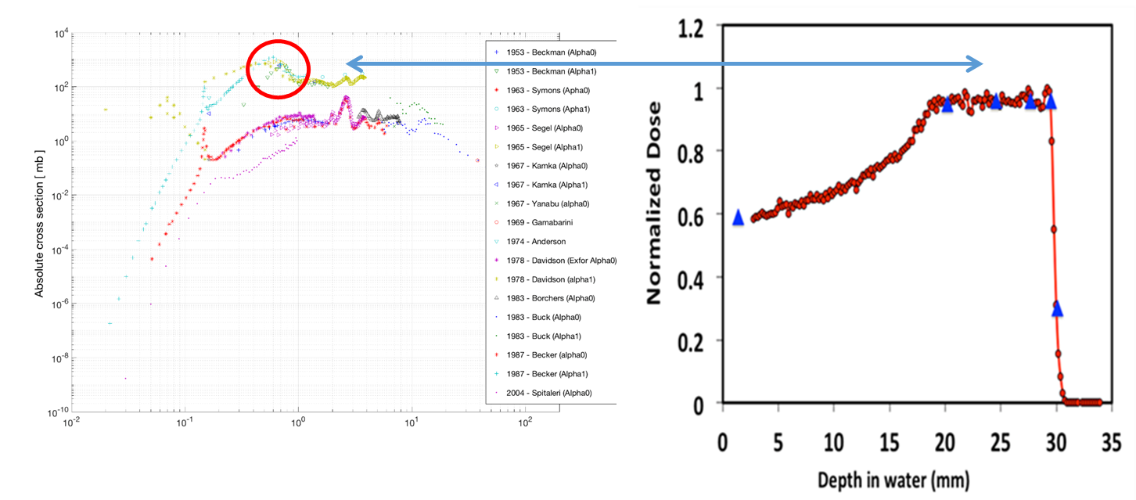
Proton-Boron Capture Therapy (PBCT) to enhance protontherapy effectiveness
Incident proton energy
Notes:
Do-Kun, Y. et al.,, Joo-Young, J. & Tae S.S. Application of proton boron fusion reaction to radiation therapy: A Monte Carlo simulation study. Appl. Phys. Lett. 105, 223507 (2014).
The 11B(p, α)αα reaction at the 0.675 MeV resonance

Slide 9
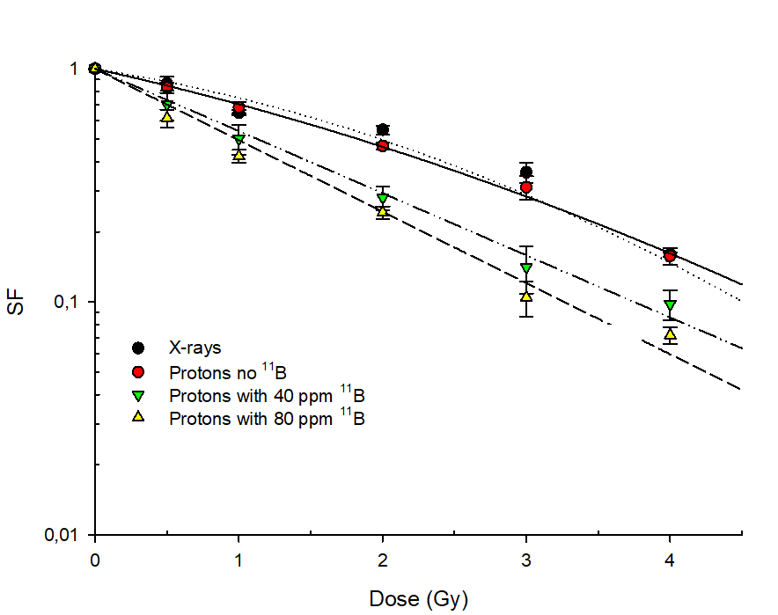
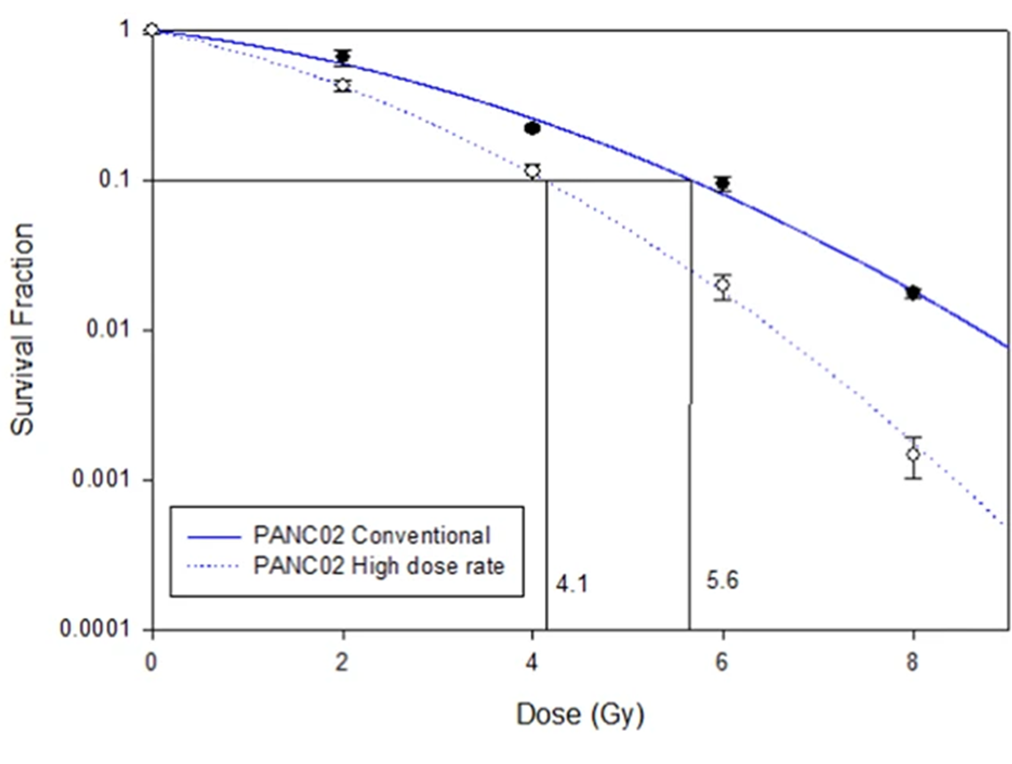

First experimental proof of PBCT
Cirrone et al., Sci. Rep., 2018
Definition of DMF
DMF₁₀ =1.46 ± 0.12
Notes:
For x-rays and protons no BSH fitting equation SF=exp(-αD-βB²)
For protons with 40 and 80 ppm ¹¹B fitting equation SF= exp (-αD)

Slide 10
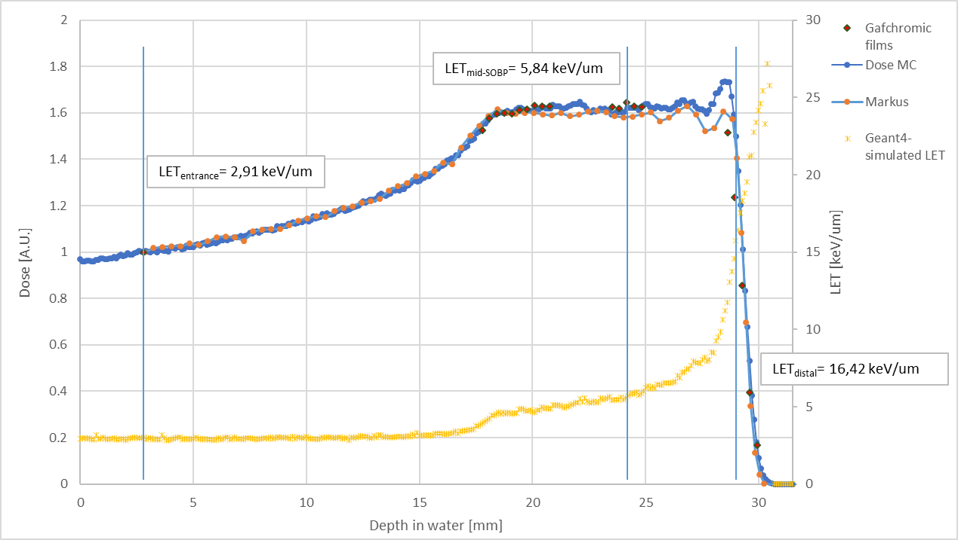
Dependence of PBCT on proton energy-1

Slide 11
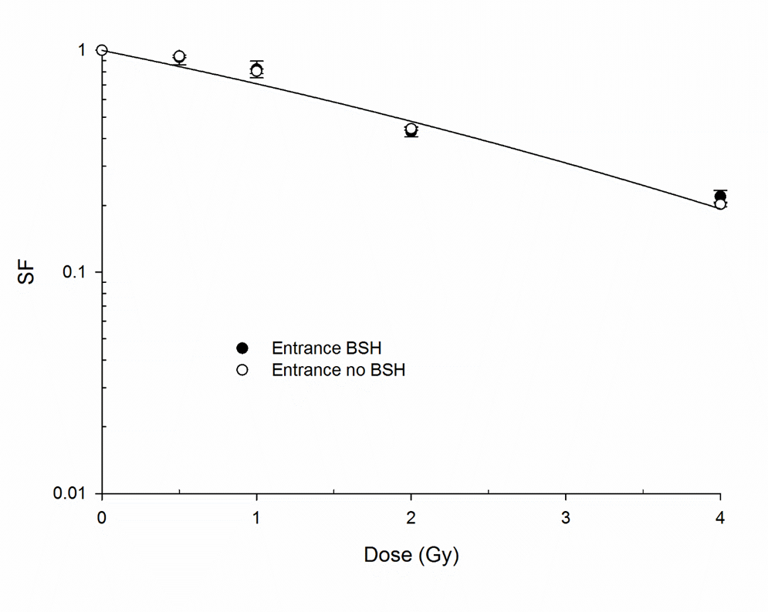
Dependence of PBCT on proton energy-2
DMF₁₀ =1.75 ± 0.13
Cirrone et al., Sci. Rep., 2018

Slide 12
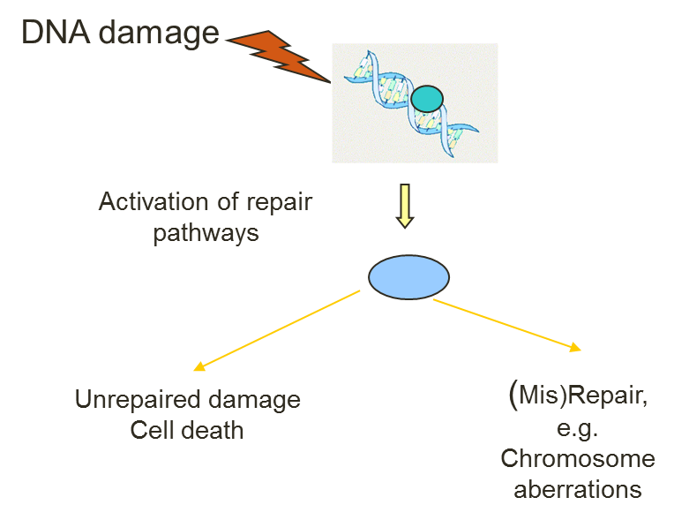
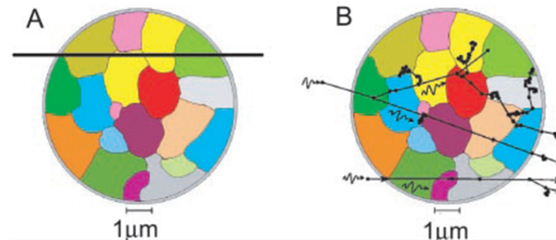
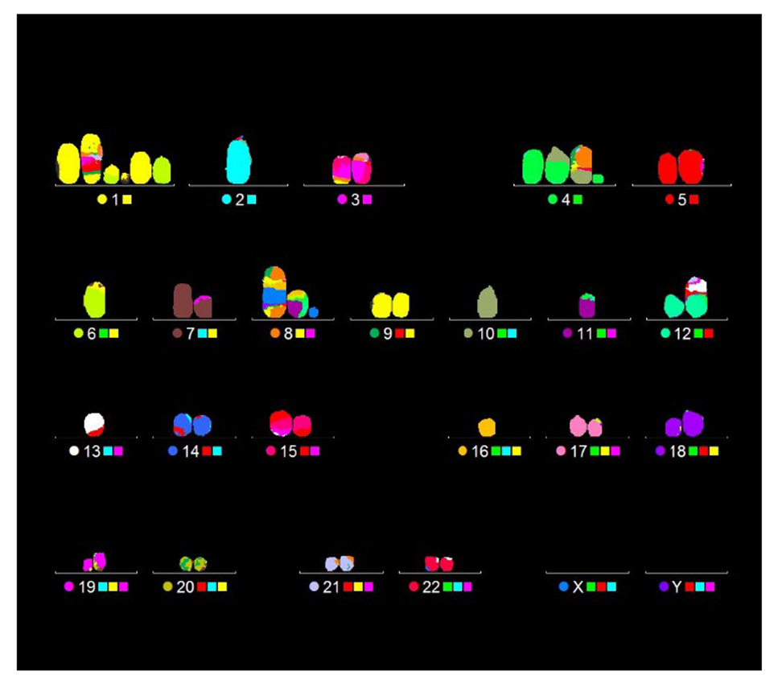
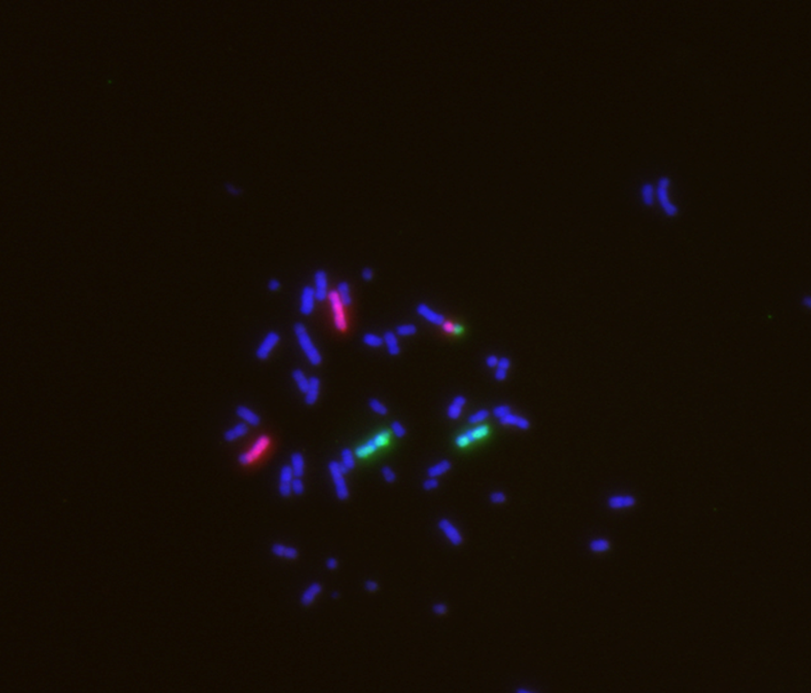
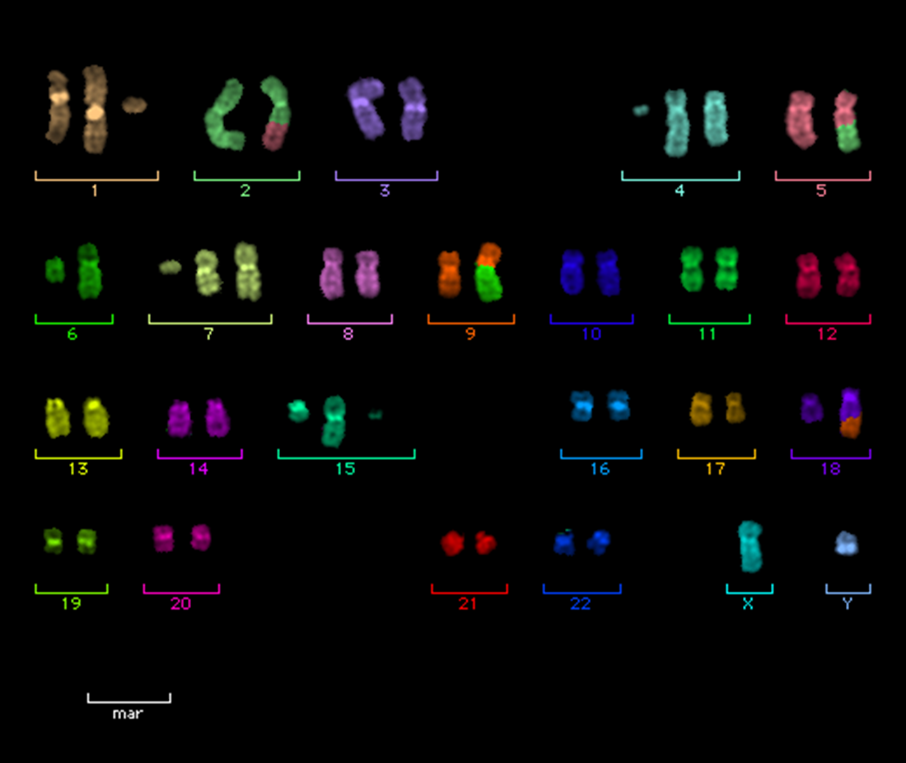
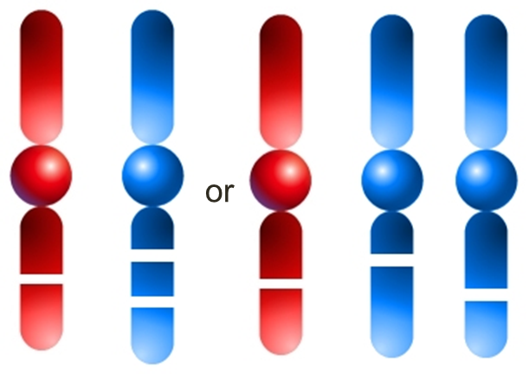
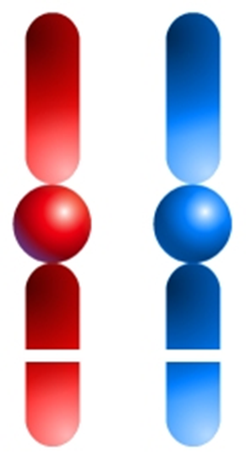
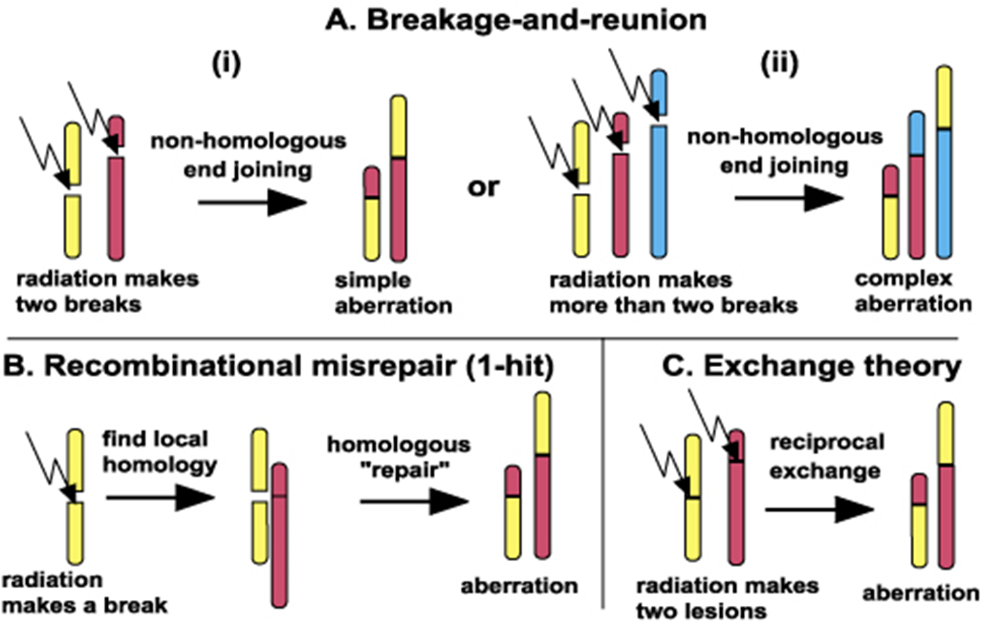
Are pB fusion high-LET α-particles that make PBCT work?

Slide 13
Total aberration yield: FISH analysis
Cirrone et al., Sci. Rep., 2018
Notes:
Fitting procedure was applied to protons no BSH and protons with 80 ppm 11B using equation Y=Y0+aD+bB2 Y0 being the yield of aberrations at 0Gy
Fitting parameters: for protons no BSH a=0.005±0.022 Gy-1 and b = 0.023±0.007 Gy-2 ; for protons with 80 ppm 11B a=0.085±0.028Gy-1 and b = 0.012±0.008 Gy-2

Slide 14
Complex chromosome aberration frequency: mFISH analysis
Cirrone et al., Sci. Rep., 2018

Slide 15
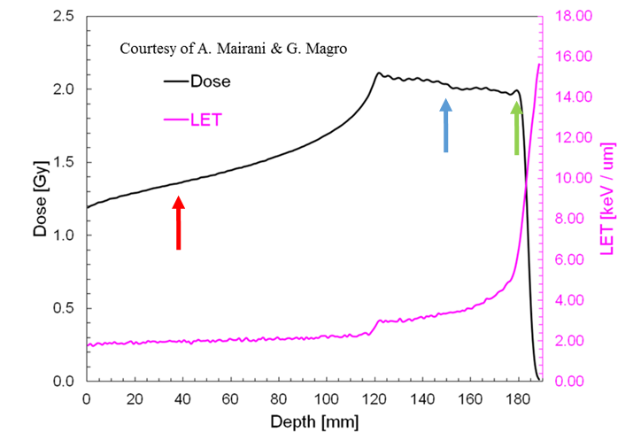
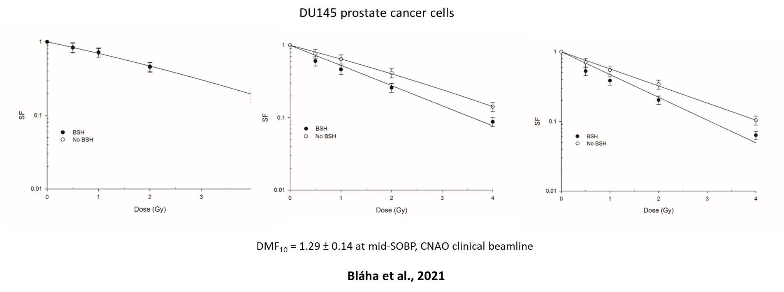

High-energy clinical proton beams: CNAO

Slide 16
Damage complexity along CNAO SOBP-1
Bláha et al., Front Oncol. 2021

Slide 17

Damage complexity along CNAO SOBP-2

Slide 18
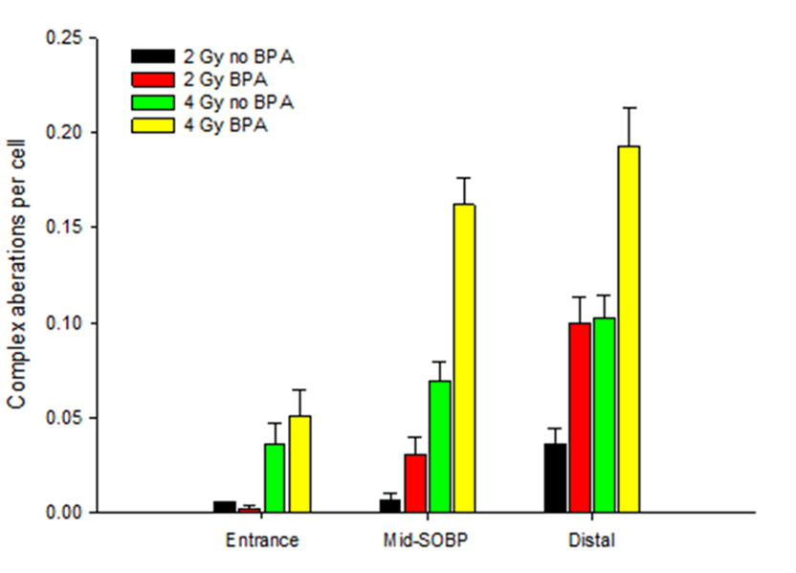
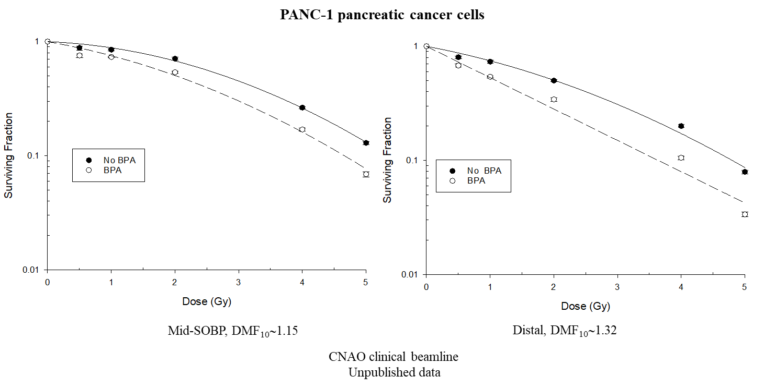
From BSH to BPA

Slide 19
Premature senescence induced by pB reaction
CNAO
Unpublished data

Slide 20
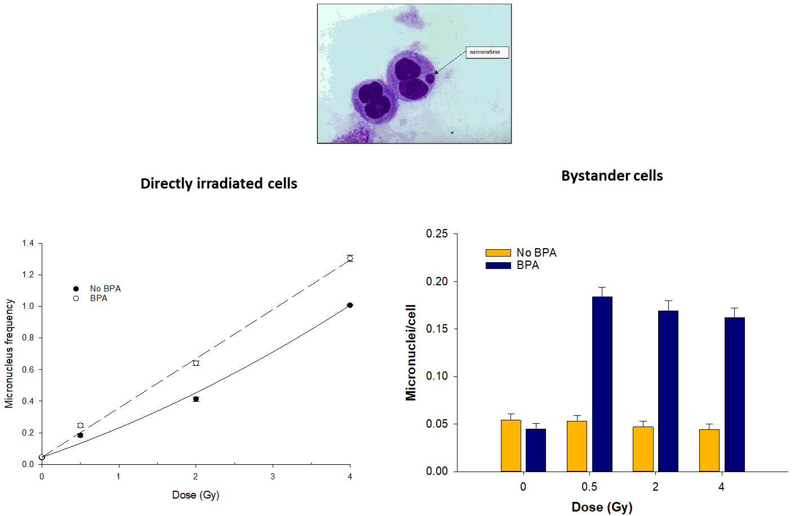
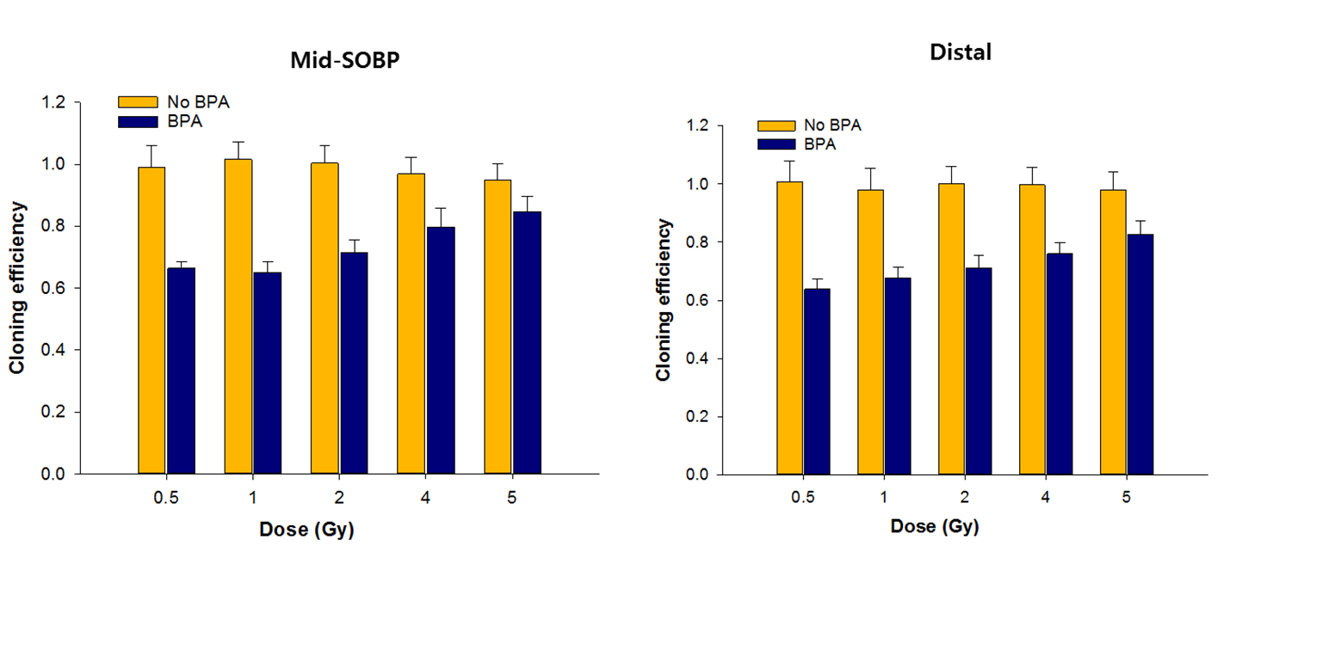
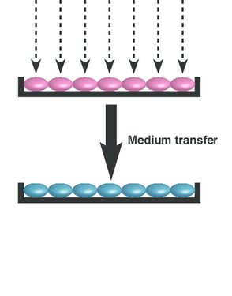
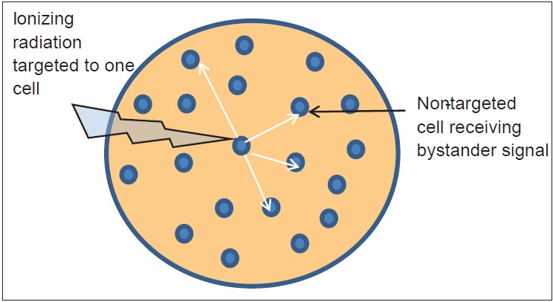
Evidence for bystander effect contributing to PBCT

Slide 21
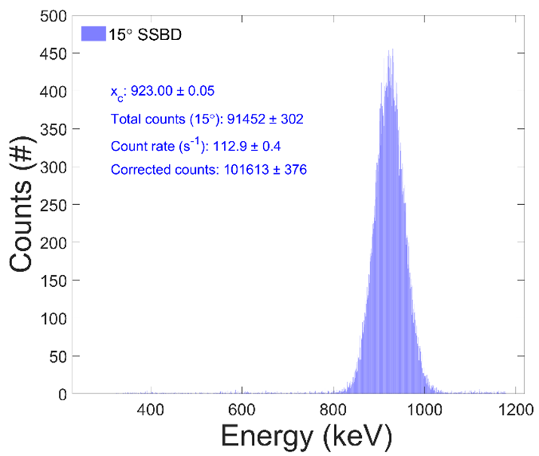
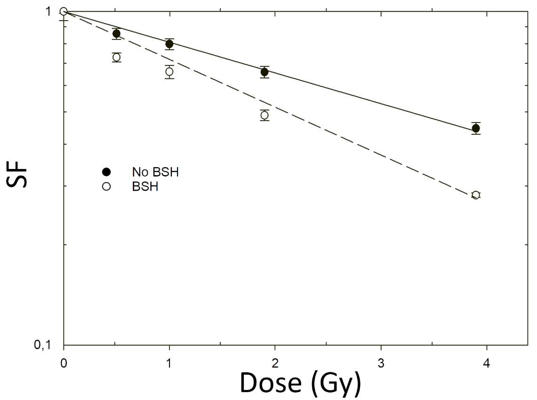
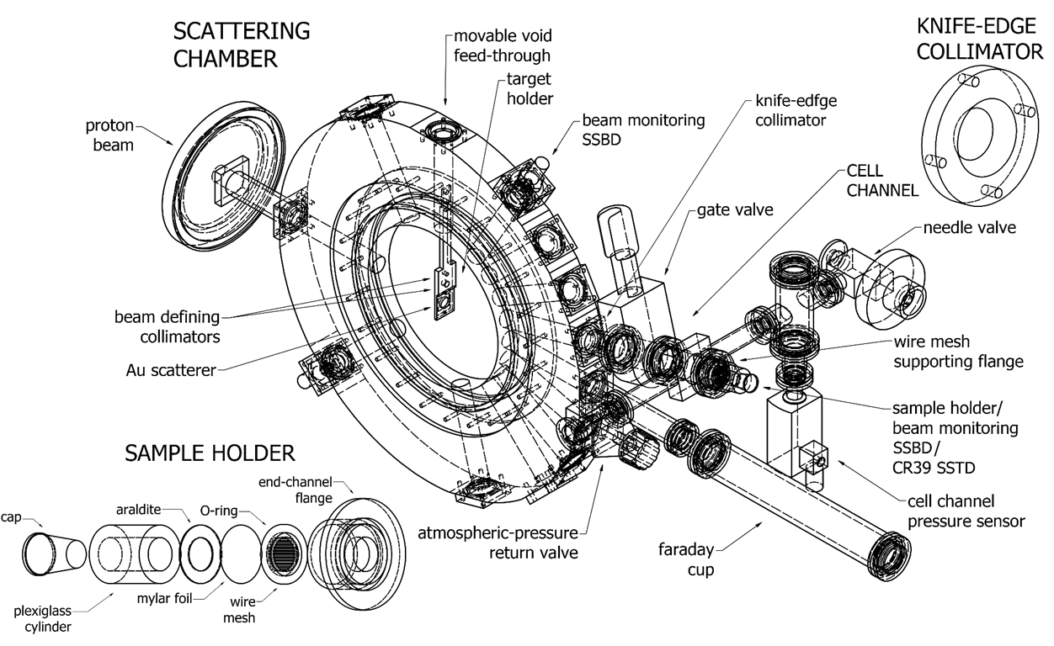
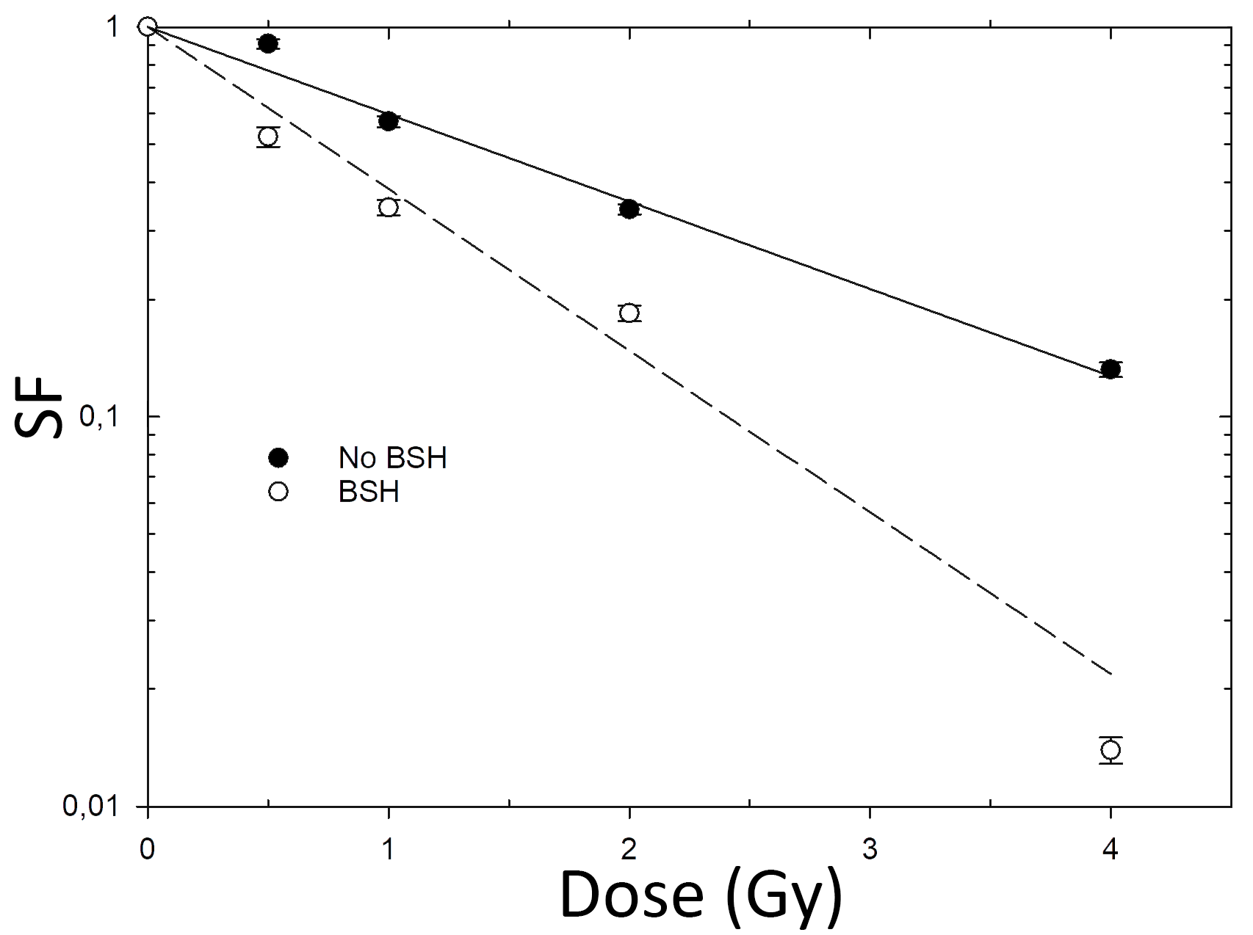
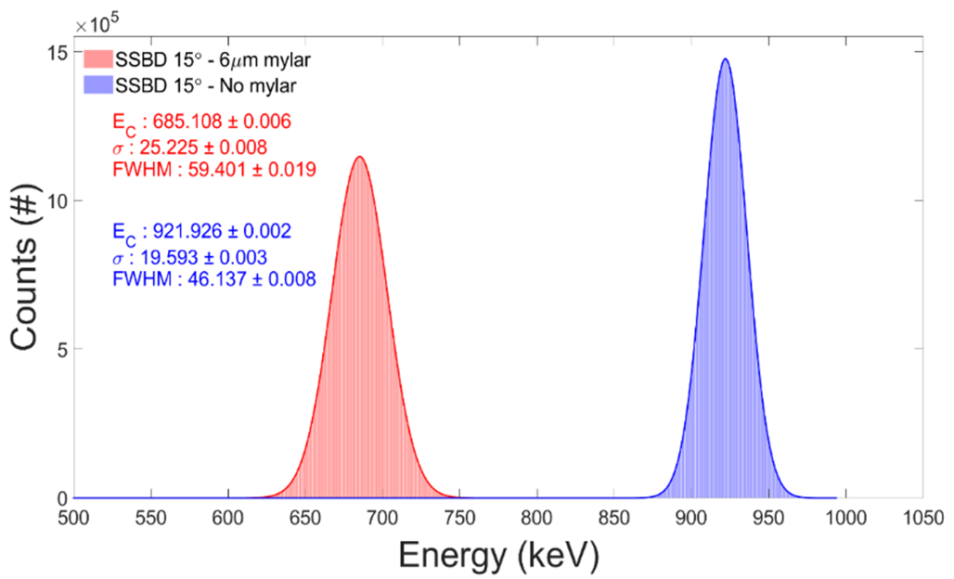
Low-energy (～700 keV) monochromatic proton beam irradiations
DU 145
PANC-1
DU 145 | α (Gy⁻¹) | DMF₁₀
NO BSH | 0.52 ± 0.03
BSH | 0.96 ± 0.08 | ∼ 1.85
PANC-1 | α (Gy⁻¹) | DMF₁₀
NO BSH | 0.212± 0.006
BSH | 0.330± 0.012 | ~1.56
Ricciardi et al., Appl Sci, 2021

Slide 22

The NEPTUNE network
(Nuclear process-driven Enhancement of Proton Therapy UNravEled)
LNS-INFN Medical Physics Group (Catania)
Naples University and INFN Section Naples (Naples)
Università della Campania L. Vanvitelli (Caserta)
CNR- Institute of Molecular Bioimaging and Physiology (Cefalù)
Milan University and INFN Section (Milan)
LNL-INFN (Legnaro, Padua)
Rome University La Sapienza/INFN Section Rome1 (Rome)
Pavia University/INFN Section Pavia & CNAO (Pavia)

Slide 23
Conclusions
Proton biological effectiveness is enhanced by treatment with ¹¹B carriers (DMF >1)
Chromosome aberration data point to a role in radiosensitization by high-LET particles (other biological mechanisms possibly at play)
DMF is sensitive to position along SOBP, i.e., to variation of pB fusion reaction cross section with incident proton energy
Irradiations with monochromatic low-energy protons yield the greatest DMFs
Current and future work need:
  To further validate the PBCT approach feasibility using in vivo pre-clinical models (involving carrier uptake kinetics, etc)
  To reconcile experimental radiobiology results with in silico data

Slide 24
Acknowledgments
Radiation Biophysics Group, Physics Dept., Università Federico II and INFN Section, Naples
Pavel Blàha,
Chiara Feoli
Katarina Michaličková
Valerio Ricciardi
Enrico Rosa
Funding: INFN Call NEPTUNE & MIUR PRIN 2017 PBCT
PI: G. Cuttone, INFN-LNS, Catania

Slide 25

Thank you for the attention!

Slide 26
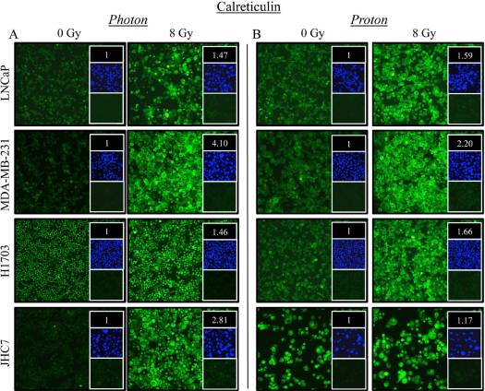
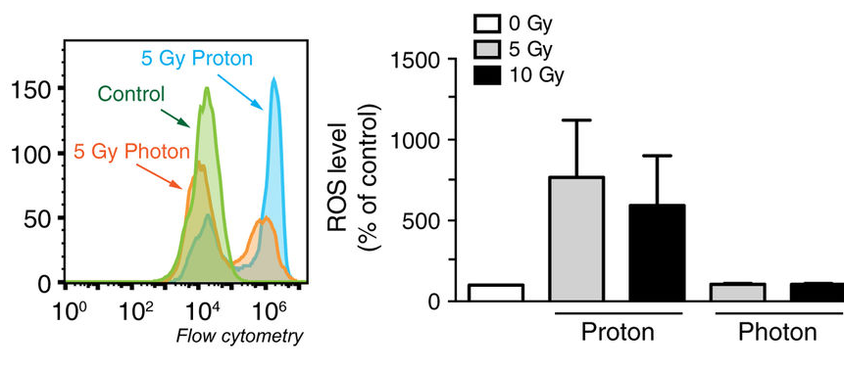
Proton radiobiology
Mitteer et al., Sci Rep., 2015
Gameiro et al, Int. J. Radiat Biol Oncol Phys, 2016

