Slide 1
High sensitivity Thomson spectrometry in experiments of laser-driven low-rate neutron-less fusion reactions
M. Scisciò¹, G. Di Giorgio¹, P.L. Andreoli¹, M. Cipriani¹, G. Cristofari¹, R. De Angelis¹, M. Salvadori¹, G. A. P. Cirrone², L. Giuffrida³, D. Margarone^{3,4}, G. Milluzzo², G. Petringa² & F. Consoli¹
¹ENEA, Fusion and Nuclear Safety Department - C. R. Frascati, 00044 Frascati, Italy
²Laboratori Nazionali del Sud, Istituto Nazionale di Fisica Nucleare (LNS-INFN), 95125 Catania, Italy
³ELI Beamlines, Institute of Physics of the Czech Academy of Sciences, 25241 Dolni Brezany, Czech Republic
⁴Queen's University Belfast, School of Mathematics and Physics, BT7 1NN Belfast, United Kingdom
2nd International Workshop on Proton-Boron Fusion
Sept. 5-8, 2022
Catania, Italy

Slide 2
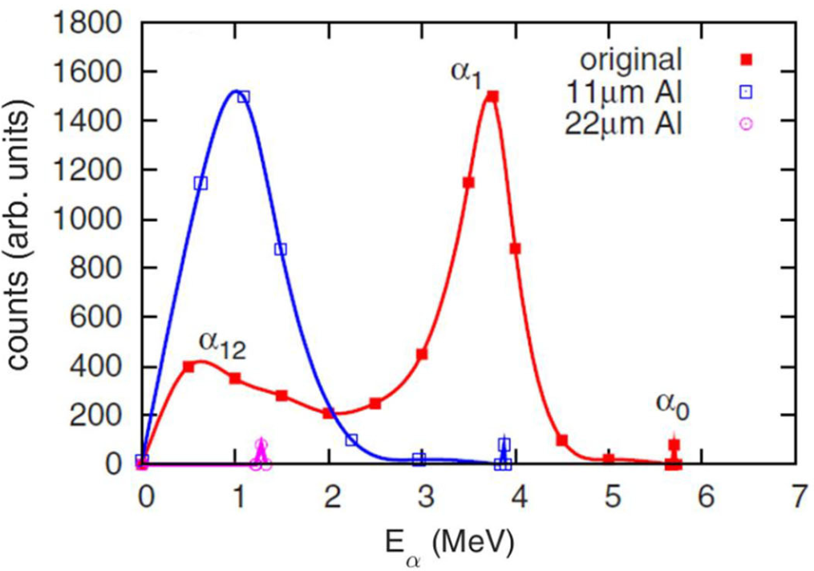
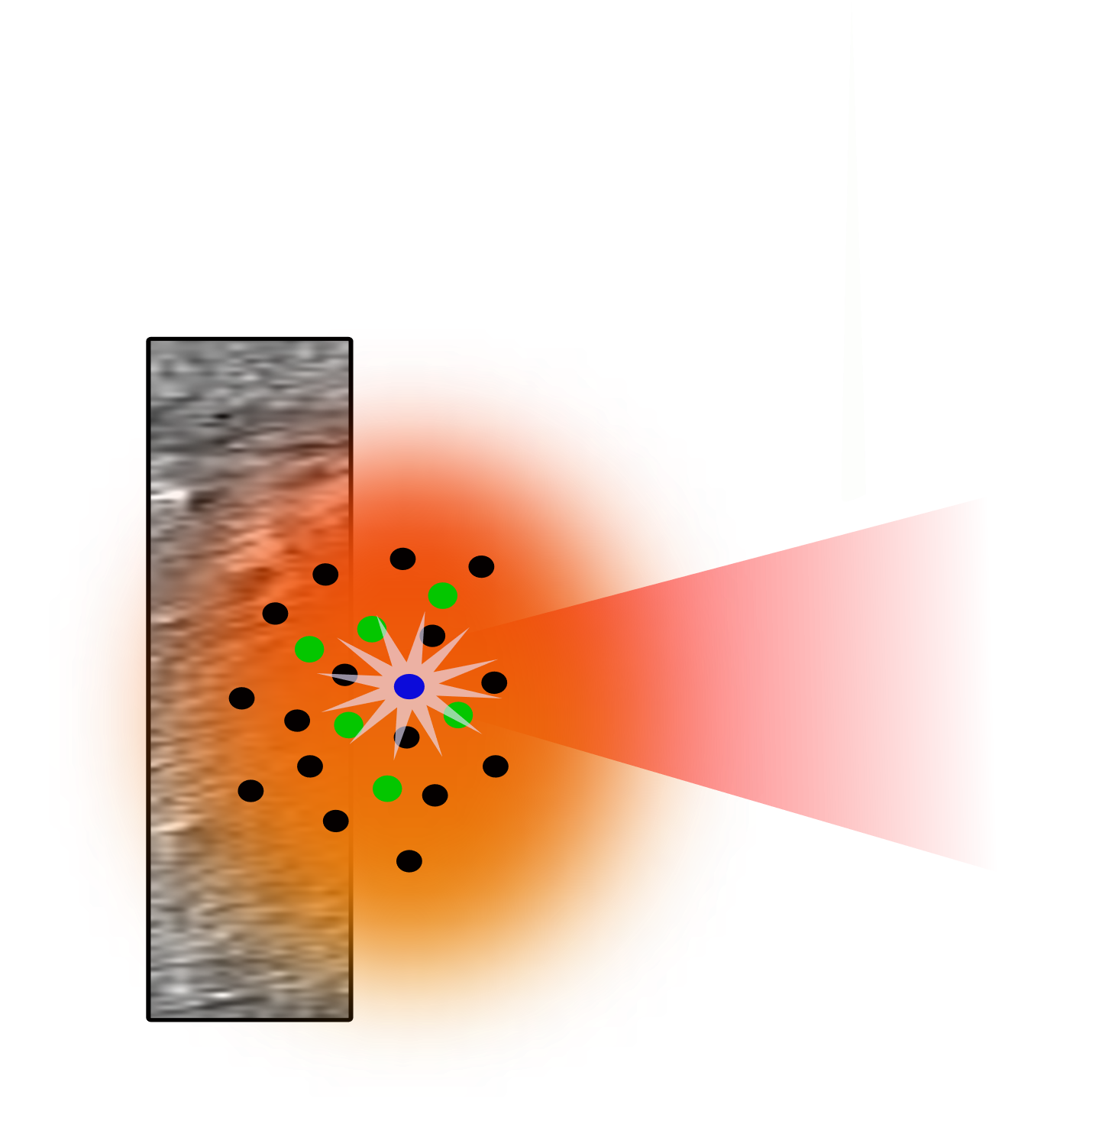
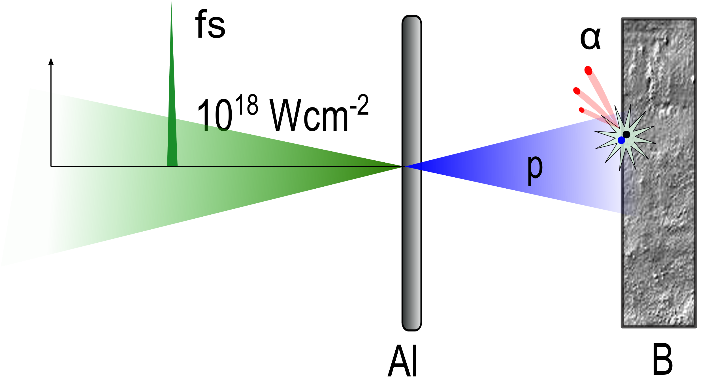
¹¹B(p,α)2α fusion reaction
¹¹B(p,α)2α nuclear fusion reaction: $p{+ }^{11}B→3α+8.7$MeV
Kimura et al., Phys. Rev E 79, 038401 (2009)
No/few neutrons are produced
No need for radioactive reactant
Energetic alpha particles are obtained
Fusion reaction initiated by high energy lasers,
two main schemes are adopted:
“In target”
“pitcher-catcher”
Nuclear fusion rates are determined by the produced alphas:
needs for an effective way for the detection and characterization of the produced alpha particles.
Not only for energy production:
interest for both medical applications and astrophysics research
F. Consoli et al. Front. Phys. 8, (2020) 561492
P. Cirrone et al. Sci. Rep. 8 (2018) 1141

Slide 3
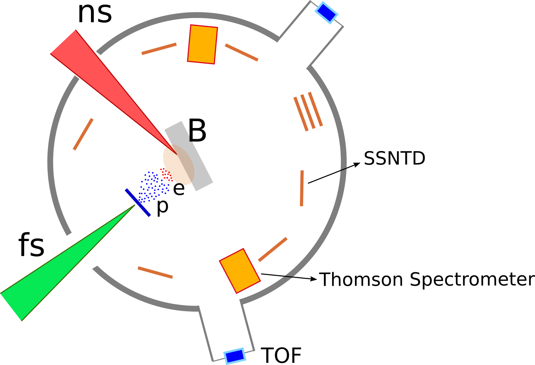
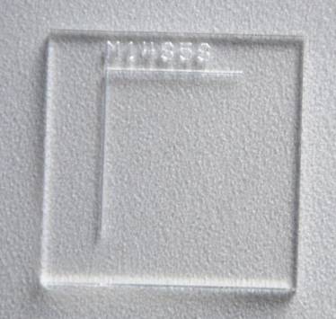
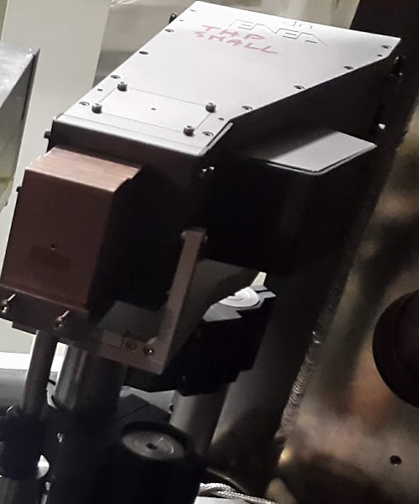
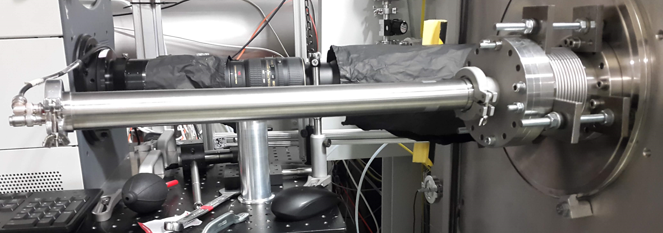
The detection of α-particles is a challenging task
Typical diagnostics for p-B experiments:
Solid State Nuclear Track Detector (SSNTD)
■ Ion discrimination
■ ■ Spectrum reconstruction is challenging
■ Strong background
EMP radiation
particle radiation
Time Of Flight (TOF)
■ Provide prompt information on velocity distribution
■ Spectrum reconstruction
■ Does not allow for particle discrimination
■ Sensitive to EMP noise
ionizing radiation
Thomson spectrometers (TS)
■ Ion discrimination according to mass-to-charge ratio
■ Spectrum reconstruction
■ α trace overlaps with fully stripped ions (C⁶⁺, N⁷⁺…)
■ Sensitive to EMP and ionizing radiation noise
F. Consoli et al. Front. Phys. 8, (2020) 561492

Slide 4
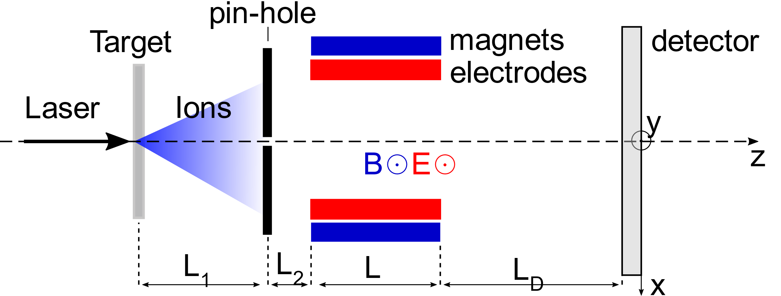
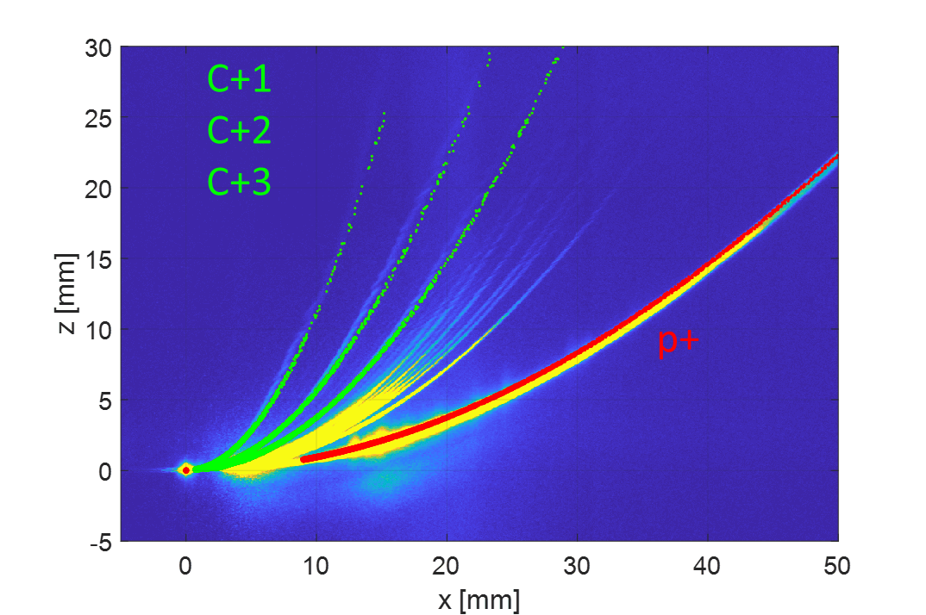
Thomson spectrometer working principle
Typical traces generated by the particles on the detector
y
$$\left\{\begin{aligned}&x=\frac{Zq_{e}}{Am_{p}}\frac{A_{B}}{v_{z}} \\ &y=\frac{Zq_{e}}{Am_{p}}\frac{A_{E}}{v_{z}^{2}}\end{aligned}\right.$$
$$y\left(x\right)=\frac{Am_{p}}{Zq_{e}}\frac{A_{E}}{A_{B}^{2}}x^{2}$$
$$A_{B}=\int_{0}^{L_{1}+L_{2}+L+L_{D}}{\int_{0}^{z}{B\left(z^{′}\right)dz′dz} }$$
$$A_{E}=\int_{0}^{L_{1}+L_{2}+L+L_{D}}{\int_{0}^{z}{E\left(z^{′}\right)dz′dz} }$$
Each parabolic trace corresponds to one $\frac{A}{Z}$ ratio.
$α−particles →$ $\frac{A}{Z}=2$ : their contribution to the retrieved signal is on this parabola, together with all the other ions with the same mass-to-charge ration, e.g. C⁺⁶ ions.
with
M. Scisciò et al. J. Inst. 17, (2022) C01055

Slide 5
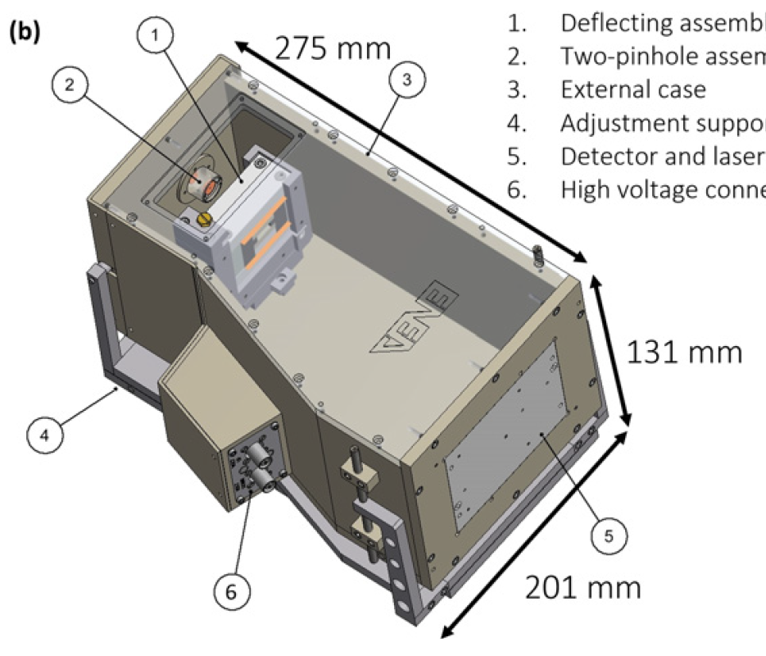
The TS designed at ENEA - Frascati
Compact dimensions for in-chamber use
EMP shielding allows positioning close to the target
Medium size pinhole system for high sensitivity
Optimized for proton energies up to 10 MeV
Can be equipped with both IPs or CR-39
Internal (external) pin-hole diameter | 0.35 mm (2 mm)
Dipole length L | 25 mm
Dipole gap | 5 mm
Magnetic field B | 0.405 T
Max. electric field E | 1.56 MV/m
Drift space L_{D} | 197 mm
Deflecting assembly
Two-pinhole assembly
External case
Adjustment supports
Detector and laser alignment
High-voltage connectors
G. Di Giorgio et al., J.Inst. 15, C10013 (2020)
F. Consoli et al., J.Inst. 11, C05010 (2016)

Slide 6
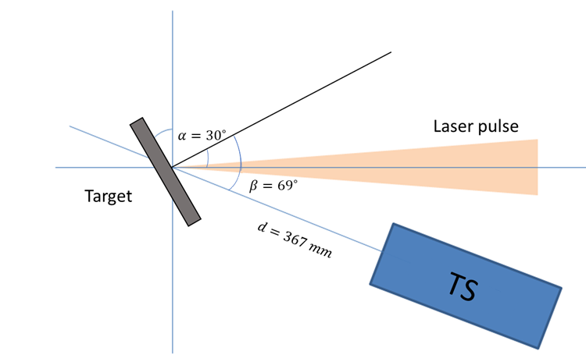
PALS experimental campaign: setup
Experimental setup at the PALS facility: “in-target” scheme
Laser parameters:
Wavelength λ = 1315 nm
Pulse duration $τ≈$350 ps
Pulse energy between 600 J and 700 J Intensity on target $I≈{10}^{16} W/cm^{2}$
The maximum voltage applied to the electrodes of the TS was of ΔV = 4 kV (resulting in an electric field E ≈ 0.78 MV/m).
Target: 10 µm thick plastic foil, doped with ¹¹B.
Detector on TS: BAS-TR type Imaging Plate with no filter on the sensitive surface.
External lead slit
Device at close proximity to the target, inside the target chamber.

Slide 7
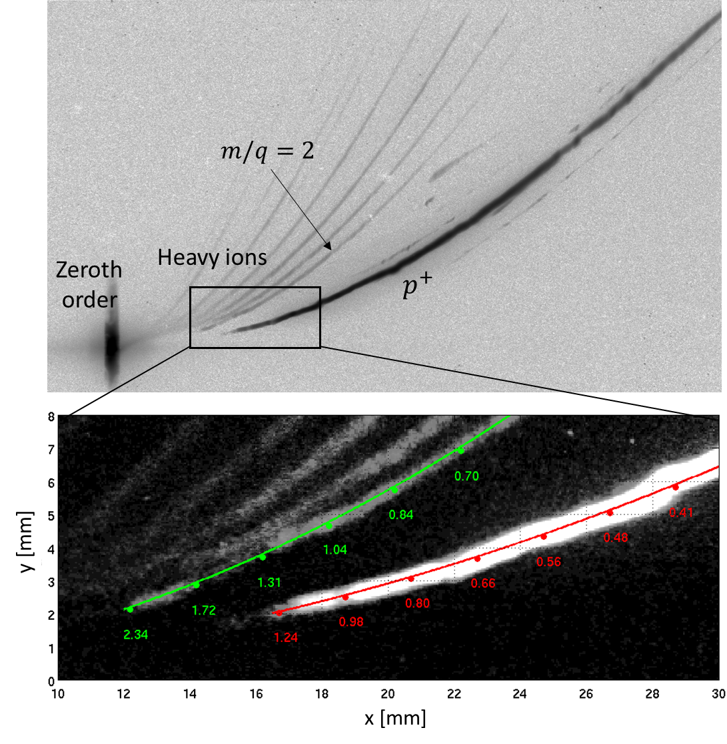
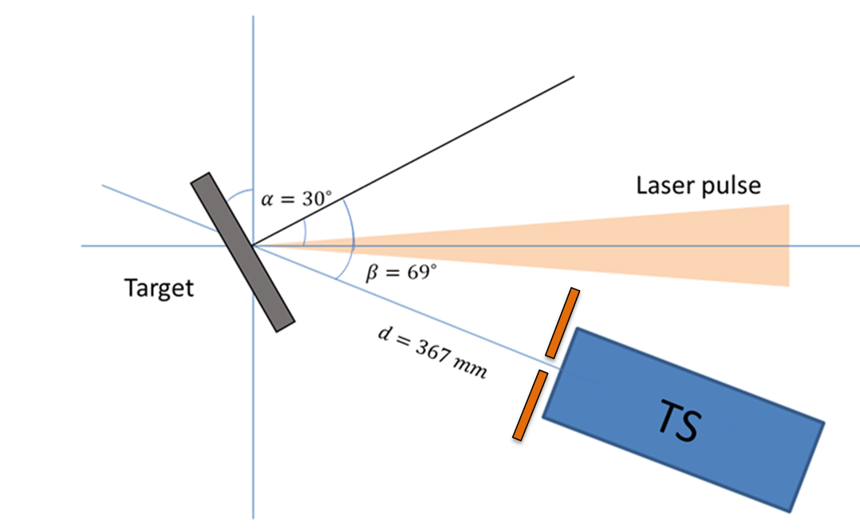
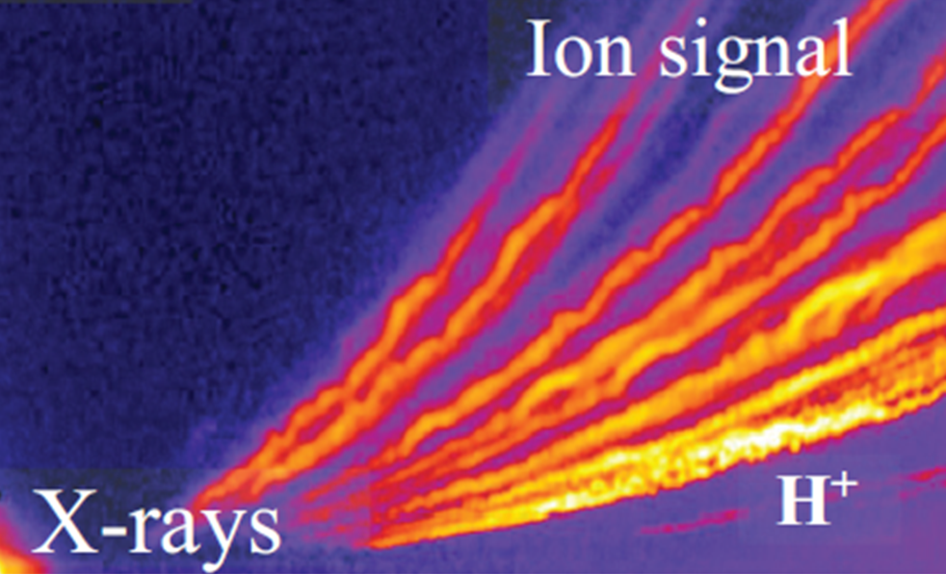
PALS experimental campaign: IP scan
Obtained Imaging Plate scan:
No digital enhancing used!
$$A/Z$$
Comparison:
Obtained traces when no special shielding against EMP and other background noise is used. Here, the TS was placed at $∼$1.5 m from the target, outside the chamber.
L. Giuffrida et al., Physical Review E 101, 013204 (2020)
IP type: BAS TR (no filter)
Shot #56027 :
Protons $E_{max}$ = 1.24 MeV
Alphas $E_{max}$ = 2.34 MeV
Laser energy 661 J
0.70
0.84
0.41
1.04
0.48
0.56
1.31
0.66
1.72
0.80
2.34
1.24
0.98

Slide 8
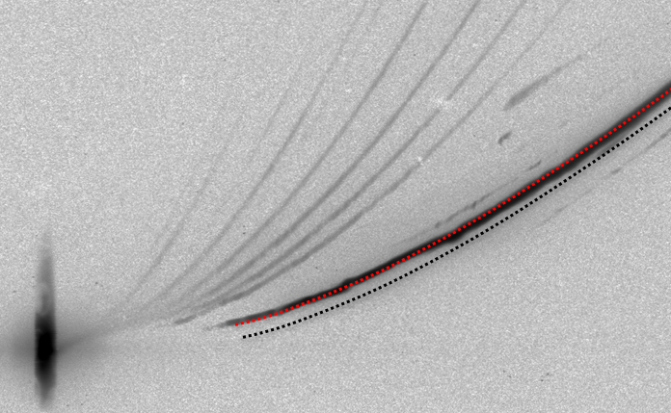
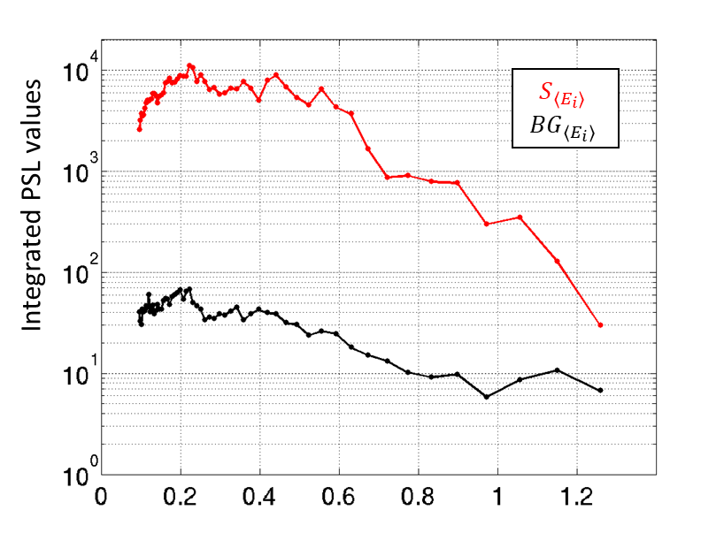
Analysis on the obtained signal and background noise level
Evaluation of the signal (black-level of the retrieved trace) and background (black-level adjacent to the trace), as a function of the particle energy, according to $x=A_{B}{Zq}_{e}/\sqrt{2Am_{p}E_{i}}$
Signal generated by the particles: $S_{\left\langle E_{i}\right\rangle }$
Background : ${BG}_{\left\langle E_{i}\right\rangle }$
$$x$$
Proton energy [MeV]

Slide 9
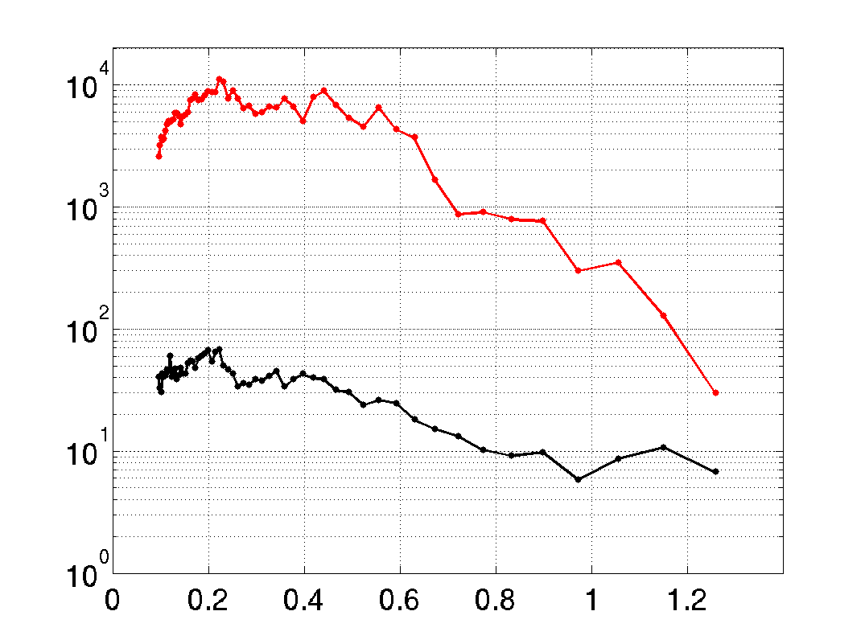
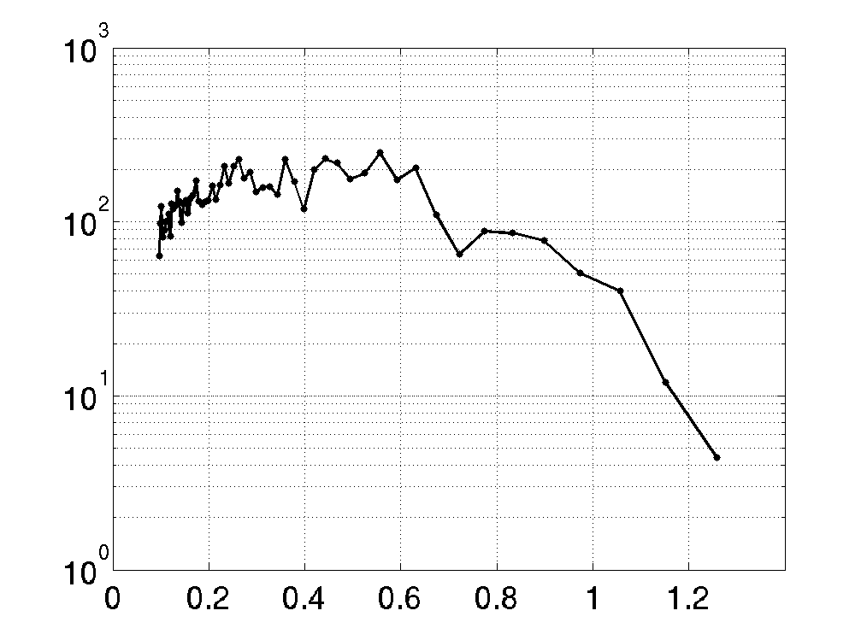
Analysis on the obtained signal and background noise level
Signal-to-background-ratio ${SBR}_{\left\langle E_{i}\right\rangle }=\frac{S_{\left\langle E_{i}\right\rangle }}{{BG}_{\left\langle E_{i}\right\rangle }}$ for $\frac{A}{Z}=1$ trace (protons)
$$S_{\left\langle E_{i}\right\rangle }$$
$${BG}_{\left\langle E_{i}\right\rangle }$$
Integrated PSL values
$${SBR}_{\left\langle E_{i}\right\rangle }$$
$${SBR}_{\left\langle E_{i}\right\rangle }=\frac{S_{\left\langle E_{i}\right\rangle }}{{BG}_{\left\langle E_{i}\right\rangle }}$$
Proton energy [MeV]
Proton energy [MeV]
Energy range 0.1-0.7 MeV : SBR>100
Up to energy 1.1 MeV : SBR>10
At $E_{max}$= 1.2 MeV : SBR>4

Slide 10
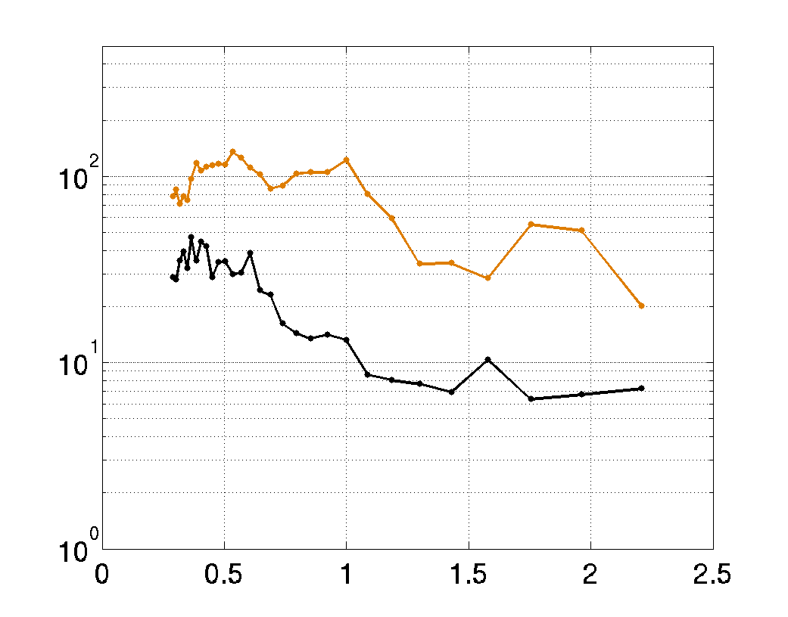
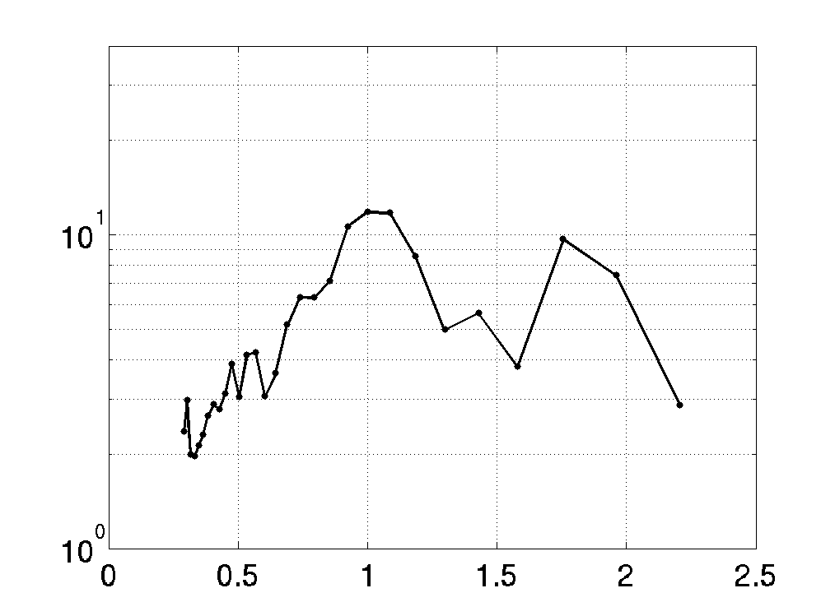
Analysis on the obtained signal and background noise level
Signal-to-background-ratio ${SBR}_{\left\langle E_{i}\right\rangle }=\frac{S_{\left\langle E_{i}\right\rangle }}{{BG}_{\left\langle E_{i}\right\rangle }}$ for $\frac{A}{Z}=2$ trace (in case of signal generated by $α$ particles)
$$S_{\left\langle E_{i}\right\rangle }$$
$${BG}_{\left\langle E_{i}\right\rangle }$$
$${SBR}_{\left\langle E_{i}\right\rangle }=\frac{S_{\left\langle E_{i}\right\rangle }}{{BG}_{\left\langle E_{i}\right\rangle }}$$
Integrated PSL values
$${SBR}_{\left\langle E_{i}\right\rangle }$$
Alpha particles energy [MeV]
Alpha particles energy [MeV]
Energy range 0.2-0.5 MeV : SBR>2
From 0.5 MeV up to $E_{max}$= 2.4 MeV : SBR>3

Slide 11
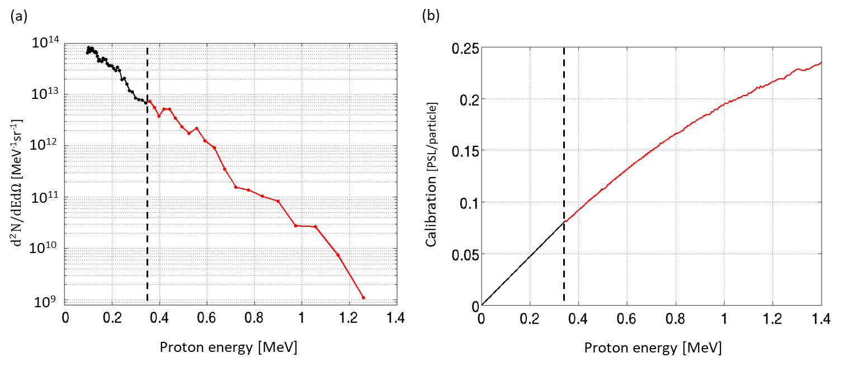
Obtained spectrum for the $\frac{A}{Z}=1$ trace
Particle spectrum
Used calibration curve for TR type IPs
Calibration data for TR IPs are available only for energies above 350 keV (red)
[T. Bonnet et al., Review of Scientific Instruments 84, 013508 (2012)]
For lower energies (black), a linear response was used.
$$\frac{E_{p+}^{total} }{E_{laser}}=\frac{5.79 J}{661 J}≈8.7⋅{10}^{−3}$$

Slide 12
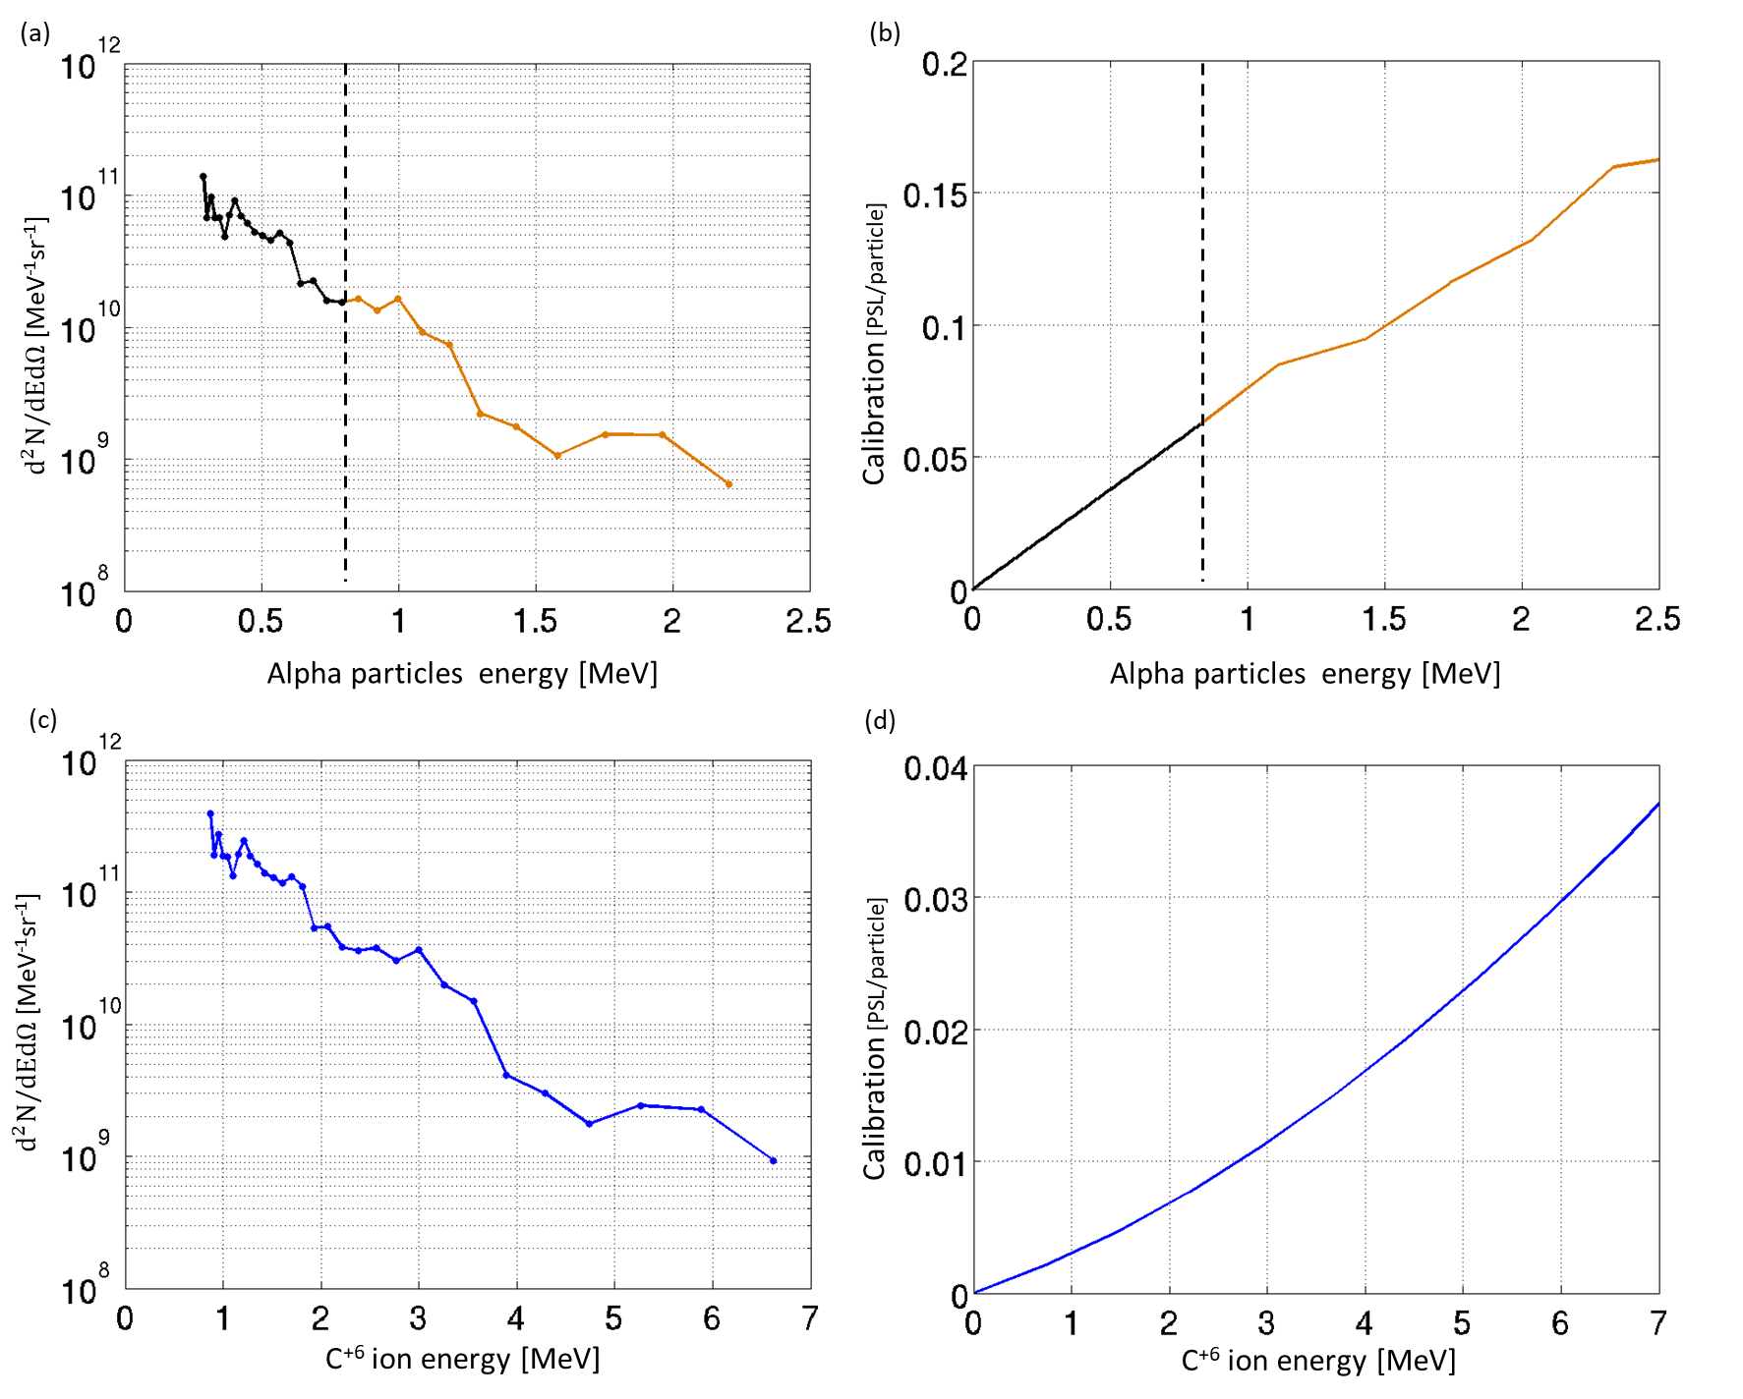
Obtained spectrum for the $\frac{A}{Z}=2$ trace
Case where the signal is generated by $α−$particles only.
Calibration of TR type IPs available only for $E_{α}$>800 keV: C. G. Freeman et al., Review of Scientific Instrument 79, 073301 (2011).
For lower energies a linear response was used.
$$\frac{E_{α}^{total} }{E_{laser}}=\frac{0.03 J}{661 J}$$
$$≈4.5⋅{10}^{−5}$$
Case where the signal is generated by C⁺⁶ ions only.
Calibration of TR type IPs is a polynomial fit of exp. data in D. Doria et al., Review of Scientific Instruments 86, 123302 (2015)
$$\frac{E_{C^{+6}}^{total} }{E_{laser}}=\frac{0.25 J}{661 J}$$
$$≈3.7⋅{10}^{−4}$$

Slide 13
Obtained spectrum for the $\frac{A}{Z}=2$ trace
Case where the signal is generated by $α−$particles only.
Calibration of TR type IPs available only for $E_{α}$>800 keV: C. G. Freeman et al., Review of Scientific Instrument 79, 073301 (2011).
For lower energies a linear response was used.
This is for particle detected outside plasma. What was inside?
$$\frac{E_{α}^{total} }{E_{laser}}=\frac{0.03 J}{661 J}$$
$$≈4.5⋅{10}^{−5}$$
Case where the signal is generated by C⁺⁶ ions only.
Calibration of TR type IPs is a polynomial fit of exp. data in D. Doria et al., Review of Scientific Instruments 86, 123302 (2015)
This is for particle detected outside plasma. What was inside?
$$\frac{E_{C^{+6}}^{total} }{E_{laser}}=\frac{0.25 J}{661 J}$$
$$≈3.7⋅{10}^{−4}$$

Slide 14
Obtained spectra for a pair of similar shots
Spectra for the $\frac{A}{Z}=2$ trace (alphas)
Comparison of two shots with the same exp. setup.
Shot #56025 - $E_{laser }=686 J$
Shot #56027 - $E_{laser }=661 J$
Spectra for the $\frac{A}{Z}=1$ trace (protons)
Spectra for the $\frac{A}{Z}=2$ trace (C⁺⁶ ions)

Slide 15
Summary and remarks
The ENEA Thomson Spectrometer successfully implemented in a p-B fusion experiment:
Implementation at close distance to the target (d=367 mm)
Good EMP shielding (non oscillating traces)
Signal-to-background ration proves good shielding against ionizing radiation (outside&inside) and particle noise
Analysis of the $\frac{A}{Z}=1$ and $\frac{A}{Z}=2$ traces and evaluation of the obtained particle spectra
Results and analysis submitted to Laser and Particle Beams special issue Advances In the Study of Laser-Driven Proton-Boron Fusion
Open / work-in-progress issues:
Imaging plate calibration is necessary for particles at low energies
The distinction of $α$-particles from other ions requires additional techniques (e.g. CR-39 detectors, differential filtering system)

Slide 16
Acknoledgment
This work has been carried out within the framework of the EUROfusion Consortium, funded by the European Union via the Euratom Research and Training Programme (Grant Agreement No 101052200 — EUROfusion). Views and opinions expressed are however those of the author(s) only and do not necessarily reflect those of the European Union or the European Commission. Neither the European Union nor the European Commission can be held responsible for them. The involved teams have operated within the framework of the Enabling Research Project: ENR-IFE.01.CEA “Advancing shock ignition for direct-drive inertial fusion”
.

Slide 17
Thank you
for your attention!
Massimiliano Scisciò - massimiliano.sciscio@enea.it
Fabrizio Consoli - fabrizio.consoli@enea.it

