Slide 1



Proton Boron Fusion with respect to Accelerator Driven High Energy Density Science
霍迪 Huo = Dieter HH Hoffmann
on behalf of p11B project team of
Xi’An Jiaotong University, School of Physics, Xi’An, China
PI: Yongtao Zhao
Hebei Key Laboratory of Compact Fusion, Langfang 065001, China
ENN Science and Technology Development Co., Ltd., Langfang 065001, China
CSO: Martin Peng
Institute of Modern Physics, CAS, Lanzhou, China
PI: Rui Cheng
Shanghai Inst. Of Applied Nucl. Phys., Shanghai, China
PI: Guoqiang Zhang
2nd International Workshop onProton-Boron Fusion Catania 2022
Notes:
Introductory remarks about the collaboration

Slide 2
A few remarks on my opinion on fusion energy in general
and more so on p11 B Fusion

Slide 3
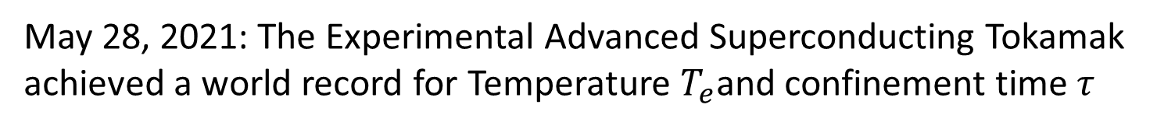
Motivation and Introductory Remarks:
Magnetic Confinement Fusion
May 28, 2021: The Experimental Advanced Superconducting Tokamak
achieved a world record for Temperature $T_{e}$and confinement time $τ$
Another remarkable achievement (59 MJ)is reported
From JET in a DT experiment in 2021
$T_{e}=100 Million K τ=101 s$ ${ ; T}_{e}=160 Million K$ $τ= 20s$
Notes:
Fusion is making progress, however slow. My remark and personal opinion is that Fusion will not help to solve any current energy and environmental problems. It is for the future and in my mind not in 10 or 40 years. Kstar in Korea similar values

Slide 4
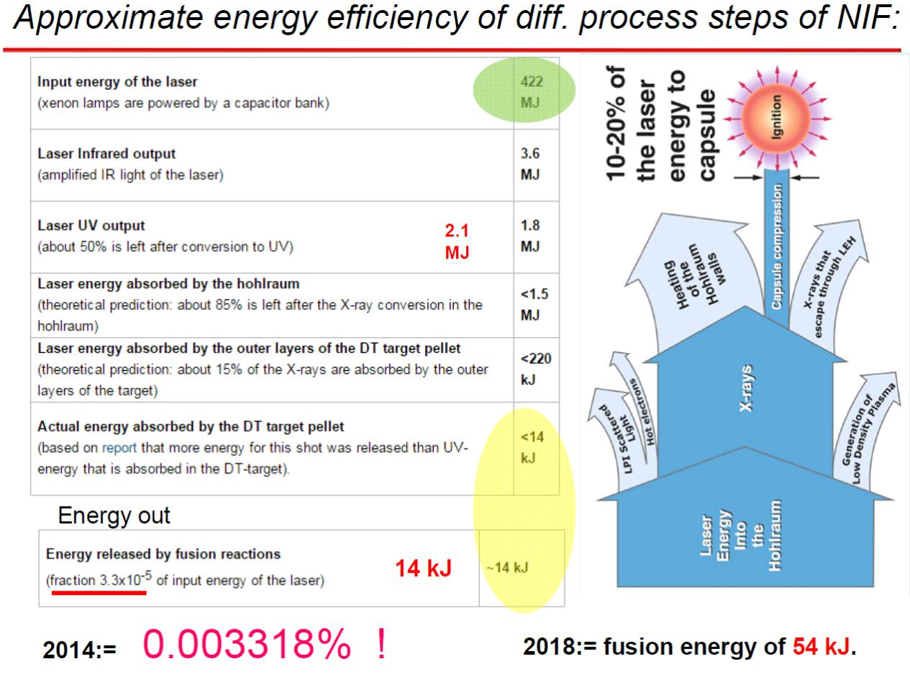

Courtesy of:Laszlo Cszernai, 2019
2021 fusion energy $≈$ 1.8 MJ
Notes:
Very little of the original 422 MJ arrives at the target

Slide 5
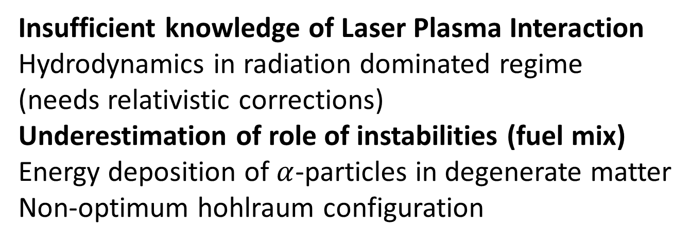
What is the reason for this discrepancy ?
Probably a number of reasons among them:
Insufficient knowledge of Laser Plasma Interaction
Hydrodynamics in radiation dominated regime
(needs relativistic corrections)
Underestimation of role of instabilities (fuel mix)
Energy deposition of $α$-particles in degenerate matter
Non-optimum hohlraum configuration
From the scientific and technology point of view the NIF program is a success story

Slide 6
Challenges of p11B Fusion
¹¹B(p,α)2α Reaction

Slide 7

Programme
Introductory remarks
Understanding the abundance of 11B
p11B Fusion Experiments
a) at accelerators b) using high power laser radiation
Conclusion and Outlook
Notes:
Probable topics for the talk

Slide 8
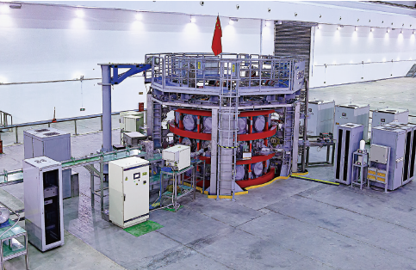
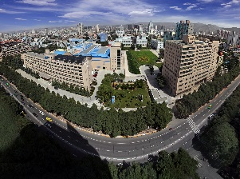

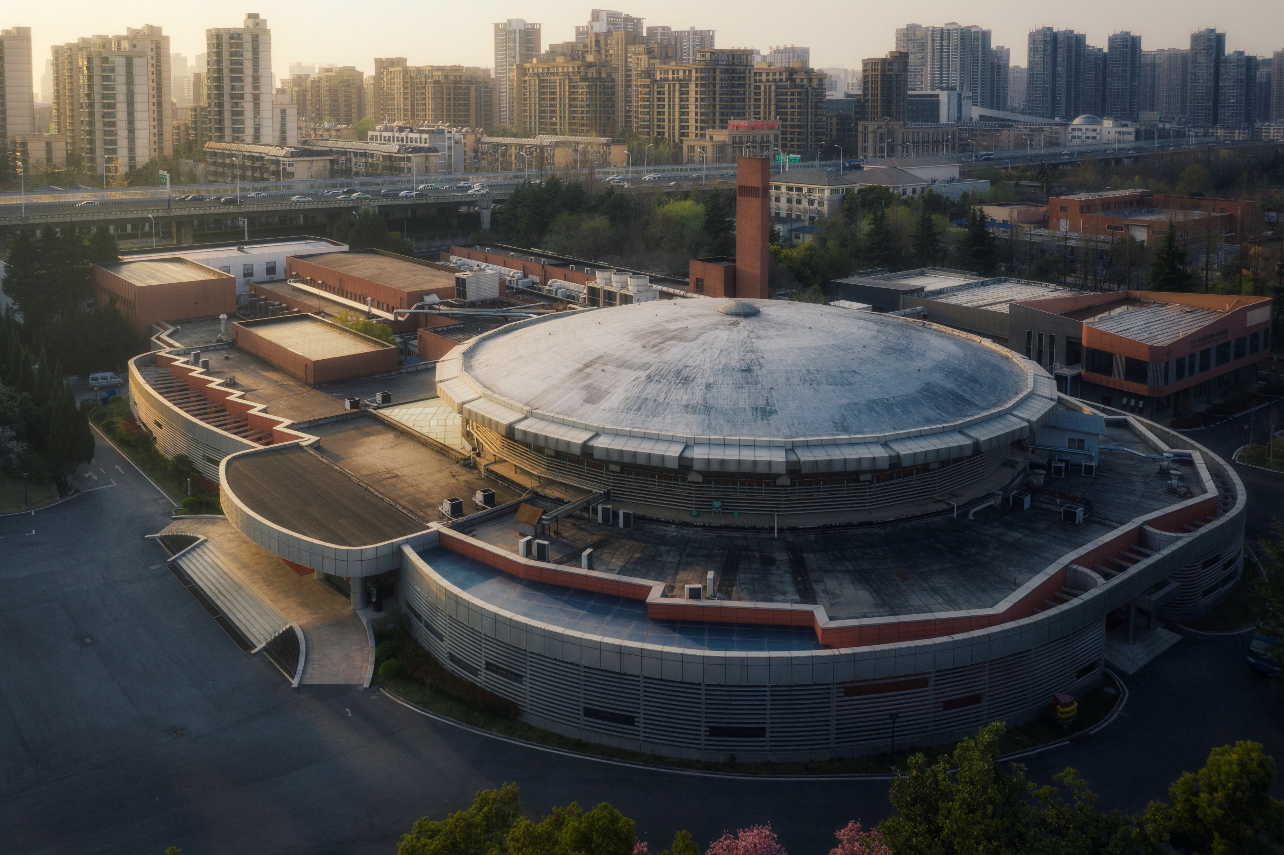

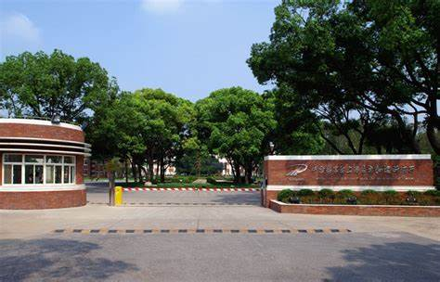
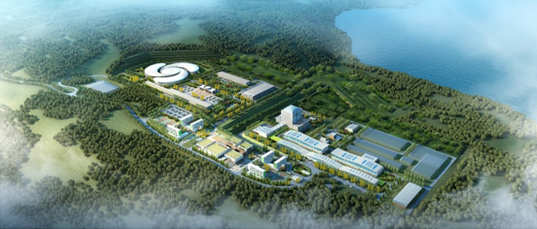
ENN Langfang
兰州重离子加速器
国家实验室
（1991年国家计委批准成立）
IMP Lanzhou
Hefei Synchrotron
Institute of Applied
Nuclear Physics
HIAF

Slide 9
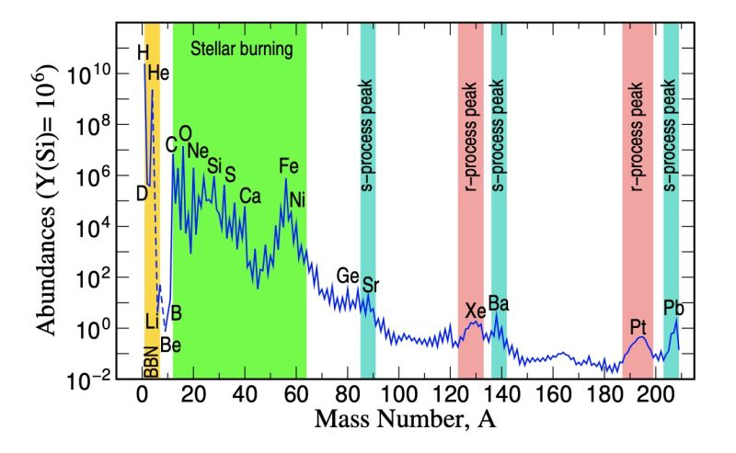
Abundence of Elements in the solar system
Review of Mod. Phys 93.015002

Slide 10
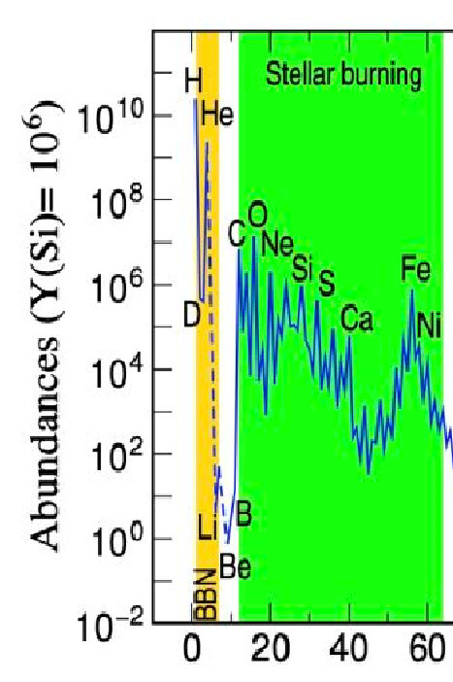
Simulated r-abundance normalized to solar
B
5.101980e-09
3.133204e-11
R-process simulation for Boron
by Bowen Jiang (GSI)
28.07.2021
Ba
3.304903e-10

Slide 11
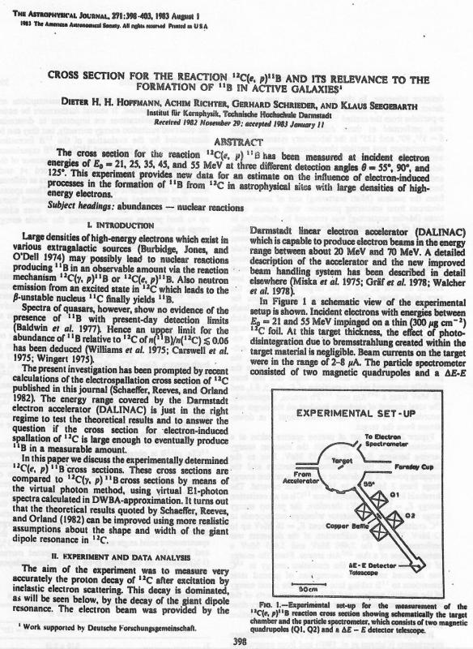

Slide 12
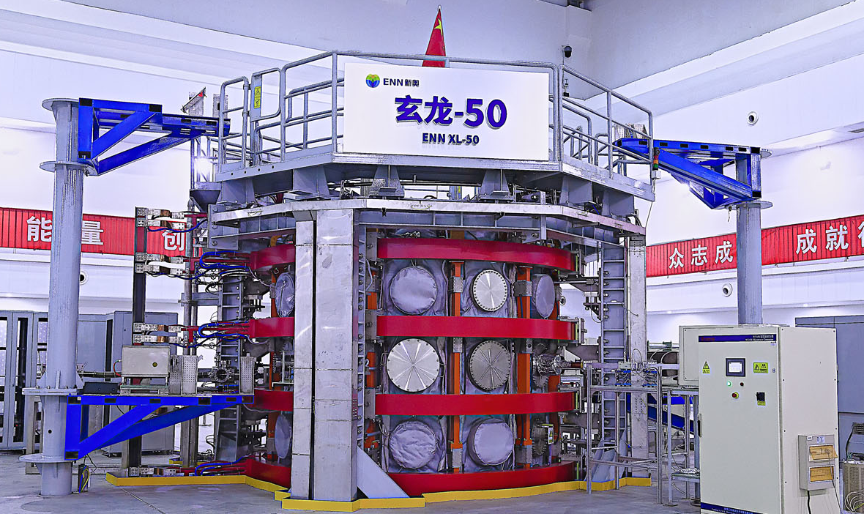
EXL-50 @ ENN Langfang
Project started from October 2018.
First plasma achieved in August 2019.

Slide 13
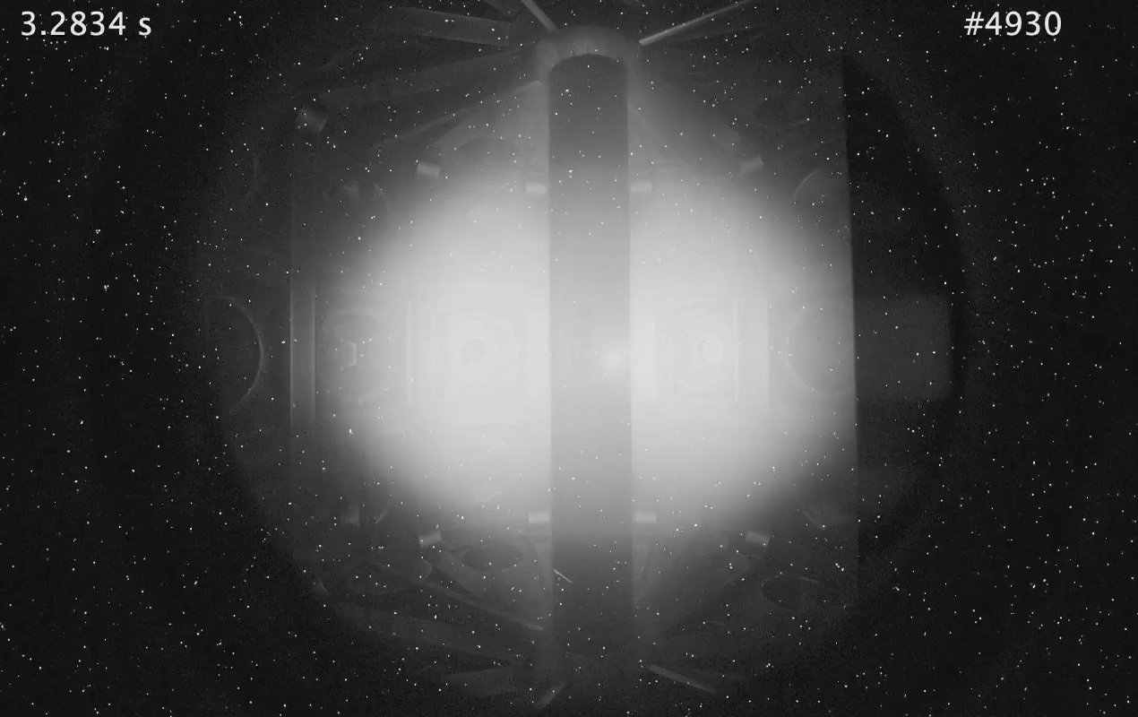
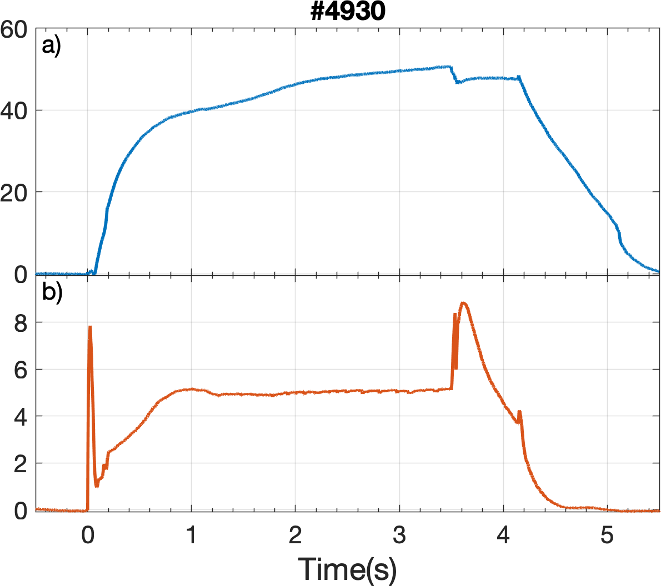
EXL-50 solenoid-free startup experiment
I_{p} (kA)
n_{e} (10¹⁷m⁻²)
Fast camera 1280X800
solenoid-free current drive: >1.2A/W
ECRH heating：2.45GHz: 5~8kW，28GHz: 35kW

Slide 14
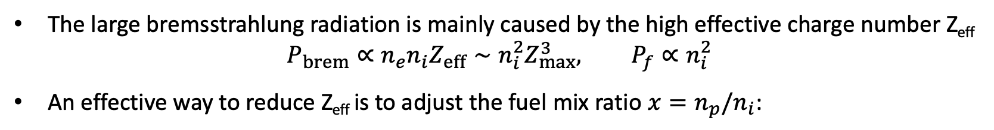


Optimal Fuel Mixture
The large bremsstrahlung radiation is mainly caused by the high effective charge number Z_{eff}
$$P_{brem}∝n_{e}n_{i}Z_{eff}∼n_{i}^{2}Z_{max}^{3}, P_{f}∝n_{i}^{2}$$
An effective way to reduce Z_{eff} is to adjust the fuel mix ratio $x=n_{p}/n_{i}$:
J.R. Roth ‘87
$$n_{i}=10^{19}{\text{m}}^{−3}$$
$${T_{e}=T}_{i}$$

Slide 15
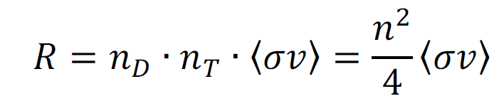
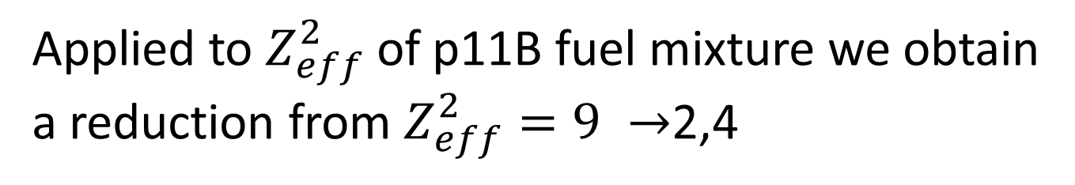
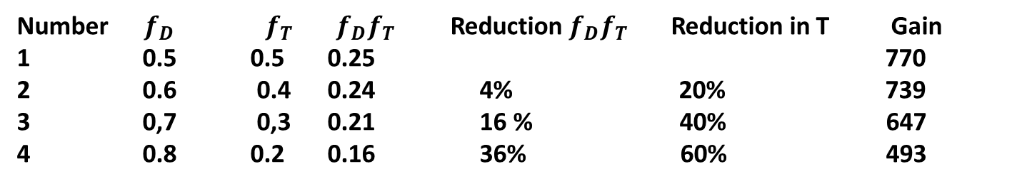
Number $f_{D }f_{T}$ $f_{D}f_{T}$ Reduction $f_{D}f_{T}$ Reduction in T Gain
0.5 0.5 0.25 770
0.6 0.4 0.24 4% 20% 739
0,7 0,3 0.21 16 % 40% 647
0.8 0.2 0.16 36% 60% 493
Applied to $Z_{eff}^{2}$of p11B fuel mixture we obtain
a reduction from $Z_{eff}^{2}=9 →$2,4
Notes:
With the same procedure applied to P11B the effective Z would vary from

Slide 16
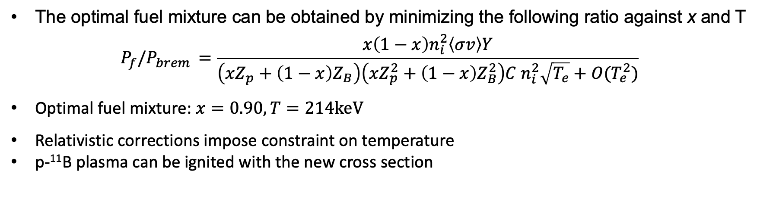

Optimal Fuel Mixture
The optimal fuel mixture can be obtained by minimizing the following ratio against x and T
$${P_{f}/P}_{brem }=\frac{x\left(1−x\right)n_{i}^{2}\left\langle σv\right\rangle Y}{\left(xZ_{p}+\left(1−x\right)Z_{B}\right)\left(xZ_{p}^{2}+\left(1−x\right)Z_{B}^{2}\right){C n}_{i}^{2}\sqrt{T_{e}}+O(T_{e}^{2})}$$
Optimal fuel mixture: $x=0.90, T=214\text{keV}$
Relativistic corrections impose constraint on temperature
p-¹¹B plasma can be ignited with the new cross section
McNally ’82; Rider ’95 & ‘97; Nevins ‘98
$${T_{e}=T}_{i}$$

Slide 17
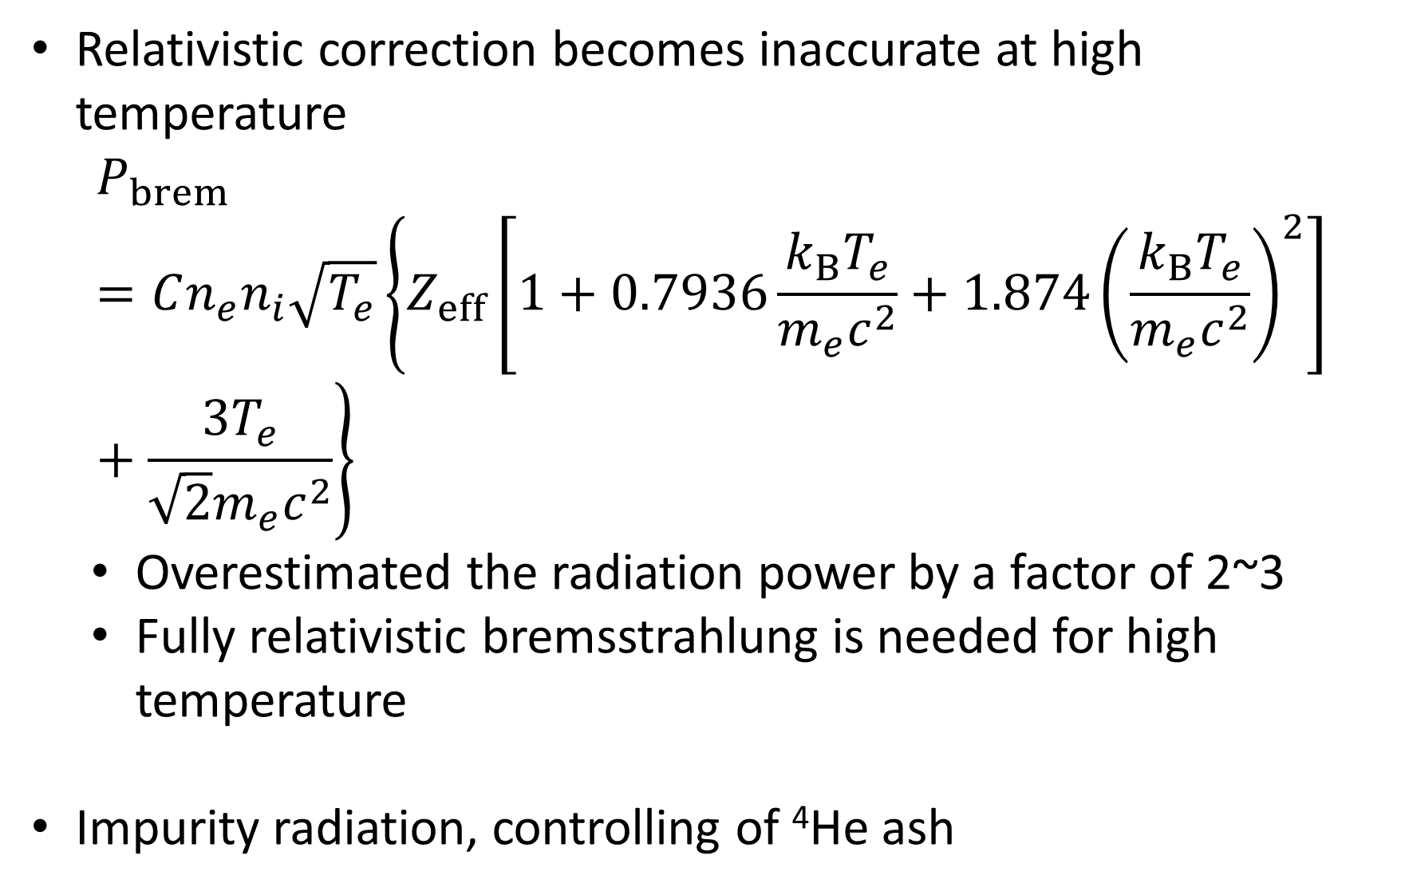

Relativistic correction becomes inaccurate at high temperature
$$P_{brem}=Cn_{e}n_{i}\sqrt{T_{e}}\left\{Z_{eff}\left[1+0.7936\frac{{k_{B}T}_{e}}{m_{e}c^{2}}+1.874{\left(\frac{k_{B}T_{e}}{m_{e}c^{2}}\right)}^{2}\right]+\frac{3T_{e}}{\sqrt{2}m_{e}c^{2}}\right\}$$
  Overestimated the radiation power by a factor of 2~3
  Fully relativistic bremsstrahlung is needed for high temperature
Impurity radiation, controlling of ⁴He ash
Caveats
McNally ’82; Rider ’95 & ‘97;
Nevins ’98; Dawson ‘81
$${T_{e}=T}_{i}$$

Slide 18
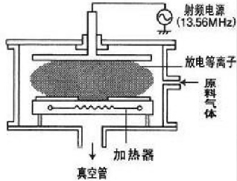
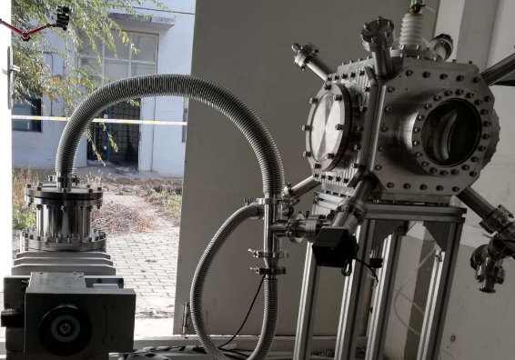
1、 技术研发进展与过程改进（硼靶制备项目）
2.氢硼靶制备：
  完成新的CVD平台搭建：真空系统改造和维修、气体系统管路焊接和安装、控制系统配置
  完成新的CVD平台性能初步测试
电极
抽气系统
真空腔
原理图
CVD实验平台
18

Slide 19
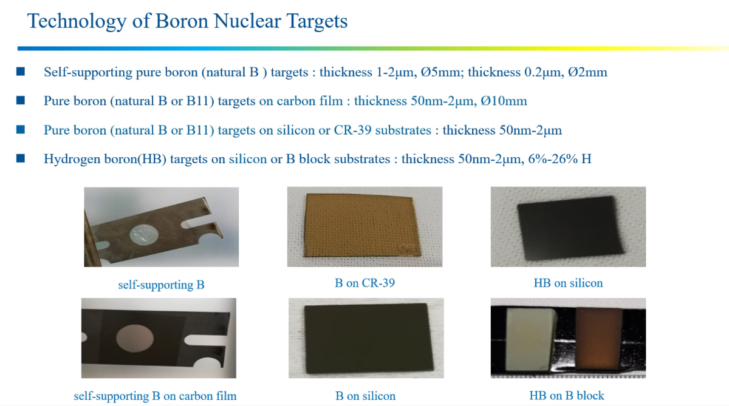

Slide 20
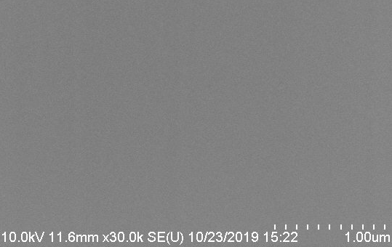
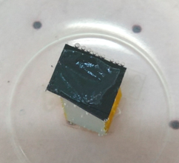
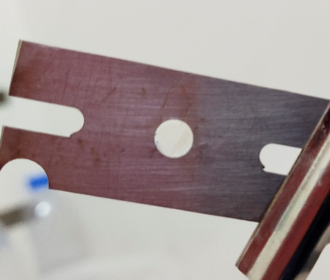
1、主要工作进展（硼靶制备项目）
1.纳米厚度硼靶制备：
完成500纳米厚硼靶制备技术开发
硼膜
均匀的硼膜
脱膜
捞到靶托上的硼膜
Uniform distributed Boron film
Boron film on the target holder
Take off the film

Slide 21

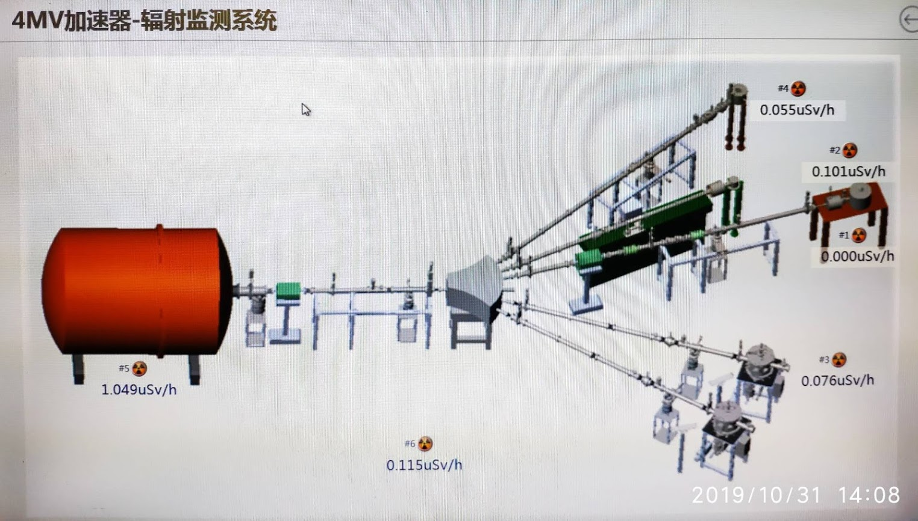
Notes:
Accelerator in China

Slide 22
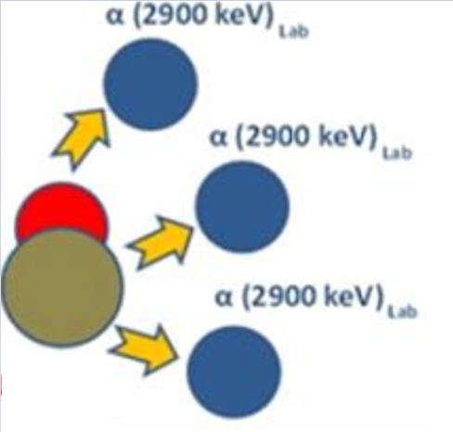
The Fairy Tale of 3 Alphas at 2.9 MeV

Slide 23

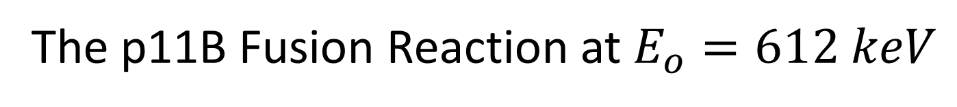

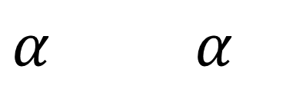
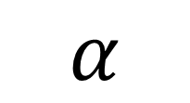
The p11B Fusion Reaction at $E_{o}=612 keV$
$$α$$
5.8 MeV
$$p {}_{ }^{11}{B }{}_{ }^{12}{C_{ }^{∗}}$$
$${}_{ }^{8}{{Be}_{ }^{∗}}$$
$α$ $α$
2,9 MeV
Notes:
There used to be a misconception about the 3 alpha particles. One alpha particle is at 5.8 MeV called Alpha 1 the 2 other originate from a 2 particle decay of Be and they share the 2.9 statistically, which gives rise to a continuum in the spectrum

Slide 24
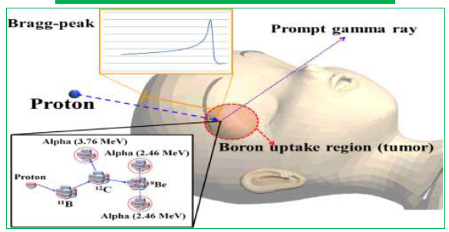
Proton-Boron Tumor Therapy

Slide 25
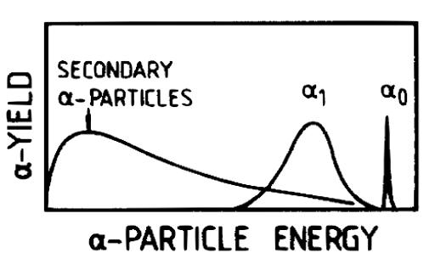

Slide 26
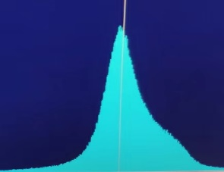
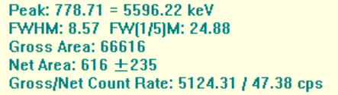



p(¹¹B,3α)12 C Experiment
Inst. Modern Physics CAS, Lanzhou, China
Date | Energy | Current | Detector Angle | Remarks
7月6日 | 160keV | 280nA | 0 | High count rate 13 s
7月7日 | 170keV | 36nA | 65 | Low count rate for 2 h
P->${}_{ }^{11}{B } E_{o}=160 keV$
$$α_{o}$$
$$α_{1}$$

Slide 27

Measured Alpha Spectrum at 560 keV Proton Energy
Measurement at SINAS (Shanghai) by ENN-XJTU- IMP collaboration
Notes:
Measured spectrum in Shanghai at 560 keV proton energy.. Alpha 0 a rare event also visible

Slide 28
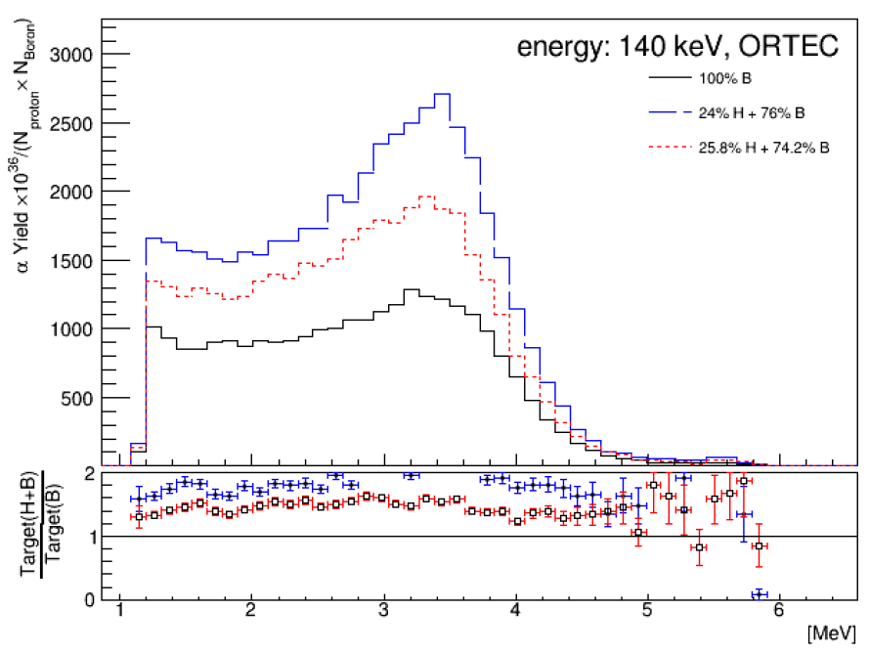
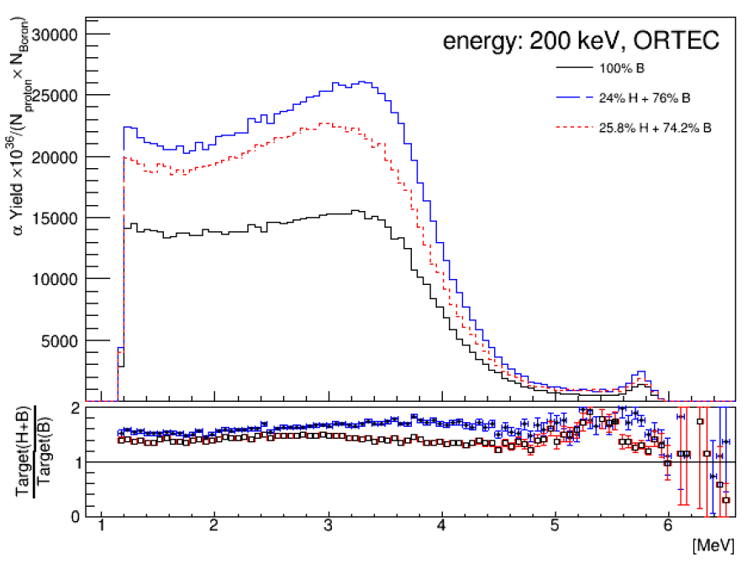

Slide 29
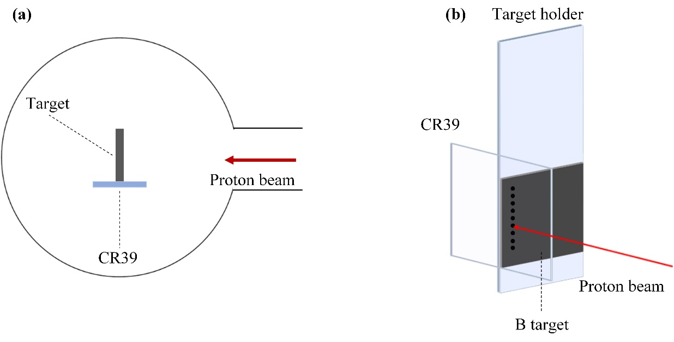
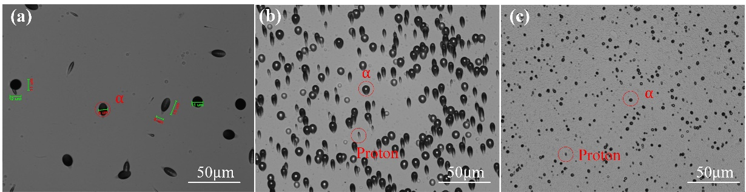
Experiments at IMP Lanzhou at very low proton energy (160 keV regime)
CR 39 tracks

Slide 30
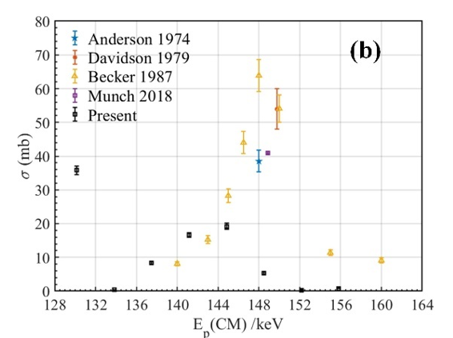

Slide 31
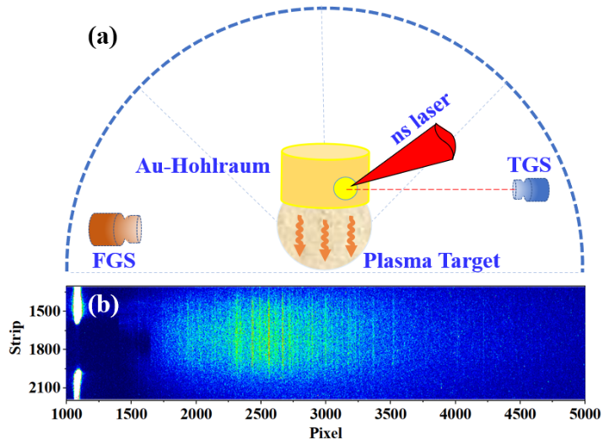
Plasma generation from laser heated Hohlraum
for experiments at the XG-III laser facility of the Laser Fusion Research Center in Mianyang
we plan to use this set-up for opacity measurements also
Bubo Ma et al. with Yongtao Zhao accepted for publication by Astrophysical Journal (July 2020
Notes:
The target was used to simulate a special white dwarf atmosphere. In my mind it is also perfectly suited for opacity measurement that we need for Boron atmosphere

Slide 32
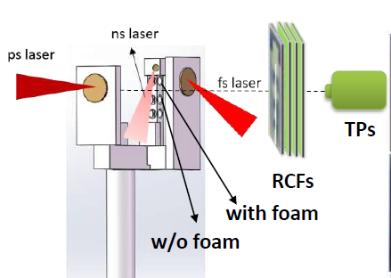
XGIII experimental setup and target design
Laser: ps-120J, 0.8ps, 10μm;
ns-150J, 2ns, 100μm, 532nm;
ns ahead of ps by 8ns
Target: 20% B-CHO foam；density- 2mg/cc,
diameter-1mm，length-1mm
10μm Cu solid foil for laser acc.
ps laser accelerates intense proton beam (TNSA)
ns laser heats the boron-CHO foam

Slide 33
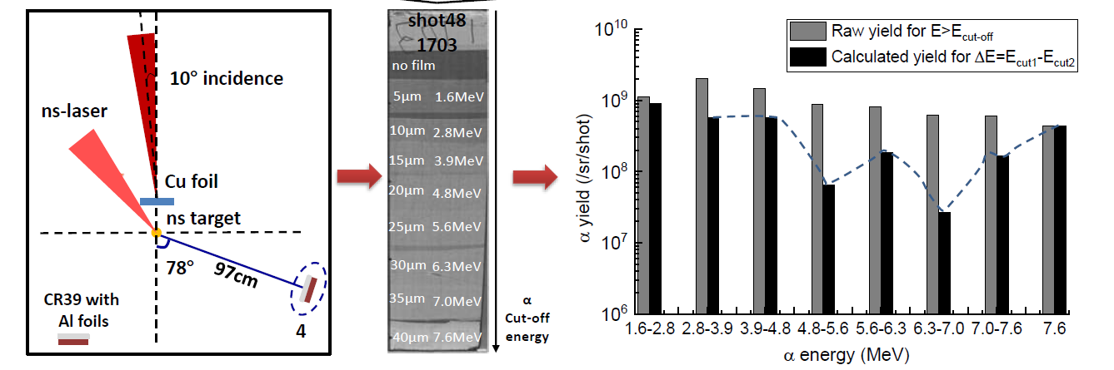
Experimental Results and Analysis
Energy spectra of α particles from CR39 with Al foils (5-40μm)

Slide 34
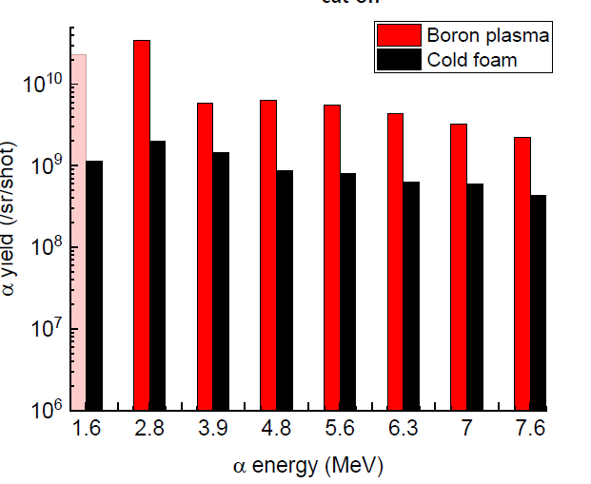
alpha yield normalized by beam intensity for plasma and cold foam

Slide 35
Summary and Outlook
The α yield from plasma is generally 1~2 orders higher than that from the cold foam.
Nonlinear increase of alpha particle yield with proton beam intensity
Alpha spectra depend on proton energy
Alpha yield depends on Hydrogen Boron ratio of the target
All of this needs further verification

Slide 36
To Do List:
1:Remeasure the fusion cross section up to about 10 MeV
2: If possible measure under plasma conditions
3: Study the influence of magnetic fields
4:Opacity measurements on p11B plasma
5: Experimental and theoretical data on EOS
6: make better Boron Targets and Boron Hydrogen Targets

Slide 37
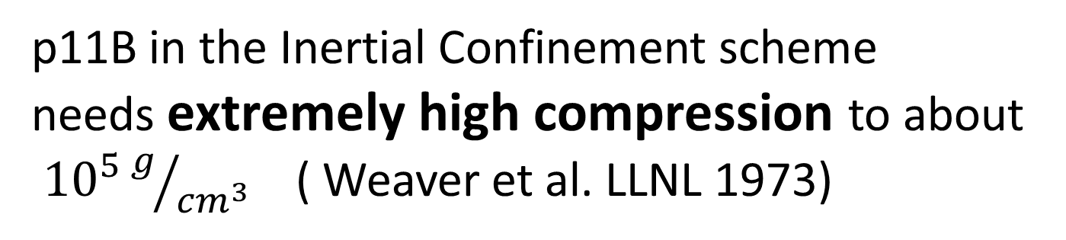
Problems for p11B energy production
p11B in the Inertial Confinement scheme
needs extremely high compression to about
${10}^{5}g/{{cm}^{3}}$ ( Weaver et al. LLNL 1973)
It will be extremely difficult to produce a Boron
pellet with the required surface roughness
We need an efficient driver to do the compression
work
Notes:
Due to my experience with Boron targets it needs a huge effeort to produce Boron inertial fusion targets with the required surface roughness. It seems to be a technical problem but is probably not easy to achieve

