Slide 1
RICH software in DD4Hep
Chandradoy

Slide 2
The overview of the workchain
IRT→ Inverse ray tracing
Simulation
Reconstruction
Inputs:
Geometry (.xml, .cpp files)
Particle information (.hepmc file/s)
Outputs (.root format):
Geometry information
Simulation (hit) information
Inputs:
Simulation .root files
IRT instructions via .py option file
Output:
Final Outfile.
NPSIM
Juggler
Analysis Code → Final Outfile = RICH analysis

Slide 3
Requirement for IRT in DD4Hep
The option file (.py) is passed individually for pfRICH (dRICH) containing the options for the reconstruction of the said detector in dd4hep.
Elements the .py file contains:
The geometric and simulation root files.
The QE values as a function of photon wavelength. → Internally the bins are made smoothen. The number of QE bins are passed here (QEbins = 100).
The parameters for the radiators. E.g. Number of z bins, the gaussian smearing, working refractive index and the attenuation length if required.
Variable to treat the type of particles. Right now we deal mcparticles.
Safety factor.
Technical note: The two inputs are associated to the EIC data services and Geometric services.
Tasks served by IRT:
Reconstruction of single photon Cherenkov angle.
Assignment of weights to photons → used in PID, computation of track theta (Not by ring recognition) …

Slide 4
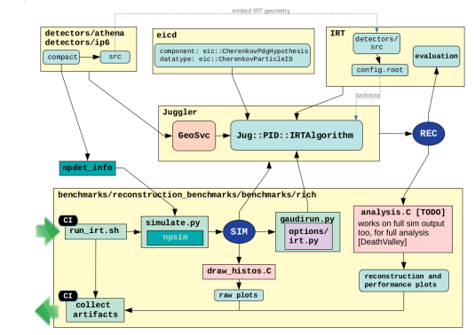
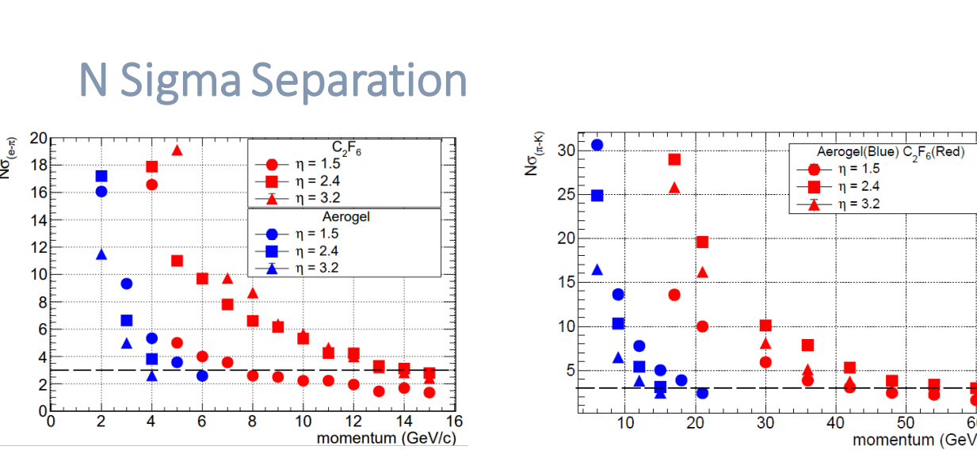
Results with the described software:
Software scheme
Embed IRT Geometry
ATHENA software is modular.
Yellow boxes are the individual modules
Arrows indicate the connections and information exchange.
The ‘new’ IRT module is connected to the juggler.
The reconstructed info are usable for PID evaluation in the sandbox or can be passed to the benchmark plots (hit info)
PID Eval.
Characterization of pfRICH and dRICH with single particle in vertex, true mc particle information.
No noise had been included.
No physics performance had been studied.

Slide 5
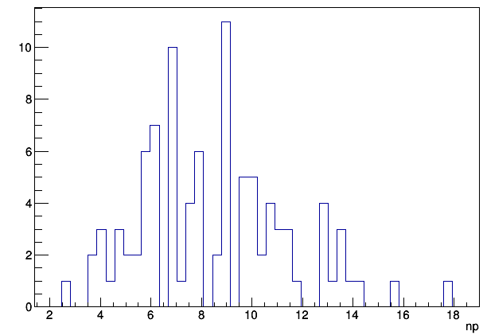
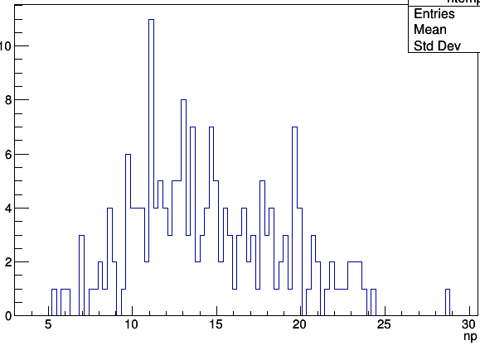
Situations with the multiparticle studies
Sthe similar performance plots with multiparticles in the vertex. First to study with pfRICH (simple geometry and less impact of B Field) 12 GeV pi-K in a vertex. Expected <npe> ~9; From Frank-Tamm formula.
<np> ~14
<np> ~9
100 evt
100 evt
Single particles at vertex
Two particles at vertex
Unphysical associated number of photons (larger than expected number of photons at saturation) is observed. Double counting?
The current algorithm does not use a pattern recognition. Uses the photons in an event and assign a weight to the photons for mass hypothesis.
Inclusion of ring recognition → Similar to Alexander’s standalone G4 studies?
Single particle studies are not affected by this cause.
How important is pattern recognition?
→ Consistency checks
→ PID can foresee sophisticated methods.

Slide 6
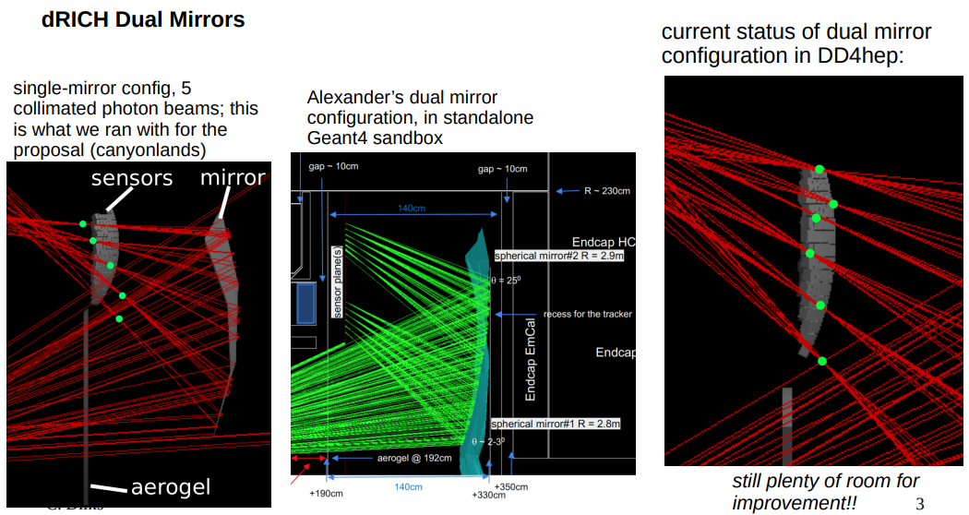
Dual mirror → Cost impact? Worth investigating with priority?

Slide 7
Work status on the software side
Merging of different commits to the main Branch is ongoing.

Slide 8
Current situation and work to be done
Materials presented w/ single mirror (canyonland) config. For single particles w/o noise hits.
The true mcparticles are used and ACTS related modifications are foreseen to use reconstructed tracks.
Inclusion of noise information and ring recognition related modification of the IRT codes are to be done.
Optimization and studies related to the dual mirror configuration.
Possibility to implement reflective side mirrors → improvement of the acceptance.

Slide 9
DISCUSSION
Strategy for PID : Pattern Reco. → LH/ML
Adopt existing PRs. (COMPASS/HERMES?)
Direction of the B-field wrt Sensor normal direction.
Any other suggestions?

