Slide 1
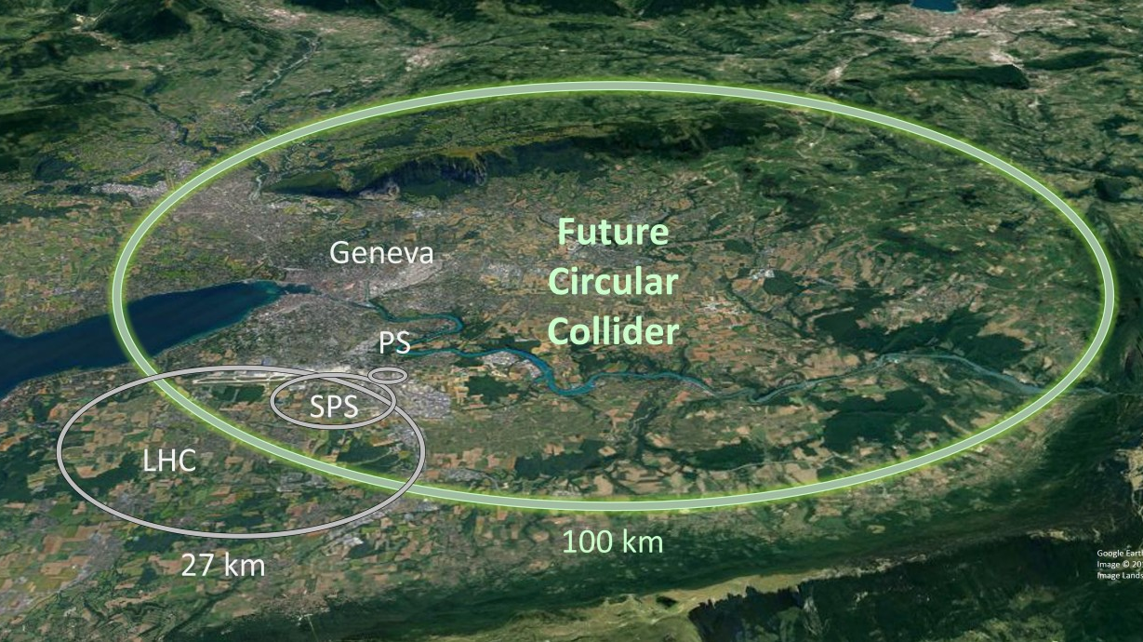
Calorimetry for future experiments
G. Gaudio
INFN-Pavia

Slide 2
Outline
General recap of Calorimetry
Trends in Calorimetry
Key techniques for Calorimeters in Future experiments
Disclaimers:
not exhaustive review
examples mainly taken from collider experiments

Slide 3
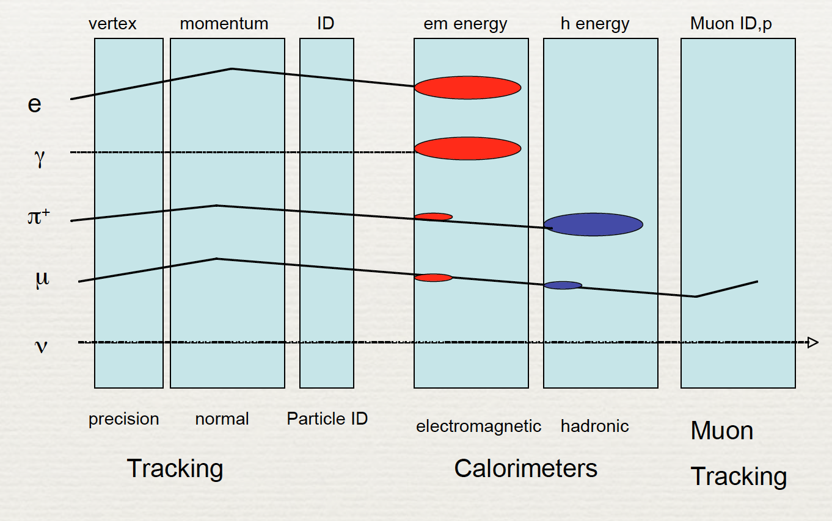
Why Calorimeters ?
Sensitive to both charged and neutral particles
Differences in the shower patterns
  some particle identification is possible
  h/e/μ/ν(missing E_{T}) separation
No magnetic field needed to measure E
Resolution improve with E

Slide 4
Why Calorimeters ?
Fast: response times < 100 ns feasible
High segmentation possible ⇒ precise measurement of the direction of incoming particles
Moving from fixed target to Colliders emphasis
  from detailed reconstruction of particle four-vectors
  to energy flow (jets, missing ET) especially when observed in combination with electrons and muons
Bubble Chamber event
CDF
Top event
and back! (see modern paradigm for future experiments)

Slide 5
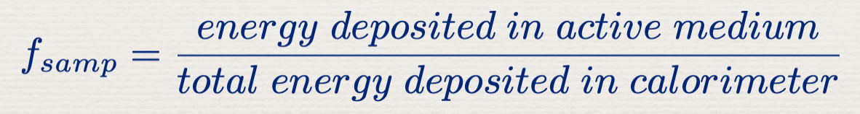
Calorimeter Classification
According to particle to detect
  Electromagnetic Calorimeter
  Hadronic Calorimeter
According to Construction Technique
  Homogeneous calorimeter: absorber and active media are the same
  Sampling calorimeter: only part of shower energy deposited in active medium
    Sampling fraction f_{samp} is usually determined with a mip (dE/dx at minimum)

Slide 6
Which one do you need?
Physics is the main driver
  determine needed performance on benchmark channels
Other important parameters to take in account
  radiation levels
  environmental conditions
  budget
  ...
Choices:
  active/passive materials
  longitudinal and lateral segmentation etc.

Slide 7
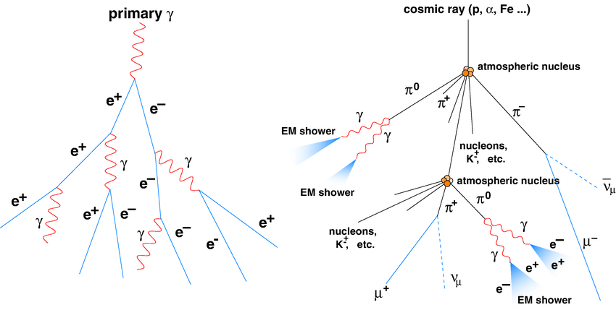
Showers in calorimeters
primary hadron

Slide 8
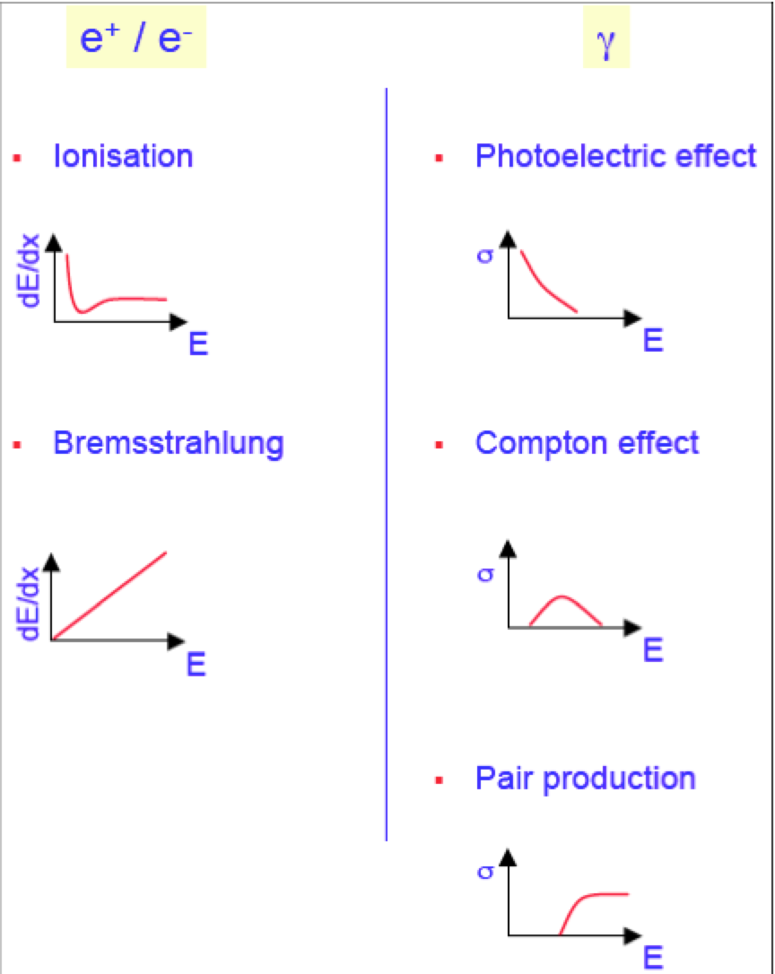
Electromagnetic Showers
Shower development is based on interaction of e⁺ e⁻ and photons with matter
The dominant process depends on the energy of the particles and therefore on the “age” of the shower
  Pair production and bremsstrahlung dominate the early stages of the shower development (multiplication phase)
  Photoelectric effect and Compton scattering dominate the late stage of the shower development (dissipation).

Slide 9
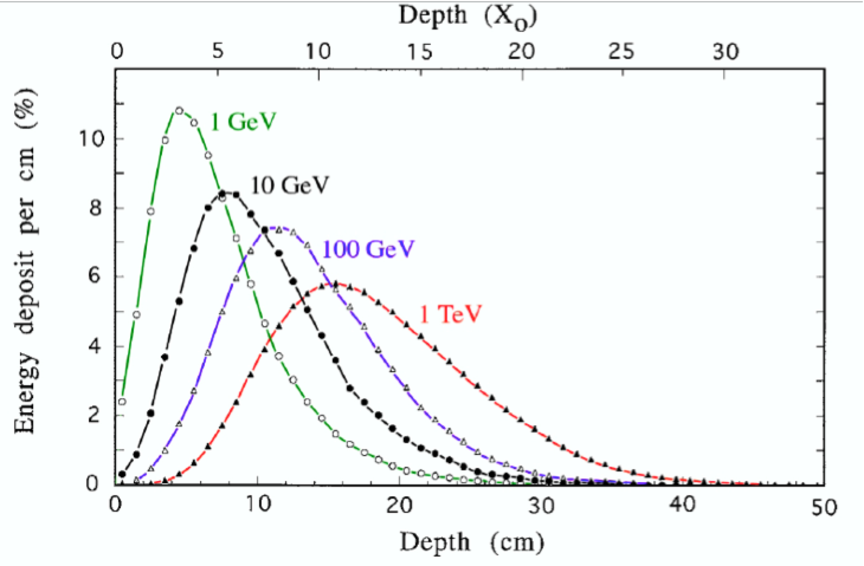
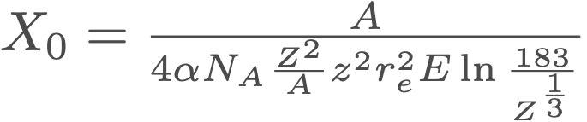
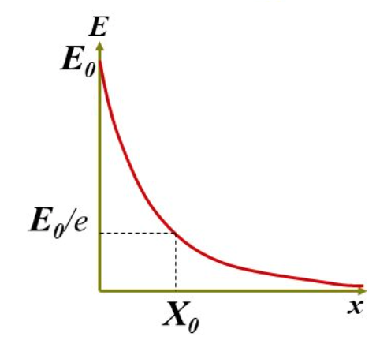
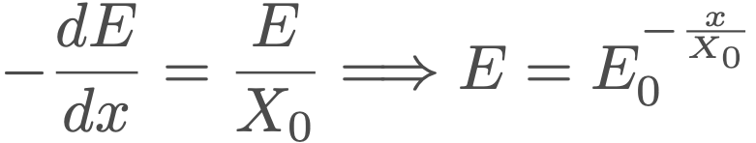
Electromagnetic Showers: longitudinal development
Longitudinal development governed by radiation length (X₀)
There are important differences between showers induced by electrons and photons
  e.g. Leakage fluctuations, effects of material upstream, ....
  Mean free path of 𝛾s = 9/7 X₀
material | X0 (cm)
Cu | 1.4
Pb | 0.5
W | 0.35
PbW04 | 0.89
BGO | 1.12

Slide 10
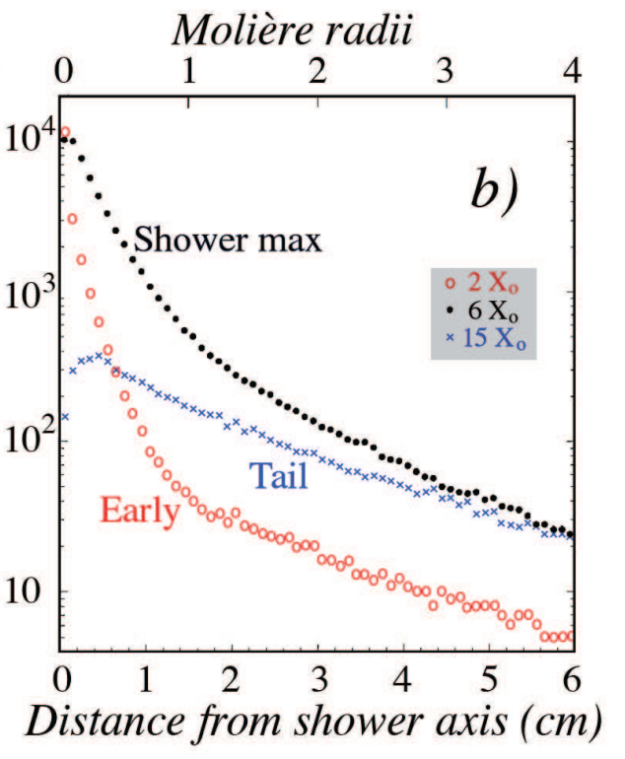
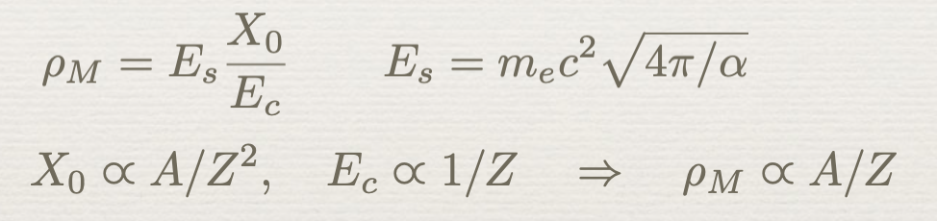
Electromagnetic Showers: lateral development
Lateral shower width scales with Molière radius ρ_{M}
  ρ_{M} much less material dependent than X₀
Lateral shower width determined by:
  Multiple scattering of e± (early, 0.2 ρ_{M})
  Compton 𝛾s travelling away from axis (1 - 1.5 ρ_{M})

Slide 11
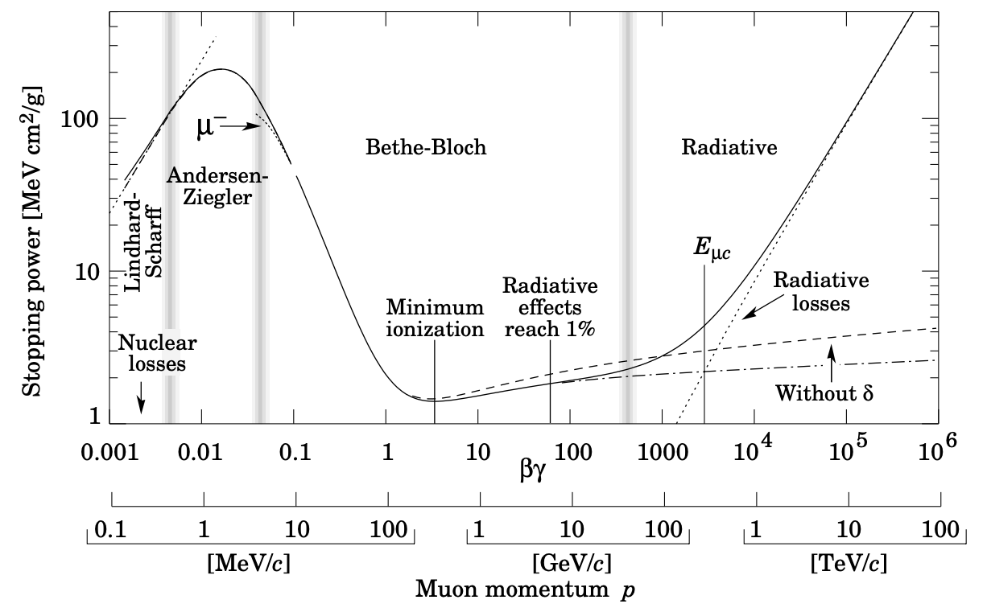

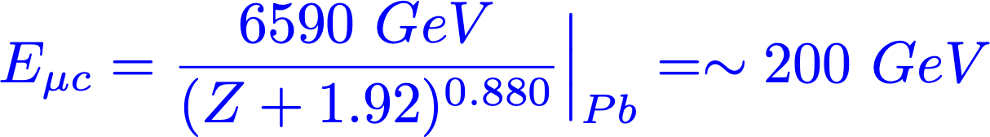
Muon detection in calorimeters
Ionization
Bremmstrahlung
Pair production
Nuclear interaction

Slide 12
Muon Energy loss in a nutshell
The effects of radiation are clearly visible in
calorimeters, especially for high-energy muons in high-Z absorber material

Slide 13
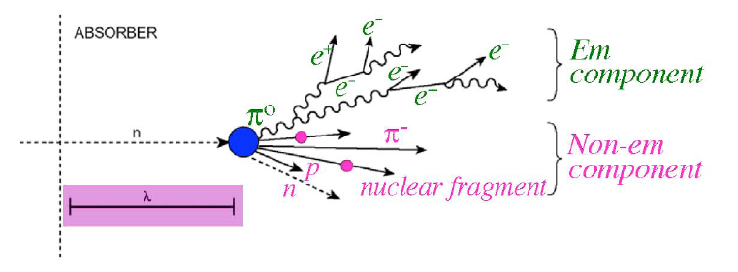
Hadron showers
Extra complications: strong interaction
Much larger variety may occur both at the particle level and at the level of the stuck nucleus
  Production of other particles, mainly pions
  Some of these particles (𝜋⁰, η) develop electromagnetic showers
  Nuclear reactions: protons, neutrons released from nuclei
  Invisible energy (nuclear binding energy, target recoil)
    em showers: all energy carried by incoming e or γ goes to ionization
    had showers: certain fraction of energy is fundamentally undetectable
electrons positrons, photons, π⁰
Charged hadrons (π,k…), nuclear fragments, neutrons, neutrinos, breakup of nuclei (invisible energy)

Slide 14
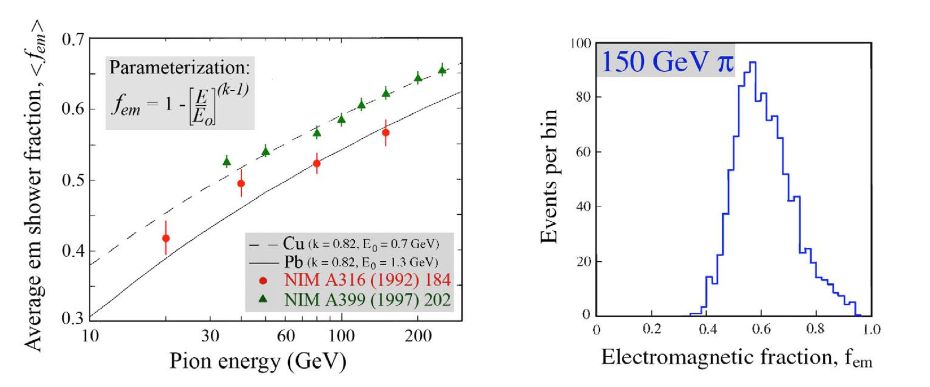
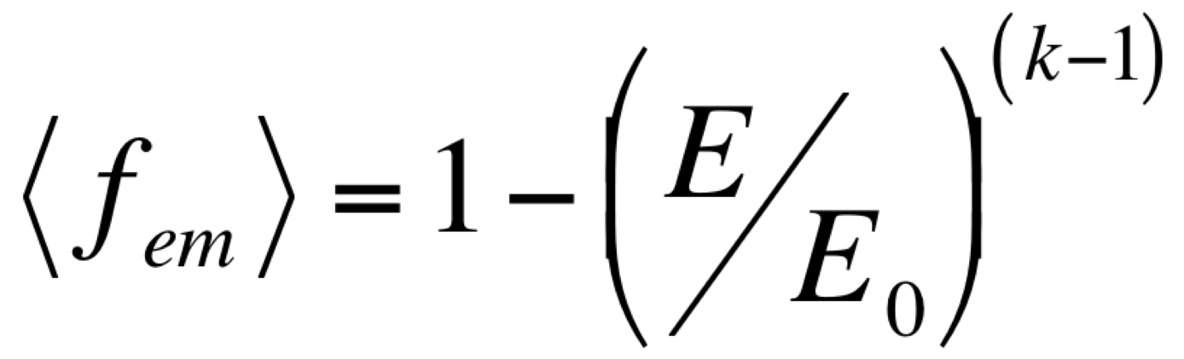
The electromagnetic fraction in hadronic showers
π₀ decays into 2 photons start an electromagnetic shower (f_{em})
  f_{em} grows with energy → non-linearity
  f_{em} varies event-by-event → fluctuation in calorimetry response
E₀ = average energy to produce a π⁰
(k-1) related to average multiplicity

Slide 15
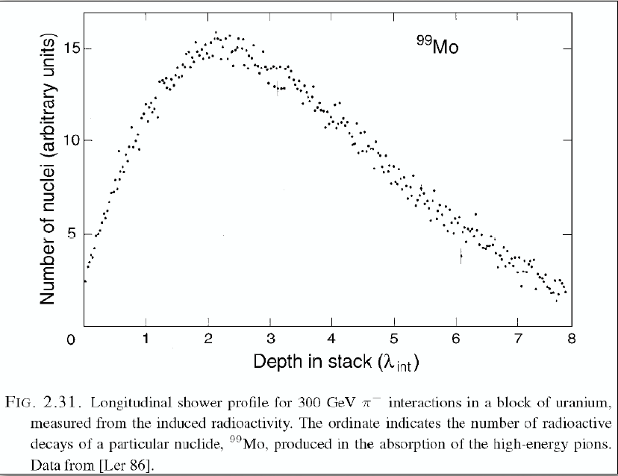
Hadronic shower profiles
Shower profiles are governed by the
Nuclear interaction lenght, λint
      average distance a high-energy hadron has to travel inside a medium before a nuclear interaction occurs
  λint (g cm⁻²) ∝ A^{1/3}
  Fe 16.8 cm, Cu 15.1 cm, Pb 17.0 cm, U 10.0 cm
    For comparison X0 :
    Fe 1.76 cm, Cu 1.43 cm, Pb 0.56 cm, U 0.32 cm

Slide 16
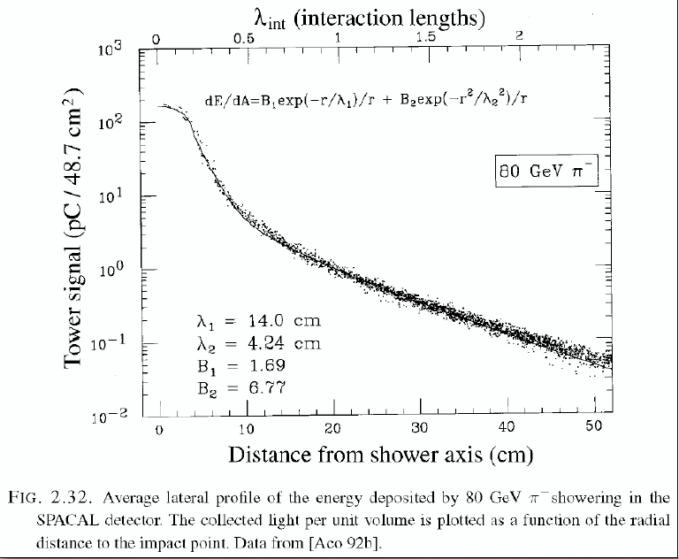
Hadronic lateral shower profiles
Lateral shower profile has two components:
  Electromagnetic core (𝜋⁰)
  Non-em halo (mainly non-relativistic shower particles)

Slide 17
Hadronic shower profiles
The λint/X0 ratio is important for particle ID
  In high-Z materials: λint/X0 ∼ 30 ⇒ excellent e/π separator
  1 cm PB + scintillator plate makes spectacular preshower detector
Ratio of the nuclear interaction length and the radiation length as a function of Z

Slide 18
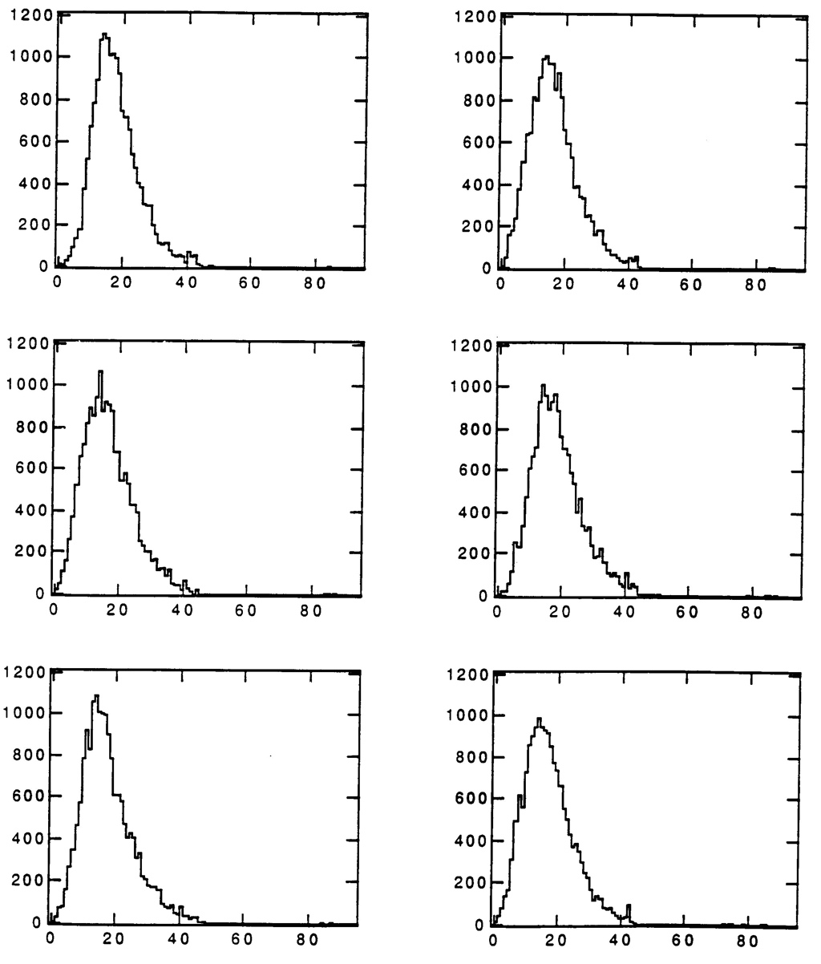
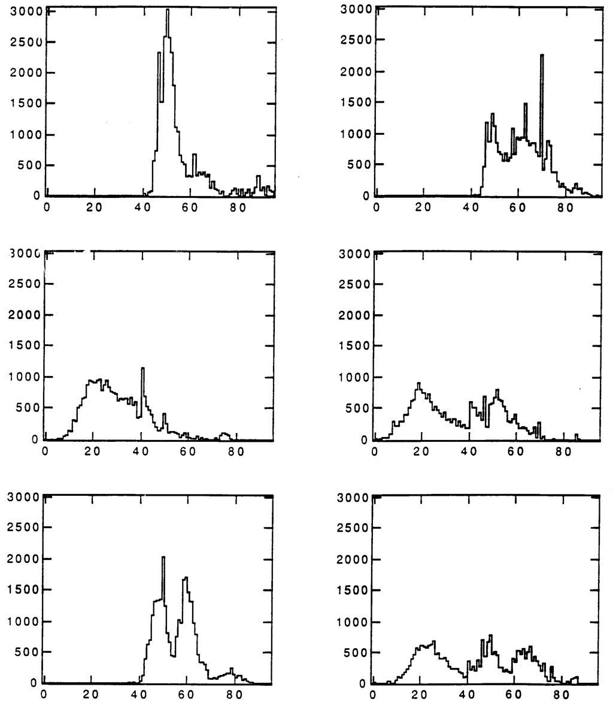
Hanging file calorimeter
electromagnetic shower
hadronic shower

Slide 19
e/π separation
Exploit differences in time structure of electromagnetic and hadronic calorimeter signals
electron signals rather identical
pion signals exhibits a variety of shapes
    fluctuations in shower starting point and shower development
Example
  SPACAL: measurement of signal width at fixed fraction of the amplitude (e.g. 20%)

Slide 20
Shower containment
Depth to contain showers increases with log E
Lateral leakage decreases as the energy goes up !
  <fem> increases with energy
  Electromagnetic component concentrated in a narrow cone around shower axis
  ⇒ Energy fraction contained in a cylinder with a given radius increases with energy

Slide 21
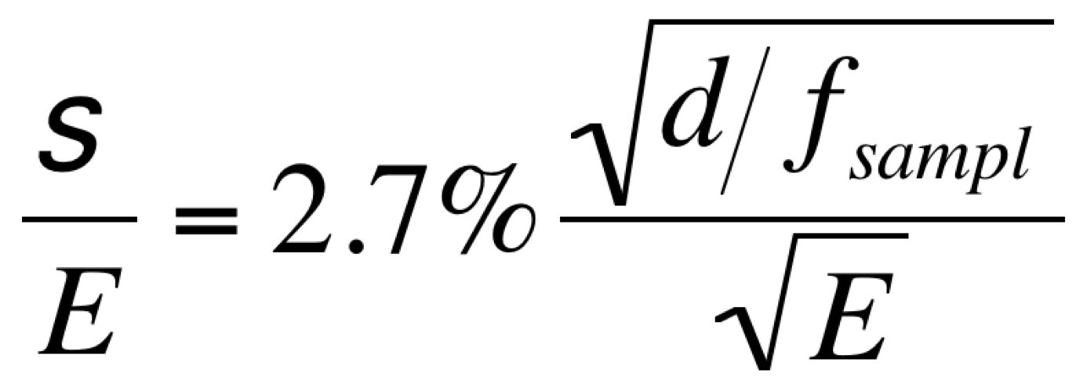
Energy Measurement
Calorimeter’s energy resolution is determined by fluctuations
Many sources of fluctuations may play a role, for example:
  Signal quantum fluctuations (e.g. photoelectron statistics)
  Sampling fluctuations
  Shower leakage (non Poissonian)
  Instrumental effects (e.g. electronic noise, light attenuation, structural non-uniformity)
  but usually one source dominates
  ⇒ to improve performance ⇒ work on that source
𝜎

Slide 22
Energy Measurements
Different effects have different energy dependence
  quantum, sampling fluctuations σ/E ∼ E^{-1/2}
  shower leakage σ/E ∼ E^{-1/4}
  electronic noise σ/E ∼ E⁻¹
  structural non-uniformities σ/E = constant
Add in quadrature σ²_{tot} = σ²₁ + σ²₂ + σ²₃ + σ²₄+......
In hadronic shower two other fluctuations play a role:
  Fluctuations in visible energy
  Fluctuations in the em shower fraction, f_{em}
ATLAS EM calorimeter

Slide 23
The Calorimeter Response Function
Response = Average signal per unit of deposited energy
e.g. # photoelectrons/GeV, picoCoulombs/MeV, etc
A linear calorimeter has a constant response

Slide 24
Hadronic shower response and the e/h ratio
The hadronic response is not constant
  fem, and therefore e/π signal ratio is a function of energy
  ➙ If calorimeter is linear for electrons, it is non-linear for hadrons
Energy-independent way to characterize hadron calorimeters: e/h
  e = response to the em shower component
  h = response to the non-em shower component
  → Response to showers initiated by pion
  e/h is inferred from e/π measured at several energies (fem values)

Slide 25
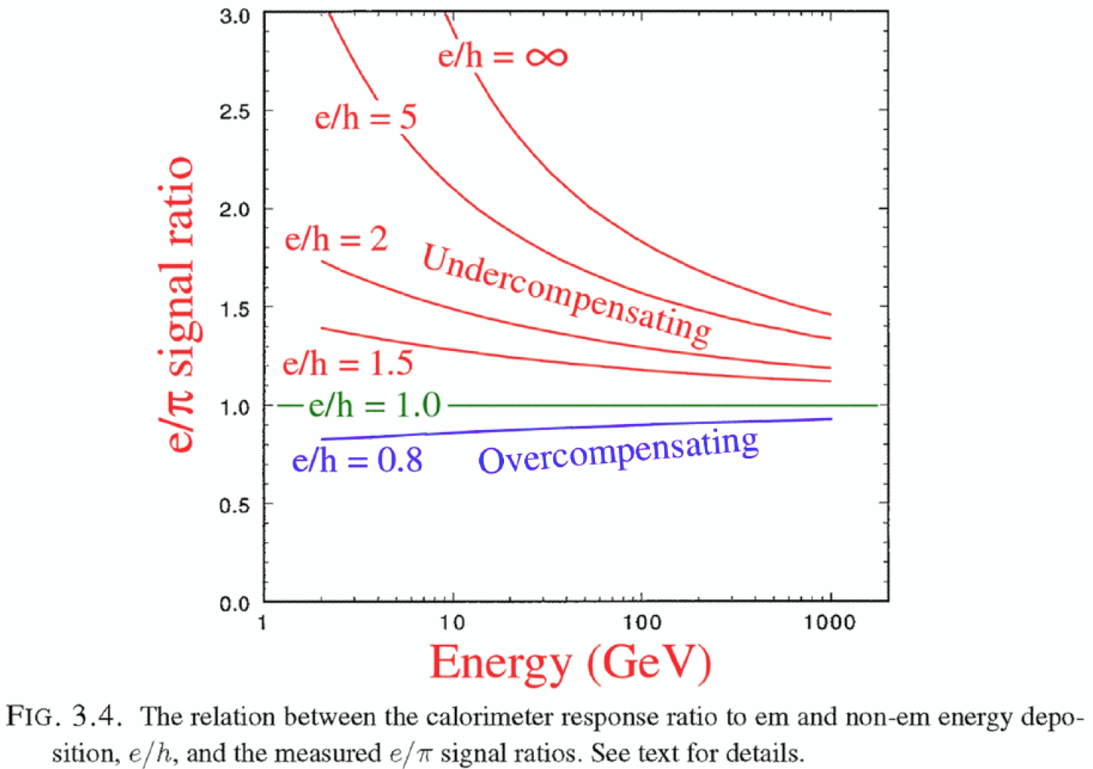
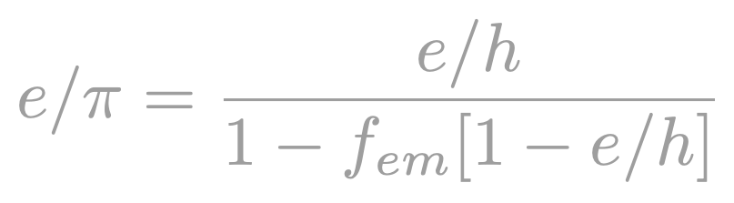
Hadron showers: e/h and the e/π signal ratio
Calorimeters can be
Undercompensating (e/h > 1)
Overcompensating (e/h < 1)
Compensating (e/h =1)

Slide 26
Non-em calorimeter response
Energy deposition mechanisms that play a role in the absorption of the non-em shower energy:
Ionization by charged pions (Relativistic shower component). The fraction of energy carried by these particles is called frel
Ionization by spallation protons (non-relativistic shower component). The fraction of energy carried by these particles is called fp
Kinetic energy carried by evaporation neutrons may be deposited in a variety of ways. The fraction of energy carried by these particles is called fn
The energy used to release protons and neutrons from calorimeter nuclei, and the kinetic energy carried by recoil nuclei do not lead to a calorimeter signal. This energy represent the invisible fraction finv of the non-em shower energy

Slide 27
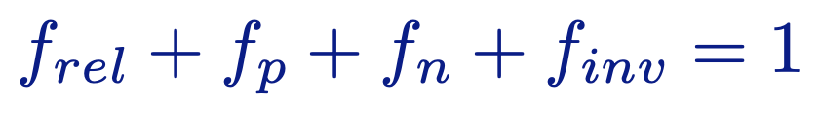
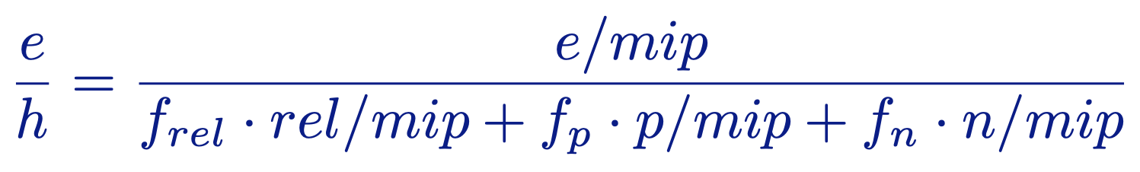
Non-em calorimeter response
h can be written as follows:
  rel, p, n and inv denote the calorimeter responses
Normalizing to mips and eliminating the last term (inv =0)
The e/h value can be determined once we know its response to the three components of the non-em shower components

Slide 28
Compensation
Need to understand response to typical shower particles (relative to mip)
Spallation neutrons
  (n, n’γ) inelastic scattering: not very important
  (n, n’) elastic scattering: most interesting
  (n, γ) capture (thermal): lots of energy, but process is slow (μs)

Slide 29
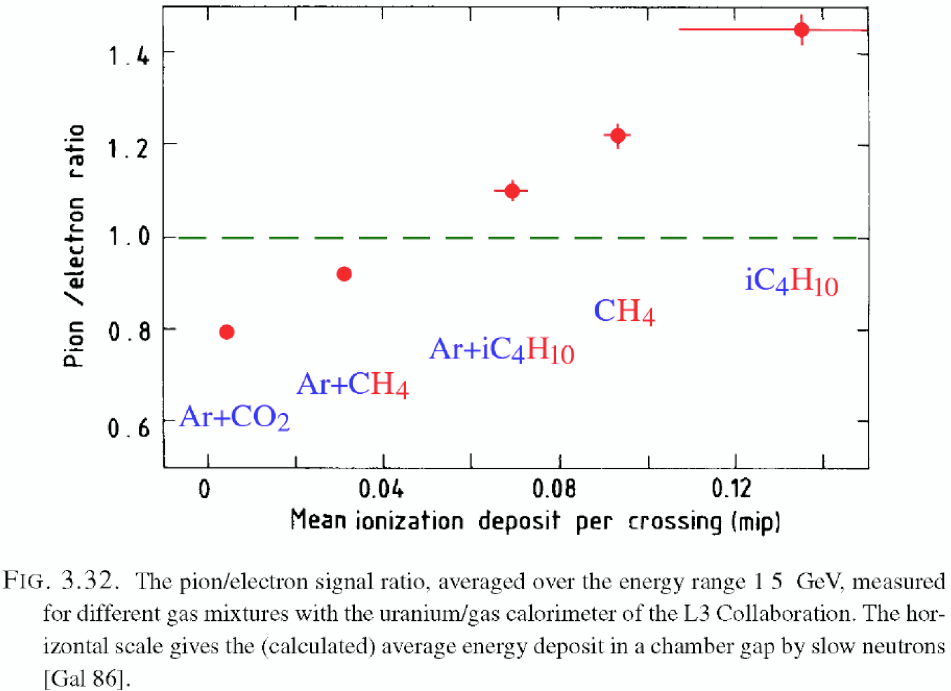
Compensation
Need to understand response to typical shower particles (relative to mip)
average fraction of neutron’s kinetic energy transferred in elastic collisions with a nucleus containing A nucleons
Elastic scattering felastic = 2A/(A+1)²
  Hydrogen felastic = 0.5 Lead felastic = 0.005
    Pb/H2 calorimeter structure (50/50)
      1 MeV n deposits 98% in H2
      mip deposits 2.2% in H2
Recoil protons can be measured!
  Neutrons have an enormous potential to amplify hadronic shower signals, and thus compensate for losses in invisible energy

Slide 30
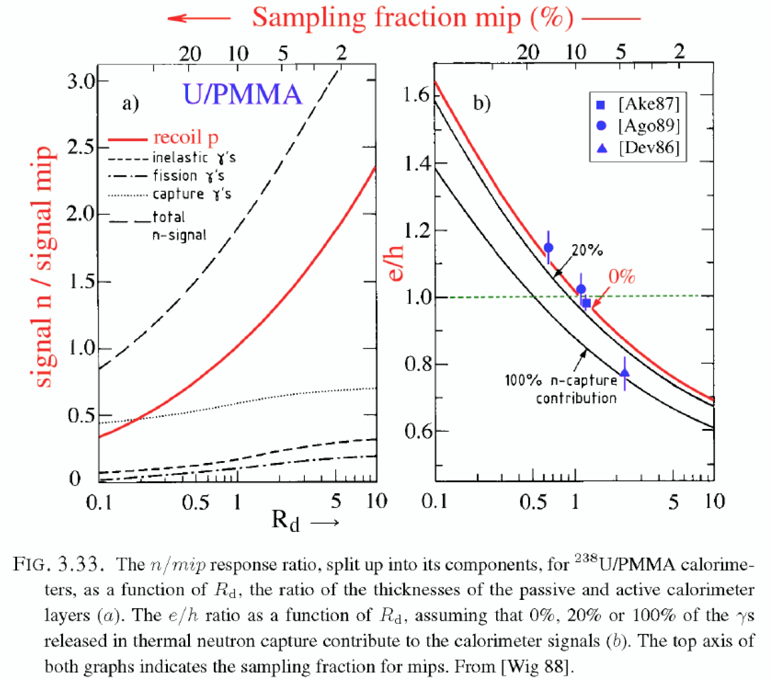
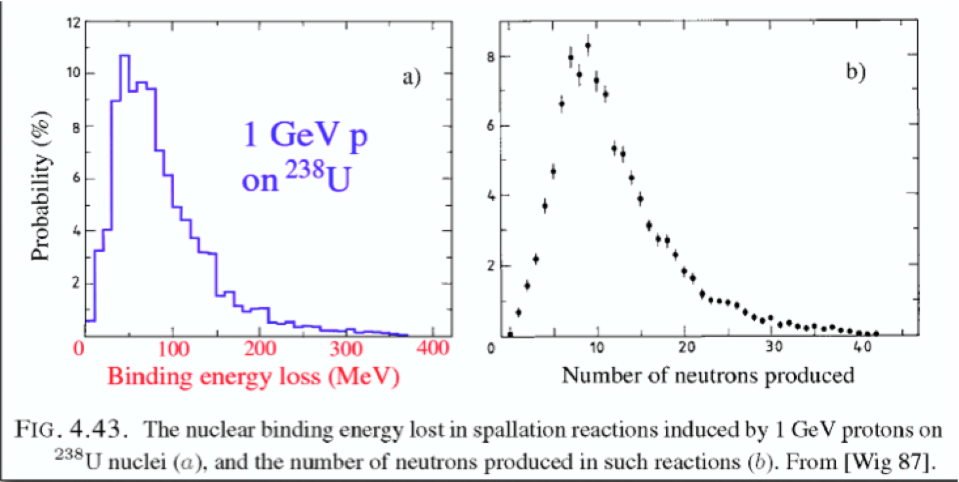
Compensation
Correlation between invisible energy and kinetic energy carried by released nucleons

Slide 31
What compensation does and does not for you
Compensation does not guarantee high resolution
  Fluctuations in fem are eliminated, but others may be very large
Compensation has some drawbacks
  Small sampling fraction required → em resolution limited
  Relies on neutrons → calorimeter signals have to be integrated over large volume and time. Not always possible in practice
High-resolution Electromagnetic and high-resolution Hadronic calorimetry are mutually exclusive:
  Good jet energy resolution ⇒ Compensation ⇒ very small sampling fraction (∼ 3%) ⇒ poor electron, photon resolution
  Good electromagnetic resolution ⇒ high sampling fraction (100% Crystals, 20% LAr) ⇒ large non compensation ⇒ poor jet resolution

Slide 32
Calorimeters @ LHC (examples)
ATLAS Calorimeters:
EM: Lead-Liquid Argon
  𝜎/E ~ 10%/√E(GeV) ⊕ 0.7%
HAD: Stainless steel /Scintillator Tile
  𝜎/E ~ 50%/√E(GeV) ⊕ 3%
CMS Calorimeters:
EM: Lead-Tungstate (PbWO₄) crystal
  𝜎/E ~ 3%/√E(GeV) ⊕ 0.5%
HAD: Brass/Scintillator Tile
  𝜎/E ~ 100%/√E(GeV) ⊕ 5%

Slide 33
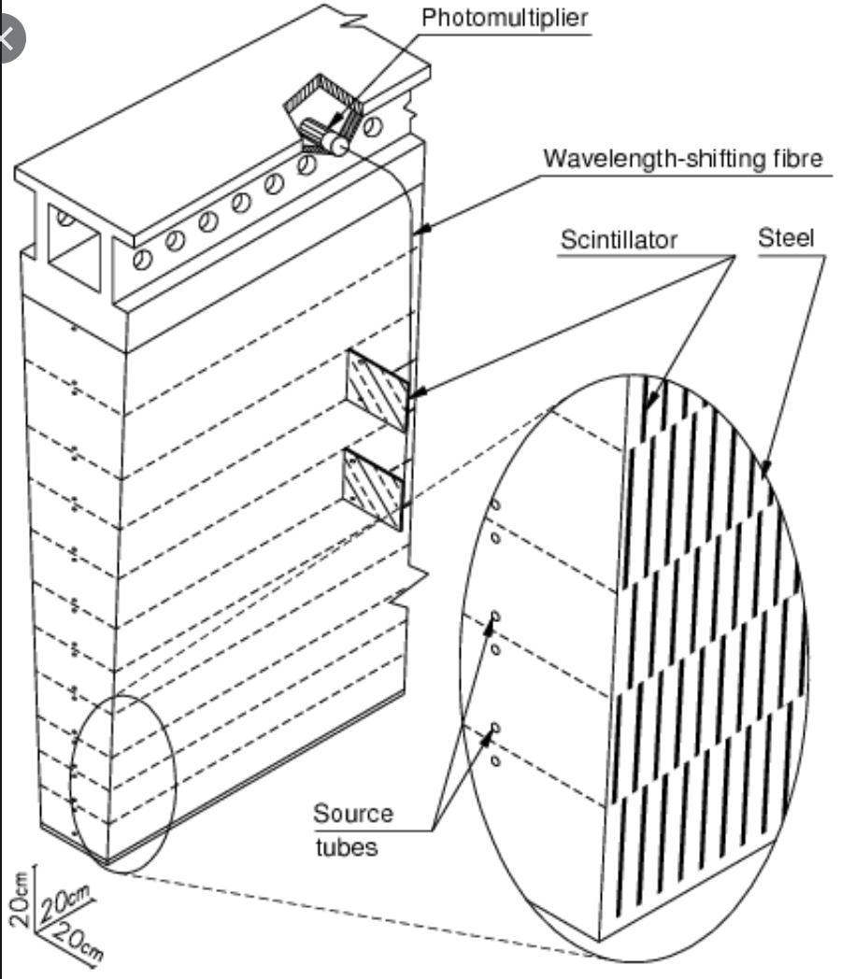
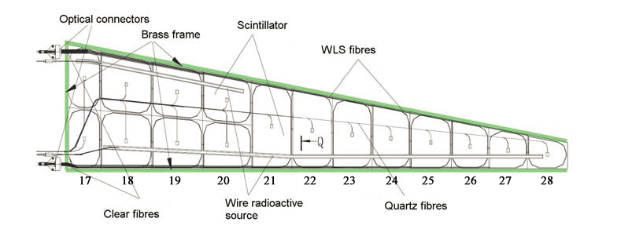
Calorimeters @ LHC (examples)
ATLAS Calorimeters:
EM: Lead-Liquid Argon
  𝜎/E ~ 10%/√E(GeV) ⊕ 0.7%
HAD: Stainless steel /Scintillator Tile
  𝜎/E ~ 50%/√E(GeV) ⊕ 3%
CMS Calorimeters:
EM: Lead-Tungstate (PbWO4) crystal
  𝜎/E ~ 3%/√E(GeV) ⊕ 0.5%
HAD: Brass/Scintillator Tile
  𝜎/E ~ 100%/√E(GeV) ⊕ 5%

Slide 34
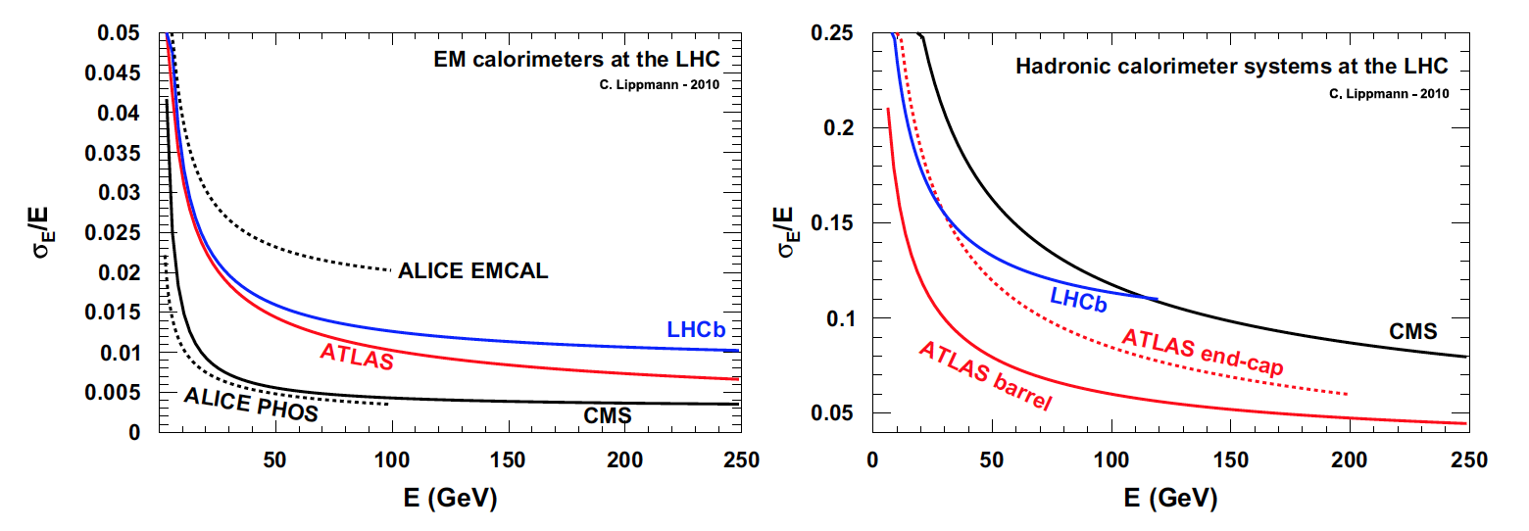
LHC calorimeters performances

Slide 35
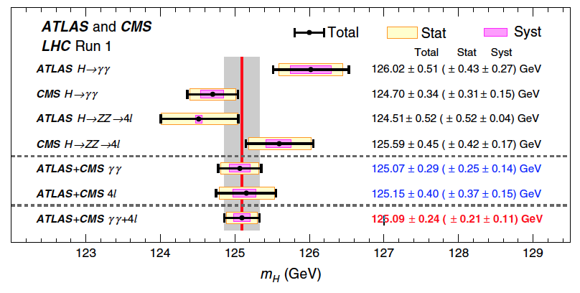
Combined (Run I) Higgs boson mass

Slide 36
Calorimetry Today ... and Tomorrow

Slide 37
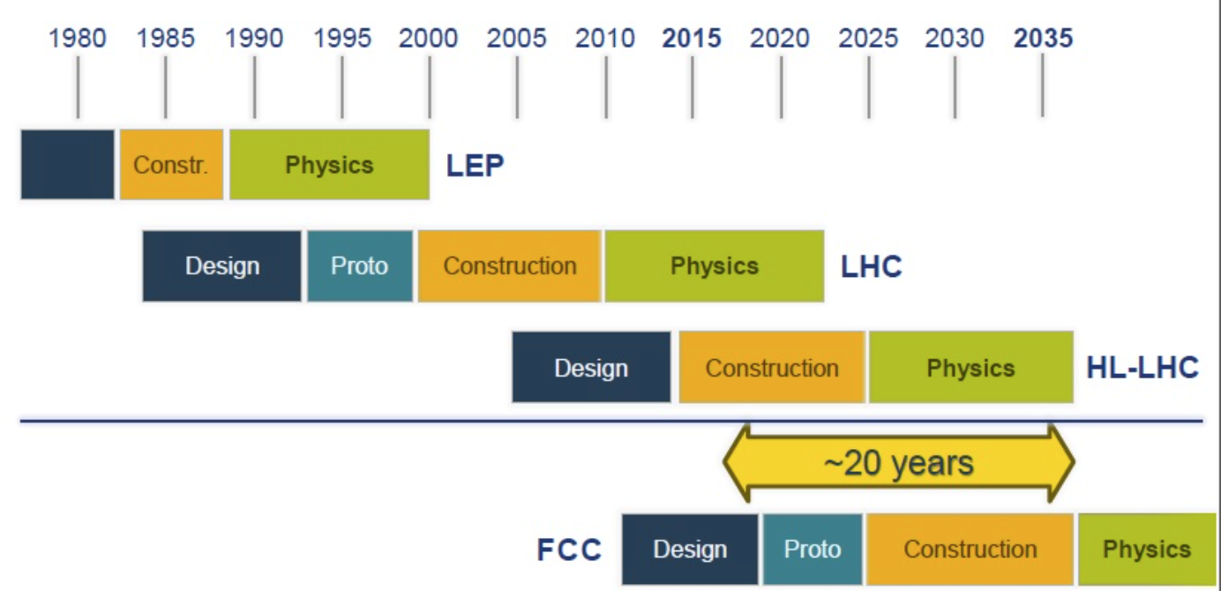
Energy Frontier
to be updated

Slide 38






Intensity Frontier
Belle II
BES III
Mu2e
DUNE
MINERvA
Muon g-2
...

Slide 39
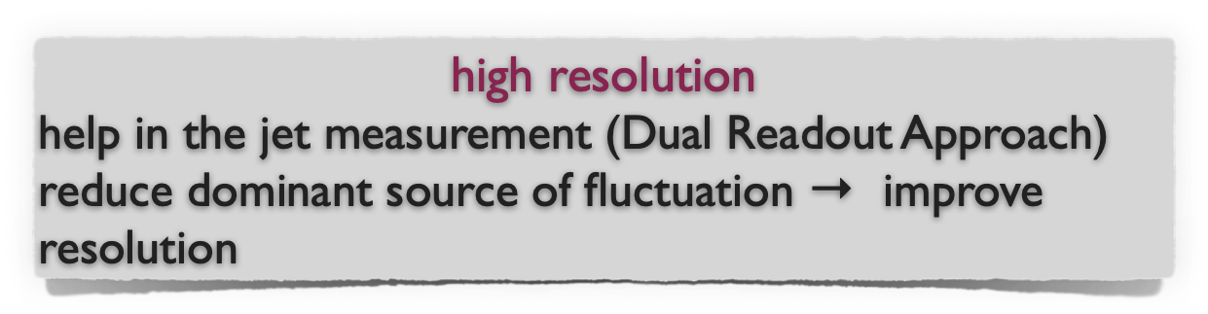

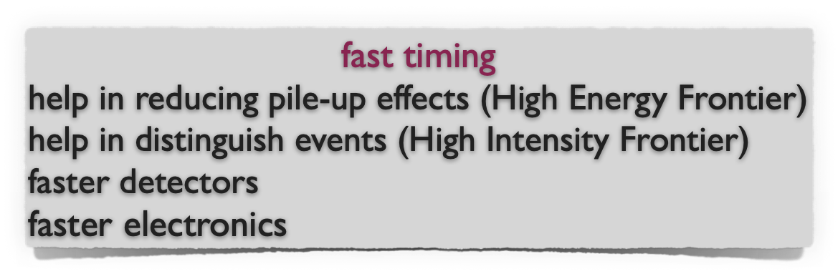

New Trends in Calorimetry
How to cope with physics and performance requirements?
High Resolution
High Rate
Rad-Hard

Slide 40
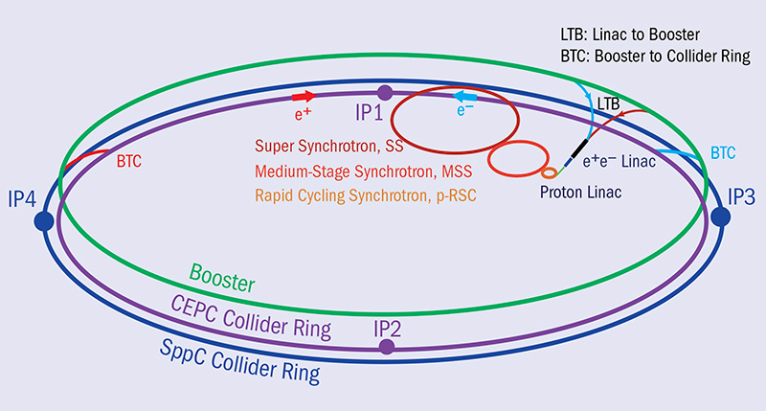
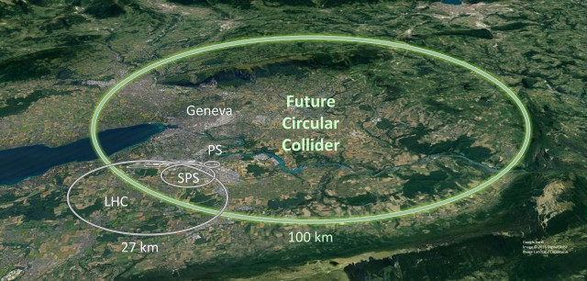
Future accelerators

Slide 41
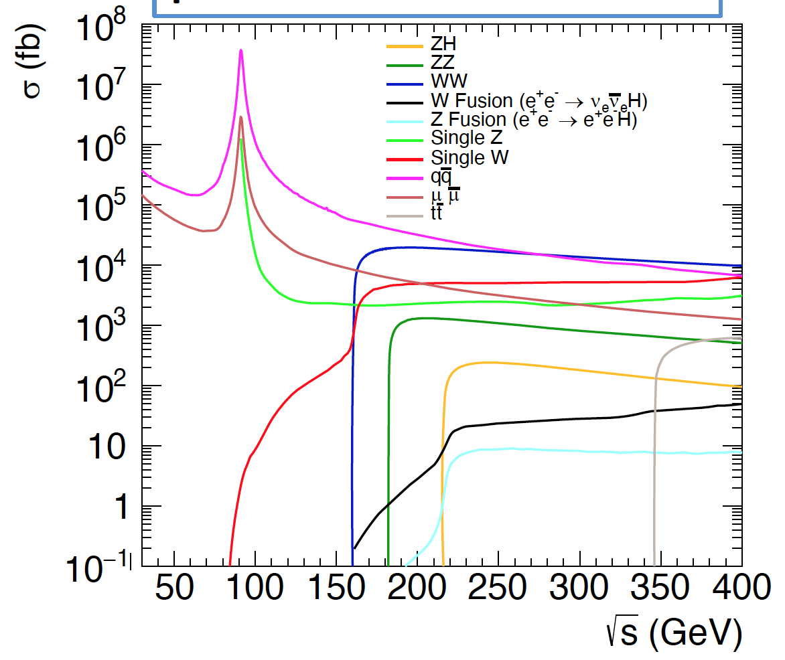
High Resolution Calorimetry
e⁺e⁻
91.2 GeV Z-pole
161 GeV WW
240 GeV ZH
365 GeV tt
pp 100 TeV
97% of the
SM Higgsstrahlung signal has jets in the final states

Slide 42
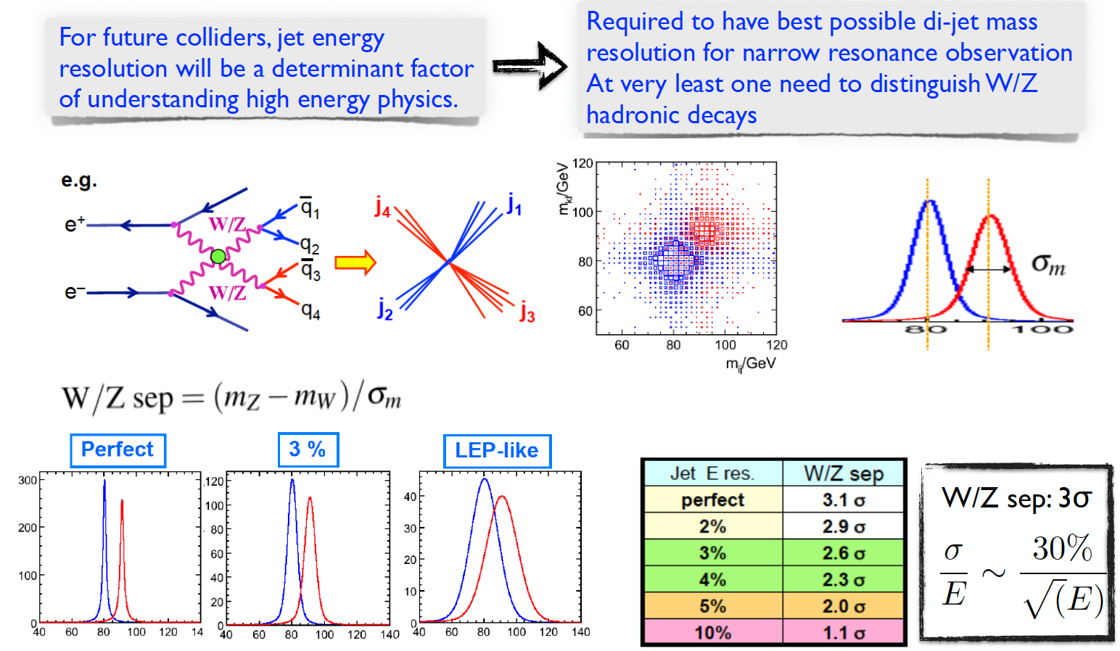
High resolution Calorimetry

Slide 43
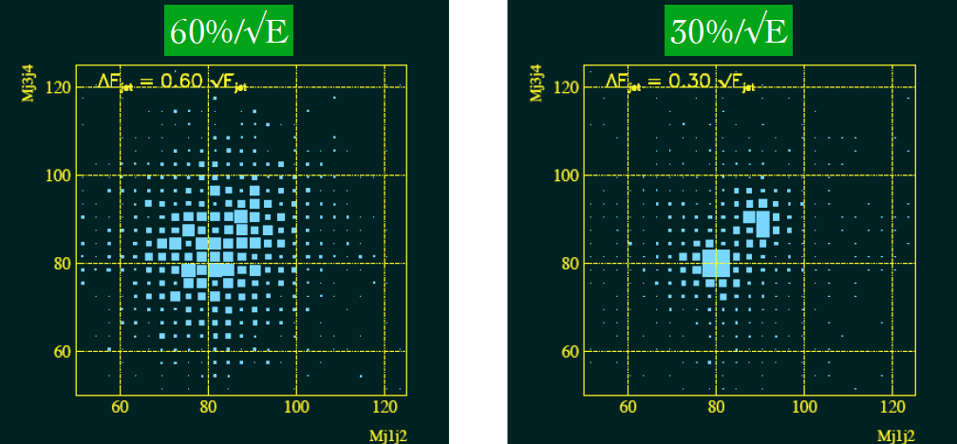
Design goal future accelerators: separate W, Z ➝ qq
LEP-like detector
Future accelerators design goal
Mjj
Mjj

Slide 44
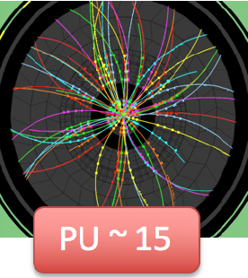
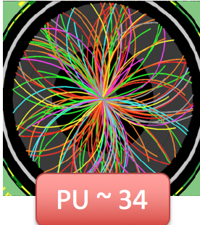
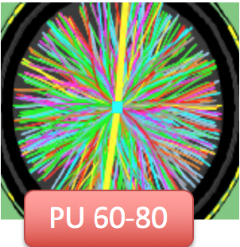
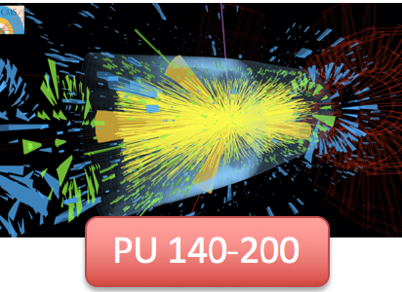
High Rate Calorimetry
<μ> ≈ 20-40 evts/crossing RunI
<μ> ≈ 50 evts/crossing RunII
<μ> ≈ 60 evts/crossing RunIII
<μ> ≈ 140 evts/crossing HL-LHC
}
40x10⁶ bunch crossing/s
20 collisions/bunch crossing
140 PU evt/bunch crossing
~ 10¹⁰ evt/s
⬇
time scale ~ 100 ps

Slide 45
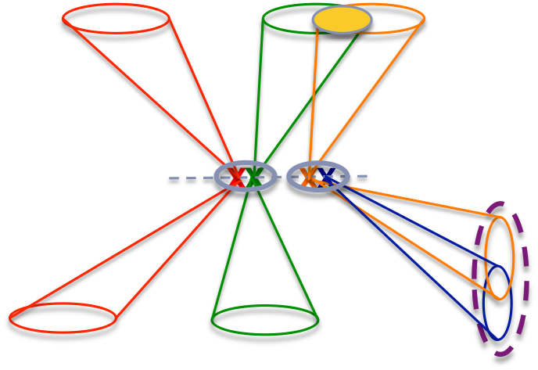
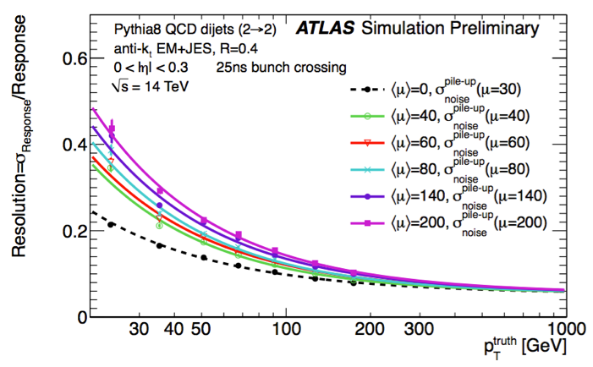
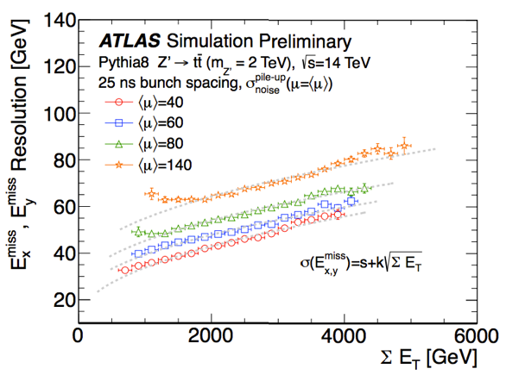
High Rate Calorimetry
Effect on Jet and ET^{miss} resolution @high pileup

Slide 46
High Rate Calorimetry
Pile up suppression:
identify high-energy clusters, then make timing cut to retain hits of interest

Slide 47
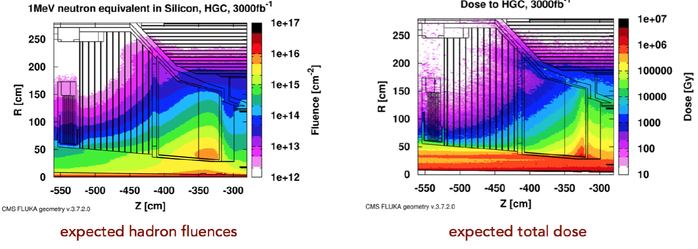
Rad-Hard Calorimetry
Irradiation changes the performance of detectors and electronics
Total Ionizing Dose (TID)
  Mainly due to photons, electrons and positrons
  Measured in Gray (Gy), 1 Gy = 1 J/kg = 100 rad
Non Ionizing Energy Loss (NIEL) / equivalent fluence (Φeq)
  Expressed in 1 MeV neutron equivalent fluence (n/cm²)
Thermal neutron fluence

Slide 48
Two Main Approaches
electrons positrons, photons, π⁰
Charged hadrons (π,k…), nuclear fragments, neutrons, neutrinos, breakup of nuclei (invisible energy)
Particle Flow
Dual Readout

Slide 49
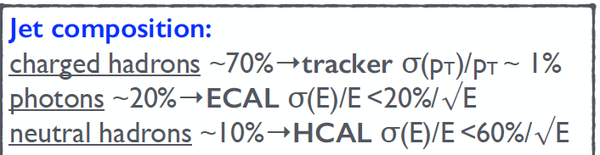
Particle Flow & “High granularity paradigm”
Particle Flow combines tracking and calorimeter for optimal jet reconstruction
Jet energy measurement by measurement of individual particles
Maximal exploitation of precise tracking measurement
Need to minimize the confusion
term as much as possible !!!

Slide 50
Particle Flow & “High granularity paradigm”
Particle Flow combines tracking and calorimeter for optimal jet reconstruction
large radius and length
➔ to separate the particles
large magnetic field
➔ to sweep out charged tracks
“no” material in front of calorimeters
➔ stay inside coil
small Moliere radius of calorimeters
➔ to minimize shower overlap
high granularity of calorimeters
➔ to separate overlapping showers
High 𝜆/X₀ ratio
  ➔ to distinguish Hadronic/EM showers

Slide 51
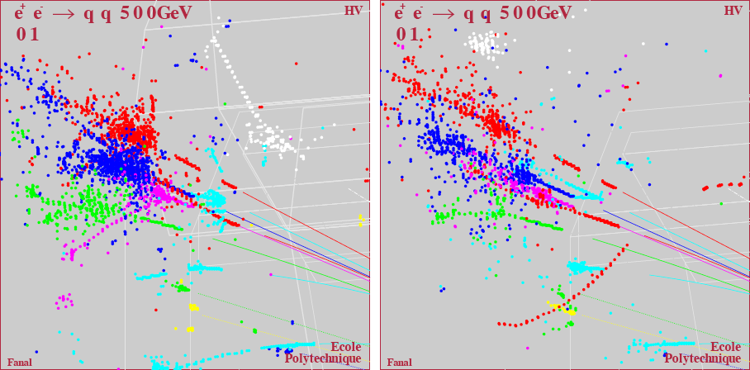
PFA: High Density + Fine Granularity
In order to reduce problems of shower overlap, R&D focuses on reducing the shower dimensions and decreasing the calorimeter cell size
X0 = 1.8 cm, λI=17 cm
X0 = 0.35 cm, λI=9.6 cm
Iron
Tungsten

Slide 52


Particle Flow & “High granularity paradigm”
PF in action already at LHC, CMS (non optimized for PF)
B=3.8 T
track σ(pT)/pT ~ 1%
photons σ(E)/E ~3%/sqrt(E)
neutral hadrons σ(E)/E ~ 120%/sqrt(E)
PF approach also beneficial for PU mitigation (tracks can be easily associated with production vertices)
MET Resolution (GeV)

Slide 53

Particle Flow and the CALICE collaboration
R&D pursued within CALICE collaboration, a 15 year long R&D
R&D moving from 1st generation prototypes demonstrating the PF concept, to 2nd generation prototypes addressing technical issues to demonstrate experimental application (mechanics, power, integration…)

Slide 54

High granularity calorimeter design
A “Calice” calorimeter is:
a calorimetric system including ECAL+HCAL+X₀-thin High Performance Tracker
It’s optimised for Particle Flow

Slide 55

High granularity calorimeter design

Slide 56

Semi-Digital HCAL
SDHCAL with gas: RPC, Micromegas or GEM
cheaper alternative to scintillator
advantages for 2 bits readout (1, several, many MIPS) over 1 bit
Micromegas and GEM have potential to improve RPC dynamic range & proportionality

Slide 57


Semi-Digital HCAL
SDHCAL-GRPC
48 layers Glass RPC as sensitive medium
Dimensions: 1m×1m×1.3m
MUON

Slide 58

High Granularity for Particle Identification
To reject electrons and muons without losing hadrons make use the excellent granularity of SDHCAL to discriminate the three species. Several discriminatory variables were selected:
First layer of the shower (begin)
Number of tracks in the shower (trackMultiplicity)
Ratio of shower layers over total fired layers (nShowerLayer/Nlayers)
Shower density (density)
Shower radius (radius)
Maximum shower position (length)
Ratio of N3/Ntot
Average number of clusters
….
JINST 15 (2020) P10009

Slide 59

High Granularity for Particle Identification
To reject electrons and muons without losing hadrons make use the excellent granularity of SDHCAL to discriminate the three species. Several discriminatory variables were selected:
First layer of the shower (begin)
Number of tracks in the shower (trackMultiplicity)
Ratio of shower layers over total fired layers (nShowerLayer/Nlayers)
Shower density (density)
Shower radius (radius)
Maximum shower position (length)
Ratio of N3/Ntot
Average number of clusters
….
JINST 15 (2020) P10009

Slide 60

High Granularity for Particle Identification
BDT technique was used.
Simulated events of electrons, muons and pions were used for training/validation before to apply to data.
Electron and muon rejection > 99%
JINST 15 (2020) P10009

Slide 61


CMS: HGCAL for HL-LHC
CMS Phase II upgrade: High Granular CALorimeter for the forward region (1.5 < |η| < 3)
High granularity (transverse & longitudinal) for PF in very dense environment: <PU> at HL-LHC 140-200

Slide 62


CMS: HGCAL for HL-LHC
CMS Phase II upgrade: High Granular CALorimeter for the forward region (1.5 < |η| < 3)
High granularity (transverse & longitudinal) for PF in very dense environment: <PU> at HL-LHC 140-200

Slide 63


CMS: HGCAL for HL-LHC
CMS Phase II upgrade: High Granular CALorimeter for the forward region (1.5 < |η| < 3)
High granularity (transverse & longitudinal) for PF in very dense environment: <PU> at HL-LHC 140-200

Slide 64


CMS: HGCAL for HL-LHC
CMS Phase II upgrade: High Granular CALorimeter for the forward region (1.5 < |η| < 3)
High granularity (transverse & longitudinal) for PF in very dense environment: <PU> at HL-LHC 140-200
TB results Z. Gecse Calor2022

Slide 65
Two Main Approaches
electrons positrons, photons, π⁰
Charged hadrons (π,k…), nuclear fragments, neutrons, neutrinos, breakup of nuclei (invisible energy)
Particle Flow
Dual Readout

Slide 66
Aims of Dual Readout Project
Address the factors which limit the resolution of hadron calorimeter to reach the theoretical resolution limit
  High resolution EM and HAD calorimetry
  Calibration of the calorimeter can be done with electrons
  Can comply with the requirements for Future collider physics
Study and eliminate/reduce dominant source of fluctuation

Slide 67
Fluctuations in the em shower component (fem)
Why are these important ?
  calorimeter response to em-component ≠ non-em response (e/h ≠ 1)
  Event-to-event fluctuations are large and non-Gaussian
  <fem> depends on shower energy and age
Cause of all common problems in hadron calorimeters
  Energy scale different from electrons, in energy-dependent way
  Hadronic non-linearity
  Non-Gaussian response function
  Poor energy resolution
Solutions
  Compensating calorimeters (e/h = 1), e.g. Pb/plastic scintillator
  Measure fem event-by-event

Slide 68
Principles of Dual Readout Calorimetry
Cherenkov light C | only produced by relativistic particles, dominated by electromagnetic shower component
Scintillation light S | measure dE/dx
Simultaneous measurement on event-by-event basis of elm fraction of hadron showers
S = [ f_{em} + (h/e)_{s} × (1 – f_{em}) ] × E
C = [ f_{em} + (h/e)_{c} × (1 – f_{em}) ] × E
e/h ratio of the C (S) calorimeter structure
(measured)
It is possible
to evaluate
and

Slide 69



Principles of Dual Readout Calorimetry
S/E = f_{em} + (h/e)_{s} × (1 – f_{em})
C/E = f_{em} + (h/e)_{c} × (1 – f_{em})
χ independent of both
energy
type of hadron
Calorimeter calibration done with electrons
Notes:
Barion number and strangeness: diversa risposta e quindi incertezza sistematica

Slide 70

E.M. Fraction Fluctuation

Slide 71
Before Correction
Calculate C/S ratio event-by-event
Calculate fem
Obtain corrected C and S and Energy which one would obtain if fem=1 ( em scale calibration)
Notes:
Asimmetrico (hadron in non compensating calo), larga e al valore sbagliato

Slide 72
After Dual Readout approach
Notes:
Più stretta, gaussiana e al valore corretto

Slide 73
Measuring h/e
C/E = f_{em} + (h/e)_{c} × (1 – f_{em})
S/E = f_{em} + (h/e)_{s} × (1 – f_{em})
From the linear fit it is possible to determine the (e/h) values for both calorimeter structure (scintillation and Cherenkov)

Slide 74



Invisible Energy
Measurement of the kinetic energy of neutrons which is correlated to nuclear binding energy loss (invisible energy) from time structure of the signal (NIM A 598 (2009) 422)
Time structure of DREAM signal.
Tail absent in em showers
N fraction anti-correlated
to f_{em} (C/S)
Probing the tot. signal distribution with N fraction

Slide 75
Dual-readout R&D
Homogeneous Calorimeter | Sampling Calorimeter
Possibility to solve light yield and sampling fluctuation problem. Need to separate C and S light. | Two types of fibers, either sensitive to Cherenkov and Scintillation Separated by construction
Proof of concept phase

Slide 76




Dual Readout method in sampling calorimeter
In sampling calorimeter with two different types of fibers,
Cherenkov and Scintillation are separated by construction
Lead-fibers
NEW DREAM
Each module divided in 4 towers
Each tower read out by 2 PMTs, one for Cherenkov and one for scintillation
Copper-fibers

Slide 77






Dual Readout method in sampling calorimeter
Electromagnetic
Resolution
Lead
Copper
Hadronic Resolution
(Pb Module)
To include corrections on:
- light attenuation
- lateral leakage

Slide 78
Light attenuation and longitudinal profile
Depth at which light is produced in had shower fluctuate at the level of a λ_{int} ( ~25 cm in RD52 calo)
Particles travel ~ c
Light in media travel at c/n
Using signal starting time it is possible:
to correct for light attenuation effect
Particle information

Slide 79
PMT vs SiPM readout
SiPM advantages:
  compact readout (no fibres sticking out)
  operation in magnetic field
  larger light yield (# of Čerenkov p.e. limits resolution)
  very high readout granularity → particle flow “friendly”
SiPM (potential) disadvantages:
  signal saturation (digital light detector)
  cross talk between Čerenkov and scintillation signals
  dynamic range
  instrumental effects (stability, afterpulsing, ...)

Slide 80
PMT vs SiPM readout
SiPM advantages:
  compact readout (no fibres sticking out)
  operation in magnetic field
  larger light yield (# of Čerenkov p.e. limits resolution)
  very high readout granularity → particle flow “friendly”
SiPM (potential) disadvantages:
  signal saturation (digital light detector)
  cross talk between Čerenkov and scintillation signals
  dynamic range
  instrumental effects (stability, afterpulsing, ...)

Slide 81



SiPM linearity
One SiPM per fiber
Using multiphoton spectrum for the calibration
Cross-calibrate high and low gain

Slide 82



SiPM linearity

Slide 83

Moving towards experiments
Successfully pioneered SiPM readout to replace PMT
→ High granularity
• Studying scalable solution for
  • Mechanical construction
  • Sensors and RO system
• Full scale prototypes
→ Assess performance
IDEA
Innovative Detector for E+e- Accelerator

Slide 84
Dual Readout method in homogeneous calorimeter
Motivations:
high density scintillating crystal widely used in particle physics experiment: ensure excellent energy resolution for electromagnetic showers
calorimeters with a crystal EM compartment usually have a poor had. resolution due to
  fluctuation of the starting point of the hadronic shower in the EM section
  different response to the em and non-em component of the shower in the two calorimeters
Dual readout applied to an hybrid system:
Measuring f_{em} on an event-by-event basis allows to correct for such fluctuations and allows to eliminate the main reasons for poor hadronic resolution

Slide 85

Crystal matrix + fiber sampling calo

Slide 86





Dual Readout method in homogeneous calorimeter
Separation can be achieved by:
optical filters: exploit different spectral region of Č and S
time integration: exploit different time structure of Č and S

Slide 87

2011 Conclusion from testing homogeneous DRC
2011: Outcomes from performed tests :
To separate the C and S component, crystals have to be readout in non conventional way
→ results not good as the ones obtained by standard EM calorimetry
Extraction of pure C and S signals implies
To sacrifice a large fraction of available C photons (optical filters)
C photons are attenuated by crystal UV self absorption
Crystal + optical filters don’t offer a benefit in term of C light yield in dual readout calorimetry (comparable with the one measured with the RD52 fiber calorimeter)
but this is not the end of the story ...

Slide 88

DR crystals: “A new hope”

Slide 89

DR crystals: “A new hope”

Slide 90

DR crystals: “A new hope”

Slide 91

DR crystals: “A new hope”
meant for pp collider
meant for ee collider

Slide 92
New Materials for Calorimetry

Slide 93

Garnet Fiber Crystals readout
Garnet Fiber Crystals
  YAG: Yttrium Aluminum Garnet
  GAGG: Gadolinium Aluminum Gallium Garnet
  GFAG: Gadolinium Fine Aluminum Gallate
Garnet crystals are radiation hard
Scintillation properties can be tuned with different levels of dopants (Ce,Mg) and growth conditions

Slide 94
Garnet Fiber Crystals readout
Garnet Fiber Crystals
  YAG: Yttrium Aluminum Garnet
  GAGG: Gadolinium Aluminum Gallium Garnet
  GFAG: Gadolinium Fine Aluminum Gallate
Garnet crystals are radiation hard
Scintillation properties can be tuned with different levels of dopants (Ce,Mg) and growth conditions

Slide 95

Garnet Fiber Crystals readout

Slide 96


SPACAL prototype with garnet crystal fibres
LHCb ECAL upgrade

Slide 97





Ceramics: a rad-hard material for calorimeters
Development of scintillating ceramics (LuAG:Ce, YAG:Ce) could provide a cost-effective solution for calorimeters:
e.g LuAG:Ce
LY ~ 20 kɣ/MeV
ρ = 6.76 g/cm³
X0 = 1.45 cm
Also available as crystal fibres
YAG:Ce
Excellent radiation hardness
Relatively fast, possible ways to improve response time
(Ce co-dopants, Pr)

Slide 98

Ceramics: a rad-hard material for calorimeters
Ceramics provide a cost-effective solution for future HEP experiments.
Unlike single crystal, ceramic fabrication does not require melting raw material
Lu₂O₃:Yb ceramics
show light yield up to 280 ph/MeV with negligible slow component.
high density

Slide 99



R&D: Rad-hard optical calorimeters
R&D for optical calorimeters who can cope with O(300 kGy) & O(10¹⁴⁻¹⁵) hadrons cm⁻²
Shashlik design to minimise the optical path in the scintillator. Also rad-hard WLS fibres & photodetectors
W/LYSO shashlik cell designed 14x14x114 mm³
Quartz capillaries with WLS liquid
R&D for InGaAs SiPM
σ(E)/E ~ 10%/√E/GeV
hadron damage for PbWO4, LYSO, CeF3
W/CeF3 as an alternative:
CeF3 excellent hadron damage radiation hardness
Can use SiO2:Ce as radiation hard WLS

Slide 100
New Trends in Calorimetry
How to cope with physics and performance requirements?
High Resolution
High Rate
Rad-Hard

Slide 101
Additional material

Slide 102
Sampling calorimeters
Energy resolution of sampling calorimeters is in general worse than that of homogeneous calorimeters, owing to the sampling fluctuations
  fluctuation of ratio of energy deposited in the active and passive material.
Sampling calorimeters are relatively easy to segment longitudinally and laterally and therefore they usually offer better space resolution and particle identification than homogeneous calorimeters.
Contribution to Energy resolution due to sampling fraction:

Slide 103
Importance of SOFT particles
Phenomena at E < Ec determine important calorimeter properties
In lead > 40% of energy deposited by e± with E < 1 MeV
Only 1/4 deposited by e⁺, 3/4 by e⁻ (Compton, photoelectrons!)
The e⁺ are closer to the shower axis, Compton and photoelectrons in halo
  Results of EGS4 simulations
  The composition of em showers. Shown are the percentages of the energy of 10 GeV electromagnetic showers deposited through shower particles with energies below 1 MeV, below 4 MeV or above 20 MeV as function of the Z of the absorber material.

Slide 104
Compensation
Need to understand response to typical shower particles (relative to mip)
Relativistic charged hadrons
Even if relativistic, these particles resemble mip in their ionization losses
⇒ rel/mip = 1

Slide 105
Compensation
Need to understand response to typical shower particles (relative to mip)
Spallation protons
More efficient sampling
Signal saturation
Sampling of spallation protons:
quite complicated picture, many effects contribute:
  ratio of specific ionization in the active and passive materials ↑,
  multiple scattering effects ↓,
  sampling inefficiencies due to limited range ↓
  saturation and recombination effects in the active medium

Slide 106
Compensation
Need to understand response to typical shower particles (relative to mip)
Spallation protons
Soft shower protons
More efficient sampling
Signal saturation

Slide 107


Compensation
Need to understand response to typical shower particles (relative to mip)
Spallation protons
Soft shower protons
More efficient sampling
Signal saturation
Birk’s Law

Slide 108

Compensation
Need to understand response to typical shower particles (relative to mip)
Spallation protons
Soft shower protons
More efficient sampling
Signal saturation

Slide 109
Compensation
Need to understand response to typical shower particles (relative to mip)
Spallation protons
Soft shower protons
More efficient sampling
Signal saturation
  Response to spallation protons depends on:
    spallation protons energy spectrum
    Z value of the absorber
    fsamp and ffreq
    saturation properties of the active medium

