Slide 1



Physics at the future
Eletron-Ion Collider
Salvatore Fazio
Università della Calabria & INFN Cosenza
XXXIII INTERNATIONAL SEMINAR of NUCLEAR and SUBNUCLEAR PHYSICS "Francesco Romano"
Otranto - June 3-10, 2022

Slide 2
Plan of the Talk
Introduction
The EIC project and goals
Physics Highlights
  Spin Physics
  Partonic Imaging
  Structure of Nuclei
  Gluon Saturation
EIC Community and Project timelines

Slide 3
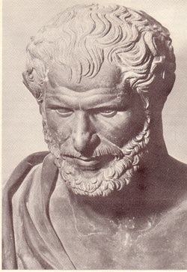
The hypothesis of Democritus
The dawn of “atomism”
All matter is made of invisible elementary particles (“atoms”).
These particles are indestructible
The properties of these particles (shape, mass, position, distribution, motion) make up for all the properties of the visible matter
Δημόκριτος
(Abdera 460 B.C. – 370 B.C.)

Slide 4
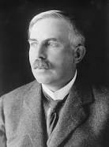
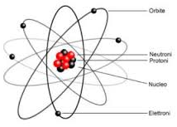
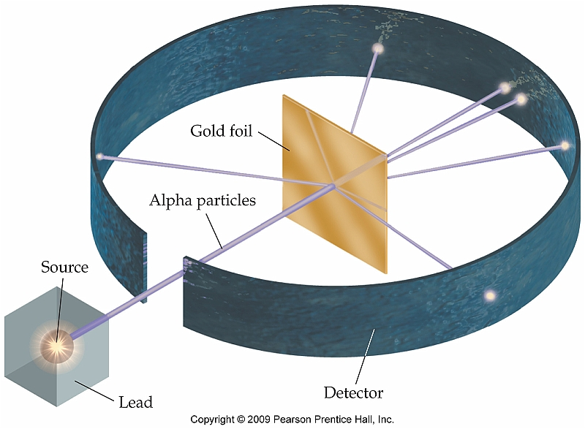
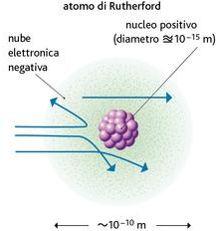
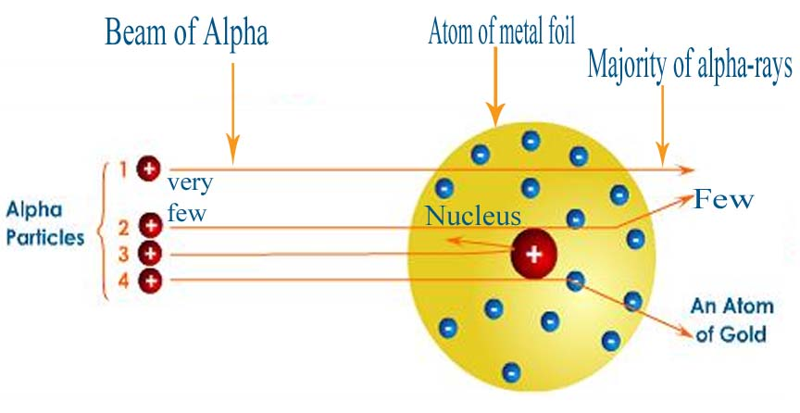
The experiment of Rutherford
The atom is mostly empty, with a central nucleus
The nucleus is positively charged and contains most of the atom’s mass
Atomic radius ~10⁻¹¹ m
Nuclear radius ~10⁻¹⁵ m
The nucleus is 10000 times smaller than the atom!
Ernest Rutherford
(1871 – 1937)
The electric charge of the nucleus corresponds to the number of protons within, known as atomic number
The electrons orbit around the nucleus bound by electrostatic forces
The Rutherford’s idea:
to study the subatomic structure using collisions between projectile particles and target atoms

Slide 5

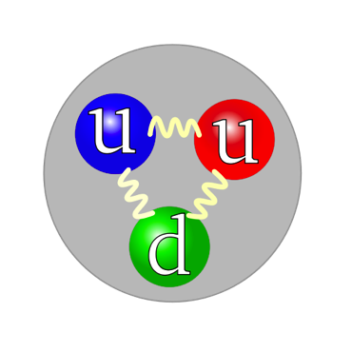
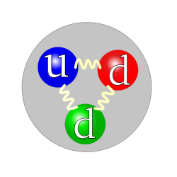

The quest for the elementary constituents of matter
NUCLEUS
A major goal of physics is to investigate the basic building blocks of all matter
  pieces that make up atoms, nuclei...
    and the pieces that make up those pieces…
Nucleus made of nucleons: protons and neutrons
Proton
Neutron
But the nucleons are very complex objects!!
Nucleon made of quarks bonded by gluons
Properties of quarks and gluons combine to for the total properties of the nucleon (electric charge, mass…)
Description of interactions via strong nuclear force
→ the birth of Quantum Cromo-Dynamics (QCD)

Slide 6
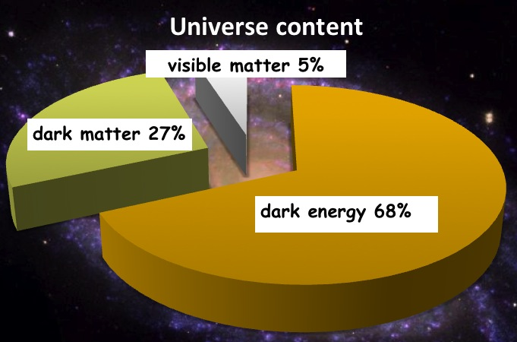
Understanding the properties of visible matter
This is us !!!
protons, neutrons, electrons
Proton:
The Higgs mechanism is responsible for quarks mass
Quark-Masses: ~1-5% M_{p}
All strongly interacting matter is an emergent consequence of many-body quark-gluon dynamics in QCD

Slide 7
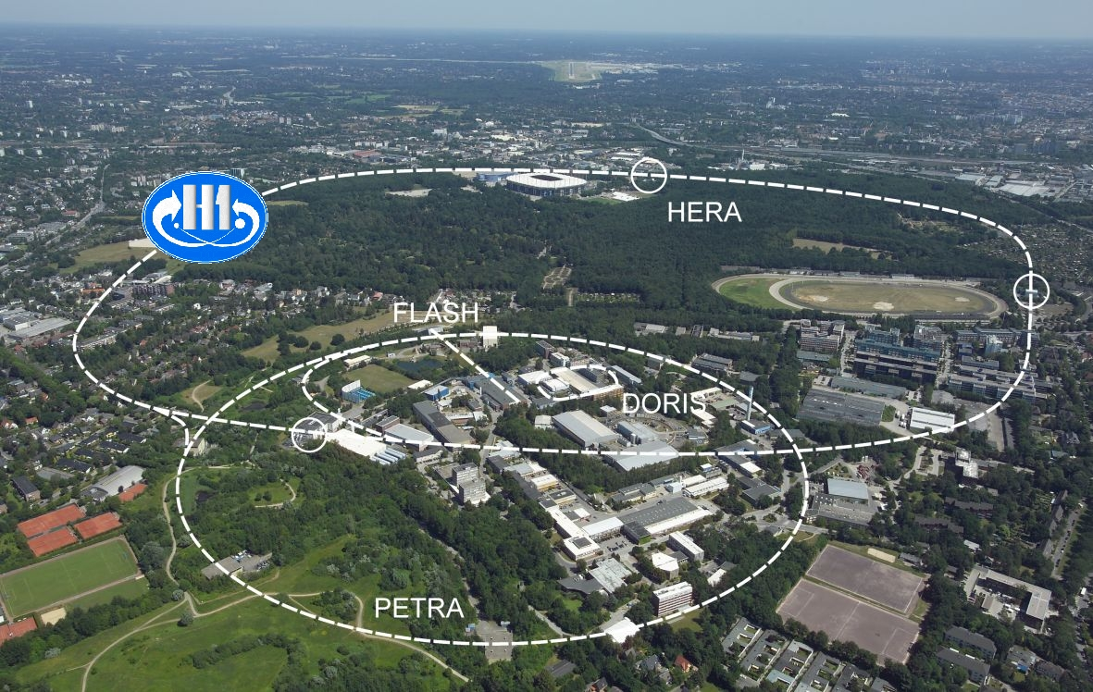

Understanding the properties of visible matter
To investigate the nucleon’s partonic structure, HERA, the previous and only
electron (projectile beam) → proton (target beam) collider, was built

Slide 8

What did HERA found?
HERA studied in detail the one-dimensional picture of a free proton
higher
√s
Density of partons
?
HERA discovery:
Gluon density dominates at x < 0.1
Limits of HERA: Low luminosity; no nuclei; no polarization of the proton beam
Relative momentum of partons
Need a high lumi, highly polarized e+p(A) collider to resolve quark and gluon spatial, momentum and spin structure in multi-dimensions in both protons and nuclei → EIC

Slide 9



Most compelling physics GOALS
How are sea quarks and gluons, and their spins, distributed in space and momentum inside the nucleon?
How do the nucleon properties emerge from them and their interactions?
What happens to the gluon density in nuclei?
gluon
emission
gluon recombination
Does it saturate at high energy?
?
Does this saturation give rise to a gluonic matter with universal properties in all nuclei, even proton?
=
How does a dense nuclear environment affect the quarks and gluons, their correlations and interactions?
How do color-charged quarks and gluons, and colorless jets, interact with a nuclear medium?
How do the confined hadronic states emerge from these quarks and gluons?
How do the quark-gluon interactions create nuclear binding?

Slide 10
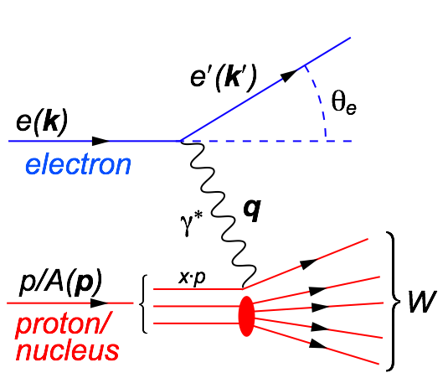
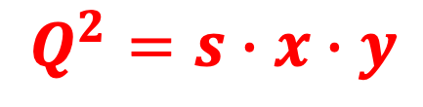
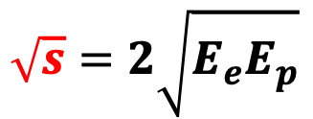
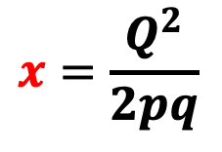
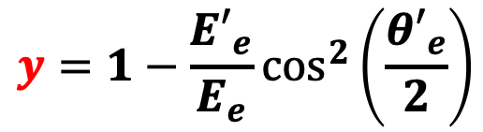
Our Tool – Deep Inelastic Scattering
Kinematics:
$$Q^{2}=2E_{e}{E′}_{e}\left(1−\cos{θ_{e′}}\right)=−{\left(k−k^{′}\right)}^{2}=−q^{2}$$
Measure of resolution power
$$y=1−\frac{{E′}_{e}}{E_{e}}\cos^{2}\left(\frac{{θ′}_{e}}{2}\right)$$
$$x=\frac{Q^{2}}{2pq}$$
$$\sqrt{s}=2\sqrt{E_{e}E_{p}}$$
Measure of inelasticity
Measure of momentum fraction of struck quark
Center-of-mass energy of electron-hadron system
All variables are correlated:
$$Q^{2}=s∙x∙y$$
DIS:
As a probe, electron beams provide unmatched precision of the electromagnetic interaction
Direct, model independent, determination of kinematics of physics processes
Indirectly probes gluons with high precision

Slide 11
Ingredients for a high resolution “femtoscope”
Large center-of-mass coverage:
Access to wide kinematic range in x and Q²
Polarized electron and hadron beams:
access to spin structure of nucleons and nuclei
Spin vehicle to access the 3D spatial and momentum structure of the nucleon
Full specification of initial and final states to probe q-g structure of NN and NNN interaction in light nuclei
Nuclear beams:
Accessing the highest gluon densities → amplification of saturation phenomena
High luminosity:
Detailed mapping the 3D spatial and momentum structure of nucleons and nuclei
Access to rare probes
All these requirement can be addressed by the future Electron-Ion Collider

Slide 12
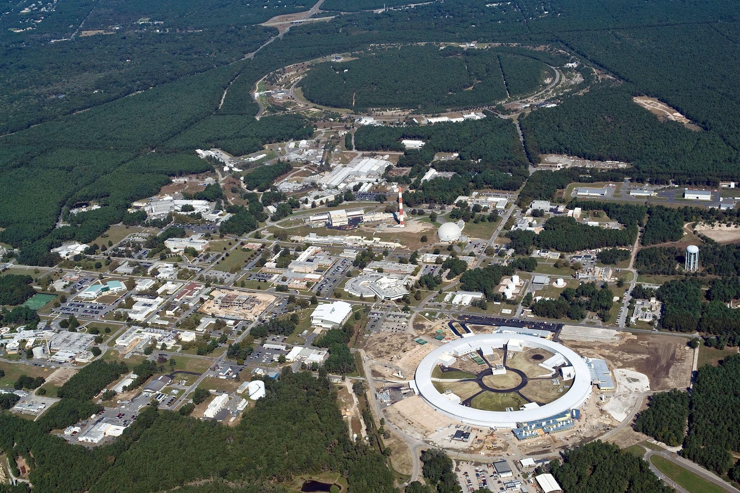
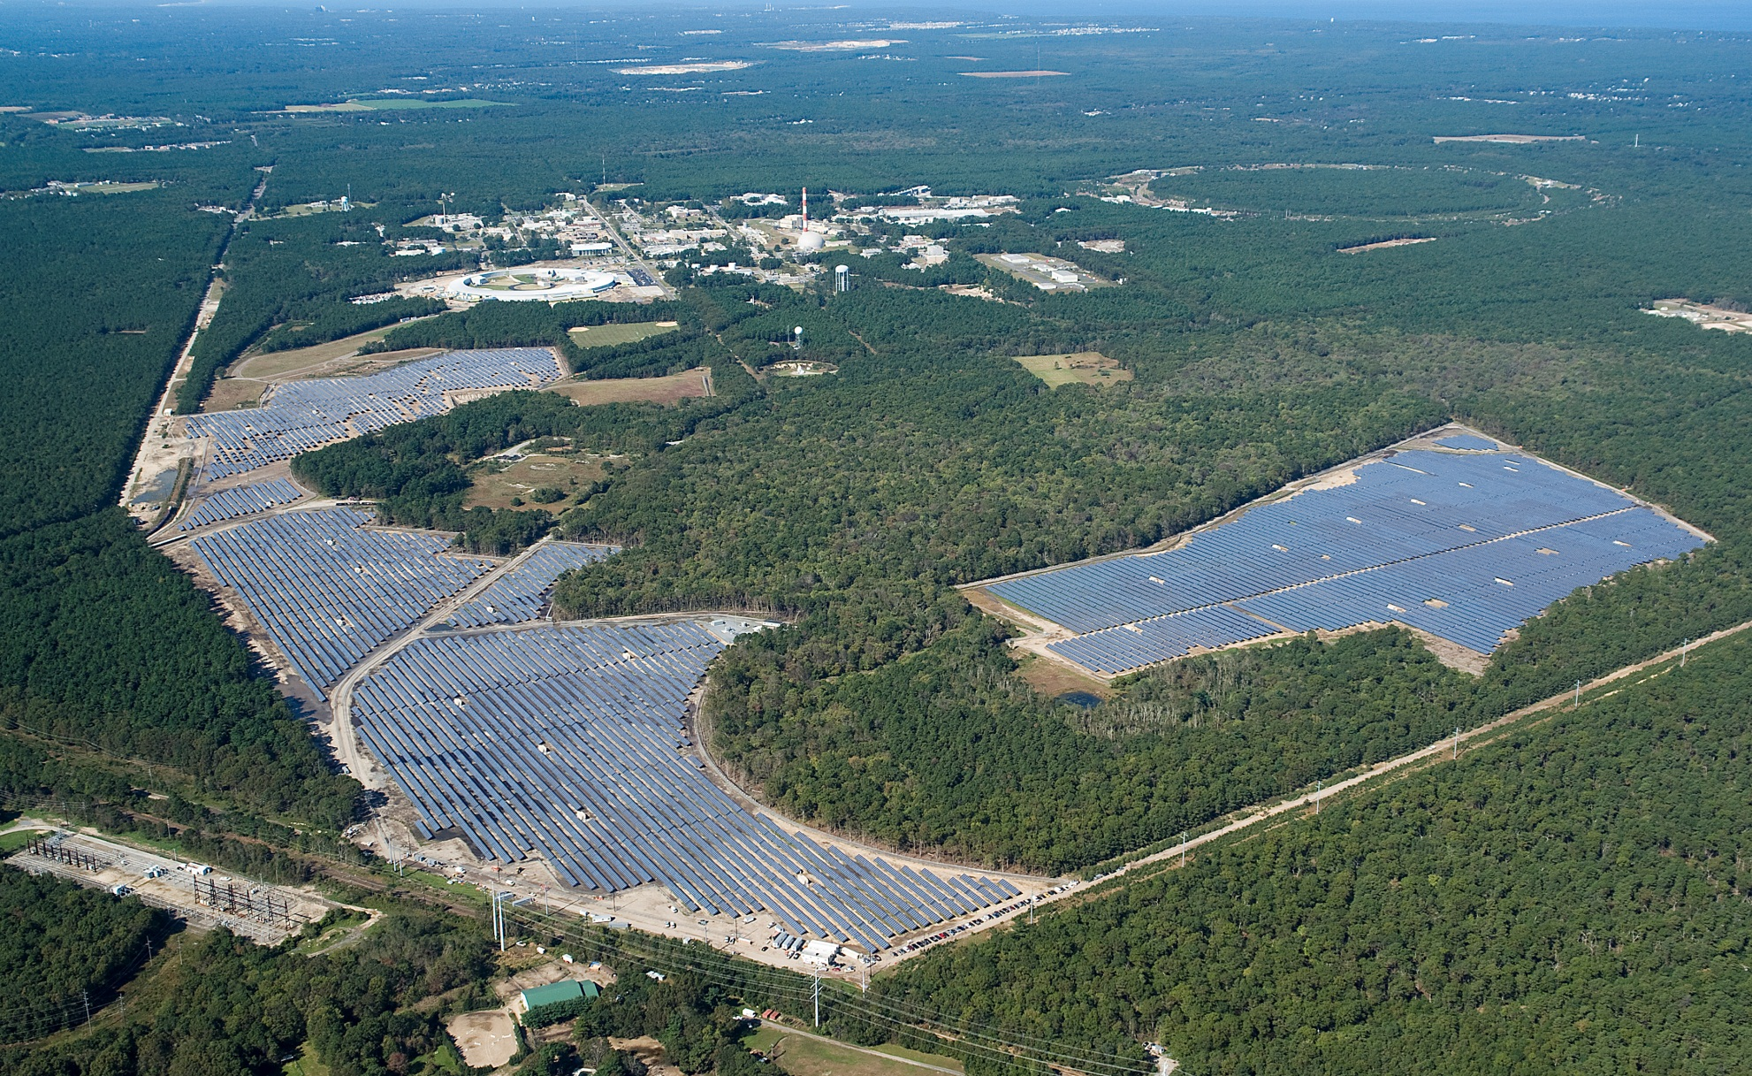
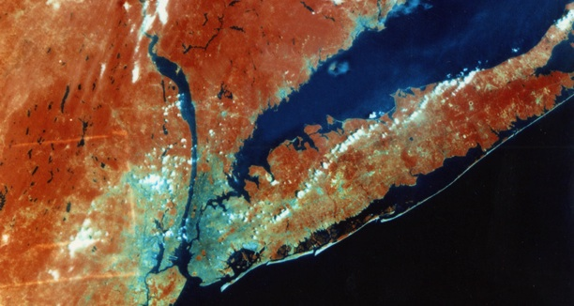
Brookhaven National Laboratory
as seen from space
RHIC
RHIC
NSLS-II
Solar Farm
Long Island
New York City
NSLS-II
S. Fazio - Brookhaven National Lab
12

Slide 13
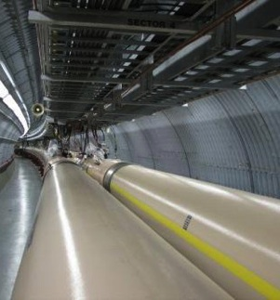
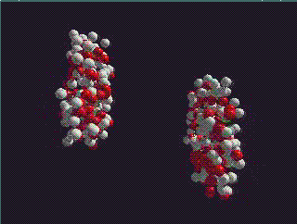
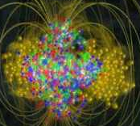
What is the Relativistic Heavy-Ion Collider?
RHIC is a particle collider operating at the Brookhaven National Laboratory (Long Island, New York)
Two particle accelerators collide beams of:
Polarized protons (the only venue in the world!)
Light nuclei
Heavy nuclei
RHIC tunnel
nucleus
nucleus
Main physics goals
Quark-gluon plasma (QGP): a state of matter in the early Universe, when quarks e gluons existed on a free state (not confined into hadrons)
  → outcome: QGP exists at extreme temperatures and behaves like a perfect fluid
Study of the proton spin
→ outcome: gluons and sea quark have also a significant contribution to the proton spin

Slide 14

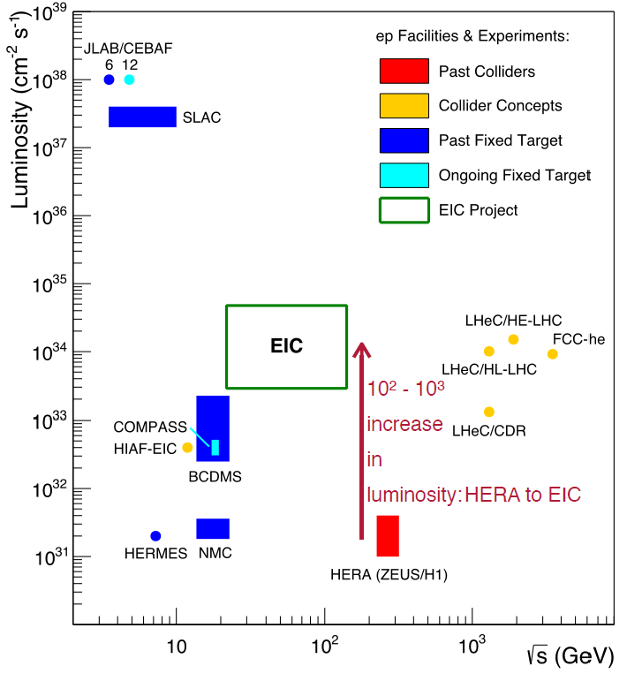

The Electron-Ion Collider
For e-N collisions at the EIC:
High Luminosity: up to 10³⁴ cm⁻²sec⁻¹
100-1000 times HERA
Flexible √s = 30-140 GeV (per nucleon)
Highly polarized beams: e (80%); p, D/³He (70%)
Wide range of nuclear beams: (D to Pb/U)
World’s first
Polarized electron-proton/light ion and electron-Nucleus collider

Slide 15
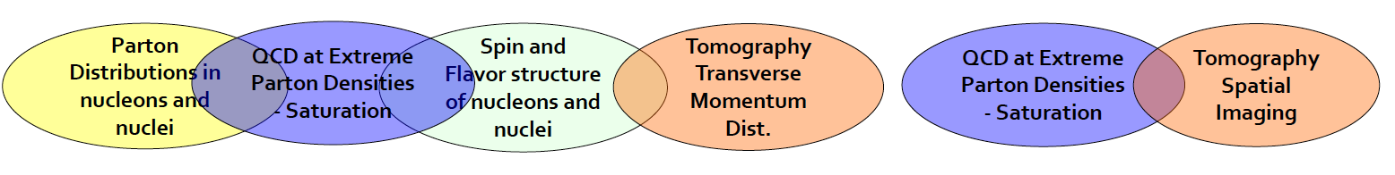


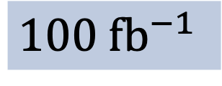
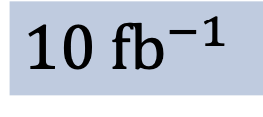
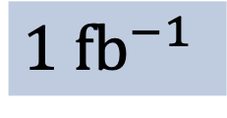
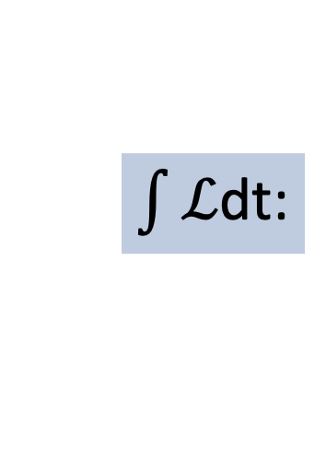
What process must be measured?
e’
γ, π,J/Ψ
e
γ_{L}*
(Q²)
x+ξ
x-ξ
~
~
H, H, E, E (x,ξ,t)
p
p’
t
Inclusive DIS
Semi-Inclusive DIS
Exclusive Reactions
$\int{ℒ}$dt:
$1 \text{f}{\text{b}}^{−1}$
$10 \text{f}{\text{b}}^{−1}$
$100 \text{f}{\text{b}}^{−1}$

Slide 16


First EIC-related workshop at the INT
Institute for Nuclear Theory – 2010 Seattle
Workshop:
Gluons and the quark sea at high energies: Distributions, polarization, tomography
arXiv: 1108.1713 [nucl-th] – 547 pages, ~ 600 citations (as of June 2022)
The principal aim of the program was to develop and sharpen the science case for an Electron-Ion Collider (EIC), a facility that will be able to collide electrons and positrons with polarized protons and with light to heavy nuclei at high energies, offering unprecedented possibilities for in-depth studies of quantum chromodynamics. This report is organized around four major themes: i) the spin and flavor structure of the proton, ii) three-dimensional structure of nucleons and nuclei in momentum and configuration space, iii) QCD matter in nuclei, and iv) Electroweak physics and the search for physics beyond the Standard Model. Beginning with an executive summary, the report contains tables of key measurements, chapter overviews for each of the major scientific themes, and detailed individual contributions on various aspects of the scientific opportunities presented by an EIC.

Slide 17



Endorsements to the EIC projects
In the 2015 Long Range Plan, the American National Science Advisory Committee (NSAC) recommended the realization of an EIC as top priority
“We recommend a high-energy high-luminosity polarized EIC as the highest priority for new facility construction following the completion of FRIB”
http://science.energy.gov/~/media/np/nsac/pdf/2015LRP/2015_LRPNS_091815.pdf
In July 2018, a Report by National Academy of Science (& Engineering & Arts) unanimously concluded that an EIC will be:
“... a unique facility in the world that would answer science questions that are compelling, fundamental, and timely”.
https://www.nap.edu/catalog/25171/an-assessment-of-us-based-electron-ion-collider-science
The EIC White Paper - 2015
Eur. Phys. J. A (2016) 52: 268
The U.S. Department of Energy (DOE) started its “critical decisions” with CD0 in December 19 and selected Brookhaven National Lab as the host lab.

Slide 18

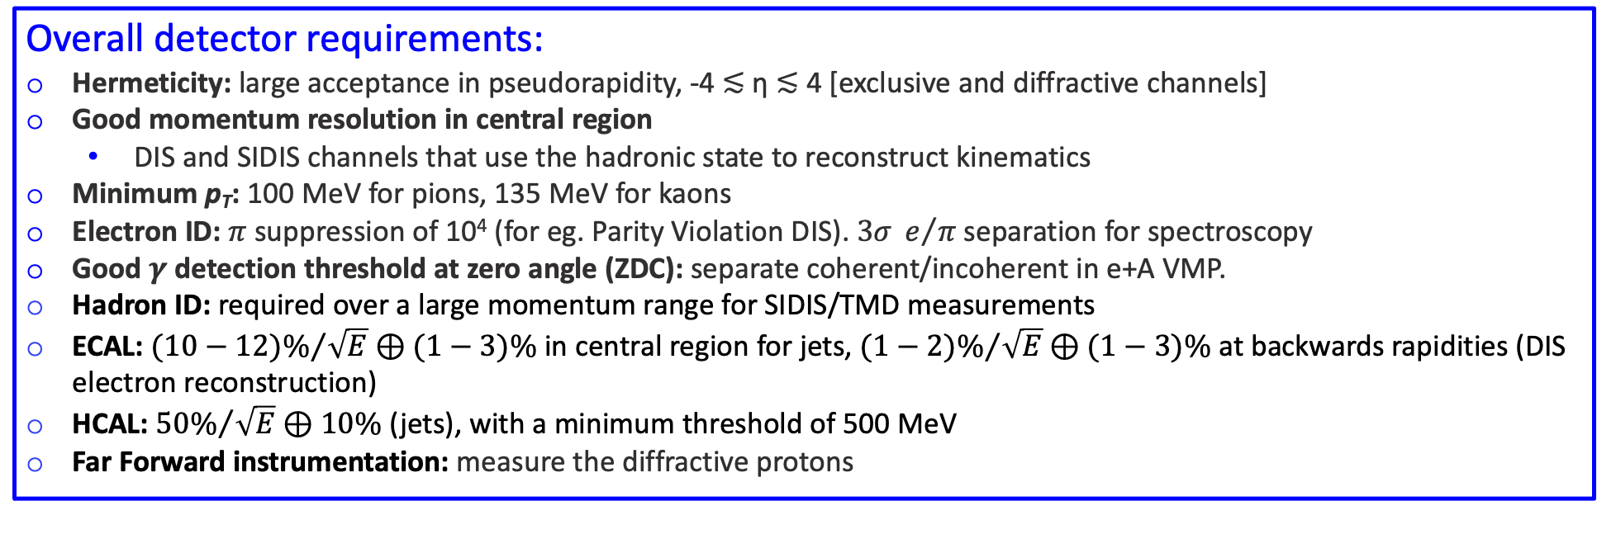
Requirements for a “general-purpose” detector
The Yellow Report Initiative (Jan-Dec 2020) – to advance the state of the documented physics studies (W.P., INT Reports) and detector concepts in preparation for the realization of the EIC.
Report released in March 2021: arXiv:2103.05419
Enormous community effort: 902 pages, 415 authors, 151 institutions
Overall detector requirements:
Hermeticity: large acceptance in pseudorapidity, -4 ≲ η ≲ 4 [exclusive and diffractive channels]
Good momentum resolution in central region
  DIS and SIDIS channels that use the hadronic state to reconstruct kinematics
Minimum p_{T}: 100 MeV for pions, 135 MeV for kaons
Electron ID: $π$ suppression of 10⁴ (for eg. Parity Violation DIS). $3σ{ e}/π$ separation for spectroscopy
Good $γ$ detection threshold at zero angle (ZDC): separate coherent/incoherent in e+A VMP.
Hadron ID: required over a large momentum range for SIDIS/TMD measurements
ECAL: ${(10−12)\%}/{\sqrt{E}}⊕(1−3)\%$ in central region for jets, ${(1−2)\%}/{\sqrt{E}}⊕(1−3)\%$ at backwards rapidities (DIS electron reconstruction)
HCAL: ${50\%}/{\sqrt{E}}⊕10\%$ (jets), with a minimum threshold of 500 MeV
Far Forward instrumentation: measure the diffractive protons

Slide 19
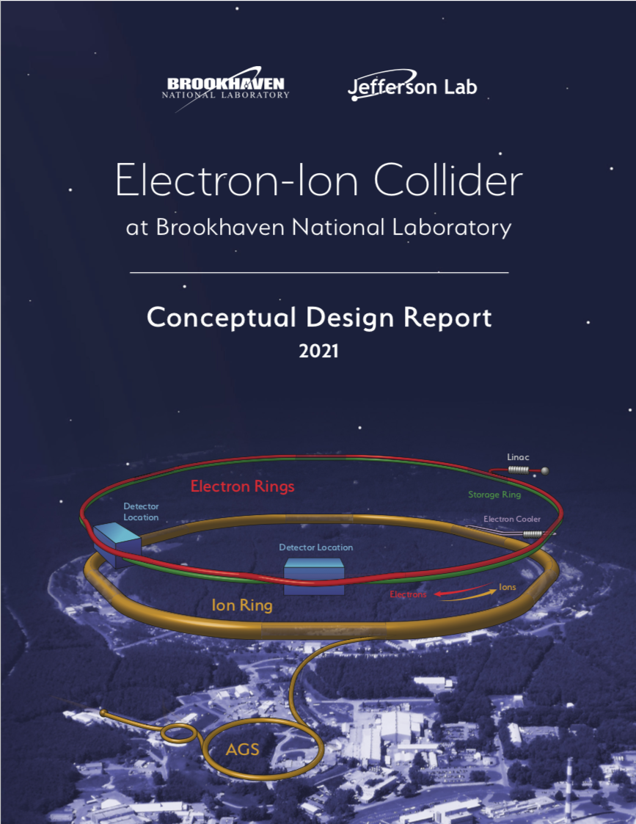

The 2021 “marathon”
February 2021: EIC Conceptual Design Report: https://doi.org/10.2172/1765663
8 March 2021 Yellow Report released: https://arxiv.org/abs/2103.05419
March 2021: Call for detector proposals: https://www.bnl.gov/eic/CFC.php
March: First meetings of protocollaborations
28 June 2021: CD-1 passed "completion of the project Definition Phase and the conceptual design."
2-7 August 2021 EICUG meeting: https://indico.bnl.gov/event/11463/
10 August 2021 call EIC Detector R&D FY22: https://indico.bnl.gov/event/10974/contributions/53172/attachments/36485/59965/Detector_RD_Plan_Aug10.2021.pdf
1st December 2021: experiment proposals sent to DoE (ATHENA, ECCE, CORE)
13-15 December 2021: first meeting of Detector Proposal Advisory Panel vis à vis proto-collaborations

Slide 20

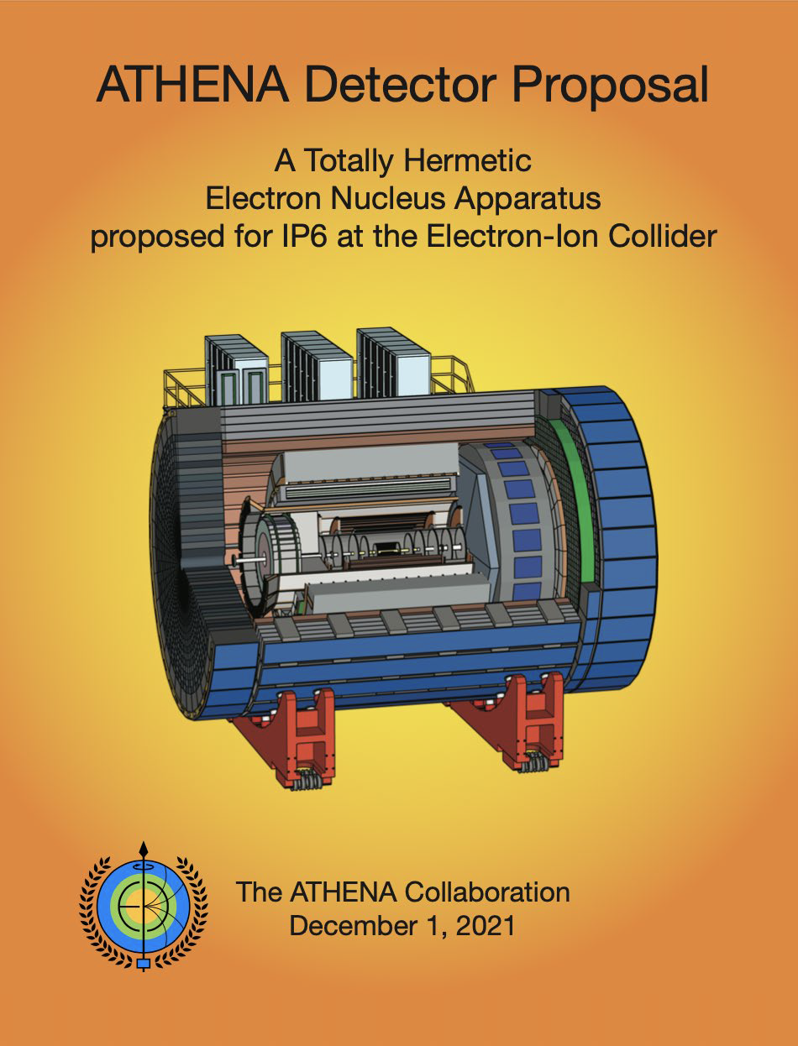
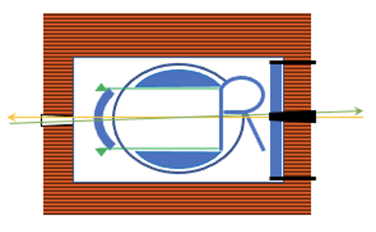

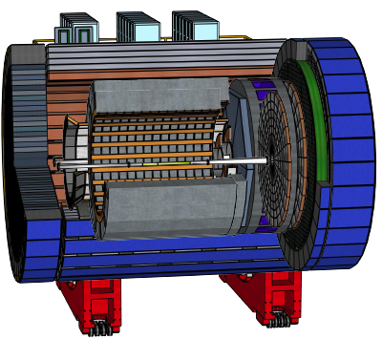
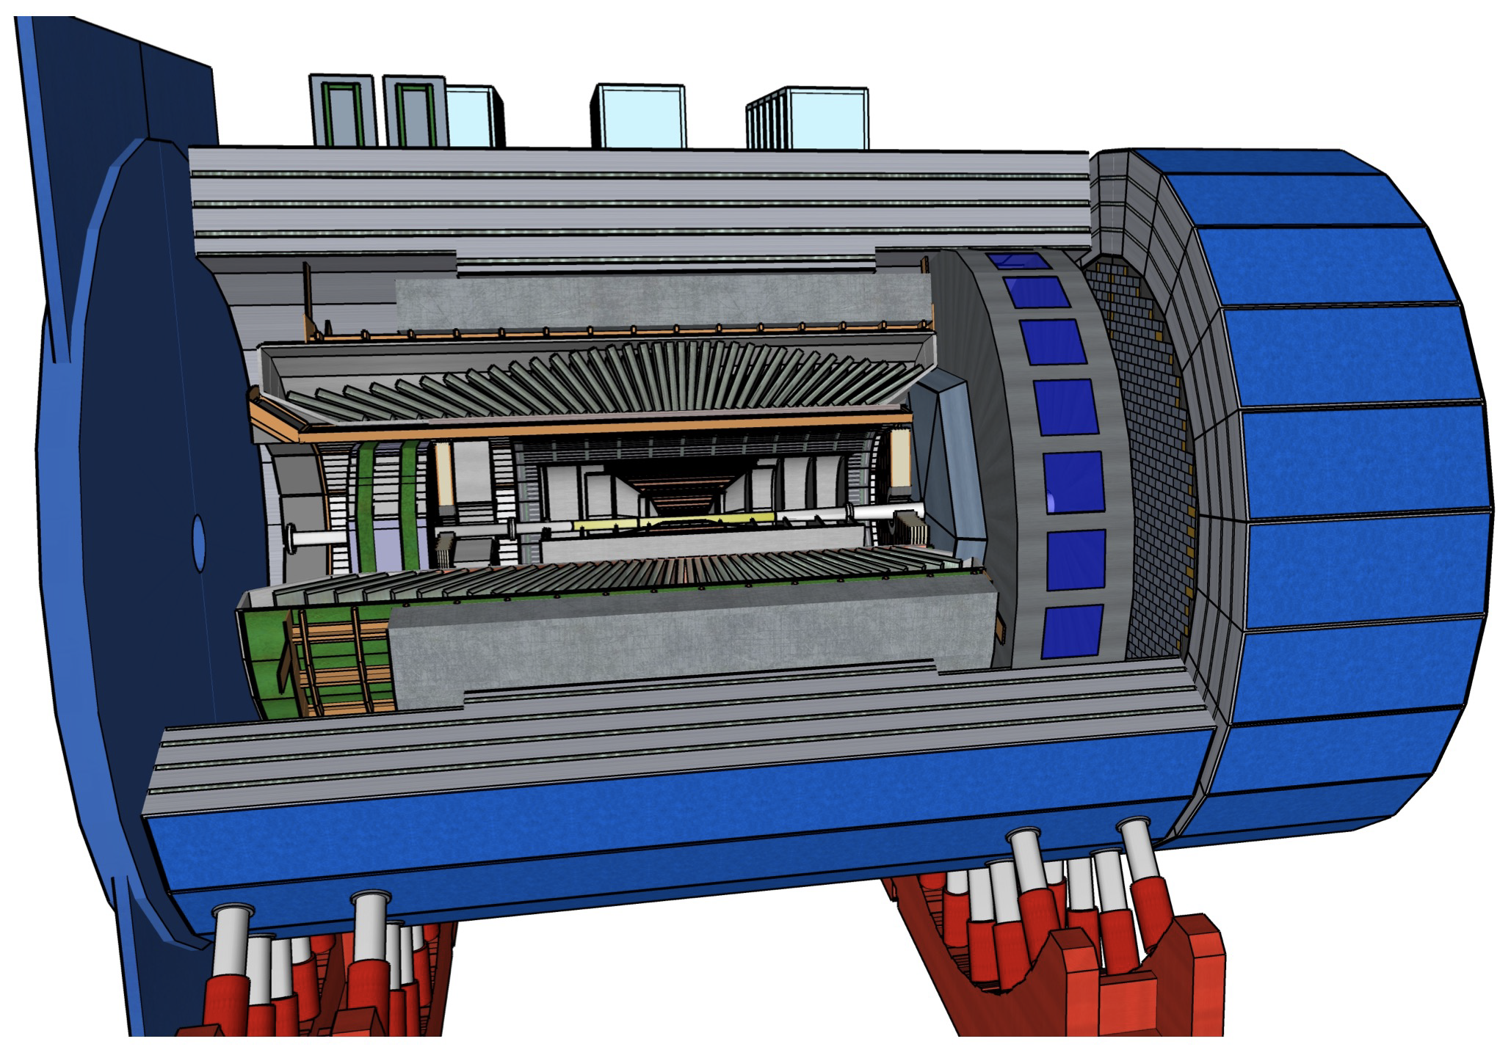
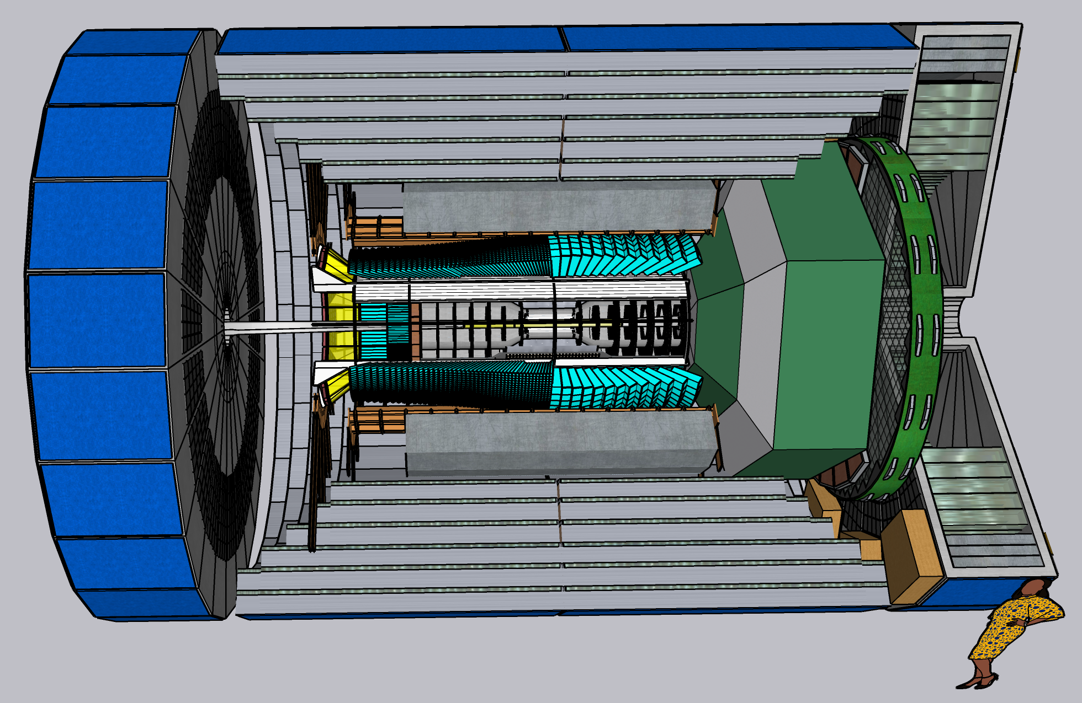
Proposed EIC detectors
Two proposals for a general purpose
«project detector»
A proposals for a
(still general purpose) complementary detector
I will often show «performance plots» based on these proposals!

Slide 21
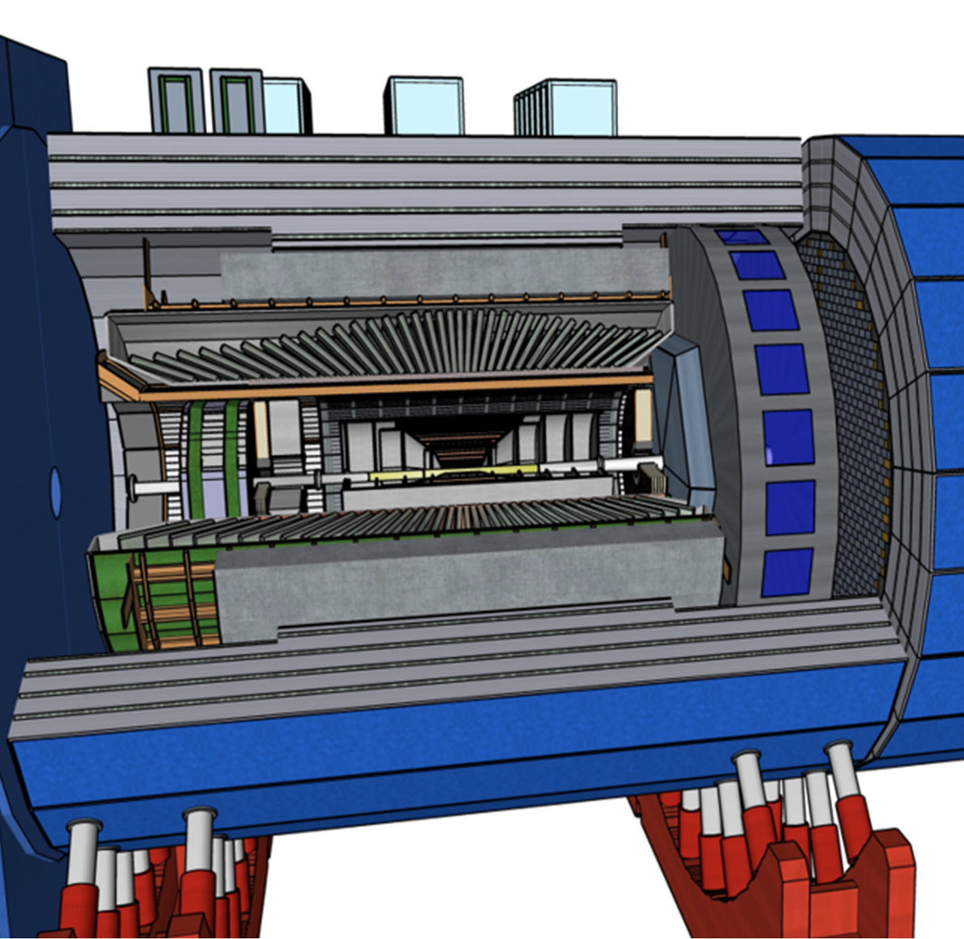
“Project Detector 1”
ECCE as reference design (1.5 T solenoid)
Design will be optimized (ATHENA expertise and beyond)
Collaboration forming process will start at the EIC Users’ Group meeting on July 26-30 at the Stony Brook University of NY
Goal is to form a new collaboration by the end of the current year
Process for including a second detector into the project scope can start soon.

Slide 22
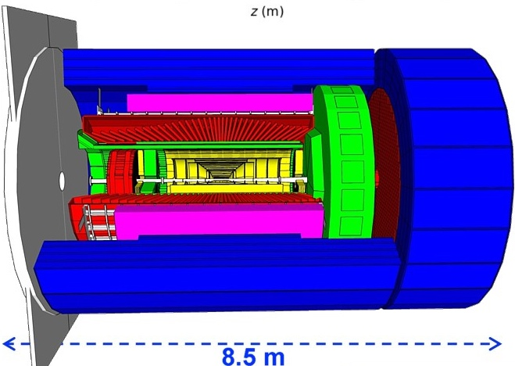
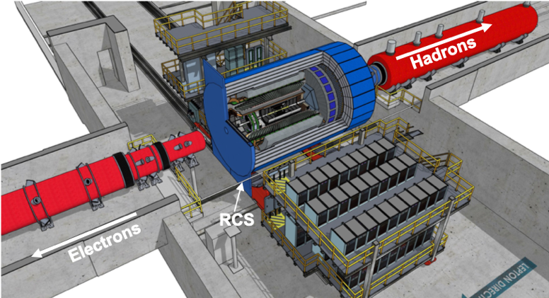
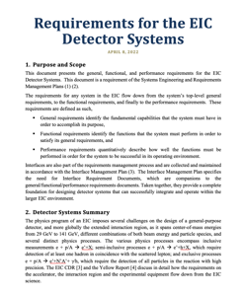
Project Detector 1
hadronic calorimeters
solenoid coils
ToF, DIRC,
RICH detectors
e/m calorimeters
MPG & MAPS trackers
Finalized Project Detector selection process 8th of March 2022
→ ECCE general-purpose Detector around
the BaBAR 1.5 T Solenoid
Hermetic coverage:
full Φ-coverage in 2º < Θ < 178º (-4<η<4 )
Consolidation of ECCE and ATHENA in full swing, make integration of all groups as welcoming as possible
Combined Leadership Team formed
Combined Physics and Technical WG formed

Slide 23
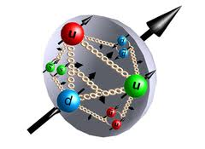

Spin Physics
what is the polarization of gluons at small x where they are most abundant?
what is the flavor decomposition of the polarized sea depending on x?
The Holy Grail
Determine quark and gluon contributions to the proton spin
The Spin Sum Rule

Slide 24
Proton’s helicity structure
Σ_{q}Δq
L_{g}
Jaffe and Manohar “sum rule” [Nucl. Phys. B337, 509 (1990)]
Σ_{q}L_{q}
δq
gluon spin
ΔG
total u+d+s
quark spin
angular
momentum
What we know:
DIS (fixed targ.) + RHIC (till 2009)
[Phys. Rev. Lett. 113, 012001 (2014)]
First time a significant
non-zero Δg(x)
RHIC: All data until 2015 factor 2 reduced uncertainties at x ~ 10⁻³
Expected impact of the EIC:
The x-range will be extended by two orders of magnitude, allowing an extremely precise measurement in the earlier poorly known area

Slide 25
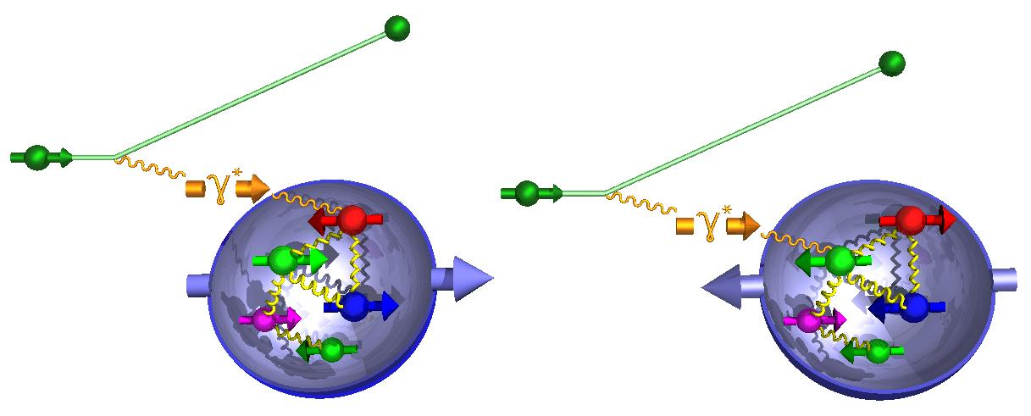
Proton’s helicity structure - Δg
DIS scaling violations of polarized structure fcn. determine Δg at small x
Δg(x,Q²)=g (x,Q²)-g (x,Q²)
g₁ scaling violation
world data
till EIC

Slide 26
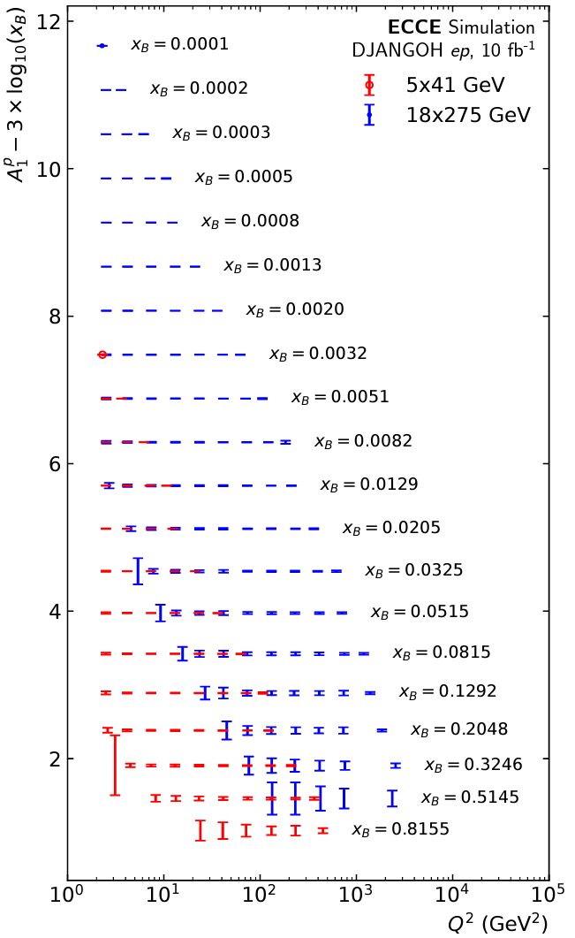
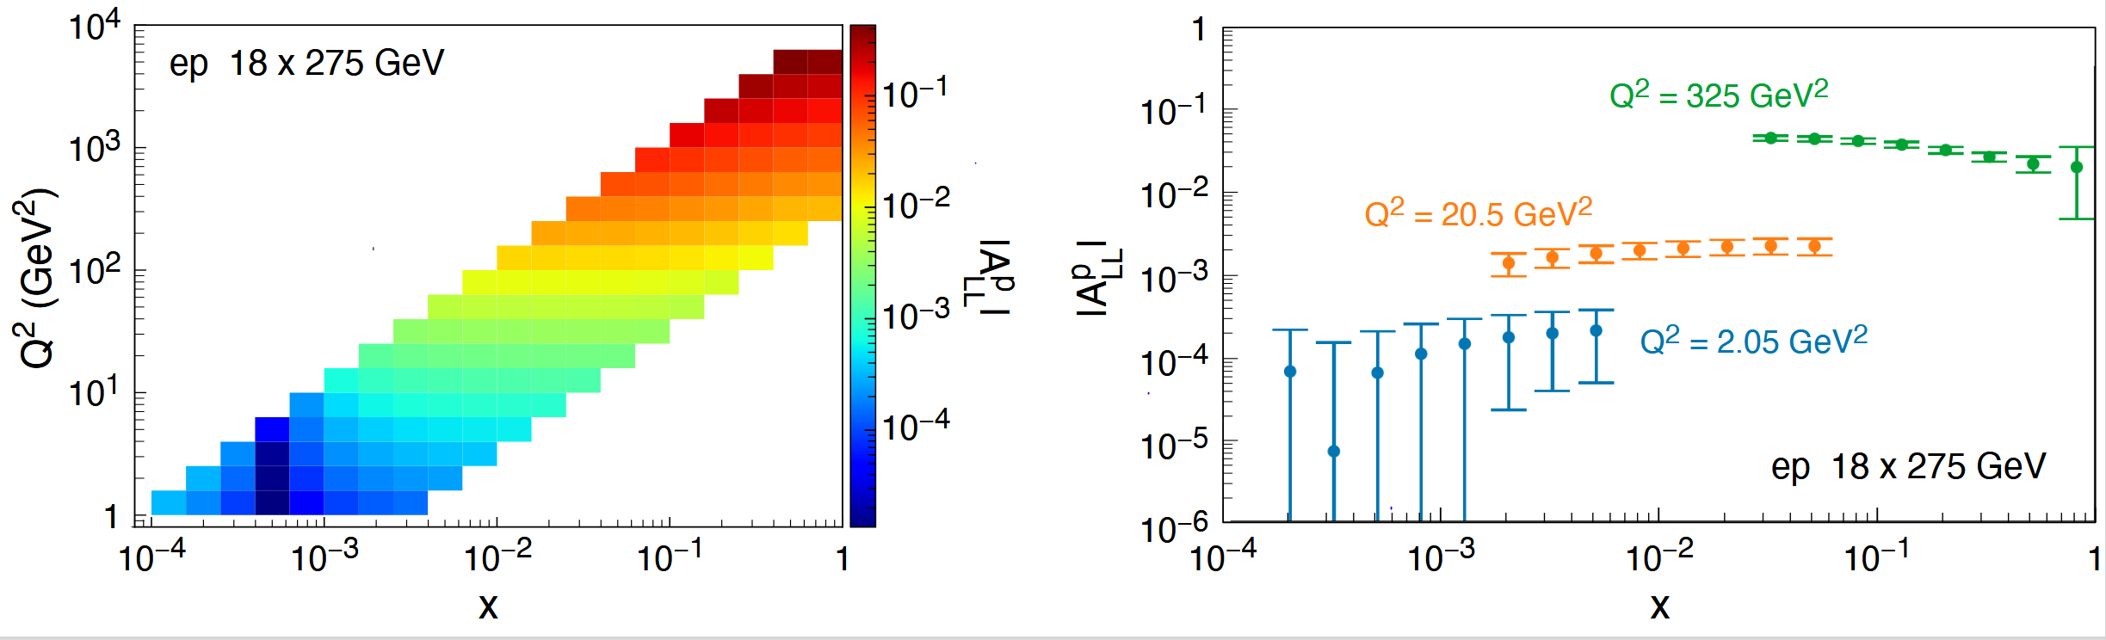

Proton’s helicity structure
Observable: Longitudinal double spin asymmetries ($A_{LL}$)
DIS scaling violations determine gluons at small x
Δg(x,Q²)=g (x,Q²)-g (x,Q²)
Key:
Acceptance
electron id
Inclusive double spin asymmetry A₁(x)
g₁ scaling violation
- Double spin asymm. in NC DIS
10 fb⁻¹

Slide 27
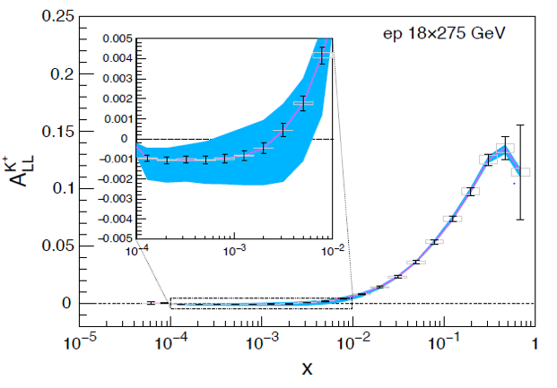
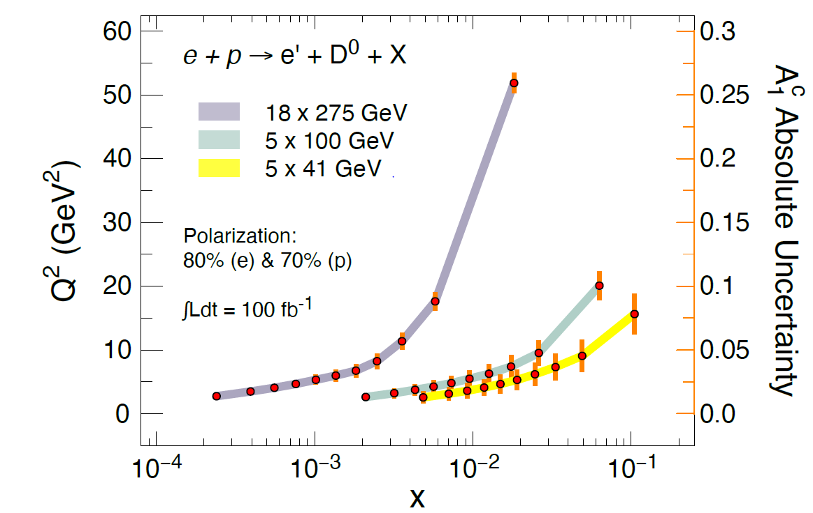
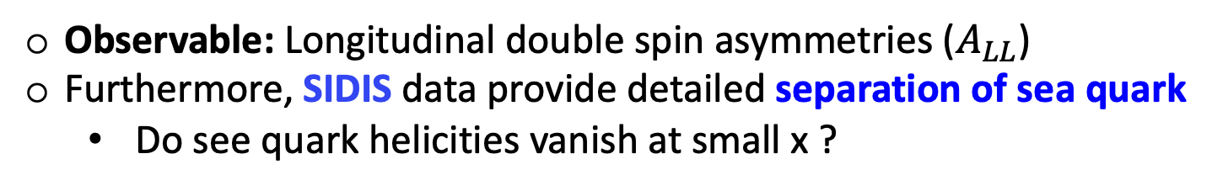
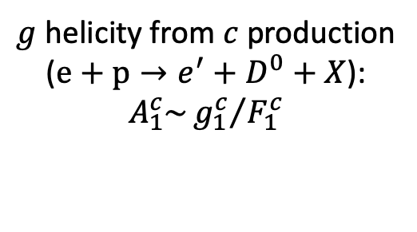
Proton’s helicity structure from SIDIS
Observable: Longitudinal double spin asymmetries ($A_{LL}$)
Furthermore, SIDIS data provide detailed separation of sea quark
  Do see quark helicities vanish at small x ?
Key:
PID (barrel, forward
Vertexing for charm tagging
Charged kaons
Charm production
$g$ helicity from $c$ production
($e+p→e^{′}+D^{0}+X$):
$$A_{1}^{c}\sim {g_{1}^{c}}/{F_{1}^{c}}$$
Theory bands from:
DSSV PDF & DSS FFs
15.5 fb⁻¹

Slide 28
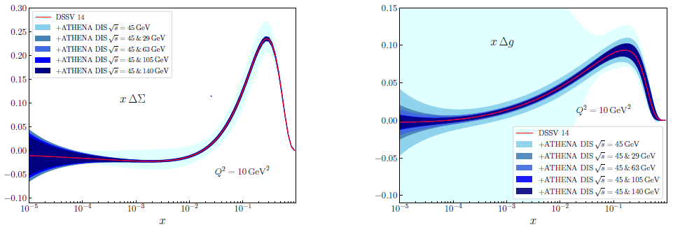

The spin sum rule
q spin
ΔΣ
g spin
Δg
New global fit by
JAM/DSSV collaboration
1/2 -
Quarks
-
Gluons
=
orb. angular momentum

Slide 29
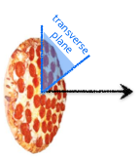
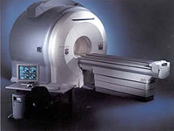
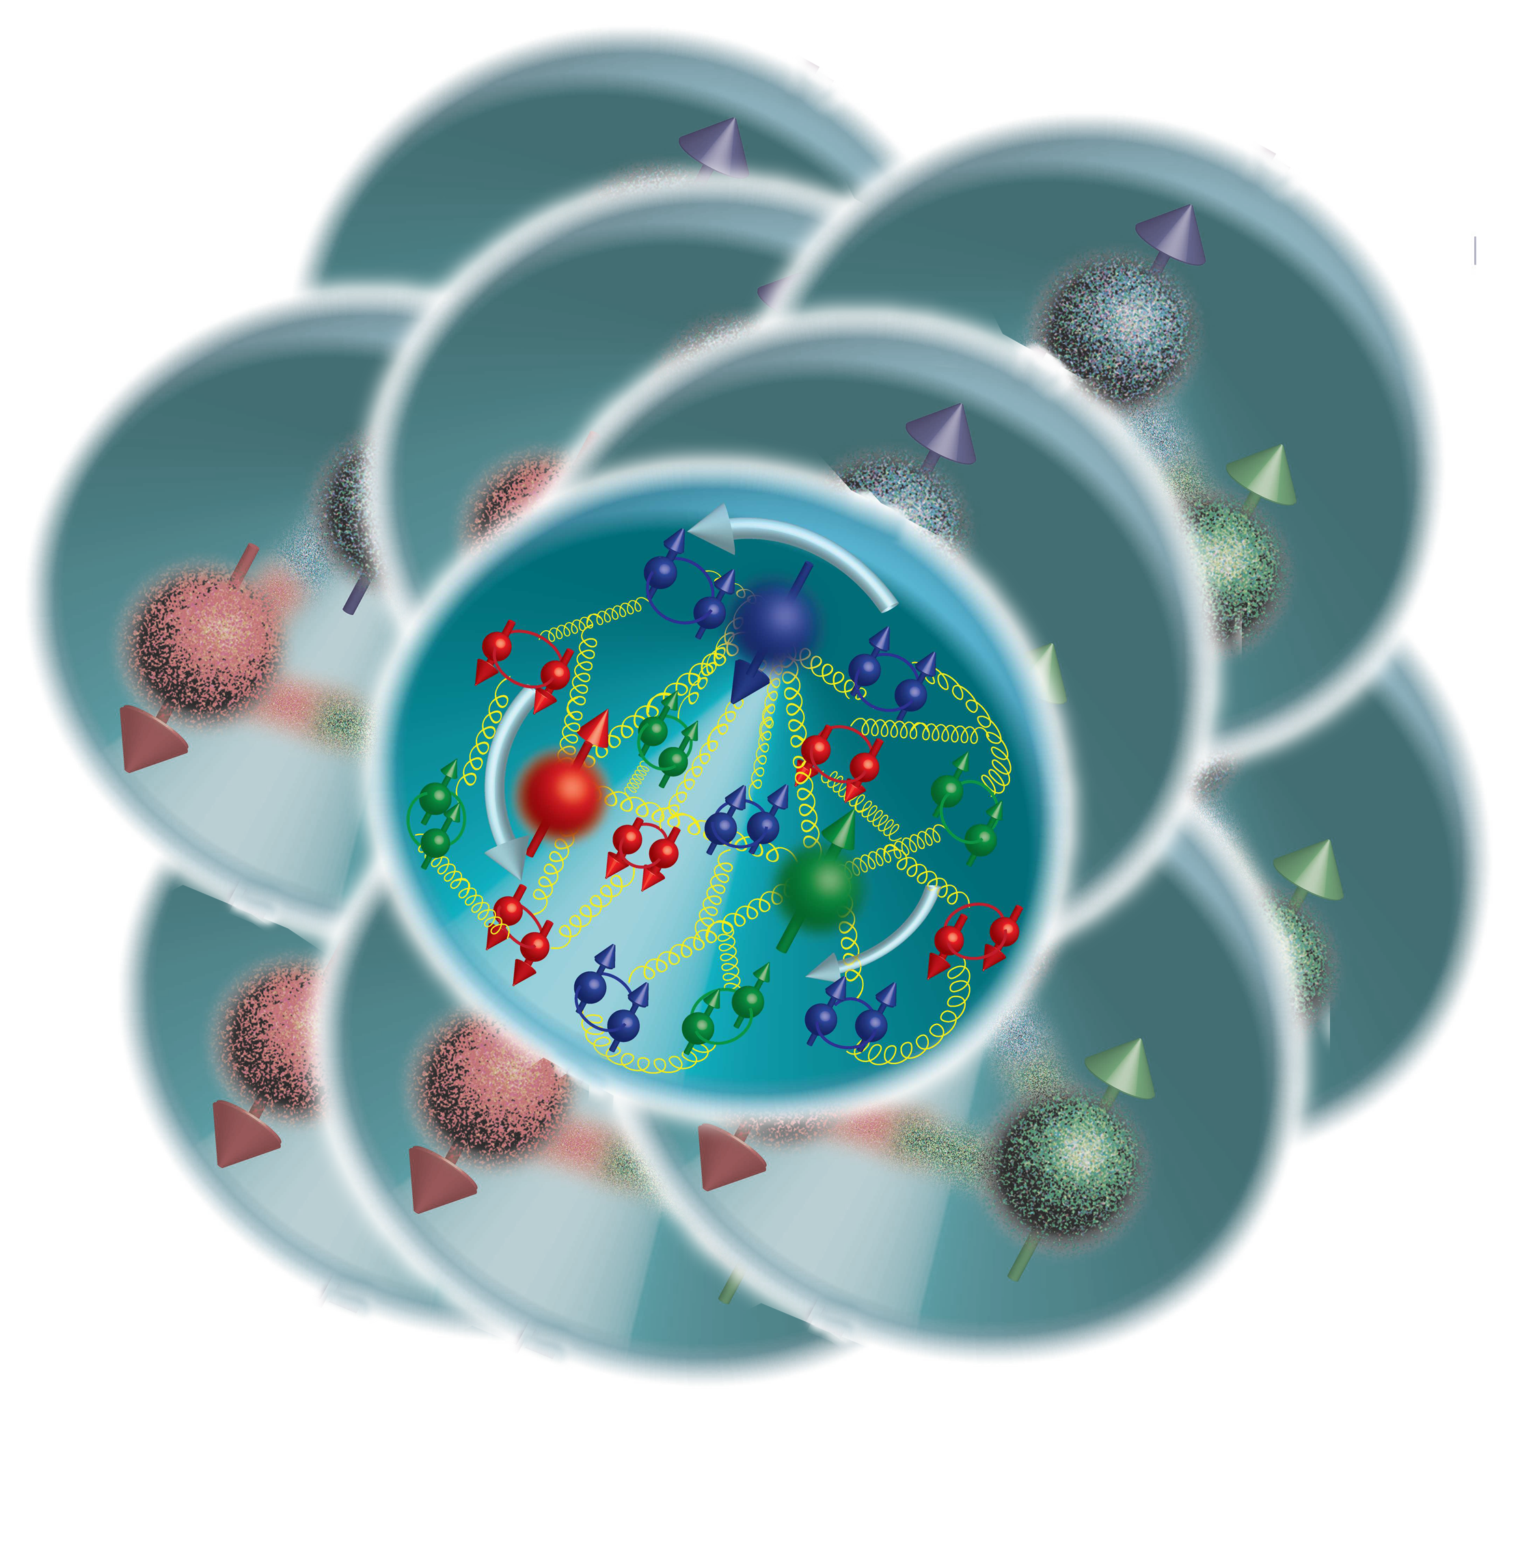
EIC: the Ultimate Multi-dimension Experience!
Proton Imaging
In a fast-moving nucleon the longitudinal size squeezes like a “pizza” but transverse size remains about 1 fm
what is the spatial and momentum distribution of quarks and gluons in nucleons/nuclei?
Can we produce tomographic images at a partonic scale?

Slide 30
Multidimensional imaging of quarks and gluons
Wigner functions
offer unprecedented insight into confinement and chiral symmetry breaking
W(x,b_{T},k_{T})
Momentum
space
∫d²b_{T}
∫ d²k_{T}
Coordinate
space
f(x,k_{T})
f(x,b_{T})
Spin-dependent 3D momentum space
images from semi-inclusive scattering
→ TMDs
Spin-dependent 2D coordinate space (transverse) + 1D (longitudinal momentum) images from exclusive scattering
→ GPDs
Direct access to W(x,b_{T},k_{T})
for gluons through exclusive di-jets measurements at an EIC under investigation

Slide 31



Momentum tomography
Transverse Momentum Dependent distributions (TMDs) are PDFs depending on transverse momentum
At low k_{T}, these functions cannot be perturbatively calculated → need precision measurement
What we want to measure:
6-fold differential cross sections in SIDIS
Azimuthal asymmetries and their modulations

Slide 32


Momentum tomography – SIDIS, Heavy Flavor, Jets
Unpolarized cross section uncertainties
Projected Sievers asymmetries
Heavy flavor
Sensitivity for Sivers in di-charm
Sensitivity for Sivers in lepton-jet
Jets:
excellent proxies for partons
probe quark TMDs without convolution with FF
di-jets can probe gluon Sivers
Key:
Azimuthal acceptance
PID
Acceptance
Vertexing (heavy flavor)
Quality of tracking
HCal (for jets)

Slide 33








Generalized Parton Distributions
Longitudinal momentum & helicity distributions
transverse charge & current densities
$f\left(x\right)$parton densities
$H\left(x,ξ,t\right)$GPDs
$F\left(t\right)$ form factors
The nucleon (spin-1/2) has four quark and gluon GPDs (H, E and their polarized-proton versions $\tilde{H}$, $\tilde{E}$). Like usual PDFs, GPDs are non-perturbative functions defined via the matrix elements of well-defined parton operators:

Slide 34

Accessing GPDs
The nucleon (spin-1/2) has four quark and gluon GPDs
Dominated by H
slightly dependent on E
sin(Φ_{Τ}−φ_{Ν})
governed by E and H
[Requires a polarized proton target]
Responsible for total orbital angular momentum through Ji sum rule: a window to the SPIN physics
[X.D. Ji, Phys. Rev. Lett. 78, 610 (1997)]
Done @ HERA
[Requires a positron beam]
Re(A) related to D-term, “last global unknown property” of a hadron, related to distribution of forces inside the nucleon [M. V. Polyakov and P. Schweitzer, Int. J. Mod. Phys. A 33, no. 26, 1830025 (2018)]

Slide 35






Accessing GPDs in exclusive processes
DVCS (γ)
VM (ρ, ω, φ, J/ψ, Υ)
^{γ*}
^{γ}
^{γ*}
V
4-momentum transfer
at the p vertex:
IP
$$p$$
$$p^{′}$$
$$p$$
$$p^{′}$$
$$t$$
t
Scale:
Q²
Q² + M²
DVCS:
Very clean experimental signature
No VM wave-function uncertainty
Hard scale provided by Q²
Sensitive to both quarks and gluons [via Q² dependence of xsec (scaling violation)
HEMP:
Uncertainty of wave function
J/Psi → direct access to gluons, c+bar-c pair produced via quark(gluon)-gluon fusion
Light VMs → quark-flavor separation
Psedoscalars → helicity-flip GPDs
DVCS on a real neutron target → polarized Deuterium or He³
Alternative/complementary way to quark-flavor separation

Slide 36
Accessing GPDs in exclusive processes
Exclusive Processes
^{γ*}
DVCS (γ),
Mesons (ρ, ω, φ, J/ψ, Υ…)
p
p’
t
Far Forward
spectrometers
Hard Exclusive processes probe specific components of GPDs
  DVCS, TCS -> whole set of GPDs
    heavy vector mesons (J/ψ, Y) -> gluon GPDs
    light vector mesons (⍴⁰; ⍴⁺; ⍵) -> quark flavors GPDs
    light pseudoscalar mesons (π⁺; π⁰; η) -> helicity-flip GPDs
  GPDs also sensitive to
    Distribution of forces inside the proton
    Contribution from orbital angular momentum to proton spin
    Energy-Momentum Tensor trace anomaly → origin of p-mass

Slide 37
Scattered proton measurement
Remember:
p_{T} of proton critical for physics
p_{T} = pʹ sin(𝛩)
ZEUS Coll, JHEP 06 (2009) 074
non-diffractive events
⟻
X_{L}=pʹ_{L}/p_{Beam}
Note:
High energy colliders (HERA, Tevatron, LHC, RHIC) use Roman Pots to detect these protons
→ RPs are high resolution movable small tracking detectors (Si strips, Si pixels…), a crucial component
Magnets aperture limits larger angles acceptance
Smaller angles acceptance limited by beam divergence and immittance
→ rule of thumb keep 10s between RP and beam

Slide 38

DVCS at the EIC
E.C. Aschenauer, S. F., K. Kumerički, D. Müller [JHEP09(2013)093]
DVCS signal
Bethe-Heitler QED bkgd.
Comprehensive EIC studies
Signal extraction “a la HERA”
xSec meas.: Specific requirements to suppress BH
keep BH/sample below 60% at high energies
Radiative Corrections evaluated
detector acceptance & smearing
t-slope: b=5.6 compatible with H1 data
|t|-binning is (3*resolution)
5% systematic uncertainties
Overlap with HERA:
Large impact on current fits at low x
Overlap with JLAB12:
Sanity check
Intermediate region:
Fine mapping of the GPDs evolution
HERA results limited by lack of statistics
EIC: the first machine to measure cross sections and asymmetries

Slide 39
BH contamination
Special selection criteria can be optimized to suppress BH below 60% at large y>0.5
20 x 250 GeV²
BH subtraction will be not an issue for y<0.6
But… BH subtraction will be relevant at lower energies and large y, in many x-Q² bins
Low energy consiguratinons require extra care
y

Slide 40

Initial state radiation
Fraction of ISR events for three Q²-bins vs. x for two EIC beam energy combinations
ONLY 15% of the events emit a photon with > 2% energy of the incoming electron
ISR photons with E_{γ} < 0.02 E_{e} do not result in a significant correction for the event kinematics
q₃
DVCS &
BH -ISR

Slide 41


DVCS – differential cross section
$$\int{L=10{fb}^{−1}}$$
EIC White Paper
DVCS
L = 10 fb⁻¹ per energy configuration
Measurement dominated by systematics
Fine binning in a wide range of x-Q² needed for GPDs
Assumed t-range: 0.03 < |t| (GeV²) < 1.6
Fourier transform of dσ/dt → partonic profiles

Slide 42

DVCS – Transverse T. Spin Asymmetry
$$\int{L=100{fb}^{−1}}$$
E.C. Aschenauer, S. F., K. Kumerički, D. Müller [JHEP09(2013)093]
Theory curves show different assumptions for E
Transversely polarized protons: sin(Φ_{Τ} − φ_{Ν})
gives access to GPD E
Access to orbital angular momentum through “Ji sum rule”
[X.D. Ji, Phys. Rev. Lett. 78, 610 (1997)]

Slide 43
DVCS-based spatial imaging
E.C. Aschenauer, S. F., K. Kumerički, D. Müller [JHEP09(2013)093]
Fourier
Fourier
Unpolarized
sea-quarks
Polarized
sea-quarks
gluons
A global fit over all mock data was done, based on: [Nuclear Physics B 794 (2008) 244–323]
Known values q(x), g(x) are assumed for H^{q}, H^{g} (at t=0 forward limits E^{q}, E^{g} are unknown)

Slide 44
DVCS-based spatial imaging
E.C. Aschenauer, S. F., K. Kumerički, D. Müller [JHEP09(2013)093]
Much still to be investigated!
Gluon GPD H can be much improved by including J/ψ
Access to gluon GPD E → orbital momentum (Ji sum rule)
Flavor Separation of GPDs (VMP and/or DVCS on deuteron)
Nuclear imaging (modification of GPDs in p+A collisions)
Unpolarized
sea-quarks
Polarized
sea-quarks
gluons
Shift due to GPD E
Impact of EIC (based on DVCS only):
Excellent reconstruction of H^{sea}, and H^{g} (from dσ/dt)
Reconstruction of sea-quarks GPD E

Slide 45


DVCS vs exclusive π⁰
Based on Goloskokov-Kroll model
Kinematic range: 10⁻⁴ < x_{B} < 0.7
1 GeV² < Q² < 1000 GeV²
0 < |t| < 1 GeV²
Yellow Report
10x100 – 10 fb⁻¹
Δ angle [deg]
Take away message:
π⁰ x-sec lower than signal (DVCS)
Min 2𝛾 angle ~0.2 deg
Exclusive π⁰ can reach high momentum/energy (but xSec decreases with meson’s energy)

Slide 46







Detector Proposals – DVCS/TCS
DVCS
Observables:
${dσ}/{dt}$; A_{LU}; A_{UT}
Asymmetries (DVCS & TCS):
GPDs via amplitude-level interference with Bethe-Heitler
DVCS
10 x 275 GeV²
Reconstructed from (e,e’𝛾)
  Generated (Green), Accepted (black), Reconstructed (red)
Key:
Acceptance (including FF)
$γ/{π^{0}}$ separation in ECAL
$t$- lever arm in FF spectrometers
DVCS
TCS
B0-RPs gap
(beamline design)
Timelike Compton Scattering (TCS)
$γp→γ^{∗}p$ ($γ^{∗}→l^{+}l^{−}$)
$Q^{′}$: invariant mass of $l^{+}l^{−}$
$τ=Q^{2}=\left(s−m_{p}^{2}\right)$ equivalente to $x_{B}$

Slide 47











How to separate flavors?
Hard Exclusive Meson Production (HEMP) → a powerful tool!
quantum numbers of final state select different GPD
DVCS
pseudo-scalar mesons
vector mesons
$$H^{q }$$
$$E^{q }$$
$$\tilde{H^{q}}$$
$$\tilde{E^{q}}$$
$$\tilde{H^{q}}$$
$$\tilde{E^{q}}$$
$$H^{q }$$
$$E^{q }$$
π⁰ | 2Δu+Δd
η | 2Δu−Δd
ρ⁰ | 2u+d, 9g/4
ω | 2u−d, 3g/4
φ | s, g
ρ⁺ | u−d
J/ψ, Y | g
DVCS on protons and neutrons also separates u/d flavors
We do not have a real neutron target → Use Deuterium

Slide 48


Imaging gluons with J/ψ
$$\int{L=10 {fb}^{−1}}$$
EIC White Paper
Challenges of VMP
Uncertainty on wave function
measuring muon vs electron decay channel
We simulated the J/ψ cross section, extracted the Fourier transform but never included it on GPDs fits
Measurement dominated by systematics at low |t|
Large-|t| spectrum would benefit of collecting more luminosity
Only possible at EIC:
from valence quark region, deep into the sea!
Average densities

Slide 49

J/ψ signal vs background
Yellow Report: Sylvester Joosten (ANL)
Comparisons of signal and di-lepton background (empty circles)
Basic analysis cuts applied
Electroproduction (Q²>1GeV²): Di-lepton background under control at all energies for heavy mesons [J/ψ; Y]
photoproduction (Q²~0): at lower energies, di-lepton higher that signal at backward rapidities: η<-2 (J/ψ) and η<-3 (Y)

Slide 50


Imaging gluons with Y(1s)
$$\int{L=100 {fb}^{−1}}$$
Yellow Report exercise:
More simulation and studies at different energies (S. Joosten)

Slide 51







Detector Proposals- VMs
$$\vec{e}+\vec{p}→e+p+\vec{V}$$
VMs invariant mass at CORE
Key:
Acceptance and low material for VM decay leptons
Resolution of lepton pair inv. mass
Muon id
Scattered electrons over full kinem.
$t$- lever arm in FF spectrometers
$Y$ Photopoduction near threshold and electro-production (Q² < 1 GeV²) -> origin of p-mass

Slide 52


Imaging neutron via spectator tagging
Yellow Report: Kong Tu and Alexander Jentsch (BNL)
Possibility to study neutron structure
DVCS/VMP on neutron compared to proton is important for flavor separation
Using a Deuteron is the simplest case:
DVCS on incoherent D (D breaks up) but coherent on the neutron, the “double tagging” method
  Gives you a free neutron structure, not affected by final state interactions
n
p
n’
p’
Polarized He3 also available but more complex theoretically

Slide 53





Study of neutrons with light nuclei
Possibility to study neutron structure
DVCS on neutron compared to proton is important for flavor $u/d$ separation
𝛾
DVCS on incoherent D (D breaks up) but coherent on the neutron, the “double tagging” method
  Tag DIS on a neutron (by the ZDC)
  Measure the recoil proton momentum
  The recoil proton momentum cone is
    $α_{R}={\left(E_{R}+p_{R||}\right)}/{\left(E_{D}+p_{D||}\right)}$ and $p_{RT}$
  Gives you a free neutron structure, not affected by final state interactions
ATHENA – DVCS on e+D:
80-90% acceptance at low |t|,
|t|-acceptance loss at higher value mostly due to the loss in tagging the active neutron in ZDC.
Alternatively, |t| can be measured via scattered e and $γ$ → higher acceptance at large |t|.
Proton momentum is well reconstructed

Slide 54

And what about the nuclei?
How does the nuclear environment affect the distribution of quarks and gluons and their interaction in nuclei?
Incoming
Electron Beam
Where does the saturation of the gluon density set in?

Slide 55


Nuclear Structure Functions
Ratio:F₂(x,Q²)_{Pb}/F₂(x,Q²)_{p}
Inclusive DIS on e+A analog to e+p:
quark+anti-quark
gluons
(or tag on F₂-charm)
DGLAP evolution model:
predicts Q² but not A-dependence and x-dependence
Saturation models:
predict A-dependence and x-dependence but not Q²
→ Need: large Q² lever-arm for fixed x, A-scan
Aim at extending our knowledge on structure functions into the realm where gluon saturation effects emerge ⇒ different evolution
An EIC provides a factor 10 larger reach in Q² and low-x compared to available data

Slide 56
Reduced Cross Section & F₂ (e+Au)
  Systematics = 3%
  Stat. and Sys. error summed in quadrature (Sys. dominate!)
  Gluon extraction via scaling violation → dσ(x,Q²)/dlnQ² (requires ~> 1 decade in Q² at a fixed x)
  Comparison of linear with non-linear evolution in x will signal saturation ⇒ needs low-x reach
σ
An EIC at its highest energy provides a factor 10 larger reach in Q² and low-x compared to available data
Large expected impact on current theory uncertainty, especially at low-x and low-Q²

Slide 57


Extracting F_{L} (e+Au)
Higher energy EIC: √s = 63, 78, 89 GeV
Simulation:
[√s = 63 GeV] –> L = 2 fb⁻¹/A
[√s = 78 GeV] –> L = 4 fb⁻¹/A
[√s = 89 GeV] –> L = 4 fb⁻¹/A
Errors still dominated by systematics
Total simulated event sample L = 10 fb⁻¹/A
total error = stat. + sys. in quadrature
assumed sys. = 3%

Slide 58

Charm production: a unique tool!
Direct access to gluons at medium to high x by tagging photon-gluon fusion
Helps determining heavy quarks mass scheme
Novel probe!
Selection of charm-production events:
We select kaons in the final state of the D meson decay, looking for:
a displaced vertex: 0.01 cm <|Vertex|< 3 cm
Momentum within the acceptance of an EIC model detector

Slide 59

Charm - reduced Cross Section & F₂ (e+Au)
  Systematics = 7%
  Stat. and Sys. error summed in quadrature (Sys. dominate!)
  No world data exist!
σ
Large expected impact on current theory uncertainty, in the whole x range

Slide 60
The EIC impact on gluon nPDFs
EPPS16*→ functional form with less constraints (for gluons) in extrapolating for x < xdata
low-energy scenario
high-energy scenario
EPPS16*
EPPS16*
E.C. Aschenauer, S. F., M.A.C. Lamont, H. Paukkunen, P. Zurita
[arXiv:1708.05654]
  Higher c.o.m. energy constrains gluons at mid- and low-x
  Fitting the charm pseudo-data has a dramatic effect at high-x

Slide 61









Detec. Proposals - Collinear PDFs on protons and nuclei
nPDFs: Au/p
Impact after global fits
proton PDFs
gluon nPDFs
constrained at the ~10% level over large x-arm
$$g$$
$$g$$
$$u_{V}$$
proton PDFs
impact on HERA + LHC global fits
EIC/ATHENA constrains the high-x region
$$\overline{u}$$
xFitter framework
$$d_{V}$$
$$u_{V}$$
$$u_{V}$$
Key:
Fine resolution in y over a large phase space
Minimum x for p fit
Minimum x for A fit

Slide 62



Imaging of gluons in Nuclei
Diffractive vector meson production:
e + Au → e′ + Au′ + J/ψ
Fourier Transform
suppress
by detecting
break-up
neutrons
PRC 87 (2013) 024913
J/ψ
possible Source distribution with b_{T}^{g} = 2 GeV⁻²
  Nuclear modifications of GPDs & gluon saturation
  Coherent part probes “shape of black disc”
  Incoherent part (large t) sensitive to “lumpiness” of the source [= proton] (fluctuations, hot spots, ...)

Slide 63



A window into the Gluon Saturation regime
gluon
emission
gluon recombination
?=?
L ~ (2m_{N} x)⁻¹ > 2 R_{A} ~ A^{1/3}
Probe interacts coherently with all nucleons
Gold: 197 times smaller effective x !
EIC will map the transition between a non-saturated and a saturated regime with high precision, by making use of a large range of nuclei and spin
With its flexible ion source we will be able to measure the A-dependence of the saturation scale Q_{s}(x)
→ a fundamental landmark of QCD
Ca
p

Slide 64

Saturation via Di-hadron correlations
side-view:
jet-1
beam-view:
p
π
A
Low gluon density (ep):
pQCD predicts 2→2 process
⇒ back-to-back di-jet
jet-2
High gluon density (eA):
2 → many process
⇒ expect broadening of away-side

Slide 65


Detector Proposals - Di-hadron correlations
Relative yield of correlated back-to-back hadron pairs in e+Au/e+p scaled down by A^{1/3} (the number of nucleons at a fixed impact parameter)
w/o saturation
di-jets
w/ saturation
Key:
Quality detection at mid rapidity
Reconstruction of dijets sensitive to saturation effects

Slide 66


Saturation via Diffraction
Diffraction
High sensitivity to gluon density in linear regime σ~[g(x,Q²)]²
Inclusive diffraction:
Exclusive VMP
Transition in M_{x}
Φ meson production

Slide 67


The EIC Users’ Group
EIC is an International enterprise!
EIC Users Group formally established in 2016
> 1330 di Ph.D. members
267 institutions from more than 36 countries
Continuously growing!
Visit EICUG.ORG
# of participants/country
Strong interest by the INFN
Italy is the second Contry by # of participants!

Slide 68

The INFN “EIC_net” initiative
EIC-related INFN experimental community
A growing community with different background:
COMPASS, JLAB/CLAS12, ALICE, ATLAS, CMS, STAR.
  From generic R&D to "experiment mode”
    dRHIC
    Si tracker (MAPS)
    LGADs silicon sensors (?)
    Simulation
  Having a good role in forming the new experimental collaboration
  Grow an EIC generation
PV(?)
PD
TS
TO
FE
GE
BO
RM1/RM2
LNF
BA
SA(?)
CS
CT/LNS
+ a very active theory component

Slide 69
The EIC Project time schedule
E.C. Aschenauer – Det. 1 Meeting, Apr. 22, 2022
EIC
Operating* Funds
Project Engineering and Design (PED) Funds
Construction & PED
Funds
Operating Funds
Initiation
Definition
Execution
Closeout
Conceptual Design
Preliminary Design
Final Design
Construction
Critical
Decisions
CD-0
Approve Mission Need
CD-1
Approve Alternative Selection
and Cost
Range
CD-2
Approve Performance Baseline (PB)
CD-3
Approve Start of Construction or Execution
CD-4
Approve
Start of Operations or Project Completion
Gateway Reviews
CD-0, Mission Need
CD-1, Alternative Selection and Cost Range
CD-2, Performance Baseline
CD-3a, Long Lead Procurement
    EIC Critical Decision Plan at CD-1*
    CD-2/3a April 2023
    CD-3 July 2024
    CD-4a early finish July 2030
    CD-4a July 2031
    CD-4 early finish July 2031
    CD-4 July 2033
*revision ongoing based on FY22 actuals.

Slide 70
Summary
The EIC (with a state of art detector) will allow us to obtain the answers to the big questions discussed
  Solve the proton spin puzzle
  How visible matter emerges from quarks and gluons, confined in hadrons?
  3D imaging in momentum and coordinate space of nucleons and nuclei
    Investigate the origin of proton mass
  Map the region of the transition from non-saturated to saturated regime
  And much more I had no time to cover: e.g. Spectroscopy, Cold Nuclear matter, Wigner fnc., separation of Y states...
Excellent proposals have been presented for possible collider detector with high resolution, wide acceptance and good particle identification
  we are one single dedicated and enthusiastic community worldwide.

Slide 71

Impact of the EIC on other fields
Maintain Leadership in Accelerator Science
  Applications of Energy Recovery Linacs
  Superconductive RF Technology
  Magnet Technology
  High-Current Polarized Electron source
Workforce: Training Next Generation Scientists
Advanced Scientific Computing
Connections with Atomic, High Energy, and Astro-Physics
Chapter 6
of the N.A.S. Report
https://www.nap.edu/download/25171
Fundamental Science is a constant source of direct and indirect technological applications.
Nevertheless, it is the passion and enthusiasm for basic knowledge that constantly motivates scientists to explore the unknown, pushing further the frontier of human knowledge.

Slide 72


Impact of the EIC on other fields
vs.
Michael Faraday (1791-1867)
William E. Gladstone (1809–1898)
Faraday's reply to William Gladstone, then British Chancellor of the Exchequer (minister of finance), when asked of the practical value of electricity (1850)
"One day sir, you may tax it."
As quoted in The Harvest of a Quiet Eye : A Selection of Scientific Quotations (1977), p. 56

