Slide 1
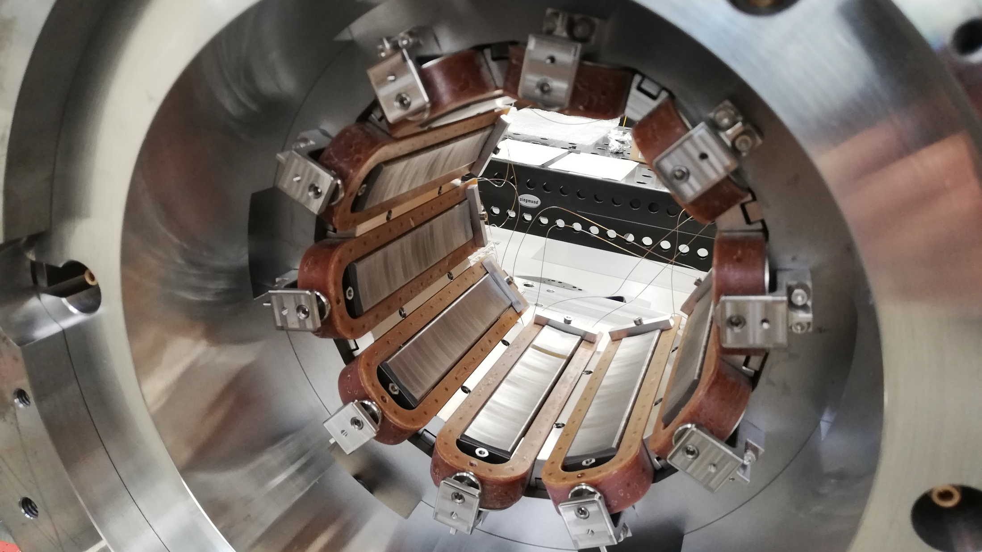




Quench Localization in Superconducting Magnets using the Harmonic Field Analysis Method
Samuele Mariotto
on behalf of INFN LASA
Superconducting Magnet Group
Milan, Italy

Slide 2
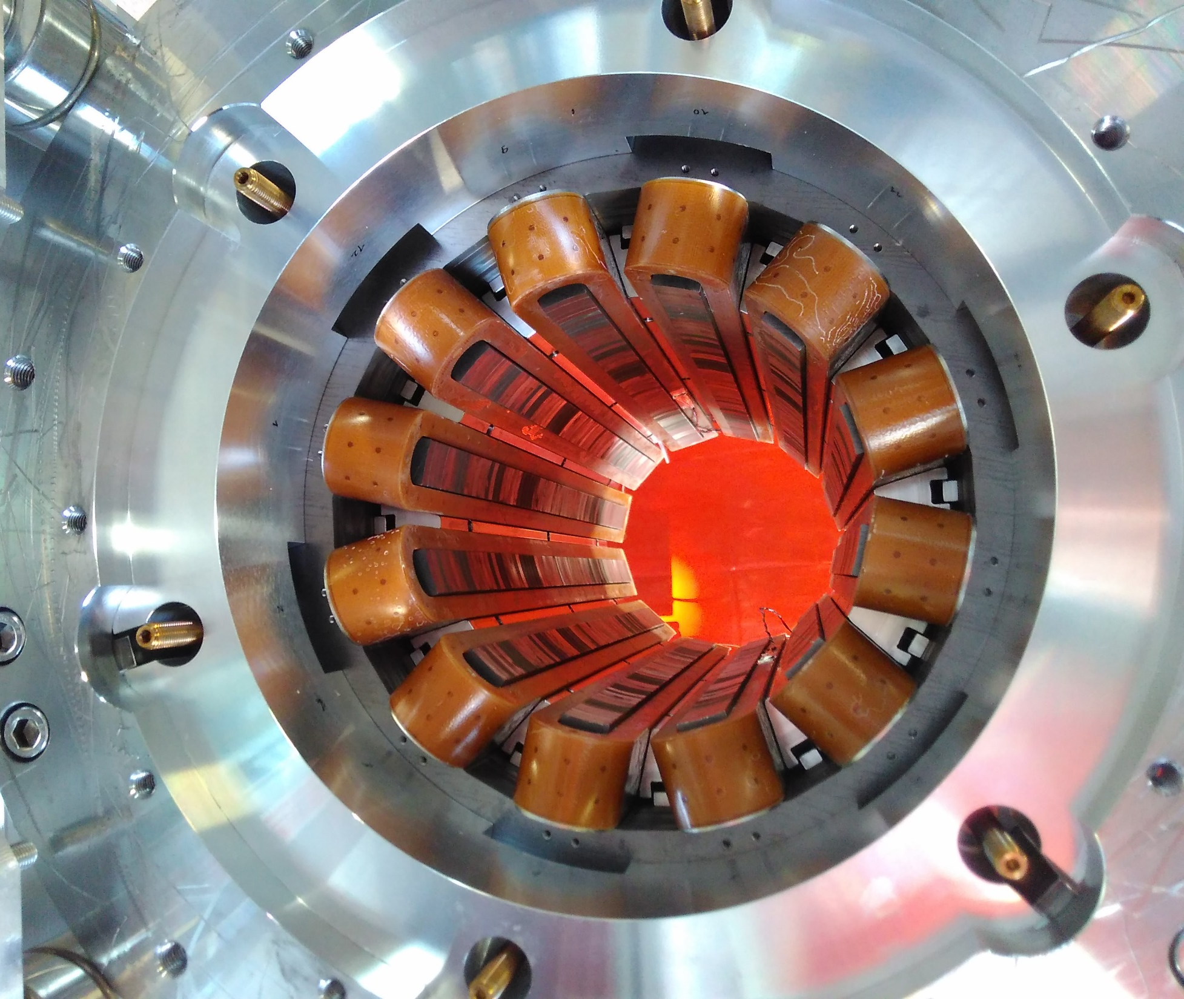
Structure
The HL-LHC High Order Corrector Magnets
Theoretical Model of magnetic analysis for Quench localization
Experimental Quench Reconstructions
Case of Multi-coil Quench
Conclusion

Slide 3
High Luminosity Project
LHC - integrated luminosity 300 fb⁻¹ by 2023
HL LHC - upgrade interacting regions 2025/27
  3000 fb⁻¹ integrated luminosity by 2040

Slide 4
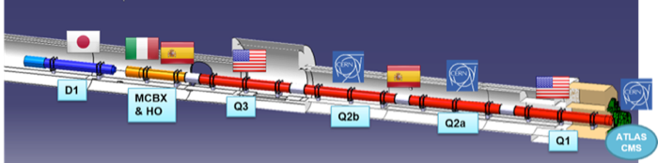
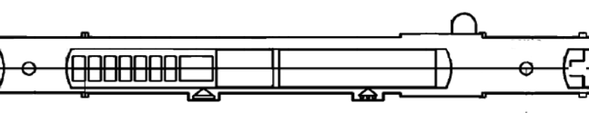
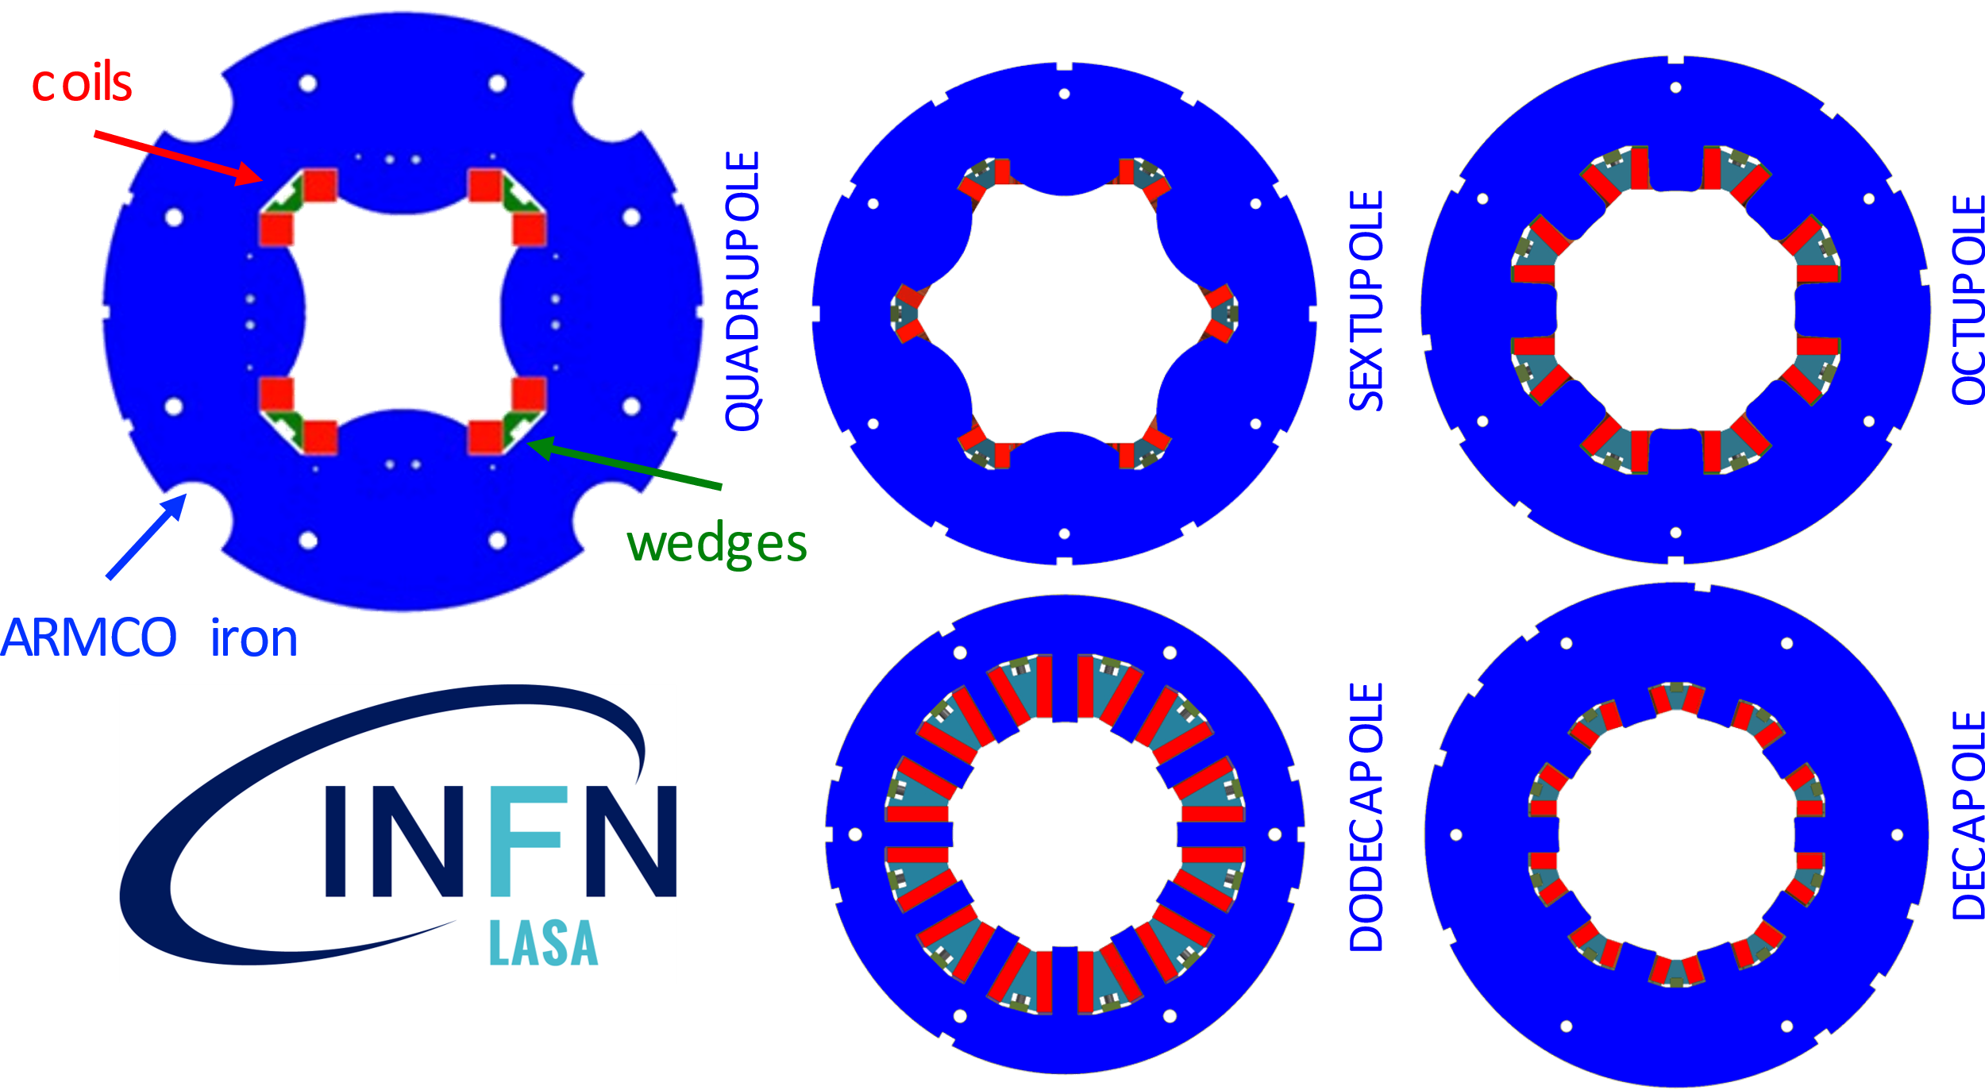
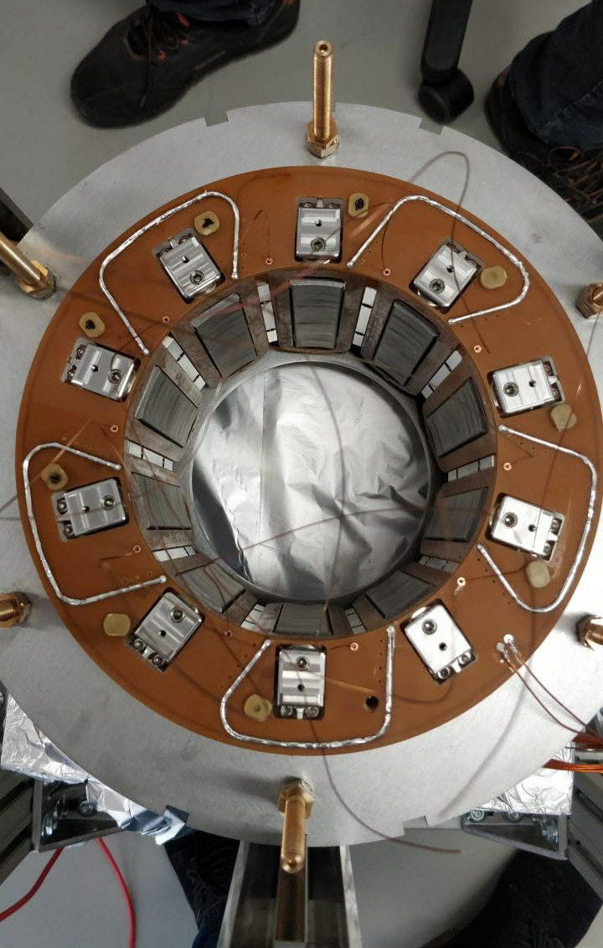
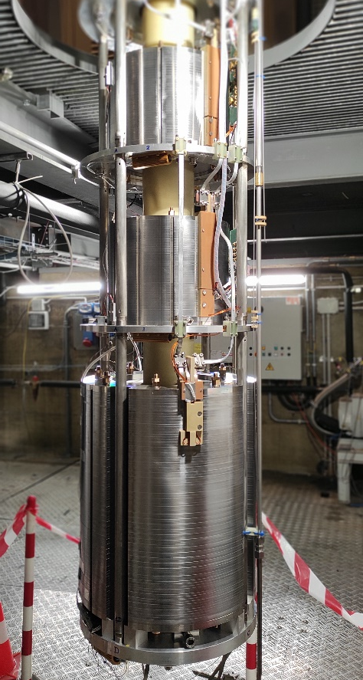
High Order Corrector Magnets
~70 m
In kind contribution CERN-INFN (2014-2019)
5 types of NbTi superferric corrector magnets:
Quadrupole, Sextupole, Octupole, Decapole and Dodecapole
Agreement CERN and INFN-LASA (2019-2022)
Construction of all the 54 magnets for the installation in HL-LHC

Slide 5
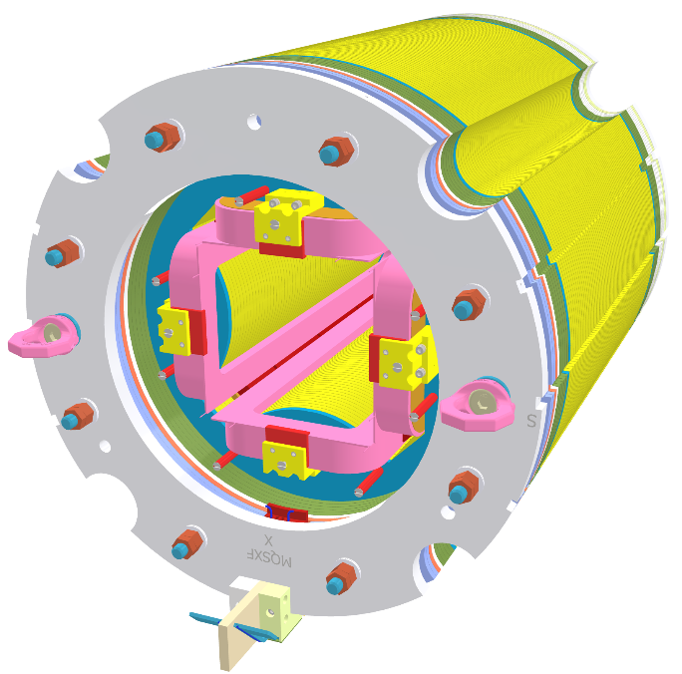
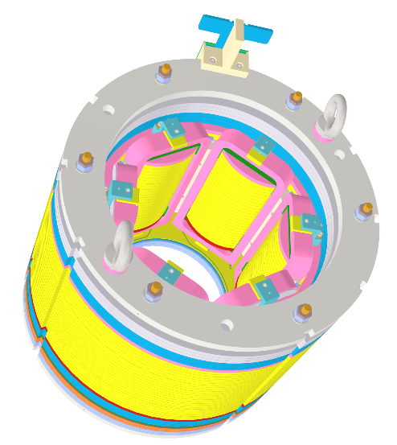
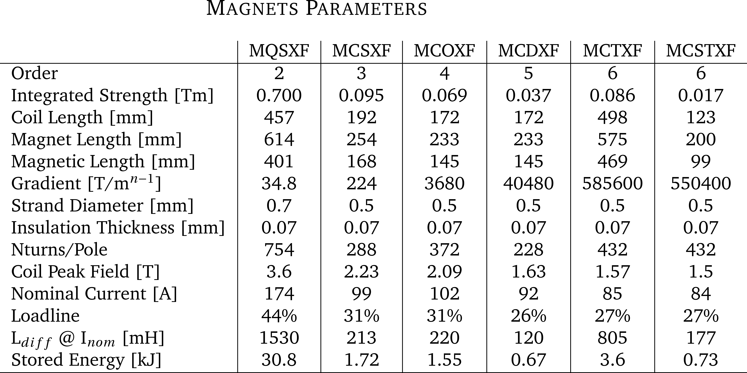
Design and Quench Protection
MQSXF
Superferric design
Compact and modular
Strong contribution of the iron poles
Field quality influenced by the shape of the poles
NbTi superconding coils
Racetrack
Insulation by S2 glass reinforced material
MCSXF
No INFO on which
Coil Quenched!

Slide 6

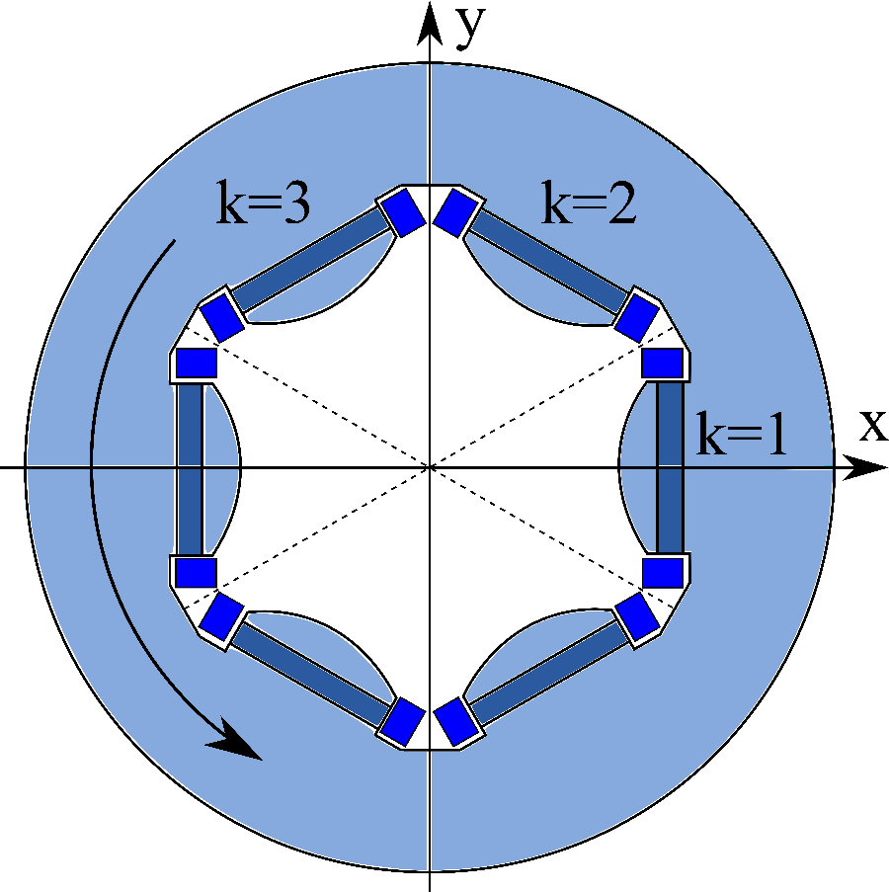
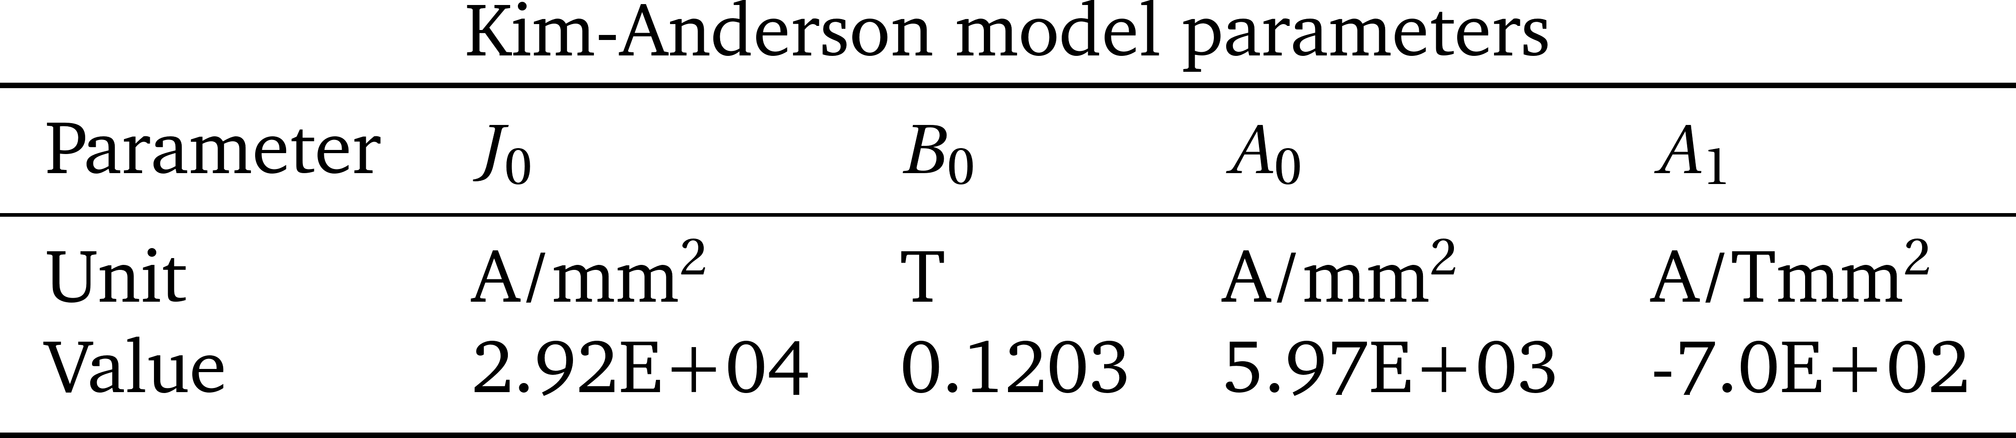
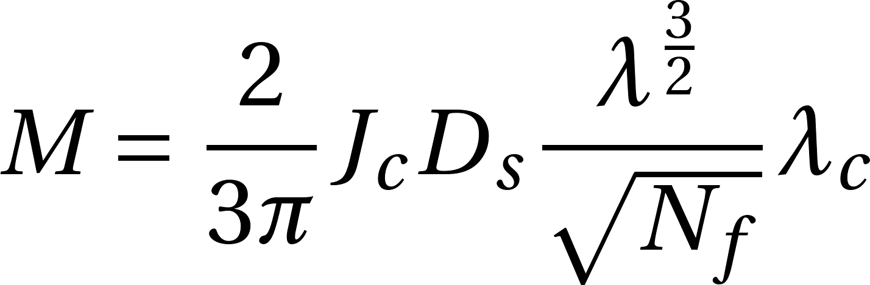
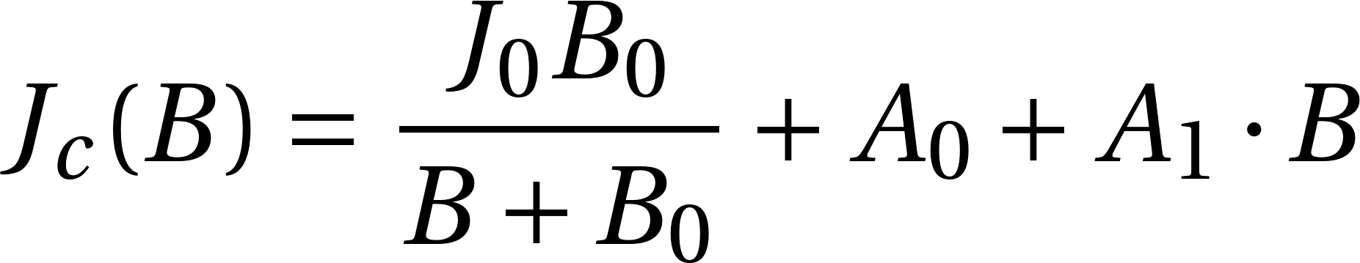
New Idea
Uniform 2D Model
Assumptions
Only Single Coil quench observed during prototype construction phase
  No quench propagation to all the magnet coils
Quenched coils will not have residual magnetization
The all coil volume is not magnetized after the quench
Single Superconducting coil cross section contribution

Slide 7
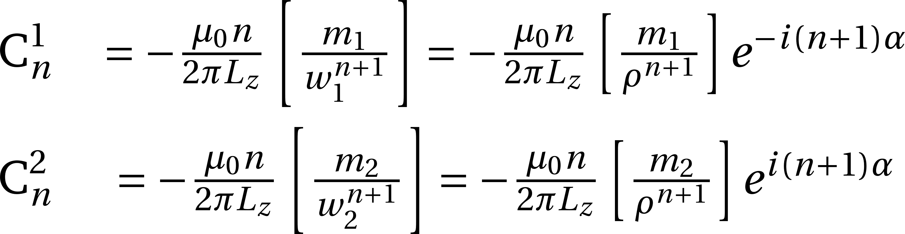
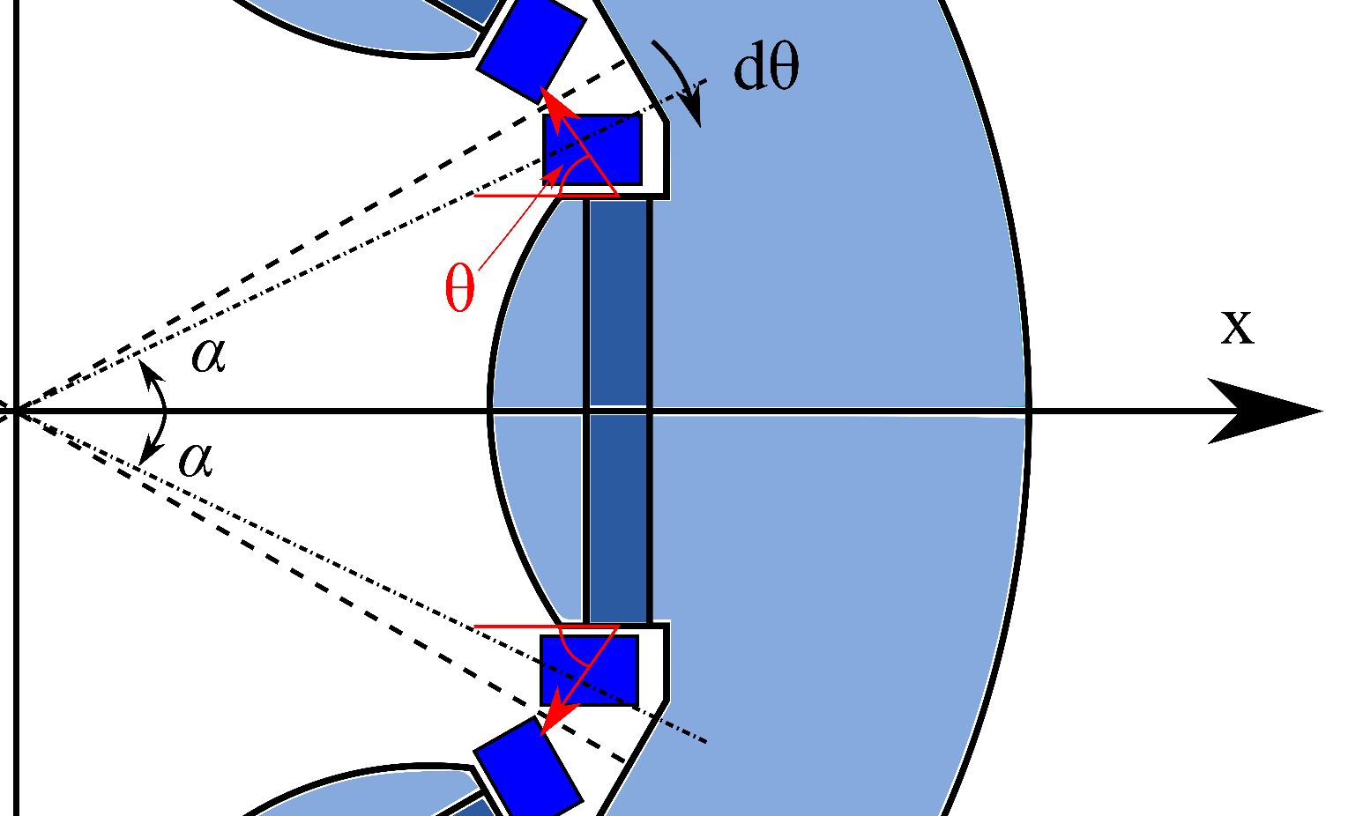
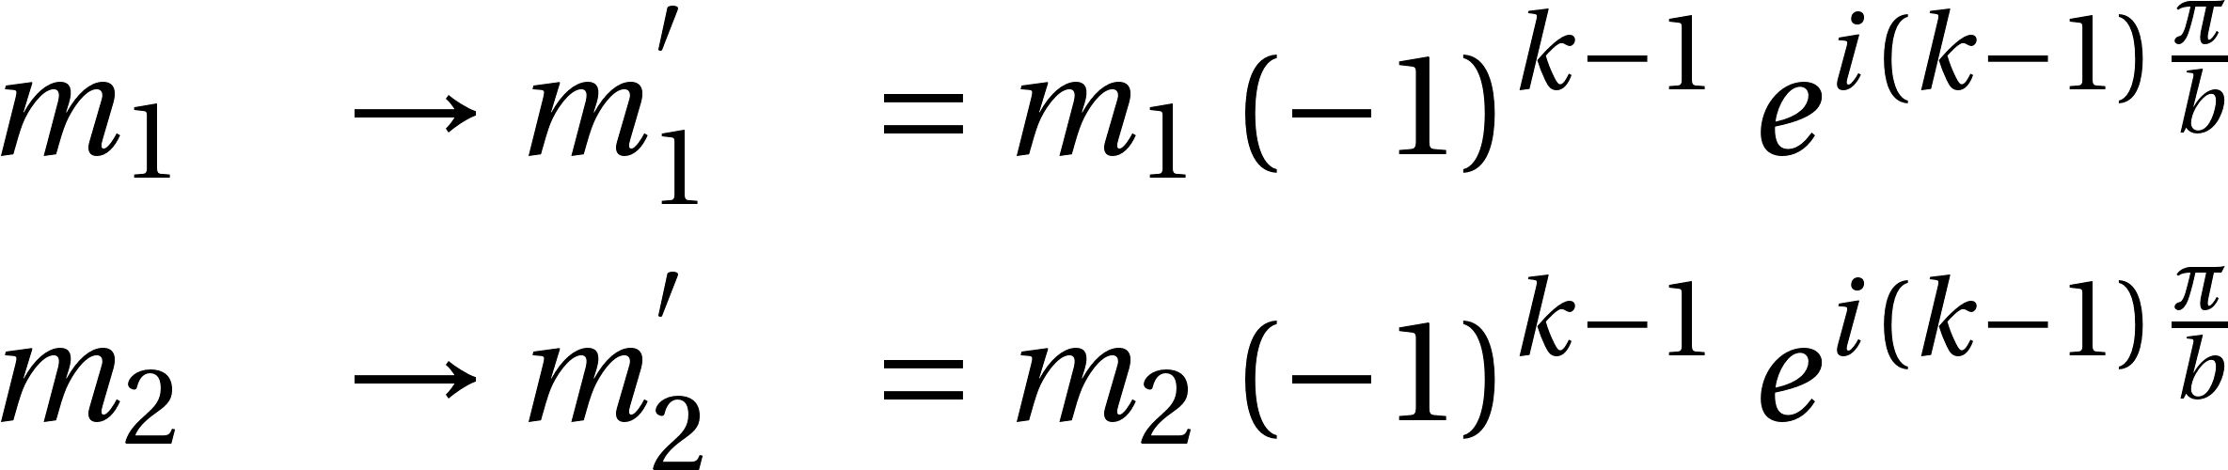
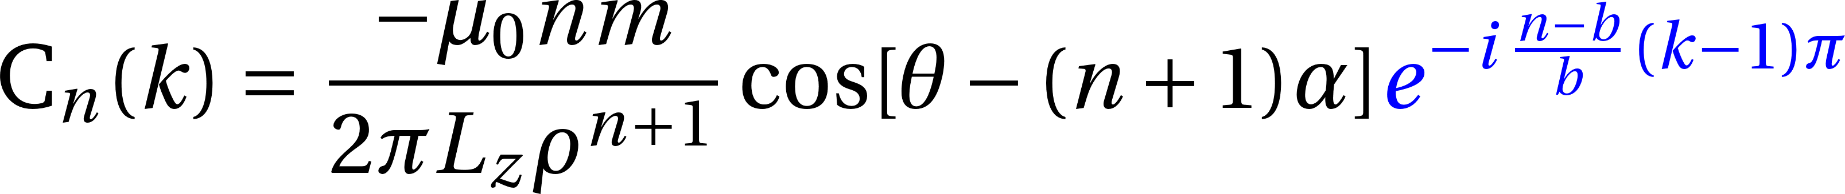
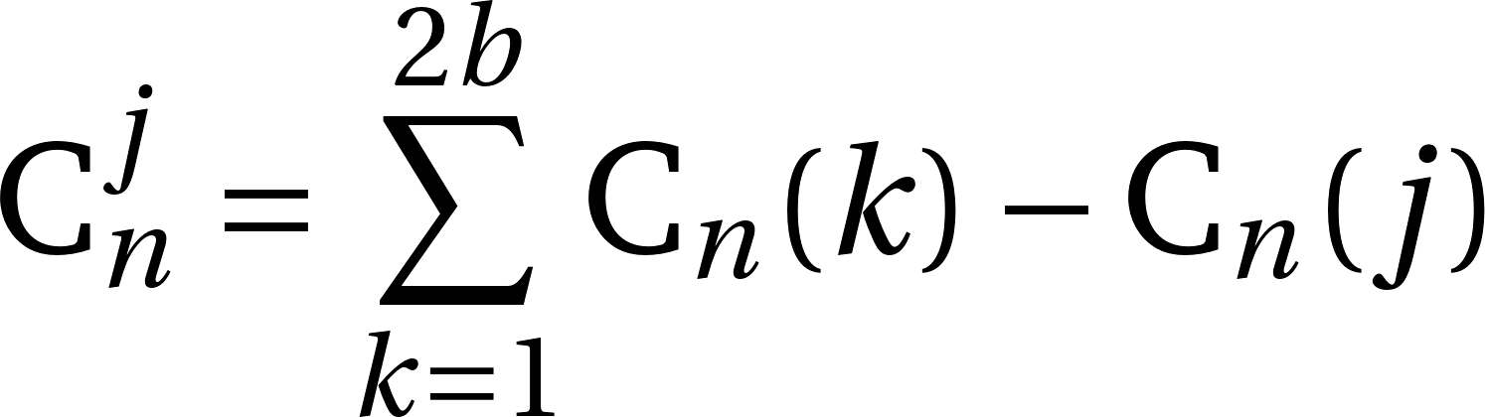
Analytical Model
Direct calculation of the Harmonic Coefficients
Transformation to calculate the different coils contribution
Each magnetic dipole moment is rotated and inverted in the direction to account for the opposite polarities
Single k_{th}-Coil Contribution
FINAL Harmonic Content
S. Mariotto and M. Sorbi. “Quench position reconstruction through harmonic field analysis in superconducting magnets”. Superconductor Science and Technology, 35(1):015006, nov 2021.

Slide 8
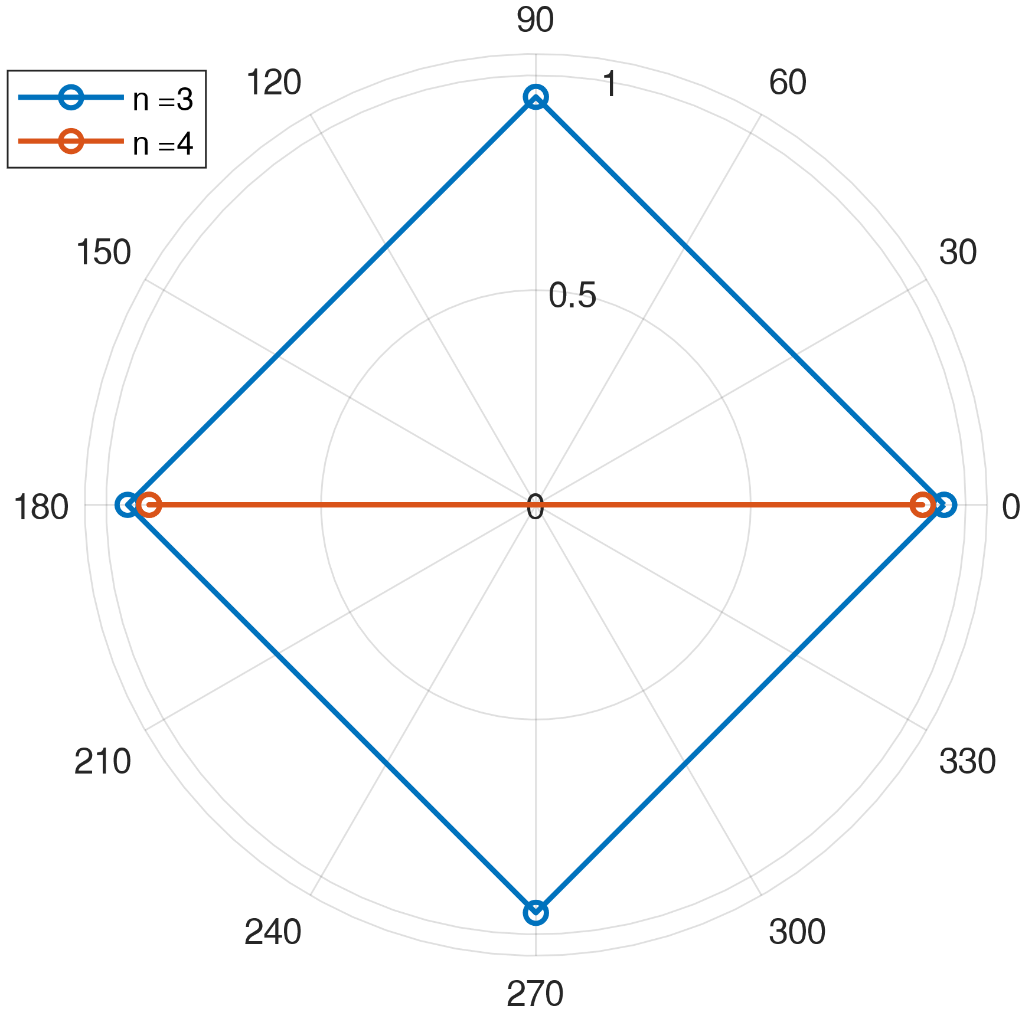
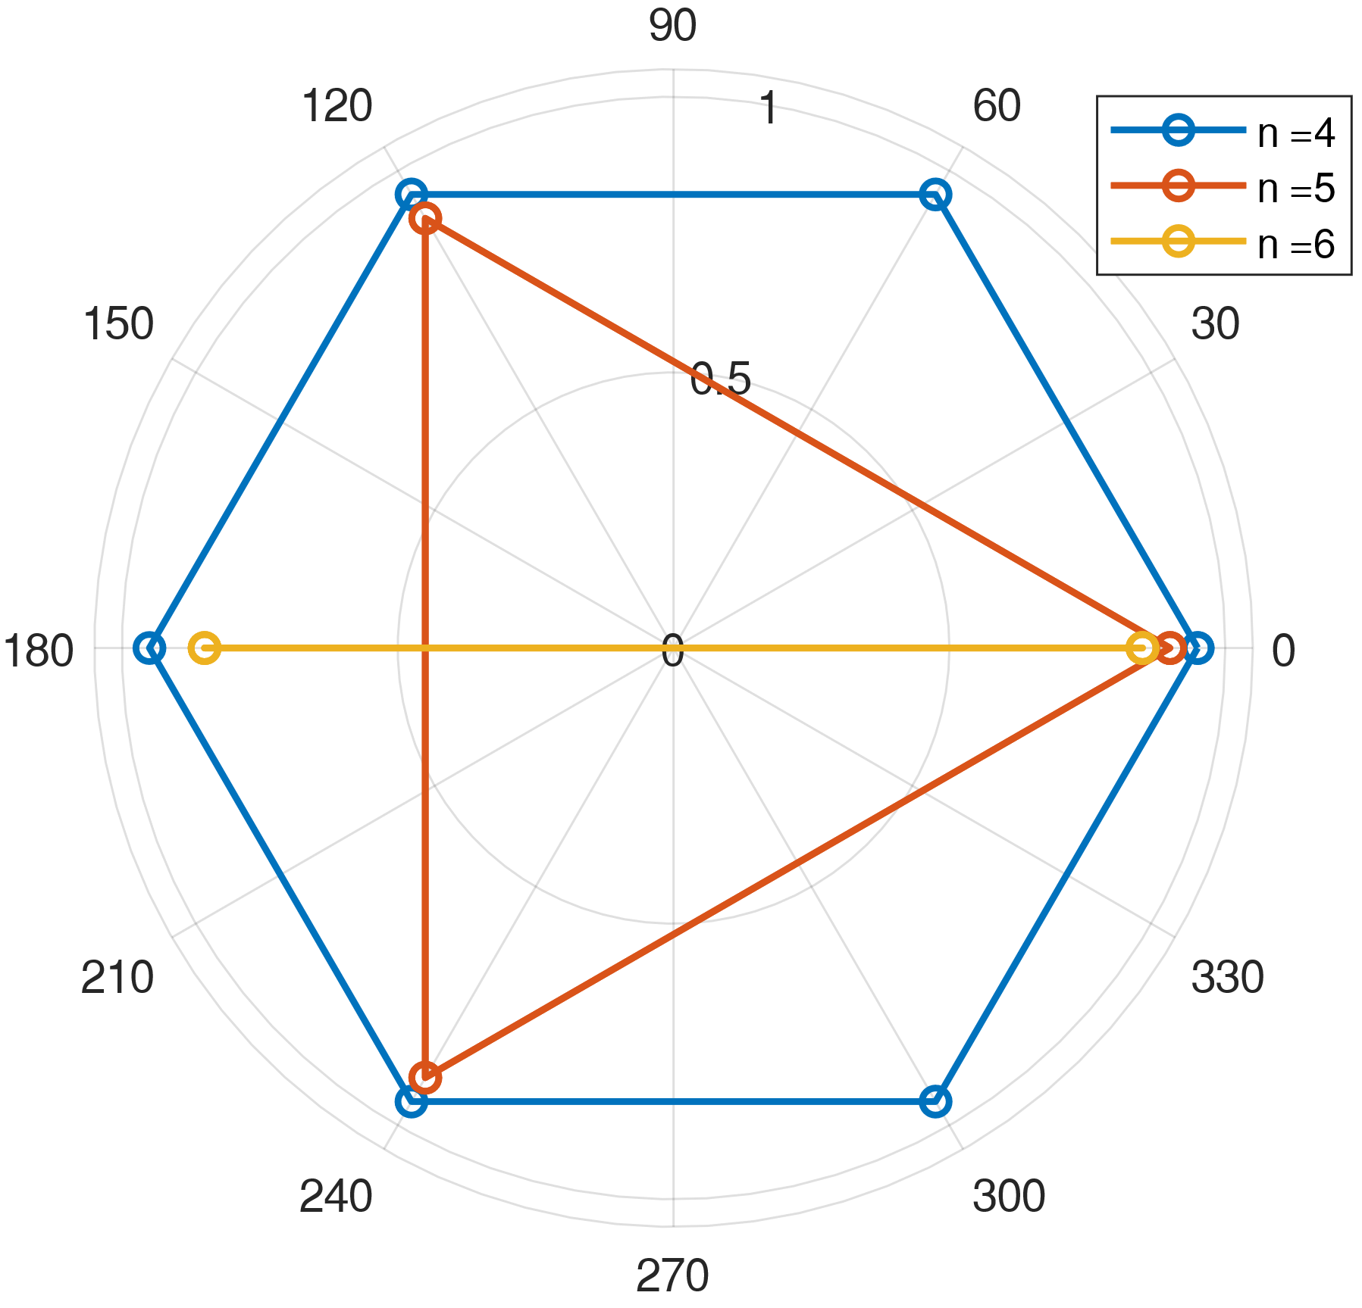
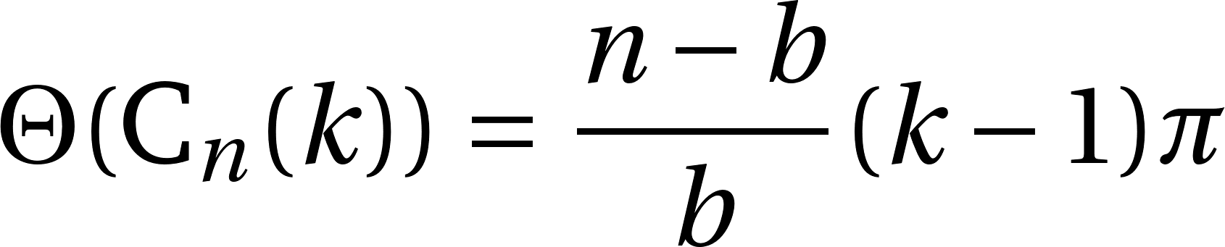
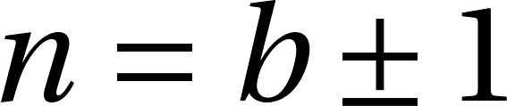
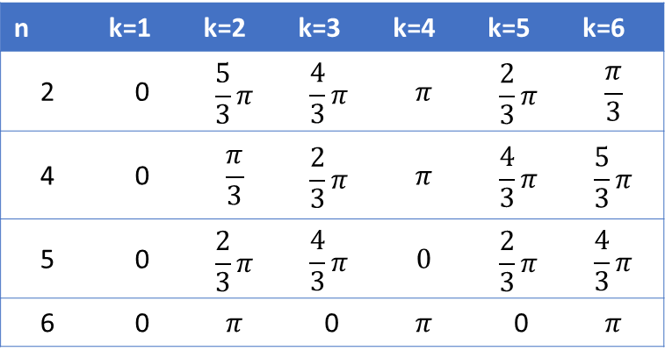
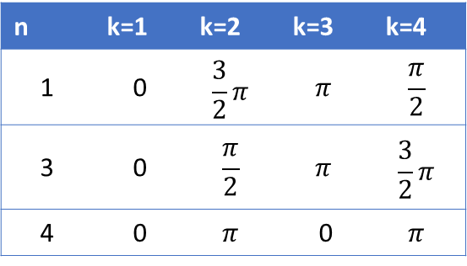
Field Harmonics Phase
4P
6P
Possible Harmonic Phases
Best Harmonic
For Unique Reconstruction
b=3
b=2
n | k=1 | k=2 | k=3 | k=4 | k=5 | k=6
2 | 0 | $$\frac{5}{3}π$$ | $$\frac{4}{3}π$$ | $$π$$ | $$\frac{2}{3}π$$ | $$\frac{π}{3}$$
4 | 0 | $$\frac{π}{3}$$ | $$\frac{2}{3}π$$ | $$π$$ | $$\frac{4}{3}π$$ | $$\frac{5}{3}π$$
5 | 0 | $$\frac{2}{3}π$$ | $$\frac{4}{3}π$$ | $$0$$ | $$\frac{2}{3}π$$ | $$\frac{4}{3}π$$
6 | 0 | $$π$$ | 0 | $$π$$ | 0 | $$π$$
n | k=1 | k=2 | k=3 | k=4
1 | 0 | $$\frac{3}{2}π$$ | $$π$$ | $$\frac{π}{2}$$
3 | 0 | $$\frac{π}{2}$$ | $$π$$ | $$\frac{3}{2}π$$
4 | 0 | $$π$$ | 0 | $$π$$

Slide 9
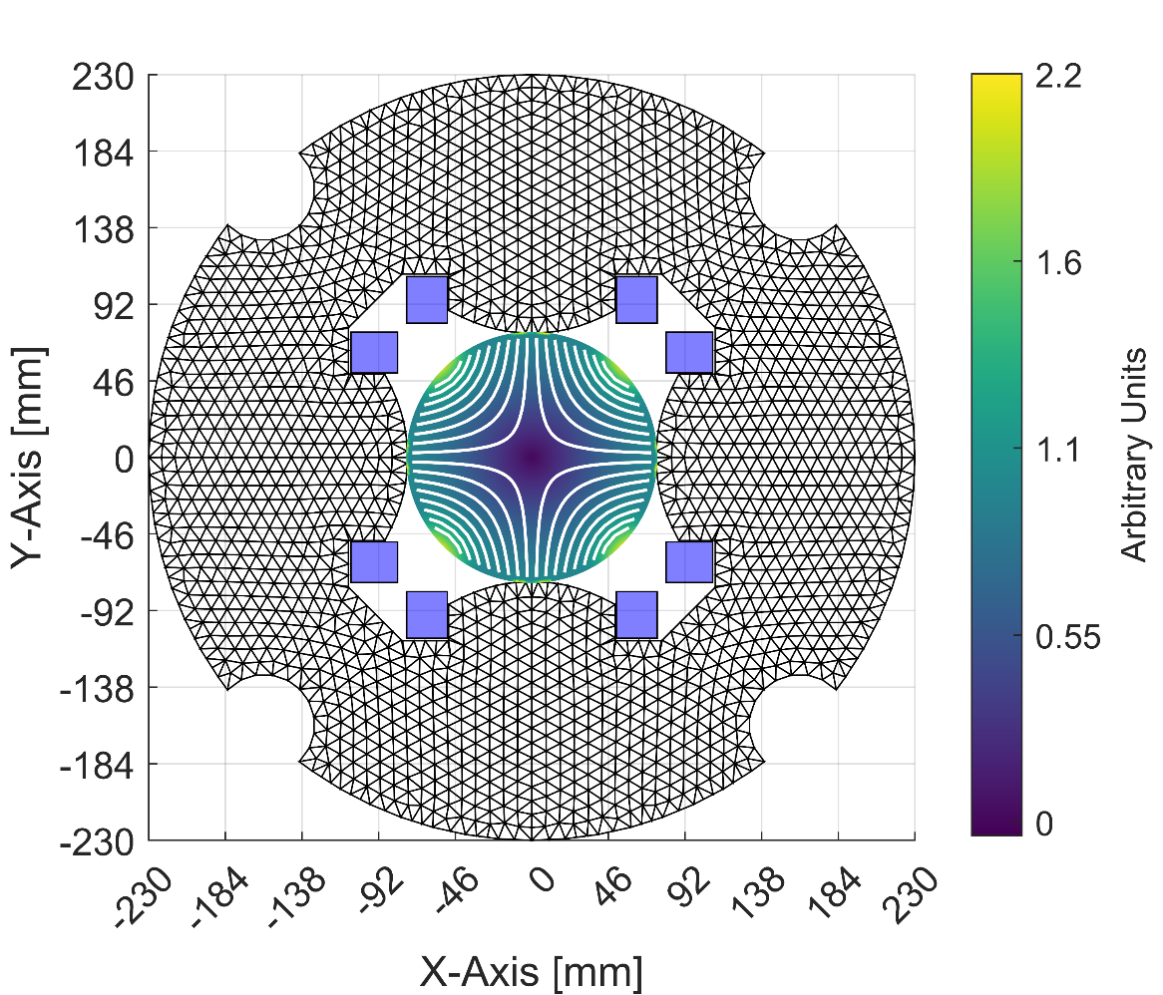
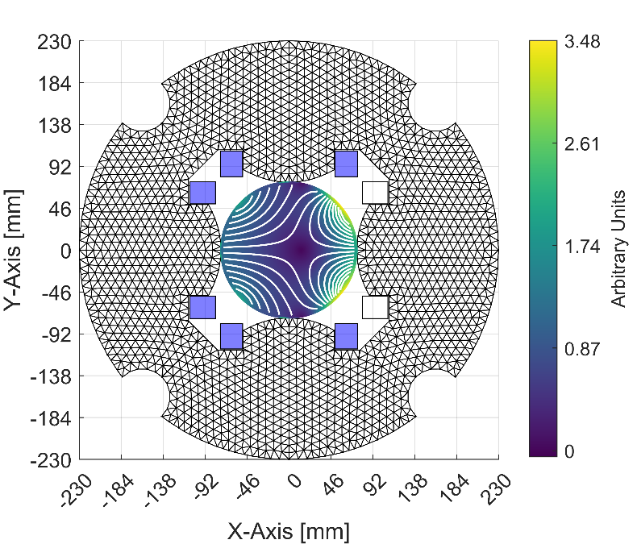
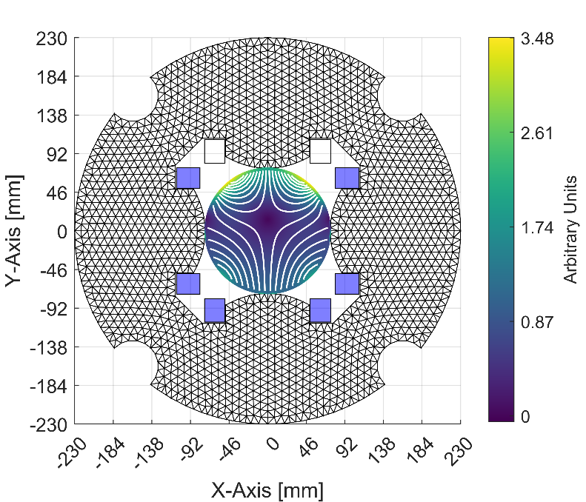
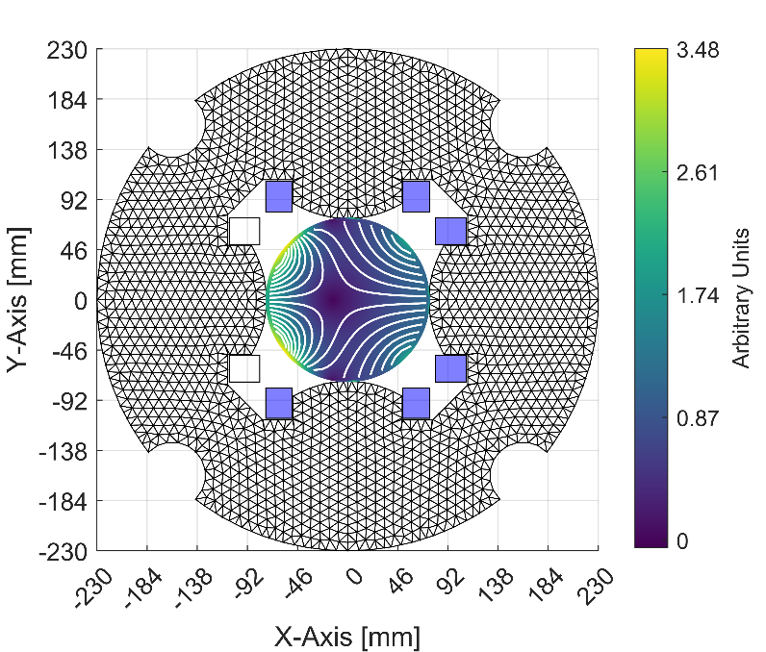
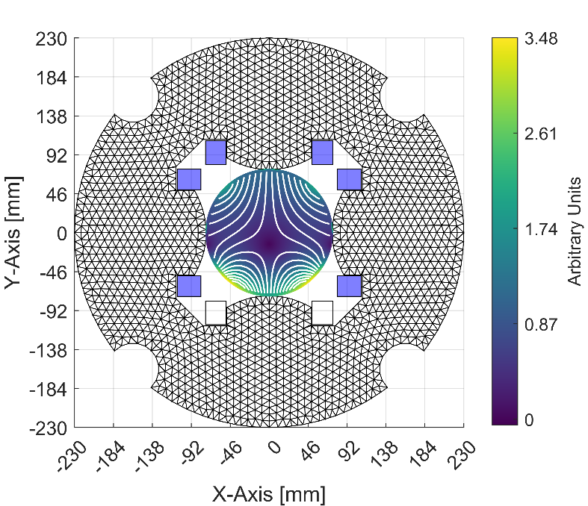
Not Allowed Harmonics
No Quench
Coil 1
Coil 2
Coil 3
Coil 4

Slide 10
FEM Model
5 different OPERA 2D Models
No consideration of 3D coil end shape
ARMCO Iron BH Curve
Imposed permanent magnet strenght based on MQSXFP1c measured data to reproduce the residual magnetization iron
Permanent Magnet
RESULTS:
Negligible iron effect on the not allowed harmonic orders

Slide 11
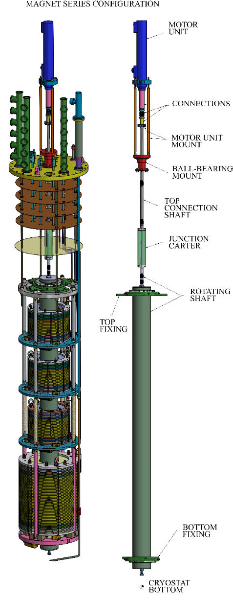
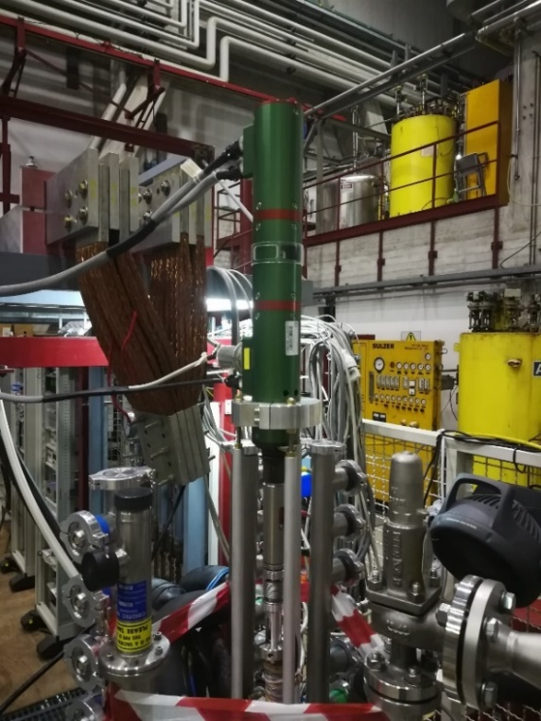
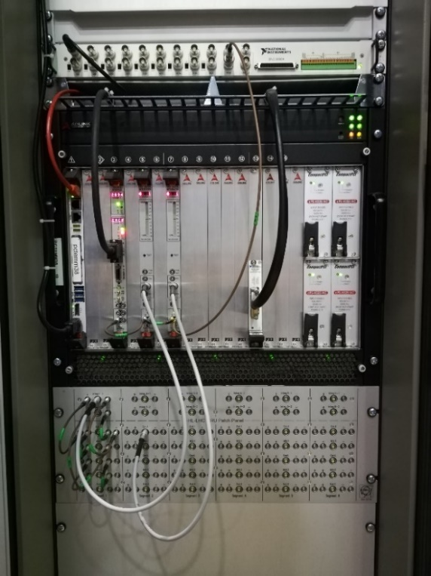
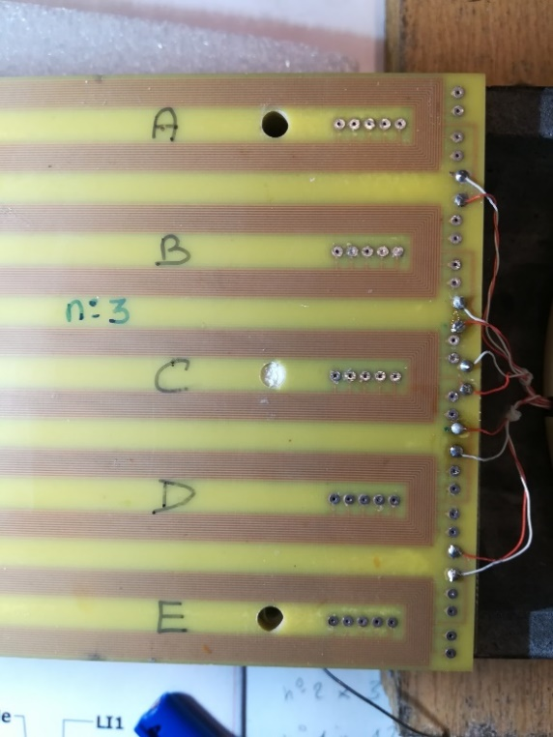
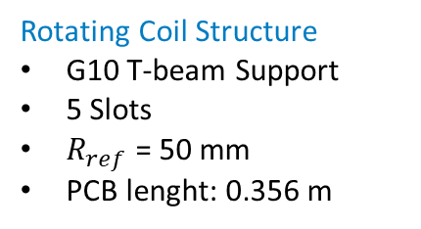
Magnetic Measurement Test Station
Collaboration CERN-INFN LASA
Rotating Coil Design
FFMM framework for the analysis of the signal
Mechanical integration with cryogenic vertical test station at LASA
Rotating Coil Structure
G10 T-beam Support
5 Slots
$R_{ref}$ = 50 mm
PCB lenght: 0.356 m
Motor
Pin for aligment
Encoder
Integrators
130 mm
Connections
Connections
AD-HOC Design

Slide 12
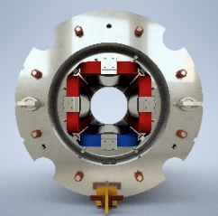
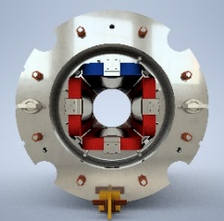
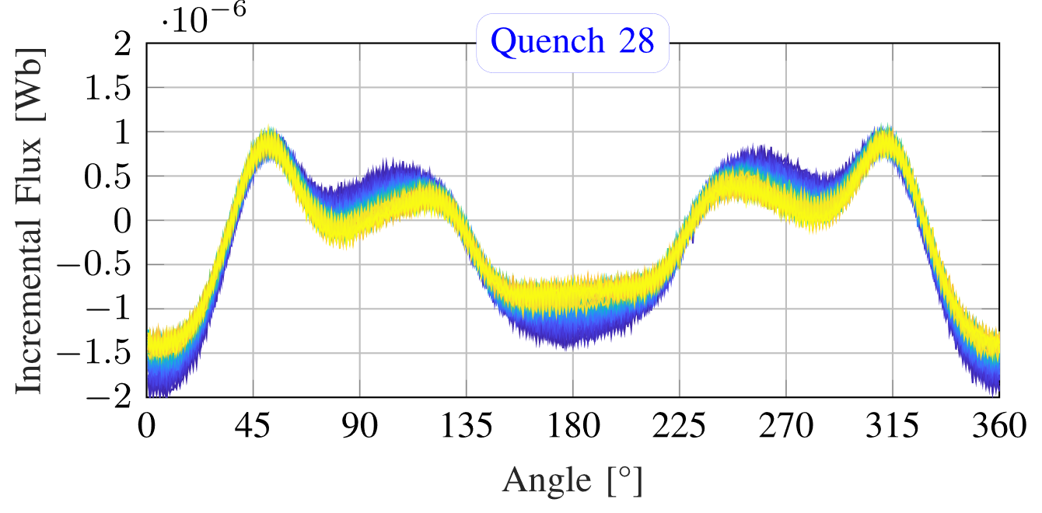
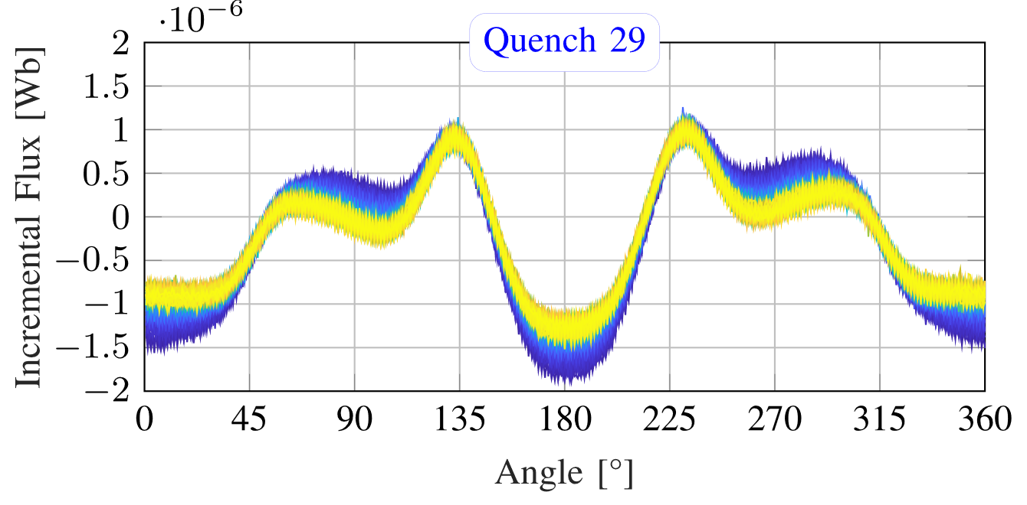
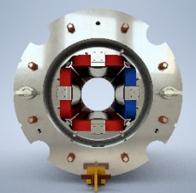
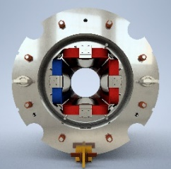
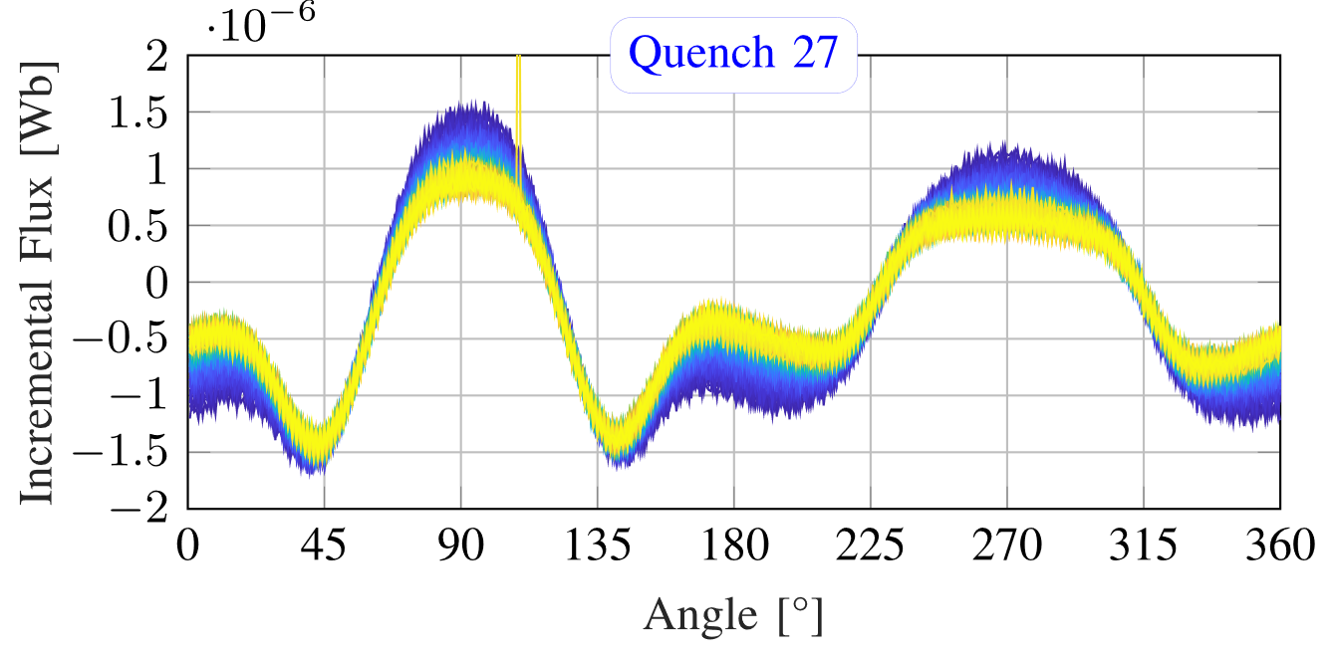
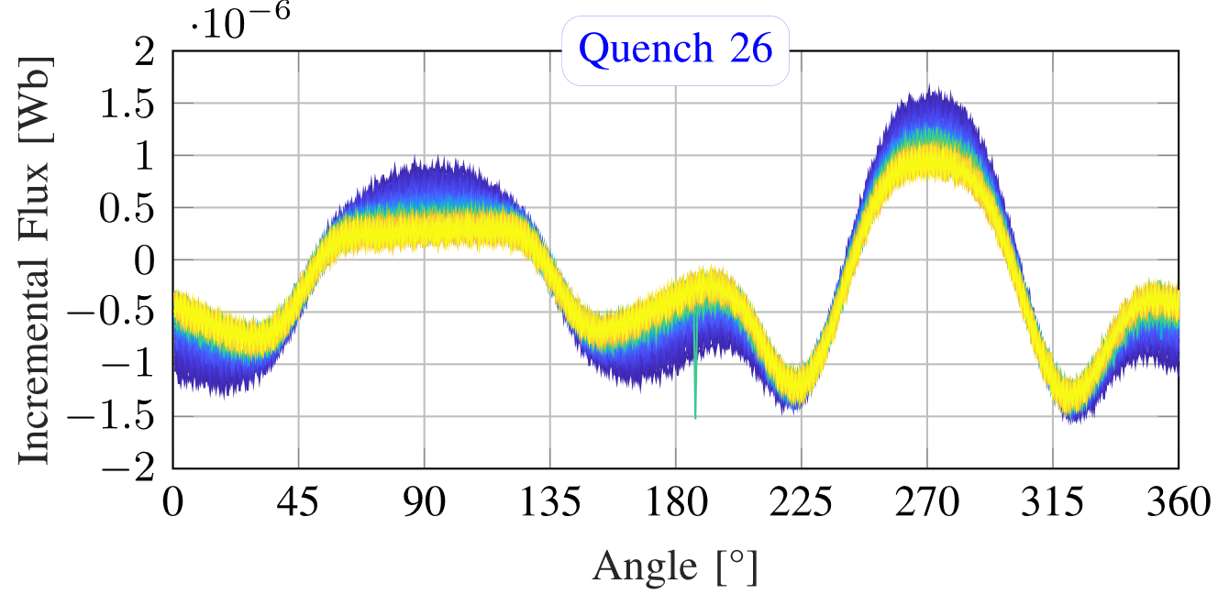
Raw Signal Example MQSXF1
Coil 1
Coil 3
Higher Peak
Higher Peak
Lower Peak
Lower Peak
Coil 2
Coil 4
Higher Peak
Higher Peak
Lower Peak
Lower Peak

Slide 13
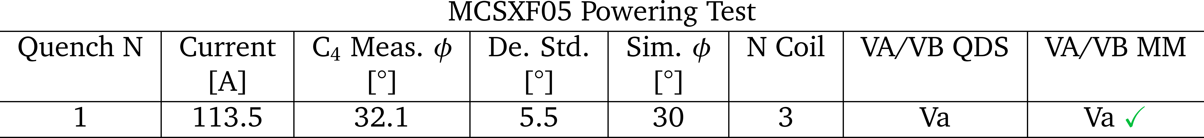
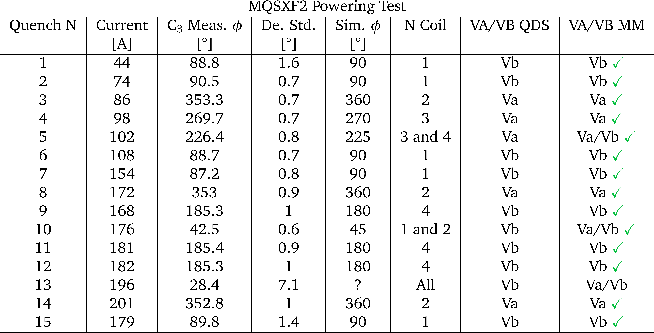
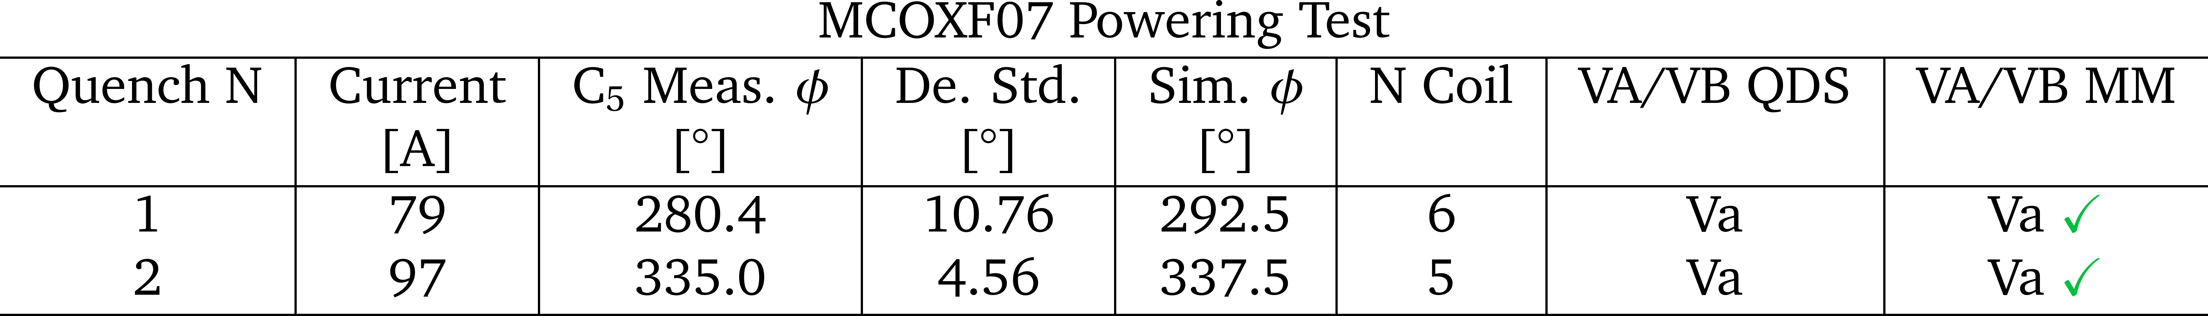
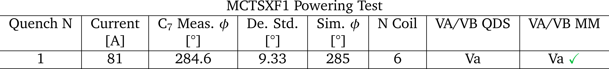
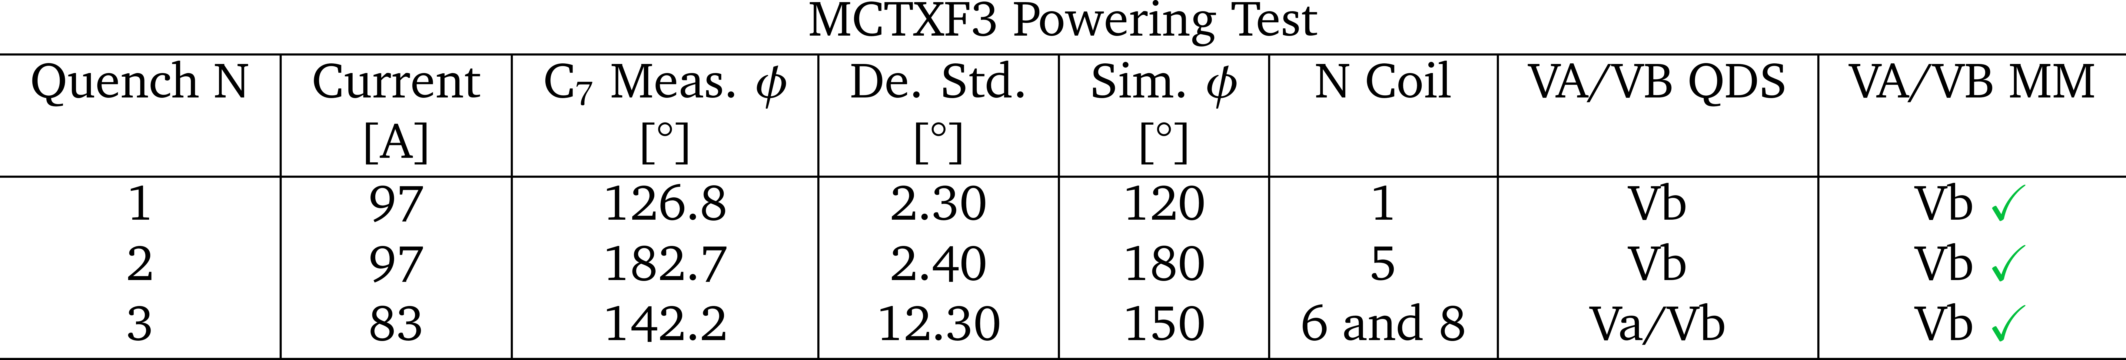
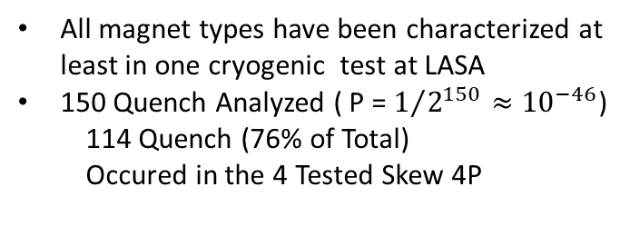
Analysis Results
6P
4P
8P
12PS
12PN
All magnet types have been characterized at least in one cryogenic test at LASA
150 Quench Analyzed ( P = $1/{2^{150}}≈{10}^{−46}$)
  114 Quench (76% of Total)
  Occured in the 4 Tested Skew 4P
S. Mariotto et al. “Quench Localization in the High Order Corrector Magnets using the Harmonic
Field Method”. Accepted by IEEE Transaction on Applied Superconductivity, 2022.

Slide 14
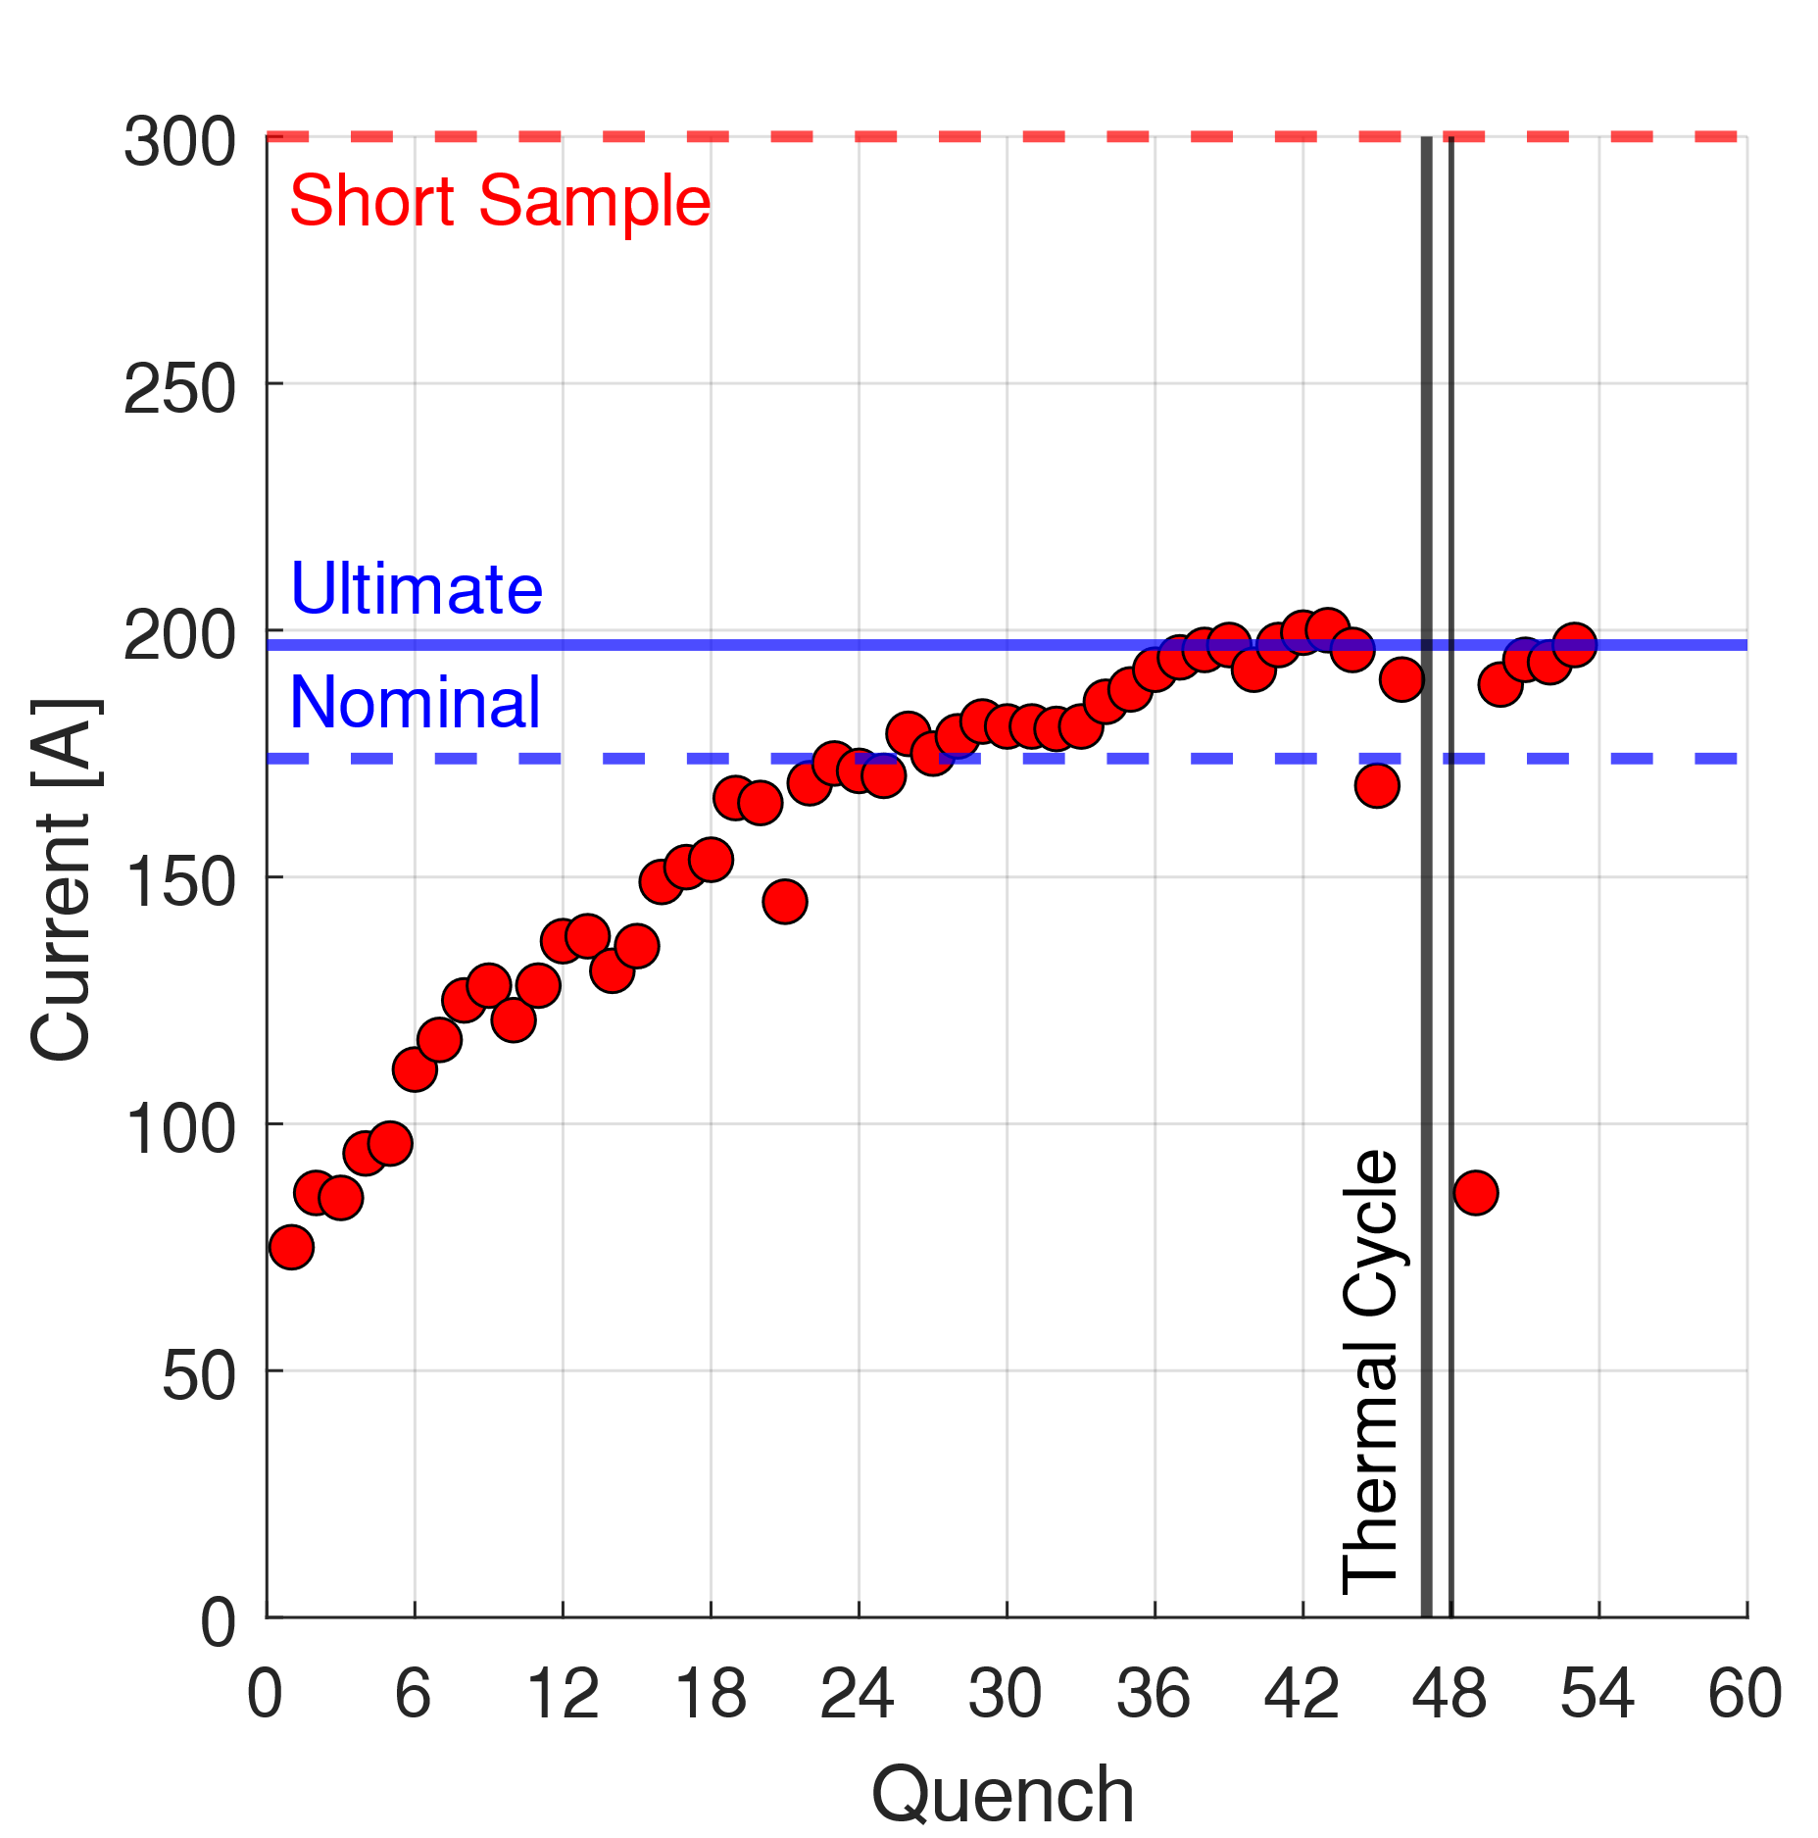



MQSXF1 Case Study
Why so many Quench in MQSXF1??? How many of them are MULTIPLE-COILS quench?
MQSXF1
MQSXF1b
MQSXF2
MQSXF3
MQSXF5
4.2K
4.2K
4.2K
4.2K
TOT=46
TOT=5
TOT=15
TOT=24
TOT=24

Slide 15


MQSXF1 Case Study
Coil 3
Coil 4
Coil 2
Coil 1
Quench in Opposite Coils
Continue in the next slide…..

Slide 16

MQSXF1 Case Study
Coil 3
Coil 4
Coil 2
Coil 1
More multi-coil quench at high current values
  Higher current decay rate

Slide 17






Multi-Coil Quench – 2 adjacent Coils
Harmonic Content Comparison
Single-Coil Quench
Double-Coil Quench
Suppressed
Suppressed
New Harmonic Content:
With Some algebra:

Slide 18





Multi-Coil Quench – 2 Opposite Coils
Harmonic Content Comparison
Single-Coil Quench
Double-Coil Quench
Suppressed
Suppressed
Suppressed
Harmonic Content:
With Some algebra:
Amplification

Slide 19



Multi-Coil Quench – 3 and 4Coils
Harmonic Content Comparison
Single-Coil Quench
Triple-Coil Quench
Quadruple-Coil Quench
Suppressed

Slide 20
Time Dependance
MQSXF5
MQSXF5
3
2
1
Main allowed harmonics depends from time after quench event
  Time Constant: order of 100 seconds!!!
  Iron Magnetization Relaxation
    (Current decay rate dependenance)
Three Main Regions of Amplitude
  All Quenched Coils
  Three Quenched Coils
  One Quenched Coil

Slide 21
Time Dependance
MQSXF5
MQSXF5
3
3
2
2
1
1
Three Main Regions of Amplitude
  All Quenched Coils
  Three Quenched Coils
  One Quenched Coil
Not-allowed harmonics DO NOT depend from time after the quench event

Slide 22

Conclusions
Developed an innovative method for quench localization
  Based on magnetic measurent of the harmonic content produced by the residual superconductor magnetization after the quench event
Both analytical and FEM model are able to reconstruct exactly the quenched coil
  Unique Reconstruction using phase of the $n=b±1$ harmonic field component
All 150 Quench Events analyzed and reconstructed
  Very good agreement between QDS Va/Vb signal and magnetic measurement
Improved diagnostic system for magnet performances during series production phase
Experimental evidence of multi-coil quench in the skew quadrupole training
  Developed model is able to reconstruct these events too
  Evidence of allowed harmonics time dependance due iron residual magnetization relaxation

Slide 23
Thank you for the Attention
LASA TEAM
F. Broggi, E. De Matteis, S. Mariotto, A. Paccalini, A. Palmisano, A. Pasini, D. Pedrini, A. Leone, M. Prioli, L. Rossi, M. Sorbi, S. Sorti, M. Statera, M. Todero, C. Uva, R. Valente
Samuele Mariotto
Seminar Rete MS&TA INFN, 3 March 2022
22

