Slide 1
The Scientific Payload of LIGHT-1: A 3U Cubesat Mission for the detection of Terrestrial Gamma-Ray Flashes
Adriano Di Giovanni on behalf of the LIGHT-1 team
الحمولة العلمية لضوء - ١ : قمر صناعي مصغر من ثلاث مكعبات مخصص لكشف ومضات جاما الأرضية
Adriano Di Giovanni (GSSI, INFN-LNGS & CAP3-NYUAD)
AtmoHEAD, 13-15/07/2022- Villa Orlandi, Centro Congressi Federico II - Anacapri (Na) - Italy
1

Slide 2
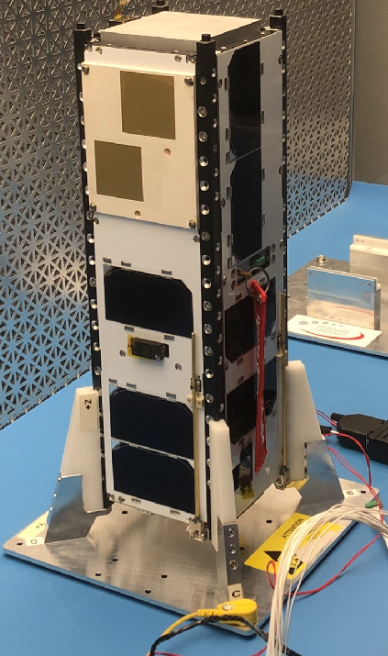
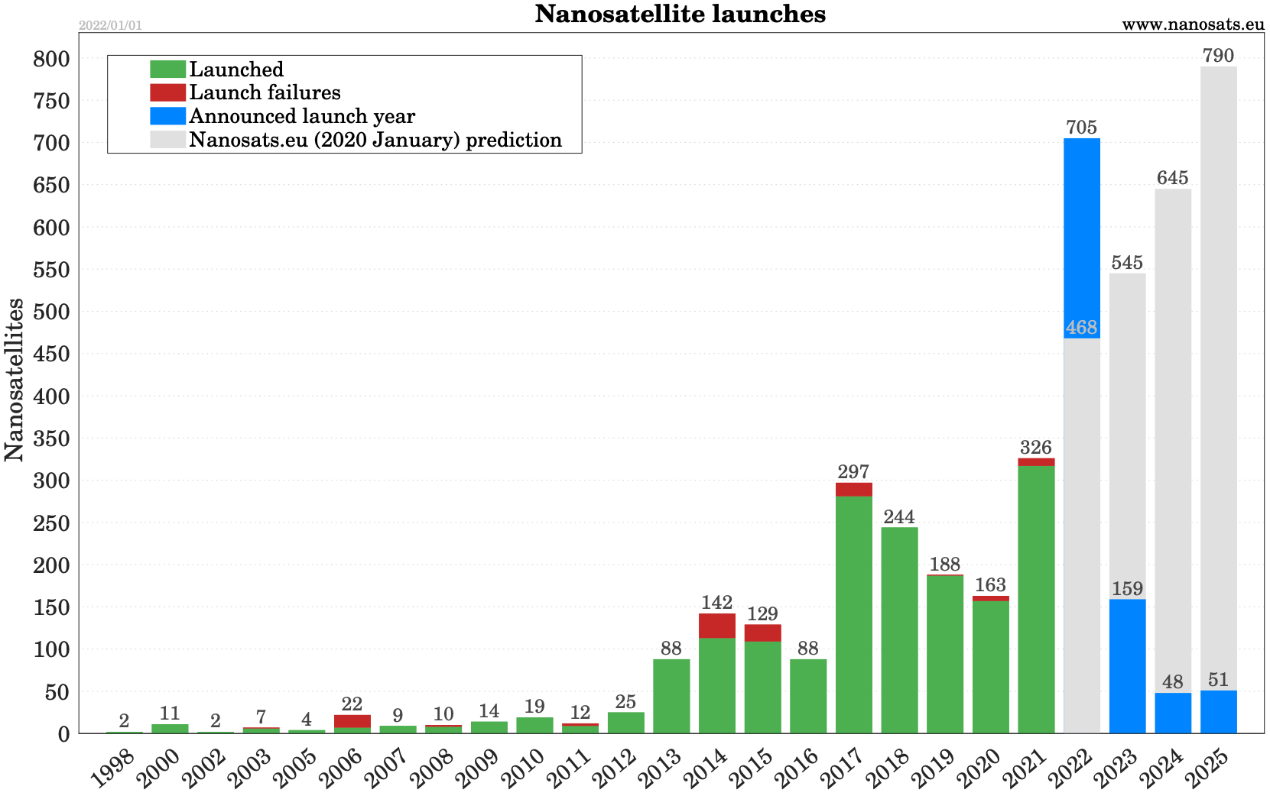
Contents
The CubeSat standard as a new paradigm to access Space
The LIGHT-1 Mission
The Scientific Payload
First Flight Data and preliminary results
Adriano Di Giovanni (GSSI, INFN-LNGS & CAP3-NYUAD)
2

Slide 3
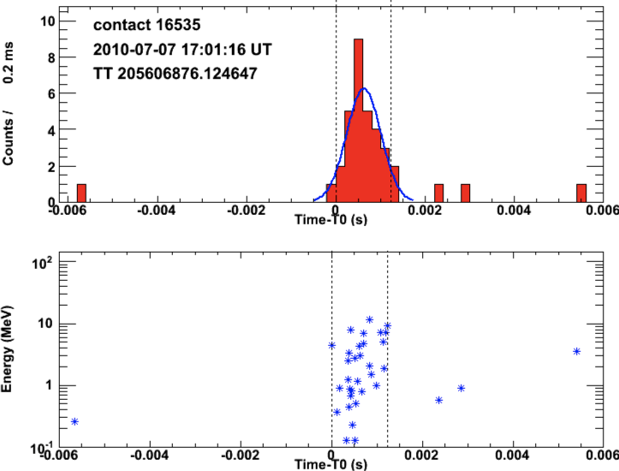
Discovering TGFs
1969 - 1972
Detection of 16 GRBs
Vela 5A/B and 6A/B
1991 - 2000
Detection of 2704 GRBs + a handful of high energetic short burst
from ground (TGFs ?)
BATSE-CGRO
2007 - present
Detection of TGFs
AGILE
AGILE
2008 - present
Detection of TGFs
FERMI
2018 - present
Optimised to detect TGFs
ASIM
2020 - 2020
VEGA 17 launch failure
TARANIS
Adriano Di Giovanni (GSSI, INFN-LNGS & CAP3-NYUAD)
3

Slide 4
Terrestrial Gamma-Ray Flashes
Origin | Atmospheric Process: Lightning, Thunderstorms, Tropical Storms
Primary particle counterpart | Gamma via bremsstrahlung
Other detectable counterparts | Radio emission (sferics) + …
Energy Range | 10 keV up to ~100 MeV
Event Duration | ~ hundreds of μs
Fluence @ 400-500 km | ~ 1 gamma/cm²
Estimated rate (FERMI) | 400k events per year
Originating Altitude | (usually) 9 km to 15 km
Adriano Di Giovanni (GSSI, INFN-LNGS & CAP3-NYUAD)
4

Slide 5
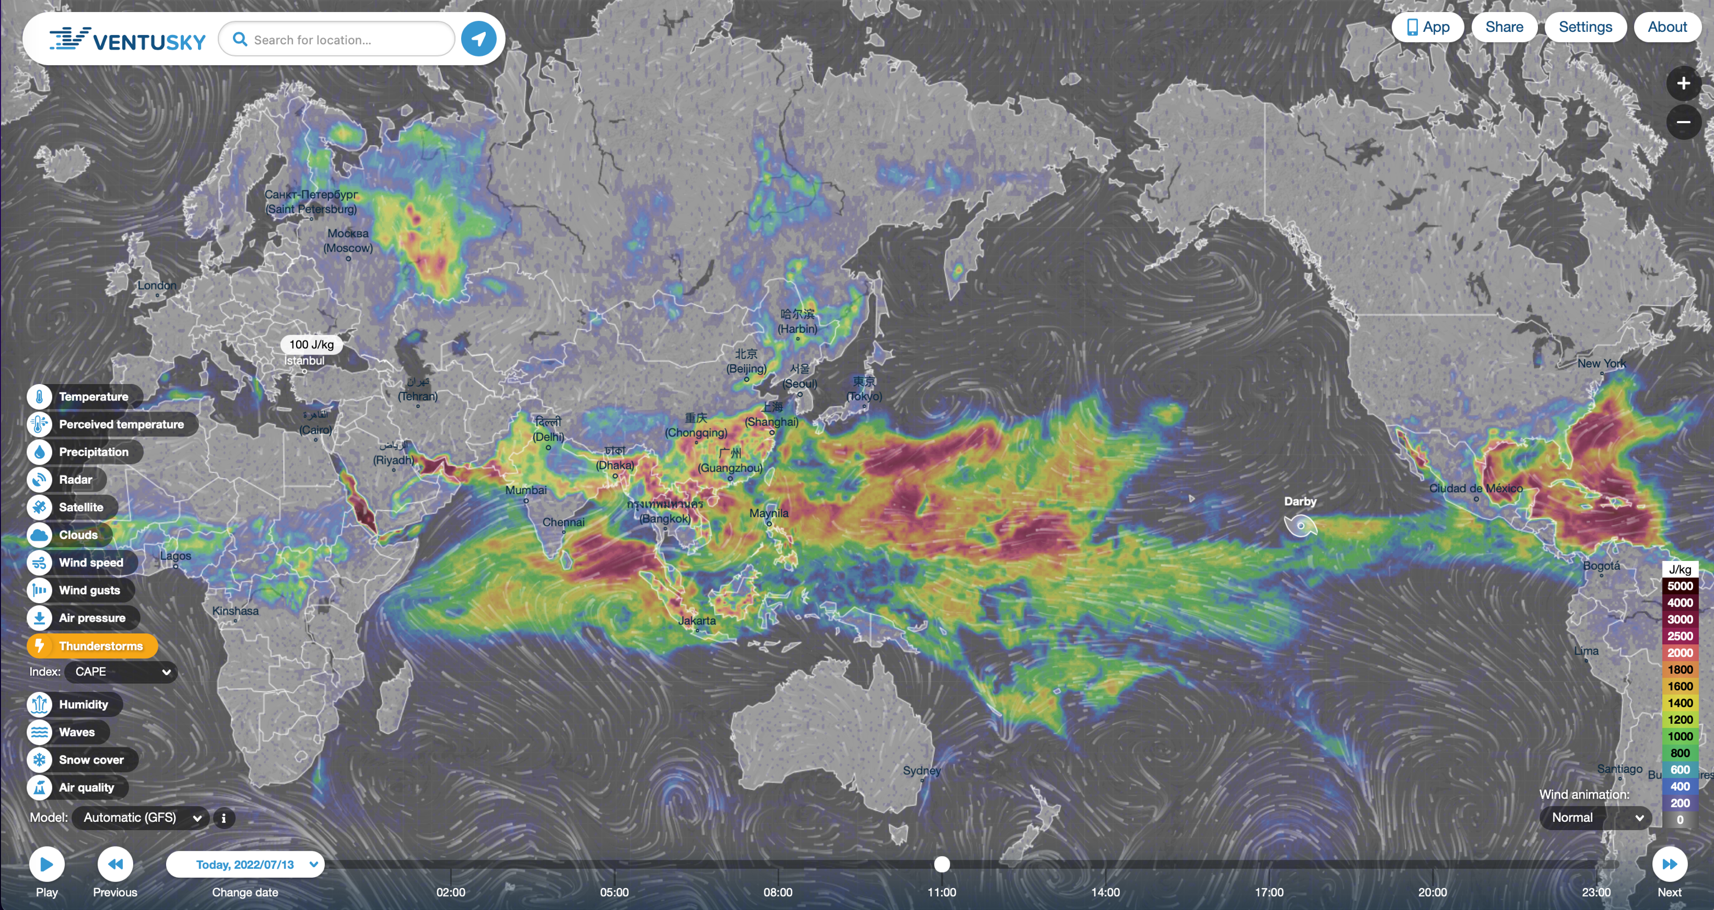
Daily Thunderstorm Distribution
Adriano Di Giovanni (GSSI, INFN-LNGS & CAP3-NYUAD)
5

Slide 6
A ~typical 3U CubeSat
Modular satellite built up from 10 cm x 10 cm x 11.35 cm units (1U);
Relatively low cost to build and launch (typically << $1M);
Strict size and weight limits (<1.5 kg/U), and very limited power budget (a few W per U)
Little-to-no propulsion systems.
Adriano Di Giovanni (GSSI, INFN-LNGS & CAP3-NYUAD)
6
6

Slide 7
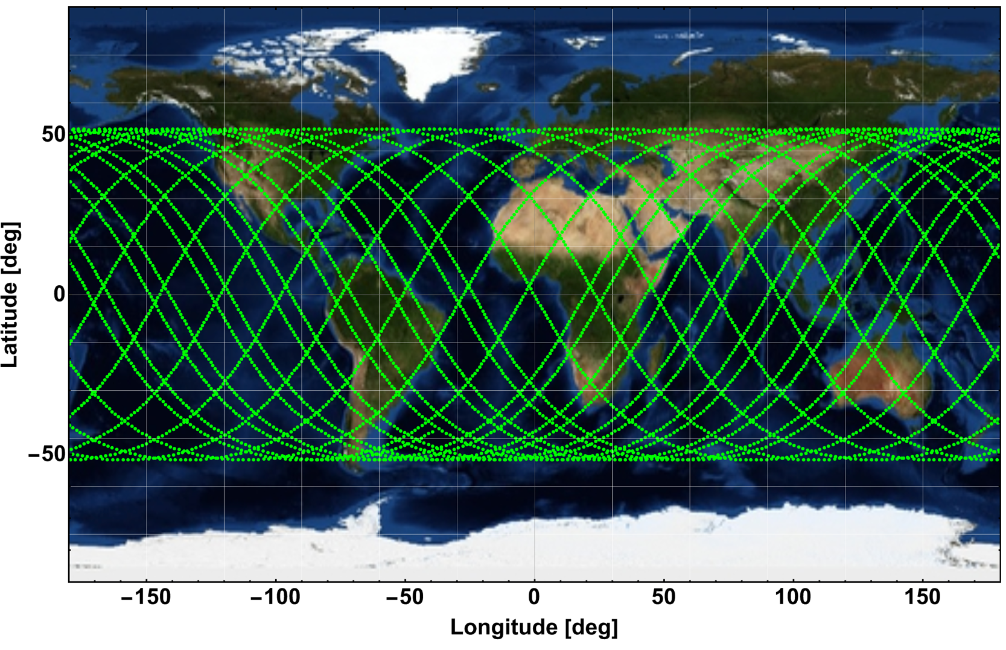
LIGHT-1 mission requirements
To survive the extreme stress of a SpaceX Falcon9/Dragon launch;
To be on time (from PDR to ON-ORBIT operations < 3 y, + COVID19);
To measure the particle rate (1 sample every 20 s, or every ~160 km) at LEO (ISS polar orbit, 51.6º );
To study TGFs at sub-microsecond timescale;
To space-qualify the technology and prove the detection concept;
To measure the activity in the South Atlantic Anomaly region.
LIGHT-1 orbit
IGRF: total field Intensity
Adriano Di Giovanni (GSSI, INFN-LNGS & CAP3-NYUAD)
7

Slide 8
LIGHT-1 path VS thunderstorm location
3 typical orbits (90’ each) - Tracking based of TLE technique, Lightnings (x,y,z,t) from open data repository
Adriano Di Giovanni (GSSI, INFN-LNGS & CAP3-NYUAD)
8
8

Slide 9
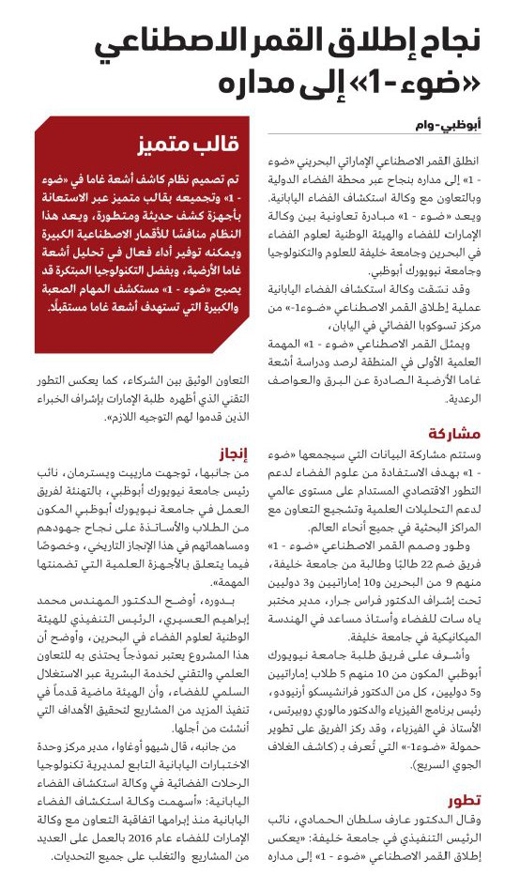
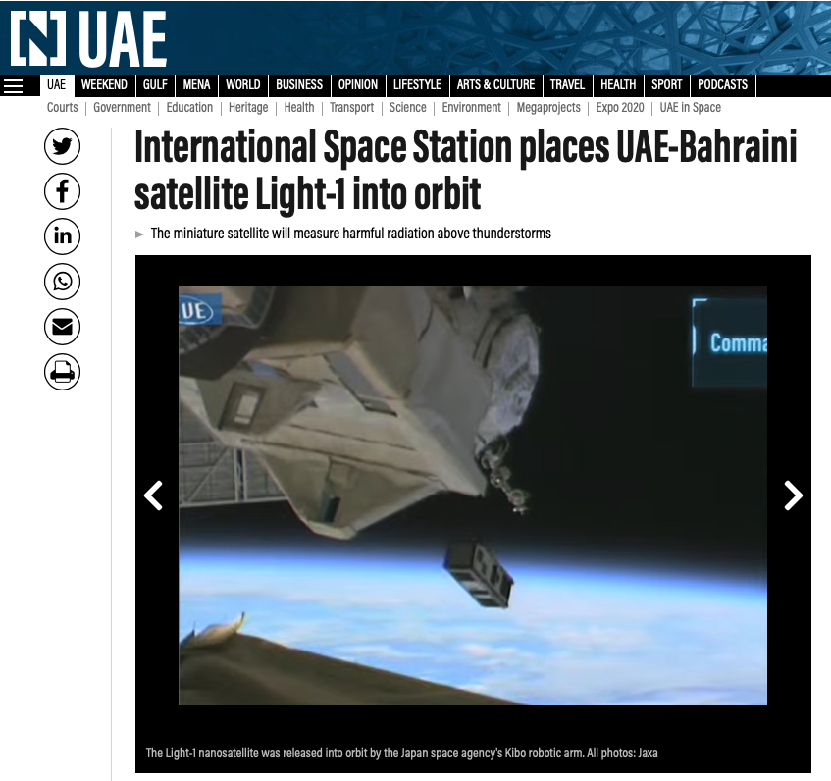
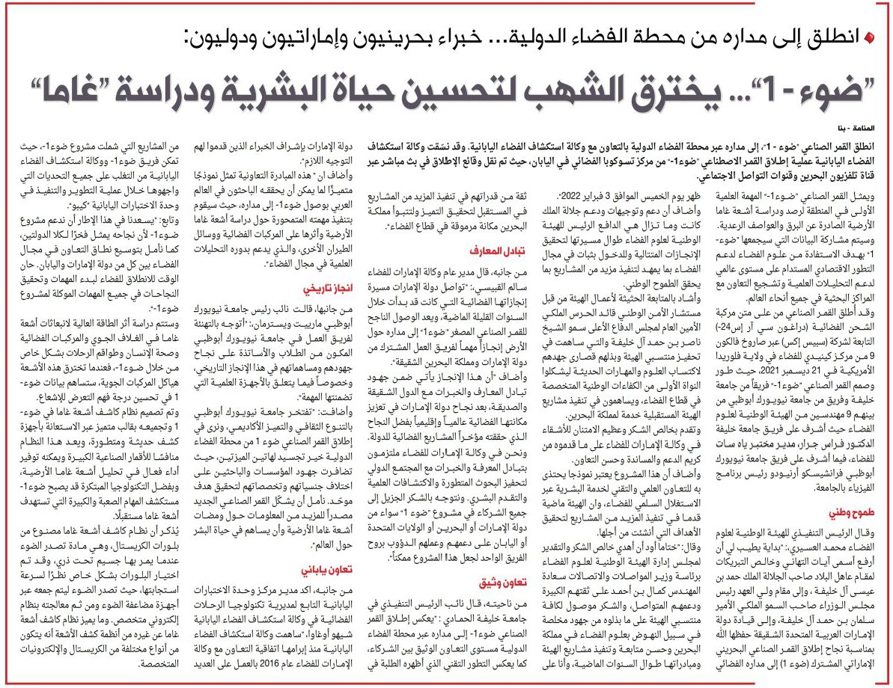
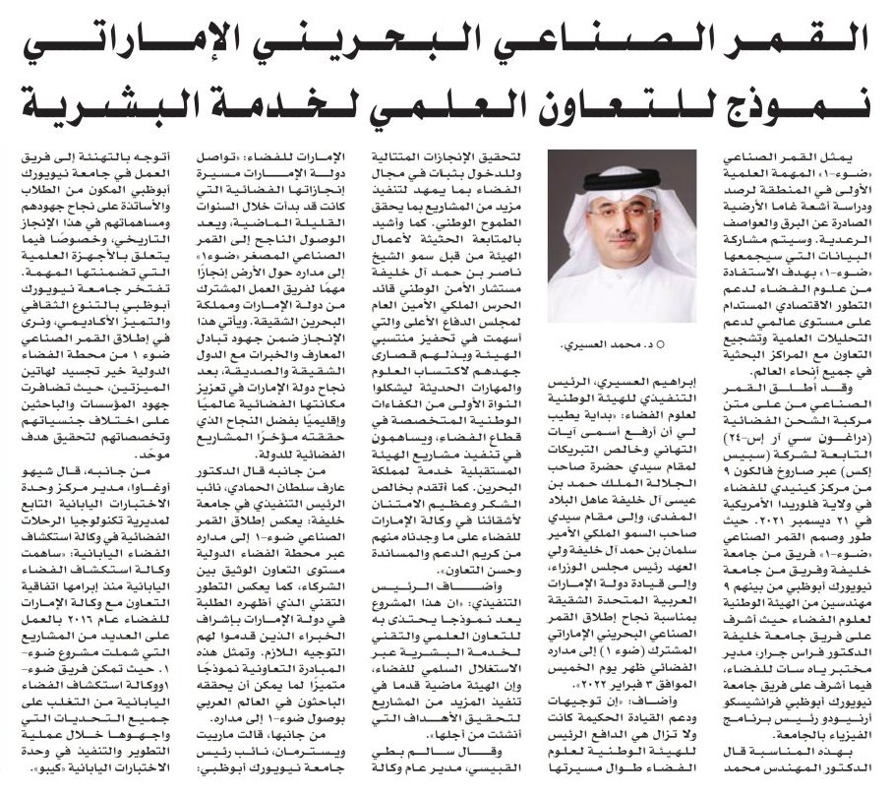
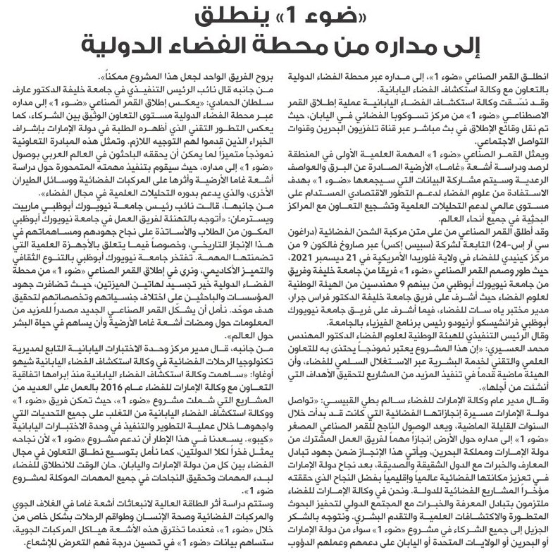
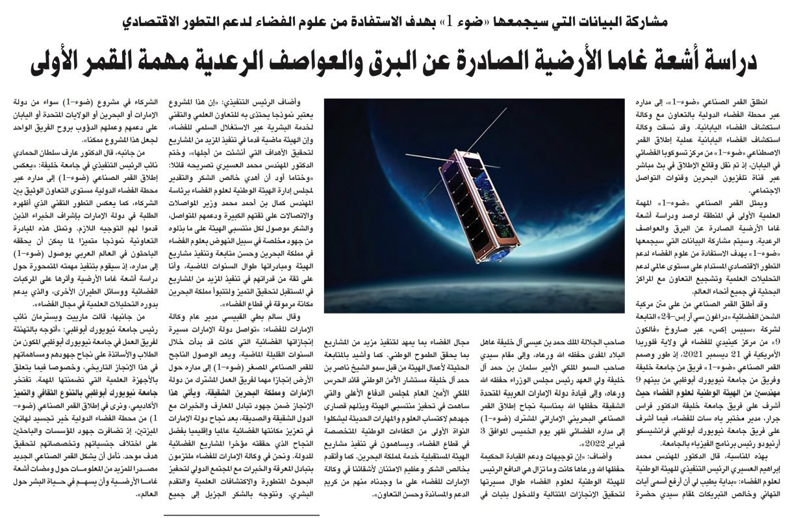
LIGHT-1: the first Arab-led astroparticle-like space mission
Adriano Di Giovanni (GSSI, INFN-LNGS & CAP3-NYUAD)
9

Slide 10
LIGHT-1 Payload: Design Characteristics
Parameter | Value
Detection Energy Range | ~ 20 keV - 3 MeV
Time resolution | ~ 100 ns
Absolute Timing | < 4 μs
Spectral Resolution | 15% @ 20 keV, < 5%@ 511 keV
Effective Area | 40 cm² @ 50 keV, 20 cm²@ 511 keV
PMT Payload Size (Fits in 1U) | 74 x 74 x 86 mm
SiPM Payload Size (Fits in 0.75U) | 74 x 74 x 68 mm
PMT Payload Weight | 1,085 g
SiPM Payload Weight | 966 g
Power Consumption | < 5.9 W average
Data Budget | 50 MB/day
Operational Temperature Range | Between -30º C to 55º C
Survival Temperature range | Between -40º C to 60º C
Adriano Di Giovanni (GSSI, INFN-LNGS & CAP3-NYUAD)
10
10

Slide 11
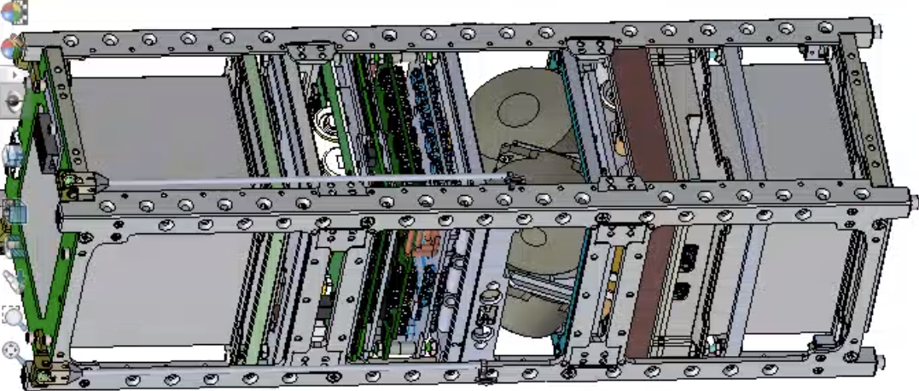
The bus of LIGHT-1 satellite
On Board Computer
Magneto-Torquer
PMT payload
SiPM payload
Rotating wheels
10 cm
34 cm
10 cm
S-Band receiver
Electrical Power System
Adriano Di Giovanni (GSSI, INFN-LNGS & CAP3-NYUAD)
11
11

Slide 12
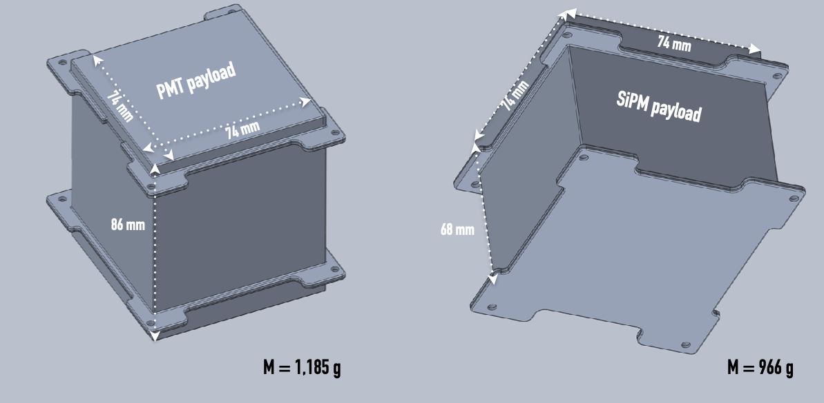
3D model of the LIGHT-1 payload
Aluminum 6061-T6
Adriano Di Giovanni (GSSI, INFN-LNGS & CAP3-NYUAD)
12
12

Slide 13
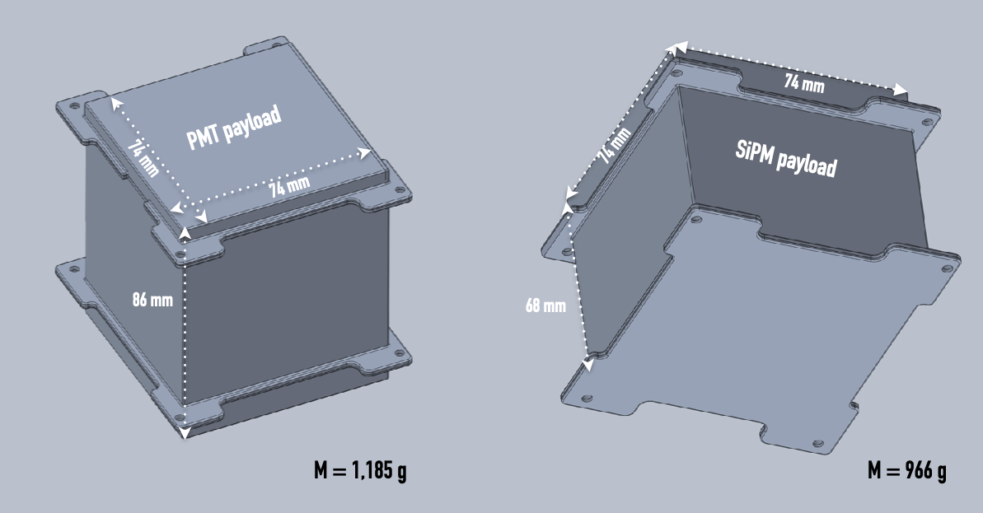
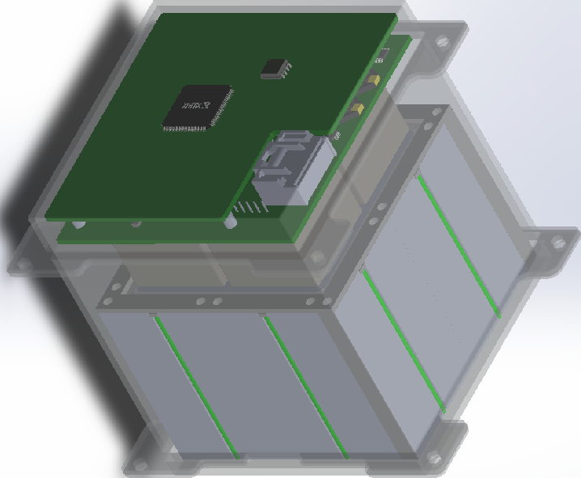
3D model of the LIGHT-1 payload
Adriano Di Giovanni (GSSI, INFN-LNGS & CAP3-NYUAD)
13
13

Slide 14
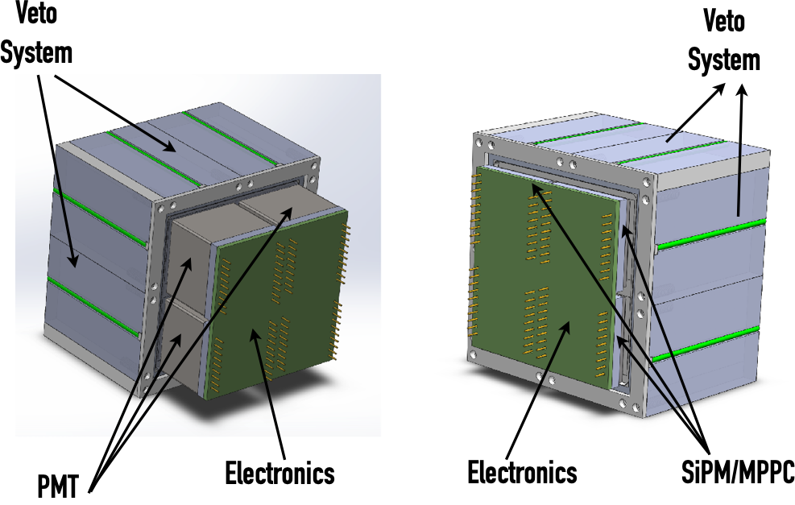
The LIGHT-1 PMT and SiPM payloads
Adriano Di Giovanni (GSSI, INFN-LNGS & CAP3-NYUAD)
14
14

Slide 15
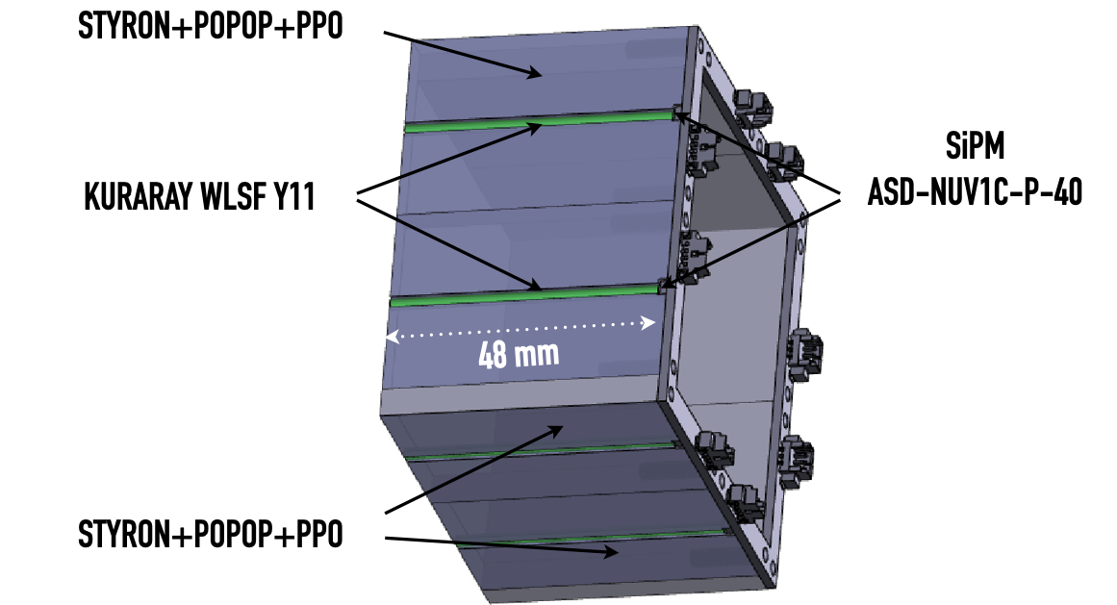
A VETO to reject charged particle induced events
Adriano Di Giovanni (GSSI, INFN-LNGS & CAP3-NYUAD)
15
15

Slide 16
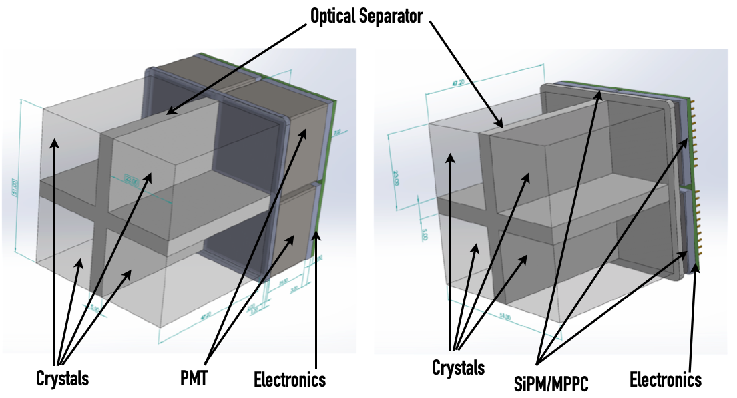
The LIGHT-1 detection targets
Adriano Di Giovanni (GSSI, INFN-LNGS & CAP3-NYUAD)
16
16

Slide 17
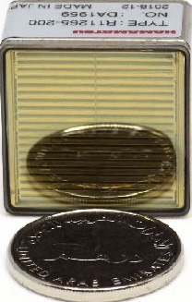
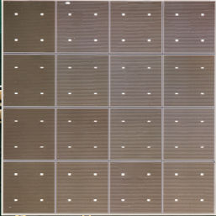
The Hamamatsu Photosensors
Characteristics | R11265-200 | S13361-6050AE-04
Type of photosensors | PMT | MPPC (aka SiPM)
Dimensions(LXDXH) [mm³] | 26X26X19 | 25X25X1.4
Weight [g] | 24 | 2
Peak Sensitivity [nm] | ~ 400 | ~ 450
Q.E. [%] | 43 | -
P.D.E. [%] | - | 40
Typical Operating Voltage [V] | 900 | 55
Typical Gain at working point | ~10⁶ | ~10⁶
Dark Count at working point, room temperature [Hz] | Negligible | > 10 M
Operating Temperature [ºC] | -30 to +60 | -20 to +60
# of photosensors in LIGHT-1 | 4 | 4
Photomultiplier Tubes R11265-200
Multi-Pixel Photon Counters S13361-6050AE-04
Adriano Di Giovanni (GSSI, INFN-LNGS & CAP3-NYUAD)
17
17

Slide 18
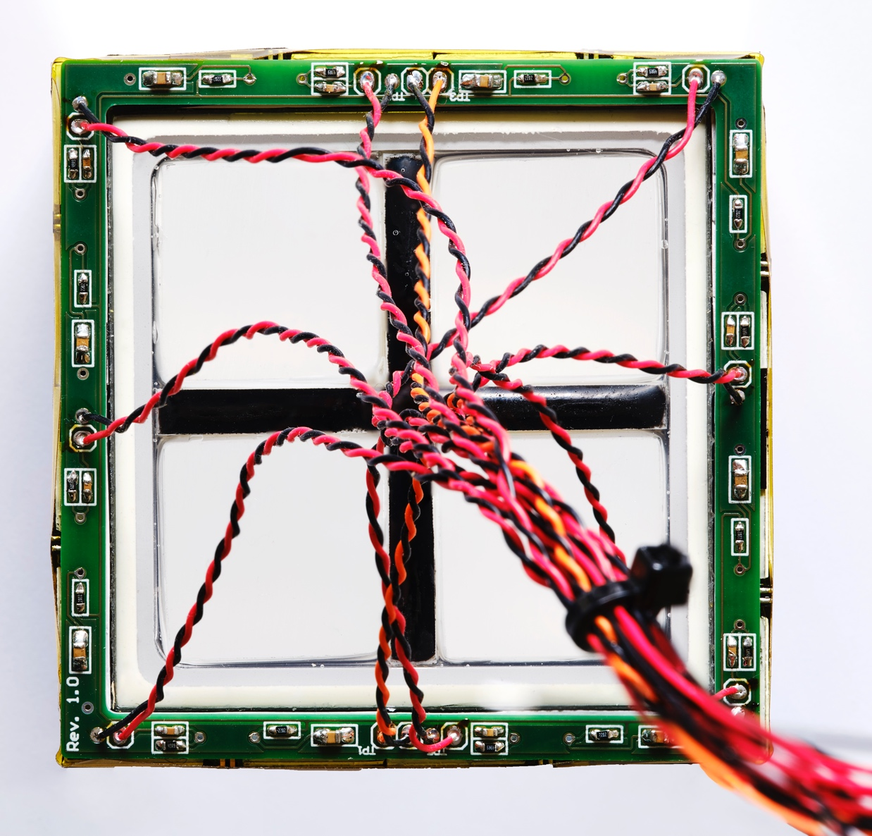
CeBr3(LB) and LBC scintillating crystals by Scionix
Characteristics | CeBr₃(LB) | LBC
Density [g/cm³] | 5.1 | 4.9
Hygroscopic | YES | YES
Emission Peak [nm] | ~370 | ~ 380
Typical Resolution @122 keV (⁵⁷Co) [%] | 10 | 7
Typical Resolution @662 keV (¹³⁷Cs) [%] [%][%] | 4 | 3
Typical Decay Time [ns] | ~ 20 | ~ 35
Activity [Bq/cm³] | < 0.01 | ~ 1
The LIGHT-1 detection target consists of:
6X (23 mm X 23 mm X 45 mm) Low Background Cerium Bromide (CeBr3(LB))
2X (23 mm X 23 mm X 45 mm) Lanthanum Bromo Chlorine (LBC)
For Basic Unit characterization see here: https://doi.org/10.1088/1748-0221/14/09/P09017
Adriano Di Giovanni (GSSI, INFN-LNGS & CAP3-NYUAD)
18
18

Slide 19
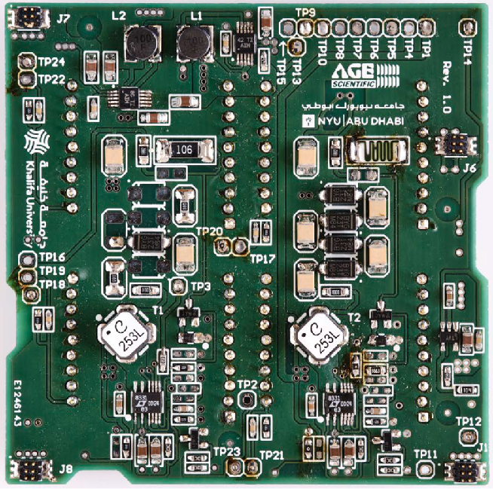
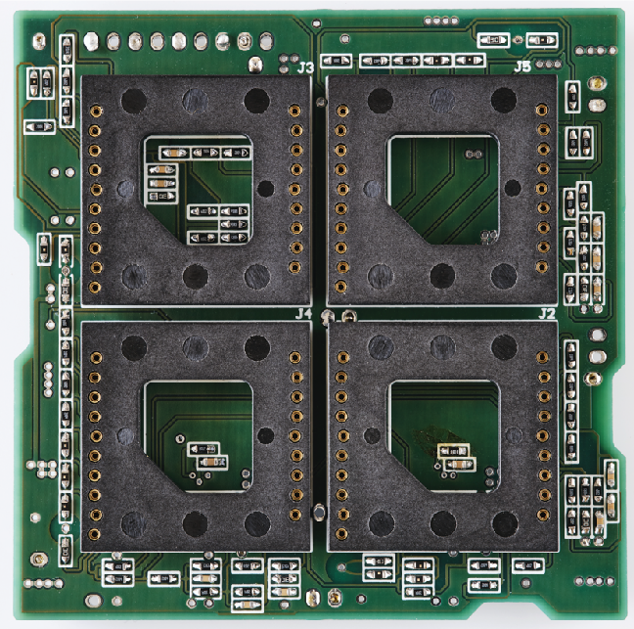
Proximity Electronics (Power Supply)
Main Characteristics:
- Operation and Readout of 4 photosensors (each) + VETO SiPMs (8)
- Based on C.O.T.S. (Components off-the-shelf);
- Detector Voltage Biasing (PMT/SiPM and VETO). PMT: -600 V to -750 V; SiPM: 25 V to 62 V; VETO: 25 V to 38 V;
- Voltage Inputs: +3.3 V, -3.3 V, +5 V;
- Weight: 27 g (SiPM) - 35 g (PMT)
Adriano Di Giovanni (GSSI, INFN-LNGS & CAP3-NYUAD)
19
19

Slide 20
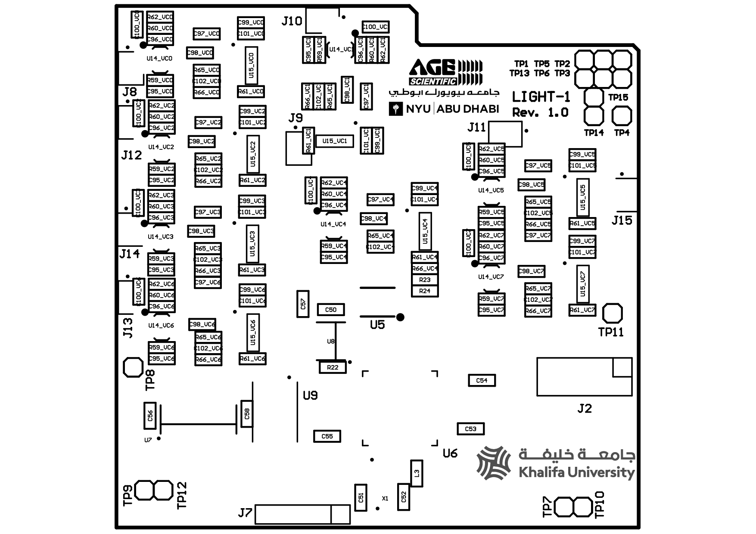
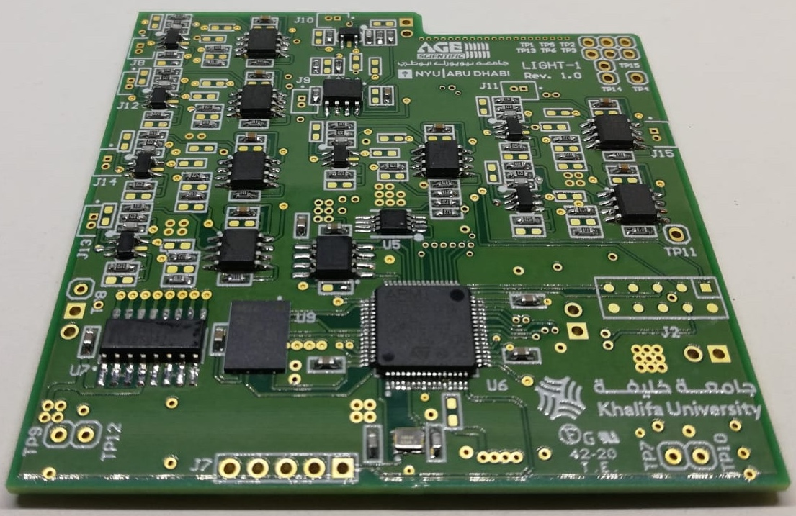
Proximity Electronics (CTRL & FE board)
Payload operations;
Signal conditioning;
Signal Charge extraction (ADC+FPGA);
CubeSat Software Protocol (CSP) compliant ;
Event builder;
Time stamping;
Preprocessing and data priority assignment;
Temperature monitoring;
Voltage Input: +3.3 V;
Weight: 27 g .
Adriano Di Giovanni (GSSI, INFN-LNGS & CAP3-NYUAD)
20
20

Slide 21
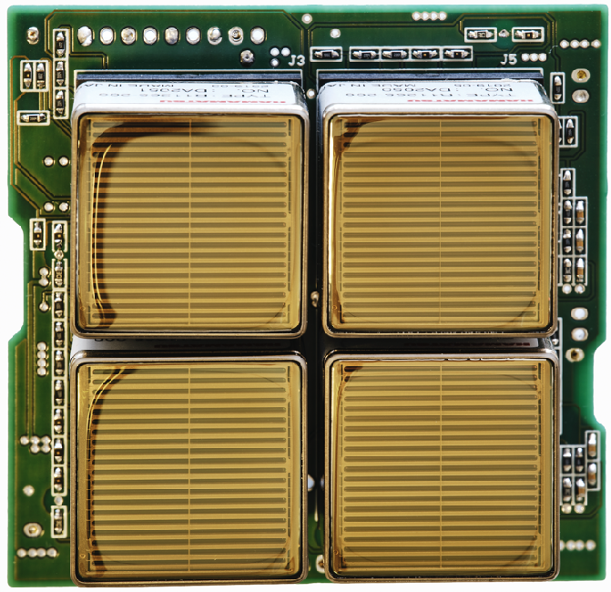
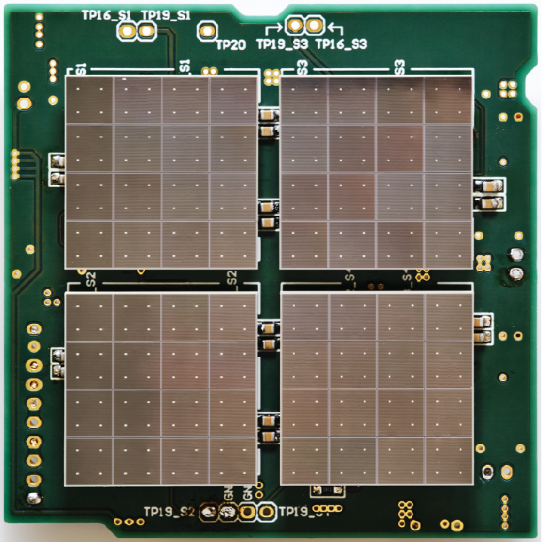
The photosensor Arrays
PMT Array
MPPC/SiPM Array
Adriano Di Giovanni (GSSI, INFN-LNGS & CAP3-NYUAD)
21
21

Slide 22
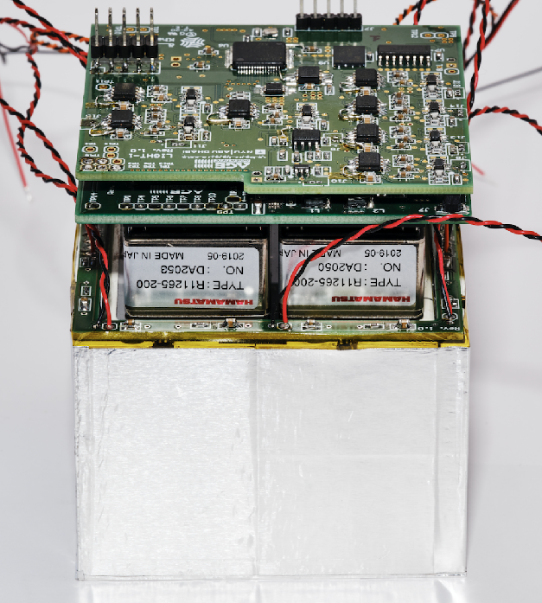
The PMT payload (Inner View)
Controller Electronics
Power Supply
Electronics
Photomultiplier
tube
VETO
Electronics
VETO system
VETO system
Adriano Di Giovanni (GSSI, INFN-LNGS & CAP3-NYUAD)
22
22

Slide 23
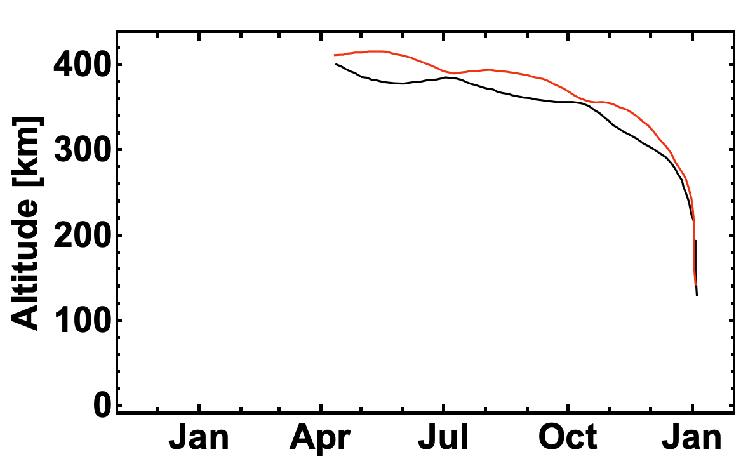
A very intense and (eventually) sad story
SpaceX Launch from Kennedy Space Center
on 2021-12-21 (Falcon9/Dragon docked ISS the day after)
LIGHT-1 PAYLOAD
COMMISSIONING
LEOP
LIGHT-1
SCIENCE DATA
LIGHT-1
END OF LIFE
Deployment from ISS on 2022-02-03
LEOP = LAUNCH and EARLY ORBIT PHASE
Adriano Di Giovanni (GSSI, INFN-LNGS & CAP3-NYUAD)
23
23

Slide 24
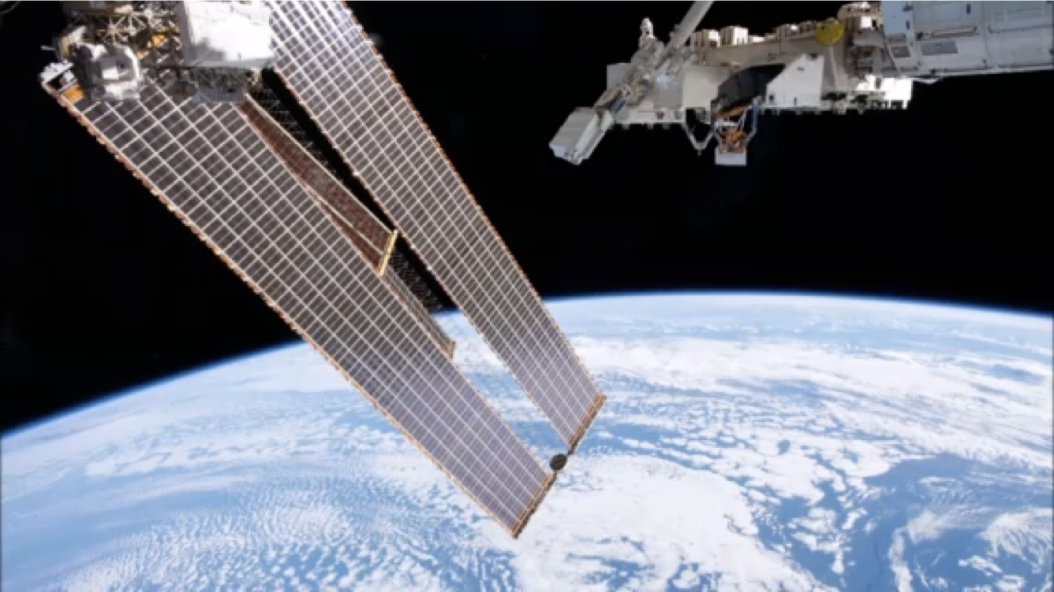
LIGHT-1 moment of celebrity
Deployment from ISS on 2022-02-03
Adriano Di Giovanni (GSSI, INFN-LNGS & CAP3-NYUAD)
24
24

Slide 25
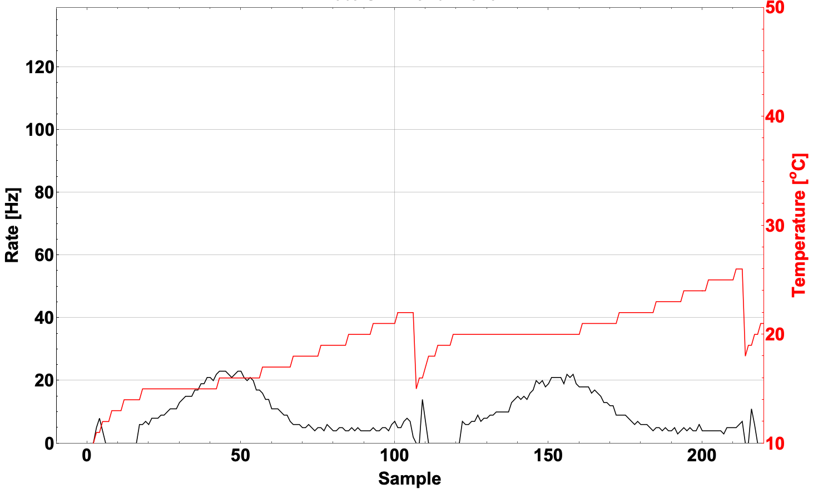
Measured particle rate (SiPM CH2)
1 Sample/20 s (1 Sample/~160 km)
Payload ON
Noise Mode
Payload OFF
Payload in Flight Mode
SiPM CH2 detection THR set to 1800 ADC CH / 64k ADC CH
LIGHT-1 Operational DutyCycle (DC): 61%, Effective DC (checks, reboot, SAA): 48%
Adriano Di Giovanni (GSSI, INFN-LNGS & CAP3-NYUAD)
25
25

Slide 26
Measured particle rate (SiPM CH2)
1 Sample/20 s (1 Sample/~160 km)
61% of 1 orbit (~3300 s)
Payload ON
Noise Mode
Payload OFF
Payload in Flight Mode
SiPM CH2 detection THR set to 1800 ADC CH / 64k ADC CH
LIGHT-1 Operational DutyCycle (DC): 61%, Effective DC (checks, reboot, SAA): 48%
Adriano Di Giovanni (GSSI, INFN-LNGS & CAP3-NYUAD)
26
26

Slide 27
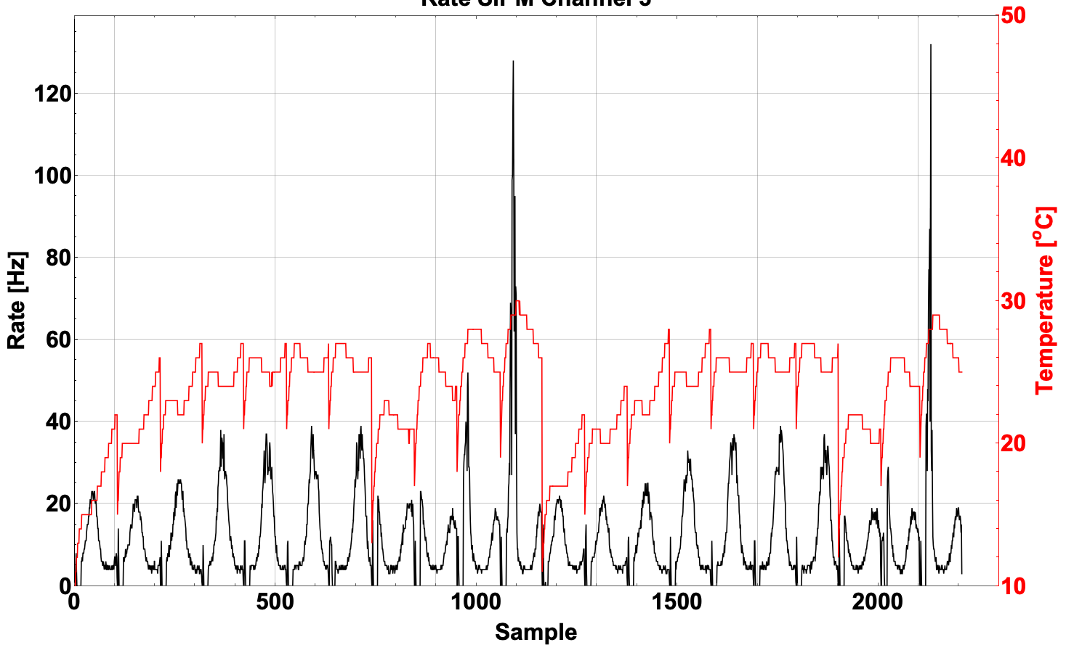
Measured particle rate (SiPM CH2)
1 Sample/20 s (1 Sample/~160 km)
Transits nearby SAA region
SiPM CH2 detection THR set to 1800 ADC CH / 64k ADC CH
LIGHT-1 Operational DutyCycle (DC): 61%, Effective DC (checks, reboot, SAA): 48%
Adriano Di Giovanni (GSSI, INFN-LNGS & CAP3-NYUAD)
27
27

Slide 28
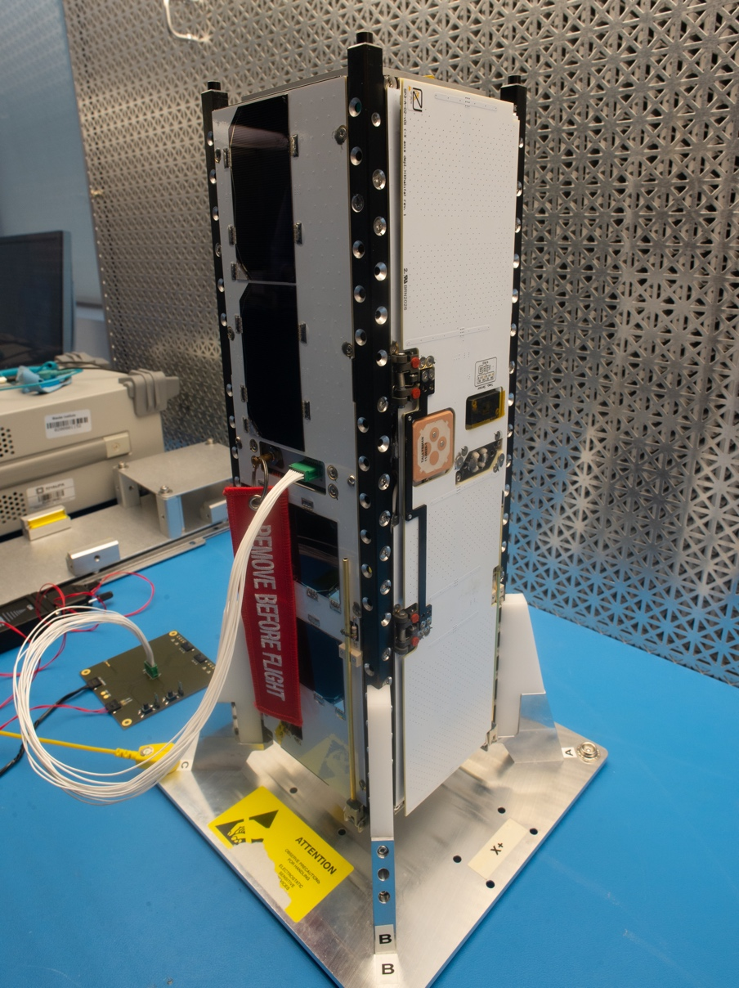
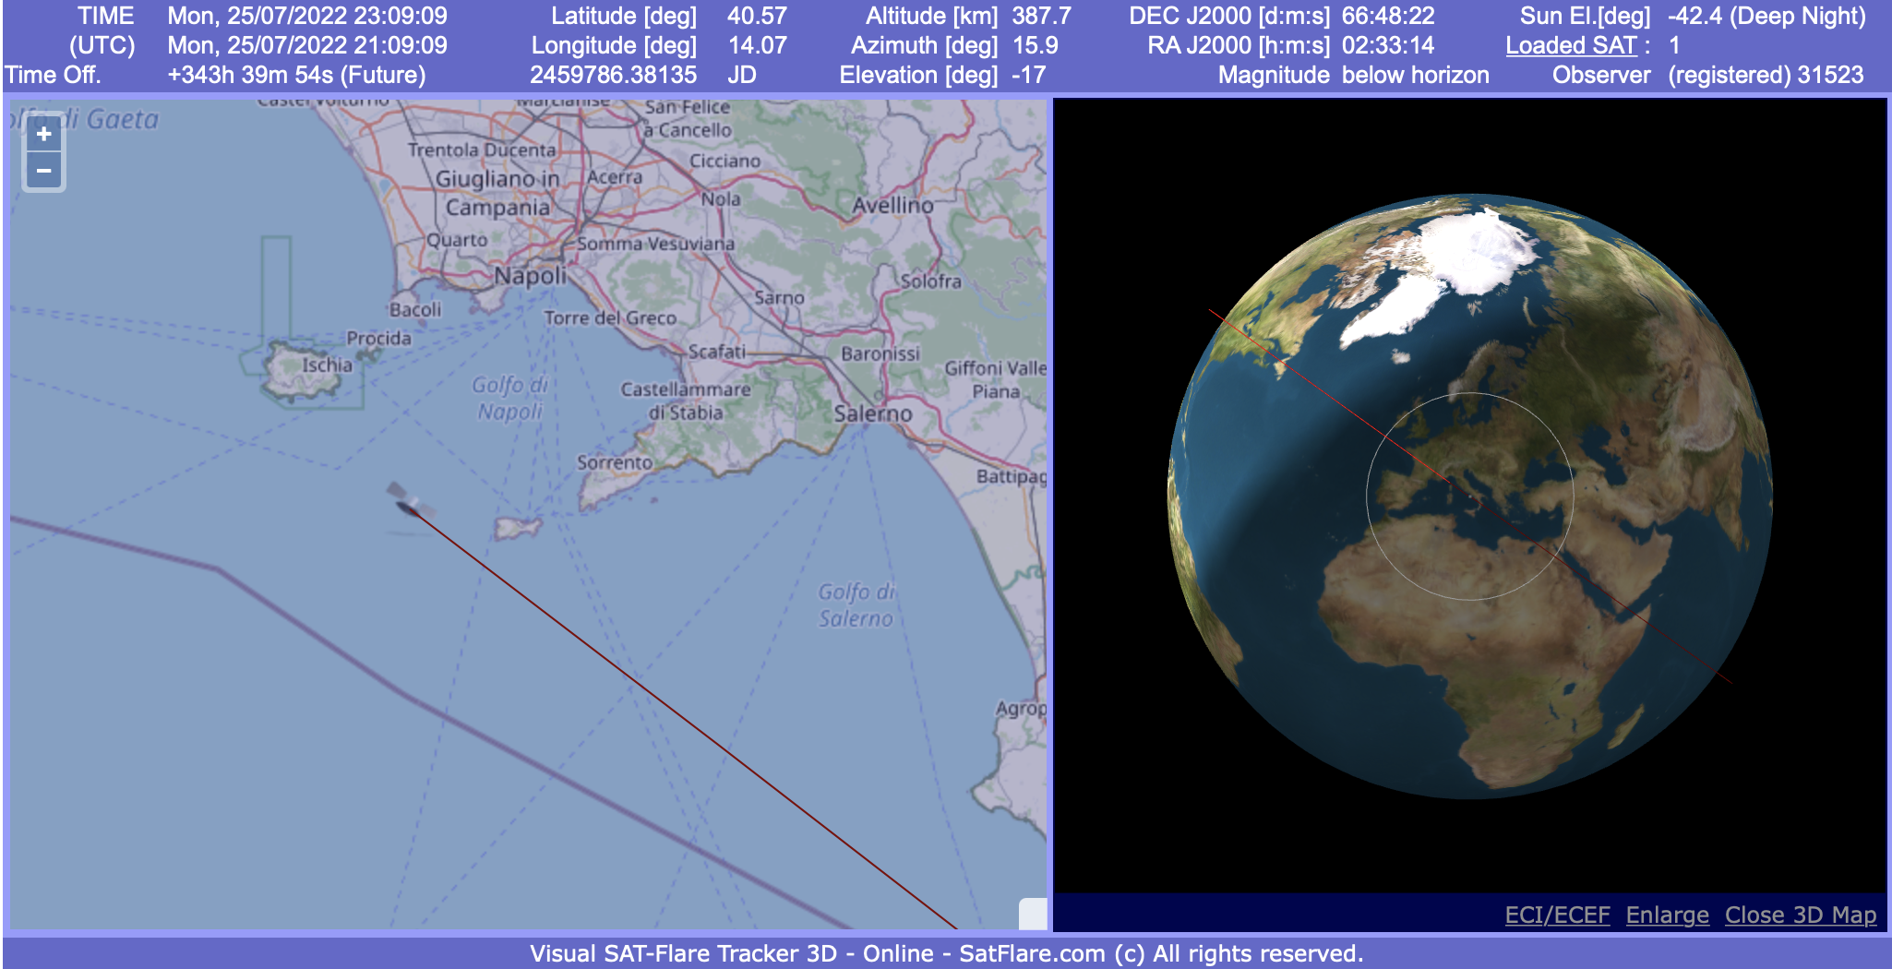
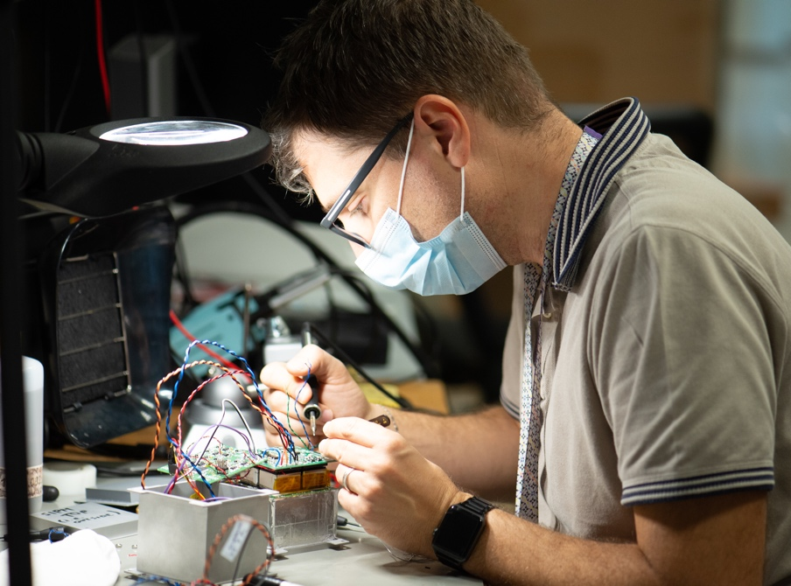
Summary and present status
LIGHT-1 was launched on December 21st, 2021 SpaceX Falcon9/Dragon;
LIGHT-1 was set into orbit (LEO, from ISS) on February 3rd, 2022;
LEOP completed, LIGHT-1 payload commissioning completed;
LIGHT-1 entered in the operating phase on May 10th, 2022;
It has been a tremendous opportunity to teach students on instrumentation and detector operations;
working fast toward the identification of TGF candidates.
Adriano Di Giovanni (GSSI, INFN-LNGS & CAP3-NYUAD)
28
28

