Slide 1
The LHCb Event Builder: an update
Francesco Sborzacchi, I.N.F.N L.N.F./CERN
Workshop sul calcolo nell’ I.N.F.N May 2022

Slide 2
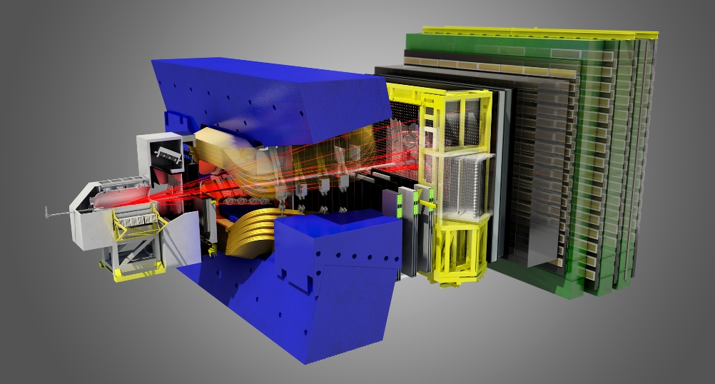
The LHCb Upgrade 1
100 m underground
30 m long
40 MHz p-p bunch crossing rate
Trigger-less readout
MHz

Slide 3
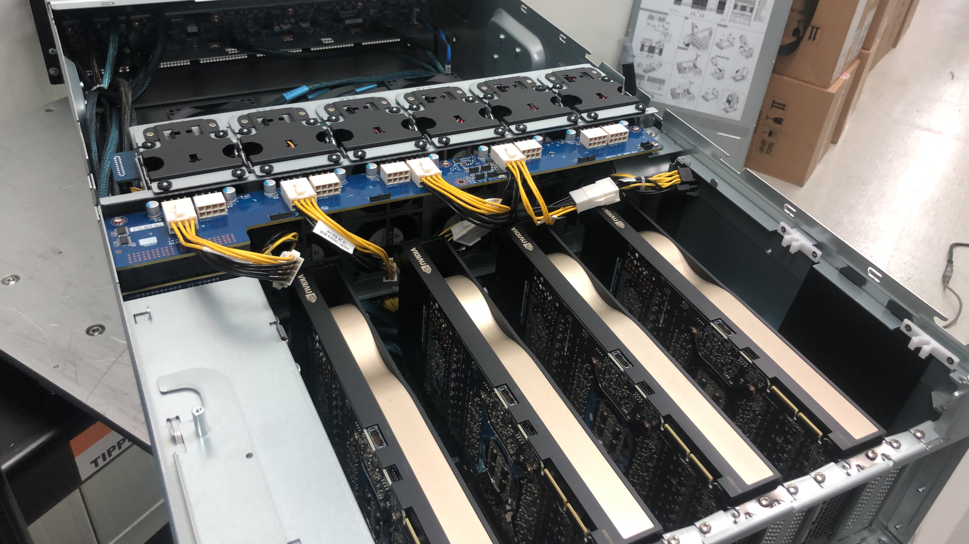
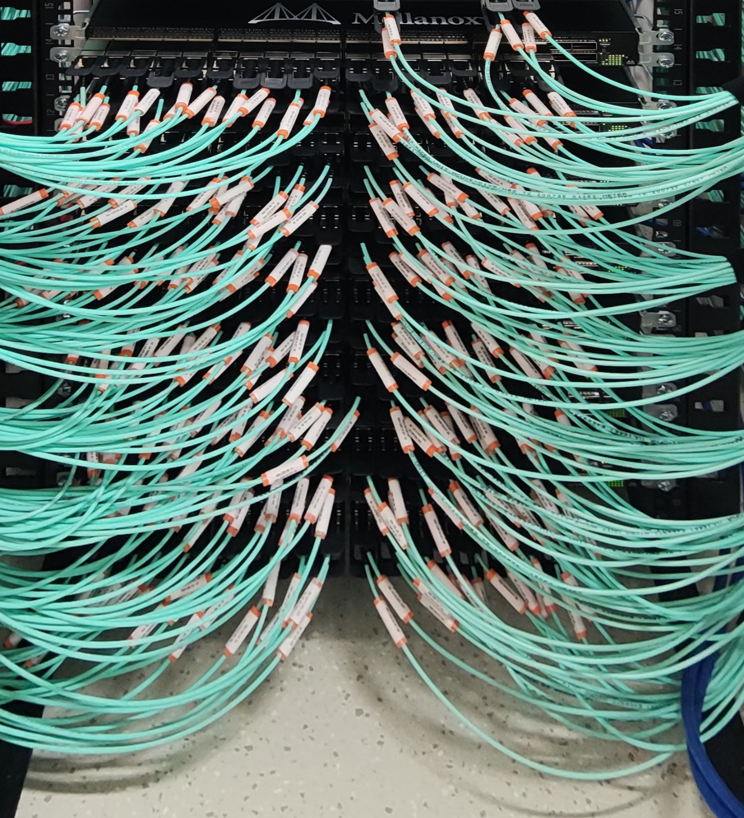
LHCb Online Computing 2020+
10 million channels
4 TerabByte/s total data rate
400 Port InfiniBand + 4000 port Ethernet (10/100/200 Gbits) network
170 Readout servers (AMD Rome) with FPGA and GPGPU (A5000)
4000 dual socket servers (AMD/Intel)
60 PB storage

Slide 4
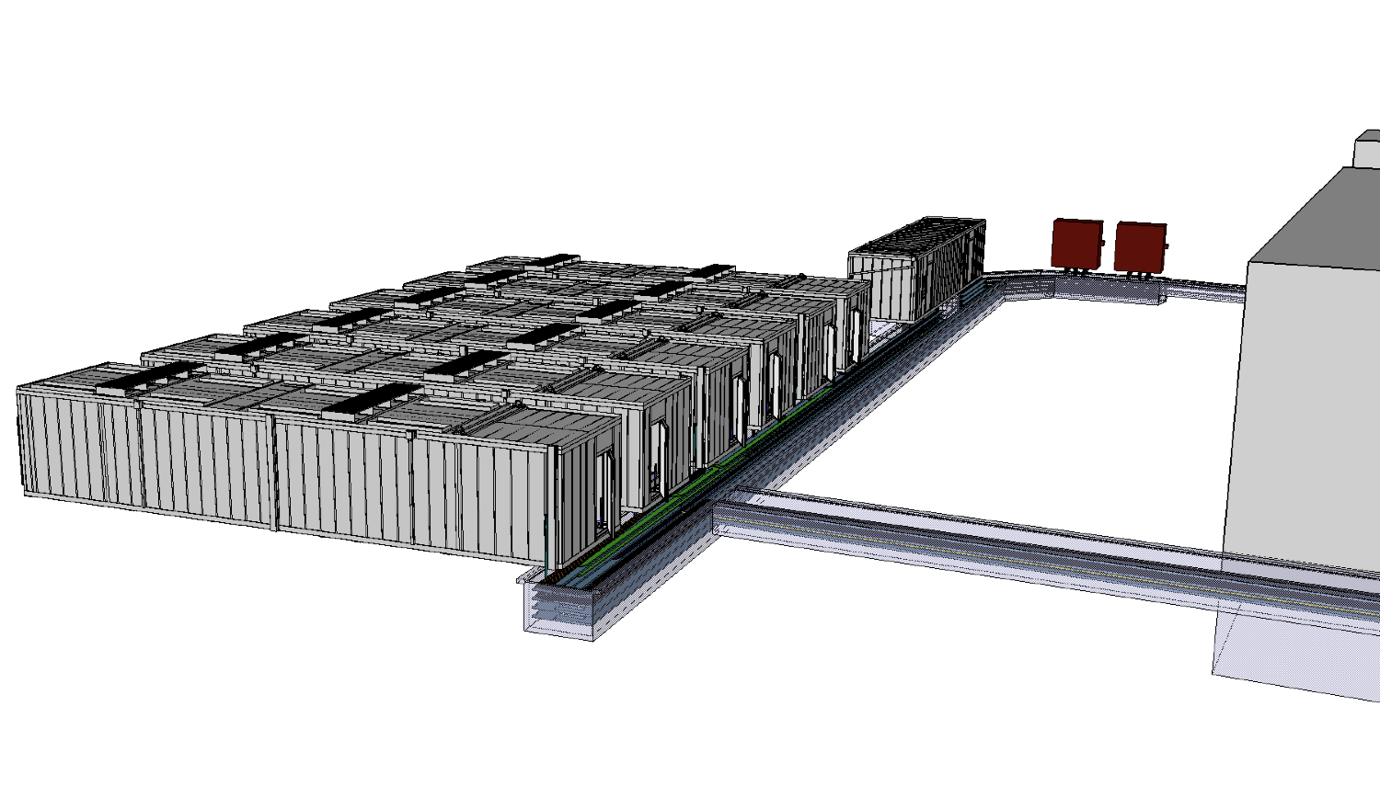
Increase in data lets system grow…
No additional space nor cooling in the underground facilities
Computing Power needed : 2MW nominal
Space constraints: 5000Us
I/O connectivity @ 14000+ optical fibres

Slide 5
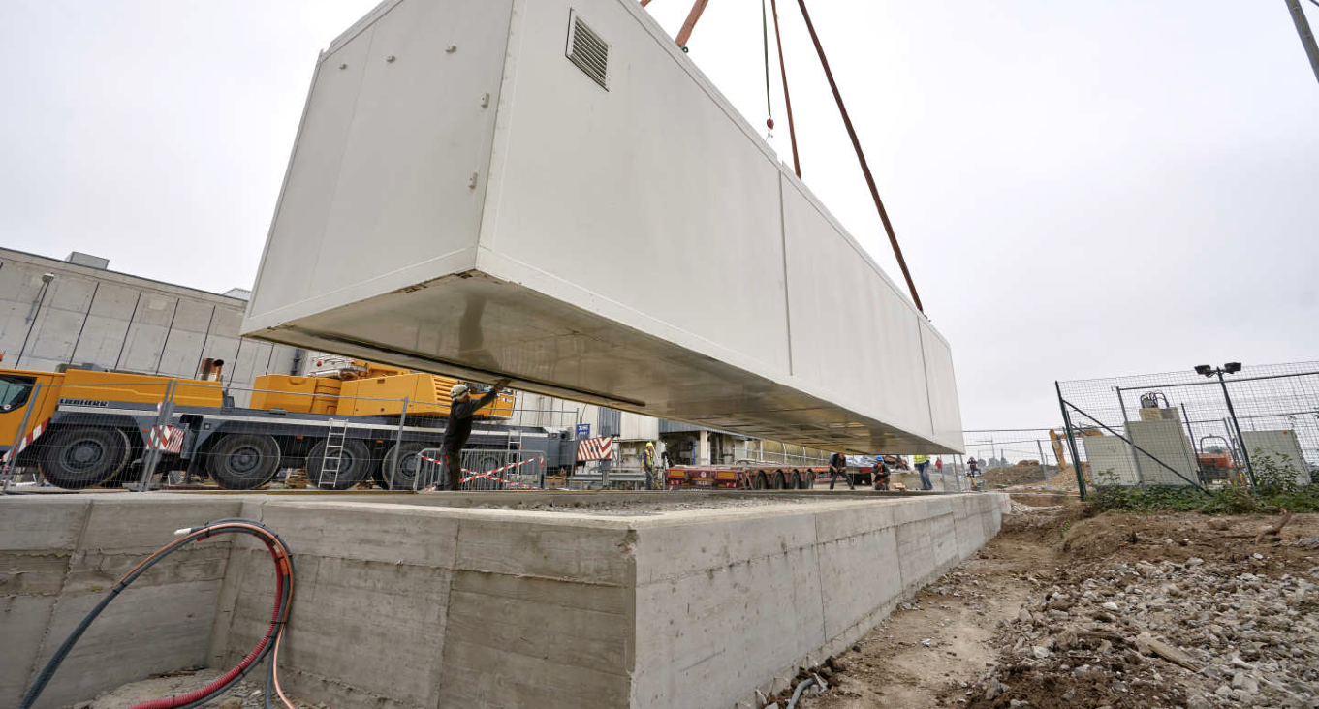
The Modular DC installation

Slide 6
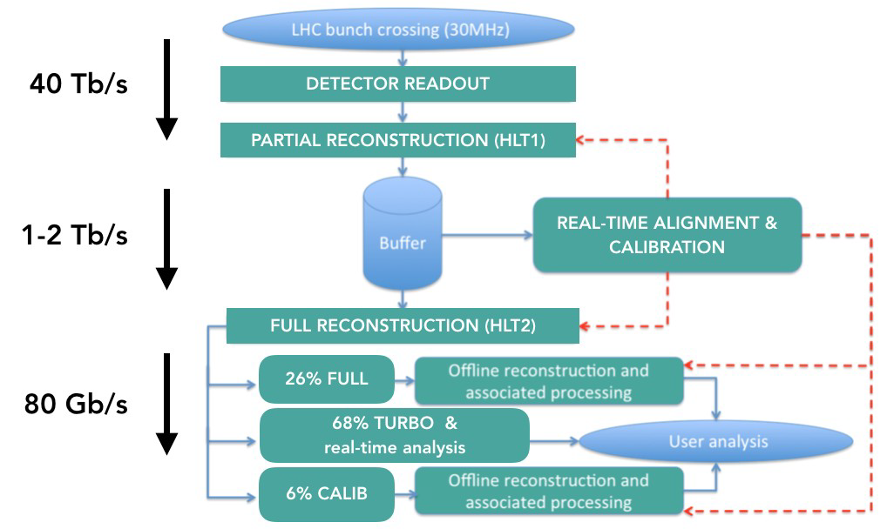
Data Processing and Selection
Two stages of software filtering:
1) "HLT1" on GPGPUs
2) "HLT2" on CPUs
Large storage buffer to decouple the two
Calibration and alignment are performed "semi live", while the data are buffered
HLT2 output is offline-ready for “grid” analysis

Slide 7
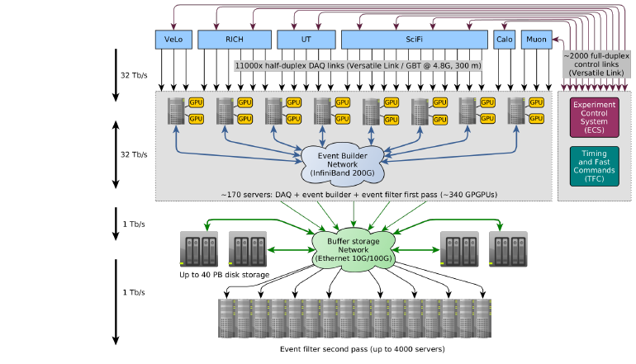
System Overview

Slide 8
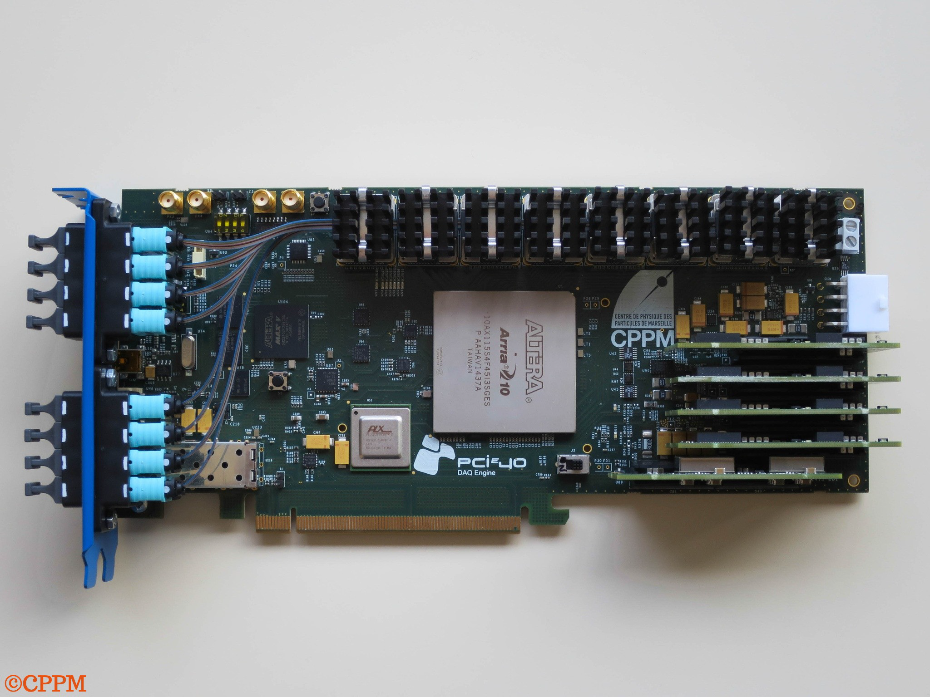
Back-end PCIe40
A single custom-made FPGA board for DAQ and Control
Based on Intel Arria10
48x10G-capable transceivers on 8xMPO for up to 48 full-duplex Versatile Links
478 boards in total
16x PCIe 3.0

Slide 9
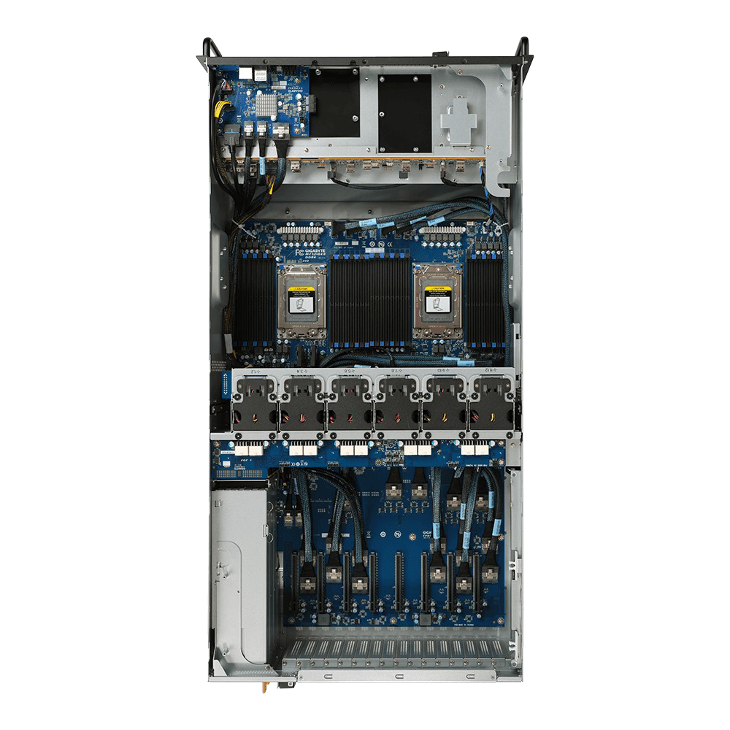
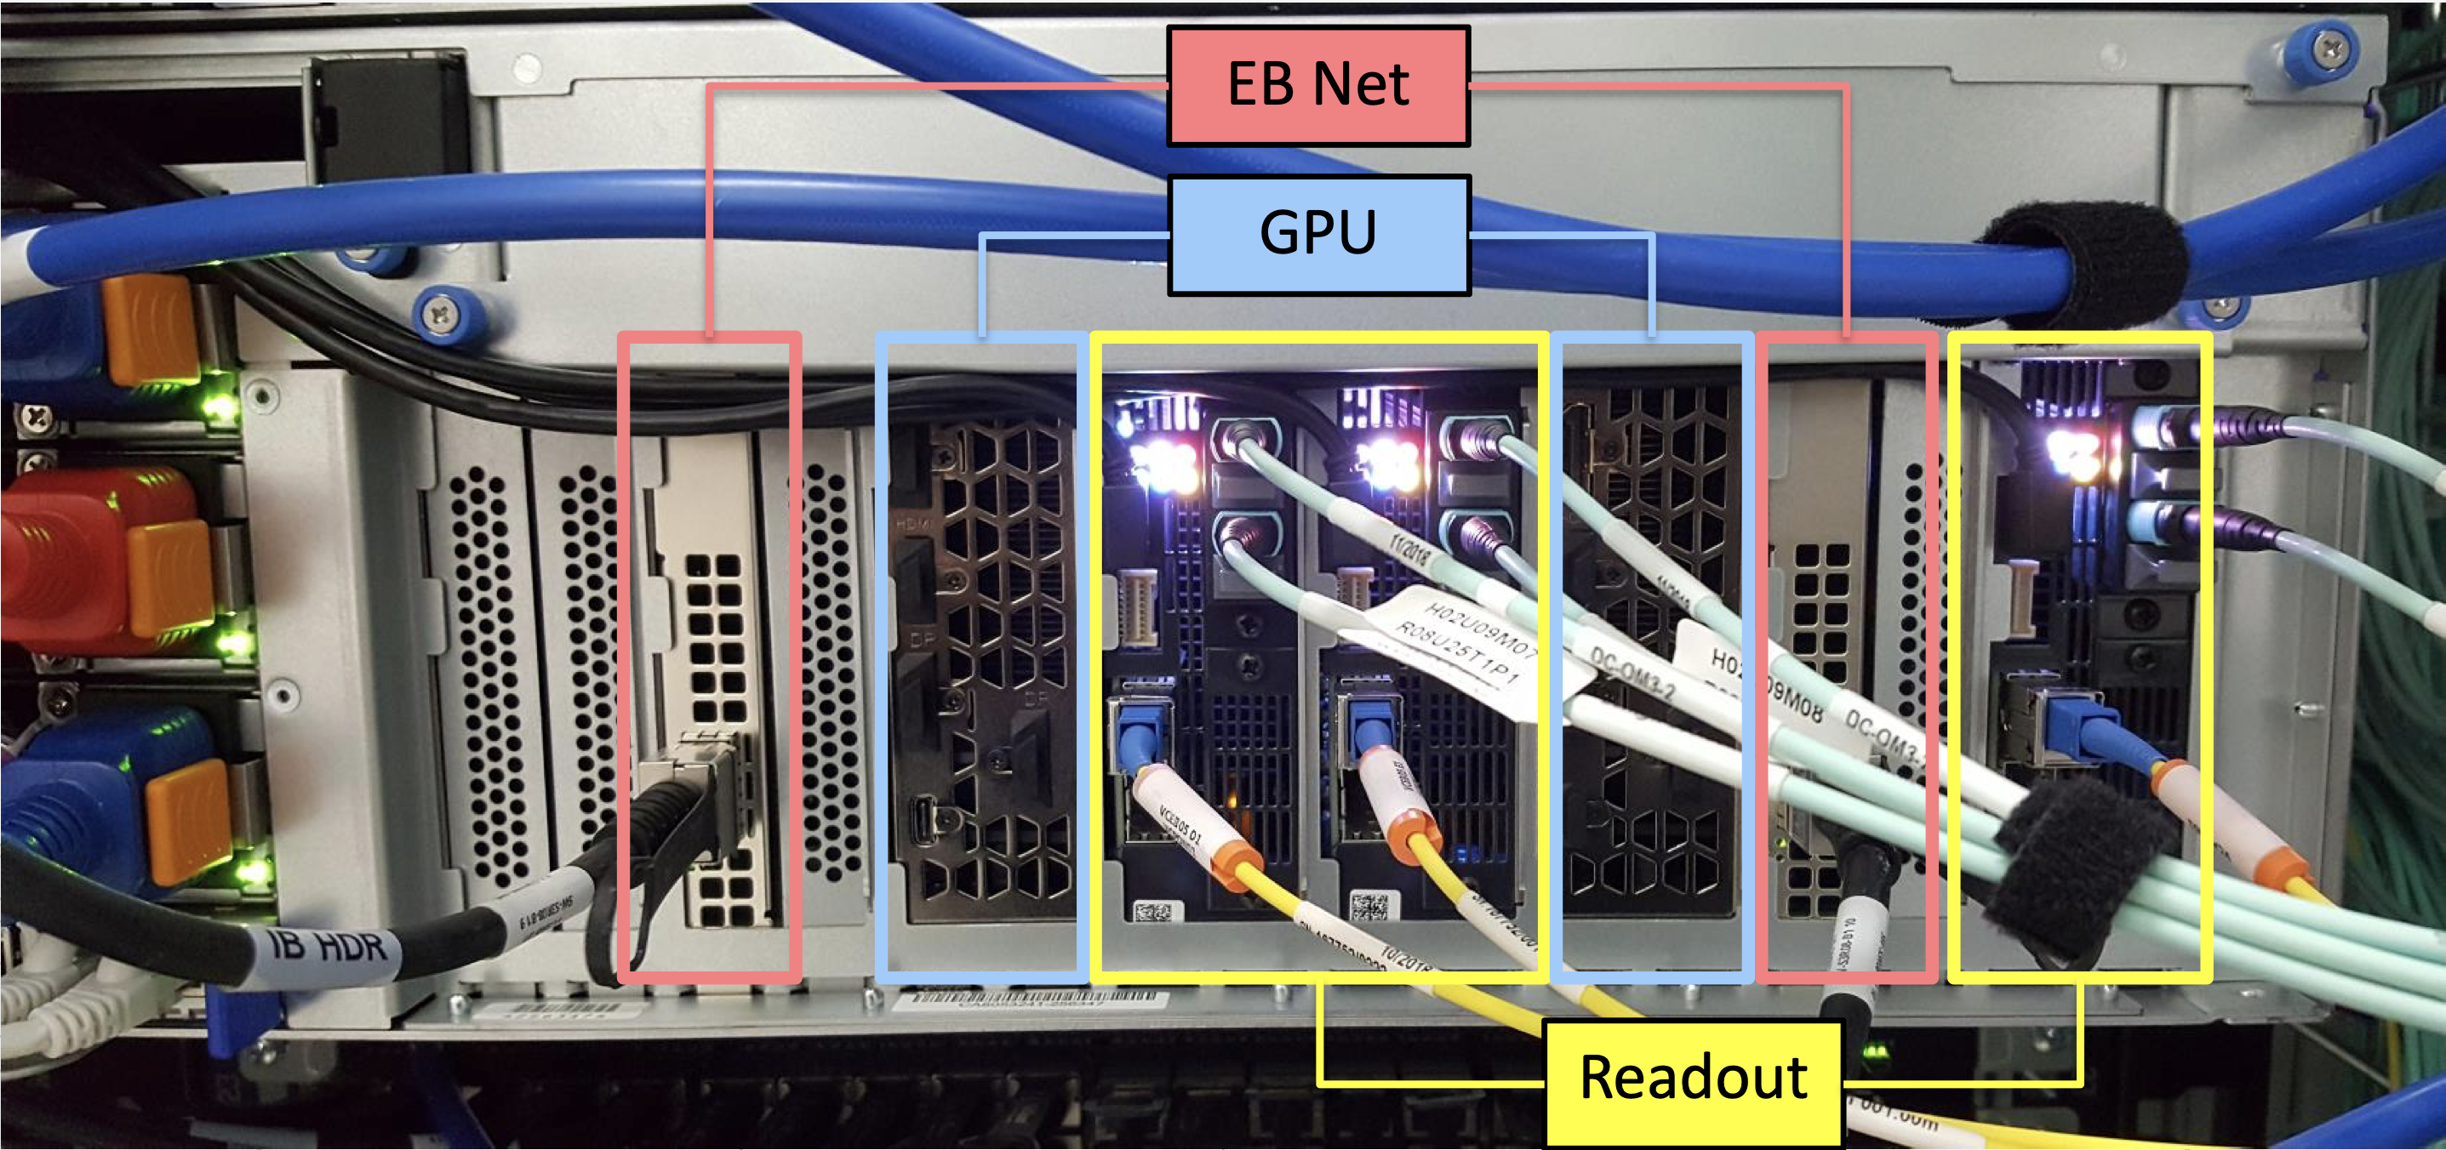
Event builder server
2 AMD EPYC 7002-series CPUs
3 readout boards
2 InfiniBand 200G NICs
Up to 3 GPUs
512 GiB RAM
PCIe 4.0
8+8 DDR4 channels

Slide 10
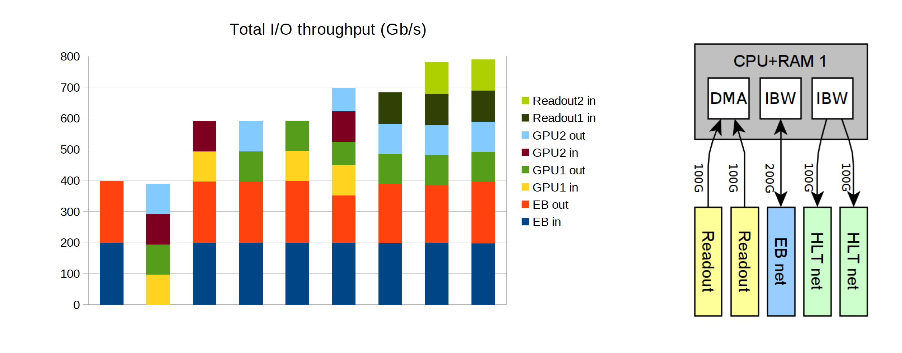
EB Servers Challenges
Memory subsystem pushed to the limits! RDMA is crucial.

Slide 11
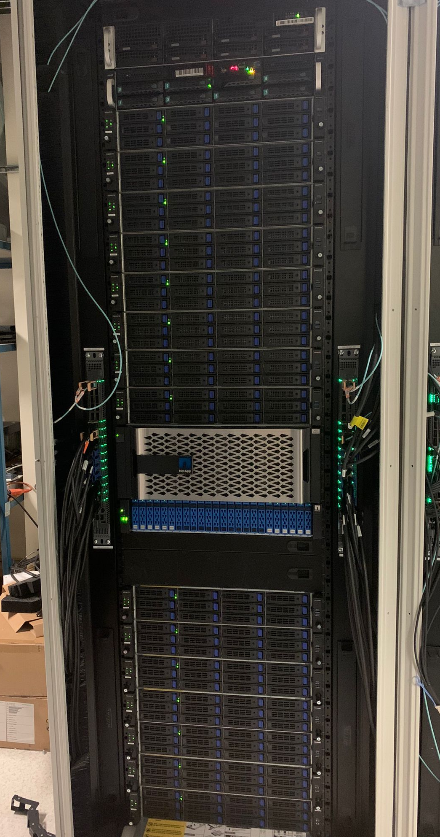
Experiment Control System
SCADA control system based on WinccOA
500 VMs (RHEV cluster)
NetApp AllFlash Nvme storage (NFS)
16 Hypervisors
16 TiB of Ram
1024 cores in total
2x100Gb/s network

Slide 12
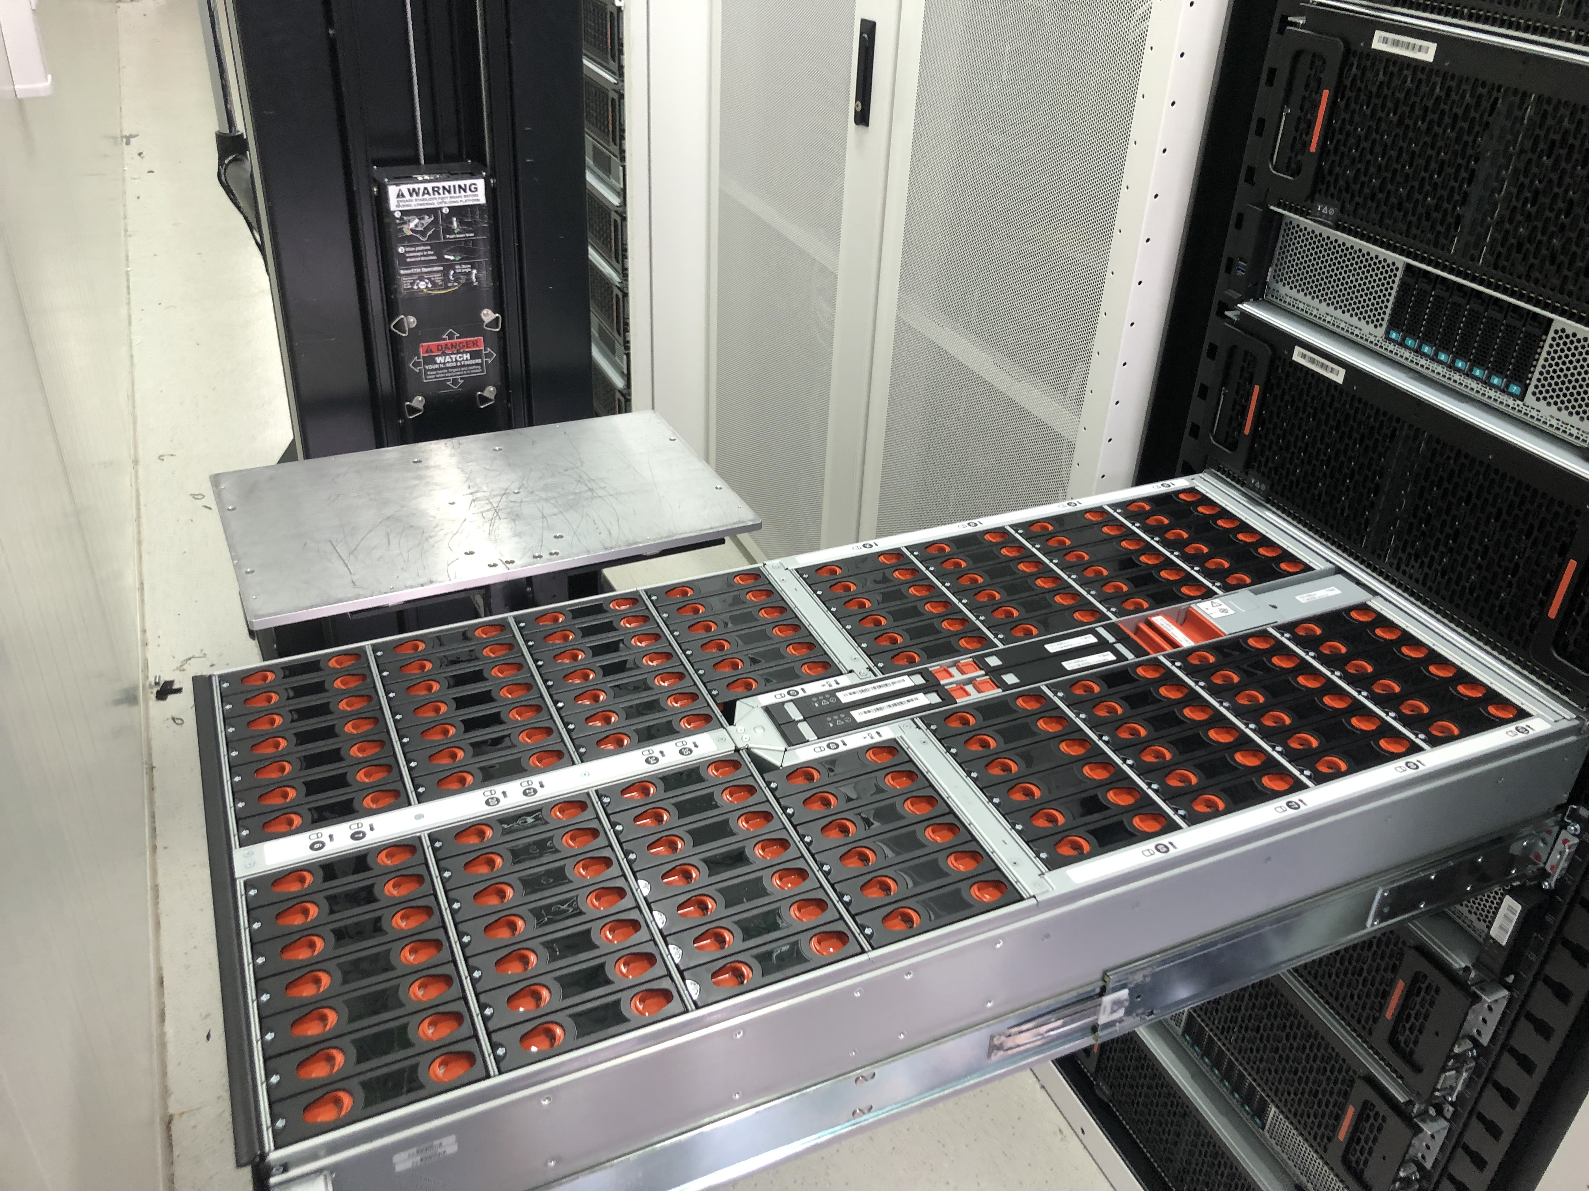
HLT1 Buffer Storage
32 x WD shelves @ 102 disks 14TB
~40 PiB raw space
EB Storage Servers Intel GOLD series with PMEM
Data Handling and book-keeping software defined storage
No redundancy
Target BW 100GB/s in and 100GB/s out
WIP

Slide 13
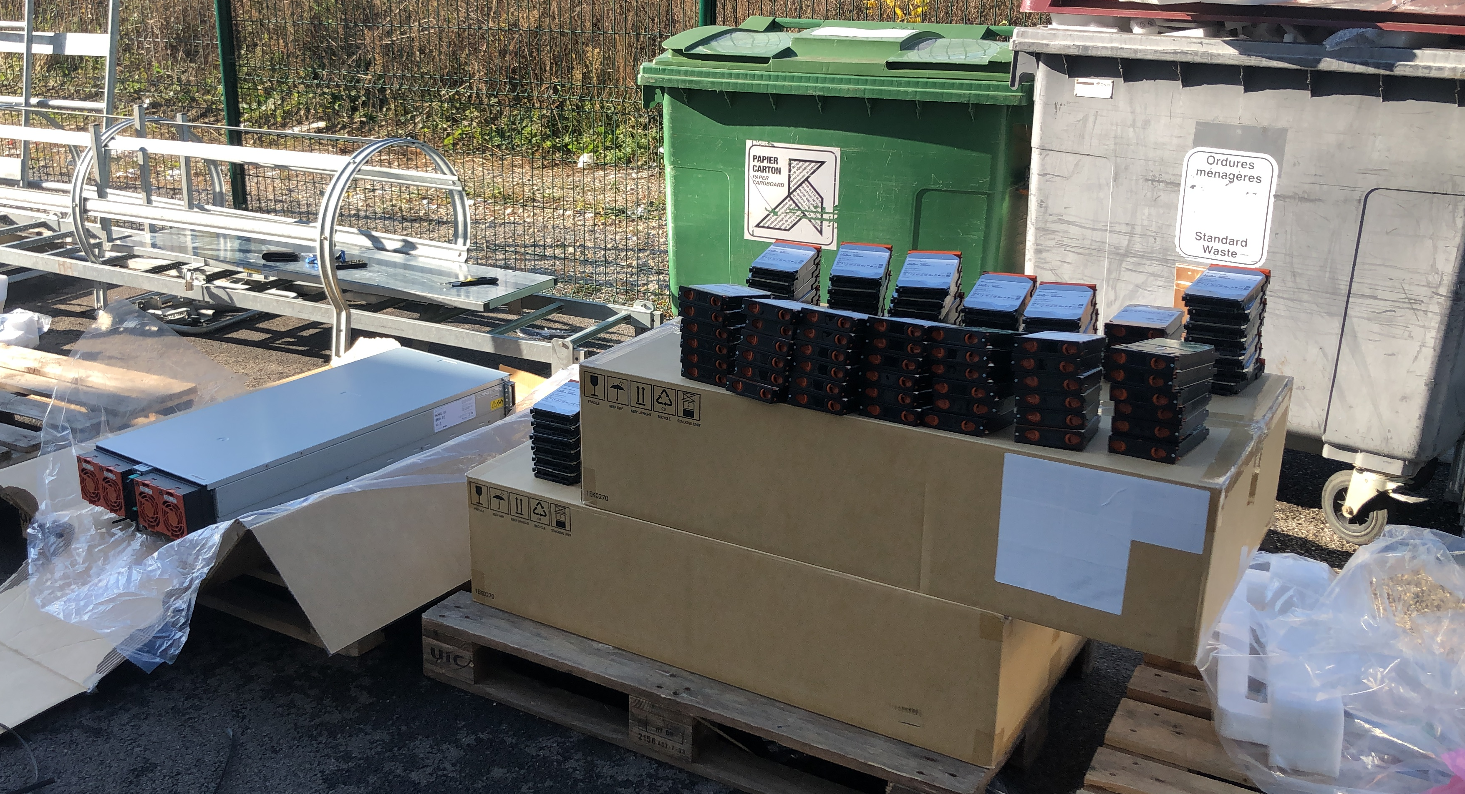
HLT2 Buffer Storage
Software defined storage Ceph
Erasure coding 8d+2p
12 OSD servers (60 disks @ 18TB)
CEPHFS native kernel integration
Target BW 10GB/s in and 10GB/s out
4000 clients writing in parallel
~ 16 clients/500 streams reading EOS exports

Slide 14
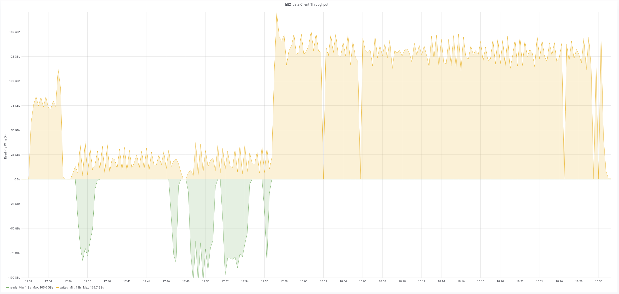
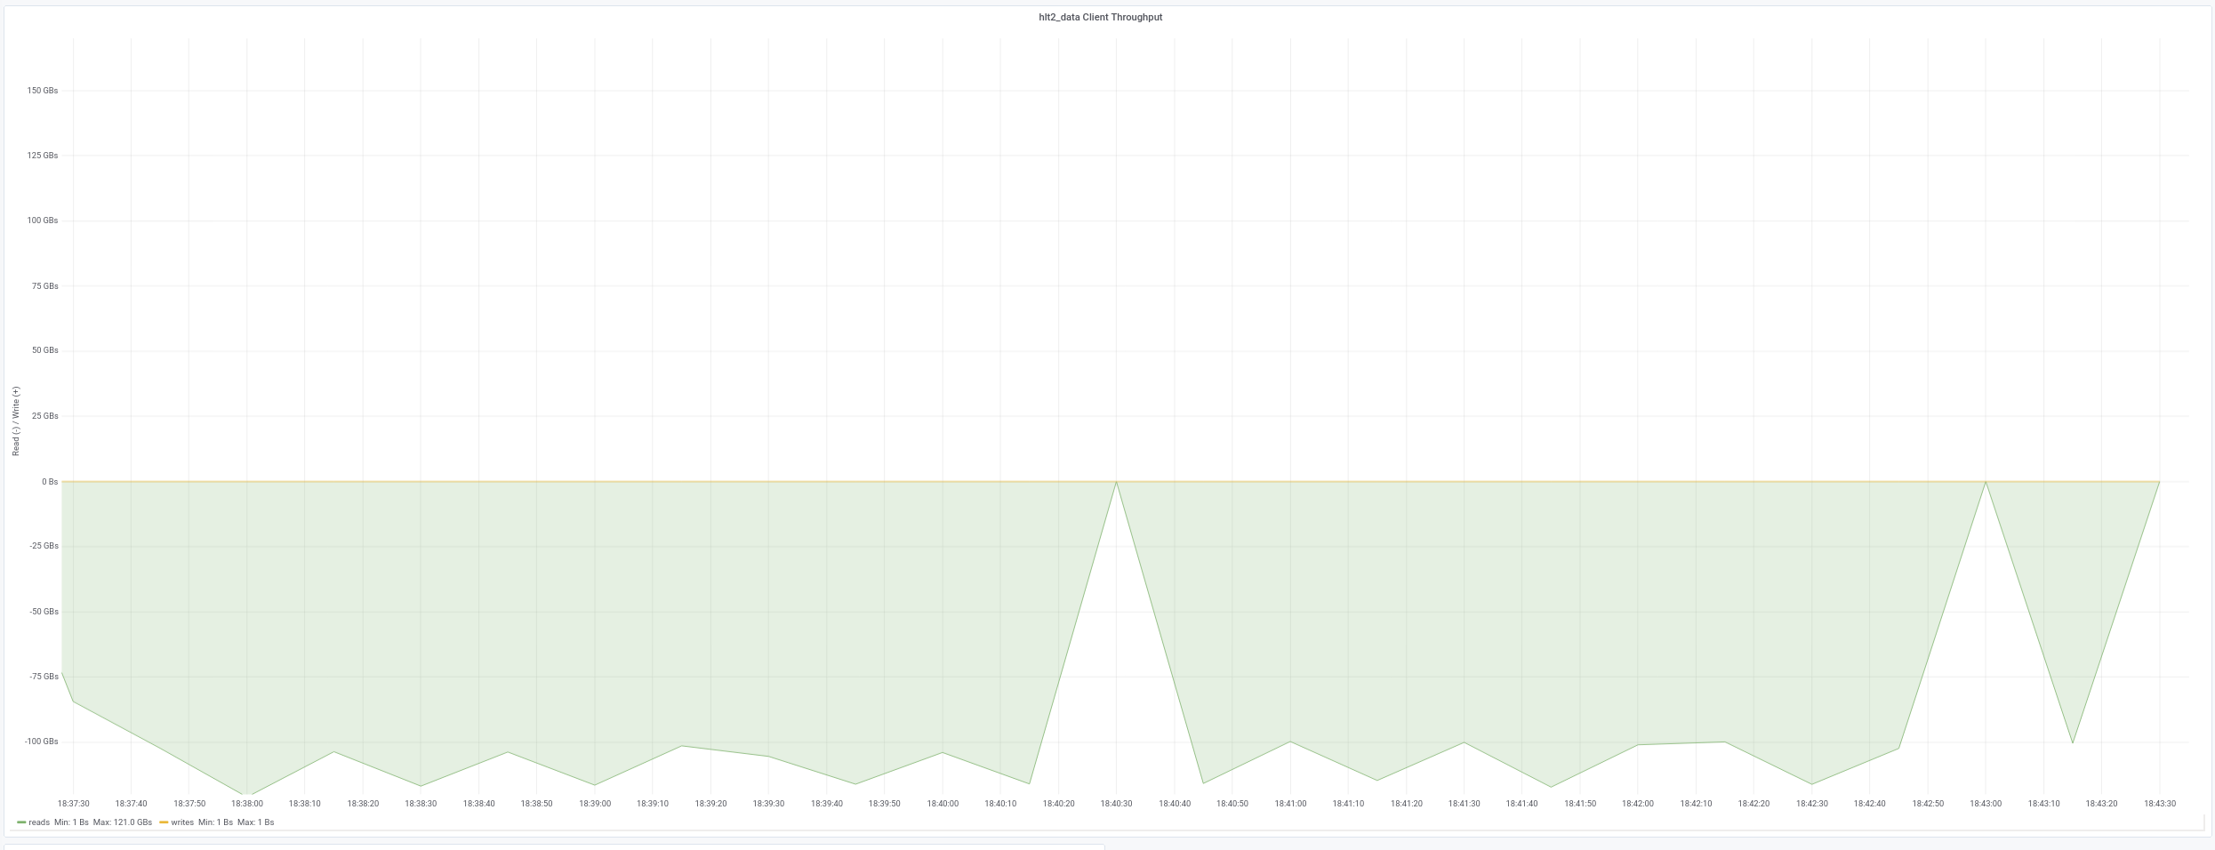
HLT2 Storage Benchmarking
Performance
at 70% occupancy
125 GB/s writing
110 GB/S reading

Slide 15
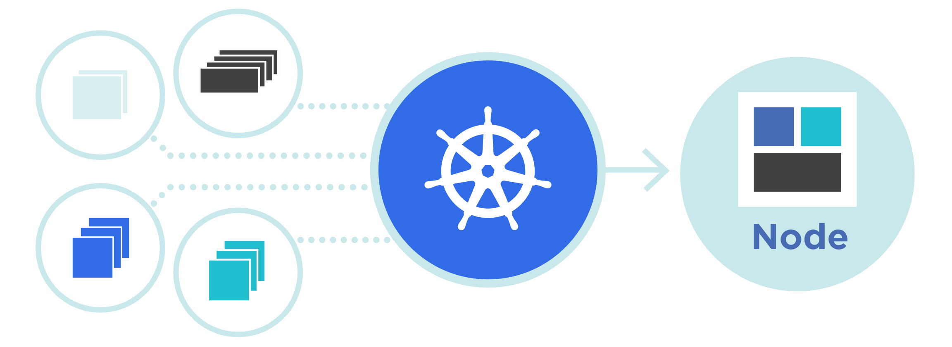
Core Infrastructure Business continuity
ECS
k8s
Do we really
need backups?
Computing nodes

Slide 16
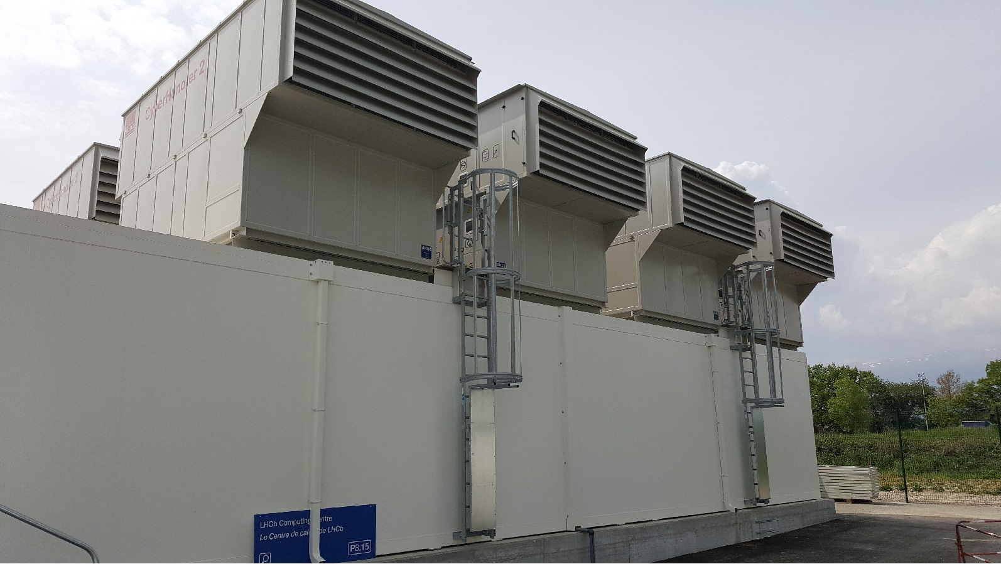
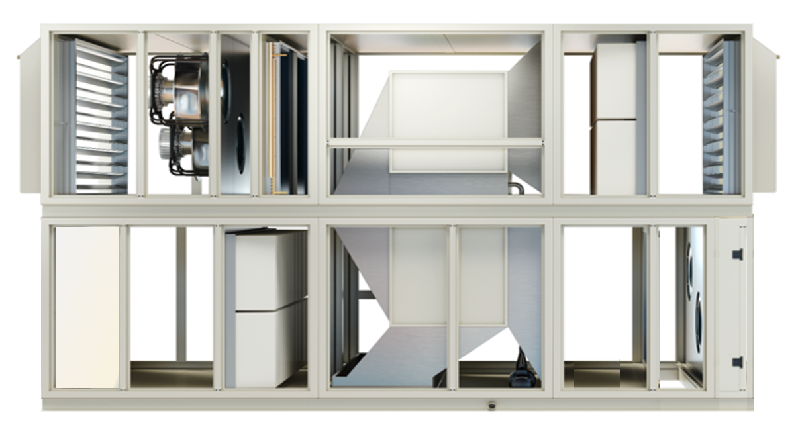
The Green Free Cooling
Cooling principle “indirect free air cooling” = Air/Air Heat exchanger
‘Outside’ Fans running 10 - 85%
Supply Air
Return Air
~ 27°C
~40°C

Slide 17
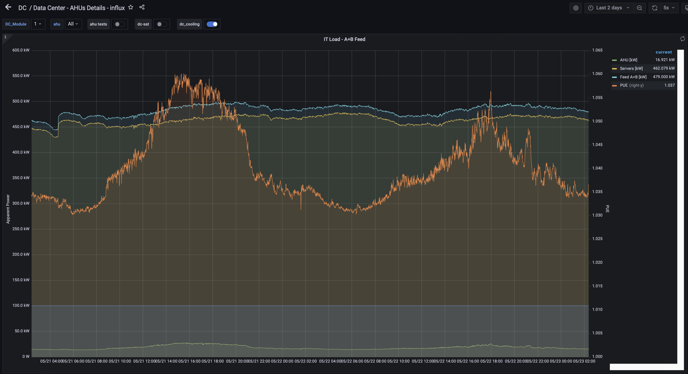
Does it work? PUE ~ 1.04 @ 450kW

Slide 18
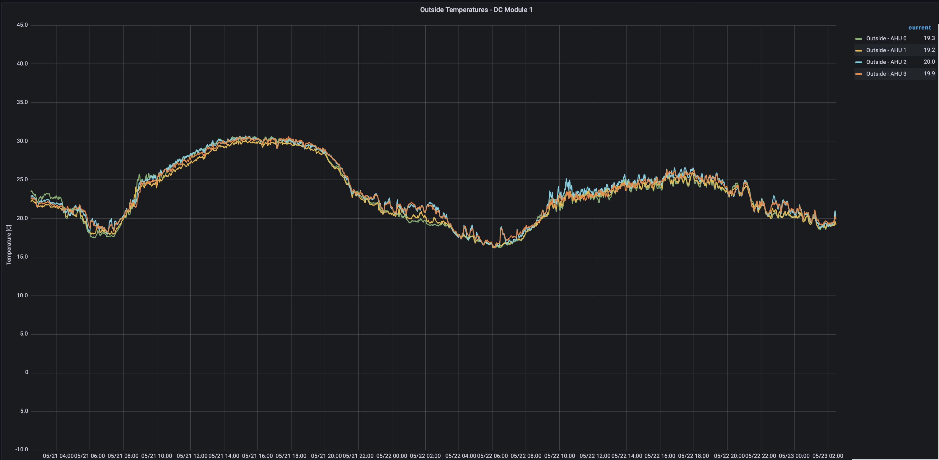
Outside temperature

Slide 19
Summary
LHCb can do and afford a full read-out at bunch-crossing rate
AMD Rome (PCIe Gen4) based servers make compact, very-high-I/O event-builder, connected with 200 Gb/s InfiniBand
Event-selection is entirely in software to maximize physics yield, increase the amount of data collected, flexibility and minimize cost
Fingers crossed ☺
THANK YOU!

