Slide 1

NEW MISSION CONCEPT: GALACTIC EXPLORER WITH A CODED APERTURE MASK COMPTON TELESCOPE (GECCO) AND ITS SCIENCE PERSPECTIVES
Alexander Moiseev (University of Maryland, College Park, and CRESST/NAS/GSFC)
For the GECCO Team
One who wants to do something will find a way; one who does not will find an excuse
(Socratus, Confucios,… Abraham Lincoln, Russian saying)

Slide 2
I AM GRATEFUL TO THE ORGANIZERS FOR THE INVITATION!
GREAT MEETING: GREAT AGENDA, GREAT PLACE, SUPERIOR ORGANIZATION!
THANK YOU Antonella, Maria Cristina, Alessio, Roberto,
🌹🌹🌹🌹🌹 Lia, and All ! 🌹🌹🌹🌹🌹
2

Slide 3
The GECCO Team
FRANCE:
Saclay (Isabelle Grenier, Philippe Laurent, Olivier Limousin)
GERMANY:
Max Plank Institute (Werner Collmar, Vincent Eberle, Torsten Ensslin, Andrew Strong)
ITALY:
INFN and University of Trieste (Francesco Longo, Elena Orlando, Alessandro Vigliano)
INFN and Tor Vergata University (Aldo Morselli)
University of Padova (Eugenio Bottacini)
The NETHERLANDS:
University of Amsterdam, GRAPPA (Adam Coogan)
RUSSIA:
IKI (Roman Krivonos)
United Kingdom:
University of Birmingham (Gerry Skinner)
JAPAN:
Nagoya University (Hiro Tajima)
USA:
GSFC (Georgia DeNolfo, Alice Harding, Demos Kazanas, John Mitchell, Floyd Stecker, Dave Thompson)
University of Maryland (Nickolas Cannady, Alexander Moiseev (PI), Richard Mushotzky, Michela Negro, Makoto Sasaki, Chris Shrader, Steven Sturner, Peter Shawhan, Lucas Smith, Zorawar Wadiasingh, Eric Yates)
BNL (David Asner, Aleksey Bolotnikov, Gabriela Carini, Sven Herrmann)
ORNL (Klaus-Peter Ziock)
LANL (Peter Bloser)
University of Berkeley (John Tomsick, Andreas Zoglauer)
Stanford University and SLAC (Seth Digel, Igor Moskalenko)
NRL (Matthew Kerr, Bernard Phlips, Richard Woolf, Daniel Shy)
Rice University (Matthew Baring)
Clemson University (Dieter Hartmann)
UCSC (Logan Morrison, Stefano Profumo)
3

Slide 4
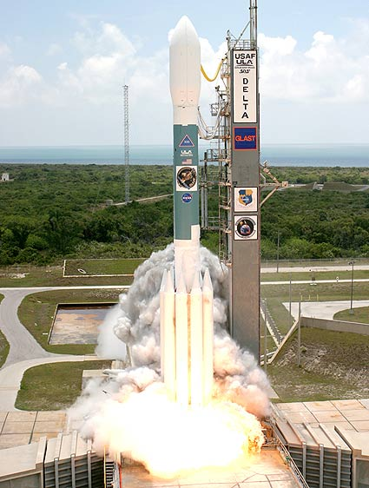
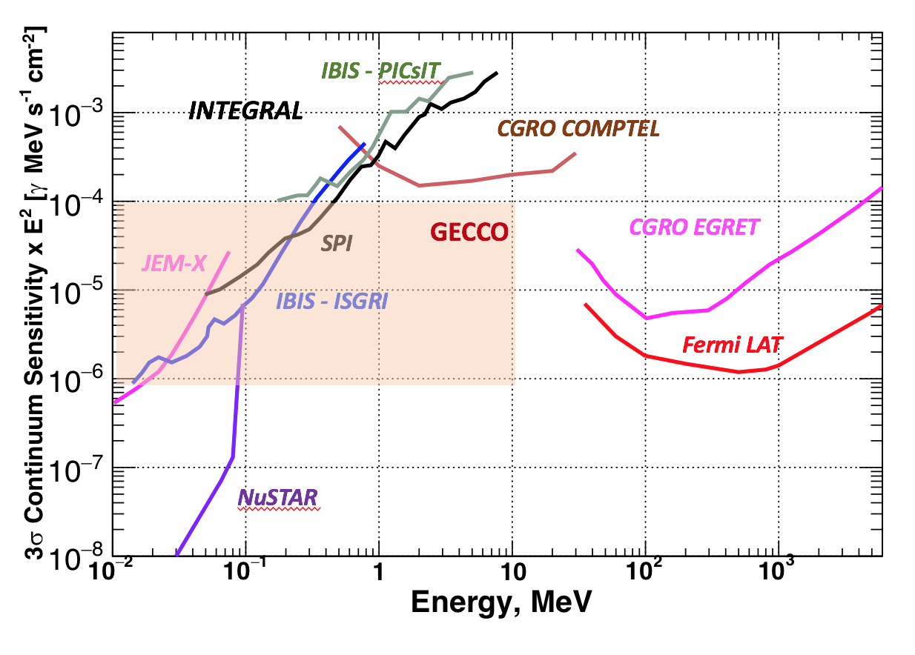
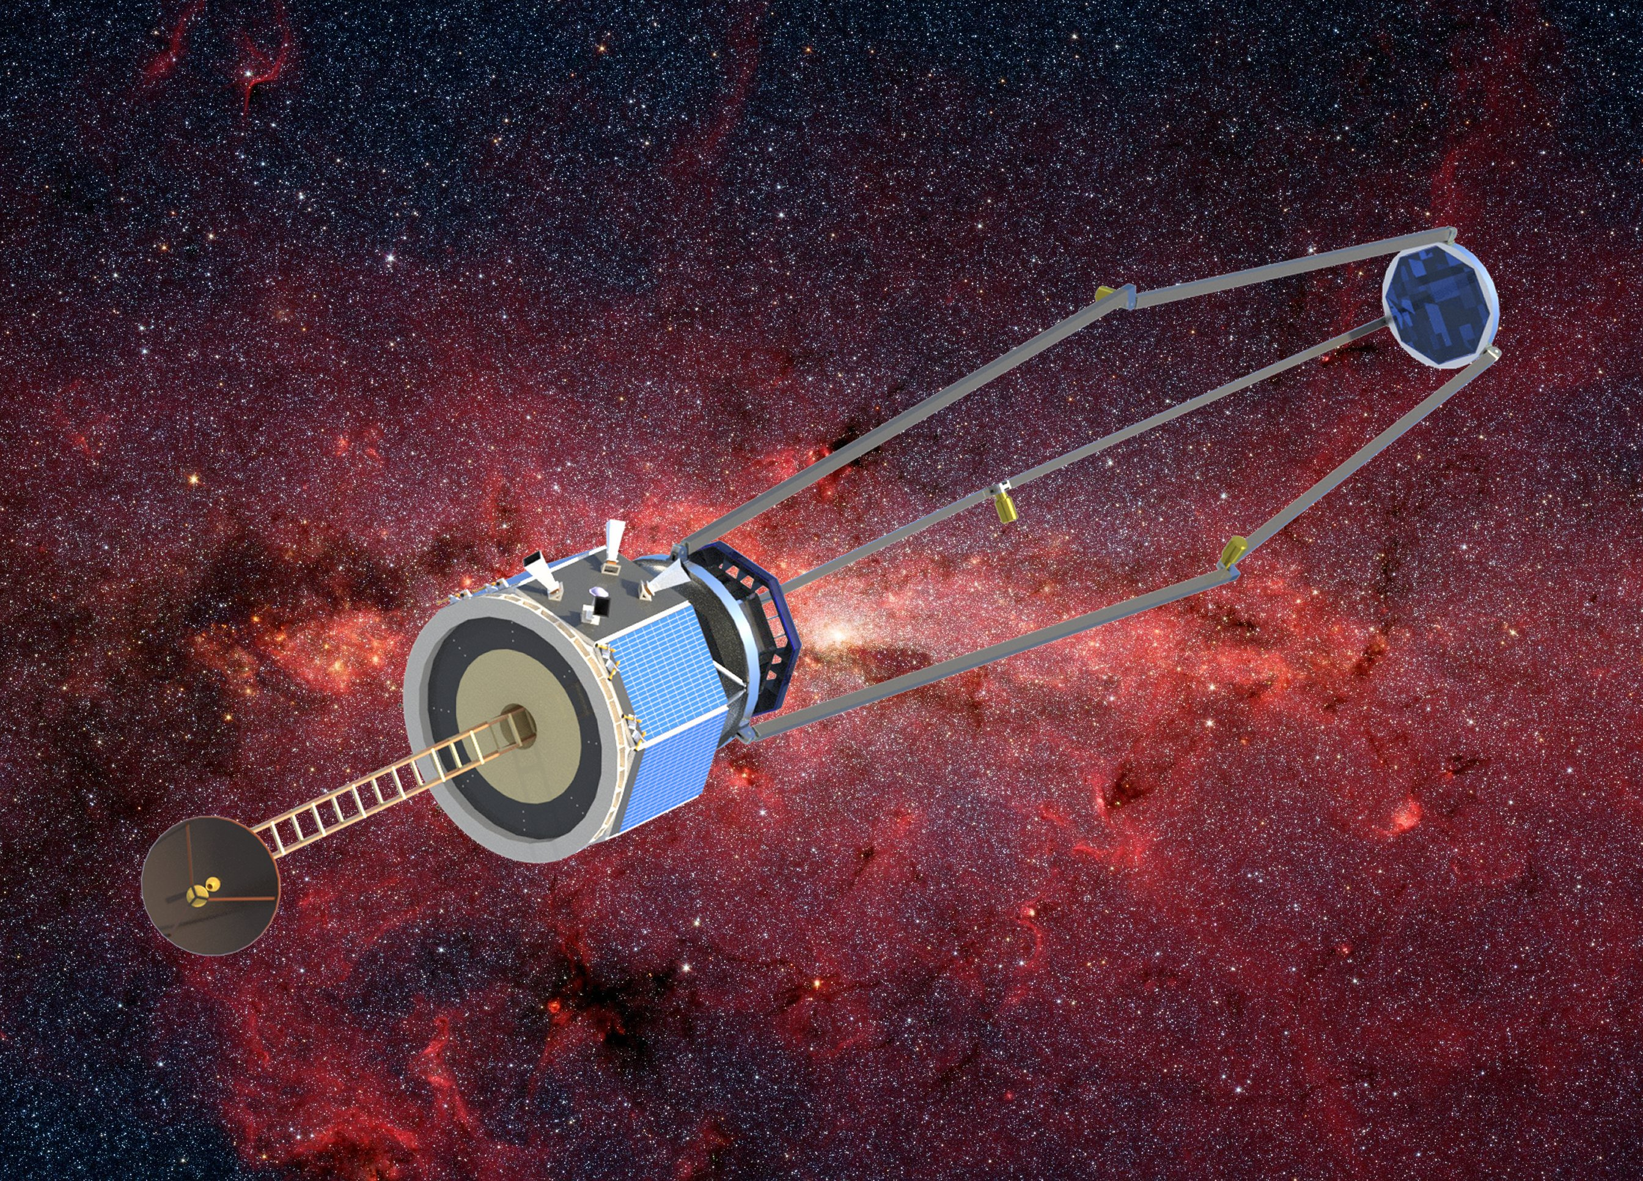
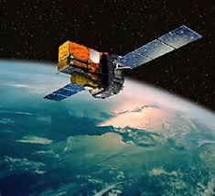
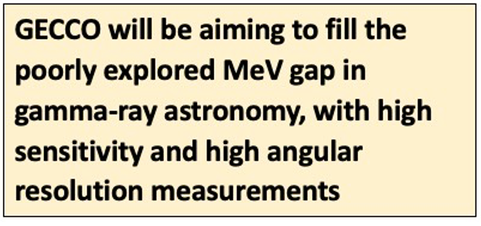
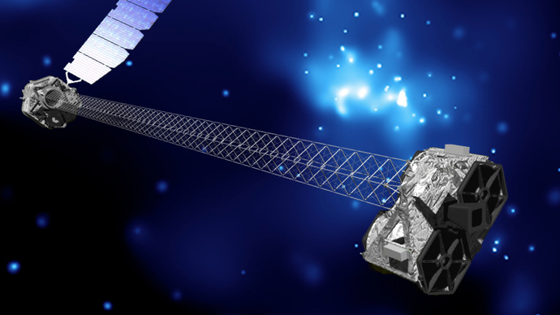
GECCO Place in gamma-ray astronomy
Fermi
INTEGRAL
NuSTAR
4

Slide 5
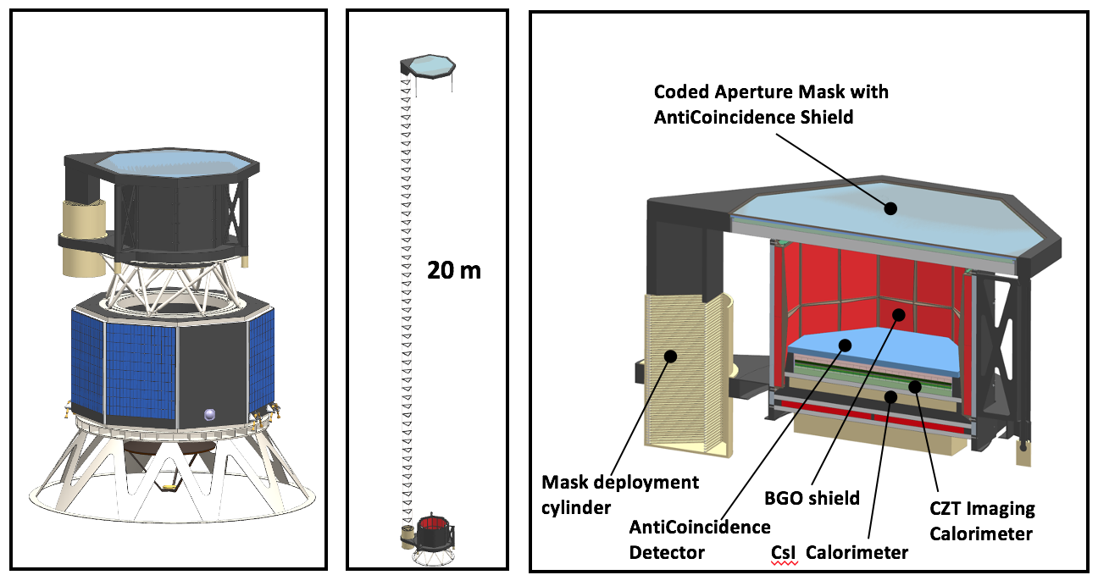
GECCO Concept: Compton telescope with deployable coded aperture mask
EXTENDING AGILE AND INTEGRAL USE OF CODED MASK FOR GAMMA-RAY ASTRONOMY
GECCO with Mask in stowed position, and notional SC bus
GECCO, with Mask deployed
GECCO, cutaway
5

Slide 6
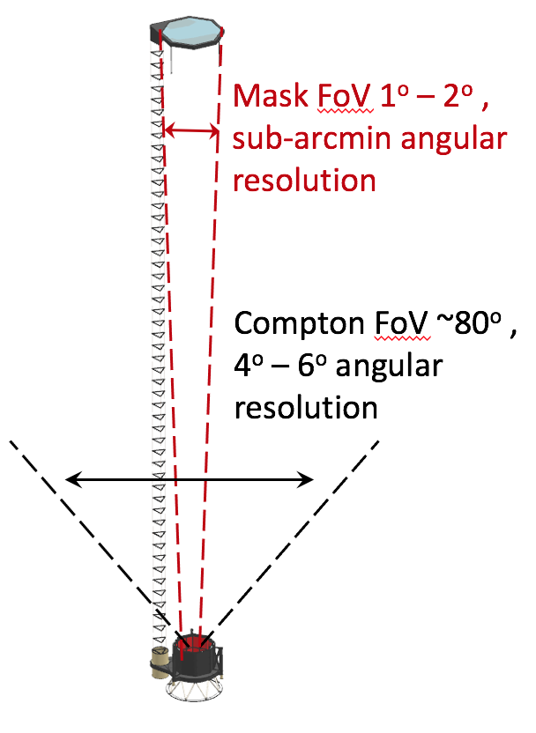
GECCO distinctive features
A combined CZT-based Compton telescope with a Coded aperture mask enables simultaneous “bi-focal” observations: wide field-of-view modest angular resolution with a Compton telescope, and narrow field-of-view high angular resolution observations with a Coded Aperture Mask
Deployed at large-distance from the Focal plane detector (CZT Imaging Calorimeter), the Coded Aperture Mask with unshielded aperture provides practically unlimited angular resolution, made possible by using a novel method of “off-line, by software” removal of side-entering gamma-background by Compton pointing to the Mask location
A BGO shield, which surrounds the GECCO detectors, is used to efficiently detect and localize the Gamma-Ray bursts with good accuracy, prompting the instrument to re-point to the burst direction within the Coded Mask field-of-view, and localize it with sub-arcmin precision
Energy Range: 50 keV – 10 MeV,
Energy resolution: < 1% at 0.5 – 5 MeV,
Angular resolution:
  ∼1 arcmin in the Mask mode with 1º – 2º fully-coded field-of-view,
  4º – 6º in the Compton mode with a ~2 sr (80º ) field-of-view
Sensitivity: 10⁻⁴ - 10⁻⁶ MeV cm⁻² s⁻¹ (10⁶ s) over the entire energy range
GECCO can operate in either pointed or scanning mode
concept of bi-focal observations
6

Slide 7
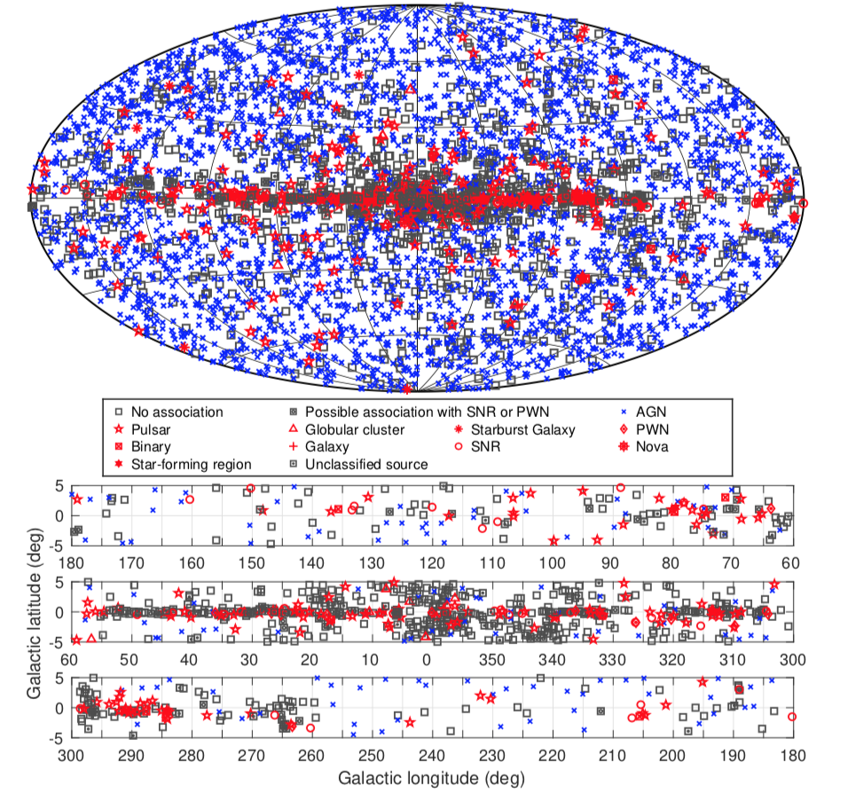
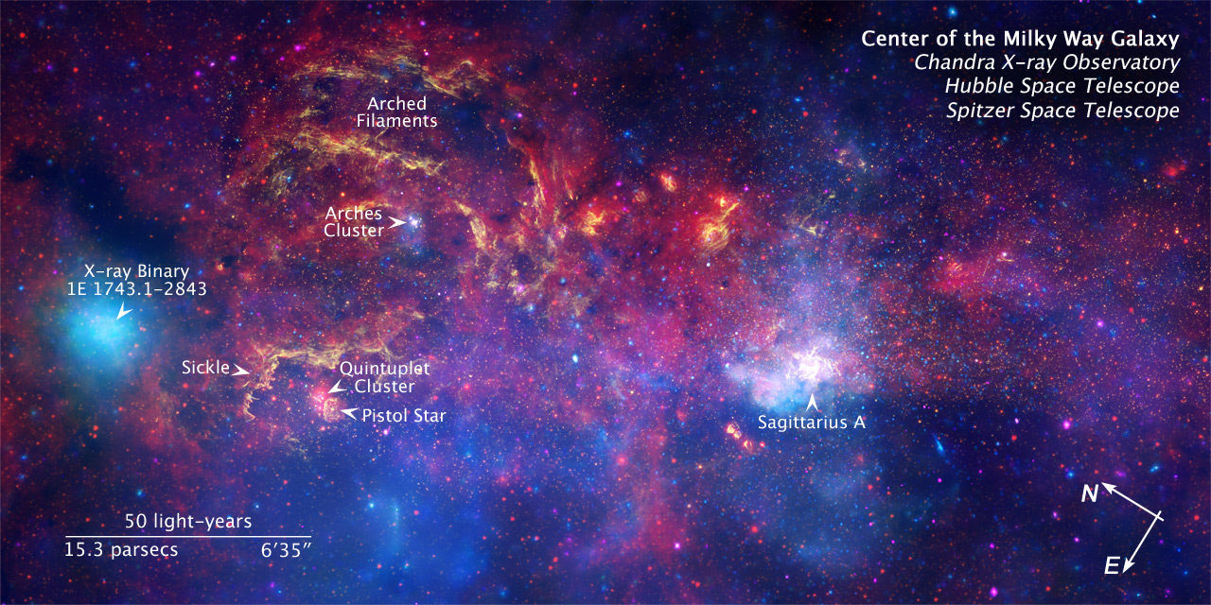
Motivation: Galactic Plane Fermi-LAT unassociated sources
5,065 sources (4th Catalog)
1,323 sources (~25%) do not have associations with other wave-length sources, with majority in GP and GC: Why not associated? and Who Are They?
Position resolution of ~arcmin will help to resolve
Source population density in the GC (Chandra/Hubble/Spitzer data) is <arcsec (however most of them do not radiate in MeV range)
~ 10’
7

Slide 8
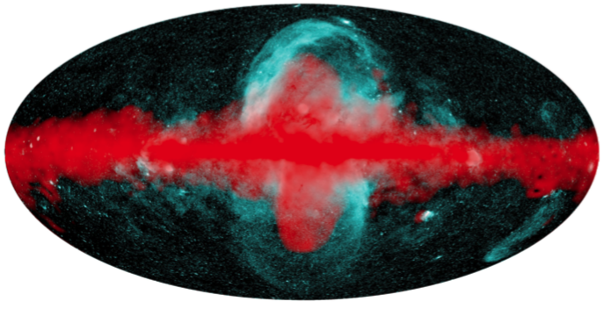
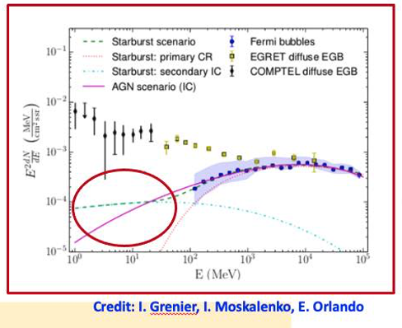
Motivation: The Fermi-eROSITA Bubbles
Comparison of the morphology of the 𝝲-ray (Fermi-LAT, >50 MeV, shown by red) and X-ray (eROSITA, 0.6-1 keV, shown by cyan color) Bubbles (P. Predehl et al., Nature 2020)
Likely Fermi and eROSITA Bubbles have different nature
What to expect in sub-MeV (GECCO) energy range?
8

Slide 9
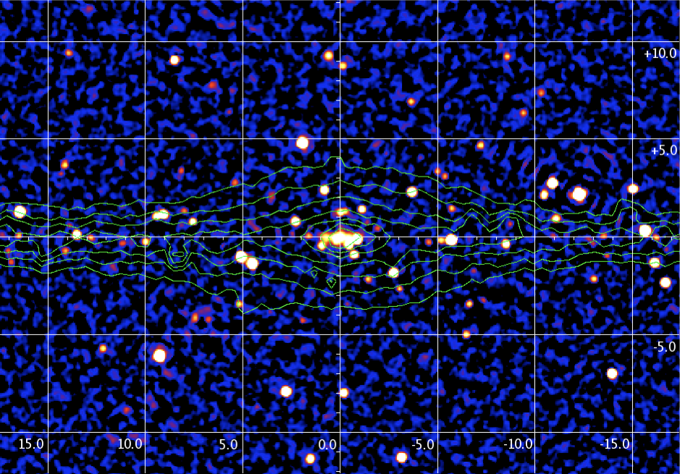
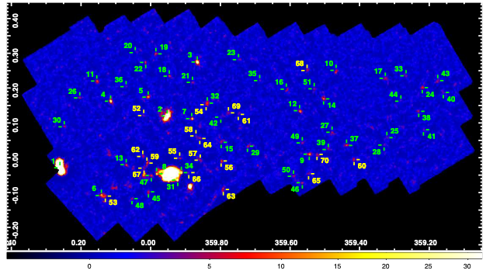
Motivation: INTEGRAL and NuSTAR observations of the GC sources
INTEGRAL/IBIS observations
NuSTAR observations
3-79 keV
5º
JS Hong et al., 2016
The image of the central part of the Galaxy as measured by INTEGRAL / IBIS 17-60 keV (Krivonos et al., 2010, C. Winkler 2014 ). IBIS angular resolution is 12 arcmin.
NuSTAR detected 70 hard (3–79 keV) X-ray point sources in a 0.6 deg² region around the GC, or ~ 10 arcmin in average between sources
9

Slide 10
GECCO mission and observation strategy
Low-Earth (550-600km) circular equatorial orbit (declination <5º ) to minimize spacecraft and instrument activation by cosmic rays. Orbit is similar to that of AGILE
Main mode of observation: pointing to the region of interest (heavy-populated area as GC, Cygni, Carina, any other RoI) for the extended time to detect faint sources with their spectra and temporal behavior. Scanning (“discovery”) mode is also possible
Quick re-pointing to the ToO: could be self-pointing to the GRB, or prompted by other instruments
Mission observation strategy and the prioritization of the science objectives will be made closer to the Proposal time and will be aligned with newest developments and standing problems, including the development of the new GW facilities
10

Slide 11
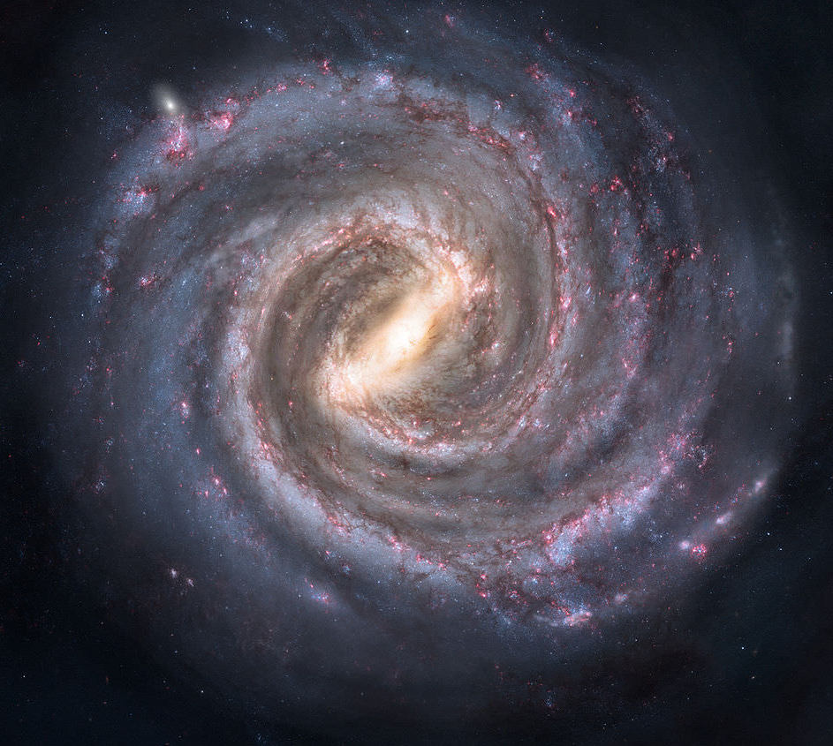
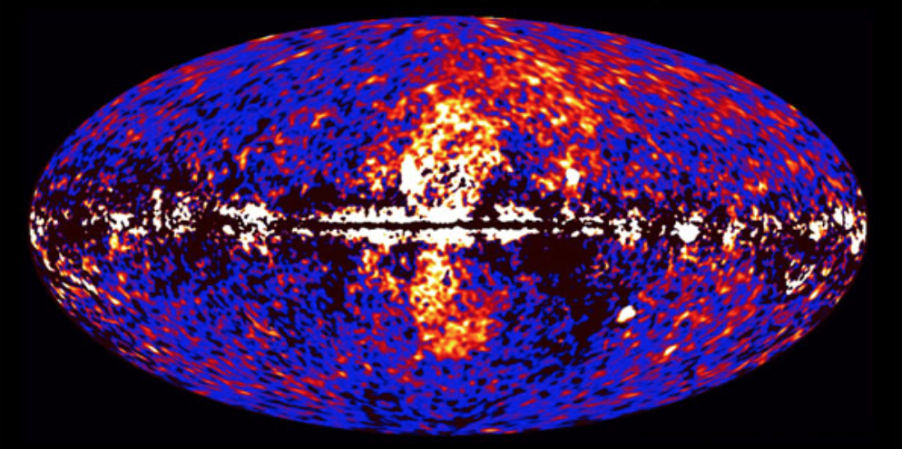
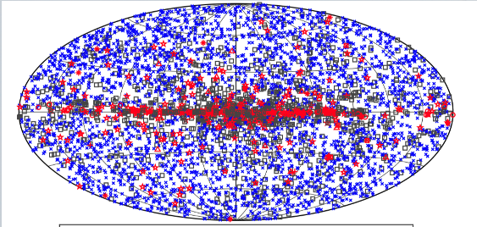
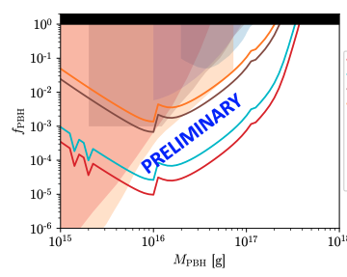
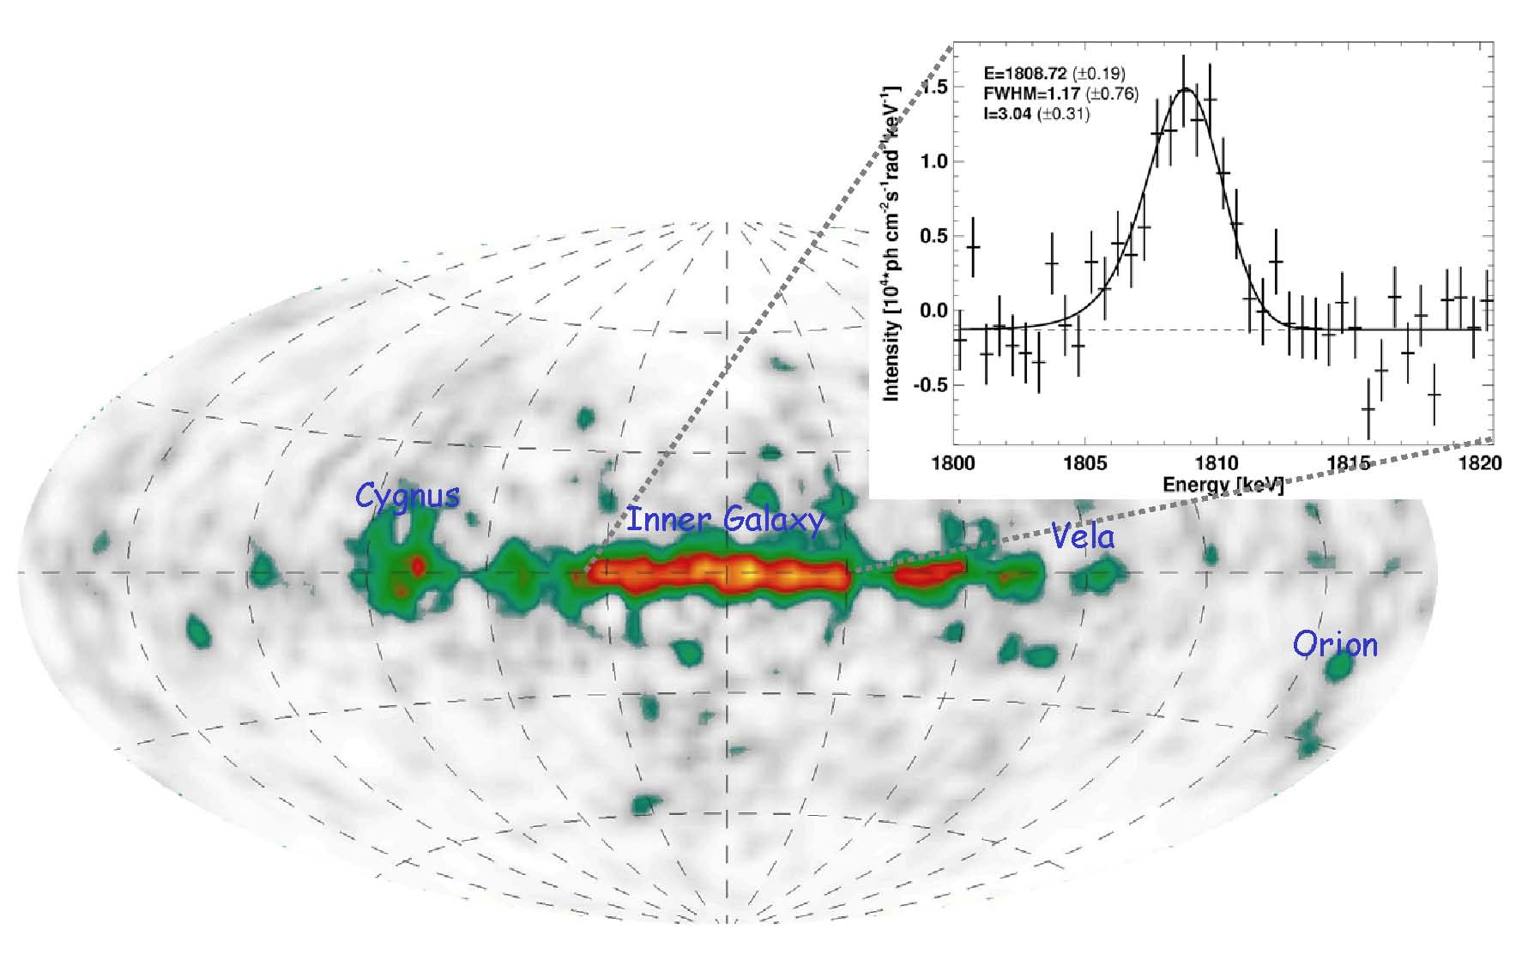
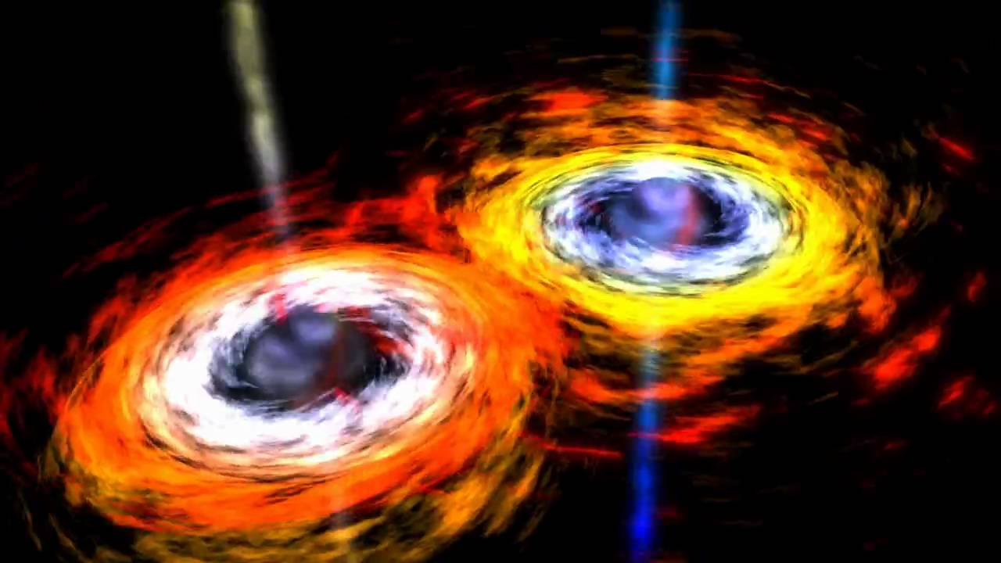
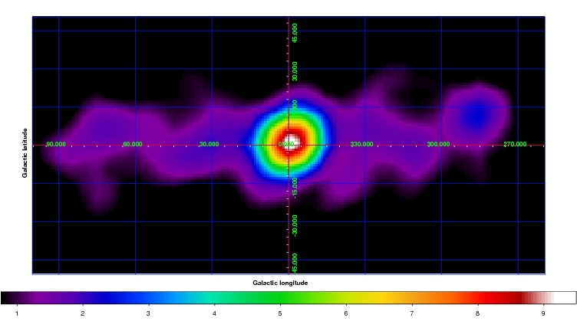
GECCO Science and Observations capabilities
Understand the nature of the central supermassive black hole environment and sources, address the enigma of Galactic Center excess and the Fermi-eROSITA bubbles
Resolve heavily populated sky
regions, including tangential
directions to the spiral arms
in the Galactic plane
Test as-yet unexplored candidates for
the dark
matter,
including
that responsible for the GC excess
Identify and precisely localize the source
of the gravitational wave and
neutrino
events
Resolve Galactic chemical evolution and sites of explosive element synthesis
Localize and clarify the origin(s) of the 511 keV positron annihilation
line, including in the GC
Detection and identification
of high-redshift blazars
11

Slide 12
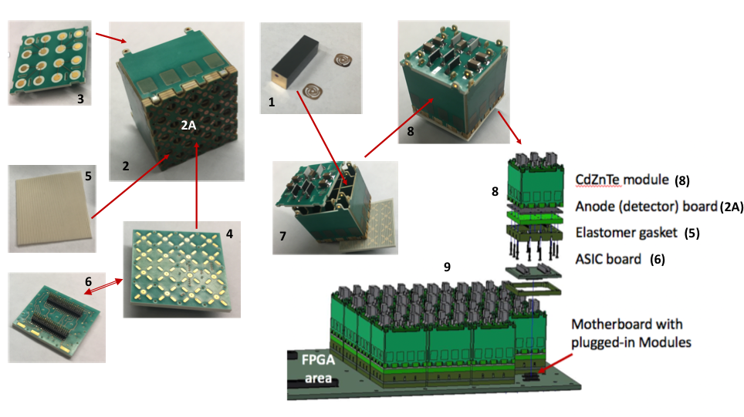
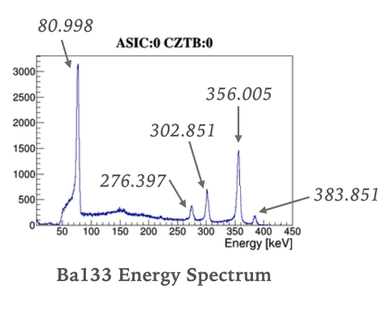
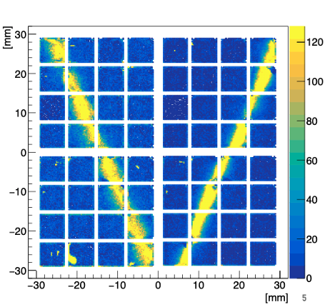
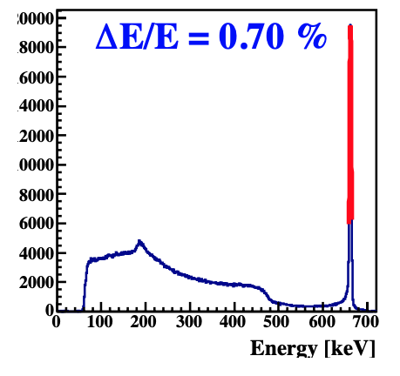
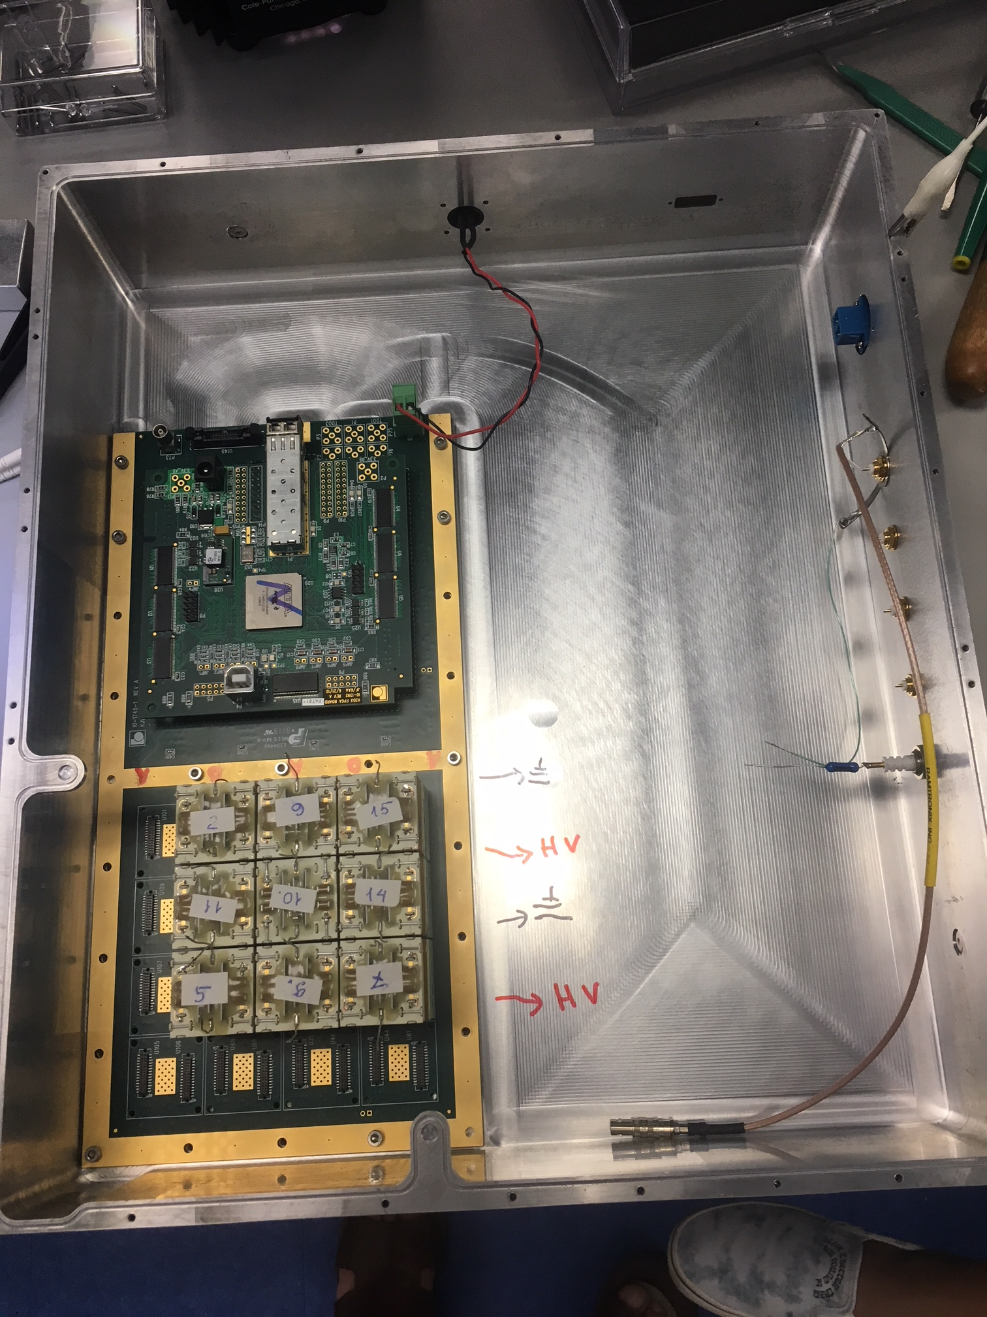
Enabling Technology: Modular CdZnTe Imaging Calorimeter
Basic unit – the module, containing 16 CZT Virtual Frisch-grid bar detectors served by an individual ASIC
Approach: The Imager Can be made of practically any needed area by simply plugging needed number of basic units (the modules) into the Motherboard
We designed and built the prototype containing 9 modules, currently being integrated in the ComPair balloon instrument
9 CZT modules
Readout
Cs¹³⁷ (662 keV)
Image of the 1mm wide slit collimator, made with 4 CZT modules
12

Slide 13
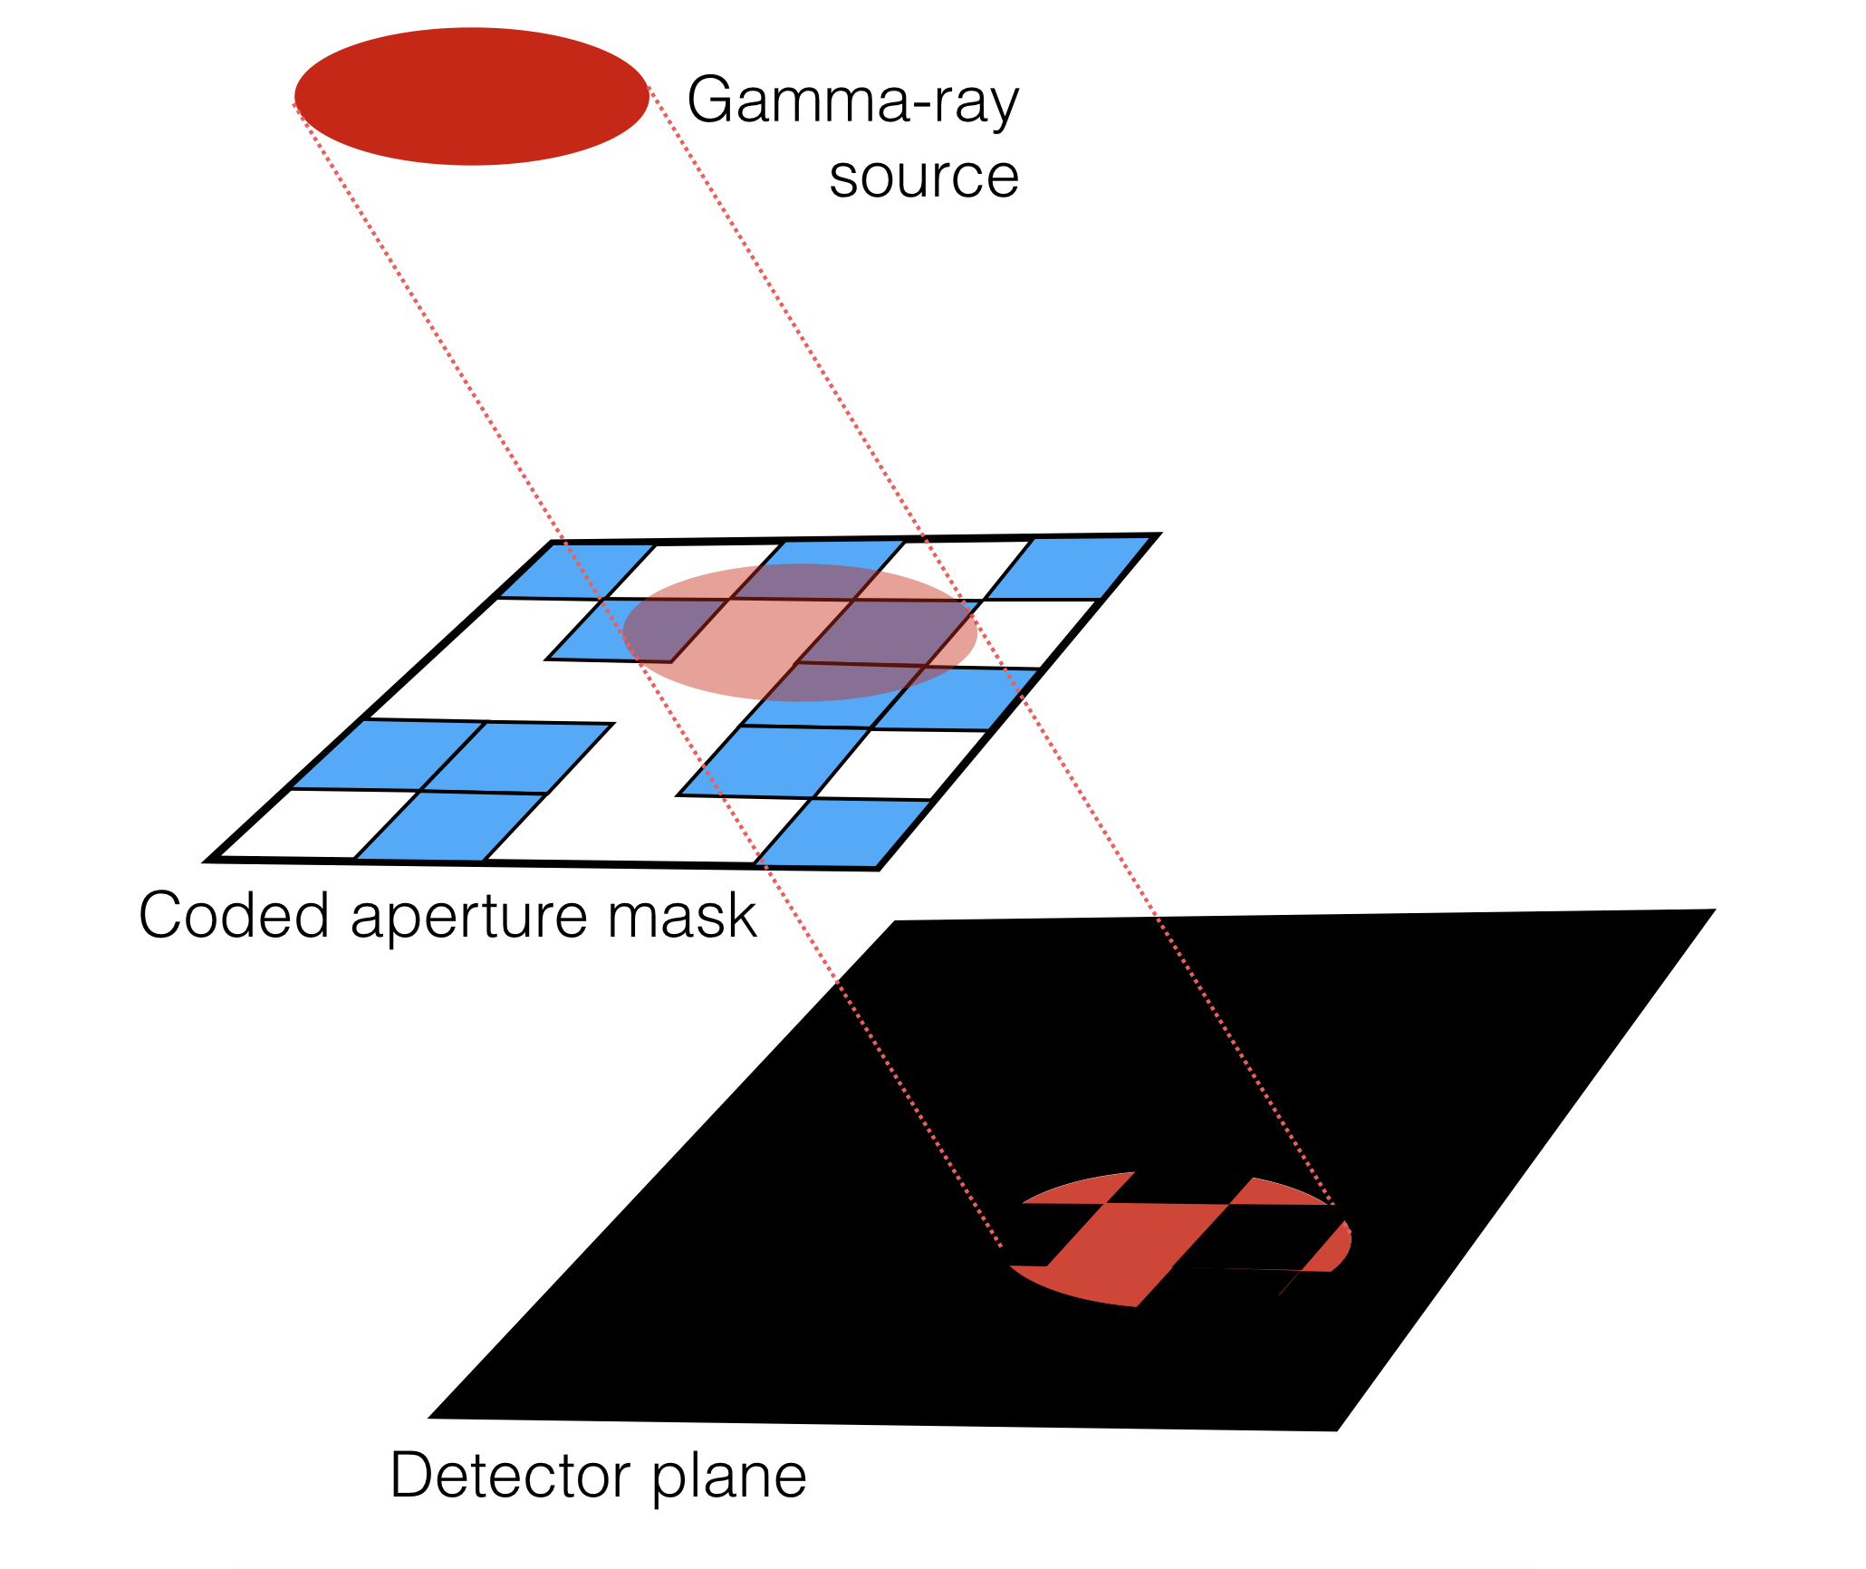
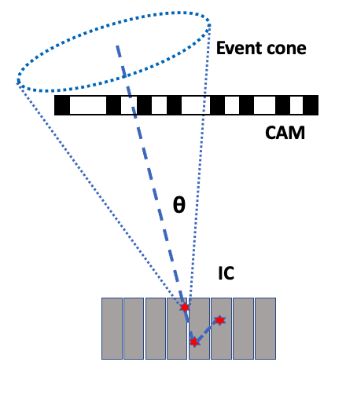
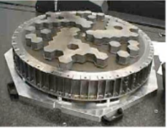
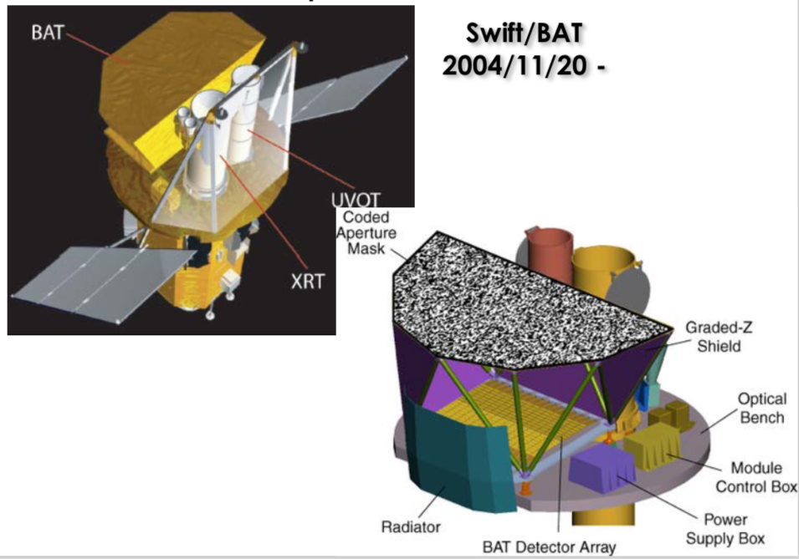
Enabling Technology: Coded Aperture Mask and Compton pointing
  A Coded Aperture Mask (array of transparent and opaque elements) modulates the incident photon flux and creates its shadow (image) on the detector.
Flown coded masks
INTEGRAL - SPI
Gehrels SWIFT / BAT
Angular resolution of the system is a ratio of the mask element size to the mask-detector separation
Schema of event selection by Compton pointing to the Mask location
13

Slide 14
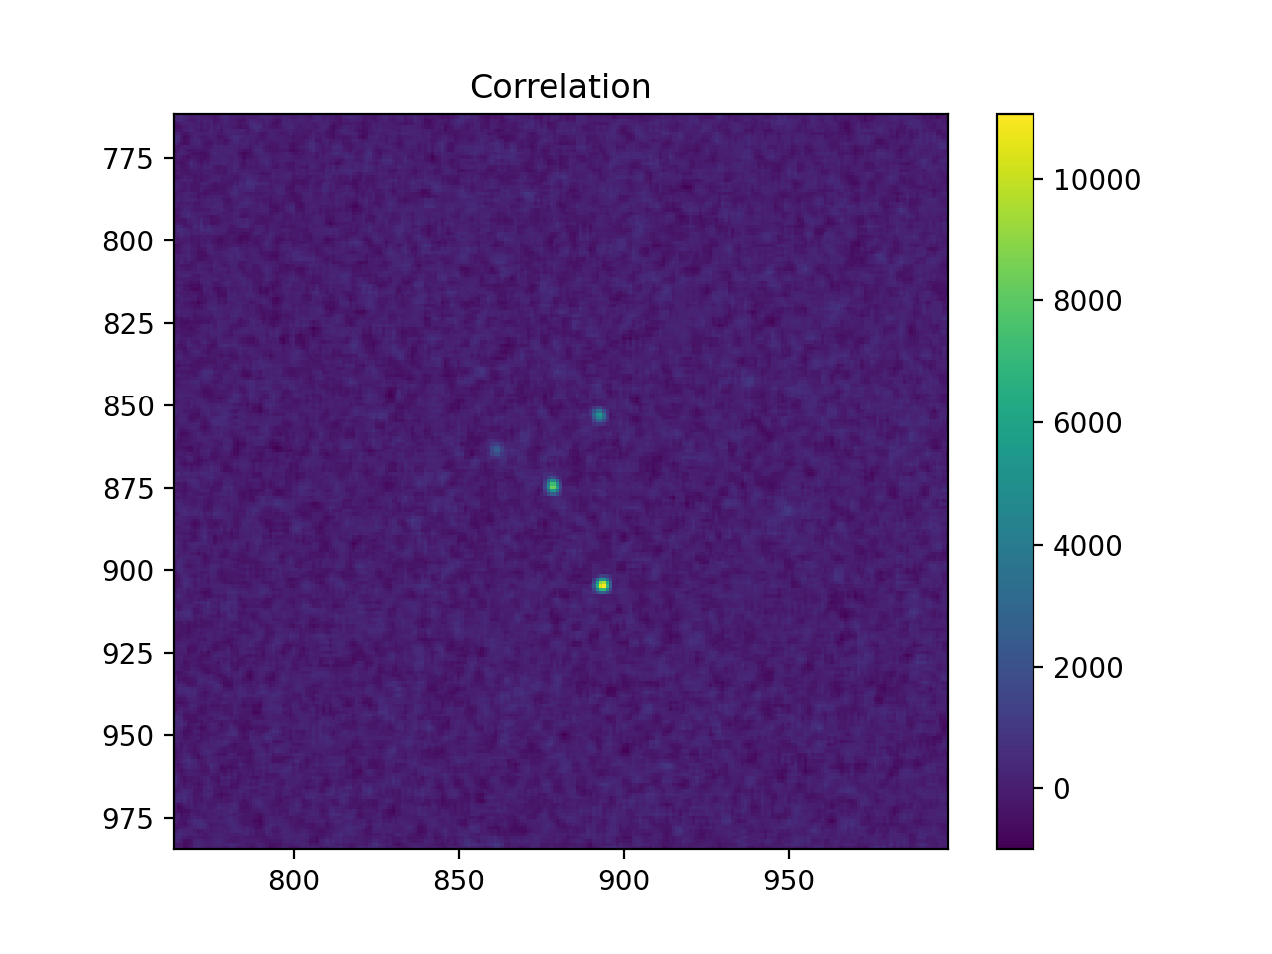
Resolving point sources in heavy populated regions with Coded Aperture Mask
Simulated: 4 sources, 3-5 arcmin separation, 1x, 2x, 3x, 4x flux (relative)
Compton telescope
Coded Aperture Mask
P R E L I M I N A R Y
High-accuracy detection of point sources allows to disentangle the true diffuse emission from possible unresolved sources by, e.g., D3PO method
Credit: Eric Yates, with critical support from Gerry Skinner
14

Slide 15
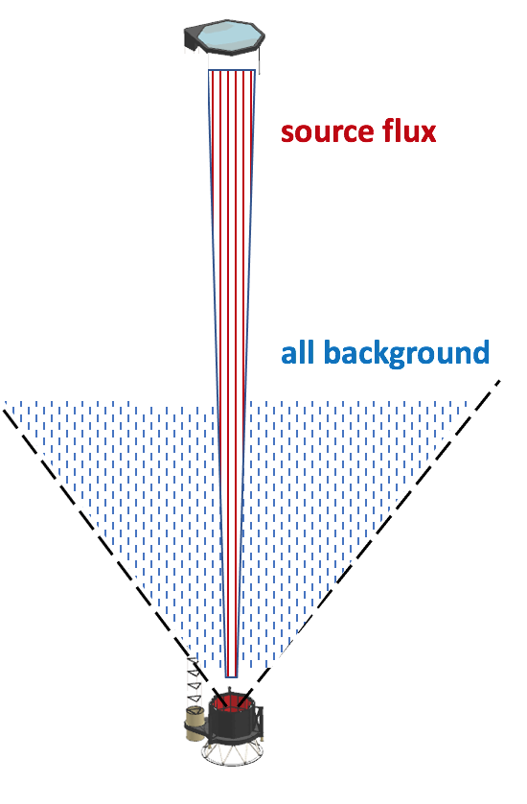
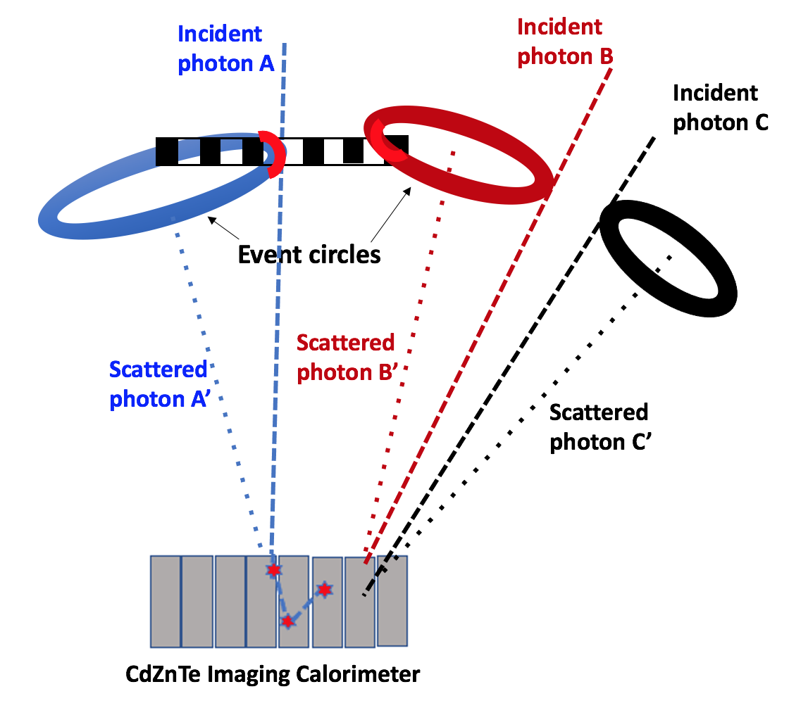
Side-entering background suppression by Compton pointing
Source detection by Compton telescope with Coded mask
Event selection by Compton pointing: accepted good event, accepted bckg event, and rejected bckg event
15

Slide 16
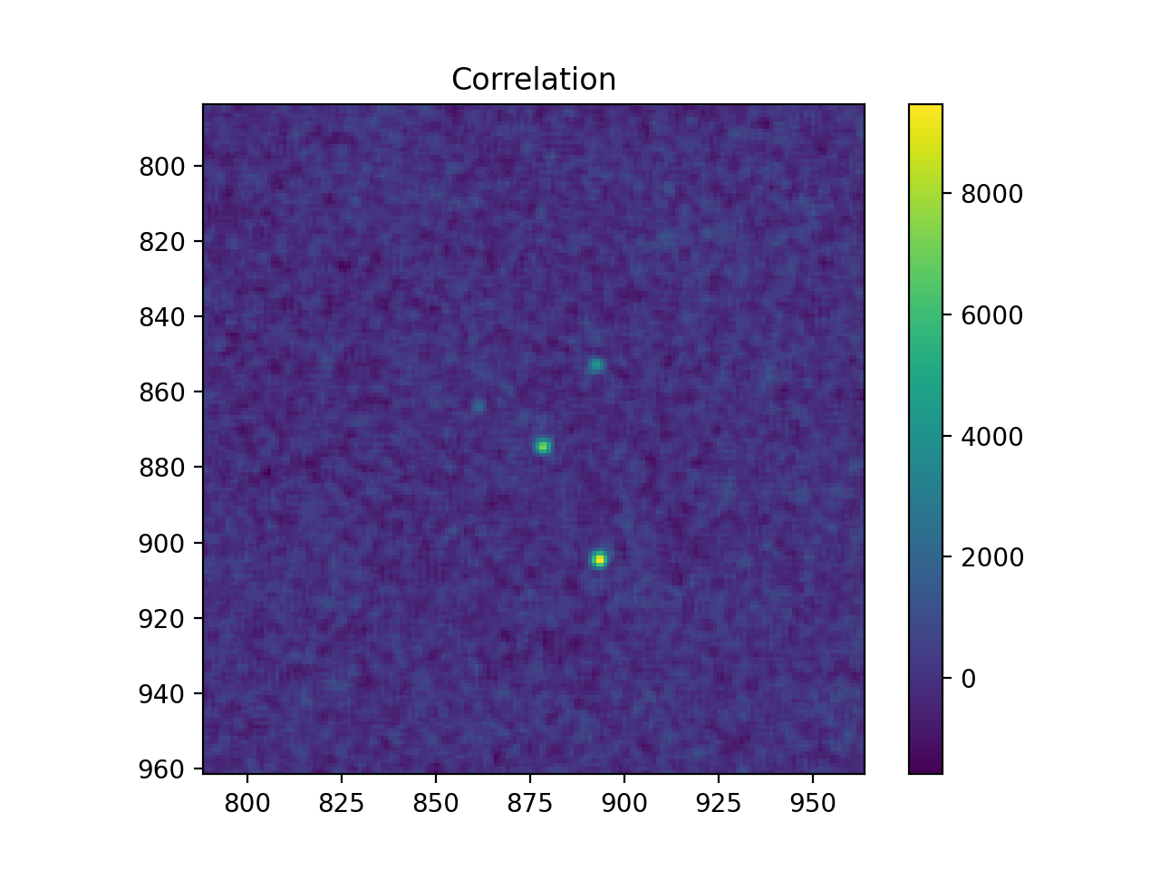
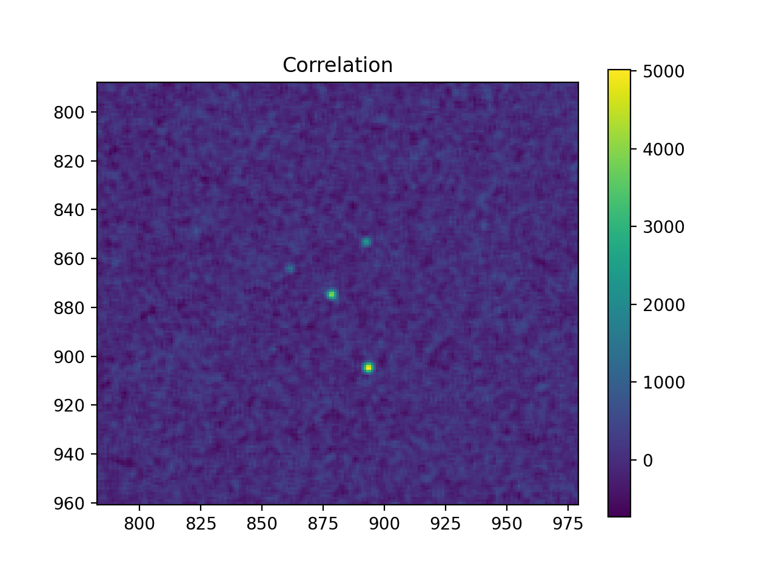
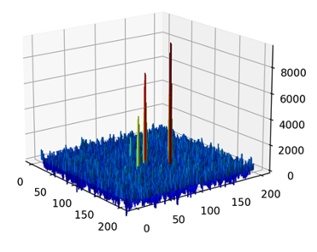
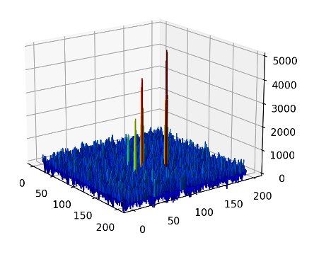
Illustration of the Compton pointing efficiency
Simulated: 4 sources, 3-5 arcmin separation, 1x, 2x, 3x, 4x flux (relative), 12x background flux
Without Compton pointing
130K photons survived the event selections
Out of them:
23K photons are from the sources
107K events from background
With Compton pointing
30K photons survived the event selections and pointing reconstruction to the Mask location
Out of them:
23K photons are from the sources
7K events from background
P R E L I M I N A R Y
Credit: E. Yates
16

Slide 17
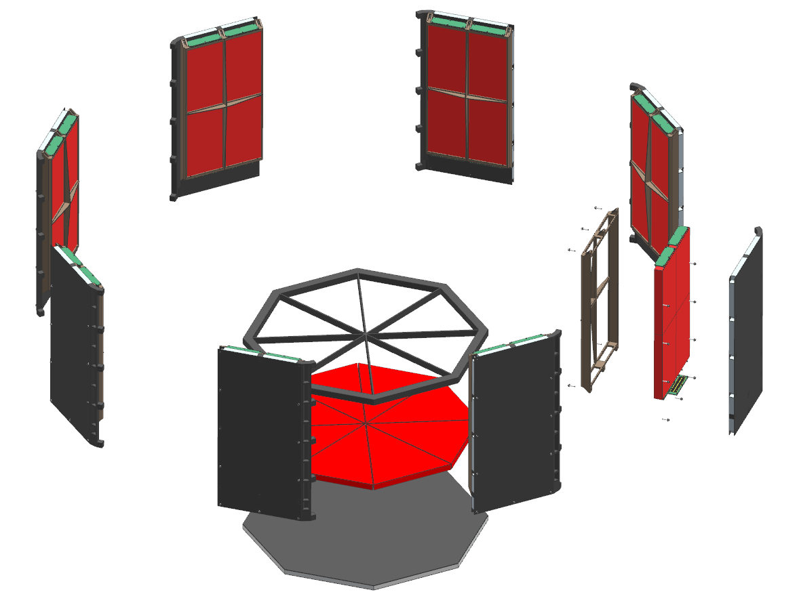
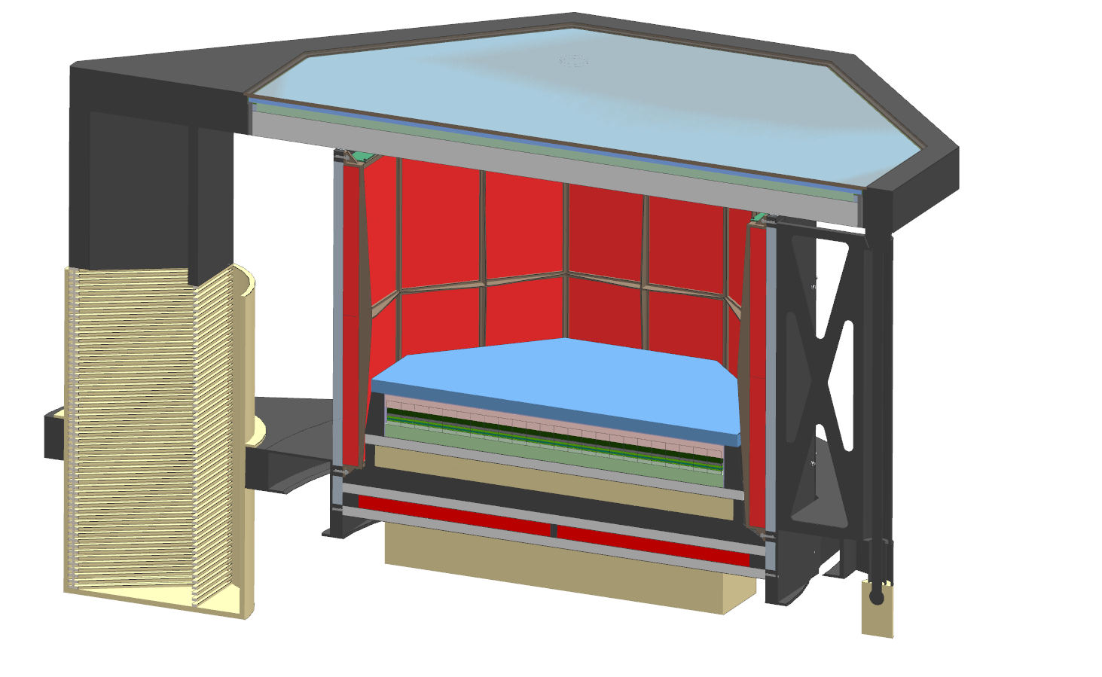
Detection of GRB with GECCO
Use of 8 GECCO’s heavy-scintillator, 4cm-thick shield panels, 2,800 cm² area each, as a sensitive GRB locator (BurstOctagon). They provide high detection efficiency for photons
Prompting GECCO to re-point towards the detected transient event to localize it with the full power of the Coded Mask (sub-arcmin accuracy)
17

Slide 18
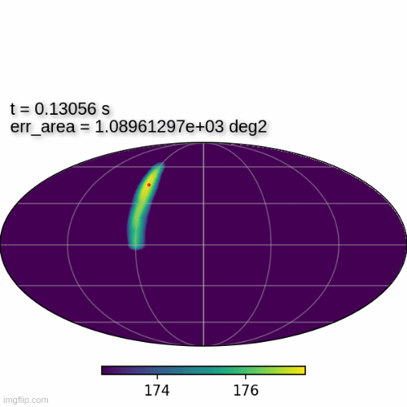
Illustration: GRB localization with time
Simulations were performed using the Fermi-GBM burst catalog and various background rate, scaled from that observed by AGILE (same orbit)
P R E L I M I N A R Y
Credit: A. Vigliano, F. Longo
18

Slide 19
PROJECT STATUS
We are at the end of the second, 3-year long each, technology development grants (APRA), in which we developed the CZT-based Imaging Calorimeter, in collaboration with Brookhaven National Laboratory
The baseline mechanical concept of GECCO with maximized use of non-metal composite materials to reduce the instrument activation during the flight has been developed, funded by GSFC’s IRAD grant
Currently we are proposing to NASA to build and comprehensively test the small prototype of GECCO to validate its performance, with potential extension to the Ultra-long duration balloon flights
The ultimate goal is to propose GECCO for the NASA Medium Explorer mission (MIDEX), with the AO expected in 2025-2026
MY DREAM: Combine GECCO and NuSTAR in one mission, using the same boom 😇
THANK YOU!
MAIN PUBLICATIONS
1. E. Orlando, et al., Exploring the MeV sky with a combined coded mask and Compton telescope: the Galactic Explorer with a Coded aperture mask Compton telescope (GECCO), JCAP 07 (2022) 036, arXiv:2112.07190 (Apr 2022)
2. A. Coogan, et al., Hunting for Dark Matter and New Physics with (a) GECCO, arXiv:2101.10370 (2021), submitted to PRD
3. A. Moiseev, et al., New mission concept: Galactic Explorer with a coded aperture mask Compton telescope (GECCO), PoS (ICRC2021) 648
19

