Slide 1
FRIDA-WP1
FLASH mechanism
Pre – KickOff Meeting
21-1-2022

Slide 2
Outline
The Mechanistic challenge of FLASH
FRIDA-WP1 plan, M&D
Tentative Schedule KOM 15 Feb
UHDR Experimental facilities update summary
Resume Who does What , Where and How
Links with other WPs
AOB (Eventual Budget issues etc..)

Slide 3
FRIDA - FLASH Radiotherapy with hIgh Dose-rate particle beAms project
INFN-CSNV Call 2022-2024
The FLASH mechanism
Beam delivery
WP1
WP2
Treatment planning
WP3
WP4
units
CT –F. Romano
LNS – G. Cirrone
MI – D. Giove
PI – G. Bisogni
RM1 – A. Sarti
TIFPA – E. Scifoni
TO – A. Vignati
WP0
Coordination
E. Scifoni (modeling)
G. Forte (bio experiments)
A. Mostacci (e-)
G. A. P. Cirrone (p)
A. Sarti
Beam/dose monitoring
A. Vignati (Beam monitoring)
G. Bisogni (Dose monitoring)
A. Schiavi (Dose sim/optim.)
M. Schwarz (Treatment planning)
Partners:

Slide 4
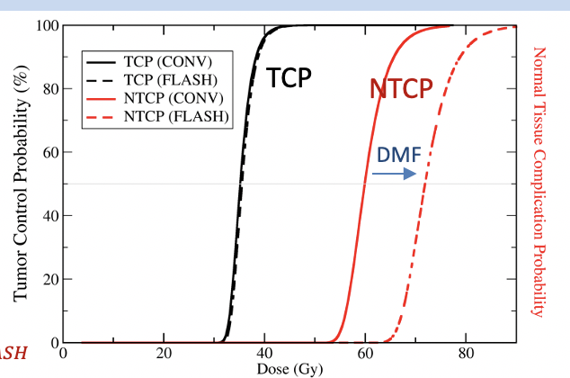
Ultrahigh Dose Rate Response and FLASH
$$DREF={\left.\frac{D(\dot{D})}{D({\dot{D}}_{ref})}\right\rceil }_{same effect}$$
Durante et al. Br J Radiol 2019
Dose-Rate Effectiveness Factor
DREF^{T}~1
DREF^{NT}
This we understand
(sublethal damage repair etc..)
This we presently DON’T understand
Despite plenty of accumulating exp evidence….

Slide 5
Dose Delivery Time Structure
Romano et al. Med. Phys. Under rev.

Slide 6
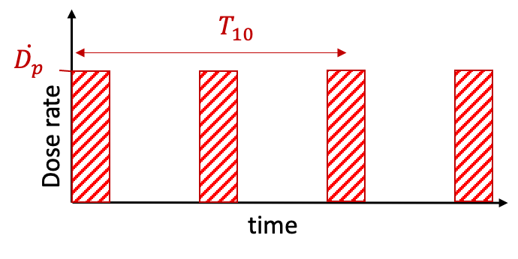
Parameters for observing FLASH/noFLASH
ELIMAIA
$$T_{10}=\frac{10}{\dot{D}}=\frac{10}{\dot{n}\dot{D_{p}}t_{p}}$$
$$T_{10}$$
$$\dot{D_{p}}$$
From: Montay-Gruel et al. Clin Cancer Res 2020

Slide 7
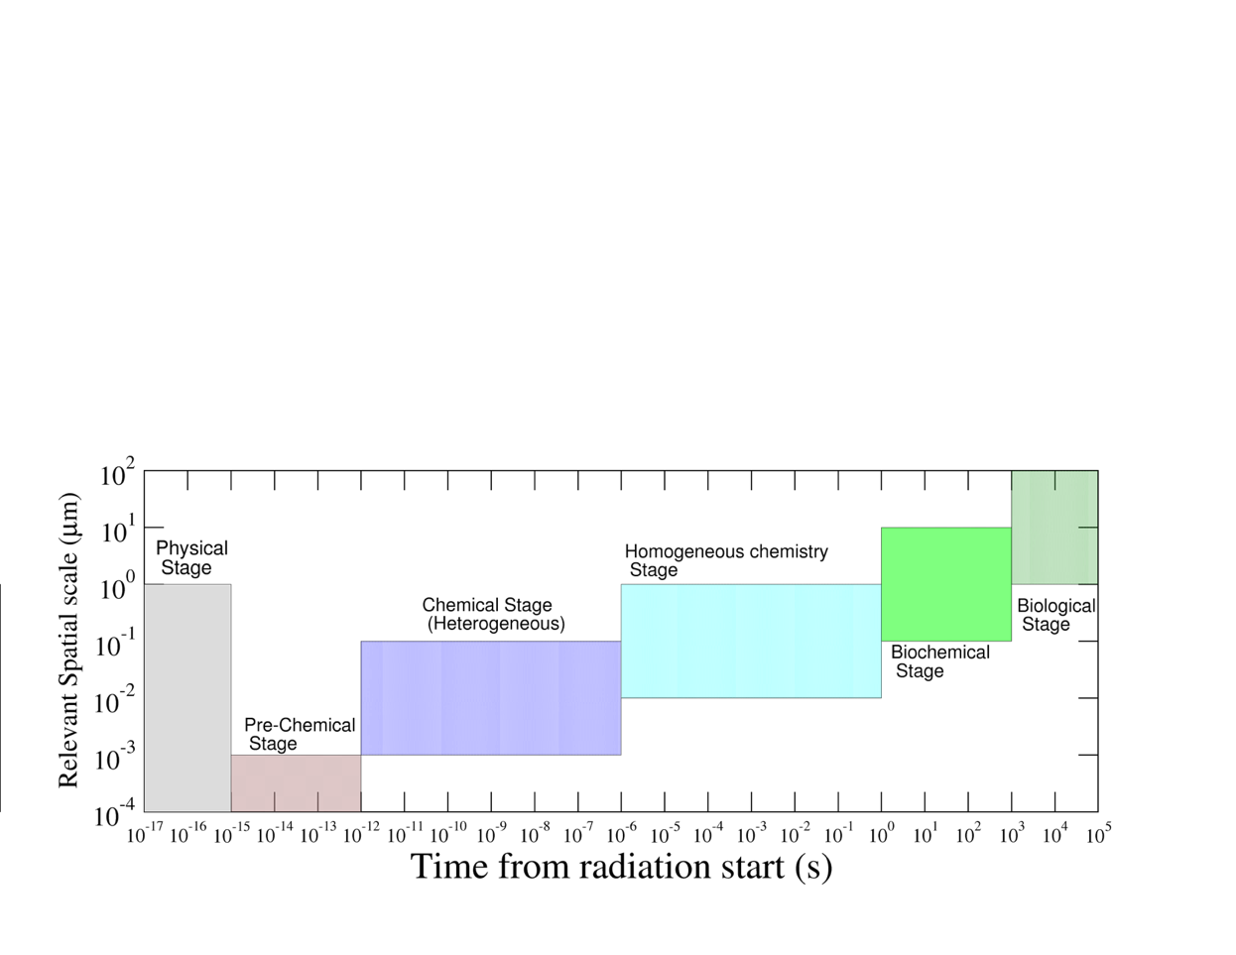
FLASH and spatiotemporal scales of Radiation Damage
a FLASH pulse
Time to deliver 10 Gy CONV
C?
p
Time to deliver 10 Gy FLASH
x
e
Cellular &tissue response
Enzimatic repair processes
Primary ionization, excitation, transport of secondary electrons
Further chemical reactions
(no memory of initial track)
Diffusion and reaction of generated radical species
Dissociation of excited/ionized molecules
Weber, Scifoni, Durante Med Phys 2021.

Slide 8
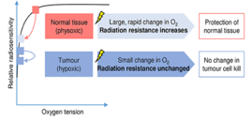
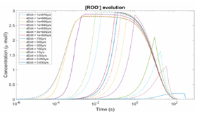
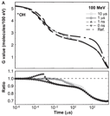
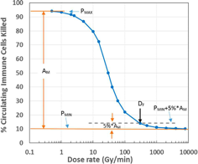
Main FLASH mechanistic hypothesis
Wilson et al 2020
Organic radical-radical
recombination
R. Labarbe, et al. "A physicochemical model of reaction kinetics supports peroxyl radical recombination as the main determinant of the FLASH effect." Radiother. Oncol. (2020
D. R. Spitz, et. al., An integrated physico-chemical approach for explaining the differential impact of FLASH versus conventional dose rate irradiation on cancer and normal tissue responses, Radiother. Oncol. (2019)
C. Koch, Re: Differential impact of FLASH versus conventional dose rate irradiation, Radiother. Oncol. (2020
D. R. Spitz, et al, Response to Ling et al. regarding, Radiother. Oncol. (2020).
D. Boscolo et al.. (2020). Impact of target oxygenation on the chemical track evolution of ion and electron radiation. International Journal of Molecular Sciences, 21(2), 424.
D. Boscolo, et al. May oxygen depletion explain the FLASH effect? A chemical track structure analysis. Radiother Oncol, 162:68-75.
Y. Lai et al “Modeling the effect of oxygen on the chemical stage of water radiolysis using GPU-based microscopic Monte Carlo simulations, with an application in FLASH radiotherapy” Phys Med Biol 2020
Transient Hypoxia
(O₂ Depletion)
G. Pratx, D. S. Kapp, A computational model of radiolytic oxygen depletion during FLASH irradiation and its effect on the oxygen enhancement ratio, PMB (2019)
K. Petersson, et al. A quantitative analysis of the role of oxygen tension in FLASH radiotherapy, IJROBP (2020)
G. Adrian, et al., The FLASH effect depends on oxygen concentration, Brit. J. Radiol. (2020)
R. Abolfath, et al, "Oxygen depletion in FLASH ultra‐high‐dose‐rate radiotherapy: A molecular dynamics simulation." Med. Phys. (2020).
S. Zhou, et al. "Minimum dose rate estimation for pulsed FLASH radiotherapy: A dimensional analysis." Med. Phys. (2020).
A. Hu, et al. "Oxygen depletion hypothesis remains controversial: a mathematical model of oxygen depletion during FLASH radiation."" subm.arXiv (2021)
Zakaria, A. et al.. (2021). Transient hypoxia in water irradiated by swift carbon ions at ultra-high dose rates: implication for FLASH carbon-ion therapy. Canadian Journal of Chemistry,
Zhu, H, et al. "Modeling of cellular response after FLASH irradiation: a quantitative analysis based on the radiolytic oxygen depletion hypothesis." arXiv subm.(2021).
Labarbe et al 2020
2019-2021 (!)
Intertrack Effects
A.M. Zakaria, et al. "Ultra-High Dose-Rate, Pulsed (FLASH) Radiotherapy with Carbon Ions: Generation of Early, Transient, Highly Oxygenated Conditions in the Tumor Environment." Rad. Res. (2020).
J. Ramos-Méndez, et al. "LET-Dependent Intertrack Yields in Proton Irradiation at Ultra-High Dose Rates Relevant for FLASH Therapy." Rad. Res. (2020).
Alanazi, A., et al.. (2021). A computer modeling study of water radiolysis at high dose rates. Relevance to FLASH radiotherapy. Radiation research, 195(2), 149-162.
Immune system
driven
the differential responses to ionizing radiation between normal and tumor tissues. Radiation Medicine and Protection, 1(1), 35-40.
Jin J. Y., et al. FLASH Dose Rate Effect on Circulating Immune Cells: A Potential Mechanism for FLASH-RT?. International Journal of Radiation Oncology, Biology, Physics, 2020, 108.3: S7.
Jin, Jian-Yue, et al. "Ultra-high dose rate effect on circulating immune cells: A potential mechanism for FLASH effect?." Radiotherapy and Oncology 149 (2020): 55-62
Ramos et al 2020
8
Zhou et al 2020

Slide 9
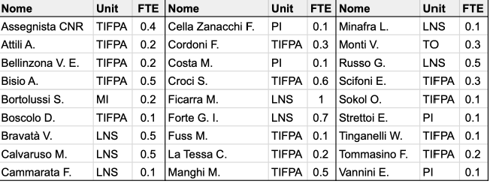
FRIDA WP1: Understanding FLASH
Multiscale modelling of the FLASH effect
Dedicated in vitro/ex vivo experiments
UHDR Upgrade of Facilities

Slide 10
WP1: deliverables & schedule
With a budget of 250 k€ (25% of the total), WP1 aims to
Modelling / simulation of the heterogeneous and homogeneous chemical stages; take into account the kinetics of the DNA damaging and repair mechanisms.
The experience already gained in performing this kind of studies (creation and diffusion of chemical species that could have a role in enhancing or suppressing the FLASH effect), experience in managing the chosen cell line, modelling of the DNA damaging and repair mechanism.. is one of the cornerstones of FRIDA, ensuring that FRIDA has the potential to really going beyond the state of the art.
In vivo and ex-vivo (using transplanted retinas) measurements will be performed in order to test different FLASH mechanism hypothesis and verify the role and impact of Oxygen..
Both e- and p will be used, breast cancer and control sample cellular lines have been defined

Slide 11
FRIDA WP1: M&D Gant

Slide 12
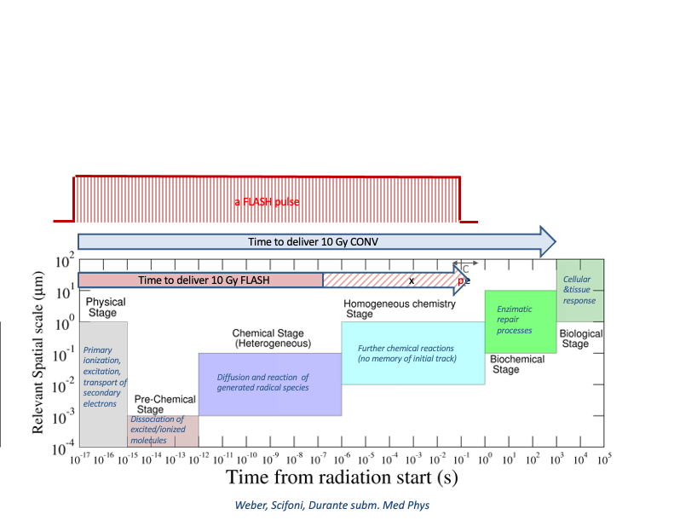
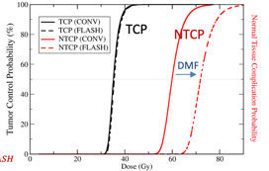
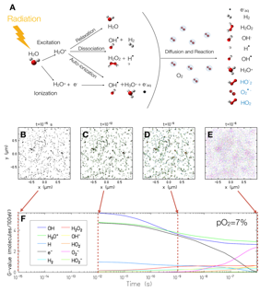
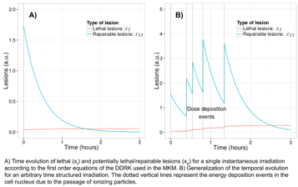
FRIDA WP1: Multiscale Modeling
Task 1..3
NTCP modeling
Task1.1
Radiation Chemistry
From hetero to homo
Task 1.2
DNA damage repair kinetics
Manganaro wt al Med Phys 2017
Cordoni et al. Rad Res 2021
Boscolo et al. Radiother. Oncol. 2021

Slide 13
Importance of in vitro and ex vivo analysis
FLASH is indeed a in vivo observation, since regards a differential NT/Tumor effect
BUT an impact of the ultrahigh dose rate was seen also on in vitro data, e.g. on survival data (e.g. Adrian 2020), or DNA damage (e.g. Fouillade 2019)
Clinical relevance requires in vivo, while mechanistic studies requires high throughput..
Ex vivo is a relevant compromise, allowing consideration of important aspects like Volume effect

Slide 14
Exp facilities : Where is possible to go for doing what
Summary of Facilities Available or in Development in the Project
Facility | Radiation type | Energy | Dose Rate(s) | Beam size FWHM | Availability probability within the project | Estimated time of Availability | Equipment availability for bio-exp | Possibility of in vivo
TIFPA proton beam lab | p | 220 MeV | ~100 Gy/s | ~2cm | 80% | Mar 2022 | Hood, Incubator, on site, bio-lab at the department | Not for now.. battles ongoing with PAT
Pisa | e | 7 MeV | ~500 Gy/s | ~1cm | 100% | now |  | no, only ex-vivo and vitro
TO Linac
CNAO | p/C?
ELI-Beamlines (CZ) | laser driven protons | 5-30 MeV | E6 Gy/s | 1.5 cm | 100% in the second and third year | 2023 | yes: bio lab of safety level 3 is available | yes, but to be agreed
RAL Laboratory (UK) | laser driven protons | up to 60 MeV | E6-E9 | 1 cm | 100% but proposal must be submitted | depending on proposal submission and approval | yes | yes

Slide 15
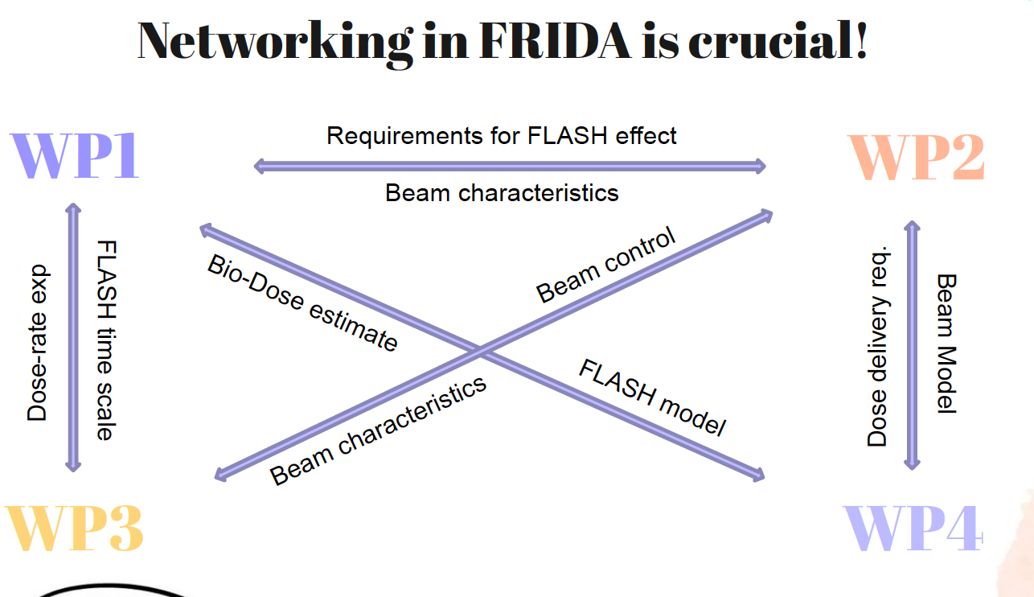
Links with other WPs

Slide 16
KOM (15 feb) WP1: Tentative Schedule
Requirements: -1,5h+...incl.discussion
-Limited N speakers
-State of the Art and Plan covering
State of the Art of FLASH Understanding + Modeling plan (ES..or any other volunteer?)
State of the Art Bio-exp approaches and Experimental Plan in vitro (Giusi)
Experimental Plan ex vivo (Mario)
Summary status of Exp Facilities available/in preparation (Fabio/Anna..?)
…?

Slide 17
Budget

