Slide 1

INFN: Cinquant'anni di ricerca e sviluppo
Einstein Telescope
Edoardo Milotti
Università di Trieste e INFN-Sezione di Trieste

Slide 2
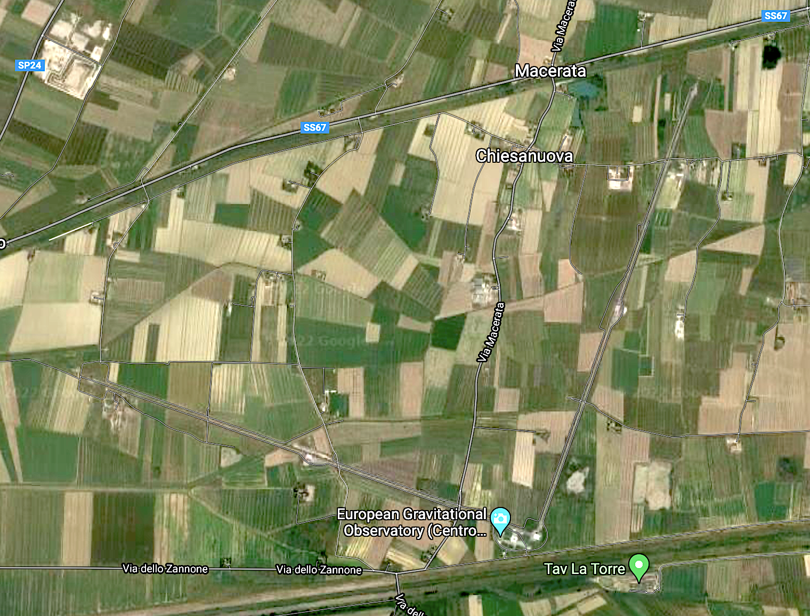

Slide 3
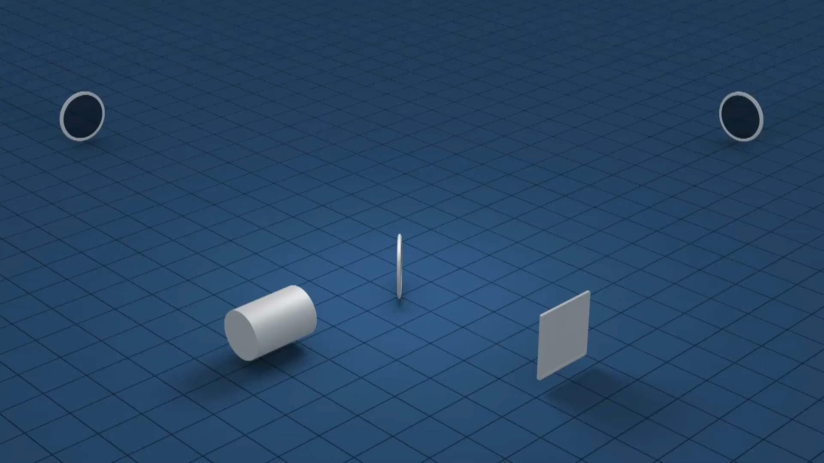

Slide 4
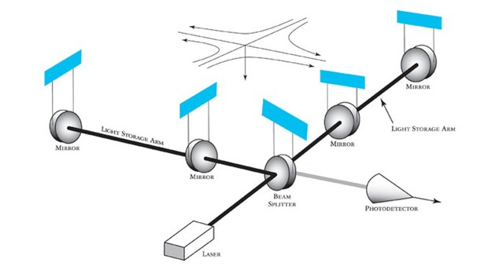

Slide 6
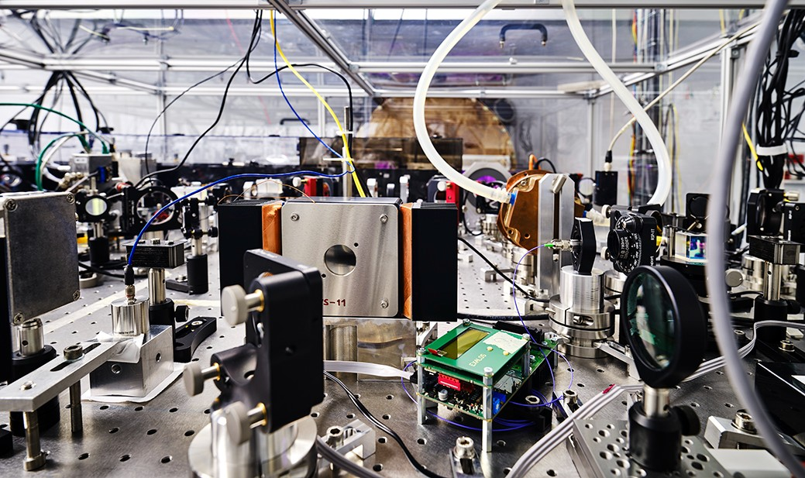

Slide 7
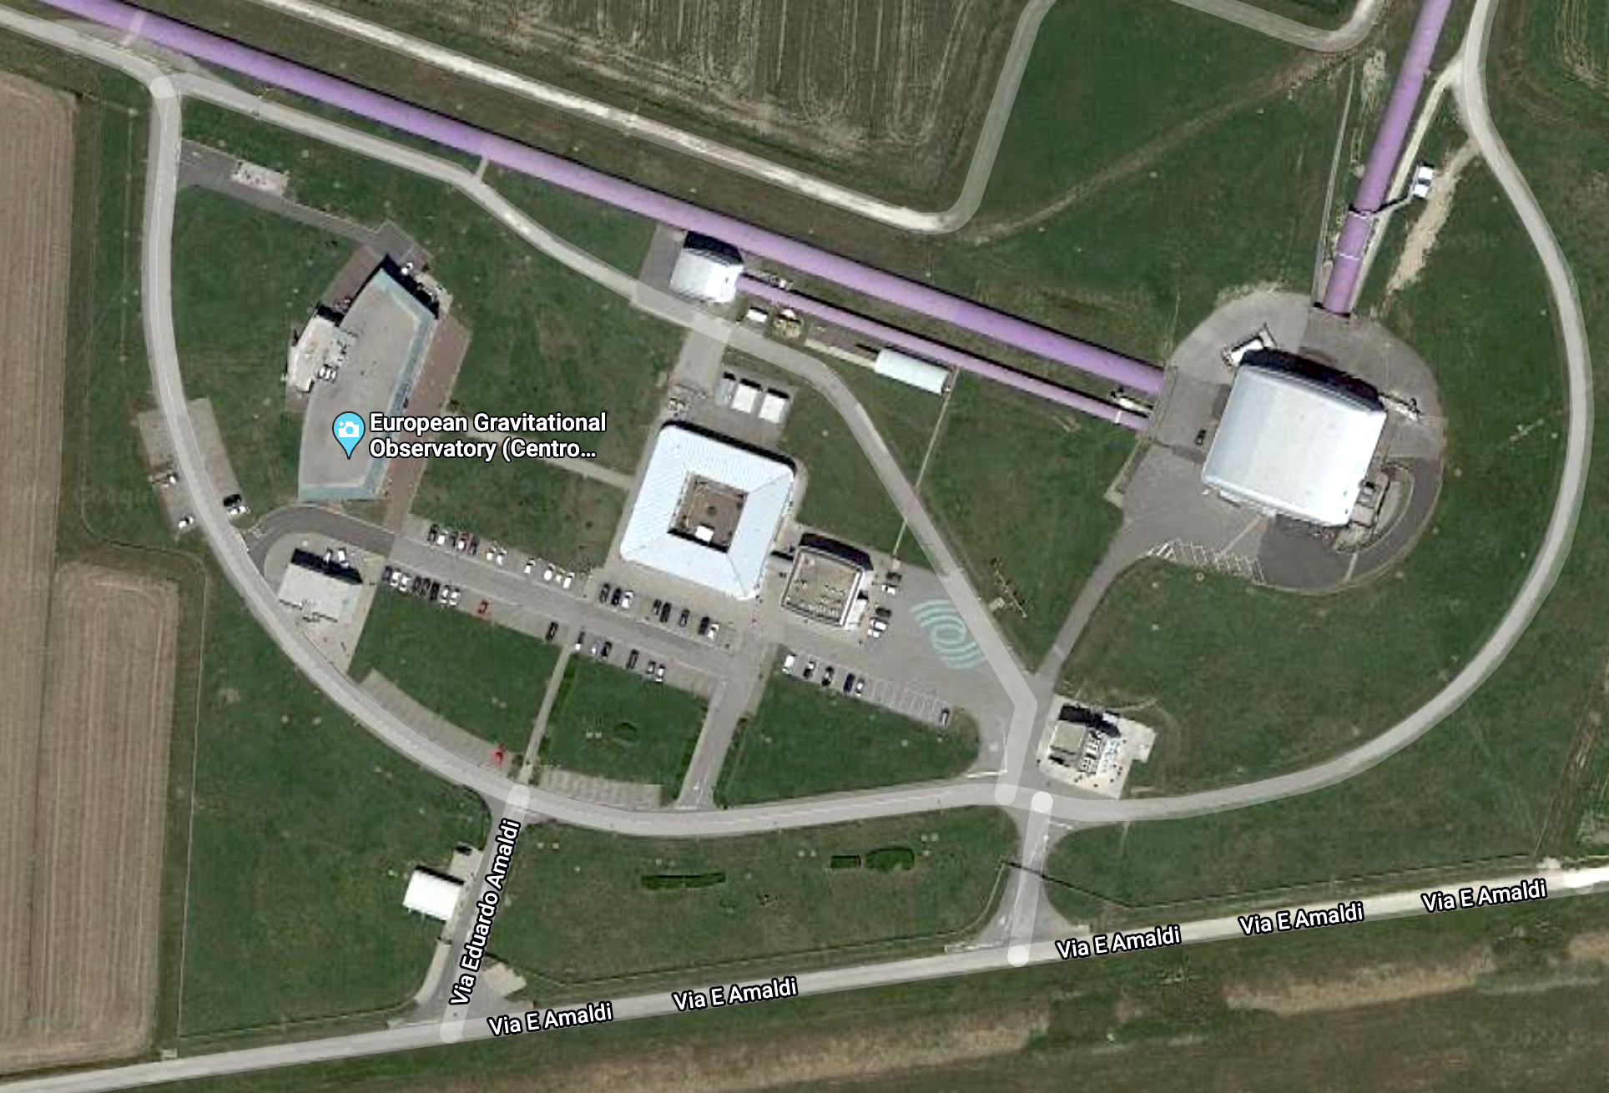

Slide 8
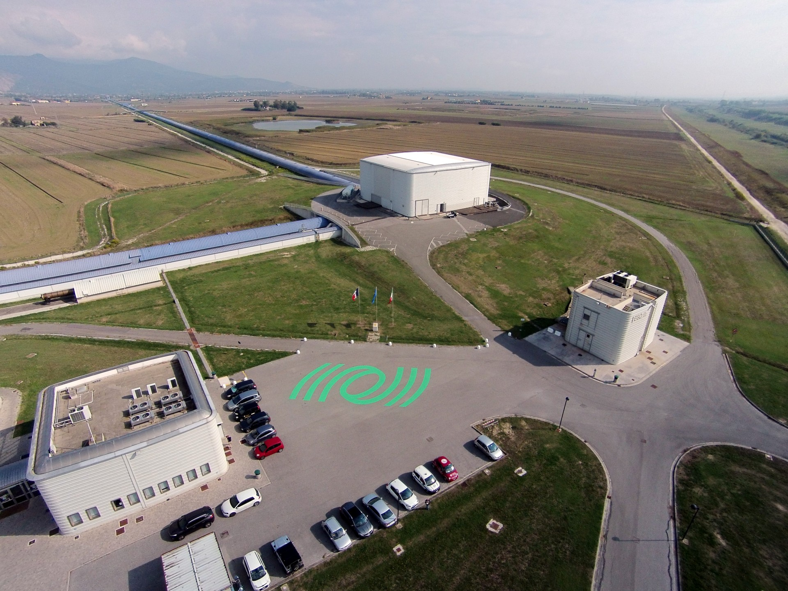

Slide 9
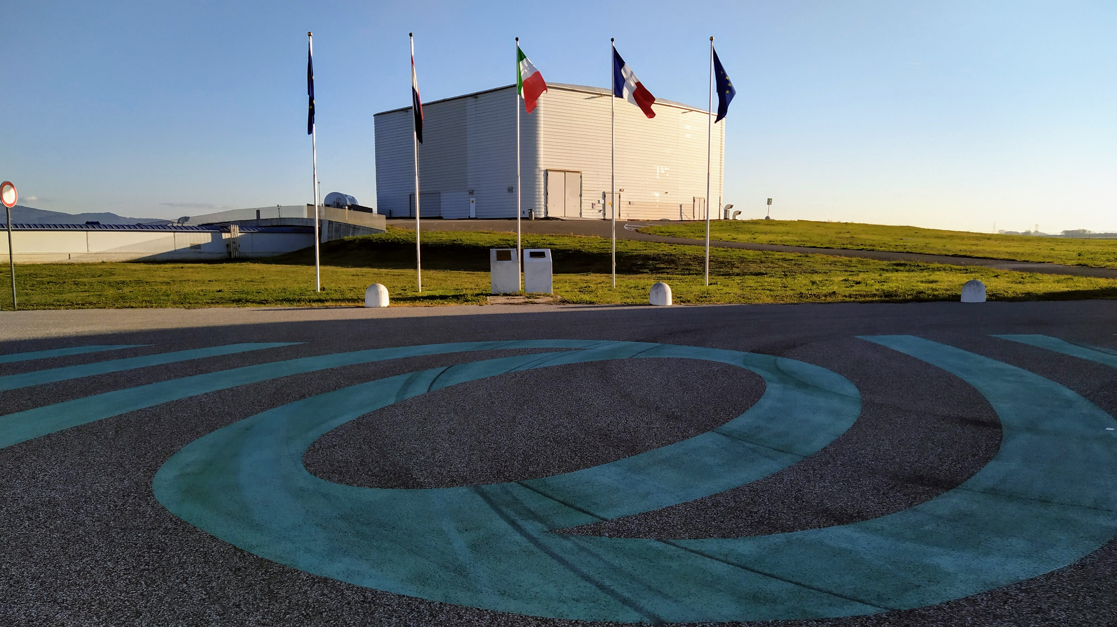

Slide 10
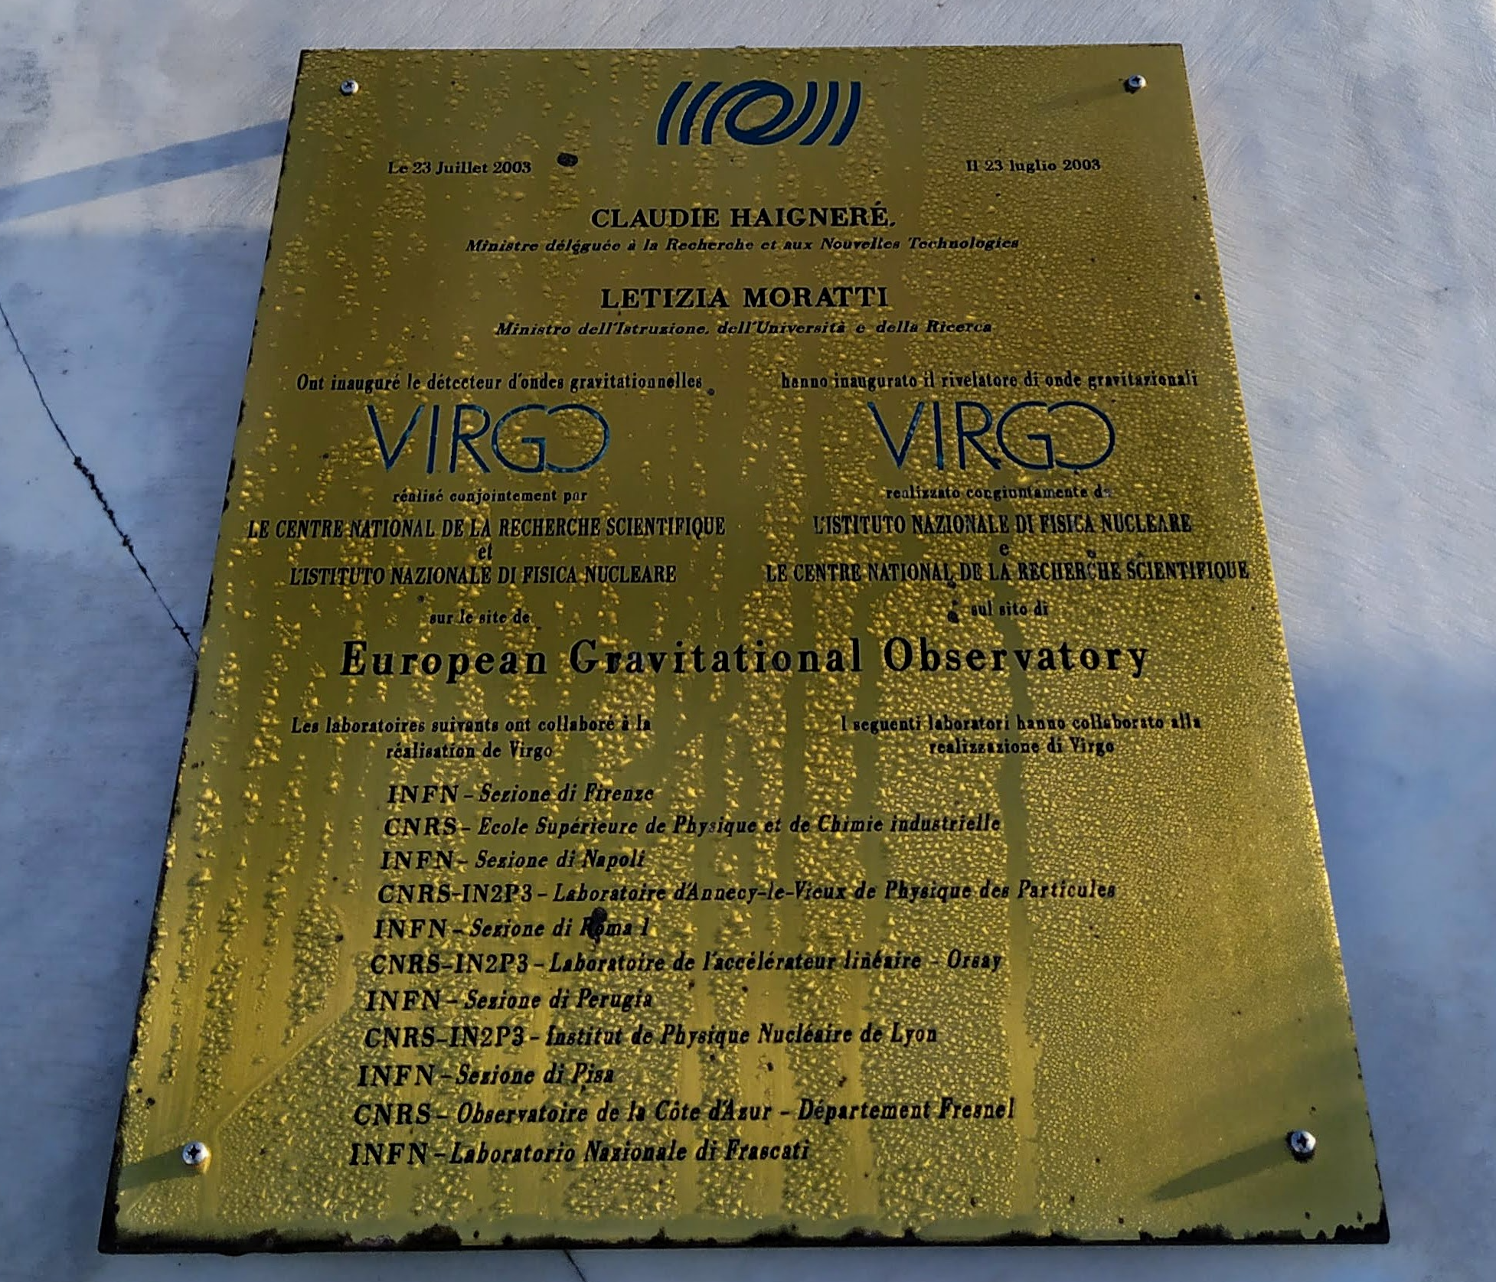

Slide 11
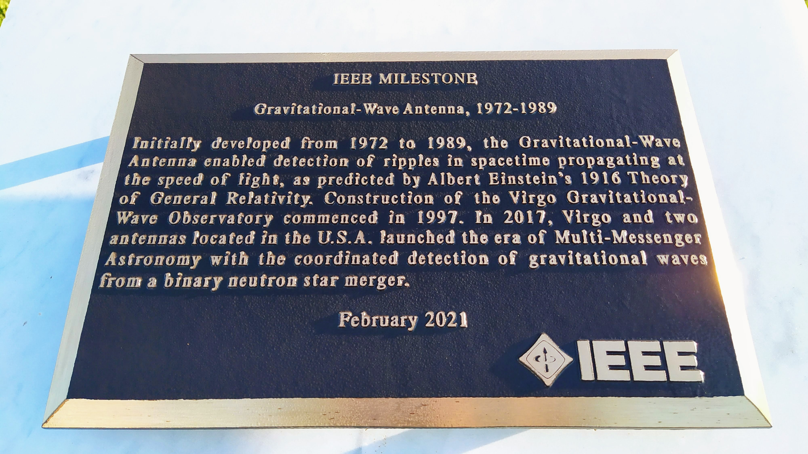

Slide 12
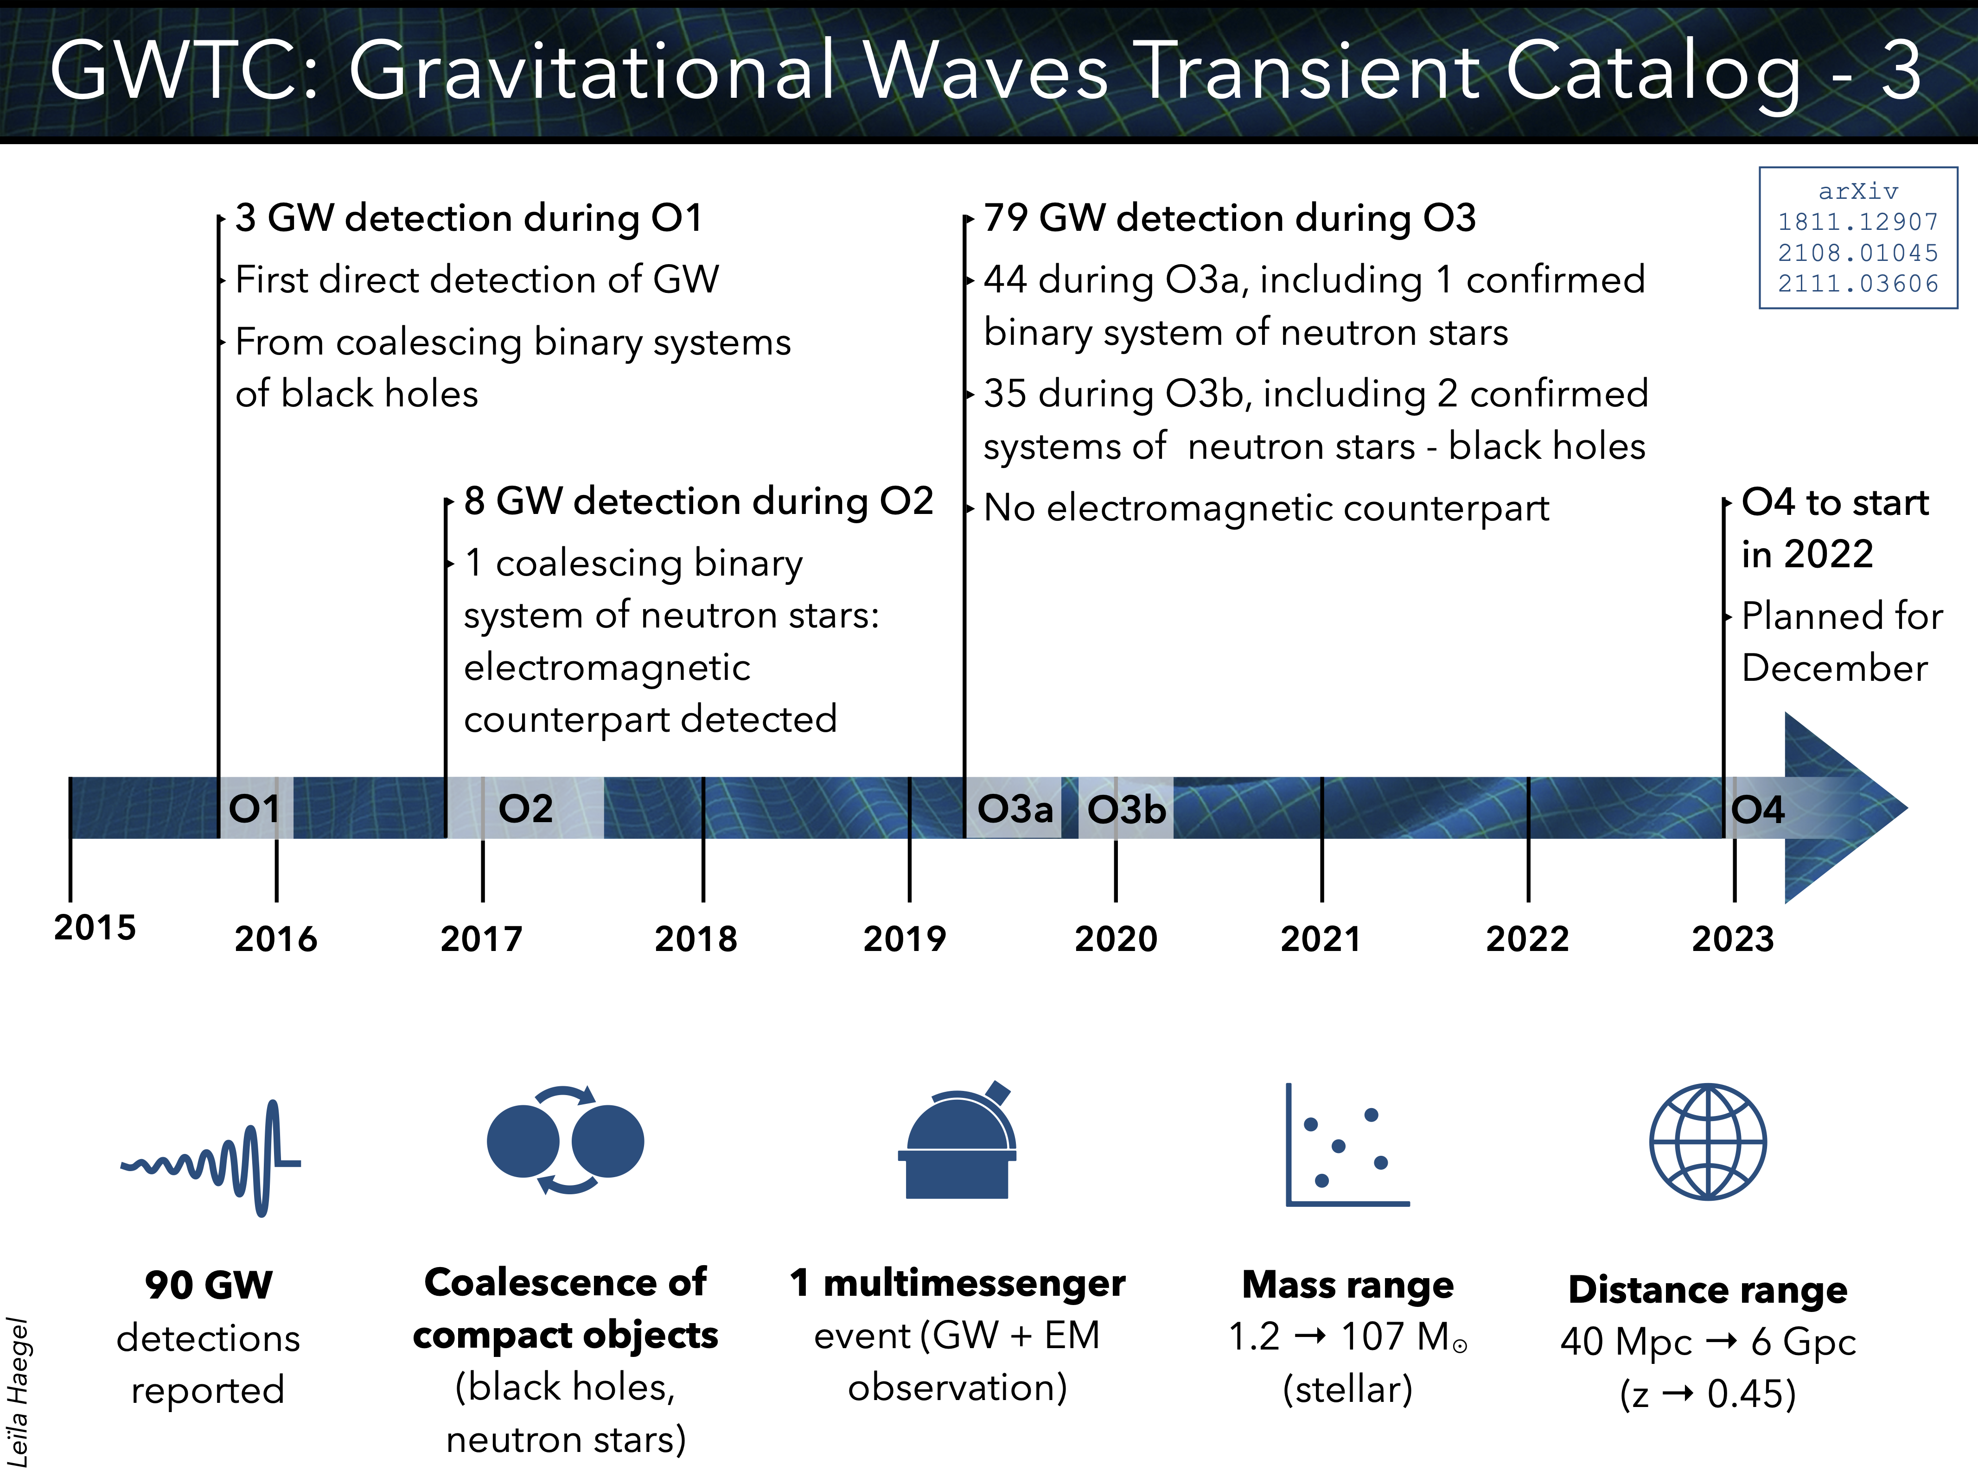

Slide 13
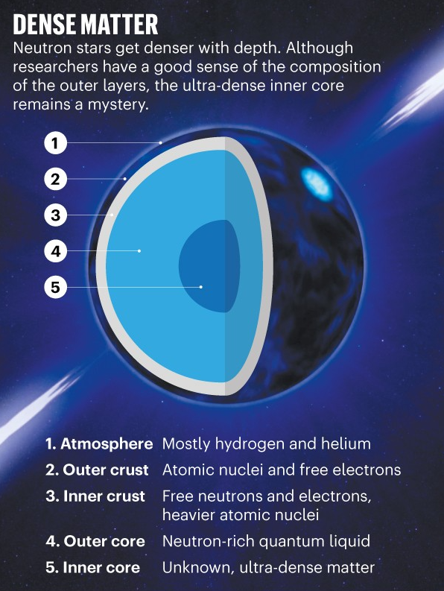
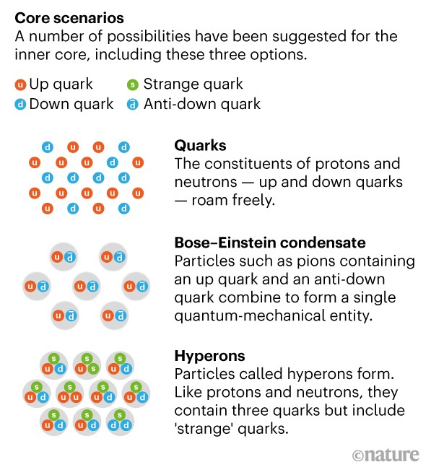

Slide 14
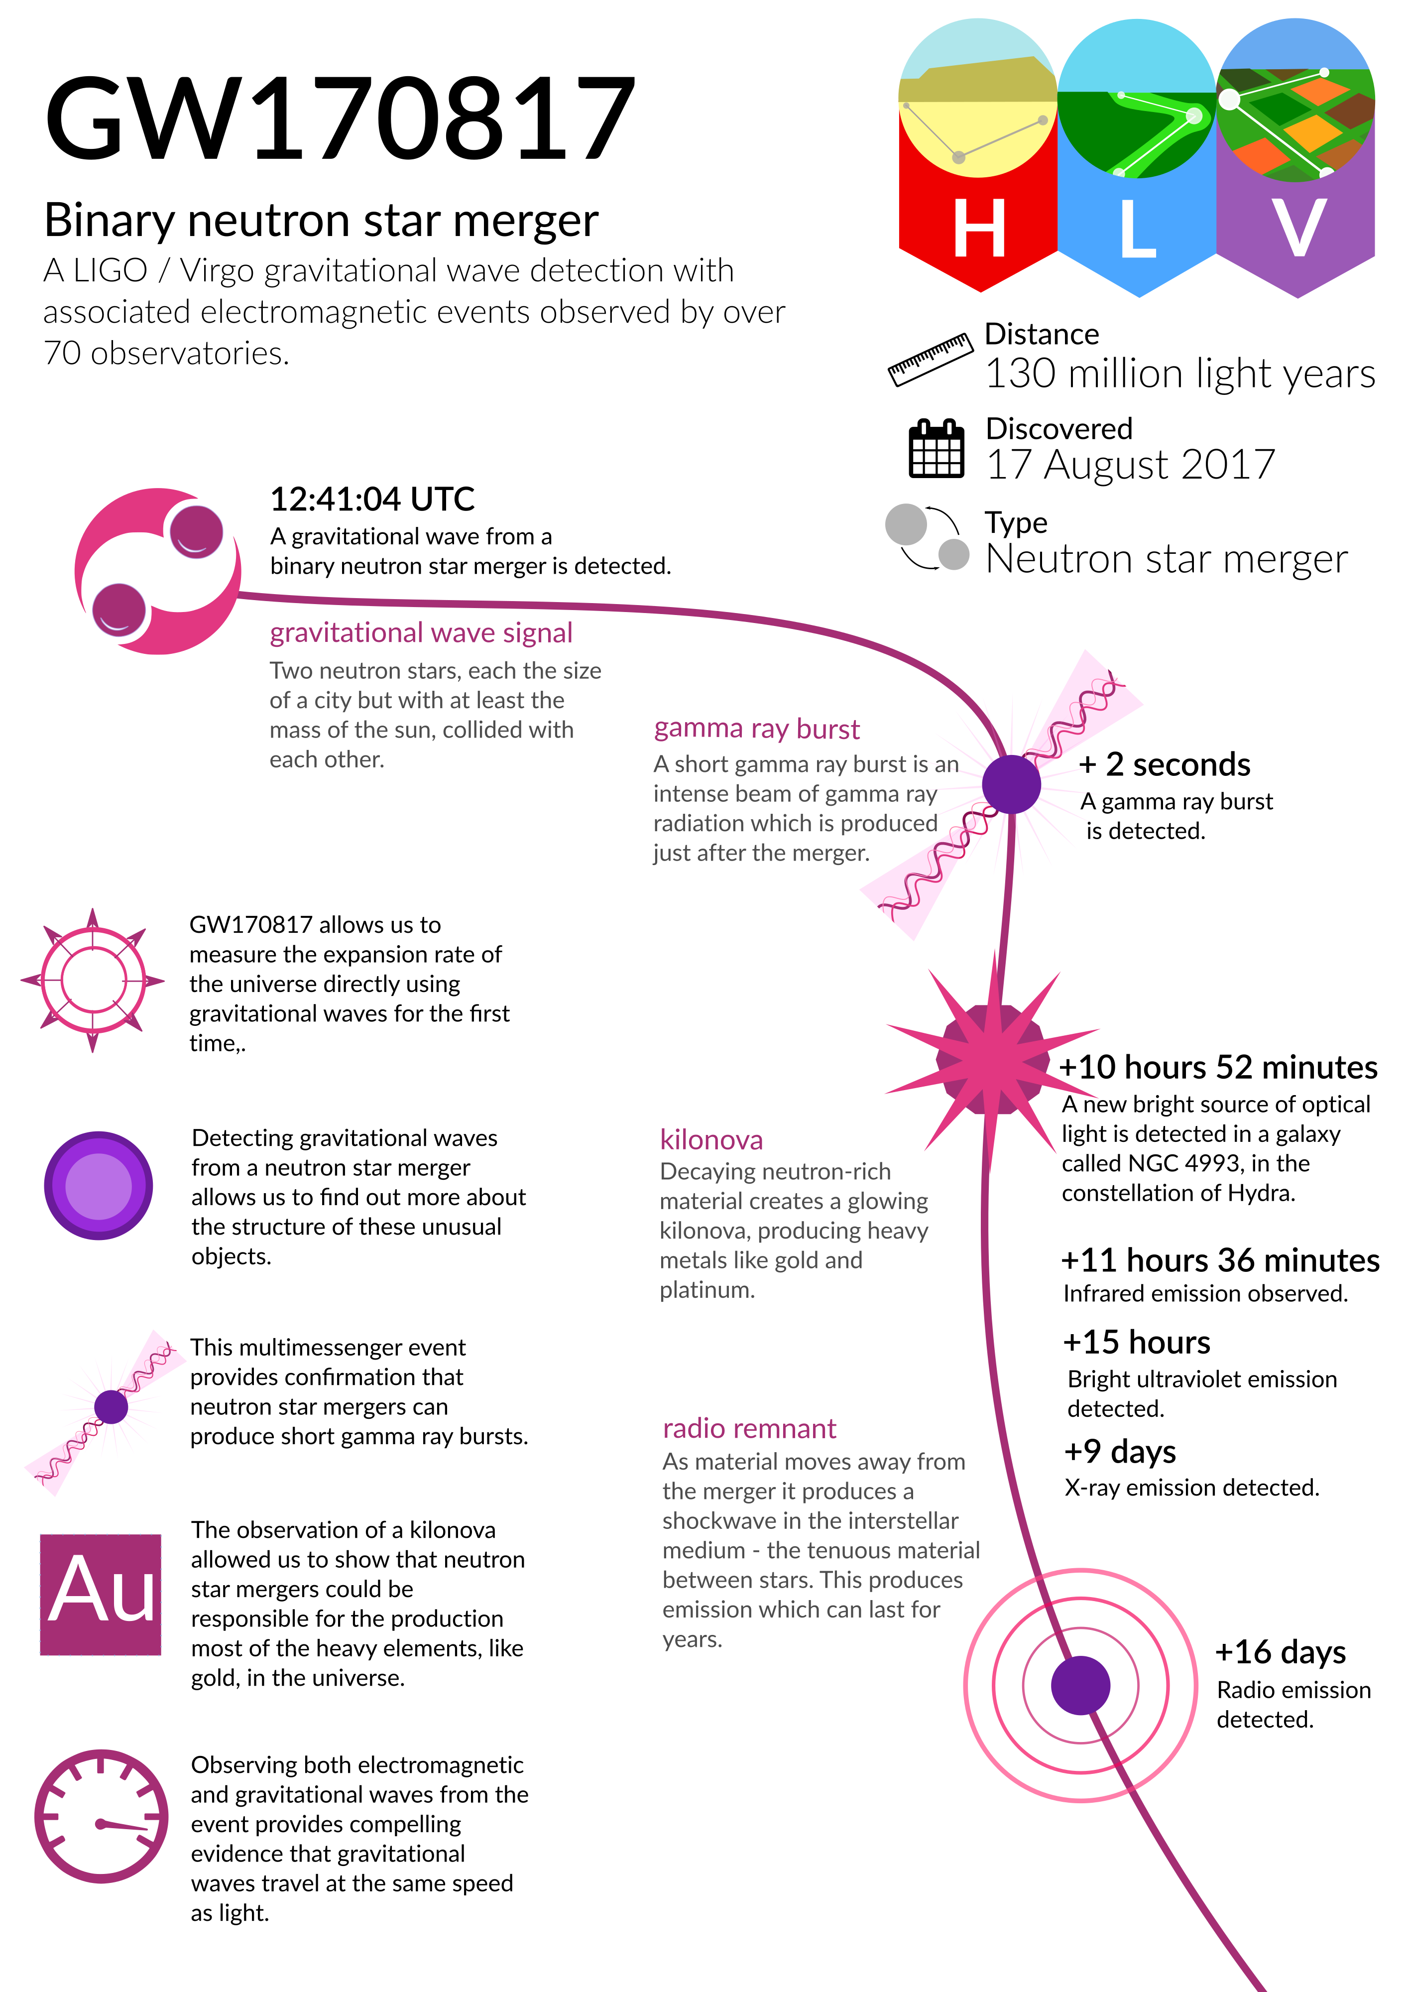

Slide 15
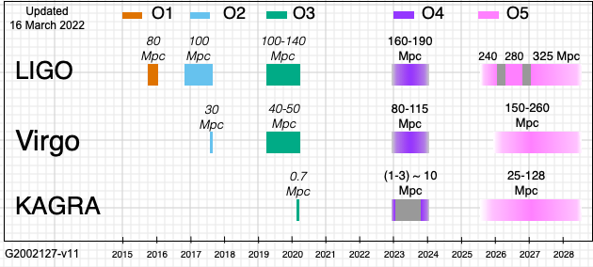

Slide 16
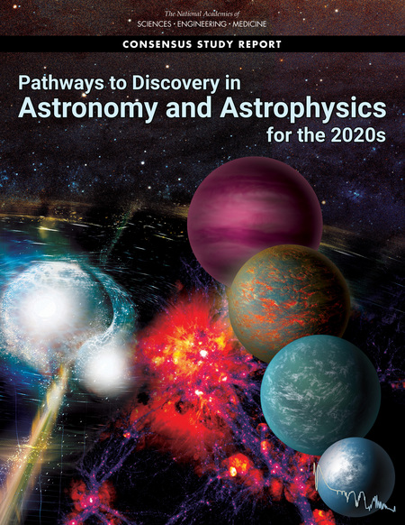
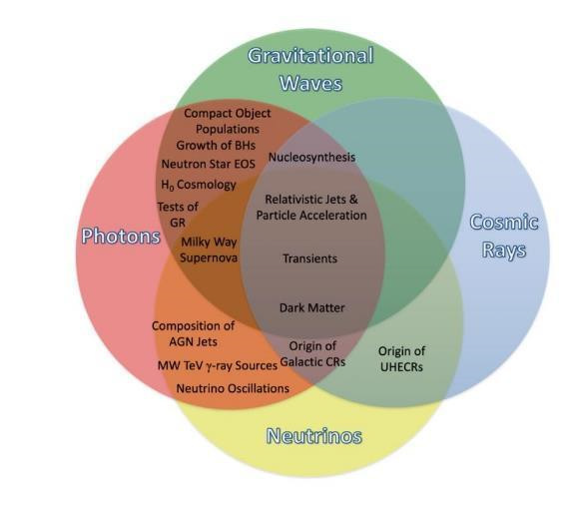

Slide 17
The panel sees a compelling opportunity to dramatically open the discovery space of astronomy through a bold, broad multi-messenger program, with three components:
• Neutrino program: A large-scale (MREFC) investment by the National Science Foundation (NSF) in IceCube-Gen2, to resolve the bright, hard-spectrum, TeV–PeV diffuse background discovered by IceCube into discrete sources and to make first detections at higher energies.
• Gravitational-wave program: Medium-scale investments in three bands (kHz, nHz, and mHz) to develop a rich observational program: Cosmic Explorer, with NSF support for technology development to set the stage for large-scale investments and huge detection rates in the 2030s; the North American Nanohertz Observatory for Gravitational Waves (NANOGrav), with NSF support for expanded operations in the 2020s; and the Laser Interferometer Space Antenna (LISA), with National Aeronautics and Space Administration (NASA) support for a broad scope of activities to build a vibrant U.S. community for significant science contributions in the 2030s.
• Gamma-ray program: Medium-scale investments that support observations over a wide energy range, with two components. (In this report, for simplicity we use “gamma-ray” to mean photons at or above hard X-ray energies.) First, a NASA Probe-scale mission, targeted to multi-messenger astronomy, with sensitivity in the keV–MeV–GeV range and with capabilities for the identification, localization, and characterization of transients. This would be selected by competitive review; potential projects include the All-sky Medium Energy Gamma-ray Observatory (AMEGO), the Advanced Particle-astrophysics Telescope (APT), or the Transient Astrophysics Probe (TAP). Second, U.S. participation in TeV-range ground-based experiments for precision studies—for example, the Cherenkov Telescope Array (CTA) and the Southern Wide-Field Gamma-Ray Observatory (SWGO)—as NSF medium- scale projects. All of these projects will be valuable themselves—gamma rays reveal processes that longer-wavelength photons cannot—and will greatly enhance the returns of neutrino and gravitational-wave observatories.

Slide 20
Einstein Telescope concept
Three nested detectors in a triangular arrangement will form the final Einstein Telescope geometry.

Slide 22
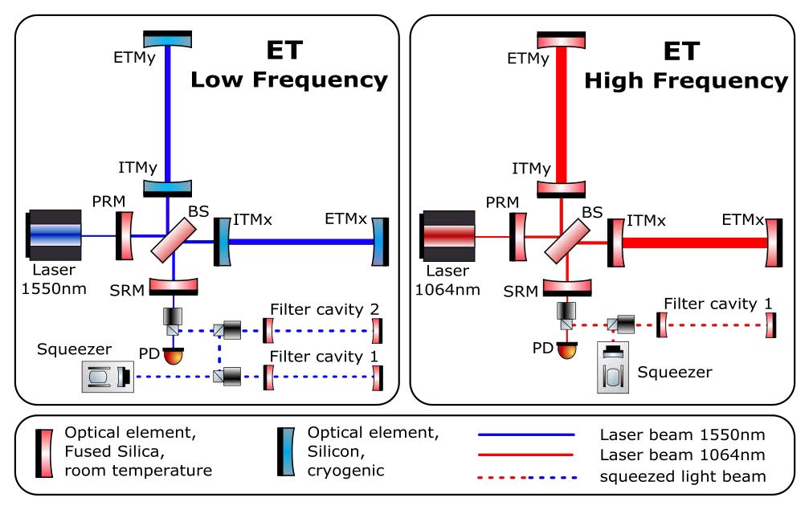
The baseline for ET is a 2-band xylophone detector configuration, composed of a low-frequency (ETLF) and a high-frequency (ET-HF) interferometer.
Both interferometers are Michelson interferometers featuring 10 km arm length with an opening angle of 60 degrees.
Due to their similar geometry both detectors will share common tunnels.

Slide 23
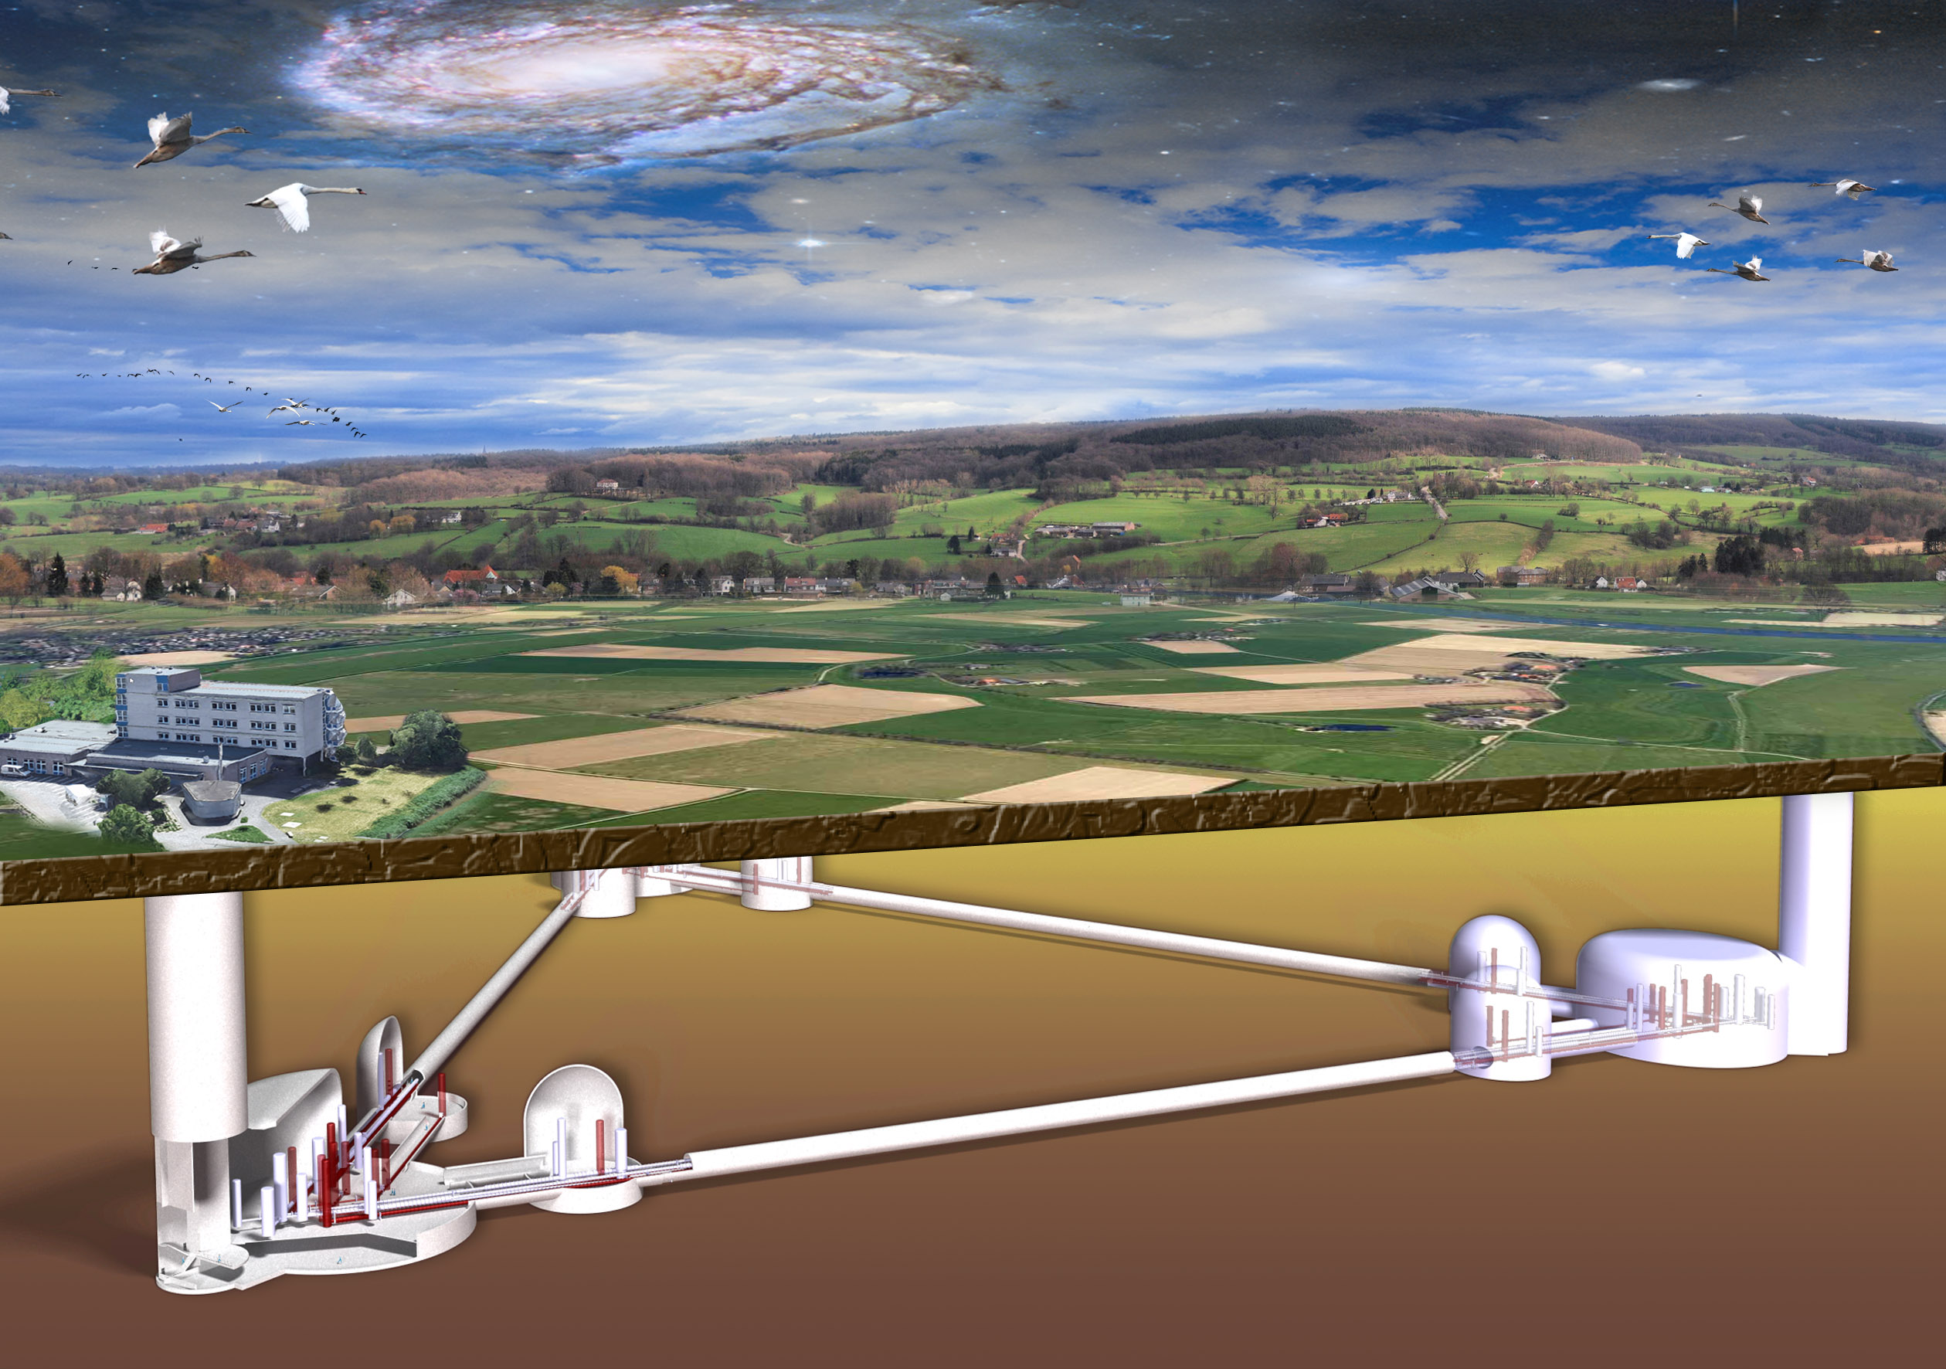

Slide 24
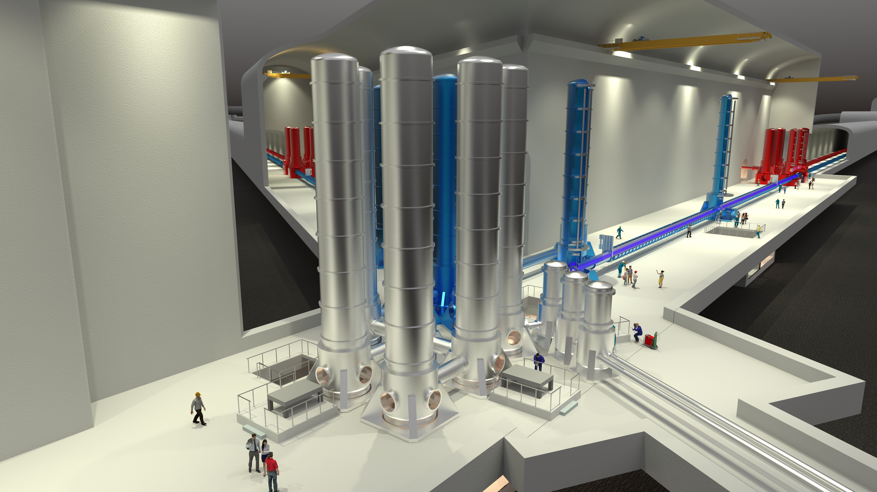

Slide 25
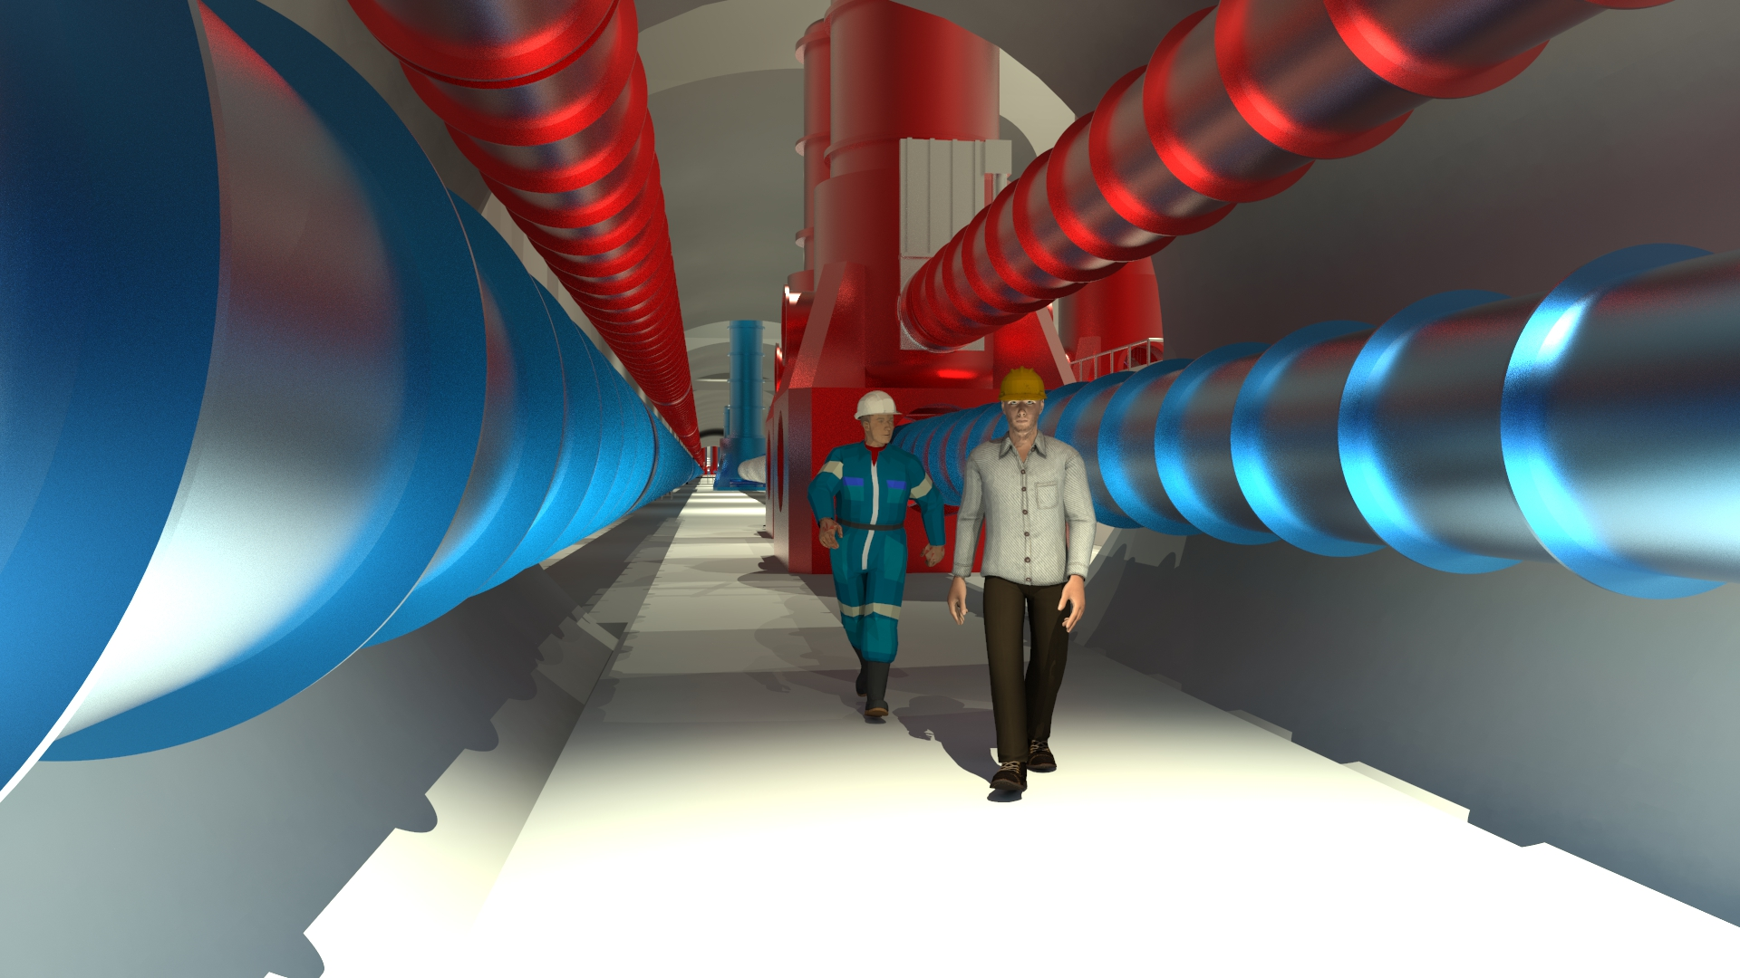

Slide 26
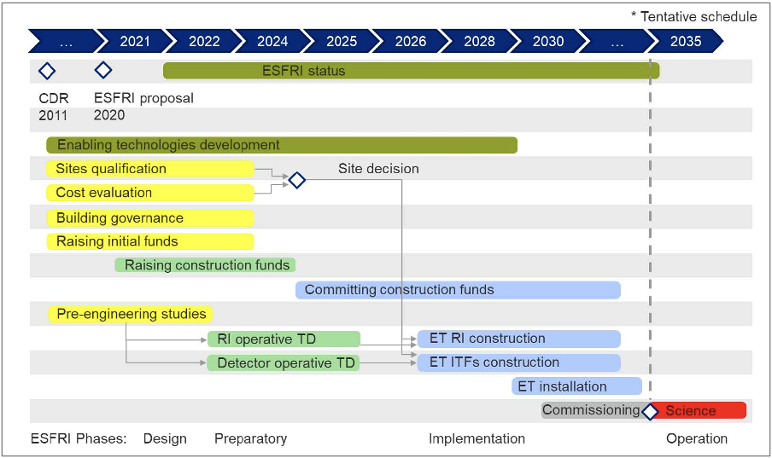
Einstein Telescope timeline

Slide 27
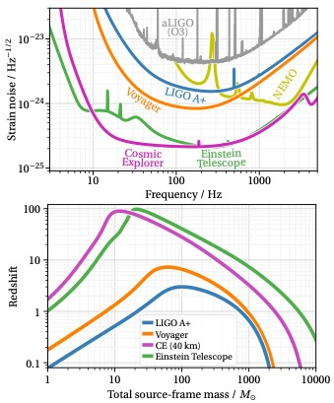
Top: Amplitude spectral densities of detector noise for Cosmic Explorer (CE), the current (O3) and upgraded (A+) sensitivities of Advanced LIGO, LIGO Voyager, NEMO, and the three paired detectors of the triangular Einstein Telescope.
Bottom: Maximum redshift (vertical axis) at which an equal-mass binary of given source-frame total mass (horizontal axis) can be observed with a signal-to-noise ratio of 8. Different curves represent different detectors.
For binary neutron stars (total mass ∼3M⊙), ET and CE will give access to redshifts larger than 1, where most of the mergers are expected to happen.
For binary black holes, they will enable the exploration of redshifts of 10 and above, where mergers of black holes formed by either the first stellar population in the universe (Pop III stars) or by quantum fluctuations shortly after the Big Bang (primordial black holes) might be found.

Slide 28
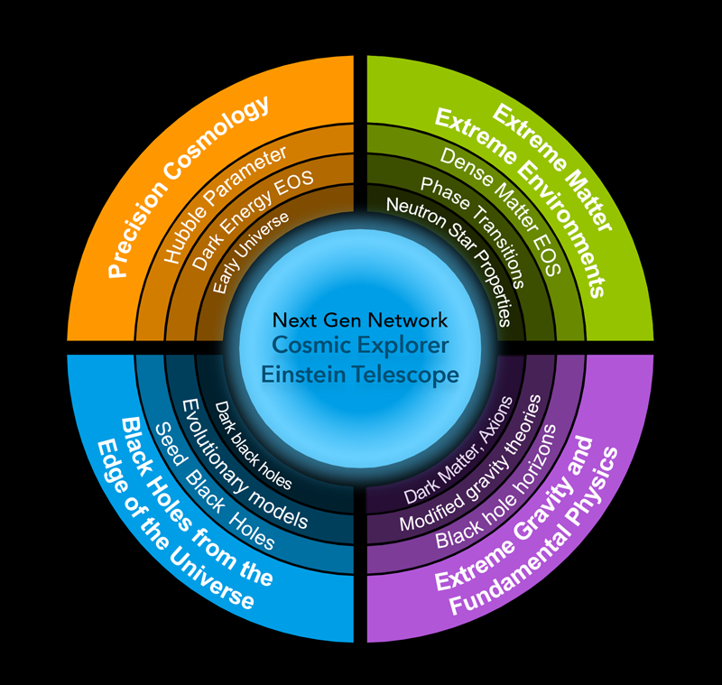

Slide 29
Astrophysical horizon of current and proposed future detectors for compact binary systems.
The lines indicate the maximum redshift at which a detection with signal-to- noise ratio 8 could be made. The detectors shown here are Advanced LIGO during its third observing run (“O3”), Advanced LIGO at its anticipated sensitivity for the fifth observing run (“A+”), a possible cryogenic upgrade of LIGO called Voyager (“Voy”), the Einstein Telescope (“ET”), and Cosmic Explorer (“CE”).
The yellow and white dots are for a simulated population of binary neutron star mergers and binary black hole mergers, respectively, following the Madau and Dickinson stellar formation rate.

Slide 30
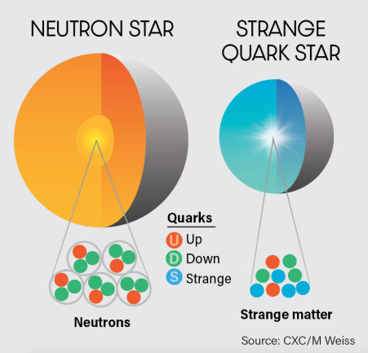

Slide 31
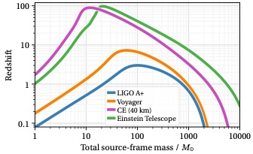
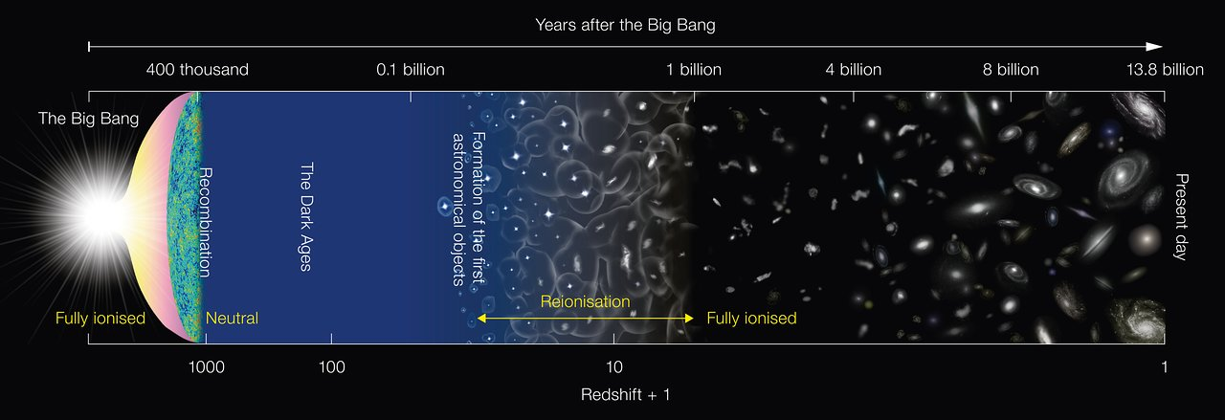
The 3G detectors shall look deep into the Dark Ages of the Universe, down to times before the start of the Cosmic Dawn – the period from about 50 million years to one billion years after the Big Bang when the first stars, black holes, and galaxies in the Universe formed – and thus may be able to get a glimpse of the history of Population III stars.
ET horizon
current detectors' horizon
Cosmic dawn

Slide 33
