Slide 1
Future Circular Collider
M. Cobal (INFN TS/Ud & UniUD)
21 APRILe 2022
Thanks to: P. Azzi, F. Bedeschi, L. Rossi

Slide 2
ESPP Update, FCC Feasibility Study, June ‘20
CERN Council updated the European Strategy for Particle Physics in June 2020.
Scientific recommendations:
full exploitation of the LHC and HL-LHC
highest-priority next collider: e+e- Higgs factory
increased R&D on accelerator technologies
investigation of the technical and financial feasibility of a
future ≥ 100 TeV hadron collider
The FCC Feasibility Study (FS) will address all these

Slide 3
Physics motivation for Hadron Collider
A very large circular hadron collider seems the only approach to reach 100 TeV c.m. range in coming decades
Access to new particles (direct production) in the few TeV to 30 TeV mass range, far beyond LHC reach.
Much-increased rates for phenomena in the sub-TeV mass range → increased precision w.r.t. LHC and possibly ILC
M. Mangano
the name of the game of a hadron collider is energy reach
cf. LHC: factor $≈$4 in radius, factor $≈$2 in field → factor $≈$10 in E_{c.m.}
$$E∝B_{dipole}{×ρ}_{bending}$$

Slide 4
Status of Global FCC Collaboration
Increasing international collaboration as a prerequisite for success: links with science, research & development and high-tech industry will be essential to further advance and prepare the implementation of FCC
ITALY:
15 institutes,
113 persons, 22,25 FTE
EC
H2020
147
Institutes
30
Companies
34
Countries

Slide 5
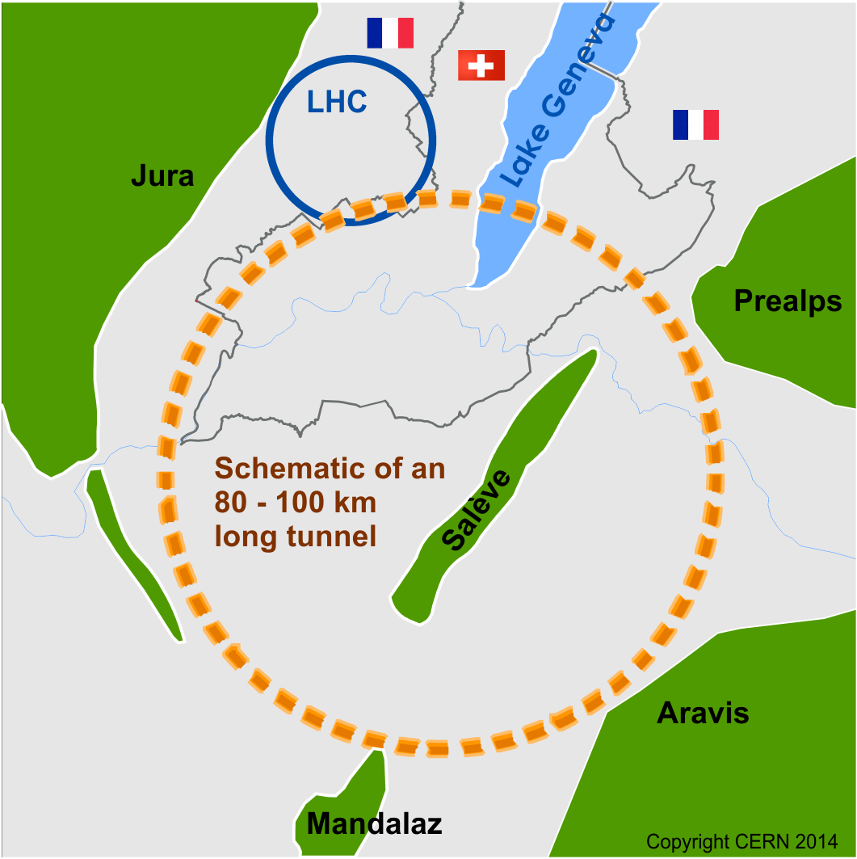
FCC Project
pp-collider (FCC-hh) → main emphasis, defining infrastructure requirements
80-100 km infrastructure in Geneva area
e⁺e⁻ collider (FCC-ee) as intermediate step
p-e (FCC-he) option
~16 T ⇒ 100 TeV pp in 100 km
Feasibility Study: 2021-2025
If project approved before end of decade → construction can start beginning 2030s
FCC-ee operation ~2045-2060
FCC-hh operation 2070-2090++

Slide 6
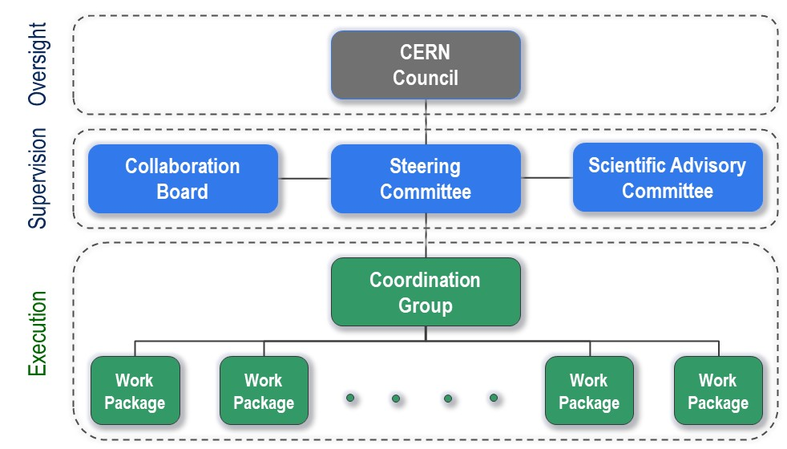
FCC Feasibility Study - organisation
Total CERN funding for the Feasibility Study 2021 - 2025:
100 MCHF material & personnel
Physics Performance

Slide 7
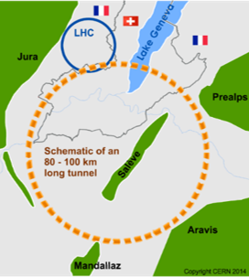
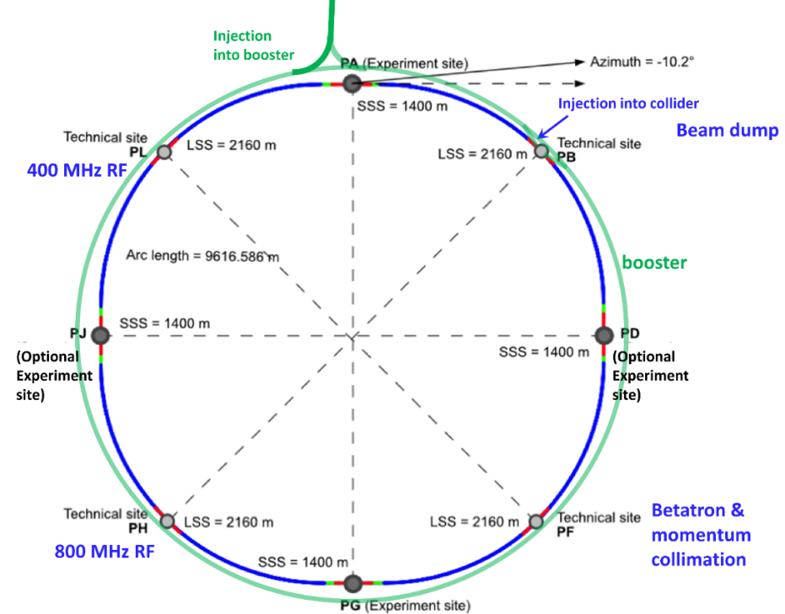
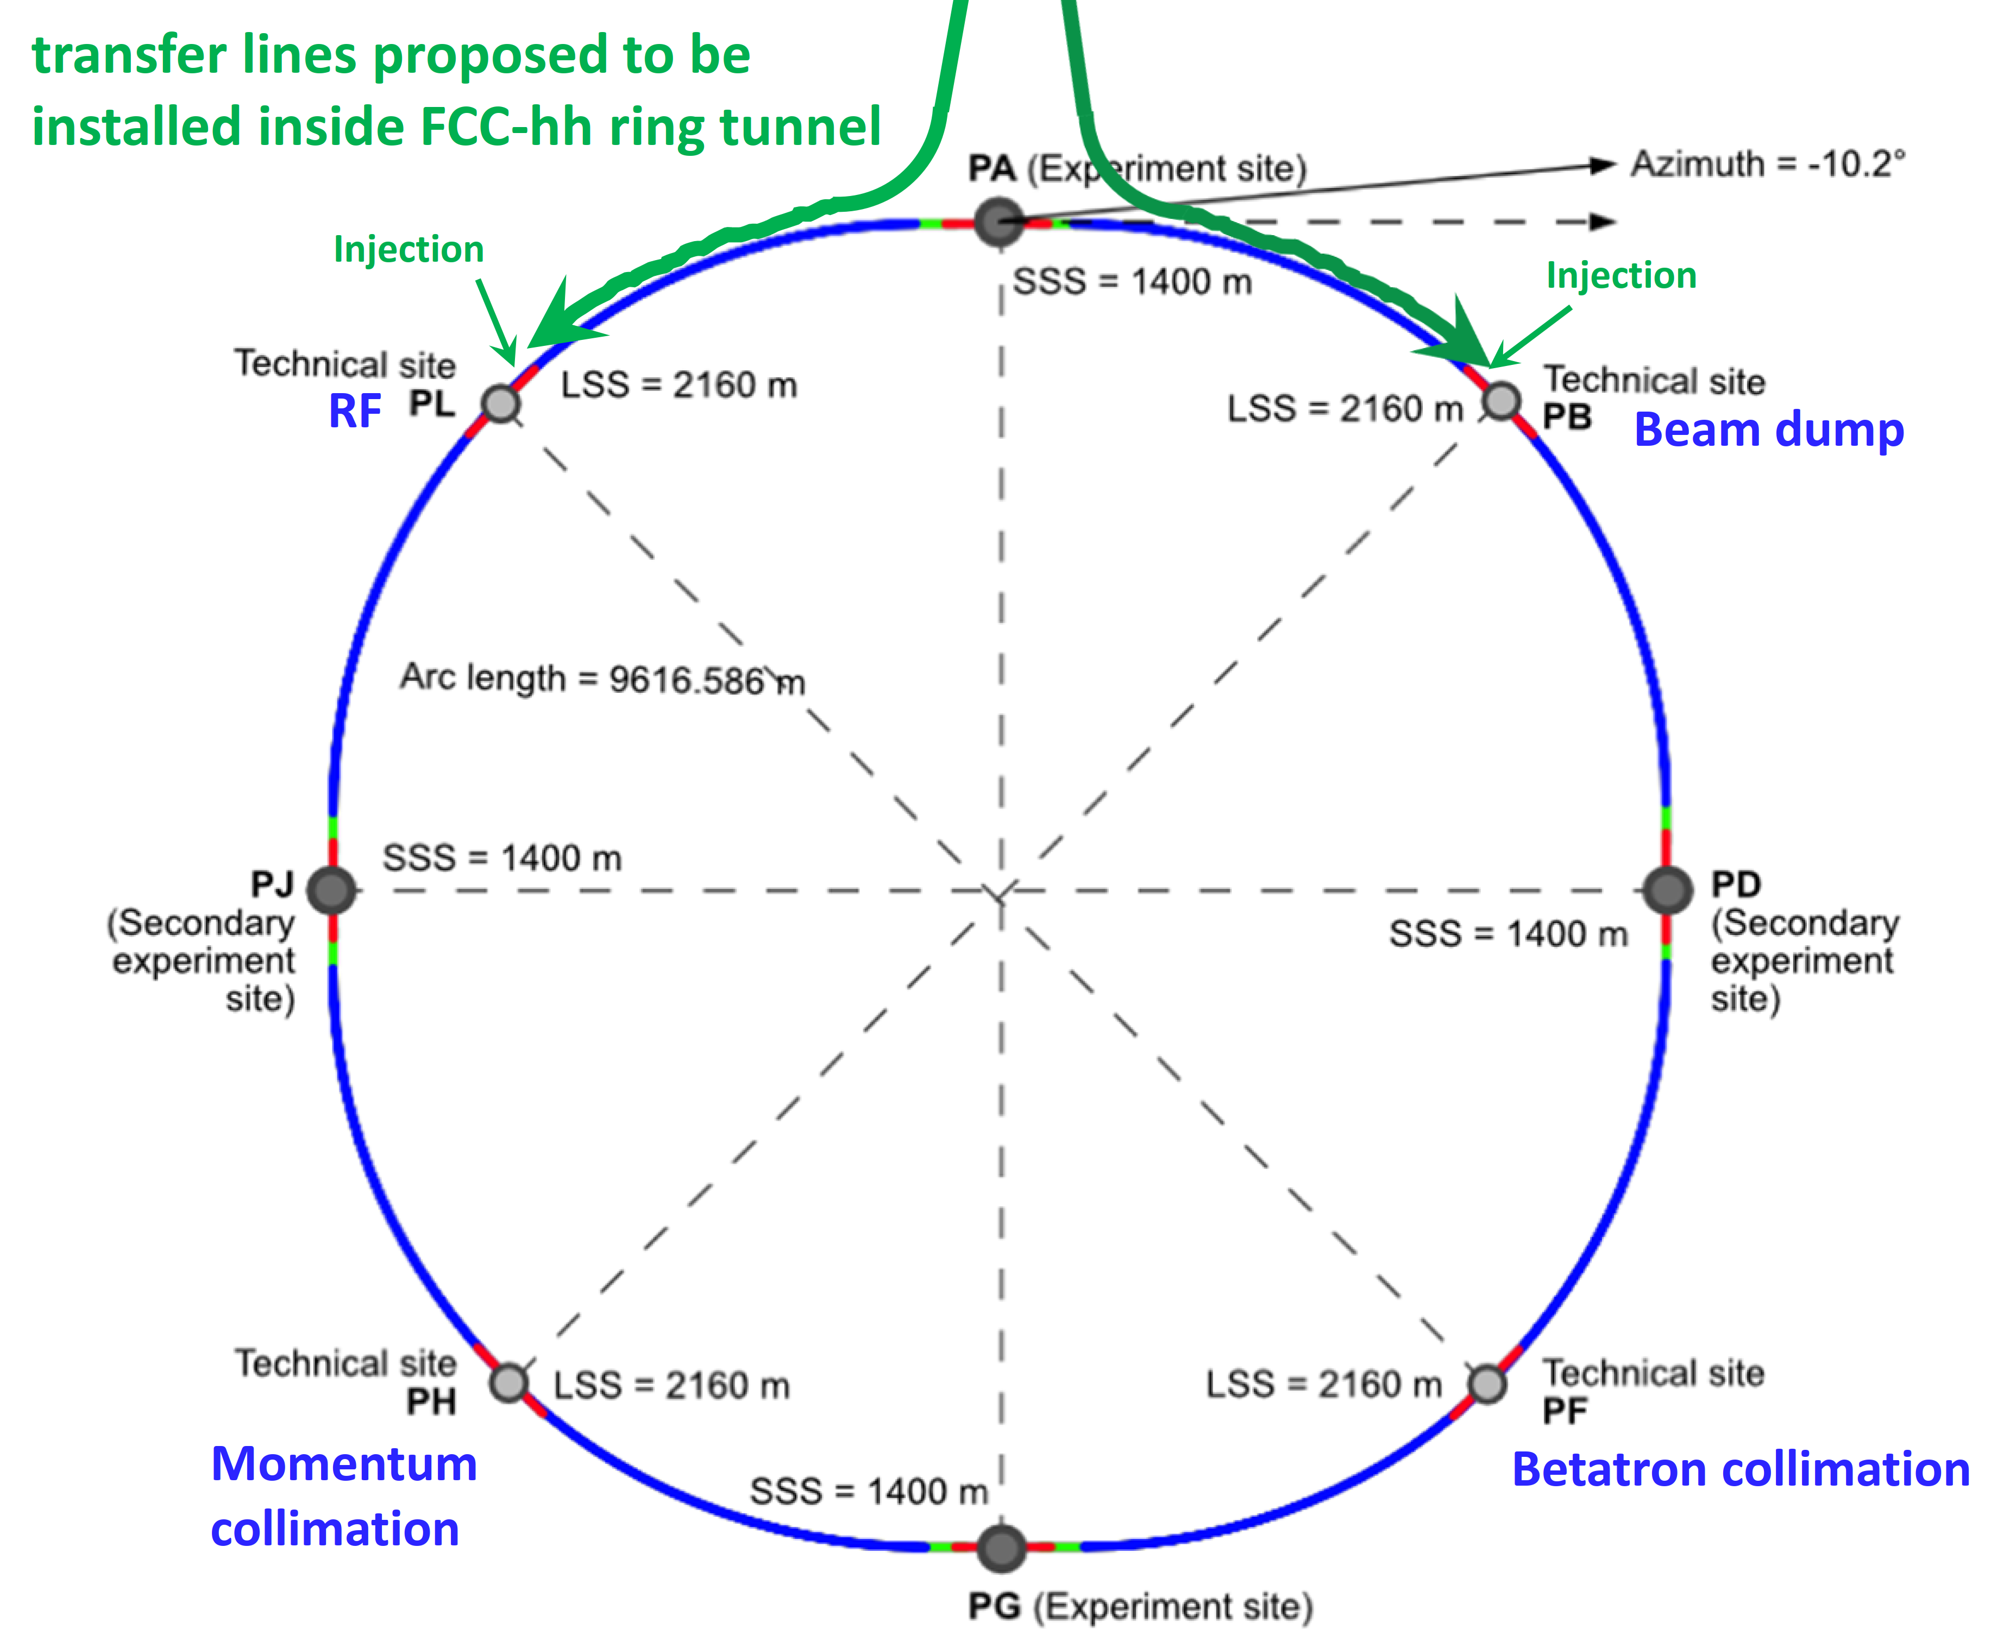
The FCC integrated program
common civil engineering and technical infrastructures, reusing CERN’s infrastructure
FCC integrated project allows seamless continuation of HEP after completion of the HL-LHC
comprehensive long-term program maximizing physics opportunities
stage 1: FCC-ee (Z, W, H, $\text{t}\overline{\text{t}}$) as Higgs, EW & top factory at highest luminosities
stage 2: FCC-hh (~100 TeV) natural continuation at energy frontier (ion and eh options)
FCC-ee
FCC-hh
2020 - 2040
2045 - 2060
2070 - 2090

Slide 8
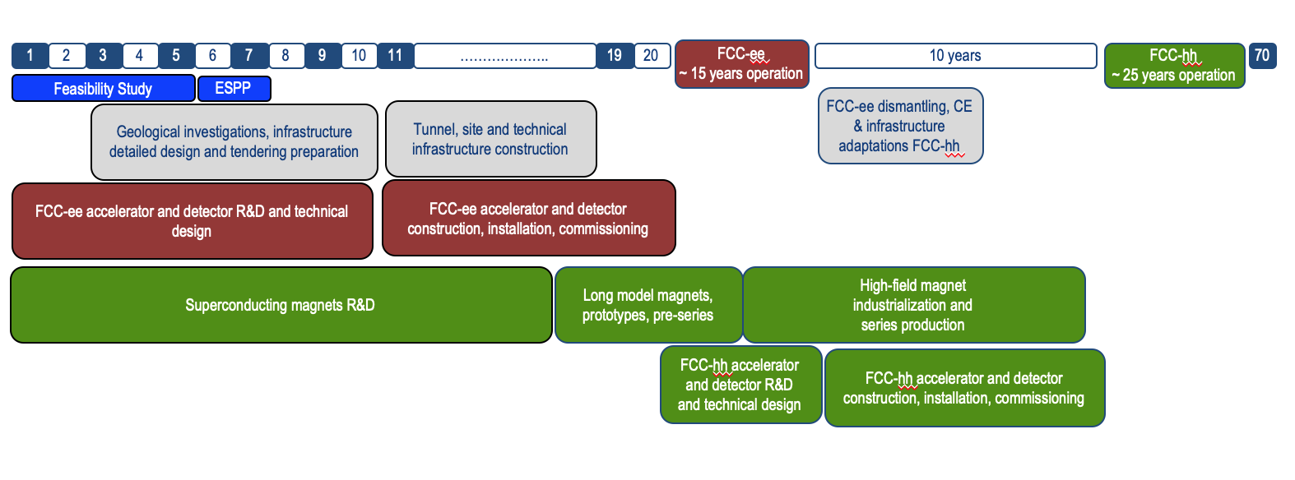
Timeline of the FCC integrated programme
Technical
schedule

Slide 9
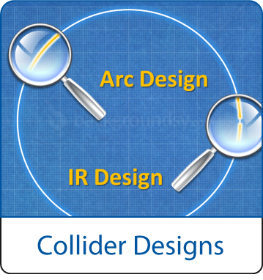
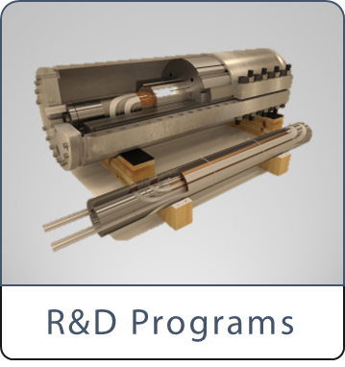
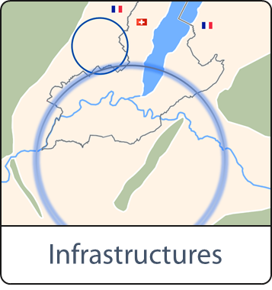
FCC Study : Accelerator /Infrastructure
FCC-hh: 100 TeV pp collider as long-term goal → defines infrastructure needs
FCC-ee: e⁺e⁻ collider, potential intermediate step
FCC-he: integration aspects of pe collisions
Push key technologies in dedicated R&D programmes e.g.
16 Tesla magnets for 100 TeV pp in 100 km
SRF technologies and RF power sources
Tunnel infrastructure in Geneva area, linked to CERN accelerator complex
Site-specific, requested by European strategy

Slide 10
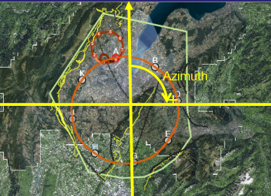
FCC implementation - footprint baseline
Present implementation variant established considering:
Geological 3D model and tunnelling risks
Territorial aspects from previous studies, also with Host States
No site visits, no interactions with land yet
91.2 km circumference
95% in molasse geology (minimize tunnel construction risks)
8 surface sites with ~5 ha area each.

Slide 11
FCC-ee collider parameters with 2 IPs
Parameter [4 IPs, 91.2 km,T_{rev}=0.3 ms] | Z | WW | H (ZH) | ttbar
beam energy [GeV] | 45 | 80 | 120 | 182.5
beam current [mA] | 1280 | 135 | 26.7 | 5.0
number bunches/beam | 12000 | 880 | 272 | 40
bunch intensity [10¹¹] | 2.02 | 2.91 | 1.86 | 2.37
SR energy loss / turn [GeV] | 0.0391 | 0.37 | 1.869 | 10.0
total RF voltage 400/800 MHz [GV] | 0.120/0 | 1.0/0 | 2.48/0 | 4.0/7.67
long. damping time [turns] | 1170 | 216 | 64.5 | 18.5
horizontal beta* [m] | 0.1 | 0.2 | 0.3 | 1
vertical beta* [mm] | 0.8 | 1 | 1 | 1.6
horizontal geometric emittance [nm] | 0.71 | 2.17 | 0.64 | 1.49
vertical geom. emittance [pm] | 1.42 | 4.32 | 1.29 | 2.98
horizontal rms IP spot size [μm] | 8 | 21 | 14 | 39
vertical rms IP spot size [nm] | 34 | 66 | 36 | 69
beam-beam parameter ξ_{x} / ξ_{y} | 0.003/ .159 | 0.011/0.111 | 0.0187/0.129 | 0.096/0.138
rms bunch length with SR / BS [mm] | 4.38 / 12.1 | 3.55 / 7.06 | 3.34 / 5.12 | 2.02 / 2.56
luminosity per IP [10³⁴ cm⁻²s⁻¹] | 193 | 22 | 7.7 | 1.31
total integrated luminosity / year [ab⁻¹/yr] | 46 | 5.3 | 1.9 | 0.33
beam lifetime rad Bhabha / BS [min] | 35 | 32 | 9 | 16
K. Oide, D. Shatilov,
preliminary – example parameters
for present layout & with 4 IPs

Slide 12
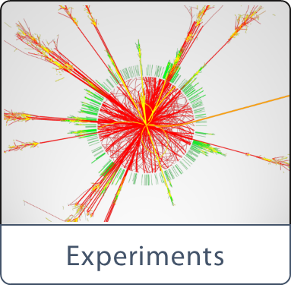
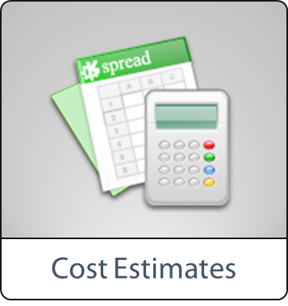
FCC scope : Physics and Experiment
- Physics opportunities
- Discovery potentials
Experiment concepts for hh, ee and he
Machine Detector Interface studies
Concepts for worldwide data services
Overall cost model
Cost scenarios for collider options
Including infrastructure and injectors
Implementation and governance models

Slide 13
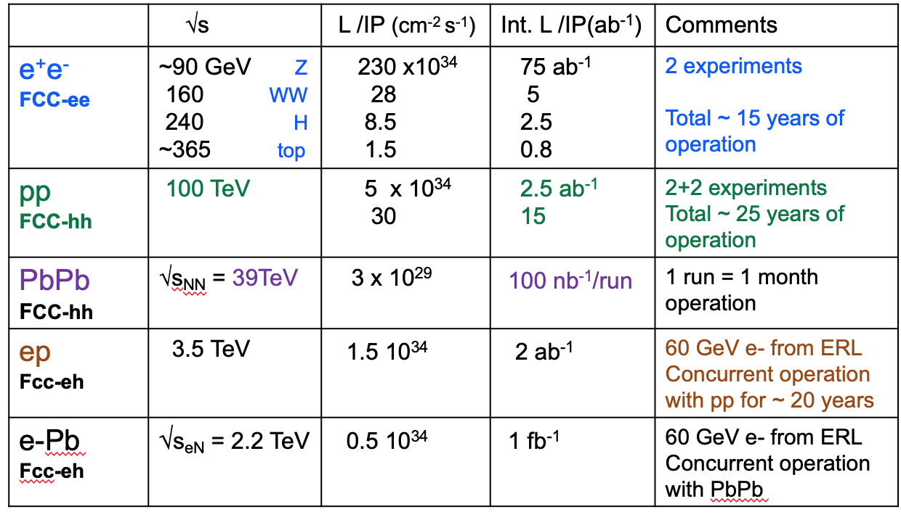
Timeline of the FCC integrated programme
2-4 experiments
20-30

Slide 14
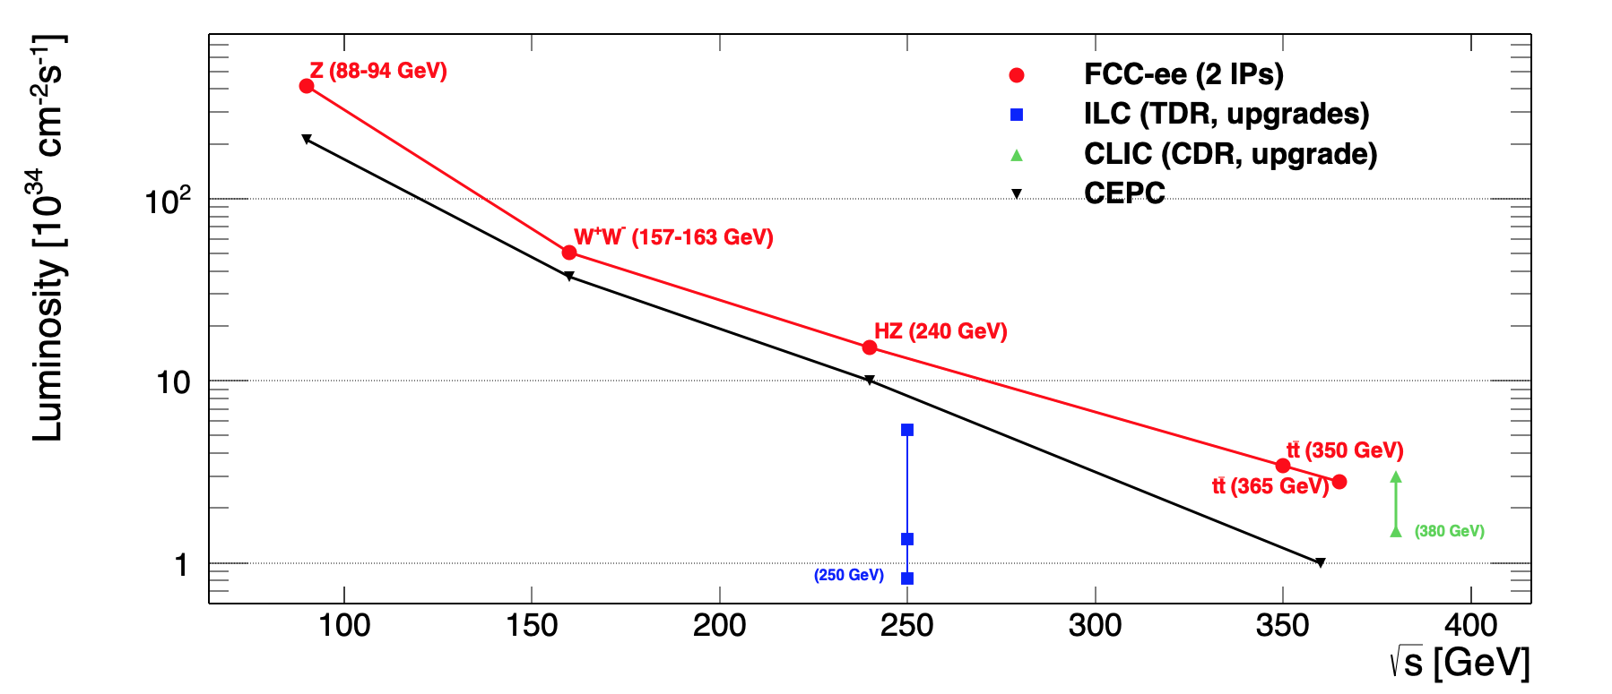
FCC-ee Particle production
High integrated luminosity at the needed Ecm
Clean environment
Precise knowledge of the center-of-mass energy and of the luminosity
Z factory:
LEP x 2.10⁵
ILC x 10³
Total
√s errors
Notes:
4IP increases Total Lumi by 1.7
-- 2IP assumed in all numbers below
-- order and duration of Z/WW/ZH
can be decided at a later stage
-- ee→ H must be after both Z and ZH
and before tt

Slide 15
What can FC-ee do?
EXPLORE the 10-100 TeV energy scale region with precision measurements of the properties of the Z, W, Higgs and top particles
20-50 fold improved precision on EWK observables
10 fold more precise and model-independent Higgs coupling measurements
DISCOVER that the Standard Model does not fit
Allows understanding of the underlying physics structure
DISCOVER a violation of flavour conservation/universality
Flavour physics in 10¹² bb events (B₀ → K*⁰τ+τ− , B_{S}→ τ+τ− , …)
DISCOVER dark matter as invisible decays of the Z or Higgs
DISCOVER feebly coupled particles in the 5-100 GeV mass range
Such as right handed neutrinos, dark photons, …

Slide 16
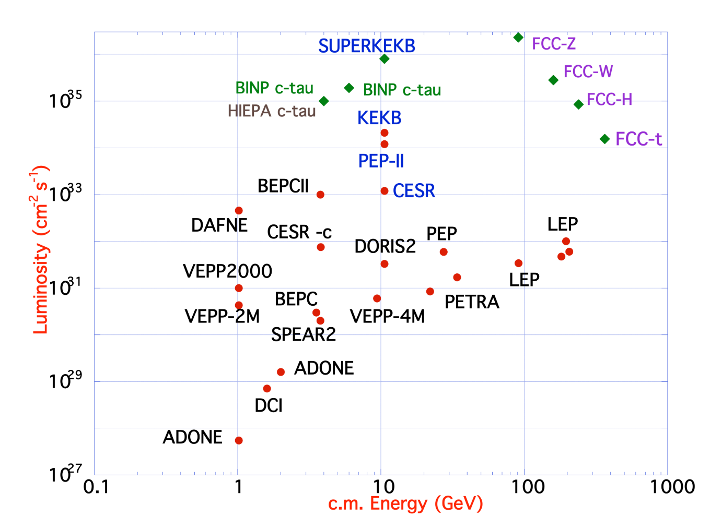
FCC-ee design concept
B-factories: KEKB & PEP-II:
double-ring lepton colliders,
high beam currents,
top-up injection
DAFNE: crab waist, double ring
S-KEKB: low β_{y}*, crab waist
LEP: high energy, SR effects
VEPP-4M, LEP: precision E calibration
KEKB: e⁺ source
HERA, LEP, RHIC: spin gymnastics
Marica Biagini
Marica Biagini
combining successful ingredients of several recent colliders → highest luminosities & energies

Slide 17
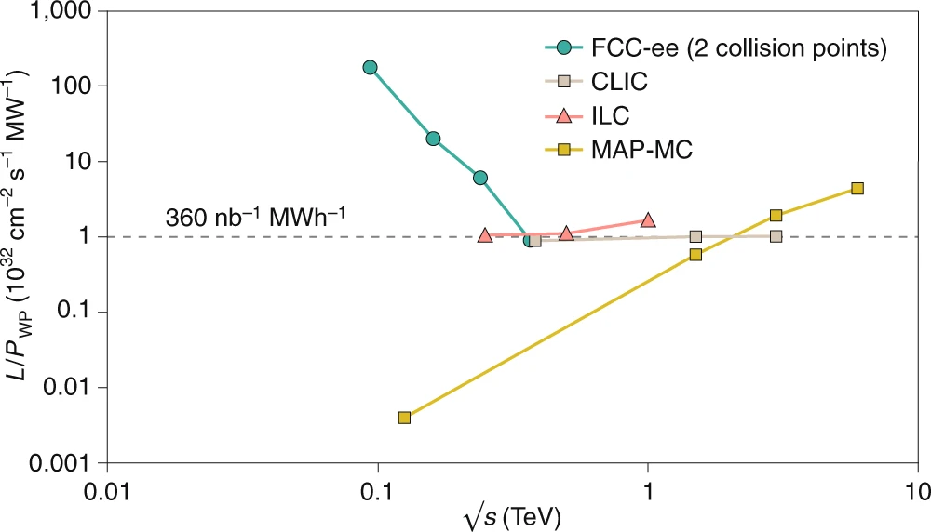
FCC-ee figures of merit
Luminosity vs. costs
Luminosity vs. electricity consumption
With 5 ab⁻¹ accumulated over 3 years and 10⁶ H produced, the total investment cost (~10 BCHF) corresponds to → 10 kCHF per produced Higgs boson
With 150 ab⁻¹ accumulated over 4 years and 5x10¹² Z produced (two IPs), the total investment cost corresponds to → 10 kCHF per 5×10⁶ Z bosons , almost 2x better still with four IPs
= Nr of Z bosons collected by each experiment during the entire LEP programme !
Thanks to twin-aperture magnets, thin-film SRF, efficient RF power sources, top-up injection
Capital cost per luminosity dramatically decreased compared with LEP !
Highest lumi/power of all proposals
Electricity cost ~200 CHF per Higgs boson
M. Benedikt, A. Blondel, P. Janot, et al., Nature Physics 16, 402-407 (2020), and European Strategy for Particle Physics Preparatory Group, Physics Briefing Book (CERN, 2019)

Slide 18
FCC-ee Physics Programme
2
precise acceptances
High efficiency
energy resol.
particle ID
particle flow
Higgs
mHiggs, ΓHiggs
Higgs couplings
self-coupling
detector hermeticity
tracking, calorimetry
time-of-flight
1
"intensity
frontier”
FCC-ee
direct searches
of light new physics
𝜈
flavour factory
(10¹² bb/cc; 1.7x10¹¹ 𝜏𝜏)
3
Axion-like particles, dark photons,
Heavy Neutral Leptons
long lifetimes - LLPs
Top
Momentum resol.
tracker
Ecal granularity
vertexing, tagging
energy resolution
hadron identification
mtop, Γtop
EW top couplings
𝜏 physics
B physics
𝜏-based EWPOs
lept. univ. violation tests
detector req.
Flavour EWPOs (R_{b}, A_{FB}^{b,c})
CKM matrix,
CP violation in neutral B mesons
Flavour anomalies in, e.g., b ➝ s𝜏𝜏

Slide 19
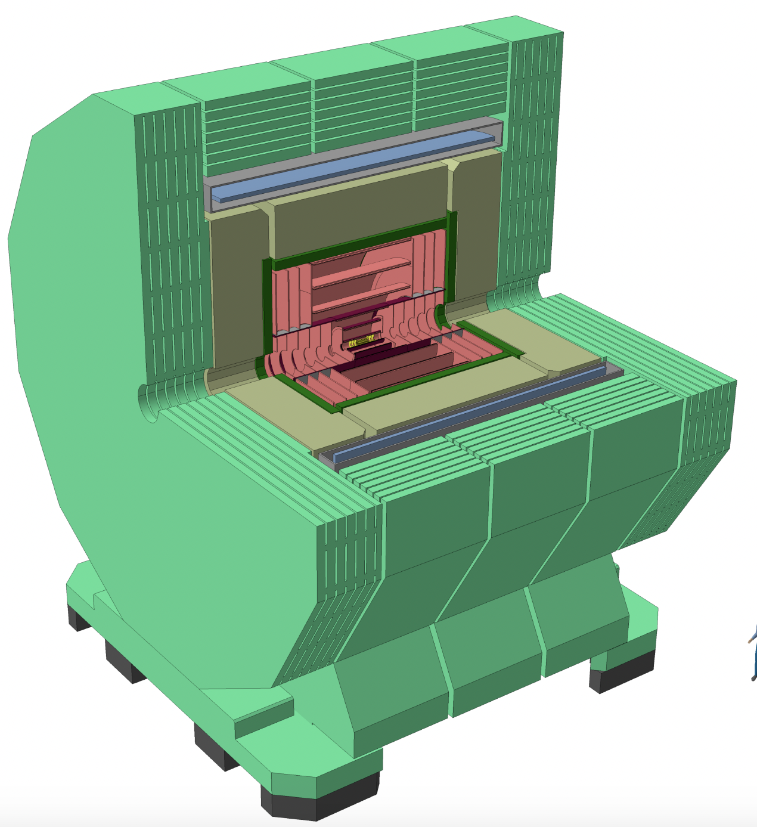
Detector concepts:
IDEA(baseline) consists of:
A silicon pixel vertex detector.
A large-volume extremely-light drift wire chamber.
A layer of silicon micro-strip detectors
A thin low-mass superconducting solenoid coil (optimized at 2 T) to maximize luminosity.
A preshower detector.
A dual read-out calorimeter.
Muon chambers inside the magnet return yoke.
CLD (baseline) consists of:
A silicon pixel vertex detector.
A silicon tracker.
A 3D-imaging, highly granular calorimeter system (a silicon-tungsten ECAL and a scintillator-steel HCAL)
A superconducting solenoid
Muon chambers interleaved with a steel return yok.

Slide 20
Detector concepts:

Slide 21
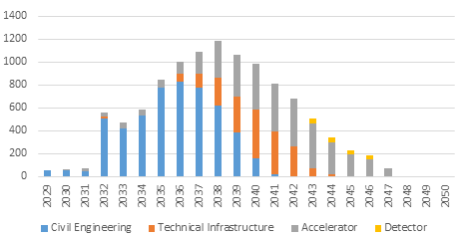
FCC stage 1: cost estimate spending profile
Construction cost estimate for FCC-ee
Machine configurations for Z, W, H working points included
Baseline configuration with 2 detectors
CERN contribution to 2 experiments incl.
Spending profile for FCC-ee
CE construction 2032 - 2040
Technical infrastructure 2037 - 2043
Accelerator and experiment 2032 – 2045
Commissioning and operation start 2045 -2048.
cost category | [MCHF] | %
civil engineering | 5.400 | 50
technical infrastructure | 2.000 | 18
accelerator | 3.300 | 30
detector | 200 | 2
total cost (2018 prices) | 10.900 | 100

Slide 22
FCC-hh: parameters
parameter | FCC-hh |  | LHC | HL LHC
c.m. energy [TeV] | 100 |  | 14
dipole field [T] | 16 |  | 8.3
# interaction points (IPs) | 2 main & 2 |  | 2 main & 2
bunch intensity [10¹¹] | 1 | 1 (0.2) | 1.1 | 2.2
bunch spacing [ns] | 25 | 25 (5) | 25 | 25
luminosity/IP [10³⁴ cm⁻²s⁻¹] | 5 | 20 | 1 | 5
events/bunch crossing | 170 | 680 (136) | 27 | 135
stored energy/beam [GJ] | 8.4 |  | 0.36 | 0.7
synchr. rad. [W/m/aperture] | 30 |  | 0.2 | 0.35

Slide 23
FCC: some design challenge
stored beam energy: 8 GJ/beam (0.4 GJ LHC) = 16 GJ total
➔ equivalent to an Airbus A380 (560 t) at full speed (850 km/h)
collimation, beam loss control, radiation effects: important
injection/dumping/beam transfer: critical operations
magnet/machine protection: to be considered early on

Slide 24
Key challenges for FCC-hh
high energy
high field superconducting magnets
large tunnel infrastructures
high luminosity
beam optics
beam current
synchrotron radiation impacting SC magnets
IR shielding and component lifetime
high stored beam energy
machine protection
beam handling
beam injection and beam dumping

Slide 25
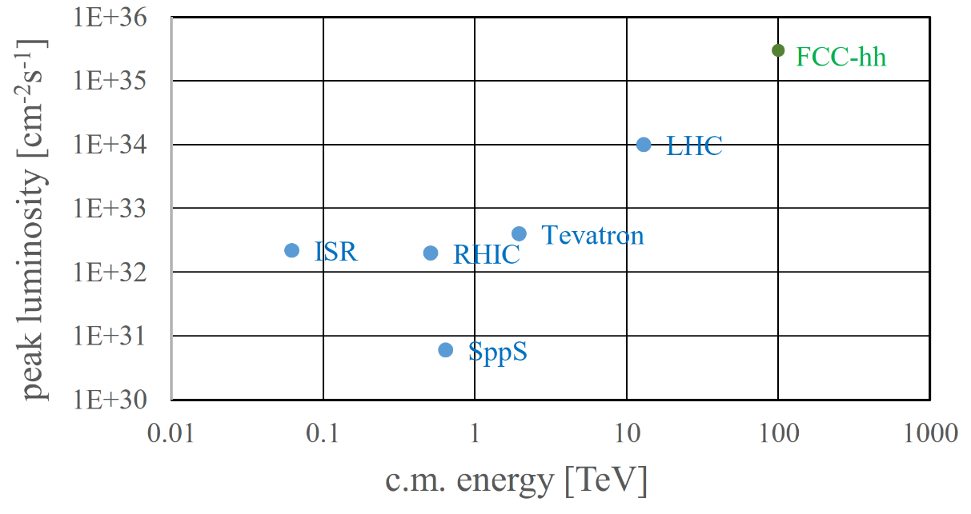
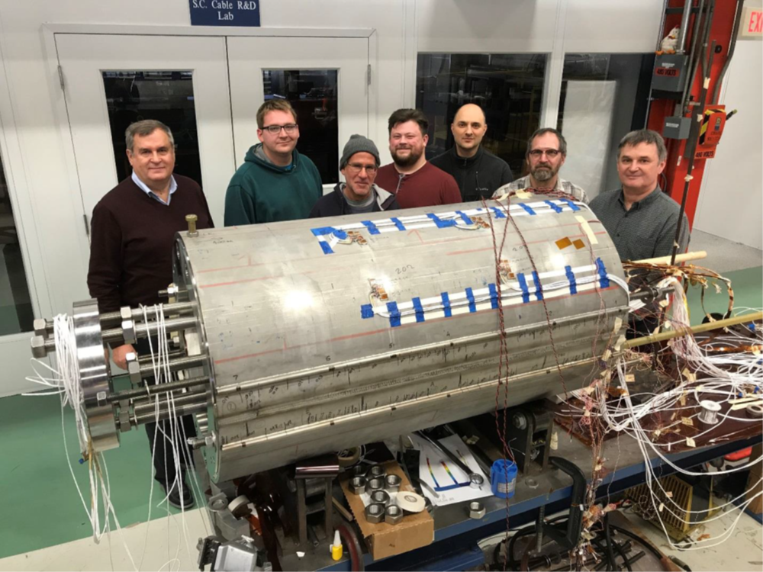
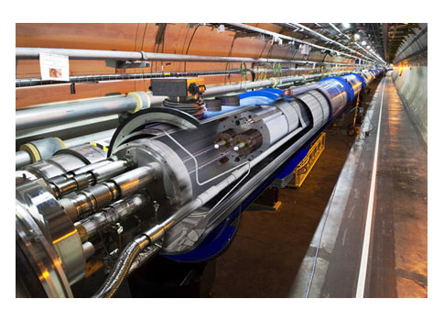
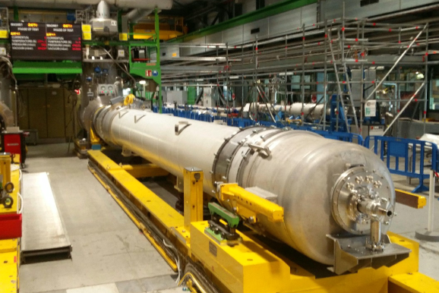
FCC-hh: highest collision energies
order of magnitude performance increase in both energy & luminosity
100 TeV cm collision energy
20 ab-1 per experiment collected over 25 years of operation (vs 3 ab⁻¹ for LHC)
similar performance increase as from Tevatron to LHC
key technology: high-field magnets
from
LHC technology
8.3 T NbTi dipole
via
HL-LHC technology
12 T Nb₃Sn quadrupole
FNAL dipole demonstrator
4-layer cosϑ
14.5 T Nb₃Sn in 2019

Slide 26
Conclusions
The European Strategy Update 2019/20 issued the request for a feasibility study of the FCC integrated programme to be delivered by end 2025.
FCC Feasibility Study: concrete local/regional implementation scenario in collaboration with host state authorities, accompanied by machine optimization, physics studies and technology R&D, performed via global collaboration and supported by EC H2020 Design Study FCCIS, in parallel High Field Magnet R&D program as separate line, to prepare for FCC-hh.
Long term goal: world-leading HEP infrastructure for 21st century to push the particle-physics precision and energy frontiers far beyond present limits.
FCC success relies on strong global (& Italian !) participation

Slide 27
FCC upcoming events
ICFA Advanced Beam Dynamics Workshop on High Luminosity Circular e⁺e⁻ Colliders (eeFACT2022), Frascati 12-15 Sep 2022
https://agenda.infn.it/event/21199/
FCC Week Paris 30 May to 3 June 2022
ECLOUD’22 and the GWDVac’22 workshops,
La Biodola Bay, Isola d'Elba,
25 September 2022 to 1 October 2022,
https://agenda.infn.it/event/28336/
https://indico.cern.ch/event/1064327/

Slide 28
Backup

Slide 29
FCC-ee basic design choices
Double ring e+e- collider
Common footprint with FCC-hh, except around IPs
Asymmetric IR layout and optics to limit synchrotron radiation towards the detector
Perfect 4-fold superperiodicity allowing 2 or 4 IPs; large horizontal crossing angle 30 mrad, crab-waist collision optics
Synchrotron radiation power 50 MW/beam at all beam energies
Top-up injection scheme for high luminosity Requires booster synchrotron in collider tunnel

Slide 30
FCC Feasibility Study (2021-205): objectives
Geological, technical, environmental, administrative feasibility of tunnel and surface areas;optimisation of placement and layout of the ring and related infrastructure;
Administrative processes for a potential project approval (identify/remove showstopper);
Optimisation of the colliders design and their injector chains
Sustainable operational model for colliders and experiments in terms of human and financial resource needs, as well as environmental aspects and energy efficiency;
Consolidated cost estimate, as well as funding and organisational models needed to enable the project completion, implementation and operation;
Resources from outside CERN’s budget tunnel and FCC-ee
Physics case and detector concepts for both colliders.
Total CERN funding for the Feasibility Study 2021 - 2025:
100 MCHF material & personnel

Slide 31
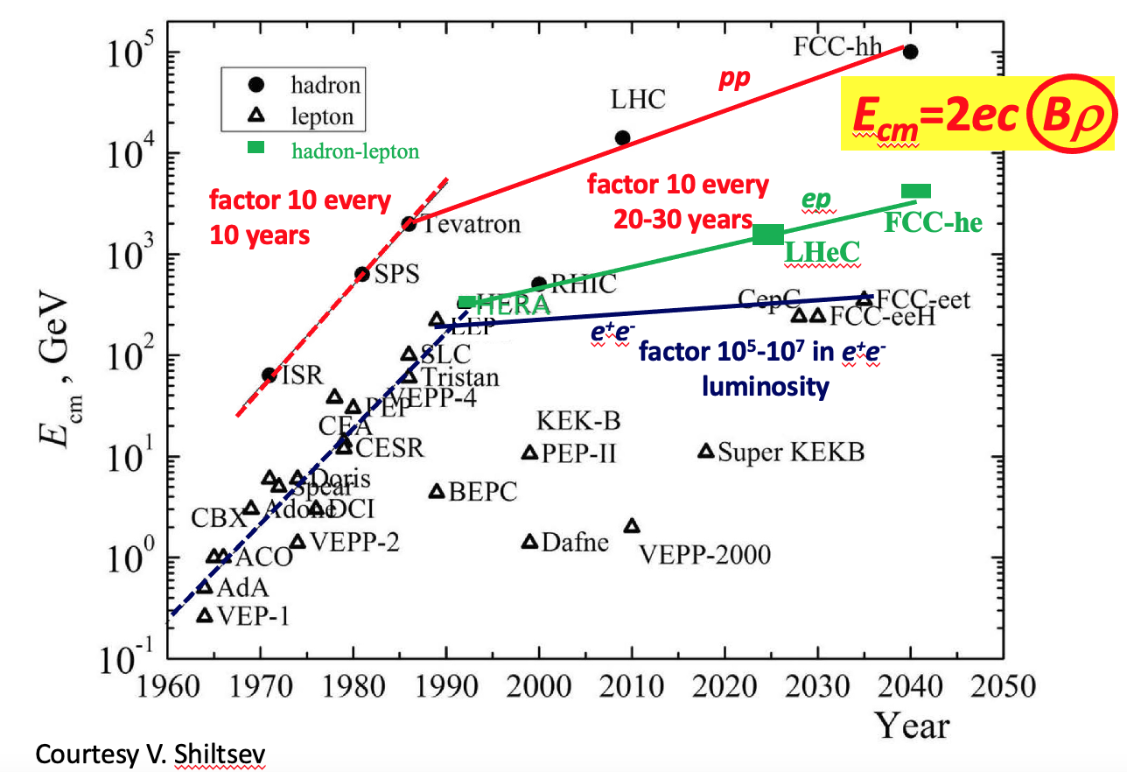
Collider cm Energy vs year

Slide 32
The FCC Feasibility Study
Design new detector concepts to realise the physics potential of the FCC-ee
both in term of precision and sensitivity
Focus on benchmark studies
that represent the physics goals and allow to extract the detector requirements
Need to develop simulation and analysis tools to get this done
CASE STUDIES: reverse engineering of analysis

Slide 33
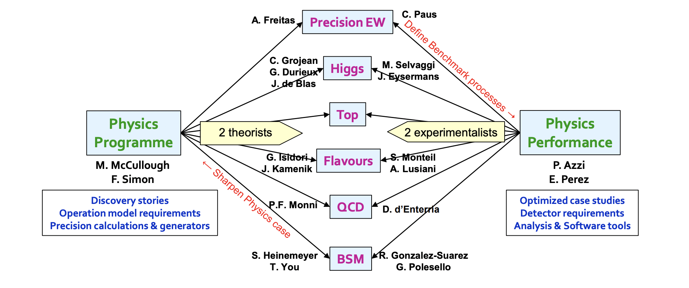
Interplay of activities
Full integration between Phys.Programme and Phys. Performance
In RD-FCC this is already the case in Working Package 1: “Physics & Simulation”
Notes:
Here point out several Italians involved

Slide 34
Interplay of activities
Physics Programme: proposes physics benchmarks
Detector Concepts: explores new technologies
Physics Performance: connects the two by means of “case studies”
To optimise the ultimate statistical sensitivity
To identify and evaluate the limiting systematic uncertainties
To establish detector requirements and pass them on to the Detector Concept
Notes:
To establish detector requirements to match systematic uncertainties with statistical precision and pass them on to the Detector Concept WP

Slide 35
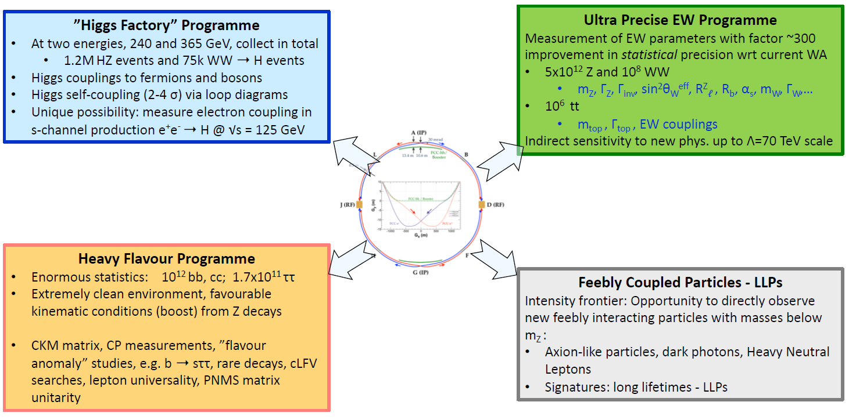
FCC-ee Physics programme
& QCD

Slide 36
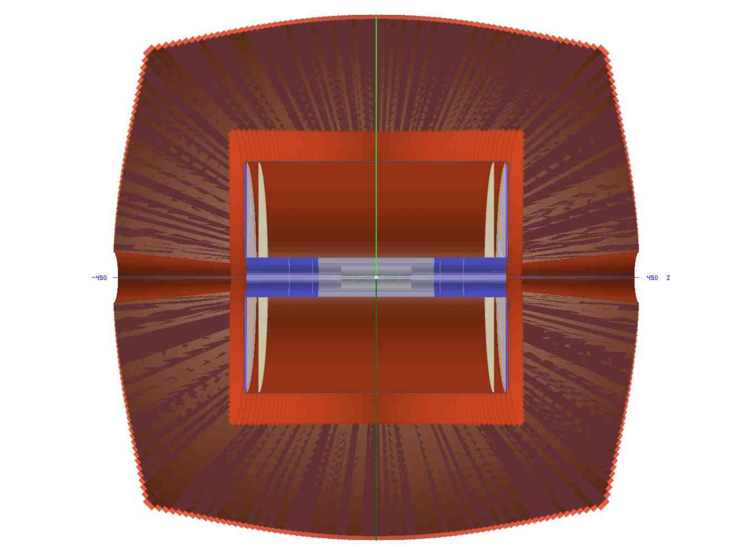
Full Simulation of IDEA
BARI,LECCE, FERRARA,PAVIA, TORINO+CERN, SUSSEX
Calo-hits
DC-hits
Description of the full detector response at the hit level for:
Reconstruction algorithms development
physics performance studies
TestBeam data comparison for validation
Visualization of IDEA geometry in GEANT
Vertex, Drift Chamber and DR Calorimeter

Slide 37
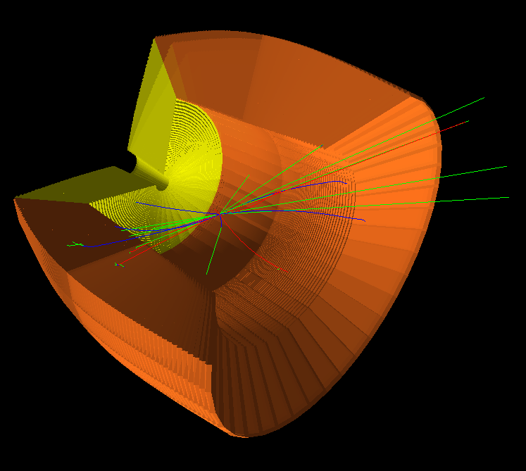
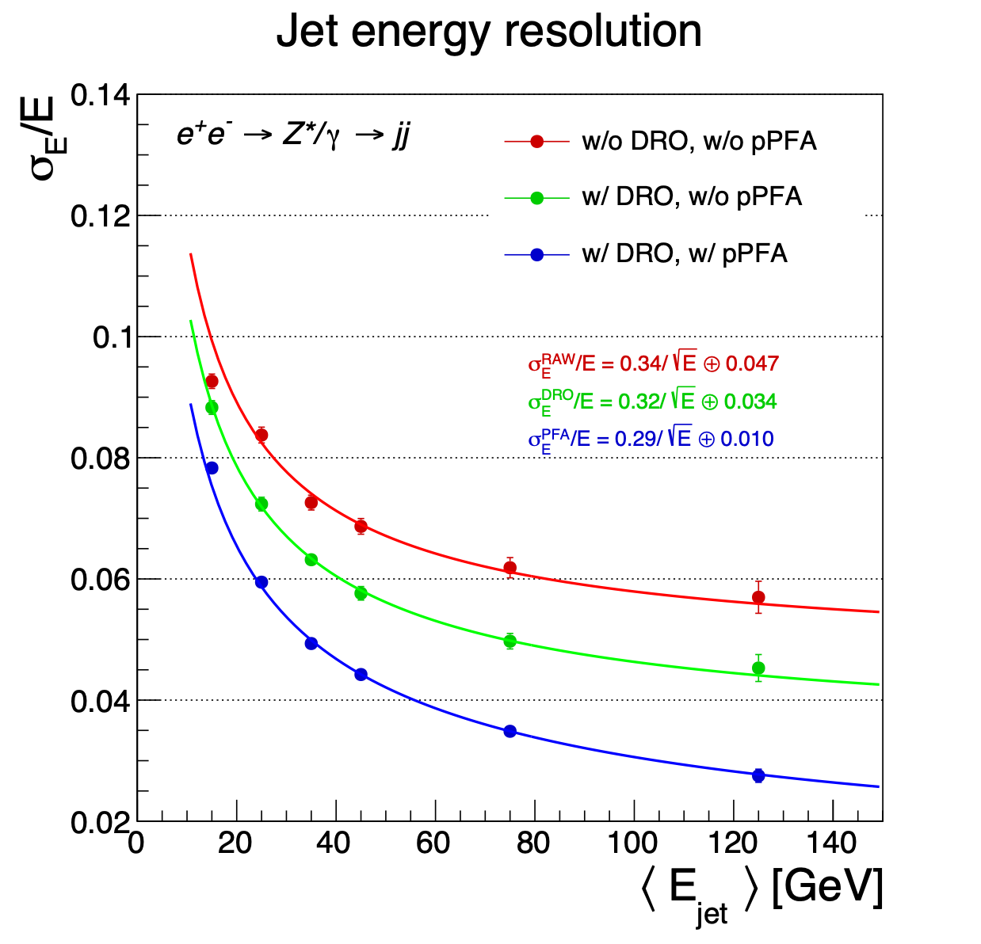
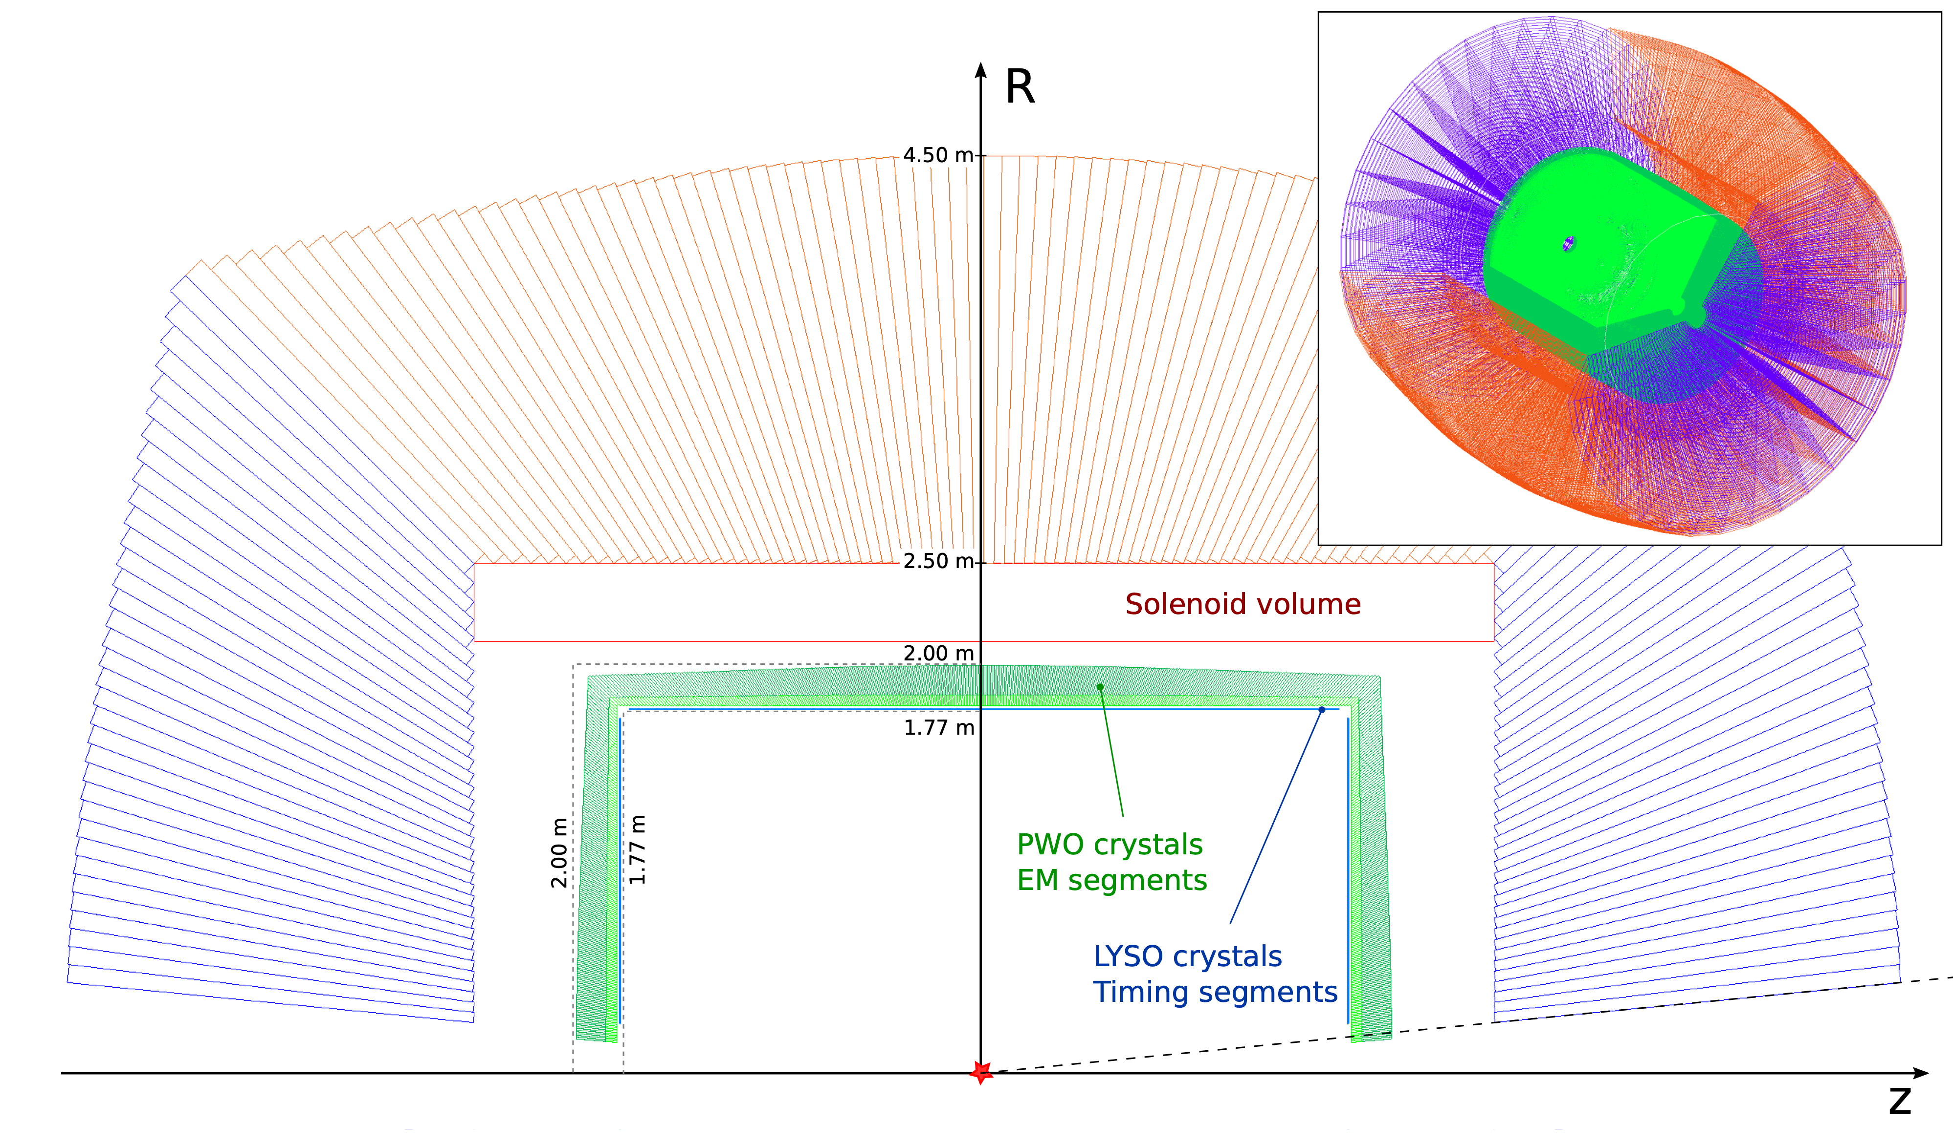
Exploring calorimetry options
MIB,PAVIA+SUSSEX
GEANT4 - Qt visualizer - IDEA / $e^{+}e^{−}→jj$
Full simulations describing different configurations including response of the electronic
Develop and test new reco algorithms
Reach desired 3-4% resolution for jets >50 GeV with crystal+PF
DR+Crystal option

Slide 38
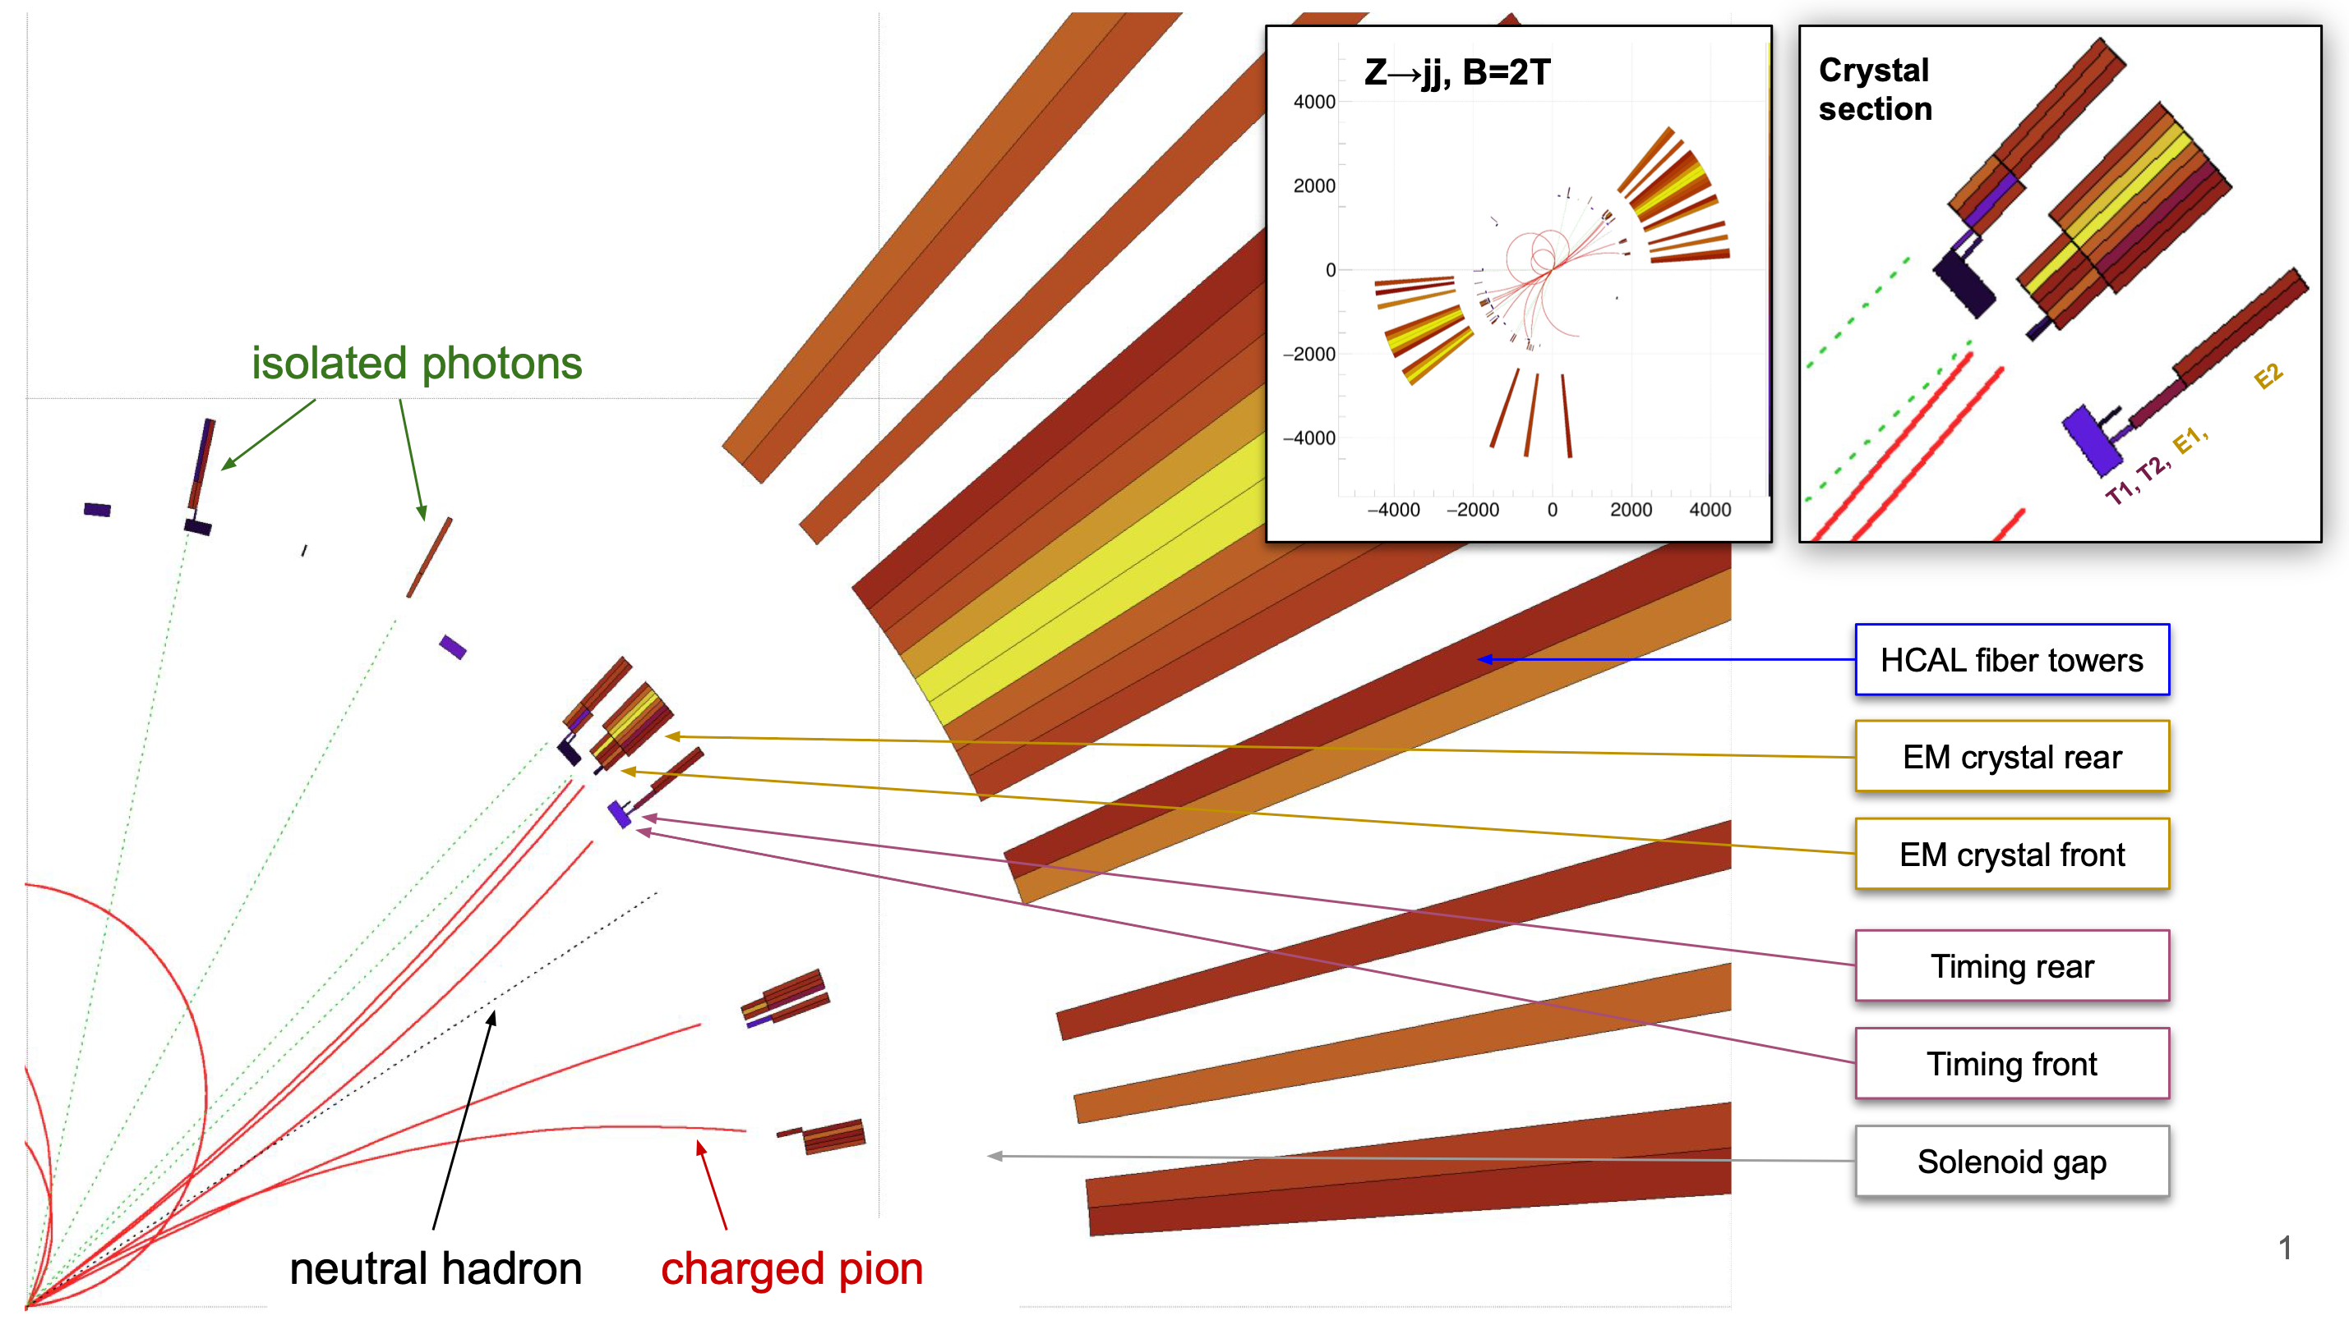
On the way to ParticleFlow reconstruction…
ROMA3,PADOVA,PAVIA,ROMA1+CERN,SUSSEX
1) Hits around crystal neutral seeds are clustered as photon hits and are not associated to tracks.
Crystal section is crucial in 1) ↑
2) Calorimeter hits are associated to tracks based on their track-distance. If the sum of the energy associated to a track is within $1σ$ from the expected energy the calorimeter hits are replaced with the track momentum.
Slide from L. Pezzotti

