Slide 1
Charge Injection and External Capacitor
Rui Qiao; Wenxi Peng; Ke Gong

Slide 2
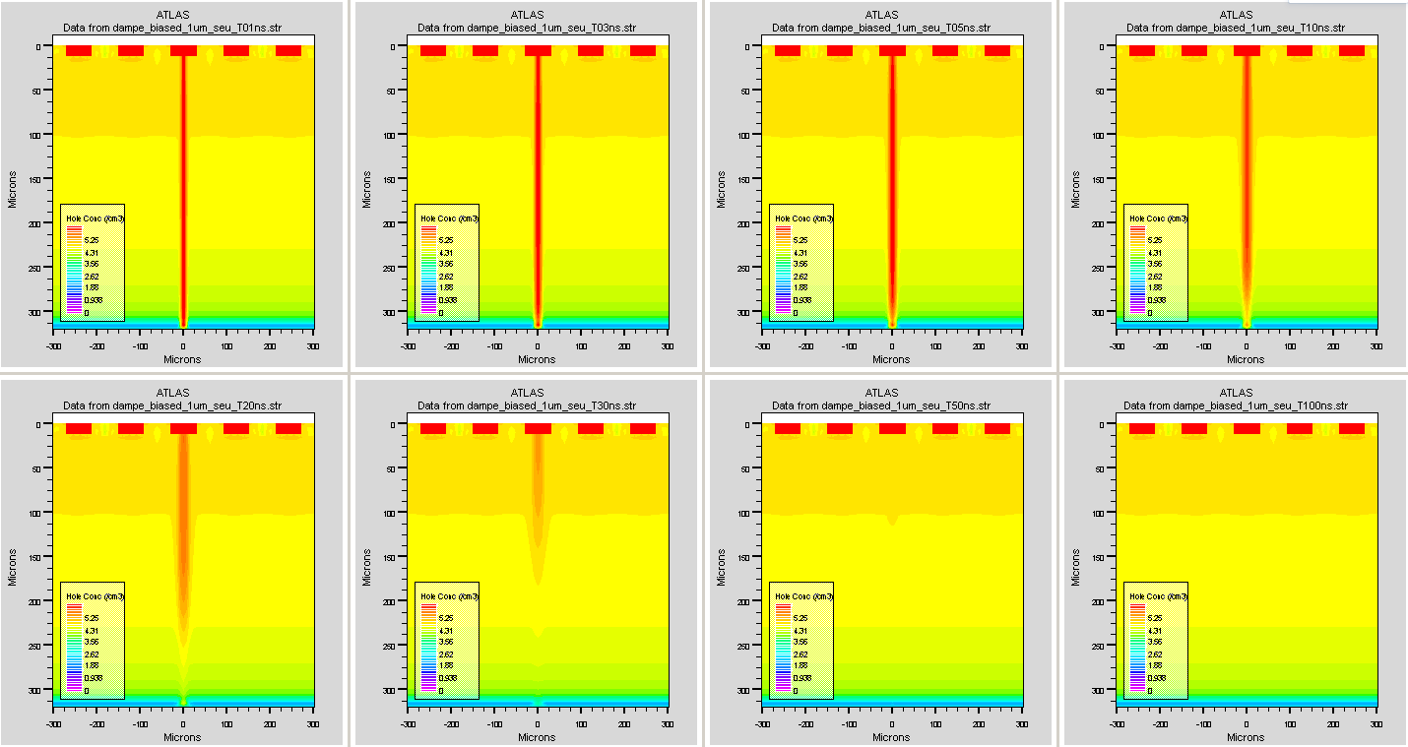
Background: Charge injection in TCAD
1ns
3ns
5ns
10ns
20ns
30ns
50ns
100ns
Notes:
来源：G:\keyan\科研任务\211212_硅微条模拟\MyTCAD\220124——DAMPE 5个注入条的单粒子\

Slide 3
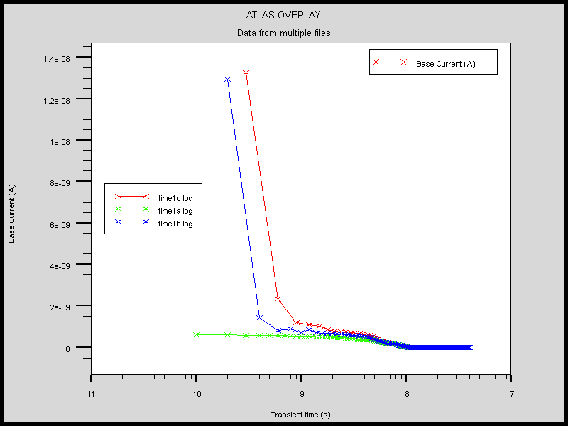
The time step problem
A small time step is important to get accurate result!
A large time step may save CPU time, but the result is wrong.
Large
time
step
Small
time
step
Transient current of charge injection in PN detector

Slide 4
The transient current
Negative current due to charge release through bias resistor
Neighbor
channel
Current (A)
The pre-amplifier integrate the transient current in short period.
In a long period, the charge is release.
Hit channel
Log Transient time (s)

Slide 5
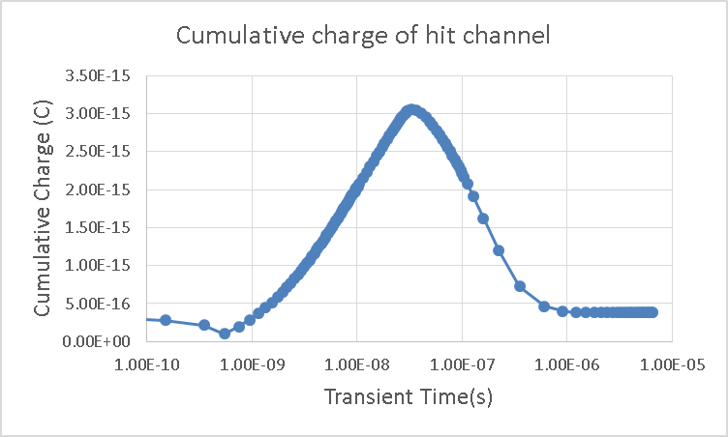
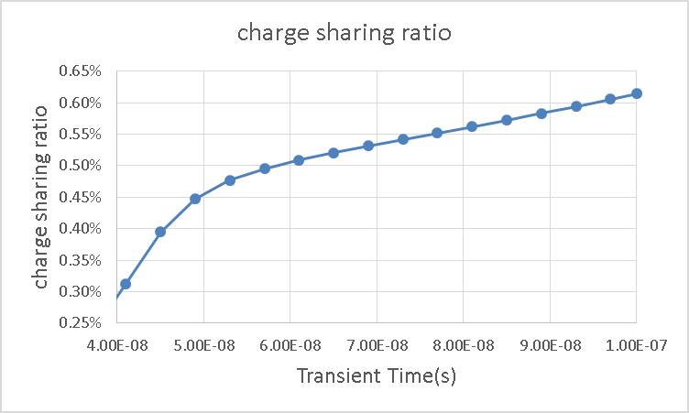
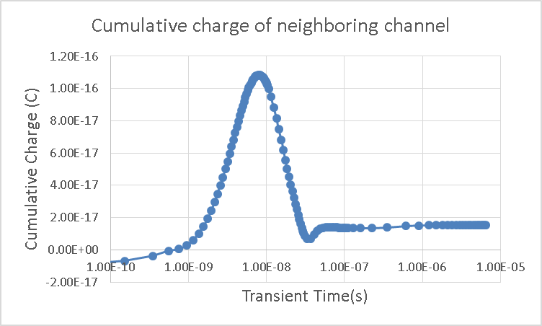
The cumulative charge
Charge
accumulation
Charge
release
$$\frac{Q_{hit}}{Q_{neighboring}}$$
Inorbit
Alberto
SPICE

Slide 6
The external capacitor
AMS-02 use external capacitors of 760 pF for one ladder. If 10 sensor in one ladder, each sensor has equivalent 76 pF external capacitor, which is comparable to the interstrip capacitance 20pF.
The small external capacitor block the transient current from going into ASIC, leading to a stronger charge sharing.
TCAD can implement contact capacitor to electrodes.

Slide 7
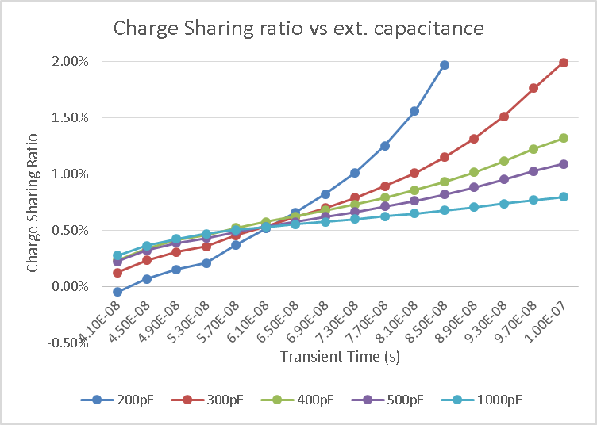
Charge sharing ratio vs ext. capacitor
For long time period (>60ns), a smaller external capacitor increase the charge sharing ratio.
For short time period(<60ns), a smaller external capacitor decrease the charge sharing ratio.
200pF
1000pF

Slide 8
Conclusion
The cumulative charge will slowly release due to the bias resistor. The ASIC should not be sensitive to this slow components (test).
The charge sharing ratio from 40~60ns ranges from 0.28% ~ 0.5%, which match previous calculation.
The external capacitor affects the charge sharing ratio. Need spice to verify.

