Slide 1
How do we explain the UHECR dipole anisotropy?
UHECR : where they come from?
14 September 2022-Naples
D.Fargion,
P.G.Desanctis Lucentini,
M.khlopov
arXiv:submit/2269349 , 21 May 2018, PoS

Slide 2
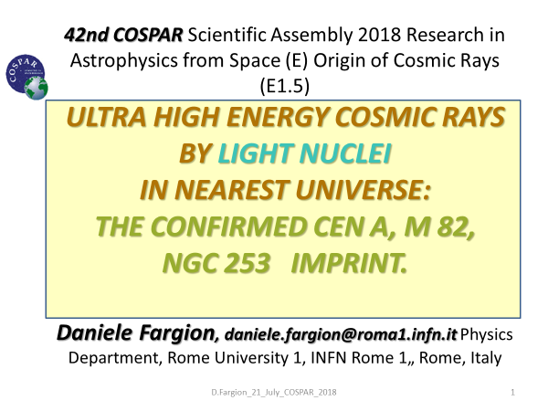
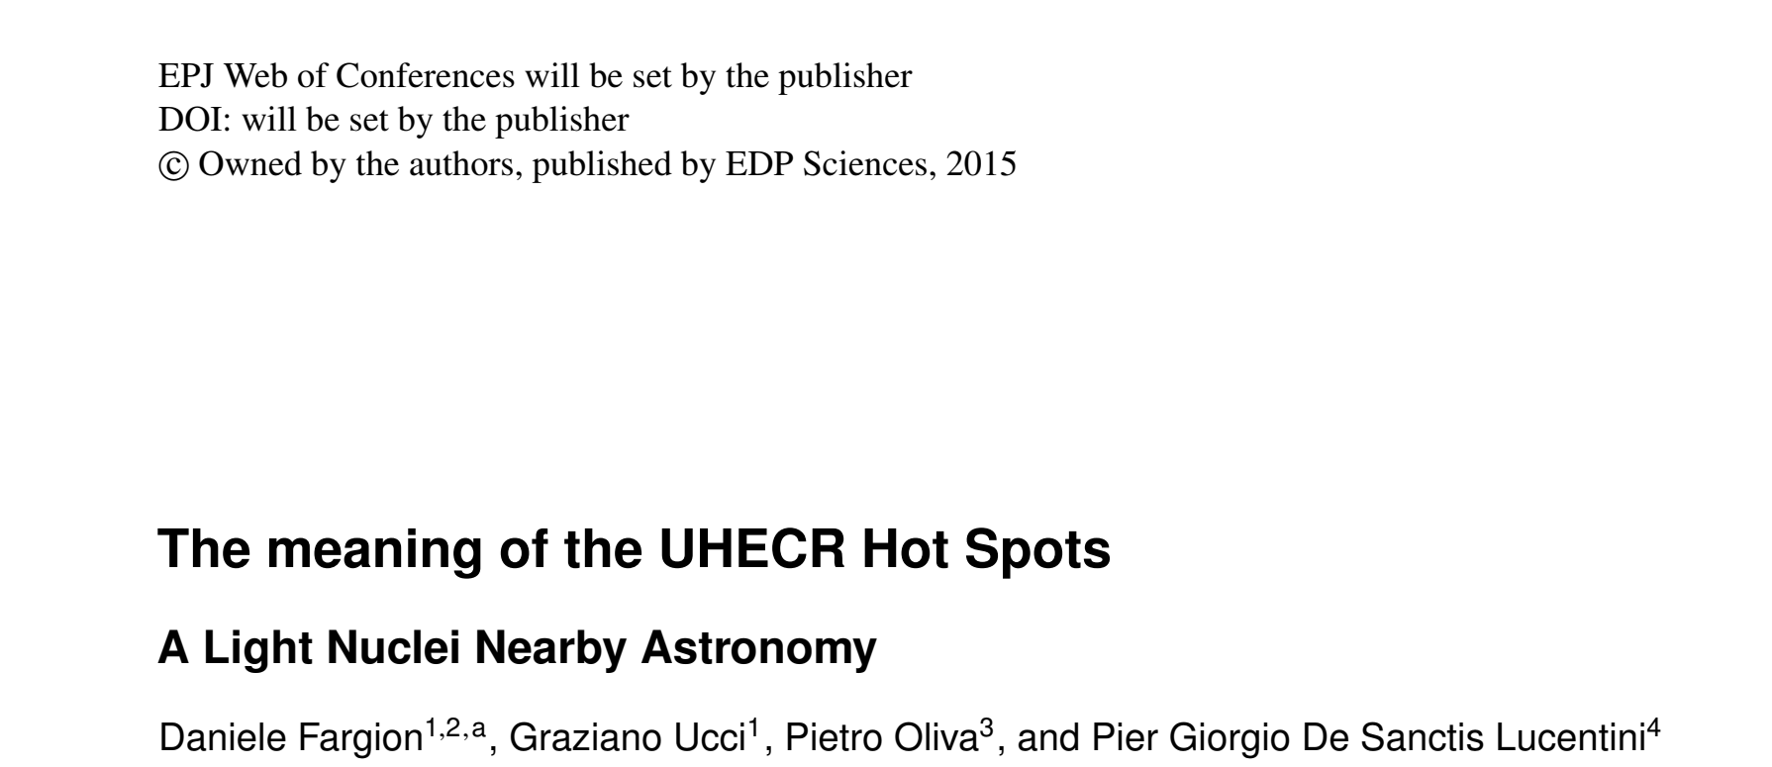
UHECR : where they come from?
arXiv:submit/2269349 ,
21 May 2018
PoS 2018

Slide 3
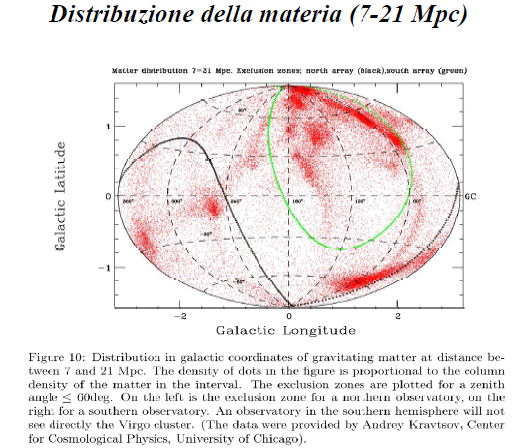
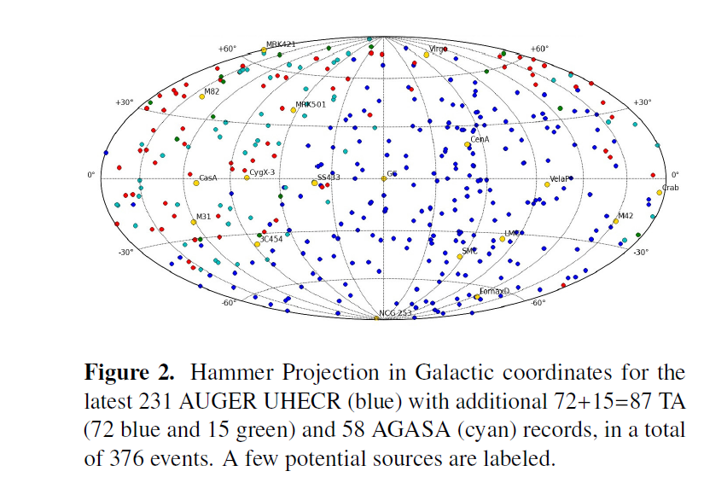
ANISOTROPIES in UHECR versus nearby mass anisotropy on 2016 the VIRGO MISSING

Slide 4
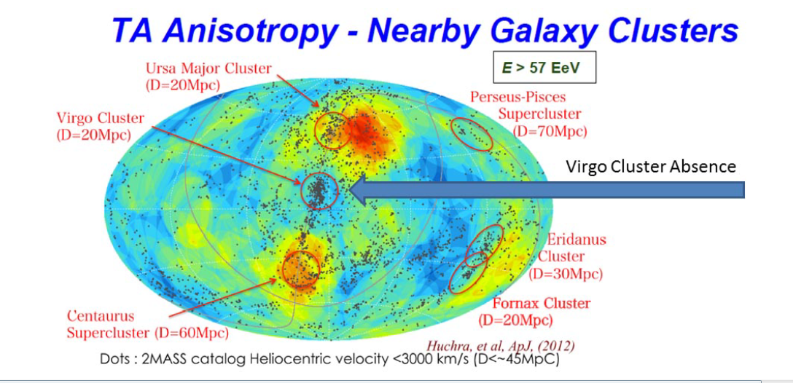
1) The Virgo Absence in a centered map: two Hot Spot

Slide 5
Main NON Message since AUGER 2007
NO VIRGO CLUSTERING
From Nearest Largest Mass Galaxy Cluster in GZK volume
NO NARROW CLUSTERING
(3-6 degrees) as expected for UHECR protons

Slide 6
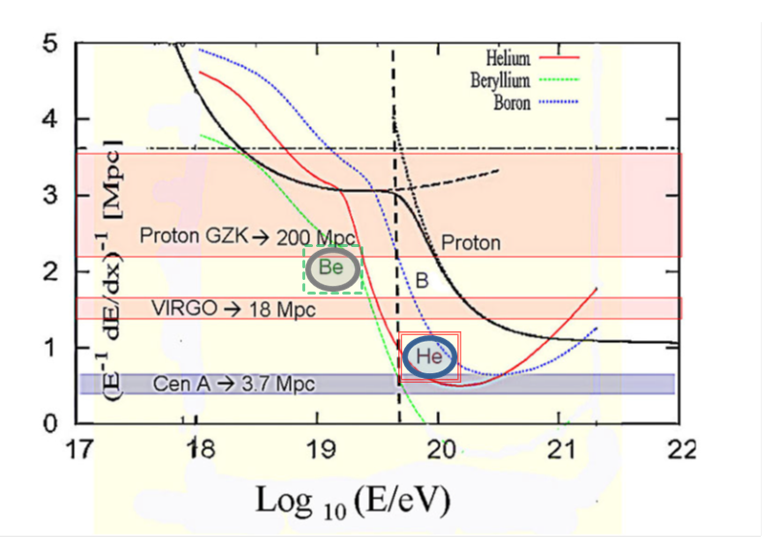
Lightest nuclei only for nearby Mpcs source

Slide 7
Lightest Nuclei are opaque and filtered from 20 Mpc
Virgo may be hidden as observed

Slide 8
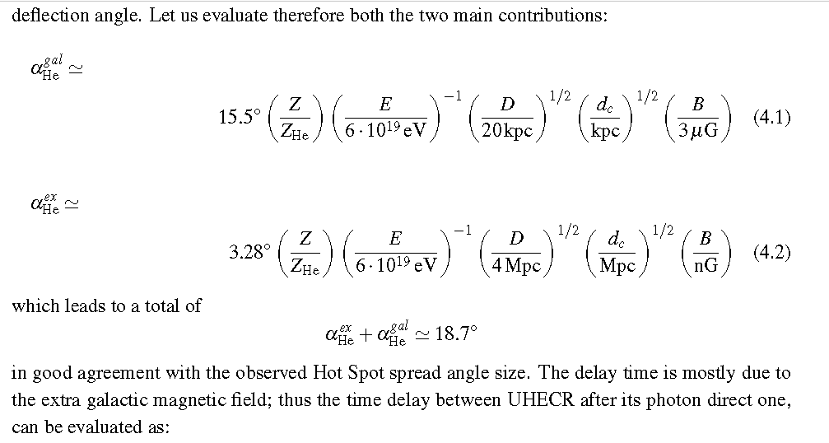
Composition, Deflection, Clustering

Slide 9
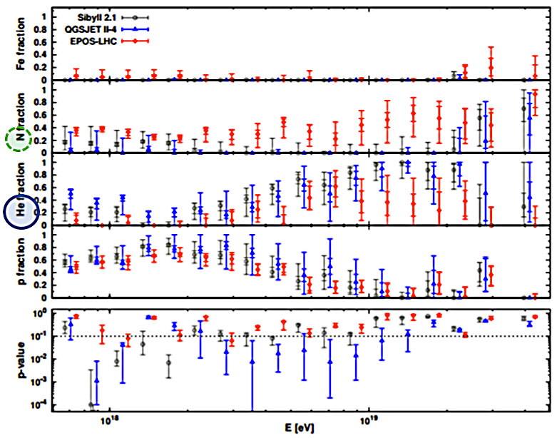
The recent 2015 Light Nuclei signature probing proton and Fe almost absence above 10 EeV and showeing He –Be dominance at UHECR

Slide 10
UHECR narrow Anisotropy Summary
UHECR have been found mostly made by light and lightest nuclei.
We considered a few localized nearby extragalactic sources for most UHECR clustering as CenA, NG 253, M82.
Foreseen Lower energy, 20 EeV multiplet around Cen A →

Slide 12
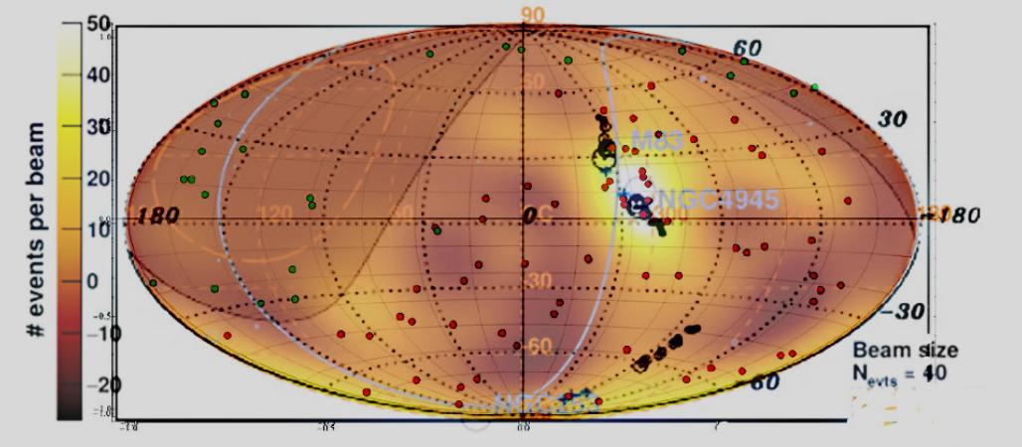
20 EeV Multiplet at Cen A Hot Spot anisotropy foreseen 2009, observed 2011…. Here overlap on 2018 Auger 39 EeV anisotropy

Slide 13
Large scale anisotropy above 4 EeV:

Slide 14
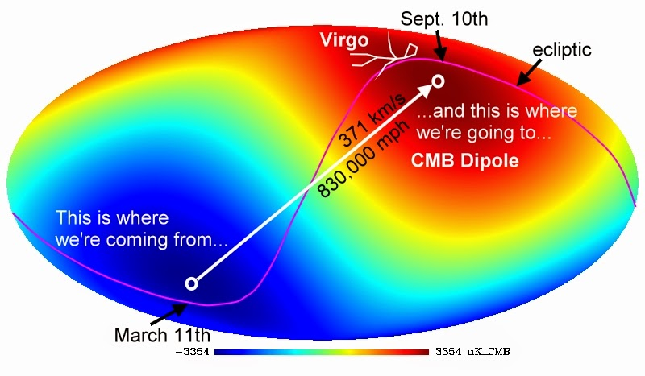
Doppler shift at 600 km/s flight: 0.2% much smaller than AUGER UHECR dipole 6% ➔ 18.000 km/s

Slide 15
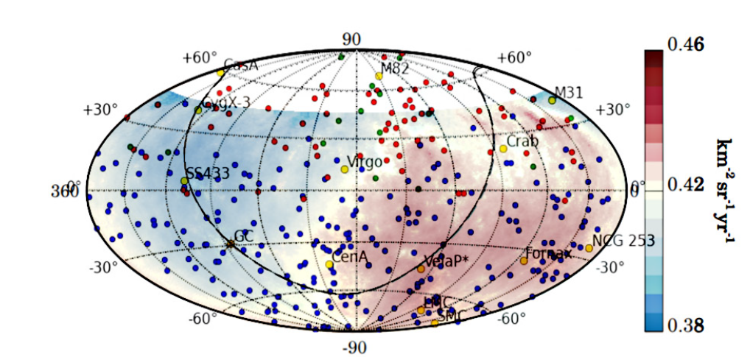
A 5 sigma Dipole 10 EeV UHECR anisotropy: 6 times wider : 90-100 degrees; 6 % value

Slide 16
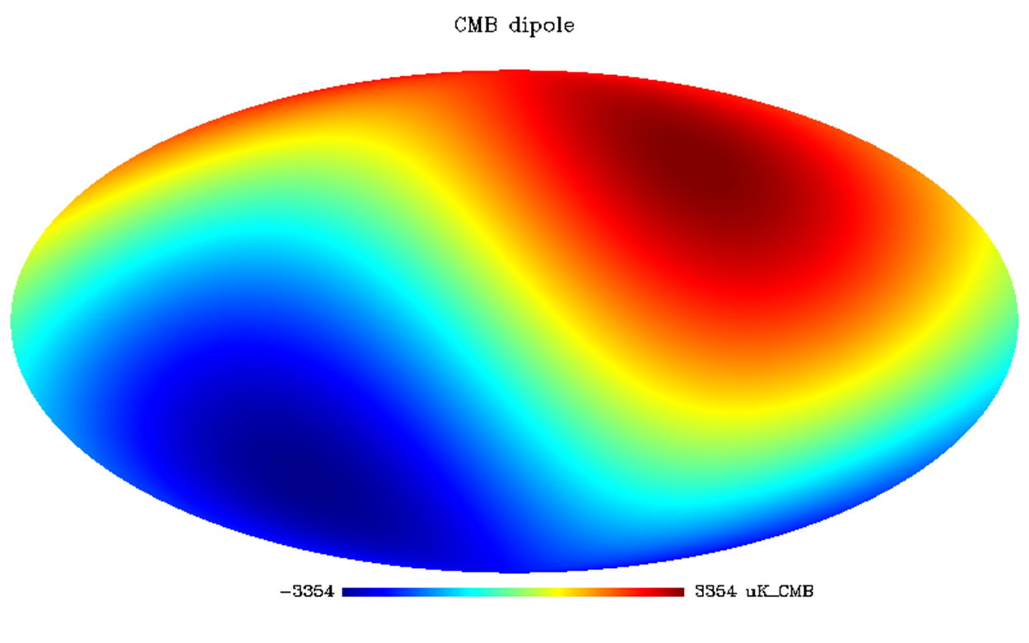
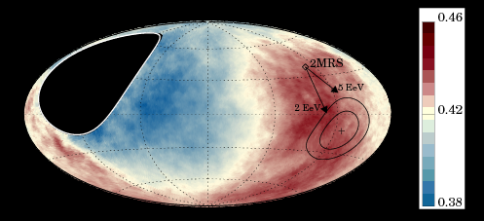
Different direction and SIZE Some missing connection with cosmic big bang dipole

Slide 18
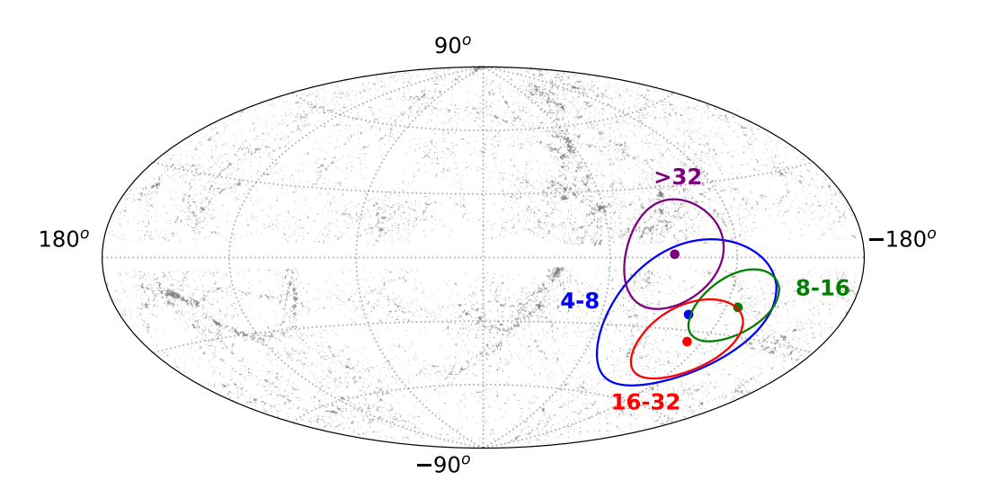
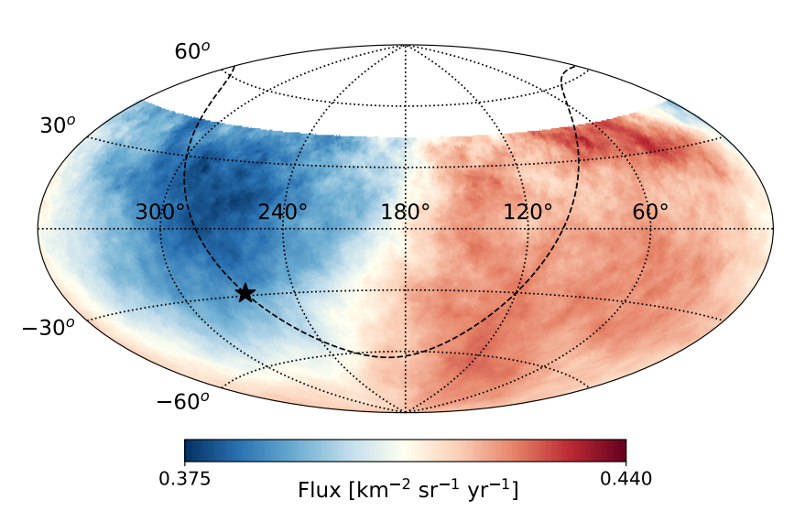
Few EeVs UHECR: smeared maps in space , energy and time: A «fast» variable angle directions→ very near sources: Even Galactic ones?
CRAB
NGC 253
VELA
LMC

Slide 19
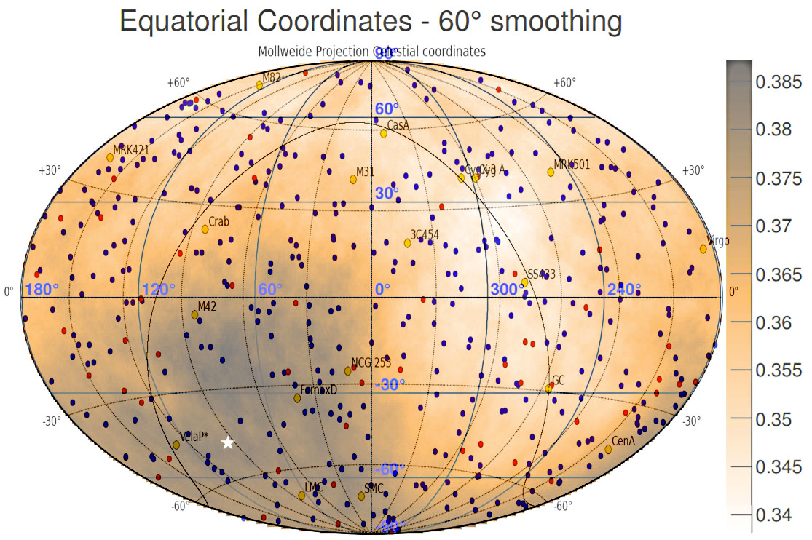
Different map: with galactic sources

Slide 20
Forced Consequences:
Observed a UHECR 6 % anisotropy
It must be a very local, almost Galactic origin:
AS NEAR AS:
LMC, Vela, Crab, NGC 253, FORNAX galaxy among the best candiates

Slide 21
Our Old proposal about tens EeV nearby galaxies clustering→ becoming more real in recent ones

Slide 22
NEAR SOURCES CONSIDERED by above authors

Slide 23
UHECR Anisotropy Summary
Results on UHECR (Ultra High Energy Cosmic Ray) composition and their distribution in the sky from ten EeV energy (the dipole anisotropy) up to the highest UHECR energies and their clustering maps:
UHECR have been found mostly made by light and lightest nuclei in a few Mpc Universe.
We considered a few sources as
CenA, NG 253, M82.
Possible Vela , Crab and LMC at 10 EeV play a role too

Slide 24
In a unique sentence
After a century of CR and half a century of UHECR we are discovering the few nearby AGN sources of UHECR
Discovering also mainly that
1) UHECR are not proton, but He-like
2) few EeV UHECR are not much cosmic but they might be partially galactic

Slide 25
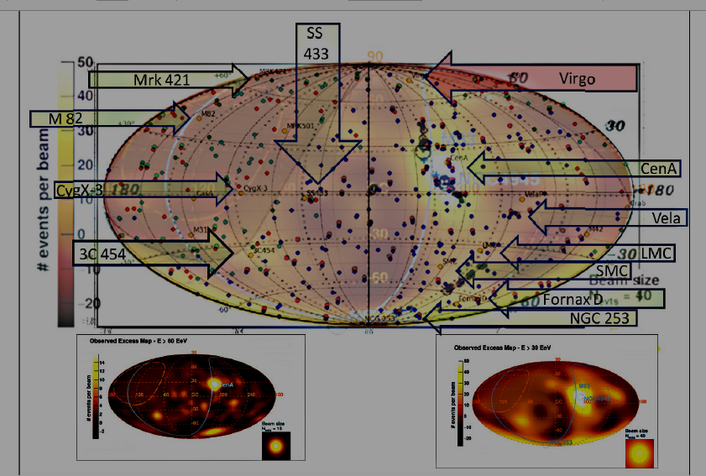
Source names and nearer sources: Cen A, M82, NG 253, Vela, LMC, SS433----POS 2018

Slide 26
Thank you for the cosmic attention

Slide 27
TEVS-UHECR connection?

Slide 28
The key question about UHECR Dipole connection with TeVs AYGO HAWC region A

Slide 31
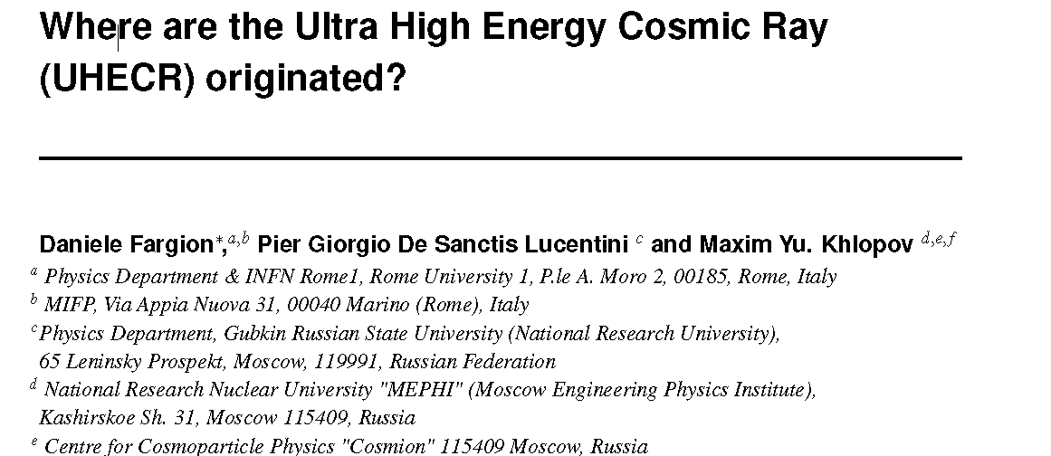
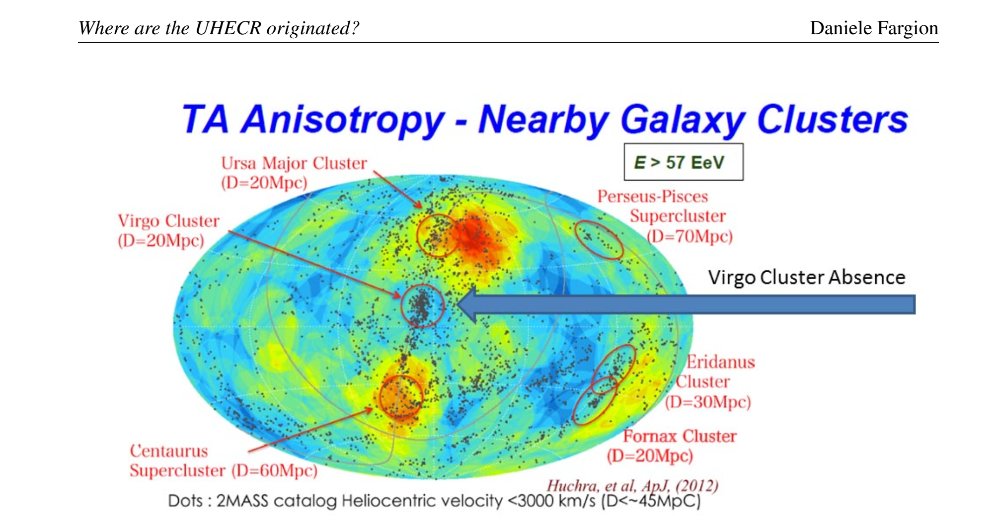
Criss May 2018
Arxiv, POS, 21 May 2018

Slide 32
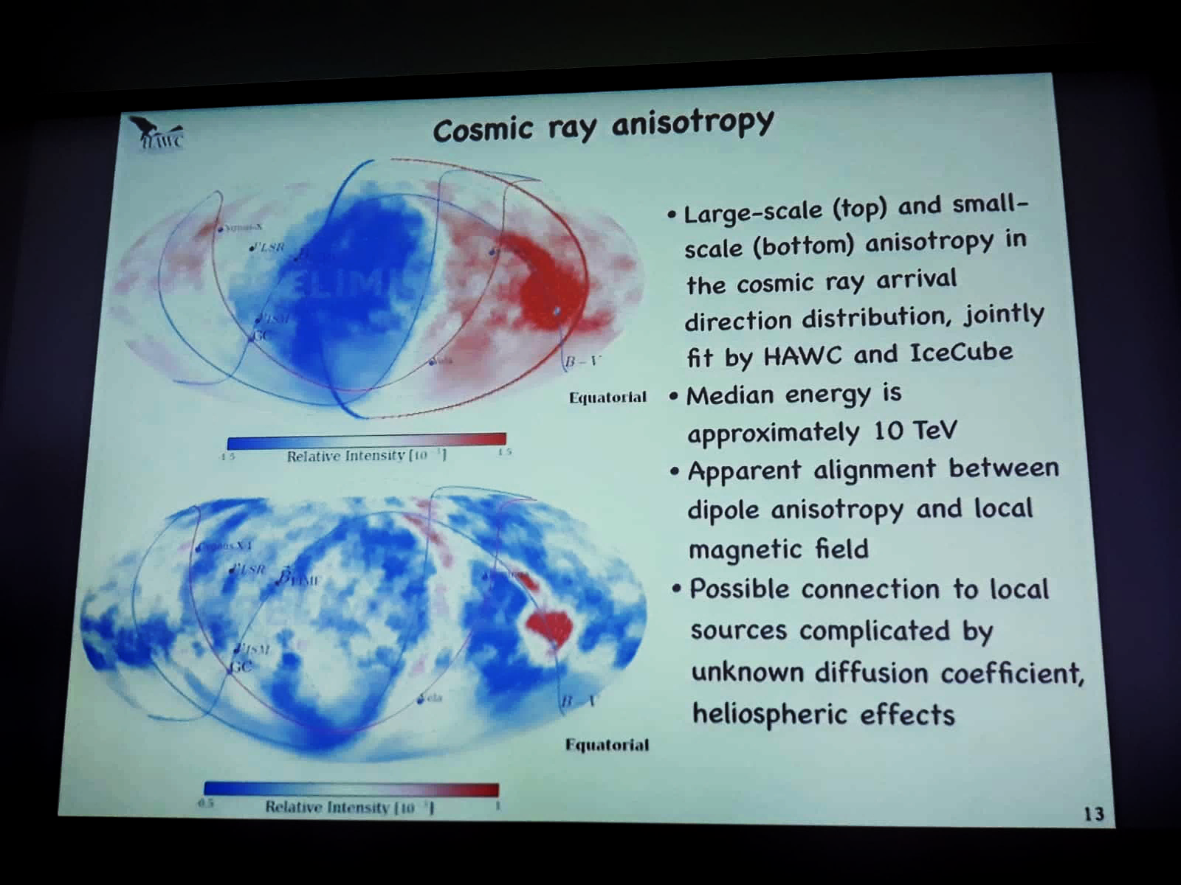
Hawc talk on Dipole Anisotropy at TeVs SAME ANISOTROPY as UHECR one but at 0.1 millipercent! A secondary tail?

Slide 33
Conclusions
Lightest Nuclei are main currier of UHECR
Probable overlapping of the Hawc, ARGO,
Dipole at TeVs with 10 EeV UHECR AUGER Dipole
Interpretation:
A Galactic Role by Vela, LMC, Crab and maybe Extragalactic Fornax D, NGC 253
Rare clustering at 3C454 made by Z-Burst events due to UHE ZeV neutrinos scattering on relic (sterile?) eV neutrinos in hot dark halos.?

Slide 34
Suggestion
UHECR are mostly LIGHTEST NUCLEI by Cen A, M82, NGC 253, but some cases might be NUCLEONS:
TO DISENTANGLE WE NEED A LOCAL
UHECR SPECTROSCOPY:
Composition for each group.

Slide 35
Thank You for the kind attention

Slide 36
UHECR: Also Galactic? Also Cosmic?
We comment also on the possible partial role of a few remarkable galactic UHECR sources at 10 EeV energies.
Finally we revive the eventual role of a relic neutrino eV mass in dark hot halo (hit by ZeV neutrinos) to explain the new UHECR clustering events centered around a very far cosmic AGN sources as 3C 454.

Slide 37
Most Lightest Nuclei..but an apparent clustering to 3c 454 at redshift z=1 !
Z Burst solution based on ZeV neutrino scattering on relic cosmic ones:
UHECR by NUCLEONS and not NUCLEI

Slide 40
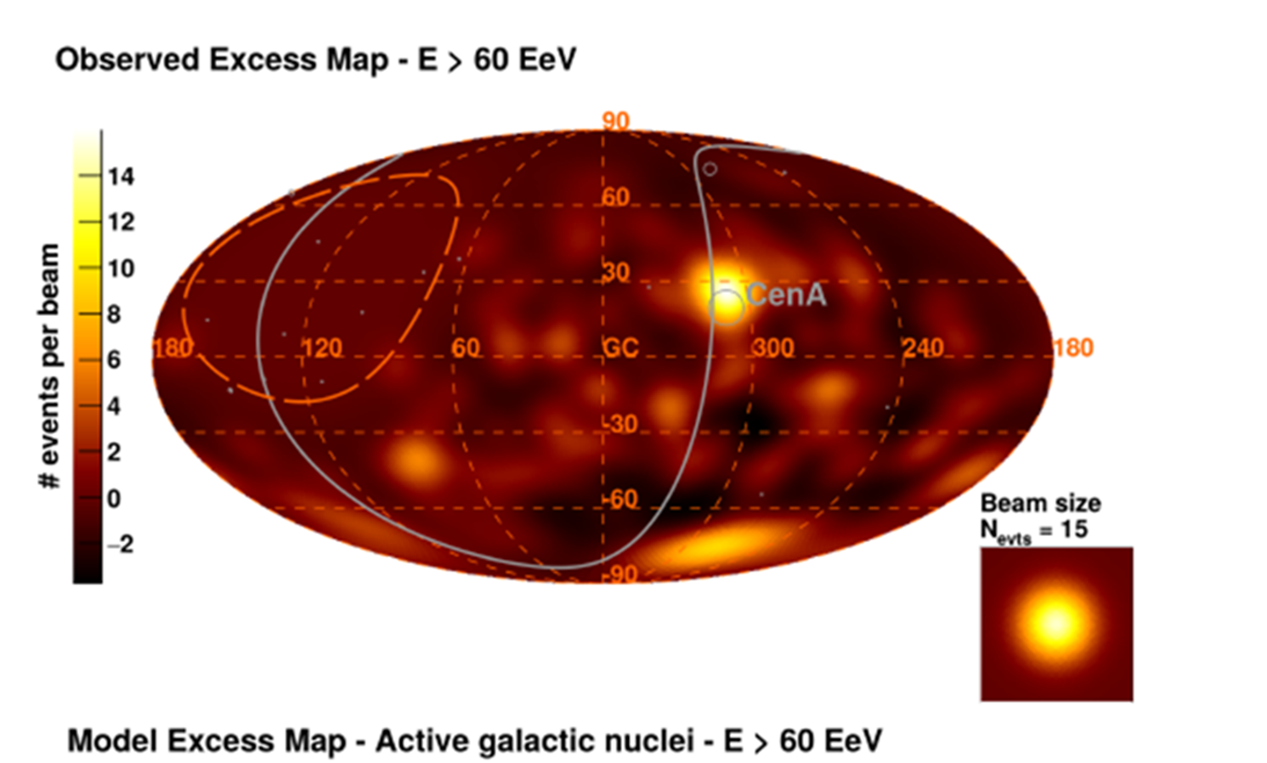
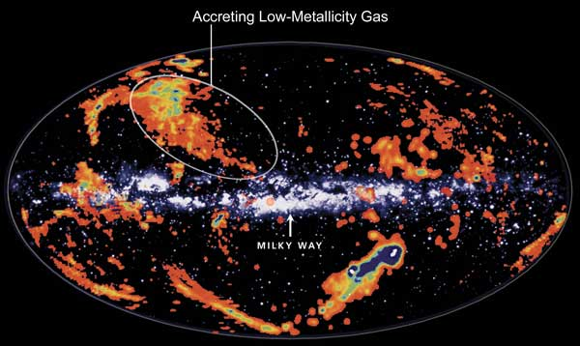
A much local trace?

Slide 41
Summary
The recent Ultra High Energy Cosmic Ray (UHECR) dipole anisotropy found by AUGER at EeVs energies, requires an explanation. In analogy to the dipole Cosmic Black Body Radiation or other expected cosmic anisotropy one would like to understand the large UHECR dipole at EeV energy by a cosmic (bending, cosmic local clustering, Doppler shift) mechanism. However there is not such a tuned process and-or a cosmic source . We suggest a different reading key of present AUGER dipole data.

