Slide 1

Timepix detectors in space:
From radiation monitoring in low earth orbit to astroparticle physics
B. Bergmann
Institute of Experimental and Applied Physics, Czech Technical University in Prague
Benedikt.bergmann@utef.cvut.cz

Slide 2
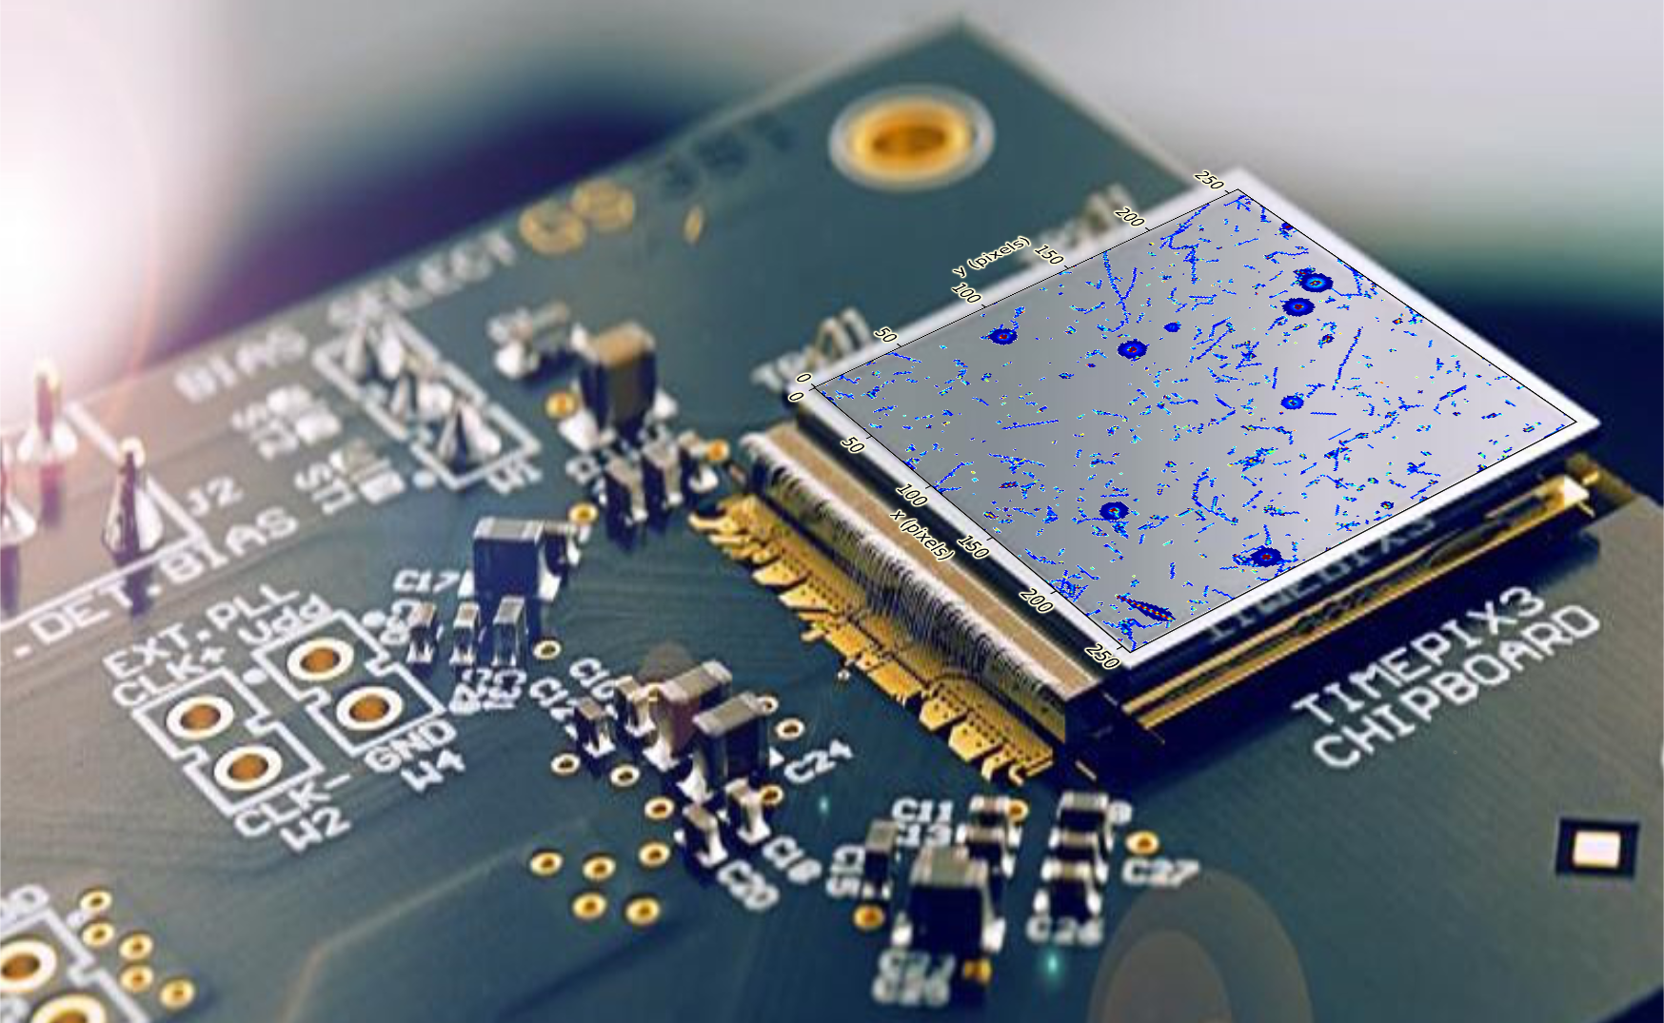
Measuremenct of traces left by ionizing particles in semiconductors
→ Radiation imaging detector

Slide 3
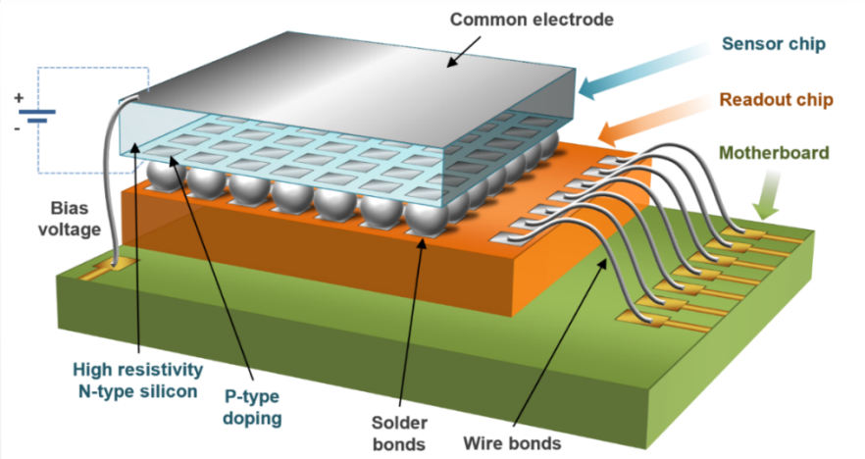
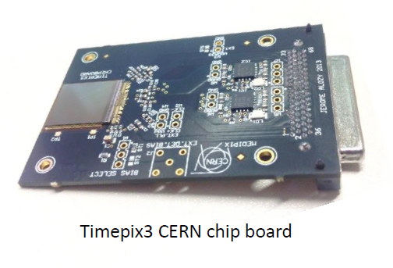
Timepix and Timepix3
256 x 256 pixels with 55 µm pitch (1.98 cm²)
  Sensor layer (Silicon, GaAs, CdTe, ...) flip-chip bump bonded to the ASIC
Timepix
Frame based readout (92 fps) – dead time > 11 ms
Measurement of energy or time (Δt = 20.8 ns)
Minimal detectable energy: ~ 3.5 keV
Timepix3
Data-driven readout (Max. count rate 40 Mpix/s)
Per-pixel dead time of 475 ns
Measurement of energy and time (Δt = 1.56 ns)
Minimal detectable energy per pixel 2.5 keV
Timepix3 with chipboard.

Slide 4
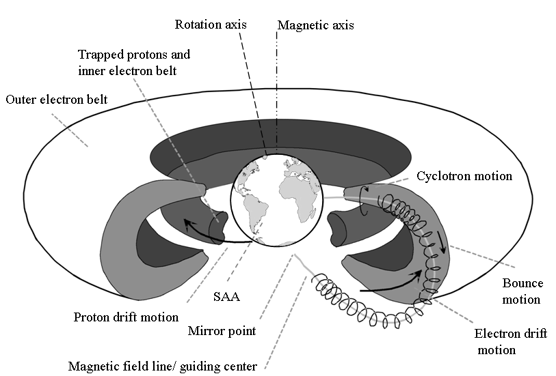
Radiation environment in LEO
E_{p} < 400 MeV
E_{e} < 7 MeV
Mauk, B.H., Fox, N.J., Kanekal, S.G. et al. Space Sci Rev (2013) 179: 3.

Slide 5
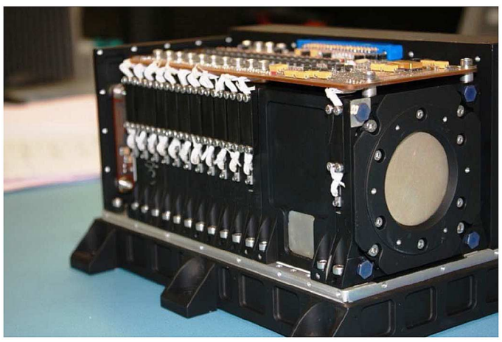
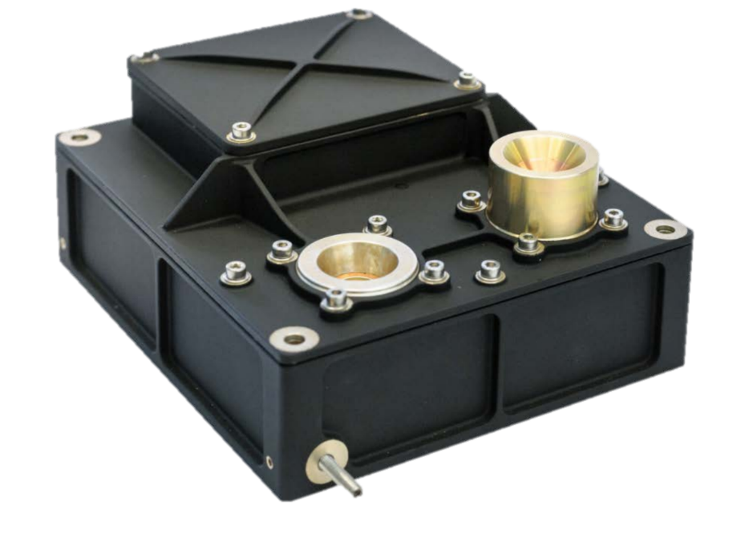
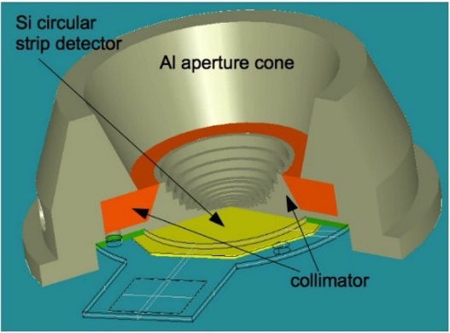
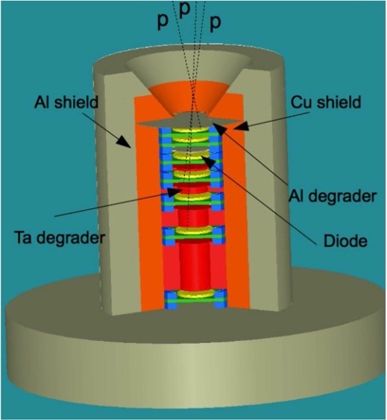
Instruments for measurements in LEO
EPT (Energetic Particle Telescope)
Mass: 4.6 kg
Consumption: 5.6 W
Next Generation Radiation Monitor (NGRM)
Mass ~ 1 kg
Consumption ~1-2 W
ICARE-NG:
Mass: 2.4 kg
Consumption: 3 W

Slide 6
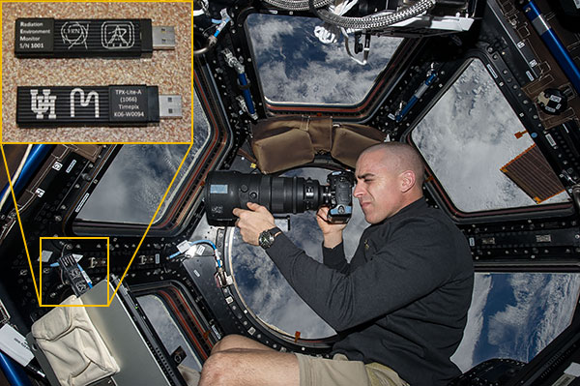
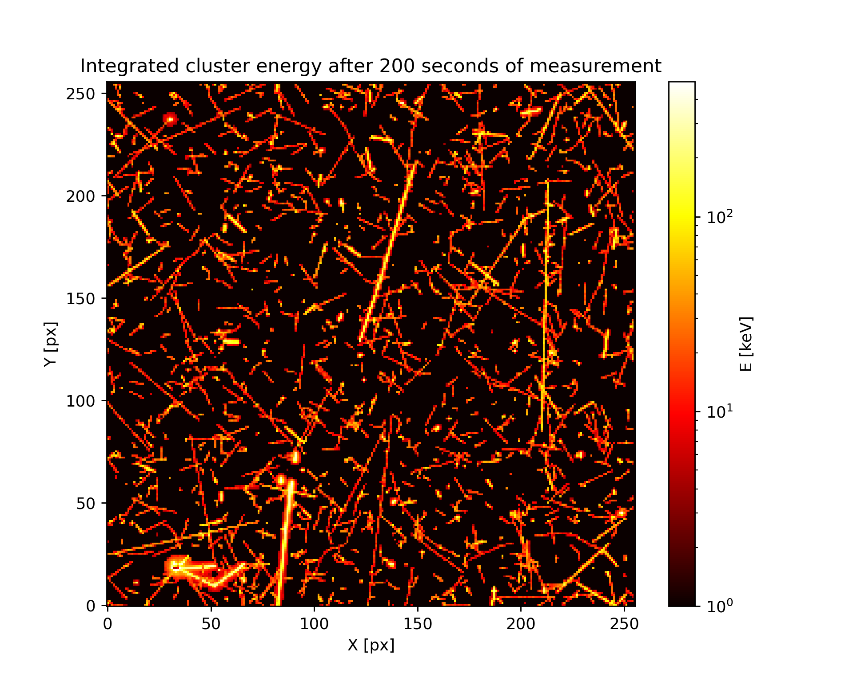
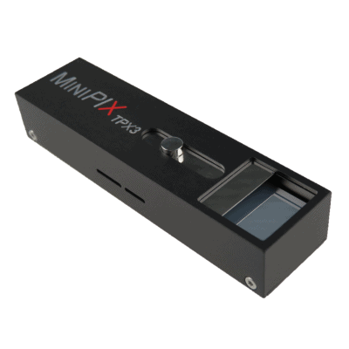

Timepix devices in Space
Single-layer particle discrimination
Small dimensions and low mass
Large field of view
Current missions (chronologically sorted):
REM on ISS (since 2012: different versions; MiniPIX TPX3 by Advacam deployed in 2021)
SATRAM on Proba-V (launch in 2013, 820 km)
LUCID-Timepix (2014-2017, 635 km)
VZLUSAT-1 (launch in 2017, 510 km)
RISESAT (launch in 2019, 500 km)
VZLUSAT-2 (launch in 2022, 500 km, CdTe 2 mm)
Space radiation in LEO measured by TPX3, integrated frame, 200 s, energy display
Minipix TPX3 and shielding by ADVACAM
*
First deployment of TPX3 detector in space

Slide 7



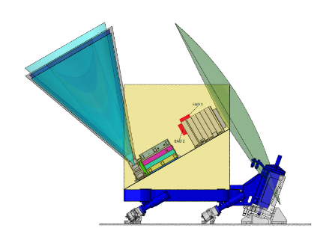
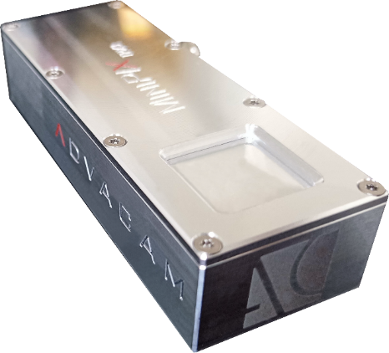
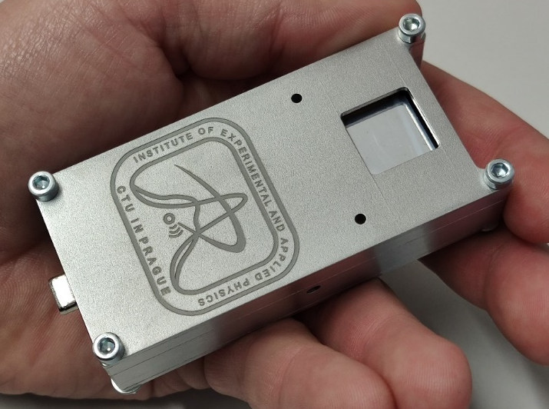
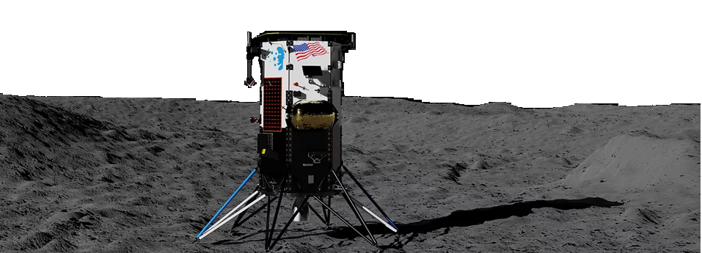

(Near future) flights
*⁾ St. Gohl et al., “A Miniaturized Radiation Monitor for Continuous Dosimetry and Particle Identification in Space“, JINST 17 C01066 (2022).
MIRAM (Miniaturized Radiation Monitor)*⁾
GOMX-5 cubesat mission (12U, 20 kg) – 2023
2 Modules outside of the Lunar Gateway as a part of the ESA ERSA (European Radiation Sensors Array) – 2024
Scientific payload for ASE EL3 rover (neutron spectrometer for water mapping on the moon)
MiniPIX TPX3:
IM Nova-C lunar landing module, carried by a SpaceX Falcon 9 rocket 2022/23 (Minipix Timepix3 will measure during the entire duration of the mission)
2x Minipix TPX3 silicon sensor with hardened shielding and space RO port by ADVACAM
Two detector units
Nova-C lunar landing module by Intuitive Machines

Slide 8
C. Granja et al., “The SATRAM Timepix spacecraft payload in open space on board the Proba-V satellite for wide range radiation monitoring in LEO orbit”, Planetary and Space Science 125, pp. 114-129, ISSN 0032-0633 (2016).
https://doi.org/10.1016/j.pss.2016.03.009
Timepix
256 x 256 pixels
pixel pitch 55 µm
Energy measurement in each pixel
Sensor: Si 300 µm
SATRAM
Space Application of Timepix Radiation Monitor

Slide 9
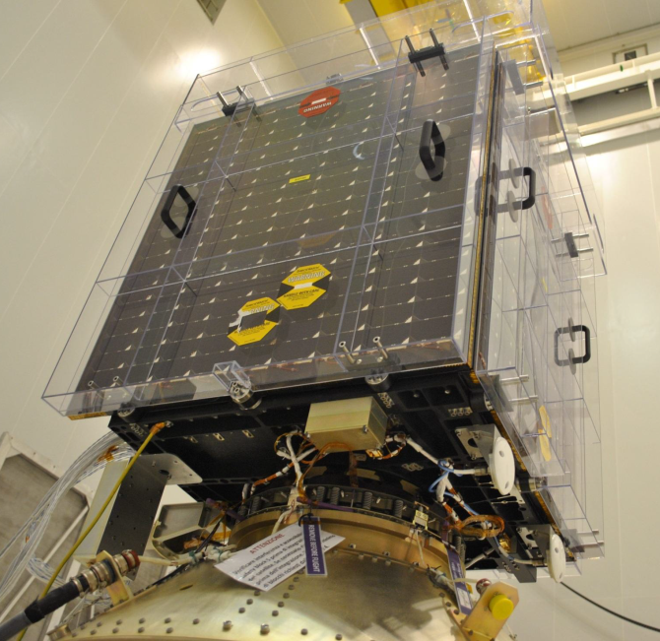
SATRAM:
Space Application of Timepix Radiation Monitor
First Timepix in open space
Power consumption of 2.5 W
Total mass 380 g (107 x 70 x 55 mm)
SATRAM is a platform technology demonstrator
Proba-V
Minisatellite (158 kg)
Altitude ~ 820 km (LEO)
101.21 minutes orbit duration
Inclination 98.6°
Sun-synchronous
Launched 7th March 2013

Slide 10
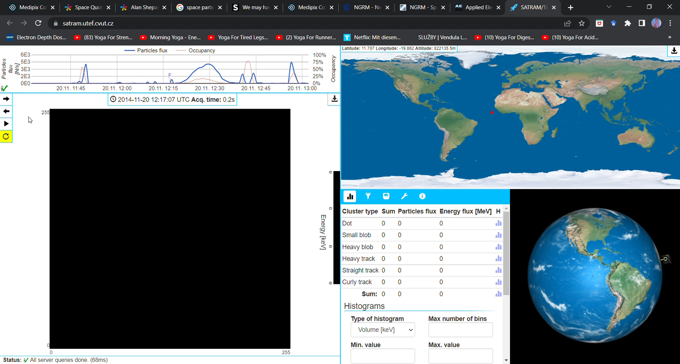
https://satram.utef.cvut.cz/
Notes:
I would like to show you how the data we are analysing look like

Slide 11
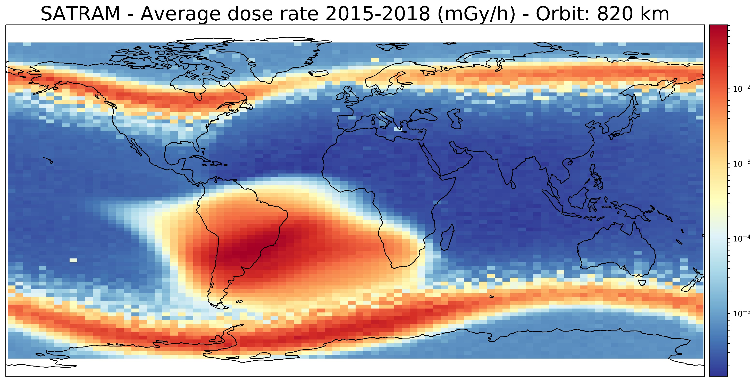
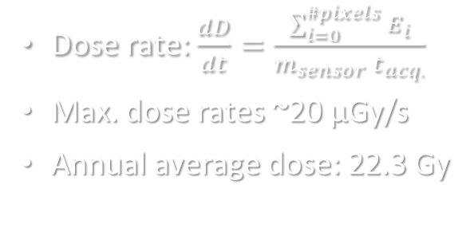
Dose rate: $\frac{dD}{dt}=\frac{\sum_{i=0}^{\#pixels}{E_{i}}}{m_{sensor} t_{acq.}}$
Max. dose rates ~20 µGy/s
Annual average dose: 22.3 Gy

Slide 12
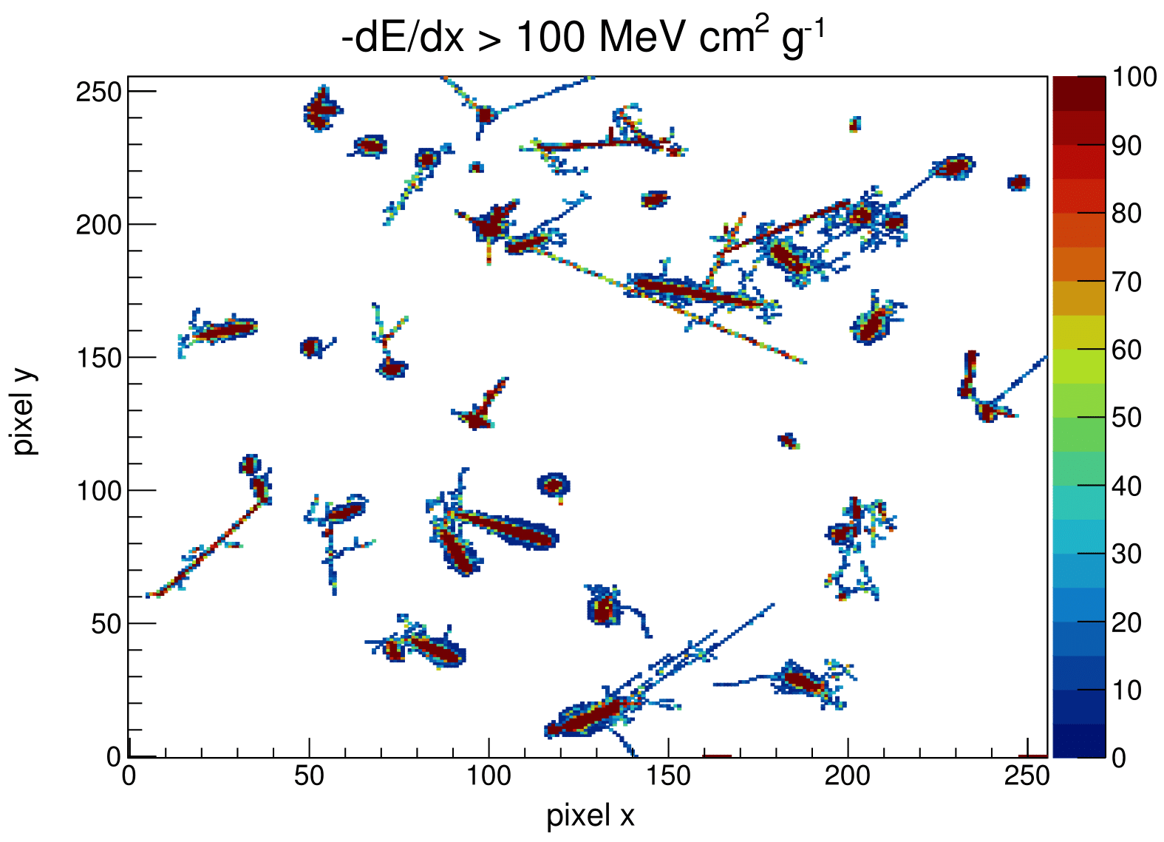
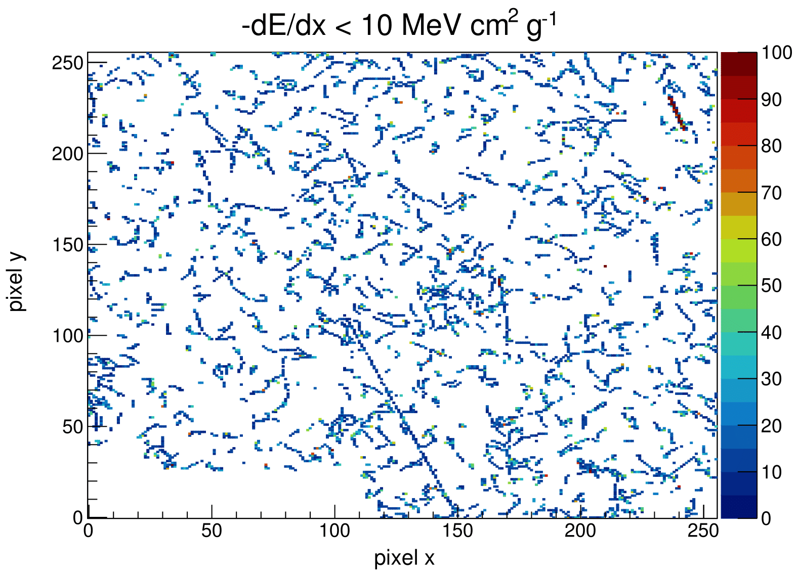
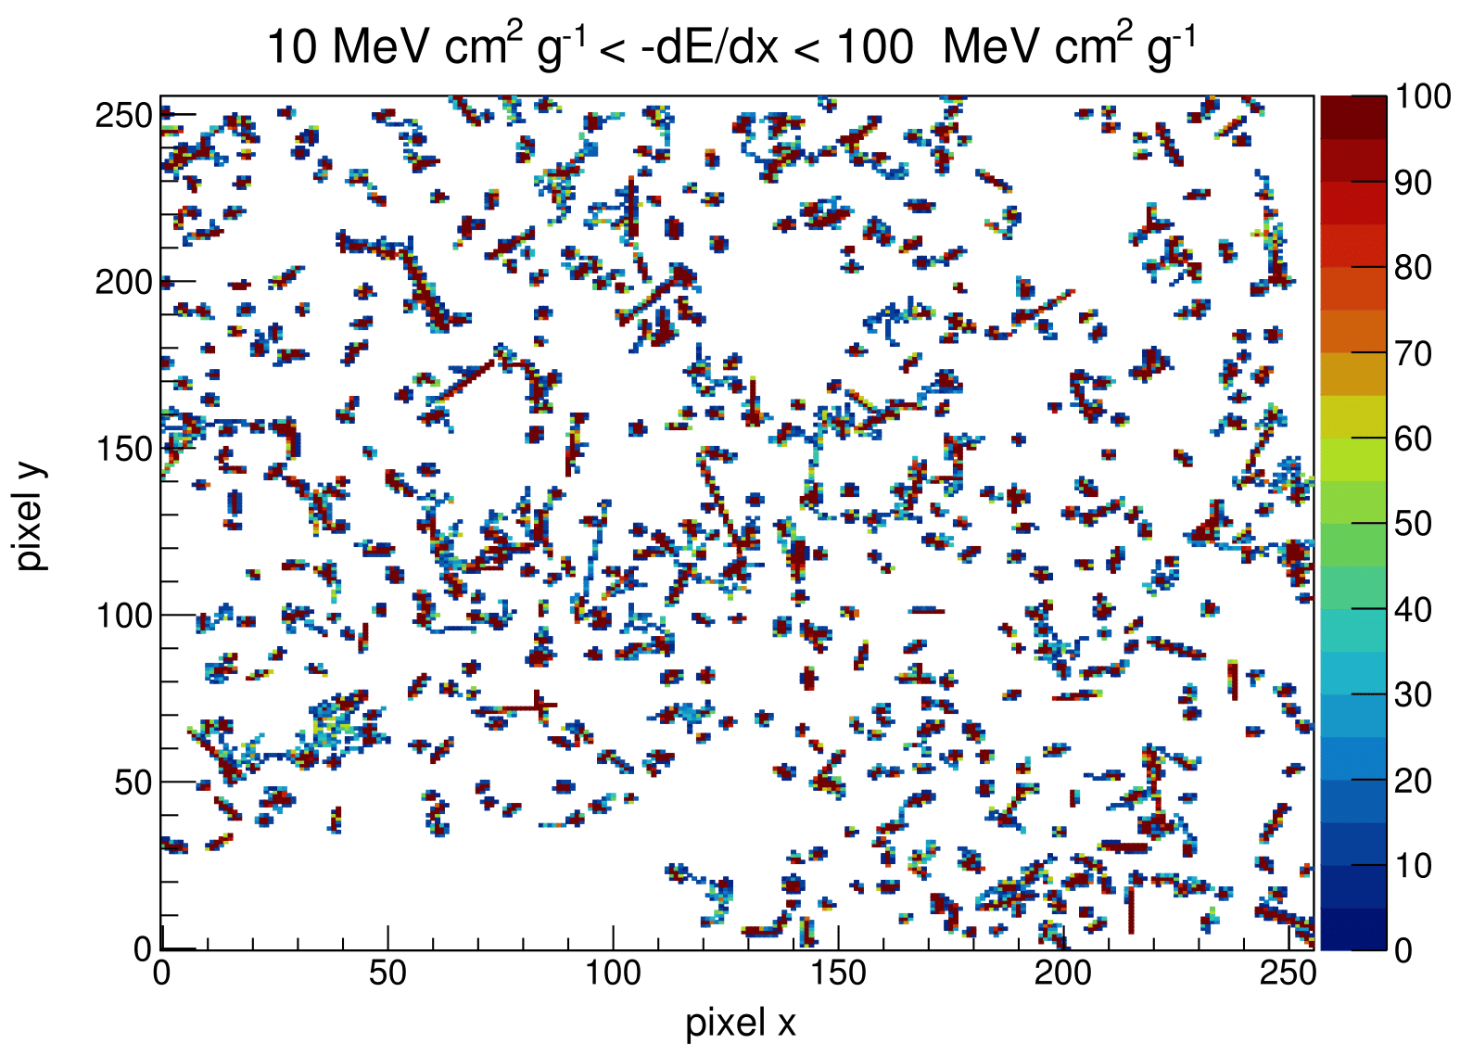
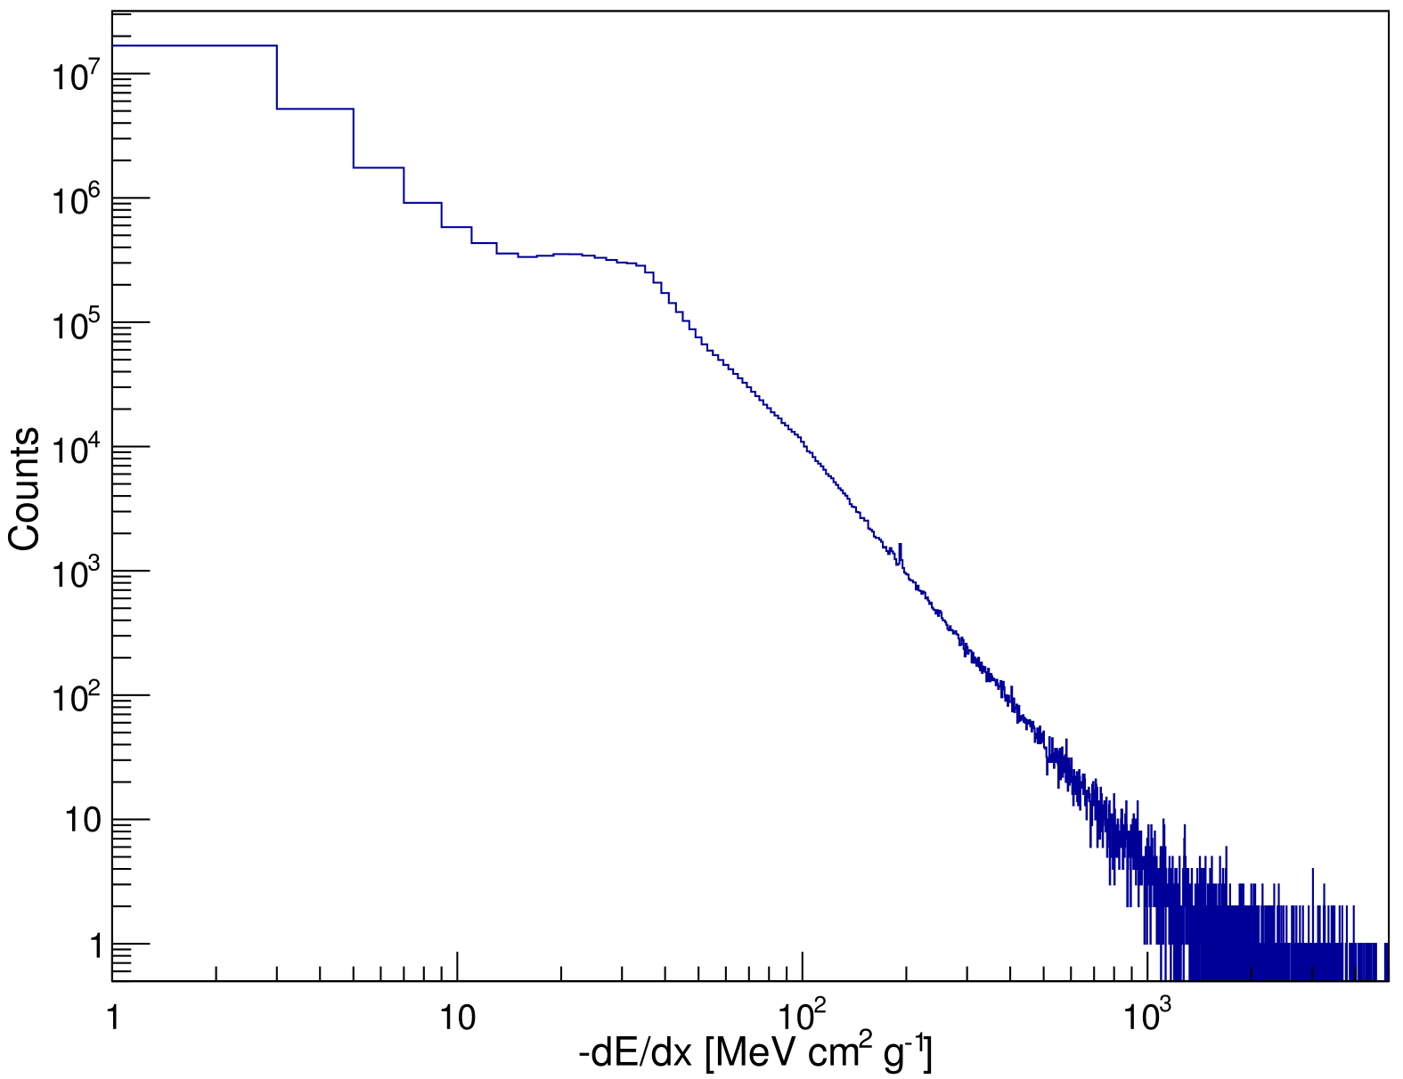
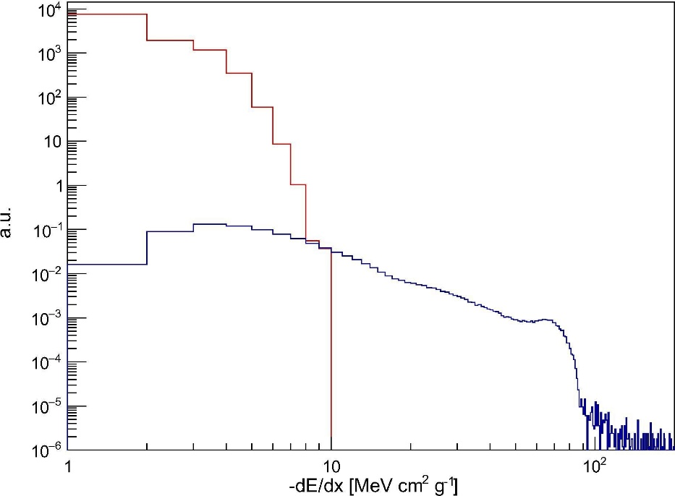
dE/dX and particle classification
Simulation
e⁻
e⁻
p⁺
p⁺
St. Gohl et al., “Study of the radiation fields in LEO with the Space Application of Timepix Radiation Monitor (SATRAM)”, Advances in Space Research 63, Issue 5, pp. 1646-1660, (2019).
HZE

Slide 13
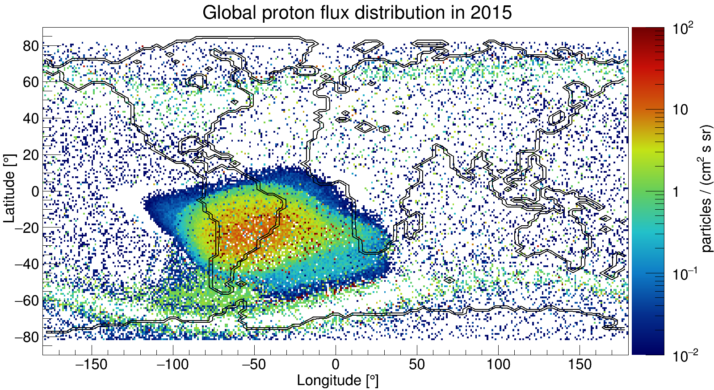
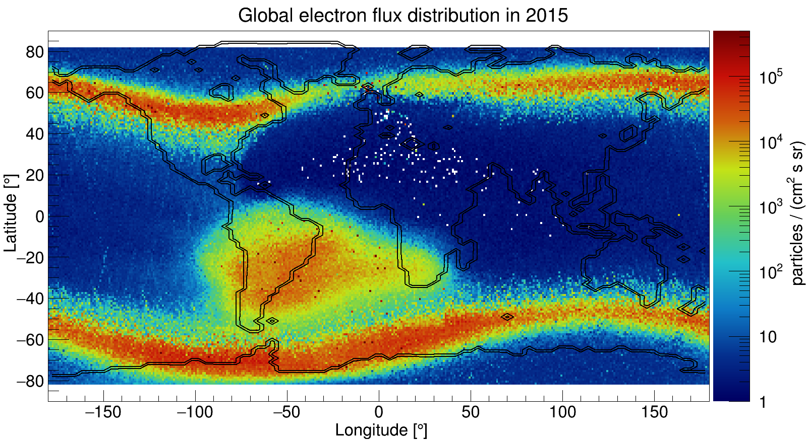
Electron and proton flux maps
e⁻ fluxes 3 orders of magnitude larger than p⁺ fluxes
→ Even small e⁻ misclassification distorts p⁺ flux measurement
St. Gohl et al., “Study of the radiation fields in LEO with the Space Application of Timepix Radiation Monitor (SATRAM)”,
Advances in Space Research 63, Issue 5, pp. 1646-1660 (2019).

Slide 14




Demonstrator of a penetrating particle analyzer (mini.PAN)
This project has received funding from the European Union's Horizon 2020 research and innovation programme under grant agreement No 862044.
X.Wu et al., Penetrating Particle ANalyzer (PAN), Adv. Space Res. 63, 8, 2672-2682 (2019) https://doi.org/10.1016/j.asr.2019.01.012
http://www.pan-space.eu/

Slide 15
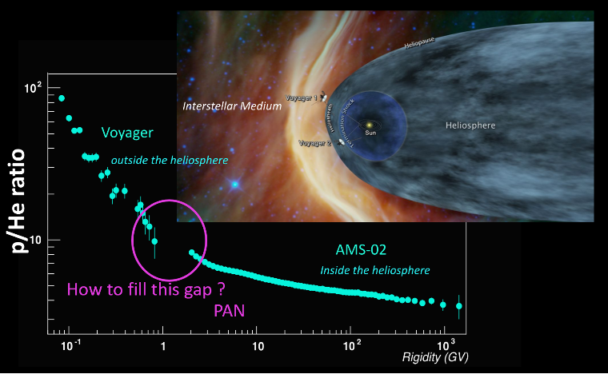
Scientific objectives
  Precisely measure and monitor flux, composition, and direction of penetrating particles (~200 MeV/nucleon to ~10 GeV/nucleon)
Galactic cosmic ray (GCR) physics:
Understand origin, acceleration mechanisms and propagation properties
Antimatter content
Dosimetric aspect:
GCR major source of dose for astronauts on (interplanetary) missions

Slide 16
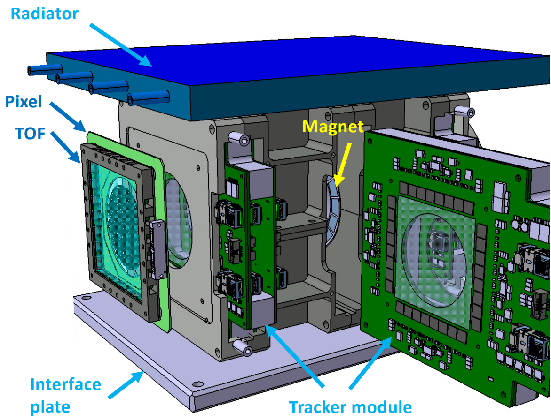
Conceptual design
Expected performance:
Magnetic spectrometer:
2 magnet sectors in Halbach geometry 0.4 T
3 Tracker modules with 3 layers of strip detectors
  2 StripX (bending direction) – pitch: 25 µm
  1 StripY – pitch: 500 µm
2 Pixel modules
  Timepix3 quad (262,144 pixels, pitch: 55 µm)
2 ToF modules (time resolution < 100 ps):
  Scintillators (EJ230) coupled with SiPMs
  Mini.PAN ~10 kg, ~20-30 W

Slide 17
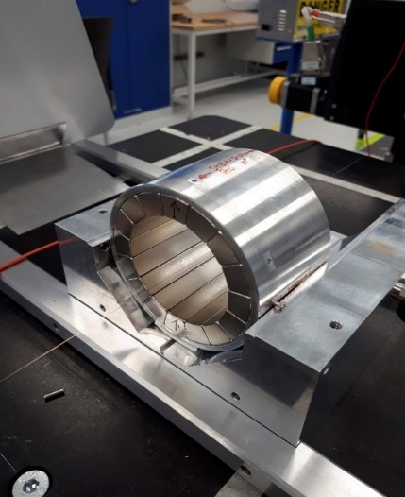
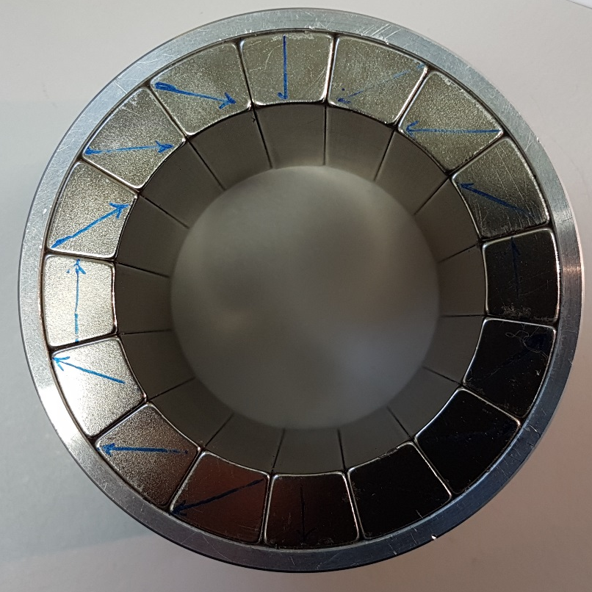
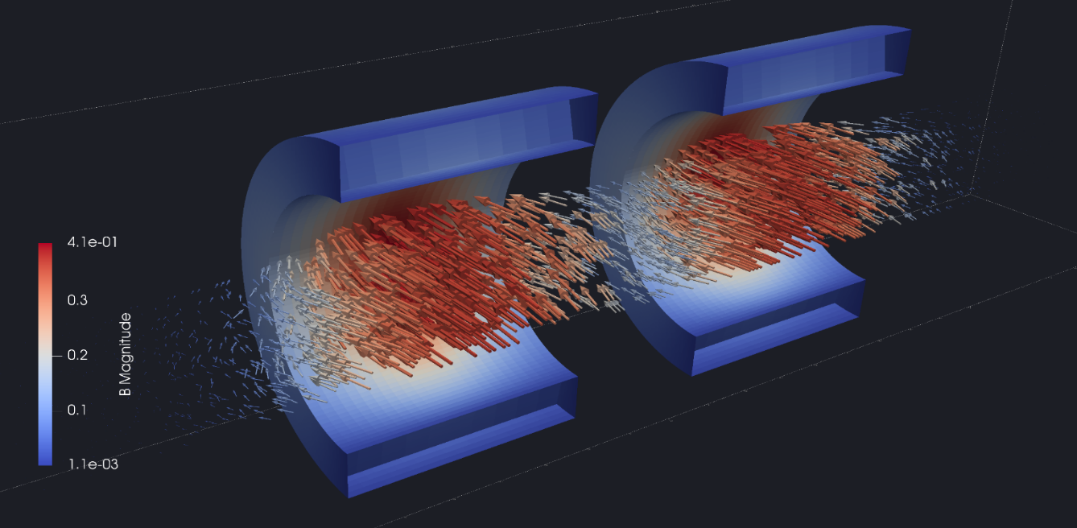
Magnet sectors
Ring, aluminium
Permanent magnet block, NdFeB
120 mm
50 mm
Mapping the B-field strength

Slide 18
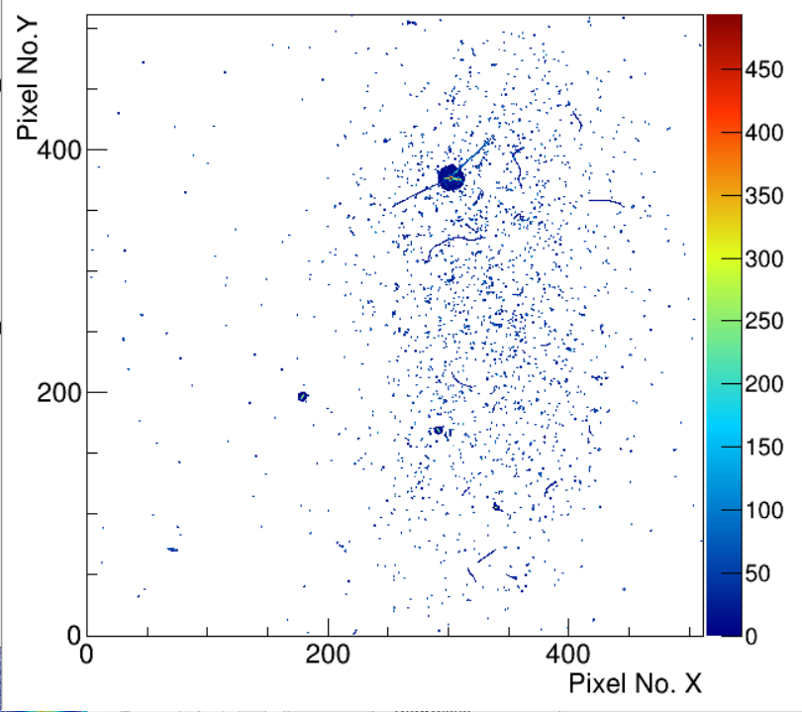
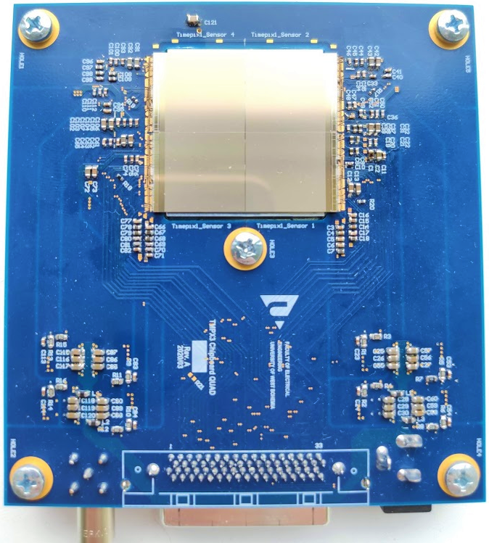
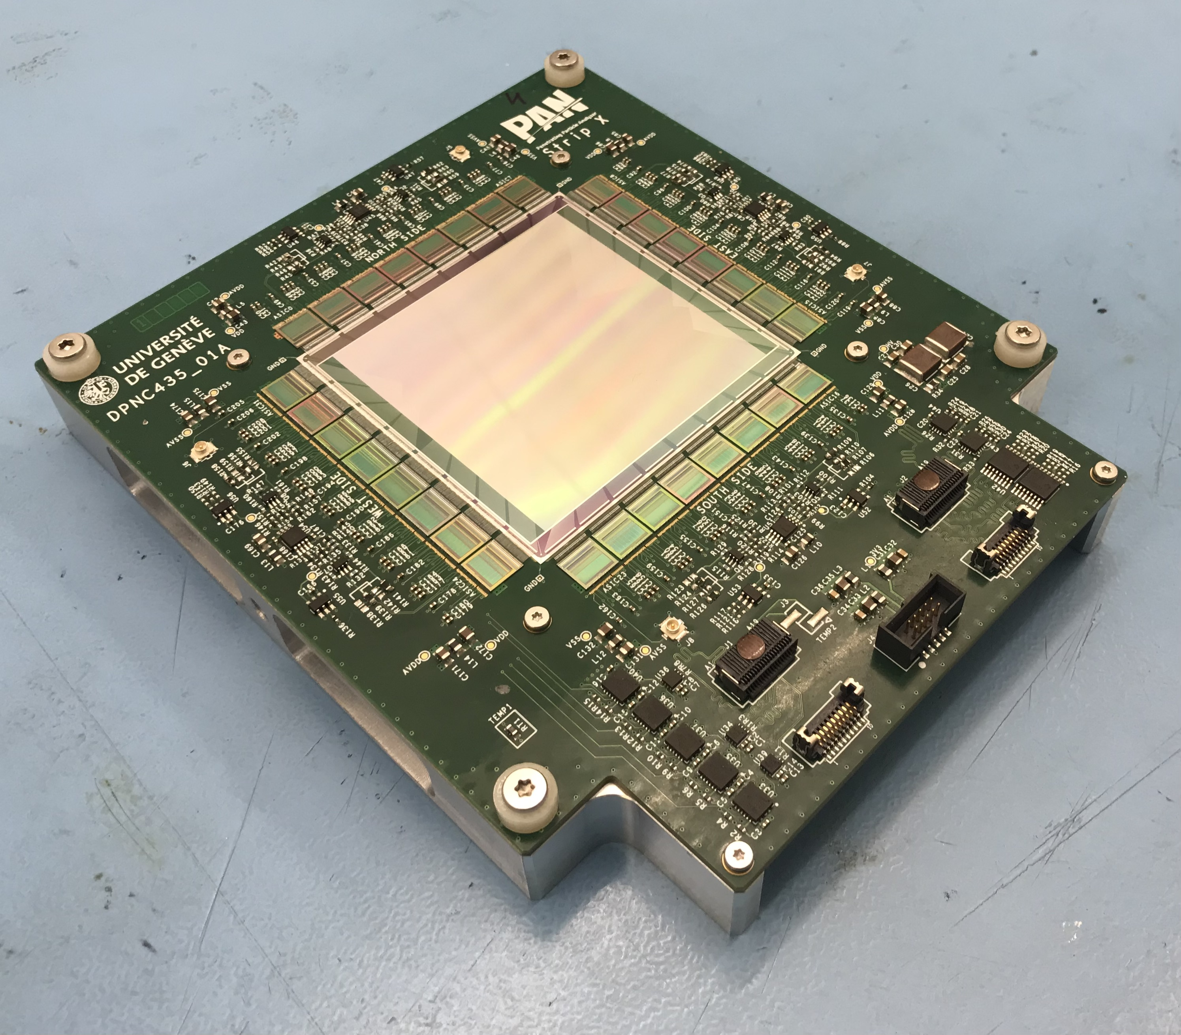
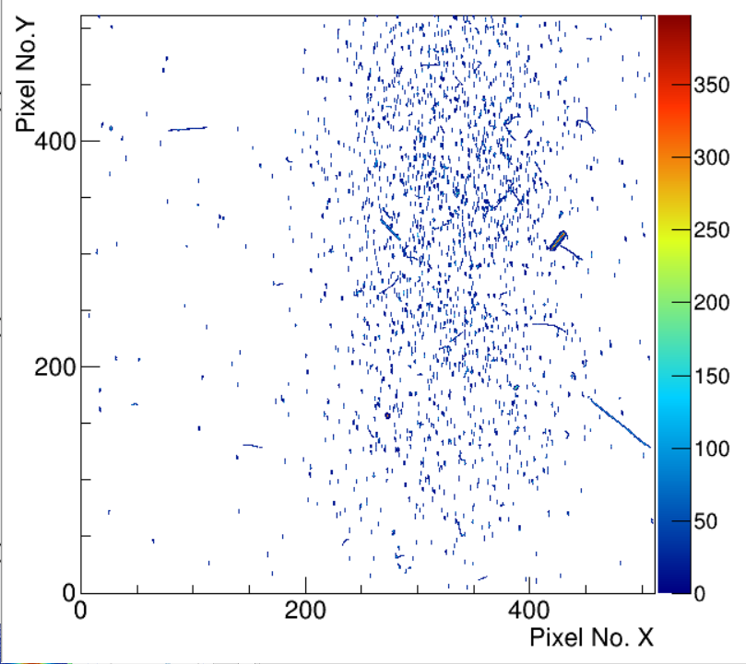
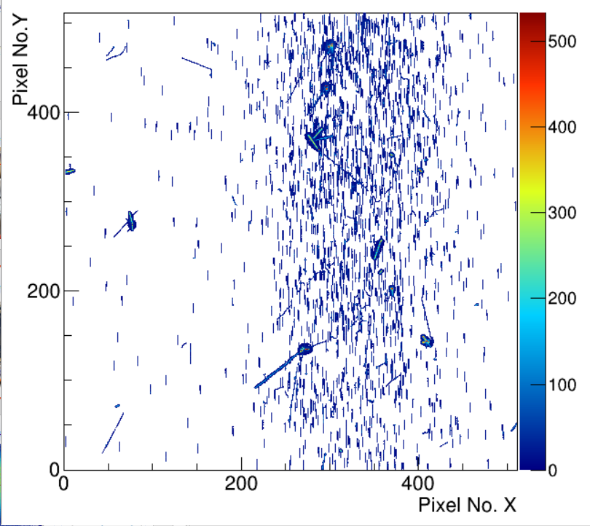
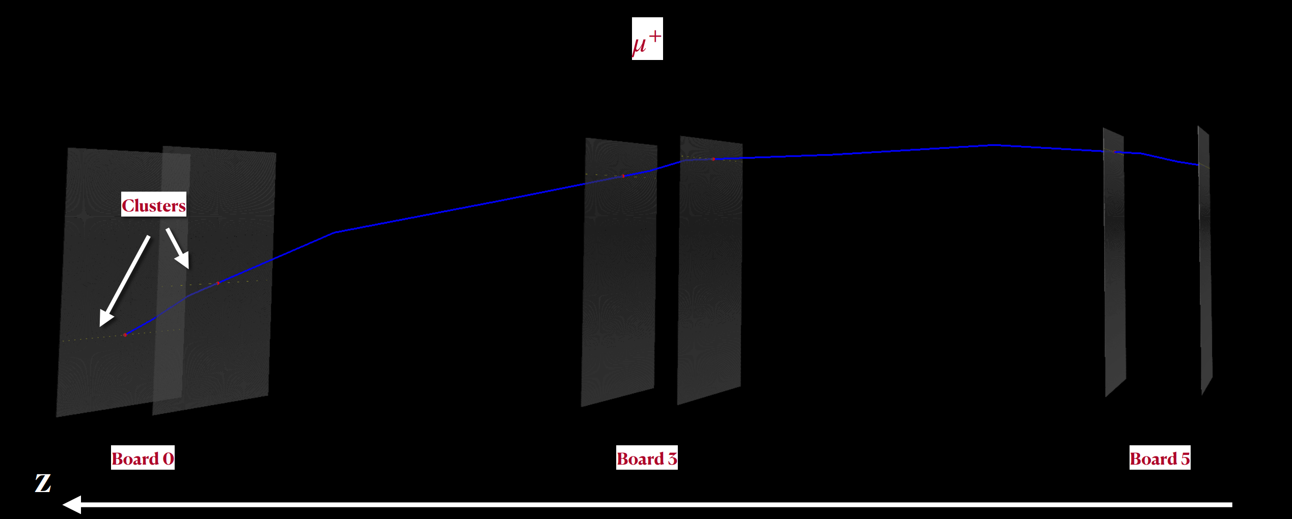
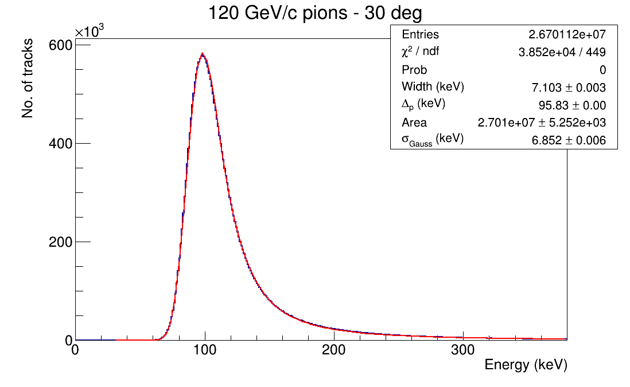
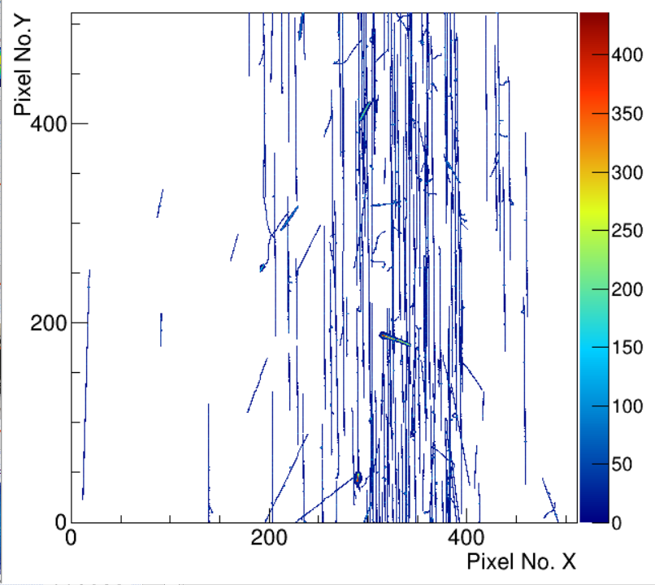
Tracking modules
Mapping the B-field strength

Slide 19
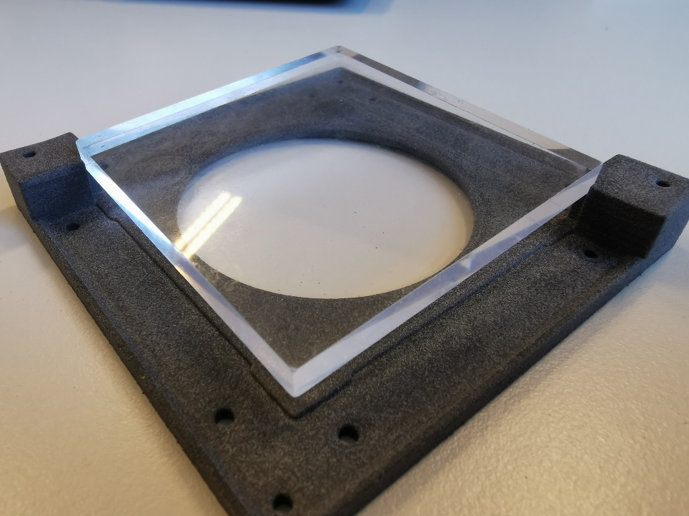
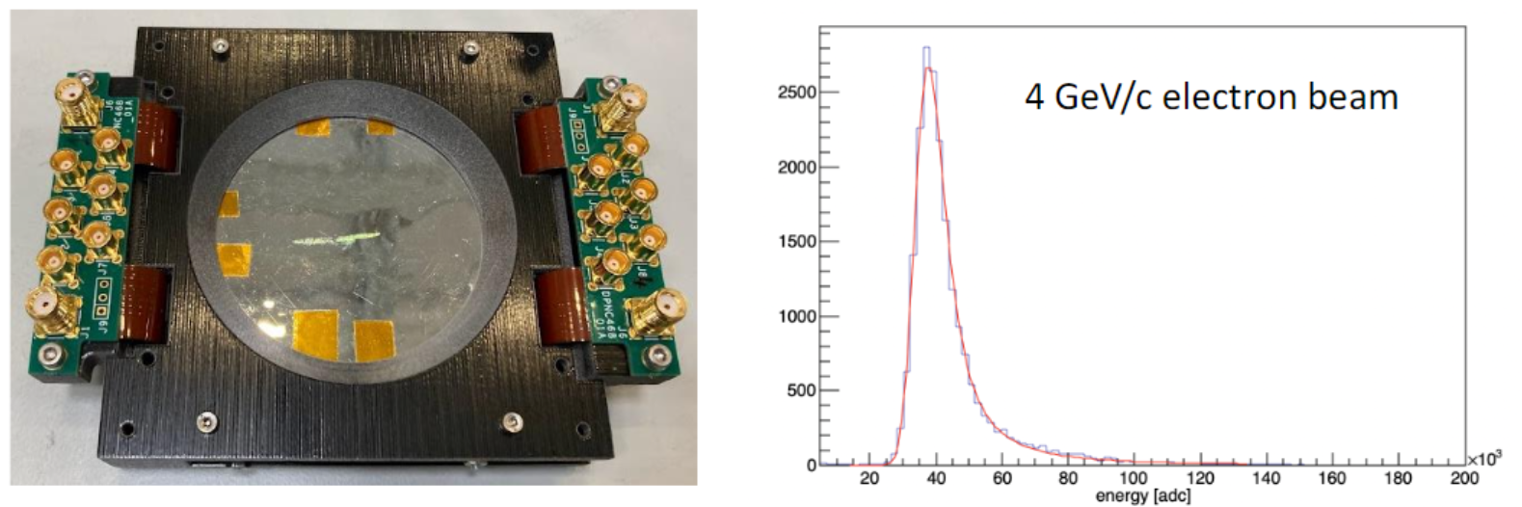
TOF module
Plastic scintillator coupled to SiPM
Time resolution is ~200 ps.
Mapping the B-field strength

Slide 20
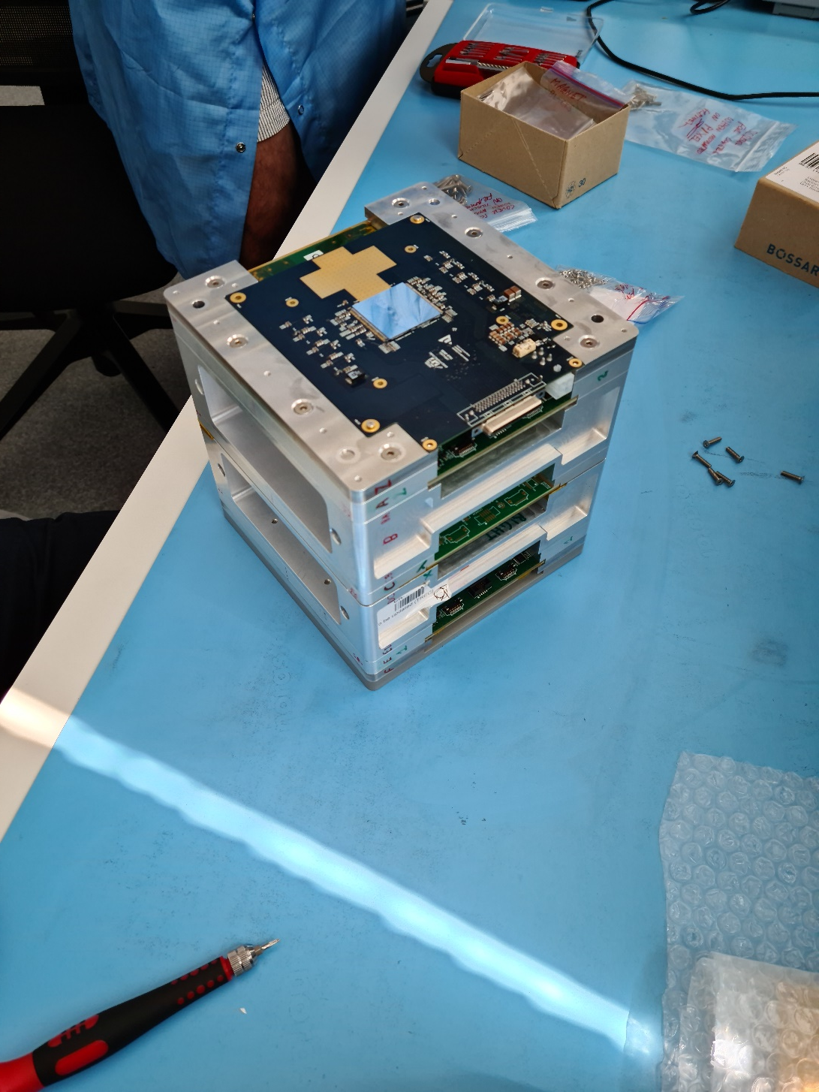
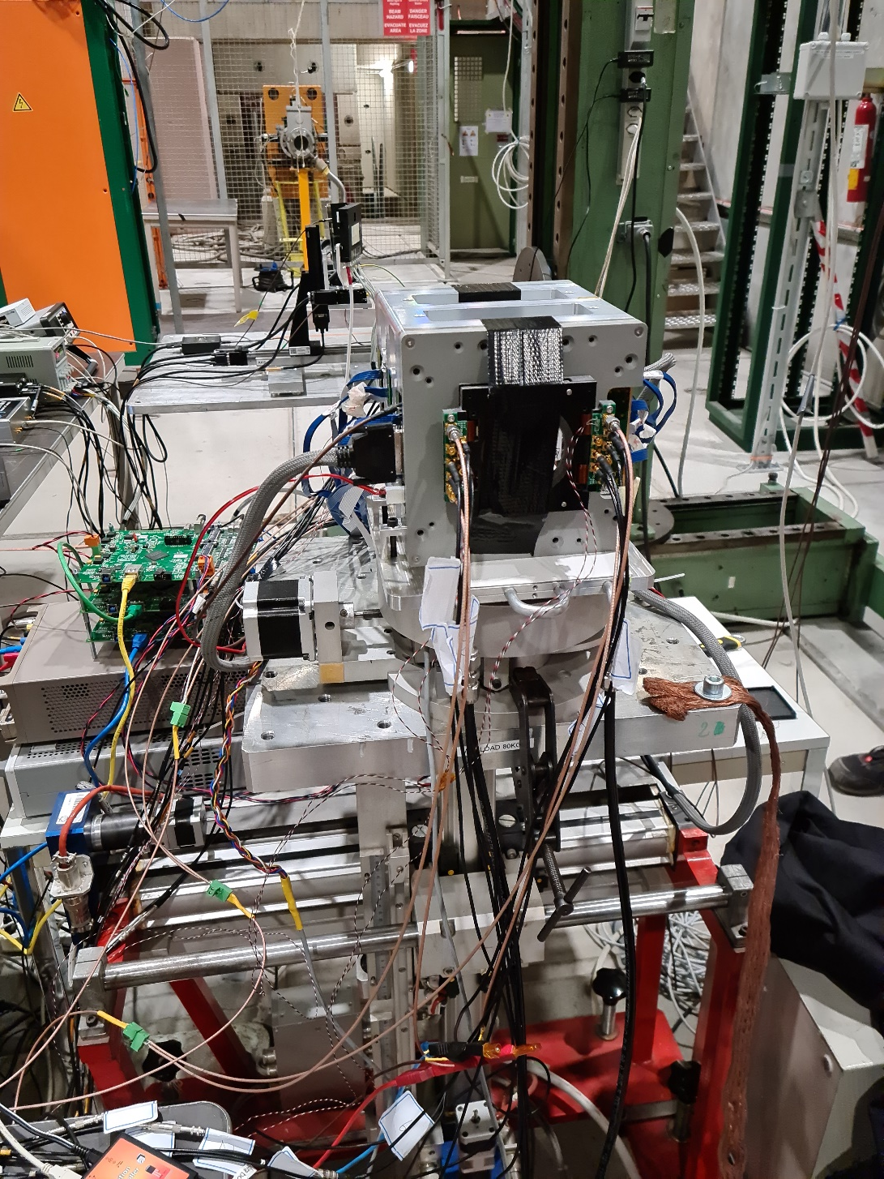
Mechanics integration
SPS test beam setup
Pixel module integration

Slide 21
Conclusion and outlook
The Timepix detector‘s capability of single-layer particle tracking and particle species separation allows production of competitive radiation monitors with one order of reduction in mass
Timepix3 detectors are part for particle spectrometers for measurements of galactic cosmic ray properties
We are applying for funding to build a magnetic spectrometer purely based Timepix4 (dt ~ 200 ps, modified pixel pitch) → Pix.PAN

Slide 22
Thank you for your attention!
PAN collaboration G. Ambrosi, P. Azzarello, M. Barbanera, B. Bergmann, B. Bertucci, P. Burian, F. Cadoux, M. Campbell, M. Caprai, F. Cosso, M. Duranti, Y. Favre, St. Gohl, M. Graziani, T. Iizawa, M. Ionica, M. Kole, D. Lamarra, M. Malich, E. Mancini, P. Manek, L. Mussolini, M. Paniccia, P. Smolyanskiy, S. Pospisil, J. Stauffer, D. Sukhonos, P. A. Thonet, N. Tomassetti, X. Wu, and P. Xie
Medipix collaborations

Slide 23
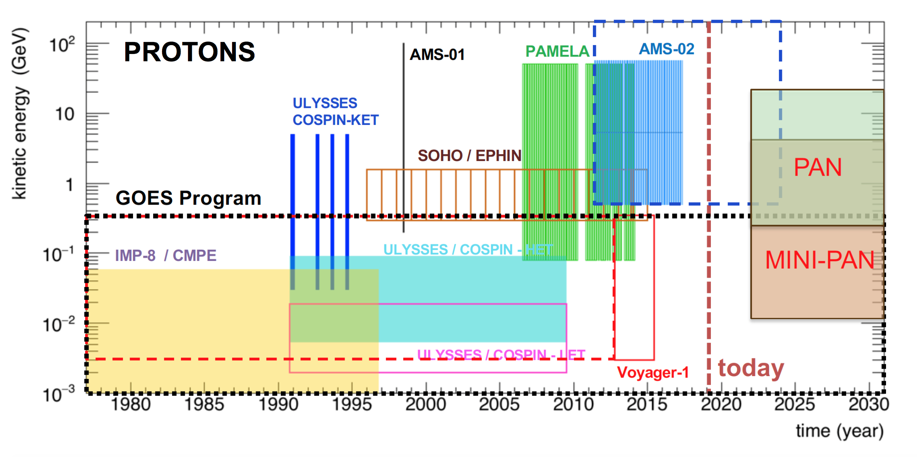
G. Ambrosi et al., "The Penetrating particle ANalyzer (PAN) instrument for measurements of low energy cosmic rays," 2019 IEEE Nuclear Science Symposium and Medical Imaging Conference (NSS/MIC), 2019, pp. 1-8, doi: 10.1109/NSS/MIC42101.2019.9059946.

Slide 27
Improving particle identification and spectroscopy using machine learning
Notes:
Ok. So far so good, but can’t we do better, e.g. using neural networks.

Slide 28


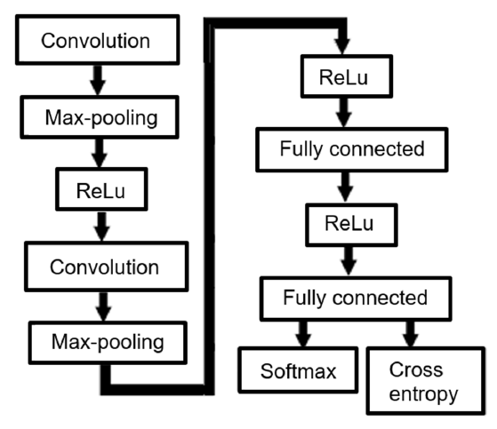
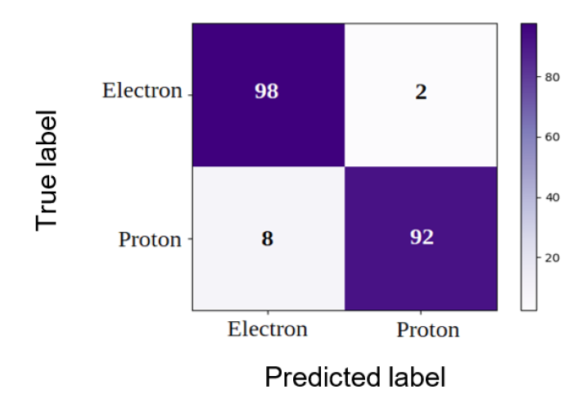
CNN – convolution neural network for separation of electrons and protons
Ground truth - simulation:
Spherical source with cosine distributed angles
10 Mio electrons from 0.4 to 5 MeV
10 Mio protons from 17 to 200 MeV
M. Ruffenach et al., “A new technique based on convolutional neural networks to measure the energy of protons and electrons with a single Timepix detector”, in IEEE TNS, 68, 8, pp. 1746-1753, (2021). doi: 10.1109/TNS.2021.3071583
Notes:
At the end of the 50 epochs, the accuracy of the training set is about 95.35% and the accuracy of the validation set is about 96.06%.
Normalized confusion matrix.
Here a nice study was done by Marine from CNES / Onera! As ground truth, she simulated 10 Mio electrons in the relevant energy range and the same amount of protons.
Electrons were identified correctly in 98% while 92% were identified correctly.

Slide 29
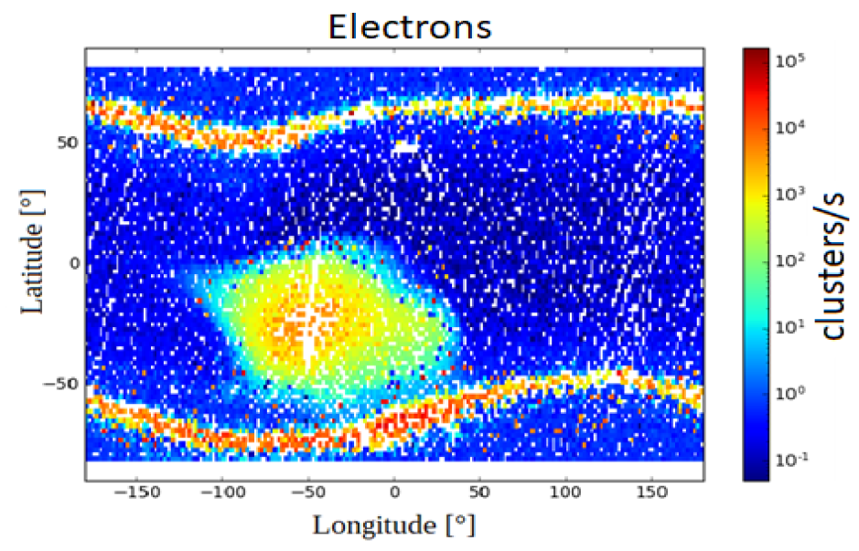
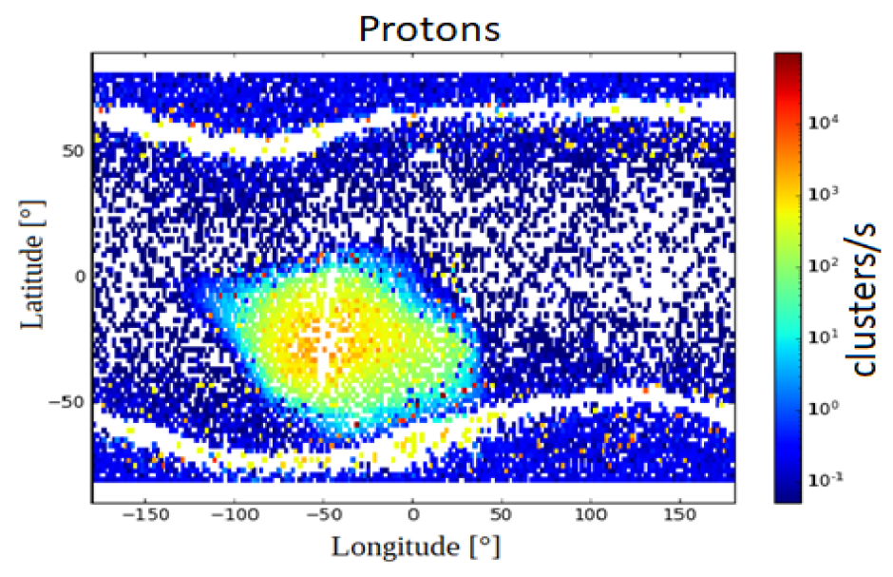
CNN – convolution neural network for separation of electrons and protons
M. Ruffenach et al., “A new technique based on convolutional neural networks to measure the energy of protons and electrons with a single Timepix detector”, in IEEE TNS, 68, 8, pp. 1746-1753, (2021). doi: 10.1109/TNS.2021.3071583
Notes:
The in-orbit maps of this study are seen here … They confirm the results seen with the analytical model with statistical interpolation.

Slide 30
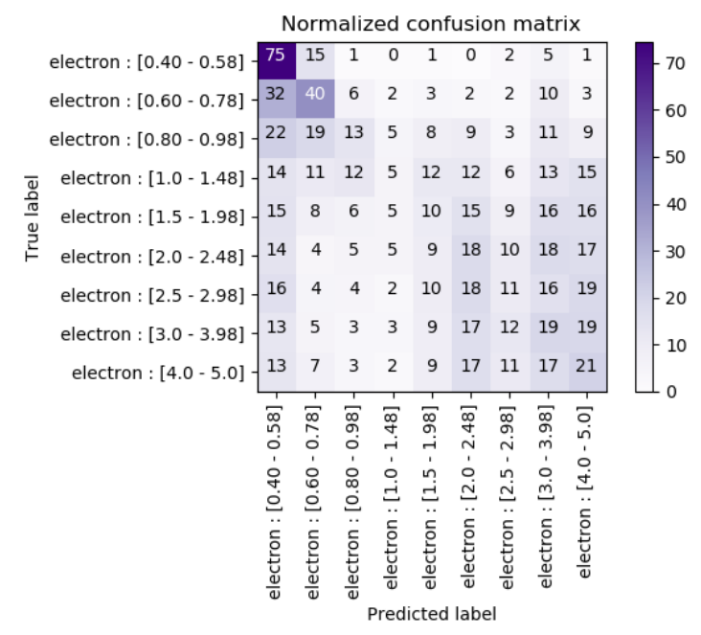
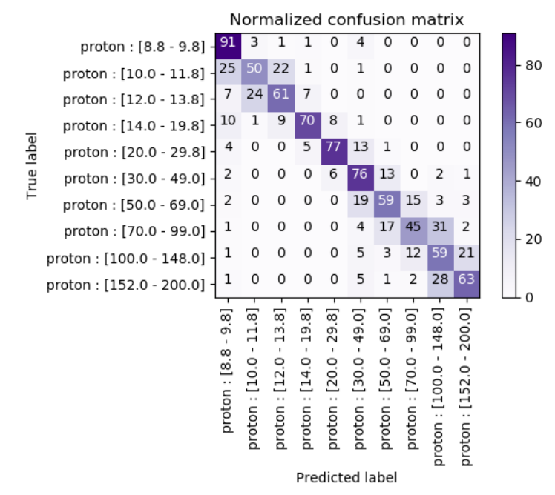
CNN – convolution neural network for incident energy determination
Particle spectroscopy capability is key for improvements of models in space physics
Proton incident energy determination with reasonable accuracy
Electron incident energy determination was not possible with good accuracy
Use e.g. stopping filters defining different regions on the sensor and do statistical analysis
Notes:
In a next step the question was whether such a network would also be able to determine the imping particle energy. Therefore the electron and proton categories were divided into energy bins. The resulting normalized confusion matrices are shown here. While for protons a crude energy separation could be achieved , there is no sensitivity to the electron spectrum.

Slide 31





Slide 32
Comparison with other radiation detectors in LEO

Slide 33


SATRAM vs. EPT (Energetic Particle Telescope)*⁾:
Electron fluxes
*⁾ EPT and SATRAM are both on Proba-V.
60 seconds integration time
Notes:
Electron energy spectra as a function of time and the L-parameter;
Binning 60 s

Slide 34



SATRAM vs. ICARE-NG:
Proton fluxes
Latitude = -30°
M. Ruffenach et al., “A new technique based on convolutional neural networks to measure the energy of protons and electrons with a single Timepix detector”, in IEEE TNS, 68, 8, pp. 1746-1753, (2021). doi: 10.1109/TNS.2021.3071583

Slide 35
Penetrating particle analyzer based on Timepix4 - Pix.PAN

Slide 37



Pix.PAN:
Performance considerations and Timepix4
Mini.PAN with 3 tracking station consisting of 2 Timepix4 quads as sensing element
Significant simplification of mini.PAN
Add high rate capability
Self-triggered operation in data-driven mode
5D vector ($\overset{⃑}{x}$,$t$,$\frac{dE}{dX}$) with $∆t<200$ ps in each station
Requirements/challenges:
Thin sensor and ASIC (total thicknesss < 400 µm)
Synchronization of 24 Timepix4 with low jitter
Desired power consumption < 20 W (vs 60 W)
Bending direction spatial resolution needed is < 5µm (vs current Timepix4 baseline design 16 µm)
(optional)

Slide 38

Pix.PAN:
Rectangular pixel design as solution?
Pitch in non-bending direction is not crucial for particle kinetic energy determination
Use asymmetric “long thin“ pixels with a “pitch adapter“ for oversampling in one direction and connect only 1/8 pixels!
Pixel 13.75 x 1760 µm - creates a matrix of 8224 in bending by 56 pixels in non-bending direction with $dx=3.7$ µm
Power comsumption reduced to ~25 W. Further reduction by explointing chip configurations (operation at reduced clock, ... )
32 Timepix4 pixels

Slide 39
Conclusion and outlook
The Timepix detector‘s capability of single-layer particle tracking and particle species separation allows production of competitive radiation monitors with one order of reduction in mass
Future development should focus on improving
  Resource-efficient algorithms for on-board processing and data compression
  Electron and proton spectroscopy
Timepix3 detectors are part for particle spectrometers for measurements of galactic cosmic ray properties
We are applying for funding to build a magnetic spectrometer purely based Timepix4 (dt ~ 200 ps, modified pixel pitch) → Pix.PAN

