Slide 1
ATHENA NEWS, 1/31/2022
About Collaboration Meetings
Restarting with all meetings
WG meetings (today at 18.00 CET: PID)
Bi-weekly (ATHENA Collaboration meeting) on February 3rd at 11.00 am EST, as usual
EIC_NET meeting, January 31, 2022

Slide 2
ATHENA NEWS, 1/31/2022
Proposal completion and Proposal defending
First message: the written version of the Proposal is only part of the effort !
Proposal submitted
It will become public (w/o costing matter) at
the end of the Call for Proposal process
A limited number of printed copies will be available
EIC_NET meeting, January 31, 2022

Slide 3
DPAP MEETINGS
December 13-15 ( https://indico.bnl.gov/event/13614/ )
Open presentations, 3 for ATHENA:
Silvia Dalla Torre
Overview of key points, addressing the science requirements in the Call for Proposals, the conceptual realization of the detector given the technology choices, and expected performance via simulation studies.
Thomas Ullrich
Describe the R&D needs and risks, and potential upgrade paths.
Bernd Surrow
Describe the collaboration and its structure, the proposed schedule and cost, including potential sources of non-project funding and assumptions.
Contribution came from ATHENA members during the discussion phases
January 19-31
Executive Session with ATHENA on 1/19:
Silvia, Bernd
a small group of experts invited to attend
Directly involved in preparing the answers
“online” on SLACK all EB and WG conveners
All this contributions fundamental for appropriate professional answering to the DPAP questions posed during the session
Valerio Calvelli, CEA-Saclay Alexandre Camsonne, JLab Alex Jentsch, BNL Laura Gonella, Birmingham University Leo Greiner, LBL Thomas K Hemmick, Stonybrook University Sylvester Joosten, ANL Alexander Kiselev, BNL Jeff Landgraf, BNL Paul Newman, Birmingham University Brian Page, BNL Krzysztof Piotrzkowski, Matt Posik, Temple University Paul Reimer, ANL Ernst Sichtermann, LBL Oleg Tsai, BNL Zhoudunming Tu, BNL Thomas Ullrich, BNL Alexander Vasilyev, BNL Anselm Vossen, Duke University Zhenyu Ye, University of Illinois Chicago Maria Zurek, ANL

Slide 4
HOMEWORK
Timelines
DPAP
Questions received: 12/17/2031
dead-line for answers: 1/16, 2022 matched
Further DPAP questions
Questions received: 1/21/2022
dead-line for answers: 1/30, 2022 matched
DAC
Questions received: 12/22/2031
dead-line for answers: 1/9, 2022 matched
Reminder: also answers to oral questions during December 2031 DPAP meeting
All submitted material :
Is going to be collected in a single site with password;
Information to you all in a few days
EIC_NET meeting, January 31, 2022

Slide 5
WHAT’s next?
ABOUT THE CALL
It is expected that the whole process is concluded by March 1st (according to schedule)
We will learn about the outcome in ~ 1.5 m
ABOUT WG conveners
Baseline: they continue till we will have to move to a different structure
WG conveners that prefer to pause, have to contact the SP-team
EIC_NET meeting, January 31, 2022

Slide 6
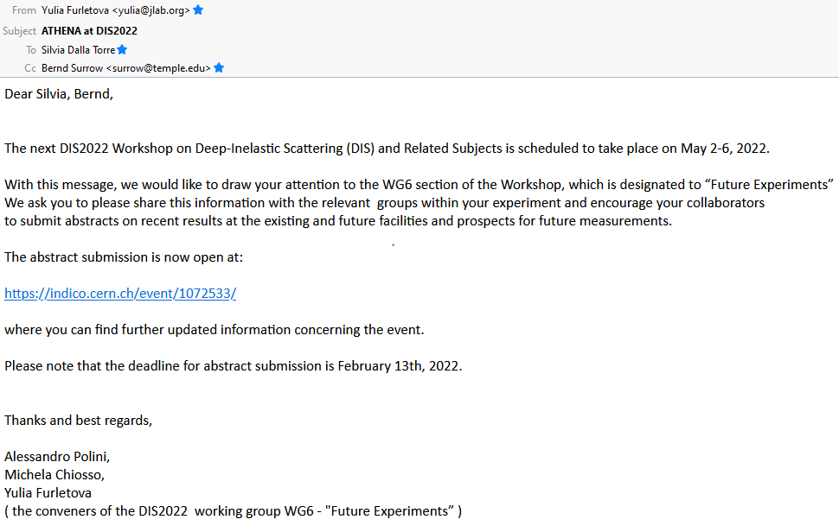
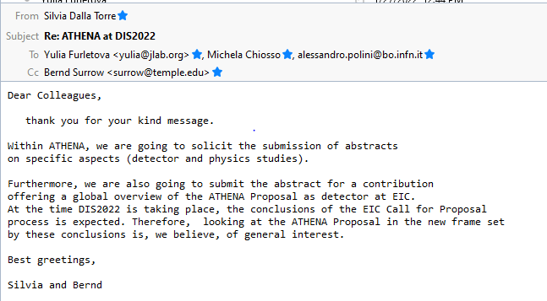
ATHENA at DIS2022
EIC_NET meeting, January 31, 2022

