Slide 1

ERL in EUROPEAN STRATEGY FOR PARTICLE PHYSICS.
Accelerator R&D Roadmap and it's impact on photocathode research.
Boris Militsyn
STFC Daresbury Laboratory, UK
European Workshop on Photocathodes for Accelerator Applications (EWPAA 2022)
Milano, Italy, 20-22 September 2022

Slide 2
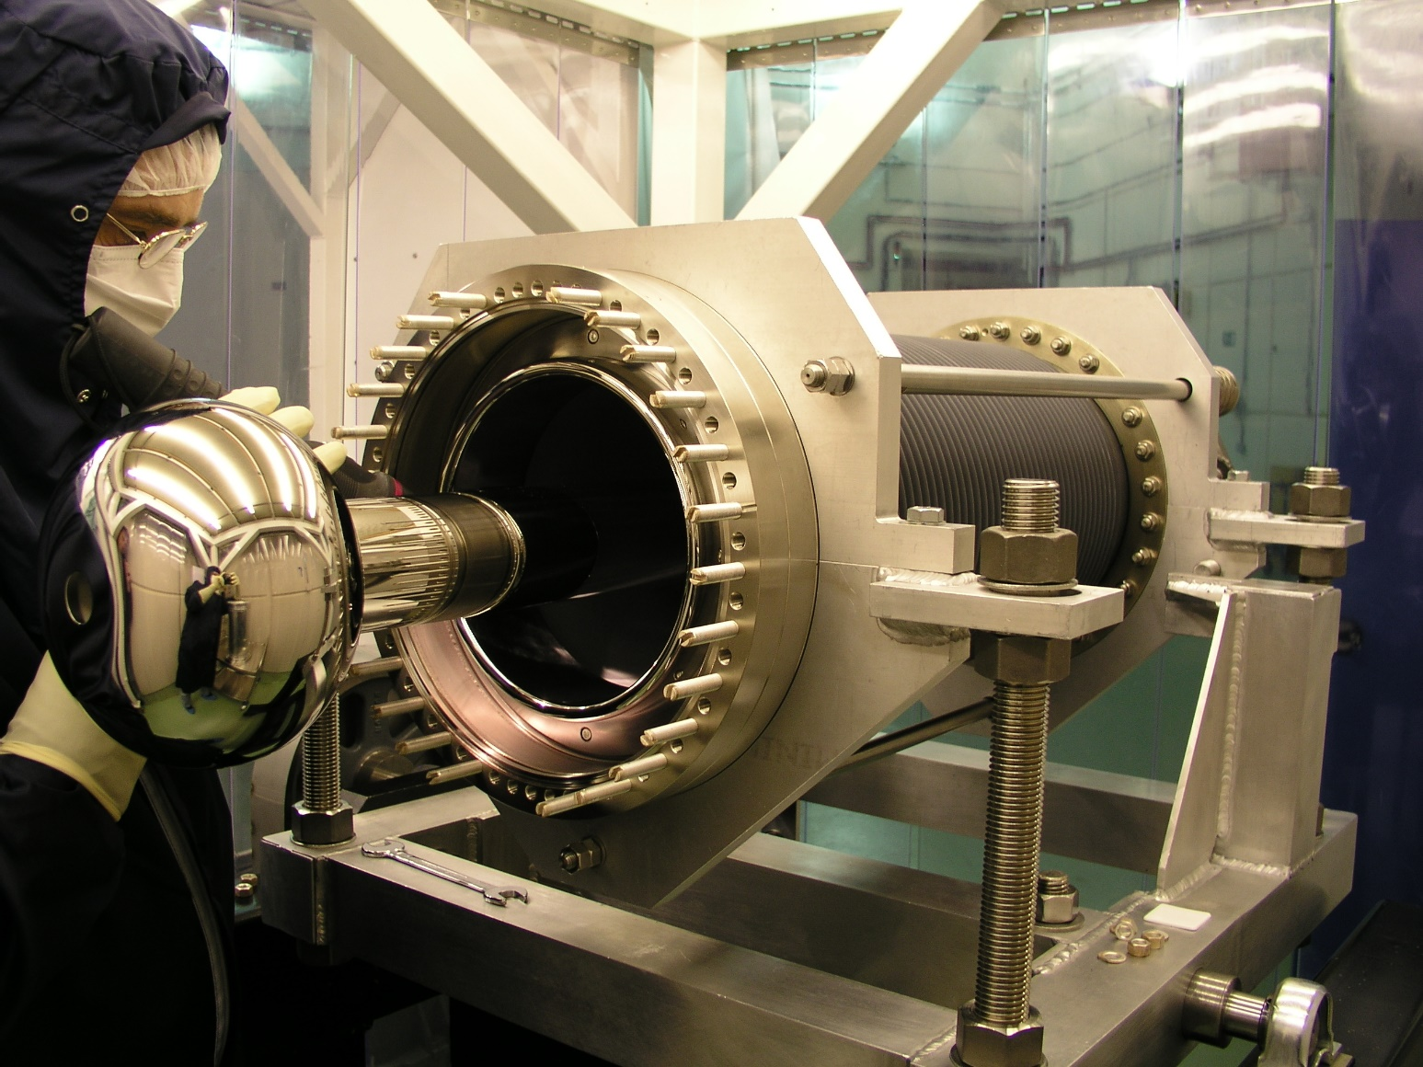
Outline
New challenges in particle physics
ERL in Accelerator R&D roadmap
Applications of ERL
High average current electron sources for ERL, current status and development
Photocathode infrastructure for ERL injector
PERLE and its electron injector
Conclusion
Image © STFC John Dawson
Notes:
There were several perfect reviews about CW injectors given to LINC’2020 and IPAC’2021 so I would concentrate on injectors which operate or designed for operation at a current of 100+ mA.

Slide 3

EUROPEAN STRATEGY FOR PARTICLE PHYSICS
Accelerator R&D Roadmap
High-ﬁeld magnets
High-gradient RF structures and systems
High-gradient plasma and laser accelerators
Bright muon beams and muon colliders
Energy-recovery linacs
The FCC-ee R&D programme
ILC-speciﬁc R&D programme
CLIC-speciﬁc R&D programme
Sustainability considerations
https://doi.org/10.23731/CYRM-2022-001

Slide 4
Particle Physics: The Challenge Ahead
From ERL White Paper arXiv:2207.02095
High field magnets, SRF, ERL, Muon Collider, and Plasma Wakefield
The five acc. technology pillars identified last year and by Council/SPC/LDG.

Slide 5
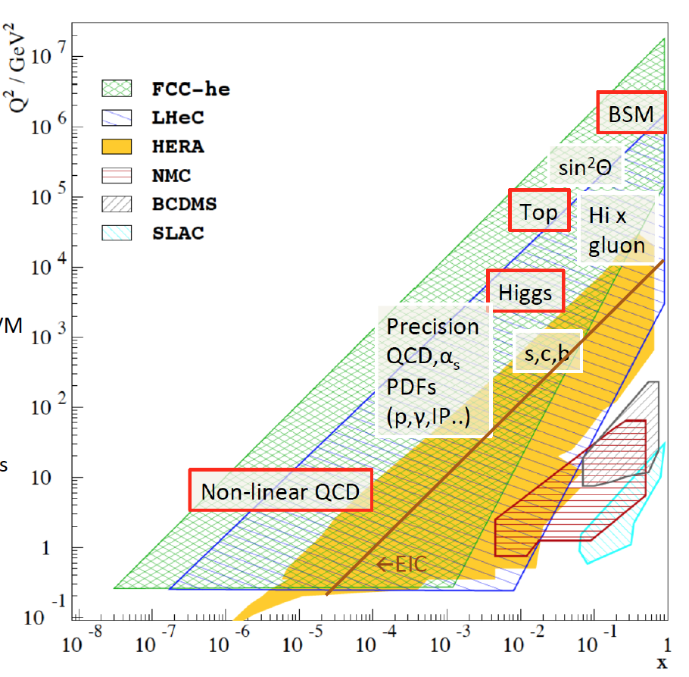
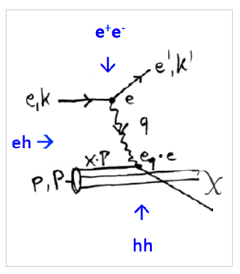
Physics with Energy Frontier DIS
Deep Inelastic Scattering
Raison(s) d’etre of ep/eA
at the energy frontier
Cleanest High Resolution
Microscope: QCD Discovery
Empowering the LHC/FCC
Search Programme
Transformation of LHC/FCChh into
high precision Higgs facility
Discovery (top, H, heavy ν’s..)
Beyond the Standard Model
A Unique
Nuclear Physics Facility

Slide 6
[from a report to LDG 5/21]
4

Slide 7
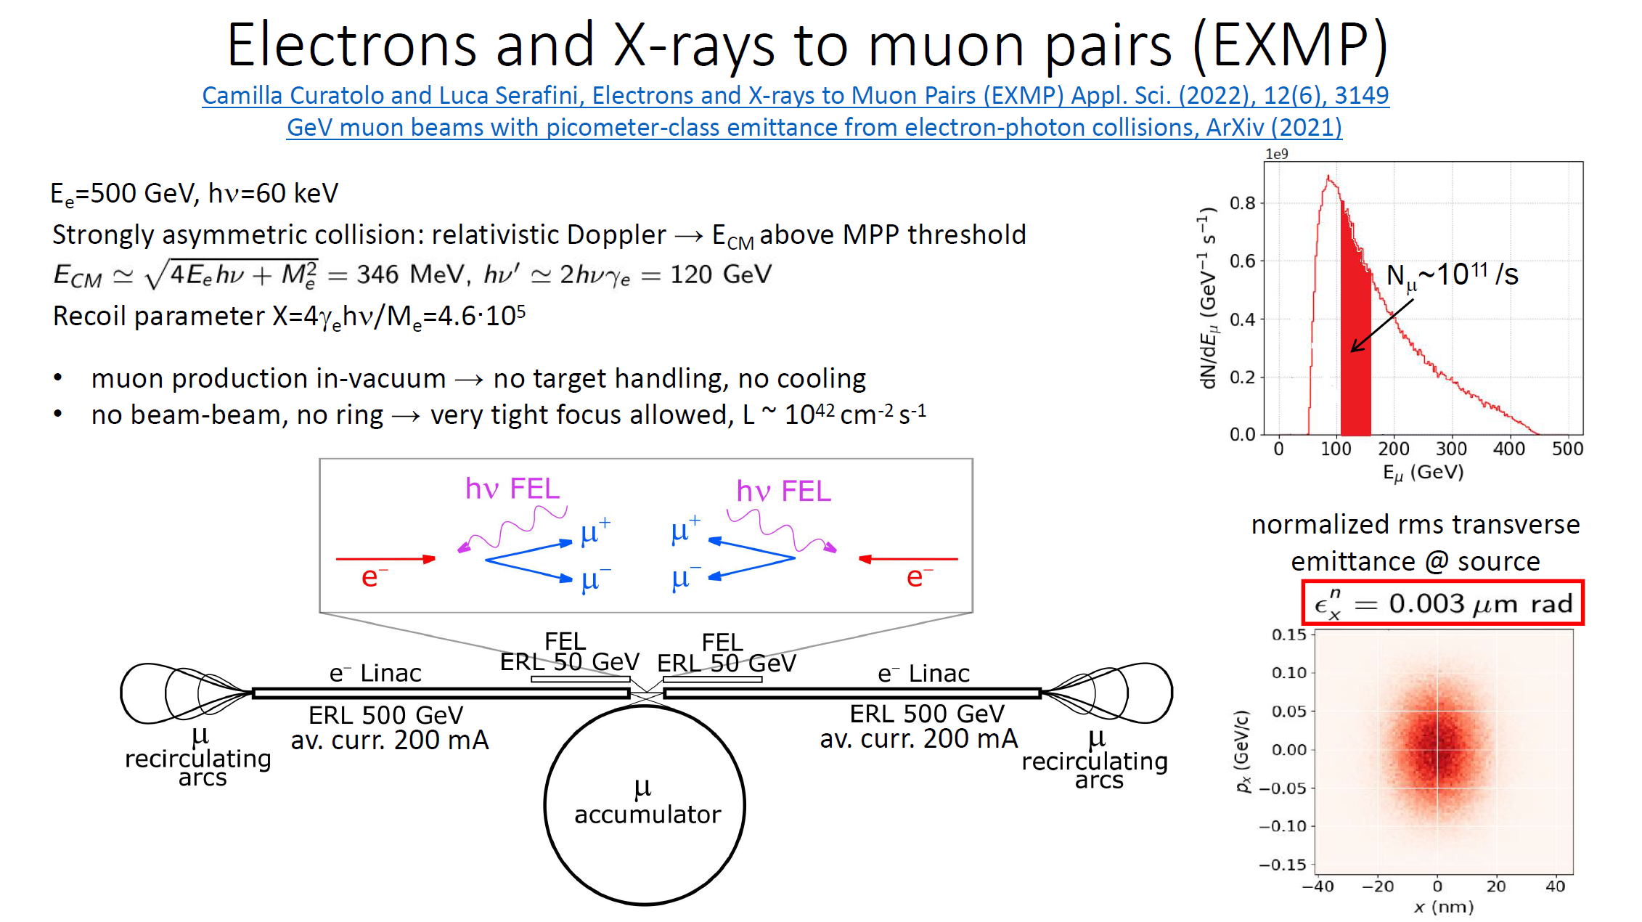
Courtesy Camilla Curatolo

Slide 8
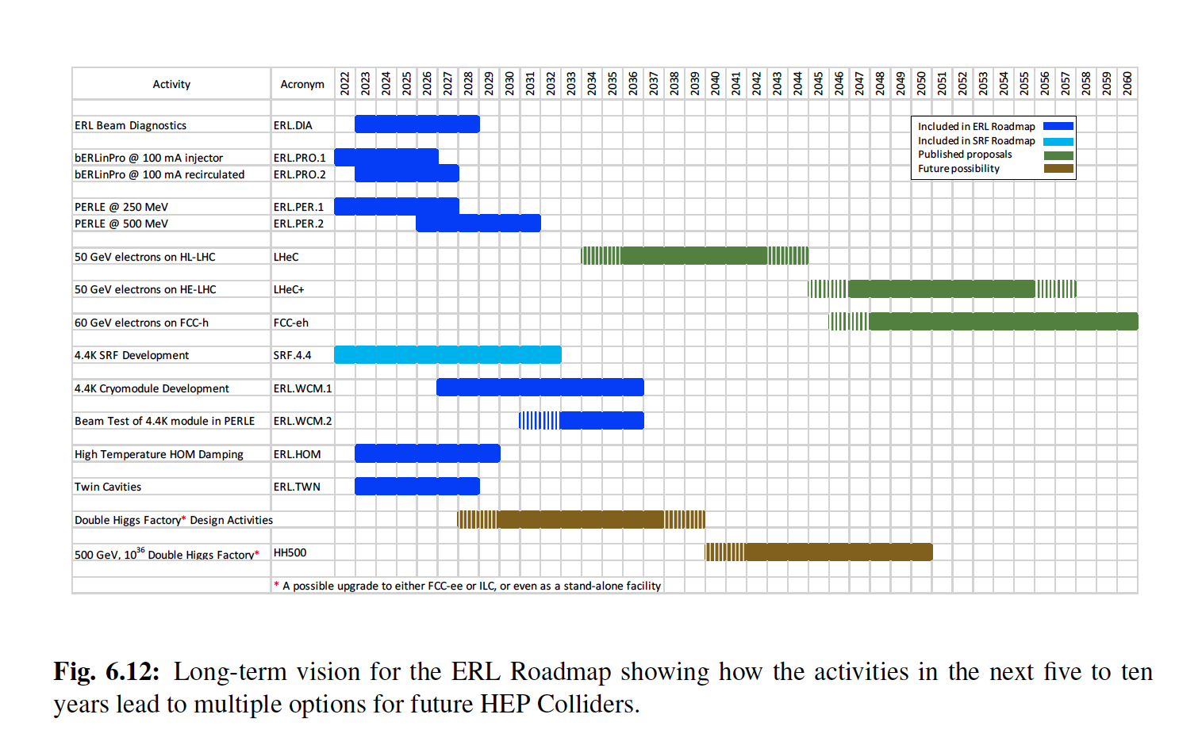

Slide 9
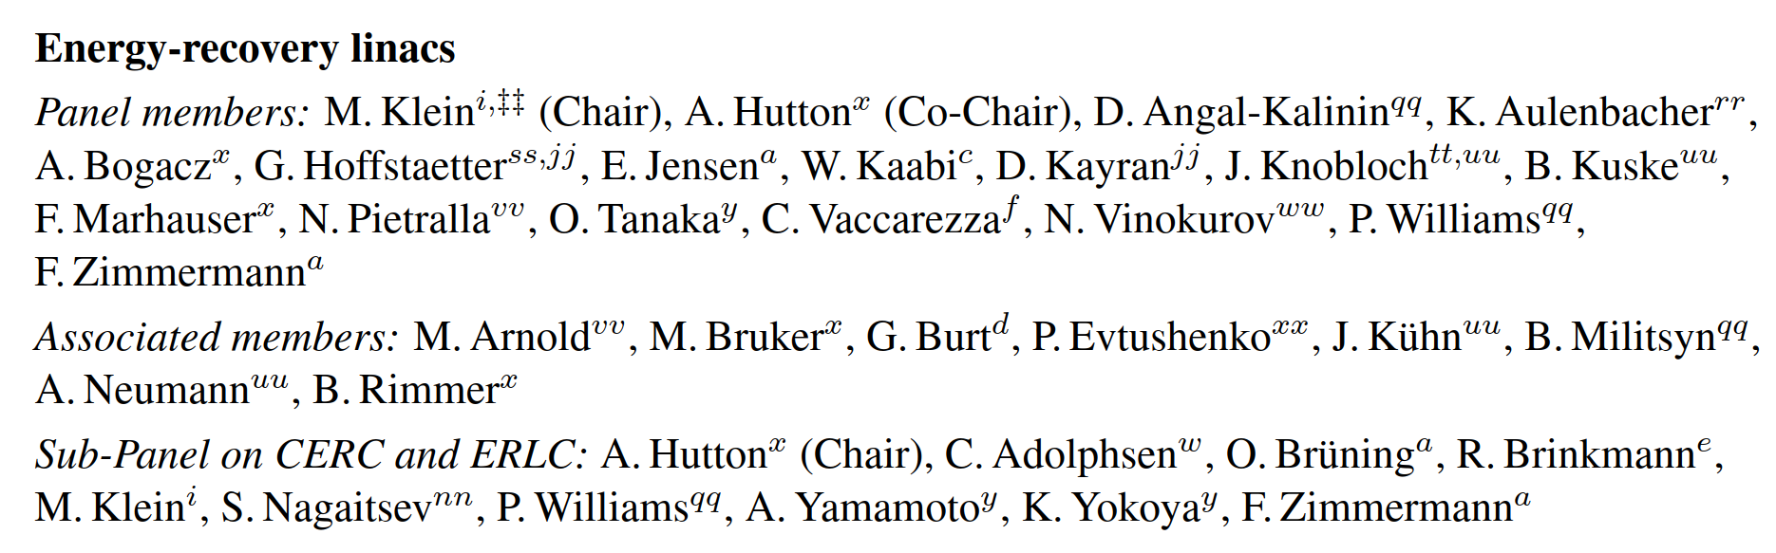
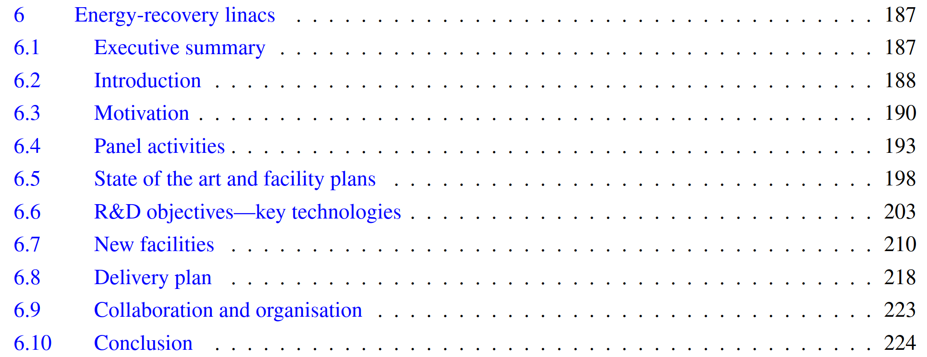
ERL chapter contents
6 Energy-recovery linacs . . . . . . . . . . . . . . . . . . . . . . . . . . . . . . . . . . 187
6.6.1 High-current electron sources
Injectors for particle physics ERLs, which require high average current in combination with a complicated temporal beam structure, are typically based on photocathode guns. These guns rely on photocathodes, e.g., semiconductor materials, which for high average current are based on (multi)alkali antimonides, or GaAs-based systems for polarised beams, in combination with a photocathode drive laser and extremely-high-vacuum accelerating structure.
6.6.2 SRF technology and the 4.4 K perspective
6.6.3 Fast reactive tuners
6.6.4 Monitoring and beam instrumentation
6.6.5 Simulation and education
6.6.6 Higher-Order Mode damping at high temperature
6.6.7 SC twin cavities and cryomodules

Slide 10
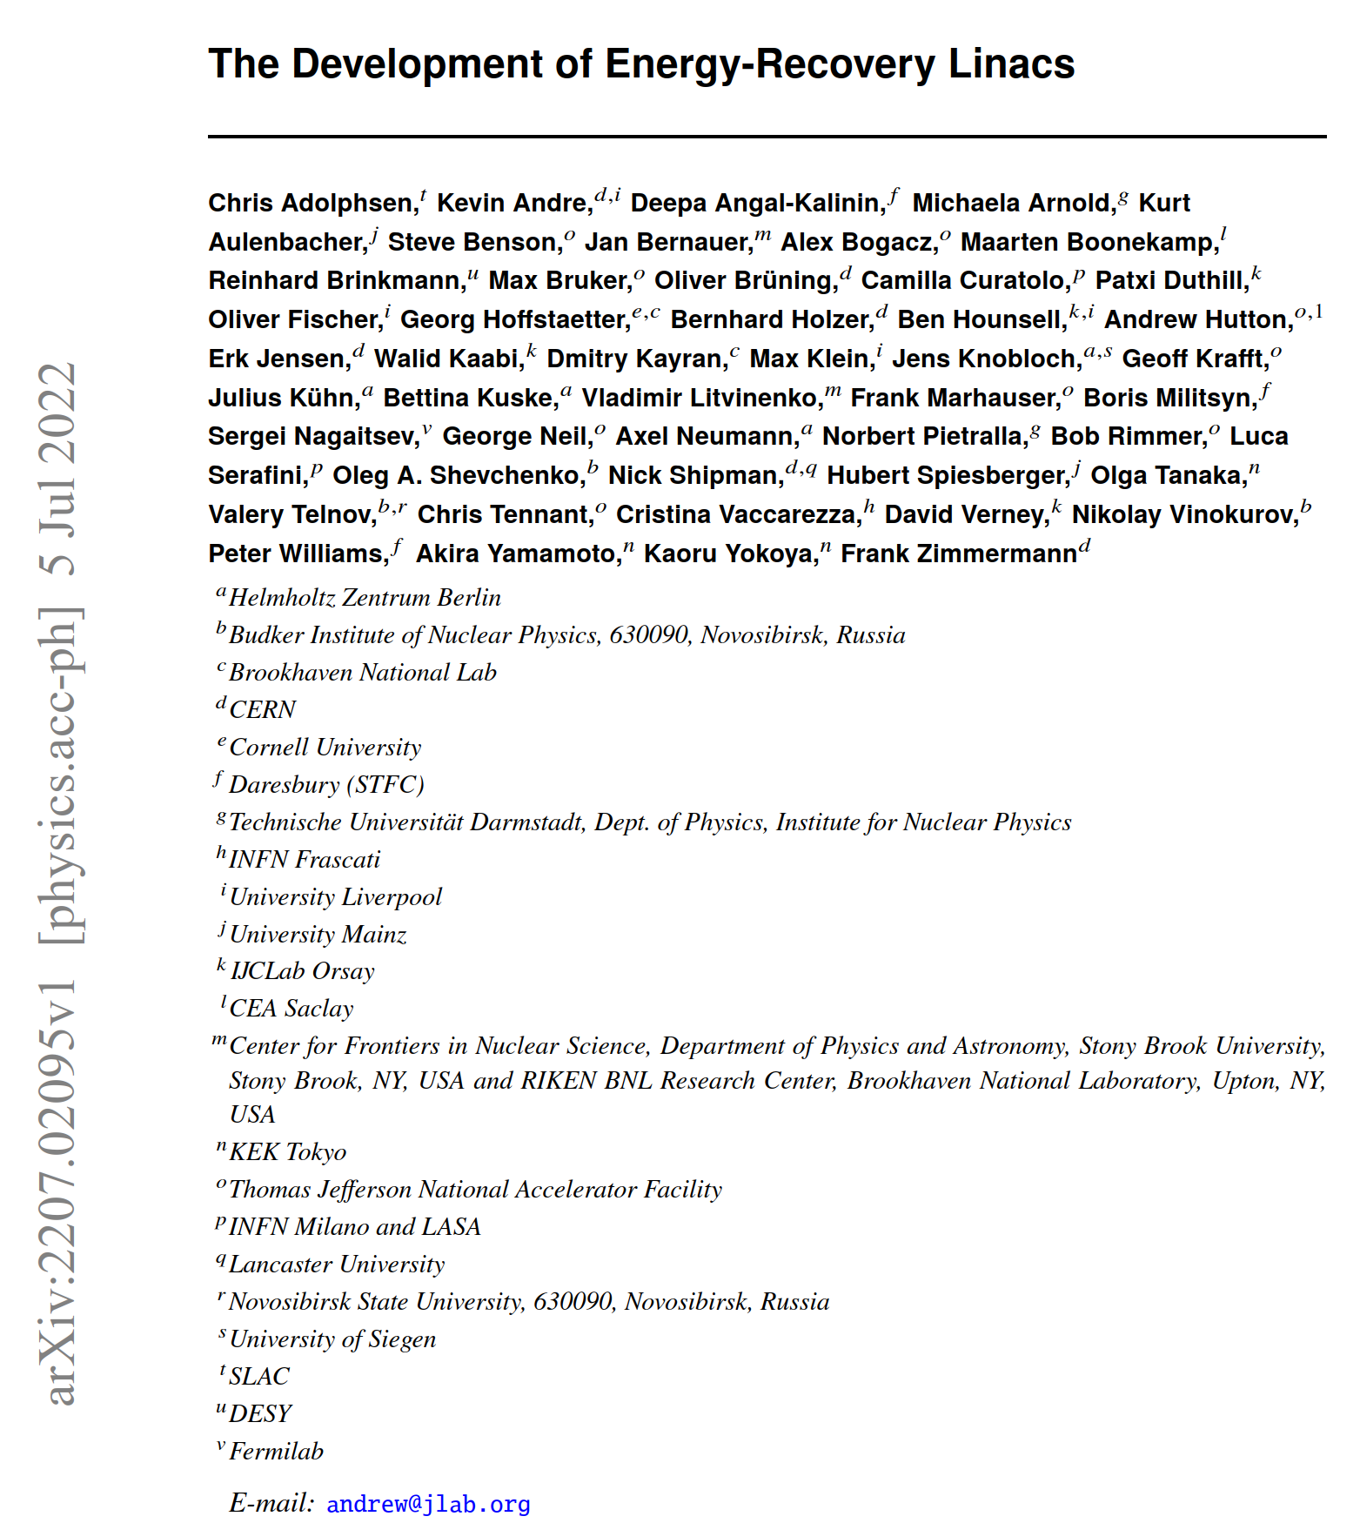
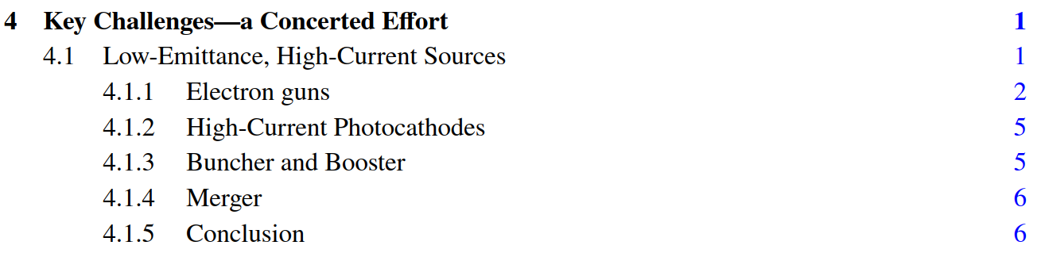
Development of ERLs
More detailed document on Development of ERL is submitted for publication in JINST. A preprint is available in arXiv:2207.02095

Slide 11
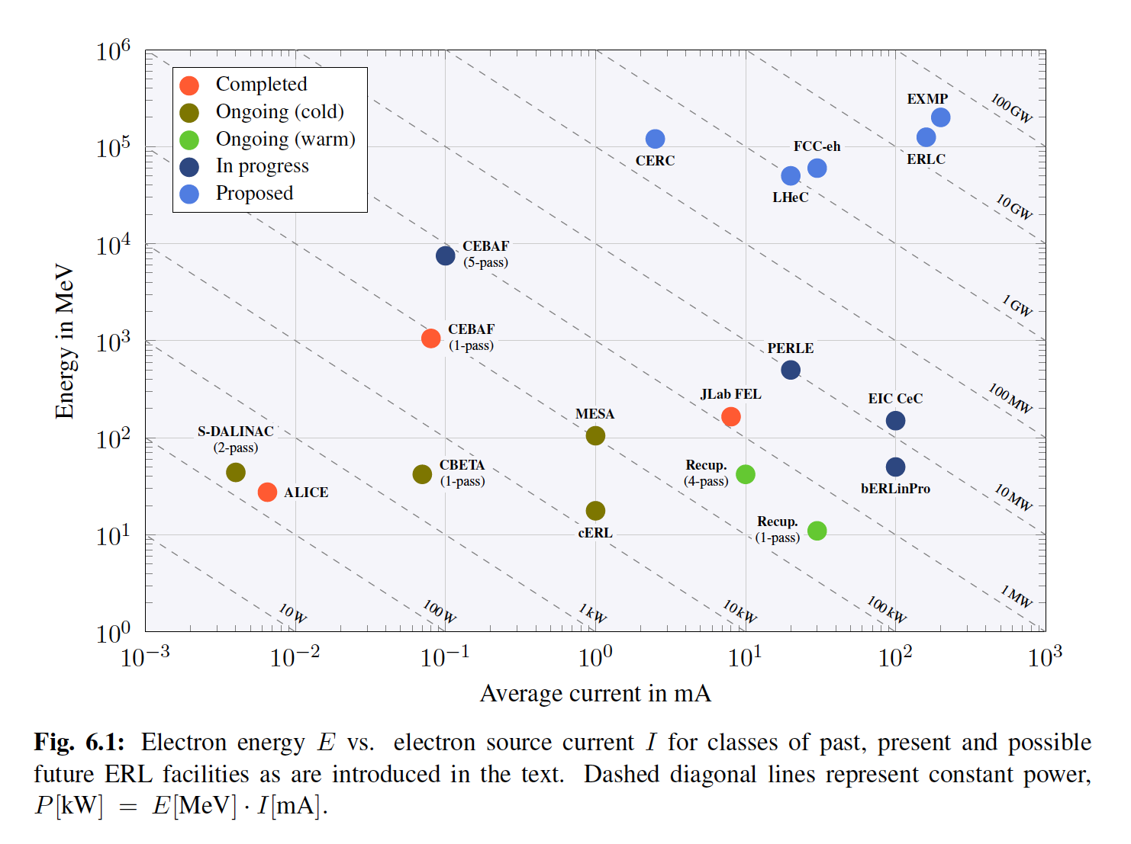
ERLs in the world

Slide 12
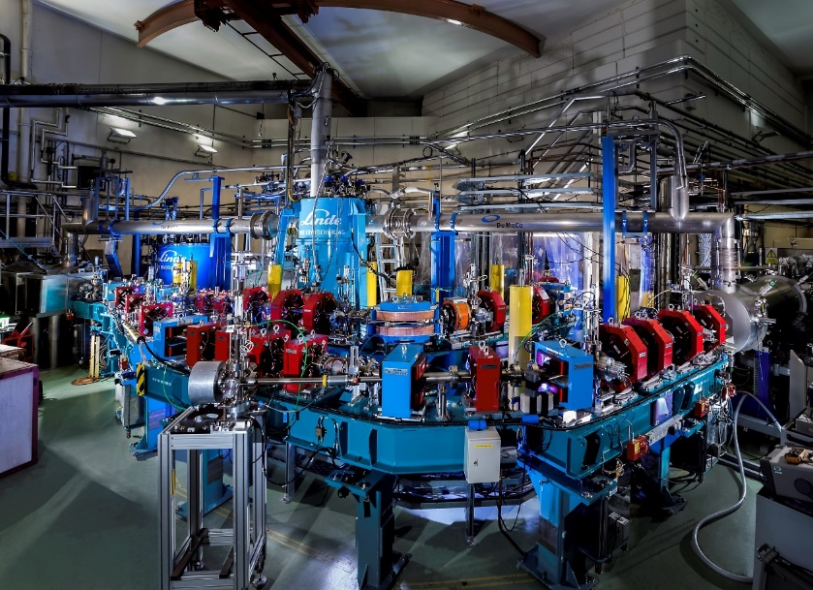
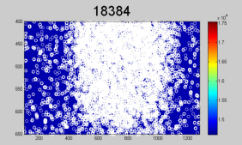
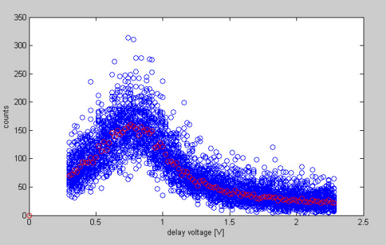
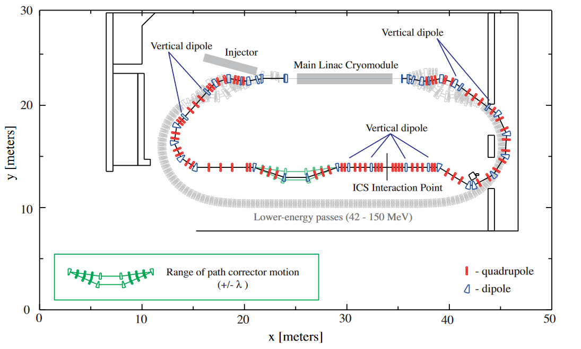
ERL applications
Free Electron Lasers
Inverse Compton Scattering Gamma Sources
Test experiments carried out on Daresbury ALICE (2009)
JLab FELs (1995 – 2013): 10kW IR-FEL, 1kW UV-FEL, broadband THz
Daresbury ALICE (2005 – 2017)
EUV-FEL for semiconductor lithography
CBETA ERL https://doi.org/10.1103/PhysRevAccelBeams.24.050701

Slide 13
ERL electron photoinjectors. Beam emission
Charge delivered by photoinjector
  Photocathode material: its Quantum Efficiency (QE) and lifetime
    Level of operational vacuum required to provide acceptable photocathode lifetime for chosen material
  Laser pulse parameters on the cathode
    Spatial and temporal laser profile – pulse length and, as result, power density
    Laser pulse energy
      No problem for delivery by laser for “green” photocathodes, may be an issue for UV ones
      Laser pulse transport
        Mirror damage due to high peak and average power density - no problem for “green” photocathodes
Minimum dark current which may be an issue for “green” photocathodes
No problems with charge generation by thermionic injector

Slide 14
Photocathodes for 10’s mA ERL photoinjectors
Photocathodes which are of interest for HEP ERL’s
  Sb-based “green” photocathodes such as Cs₃Sb, Cs₂KSb, Na₂KSb, CsNaKSb and others
  Widely used in industry in PMT
  Enough robust for operation with high average current
  Laser systems are available
  Technolohgy under development for accelerator applications
    Optimisation of deposition procedure to obtain high QE
    Lifetime at high average current
    Operation at cryogenic temperature
    Mean Transverse Energy
GaAs based photocathode for delivery of polarised electrons
  Very sensitive to operational vacuum and as result low charge lifetime in the range of 100’s C
  Major efforts are concentrated on improving operational performance
  Potential shortage of supplying vendors
Cs₂Te photocathodes
  Very robust. Operated at DESY FLASH for 2 years
  High QE, but require UV laser which is not available for 10’s mA range
Low work function metal photocathodes: Pb, Mg
  Same cons & pros as Cs₂Te
Notes:
Sb-based photocathodes Collaboration BNL, HZB, LANL, INFN, DESY, LBNL

Slide 15
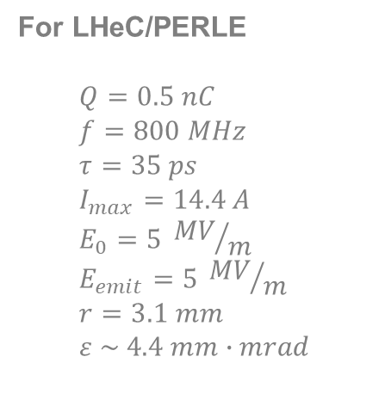
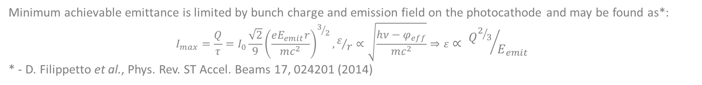


Optimal “cigar type” photoemission
For LHeC/PERLE
$$Q=0.5 nC \\ f=800 MHz \\ τ=35 ps \\ I_{max}=14.4 A \\ E_{0}=5 {MV}/m \\ E_{emit}=5 {MV}/m \\ r=3.1 mm \\ ε \sim 4.4 mm∙mrad$$
$$2r$$
$$τ={T_{RF}}/{36}$$
Photocathode
Minimum achievable emittance is limited by bunch charge and emission field on the photocathode and may be found as*:
$$I_{max}=\frac{Q}{τ}=I_{0}\frac{\sqrt{2}}{9}{\left(\frac{eE_{emit}r}{mc^{2}}\right)}^{3/2}, ε/r∝\sqrt{\frac{hν−φ_{eff}}{mc^{2}}}⇒ε∝ {Q^{2/3}}/{E_{emit}}$$
* - D. Filippetto et al., Phys. Rev. ST Accel. Beams 17, 024201 (2014)
Notes:
This formula does not take into account beam lengthening during propagation from cathode to the exit of the gun

Slide 16
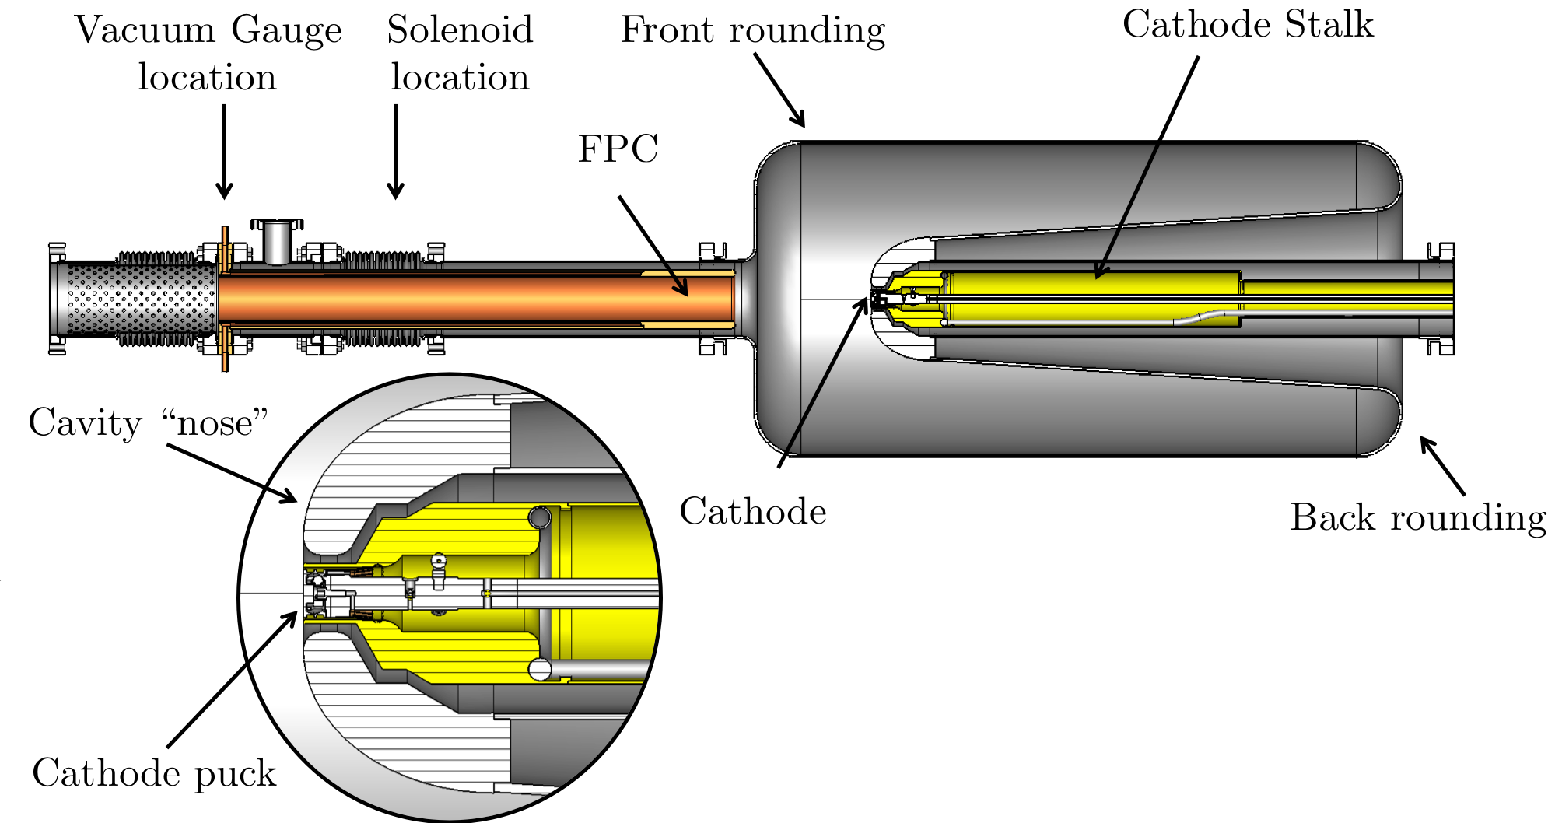
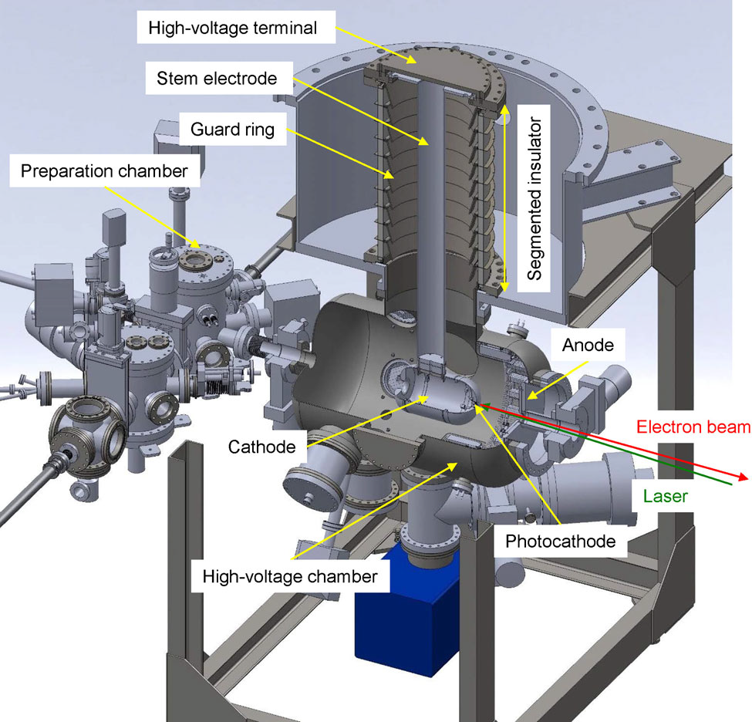
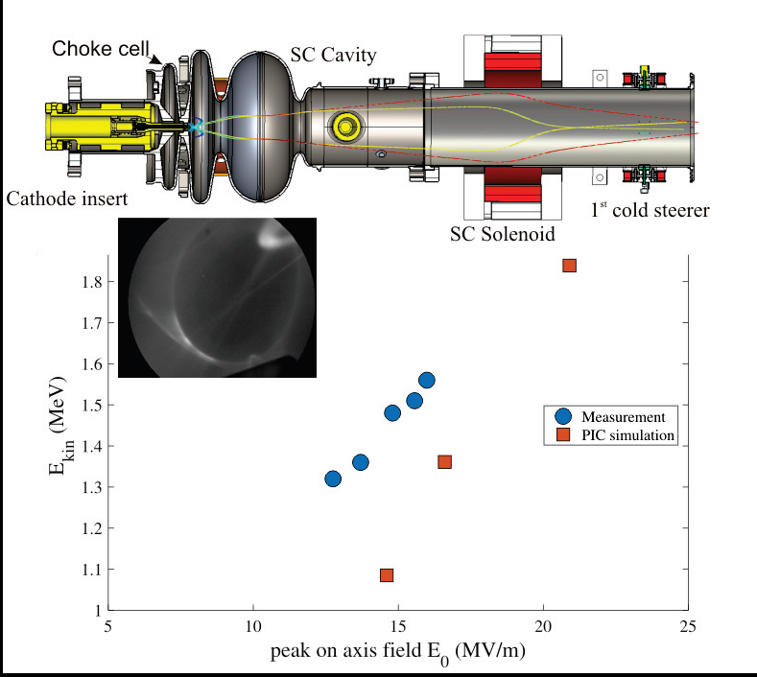
Technologies of high average current CW photoinjectors
SRF VHF photocathode guns
(BNL, LCLS)
NCRF VHF photocathode guns
(LCLS, SHINE)
DC photocathode guns (Jlab, Cornell, DL, KEK)
SRF L-band photocathode guns
(HZDR, HZB, DESY)

Slide 17
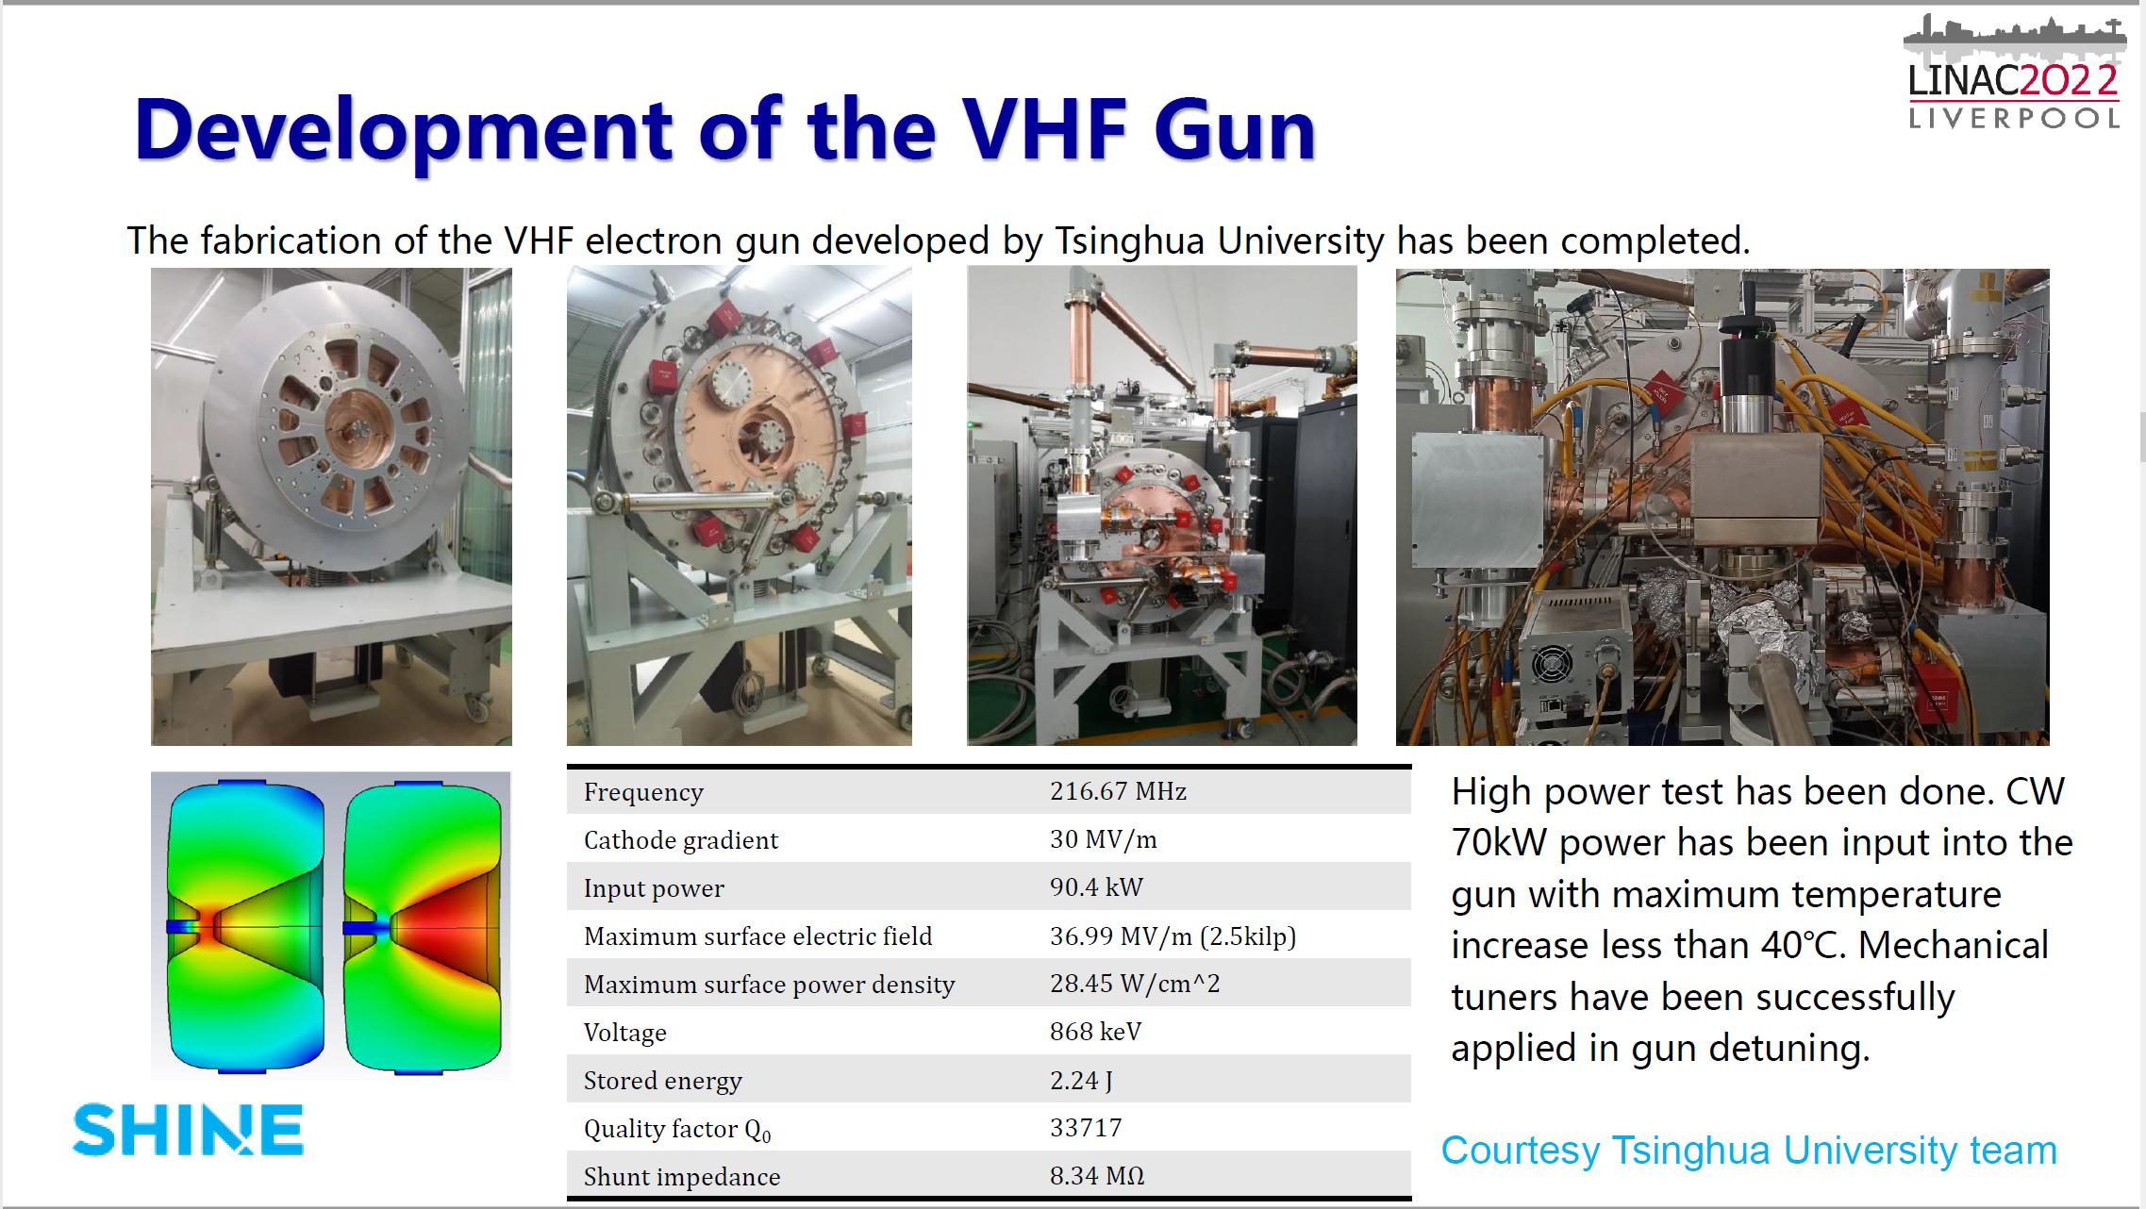
Bo Liu, LINAC2022, TU1AA05

Slide 18
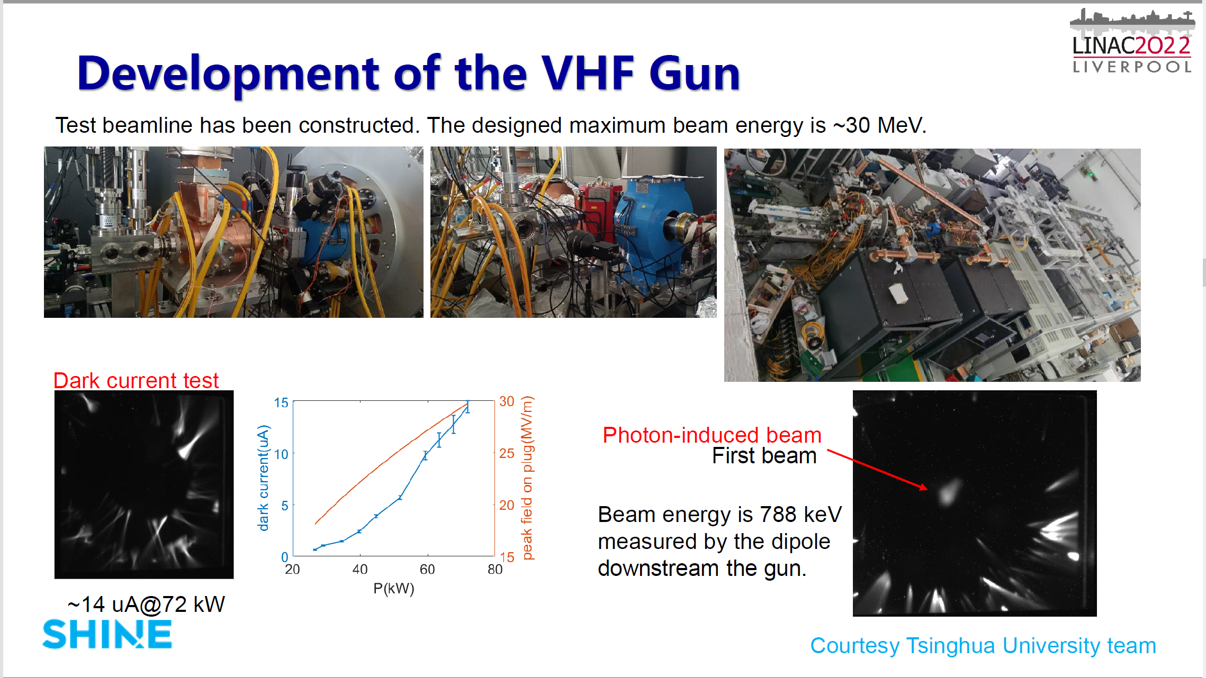
Bo Liu, LINC2022, TU1AA05

Slide 19
Laser system for 20 mA LHeC/PERLE electron source with Sb-based photocathods
Lase wavelength, nm | 500-550
Laser pulse repetition rate, MHz | 10-40
Energy in the single pulse at photocathode Qe=1%, µJ | 0.12*
Average laser power at photocathode Qe=1%, W | 4.7*
Laser pulse duration, ps FWHM | 35
Laser pulse rise time, ps | 3.5
Laser pulse fall time, ps | 3.5
Spot diameter on the photocathode surface, mm | 6 mm
Laser spot profile on the photocathode surface | Flat top
Laser operation mode | CW/Train-pulsed
Train length, µs | 100/TBC
Train repetition rate, Hz | 10/TBC
* - at photocathode surface

Slide 20
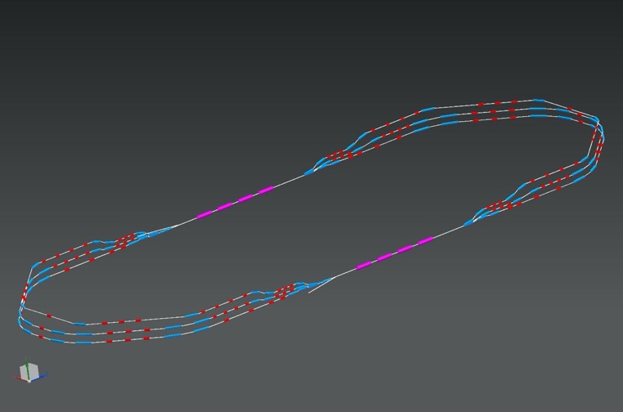
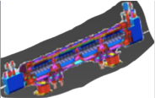
PERLE Collaboration Meeting 11-12/01/2022
Part 1 : The list of the components
2 Linacs (Four 5-Cell 801.58 MHz SC cavities)
3 turns (164 MeV/turn)
Max. beam energy 500 MeV
1 : 3 : 5
DE = 82.2 MeV
injector
7 MeV
7 MeV
2 : 4 : 6
1 : 3 : 5
ΔE = 82.2 MeV
DE = 82.2 MeV
5.5 m
Top view
2 : 4 : 6
29 m
7 MeV
ΔE = 82.2 MeV
dump
10 m
7 MeV
10 m
9 m
DC = l_{RF}/2
Footprint: 29 m × 5.5 m × 0.9 m
45 cm
Side view
45 cm
ΔC = λ_{RF}/2
IP
Notes:
puis le treillis
et les deux en même temps.

Slide 21







Status of the PERLE Collaboration
IJCLab (CNRS) to host PERLE on its site in Orsay (France), with other French labs collaborating to the project (LPSC-Grenoble and GANIL).
A Collaboration Agreement (CA) is now signed by all national and international partners including CERN, University of Liverpool - UK, STFC - UK, An-Najah National University from Naplouse - Palestine and others.
An International Cooperative Research And Development Agreement (ICRADA) signed between CNRS and DOE to frame the involvement of JLab on PERLE.
Discussions ongoing to include other international labs
The collaboration aims at performing a technical detailed study of the PERLE facility and at preparing the ground at its construction and operation phase.
11/01/2022

Slide 22
PERLE injector gun
PERLE electron injector is based on a DC photocathode electron gun as photocathode gun only is able to deliver required beam time structure and brightness
The basic of the injector is the ALICE gun operated with permanently installed GaAs photocathode. The gun has been transferred to IJCLab by Daresbury after decommissioning of the ALICE ERL
At the moment 3 options of the gun use are considered:
  To use the gun as it is with non-interchangeable photocathode for initial commissioning
  Upgrade the gun for operation with interchangeable photocathodes including Sb-based photocathodes to study high bunch charge
  At last equip the gun with GaAs photocathode preparation system to deliver polarised beams

Slide 23
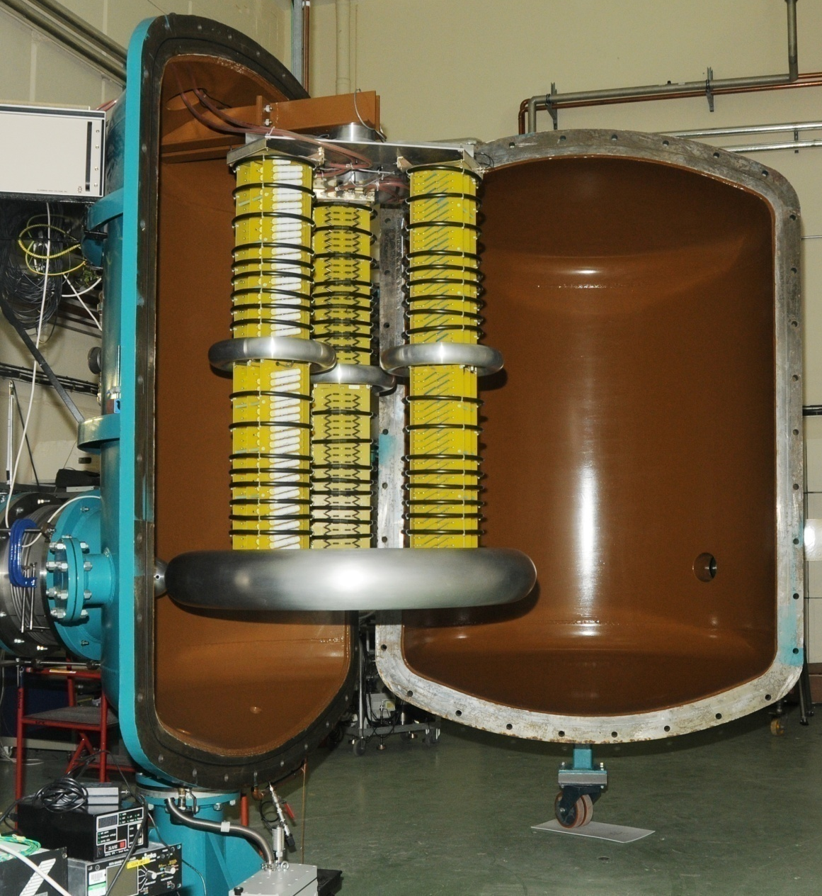
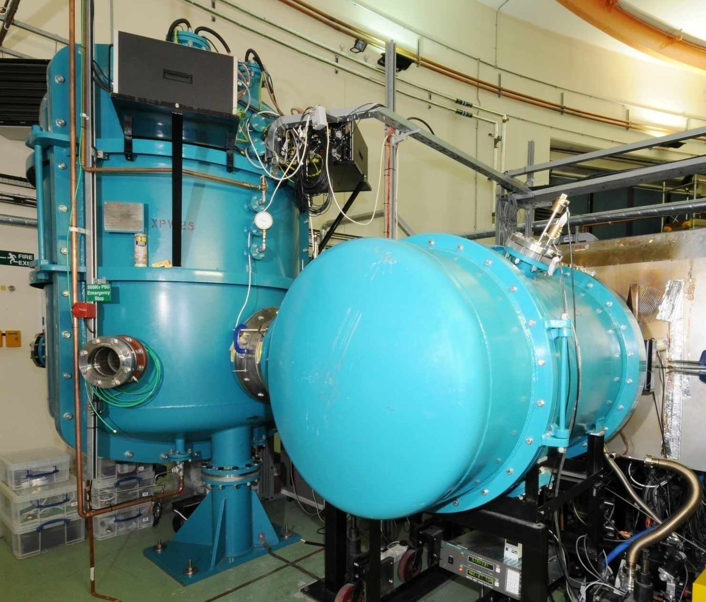
The ALICE gun with high voltage power supply

Slide 24
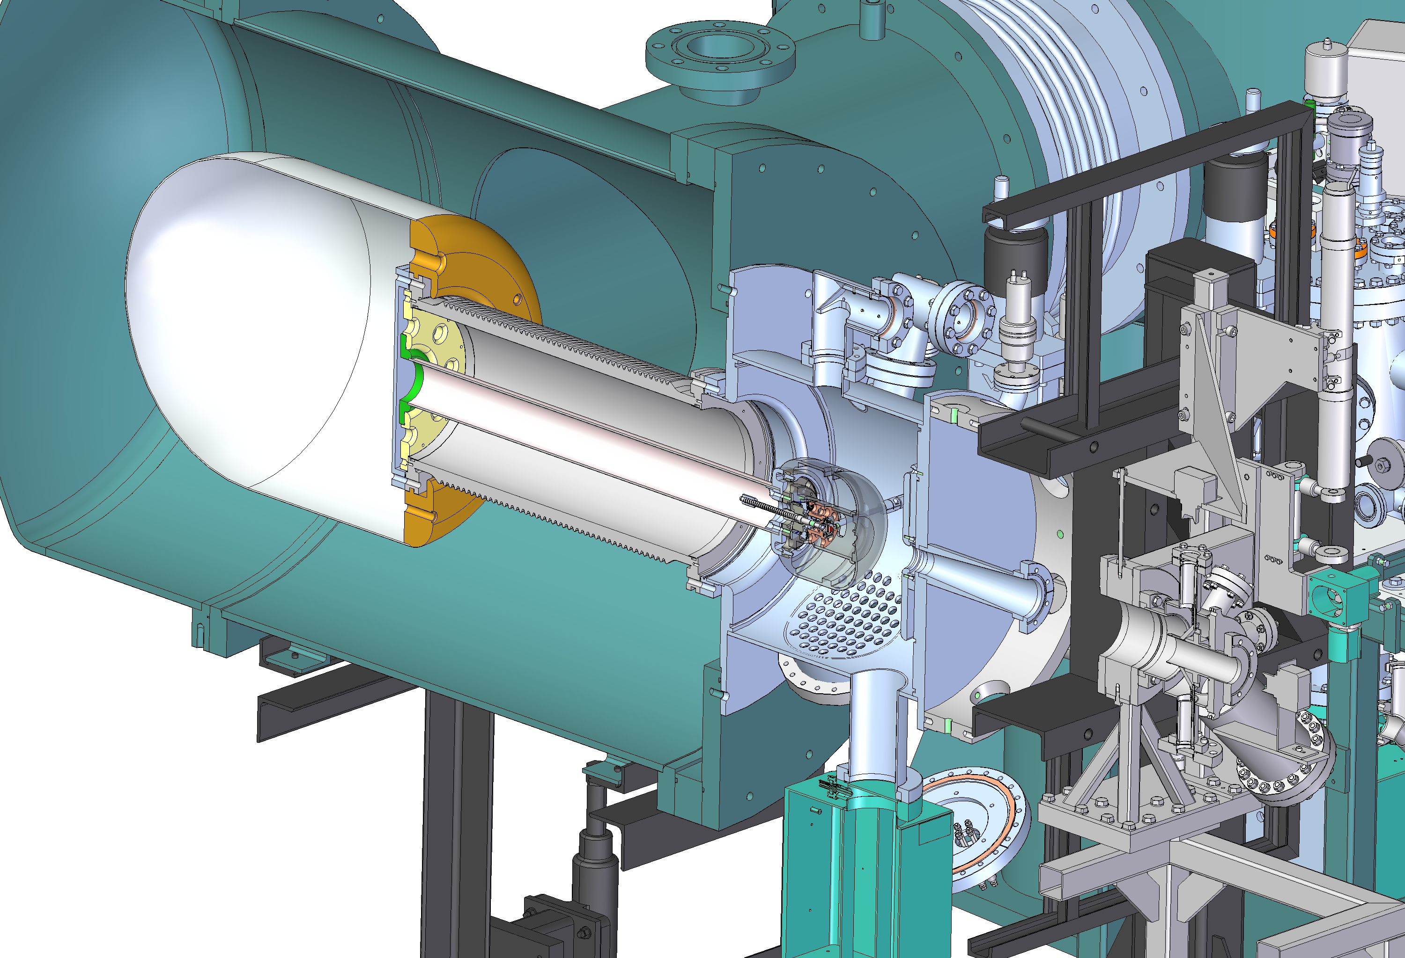
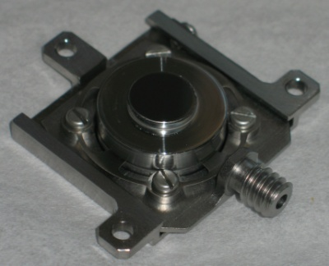
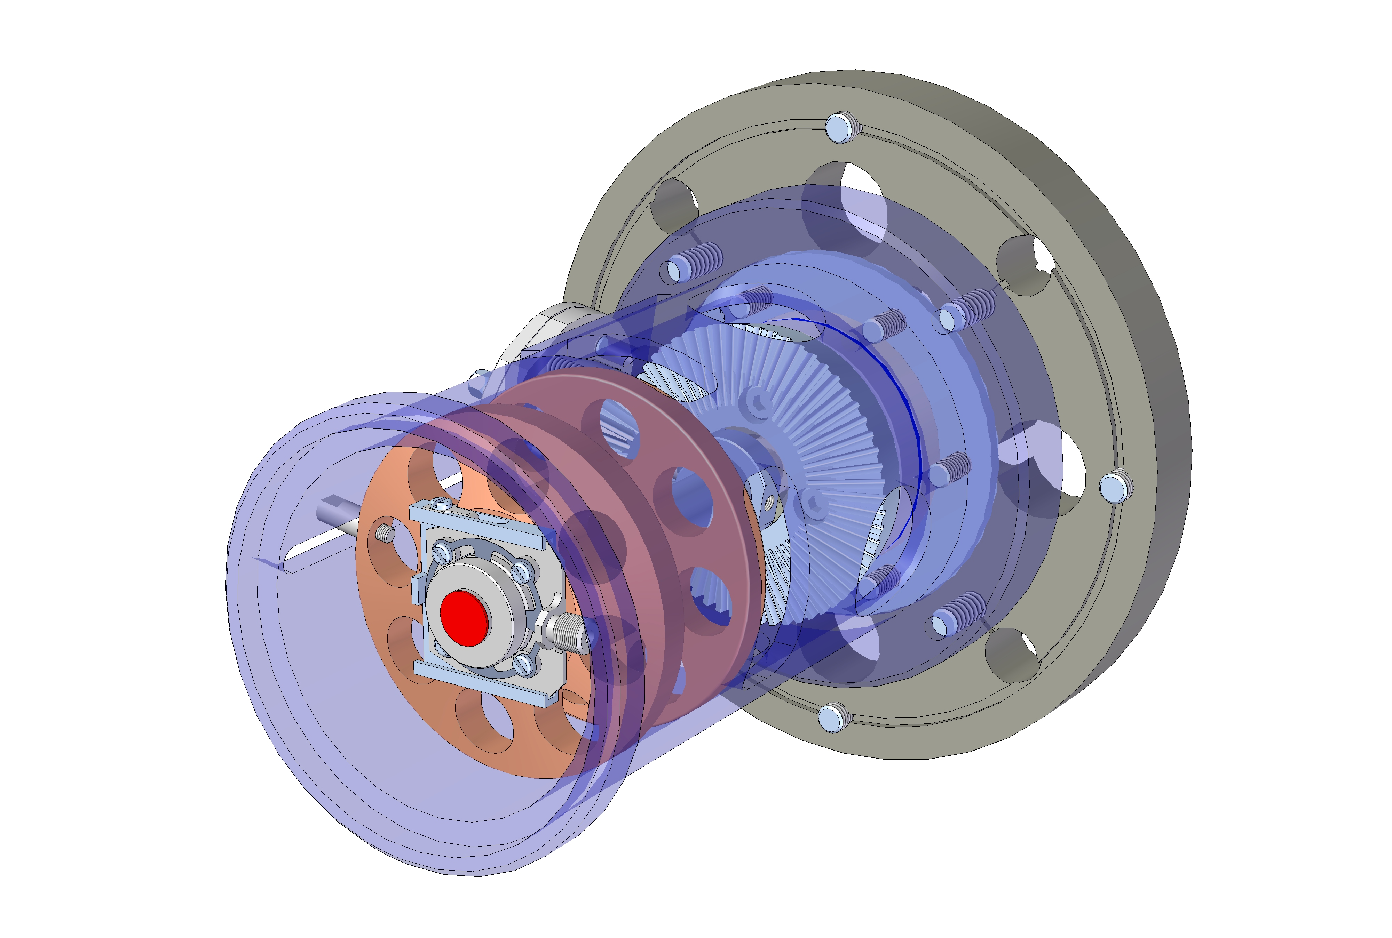
ALICE gun upgrade for operation with interchangeable photocathodes
Kovar cathode
holder
Photocathode layer
Inconel
spring
Titanium
base plate
Molybdenum
plug

Slide 25
Gun operation modes during commissioning
Main goal – demonstration of the 500 pC bunches following with repetition rate 40 MHz. That means that at average beam current of
20 mA and a gun voltage of 350 kV beam power is 7 kW.
Main constrains:
  HV PS maximum current – 8 mA, at 350 kV it will be 2.8 kW
  Radiation protection of the gun commissioning area
Possible modes
  500 pC bunches following with a frequency of 10 MHz – dynamic of 500 pC bunches
  Operation at frequency of 40 MHz at lower bunch charge 100 pC – demonstration of operation at 40 MHz
  Short train of 500 pC following with a repetition rate of 40 MHz (regime similar to ALICE) – dynamics of the beam with a structure required for PERLE

Slide 26
Conclusion and Future plans
New accelerator roadmap emphasise interest to further development of Energy Recovery Linacs as high efficiency sustainable accelerator facilities.
High average current, in 100 mA range, electron injectors are one of the most critical components of ERLs and additional efforts should be concentrated on further development of the injectors.
Major efforts should be concentrated on the following:
  Optimisation technology of existing photocathode materials. Currently Sb base photocathodes are baseline for high average current injector. Additional efforts should be concentrated on optimisation of deposition procedures of this material to reach industrial level of 15-20% QE. Additional efforts should be concentrated on investigation parameters (MTE) of emitted electrons.
  Development new photocathode materials which could operate with existing laser system
  Design photocathode plug which may be compatible with different types of the guns
Development of laser systems which would allow for delivery required current with UV photocathodes
Development of gun technologies which would allow for providing beams compatible with existing accelerator structures without excessive bunching schemes. Potential to reach this goal have.
  High filed QWR SRF gun
  High field QWR NCRF gun
  Elliptical cavity SRF gun
There is no operational injector which can demonstrate 100 mA of polarised current, it’s limited by photocathode lifetime
Potential to deliver this current, in case of success of the program on improving GaAs lifetime by activation with Cs-alkali metal layer,
  DC photocathode guns
  SRF photocathode guns

Slide 27
Acknowledgement
Kurt Aulenbacher, University of Mainz, Germany
Maud Baylac, LPSC, France
Luca Cultrera, BNL, USA
Camilla Curatolo, INFN, Italy
Walid Kaabi, IJCLab, Orsay, France
Thorsten Kamps, HZB, Germany
Max Klein, University of Liverpool, UK
Axel Neumann, HZB, Germany
Irina Petrushina, BNL, USA
Denis Reynet, IJCLAb, Orsay, France
Elmar Vogel, DESY, Germany
Peter Williams, STFC, UK
Masahiro Yamamoto, KEK, Japan
Feng Zhou, SLAC, USA

Slide 28
Thank you
Facebook: Science and Technology Facilities Council
Twitter:@STFC_matters
YouTube: Science and Technology Facilities Council
Notes:
Thank you for your attention

Slide 29
Additional slides

Slide 30
Cathode screwed to the backside
for optimal integration in an ultra-clean SC cavity
Metallic cathode attached to the cavity backside
cleaning after cathode insertion in a clean room
ideal cathode cooling
in case of superconducting cathode materials particles should not heat and quench the cavity
exchanging the cathode
only reasonable with cathode lifetimes above 100 days
Cathode materials and types
further R&D required studying the adhesion of cathode materials while performing cleaning
just started studying plasmonic state QE enhancement
by surface structuring
more options for plugs and cathodes
indium gasket (T_{c} = 3.4 K, B_{c} = 28 mT)
Nb plug
lead coating (T_{c} = 7.2 K, B_{c} = 80 mT)
niobium (T_{c} = 9.2 K, B_{c} = 180 mT)
Courtesy Elmar Vogel, DESY

Slide 31
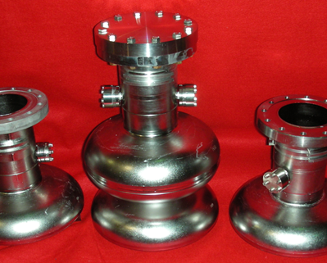
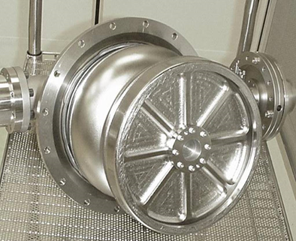
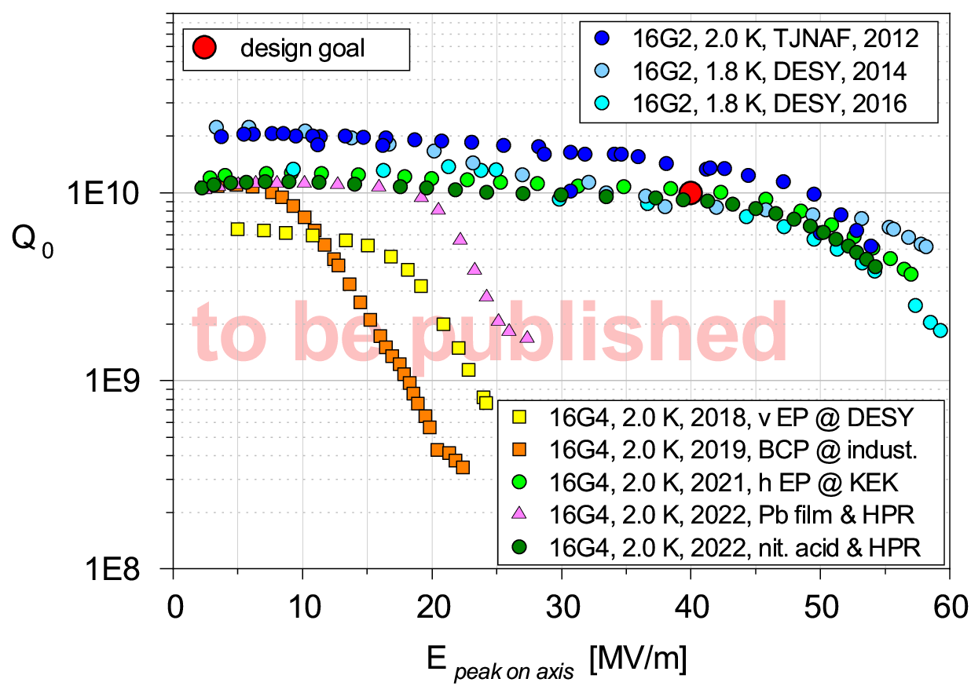
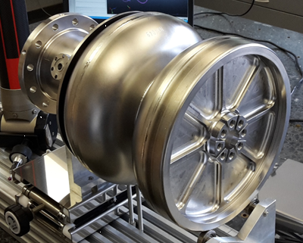
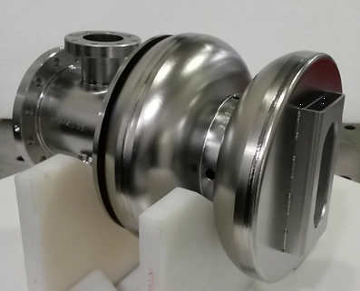
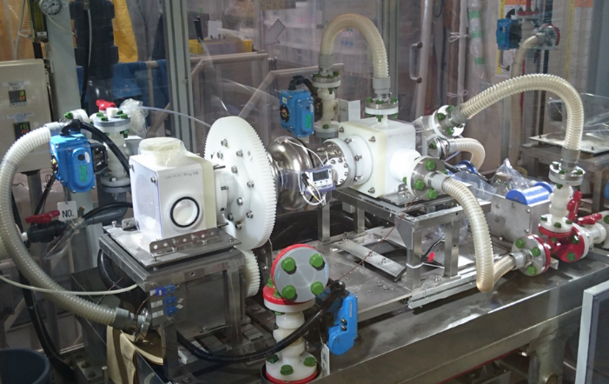
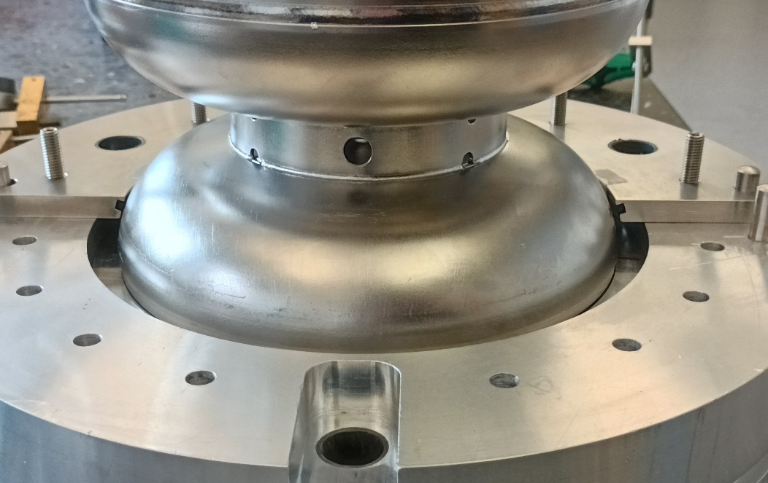
SRF Gun Cavity Status
present R&D status and activities
Vertical test results
Several generations of cavities
16G1
16G2
Present main activities and status:
typical peak on axis gradients around 55 MV/m
several years of surface treatment improvements
  present test objects: six cavities 16G3 to 16G8
  bad initial 16G3/4 results by back wall damage at first vert.
  EP at DESY, not cured by BCP, nor by first hor. EP at KEK
  back wall grinding plus horizontal EP at KEK successful!
  BCP and horizontal EP result both in high gradients,
  whereas the EP gives even more optimal results
16G09 and 16G10 (fifth generation of cavities)
  cavities for first horizontal tests
  hitting the cathode laser frequency acceptance of
  1300 MHz ± 0.25 MHz is essential
16G11 and 16G12 (sixth generation of cavities)
  for beam dynamics optimized cavity end-group
Cathode integration – new collaborations evolving
  Pb coating spread by HPR, Pb de-contamination possible
  bulk (surface structured) metal cathodes may be preferable!
Setup of SRF photoinjector test stand (Ts4i)
16G3/4
16G7/8
EP treatment of 16G4 at KEK
successful collaboration with KEK: applying
horizontal EP to 16G4 and VT at KEK
SRF gun cavity tuning
some new tuning tools to hit the cathode
laser frequency acceptance
Courtesy Elmar Vogel, DESY

Slide 32
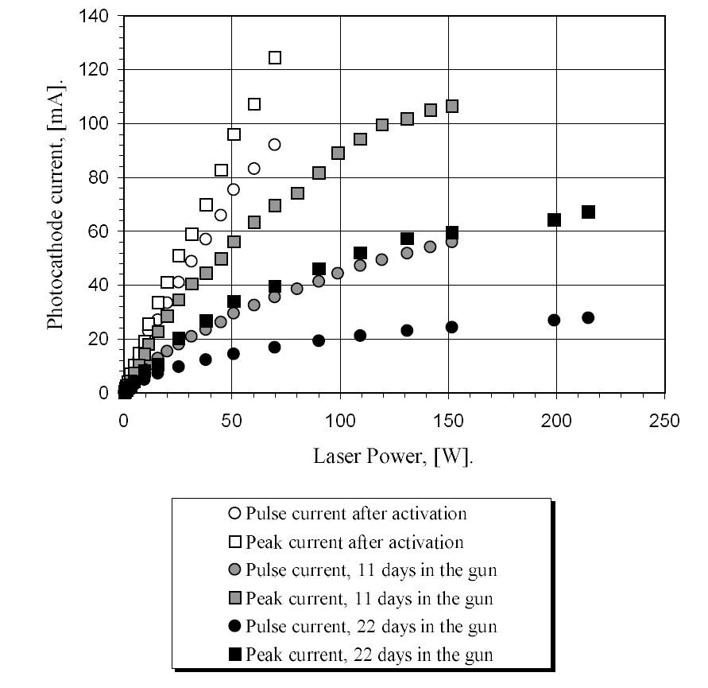
Generation of polarised electrons.
Amsterdam Pulse Stretcher(AmPS), 1998
5 µs pulses with an amplitude of 120 mA of highly polarised beam have been demonstrated from 1.7 eV bandgap
InGaAsP photocathode
B.L. Militsyn, ISBN 90-386-0777-6, 1998
Notes:
Photocathode operated in unique pulsed HV gun that allowed weeks photocathode lifetime delivered 15 mA 5 µs pulses followed with a frequency of 1 Hz

Slide 33
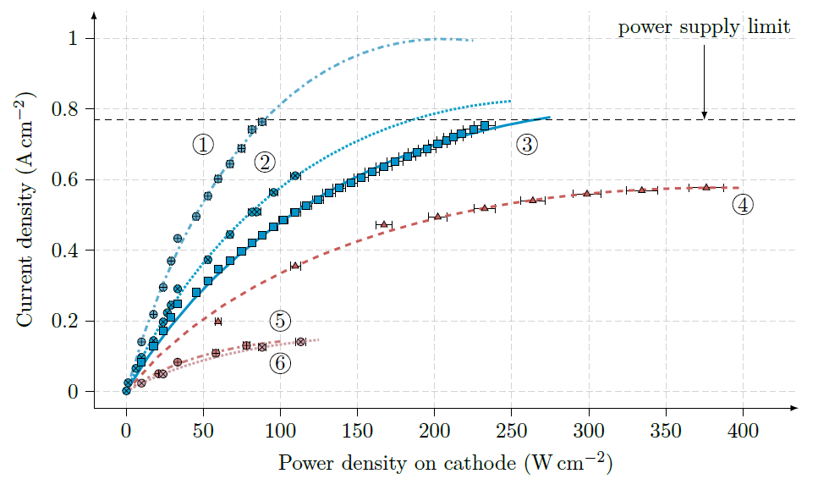
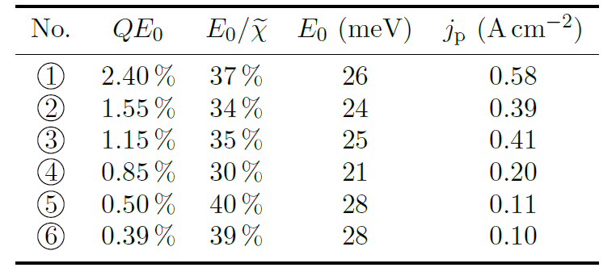
Generation of polarised electrons, UoM, 2019
S. Friederich et al 2019 J. Phys.: Conf. Ser. 1350 012045
10 mA current, limited by HV power supply, has been demonstrated from bulk GaAs photocathode in 400 µs pulses

Slide 34
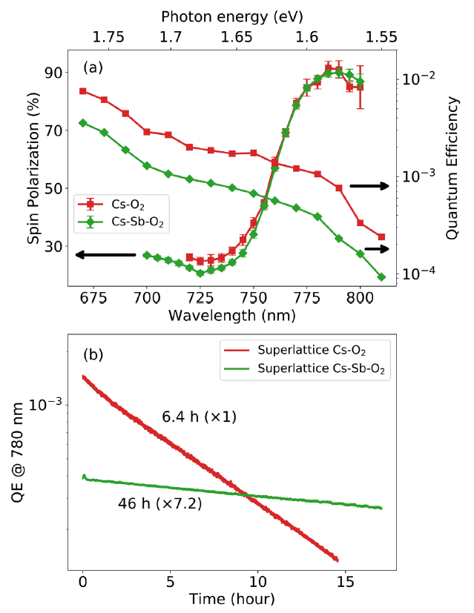
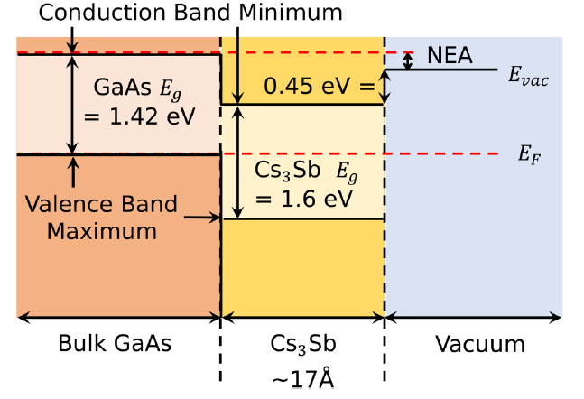
Improvement of GaAs operational performance
Operational performance of GaAs photocathodes depends on means of their activation – reducing work function. Earlier following procedures were used:
  Cs – photocurrent generation
  Cs-O – activation to NEA state
  Cs-NF₃ – slightly better operational performance, but is not currently used due to SHE restrictions
New activation procedures have been developed
Activation with alkali metals:
Activation with
Cs₃Sb
J.Appl.Phys. 127, 124901 (2020)

Slide 35
Design of the ALICE photocathode gun

Slide 36
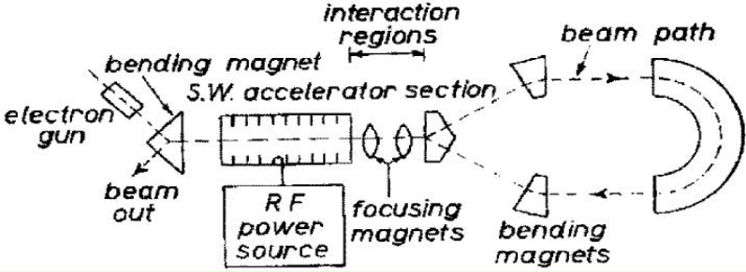
Some ERL History and achievements
1987 High Energy Physics Lab
Stanford University
SRF cavities, proof of principal experiment
1987 Los Alamos
FEL-operation, nc,
coupled acc/dec cavities
1965 M. Tigner
“A possible apparatus
for electron clashing-
beam experiments”
2000
Jefferson Lab
“Front End Test”
SRF, first CW
recovery
2002 JEARI, Japan
FEL, SRF, 700kW beam power
2005 Daresbury Lab, GB
“Alice”, SRF, 26MeV, versatile
10-year user program
under construction:
MESA, Germany
particle physics application
PERLE, France
testfacility (LHeC/FCC-eh)
bERLinPro, Germany
SRF/ERL technology test facility
CeC, BNL, USA
Coherent electron cooling for EIC
2002
Jefferson Lab
“IR-Demo”
SRF, 5mA, 48MeV,
2.1kW beam power IR
2003
CEBAF, 1 GeV, single turn
2007 Upgrade:
9mA, 150MeV
1.1MW beam power with ~300kW total power
2004 BINP, Russia
FEL-operation
normal conducting RF,
30 mA
2007: 4-passes
2013 KEK, Japan
“cERL”, prototype
ERL light source
Industrial applications
2020, Cornell/BNL
cbeta, FFA-arc
4-pass ERL
(80mA injector, ε = 0.3mm mrad)
Bettina Kuske, IPAC 2022

