Slide 1
CERN Photocathode Activities
Miguel Martinez-Calderon*, Ralf Rossel**, Baptiste Groussin, Eric Chevallay, Valentin Fedosseev, Bruce Marsh & Eduardo Granados
email: *miguel.martinez.calderon@cern.ch, **ralf.erik.rossel@cern.ch

Slide 2
Outline
Photocathode fabrication at CERN
The CERN Photoemission laboratory
Co-deposition of thin-film Cs₂Te and Cs₃Sb photocathodes
DC-gun testing platform
Built-in sequential deposition systems
Photoinjectors at CERN
AWAKE
CLEAR
New strategies for electron beam production
Conclusions and future work

Slide 3
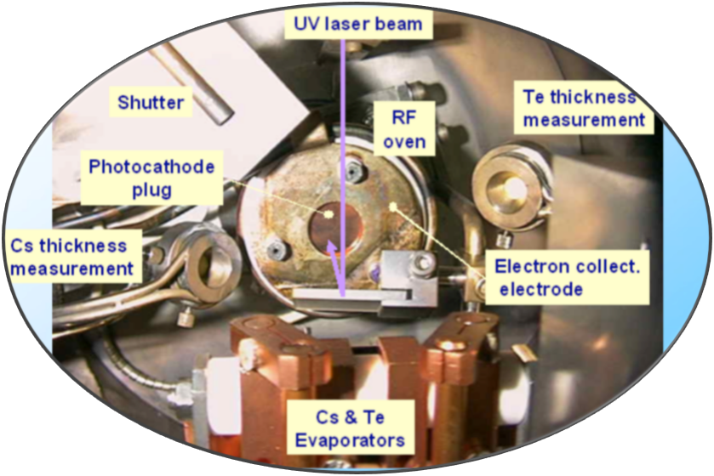
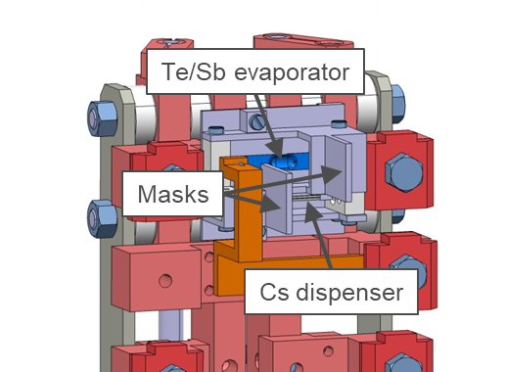
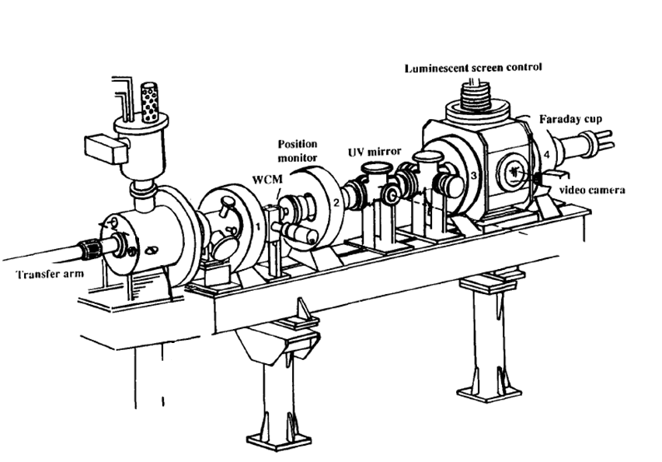
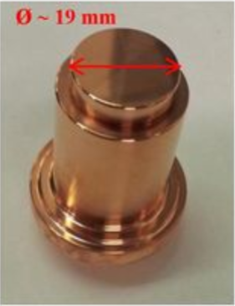
Photocathode fabrication at CERN
The CERN Photoemission laboratory
DC GUN:
65 kV supplied voltage
(6.5 MV/m electric field)
Bunch charge measured by:
Wall Current Monitor (WCM)
Faraday Cup (FC)
e-
OFC Copper with diamond powder polishing of the surface
Online QE measurement to optimize the thin-film co-deposition process
Cs and Te evaporated at the same time so the elements mix together in vapor phase
Monitoring of each component by a separate microbalance (other component is shielded by a mask)
Evaporators power is adjusted while measuring the QE and stopped when it starts to decrease from the maximum value of the curve
Pressure in-line monitoring during the whole process (goes up to 1e-8 mbar during materials evaporation)
RF-oven for substrate heating (Cs₃Sb fabrication)
UV/Green ns-LASER
CERN Photocathode Preparation Facility has been working since >25 years.
Focus on development of manufacturing techniques for Cs₃Sb and Cs₂Te photocathodes.
Pressure bellow 5*10⁻¹¹ mbar inside the preparation chamber and bellow 1*10⁻¹¹ mbar at DC-gun position
Bunch charge measurements with wall current monitor (WCM) and Faraday cup (FC)

Slide 4
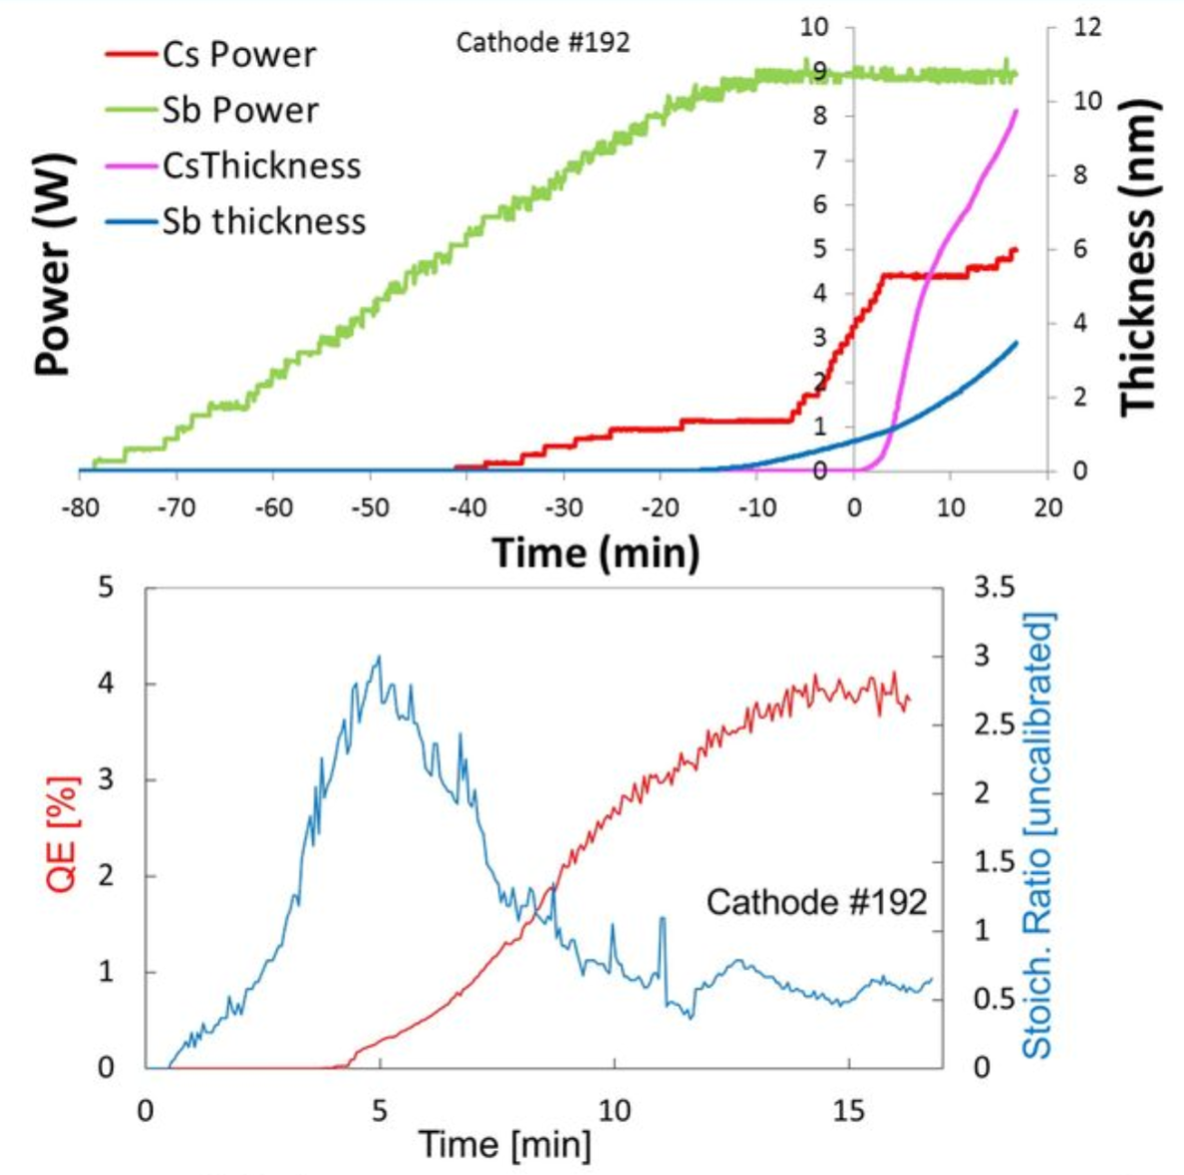
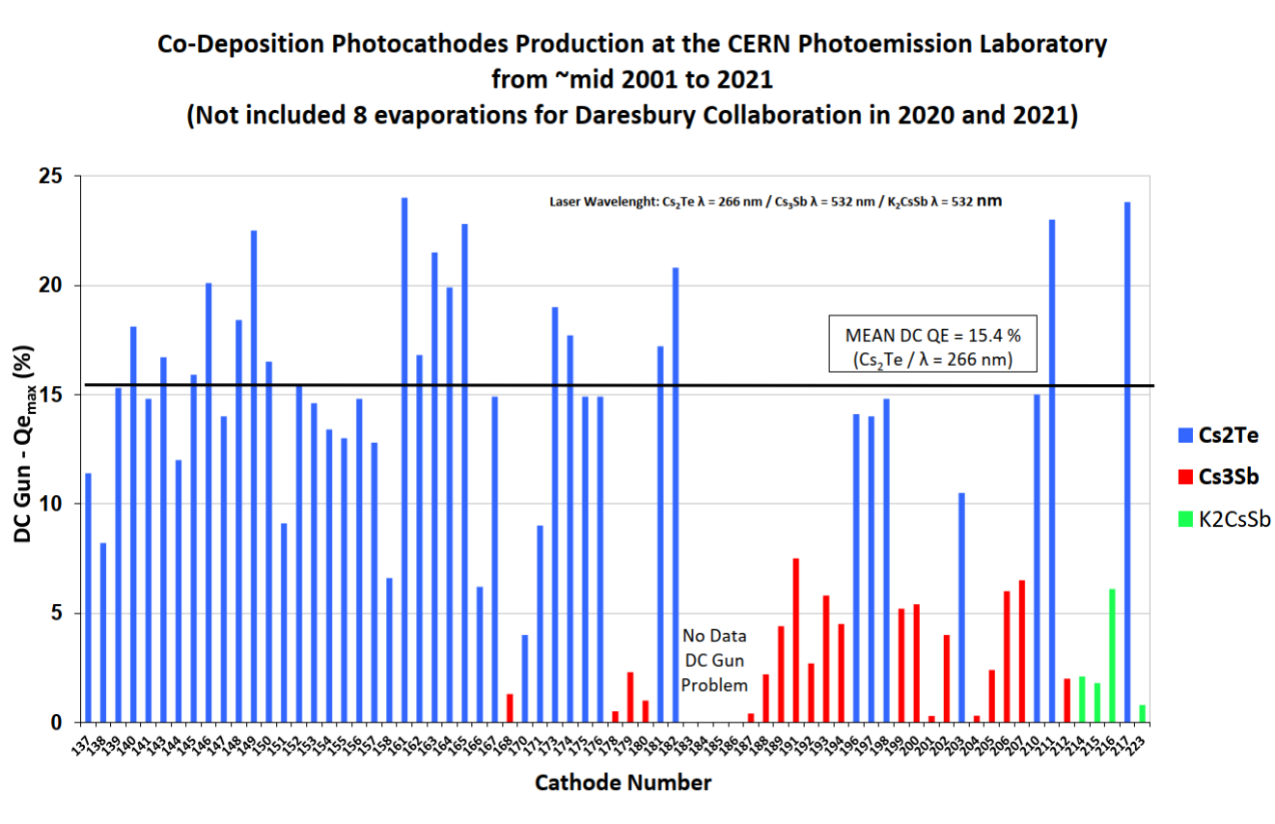
Photocathode fabrication at CERN
Example of Cs₃Sb photocathode fabrication
Co-deposition of thin-film Cs₂Te and Cs₃Sb photocathodes
I. Martini, ¨Characterization of Cs-Sb cathodes for high charge RF photoinjectors”, PhD Thesis, 2015
*Collaboration with Daresbury to fabricate bi-alkali photocathodes
*Good results although the CERN Photoemission laboratory is designed for two-elements co-evaporation and many challenges were faced
*Once the QE reaches a maximum peak, the process is stopped
*QE normalized from photocurrent data after measurement at DC-gun

Slide 5
Photocathode fabrication at CERN
Co-deposition of thin-film Cs₂Te
Photocathode fabricated at the photoemission laboratory in 2019 which was stored in the UHV vessel until installation at AWAKE in March 2022… three years successful storage!
Co-evaporation of Cesium and Tellurium with stoichiometry of Cs₂Te targeted (should be analyzed by XPS)
Fabrication data data available on request (only in paper right now)
Test after fabrication with the DC-gun prior installation at AWAKE
3D QE map obtained using UV beam with ∼ 0.1 µJ
Average QE measured with the DC-gun approximately 24%

Slide 6
Photocathode fabrication at CERN
Co-deposition of thin-film Cs₂Te
Photocathode fabricated in March 2022
Co-evaporation of Cesium and Tellurium with stoichiometry of Cs₂Te targeted
Fabrication data data available on request (only in-paper right now)
Test after fabrication with the DC-gun first
3D QE map obtained using UV beam with ∼ 0.1 µJ
Average QE measured with the DC-gun approximately 12%
Significant difference in the measured QE, probably the Cs and Te flow rates were not adjusted well enough during fabrication process
Skilled and experienced operator for a good result… lack of automation steps in the process

Slide 7
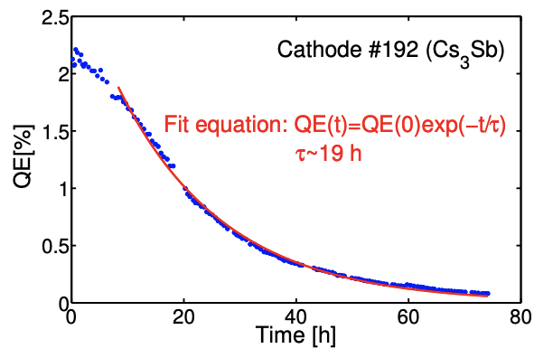
Photocathode fabrication at CERN
DC-gun testing platform
UV energy range: 0.1 – 160 µJ
Cathode surface scanning speed: 0.01 – 10 mm/s
Beam size at the cathode in the experiments approximately 2.5mm
Polarization control through a λ/2 waveplate
Same laser for DC-gun testing and QE online monitoring (different path)
DCDA crystal
KDP crystal
Nd:YAG
4-5 ns pulses
1064 nm
10 Hz
ω0 = 4-5 mm
OD filters
f = 150mm
f = 100mm
LIFETIME studies can be carried out with higher repetition rate Nd:YAG laser (2 kHz max. and 50 ns fwhm), by measuring the charge extracted per bunch in the DC gun for several days, example for Cs₃Sb
Variable telescope
Virtual line + screen
Beam splitter (75-25%)
*Polarization senstitive
f = 3 m
λ/2
Online power meter
Beam sampler
DC Gun
DC-gun viewport
Beam size at the cathode ∼ 2.5mm
In-vacuum mirror
I. Martini, ¨Characterization of Cs-Sb cathodes for high charge RF photoinjectors”, PhD Thesis, 2015

Slide 8
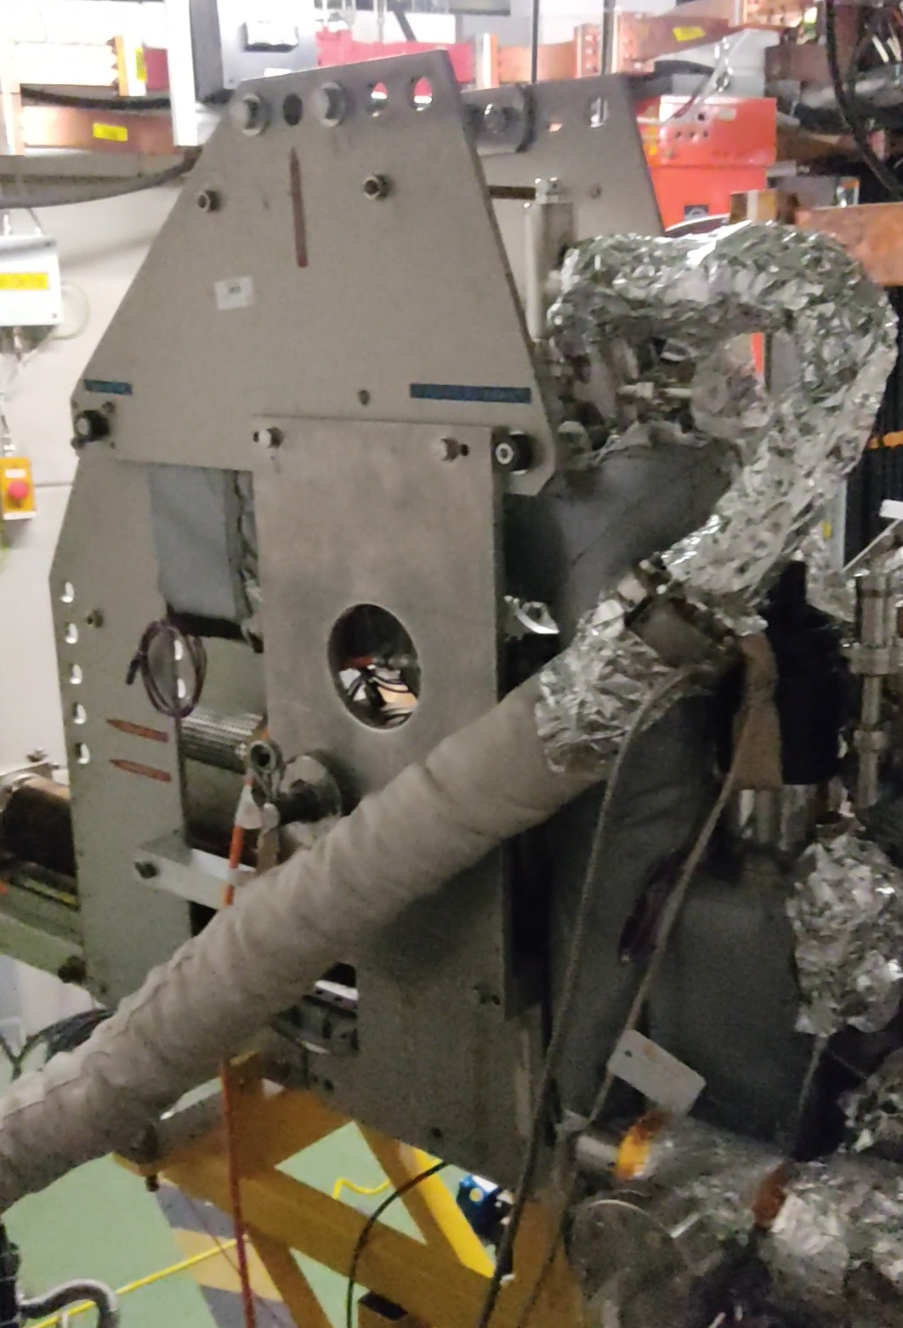
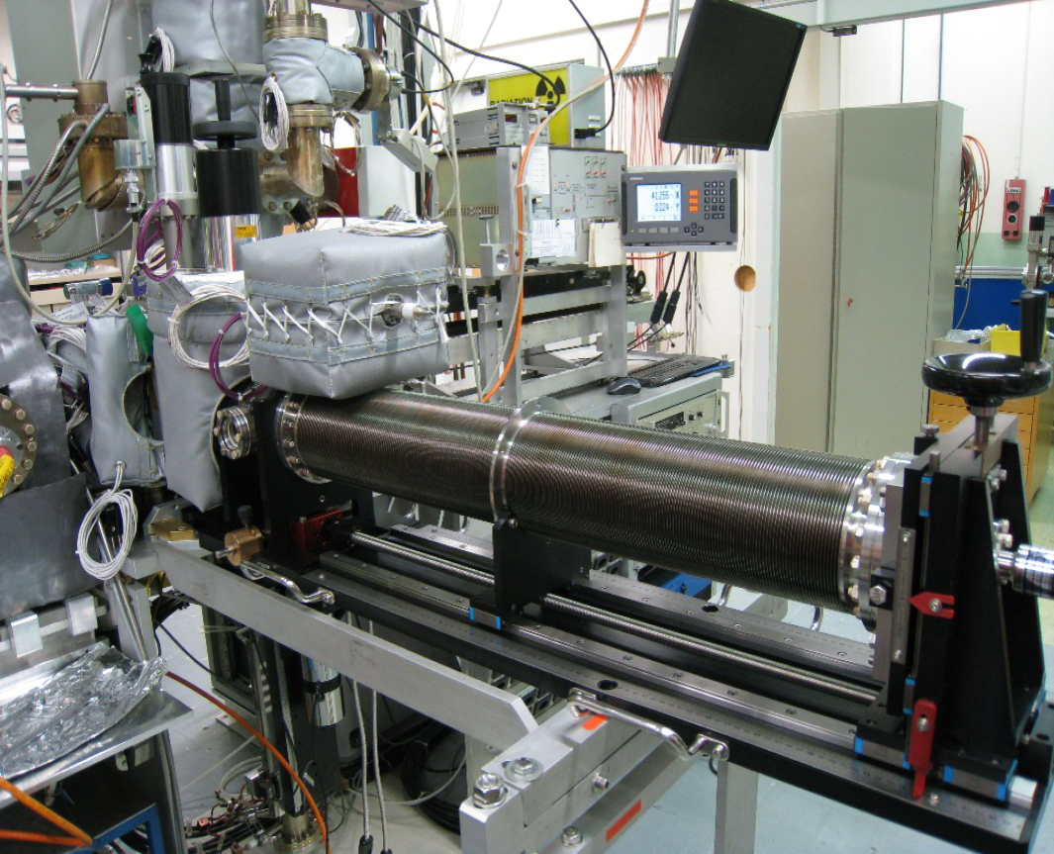
Photocathode fabrication at CERN
Photocathode transportation
UHV Transport Carrier (4 storage slots: Docked at AWAKE and moved to CERN Photoemission Laboratory when new Cs₂Te photocathodes need to be manufactured)
UHV Transfer Arm (1 storage slot) for analyizing the produced cathodes at Photoemission laboratory with the XPS machine
Transport carrier installed in AWAKE, March 2022
Transfer arm for UHV transport to XPS analysis machine at CERN

Slide 9
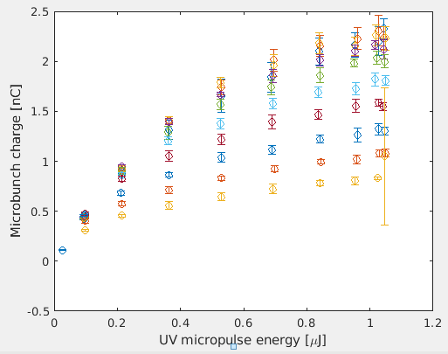
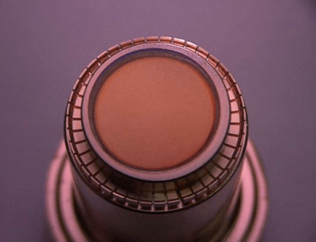
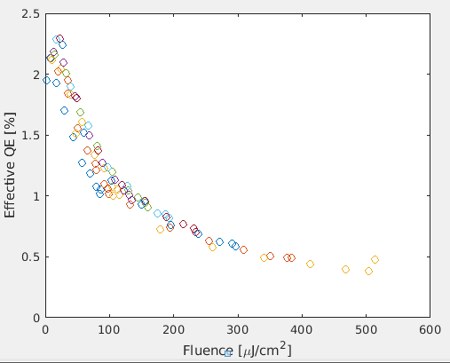
Photocathode fabrication at CERN
Built-in sequential deposition systems
In-situ fabrication of Cs₂Te photocathodes via sequential deposition
Maximum QE achieved for the actual run was 2.5%
Saturation fluence of approximately 300µJ/cm²
Historic operation of the CLEAR photocathode
Sequential deposition:
2017 => First layer: 15 nm of Tellurium; Second Layer: 45 nm of Cs
2018 => First layer: 15 nm of Tellurium; Second Layer: 40 nm of Cs
2020 => First layer: 15 nm of Tellurium; Second Layer: 40 nm of Cs
2022 => First layer: 15 nm of Tellurium; Second Layer: 40 nm of Cs

Slide 10
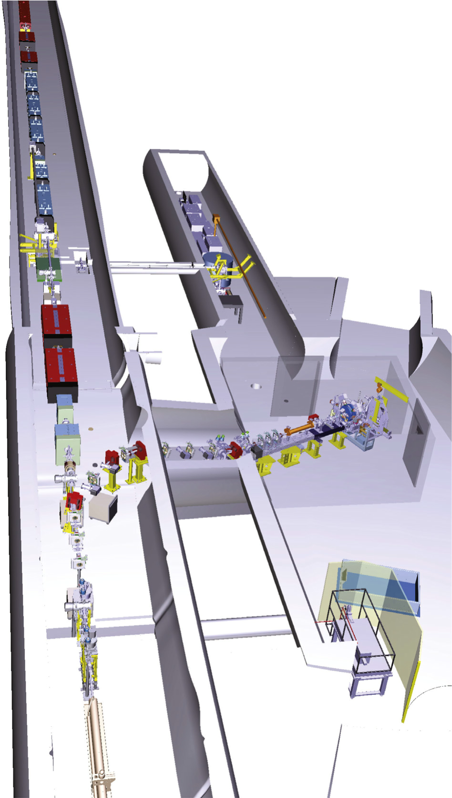
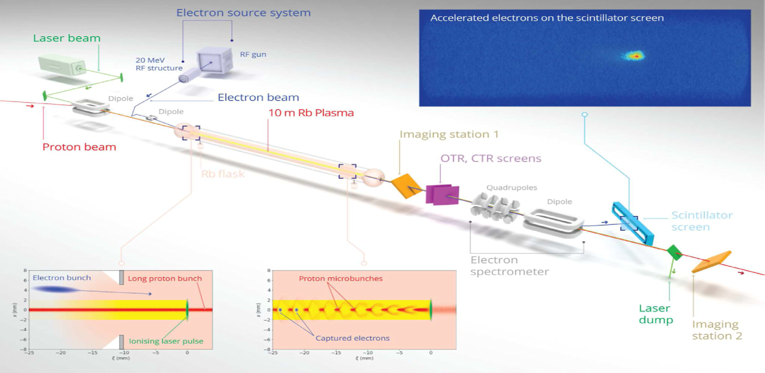
Photoinjectors at CERN
AWAKE experiment 2022
Advanced Proton Driven Plasma Wakeﬁeld Acceleration
Electron source system: 20-MeV radio-frequency structure to generate the witness beam
UV excitation of Cs₂Te photocathodes fabricated at CERN Photoemission laboratory
Successful transport thanks to the UHV vessel
Recent fabrication and transport of current AWAKE photocathode and spare for the future
Adli, E., Ahuja, A., Apsimon, O. et al. Acceleration of electrons in the plasma wakefield of a proton bunch. Nature 561, 363–367 (2018).

Slide 11
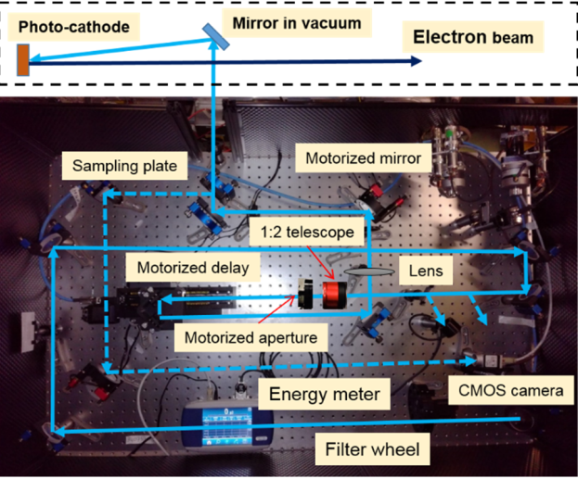
Photoinjectors at CERN
Beam Parameter | Initial set | Achieved for AWAKE run 1, run 2a, 2b
Beam Energy (MeV) | 16 | 16-20
Energy spread (rms %) | 0.5 | 0.45
Charge (pC) | 200 | 50-1000
Emittance (mm.mrad) (200 pC) | 2 | 2
Bunch length (sig ps) | 4 | 1-4
Electron beam typical parameters
AWAKE run 1 electron bunch parameters very well achieved
Operating single bunch at 10 Hz repetition rate (0.1 – 1Hz run 2c, 2d)
Energy spread improved at higher charges but worse emittance
Position jitter 25-50 µm
Photoinjector laser system
UV conversion from 2 mJ secondary beam generated from the main amplifier (450mJ for ionizing pulse, primary beam)
Perfect synchronization with the ionizing IR beam (same oscillator)
3rd harmonic generation conversion system with 25% efficiency
Motorized aperture and telescope to control beam size at the cathode
Beamline ~16m long with an in-vacuum 14.2m pipe

Slide 12
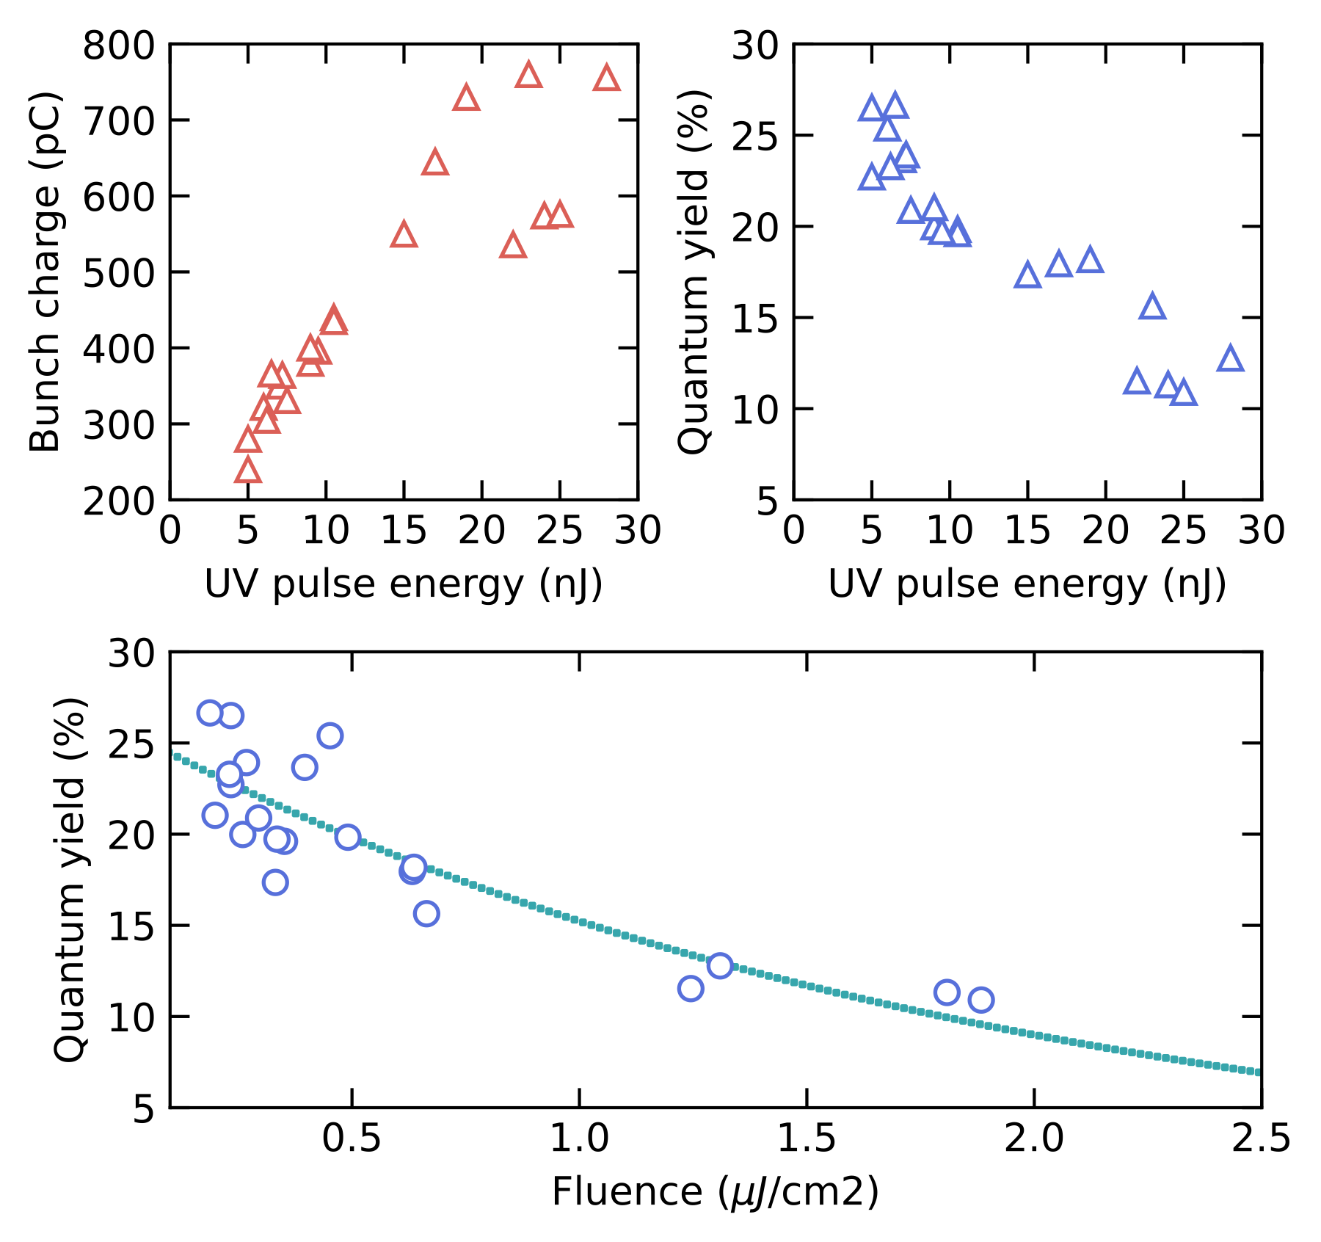
Photoinjectors at CERN
Current AWAKE photocathode fabrication and performance
Photocathode performance at AWAKE RF-photoinjector
Maximum measured QE ~ 26%, good agreement with DC-GUN measurements
Saturation Fluence ~ 1.5 µJ/cm²
Issues to measure pulse energy bellow 5 nJ and charge higher than 800pC during the commissioning tests
Photocathode performing very well during last months of intense operation at AWAKE run 2b
Position jitter measured < 25 µm

Slide 13
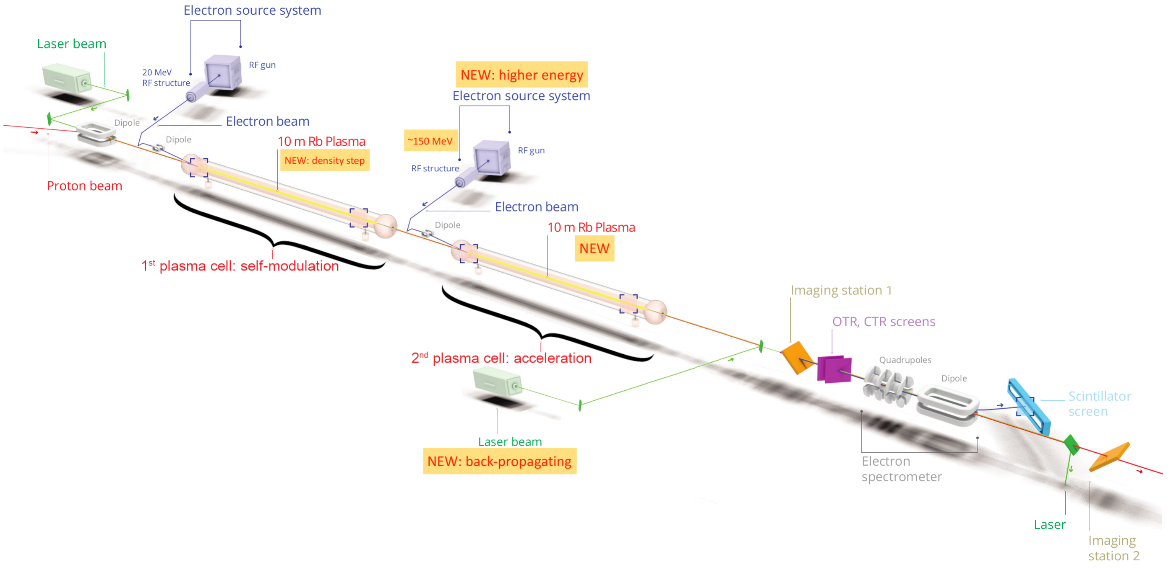
Photoinjectors at CERN
AWAKE run 2c and 2d
Targeted for AWAKE run 2c,d
100-250 MeV
Δ𝐸/𝐸 < 2% (0.2% for transfer line)
ε𝑥,𝑦 < 2 mm.mrad
𝑄 = 100 pC
0.01-0.1 Hz
𝜎𝑥,𝑦 = 5.75 µm 𝜎𝑧 = 60 µm
New electron beamline for next runs, higher energy required approximately 150MeV
Two options being considered for the second electron source:
RF gun based on Copper or Cs₂Te (Collaboration with INFN and about to be commissioned)
LWFA electron injector in collaboration with Paris-Saclay university
Gschwendtner, E.; Lotov, K.; Muggli, P. et al, “The AWAKE Run 2 Programme and Beyond” Symmetry. 2022; 14(8):1680.

Slide 14
Photoinjectors at CERN
The CERN Linear Electron Accelerator for Research (CLEAR)
CLEAR is a versatile 200 MeV electron linac + a 20 m experimental beamline, operated at CERN as a multi-purpose user facility.
Scientific and strategic goals:
Providing a test facility at CERN with high availability, easy access and high quality e- beams.
Performing R&D on accelerator components, including beam instrumentation prototyping and high gradient RF technology
Providing an irradiation facility with high-energy electrons, e.g. for testing electronic components in collaboration with ESA or for medical purposes (VHEE/FLASH)
Performing R&D on novel accelerating techniques – electron driven plasma and THz acceleration.
Maintaining CERN and European expertise for electron linacs linked to future collider studies

Slide 15
Photoinjectors at CERN
Electron beam parameters and time structure
Beam parameter | Range
Energy | 60 – 220 MeV
Energy Spread | < 0.2 % rms (< 1 MeV FWHM)
Bunch Length | 0.1 ps – 10 ps rms
Bunch Charge | 5 pC – 2 nC
Number of bunches per train | 1 to ~150
Maximum total train charge | 80 nC
Normalized emittances | 3 mm to 30 mm (bunch charge dependent)
Repetition rate | 0.8 to 10 Hz
Bunch spacing | 1.5 GHz (from Laser) or 3GHz (double-pulse setup in the UV)
Charge
Pulse
10 pC - 30 nC
Single or any number of pulses
Bunch
5 pC - 3 nC
0.1 - 10 ps
Time
0.666 ns (1.5 GHz)
1 - 150 bunches (100 ns)
0.1 - 12 s (0.833 - 10 Hz)

Slide 16
New strategies for electron beam production
Metallic photocathodes surface nanostructuring
Interest at CERN for using metallic photocathodes (Copper)
Relax vacuum requirements (cost) for future electron beam production
Allow a more robust operation and avoid periodical cathode exchange or rejuvenation (improved lifetime)
Enable their use for new XFELs, ERLs, ICS sources, FLASH therapy machines, etc
KEY requirement - increase the Copper quantum efficiency
New projects and collaborations to explore surface plasmon-assisted photoemission
Explore the use of fs/laser structuring via LIPSS (Laser Induced Periodical Surface Structures) and Electron beam lithography (NTNU collaboration)
Possibility of using the same laser as for photocathode excitation also for LIPSS manufacturing (In-situ alternatives to improve QE)
Similar to often used laser cleaning process
Already demonstrated for multiphoton absorption
Next step: Try to exploit and optimize plasmonic resonances of nanostructures at single-photon absorption (UV irradiation of Copper)

Slide 17
New strategies for electron beam production
Nanofabrication technology: Fs-laser sub-wavelength patterning Low Spatial Frequency LIPSS
Nanopatterns generated slightly above the ablation threshold
Interaction of the incident laser beam with an electromagnetic wave scattered at the surface which may involve the excitation of Surface Plasmon Polaritons (SPPs)
Spatial period Ʌ can be tuned through the irradiation wavelength, polarization, fluence and number of pulses.
Ʌ ~ $\frac{λ}{\text{η} ±\sin{θ}}$ ; being $\text{η}$ the real part of the effective refractive index
High quality and homogeneity over large areas can be achieved
From: C. Florian, S. Kirner, J. Krüger, J. Bonse, Journal of Laser Applications. 32, 022063 (2020)
First approach: LSFL fabrication with fs-lasers λ = 800nm and λ = 515nm for irradiating Cs₃Sb
Interesting results for single-photon absorption using λ = 266 nm in Copper (Cs and Te contamination issues to be addressed)
Final goal: Tailor fs-laser structuring at UV for optimized plasmon-assisted photoemission at the same wavelength

Slide 18
Conclusion and future works
Implement automation steps in the current photocathode setup to make the process more repeatable and reliable
Commissioning of new RF-gun with Copper foil photocathode for AWAKE 2c & 2d or CLEAR-2
Continue production of Cs₂Te for AWAKE experiment and future accelerators and R&D at CERN
Development of alternative routes for metallic photocathodes to enable its use in current and future CERN accelerators operation
Maintain and improve our capability of adapting the photocathodes design to specific projects, including future accelerators such as LHeC and FCC-eh potential projects

Slide 19
Thank you!
Miguel Martinez-Calderon*, Ralf Rossel**, Baptiste Groussin, Eric Chevallay, Valentin Fedosseev, Bruce Marsh & Eduardo Granados
email: *miguel.martinez.calderon@cern.ch, **ralf.erik.rossel@cern.ch

Slide 20
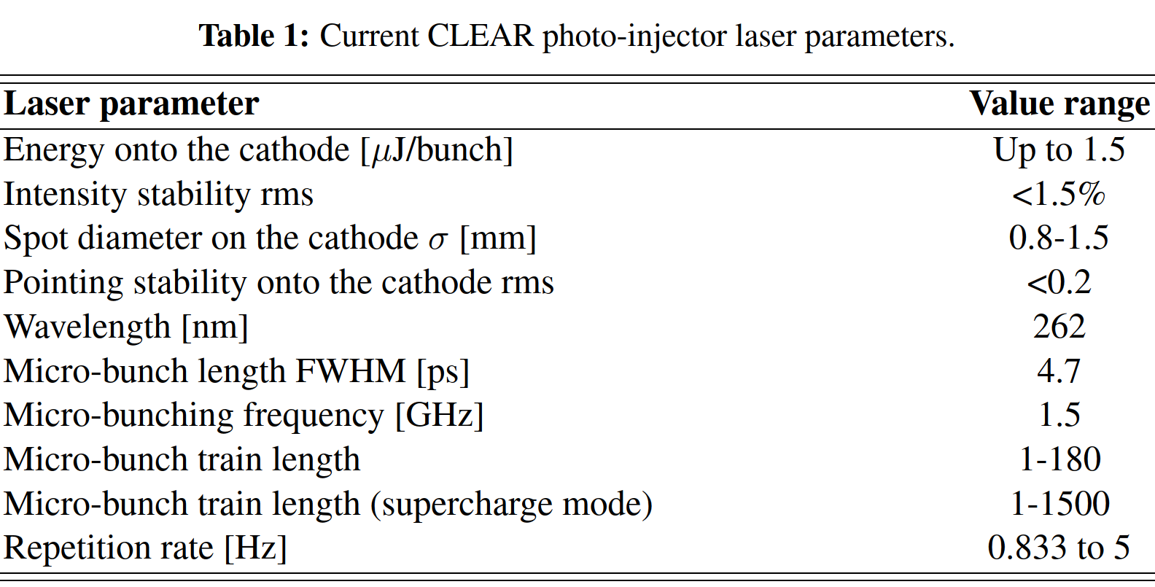
Photoinjectors at CERN
Laser system
Nd:YLF front-end + Nd:YLF 3 pass amplifier => 30µJ/pulse (λ = 1047nm)
3 GHz operation commissioned through a double pulse setup in the UV
Distance from the laser room to photocathode => 70m
Operation at 10Hz now also on a routinely basis

